Slide 1
Injuries of the elbow and forearm
P.J. Okoth

Slide 2
Classification
Injuries of the elbow:
Dislocation of the elbow
Dislocation of the head of radius
Subluxation of the head of radius
Contusion of the elbow

Slide 3
Classification…
Fractures of the forearm bones:
Fracture of the olecranon process
Fracture of the coronoid process
Fracture of the head of radius
Fracture of the upper end of ulna with dislocation of the head of the radius (Monteggia fracture-dislocation)
Fracture of the shafts of forearm bones

Slide 4
Classification…
Fractures of the forearm bones: …
Fracture of the shaft of the radius with dislocation of the inferior radio-ulnar joint (Galeazzi fracture-dislocation)
Fracture of the lower end of radius (Colles’ fracture)
Fracture of the lower end of radius with anterior displacement (Smith’s fracture; barton’s fracture)
Fracture-separation of the lower radial epiphysis

Slide 5
Dislocation of the elbow
P. J. Okoth

Slide 6
Dislocation of the elbow
Is a common injury both in children and in adults
The dislocation is nearly always posterior or postero-lateral.
This means that the ulna and the radius are displaced backwards, or backwards and laterally, relative to the humerus.
There may be an associated fracture of the coronoid process of the ulna, or of the radial head, capitulum or medial epicondyle.

Slide 7
Mode of injury
Dislocation of the elbow is usually caused by a heavy fall onto the outstretched hand.
The cause of posterior dislocation is usually a fall on the outstretched hand with the elbow in extension.
Once posterior dislocation has taken place, lateral shift may also occur.
Soft tissue disruption is considerable and surrounding nerves and vessels may be damaged

Slide 8
Clinical features
Severe pain around the elbow
Swelling of the elbow region
The patient supports his forearm with the elbow in slight flexion.
Unless swelling is severe, the deformity is obvious
The bony landmarks (olecranon and epicondyles) may be palpable and abnormally placed
The hand should be examined for signs of vascular or nerve damage.

Slide 9
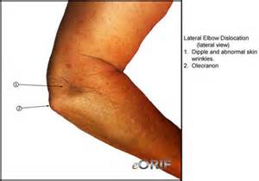
Elbow dislocation

Slide 10
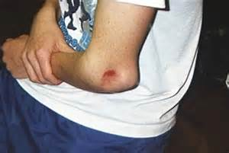
Elbow dislocation

Slide 11
X-ray findings
Confirms the presence of dislocation
Identifies any associated fractures

Slide 12
Elbow dislocation

Slide 13
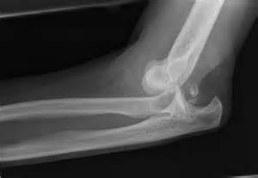
Elbow dislocation

Slide 14
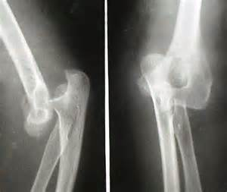
Elbow dislocation

Slide 15
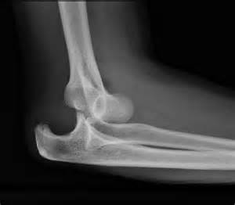
Elbow dislocation

Slide 16
Treatment
The dislocation should be reduced under anaesthesia as soon as possible
Reduction is usually easy
Pull steadily upon the forearm with the elbow semi-flexed, correct any sideways displacement, then apply direct pressure behind the olecranon to push it into the trochlear groove.
Reduction should be confirmed by radiographic examination and clinical tests.
Thereafter the elbow should be rested in a plaster backslab in 90 degrees of flexion for 2-3 weeks, and thereafter mobilizing exercises.

Slide 17
Complications
Are common; some are potentially so serious that the patient with a dislocation or fracture-dislocation of the elbow must be observed with the closest attention.
Complications can be classified into early and late as follows:

Slide 18
Early complications
Vascular injury
The brachial artery may be damaged
Absence of the radial pulse is a warning
If there are signs of ischaemia, it should be treated as an emergency
Splints must be removed and the elbow straightened somewhat.
If no improvement an arteriogram is performed and the brachial artery may have to be explored.

Slide 19
Early complications…
Nerve injury
The median or ulnar nerve is sometimes injured.
Spontaneous recovery usually occurs after 6-8 weeks.
Associated fractures of bones about the elbow

Slide 20
Late complications
Myositis ossificans
Heterotopic bone formation may occur in the damaged soft tissues in front of the joint.
Visible radiologically 4-6 weeks after injury.
Anti-inflammatory drugs may help reduce stiffness. Also used prophylactically to reduce the risk of heterotopic bone formation.
Exercises should be stopped
Elbow should be splinted in flexion till pain subsides
Later the bone mass can be excised if it restricts elbow movement and function.

Slide 21
Late complications…
Stiffness of the elbow
The elbow is prone to troublesome stiffness after injury, especially after dislocation.
Prolonged immobilization is the commonest cause of stiffness
The stiffness is usually due to intra-articular and peri-articular adhesions
Responds to active exercises over a prolonged period.

Slide 22
Late complications…
Unreduced dislocation
A dislocation may not have been diagnosed or only the backward displacement was corrected, leaving the olecranon process still displaced sideways.
Recurrent dislocation
Rare unless there is a large coronoid fracture or radial head fracture.
Osteoarthritis
Secondary osteoarthritis is quite common after severe fracture-dislocations

Slide 23
Fracture of the olecranon process
P.J. Okoth

Slide 24
Fracture of the olecranon process
The olecranon is fractured by a fall onto the point of the elbow, especially in adults.
The fracture may take three forms:
A crack without displacement
A clean break with separation of the two fragments
A comminuted fracture

Slide 25
Treatment
Depends upon the type of fracture as above:
Crack fracture:
The only treatment necessary is to protect the elbow by a light plaster splint for 2 or 3 weeks.
The plaster should be applied with the elbow held at 90 degrees. There is no fear of distracting the fragments as they are held together by the surrounding aponeurosis.

Slide 26
Treatment…
Clean break with separation:
It is hard to gain and hold perfect reduction by closed methods because the action of the triceps will angulate and distract the fragments.
Open reduction and internal fixation is the preferred choice of treatment.
The fragments are exposed and fitted together accurately under direct vision, ensuring that the articular surface of the trochlear notch is perfectly smooth.

Slide 27
Treatment…
Clean fracture with separation…
Rigid fixation is attained by a long coarse-threaded cancellous screw passed down the bone from the upper surface of the olecranon.
Fixation can also be done by short stiff parallel K-wires driven vertically across the fracture, combined with a tensed figure-of-eight loop of wire (tension band wiring)
It may be advisable to protect the elbow in plaster for two weeks before mobilizing exercises are begun.

Slide 28
Treatment…
Comminuted fracture:
Perfect placement and fixation of the multiple fragments is not usually possible.
The usual treatment is therefore to excise the olecranon fragments by dissecting them out from the aponeurosis, then securing the triceps to the stump of the ulna by strong sutures passed through drill holes in the bone.
The elbow is then protected in a plaster for 3 weeks, followed by mobilization by active exercises

Slide 29
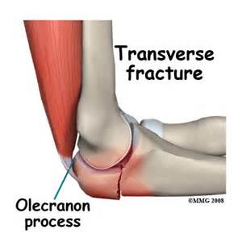
# without separation

Slide 30
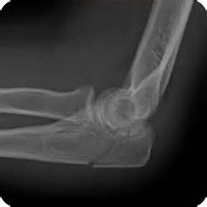
Fracture without separation

Slide 31
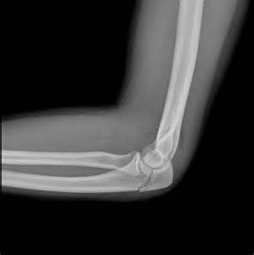
Clean # without separation

Slide 32
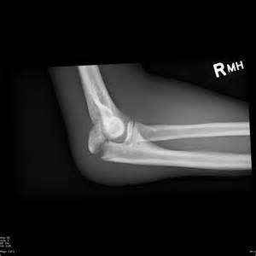
Clean # with separation

Slide 33
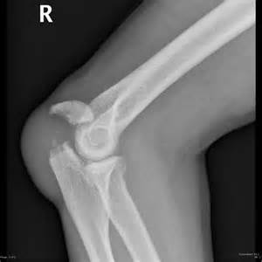
Clean break with separation

Slide 34
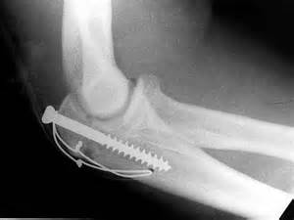
Fixation with Screw and tension band wiring

Slide 35
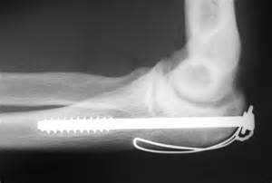
Fixation by screw

Slide 36
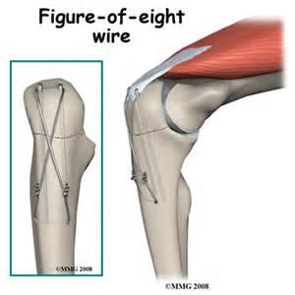
Figure-of-eight fixation

Slide 37
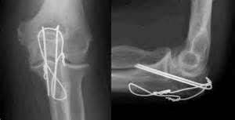
Fixation with K-wires and figure-of-eight wire

Slide 38
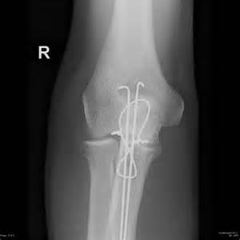
Olecranon # - tension band wiring

Slide 39
Complications
Non-union:
Olecranon fractures fail to unite if a gap is allowed to remain between the fragments.
The gap is bridged by fibrous tissue, so the continuity of the triceps is restored.
However, the power of extension is weakened.
In elderly patients the disability can usually be accepted
In younger persons, it may be advisable to excise the scar tissue, freshen the fracture surfaces, and secure the fragments in close apposition by a long screw.

Slide 40
Complications…
Mal-union:
The fracture is described as mal-united if the fragments unite with a ‘step’ or irregularity in the articular surface of the trochlear notch.
It may predispose to the later development of degenerative arthritis (osteoarthritis)
If severe deformity in a young person, operation may be considered:
Osteotomy, repositioning of misplaced fragment and fixation by a cancellous screw or
Excision of the proximal fragment, if it is small.

Slide 41
Complications…
Osteoarthritis:
May develop some years after the injury if the articular surface of the olecranon is left roughened or ‘stepped’.

Slide 42
Fracture of the head of radius
P.J. Okoth

Slide 43
Mode of injury
Fracture of the head of radius is one of the most common fractures of the upper limb in young adults.
It is caused by a fall onto the outstretched hand in pronation, the force being transmitted axially along the shaft of the radius with impaction of the radial head against the capitulum.
The fracture may be:
a vertical crack without displacement or
a segment of the radial head may be broken away or
the whole head may be extensively comminuted.

Slide 44
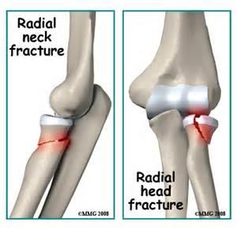
Fracture head of radius & neck

Slide 45
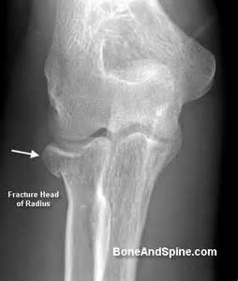
# head of radius

Slide 46
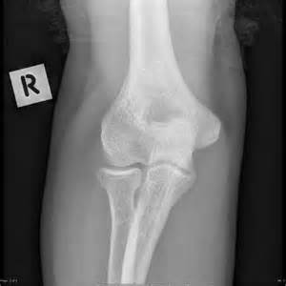
# head of radius

Slide 47
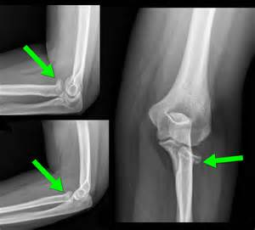
# head of radius

Slide 48
Clinical features
A fracture of the head of radius is easily overlooked because it is sometimes not immediately obvious in the radiographs, particularly when the fragments are impacted.
Suggestive features include:
A history of a fall onto the outstretched hand
Marked local tenderness on palpation over the head of the radius
Restricted elbow movement, especially of forearm rotation, with sharp pain at the lateral side of the joint at the extremes of rotation.

Slide 49
Treatment
Depends upon the severity of the damage to the radial head.
Slight damage:
Conservative treatment with application of a light plaster with the elbow at right angle and with the forearm midway between pronation and supination.
The plaster is won for 2-3 weeks until the pain settles.
Active mobilizing exercises are then begun.

Slide 50
Treatment …
Severe damage:
If the radial head is severely comminuted, with inevitable permanent distortion of the articular surface, the head of the radius should be excised.
After operation the elbow is rested in plaster for 2 weeks before active mobilizing exercises are begun.

Slide 51
Complications
Joint stiffness
Osteoarthritis

Slide 52
MONTEGGIA FRACTURE- DISLOCATION
P. J. OKOTH

Slide 53
DESCRIPTION
The Monteggia fracture is a fracture of the proximal third of the ulna with dislocation of the head of the radius.
It is named after Giovanni Battista Monteggia, professor of surgery in Milan, who described the injury in 1814, before the advent of radiology.

Slide 54
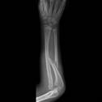

Slide 55
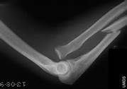

Slide 56
Causes
Mechanisms of injury include:
Fall on an outstretched hand with the forearm in excessive pronation (hyper-pronation injury).
The Ulna fractures in the proximal one-third of the shaft.
Direct blow on the back of the upper forearm (as in a person warding off an assault)
The usual displacement is characteristic: the distal ulna is angled forwards and the head of the radius is dislocated forwards.
Rarely, the reverse deformity occurs.

Slide 57
Mechanisms…
Isolated ulna shaft fractures are most commonly seen in defense against blunt trauma (e.g. nightstick injury).
Such an isolated ulna shaft fracture is not a Monteggia fracture. It is called a 'nightstick fracture'.

Slide 58
Classification [Bado type]
There are four types depending upon the displacement as follows:
Type I - Extension type (60%) – fracture proximal ulna shaft with anterior angulation (extension) and anterior dislocation of radial head.
Type II - Flexion type (15%) – proximal ulna shaft fracture with posterior angulation (flexion) and posteriorly dislocated radial head.
Type III - Lateral type (20%) – proximal ulna shaft fracture with lateral angulation and lateral dislocation of the head of radius.
Type IV - Combined type (5%) – proximal ulnar and radial shaft fractures with anterior angulation and radial head dislocation, typically anteriorly

Slide 59
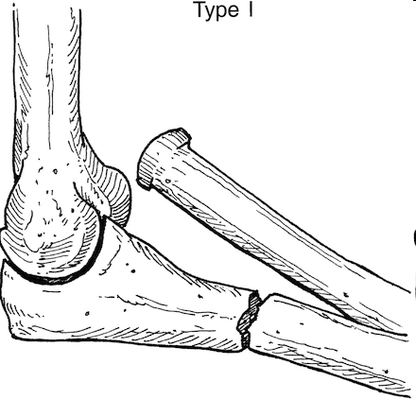
Cont..
Monteggia fracture

Slide 60
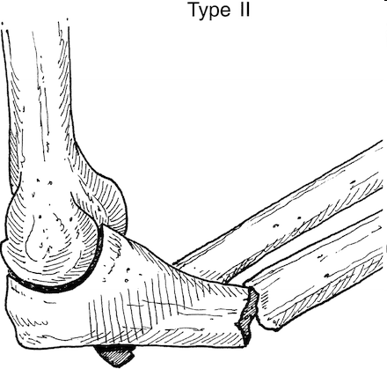
Cont..
Monteggia fracture

Slide 61
Cont..
Monteggia fracture - Type III

Slide 62
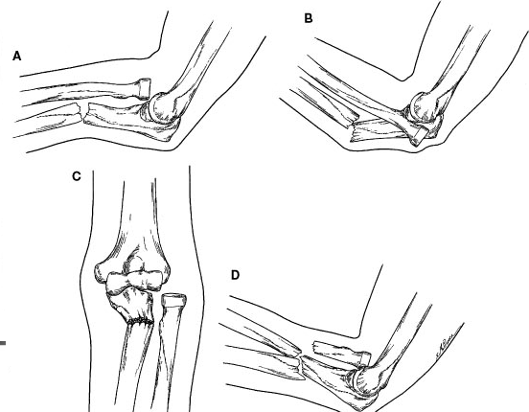
Monteggia fracture-dislocation

Slide 63
Clinical features
Marked pain and tenderness about the elbow
Swelling
Deformity as per type of fracture-dislocation
Angulation and malposition of radial head.
shortening of forearm
Severe loss of forearm movement:
No flexion , extension , pronation , and supination.

Slide 64
Radiology
AP and lateral views are taken
The head of the radius which normally points directly to the capitulum is dislocated forwards and there is a fracture on the proximal part of the ulna.

Slide 65
Treatment
Monteggia fractures may be managed conservatively in children with closed reduction and application of a full length POP with the elbow at right angle for 4-6 weeks, but due to high risk of displacement causing mal-union, open reduction and internal fixation is typically performed.
Open reduction and internal fixation of the ulnar shaft is considered the standard of care in adults.

Slide 66
Treatment…
The key to successful treatment is to restore the length of the fractured ulna. Only then can the dislocated joint be fully reduced and remain stable.
Open reduction and internal fixation is required.
The ulnar fracture is accurately reduced, with the bone restored to full length, and then fixed with a plate and screws.
The radial head usually reduces once the ulna has been fixed.
The arm is then immobilized in plaster for 4-6 weeks with elbow at right angle.

Slide 68
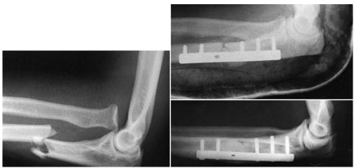
MONTEGGIA FRACTURE-DISLOCATION

Slide 69
Complications
Limitation of movement at elbow due to stiffness
Nerve injury: e.g. Posterior interosseous nerve palsy .
Radial head instability
Nonunion of fracture ulna.
Malunion of fracture ulna.
Myositis ossificans

Slide 70
Fractures of the shafts of radius and ulna
P. J. Okoth

Slide 71
Mechanism of injury
The fracture may affect one or both bones (ulna and radius)
The cause may be either an indirect force such as a fall onto the hand, or a direct blow on the forearm.
These fractures are notoriously prone to severe displacement, which is often very difficult to correct without open operation.
Displacement is more frequent in adults than in children.
Children usually have greenstick fracture with minor angulation.

Slide 72
Treatment
Accurate reduction is important because even slight residual displacement may disturb the relationship between radius and ulna, with consequent impairment of rotation, and often with subluxation of the inferior radio-ulnar joint.

Slide 73
Treatment…
Conservative treatment:
Manipulative reduction under anaesthesia
If successful, a full-length arm plaster is applied with the elbow at right angle and the forearm in a position midway between pronation and supination.
Plaster is retained for 10-12 weeks in an adult, 4-6 weeks in a child.
Check x-rays weekly for first 3 weeks to ensure no re-displacement.

Slide 74
Treatment
Operative treatment:
Indicated especially in adults where it is impossible to obtain satisfactory reduction by manipulation, or to maintain reduction by splintage in plaster.
Instability is worse when the plane of the fracture is oblique or spiral.
Operative reduction and internal fixation are required.
The fracture is exposed and the fragments are fitted together accurately under direct vision.

Slide 75
Treatment …
Operative treatment…
If both the radius and ulna are fractured they should be approached through separate incisions.
Fixation is effected by a metal plate held by 6 screws, 3 in each fragment.
If fixation is not very stable , the arm can be protected in a full-length plaster for 3-4 weeks.

Slide 76
Complications
Complications are common and include:
Compartment syndrome and vascular damage are common
Mal-union
Unless the rotational deformity is corrected, mal-union occurs.
Patient will be unable to supinate the forearm
Delayed union and non-union
Are common, particularly if rotatory shearing movements are not controlled
Cross-union
Some fractures unite with cross-union between the two bones, which makes pronation and supination impossible.

Slide 77
Galeazzi fracture
P. J. Okoth

Slide 78
Description
The Galeazzi fracture is a fracture of the radius with dislocation of the distal radioulnar joint.
It classically involves an isolated fracture of the junction of the distal third and middle third of the radius with associated subluxation or dislocation of the distal radio-ulnar joint.

Slide 79
Cause
They are associated with a fall on an outstretched arm.
After the injury, the fracture is subject to deforming forces including those of the brachioradialis, pronator quadratus, and thumb extensors, as well as the weight of the hand.

Slide 80
Galeazzi fracture-dislocation

Slide 81
Galeazzi fracture-dislocation

Slide 82
Clinical features
Pain,
Swelling,
Pain and soft-tissue swelling are present at the distal-third radial fracture site and at the wrist joint.
Deformity of the lower end of the forearm
Pronation and supination are severely restricted.
Neurovascular injury is rare.

Slide 83
Signs and symptoms
Forearm trauma may be associated with compartment syndrome.
Anterior interosseous nerve (AIN) palsy may also be present.
Injury to the AIN [A purely motor nerve, and a division of the median nerve] can cause paralysis of the flexor pollicis longus and flexor digitorum profundus muscles to the index finger, resulting in loss of the pinch mechanism between the thumb and index finger.
Galeazzi fractures are sometimes associated with wrist drop due to injury to radial nerve, extensor tendons or muscles.

Slide 84
Radiological picture
AP view :
Fracture radius , transverse or short oblique
Distal radioulnar joint is dislocated
Radius appears short
Lateral view :
Radius is angulated dorsally
Head of the ulna is prominent dorsally.

Slide 85
Treatment
Galeazzi fractures are best treated with open reduction of the radius and the distal radio-ulnar joint.
Nonsurgical treatment results in persistent or recurrent dislocations of the distal ulna.
The deforming muscular and soft-tissue injuries that are associated with this fracture cannot be controlled with plaster immobilization.
However, in skeletally immature patients such as children, the fracture is typically treated with closed reduction

Slide 86
Galeazzi fracture after surgical fixation
Galeazzi fracture is called “fracture of necessity” due to mandatory need for operative treatment.

Slide 87
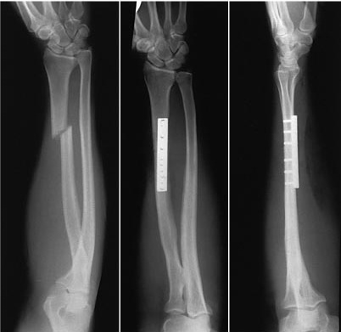
Galeazzi fracture-dislocation

Slide 88
Complications of Galeazzi fracture
High incidence of
Nonunion
Delayed union
Malunion (unstable fracture)
Limitation of pronation or supination
Compartment syndrome
Subluxation of the distal radioulnar joint

Slide 89
Colles’ fracture
P.J.

Slide 90
Description
A Colles' fracture, is a fracture of the distal radius in the forearm with dorsal (posterior) and radial displacement of the wrist and hand.
The fracture causes a deformity usually referred to as a "dinner fork” deformity
Colles' fractures are commonly seen in people with osteoporosis.

Slide 91
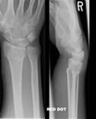
X-ray showing Colles fracture with ‘dinner fork’ deformity

Slide 92
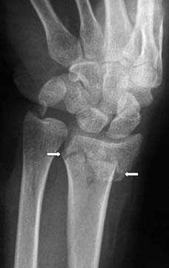
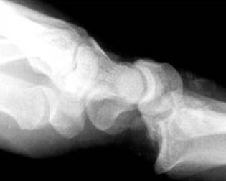
Colles’s fracture

Slide 93
Mechanism of injury
The fracture is most commonly caused by a fall onto a hard surface and breaking the fall with the outstretched hand.
Falling with wrists flexed would lead to a Smith's fracture (reverse Colles’ fracture).
Colles’ fracture usually occurs about three to five centimetres proximal to the radio-carpal joint with posterior and lateral displacement of the distal fragment resulting in the characteristic "dinner fork" or "bayonet" like deformity.
Colles' fracture is a common fracture in people with osteoporosis, second only to vertebral fractures.

Slide 94
Characteristic Features
The classic Colles’ fracture has the following characteristics:
Transverse fracture of the distal radius
2.5 cm (1 inch) proximal to the radio-carpal joint
Dorsal displacement
Dorsal angulation, and
Radial tilt

Slide 95
Features …
Dorsal tilt
Radial shortening
Loss of ulnar inclination
Radial angulation of the wrist
Dorsal displacement of the distal fragment
Comminution at the fracture site
Associated fracture of the ulnar styloid process in more than 60% of cases.

Slide 96
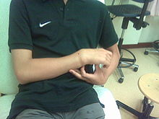
‘Dinner fork’ deformity

Slide 97
Treatment
Management depends on the severity of the fracture.
An undisplaced fracture is treated with a below elbow cast alone.
The cast is applied with the distal fragment in palmar flexion and ulnar deviation.
The cast is retained for six weeks.
A fracture with mild angulation and displacement requires reduction by closed manipulation, followed by immobilization with a below elbow plaster of Paris for six weeks.

Slide 98
Treatment…
Significant angulation and deformity may require an open reduction and internal fixation or external fixation.
The volar forearm splint is best for temporary immobilization of forearm, wrist and hand fractures, including Colles' fracture.

Slide 99
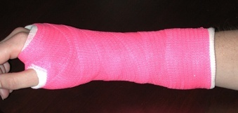
Cast for fracture distal radius

Slide 100
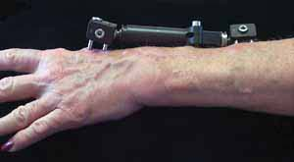
External fixation

Slide 101
Smith’s fracture
Fracture of the distal radius with anterior displacement. Also called reverse Colles’ fracture.
It is caused by a fall on the back of the hand with the wrist flexed.

Slide 102
Clinical features
Patient presents with a wrist injury but has no dinner-fork deformity.
Instead there is a ‘garden spade’ deformity.

Slide 103
X-ray findings
There is a fracture through the distal radial metaphysis.
A lateral view shows the distal fragment displaced and tilted anteriorly – the opposite of Colles’ fracture.
The entire metaphysis can be fractured or there can be an oblique fracture exiting at the dorsal or volar rim of the radius.

Slide 104
Treatment
The fracture is reduced by traction, supination and extension of the wrist, and the forearm is immobilized in a cast for 6 weeks.
Check X-rays should be taken after 7-10 days to ensure the fracture has not re-displaced.
Unstable fractures should be fixed with percutaneous wires or a plate.

Slide 105
Barton’s fracture
Intra-articular fracture of the distal radius.

Slide 106
Barton's fracture
A Barton's fracture is an intra-articular fracture of the distal radius with subluxation or dislocation of the radiocarpal joint.
There exist two types of Barton's fracture - dorsal and palmar, the latter being more common.
The Barton's fracture is caused by a fall on an extended and pronated wrist increasing carpal compression force on the dorsal rim.

Slide 107
Barton’s fracture…
Intra-articular component distinguishes this fracture from a Smith's or a Colles' fracture.
Treatment of this fracture is usually done by open reduction and internal fixation with a plate and screws.
Occasionally the fracture can be treated conservatively, but it easily gets re-displaced.

Slide 108
Barton’s fracture

Slide 109
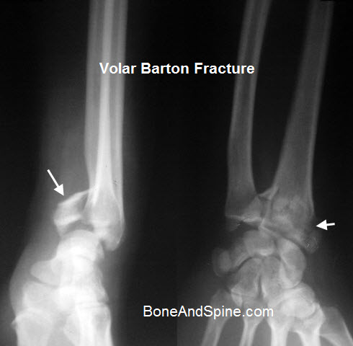
Barton’s fracture

Slide 110
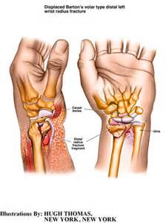
Displaced volar type Barton’s #

Slide 111
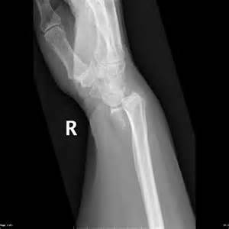
Volar type #

Slide 112
Distal forearm fractures in children
P. J. Okoth

Slide 113
Distal forearm fractures in children
The distal radius and ulna are among the commonest sites of childhood fractures.
The break may occur through the distal radial physis or in the metaphysis of one or both bones.
Metaphysial fractures are often incomplete or greenstick.

Slide 114
Mode of injury
The usual injury is a fall on the outstretched hand with the wrist in extension.
The distal fragment is forced posteriorly (often called ‘juvenile Colles’ fracture’)
Sometimes the wrist is in flexion and the fracture is angulated anteriorly.
At times due to less force the fracture is in the form of a buckle of the metaphysial cortex (compression or torus fracture)

Slide 115
Clinical features
History of a fall
Painful wrist
Swollen wrist
Sometimes there is an obvious ‘dinner-fork’ deformity

Slide 116
X-ray features
The precise diagnosis is made on the X-ray appearances.
Epiphysial fractures are almost invariably Salter-Harris type I or II, with the epiphsis shifted and tilted backwards and radially.
Metaphysial injuries may appear as mere buckling of the cortex, as angulated greenstick fractures, or as complete fractures with displacement and shortening.

Slide 117
Treatment
Displacement should be corrected by manipulation under anaesthesia and a plaster applied, as for fractures of the lower end of radius in adults.
The plaster should be retained for 3-4 weeks

Slide 118
Complications
Arrest of epiphysial growth
In crushing injuries of the epiphysial cartilage.

Slide 119
THE END.
THANK YOU.

