Slide 1
Injuries of
PELVIS
FEMUR
LEG

Slide 2
Anatomy Review
The pelvis is made up of the innominate bones (pubis, ischium, ilium), the sacrum, and coccyx
Because the pelvis is structured as a ring, a break at one point is often associated with disruption at a second point
The stability of the ring depends on the rigidity of the bones and the integrity of the ligaments that bind the three segments together across the symphysis pubis and the sacroiliac joints

Slide 3
The venous system is the most common source of significant pelvic bleeding in addition to bleeding from cancellous bone
Arterial bleeds comprise about 10% of pelvic bleeding

Slide 6
PELVIS FRACTURES
Mechanisms of injuries
direct force
violent force along the shaft of femur
fall especially in elderly
horse riding
fractures of the pelvis can lead to blood loss of 1.5 -2 litres which can lead to hypovolemic shock.

Slide 8
Mechanism of injury...
Fractures of the pelvis are caused by crush injuries and are becoming common due to automobile accidents. The direction of the violence can be
a. Antero posterior compression
b. Lateral (Side to Side) compression
c. Vertical shearing.

Slide 9
Mechanism of injury...
When the force is applied in the anteroposterior direction, the initial injury is to the anterior segment of the pelvis causing fractures of the pubic rami or separation of the symphysis pubis.
With further violence, the posterior half of the ring also gives way resulting in a disruption of the sacro iliac joint or fracture of the ilium near the sacro iliac joint.
.

Slide 10
Mechanism of injury...
When the violence is lateral compression, the disruption involves both segment. Vertical shearing violence causes an upward displacement of one half of the pelvis

Slide 11
Classification
1.stable fractures these are fractures without disruption of the pelvic ring.
2.unstable fracture fractures with disruption of the pelvic ring. Sites:
superior rami
inferior rami
through the acetabulum central dislocation of the Hip
iliac wing
separation of symphysis pubis e.g. during delivery (CPD)

Slide 12
unstable injuries
these are injuries with disruption of the pelvic ring which is composed of the sacrum and the two innominate bones.
the disruption occurs when there is a fracture with or without dislocation at two points approximately opposite each other. They are usually associated with injuries to the internal viscera e.g. the bladder ,urethra ,uterus etc.
separation of symphysis pubis

Slide 13
Clinical features
Hx of trauma
Pain
Inability to move
Blood from the urethra
hypovolemic shock due to internal bleeding.
tenderness at the symphysis pubis or sacro iliac joint.
NB.look for any evidence of rupture of the bladder or urethra and injury to the rectum. When these complications are present, there may be blood from the urethra, swelling in the perineum and abdominal wall or evidence of haemorrhage in the rectum..

Slide 14
Diagnostic test for urethral and bladder injuries
Pass a soft rubber catheter up the urethra,
- if the catheter cannot be passed into the bladder and there is blood on the withdrawn catheter, there is a rupture of the urethra
- if the catheter draws a small quantity of blood stained urine there is probably an intra peritoneal rupture of the bladder
- if a good amount of blood stained urine is drawn, in the presence of extravasation of urine there is an extra peritoneal rupture of the badder
- if normal clean urine is drawn there is no injury to the bladder or urethra.

Slide 15
MANAGEMENT
ATLS
Investigations-AP view x-ray will confirm the fracture.
Trauma series(CXR, abd.ultrasound ,skull xray, ct scan).
FAST(focused abdominal sonography trauma)
Catheterize to asses for urine output/input
A cystogram may be needed to confirm the diagnosis of injury to the urinary tract.
Prophylaxis –Anticoagulant(clexane if able)
Conservative mnx
Single segment fractures of the ilium or pubis.
These need only rest in bed for about two weeks. Strapping relieves local pain patients are allowed up as soon as the local pain subsides.

Slide 16
Ct mnx
Double Segment Fracture with Displacement
Many of these show an outward rotation of the hemi pelvis as well as an upward displacement. The pelvis opens out like a book as the patient lies supine.
Lateral recumbency reduces the rotation and displacement. This is done by putting the patient on his side and strapping him around the pelvis (the book like opening closes.
Upward displacement is corrected by applying tibial traction to the leg. The patient is supported in a pelvis sling or hammock, which helps in nursing and the traction is continued. After six weeks, a sacro iliac support is prescribed and the patient made ambulant in stages.

Slide 17
Definitive mnx

Slide 18
Surgical mnx
This is indicated in cases of unstable injuries of the pelvis. These are stabilised by,
1. External fixation
2. Internal fixation
External Fixation
This is done using pelvic frames and fixation pins passed through the iliac bones. This helps in stabilising the pelvic ring. In the acute stage it also helps in reducing the internal haemorrhage from pelvic wall veins. In the later stage it is also a definite treatment which lasts for 6-8 weeks.

Slide 19
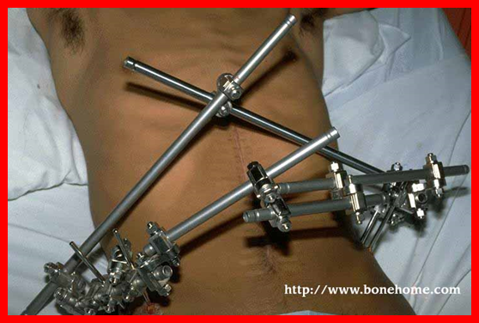
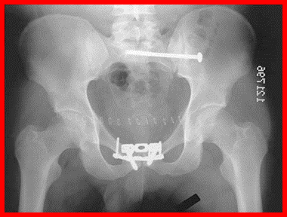
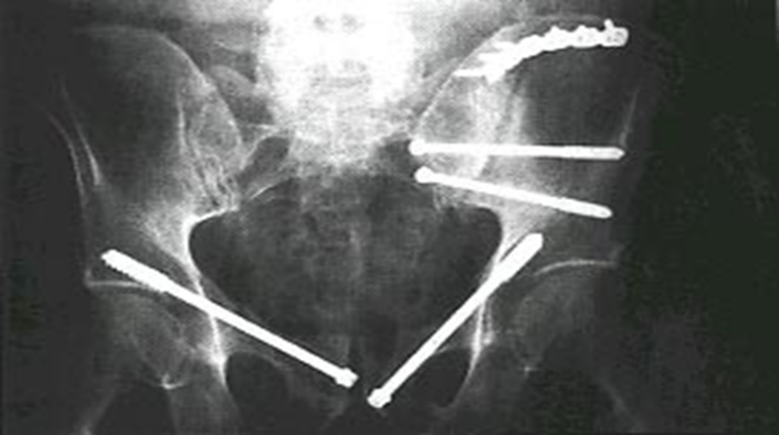
External and internal fixator

Slide 20
Internal fixation
In selected cases of gross displacement of symphysis pubis and or sacroiliac joint, open reduction and fixation by special plates and screws is done..
This makes the mobilisation of patient easier and possible earlier.

Slide 21
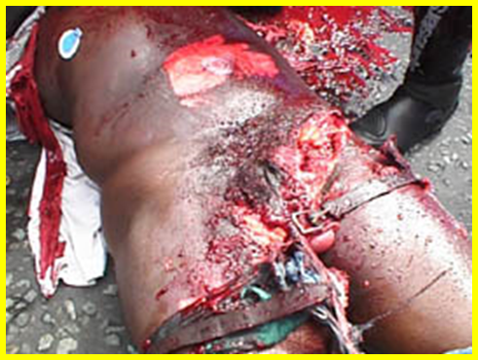
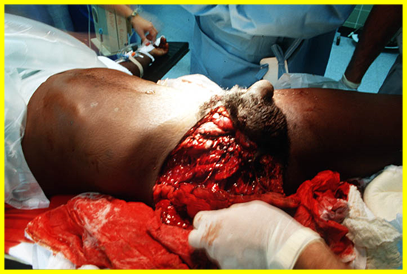
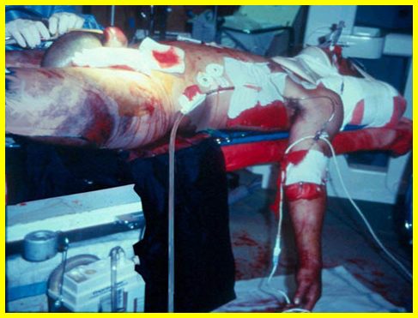
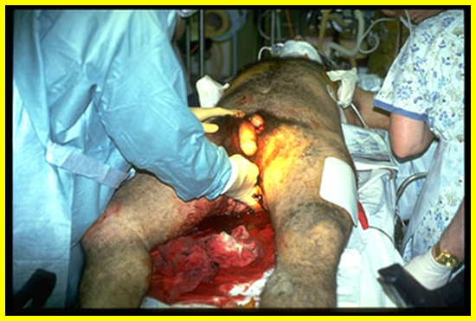
complications

Slide 22
injury to bladder or urethra,ovaries and uterus
injuries to rectum
Fat embolism
Malunion resulting in Sacro iliac pain
Leg shortening and altered gait
Non union resulting in instability.
damage to sciatic nerve

Slide 23
DISLOCATION OF HIP JOINT
It is classified into three categories
posterior dislocation is the commonest
anterior dislocation
central dislocation (fracture dislocation).

Slide 24
Posterior dislocation
The femoral head is forced out of the acetabulum and displaced posteriorly by a force along the hip.
The hip is flexed, internally rotated and adducted.
It may be associated with fracture of the acetabulum (fracture dislocation)
Causes
Dashboard injuries

Slide 26
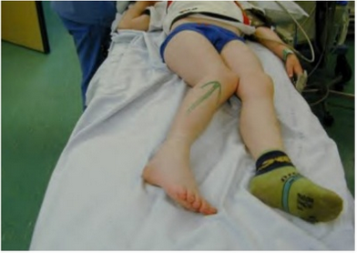
Clinical features
obvious shortening of the limb
fully internally rotated
adduction
flexion of the hip
the head is palpable behind the acetabulum(in the gluteus muscle.)
x-ray shows
free acetabulum
head behind the acetabutim

Slide 27
Xray of showing posterior disloc.

Slide 28
mnx
reduction under pethidine and valium
ALLIS maneuvre
an assistance stabilized the hip
apply a constant traction along the shaft of femur
gently externally rotate the limb
a click confirms reduction
apply light skin traction 1-2WKS
analgesics
physiotherapy

Slide 29
Stimpson method
Pt. in prone position with lower limbs
Assistant immobilizes the pelvis by applying pressure on the sacrum
Hold knee and ankle flexed to 90degrees and apply downward pressure to leg distal to the knee
Gentle rotatory motion of the limb may assist in reduction

Slide 30
Whistlers technique
Patient lies supine
Unaffected leg is flexed with an assistant stabilizing the leg
The assistant can also help stabilize the pelvis
Providers other hand grasps the lower leg of the affected leg usually around the ankle
Dislocated hip flexed at 90dgrees
When a pull is applied the knee is flexed hence pulling traction along femur.

Slide 31
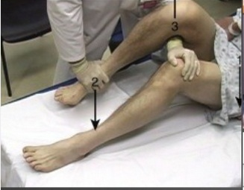

Slide 32
complications
injury to sciatic nerve in 10%
post traumatic ossification
osteoarthritis
rarely fracture neck femur either primarily or during reduction
Muscle spasm-when reduction takes more than 6hrs

Slide 33
Central dislocation
This is displacement of the head of femur through the acetabulum. The joint capsule remain intact.
Mode of injury
fall from a height and landing on the calcaneus.
RTA with the force driven along the shaft of femur when the limb is in abduction.
It is always associated with fracture of the acetabulum.

Slide 34
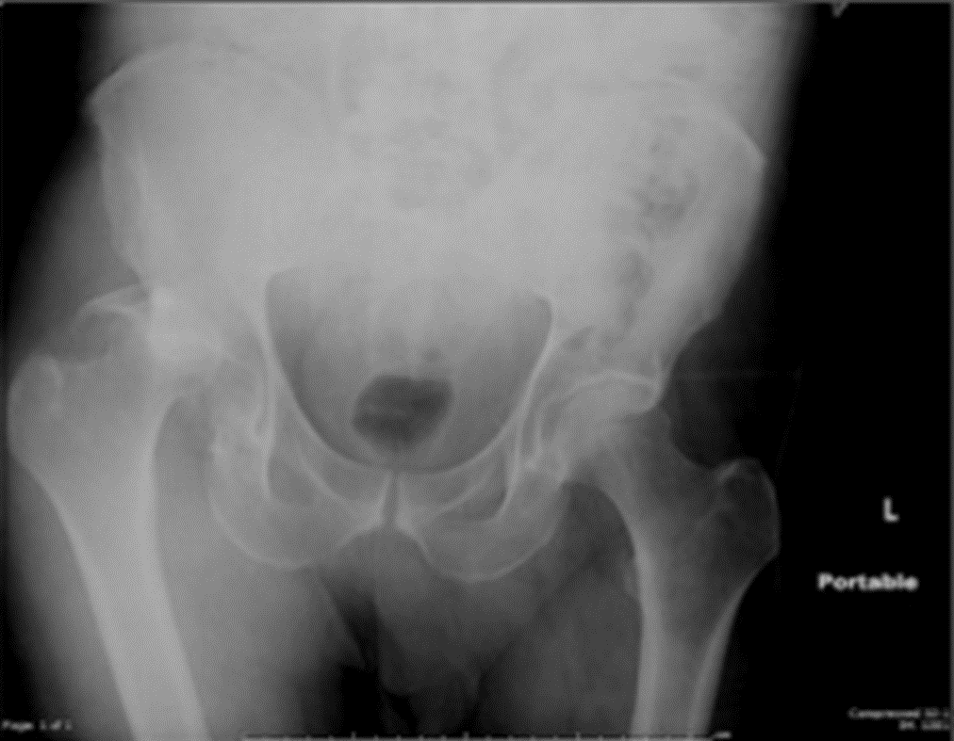
Clinical features
The patient presents with features of hypovolemic shock
Restriction in hip movements
obvious shortening.
X-ray shows fracture floor of acetabulum.

Slide 35
MNX
Treatment
ATLS -manage shock
skeletal traction in Thomas splint
complications
Shock
osteoarthritis
damage to organs, bladder ureters, urethra ovaries

Slide 36
Anterior dislocation
displacement of the head of femur anteriorly to the acetabulum.
rare
MOI
Forced abduction in rotation
Force along the shaft of femur in abduction.

Slide 37
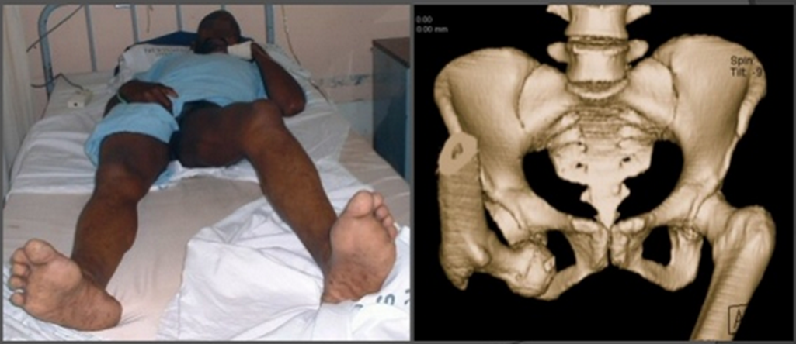
Clinical features
limb appears longer
flexion of the hip
external rotation of the hip
abduction
x-ray confirms head interiorly.

Slide 38
under pethidine and valium
reduction application of constant traction along the shaft of femur
gradually internally rotate the limb
a click confirms reduction
apply light skin traction
physiotherapy

Slide 39
Complications
avascular necrosis
osteoarthritis
post traumatic myositis

Slide 40
FRACTURE FEMORAL NECK
Anatomic Classification
a) Intracapsular - Fracture of the femoral neck proper
i) Subcapital
ii) Transcervical
iii) Basal
b) Extra capsular
i) Intertrochanteric - Trochanteric fracture
ii) Sub trochanteric - Up to 5cm below the lesser trochanter
c.# Femur-upper , mid or lower 1/3.

Slide 42
Antero-posterior radiograph of the right side proximal femur showing the anatomy and fracture positions. FNF femoral neck fracture, TF trochanteric fracture, Sub-TF sub-trochanteric fracture, LFW lateral femoral wall

Slide 43
Blood supply of the femoral head:

Slide 45
Intracapsular fractures
Common in women >60years reason being consequence of generalised osteoporosis due to post-menopausal bone loss.
Risk Factors
• Osteoporosis
• Bone-losing or bone-weakening disorders e.g. osteomalacia, diabetes, stroke (disuse), alcoholism & chronic debilitating disease.

Slide 47
Mode of injury
fall on the hip
rotational forces
RTA
The fracture of the neck of femur is important because of the complication it causes. One of the serious complication is avascular necrosis head of femur. This is because all the blood supply to the head is all off. They include:
intracapsular artery
ligamentum teres

Slide 48
Classification
This is classified into the following four types (Garden).
1. Incomplete fracture.
2. Complete fracture without displacement.
3. Complete fracture with partial displacement.
4. Complete fracture with full displacement.

Slide 50
Clinical features
history of a fall and then inability to wake up .
Marked lateral/external rotations
Loss of function
Shortening due to impaction.
On palpation, there is tenderness over the anterior and lateral aspects of the hip joint.
The greater trochanter is elevated on the injured side. All movements are extremely painful except in rare case ..

Slide 51
management
Radiological Features
An anteroposterior view of the whole pelvis to show both the hips must be taken. It shows the level and the type of fracture.
1.The best method of management is through internal fixation.
⬧ Angle plate
⬧ Smith Patterson nail
2. discharge on non weight bearing (crutches)
3. physiotherapy exercise

Slide 53
a)Smith-Petersen Nail with McLaughlin Side Plate Disassembled b)Smith-Petersen Nail with McLaughlin Side Plate intact

Slide 54
conservative management
indications:
⬧ all children with neck femur
⬧ all crack fracture
⬧ awaiting surgery
russels skin traction.
Other surgical operations
If a vascular necrosis occurs total hip replacement may occur.
1 using Austin Moore
2.arthrodesis with dynamic hip screw
3.mc murry operation change the line of force

Slide 55
Complications
Non union
Avascular Necrosis
Infections
Loosening of prosthesis
Pulmonary embolism

Slide 56
TROCHANTERIC FRACTURES
It is a fracture that occurs through the trochanter.
Incidence
common in the elderly
females are more affected than men.
It’s a darling to metastasis
MOI
Fall on the point of the hip

Slide 57
Clinical features of trochanteric
Hx of trauma and inability to walk
On examination, the injured leg lies externally rotated and is obviously shorter.
The degree of external rotation is greater than in the intra capsular fracture.
There is marked local swelling and ecchymosis over the trochanteric area.
All movements of the hip are extremely painful and limited. This has to be
differentiated from intracapsular fracture

Slide 59
management
1.Look for other associated life threatening injuries(flail chest,pneumothorax,pelvic fractures)ATLS
2. skeletal traction in adduction
3. operative angle plate

Slide 61
The-main-implant-groups-for-hip-fracture-surgery

Slide 62
Complications
Malunion.
Shortening.
coxa vara.
Haemorrhage.
Compartment syndrome of the thigh.

Slide 63
FRACTURE OF THE SHAFT OF FEMUR
Major cause of morbidity & mortality in lower limb trauma – high energy transfer
Life threatening complications – associated injuries & fractures ,ARDS , multi-organ failure
First splints wood, plantropes, leather straps
MOI
1. Fall on adjusted limb leading to spiral fracture
2. direct injury leading to transverse or communuted
3. RTA
4. pathological- oblique

Slide 65
they are very common NB the femur is the longest bone
it is commoner in the elderly after 50 years.
in children if spiral and bilateral(suspect child abuse)
High energy fracture in young people
sites upper ,mid, lower

Slide 66
Clinical Feature
⬧ history of trauma
⬧ lateral rotation of the foot
⬧ shorter than normal
⬧ obvious deformity
⬧ inability to use the limb
⬧ patient may present with hypovolemic shock (NB blood loss is 1.5 -2.0l

Slide 67
Investigations
Hip, Femur & Knee
- CXR - Baseline is useful as there is a risk of PE & ARDS in those with multiple injuries.
If bilateral you may be forced to have trauma series

Slide 68
Management
1. shock should be treated first and the fracture site splinted with Thomas splint
2. wound –surgical toilet if open fracture
Age 0-6 years gallows traction
6 – 8 years skin traction (russels)
skeletal traction and internal fixation

Slide 69
mnx
6- 18years russels skin traction for 8 -10 weeks.
Maximum weight 10% of patients body weight
Over 18 years
Skeletal traction 10 -12 weeks
Steinman pin at tibial tuberosity sliding traction

Slide 70
mnx
Once the fracture is 'sticky' (6-8wks), traction can be discontinued & the patient
allowed up & partial weight bearing in a cast or functional bracing is acceptable for the lower ⅓ or plaster spica for the Upper ½

Slide 71
Surgical management
ORIF;
i) Plating
- The combination of shaft & femoral neck fractures
- A shaft fracture with an associated vascular injury
ii) K-Nail- Fractures around the isthmus of the femur
iii) Interlocking nail;
- Fractures near the middle of the shaft
- Fractures prone to rotational forces
- Fractures of bones with a wide medullary cavity

Slide 73
Indications for external fixation
- Fractures in adolescents
- Severe open fractures
- Management of patients with multiple injuries where there is need to reduce operating time
- Dealing with severe bone loss by the technique of bone transplant

Slide 74
Complications
Shock - 1-2L of blood can be lost even with a closed fracture-renal failure
• Fat embolism & ARDS
• Thromboembolism
• Joint stiffness
• Refracture & implant failure
Osteomyelitis
Muscle wasting
Shortening
Compartment syndrome.

Slide 76
SUPRACONDYLAR FRACTURES OF THE FEMUR
fracture is just above the condyles but may extend between them & up to the distal 9cm of the femur.
When the distal fragment is intact, it may be markedly displaced by the pull of the gastrocnemius, thus risking injury to the popliteal artery.
Hence always palpate for the tibial pulses

Slide 77
Incidence and mode of injury
common in elderly and women due to osteoporosis otherwise any age can be affected
MOI
-Direct trauma.

Slide 78
Clinical features
history of trauma
swollen knee joint
obvious deformity
tenderness on movements
Pain
posterior displacement of the distal fragment due to a pull by gastrocnemius.

Slide 79
Management
Conservative
Traction through the proximal tibia; the limb cradled on a;
- Thomas' splint with a knee flexion & movements are encouraged
- Braun's splint - To relax the gastrocnemius to prevent displacement of the distal fragment.
Operative-
a) Angle plate
b) Locked intramedullary nail which is introduced retrograde through the intercondylar notch.

Slide 80
Complications
1. Soft tissues damage
2.Vessel damage- Popliteal artery - Posteriorly & Femoral Artery anteromedially
3. Stiffness of the knee.
4. Non union

Slide 81
FEMORAL CONDYLE FRACTURE
Direct injury or fall from a height
Clinical presentation
There is swelling which May be defined
Tenderness over the fracture site
“Doughy” due to haemoarthrosis
Restriction in knee movement
X-ray confirms T&Y shape

Slide 82
management
Under anaesthesia
Aspirate the joint
Skeletal traction 6/52
Non weight bearing 6/52 crutches
Exercise quadriceps

Slide 83
TIBIA CONDYLE FRACTURE
MOI
Fall from height
Direct blow especially lateral condyle
(lumber injury) fall on extended knee and slightly valgus
Incidence 50-60 years
The lateral condyle is driven upwards and smashed by the lateral femoral condyle.
High energy fracture in young patients

Slide 84
Clinical features tibial condyle
swollen knee
valgus position
doughly feeling because of haemoarthrosis
PT unable to move the limb
NB.

Slide 85
schatzer classification

Slide 87
management
X- ray confirms the diagnosis.
Evaluate by taking the pulses(posterior tibialis and dorsalis pedis)
Reduction
Full cylinder POP/knee cast/knee brace
Non weight bearing 6/52
Exercise quadriceps
Operative – pin, plates
prophylaxis anticoagulant

Slide 89
PATELLA FRACTURES
Mechanism of Injury
• Direct injury - Usually a fall onto the knee or a blow against the dashboard of a car - causes either an
undisplaced crack or else a comminuted ('stellate') fracture without severe damage to the extensor expansions.
• Indirect injury - Occurs when someone catches his/her foot against a solid obstacle & to avoid falling,
contracts the quadriceps muscle forcefully. This is a transverse fracture with a gap between the fragments

Slide 90
Predisposing factors
Fluroquinolone use
Steroid use
sports

Slide 91
Classification of patella fractures
Displaced or Undisplaced
• Transverse
• Longitudinal
• Polar
• Comminuted (stellate)

Slide 92
Clinical features of patella fractures
▪ Hx trauma
▪ Pain at the knee
▪ Swelling of the knee.
▪ Tenderness over the patella.
▪ sometimes a gap can be felt on the patella
Haemoathrosis-torn ACL & PCL,P.tibia and D.femur,tear on the periphery of the meniscus
Aspirate the knee-if fat(lipoarthrosis) there is fracture,if no fat soft tissue injury.

Slide 93
Management of fracture patella
Undisplaced or minimally displaced fractures - The extensor mechanism is intact & Mx is Conservative -
A Plaster cylinder holding the knee straight is worn for 3-4wks, & during this time quadriceps exercises are practised everyday.
Comminuted (stellate) fracture - Extensor mechanisms are intact however, the undersurface of the patella is irregular & there is a serious risk of damage to the patellofemoral joint - Patellectomy or Back-slab is applied but removed several times daily for exercises to mould the fragments into position & to maintain mobility.

Slide 94
• Displaced transverse fractures - Lateral expansions are torn & the entire extensor mechanism is disrupted.
A plaster back-slab is worn until active extension of the knee is regained; the back-slab may be removed everyday to permit active knee-flexion exercises.
Orthopaedic Surgery-tension band wires,screws

Slide 95
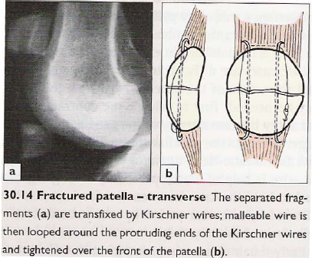
Surgical mnx.

Slide 97
KNEE DISLOCATION
ASSINGMENT:READ AND MAKE NOTES ON DISLOCATION OF KNEE JOINT AND MANAGEMENT

Slide 98
TIBIA FIBULA FRACTURES
M.O. I -
Twisting force applied to the foot usually leads to spiral fracture of tibia and fibula.
- Direct trauma
- Motorcycle accident

Slide 99
Clinical features and evaluation
Obvious deformity
Lateral rotation
Bruising over the skin .
Feel for the pulse (posterior tibial pulse/dorsalis pedis) and the sensation (popliteal nerve).
Ask the pt. to move the toes.
X-ray - spiral – communited fractures
Patient might present with shock – transverse.

Slide 101
Investigations
Radiograph
recommended views
full length AP and lateral views of affected tibia
AP, lateral and oblique views of ipsilateral knee and ankle
Arteriograms-if you suspect vascular injuries

Slide 102
Management
Compound - if pt is in shock
Resuscitation.
IV fluids N/S alt 5% dextrose
blood transfusion
Aim-convert it to simple fracture
Surgical toilet – Dirt
- Foreign body
- Dead tissues
- Ligate bleeding vessel

Slide 103
Ctd mnx
Close the wound * If there is tension make a release incision next to the wound and then close it after 48hrs.
Manipulative reduction – if this fails skeletal traction
• Insert pin at the calcaneus.
• Limbs elevated on a Brauns splint until the swelling has subsides

Slide 104
Ctd mnx
Back slab is usually applied when there is swelling.
Full leg P.O. P after the swelling has subsided with a window at the site of the wound for dressing x 12/52.
Non weight bearing 8/52
Antibiotics
Analgesics
Tetanus toxoid.

Slide 105
mnx
standard antibiotics for open fractures (institution dependent)
cephalosporin given for 24-48 hours in Grade I,II, and IIIA open fractures
aminoglycoside added in Grade IIIB injuries
minimal data to support this
penicillin administered in farm injuries
minimal data to support this

Slide 106
Operative mnx
external fixation
indications
Provisional external fixation an option for open fractures with staged IM nailing or plating
indicated in children with open physis
IM Nailing
indications
most open fractures can be treated with IM nail within 24 hoursi.e segmental and communited fractures
contraindicated in children with open physis (use flexible nail, plate, or external fixation instead)

Slide 107
Complications
Malunion
Non-union (>9mnths)
Delayed union(6-9mnths)
Dvt
Fat embolism
Compartment syndrome

Slide 108
PILLON FRACTURES
This injury to the ankle joint occurs when a large force drives the talus upwards against the tibial plafond.
There is considerable damage to the articular cartilage & the subchondral bone may be broken into several pieces.

Slide 109
Presentation of Pillon
Symptoms
ankle pain, inability to bear weight, deformity
Physical exam
inspection
examine soft tissue integrity
swelling, abrasions, ecchymosis, fracture blisters, open wounds
examine for associated musculoskeletal injuries
ROM & stability
examine stability and alignment of the ankle join
neurovascular
check DP and PT pulses
look for neurologic compromise
check for signs of compartment syndrome(5ps).

Slide 110
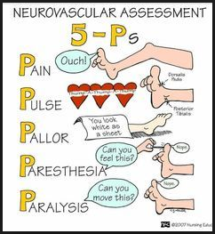

Slide 111
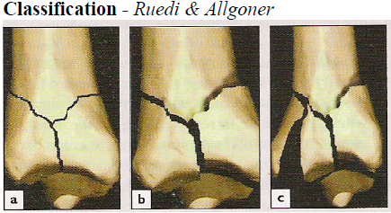

Slide 112
Mnx of Pillon Fractures
Conservative Mx;
•Control soft-tissue swelling is a priority; this is best achieved either by;
a) Elevation & calcaneal traction or
b) Applying an external fixator across the ankle joint
This may take 2-3wks by which time surgery may be considered
Definitive mnx is surgery-with plates and screws.

Slide 113
ANKLE FRACTURES
Assignment
READ AND MAKE NOTES
Make sure you know Dani and webers classifications

Slide 115
success/!!!!!

