Slide 1
INTERPRETING CHEST XRAY IN RELATION TO TUBERCULOSIS
PRESENTER: DR TIMA NASSIR

Slide 2
INTRODUCTION
Pulmonary Tuberculosis – infection with Mycobacterium tuberculosis , acquired through droplet inhalation
Primary TB- commonly seen in infants and children if previously unexposed to TB (hypersensitivity is absent)
Patient is immunologically able to kill the organism and heals with fibrosis (+-calcification)
Can be anywhere in the lung in children, predilection for upper or lower lung zones in adults
Post primary TB-If hypersensitivity is present (due to previous infection or BCG vaccination) a greater inflammatory rection and caseous necrosis results
Strong predilection for upper zones

Slide 3
Progressive primary TB- direct transition from primary to post primary disease
Notes:
Miliary Tb distribited throughout the lung

Slide 4
CLINICAL PRESENTATION
Loss of weight or appetite
Malaise
Fever
Night sweats
Cough (productive with hemoptysis)

Slide 5
RADIOLOGICAL FEATURES- PRIMARY TB
Homogeneous pneumonia- mimicks community acquired pneumonia
Any lobe may be involved to any size
Commonly sub pleural location within well ventilated lower lobes
Multifocal involvement and cavitation unusual
A pneumothorax may occur due to rupture into pleural space

Slide 6
Notes:
Homogeneous consolidation

Slide 7
Notes:
Dense homogeneous opacity

Slide 8
Notes:
Primary TB in a small child

Slide 9
RADIOLOGICAL FEATURES- PRIMARY TB
Nodal enlargement- ipsilateral hilar +- mediastinal adenopathy
Most common manifestation in children, less commonly seen in adults (50% of cases)
Nodal pressure and bronchial erosion may cause segmental or lobar collapse

Slide 10
Notes:
Bilateral hilar adenopathy of primary pulmonary Tb

Slide 11
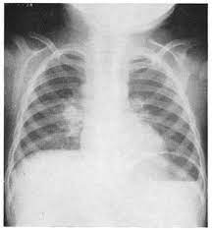

Slide 13
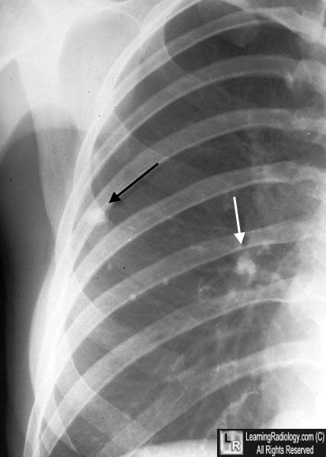
RADIOLOGICAL FEATURES- PRIMARY TB
Ghon lesion or focus- in 1/3 of cases a residual well defined rounded or irregular linear opacity remains +/- calcification

Slide 14
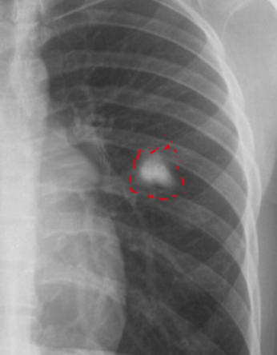

Slide 15
RADIOLOGICAL FEATURES- PRIMARY TB
Ranke complex- irregular and heterogeneous nodal calcification within ipsilateral hilum or mediastinum which is seen in conjunction with a Ghon lesion

Slide 16
Notes:
Ghon lesion in right axillary region in right lung field, Multiple high density round/oval masses in hilar region bilaterally (calcified lymph nodes)

Slide 18
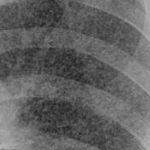
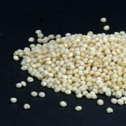
RADIOLOGICAL FEATURES- PRIMARY TB
Miliary TB- This is classically a manifestation of primary disease (representing overwhelming infection with hematogeneous spread)
Although now commonly seen with post primary disease
Multiple 1-2mm discrete nodules (which are rarely calcified) are scattered evenly throughout the lung
Notes:
Millet seeds

Slide 19
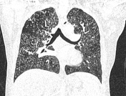

Slide 21
RADIOLOGICAL FEATURES- PRIMARY TB
Pleural effusion- this follows sub pleural infection.
It is often large, unilateral and isolated
Seen in children and young adults
Residual pleural change is unusual

Slide 22
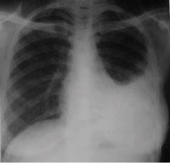

Slide 24
RADIOLOGICAL FEATURES-POST PRIMARY TB
Initial lesion- Poorly marginated, nodular and linear opacities (approximatekly 5-10mm) arising within the apico-posterior segment of a lobe or superioe segement of a lower lobe
Can be unilateral or bilateral but with progression these opacities may coalesce

Slide 25
Notes:
Tree in bud sign

Slide 27
RADIOLOGICAL FEATURES-POST PRIMARY TB
Cavitation- Affects 40-80% of cases
Cavities may be single or multiple, large or small, or thin or thick walled
Rasmussen aneurysm – a rare granulomatous weakening of a pulmonary arterial wall which can be life threatening

Slide 28
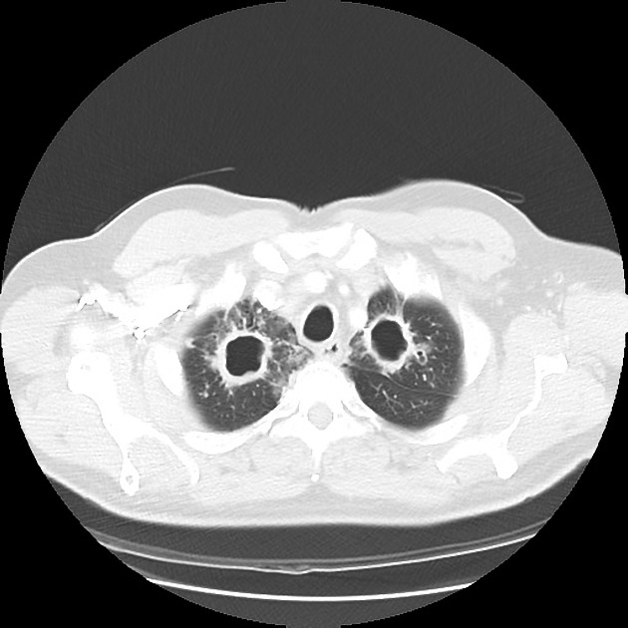
Notes:
Bilateral apical cavities

Slide 29
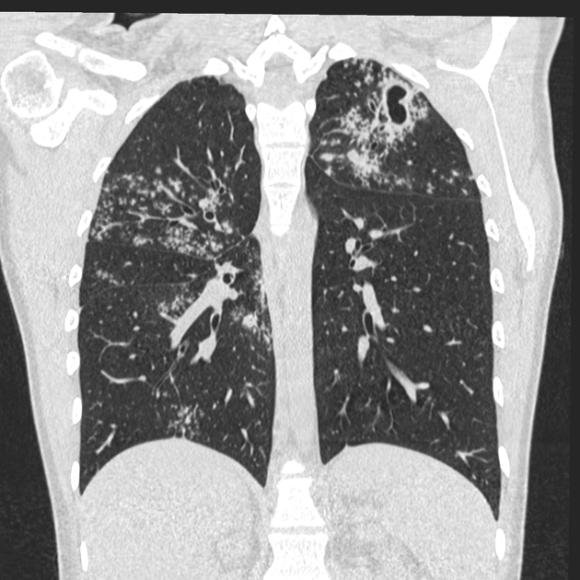

Slide 32
RADIOLOGICAL FEATURES-POST PRIMARY TB
Pleural effusions- these often progress to an empyema
Healing is complicated by pelural thickening and calcification

Slide 33
Notes:
empyema

Slide 34
Notes:
Pleural calcification

Slide 35
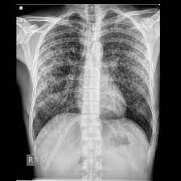
RADIOLOGICAL FEATURES-POST PRIMARY TB
Miliary TB- Endobronchial spread , appearing similar to that seen in primary TB

Slide 36
HEALING
The resultant fibrosis and scar formation results in well- defined upper lobe nodular or linear opacities
Associated volume loss, pleural thickening and occasional calcification
Bronchiectasis cysts and bullae can develop

Slide 37
Notes:
Right upper lobe collapse due to fibrosis and pleural thickening with right sided tracheal and mediastinal shift, crowding of right upper ribs, uplifting of right hilum and juxtaphrenic peak sign
Left l;ung id hyperinfalted

Slide 38
COMPLICATIONS
Aspergilloma- colonization of cavities by fungus

Slide 39
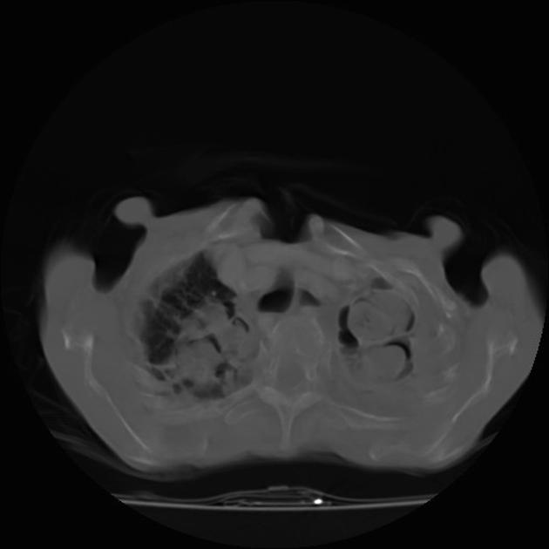

Slide 40
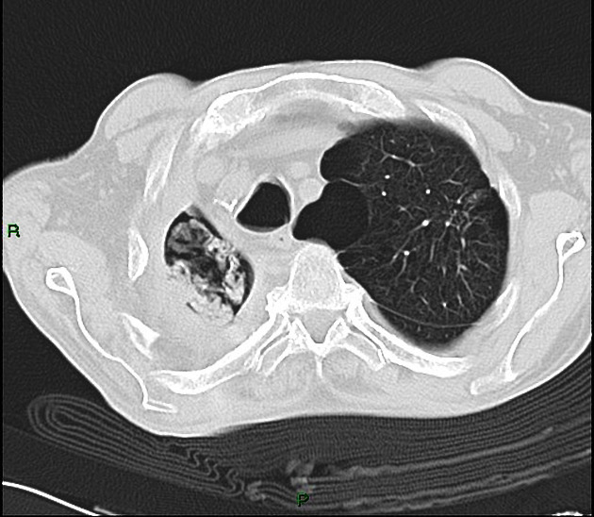

Slide 42
Notes:
Traction bronchiectasis

Slide 43
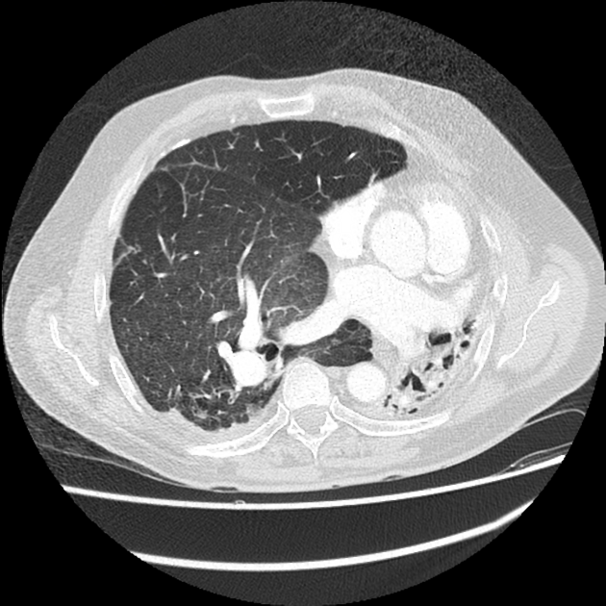
UNILATERAL TUBERCULOUS LUNG DESTRUCTION
Notes:
Opacification of the left hemithorax with mediastinal shift to the left, compensatory hyperinflation of the right lung

Slide 44
Notes:
Destruction of left lung parenchyma with replacement by large cavity showing free communicatio and air fluid level within it

Slide 45
TUBERCULOUS SPONDYLITIS/ POTT DISEASE
Vertebral body osteomyelitis and intervertebral discitis from tuberculosis
Symptoms- back pain, lower limb weakness/paraplegia, kyphotic deformity, fever , weight loss

Slide 46
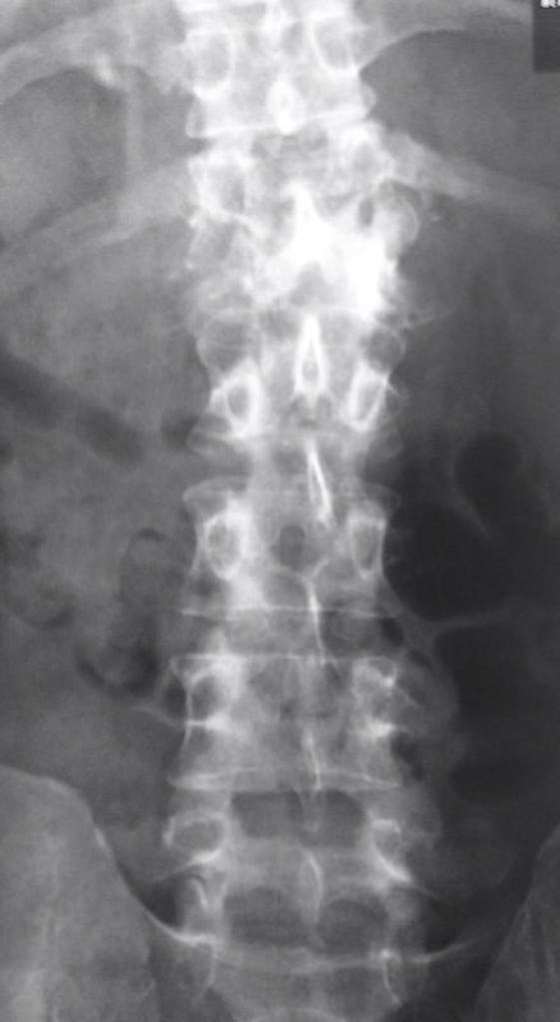
Notes:
Destruction of T12 and L1 with a resultant gibbus

Slide 47
TUBERCULOUS PERICARDITIS
Infection of pericardium with tubercle bacilli
Notes:
Enlarged cardiac shadow with water bottle configuration suggestive of pericardial effuion
Small left pleural effusion

Slide 48
Notes:
Pericardiocentesis one week post pericardiocentesisi

Slide 51
REFERENCES
https://radiopaedia.org/cases/chronic-pulmonary-tuberculosis-2
@MBS_MedicalBooksStore_2019_Grainger.pdf

