Slide 1
INTRAVENOUS CUT DOWN

Slide 2
INTRAVENOUS CUT DOWN
Purpose
To create access for infusion or blood transfusion when it’s difficult to get access into superficial veins
The venous cut-down procedure is a last resort, it should be attempted after unsuccessful peripheral IV and intra-osseous attempts or you do not have intra-osseous capability
Procedure-NCK procedure manual page 191

Slide 3
indications
Absence of peripheral iv site in obese pts and iv drug users
Hypovolemic shock necessitating large volume resuscitation
Non-visible non-palpable veins in critically ill infants and small children
For prolonged periods of iv therapy
For parenteral nutrition
For measurement of cvp

Slide 4
contraindications
Bleeding diathesis
Overlying cellulitis
Significant vascular or orthopedic injury to the site of cut down

Slide 5
Anatomical Considerations
Primary site. The primary site is the greater saphenous vein at the ankle , located at a point approximately two centimeters anterior and medial from the medial malleolus.
(2) Secondary sites.
Basilic vein at the arm
Cephalic vein at the deltopectoral grove

Slide 6
Steps:
Wheel the equipment to the bedside
Explain the procedure to the patient
Assist doctor or clinician as appropriate
Support client during procedure(positioning and reassuring)
Regulate fluids accordingly
After the procedure clear equipment and dispose waste according to the institutions policy of waste management

Slide 7
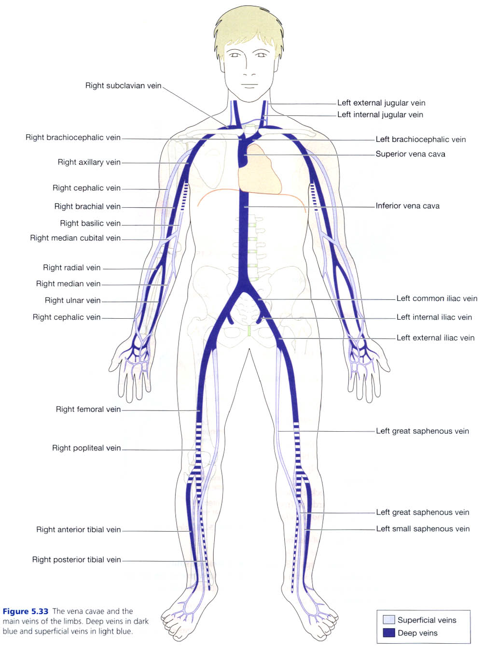

Slide 8
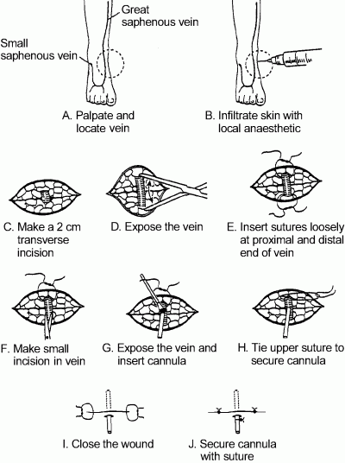

Slide 9
Post procedure
Immobilize the limb by splinting and advise the patient to immobilize it as well
Evaluate patient’s condition and tolerance to procedure
Document the procedure

Slide 10
Complications of venous cut down
Cellulitis–a diffuse spreading infection, especially of the subcutaneous tissues.
Hematoma–a localized mass of blood outside of the blood vessels. Such blood is usually found in a partly clotted state.
Phlebitis–inflammation of a vein.
Perforation of the posterior wall of a vein–a back wall of a vein is pierced.
Venous thrombosis–a blood clot in a vein.
Nerve transections–cutting across a nerve.
Arterial transection–cutting across an artery.

Slide 11
Incision and drainage
This is a minor surgical procedure for treating abscesses and boils
They can form in any loose tissue or subcutaneous tissue
They release pus or pressure built up under the skin from abscesses, boils or infected paranasal sinus
Incision
This is the surgical cutting of soft tissues E.g skin or muscle with a scapel and blade
It should be large enough to allow free drainage
The skin has to be cleaned first with antiseptic before an incision is made
A drainage tube is stitched to the skin after incision and and instructions given when to shorten or remove
Skin around the wound is dressed with antiseptic

Slide 12
Drainage
This is removal of fluid that has accumulated abnormally from a cavity in the body E.g. serous fluid from a swollen joint, pus from an internal abscess.
A drain
This is a device which is rubber, tube or wick used to draw fluid or pus from internal cavity to the surface
It can also be inserted during an operation to ensure any fluid formed passes to the surface preventing accumulation and infection or pressure in the operation site
Indications
Soft tissue abscesses

Slide 13
Contraindications
Infections without abscess formation
Premature incision before localization of pus will not be curative and bacteremia from manipulation may result
Requirements
A standard suture tray with a scapel and packing gauzes added
Sterile gauzes
Antiseptic solution
Local anaesthesia
Syringe and needles for anaesthesia infiltration
Blade/ scapel
Dressing supplies

Slide 14
Steps
The area around the abscess or swelling is cleaned with antiseptic.
The abscess is then incised so that the pus or fluid can drain away
A rubber tube or wick or ribbon gauge is placed in the incision to assist in the drainage to allow healing to take place. suturing is done ( depending). The wound is then cleaned with antiseptic and sterile dressing of the right size applied. If too deep and doesn’t need a tube, its packed, then dressed.

Slide 15
AFTER CARE
Advice the patient to keep the area elevated
Instruct patient not to disturb the dressing or splint(to immobilize arm or leg)until the first follow up visit
Provide appropriate analgesia especially immediately post-operatively though drainage relieves most of the pain of an abscess
Therapeutic antibiotics are administered

Slide 16
Complications
Transient bacteremia
Scar formation
Recurrence of infection
Neurovascular injury

