Slide 1
FUNDAMENTALS OF NURSING II-YEAR ONE SEMESTER TWO
BY BERNARD CHEPKWONY

Slide 2
BROAD OBJECTIVE
The student to be able to provide holistic care to the unconscious and critically ill patients using the Nursing Process as the frame work for providing quality nursing care.

Slide 3
SPECIFIC OBJECTIVES
1 Apply the Nursing process in the provision of care
2 Perform health assessment on a patient
3 Provide holistic care to the unconscious and the critically ill patients
4 Provide follow up care to medical /surgical patients following discharge.

Slide 4
THE NURSING PROCESS (NP)

Slide 5
Background
Nursing Process (NP) is widely accepted as a scientific method that guides procedures for evidence informed nursing practice and helps define nursing as a profession (Alfaro-Lefevre, 2006; Berman & Snyder, 2012; Rivas, F.P.,García,J.S., Arenas, C. M., Lagos, M. B. &López, M.G., 2012).

Slide 6
Background Cont..
The NP is an essential core of practice for the nurse to deliver holistic, patient-focused care (American Nurses’ Association (ANA), 2011 ).
Effective implementation of NP leads to improved quality of care and stimulates the construction of theoretical and scientific knowledge based on the best clinical practice.

Slide 7
Definition of NP
Systematic, rational, scientific method of providing individualized quality Nursing Care to:
Individual
Family
Community

Slide 8
Definition Cont…
Systematic–planned in sequence; step by step.
Rational–reason, critical thinking.
Scientific–tested and approved approaches
Individualized –based on specific unique a person or group of people to the actual or potential alteration in health.

Slide 9
Historical Perspectives
The nursing process has evolved as various nurse theorists and organizations wrote about it:
1952:Peplau (a psychiatric/MH nurse) identified 3phases of the NP in four sequential phases related to personal therapeutic interactions: (1) orientation, (2) exploitation, (3) resolution.
1955: Lydia Hall originated the term nursing process

Slide 10
Historical Perspectives Cont…
1959: Johnson described the steps as (1) assessing situations, (2) decision making,(3) implementation of actions to resolve problems, (4) evaluation.
1961:Orlando (a psychiatric/MH nurse) described three phases: (1) client’s behavior, (2) reaction of the nurse, (3) nursing actions.
1963:Wiedenbach described the steps as (1) identify help needed, (2) minister help,(3) validate help given.

Slide 11
Historical Perspectives Cont…
1967: Knowles described the “five Ds”: (1) Discover, (2) Delve, (3) Decide, (4) Do,(5) Discriminate.
Western Interstate Commission on Higher Education (WICHE) described five steps as (1) perception (2)communication, (3) interpretation, (4) intervention, (5) discrimination.
Catholic University of America described four components: (1) assessing, (2) planning,(3) interventions, (4) evaluation.
NP officially introduced as a tool for Nursing practice
Yura & Walsh came up with four steps that included implementation

Slide 12
Historical Perspectives Cont…
In UK-The term “Nursing Process” was used in the 1970’ s and came to be understood as:
A form of documentation
a means of organizing work, that is patient allocation or primary nursing
an educational tool to help achieve patient centred nursing
a philosophy to help nursing attain professional status by offering an
alternative to the medical model
1971:Orem described three steps: (1) initial and continuing determination of need for nursing care, (2) designing nursing actions that will contribute to client’s achievement of health goals,(3) initiating, conducting and control of assisting actions

Slide 13
Historical Perspectives Cont…
1973:the ANA Standards of Nursing Practice identified five steps: (1) assessing,(2) diagnosing, (3) planning, (4) intervention, and (5) evaluation.
The term Nursing Diagnosis was introduced in the literature of nursing.
Fry(1953) first used the term Nursing Diagnosis but it was until 1974 when it was added as a separate step

Slide 14
Historical Perspectives Cont…
1975: Gebbie and Lavin instituted the first national conference on classification of nursing diagnoses, which led to the use of the five step nursing model: (1) assessment, (2) nursing diagnosis, (3) planning, (4) intervention (5) evaluation.
In 1985, the World Health Organization officially proposed its four-phase operationalization:
Assessment
Planning
Implementation
and Evaluation.

Slide 15
Historical Perspectives Cont…
In 1991 NANDA made revisions to include outcome identification as a specific part of the planning step
Current steps-Assessment, Diagnosis, Outcome identification, planning, implementation, Evaluation,
2010:Kenyan model -Assessment, Diagnosis, planning(including outcome identification), implementation, Evaluation, Documentation

Slide 16
Historical Perspectives Cont…
Definitions of NP and its components have undergone revision over the years and now include emphasis on professional accountability, multiculturalism and aging issues
NP is conceptualized as an organizing framework derived from scientific method of problem solving to guide what nurses do in practice .

Slide 17
Benefits of Nursing Process
Provides an orderly & systematic method for planning & providing care
Enhances nursing efficiency by standardizing nursing practice
Facilitates documentation of care
Provides a unity of language for the nursing profession-Nursing diagnosis, outcome criteria, goals, etc

Slide 18
Benefits of Nursing Process Cont…
Increased client participation
Stresses the independent function of nurses-
Collaboration of care and not assistants
Continuity of care and Prevention of duplication
Individualized care
Increases care quality through the use of deliberate actions

Slide 19
Characteristics
Client centered-individualized ,according to client’s needs/problems rather than nursing goals
Permits creativity and rational Decision making
Involves decision making at every phase-data from every phase are used to make decisions. The nurse is not bound by standard responses e.g. deciding priorities rather than routine dependant

Slide 20
Characteristics cont..
It is a G O S H approach (goal-oriented, organized, systematic and humanistic care) for efficient and effective provision of nursing care.
Facilitates use of critical thinking

Slide 21
Examples of critical thinking skills NP
Phase of NP Sample Critical thinking activities
Assessment phase Making reliable observations
Distinguishing relevant from irrelevant data
Categorizing data according to framework
Diagnosis phase Finding patterns and relationships among cues
Comparing patterns with norms
Suspending judgment when lacking data
Planning Forming valid generalization
Transferring knowledge from one situation to another
Developing evaluative criteria

Slide 22
Examples of critical thinking skills NP
Phase of NP Sample critical thinking activities
Implementing Applying knowledge to perform interventions
Testing hypotheses
Evaluating Deciding whether hypotheses are correct
Making criterion-based evaluations
Documenting Deciding on information to report
Summarizing details
Accuracy

Slide 23
Application of NP
Universally applicable –used as a framework for nursing care in all types of settings, for all individuals in all circumstances and age groups globally.
Humanistic-Respect for human dignity
Interpersonal and Collaborative-Requires the nurse to communicate directly and consistently with individual clients and their families to meet their needs .It also requires the nurse to collaborate as members of the health care team in a joint effort to provide quality client care

Slide 24
Application of NP cont..
Cyclic and Dynamic -data from each phase provides input into the next phase so that is becomes a sequence of events (cycle) that are constantly changing (dynamic) according to the client’s needs
All phases are interrelated
no absolute beginning or the end.
Interdependent

Slide 25
Nursing Process Vs Medical process
Nursing process is parallel to but separate from the medical process
Both:
begin with data gathering and analysis
Base interventions on identified problem-medical /nursing diagnosis
Include and evaluative component
But:
Medical process focuses on physiological systems and the disease process
Nursing process is directed towards a client’s response to actual or potential disease or illness

Slide 26
Nursing Process VS Medical process-Diagnoses
Nursing diagnosis Medical diagnosis
Identifies situations the nurse is Identifies conditions the MD is
licensed & qualified to treat. licensed & qualified to treat
Focuses on the clients responses Focuses on illness,
to actual or potential health / life injury or disease processes
problems.
• Changes as the clients response Remains constant until a cure
and/or the health problem changes is effected(sometimes at discharge)

Slide 27
Nursing Process VS Medical process-Diagnoses
Nursing diagnosis Medical diagnosis
Ineffective breathing patterns Chronic obstructive pulmonary
disease
Activity intolerance Anaemia, Congestive Cardiac
failure
Pain Appendectomy
Self care deficit Amputation
Body image disturbance

Slide 28
Phases/Steps of the nursing process
1. Assessment
2. Diagnosis
3. Outcome identification
4. Planning
5. Implementation/Intervention
6. Evaluation
7. Documentation

Slide 29
The NP Kenyan model
Customized for Kenyan nurses.
Nursing diagnoses-3parts
Outcome identification in planning
Documentation last phase
Use of team nursing

Slide 30
NURSING PROCESS Kenyan Model
Based on identified needs
Integration of policies
Use of Virginia Henderson needs theory
Use of patient categorization
Use Gordons functional health pattern to organize data

Slide 31
NURSING PROCESS and ICNP
ICNP: One of the classification systems for the implementation of the NP
Consists of a standardization of scientific terminologies used in nursing, the diagnoses, interventions and outcomes of nursing practice.
Provides a structure for data, information and knowledge that meets the nurses’ practice needs
Integrates diagnosis, interventions and outcomes within each patient’s clinical evaluation

Slide 32
NP facilitates use of standardized nursing terminologies (SNTs) for;
Ubiquity: With changing models of healthcare delivery, information and knowledge should be available everywhere
Longevity: Information should be usable beyond the immediate clinical encounter

Slide 33
Outcomes of SNTs
Accessibility: It should be easy to access the information and knowledge needed to deliver care or manage a health service
Reusability: Information should be useful for a range of purposes

Slide 34
Outcomes of SNTs
Better communication among nurses and other healthcare providers
Increased visibility of nursing interventions and patient outcomes
Furthering nursing research agenda by generating data on patient care in a consistent manner

Slide 35
Useful books-Get most current where new editions exist
Ackermann A,critical-thinking-the-nursing-process
KozierB., ErbG., Berman J.A & Burke K (2004).Fundamentals of Nursing Concepts, Process and Practice (2nd Ed.). New Jersey: Prentice-Hall
Berman, A & Snyder, S (2012). Kozier& Erb’sFundamentals of Nursing; concepts, process and Practice(9th Ed.) New Jersey ,Upper saddle River : Pearson education, inc.

Slide 36
References
Carpenito, LJ(2013).Nursing Diagnosis; Application to clinical practice (14th ed). Philadelphia : Wolters Kluwer Health/Lippincott Williams & Wilkins
Wilkinson ,JM (2007).Nursing process & critical thinking (4th Ed.) Upper Saddle River :Pearson Prentice
Tucker C-Module An Introduction To Nursing Process
Wiscombe S,-Nursing Process ,Wallace Community College

Slide 37
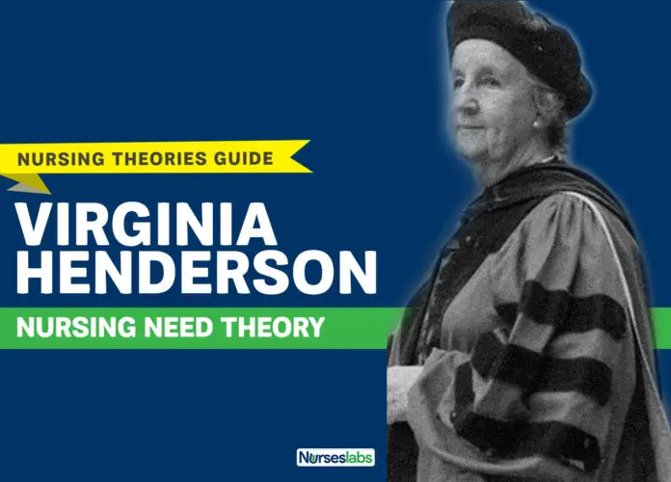

Slide 38
DEF Virginia Henderson's need theory
Among her other works, Henderson’s widely known contributions to nursing are the Need Theory. The Need Theory emphasizes the importance of increasing the patient’s independence and focus on the basic human needs so that progress after hospitalization would not be delayed. The Need Theory is discussed further below.

Slide 39
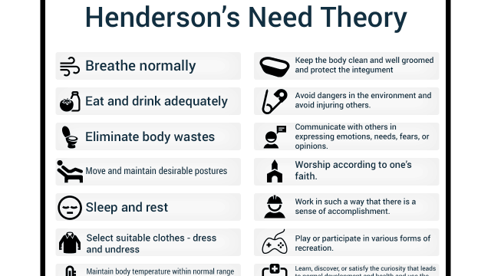

Slide 40
Physiological Components
1. Breathe normally
2. Eat and drink adequately
3. Eliminate body wastes
4. Move and maintain desirable postures
5. Sleep and rest
6. Select suitable clothes – dress and undress
7. Maintain body temperature within normal range by adjusting clothing and modifying environment

Slide 41
8. Keep the body clean and well-groomed and protect the integument
9. Avoid dangers in the environment and avoid injuring others
Psychological Aspects of Communicating and Learning
10. Communicate with others in expressing emotions, needs, fears, or opinions.
11. Worship according to one’s faith
Sociologically Oriented to Occupation and Recreation
12. Work in such a way that there is a sense of accomplishment
13. Play or participate in various forms of recreation
14. Learn, discover, or satisfy the curiosity that leads to normal development and health and use the available health facilities.
Spiritual and Moral

Slide 42
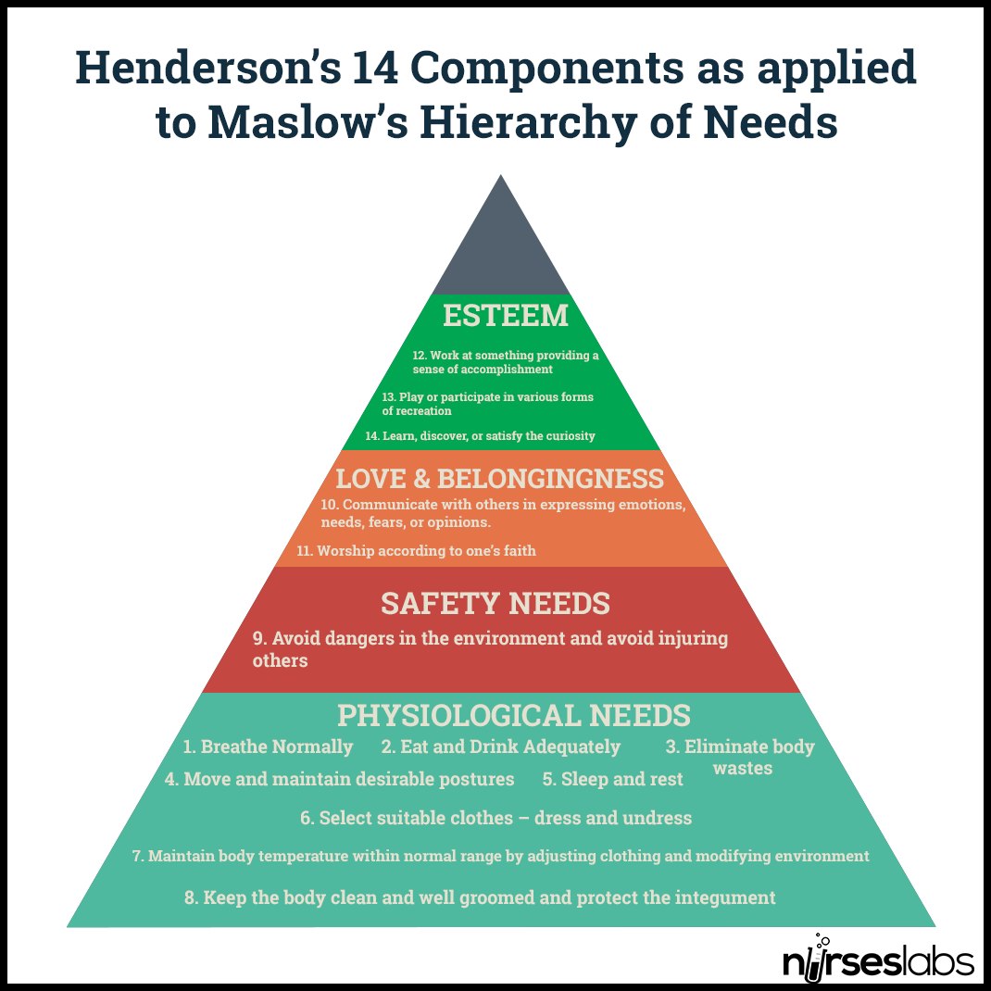

Slide 43
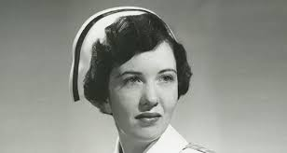
Marjory GORDON
Marjory Gordon (Cleveland, November 10, 1931 – Massachusetts, April 29, 2015) was a nursing theorist and professor who created a nursing assessment theory known as Gordon's functional health patterns. Gordon served in 1973 as the first president of the North American Nursing Diagnosis Association until 1988.

Slide 44
GORDONS FUNCTIONAL HEALTH PATTERNS
Gordon's functional health patterns provide a holistic model for assessment of the family because assessment data are classified under 11 headings
She devised functional health patterns to be used by nurses in the nursing process to provide a more comprehensive nursing assessment of the patient.

Slide 45
The 11 areas of Gordon's functional health patterns
Health Perception and Management
Nutritional metabolic
Elimination-excretion patterns and problems need to be evaluated (constipation, incontinence, diarrhea)
Activity exercise-whether one is able to do daily activities normally without any problem, self care activities
Sleep rest-do they have hypersomnia, insomnia, do they have normal sleeping patterns

Slide 46
6. Cognitive-perceptual-assessment of neurological function is done to assess, check the person's ability to comprehend information
7. Self perception/self concept
8. Role relationship
9. Sexuality reproductive
10. Coping-stress tolerance
11. Value-Belief Pattern

Slide 47
Http://Www.Umanitoba.Ca/Nursing/Courses/128,(200e manuals
NCK nursing practice guidelines5)
Clinical methods
NCK procedure manual
NCK practice guidelines

