Slide 1
INTRODUCTION TO
MIDWIFERY AND OBSTETRICS
>MARCH 2016 KECHN CLASS <
By: RHODA LODIO
REPRODUCTIVE HEALTH DEPT.

Slide 2
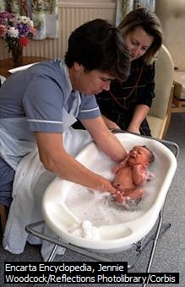

Slide 3
The main objective
By the end of the lesson, the learners will be able to define different terminologies in Midwifery and explain appropriately the Anatomy and physiology of the female pelvis, describe the menstrual cycle, state the process of pregnancy, labour and delivery and manage puerperium and neonatal periods.

Slide 4
Enabling objectives
The learners will be able to define different terminologies in Midwifery
The learners will be able to effectively explain the anatomy and physiology of the female reproductive system
The learners will be able to draw the different diagrams of the reproductive system
The learners will be able to describe the menstrual cycle
The learners will be able to explain the process of conception
The learners will be able to describe FANC
The learners will be able to manage a pregnant woman
The learners will be able to identify signs of true labour, manage the four stages of labour, early post natal and early puerperium

Slide 5
Definition of terms
The midwife –
This is a person who , having been regularly admitted to a midwifery programme , dully recognized in the countries they hail from , has successfully completed the prescribed course of studies in midwifery , and has acquired the requisite qualification to be registered and or legally licensed to practice midwifery.

Slide 6
Midwifery:-
Involves the act of dealing with childbirth.
It is the art and science of caring for women undergoing normal pregnancy, labour and puerperia.

Slide 7
Obstetrics:-
The medical science and art of caring for women with abnormal pregnancies , labours , or post natal periods.
- it is the branch of medicine dealing with pregnancy , labour and the purperium.

Slide 8
DUTIES OF A MIDWIFE
Must be able to give necessary supervision , cares, and advice to women during pregnancy , labour, and postnatal periods ( after delivery/ puerperium ).
She/ he must be able to conduct delivery on her/ his own.
Should be able to care for the newborn.
The care includes –
1 . The detection of abnormal conditions in the mother and baby
2. The procurement of medical assistance
The execution of emergency measures in the absence of medical help
Has an important task/ role like giving of health education and preparation for parenthood within the family or the community.

Slide 9
Duties of a midwife cont..
5. Extends to certain areas of gynaecology , e.g. Family planning , and children
6. A midwife can practice in clinics, health units, domiciliary service, i.e. attending to women at home.
The term midwifery was amended in 1990 by the international confederation of midwifery ( ICM ) from the one in 1982.
It was later rectified by the international federation of gynaecology and obstetrics ( FIGO ) and it was also adopted and ratified by the WHO in 1992.

Slide 10
History of midwifery
PRE-HISTORIC TIMES
Although one might summarize that in the remote ages , the first woman who helped another in childbirth was a midwife, this is probably not correct , for only a husband or a female relative was permitted to attend the woman in labour.
-- later women from outside the family circle earned their livelihood in this way and became known as midwives.
-- Tribal customs during labour were based on belief in magic, charms , and incantations being used to ward off demons.
-- practice during prolonged labour was crude , even cruel , for the midwives had no understanding of the process of birth.
-- in difficult cases the midwife sought advice but not assistance from physicians and surgeons .

Slide 11
History of midwifery cont…
-- women continued to care for women during childbirth up to the 16th century.

Slide 12
History of midwifery cont…
Following reformations , the Bishop of the church of England was given responsibility to issue licenses to midwives to allow them practice their profession. Requirements were good moral character. In 1813, the society of Apothecaries ( a historical name for medical professions who formulates & dispenses medical material to physicians), tried to persuade the English parliament to pass a law forbidding women to practice as midwives for gain without having undergone an examination & obtaining a certificate of their ability to practice as midwives.

Slide 13
History of midwifery cont…
The committees of the house of commons would not permit any mention of midwives who at that time were of the lowest strata of society, unable to read or write, the gin – drinking type.
The ladies Obstetrical college London was founded in 1864 and the daughters of professional men attended lectures and became midwives. In 1872, the Obstetrical Society of London proceeded to constitute an examining board which awarded certificates to successful candidates. In 1886, it became compulsory for medical trained doctors who gradually took care of childbearing in upper class groups. Midwives practice therefore became limited to lower classes which resulted to loss of payment and status.

Slide 14
History of midwifery cont…
The coming in of men in midwifery occurred from the 19th century.
A number of men who contributed enormously in midwifery included -;
1. William Harvey: He wrote a book on midwifery and obstetrics which contained details of the development of the embryo and management of labour. It was translated to English in 1653.During 1663 King Louis xiv employed a surgeon from Paris to attend to one of his mistresses in preference to the gossiping midwives . He was pleased with the decorous conduct of the man midwife and honored him with the most dignified title of accoucheur ( Masculine midwife). The fashion spread among the ladies of the court and was followed by women of France.

Slide 15
History of midwifery cont…
2. Dr . Percival Willoughby ( 1663). A physician, assisted his midwife daughter to deliver a breech presentation. She requested her father to creep into the birth chamber on his hands and knees unknown to her patient to assist her with the delivery. He later wrote a book for midwives and physicians. It contained 150 case studies and histories but, it was not established until 1863.

Slide 16
History of midwifery cont…
3. The Chamberlain family – ( 1569 – 1683) discovered / invented midwifery forceps used to pulp the baby out where the mother was unable to push .
4. William Smellie ( 1697 – 1763) , was a doctor who became concerned at the high death rate of babies. He studied obstetrics and taught the doctors about it.
5. James Young Simpson, introduced anesthesia ( pain reliever) for pain relieve in labour in 1847. he introduced chloroform taken by inhalation.
6. Dr. J.W. Ballantine , has been called the father of antenatal care . Was a lecturer in ante natal pathology at the university of Edinburgh. He set apart the first bed ever for the study of the pregnant woman in 1901.

Slide 17
History of midwifery cont…
Ignatius Phillip Semmelweis – observed the high incidence of infection ( puerperal sepsis) , especially where medical students and doctors delivered the woman, it was three times greater than in the midwives wards because doctors carried infections from post mortem examinations they made. In 1847 he advocated the use of hand washing using chlorine of lime prior to attendance of a woman in labour. He was the pioneer in the treatment of puerperal sepsis ( infection after delivery) .

Slide 18
Hx of midwifery cont..
Biblical times
Midwives are mentioned in the old testament , Genesis 1:15-21 when Pharaoh , King of Egypt commands the midwives to slay all Jewish infants of the male sex . The midwives feared God , so they disobeyed these orders , saying to Pharaoh that the Hebrew women were not as Egyptians , for they are lively and deliver faster.

Slide 19
The Hippocratic era ( 470 – 37 BC)
Hippocrates, the father of medicine inaugurated the scientific approach to the healing of the sick. He believed that disease was due to natural causes , so he discarded practices based on superstition. He took some part in the management of child birth and the midwives contemptuously called him a he- grand mother.

Slide 20
history of midwifery cont…
The midwives saw the need to raise their standards through education of midwives towards the end of the 18th century. The midwives were given instructions in hospitals and training was 6 months after which certificates were awarded. Requirements were to witness 15 deliveries and conduct 5 normal deliveries. Certificates were awarded by an examination board in 1872, and by the obstetrical society of London in 1902.

Slide 21
History of midwifery in kenya
Every ethnic group had their own practices during child birth. In some tribes the mother in law used to conduct while others, the TBAs conducted deliveries.
Even today we have TBAs who have undergone an in-service training in safe motherhood. Early missionaries started Hospitals in spite of difficulty in communication. They instructed local women and the training lasted as long as the midwives grasped whatever was taught.

Slide 22
History of midwifery in Kenya cont..
1911 – Maseno Hospital started giving instructions in midwifery.
1927- Sandry Griggs’ ( present Pumwani Maternity) was started.
1929 – Mombasa Hospital was opened ( Lady green)
1930 – Kikuyu Presbyterian Hospital was opened by Dr. Brian.
1943 – Some women qualified as midwives from Pumwani Maternity Hospital and the training was conducted in Kiswahili.

Slide 23
History of midwifery in kenya cont…
In 1948 – the government recognized the need for midwifery and the following hospitals were given help.
1. Pumwani Mat. Hospital
2. Consolata Hosp. Nyeri
3. Tumutumu Hospital
4. Maseno Hospital.

Slide 24
History of midwifery in kenya cont…
1949 – the nurses / midwives act was made
1950 – a registered body to enroll nurses and midwives was started by a council of nurses
1953 – the first official Midwifery examination was done at Enrolled level – was a certificate.
1965 – midwifery training was started at King George Hospital ( Kenyatta Hosp.) by MS Mundi.
1972 – midwifery training was started at Mater Hospital.
1973 – training of male students started at Kenyatta Hosp. with 2 of them.

Slide 25
Terms used in midwifery
Amenorrhea = absence of menstruation
Menarche = onset of menstruation
Menopause = stopping of menstruation
Abortion = expulsion of the fetus, placenta, & membranes from the uterus before 24th week of pregnancy.
LMP = Last menstrual period i.e. last day of menstruation & not the last.
EDD = Expected date of delivery @ the 40th week of pregnancy.

Slide 26
Terms used in midwifery cont..
Gestation = pregnancy
Gestation period = period of pregnancy
Fertilization = a process by which one sperm unites with one ovum & pregnancy begins
Embryo = term used for a developing offspring from the time of fertilization up to 8 weeks of gestation.
Fetus = the developing baby from 8 weeks of pregnancy until birth.

Slide 27
Terms used in midwifery cont…
Nulli = means none
Nulligravida = a woman who has never been pregnant till now.
Nullipara = a woman who has never given birth to a viable child
Multi = more than one
Multigravida = a pregnant woman who has previously had more than one pregnancy
Grand Multigravida = a pregnant woman who has previously had four or more pregnancies
Primi = first pregnancy

Slide 28
Terms used in midwifery cont…
Primi gravida = a pregnant woman for the first time
Parity = a condition of a woman with respect to her having given birth to viable infants
Viable = capable of independent life. A term applied to a fetus after 24 weeks of gestation
Young Primi gravida = a woman pregnant for the first time below 18 years of age
Gravida = a pregnant woman

Slide 29
Terms used in midwifery cont…
Dysmenorhoea = painful menstruation
Grand multi Para = a woman of high parity
Pre- natal = occurring after conception and before birth
Perinatal = around the time of birth
Ante- natal care = care given before birth
Ante = prefix meaning before
Natal = means birth
Labour = the process by which the fetus , placenta, and membranes are expelled through the birth canal after 24 weeks of gestation.

Slide 30
Terms used in midwifery cont…
Normal labour = labour that starts spontaneously at term ( 37 – 40 wks), gestation. The fetus presents by vertex & the process is completed within 18 hrs with no complications arising from the mother or baby.
True post maturity = having past the expected date of delivery by two weeks.
Post natal = after birth ( post partum)

Slide 31
Terms used in midwifery cont…
PPH = Excessive bleeding from the genital tract at any time following the birth of the baby up to 6 wks , amounting to 500mls of blood or any amount that deteriorates the condition of the mother.
Lie = relationship of the long axis of the fetus with the long axis of the uterus. It can be longitudinal, transverse, or oblique.
Attitude = the relationship of the foetal parts to each other. Normally it should be one of flexion

Slide 32
Terms used in midwifery cont…
Presentation = refers to the part of the foetus which lies at the pelvic brim or in the lower pole of the uterus. It can be vertex, breech, face, brow or shoulder.
Presenting part = this is the part of the foetus which lies over the cervical OS during labour. The first part felt on examination per vaginum. In the normal vertex presentation this is the occiput

Slide 33
Terms used in midwifery cont…
Low birth weight = a baby born with less than 2.5 kgs regardless of the gestation
Preterm = a baby born before 37 complete weeks of gestation.
Denominator = name given to a particular point on the presenting part of the fetus used to indicate its position in relation to a particular part of the mothers’ pelvis. In vertex presentation , the denominator is the occiput , in a breech presentation, it is the sacrum, & in the face presentation, it is the mentum

Slide 34
Terms used in midwifery cont…
Position of the fetus = the relation of a particular part of the fetus – the denominator to a particular part of the mothers’ pelvis. In the vertex presentation, the denominator is the occiput. Eight positions may be described. If the occiput is directed towards the syphysis pubis, the position is direct OAP. If to the right or left iliopectineal eminences , it is right or left occipital anterior. If to the mid point of the left or right iliopectineal line – this is right or left occipital lateral. If to the left or right sacroiliac joint , this is left or right OPP.

Slide 35
Terms used in midwifery cont…
Anoxia = a state of being deprived of oxygen
Asphyxia = suffocation i.e. asphyxia neonatorum, which is failure of the child to breath at birth
APH = bleeding from the birth canal after 24 wks gestation until the baby is born
Still birth = a baby born after 24 weeks of pregnancy and does not show any sign of life
Fresh still birth = the baby died just before the onset of labour or in the process of being born.

Slide 36
Terms used in midwifery cont…
Macerated still birth = baby has been dead in the uterus for more than 24 hrs, born with signs of decomposing ( decaying e.g. skin is peeling)
Neonatal period = period within 28 days after birth
Neonate = a newborn child up to 28 days
Mortality rate = death rate
Perinatal mortality rate = No, of still births and early neonatal death.
. PMR = STILL BIRTHS x 100
No. of Live births

Slide 37
Terms used in midwifery cont…
Infant mortality rate = No of deaths recorded among infants under 1 year of age per 1000 registered @ birth
Maternal mortality rate = calculated as the number of deaths occurring due to pregnancy per 10,000 total births. Includes deaths due to abortion
Maternal deaths = deaths occurring during pregnancy or labour as a consequence of pregnancy within 42 days after delivery or abortion. Causes could be hypersensitivity & haemorrhagic conditions

Slide 38
ANATOMY AND PHYSIOLOGY OF THE FEMALE REPRODUCTIVE SYSTEM
Objectives
By the end of this section you will be able to:
· Describe the components of the female
reproductive system
.Describe the functions of the hormones
that regulate the menstrual cycle and pregnancy
· Describe obstetric anatomy

Slide 39
The Components of the Female Reproductive system
The female reproductive system consists of two
parts: the external genitalia and the internal
genitalia.
The External Genitalia (Vulva)
The external genitalia is also known as the
vulva. It is made up of all the external organs as
shown in the illustration opposite. It extends
from the Mons veneris anteriorly, to the perineal body posteriorly .

Slide 40
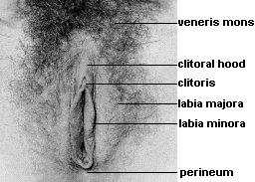
The Components of the Female Reproductive system cont…

Slide 41
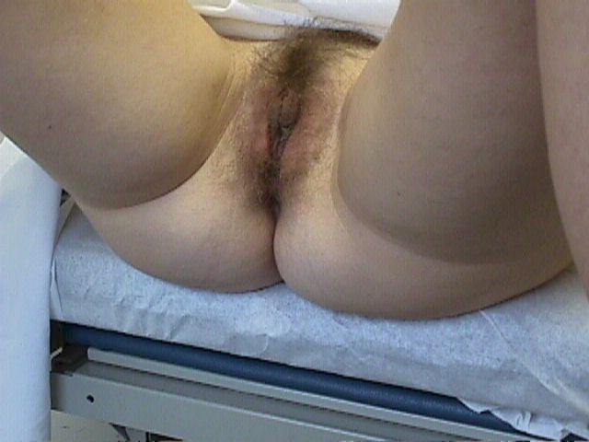
The Components of the Female Reproductive system cont…
Mons Veneris
clitoris
anus
Labia majora
buttocks
Labia minora

Slide 43
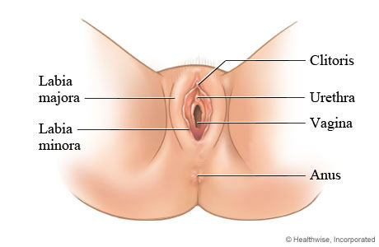

Slide 44
The Components of the Female Reproductive system cont…
The External Genitalia (Vulva)
The following are parts of the external genitalia
The Mons Veneris/Mons Pubis
This is a pad of fat lying over the body of the
pubic bone and is covered by skin on which hair grows from the time of puberty.
The Labia Majora
These are two thick folds of fatty and areola tissue covered by skin externally. They start in the Mons Veneris and merge into the Perineum posteriorly.

Slide 45
The Components of the Female Reproductive system cont…
The Labia Minora
The labia minor are two small thin folds of skin lying between, and almost covered by the labia majora. They fuse posteriorly thus forming the fourchette.
The Clitoris
This is a highly sensitive erectile structure situated at the anterior junction of the Labia minora. It is the female equivalent of the male penis.
The Urethral Meatus
This is a small opening about 2.5 centimetres below the clitoris.
The Vaginal Orifice
This is also known as the introitus of the vagina.
It lies between the labia minora and posteriorly to the urethra. It is partially occluded by the hymen in girls who have not been sexually active.

Slide 46
The Components of the Female Reproductive system cont…
The Hymen
This is a thin membrane which partially shuts the introitus in the vagina.
The Bartholin's Glands
These are two small glands, one on either side of, and slightly posterior to the vagina, beneath the labia majora. Their ducts open into the vaginal orifice. They secrete mucus, which lubricates the vaginal orifice.
The vulva receives its blood supply from the internal and external pudendal arteries and which is then returned through the pudendal
veins. The lymphatic drainage is via the inguinal glands, while the nerve supply is derived from the pudendal nerve
These parts make up the external genitalia. Now move on to look at the internal genitalia.

Slide 47
The Components of the Female Reproductive system cont…
The Internal Genitalia
The internal genitalia comprises of:
· The vagina
· The uterus
· The uterine tubes (also called the fallopian tubes)
· The ovaries

Slide 48
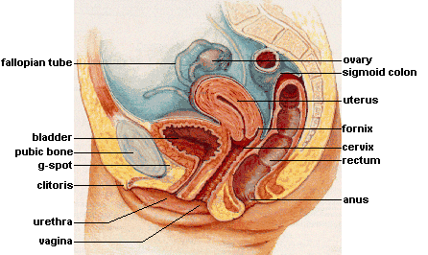
The Components of the Female Reproductive system cont

Slide 49
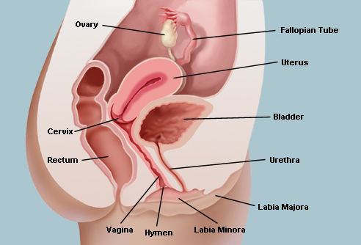

Slide 50
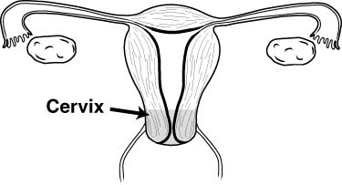
The Components of the Female Reproductive system cont…
ovary
Fallopian tube
Fimbriae
Fallopian tube
Myometrium
Uterus
Cervical os
vagina

Slide 51
The Components of the Female Reproductive system cont…
The Vagina
The vagina is a fibro-muscular canal joining the external genitalia and the uterus. The posterior wall of the vagina is longer than the anterior wall. This is because the cervix projects at right angle into the upper part of the anterior wall. Its walls are arranged in folds known as reggae, which allow the vagina to stretch during sexual intercourse and childbirth.
The vault is the upper end of the vagina, which forms four arches known as fornices. The posterior fornix is the largest.
The vagina has four layers, these are:
· The inner layer or lining made of squamous epithelium
· The vascular connective tissue beneath it
· The muscle layer that is divided into a weak inner fibre and a stronger outer coat of longitudinal fibres
· A layer of connective tissue, which surrounds the vagina

Slide 52
The vagina cont..
Blood Supply - The blood supply comes from branches of the internal iliac artery, the vaginal
artery and a branch of the uterine artery. The
blood drains through the vaginal vein and a
branch of the uterine artery. Lymphatic drainage is via the inguinal, the internal iliac and the sacral glands. Nerve supply is via the Lee Frankenhauser plexus.
In front of the vagina lies the bladder and the urethra, which are closely connected to the anterior wall. Behind the vagina are the pouch of Douglas, the rectum and the perineal body.
Each of these occupies about one third of the posterior vaginal wall. The uterus lies above the
vagina.

Slide 53
The Uterus
The non-pregnant uterus is a hollow pear shaped muscular organ situated in the pelvic cavity. It is 7.5 centimetres long, 5 centimetres wide, 2.5 centimetres deep and 1.25 centimetres thick.
It lies behind the bladder and in front of the rectum. It leans forward over the bladder, which is known as anteversion and bends forward the cervix at the level of the internal os, which is known as anteflexion. When a woman stands, the position becomes almost horizontal with the fundus, resting on the bladder.

Slide 54
The Uterus cont…
The uterus performs the following functions among others:
· Receives the fertilized ovum
· Provides shelter for the foetus during pregnancy
· Expels the uterine contents during childbirth
Anterior to the uterus lie the utero-vesical pouch and the bladder, while posteriorly lie the recto-uterine pouch of Douglas and the rectum.
Laterally, on either side, are the broad ligaments, the uterine tubes and the ovaries.

Slide 55
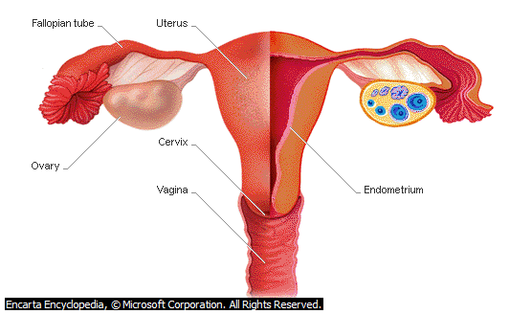
A section of the uterus

Slide 56
The uterus cont…
The uterus is kept in its normal position in the pelvis by the following supports:
· Ligaments
· The muscles of the pelvic floor which is mainly the levator ani
· The pubovesico-cervical support consisting mainly of fascia
The ligaments are the most important support
structures and help to maintain the uterus in its position. They consist of the following:

Slide 57
The uterus cont…
· The transverse cervical ligaments
· The uterosacral ligaments
· The pubocervical ligaments
· The broad ligaments
· The round ligaments
· The ovarian ligaments

Slide 58
Structure of the Non-Pregnant Uterus
The uterus of a non-pregnant woman is a hollow pear shaped muscular organ that consists of the following parts:
· The body makes up the upper two-thirds of the uterus and is the biggest part.
· The fundus is the upper rounded part above the insertion of the fallopian tubes.
· The cornua are the upper outer angles where the uterine tubes join.

Slide 59
Structure of the Non-Pregnant Uterus cont…
· The uterine cavity is the triangular space between the anterior and posterior walls, with the base of the triangle uppermost.
· The isthmus is the narrow area between the cavity and the cervix.
· The cervix protrudes into the vagina with the upper half above the vagina.· The internal os is a narrow opening between the isthmus and the cervix, the external os is a small round opening at the lower end of the cervix.

Slide 60
Structure of the Non-Pregnant Uterus cont…
The Layers of the Uterus
The uterus has three layers: the endometrium, the Myometrium and the perimetrium.
The Endometrium
This is the inner lining of the uterus composed of
ciliated epithelium (mucous membrane) on a
connective tissue base and it changes in
thickness during the menstrual cycle. The basal
layer does not change. This will be discussed further under the menstrual cycle.

Slide 61
The Layers of the Uterus
The Myometrium (or Muscle Coat)
This is the middle layer of the uterus. It is the
thickest layer and is made up of three layers of
muscle fibre. The fibres run in all directions and intermingle to surround the blood vessels and lymphatics.
The Perimetrium
This is a double serous membrane and extension of the peritoneum, which is draped over the uterus and uterine tubes.

Slide 62
The Uterine Tubes (Fallopian Tubes)
The fallopian tubes are passages that link the
ovaries to the uterus. Each tube is between 10 -
12 centimetres long and is divided into four main
parts, namely:
· The interstitial portion, which is the medial part that opens into the uterus.
Its whole length lies within the walls of the uterus. It is the shortest and narrowest part of the tube with a length of 1.25 centimetres and its lumen is 1 millimetre wide.

Slide 63
The Uterine Tubes cont…
· The isthmus, which is the narrow portion immediately adjoining the uterus.
· The ampulla, which is the widest and longest (5 centimetres long) part of the fallopian tube and it is here that fertilization occurs·
The infundibulum, which is the fimbriated end of the fallopian tube. It is in close proximity to the ovary and its finger-like projections are known as Fimbriae. One of the Fimbriae, being longer than the others is in contact with the ovary and picks up the ovum from the surface of the ovary at ovulation.

Slide 64
The Uterine Tubes cont…
Layers of Wall
The wall of the tube has 4 coats: serous (peritoneal), subserous or adventitial (fibrous and vascular), muscular, and mucous. Each tube is enclosed within a peritoneal covering except along a small strip on its lower surface, where the mesosalpinx ( peritoneum covering the fallopian tubes) is attached. At the margins of the infundibulum and the fimbriae, this peritoneal covering becomes directly continuous with the mucous membrane lining the interior of the tube. The subserous tissue is lax in the immediate vicinity of the tube. The blood and nerve supply is found within this layer. The muscular coat has an outer longitudinal and an inner circular layer of smooth muscle fibres, more prominent and continuous with that of the uterus at the uterine end of the tube. The mucous coat is ciliated columnar epithelium with coarse longitudinal folds, simple in the region of the isthmus but becoming higher and more complex in the ampulla. The epithelial lining extends outward into the fimbriae. The ciliary motion is directed toward the uterus.

Slide 65
The Uterine Tubes (Fallopian Tubes) cont…
The uterine tube has three coats or layers.
These are the serous, the muscular, and the mucous layers. The inner epithelium is lined with a mucous membrane of ciliated cubical epithelium, which is arranged in folds. These folds slow the ovum down on its way to the uterus. In the lining are cells that produce a secretion containing glycogen to nourish the ovum. Beneath the lining is a layer of vascular connective tissue.

Slide 66
The Uterine Tubes (Fallopian Tubes) cont’
The middle layer of thin muscle coat consists of two layers, a longitudinal outer layer and a circular inner layer, both of smooth muscles. The tube is covered with peritoneum.
The blood supply comes from the uterine and ovarian arteries and returns through the corresponding veins. The lymphatic drainage is carried out through the lumbar glands and the nerve supply is from the ovarian plexus.

Slide 67
The Ovaries
These are two glandular structures lying on the posterior surface of the broad ligament, supported by the ovarian and the infundibulopelvic ligaments. They are oval shaped and are composed of a medulla and a cortex, which is covered with germinal epithelium.
The medulla is made up of fibrous tissue, throughout which the ovarian blood vessels and the lymphatics and nerves travel. The cortex is the functional part of the ovary.

Slide 68
The Ovaries cont…
It contains the Graafian follicles that are in different stages of development, surrounded by the stroma.
From puberty some of the Graafian follicles enlarge under the influence of the follicle stimulating hormone. One Graafian follicle matures each month and ruptures to release an ovum. The ovaries produce ova and the hormones oestrogen and progesterone.

Slide 69
The diagrammatic Ovaries

Slide 70
The ovaries cont..
Blood supply to the ovaries is provided by the ovarian arteries and drained by the ovarian veins. The lumbar glands maintain lymphatic drainage while nerve supply is from the ovarian plexus.
So far, you have learned about the different structures that make up the female reproductive system. You now know that the vagina acts as a receptacle of the semen during sexual intercourse, as a passage for menstrual blood and for the foetus during delivery. It was also mentioned that the uterus is the site where the foetus grows from implantation to maturity, the fallopian tubes are passages through which the ova passes to be propelled to the uterine cavity, and that the functions of the ovaries include production of ova and hormones.

Slide 71
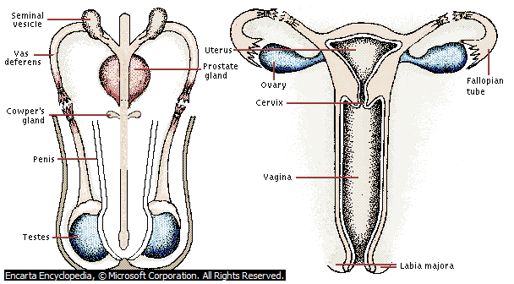

Slide 72
Hormones
From puberty to menopause, the female reproductive system goes through regular cycles, governed by various hormones. Will now look at these hormones and what they do.
The most important hormones in relation to
reproduction in the female are:
The Follicle-Stimulating Hormone (FSH)
The Luteinizing Hormone (LH)
Oestrogen
Progesterone

Slide 73
Hormones cont…
What are the functions of FSH and LH?
The hypothalamus controls and governs the anterior pituitary gland. The hypothalamus produces Gonadotrophin-Releasing Hormone (GnRH) which acts on the anterior pituitary gland to secrete two Gonadotrophin: the Follicle-Stimulating Hormone (FSH) and Luteinizing Hormone (LH).

Slide 74
Hormones cont…
Follicle-Stimulating Hormone (FSH)
The FSH causes the Graafian follicle in the ovarian cortex to develop, mature and rupture to release the ovum into the fimbriated end of the fallopian tube. This is known as ovulation.
Luteinizing Hormone (LH)
It influences development of the corpus luteum
to produce oestrogen and progesterone. LH is produced for only fourteen days after which the FSH reappears

Slide 75
Hormones cont…
Ovarian Hormones
As mentioned while discussing the structure of
the ovaries, the ovaries produce two hormones:
oestrogen and progesterone.
Oestrogen
This is produced under the influence of FSH. It
is produced by three different parts, which are:
· The granulosa and theca cells of the Graafian follicle during the first 14 days of the twenty eight day cycle.
· The corpus luteum and the adrenal cortex in small quantities after ovulation.

Slide 76
Oestrogen cont…
Oestrogen is comprised of oestriol, oestriadiol and oestrone compounds.
The following are some of the effects of oestrogen:
· Oestrogen stimulates the growth of the secondary sex characteristics.
· It causes proliferation of the uterine endometrium during the menstrual cycle.
· During pregnancy it promotes growth of the uterine muscles.
· It promotes proliferation of the uterine endometrium.
· It suppresses ovulation.
· It inhibits lactation.
· It assists water and electrolyte retention in the body.

Slide 77
Progesterone
Progesterone is produced by the corpus luteum
under the influence of the Luteinizing Hormone
(LH) and by the placenta during pregnancy.
Progesterone only acts on tissues, which have
previously been acted on by oestrogens, and its
effect is mainly evident during the second phase
of the menstrual cycle when it causes the
endometrium to increase in size. It also increases secretions and blood supply in readiness for possible arrival of a fertilised ovum.

Slide 78
The menstrual cycle
The Menstrual Cycle
The average menstrual cycle is taken to be 28 days, although it may vary in length from 22 to 35 days. The hormones you have just looked at control the menstrual cycle. A normal menstrual cycle is divided into three phases, which will now be covered individually.
Phase 1: The Menstrual Phase
This is the phase during which vaginal bleeding occurs. It lasts three to five days. The endometrium is shed down to the basal layer and discharged together with blood from the capillaries and the unfertilized ovum. occurs every 28 – 30 days from puberty to menopause.

Slide 79
Luteal ( Secretory) Phase
This is the premenstrual phase. Begins after ovulation and is under the influence of progesterone and oestrogen from the corpus luteum. The functional layer thickens to 3.5 mm and becomes spongy in appearance because the glands are more tortuous.

Slide 80
The menstrual cycle cont…
Phase 2: The Proliferative/Follicular Phase
This phase follows the menstrual phase and lasts until ovulation, approximately 14 days from the first day of menstruation in a 28-day cycle. It is the phase of regrowth and thickening under the influence of oestrogen.

Slide 81
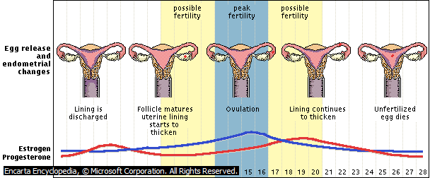

Slide 82
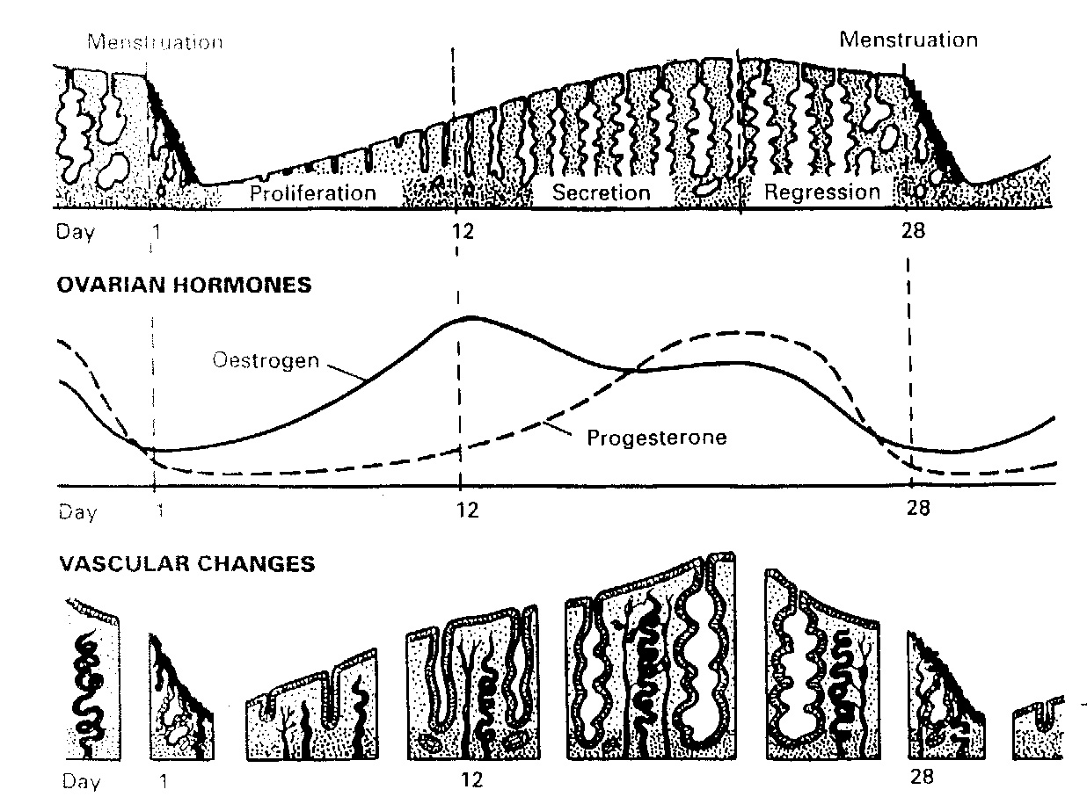
Menstrual cycle cont…

Slide 83
Obstetric Anatomy
In a normal vaginal delivery, the foetus must pass through the bony canal formed by the pelvic bones. The foetal skull is the most rigid structure that has to pass through this canal.
You should therefore know the limits of a normal female pelvis so that you can detect deviations from the normal. By so doing, you will be able to identify women at risk and refer them to a hospital, where a caesarean section can be performed.

Slide 84
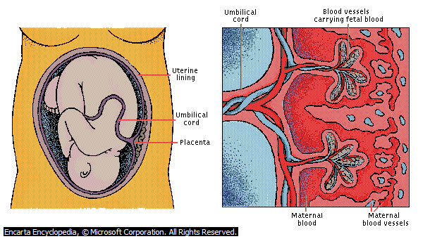
Obstetric Anatomy cont..

Slide 85
Obstetric Anatomy cont…
The Bony Pelvis
The shape of a normal female pelvis is
cylindrical and has a slight anterior curve near
the outlet. The curve results from the fact that
the posterior body of the pelvis sacrum and
coccyx is longer than the anterior border which
is the symphysis pubis.
In order for the foetal head to pass through the
maternal pelvis, the diameter of the pelvis at the
inlet, outlet and mid-cavity levels must be adequate.

Slide 86
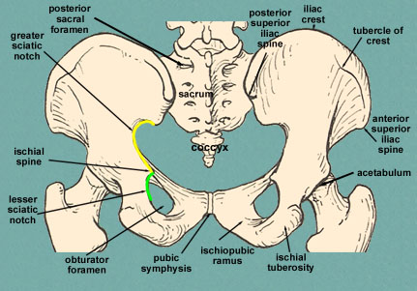
The Bony Pelvis

Slide 87
The Bony Pelvis
As you can see from the illustration, the bony
female pelvis is a basin-like structure with a hole at the bottom through which the baby passes. It is made up of four bones, namely: two innominate bones, one sacrum and one coccyx
The Innominate Bones
These form the sides of the basin. They are
joined together at the front by the symphysis pubis and are separated at the back by the sacrum. Each innominate bone is composed of three parts: the ilium the ischium and the pubic bone.

Slide 88
The Bony Pelvis
The Three Parts of the Innominate Bones
The Ilium
The ilium is large and flares out. The upper border is called the iliac crest. The anterior superior iliac spine is a bony prominence that is at the front of the iliac crest, and below it is the anterior inferior iliac spine. At the end of the iliac
crest are the posterior-superior and posteriorinferior iliac spines. The iliac fossa is the concave anterior surface of the ilium.
The Ischium
This is the thick lower part of the Innominate bone. When sitting, the body rests on its large prominence, that is, the ischial tuberosity. The ischial spine lies behind the ischial tuberosity.

Slide 89
The Pubic Bones
The ischium cont..
These form the anterior part of the innominate bone. They have a body and two projections: the superior ramus and the inferior ramus. The two pubic bones meet at the symphysis pubis and the two inferior rami form the pubic arch.
The Sacrum
The sacrum is a wedge shaped bone consisting of five fused vertebrae. The upper border of the first sacral vertebra juts forward and is known as the sacral promontory. The anterior surface of the sacrum is concave and is known as the hollow of
the sacrum.

Slide 90
Pelvic Joints
The Coccyx
The coccyx is the tailbone. It consists of four fused vertebrae and is the lowest part of the vertebral column. It has no significance in applied obstetric anatomy as it moves out of the way during delivery.
There are four pelvic joints, namely:·
The symphysis pubis is formed at the junction of the two pelvic bones, which are united by a pad of cartilage.
· Two sacroiliac joints which join the sacrum to the ilium and so connect the spine to the pelvis.
·

Slide 91
There are four pelvic joints cont..
The sacrococcygeal joint that is formed where the base of the coccyx articulates with the tip of the sacrum. When there is no pregnancy, there is very little movement in these joints. However, during pregnancy due to endocrine activity, the ligaments soften, allowing the joints to give. This allows for more room for the foetal head as it passes through the pelvis. The sacroiliac joints allow a limited backward and forward movement of the tip of the promontory of the sacrum.
The sacrococcygeal joint allows the coccyx to be deflected backward during the birth of the head.

Slide 92
The Pelvic Ligaments
Ligaments hold each pelvic joint together. These
are:
· Interpubic ligament at the symphysis pubis
· Sacroilliac ligaments
· Sacroccygeal ligaments
There are two more ligaments that are also important in midwifery, namely:
· The sacrotuberous ligament, which runs from the sacrum to the ischial tuberosity.
· The sacrospinous ligament, which runs from the sacrum to the ischial spine.

Slide 93
Types of Pelvis
The pelvis has been classified into four types, according to the shape of the pelvic brim.
However, many individuals have a combination of more than one type. The four types are:
The Gynaecoid Pelvis
Also referred to as the true female pelvis, the gynaecoid pelvis has the following features:
· A rounded brim
· A generous fore-pelvis
· Straight side walls
· A shallow cavity with a broad, well curved sacrum
· Blunt ischial spines
· A wide sciatic notch and pubic arch of 90°
The gynaecoid pelvis is found in women of average build and height with a shoe size of four or larger. It is the ideal pelvis for child bearing.

Slide 94
Types of Pelvis cont….
The Android Pelvis
The android pelvis is also known as the male pelvis. Its brim is heart-shaped with a narrow fore-pelvis. The pelvic cavity is funnel-shaped.
The ischial spines are prominent and the pubic arch is less than 90°. It is mostly found in short and heavily built women. It predisposes to an occipital posterior position of the foetal head. It is the least suited to childbearing.

Slide 95
The Anthropoid Pelvis
The anthropoid pelvis has a long oval brim, in which the anteroposterior diameter is longer than the transverse. The sides diverge and the sacrum is long and deeply concave. The ischial spines are not prominent and the sciatic notch is very wide and so is the sub-pubic angle. It tends to be found in tall women with narrow shoulders.
Labour usually does not present any difficulties,
but a direct occipito-anterior or occipito-posterior
position is often a feature.

Slide 96
The Platypelloid Pelvis
As illustrated below, the Platypelloid pelvis is a
flat pelvis, with a kidney shaped brim. The
antero-posterior diameter is reduced while the
transverse is increased. The sidewalls diverge,
the sacrum is flat, and the cavity is shallow.
The ischial spines are blunt. The sciatic notch
and sub-pubic angle are both wide. The foetal
head usually descends through the cavity without difficulty.

Slide 97
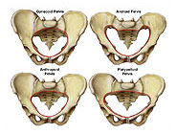
Gynaecoid pelvis
Android pelvis
Anthropoid pelvis
Platypaloid pelvis

Slide 98
The features of the different types of female pelvis are summarised .
features | gynaecoid | android | anthropoid | platypelloid
Brim Fore pelvis Side walls Ischial spines Sciatic notch | Rounded Generous Straight Blunt Rounded | Heart shaped Narrow Convergent Prominent narrow | Long oval Divergent Narrowed Blunt wide | Kidney shaped Wide Divergent Blunt wide
Sub pubic angle incidence | 90 degrees 50% | <90 degrees 20% | >90degree 25% | >90 degrees 5%

Slide 99
The True Pelvis
The true pelvis is the body canal through which
the foetus must pass during birth. It has a brim, a cavity and an outlet.
The Pelvic Brim
The pelvic brim, which is also known as the inlet, is surrounded anteriorly by the symphysis pubis, laterally by the iliac bones and to the posterior by the sacral promontory. The sacral promontory projects into the brim. This tends to make the anteroposterior diameter less than the transverse diameter, thus forcing the oval head of the foetus to engage the brim in the more accommodating transverse diameter.

Slide 100
The True Pelvis cont..
· Sacral promontory
· Sacral ala or wing
· Sacroiliac joint
· Iliopectineal line
· Ileopectineal eminence - rough area where the superior ramus of the pubic bone meets the ilium
· Superior ramus of the pelvic bone
· Upper inner border of the body of the pelvic bone
· Upper inner border of the symphysis pubis .

Slide 101
The True Pelvis cont…
The Anteroposterior Diameter
This is measured from the upper border of the
symphysis pubis to the sacral promontory. When
measured to the uppermost point of the pubis, it is called the anatomical conjugate and measures 12 centimetres. When taken to the posterior border of the upper surface, which is about 1.25 centimetres lower, it is called the obstetrical conjugate and measures 11 centimetres.
The obstetrical conjugate represents the available space for the passage of the foetus.
Both these diameters are sometimes referred to as the true conjugate.

Slide 102
The True Pelvis cont…
The Diagonal Conjugate
This is measured from the lower border of the
symphysis pubis to the sacral promontory. It measures 12 to 13 centimetres. It can be estimated per vaginum when conducting pelvic assessment.
The Oblique Diameter
This is measured from one sacro-iliac joint to the
iliopectineal eminence on the opposite side of
the pelvis.
It measures 12 centimetres. There are two
oblique diameters, that is the, left oblique and right oblique.

Slide 103
The True Pelvis cont…
Transverse Diameter
This is the line between the furthest points on
the iliopectineal lines. It measures 13 centimetres. Another dimension is the sacrocotyloid which is between the sacral promontory and the iliopectineal eminence on each side.
It measures 9 to 9.5 centimetres. It is important because in posterior position of the occiput, the parietal eminencies of the foetal head may become caught there.

Slide 104
The Pelvic Cavity
The pelvic cavity, which is also known as the mid-cavity, is a forward curving canal that is bounded above by the plane of the pelvic brim, laterally by ischial spines, posteriorly by the forward curving sacrum and anteriorly by the ascending ramus of the ischium.
The anterior wall is only about 4 centimetres and the posterior wall is approximately 12 centimetres. The transverse diameter, which is 12.5 centimetres, is slightly narrower than the antero-posterior diameter, which is 13.5 centimetres. The oval head of the foetus therefore has to turn through 90° so that its long axis fits in this more accommodating anteroposterior diameter.

Slide 105
The Pelvic Outlet
The posterior outlet is bounded anteriorly by the pubic arch, laterally by the ischial tuberosities, posteriorly by the tip of the sacrum or coccyx and the ligament joining the ischial tuberosities to the sacrum, which are known as sacrotuberous ligaments.
There are two outlets that are described as:
· The anatomical outlet, which is formed by the lower borders of each of the bones and the sacrotuberous ligaments.
· The obstetrical outlet, which is of greater significance because it includes the narrow pelvic strait through which the foetus must pass. It is the space between the narrow pelvic strait and the anatomical outlet. The outlet is diamond-shaped and has three diameters.

Slide 106
The three diameters of the obstetrical outlet
.
The anteroposterior diameter is from the lower
border of the symphysis pubis to the sacrococcygeal
joints and is 13 centimetres. It indicates the space available during delivery.
The oblique diameter lies between the
obturator foramen and the sacrospinous
ligament but there are no fixed points. It is 12 centimetres.
The transverse diameter lies between the two
ischial spines and measures 10 to 11
centimetres.

Slide 107
Pelvic Assessment
It is very important for you to understand how to assess the landmarks and measurements of the female pelvis. This is because it will help you to anticipate complications that may occur during delivery so that you can take the appropriate action to save the mother and child.
The adequacy of the pelvis can be judged
clinically through a vaginal examination. Three
diameters are measured:

Slide 108
Anteroposterior Diameter
During a vaginal examination, you can estimate
the Antero-Posterior diameter (AP) of the pelvic
inlet by palpating for the sacral promontory with
the examining finger. Then you note where the
lower margin of the symphysis pubis touches
that finger. This gives the diagonal conjugate.
The true conjugate is the line from the sacral
promontory to the upper border of the symphysis
pubis. The true conjugate is derived by subtracting 1.5 from the diagonal conjugate.

Slide 109
The Oblique Diameter
This is the line from one sacroiliac joint to the iliopectineal eminence on the opposite side of the pelvis. It measures 12 centimetres. There are two oblique diameters, the left oblique and right oblique

Slide 110
Transverse Diameter
The transverse diameter of the pelvic outlet is measured by placing a clenched fist between the two ischial tuberosities. A measurement of 8 centimetres or more suggests an adequate diameter, which is at least about four knuckles.

Slide 111
Transverse Diameter
Another dimension is the sacrocotyloid dimension. It passes from the sacral promontory to the iliopectineal eminence on each side and measures 9 to 9.5 centimetres. It is important because in posterior position of the occiput, the parietal eminencies of the foetal head may be caught there.

Slide 112
The Pelvic Floor
The pelvic floor is formed by two muscle layers
and layers of pelvic fascia. The most important
of these is the strong diaphragm of muscles
slung like a hammock from the walls of the pelvis. This pelvic diaphragm is made up of muscles and fascia, which unite in the midline.
The muscles are:
· Levator ani, which are flat muscles that form a sling which supports the pelvic organs

Slide 113
The Pelvic Floor cont..
· Coccygeus, which are triangular sheets of muscle and tendinous fibres situated behind the levator ani.
The pelvic floor supports the weight of the
abdominal and pelvic organs. Its muscles are
responsible for the voluntary control of micturition and defecation. They also play an
important part in sexual intercourse. During
childbirth, the pelvic floor influences the passive
movement of the foetus through the birth canal
and relaxes to allow its exit from the pelvis. In
prolonged labour, it is strained and overstretched. This may lead to genital prolapse later.

Slide 114
The Pelvic Floor cont..
Every pregnant woman needs to have an
assessment of the pelvic capacity to
determine pelvic adequacy for the passage of the child she is carrying.
It is important for you to understand the obstetric anatomy of the female pelvis. You will need this knowledge in order to understand and appreciate the mechanisms of labour.

Slide 115
PHYSIOLOGY OF PREGNANCY
Introduction
This section will cover the process of fertilisation, the development of the foetus and physiological changes in pregnancy.
Pregnancy is a critical period for both the woman and her unborn child. It is, therefore, very important for you to understand the physiological changes that occur during pregnancy in order to appreciate the effect they may have on the pregnant woman and to be able to manage her pregnancy appropriately

Slide 116
PHYSIOLOGY OF PREGNANCY cont…
Objectives
By the end of this section you will be able to:
· Discuss the process of fertilization and development of the fertilised ovum
· Describe the development of the placenta and its functions
· Discuss the physiological changes that take place during pregnancy

Slide 117
PHYSIOLOGY OF PREGNANCY cont…
Fertilisation and Development of the Fertilised Ovum
Fertilisation takes place when the sperm meets
the ovum in the fallopian tube. After ovulation,
the ovum passes into the fallopian tube and is
moved along by the cilia and the peristaltic
muscular contraction of the tube. At this time the cervix produces alkaline mucus that attracts the spermatozoa.

Slide 118
PHYSIOLOGY OF PREGNANCY cont…
When intercourse takes place many spermatozoa (about 300 million) are deposited in the upper vagina. Those that reach the light cervical mucus survive and propel themselves towards the fallopian tubes while the rest are
destroyed by the acid medium of the vagina.
Many sperm will reach the fallopian tube where they meet the ovum. During this journey the sperm mature and are capable of producing an enzyme known as hyaluronidase, which will help penetration into the ovum. Only one sperm will enter the ovum. After the sperm goes into the ovum, the membrane is sealed to prevent other sperm from entering

Slide 119


Slide 120
PHYSIOLOGY OF PREGNANCY cont…
In order to understand the process of fertilisation
you will need to remember some of the basic facts.
These are:
· Each nucleus of the human body cell contains 46 chromosomes. These chromosomes are responsible for the transmission of all inheritable qualities.
· The ovum and the spermatozoon each contain only 23 chromosomes, hence when fertilisation occurs, the total 46 chromosomes are established. Thus, some inherited qualities are from the father and some from the mother.
· An ovum always contains one X chromosome.
· A spermatozoon contains either an X chromosome or Y chromosome.

Slide 121
PHYSIOLOGY OF PREGNANCY cont…
· When a sperm with an X chromosome fertilizes an ovum, the combination will be XX. This will give rise to a female. If a sperm with a Y chromosome fertilises an ovum, the combination will be XY.
This will give rise to a male.
· The unfertilised ovum stays alive for about 24 hours and spermatozoa for up to 48 hours in the genital tract.

Slide 122
PHYSIOLOGY OF PREGNANCY cont…
As mentioned earlier, the sperm and the ovum will each contribute 23 chromosomes to make a total of 46 chromosomes. The fertilised ovum is now known as a zygote.
After fertilisation has taken place in the ampulla of the fallopian tube, the zygote goes through the tube and continues until it reaches the uterus three to four days later. During this time, cell division takes place and the fertilised ovum or zygote divides into two cells, then into four and so on until a cluster of cells known as morula is formed. Next, a fluid filled cavity (blastocele) appears in the morula, which now becomes known as a blastocyst. A single layer of cells called the trophoblast, which will later form the placenta and chorion, surrounds the blastocyst.
The mass of inner cells forms the foetus and amnion.

Slide 123
PHYSIOLOGY OF PREGNANCY cont…
Pregnancy begins immediately after fertilisation.
This process is then followed by implantation of the developing embryo into the deciduas. Thereafter, there is growth and differentiation of the various organs in the foetus in the first three months of pregnancy.
Development of the placenta and membranes is almost complete by the tenth week of pregnancy.

Slide 124
PHYSIOLOGY OF PREGNANCY cont…
Formation of the Decidua
The decidua is the name given to the endometrium during pregnancy. From conception, increased secretion of oestrogen causes the endometrium to grow four times more than its non-pregnant size. The endometrial glands become larger, more tortuous and dilated. Blood vessels increase in size. This results in a soft spongy vascular bed in which the zygote implants. Three layers can now be differentiated: the basal layer, the spongy layer and the compact layer.

Slide 125
PHYSIOLOGY OF PREGNANCY cont…
The Basal Layer
The basal layer lies immediately above the myometrium.
It remains unchanged but will regenerate a new endometrium during puerperium.
The Spongy Layer
The spongy layer, also called functional layer, lies above the basal layer. It consists of tortuous glands rich in secretions, enlarged blood vessels and stroma cells. The chorionic villi invade this layer to form a secure anchorage. This allows them to access oxygen and nutrition. The spongy layer will separate as soon as the baby is born.

Slide 126
PHYSIOLOGY OF PREGNANCY cont…
The Compact Layer
The compact layer forms the surface layer of the decidua. It comprises the necks of the glands and stoma cells.

Slide 127
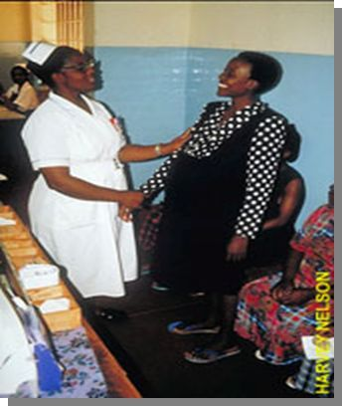
INTRODUCTORY BLOCK
MIDWIFERY AND OBSTETRICS
>march 2013 CLASS <
By: Baraza Mike

Slide 128
PHYSIOLOGY OF PREGNANCY cont…
Implantation
This is a process by which the blastocyst burrows into the thickened endometrium known as decidua. This process takes place on or about the sixth day after fertilisation. When the blastocyst enters the uterus, the trophoblast that lies over the inner cells mass becomes sticky and adheres to the endometrium.
The trophoblast secretes an enzyme, which digests the stroma cells and causes a depression in which the blastocyst lies. This digestion continues until the blastocyst is buried in the spongy layer and the site of entry is sealed. The endometrium closes over it completely.

Slide 129
PHYSIOLOGY OF PREGNANCY cont…
Implantation cont…
The blastocyst is now referred to as the embryo.
The decidua underneath the blastocyst is called
the basal decidua, that which covers it is the
capsular decidua and the remainder is called the
true decidua. Eventually, as the blastocyst grows and fills the uterine cavity, the capsular decidua meets and fuses with the true decidua.
You will now see what happens to the trophoblast and the inner cell mass, which was mentioned earlier.

Slide 130
PHYSIOLOGY OF PREGNANCY cont…
The Trophoblast
Small projections called chorionic villi appear all
over the surface of the trophoblast at the point of
contact with the basal decidua. These grow
rapidly and obtain nourishment for the growing embryo.
The villi that proliferate are known as Chorion
frondosum, which by the twelfth week are fully
developed and form the placenta. Those that
surround the decidua capsularis degenerate and
become the membrane called the chorion.

Slide 131
The Inner Cell Mass
While the trophoblast is developing into the placenta, which will nourish the foetus, the inner cell mass is forming the foetus. The cells differentiate into three layers, each of which forms particular parts as follows:
· The ectoderm, which forms the skin and the nervous system.
· The mesoderm, which forms the bones, muscles, the heart and blood vessels.
· The endoderm, which forms the mucous membranes and glands.
· Two cavities, which appear in the inner cell mass. The amniotic cavity on the side of the ectoderm and the yolk sac on the side of the endoderm.
· The amniotic cavity, which is filled with fluid, enlarges and folds round the embryo to enclose it. The amnion forms the lining. It swells and eventually comes into contact with the chorion.

Slide 132
The Inner Cell Mass
· The yolk sac nourishes the embryo until the placenta is sufficiently developed to take over.
· Embryo is the name given to the blastocyst for the period from implantation up to eight weeks. During this period all the organs and systems of the body are laid down and thereafter they only grow. From the eighth week through to delivery, the embryo is known as a foetus.

Slide 133
The Placenta
The fully formed placenta is a spongy disc, circular in shape, about 20 centimetres in diameter, and 2.5 centimetres thick. It weighs about 500 grams or 1/6th of the baby's’ wt., and is dark red in colour. It is composed of mainly chorionic villi, which are also known as chorion frondosum. The placenta begins to develop around the fourteenth day after fertilisation, and is fully formed by the sixteenth week of pregnancy.
The placenta has a foetal and a maternal surface. The maternal surface is the one attached to the uterine wall. The foetal surface lies adjacent to the foetus and is covered with amnion, which gives it a shiny appearance.
The placenta is divided into 15 to 20 centimetre lobes by deep grooves. It is made up of 15 to 20 cotyledons and an umbilical cord, which is usually attached near its centre. The umbilical cord has two arteries and one vein.

Slide 134
The Placenta cont....
The developing chorion villi are of two kinds: those that enter deeply into the basal deciduas, anchoring the placenta and shorter ones, which hang loosely in the maternal blood and absorb food, oxygen and excrete waste, known as the nutritive villi. The former are less in number. Mature chorionic villi are tree-like and contain the foetal capillaries network arising from one stem. Each villum is covered with few layers of tissue, which make it impossible for the foetal and maternal blood to mix.
It was mentioned earlier that the placenta is fully
formed by the sixteenth week after fertilisation.

Slide 135
The Placenta cont....
Foetal blood is pumped by the foetal heart along the umbilical arteries and through their branches to the capillaries in the chorionic villi in the placenta. Here the blood absorbs oxygen and nutrients and is returned via the umbilical vein to the foetus.

Slide 136
Functions of the Placenta
The placenta has several functions as indicated below:
· Respiratory, that is, oxygen from the mother's haemoglobin passes to the foetus and the foetus gives off carbon dioxide by simple diffusion.
· Nutritive, whereby the foetus obtains nutrients from the mother's diet through the placenta.
· Excretory, that is, waste products of metabolism and carbon dioxide are excreted into maternal blood by diffusion.
· Protective, where the placenta acts as a barrier against transfer of infection from the mother to the foetus. However, a few organisms such as the rubella virus and the spirochete of syphilis are able to pass through.
· Storage, that is, the placenta stores glycogen and re-converts it for use as required and also stores iron and fat soluble vitamins.
· Endocrine, where the placenta acts as an endocrine gland and produces a number of hormones as follows, which include Human Chorionic Gonadotrophin (HCG), oestrogens, progesterone and Human Placental Lactogen (HCL).

Slide 137
The Umbilical Cord or Funis
The umbilical cord extends from the foetus to the placenta. It consists of the umbilical blood vessels, two arteries and one vein. The blood vessels are enclosed and protected by Wharton's jelly and a layer of amnion covers the whole cord.
The length is about 50 centimetres. If it measures 40 centimetres or less, then it is considered to be short. A very long cord may become wrapped around the neck or body of the foetus or become knotted and cause occlusion of blood vessels, especially during labour.

Slide 138
Physiological Changes in Pregnancy
It is very important for you to understand the physiological changes that occur during pregnancy in order to appreciate their effects on the pregnant woman. This will enable you to
manage her pregnancy appropriately.
Physiological changes in pregnancy take place in the following:
· The reproductive organs
· The cardiovascular system
· The respiratory system
· The renal system
· The gastrointestinal system
· Maternal weight
· Musculo-skeletal system
· The skin

Slide 139
Changes in the Reproductive Organs
Changes in the Uterus
The uterus provides a nutritive and protective environment in which the foetus will develop and grow. The uterine muscle fibre increases in size (hypertrophy) and in number (hyperplasia). The uterus continues to grow this way for the first 20 weeks, thereafter, it stretches to accommodate its contents. It increases in size from 60 grams - 900 grams.
By the eighth week of gestation it begins to generate small waves of contractions known as Braxton Hicks contractions, which are painless and continue throughout pregnancy. The blood supply to the uterus increases to keep pace with its growth and also to meet the needs of the placenta.
In early pregnancy the uterus becomes globular in shape to accommodate the foetal growth, liquor amnii and placental tissue. This causes pressure on other pelvic organs.

Slide 140
Changes in the Reproductive Organs cont....
Changes in the Cervix
The cervix acts as an effective barrier against infection. It also protects the pregnancy.
Under the influence of progesterone, the endocervical cells secrete mucus, which becomes a cervical plug known as operculum. This plug provides protection from ascending infection. In late pregnancy, the cervix softens in response to increasing painless contractions. Prostaglandins are thought to have a role in cervical softening in readiness for the onset of labour.

Slide 141
Changes in the Reproductive Organs cont....
Changes in the Vagina
Oestrogen causes the vagina to become more elastic. These changes will allow dilatation
during the second stage of labour to receive the
descending foetal head.
There is an increased amount of the normal white vaginal discharge called leucorrhoea. The vaginal ph becomes more acidic to provide protection to some micro-organisms but also increases susceptibility to others such as candida albicans.

Slide 142
Changes in the Reproductive Organs cont....
Changes in the Cardiovascular system
The cardiac output increases from 5 litres to 7 litres per minute by late pregnancy. This is caused by an increase in resting heart rate of about 15 beats per minute by the end of pregnancy and an increase in blood volume.
The red cell mass increases by about 18% by the end of the pregnancy. The plasma volume increases from the tenth week of pregnancy and reaches its maximum level of 50% above non-pregnant values by the 32nd to 34th week, and maintains this until term.
As the plasma increase is greater than that of the red cell mass, there is haemodylution effect.
This results in lowered haemoglobin level. This effect is referred to as physiological anaemia.
The mean acceptable HB level in pregnancy is 10 - 12 g/dl of blood.
Despite these changes the blood pressure remains normal. The increased cardiac output does not affect the blood pressure. It may drop slightly by mid-trimester and towards term it returns to the level of the first trimester.

Slide 143
Changes in the Reproductive Organs cont....
Changes in the Respiratory System
The respiratory rate does not alter but the
amount of air inhaled per minute increases from
7 to 11 litres.
Changes in the Renal System
Progesterone relaxes the walls of the ureters
and allows dilation and kinking. This tends to
result in a slowing down or stasis of urinary flow,
making infection a greater possibility.

Slide 144
Changes in the Reproductive Organs cont....
Changes in the Gastrointestinal Tract
There is increased salivation. Women often experience changes in their sense of taste, leading to dietary changes and food cravings.
Craving for substances such as bricks/soil is known as pica.
Progesterone relaxes the smooth muscles.
Gastric emptying and peristalsis are reduced in order to maximise the absorption of nutrients.
Heartburn is common and is associated with gastric reflux due to relaxation of the cardiac sphincter. Constipation is also common due to sluggish gut motility. Nausea and vomiting occur mainly during early pregnancy as a result of raised hormonal levels.

Slide 145
Changes in the Reproductive Organs cont....
Changes in Maternal Weight
There is continuous weight increase during pregnancy, which is due to the foetus and fat deposition. The expected weight gain is approximately 2 kilograms in the first 20 weeks followed by an average of 0.5 kilogram per week until term leading to 12 kilograms in total.
Changes to the Musculo-Skeletal System
Progesterone encourages relaxation of ligaments and muscles. This increases the capacity of the pelvis in readiness for labour.
The unstable pelvic joints result in the rolling gait sometimes seen in pregnant women. In the multigravidae, this is likely to cause backaches and ligamental pain especially in the hip joint.

Slide 146
Changes in the Reproductive Organs cont....
Changes to the Skin
During pregnancy, there is increased activity of the melanin-stimulating hormone causing deeper pigmentation. Some women develop deeper, patchy colouring on the face known as chloasma. Many develop a pigmented line running from the pubis to the umbilicus known as linea nigra. Others may develop thin stretch marks called striae gravidarum. The increased blood supply to the skin leads to sweating.
Women often feel hotter possibly due to progesterone-induced rises in temperature of 0.45°C together with vasodilation.

Slide 147
Changes in the Reproductive Organs cont....
Changes in the Breast
The breast enlarges due to increased tissue
growth, blood supply and fat deposition.
Deposition of melanin toughens the nipple area
in preparation for breastfeeding.

Slide 148


Slide 149
Normal Labour
Part II

Slide 150
The normal Labour.
By the end of this topic you will be able to:
· Define labour
· Explain the onset of labour
· Identify the three stages of labour
· Describe the physiological changes that occur during labour
· Describe the management of normal labour

Slide 151
The normal Labour cont...
Introduction
Your role as a midwife demands clinical
expertise in supervising, caring for and supporting the pregnant mother during pre-pregnancy,
pregnancy, labour and puerperium.
You should be able to conduct deliveries on your
own, and be ready to intervene when complications arise. It is also your responsibility to recognise and act promptly should you be presented with an abnormal condition, for example: mal-presentation, obstructed labour, or obstetric and neonatal emergencies.

Slide 152
The normal Labour cont...
Introduction cont..
In order to recognise and deal with complications of pregnancy, delivery, and the puerperium, you as a health worker must first be thoroughly familiar with the characteristics of normal pregnancy, delivery and puerperium. You have already discussed normal pregnancy in the previous Unit. In this lesson, we will review the features of normal and abnormal labour and consider how each stage of labour is managed. You will also examine the normal puerperium and review methods of monitoring a mother for post-delivery complications.

Slide 153
The normal Labour cont...
Introduction cont..
Do you know that a mother, who is psychologically well prepared during pre-natal care, will go through labour and delivery with ease? Research has shown that if a woman in labour has confidence in her care giver, she will experience a considerably lower level of labour pains. Professionalism, calmness and a ‘matter of-fact’ manner on the part of the caregiver is a greater tranquilliser to the mother who is in pain than medicine (Leeder: 1994).
It goes without saying, therefore, that a midwife’s behaviour and attitude towards a mother in labour makes the difference between painful and less-painful labour. A relaxed mother will usually have a shorter period of labour than a tense mother.

Slide 154
The normal Labour cont...
Labour cont….
The word labour is commonly used by both medical and non-medical people, but what does this term mean to you as a midwife?
Labour is described as the process whereby the foetus, placenta and membranes are expelled through the birth canal after 28 weeks of gestation.
Labour, can be either normal or abnormal.
Normal labour has several important characteristics, which you should always
remember.

Slide 155
Labour cont....
These are:
· Duration - completed within 18 hours
· Occurs at term between 38 and 40 weeks
· Is spontaneous
· The foetus presents by the vertex
· Has no complications to either mother or baby
· The newborn child requires minimal or no resuscitation

Slide 156
Labour cont....
The Onset of Labour
A midwife should ensure women have sufficient information to assist them to recognise the onset of true labour. A pregnant woman would be best placed to diagnose the onset of labour herself.
Some young women, especially the primigravidae (those pregnant for the first time), may fail to recognise true labour. It is important that you help them differentiate between false and true labour signs. The contractions of true labour are regular and intense. In false labour, the contractions are sporadic (Braxton-Hicks contractions). False contractions occur during the last weeks of pregnancy.

Slide 157
Labour cont....
The presence of the following signs and symptoms will give evidence that the mother is in labour:
·Contractions of the uterus, which are increasingly strong, painful and regular
· The cervix is taken up into the lower uterine segment causing dilatation of the cervix
· There is a mucoid blood stained discharge, which is called show
· Sometimes there is rupture of membranes with drainage of liquor amnii (amniotic fluid)
The causes that trigger the onset of labour are not known. However, many theories have been offered which indicate that both hormonal and mechanical factors play a big part.

Slide 158
Labour cont....
Hormonal Factors
It is believed that close to term progesterone levels in the body falls, while at the same time levels of oestrogen (which is responsible for sensitising the uterine muscles) rises. The fall in progesterone levels is important because it has effect on muscle contractions.
The rise in oestrogen levels meanwhile triggers the release of oxytocin, which causes uterine contractions.
The foetal hypothalamus is also believed to produce releasing factors, which stimulate the anterior pituitary gland to produce adrenocorticotrophic hormone (ACTH). ACTH stimulates the foetal adrenal glands to secrete cortisol, which causes relative levels of placental hormones to rise.
These hormones cause further uterine contractions.

Slide 159
Mechanical Factors
Uterine activity can also result from the mechanical stimulation of the uterus and the cervix.
This may be due to over stretching, as in the
case of multiple pregnancy and polyhydromnios, or pressure from the presenting part, when it is well applied to the cervix.
It appears that there is a combination of hormonal (from both mother and foetus) and mechanical factors that set labour in motion.

Slide 160
Pre-Labour or Premonitory Signs of Labour
This is the period two to three weeks prior to the onset of labour when a number of changes take place. These changes are :-
Lightening
Two to three weeks before labour, the lower uterine segment expands allowing the foetal head to sink deep. The descent of the head and the body of the baby gives space to the lungs, heart and stomach, which enables these organs to function easily.
The symphysis pubis widens and the pelvic floor softens and becomes more relaxed, allowing further descent of the uterus into the pelvis.

Slide 161
Frequency of Micturition
The descent of the foetal head increases pressure within the pelvis. This limits the capacity of the bladder, which can cause irritation. The laxity of the pelvic floor muscles gives rise to poor sphincter control causing a degree of stress incontinence. This pressure results in the congestion of circulation to the lower limbs. Additionally the relaxation of the pelvic joint may give rise to backache.

Slide 162
Taking up of Cervix
The cervix is taken up gradually and merges into the lower uterine segment. Shortening of cervix is looked for when labour needs to be induced.

Slide 163
Contractions
The contractions of the uterus are coordinated by two pacemakers in the region of the cornua.
These are located where the fallopian tubes join the uterine body. The muscle contractions start at the top corner of the uterus, spread to the fundus, and then downward. During normal pregnancy, the uterus contracts intermittently but the contractions are not strong enough to overcome the resistance of a normal cervix and do not lead to its dilation. The contractions of pregnancy become more frequent towards full term and get more painful and noticeable.
A multipara may have such 'false pains' for some days before the onset of true labour. They may come to hospital too early thinking they are in established labour. This is what is referred to as 'false labour'.

Slide 164
Uterine Action
By the end of pregnancy, the uterus is divided into two anatomically distinct segments, known as the upper and the lower uterine segments.
The upper uterine segment is a thick muscular, contractile area from where the contractions begin. The longitudinal fibres retract, pulling on the lower segment and causing it to stretch, pushing the head down.
The lower uterine segment is thinner and develops from the isthmus of the uterus about eight to ten centimetres in length and is prepared for distension and/or dilatation. The lower segment stretches when being pulled by the longitudinal fibres. The force applied by the descending head or breech also aids the stretching.
The retraction ring which is an imaginary ridge, forms between the upper and the lower uterine segment. It is present in every labour and is perfectly normal as long as it is not marked enough to be visible above the symphysis pubis.

Slide 165
Fundal Dominance
During a contraction the uterus feels hard to touch. At the beginning of the process, contractions are painless and involuntary, and are controlled by the nervous system under the influence of endocrine hormones.
The contraction starts at the upper part of fundus, spreading across, and by the time they reach the lower fundus, they last longer and are very intense.
The peak of the contraction is reached simultaneously over the whole uterus and fades from all parts together. This pattern allows the cervix to dilate and the contracting fundus to expel the foetus.

Slide 166
Polarity
Polarity describes the neuromuscular harmony between the two poles or segments of the uterus throughout labour. The upper pole contracts strongly and retracts to expel the foetus. The lower pole contracts slightly and dilates to allow expulsion of the foetus to take place.

Slide 167
Contraction and Retraction
When labour starts, approximately 280 days
from the first day of the last menstrual period, the contractions change in character. They become regular and more painful. Labour contractions differ from those of pregnancy in that they are followed by retraction. This is characteristic of uterine muscle in labour.
The contracted muscle does not return to its original length when the contraction passes off. Each succeeding contraction leads to further shortening of the muscle fibres so that the uterine cavity becomes smaller and smaller. This is what makes the cervix dilate.

Slide 168
Contraction and Retraction cont...
When talking about contractions, you as a midwife are concerned with three factors, namely the strength, the duration and the frequency of the contraction.
When you talk of the strength of a contraction, you identify it as one of three categories: weak, fair or fairly strong, and strong (Mild, Moderate, Strong). The strength of a contraction is measured according to the time it has taken. Thus, a contraction which takes 30 seconds is said to be weak, one that takes 30 to 40 is said to be fair or fairly strong and one that lasts for 40 to 60 seconds is said to be strong. The duration refers to the time taken by a contraction, for example a weak contraction lasts for 10 to 30 seconds. Frequency, on the other hand refers to the number of intervals between one contraction and the next. If a mother has one contraction after every 45 minutes, the frequency is written as 1:45..

Slide 169

INTRODUCTORY BLOCK- 2014 class
MIDWIFERY AND OBSTETRICS
>Sept. 2014 CLASS<
By: RHODA LODIO

Slide 170
The Shortening and Dilation of The Cervix
Before labour begins, the cervix of a primagravida is a thick hard cone which protrudes into the vagina. The canal is at least one inch long. When labour begins the strongly contracting upper segment of the uterus starts retracting and getting shorter, while the thinner lower segment of the uterus gets pulled away from the presenting part. This stretches the lower segment. The latter, in turn pulls the internal Os. This dragging away of the internal Os from the presenting part starts dilating the upper part of the cervical canal. This goes on until the canal is shorter and shorter and finally there is no canal at all. The canal becomes part of the uterine cavity with only the undilated external Os and the thinly stretched cervix separating this cavity from the vagina. When this happens, we say the cervix has been 'effaced' or 'taken up.

Slide 171
The Shortening and Dilation of The Cervix cont....
In a primigravida the cervix usually becomes almost fully effaced before any dilation takes place, while in multiparous women the two processes take place together. The cervix of a multipara might be already effaced and be dilated enough to admit a finger to the internal Os even before labour starts. These signs of labour are assessed by doing a vaginal examination, though with experience, you can also get a good idea by doing a rectal examination.
The way you guide a mother has a great influence on the progress of her labour.

Slide 172
The Show
Throughout pregnancy the cervical canal is sealed by a plug of mucus known as an operculum. Together with the intact membranes this prevents organisms ascending into the uterine cavity.
When labour starts, the internal Os is pulled away from the foetal membranes and the canal is opened up. This releases the mucous plug which oozes out of the vagina mixed with a little blood. This is called the 'show'.

Slide 173
The Stages of Labour
Labour is divided into four stages, although in
real practice, the process is a continuous one and change from one stage to the other may not be clearly obvious. The four stages of labour are known as First stage, Second stage, Third stage and Fourth stage.

Slide 174
The First Stage
This is known as the stage of cervical dilatation.
This stage begins when regular, painful uterine
contractions start and is detected clinically by the thinning and effacement of the cervix, followed by its dilatation. The normally thick cervix becomes thinned out and stretched over the presenting part. The first stage is completed when the cervix is fully dilated and the presenting part starts being expelled. This stage has two phases, known as the latent and the active phase.
The contractions of the uterus dilates the cervix.

Slide 175
The First Stage cont...
The dilatation of the internal Os causes the separation of the chorion from the decidua closest to it. A small bag of membranes is formed and is forced into the internal Os intrauterine pressure. At the beginning of each contraction, a little more amniotic fluid is forced into the bag of membranes. The head of the foetus then comes down like a ball valve and separates the amniotic fluid above it from that in the bag. The bag of membranes may remain intact until nearly the end of the first stage.
However, even if the membranes rupture early the cervix will still become dilated as it is drawn up over the presenting part by the retraction of the upper segment.

Slide 176
The First Stage cont..
During the first stage, the foetus does not move downwards to any great degree. When a certain amount of fluid has left the uterus after the membranes have ruptured, a new form of pressure comes into play, namely foetal axis pressure. The upper pole of the foetus, normally the breech, is pressed on by the fundus of the uterus, while the lower pole is pressed down onto the lower segment and cervix. Should the membranes rupture early, foetal axis pressure will operate at an early stage. In modern practice, the membranes are often deliberately ruptured during labour because this is believed to encourage more efficient uterine action and shorten labour. You should be cautious carrying out this procedure in this era of HIV.

Slide 177
The First Stage cont..
The duration of the latent phase of labour need not be defined too accurately. Dilation of the cervix from 0 to 4cm can take six to eight hours, but slower progress may be normal and is perfectly acceptable provided that the woman is comfortable and in no way distressed. Between 4 and 10cm dilatation (that is in the active phase of labour) the cervix should dilate at a rate of about 1 cm per hour, giving a theoretical duration of six hours for this phase of labour in both primiparous and multiparous women.
During the early part of the latent phase the pains may not be very severe but towards the end of the active phase they are often very distressing, constituting the most painful part of labour. Vomiting and reflex shivering are common at the end of the active phase of the first stage of labour.

Slide 178
The First Stage cont..
By now the membranes have ruptured. If the
membranes remain intact when the cervix is fully
dilated, the onset of the expulsive stage may be
delayed. This is because the cervix does not receive the pressure of the head, which helps to
stimulate the uterus to increase its activity. If the
membranes remain intact after full dilatation,
they should be ruptured with toothed forceps or
a sterile plastic amnihook during a contraction.

Slide 179
Second Stage
This starts with the full dilatation of the cervix and the expulsion of the presenting part and ends with the complete delivery of the baby. Sometimes , there may be very little descent of the foetus during the first stage. However, in the second stage, the resistance offered by the lower uterine segment and the cervix has been overcome and the presenting part can be pushed down onto the pelvic floor.
The resistance of the pelvic floor then has to be overcome by uterine contractions, aided by the
action of the voluntary muscles of the abdominal wall and the diaphragm.

Slide 180
Second Stage cont…
In the absence of an effective epidural block, full dilatation of the cervix is accompanied by a bearing down sensation during contractions and women are usually encouraged to push. As the contraction comes on, the woman takes a deep breath, then holds it and subsequently bears down with all the force of her abdominal muscles. These partly voluntary, partly reflex, expulsive efforts place the foetus under additional stress and pushing should, therefore, not be allowed to continue for more than one hour. If delivery is not imminent, assistance in
the form of Ventouse extraction, forceps delivery
or even a Caesarean section may be necessary.

Slide 181
Third Stage
This stage commences immediately after the birth of the baby. It includes the delivery of the placenta and membranes as well as the control of bleeding. At this stage the uterus contracts down to follow the body of the foetus as it is being born. As the cavity of the uterus becomes smaller, the area of the placental site is diminished. The placenta is then cut off from the spongy layer of the decidua basalis. Further uterine contractions expel the placenta from the upper segment into the lower segment and through the vaginal vault. This process, whereby the placenta leaves the upper segment to the lower segment and through the vagina, is referred to as separation and descent.

Slide 182
Fourth Stage
This is the period from the delivery of placenta and membranes to the end of the first two hours postpartum. The uterus is firm at level of two fingers breadth above the umbilicus. Restoration of physiological stability is established. During this period myometrial contractions and retraction, accompanied by vessel thrombosis, operate effectively to control bleeding from the placenta site. Failure of this mechanism could result in excessive blood loss (postpartum haemorrhage (PPH)) that could be life threatening. The mother should be closely observed for haemorrhage, urine retention or hypotension with uterine massage every 15 minutes. The mother and child relationship should be initiated and encouraged, as it has an effect to the subsequent quality of their relationship and bonding.

Slide 183
Physiological Changes in Labour
You will continue with the study of the four stages of labour, paying particular attention to the physiological and mechanical changes that are involved

Slide 184
Physiological Changes in the First Stage of Labour
This is the stage of dilatation of the cervix. On average, it lasts eight to twelve hours in a primigravida and six to eight hours in a multipara. It should not go beyond 14 hours in either. This stage is characterised by the uterus doing an immense amount of muscular work in the form of contracting and relaxing.
Contractions are involuntary in that they do not come on through voluntary effort of the woman nor can they be voluntarily stopped. They are peristaltic and regular.
Contractions at the start of labour come every 10 to 15 minutes and last between 30 to 45 seconds. They increase in frequency and strength as labour progresses until they are separated by a minute or two. Towards the end of the first stage they last for one minute. The relaxation phase during which the muscles remain retracted also shortens.

Slide 185
Physiological Changes in the First Stage of Labour cont….
Each contraction begins with a gradual build-up towards a peak of intensity. This is followed by a relaxation phase. During the relaxation phase, the muscle recovers and gets ready for the next contraction. This relaxation phase is important to both the foetus and the mother during the first and second stages of labour. During a contraction the circulation through the uterine wall is reduced and the foetal heart rate is slowed but regains its normal rate as soon as the contraction has passed. If there is increasing foetal tachycardia between contractions or if the bradycardia is prolonged after each contraction, then foetal distress sets in. If the uterus contracts continuously the foetus dies from lack of oxygen (anoxia).

Slide 186
Physiological Changes in the First Stage of Labour cont….
The mother is also able to relax during the relaxation phase. However, if the uterus contracts continuously, the mother also gets very exhausted because the uterus uses up a lot of energy during contractions. If this goes on for too long, as is the case during prolonged labour, her energy stores become depleted and maternal distress sets in. As the mother will not be able to eat or absorb much by mouth, she should be given supplementary carbohydrates intravenously. In a normal first stage, oral fluids to which additional sugar has been added are sufficient. As the uterus contracts and retracts more and more, the upper muscular part becomes progressively thicker.

Slide 187
Physiological Changes in the First Stage of Labour cont….
The less muscular lower segment is pulled upwards over the presenting part and becomes thinner. The cervix becomes effaced. The effacement is followed or accompanied by progressive dilation of the cervix until full dilatation when the uterus becomes a continuous cavity with the vagina. A fully dilated cervix is 10 cm dilated. During the first stage the uterine cavity gets progressively smaller but the foetus moves down very little.
The presenting part helps in dilating the cervix. During this stage the woman should not use her voluntary efforts to bear down as this will exhaust her unnecessarily and may cause oedema of the cervix and/or foetal distress

Slide 188
Management of Normal Labour in the Admission Room
The proper management of labour is essential, if you are to avoid problems or to detect them early when they occur. The patient will come to you believing she is in labour. You should be able to assess and decide whether she is in labour or not. The patient may be in early labour, but often she might arrive in the late second or even third stage.
If you are sure she is not in labour send her home to wait. If she is in labour, keep her in the ward and continue monitoring her progress.
Danger, especially to the foetus, can arise suddenly and unexpectedly.
No labour should be assumed normal until the fourth stage has successfully concluded.

Slide 189
Admission
When you admit a mother in the first stage of labour, what activities should you carry out?
You would take the patient's personal history, conduct a physical examination and carry out tests/investigations.
On admission, you should check the woman's antenatal card for any identified risk factors. It will also help you to see if there were any abnormalities during her pregnancy. The records will also have information on her medical and obstetric history. If she has not been attending an antenatal clinic, this is the time to take detailed history.
Once this information has been established, find out more about the present labour. Take her history, do an examination and carry out the necessary investigations to establish the stage of labour and the state of the mother and the foetus..

Slide 190
History Taking
A detailed personal history should have been taken during pre-natal care. However, if this has not been done, this is a good time to get it recorded. Make sure the names are correctly spelled because this can eventually result in problems when registering the baby. Review the last day of menstruation to calculate the expected date of delivery. Check her age, parity and contraceptive history. Assuming that a detailed personal history had been taken during pre-natal care, you should now take information about the following:
· Any presence of show
· Presence or absence of contractions
· Onset of contractions and their characteristics
· Activity of the foetus
· Rupture of the membranes
· Any treatment given
· Food taken in the last four hours
After taking the personal history, there are some observations that you should make.

Slide 191
Observations
Assess the general condition and progress of labour in the mother, as well as vital signs and blood pressure. Test urine for protein, glucose and ketones and report any abnormalities.
After taking the history and observing the mother you now need to carry out a thorough physical and vaginal examination.

Slide 192
Head to Toe Physical Examination
You should start by explaining to the mother that you want to examine her. The health care provider should appreciate the psychological aspect of a woman in labour, respect her feelings and the need for company or privacy.
They should support the woman and her partner or family during labour, birth and the immediate postpartum period. Failure to do this has contributed to many women delivering at home, a place where they are appreciated but without an assured clean and safe deliver.

Slide 193
How to Examine the Mother Systematically
When examining her, check on her general condition. Check if she is exhausted, anaemic, in great pain, dehydrated, or with generalized oedema. You should also check her height. This
will enable you to exclude any risk factors.
You should also take her vital measurements including her blood pressure, pulse, temperature, and respiratory rate. Conduct an abdominal examination checking for:
· Height of fundus
· Over-distension of the abdomen, scars or other abnormality
· Over-distension of bladder
· Possible presence of twins or multiple pregnancy
· Contractions - frequency, length, type and strength
· Lie of foetus - this is the relation of the long axis of the foetus to the long axis of the uterus (it can be longitudinal, oblique or transverse)
· Rate and rhythm of the foetal heart

Slide 194
How to Examine the Mother Systematically cont…
You should also check on the presentation.
Which part of the foetus is at the pelvic brim? Is it a head (cephalic) or the buttocks (breech)? Check the attitude; whether the head is well flexed or extended. A well-flexed head presents the smallest diameter and delivers easily. A deflexed head presents a larger diameter and causes delayed or obstructed labour.
Finally check the position of the relation of the foetal parts to the mother. This is confirmed through a vaginal examination by checking the position of the foetal occiput relative to the mother. The position of the foetal spine is the same as that of the occiput. After a thorough head-to-toe examination you should perform a vaginal examination.

Slide 195
Vaginal Examination in Labour
This is an important examination as it can give you a lot of information, which you might not get from an abdominal examination. On the other hand, if you do it often it is uncomfortable for the woman and you might introduce infections into the uterine cavity, especially if the membranes have ruptured. To avoid infections, you should scrub and put on gloves as you would for any other sterile procedure. Then thoroughly swab the perineum of the woman with an antiseptic solution such as Savlon or Hibitane, or boiled water if these are not available.

Slide 196
Vaginal Examination in Labour cont…
A vaginal examination is necessary to:
· Check if the patient is in labour and what stage of labour (this is done on admission of the patient)
· Assess the progress of labour (this is done every four hours during the first stage of labour)
· The degree of effacement and dilatation of the cervix and the station of the head relative to the ischial spines will give you the necessary information
· Check that there is no prolapse of the cord when the membranes rupture
Remember: Do not do a vaginal examination if the mother has an ante-partum haemorrhage, because if there is placenta praevia, severe haemorrhage will occur.
A vaginal examination is contraindicated if the mother has ante-partum haemorrhage unless it is performed in an operating theatre. In case of pre-eclampsia, the procedure should be performed only after giving a sedative.

Slide 197
Vaginal Examination
· Arrange your vaginal examination pack with cheatle forceps and pour solution.
· Scrub your hands for at least five minutes.
· Glove yourself methodically to prevent contamination.
· Explain the semi-lithotomy position that should be maintained during the examination to the mother.
· Swab the vulva and drop the swab methodically (used swabs should be decontaminated in jik before disposal).
· Ask the mother to breathe in and out while you perform digital examination.
· With the right hand, gently insert the fingers obliquely inside the vagina with the thumb, facing the symphysis pubis.
Your left hand should be on the mother’s abdomen.
· The fingers to be introduced are held on a higher level than the vaginal orifice during insertion to avoid contact with the anus. Fingers should not be withdrawn until the required information has been obtained.

Slide 198
Vaginal Examination cont…
· The fingers are directed along the anterior wall of the vagina. The wall should feel soft and dilatable while the vagina should be warm and moist.
· The fingers are then directed upwards to the position of the cervical Os.
· At times the Os is not felt readily, the fingers should then be directed backwards and upwards.
While performing a vaginal examination, you
should observe the mother’s non-verbal communication.

Slide 199
The Vagina
The Cervix
· Is it bruised or oedematous?
· Is it firm or soft?
· Is it taking up, that is effaced?
· How much is the Os dilated?
Do not insert more than two fingers in the cervical Os.
The Membranes
After deciding the state of the cervical Os, check
for presence of membranes. Note the following:
· Are they ruptured or intact?
· If intact are they bulging?
The Cord
· Is it presenting or prolapsed?
· If prolapsed is it pulsating?

Slide 200
The Presenting Part
Next, determine the level of the presenting part.
You should ask the following questions:
· Is it fitting the pelvis and cervix well?
· If it is the head, can you feel a suture or fontanel? Which one?
· Is it well flexed?
· If the head is at the brim it, will not be felt vaginally unless you push it down with your left hand which is on the mother's abdomen
· If the head has just engaged, it can be touched or just be tipped
· If the head is deeply engaged, the head is felt at the level of the ischial spines.
While performing a vaginal examination, you should observe the mother’s non-verbal communication.

Slide 201
The Presenting Part cont…
The station or level of the presenting part is the level to which the presenting part has descended in the pelvis. The level of the presenting part is expressed in relation to the easily palpable ischial spines. You can also state if it is above the brim, at the brim, in the cavity or at the outlet.
Remember that if the presenting part is at the brim then it is at station -5. As the head descends down in to the cavity of the pelvis it decreases from -5, -4, -3, -2, -1. By the time it is at the ischial spines, it is said to be at 'zero station'. It reappears from the pelvic outlet into the perineum, which is classified as +1, +2, +3, and +4. By the time it is seen at the perineum it is at station +5.

Slide 202
The Presenting Part cont…
Observe the position of the presenting part.
This is the position of the foetal parts in relation to the parts of the pelvis. A point on the foetus, such as the occiput in a vertex presentation, is usually used as a reference point.

Slide 203
The Presenting Part cont…
To get the position right, you have to palpate the sutures and fontanel to determine their position relative to the pelvis. This can be confirmed by abdominal examination.
In a breech or a face presentation, the reference points on the foetus are the sacrum and the chin or mentum respectively. A soft mass is felt.
Foetal genital parts or the anus may be felt with the examining finger. The position is determined by the position of the sacrum in relation to the side of the mother's pelvis. The left side is expressed as left sacro-anterior (LSA) or the right side, which is known as right sacro-anterior (RSA). In a vertex presentation, when the occiput is persistently posterior, this causes prolonged labour. In a cephalic presentation, you will feel the hard head sutures and fontanel. Determine whether it is the anterior or posterior fontanel by its shape. If it is the posterior fontanel, then the position is occipito-anterior. If it is the anterior fontanel then the position is occipital-posterior.

Slide 204
The Presenting Part cont…
Face presentation is important as the chin is the facial landmark. Note how the position of the chin is related to the mother's right thigh (RT) or left thigh (LT), side of the pelvis and the anterior and posterior position expressed as RMP (right mento posterior). You should also note the brow or sinciput presentation on vaginal examination (VE). You should be able to feel the brow, frontal sutures and possibly the posterior fontanel. The extension is usually a temporary presentation, which converts to face or occiput presentation during labour. However, at times it persists and in such instances, a caesarean section is usually called for. Note whether the long axis of the body of the foetus is perpendicular to that of the body of the mother. A left acromiodorso posterior (LADP) indicates that the baby’s lower shoulder is to the mother’s left and its back is towards her back. A compound presentation is when the hand or occasionally a foot lies alongside the head.

Slide 205


Slide 206
The Pelvis
Next check for moulding or caput succedaneum.
What is moulding?
Moulding is when the diameters of the foetal skull are reduced in size. During labour the bones of the foetal skull tend to overlap at the sutures so that the head can easily pass through the birth canal. During a vaginal examination this is how you should check for moulding:
· In cephalic presentation, run the finger on the head feeling for the sutures
· Judge the degree of moulding by feeling the amount of overlapping of skull bones
· Check for caput
The pelvis is assessed to check if it is adequate

Slide 207
The Pelvis cont...
The following factors should be checked:
· Is it roomy?
· Are the sidewalls well spaced?
· Can you touch the promontory of the sacrum easily?
· Is the pubic arch wide enough?
· After checking for moulding, direct the fingers behind the head and make an effort to reach the sacro-promontory.
The palm of the hand should be facing upwards. Promontory of the sacrum should not be reached.
· With the palm facing downwards run the two fingers down along the hollow of the sacrum and determine the shape. The hollow of the sacrum should be curved.
· The two fingers are then moved to where the ischial spines are located on either side of the pelvis. Run the finger along this area to determine whether or not the ischial spines are unduly prominent. Or else you can stretch your fingers to see if the spines are prominent. The ischial spines should not be prominent.

Slide 208
The Pelvis cont...
· As you move the fingers with the palm facing upward, on reaching the pubic arch check if it can accommodate two fingers. The apex usually should accommodate two fingers.
· Make a fist facing downwards then place the fist between the ischial tuberosities. The Intertuberosity should accommodate four knuckles.

Slide 209
The Discharge
Withdraw the fingers and check if there is:
· Any vaginal discharge
· Any smell
· Any liquor or meconium staining
· Any bleeding
The following steps should be taken as part of your investigation:
· Take a urine sample for albumin and sugar
· Check for acetone, especially if the patient is in prolonged labour
· Take blood for haemoglobin and cross matching if the patient is anaemic or might need an operation
By this time you will have gathered enough information as to the stage of labour and whether the patient belongs to the ‘at risk’ category and needs referral or not.

Slide 210
Management of First Stage of Labour
When managing the first stage of labour, you should keep to the following procedure, making sure you record your findings in a partogram:
· Admit the patient to the waiting room, reassure her and introduce her to other patients
· Reassure her and explain what is being
done at every stage
· Give her an enema only if she is in early labour (this will reduce the risk of faecal soiling
and infection at delivery)
· The patient may have a warm bath and change into a hospital gown
· Encourage her to walk about and empty her bladder frequently

Slide 211
Management of First Stage of Labour cont…
· Give her plenty of fluids with sugar or glucose as she has to work hard and needs the energy
· Do not allow any solid foods as the stomach takes a long time to empty in Labour Should she need an operation and anaesthesia, the emptying of the stomach will be difficult and she might vomit and inhale the vomit. If she is in much pain and the delivery is still far off, give her a sedative.
Check the following regularly:
· Check the foetal heart rate half hourly or more often if you suspect distress
· Check uterine contractions (strength, type, frequency and duration) as well as maternal pulse, BP and temperature
· Check the urine output and check for albumin and acetone if indicated every two hours

Slide 212
Management of First Stage of Labour cont…
· Every four hours check the level of the presenting part and the degree of dilatation of the cervix
· Constantly check the woman's reaction to labour and be aware of her needs, especially for pain relief. You can repeat pethidine 50 mg IM if cervical dilatation is still 5 cm or less. Do not give more pethidine if delivery is imminent as it depresses the baby's respiration
· Towards the end of the first stage, she can rest on her side, or in any position she finds comfortable, for example,
squatting
· Discourage pushing or bearing down before the cervix is fully dilated
· Early pushing only exhausts the woman and will cause oedema of the cervix and interfere with normal dilatation
· If the bladder is full and she cannot empty it on her own, catheterize her using aseptic technique
· When the membranes rupture, usually at the end of the first stage, check the colour of the liquor for meconium staining, the foetal heart rate and do a vaginal examination to exclude prolapse of the cord

Slide 213
the observations you are supposed to record in the partogram
Vital signs
· Blood pressure
· Details of vaginal examination
· Contraction strength and number of contractions in ten minutes
· Fluid balance
· Urinalysis
· Drugs administered

Slide 214
Observations you have to record on the partograph cont…
When observing the contractions, you should note the following:
· Uterine contraction duration, strength and frequency
· In early labour the contractions are mild, lasting 20 to 30 seconds and are infrequent
· As labour progresses, the contractions become stronger, lasting 40 to 50 seconds and are about three contractions per ten minutes
· The uterus should always relax between contractions
· The cervix dilates progressively from 4cm at a rate of approximately 1cm and 1.5cm hourly in primigravida and multigravida respectively
· The descent of the presenting part can be noted by abdominal palpation or vaginal examination. Avoid unnecessary vaginal examination
Remember to allay the mother's fears and reassure her throughout your examination and indeed throughout labour. A mother in labour needs to feel loved, cared for and to be treated with dignity.

Slide 215
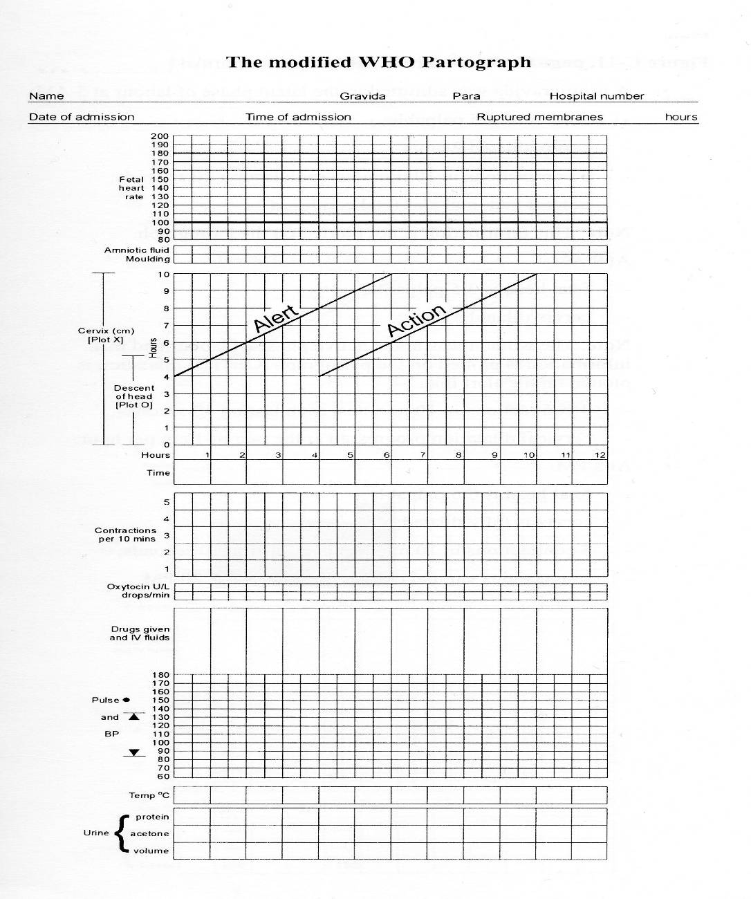

Slide 216
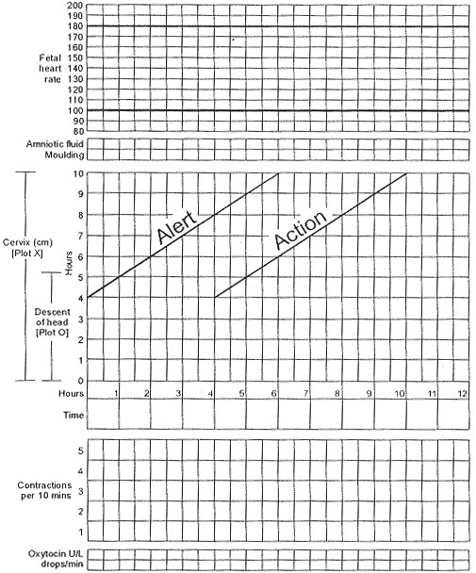

Slide 217
Prevention of Infection
To prepare for clean delivery you should:
· Give an enema or suppositories
· Avoid shaving the pubic hair, given current HIV/AIDS prevalence rates
· Allow the mother to have bath whenever she wishes as it is soothing during labour
· Practice aseptic techniques through labour
· Ensure a clean environment within and around the ward
After conducting a thorough examination of the mother and recording your observations in the partogram , there are a number of things you can do to make her feel comfortable during her labour i.e. allow her to change position and move around, use back massage, have a chosen companion with her during labour, allow her to take fluids as required and return the placenta to parents if so desired and directed by the culture. However do not forget to check on the foetus especially if you suspect foetal distress.

Slide 218
The Second Stage of Labour
As mentioned earlier, the second stage of labour begins with full dilatation of the cervix. It is the stage of descent and expulsion of the baby. It normally lasts from one to two hours on average in primigravida, and half an hour in multipara. If this stage goes beyond two hours it is considered abnormal. The contractions become stronger, lasting 40 to 60 seconds, with a one minute recovery interval.
The retracted and contracting uterus pushes the foetus down into the pelvis. During the relaxation phase the pelvic floor pushes the presenting part up again but the retracted uterus does not allow all the progress achieved to be lost. Progressively the presenting part moves down until it reaches the pelvic floor. The presence of a foreign body in the vagina makes the woman want to bear down even against her will. The voluntary muscles of her abdomen and diaphragm help the uterus in the pushing. As a contraction comes the mother should be instructed to take in a deep breath, hold it and then bear down.

Slide 219
The Second Stage of Labour cont…
These expulsive efforts are partially voluntary.
The vagina widens to accommodate the baby. It is now a continuous cavity with the uterus. The presenting part may push out faeces from the rectum as it goes through the vagina. When the presenting part reaches the pelvic floor it starts stretching the vulva, causing much pain, especially in the primigravida. For some time it keeps popping out during a contraction and receding back during the relaxation phase. After some time it can no longer slip back. This is
known as 'crowning'. The head will have passed through the bony outlet of the pelvis. The perineum becomes stretched and paper-thin and it is at this stage that an episiotomy should be performed if necessary. The next contraction normally expels the presenting part.

Slide 220
Mechanism of the Second Stage of Labour
The mechanism of labour refers to a series of movements the foetus has to make to pass through the birth canal.
Lie
Lie means the relation of the foetus to the long axis of the uterus. It may be longitudinal, oblique or transverse.

Slide 221
Presentation
The presenting part of the foetus is that part which is in or over the pelvic brim. Its position is examined in relation to the cervix. It could be vertex, face, or a breech. However, 95% of all presentations are cephalic, and the presenting part is usually the vertex.
Position
The position describes the relationship of a
For example, in a vertex presentation the selected part is the occiput. With face presentation it is the chin, and with a breech presentation, it is the sacrum.

Slide 222
Attitude
The pelvis is a curved passage with different diameters at the inlet, mid-cavity and outlet as you saw in unit two. The foetus, therefore, has to adapt itself to the shape, size, and curve of the pelvis at different levels as it descends.
To be able to manage labour skillfully, you need to understand the natural movements made by the baby so that, when assisting in delivery, you can follow the movements rather than oppose them. The factors, which influence the mechanism of labour, are known as the three 'Ps': power, passage, and passenger.

Slide 223
The three P’s
Power
The stronger the contraction in a well prepared mother, the better the outcome of labour.
Passage
The size, shape and resistance of the birth canal including the bony pelvis, cervix, vagina and pelvic floor may speed up or slow down the process of delivery. A gynaecoid pelvis and a fully dilated cervix speed up the process.
Passenger
This refers to the size, lie and presentation of the foetus, as well as the placenta and membranes. For the foetus, a vertex presentation makes labour shorter as the presenting part fits well on the cervical Os and stimulates the cervix to dilate faster.

Slide 224
The three P’s cont…
It is important to remember that descent occurs throughout and as mentioned earlier, ninety five per cent of all presentations are cephalic, and the presenting part is usually the vertex. This areas boundaries include the bregma or the anterior fontanel, the parietal eminences and the posterior fontanel. The presenting diameter is, therefore, the smallest - 9.5cm. In order to present with the smallest diameter, the head must be well flexed on the neck with the chin touching the chest. As the leading part meets resistance of the pelvic floor it rotates 1/8th forwards until it comes under the symphysis pubis.
The mechanism of labour in a cephalic vertex presentation includes the following steps:
· Engagement and descent
· Internal rotation
· Birth by extension of the head
· Restitution and external rotation

Slide 225
Engagement and Descent
Engagement is the descent of the presenting diameter through the pelvic brim. The head usually engages late in pregnancy in the primigravida while in the multipara it does not engage till labour starts. The head enters the pelvic brim in oblique diameter with sub occipital frontal diameter (10.5cm). With good uterine contraction, there is more flexion of the head.
The head engages with sub occipital bregmatic (9.5 cms) oblique diameter of the pelvis brim.
Internal Rotation
The head rotates 1/8th of a circle. Such a rotation is achieved by the action of the uterine muscle pushing downwards. The pointed vertex presents on the broad levator ani muscle. When the vertex reaches the perineum, the occiput turns from the posterior to the anterior position.
Anteriorly there is more room for further descent.
When the occiput is below the symphysis pubis, crowning takes place.

Slide 226
Birth By Extension of the Head
Once the occiput has escaped from under the symphysis pubis, the head extends forward. The nape of the neck is pressed firmly against the pubic arch. This extension of the head causes the anterior part to stretch the perineum gradually. Further extension allows the sinciput, face and chin to escape the perineum and the head is born by extension. Extension is the result of action from two forces. The abdominal and thoracic muscles exert downward pressure.
The pelvic floor and perineum resist this pressure and push the head forward and upward through the weak area, which is the vagina.

Slide 227
Restitution
The head turns 1/8 of the circle to the left, back to where it was before. This rotation takes place to undo the twist, which occurred during the previous internal rotation. This 'undoing of the twist' is known as restitution.
Internal Rotation of the shoulder
When the head is passing through the level of the ischial spines and the outlet in anterior posterior position, the shoulders enter in the oblique diameter of the pelvis and rotate forward 1/8 of a circle. The shoulders are now in the anterior posterior diameter of the outlet. The anterior shoulder escapes the symphysis pubis while the posterior shoulder sweeps the perineum.
External Rotation of the Head
As the internal rotation of the shoulders takes place, the head, which has already been born, rotates 1/8 of a circle as in restitution. The head now lies in the lateral position.

Slide 228
Lateral Flexion
Following these movements the body bends sideways to follow the curve of the birth canal.
The anterior shoulder escapes under the symphysis pubis and the posterior shoulder sweeps the perineum. The body of the baby is born by lateral flexion.
To recap, the cardinal movements of labour in a vertex presentation are:
1. Engagement
2. Descent
3. Flexion
4. Internal rotation
5. Extension
6. External restitution of the head
7. Expulsion
An easy way to remember these movements is by use of the mnemonic device -'Every Decent Family In Europe Eats Eggs'.

Slide 229
Management of the Second Stage of Normal Labour
Before you begin, try to remember the signs of the second stage of labour. Write them down on a piece of paper.
· Expulsive uterine contraction. This may happen in occipital posterior or when the head is deeply engaged with fully loaded rectum (in a case where the mother is not in second stage)
· A trickle of blood
· There may be no bleeding while the cervix is fully dilated
· Pouting and gaping of the anus
· Gaping of the vulva in primigravida. The vulva of multiparous will gape even in premature pushing
· Tenseness between the anus and coccyx
· Bulging of the perineum usually means delivery is imminent

Slide 230
Management of the Second Stage of Normal Labour cont…
Can you recall the equipment you will need during the second stage of labour?
You will need a trolley with a top and bottom shelf.
On the top shelf make sure you have:
· Sterile delivery pack
· Small bucket with 0.5% jik for decontaminating instruments
· Bucket with 0.5% jik for decontaminating linen
· A bucket with plastic bag for used swabs and gloves
On the bottom shelf you should have the following:
· Suturing pack
· Antiseptic solution
· Draw sheet and mackintosh
· Syntocinon drawn, in a receiver
· Lignocaine

Slide 231
Management of the Second Stage of Normal Labour cont…
· 5% dextrose solution 500mls
· Needles
· Branulars
· Syringes (for emergency)
· Sterile gloves
The following steps are suggested in the management of the second stage of labour:
· Explain the procedure to the mother and reassure her. ·Ask your assistant to open and arrange the delivery pack while you scrub up
· Gown and glove yourself methodically
· Instruct your assistant to put the patient in the dorsal position
· Swab the mother methodically
· Lubricate your two fingers and perform vaginal examination to confirm second stage
· You should also instruct your assistant to check the foetal heart beat after every contraction, the mother's pulse after every ten minutes and to administer Syntocinon after the delivery of the
Within 1 minute.

Slide 232
Management of the Second Stage of Normal Labour cont…
Crowning of the Head
Next is the crowning of the head. The parietal eminences pass through the bony outlet. At this stage the head no longer recedes between contractions.
Tell the mother to stop pushing as this might lead to a rapid delivery of the head and consequent brain damage. Ask her to pant.
Research has shown that a series of short pushes are more effective than a long push.
Encourage her as she pushes.
It is really hard work! So keep encouraging the mother with kind words and warmth!

Slide 233
Management of the Second Stage of Normal Labour cont…
Extension of the head
Assist the extension by grasping the parietal eminences with your left hand. Let the head come out slowly and naturally. Feel for the cord around the baby's neck. If it is there, slip it from the baby's neck over the head. If it is too tight, place two artery forceps on the cord and cut it between them. When the nose and mouth come
out, wipe away the mucus with a sterile swab.
By this point the whole head should be out.
The head will have restituted and rotated spontaneously to face the mother’s left or right thigh. This shows you that the shoulders have descended and rotated to the anterior posterior diameter.

Slide 234
Management of the Second Stage of Normal Labour cont…
Delivering the Shoulders by Lateral Flexion
of the Body
The following procedure should be followed
when delivering the shoulders by lateral flexion of the body:
Place one hand above and one below the foetal head Depress the head gently toward the anus/neck, making sure it is neither twisted nor bent sideways till the anterior shoulder is free. Guide the head upwards in the direction of the mother's abdomen. The posterior shoulder will escape smoothly over the perineum
The rest of the body will be born by lateral flexion

Slide 235
Management of the Second Stage of Normal Labour cont…
· Ask your assistant for the time and note the time of birth
· Place the baby at a slight slant to drain the mucous
· Put the baby on the baby towel, clamp and cut the cord
· Give the APGAR score to the baby
· Show the baby to the mother to identify the sex of the baby
· Ask your assistant to continue with the immediate care of the baby
· Continue with the delivery of the placenta by using control cord traction
· Check the placenta for completeness and/or malformation.
· Measure blood loss
· Do the first examination of the baby
· Weigh the baby
· Do a post natal examination and record all the findings
· Give the mother a hot drink and transfer her to the postnatal ward.

Slide 236
Management of the Second Stage of Normal Labour cont…
APGAR Score
Can you remember how to give an APGAR score?
Once the baby is out into the world, your work has just begun. You will need to assess the baby periodically.
After delivering the baby, an assessment of the general condition is done after one minute and again after five minutes. This involves the consideration of five specific signs and the degree to which they are present or absent. The factors assessed are:
· Appearance - Colour
· Pulse - Heart rate
· Grimace - good grimace
· Activity - Muscle tone
· Respiratory efforts – vigorous crying
A score of 0, 1, 2 is awarded to each of these
signs in accordance with the APGAR Score

Slide 237
Management of the Second Stage of Normal Labour cont…
A normal infant in good condition at birth will achieve an APGAR score of 7 to 10. A score of 0 to 3 is severe birth asphyxia and 4 to 6 is moderate birth asphyxia, both of which require immediate resuscitation of the baby.

Slide 238
Principles of the Third Stage of Labour
Mechanism of the Third Stage of Labour
Physiology of Third Stage
Assuming that all the aforementioned factors are
well taken care of, you will now look at the
physiology of the third stage of labour, starting
with the mechanical factors.

Slide 239
Principles of the Third Stage of Labour
During the third stage, the following mechanical factors come into play:
· The uterus reduces in size 2.5cm below the umbilicus, or 15cm above the symphysis pubis after the expulsion of the foetus
· The contraction and retraction of the uterine muscles continues
· The placental site is reduced to half
· Since the placenta is inelastic, it does not contract, so it detaches from the shrinking uterine wall
· The placenta is pushed further to the lower uterine segment by the weight of the retro-placental clot. This is the accumulated blood from the separated placenta

Slide 240
Principles of the Third Stage of Labour cont…
· With the next contraction the placenta is pushed into the vagina and expelled
You will know that the placenta has separated and has been expelled from the upper uterine segment into the lower segment or into the vagina when you have noted:
· Elongation of the cord which does not recede on pressing at the symphysis pubis
· A gush of blood
· The uterus contracts like a cricket ball.
The placenta is expelled either with maternal side exposed, known as the Mathew-Duncan method or the foetal side exposed known as the Shultz Method.

