Slide 1
AN INTRODUCTION TO SKELETAL SYSTEM
PREPARED BY :MADAM RUTH

Slide 2
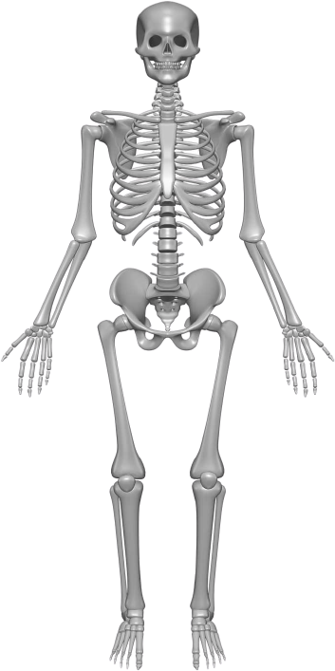
THE SKELETON

Slide 3
An Introduction to the Skeletal System
Learning Outcomes
  6-1 Describe the primary functions of the skeletal system.
  6-2 Classify bones according to shape and internal organization, giving examples of each type, and explain the functional significance of each of the major types of bone markings.
  6-3 Identify the cell types in bone, and list their major functions.

Slide 4
An Introduction to the Skeletal System
Learning Outcomes
  6-4 Compare the structures and functions of compact bone and spongy bone.
  6-5 Compare the mechanisms of endochondral ossification and intramembranous ossification.
  6-6 Describe the remodeling and homeostatic mechanisms of the skeletal system.
  6-7 Discuss the effects of exercise, hormones, and nutrition on bone development and on the skeletal system.

Slide 5
An Introduction to the Skeletal System
Learning Outcomes
  6-8 Explain the role of calcium as it relates to the skeletal system.
  6-9 Describe the types of fractures, and explain how fractures heal.
  6-10 Summarize the effects of the aging process on the skeletal system.

Slide 6
An Introduction to the Skeletal System
The Skeletal System
  Includes:
    Bones of the skeleton
    Cartilages, ligaments, and connective tissues

Slide 7
6-1 Functions of the Skeletal System
Five Primary Functions of the Skeletal System
  Support
  Storage of Minerals (calcium) and Lipids (yellow marrow)
  Blood Cell Production (red marrow)
  Protection
  Leverage (force of motion)

Slide 8
6-2 Classification of Bones
Bones
  Are classified by:
    Shape
    Internal tissue organization
    Bone markings (surface features; marks)

Slide 9
6-2 Classification of Bones
Six Bone Shapes
  Sutural bones
  Irregular bones
  Short bones
  Flat bones
  Long bones
  Sesamoid bones

Slide 10
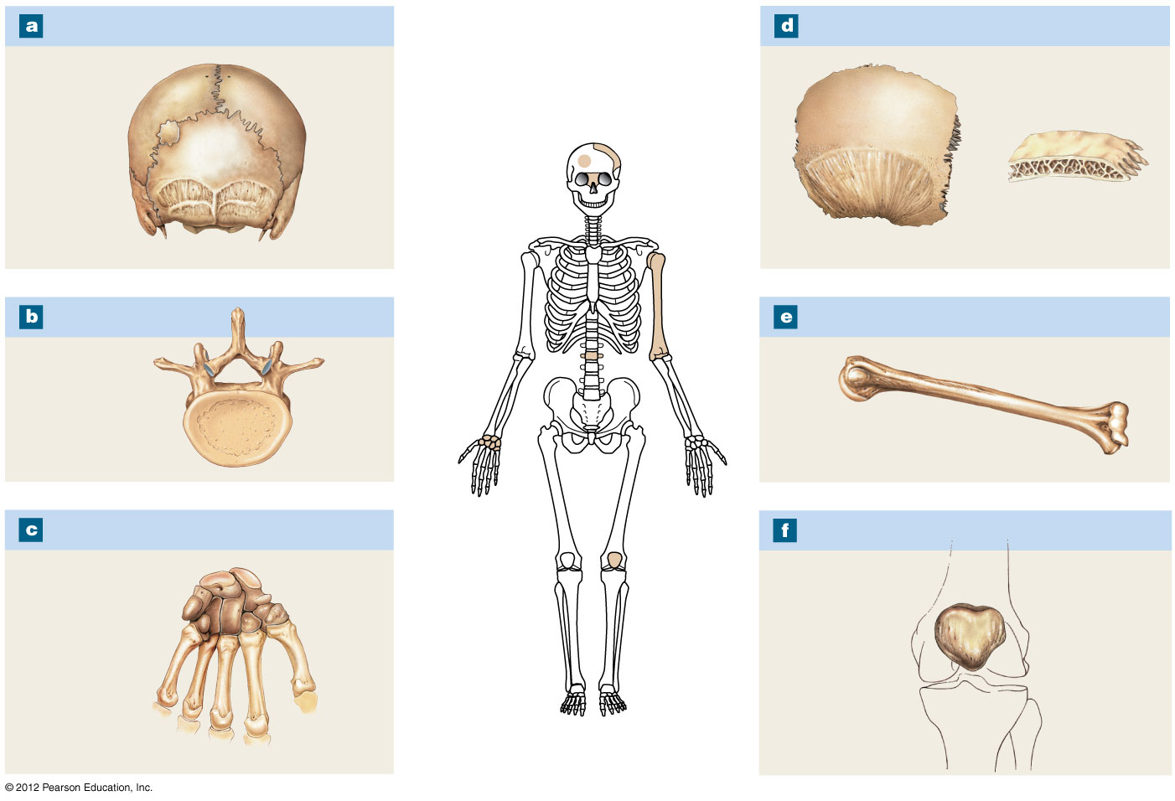
Figure 6-1 A Classification of Bones by Shape
Sutural Bones
Flat Bones
Sutures
Parietal bone
External table
Sutural
bone
Internal
table
Diploë
(spongy
bone)
Irregular Bones
Long Bones
Vertebra
Humerus
Short Bones
Sesamoid Bones
Carpal
bones
Patella

Slide 11
6-2 Classification of Bones
  Sutural Bones
    Small, irregular bones
    Found between the flat bones of the skull
  Irregular Bones
    Have complex shapes
    Examples: spinal vertebrae, pelvic bones

Slide 12
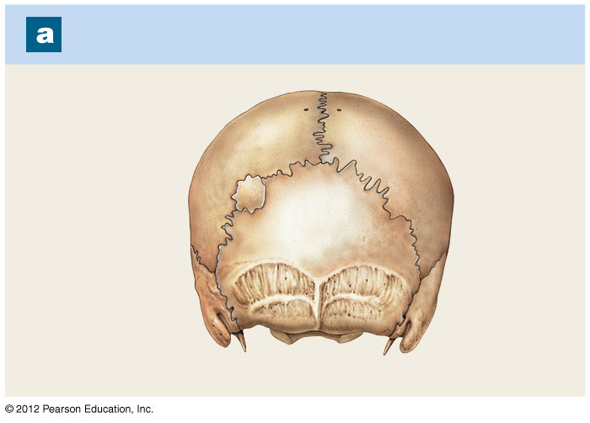
Figure 6-1a A Classification of Bones by Shape
Sutural Bones
Sutures
Sutural
bone

Slide 13
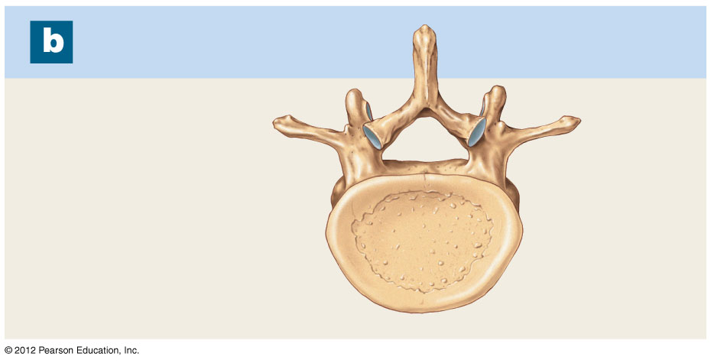
Figure 6-1b A Classification of Bones by Shape
Irregular Bones
Vertebra

Slide 14
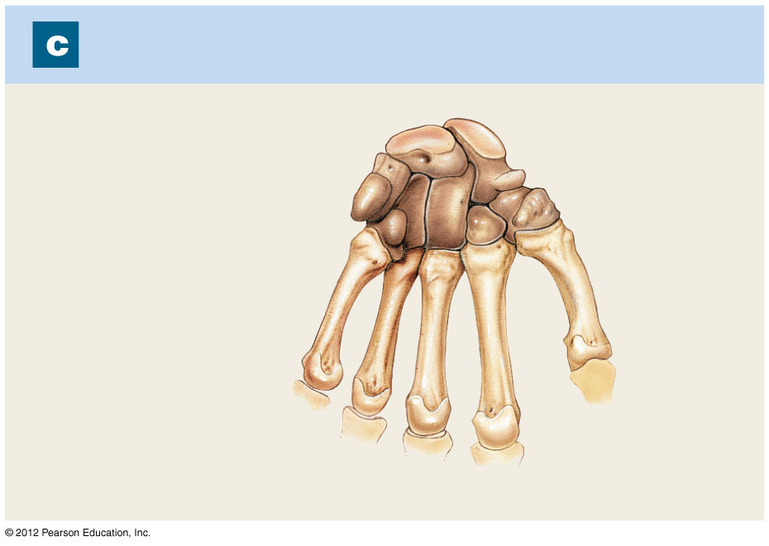
Figure 6-1c A Classification of Bones by Shape
Short Bones
Carpal
bones

Slide 15
6-2 Classification of Bones
  Short Bones
    Small and thick
    Examples: ankle and wrist bones
  Flat Bones
    Thin with parallel surfaces
    Found in the skull, sternum, ribs, and scapulae

Slide 16
6-2 Classification of Bones
  Long Bones
    Long and thin
    Found in arms, legs, hands, feet, fingers, and toes
  Sesamoid Bones
    Small and flat
    Develop inside tendons near joints of knees, hands, and feet

Slide 17
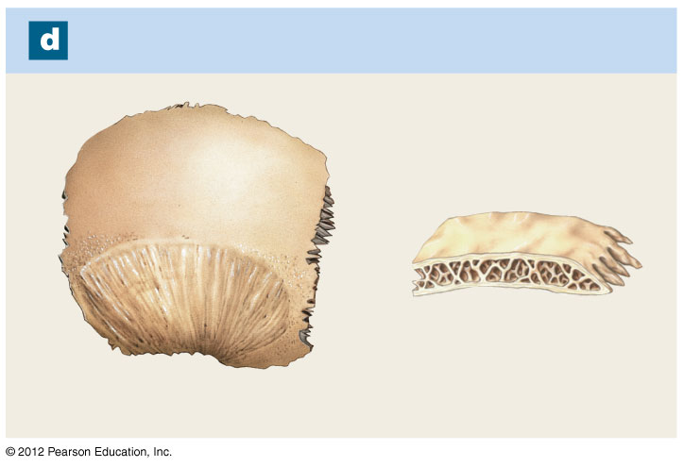
Figure 6-1d A Classification of Bones by Shape
Flat Bones
Parietal bone
External table
Internal
table
Diploë
(spongy
bone)

Slide 18
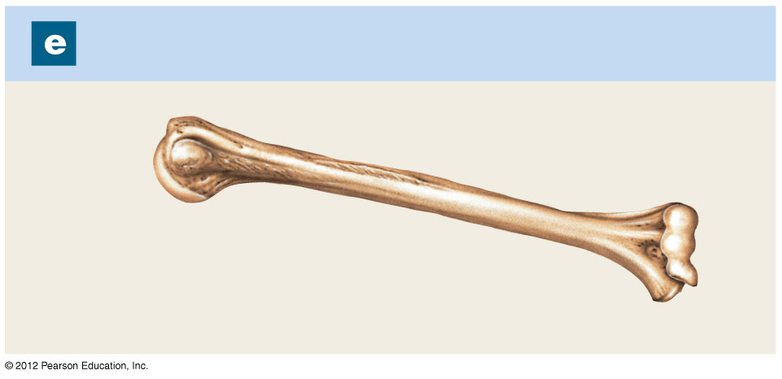
Figure 6-1e A Classification of Bones by Shape
Long Bones
Humerus

Slide 19
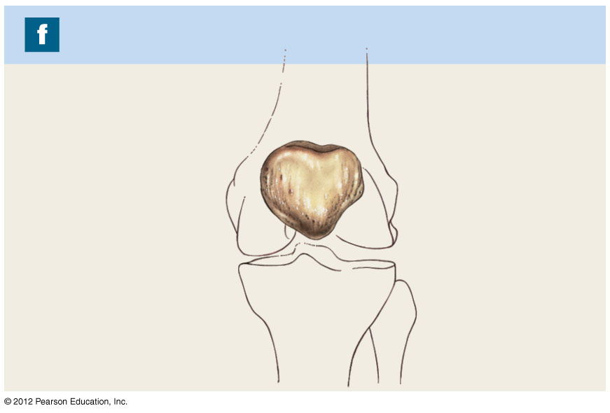
Figure 6-1f A Classification of Bones by Shape
Sesamoid Bones
Patella

Slide 20
6-2 Classification of Bones
Bone Markings
  Depressions or grooves
    Along bone surface
  Elevations or projections
    Where tendons and ligaments attach
    At articulations with other bones
  Tunnels
    Where blood and nerves enter bone

Slide 21
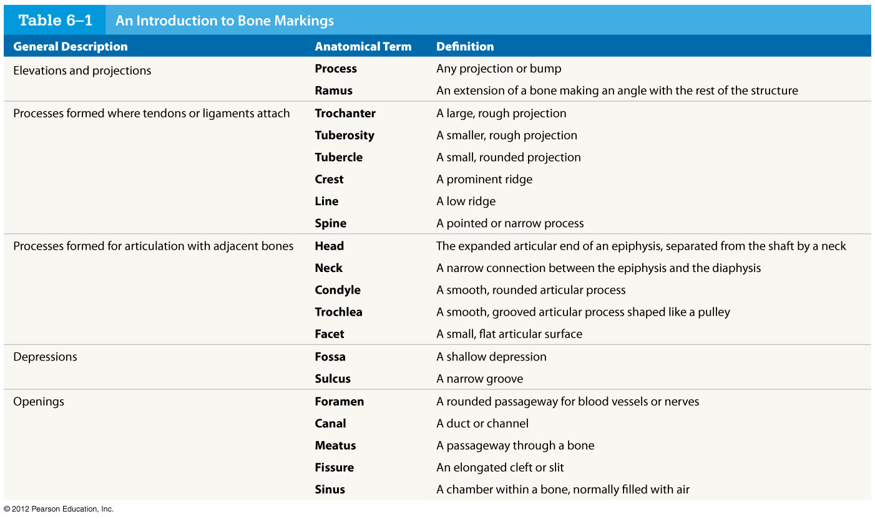
Table 6-1 An Introduction to Bone Markings
© 2012 Pearson Education, Inc.

Slide 22
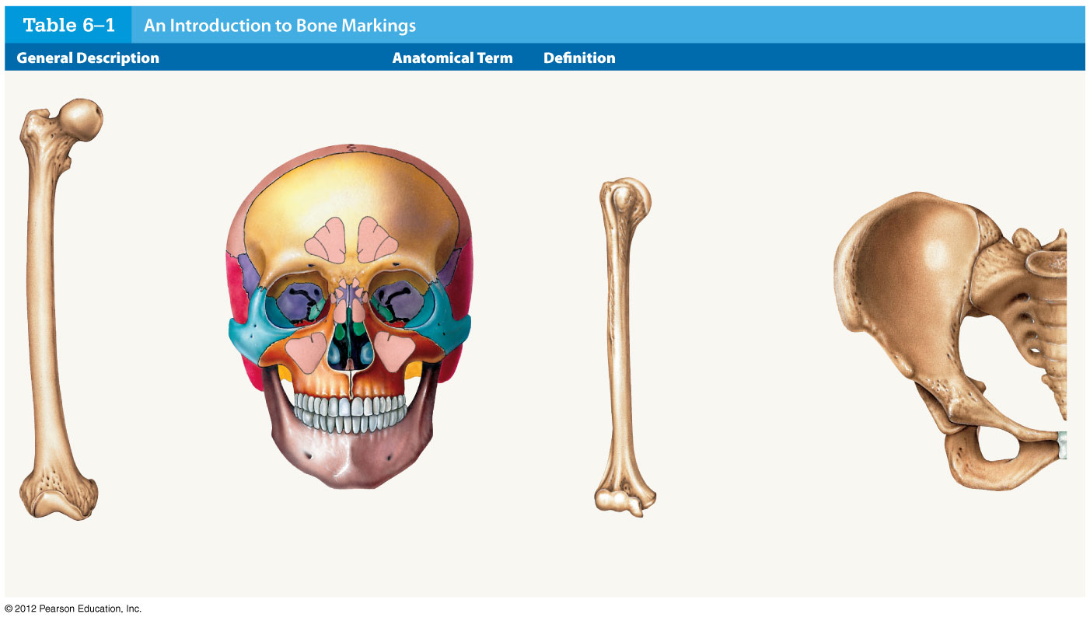
Table 6-1 An Introduction to Bone Markings
Trochanter
Sinus
Head
Neck
Tubercle
Head
Crest
Sulcus
Neck
Foramen
Fossa
Fissure
Process
Tuberosity
Spine
Ramus
Line
Facet
Fossa
Foramen
Tubercle
Trochlea
Ramus
Skull
Pelvis
Condyle
Condyle
Femur
Humerus

Slide 23
6-2 Classification of Bones
Structure of a Long Bone
  Diaphysis
    The shaft
    A heavy wall of compact bone, or dense bone
    A central space called medullary (marrow) cavity
  Epiphysis
    Wide part at each end
    Articulation with other bones
    Mostly spongy (cancellous) bone
    Covered with compact bone (cortex)
  Metaphysis
    Where diaphysis and epiphysis meet

Slide 24
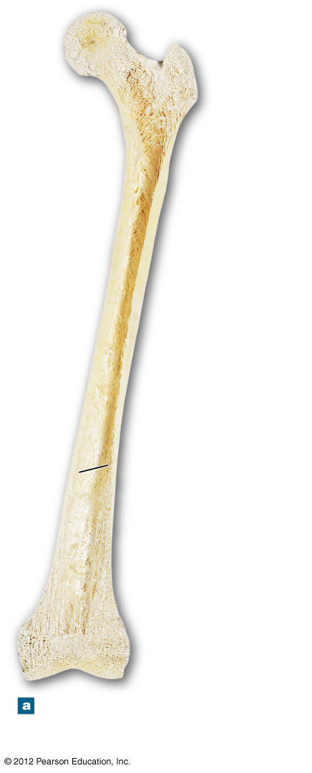
Figure 6-2a Bone Structure
Spongy
bone
Epiphysis
Metaphysis
Compact
bone
Diaphysis
(shaft)
Medullary
cavity
Metaphysis
Epiphysis
The structure of a representative
long bone (the femur) in
longitudinal section

Slide 25
6-2 Classification of Bones
Structure of a Flat Bone
  The parietal bone of the skull
  Resembles a sandwich of spongy bone
  Between two layers of compact bone
  Within the cranium, the layer of spongy bone between the compact bone is called the diploë

Slide 26
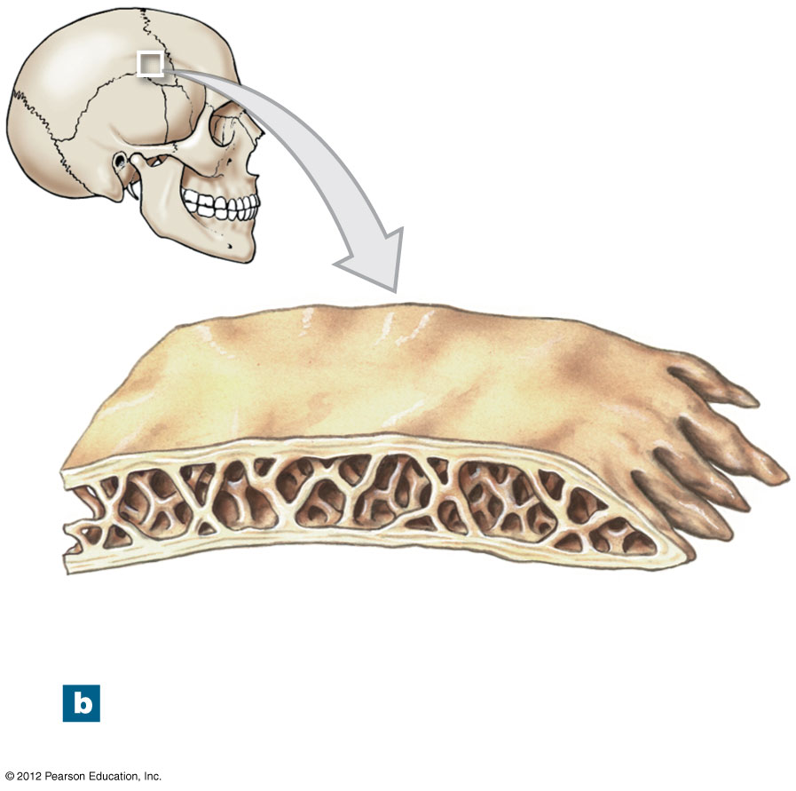
Figure 6-2b Bone Structure
Cortex
(compact bone)
Diploë
(spongy bone)
The structure of a flat bone
(the parietal bone)

Slide 27
6-3 Bone (Osseous) Tissue
Bone (Osseous) Tissue
  Dense, supportive connective tissue
  Contains specialized cells
  Produces solid matrix of calcium salt deposits
  Around collagen fibers

Slide 28
6-3 Bone (Osseous) Tissue
Characteristics of Bone Tissue
  Dense matrix, containing:
    Deposits of calcium salts
    Osteocytes (bone cells) within lacunae organized around blood vessels
  Canaliculi
    Form pathways for blood vessels
    Exchange nutrients and wastes

Slide 29
6-3 Bone (Osseous) Tissue
Characteristics of Bone Tissue
  Periosteum
    Covers outer surfaces of bones
    Consists of outer fibrous and inner cellular layers

Slide 30
6-3 Bone (Osseous) Tissue
Bone Matrix
  Minerals
    Two thirds of bone matrix is calcium phosphate, Ca₃(PO₄)₂
      Reacts with calcium hydroxide, Ca(OH)₂
      To form crystals of hydroxyapatite, Ca₁₀(PO₄)₆(OH)₂
      Which incorporates other calcium salts and ions

Slide 31
6-3 Bone (Osseous) Tissue
Bone Matrix
  Matrix Proteins
    One third of bone matrix is protein fibers (collagen)

Slide 32
6-3 Bone (Osseous) Tissue
Bone Cells
  Make up only 2% of bone mass
  Bone contains four types of cells
    Osteocytes
    Osteoblasts
    Osteoprogenitor cells
    Osteoclasts

Slide 33
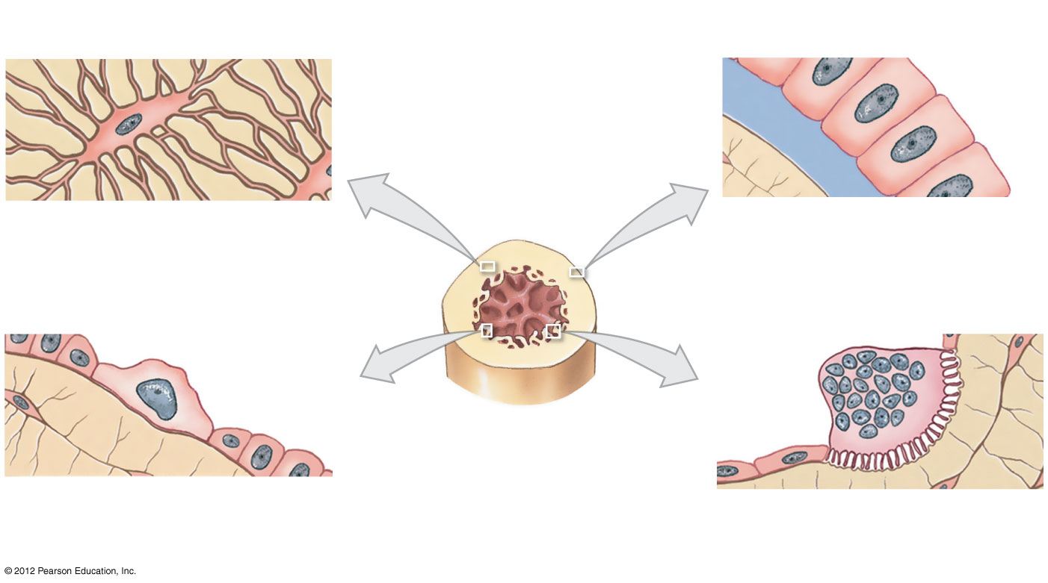
Figure 6-3 Types of Bone Cells
Canaliculi
Osteocyte
Matrix
Matrix
Osteoid
Osteoblast
Osteocyte: Mature bone cell
that maintains the bone matrix
Osteoblast: Immature bone
cell that secretes organic
components of matrix
Osteoprogenitor cell
Osteoclast
Matrix
Medullary
cavity
Medullary
cavity
Endosteum
Osteoprogenitor cell: Stem cell
whose divisions produce osteoblasts
Osteoclast: Multinucleate cell
that secretes acids and enzymes
to dissolve bone matrix

Slide 34
6-3 Bone (Osseous) Tissue
Osteocytes
  Mature bone cells that maintain the bone matrix
  Live in lacunae
  Are between layers (lamellae) of matrix
  Connect by cytoplasmic extensions through canaliculi in lamellae
  Do not divide
  Two major functions of osteocytes
    To maintain protein and mineral content of matrix
    To help repair damaged bone

Slide 35
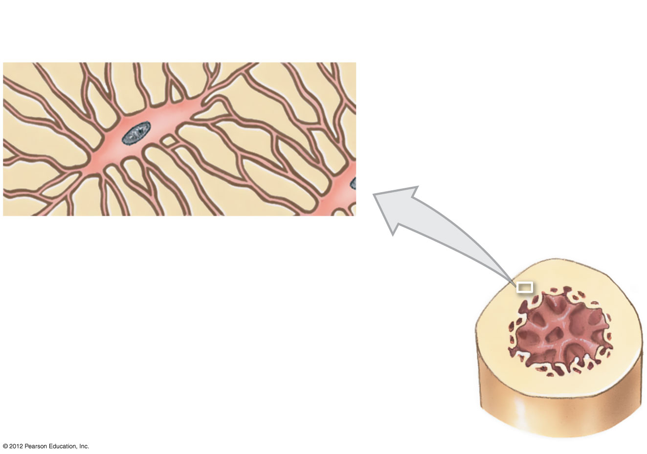
Figure 6-3 Types of Bone Cells
Canaliculi
Osteocyte
Matrix
Osteocyte: Mature bone cell
that maintains the bone matrix

Slide 36
6-3 Bone (Osseous) Tissue
Osteoblasts
  Immature bone cells that secrete matrix compounds (osteogenesis)
  Osteoid — matrix produced by osteoblasts, but not yet calcified to form bone
  Osteoblasts surrounded by bone become osteocytes

Slide 37
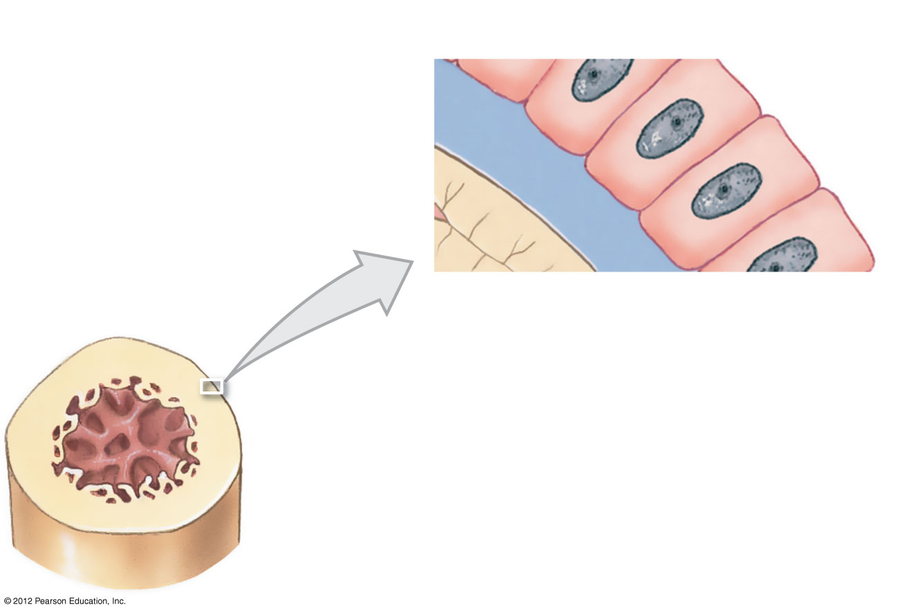
Figure 6-3 Types of Bone Cells
Matrix
Osteoid
Osteoblast
Osteoblast: Immature bone
cell that secretes organic
components of matrix

Slide 38
6-3 Bone (Osseous) Tissue
Osteoprogenitor Cells
  Mesenchymal stem cells that divide to produce osteoblasts
  Located in endosteum, the inner cellular layer of periosteum
  Assist in fracture repair

Slide 39
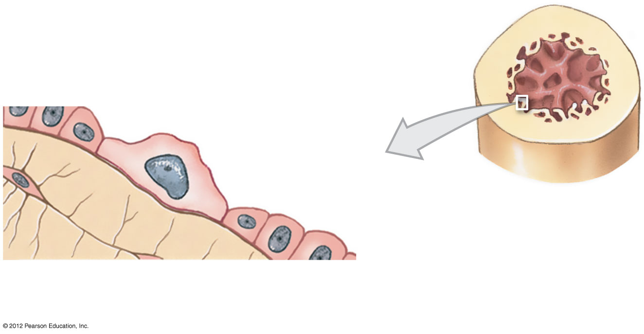
Figure 6-3 Types of Bone Cells
Osteoprogenitor cell
Medullary
cavity
Endosteum
Osteoprogenitor cell: Stem cell
whose divisions produce osteoblasts

Slide 40
6-3 Bone (Osseous) Tissue
Osteoclasts
  Secrete acids and protein-digesting enzymes
  Giant, multinucleate cells
  Dissolve bone matrix and release stored minerals (osteolysis)
  Derived from stem cells that produce macrophages

Slide 41
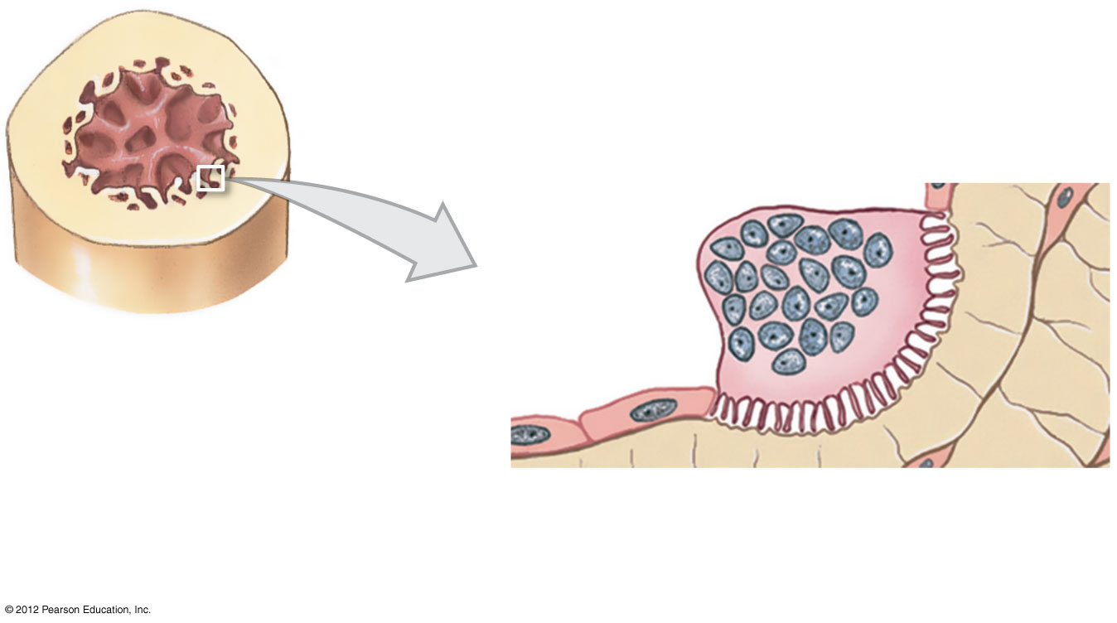
Figure 6-3 Types of Bone Cells
Osteoclast
Matrix
Medullary
cavity
Osteoclast: Multinucleate cell
that secretes acids and enzymes
to dissolve bone matrix

Slide 42
6-3 Bone (Osseous) Tissue
Homeostasis
  Bone building (by osteoblasts) and bone recycling (by osteoclasts) must balance
    More breakdown than building, bones become weak
    Exercise, particularly weight-bearing exercise, causes osteoblasts to build bone

Slide 43
6-4 Compact Bone and Spongy Bone
The Structure of Compact Bone
  Osteon is the basic unit
    Osteocytes are arranged in concentric lamellae
    Around a central canal containing blood vessels
    Perforating canals
      Perpendicular to the central canal
      Carry blood vessels into bone and marrow

Slide 44
6-4 Compact Bone and Spongy Bone
The Structure of Compact Bone
  Circumferential Lamellae
    Lamellae wrapped around the long bone
    Bind osteons together

Slide 45
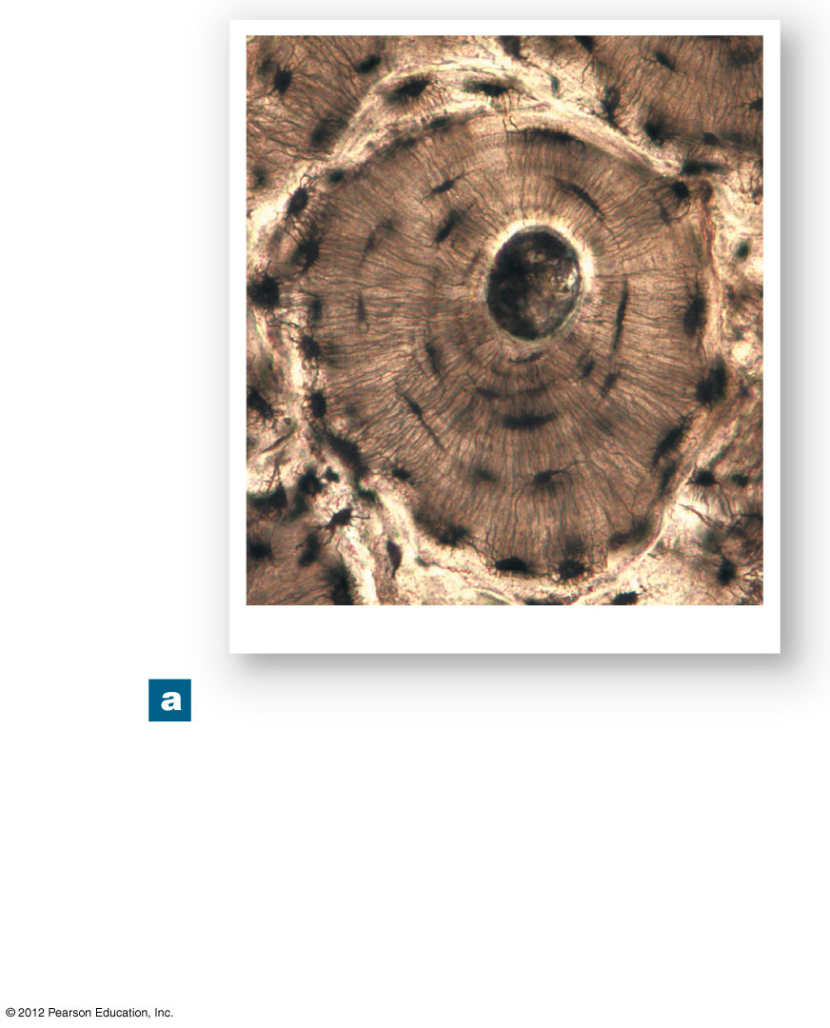
Figure 6-4a The Histology of Compact Bone
Canaliculi
Concentric
lamellae
Central canal
Osteon
Lacunae
Osteon
LM ⋅ 343
A thin section through compact
bone. By this procedure the
intact matrix making up the
lamellae appear white, and the
central canal, lacunae, and
canaliculi appear black due to
the presence of bone dust.

Slide 46
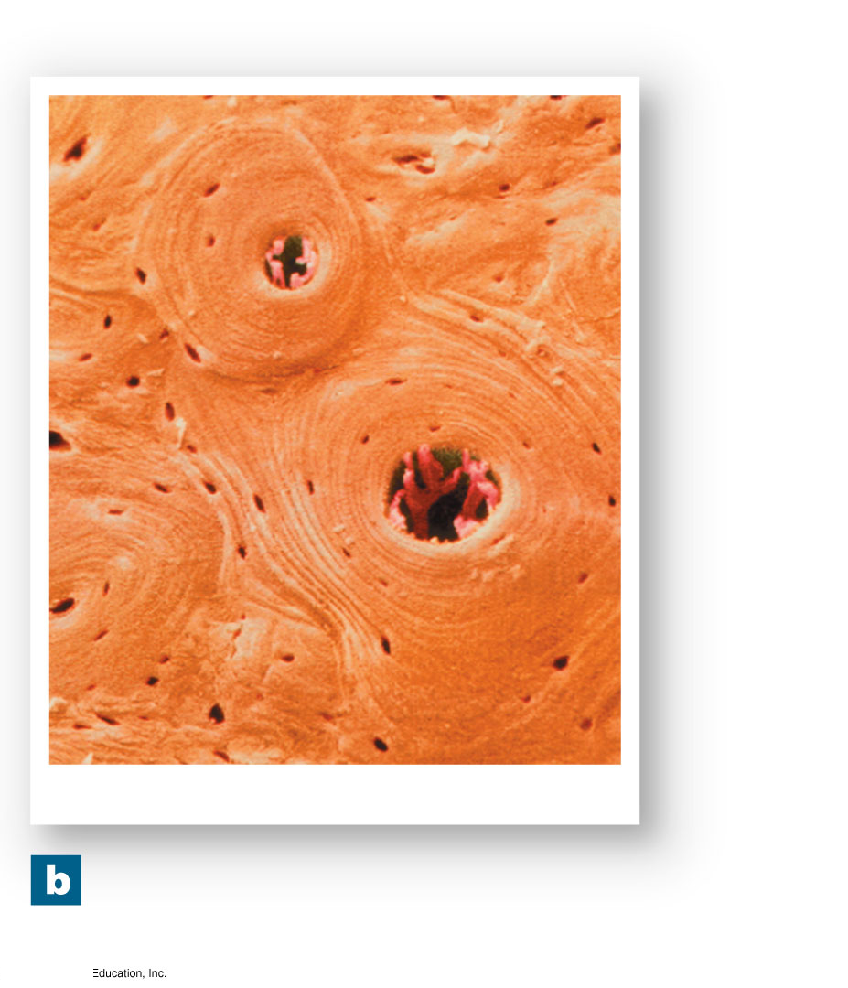
Figure 6-4b The Histology of Compact Bone
Osteon
Lacunae
Central
canals
Lamellae
Osteons
SEM ⋅ 182
Several osteons in
compact bone.

Slide 47
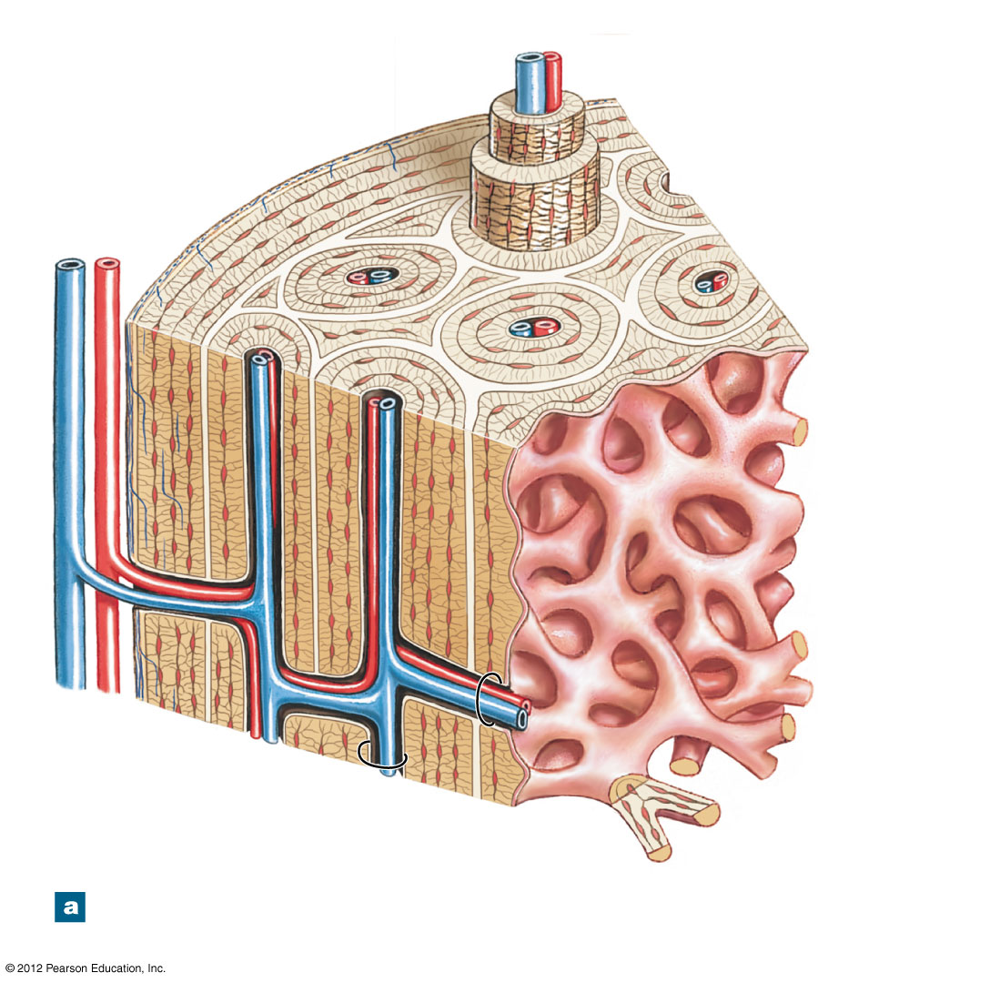
Figure 6-5a The Structure of Compact Bone
Venule
Circumferential
lamellae
Capillary
Periosteum
Osteons
Perforating
fibers
Interstitial
lamellae
Concentric
lamellae
Trabeculae of
spongy bone
(see Fig.6–6)
Vein
Artery
Arteriole
Central
canal
Perforating
canal
The organization of osteons and
lamellae in compact bone

Slide 48
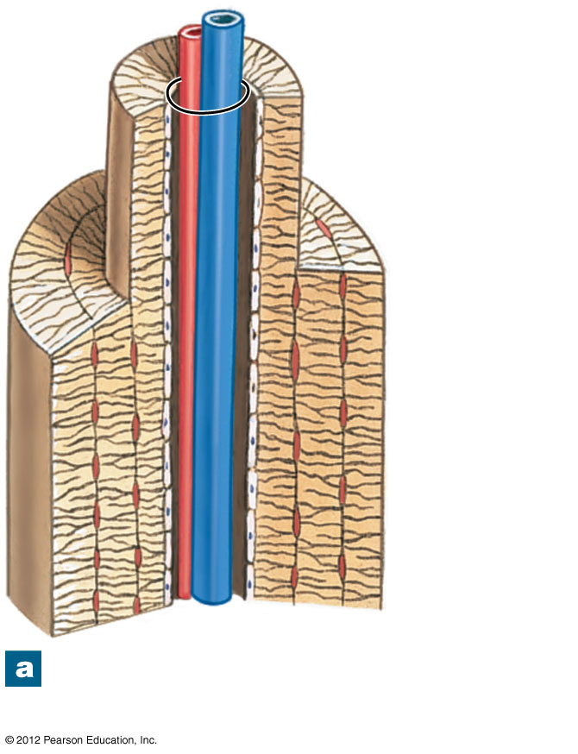
Figure 6-5a The Structure of Compact Bone
Central
canal
Concentric
lamellae
Endosteum
The organization of osteons and
lamellae in compact bone

Slide 49
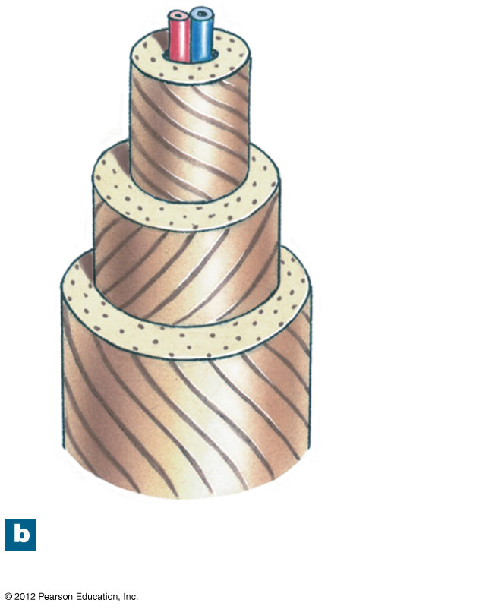
Figure 6-5b The Structure of Compact Bone
Collagen
fiber
orientation
The orientation of collagen
fibers in adjacent lamellae

Slide 50
6-4 Compact Bone and Spongy Bone
The Structure of Spongy Bone
  Does not have osteons
  The matrix forms an open network of trabeculae
  Trabeculae have no blood vessels
  The space between trabeculae is filled with red bone marrow
    Which has blood vessels
    Forms red blood cells
    And supplies nutrients to osteocytes
  Yellow bone marrow
    In some bones, spongy bone holds yellow bone marrow
    Is yellow because it stores fat

Slide 51
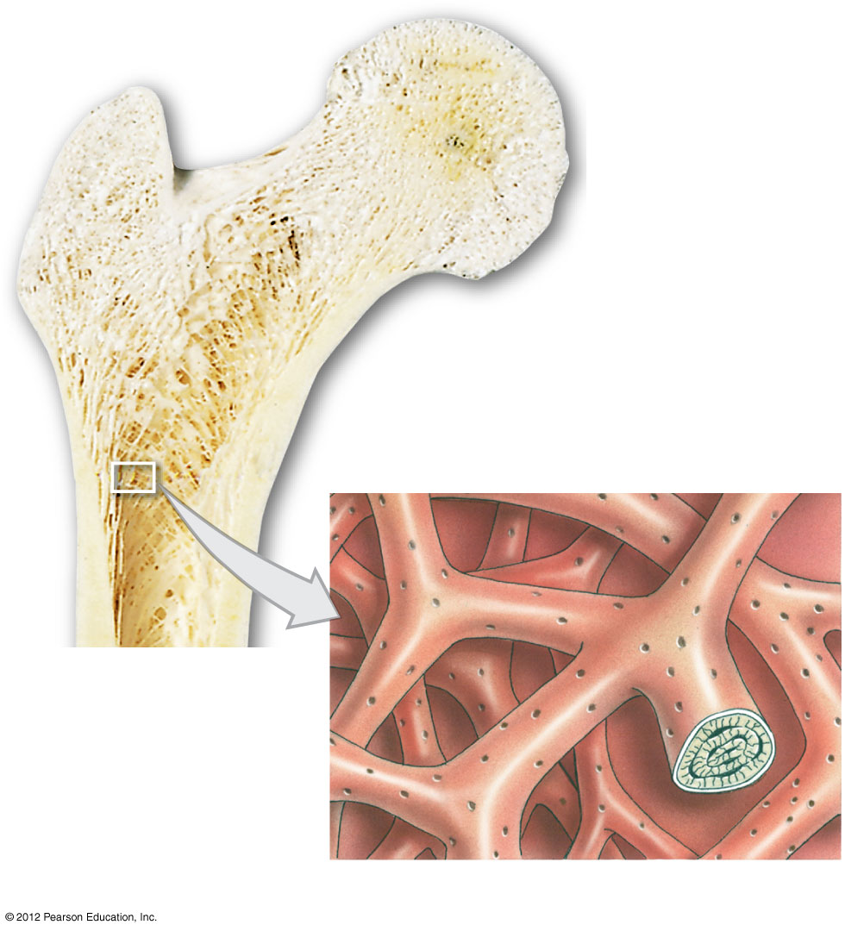
Figure 6-6 The Structure of Spongy Bone
Trabeculae of
spongy bone
Canaliculi opening
on surface
Endosteum
Lamellae

Slide 52
6-4 Compact Bone and Spongy Bone
Weight-Bearing Bones
  The femur transfers weight from hip joint to knee joint
    Causing tension on the lateral side of the shaft
    And compression on the medial side

Slide 53
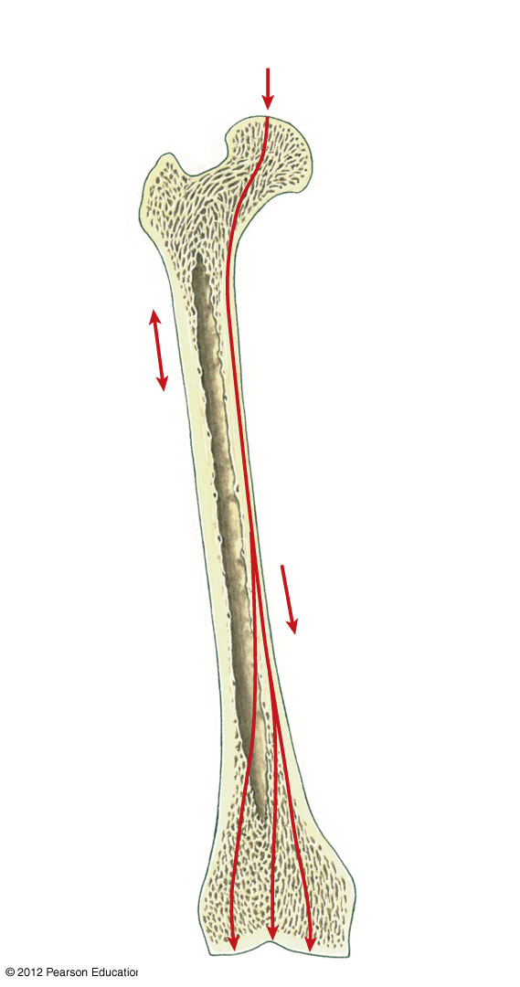
Figure 6-7 The Distribution of Forces on a Long Bone
Body weight
(applied force)
Tension
on lateral
side of
shaft
Compression
on medial side
of shaft

Slide 54
6-4 Compact Bone and Spongy Bone
Compact Bone is Covered with a Membrane
  Periosteum on the outside
    Covers all bones except parts enclosed in joint capsules
    Made up of an outer, fibrous layer and an inner, cellular layer
    Perforating fibers: collagen fibers of the periosteum
      Connect with collagen fibers in bone
      And with fibers of joint capsules; attach tendons, and ligaments

Slide 55
6-4 Compact Bone and Spongy Bone
Functions of Periosteum
  Isolates bone from surrounding tissues
  Provides a route for circulatory and nervous supply
  Participates in bone growth and repair

Slide 56
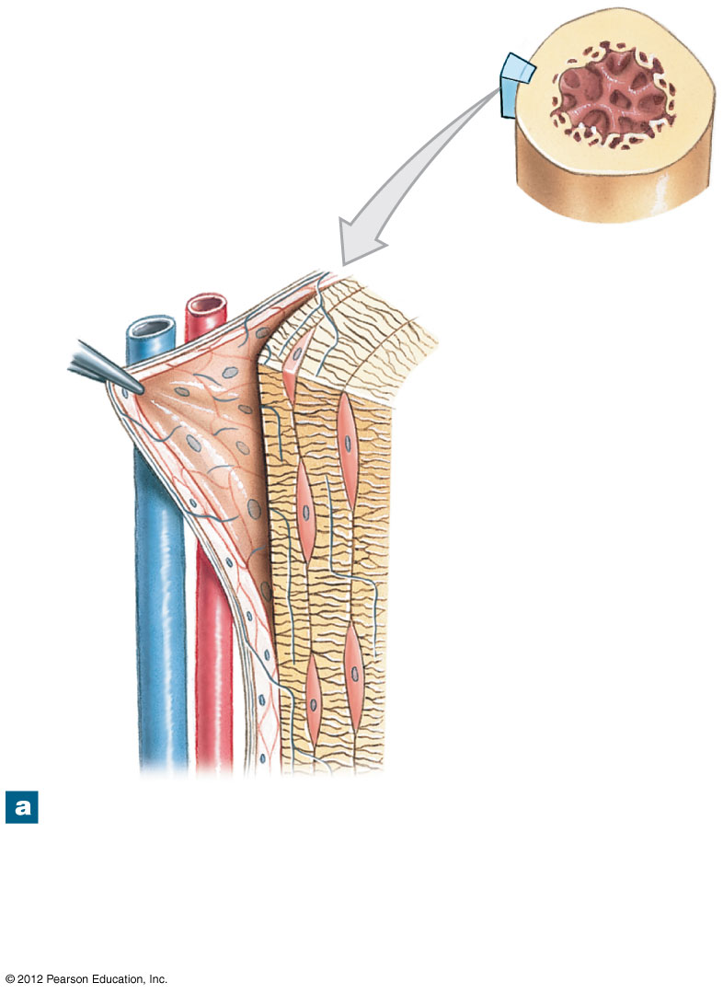
Figure 6-8a The Periosteum and Endosteum
Circumferential
lamellae
Fibrous layer
of periosteum
Cellular layer
of periosteum
Canaliculi
Osteocyte
in lacuna
Perforating
fibers
The periosteum contains outer (fibrous) and
inner (cellular) layers. Collagen fibers of the
periosteum are continuous with those of the
bone, adjacent joint capsules, and attached
tendons and ligaments.

Slide 57
6-4 Compact Bone and Spongy Bone
Compact Bone is Covered with a Membrane
  Endosteum on the inside
    An incomplete cellular layer:
      Lines the medullary (marrow) cavity
      Covers trabeculae of spongy bone
      Lines central canals
      Contains osteoblasts, osteoprogenitor cells, and osteoclasts
      Active in bone growth and repair

Slide 58
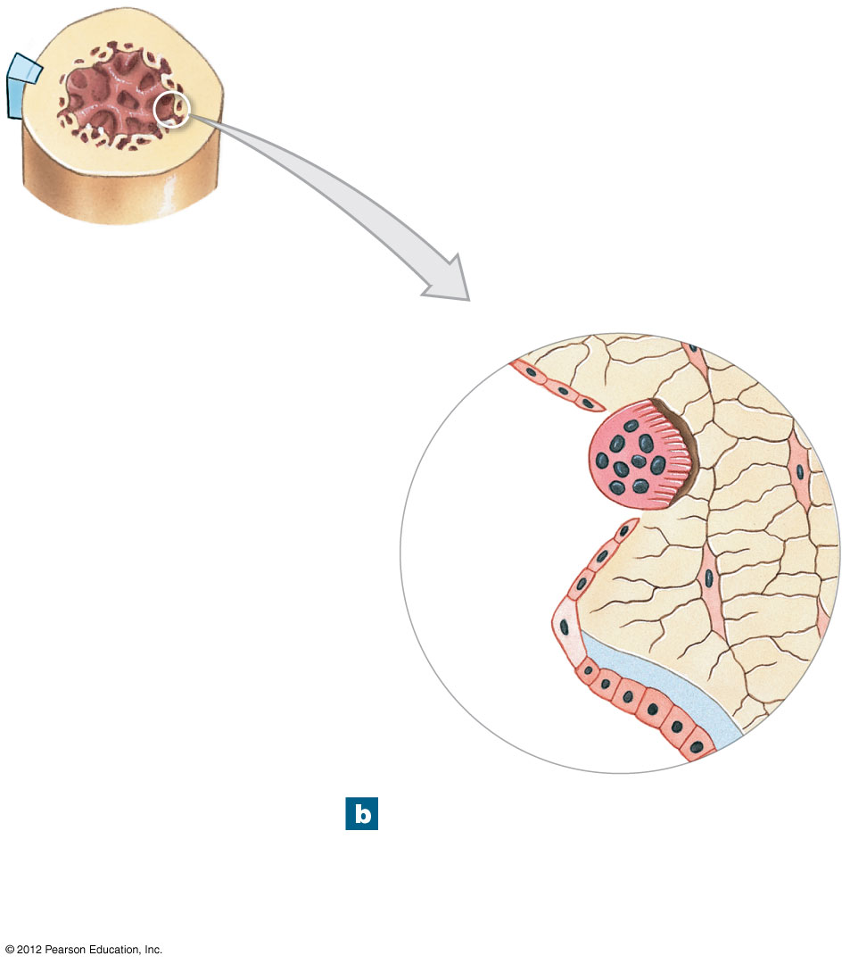
Figure 6-8b The Periosteum and Endosteum
Endosteum
Osteoclast
Bone matrix
Osteocyte
Osteoprogenitor
cell
Osteoid
Osteoblast
The endosteum is an incomplete
cellular layer containing
osteoblasts, osteoprogenitor
cells, and osteoclasts.

Slide 59
6-5 Bone Formation and Growth
Bone Development
  Human bones grow until about age 25
  Osteogenesis
    Bone formation
  Ossification
    The process of replacing other tissues with bone

Slide 60
6-5 Bone Formation and Growth
Bone Development
  Calcification
    The process of depositing calcium salts
    Occurs during bone ossification and in other tissues
  Ossification
    Two main forms of ossification
      Endochondral ossification
      Intramembranous ossification

Slide 61
6-5 Bone Formation and Growth
Endochondral Ossification
  Ossifies bones that originate as hyaline cartilage
  Most bones originate as hyaline cartilage
  There are six main steps in endochondral ossification

Slide 62

6-5 Bone Formation and Growth
Appositional Growth
  Compact bone thickens and strengthens long bone with layers of circumferential lamellae
ANIMATION Endochondral Ossification

Slide 63
6-5 Bone Formation and Growth
Epiphyseal Lines
  When long bone stops growing, after puberty:
    Epiphyseal cartilage disappears
    Is visible on X-rays as an epiphyseal line
Mature Bones
  As long bone matures:
    Osteoclasts enlarge medullary (marrow) cavity
    Osteons form around blood vessels in compact bone

Slide 64
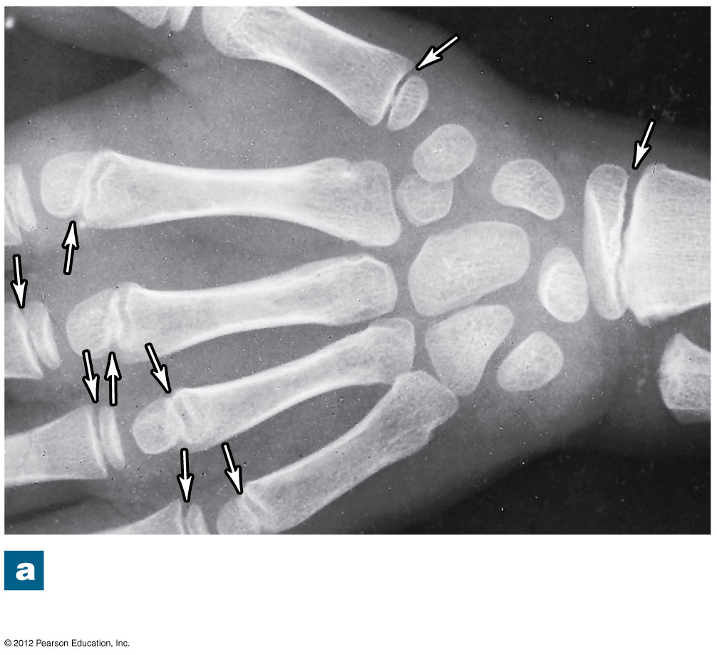
Figure 6-11a Bone Growth at an Epiphyseal Cartilage
An x-ray of growing epiphyseal
cartilages (arrows)

Slide 65
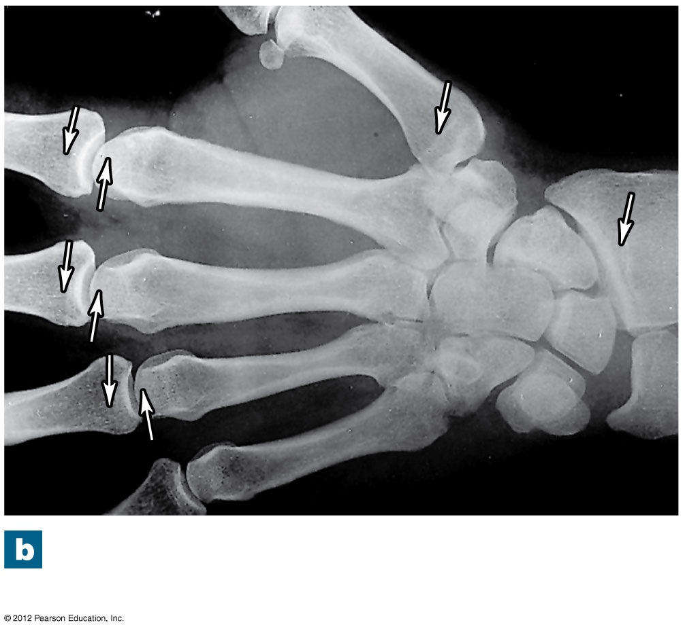
Figure 6-11b Bone Growth at an Epiphyseal Cartilage
Epiphyseal lines in an
adult (arrows)

Slide 66
6-5 Bone Formation and Growth
Intramembranous Ossification
  Also called dermal ossification
    Because it occurs in the dermis
    Produces dermal bones such as mandible (lower jaw) and clavicle (collarbone)
  There are three main steps in intramembranous ossification

Slide 67
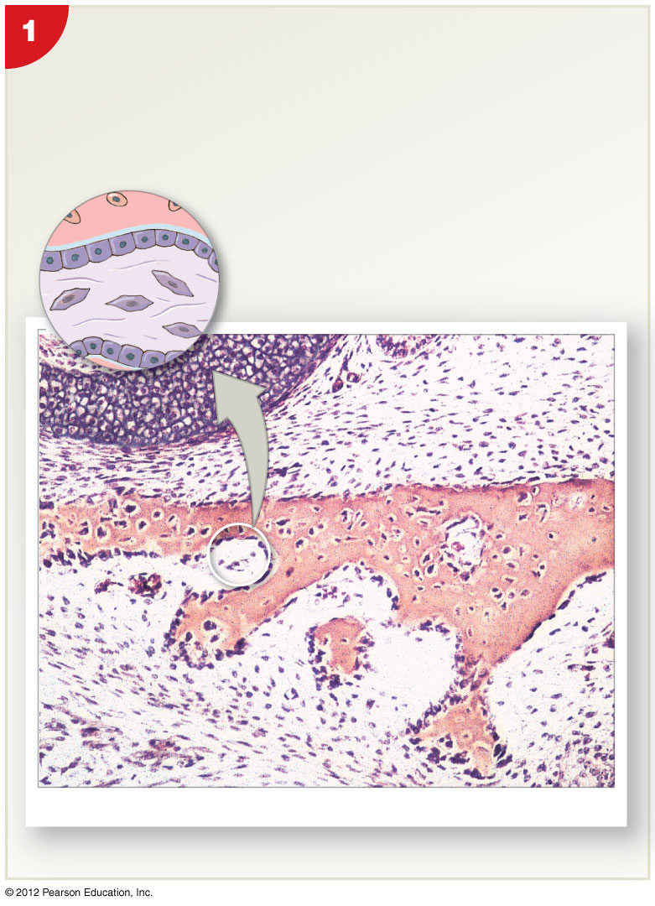
Figure 6-12 Intramembranous Ossification
Mesenchymal cells aggregate, differentiate into
osteoblasts, and begin the ossification process.
The bone expands as a series of spicules that
spread into surrounding tissues.
Osteocyte in lacuna
Bone matrix
Osteoblast
Osteoid
Embryonic connective tissue
Blood
vessel
Mesenchymal cell
LM ⋅ 22
Blood vessel
Osteoblasts
Spicules

Slide 68
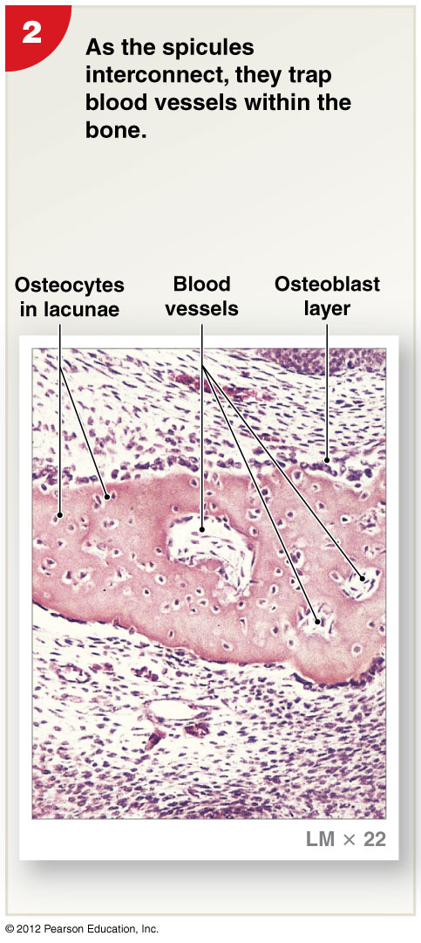
Figure 6-12 Intramembranous Ossification

Slide 69
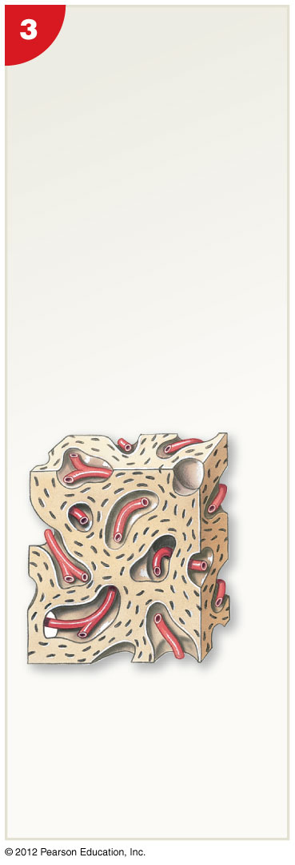
Figure 6-12 Intramembranous Ossification
Over time, the bone
assumes the
structure of spongy
bone. Areas of
spongy bone may
later be removed,
creating medullary
cavities. Through
remodeling, spongy
bone formed in this
way can be converted
to compact bone.
Blood vessel

Slide 70
6-5 Bone Formation and Growth
Blood Supply of Mature Bones
  Nutrient Artery and Vein
    A single pair of large blood vessels
    Enter the diaphysis through the nutrient foramen
    Femur has more than one pair
  Metaphyseal Vessels
    Supply the epiphyseal cartilage
    Where bone growth occurs
  Periosteal Vessels
    Blood to superficial osteons
    Secondary ossification centers

Slide 71
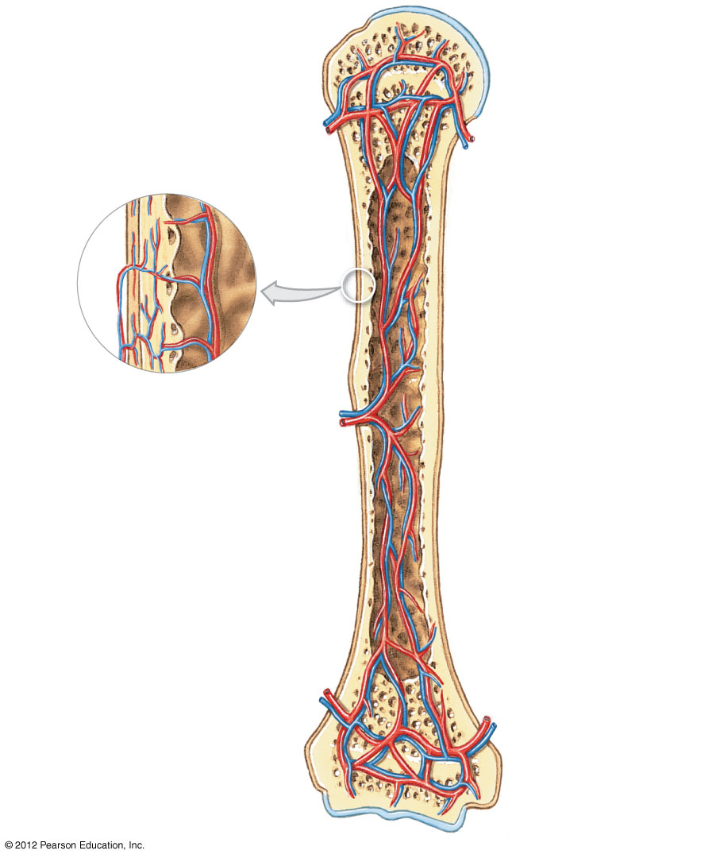
Figure 6-13 The Blood Supply to a Mature Bone
Articular cartilage
Branches of
nutrient artery
and vein
Epiphyseal artery
and vein
Metaphyseal
artery and
vein
Periosteum
Periosteum
Compact
bone
Periosteal
arteries and
veins
Connections
to superficial
osteons
Medullary
cavity
Nutrient artery
and vein
Nutrient foramen
Metaphyseal
artery and vein
Metaphysis
Epiphyseal
line

Slide 72
6-5 Bone Formation and Growth
Lymph and Nerves
  The periosteum also contains:
    Networks of lymphatic vessels
    Sensory nerves

Slide 73
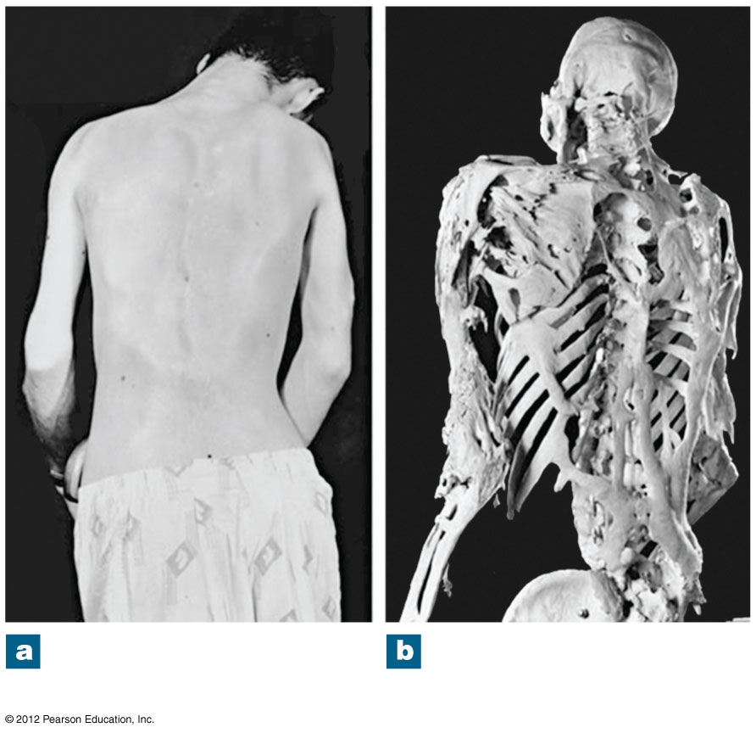
Figure 6-9 Heterotopic Bone Formation
An adult male with
FOP, posterior view
The skeleton of a man
with advanced FOP

Slide 74
6-6 Bone Remodeling
Process of Remodeling
  The adult skeleton:
    Maintains itself
    Replaces mineral reserves
    Recycles and renews bone matrix
    Involves osteocytes, osteoblasts, and osteoclasts

Slide 75
6-6 Bone Remodeling
Process of Remodeling
  Bone continually remodels, recycles, and replaces
  Turnover rate varies:
    If deposition is greater than removal, bones get stronger
    If removal is faster than replacement, bones get weaker

Slide 76
6-7 Exercise, Hormones, and Nutrition
Effects of Exercise on Bone
  Mineral recycling allows bones to adapt to stress
  Heavily stressed bones become thicker and stronger
Bone Degeneration
  Bone degenerates quickly
  Up to one third of bone mass can be lost in a few weeks of inactivity

Slide 77
6-7 Exercise, Hormones, and Nutrition
Normal Bone Growth and Maintenance Depend on Nutritional and Hormonal Factors
  A dietary source of calcium and phosphate salts
    Plus small amounts of magnesium, fluoride, iron, and manganese

Slide 78
6-7 Exercise, Hormones, and Nutrition
Normal Bone Growth and Maintenance Depend on Nutritional and Hormonal Factors
  The hormone calcitriol
    Made in the kidneys
    Helps absorb calcium and phosphorus from digestive tract
    Synthesis requires vitamin D₃ (cholecalciferol)

Slide 79
6-7 Exercise, Hormones, and Nutrition
Normal Bone Growth and Maintenance Depend on Nutritional and Hormonal Factors
  Vitamin C is required for collagen synthesis, and stimulation of osteoblast differentiation
  Vitamin A stimulates osteoblast activity
  Vitamins K and B₁₂ help synthesize bone proteins

Slide 80
6-7 Exercise, Hormones, and Nutrition
Normal Bone Growth and Maintenance Depend on Nutritional and Hormonal Factors
  Growth hormone and thyroxine stimulate bone growth
  Estrogens and androgens stimulate osteoblasts
  Calcitonin and parathyroid hormone regulate calcium and phosphate levels

Slide 81
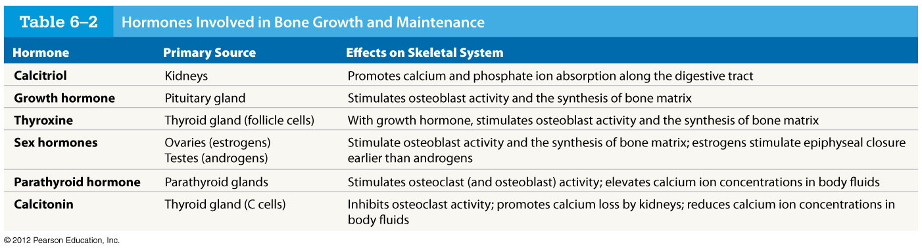
Table 6-2 Hormones Involved in Bone Growth and Maintenance

Slide 82
6-8 Calcium Homeostasis
The Skeleton as a Calcium Reserve
  Bones store calcium and other minerals
  Calcium is the most abundant mineral in the body
    Calcium ions are vital to:
      Membranes
      Neurons
      Muscle cells, especially heart cells

Slide 83
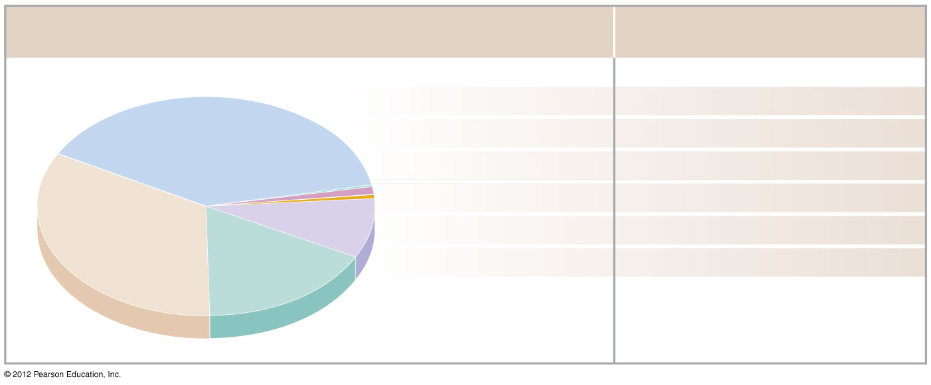
Figure 6-15 A Chemical Analysis of Bone
Composition of Bone
Bone Contains …
Calcium 39%
99% of the body’s Calcium
Potassium 0.2%
4% of the body’s Potassium
Sodium 0.7%
35% of the body’s Sodium
Organic
compounds
(mostly collagen)
33%
Magnesium 0.5%
50% of the body’s Magnesium
Carbonate 9.8%
80% of the body’s Carbonate
Phosphate 17%
99% of the body’s Phosphate
Total inorganic
components
67%

Slide 84
6-8 Calcium Homeostasis
Calcium Regulation
  Calcium ions in body fluids
    Must be closely regulated
  Homeostasis is maintained
    By calcitonin and parathyroid hormone (PTH)
    Which control storage, absorption, and excretion

Slide 85
6-8 Calcium Homeostasis
Calcitonin and Parathyroid Hormone Control
  Affect:
    Bones
      Where calcium is stored
    Digestive tract
      Where calcium is absorbed
    Kidneys
      Where calcium is excreted

Slide 86
6-8 Calcium Homeostasis
Parathyroid Hormone (PTH)
  Produced by parathyroid glands in neck
  Increases calcium ion levels by:
    Stimulating osteoclasts
    Increasing intestinal absorption of calcium
    Decreasing calcium excretion at kidneys
Calcitonin
  Secreted by C cells (parafollicular cells) in thyroid
  Decreases calcium ion levels by:
    Inhibiting osteoclast activity
    Increasing calcium excretion at kidneys

Slide 87
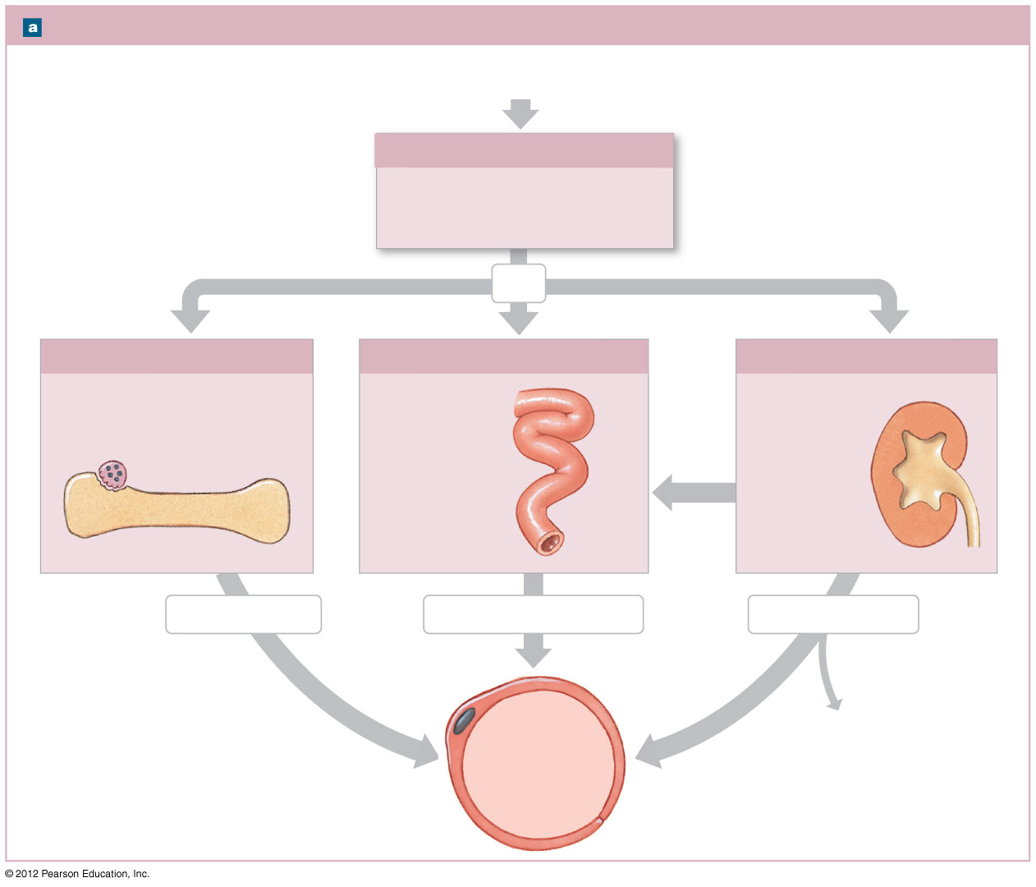
Figure 6-16a Factors That Alter the Concentration of Calcium Ions in Body Fluids
Factors That Increase Blood Calcium Levels
These responses are
triggered when plasma
calcium ion concentrations
fall below 8.5 mg/dL.
Low Calcium Ion Levels in Plasma
(below 8.5 mg/dL)
Parathyroid Gland Response
Low calcium plasma levels cause
the parathyroid glands to secrete
parathyroid hormone (PTH).
PTH
Bone Response
Intestinal Response
Kidney Response
Osteoclasts stimulated to
release stored calcium ions
from bone
Rate of
intestinal
absorption
increases
Kidneys retain
calcium ions
Osteoclast
more
Bone
calcitriol
Calcium released
Calcium absorbed quickly
Calcium conserved
↑Ca²⁺
levels in
bloodstream
Decreased calcium
loss in urine

Slide 88
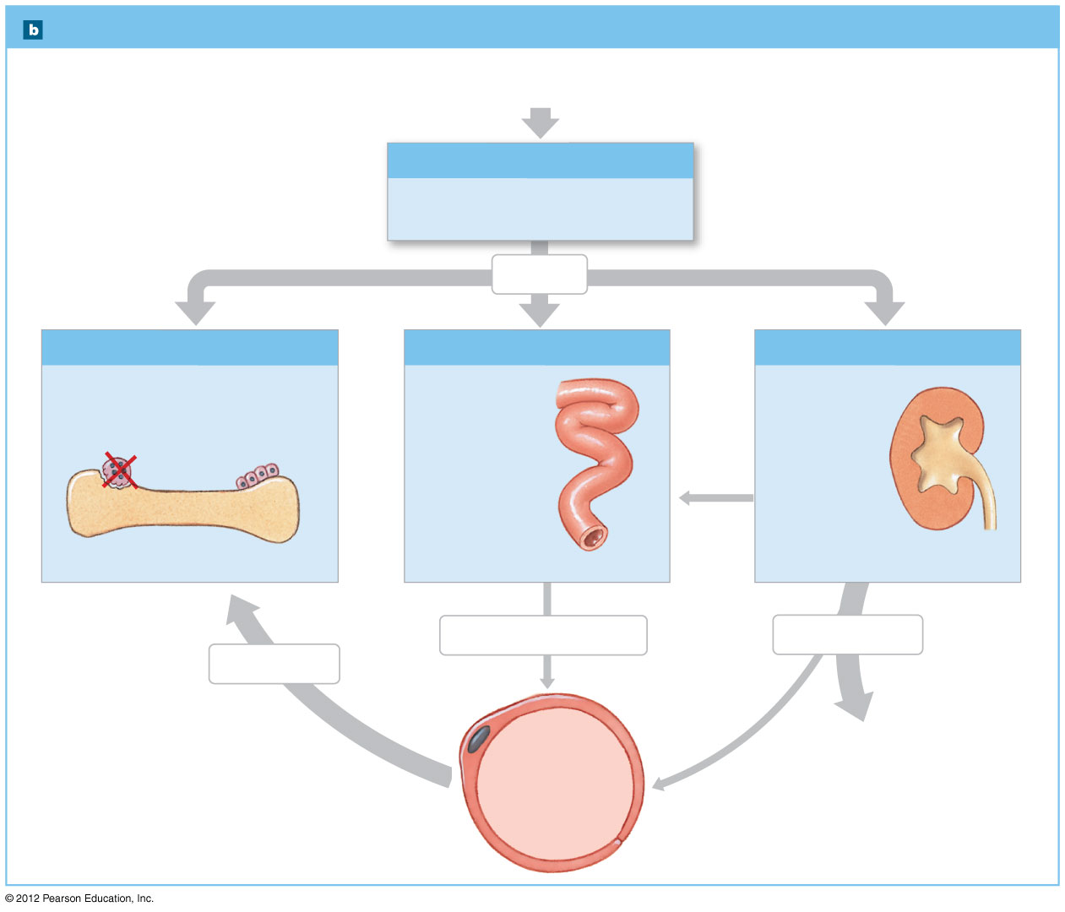
Figure 6-16b Factors That Alter the Concentration of Calcium Ions in Body Fluids
Factors That Decrease Blood Calcium Levels
These responses are
triggered when plasma
calcium ion concentrations
rise above 11 mg/dL.
HIgh Calcium Ion Levels in Plasma
(above 11 mg/dL)
Thyroid Gland Response
Parafollicular cells (C cells) in the
thryoid gland secrete calcitonin.
Calcitonin
Bone Response
Intestinal Response
Kidney Response
Osteoclasts inhibited while
osteoblasts continue to lock
calcium ions in bone matrix
Rate of intestinal
absorption
decreases
Kidneys allow
calcium loss
less
Bone
calcitriol
Calcium absorbed slowly
Calcium excreted
Calcium stored
↓Ca²⁺
levels in
bloodstream
Increased calcium
loss in urine

Slide 89
6-9 Fractures
Fractures
  Cracks or breaks in bones
  Caused by physical stress
Fractures are repaired in four steps
  Bleeding
  Cells of the endosteum and periosteum
  Osteoblasts
  Osteoblasts and osteocytes remodel the fracture for up to a year

Slide 90
6-9 Fractures
  Bleeding
    Produces a clot (fracture hematoma)
    Establishes a fibrous network
    Bone cells in the area die
  Cells of the endosteum and periosteum
    Divide and migrate into fracture zone
    Calluses stabilize the break
      External callus of cartilage and bone surrounds break
      Internal callus develops in medullary cavity

Slide 91
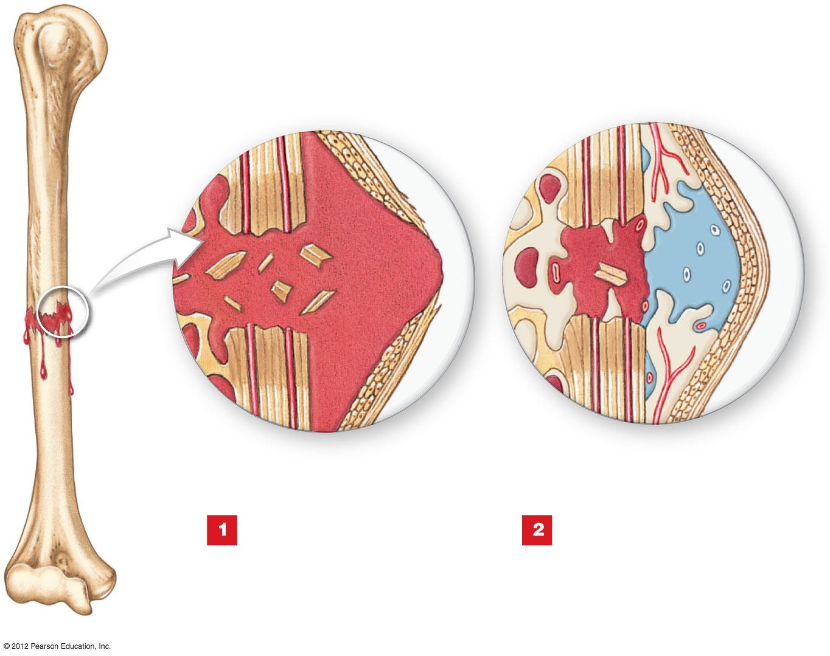
Figure 6-17 Types of Fractures and Steps in Repair
REPAIR OF A FRACTURE
Fracture
hematoma
Dead
bone
Bone
fragments
Spongy bone of
external callus
Periosteum
Immediately after the
fracture, extensive
bleeding occurs. Over a
period of several hours, a
large blood clot, or fracture
hematoma, develops.
An internal callus forms as a
network of spongy bone
unites the inner edges, and an
external callus of cartilage and bone
stabilizes the outer edges.

Slide 92
6-9 Fractures
  Osteoblasts
    Replace central cartilage of external callus
    With spongy bone
  Osteoblasts and osteocytes remodel the fracture for up to a year
    Reducing bone calluses

Slide 93
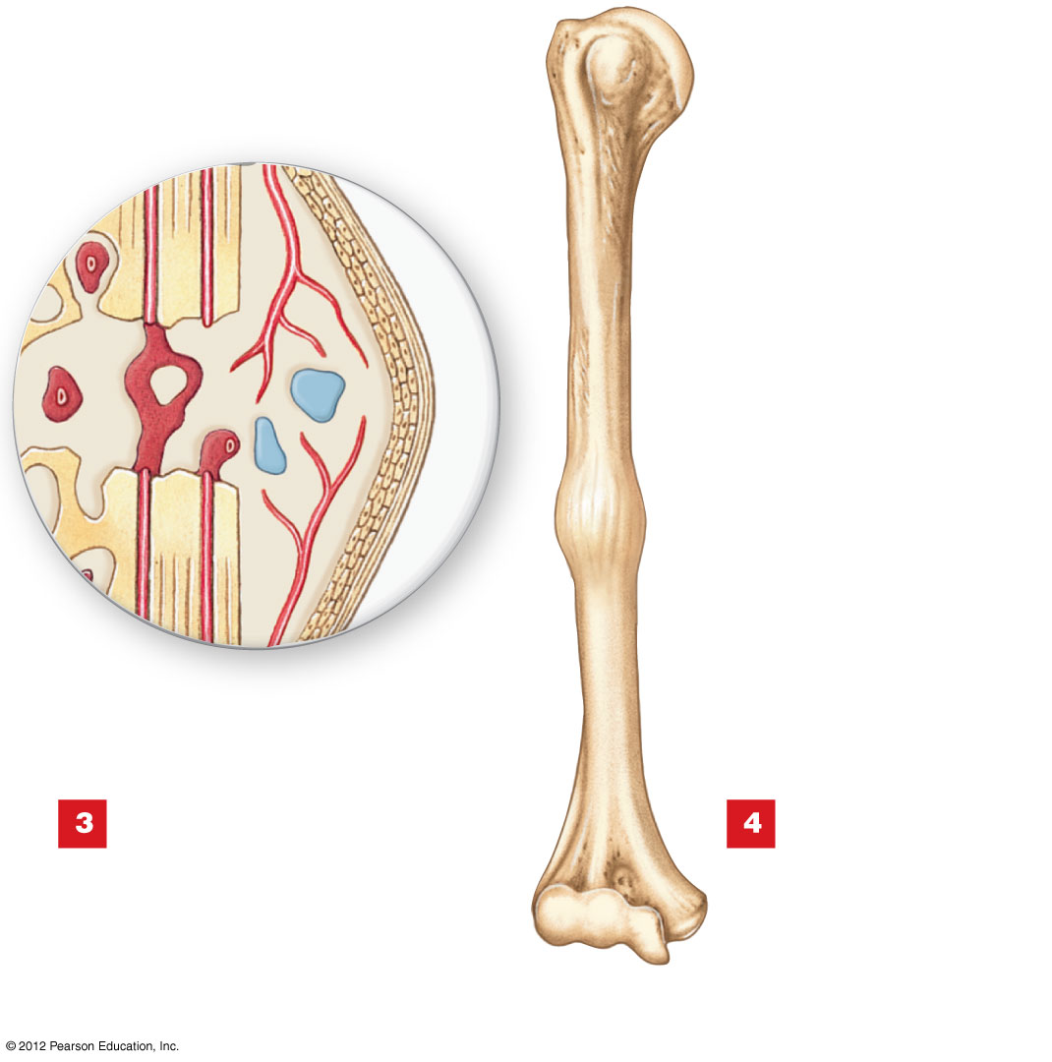
Figure 6-17 Types of Fractures and Steps in Repair
External
callus
Internal
callus
External
callus
The cartilage of the external
callus has been replaced by
bone, and struts of spongy bone now
united the broken ends. Fragments of
dead bone and the areas of bone
closest to the break have been
removed and replaced.
A swelling initially
marks the location of
the fracture. Over time, this
region will be remodeled,
and little evidence of the
fracture will remain.

Slide 94
6-10 Effects of Aging on the Skeletal System
Age-Related Changes
  Bones become thinner and weaker with age
    Osteopenia begins between ages 30 and 40
    Women lose 8% of bone mass per decade, men 3%
  The epiphyses, vertebrae, and jaws are most affected
    Resulting in fragile limbs
    Reduction in height
    Tooth loss

Slide 95
6-10 Effects of Aging on the Skeletal System
Osteoporosis
  Severe bone loss
  Affects normal function
  Over age 45, occurs in:
    29% of women
    18% of men

Slide 96
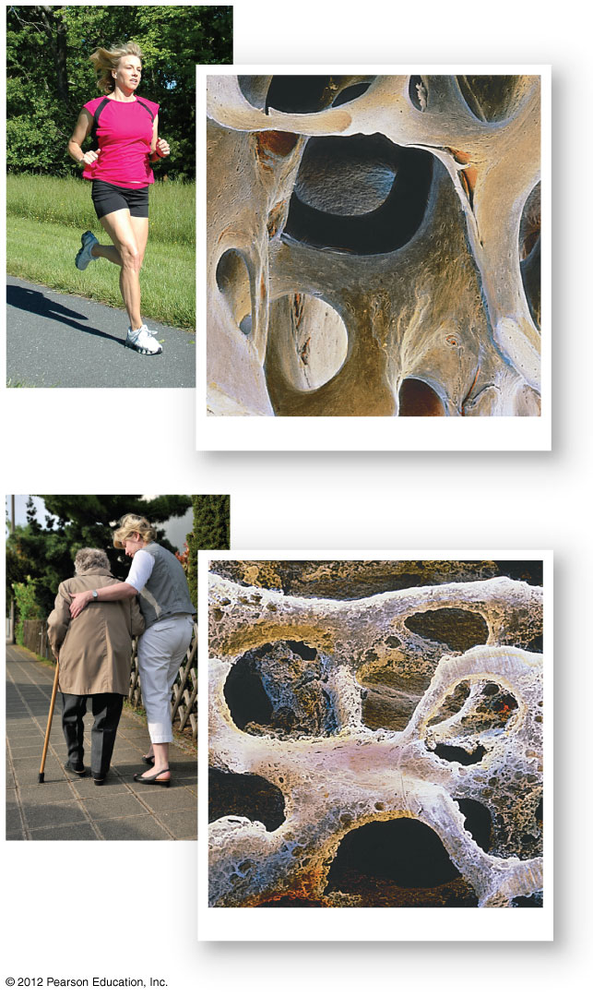
Figure 6-18 The Effects of Osteoporosis on Spongy Bone
Normal spongy bone
SEM ⋅ 25
Spongy bone in osteoporosis
SEM ⋅ 21

Slide 97
6-10 Effects of Aging on the Skeletal System
Hormones and Bone Loss
  Estrogens and androgens help maintain bone mass
  Bone loss in women accelerates after menopause
Cancer and Bone Loss
  Cancerous tissues release osteoclast-activating factor
    That stimulates osteoclasts
    And produces severe osteoporosis

