Slide 1
AN INTRODUCTION TO SKELETAL SYSTEM
PREPARED BY :MADAM RUTH

Slide 2
An Introduction to the Skeletal System
Learning Outcomes
6-1 Describe the primary functions of the skeletal system.
6-2 Classify bones according to shape and internal organization, giving examples of each type, and explain the functional significance of each of the major types of bone markings.
6-3 Identify the cell types in bone, and list their major functions.

Slide 3
An Introduction to the Skeletal System
Learning Outcomes
6-4 Compare the structures and functions of compact bone and spongy bone.
6-5 Compare the mechanisms of endochondral ossification and intramembranous ossification.
6-6 Describe the remodeling and homeostatic mechanisms of the skeletal system.
6-7 Discuss the effects of exercise, hormones, and nutrition on bone development and on the skeletal system.

Slide 4
An Introduction to the Skeletal System
Learning Outcomes
6-8 Explain the role of calcium as it relates to the skeletal system.
6-9 Describe the types of fractures, and explain how fractures heal.
6-10 Summarize the effects of the aging process on the skeletal system.

Slide 5
An Introduction to the Skeletal System
The Skeletal System
Includes:
Bones of the skeleton
Cartilages, ligaments, and connective tissues

Slide 6
6-1 Functions of the Skeletal System
Five Primary Functions of the Skeletal System
Support
Storage of Minerals (calcium) and Lipids (yellow marrow)
Blood Cell Production (red marrow)
Protection
Leverage (force of motion)

Slide 7
6-2 Classification of Bones
Bones
Are classified by:
Shape
Internal tissue organization
Bone markings (surface features; marks)

Slide 8
6-2 Classification of Bones
Six Bone Shapes
Sutural bones
Irregular bones
Short bones
Flat bones
Long bones
Sesamoid bones

Slide 9
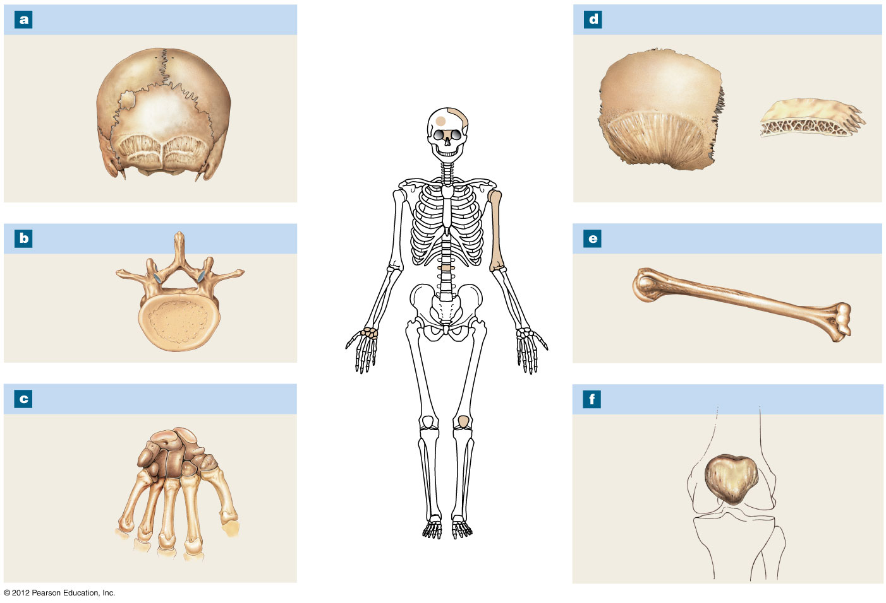
Figure 6-1 A Classification of Bones by Shape
Sutural Bones
Flat Bones
Sutures
Parietal bone
External table
Sutural
bone
Internal
table
Diploë
(spongy
bone)
Irregular Bones
Long Bones
Vertebra
Humerus
Short Bones
Sesamoid Bones
Carpal
bones
Patella

Slide 10
6-2 Classification of Bones
Sutural Bones
Small, irregular bones
Found between the flat bones of the skull
Irregular Bones
Have complex shapes
Examples: spinal vertebrae, pelvic bones

Slide 11
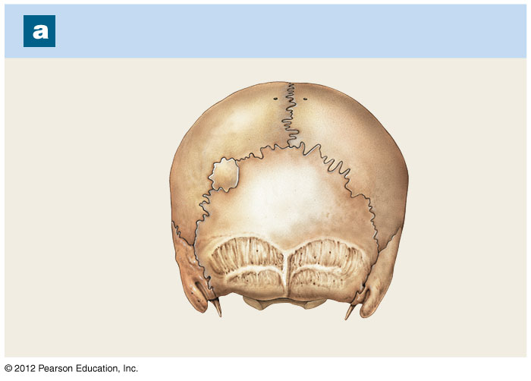
Figure 6-1a A Classification of Bones by Shape
Sutural Bones
Sutures
Sutural
bone

Slide 12
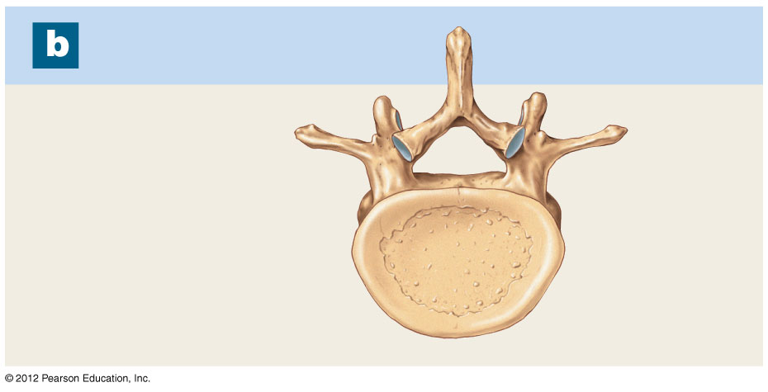
Figure 6-1b A Classification of Bones by Shape
Irregular Bones
Vertebra

Slide 13
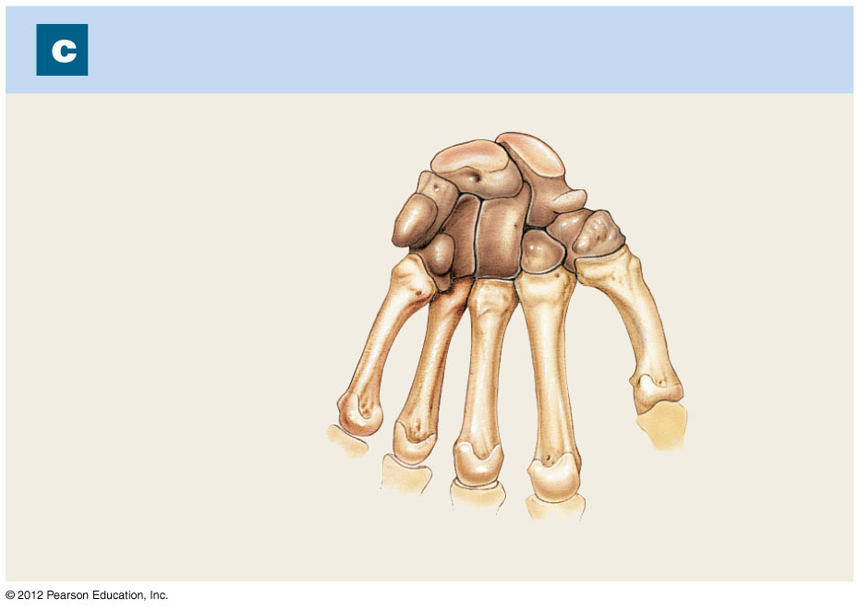
Figure 6-1c A Classification of Bones by Shape
Short Bones
Carpal
bones

Slide 14
6-2 Classification of Bones
Short Bones
Small and thick
Examples: ankle and wrist bones
Flat Bones
Thin with parallel surfaces
Found in the skull, sternum, ribs, and scapulae

Slide 15
6-2 Classification of Bones
Long Bones
Long and thin
Found in arms, legs, hands, feet, fingers, and toes
Sesamoid Bones
Small and flat
Develop inside tendons near joints of knees, hands, and feet

Slide 16
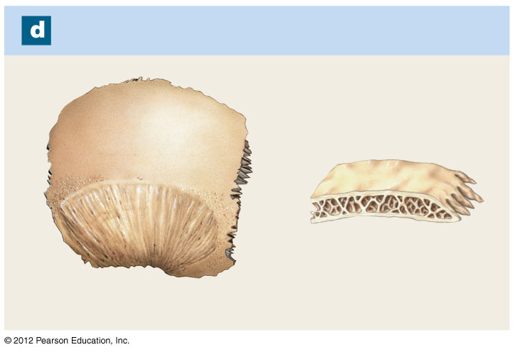
Figure 6-1d A Classification of Bones by Shape
Flat Bones
Parietal bone
External table
Internal
table
Diploë
(spongy
bone)

Slide 17
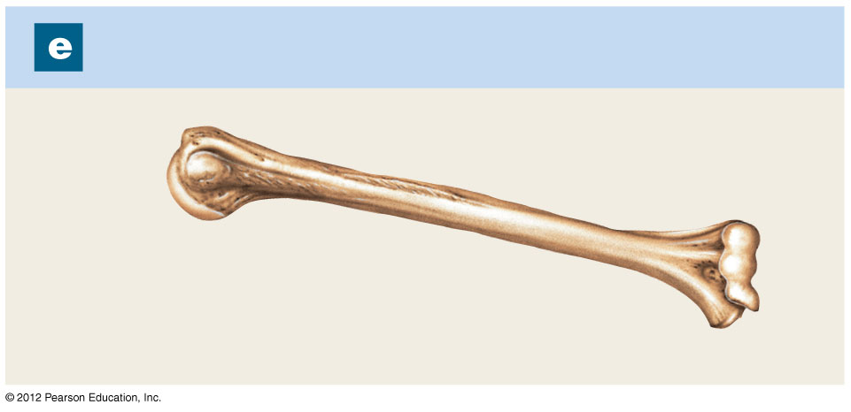
Figure 6-1e A Classification of Bones by Shape
Long Bones
Humerus

Slide 18
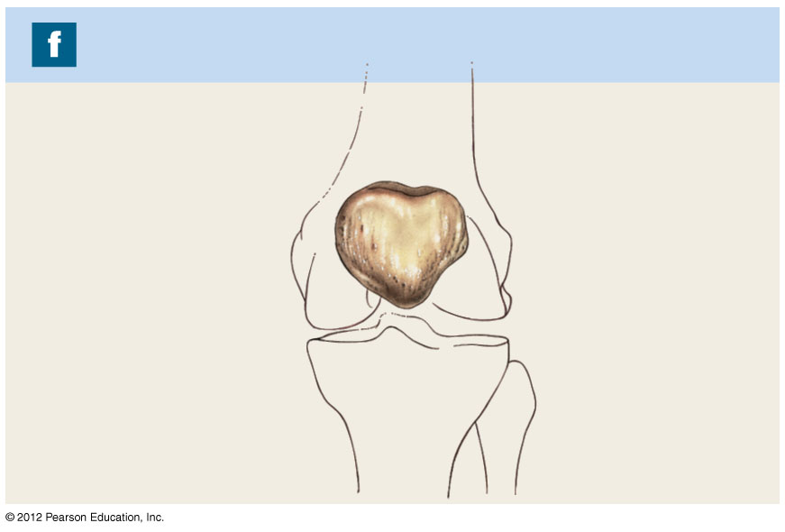
Figure 6-1f A Classification of Bones by Shape
Sesamoid Bones
Patella

Slide 19
6-2 Classification of Bones
Bone Markings
Depressions or grooves
Along bone surface
Elevations or projections
Where tendons and ligaments attach
At articulations with other bones
Tunnels
Where blood and nerves enter bone

Slide 20
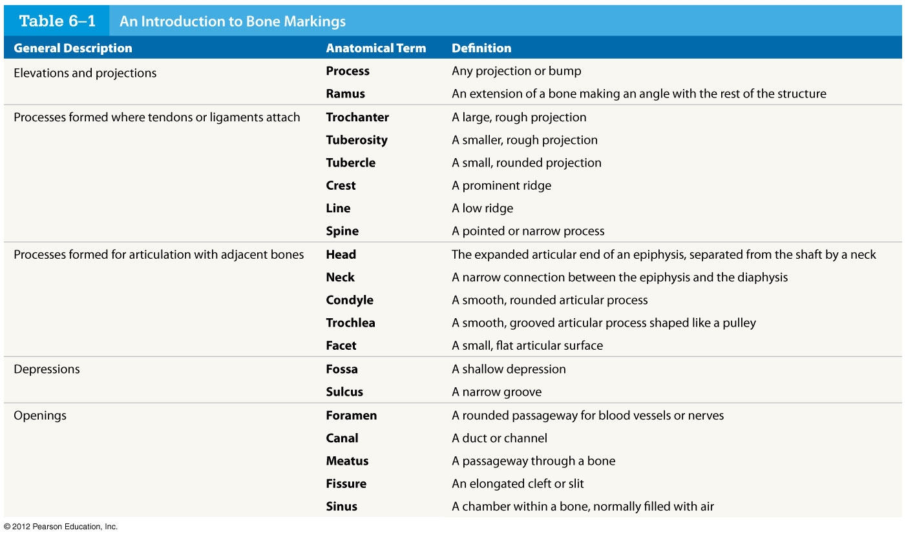
Table 6-1 An Introduction to Bone Markings
© 2012 Pearson Education, Inc.

Slide 21
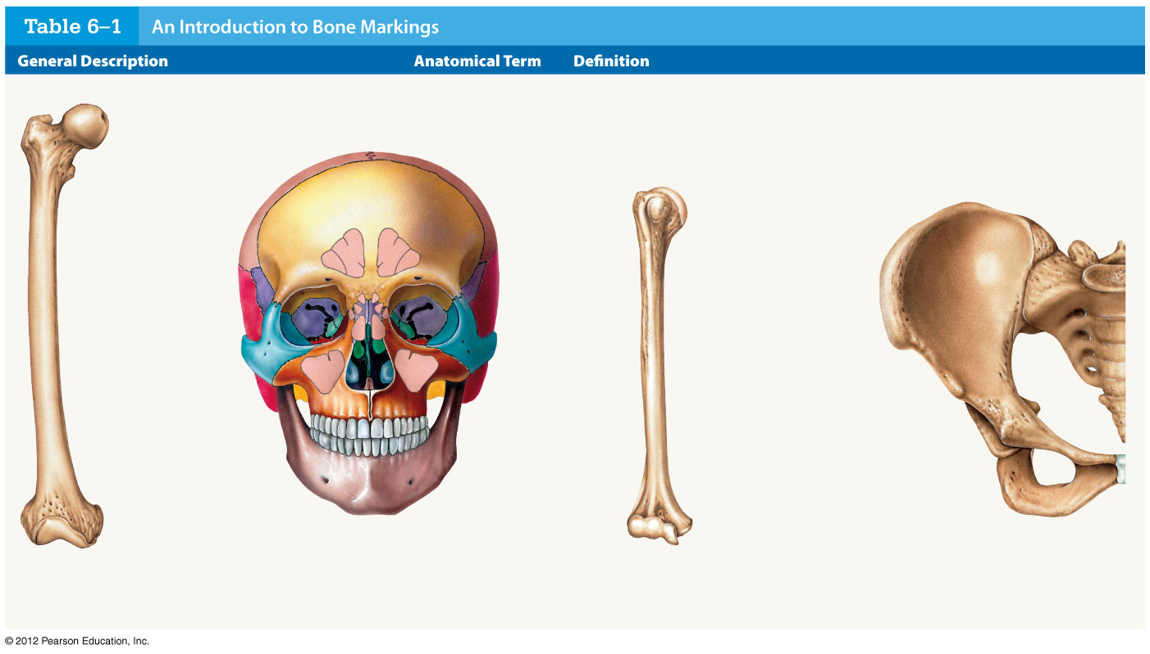
Table 6-1 An Introduction to Bone Markings
Trochanter
Sinus
Head
Neck
Tubercle
Head
Crest
Sulcus
Neck
Foramen
Fossa
Fissure
Process
Tuberosity
Spine
Ramus
Line
Facet
Fossa
Foramen
Tubercle
Trochlea
Ramus
Skull
Pelvis
Condyle
Condyle
Femur
Humerus

Slide 22
6-2 Classification of Bones
Structure of a Long Bone
Diaphysis
The shaft
A heavy wall of compact bone, or dense bone
A central space called medullary (marrow) cavity
Epiphysis
Wide part at each end
Articulation with other bones
Mostly spongy (cancellous) bone
Covered with compact bone (cortex)
Metaphysis
Where diaphysis and epiphysis meet

Slide 23
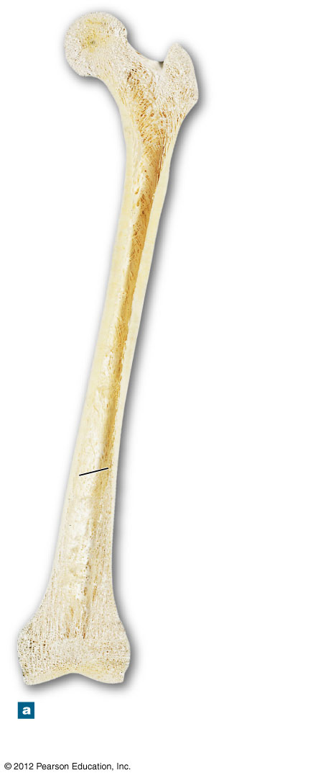
Figure 6-2a Bone Structure
Spongy
bone
Epiphysis
Metaphysis
Compact
bone
Diaphysis
(shaft)
Medullary
cavity
Metaphysis
Epiphysis
The structure of a representative
long bone (the femur) in
longitudinal section

Slide 24
6-2 Classification of Bones
Structure of a Flat Bone
The parietal bone of the skull
Resembles a sandwich of spongy bone
Between two layers of compact bone
Within the cranium, the layer of spongy bone between the compact bone is called the diploë

Slide 25
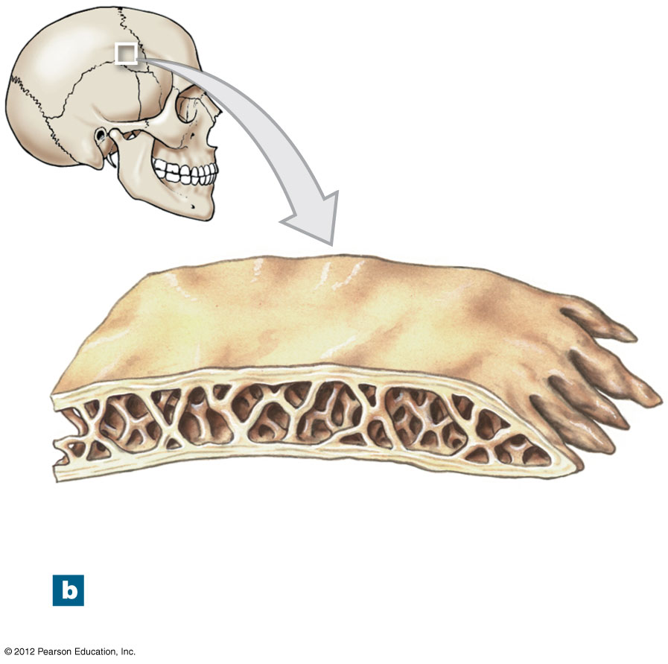
Figure 6-2b Bone Structure
Cortex
(compact bone)
Diploë
(spongy bone)
The structure of a flat bone
(the parietal bone)

Slide 26
6-3 Bone (Osseous) Tissue
Bone (Osseous) Tissue
Dense, supportive connective tissue
Contains specialized cells
Produces solid matrix of calcium salt deposits
Around collagen fibers

Slide 27
6-3 Bone (Osseous) Tissue
Characteristics of Bone Tissue
Dense matrix, containing:
Deposits of calcium salts
Osteocytes (bone cells) within lacunae organized around blood vessels
Canaliculi
Form pathways for blood vessels
Exchange nutrients and wastes

Slide 28
6-3 Bone (Osseous) Tissue
Characteristics of Bone Tissue
Periosteum
Covers outer surfaces of bones
Consists of outer fibrous and inner cellular layers

Slide 29
6-3 Bone (Osseous) Tissue
Bone Matrix
Minerals
Two thirds of bone matrix is calcium phosphate, Ca₃(PO₄)₂
Reacts with calcium hydroxide, Ca(OH)₂
To form crystals of hydroxyapatite, Ca₁₀(PO₄)₆(OH)₂
Which incorporates other calcium salts and ions

Slide 30
6-3 Bone (Osseous) Tissue
Bone Matrix
Matrix Proteins
One third of bone matrix is protein fibers (collagen)

Slide 31
6-3 Bone (Osseous) Tissue
Bone Cells
Make up only 2% of bone mass
Bone contains four types of cells
Osteocytes
Osteoblasts
Osteoprogenitor cells
Osteoclasts

Slide 32
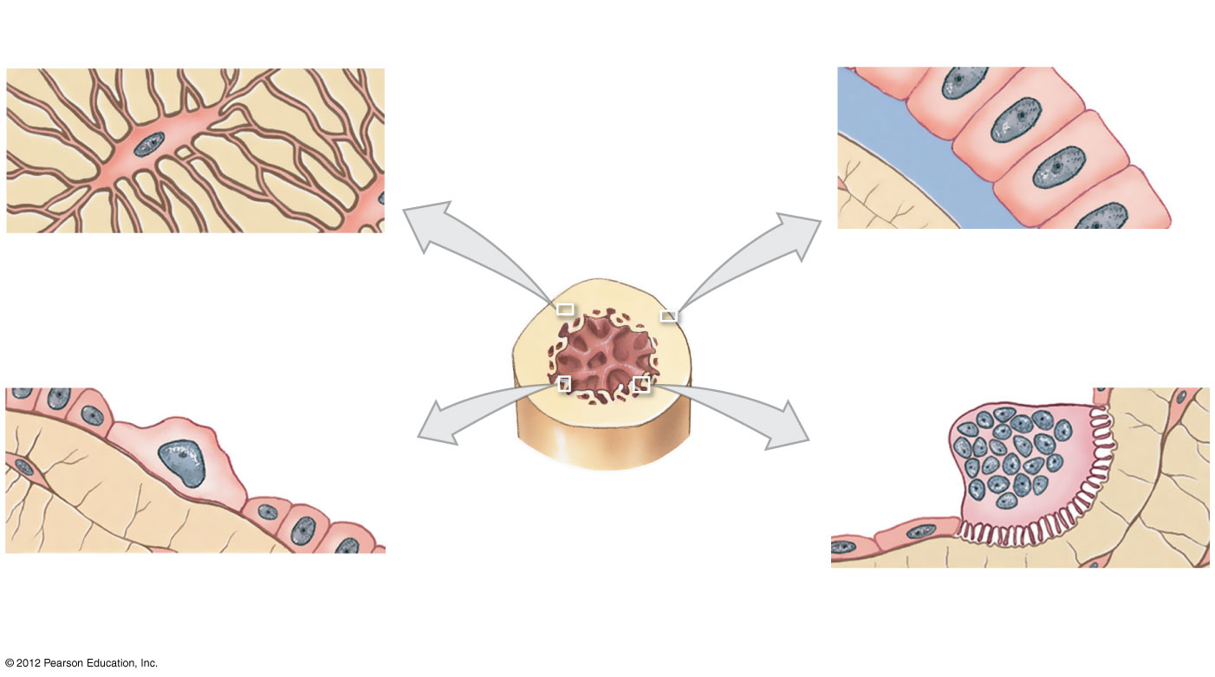
Figure 6-3 Types of Bone Cells
Canaliculi
Osteocyte
Matrix
Matrix
Osteoid
Osteoblast
Osteocyte: Mature bone cell
that maintains the bone matrix
Osteoblast: Immature bone
cell that secretes organic
components of matrix
Osteoprogenitor cell
Osteoclast
Matrix
Medullary
cavity
Medullary
cavity
Endosteum
Osteoprogenitor cell: Stem cell
whose divisions produce osteoblasts
Osteoclast: Multinucleate cell
that secretes acids and enzymes
to dissolve bone matrix

Slide 33
6-3 Bone (Osseous) Tissue
Osteocytes
Mature bone cells that maintain the bone matrix
Live in lacunae
Are between layers (lamellae) of matrix
Connect by cytoplasmic extensions through canaliculi in lamellae
Do not divide
Two major functions of osteocytes
To maintain protein and mineral content of matrix
To help repair damaged bone

Slide 34
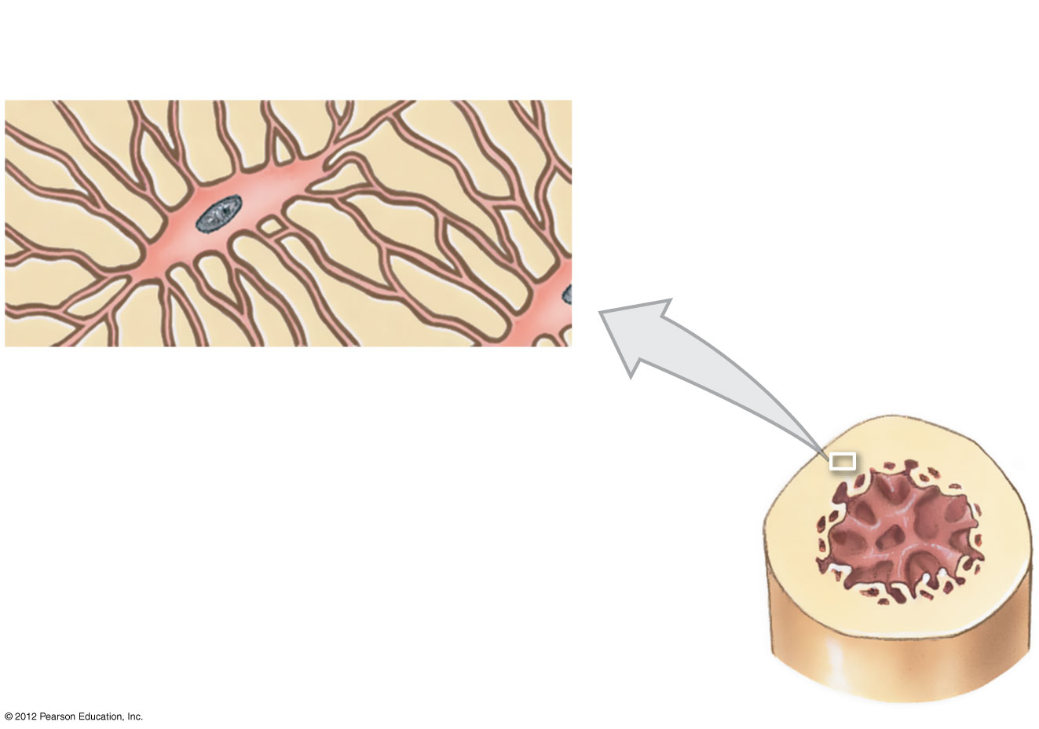
Figure 6-3 Types of Bone Cells
Canaliculi
Osteocyte
Matrix
Osteocyte: Mature bone cell
that maintains the bone matrix

Slide 35
6-3 Bone (Osseous) Tissue
Osteoblasts
Immature bone cells that secrete matrix compounds (osteogenesis)
Osteoid — matrix produced by osteoblasts, but not yet calcified to form bone
Osteoblasts surrounded by bone become osteocytes

Slide 36
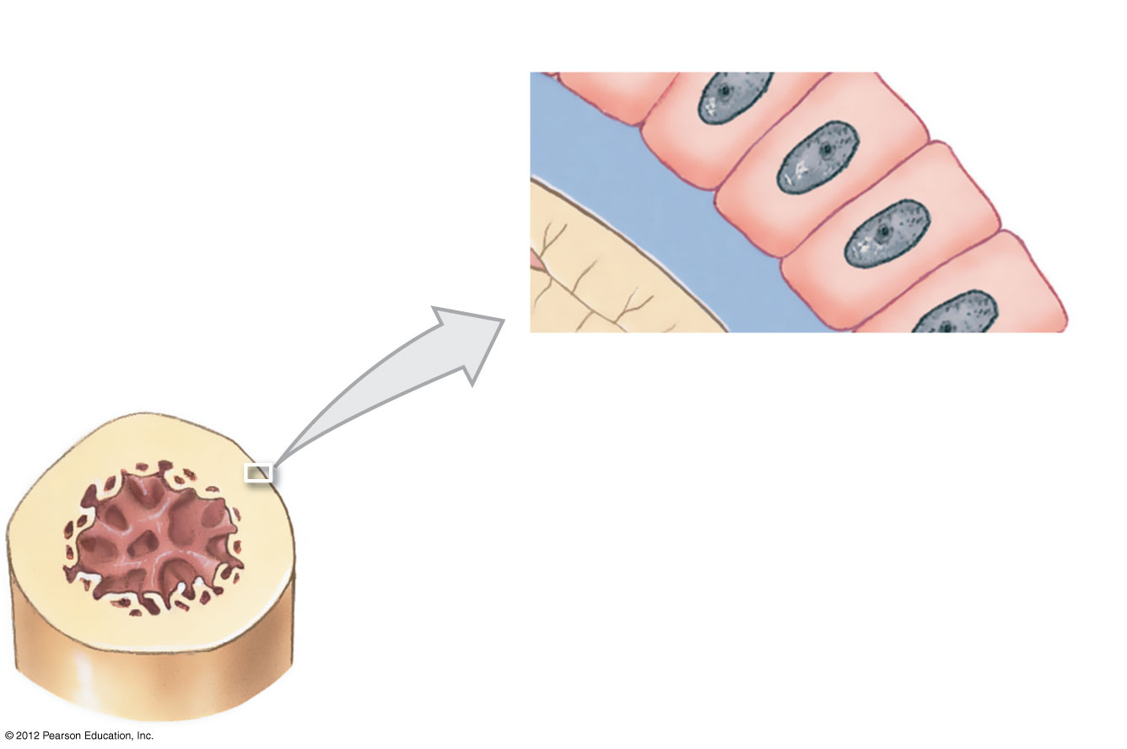
Figure 6-3 Types of Bone Cells
Matrix
Osteoid
Osteoblast
Osteoblast: Immature bone
cell that secretes organic
components of matrix

Slide 37
6-3 Bone (Osseous) Tissue
Osteoprogenitor Cells
Mesenchymal stem cells that divide to produce osteoblasts
Located in endosteum, the inner cellular layer of periosteum
Assist in fracture repair

Slide 38
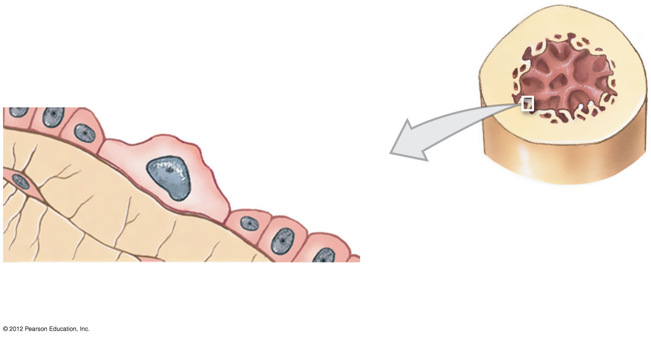
Figure 6-3 Types of Bone Cells
Osteoprogenitor cell
Medullary
cavity
Endosteum
Osteoprogenitor cell: Stem cell
whose divisions produce osteoblasts

Slide 39
6-3 Bone (Osseous) Tissue
Osteoclasts
Secrete acids and protein-digesting enzymes
Giant, multinucleate cells
Dissolve bone matrix and release stored minerals (osteolysis)
Derived from stem cells that produce macrophages

Slide 40
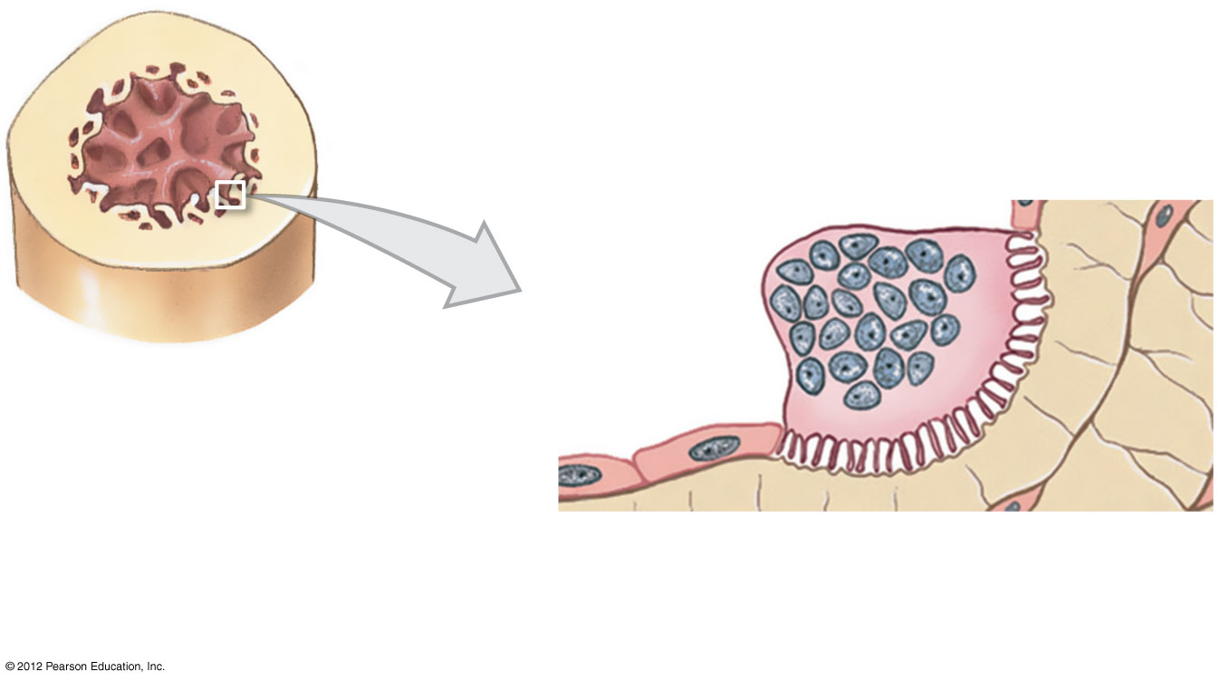
Figure 6-3 Types of Bone Cells
Osteoclast
Matrix
Medullary
cavity
Osteoclast: Multinucleate cell
that secretes acids and enzymes
to dissolve bone matrix

Slide 41
6-3 Bone (Osseous) Tissue
Homeostasis
Bone building (by osteoblasts) and bone recycling (by osteoclasts) must balance
More breakdown than building, bones become weak
Exercise, particularly weight-bearing exercise, causes osteoblasts to build bone

Slide 42
6-4 Compact Bone and Spongy Bone
The Structure of Compact Bone
Osteon is the basic unit
Osteocytes are arranged in concentric lamellae
Around a central canal containing blood vessels
Perforating canals
Perpendicular to the central canal
Carry blood vessels into bone and marrow

Slide 43
6-4 Compact Bone and Spongy Bone
The Structure of Compact Bone
Circumferential Lamellae
Lamellae wrapped around the long bone
Bind osteons together

Slide 44
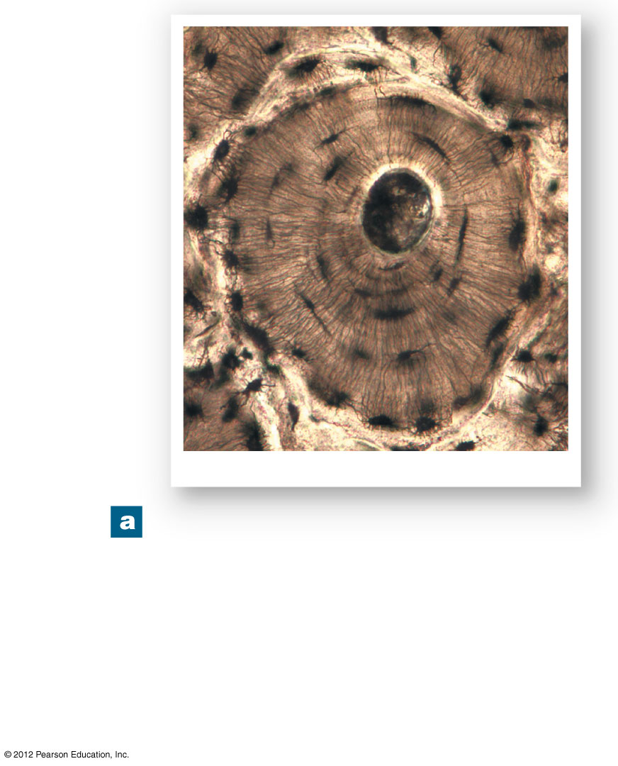
Figure 6-4a The Histology of Compact Bone
Canaliculi
Concentric
lamellae
Central canal
Osteon
Lacunae
Osteon
LM ⋅ 343
A thin section through compact
bone. By this procedure the
intact matrix making up the
lamellae appear white, and the
central canal, lacunae, and
canaliculi appear black due to
the presence of bone dust.

Slide 45
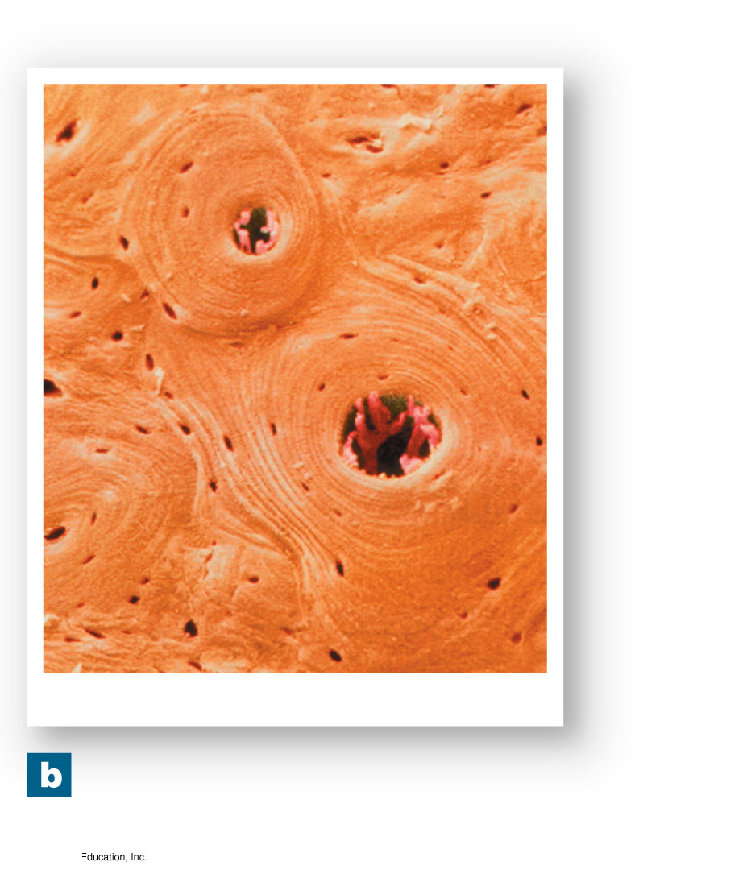
Figure 6-4b The Histology of Compact Bone
Osteon
Lacunae
Central
canals
Lamellae
Osteons
SEM ⋅ 182
Several osteons in
compact bone.

Slide 46
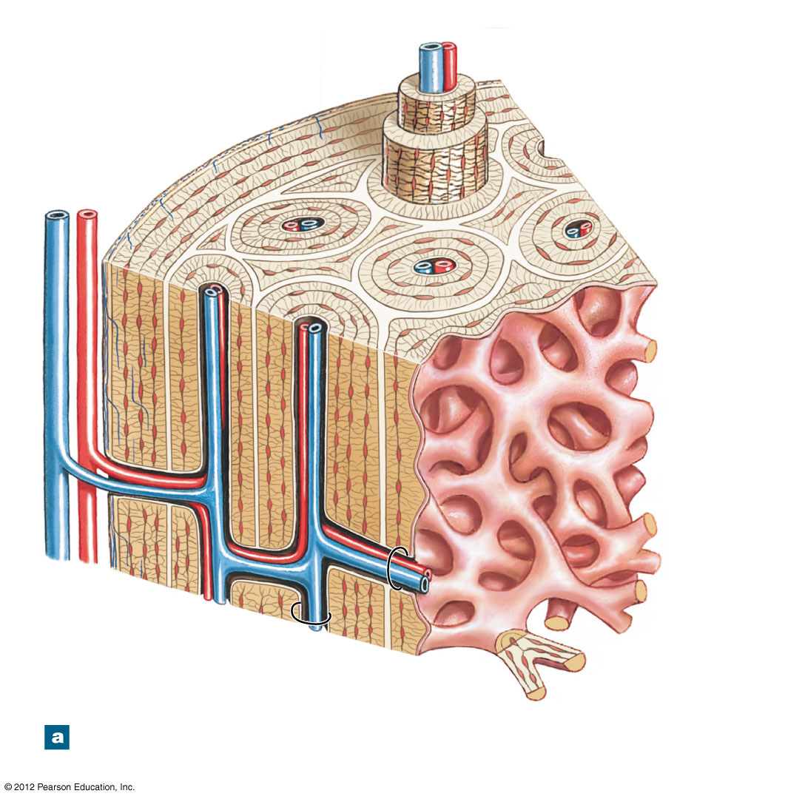
Figure 6-5a The Structure of Compact Bone
Venule
Circumferential
lamellae
Capillary
Periosteum
Osteons
Perforating
fibers
Interstitial
lamellae
Concentric
lamellae
Trabeculae of
spongy bone
(see Fig.6–6)
Vein
Artery
Arteriole
Central
canal
Perforating
canal
The organization of osteons and
lamellae in compact bone

Slide 47
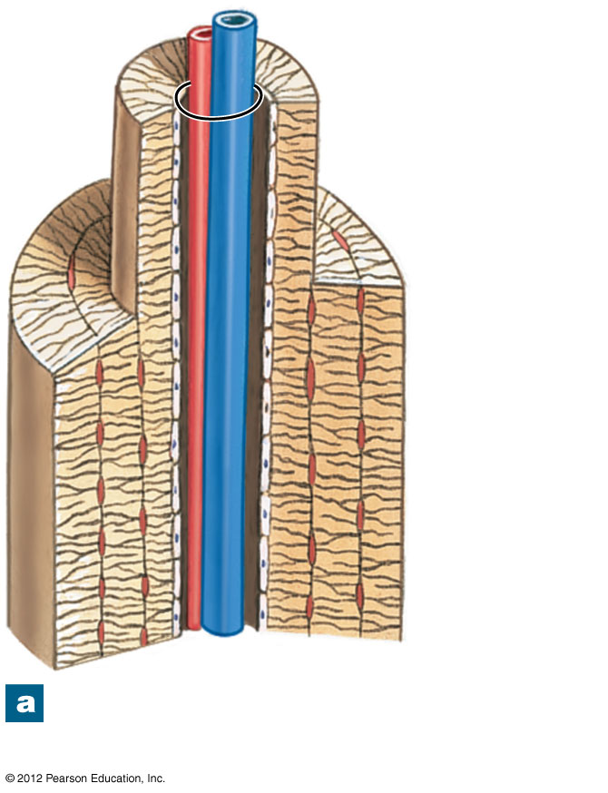
Figure 6-5a The Structure of Compact Bone
Central
canal
Concentric
lamellae
Endosteum
The organization of osteons and
lamellae in compact bone

Slide 48
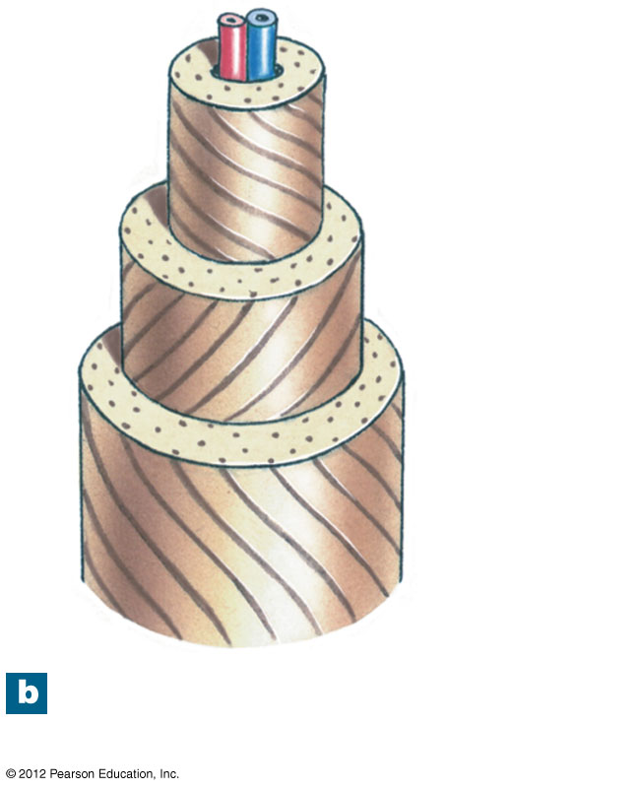
Figure 6-5b The Structure of Compact Bone
Collagen
fiber
orientation
The orientation of collagen
fibers in adjacent lamellae

Slide 49
6-4 Compact Bone and Spongy Bone
The Structure of Spongy Bone
Does not have osteons
The matrix forms an open network of trabeculae
Trabeculae have no blood vessels
The space between trabeculae is filled with red bone marrow
Which has blood vessels
Forms red blood cells
And supplies nutrients to osteocytes
Yellow bone marrow
In some bones, spongy bone holds yellow bone marrow
Is yellow because it stores fat

Slide 50
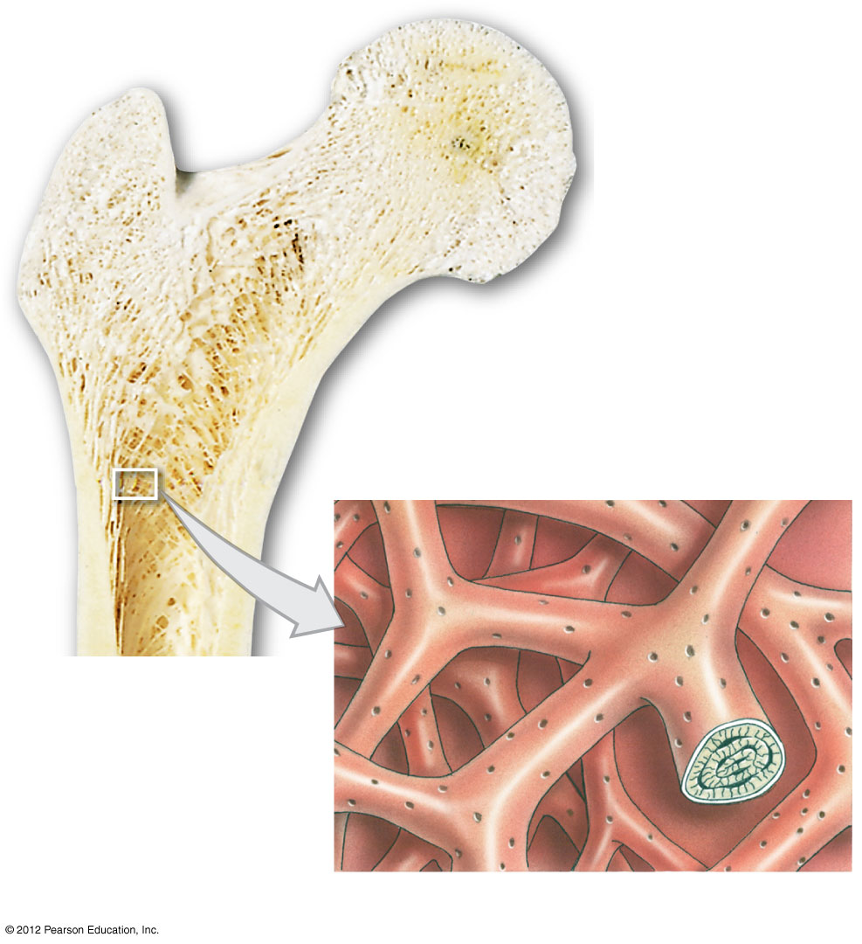
Figure 6-6 The Structure of Spongy Bone
Trabeculae of
spongy bone
Canaliculi opening
on surface
Endosteum
Lamellae

Slide 51
6-4 Compact Bone and Spongy Bone
Weight-Bearing Bones
The femur transfers weight from hip joint to knee joint
Causing tension on the lateral side of the shaft
And compression on the medial side

Slide 52
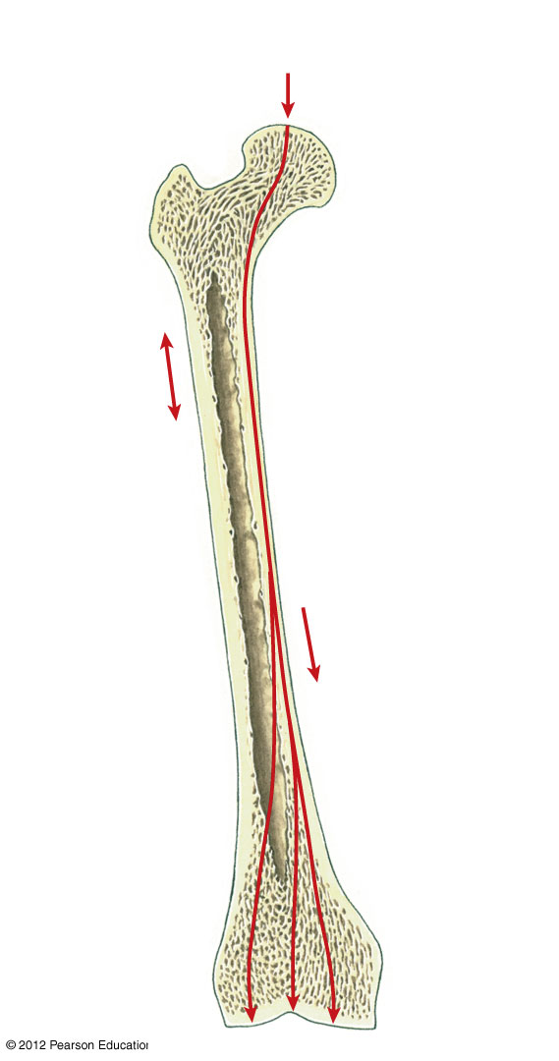
Figure 6-7 The Distribution of Forces on a Long Bone
Body weight
(applied force)
Tension
on lateral
side of
shaft
Compression
on medial side
of shaft

Slide 53
6-4 Compact Bone and Spongy Bone
Compact Bone is Covered with a Membrane
Periosteum on the outside
Covers all bones except parts enclosed in joint capsules
Made up of an outer, fibrous layer and an inner, cellular layer
Perforating fibers: collagen fibers of the periosteum
Connect with collagen fibers in bone
And with fibers of joint capsules; attach tendons, and ligaments

Slide 54
6-4 Compact Bone and Spongy Bone
Functions of Periosteum
Isolates bone from surrounding tissues
Provides a route for circulatory and nervous supply
Participates in bone growth and repair

Slide 55
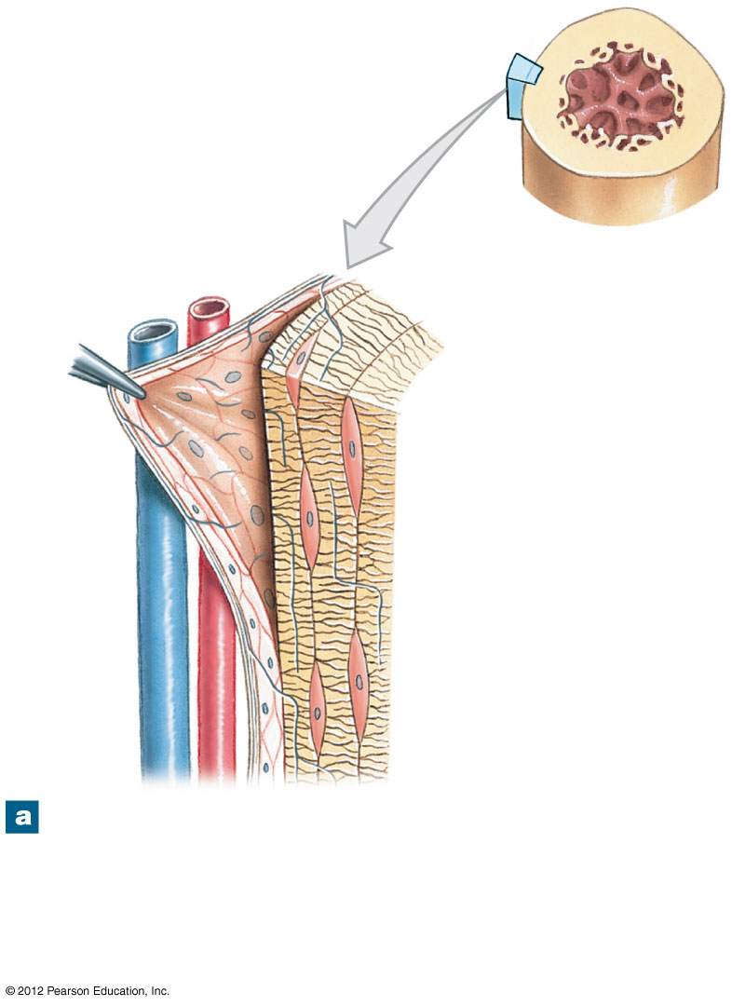
Figure 6-8a The Periosteum and Endosteum
Circumferential
lamellae
Fibrous layer
of periosteum
Cellular layer
of periosteum
Canaliculi
Osteocyte
in lacuna
Perforating
fibers
The periosteum contains outer (fibrous) and
inner (cellular) layers. Collagen fibers of the
periosteum are continuous with those of the
bone, adjacent joint capsules, and attached
tendons and ligaments.

Slide 56
6-4 Compact Bone and Spongy Bone
Compact Bone is Covered with a Membrane
Endosteum on the inside
An incomplete cellular layer:
Lines the medullary (marrow) cavity
Covers trabeculae of spongy bone
Lines central canals
Contains osteoblasts, osteoprogenitor cells, and osteoclasts
Active in bone growth and repair

Slide 57
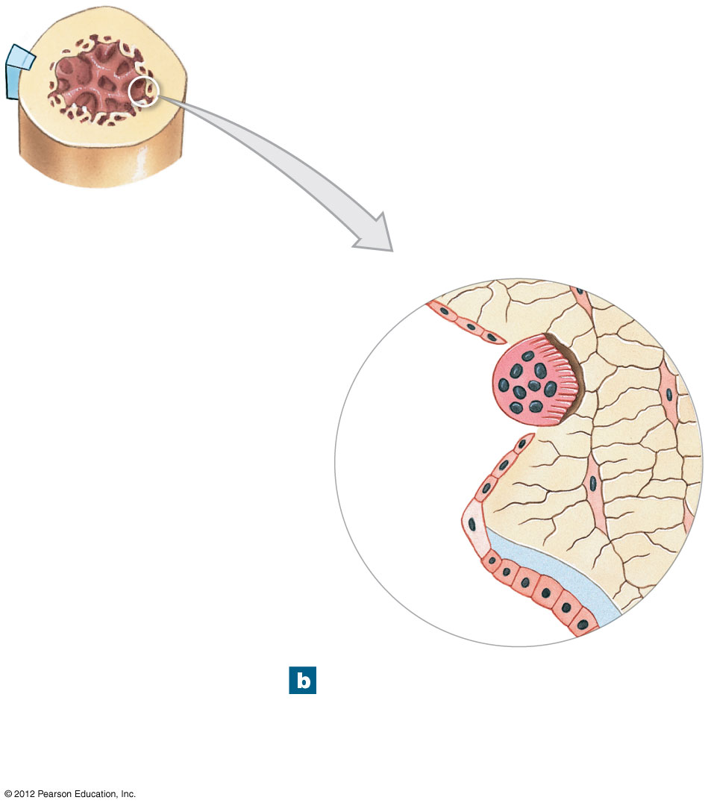
Figure 6-8b The Periosteum and Endosteum
Endosteum
Osteoclast
Bone matrix
Osteocyte
Osteoprogenitor
cell
Osteoid
Osteoblast
The endosteum is an incomplete
cellular layer containing
osteoblasts, osteoprogenitor
cells, and osteoclasts.

Slide 58
6-5 Bone Formation and Growth
Bone Development
Human bones grow until about age 25
Osteogenesis
Bone formation
Ossification
The process of replacing other tissues with bone

Slide 59
6-5 Bone Formation and Growth
Bone Development
Calcification
The process of depositing calcium salts
Occurs during bone ossification and in other tissues
Ossification
Two main forms of ossification
Endochondral ossification
Intramembranous ossification

Slide 60
6-5 Bone Formation and Growth
Endochondral Ossification
Ossifies bones that originate as hyaline cartilage
Most bones originate as hyaline cartilage
There are six main steps in endochondral ossification

Slide 61
6-5 Bone Formation and Growth
Appositional Growth
Compact bone thickens and strengthens long bone with layers of circumferential lamellae
ANIMATION Endochondral Ossification

Slide 62
6-5 Bone Formation and Growth
Epiphyseal Lines
When long bone stops growing, after puberty:
Epiphyseal cartilage disappears
Is visible on X-rays as an epiphyseal line
Mature Bones
As long bone matures:
Osteoclasts enlarge medullary (marrow) cavity
Osteons form around blood vessels in compact bone

Slide 63
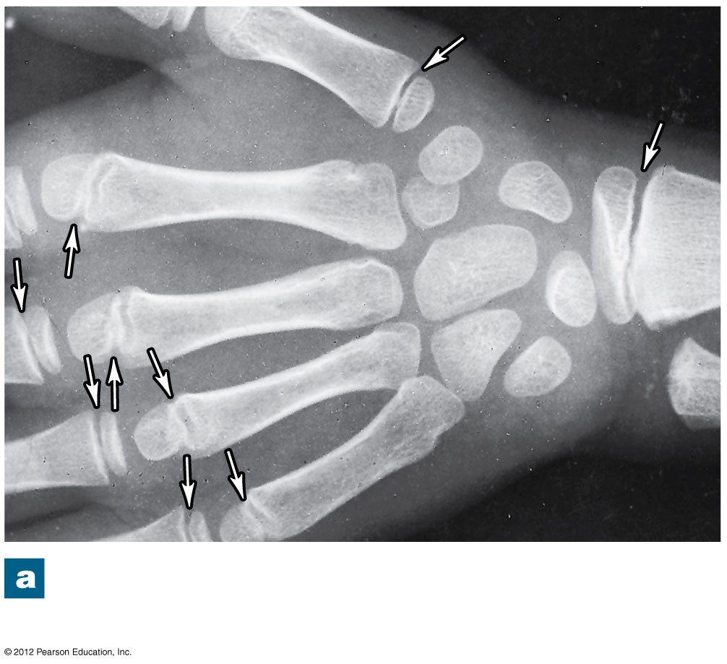
Figure 6-11a Bone Growth at an Epiphyseal Cartilage
An x-ray of growing epiphyseal
cartilages (arrows)

Slide 64
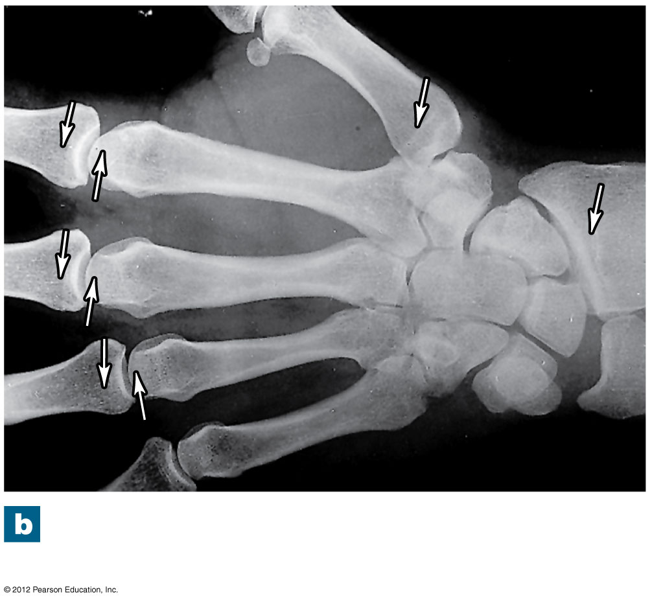
Figure 6-11b Bone Growth at an Epiphyseal Cartilage
Epiphyseal lines in an
adult (arrows)

Slide 65
6-5 Bone Formation and Growth
Intramembranous Ossification
Also called dermal ossification
Because it occurs in the dermis
Produces dermal bones such as mandible (lower jaw) and clavicle (collarbone)
There are three main steps in intramembranous ossification

Slide 66
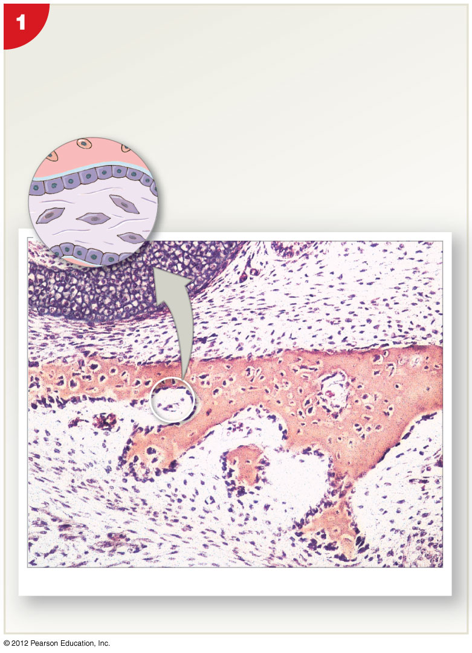
Figure 6-12 Intramembranous Ossification
Mesenchymal cells aggregate, differentiate into
osteoblasts, and begin the ossification process.
The bone expands as a series of spicules that
spread into surrounding tissues.
Osteocyte in lacuna
Bone matrix
Osteoblast
Osteoid
Embryonic connective tissue
Blood
vessel
Mesenchymal cell
LM ⋅ 22
Blood vessel
Osteoblasts
Spicules

Slide 67
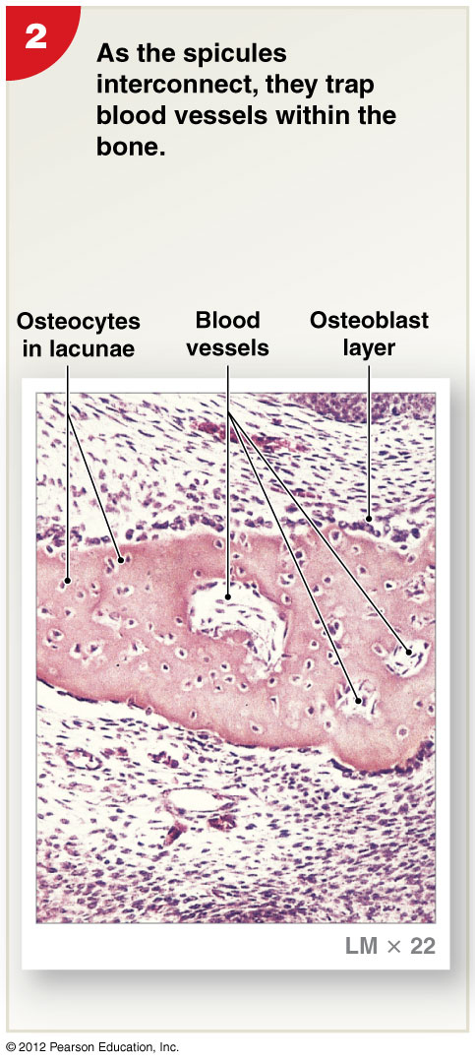
Figure 6-12 Intramembranous Ossification

Slide 68
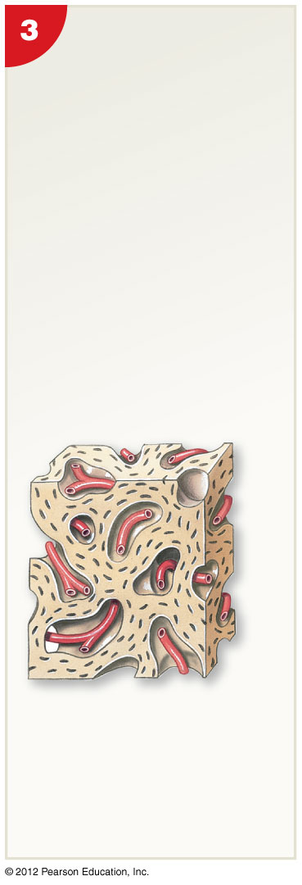
Figure 6-12 Intramembranous Ossification
Over time, the bone
assumes the
structure of spongy
bone. Areas of
spongy bone may
later be removed,
creating medullary
cavities. Through
remodeling, spongy
bone formed in this
way can be converted
to compact bone.
Blood vessel

Slide 69
6-5 Bone Formation and Growth
Blood Supply of Mature Bones
Nutrient Artery and Vein
A single pair of large blood vessels
Enter the diaphysis through the nutrient foramen
Femur has more than one pair
Metaphyseal Vessels
Supply the epiphyseal cartilage
Where bone growth occurs
Periosteal Vessels
Blood to superficial osteons
Secondary ossification centers

Slide 70
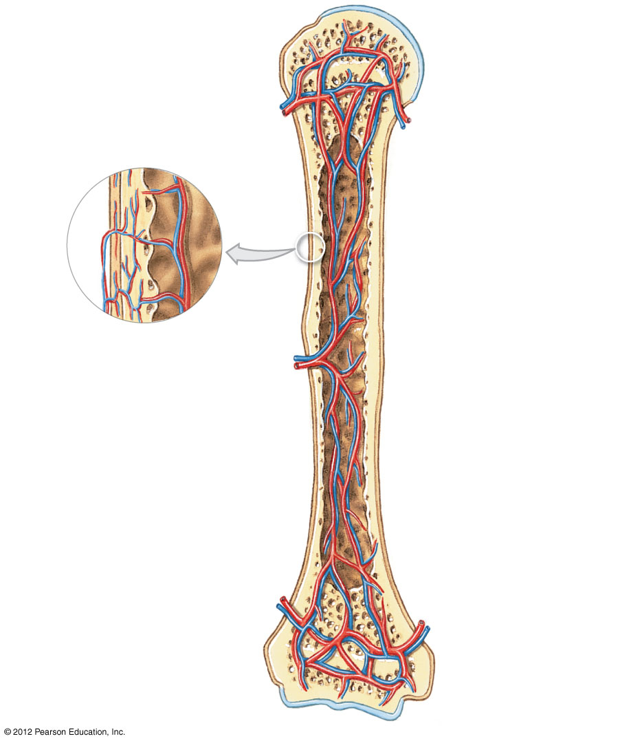
Figure 6-13 The Blood Supply to a Mature Bone
Articular cartilage
Branches of
nutrient artery
and vein
Epiphyseal artery
and vein
Metaphyseal
artery and
vein
Periosteum
Periosteum
Compact
bone
Periosteal
arteries and
veins
Connections
to superficial
osteons
Medullary
cavity
Nutrient artery
and vein
Nutrient foramen
Metaphyseal
artery and vein
Metaphysis
Epiphyseal
line

Slide 71
6-5 Bone Formation and Growth
Lymph and Nerves
The periosteum also contains:
Networks of lymphatic vessels
Sensory nerves

Slide 72
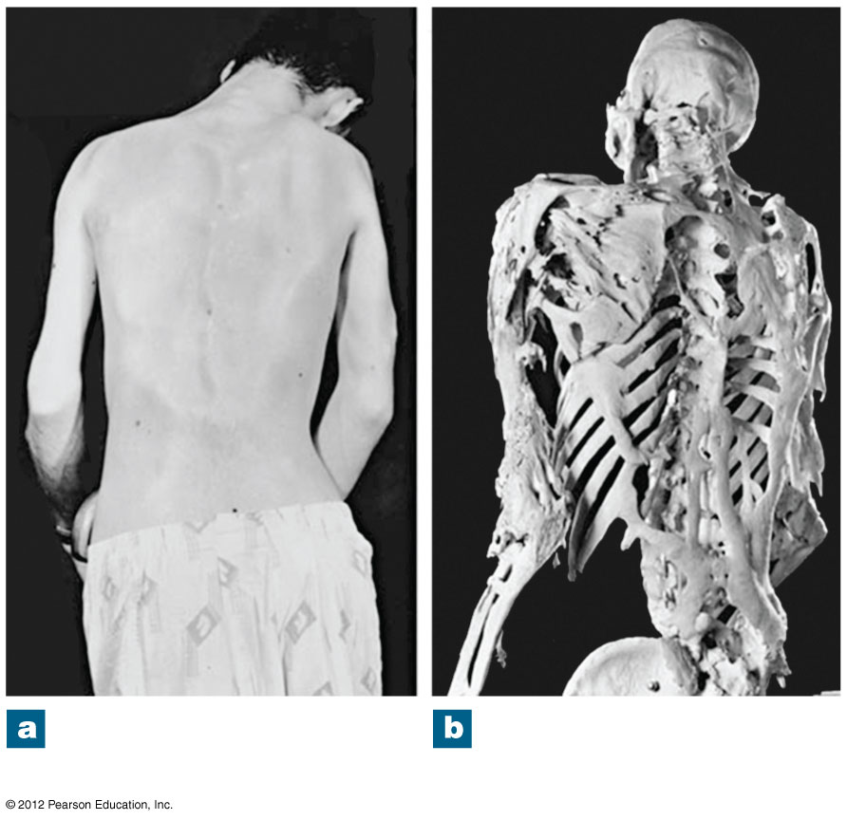
Figure 6-9 Heterotopic Bone Formation
An adult male with
FOP, posterior view
The skeleton of a man
with advanced FOP

Slide 73
6-6 Bone Remodeling
Process of Remodeling
The adult skeleton:
Maintains itself
Replaces mineral reserves
Recycles and renews bone matrix
Involves osteocytes, osteoblasts, and osteoclasts

Slide 74
6-6 Bone Remodeling
Process of Remodeling
Bone continually remodels, recycles, and replaces
Turnover rate varies:
If deposition is greater than removal, bones get stronger
If removal is faster than replacement, bones get weaker

Slide 75
6-7 Exercise, Hormones, and Nutrition
Effects of Exercise on Bone
Mineral recycling allows bones to adapt to stress
Heavily stressed bones become thicker and stronger
Bone Degeneration
Bone degenerates quickly
Up to one third of bone mass can be lost in a few weeks of inactivity

Slide 76
6-7 Exercise, Hormones, and Nutrition
Normal Bone Growth and Maintenance Depend on Nutritional and Hormonal Factors
A dietary source of calcium and phosphate salts
Plus small amounts of magnesium, fluoride, iron, and manganese

Slide 77
6-7 Exercise, Hormones, and Nutrition
Normal Bone Growth and Maintenance Depend on Nutritional and Hormonal Factors
The hormone calcitriol
Made in the kidneys
Helps absorb calcium and phosphorus from digestive tract
Synthesis requires vitamin D₃ (cholecalciferol)

Slide 78
6-7 Exercise, Hormones, and Nutrition
Normal Bone Growth and Maintenance Depend on Nutritional and Hormonal Factors
Vitamin C is required for collagen synthesis, and stimulation of osteoblast differentiation
Vitamin A stimulates osteoblast activity
Vitamins K and B₁₂ help synthesize bone proteins

Slide 79
6-7 Exercise, Hormones, and Nutrition
Normal Bone Growth and Maintenance Depend on Nutritional and Hormonal Factors
Growth hormone and thyroxine stimulate bone growth
Estrogens and androgens stimulate osteoblasts
Calcitonin and parathyroid hormone regulate calcium and phosphate levels

Slide 80
Table 6-2 Hormones Involved in Bone Growth and Maintenance

Slide 81
6-8 Calcium Homeostasis
The Skeleton as a Calcium Reserve
Bones store calcium and other minerals
Calcium is the most abundant mineral in the body
Calcium ions are vital to:
Membranes
Neurons
Muscle cells, especially heart cells

Slide 82
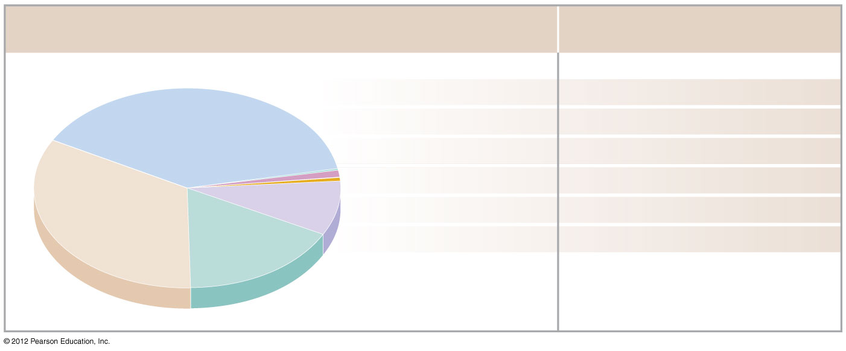
Figure 6-15 A Chemical Analysis of Bone
Composition of Bone
Bone Contains …
Calcium 39%
99% of the body’s Calcium
Potassium 0.2%
4% of the body’s Potassium
Sodium 0.7%
35% of the body’s Sodium
Organic
compounds
(mostly collagen)
33%
Magnesium 0.5%
50% of the body’s Magnesium
Carbonate 9.8%
80% of the body’s Carbonate
Phosphate 17%
99% of the body’s Phosphate
Total inorganic
components
67%

Slide 83
6-8 Calcium Homeostasis
Calcium Regulation
Calcium ions in body fluids
Must be closely regulated
Homeostasis is maintained
By calcitonin and parathyroid hormone (PTH)
Which control storage, absorption, and excretion

Slide 84
6-8 Calcium Homeostasis
Calcitonin and Parathyroid Hormone Control
Affect:
Bones
Where calcium is stored
Digestive tract
Where calcium is absorbed
Kidneys
Where calcium is excreted

Slide 85
6-8 Calcium Homeostasis
Parathyroid Hormone (PTH)
Produced by parathyroid glands in neck
Increases calcium ion levels by:
Stimulating osteoclasts
Increasing intestinal absorption of calcium
Decreasing calcium excretion at kidneys
Calcitonin
Secreted by C cells (parafollicular cells) in thyroid
Decreases calcium ion levels by:
Inhibiting osteoclast activity
Increasing calcium excretion at kidneys

Slide 86
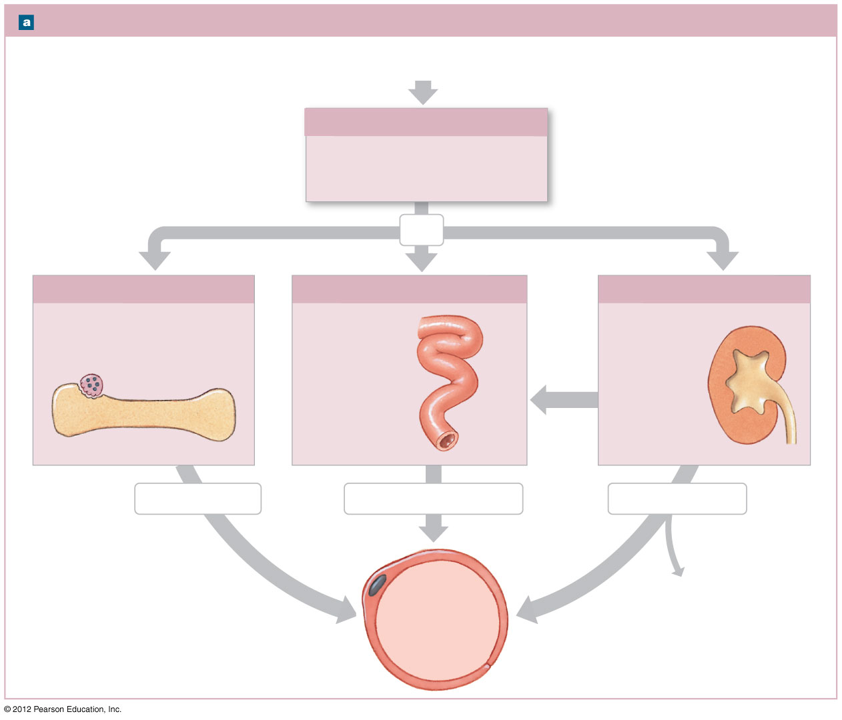
Figure 6-16a Factors That Alter the Concentration of Calcium Ions in Body Fluids
Factors That Increase Blood Calcium Levels
These responses are
triggered when plasma
calcium ion concentrations
fall below 8.5 mg/dL.
Low Calcium Ion Levels in Plasma
(below 8.5 mg/dL)
Parathyroid Gland Response
Low calcium plasma levels cause
the parathyroid glands to secrete
parathyroid hormone (PTH).
PTH
Bone Response
Intestinal Response
Kidney Response
Osteoclasts stimulated to
release stored calcium ions
from bone
Rate of
intestinal
absorption
increases
Kidneys retain
calcium ions
Osteoclast
more
Bone
calcitriol
Calcium released
Calcium absorbed quickly
Calcium conserved
↑Ca²⁺
levels in
bloodstream
Decreased calcium
loss in urine

Slide 87
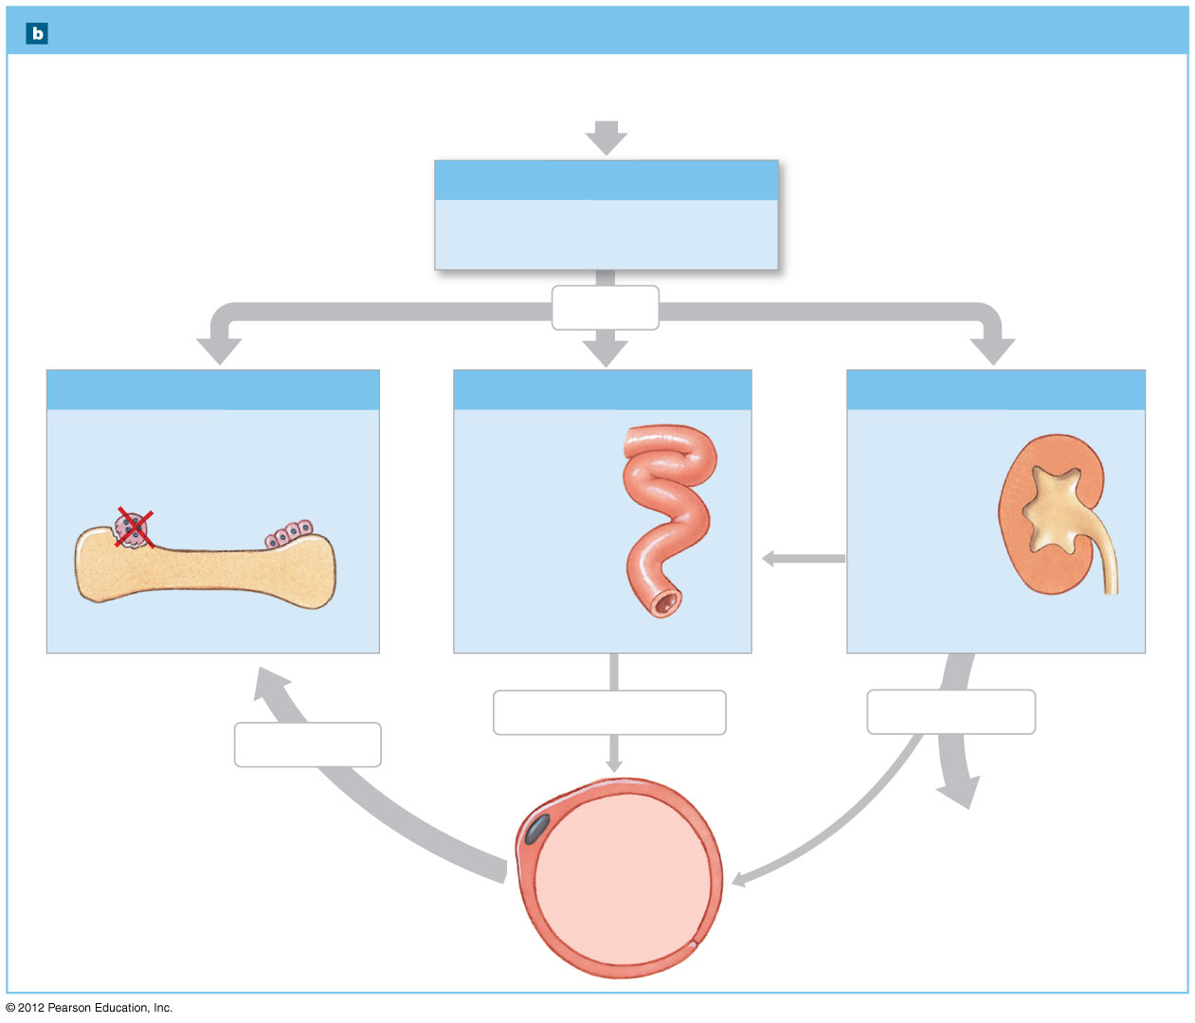
Figure 6-16b Factors That Alter the Concentration of Calcium Ions in Body Fluids
Factors That Decrease Blood Calcium Levels
These responses are
triggered when plasma
calcium ion concentrations
rise above 11 mg/dL.
HIgh Calcium Ion Levels in Plasma
(above 11 mg/dL)
Thyroid Gland Response
Parafollicular cells (C cells) in the
thryoid gland secrete calcitonin.
Calcitonin
Bone Response
Intestinal Response
Kidney Response
Osteoclasts inhibited while
osteoblasts continue to lock
calcium ions in bone matrix
Rate of intestinal
absorption
decreases
Kidneys allow
calcium loss
less
Bone
calcitriol
Calcium absorbed slowly
Calcium excreted
Calcium stored
↓Ca²⁺
levels in
bloodstream
Increased calcium
loss in urine

Slide 88
6-9 Fractures
Fractures
Cracks or breaks in bones
Caused by physical stress
Fractures are repaired in four steps
Bleeding
Cells of the endosteum and periosteum
Osteoblasts
Osteoblasts and osteocytes remodel the fracture for up to a year

Slide 89
6-9 Fractures
Bleeding
Produces a clot (fracture hematoma)
Establishes a fibrous network
Bone cells in the area die
Cells of the endosteum and periosteum
Divide and migrate into fracture zone
Calluses stabilize the break
External callus of cartilage and bone surrounds break
Internal callus develops in medullary cavity

Slide 90
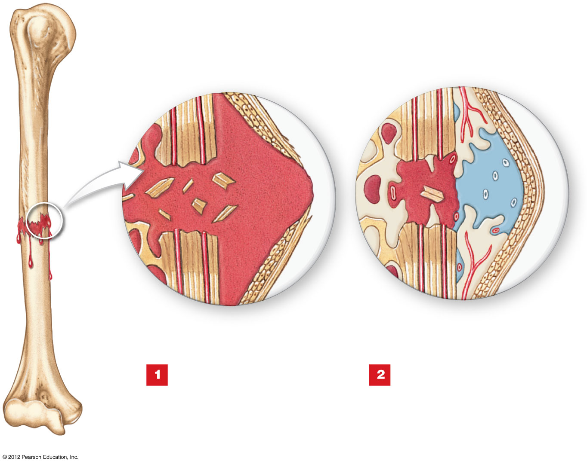
Figure 6-17 Types of Fractures and Steps in Repair
REPAIR OF A FRACTURE
Fracture
hematoma
Dead
bone
Bone
fragments
Spongy bone of
external callus
Periosteum
Immediately after the
fracture, extensive
bleeding occurs. Over a
period of several hours, a
large blood clot, or fracture
hematoma, develops.
An internal callus forms as a
network of spongy bone
unites the inner edges, and an
external callus of cartilage and bone
stabilizes the outer edges.

Slide 91
6-9 Fractures
Osteoblasts
Replace central cartilage of external callus
With spongy bone
Osteoblasts and osteocytes remodel the fracture for up to a year
Reducing bone calluses

Slide 92
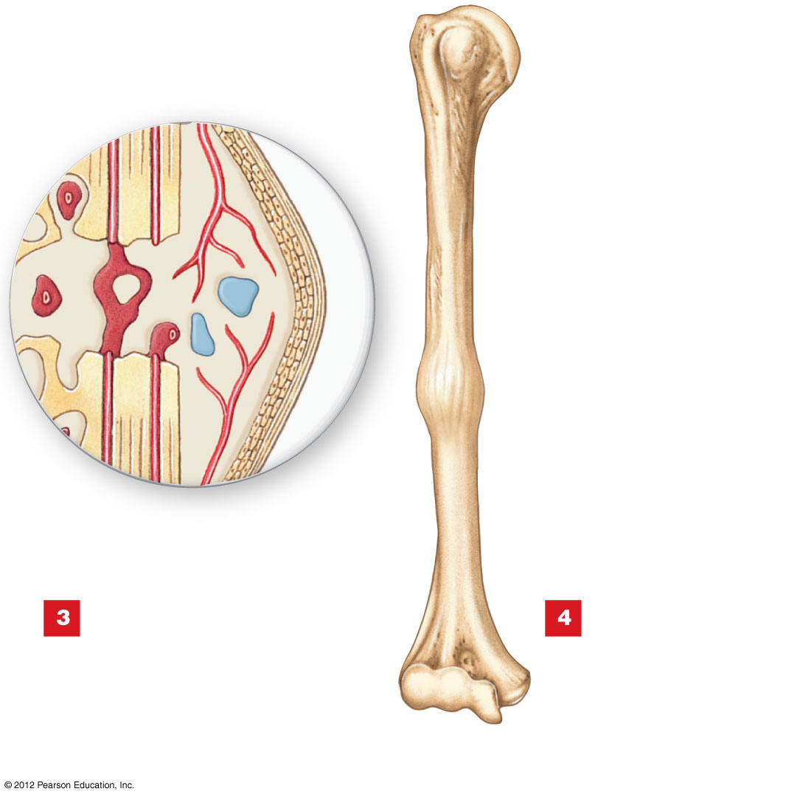
Figure 6-17 Types of Fractures and Steps in Repair
External
callus
Internal
callus
External
callus
The cartilage of the external
callus has been replaced by
bone, and struts of spongy bone now
united the broken ends. Fragments of
dead bone and the areas of bone
closest to the break have been
removed and replaced.
A swelling initially
marks the location of
the fracture. Over time, this
region will be remodeled,
and little evidence of the
fracture will remain.

Slide 93
6-10 Effects of Aging on the Skeletal System
Age-Related Changes
Bones become thinner and weaker with age
Osteopenia begins between ages 30 and 40
Women lose 8% of bone mass per decade, men 3%
The epiphyses, vertebrae, and jaws are most affected
Resulting in fragile limbs
Reduction in height
Tooth loss

Slide 94
6-10 Effects of Aging on the Skeletal System
Osteoporosis
Severe bone loss
Affects normal function
Over age 45, occurs in:
29% of women
18% of men

Slide 95
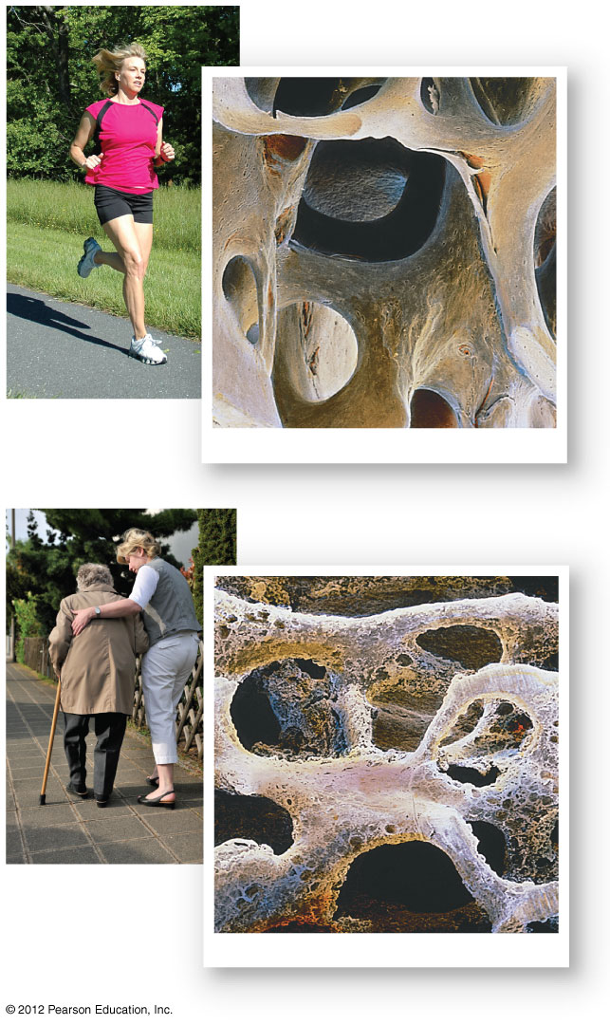
Figure 6-18 The Effects of Osteoporosis on Spongy Bone
Normal spongy bone
SEM ⋅ 25
Spongy bone in osteoporosis
SEM ⋅ 21

Slide 96
6-10 Effects of Aging on the Skeletal System
Hormones and Bone Loss
Estrogens and androgens help maintain bone mass
Bone loss in women accelerates after menopause
Cancer and Bone Loss
Cancerous tissues release osteoclast-activating factor
That stimulates osteoclasts
And produces severe osteoporosis

