Slide 1
INTRODUCTION TO SURGERY-LEVEL 2
BY YUSUF KASIDI

Slide 2
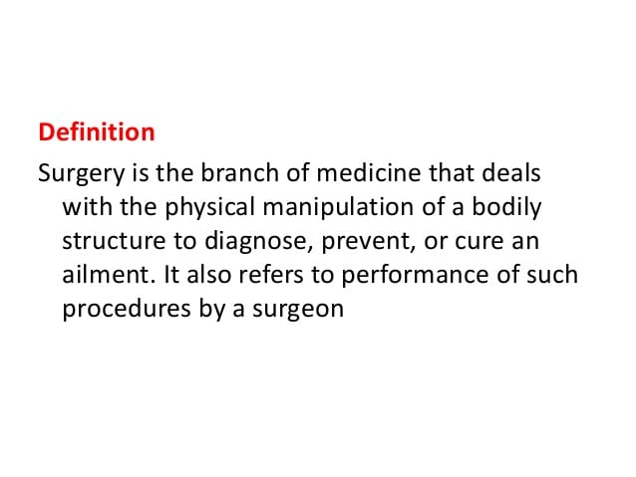

Slide 4
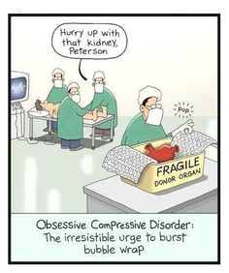

Slide 5
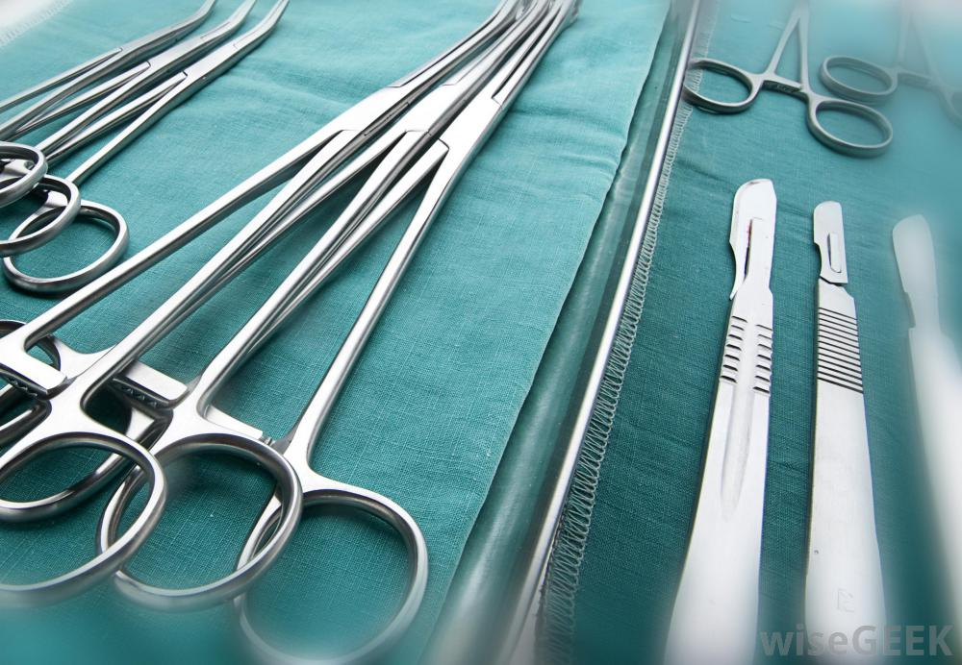

Slide 6
There are a number of basic definitions and concepts that are worth learning before starting a surgical rotation or learning about surgical topics.
Prefixes
Prefixes generally refer to an area of the body:
Laparo- refers to the abdomen (e.g., laparotomy – open surgery on the abdomen)
Thoraco- refers to the chest (e.g., thoracotomy – open surgery on the chest)
Colo- refers to the colon (e.g., colectomy – removal of the colon)
Cysto- refers to the bladder (e.g., cystoscopy – putting a endoscopic camera into the bladder)
Gastro- refers to the stomach (e.g., gastroscopy – putting a endoscopic camera into the stomach)
Mammo- refers to the breast (e.g., mammogram – imaging of the breast)
Masto- refers to the breast (e.g., mastectomy – removal of the breast)
Myo- refers to muscle tissue (e.g., myotomy – where the muscle tissue is cut open)

Slide 7
Nephro- refers to the kidneys (e.g., nephrectomy – removal of a kidney)
Pneumo- refers to the lungs (e.g., pneumonectomy – removal of a lung)
Orchid- refers to the testes (e.g., orchidectomy – removal of a testicle)
Rhino- refers to nose (e.g., rhinoplasty – changing the shape of the nose)
Lobo- refers to a lobe of an organ (e.g., lobectomy – removal of a lobe of the lung)

Slide 8
Suffixes
Suffixes generally refer to what is happening with a particular area of the body:
-otomy refers to surgically cutting open (e.g., laparotomy – open surgery on the abdomen)
-oscopy refers to viewing with a scope and keyhole surgery (e.g., colonoscopy, laparoscopy and thoracoscopy)
-ectomy refers to removal (e.g., tonsillectomy – removal of the tonsils)
-plasty refers to changing the shape (e.g., rhinoplasty – changing the shape of the nose)
-pexy refers to fixing something in place (e.g., orchidopexy – surgery to fix a testicle in the correct place)
-centesis refers to puncturing with a needle (e.g., thoracocentesis – removing air or fluid from the pleural space)
-ostomy refers to creating a new opening (e.g., colostomy – opening the colon onto the surface of the abdomen)
-itis refers to inflammation (e.g., prostatitis – inflammation of the prostate)
-algia refers to pain (e.g., mastalgia – breast pain)

Slide 9
-gram refers to recording or imaging (e.g., electrocardiogram or echocardiogram)
More Definitions
There are some further key definitions that are worth becoming familiar with:
Adhesions: scar-like tissue inside the body that bind surfaces together
Fistula: an abnormal connection between two epithelial surfaces
Tenesmus: the sensation of needing to open bowels without being able to produce stools (often accompanied by pain)
NB: I have randomly been asked to define certain terms by surgeons whilst on ward rounds and in clinics. Having key definitions ready to recite can make you look clever. I particularly recommend learning the definition of a fistula as “an abnormal connection between two epithelial surfaces”, as I have been asked this on a few occasions

Slide 10
Specific Operations
Operations with unique names to be familiar with include:
Hemicolectomy – removing a portion of the large intestine (colon)
Hartmann’s procedure (proctosigmoidectomy) – removal of the rectosigmoid colon with closure of the anorectal stump and formation of a colostomy
Anterior resection – removal of the rectum
Whipple procedure (pancreaticoduodenectomy) – removal of the head of the pancreas, duodenum, gallbladder and bile duct
Incisions and Scars
Upper abdominal surgery:
Kocher incision – open cholecystectomy
Chevron / rooftop incision – liver transplant, Whipple procedure, pancreatic surgery or upper GI surgery
Mercedes Benz incision – liver transplant

Slide 11
Abdominal organ surgery:
Midline incision – for a general laparotomy, allows good access to abdominal organs
Paramedian incision – laparotomy (midline usually used instead)
Hockey-stick incision – renal transplant
Appendix surgery:
Battle incision (paramedian) – open appendicectomy
Gridiron incision / McBurney incision (oblique) – open appendicectomy
Lanz incision (transverse) – open appendicectomy
Rutherford Morrison incision (extended version of gridiron) – open appendicectomy and colectomy
Caesarean section:
Pfannenstiel incision – curved incision two fingers width above the pubic symphysis
Joel-Cohen incision – straight incision that is slightly higher (this is the recommended incision)

Slide 12
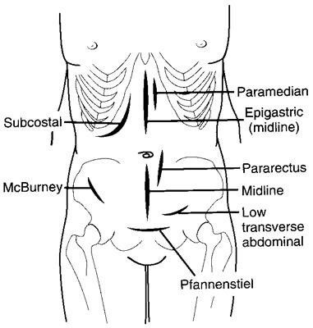

Slide 13
Laparoscopic surgery involves several 5-10mm incisions to allow the cameras and instruments to be inserted into the abdomen via port sites. A site just above or below the umbilicus is usually used as a port site.
Diathermy
Diathermy uses a high-frequency electrical current to cut through tissues or to cauterise small blood vessels to stop bleeding. It causes targeted localised burning of tissues. It is useful for making targeted incisions with minimal bleeding.
Mono-polar diathermy can be used in small or large operations. A diathermy probe is used by a surgeon and produces an electrical signal.
A grounding plate or grounding pad is placed under the leg or buttock. A circuit is formed in the patient’s body, where the electricity goes in through the diathermy instrument and out through the grounding plate. At the site where the electrical energy is applied, it causes localised burning and tissue damage. As the electrical signal spreads through the body to the grounding plate, it becomes less intense and does not cause damage to other tissues.

Slide 14
Bipolar diathermy involves an instrument with two electrodes, and a current passes between the electrodes affecting the tissues in this area. This is often used in microsurgery, for example, operations on the hand. It is also helpful to prevent the electrical signals from passing through the rest of the body, for example in patients with a pacemaker.
Sutures
There are all sorts of sutures available, which suit different purposes and are used on different tissues. The two main categories of suture are absorbable and non-absorbable.
Absorbable sutures are slowly absorbed and disappear over time. Examples include Vicryl and Monocryl. They are used for tissues that will heal well and remain sealed after the suture has been absorbed, such as within the abdominal cavity and closing the tissues beneath the epidermis.

Slide 15
Non-absorbable sutures remain in place for a long time and provide support to the tissues. Examples include silk, nylon and polypropylene. Examples of how they might be used include:
Closing the skin by interrupted or mattress suture technique (see below), removed later once the skin has healed
Fixing drains in place, removed later with the drain
Connective tissues that heal slowly, such as repairing tendons

Slide 16
Closing the Skin
The subcutaneous tissues are closed using absorbable sutures to prevent creating dead space that could fill with air, blood or fluid.
The surface layer or skin (the epidermis) can be closed with various techniques:
Staples are a rapid way of closing the skin and need removing later
Interrupted sutures involve a series of individual knots
Mattress sutures involve a series of individual sutures that each go from one side of the wound, under and out the other side, then back under again to the original side
Continuous sutures involve a single suture that goes in and out along the wound in a spiral shape
Subcuticular sutures involve using a single absorbable suture side to side just below the skin to pull the skin edges together

Slide 18
Drains
Drains are tubes left inside body cavities to allow air and fluid to drain away, usually into a bottle beside the bed. This prevents air, blood, pus or other fluid from collecting within a space. They are often secured and left in place after an operation. They are removed when they stop draining (or are draining very little) and it is assumed whatever has been drained will no longer build up if the drain is removed.
Chest drains provide a method of removing air and fluid from the pleural space. The external end of the drain is placed underwater, creating a seal to prevent air from flowing back through the drain into the chest. Air can exit the chest cavity and bubble through the water, but the water prevents air from re-entering the drain and chest. During normal respiration the water in the drain will rise and fall due to changes in pressure in the chest (described as “swinging”).

Slide 19
WHO Surgical Safety Checklist
The WHO Surgical Safety Checklist (2009) is carried out for each operation. The aim is to reduce the risk of human error. The checklist is completed at 3 stages:
Before the induction of anaesthesia
Before the first skin incision
Before the patient leaves theatre

Slide 20
It involves multiple members of the team (e.g., theatre nurse, anaesthetist and surgeon) checking essential factors, such as:
Patient identity
Allergies
Operation
Risk of bleeding
Introductions of all team members
Anticipated critical events
Counting the number of sponges and needles to ensure nothing is left inside the patient

Slide 21
