Slide 1
Immune Disorders and Immune Response
KMTC VOI
CLINICAL MEDICINE DEPARTMENT
2021

Slide 2
Course outline- immuno pathology
Definitions
Anatomy and physiology recap
Classifications
Etiology/predisposing factors
Clinical presentations
Diagnostic approaches
Management
complications

Slide 3
Definations
Immunity is defined as the resistance of an organism to infection, disease or unwanted biological invasion.
Immunity is either innate or acquired
Acquired immunity can be Natural or artificial
Define- Antibody, Antigen

Slide 4
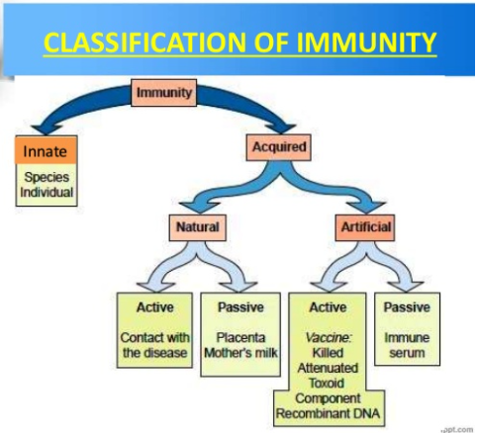

Slide 5
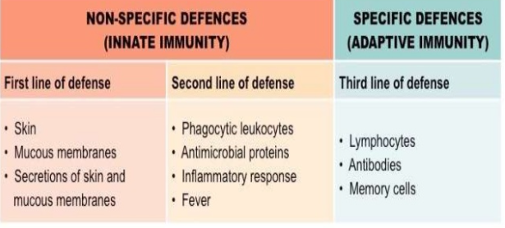
Mechanism of immunity

Slide 6
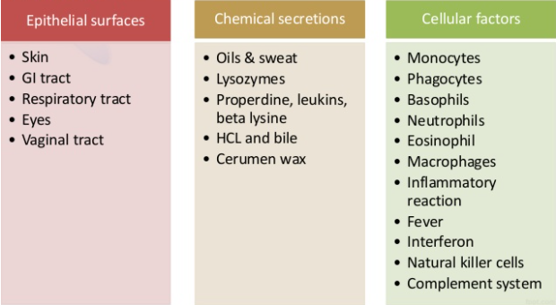
Immunity..
Notes:
Mechanisms of innate immunity

Slide 7
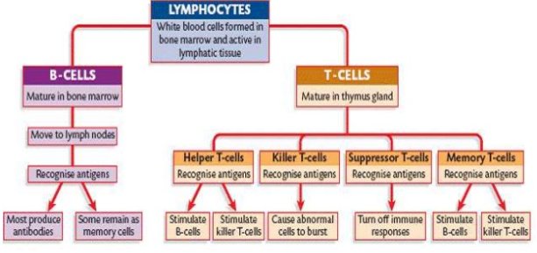
Types of specific immunity cells

Slide 8
Classification of immunity disorders
There are 3 main types of immunopathologies
Immunodeficiency- is a state in which the immune systems ability to fight infectious disease and cancer is compromised or entirely absent.(TOO LITTLE)
Hypersensitivity- an exaggerated immune response that results in tissue injury(TOO MUCH)
Autoimmunity- implies an immune response has been generated against self antigens.(MISDIRECTED)
Notes:
1854-1915- PAUL EHRLICH

Slide 9
1. AUTOIMMUNE DISEASES
Auto immune diseases are a group of disorders in which tissue injury is caused by humoral or cell mediated immune responses to self tissues( antigens)
When antigens are present in ones own cells or altered by the action of bacteria, viruses, chemicals or drugs as a non self.
The immune system cant tell the difference between a healthy body tissue and antigen
Causes- a)Sequestrated or hidden antigens
b) altered or modified antigen, drugs or viruses c) cross reacting antigens- a foreign Ag resembling self
Notes:
Once started auto immune diseases are hard to stop.

Slide 10
classification
1.organ specific ( LOCALISED)
2Non organ specific. ( SYTEMIC)
( prevalence 5% to 8%, greater in females than males. 4th largest disease class in women

Slide 11
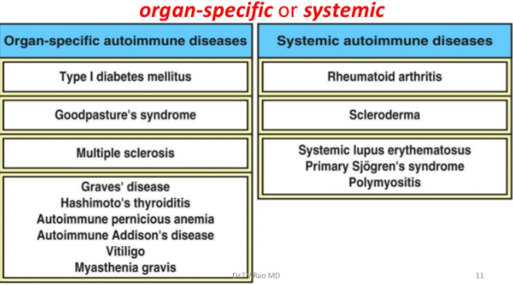
Classification image

Slide 12
ORGAN SPECIFIC
Blood- Autoimmune haemolytic anemia, ITP
Heart- Rheumatic fever
CNS- multiple sclerosis, Guillan Barr syndrome
Muscle- myasthenia Gravis
Endocrine system- Addison's dse-adrenal glands, Autoimmune thyroiditis (Hashimotos dse), Graves disease-thyroid, Type 1 DM(juvenile)
Eye-uveitis
GIT- pernicious anaemia-vit b12, ulcerative colitis,chrons dse
Kindneys- glomerulonephritis, Good pastures syndrome
Skin- psoriasis, pemphigus valgaris,eczema

Slide 13
Non organ specific
This occurs when immune complexes accumulate in many tissues and causes inflammation and damage.
Examples;
Systemic lupus erythromatous- anti nuclear Ab- harms the kidney, heart, brain, skin and lungs
Rheumatoid athritis- anti IgG antibodies- affecting the joints, heart, lungs and cns
Progressive systemic sclerosis
Dermatomyositis, sytemic sclerosis
Notes:
In allergies-the immune system reacts to outside substances

Slide 14
ETIOLOGY
Generally unknown
Genetic factors-DM
Some auto immune diseases are triggered by viral and bacterial infections i.e rheumatic fever
Exposure to certain chemicals or deficiencies- goitre

Slide 15
pathophysiology
The various mechanisms of autoimmune diseases are as follows
Bypass of helper t-cell tolerance
Emergence of sequestrated antigen
Imbalance of supressor helper t cell function
Microbial agents in autoimmunity
Molecular mimicry
Polyclonal lymphocyte activation

Slide 16
Clinical features
Fatigue
Muscle aches
Swelling and redness
Low grade fevers
Trouble concentrating
Numbness and tingly sensations
Hairloss, skin rashes
Overgrowth of tissues
General body malaise

Slide 17
Diagnostic evaluation
History taking- allergic reaction hx,FMShx, exposure hx, changes in living environment, aleivating factors
Physical exam
Laboratory tests;
Antinuclear antibody tests
Autoantibody test
CRP
ESR
Lumbar puncture
Bone marrow biopsy

Slide 18
Medical management
Systemic corticosteroids | Cytotoxic drugs | analgesics
presnisolone | Cyclophoshomide methotrexate | NSAIDS acetaminophen

Slide 19
complications
Recurrent infections
Tissue damage and death
Slowed growth
Increased risk of cancers
Death from serious infections
Anaphylactic shock
Infertility
Heart failure

Slide 20
2. HYPERSENSITIVITY DISORDERS
A hypersensitivity reaction is defined as the altered reactivity to a specific antigen that results in pathologic reactions upon exposure of a sensitized host to that specific antigen.
Hypersensitivity disorders occur rapidly. The reactions depend on the site of antigen exposure-i.e skin- hay fevers. RS- bronchial asthma- anaphylactic-general.

Slide 21
classifications
Hypersensitivity diseases are broadly divided into five categories based on the immunologic mechanism involved in the reaction.
Type 1- immediate hypersensitivity
Type 2 antibody mediated hypersensitivity
Type 3- Immune complex hypersensitivity diseases
Type 4- T cell mediated or delayed hypersensitivity
Type 5- stimulatory hypersensitivity

Slide 22
explanations
Type 1- this are allergic reactions provoked by re exposure to a specific type of antigen. The rxn maybe localised or systemic- symptoms vary from mild irritation to sudden death from anaphylactic shock.
exposure may be by ingestion, inhalation,injection or direct contact.
The naïve lymphocytes becoome primed and differentiated into an antibody secreting cell and this leads to class switching of the antibody IgE class

Slide 23
pathogenesis
-Presentation of the antigen (allergen) to precursor of TH2cells by antigen presenting dendritic cells on epithelial surfaces
Newly minted TH2 cells produce clusters of cytokines including IL-3,IL-4,IL-5 and GM-CSF
The IL-4 is essential for activation of B cells to produce IgE and IL-3 and IL-5 are important for the survival of eosinophillic activati
The IgE antibodies produced has a high affinity to attach to mast cells and basophiles
A mast cell or basophil armed with cytophilic IgE antibodies is re-exposed to the specific allergen
In this process multivalent antigens binds to more than one IgE molecules and cause cross-linkage with adjacent IgE antibody.
This bridging of IgE molecules activates signal transduction pathways from cytoplasmic portion of IgE fc receptors. This signal initiates two parallel but independent processes. One leading to mast cell degranulation with discharge of preformed (primary) mediators and the other involving denovo synthesis and release of secondary mediators.
(I) Mast cell degranulation discharge preformed granules such as primary mediators including biogenic amines, histamine, adenosine, eosinophlic and neutrophlic chemotactic factors, enzymes including proteases, and several acid hydrolases.
(II) The other involved is de novo synthesis and release of secondary mediators such as arachidomic metabolites - Leukotriens C4 & D4 – most potent vasoactive and spasmogenic agents known by – highly chemotatic for neutrophiles, eosinophiles and monocytes - Prostaglandin D2 – causesintense bronchospasm & increase mucus secretion - Platelet-activating factor release histamine, ↑ed vascular permeability - Cytokines—activation of inflammatory cells

Slide 24
..
Thus, type I reactions have two well-defined phases. a. Initial phase (response): ¾ Characterized by vasodilatation, vascular leakage, and depending on the location, smooth muscle spasm or glandular secretions. b. Late phase¾ As it is manifested for example in allergic rhinitis and bronchial asthma, more intense infiltration of eosinophiles, neutrophiles, basophilic, monocytes and CD4 + T cells are encountered and so does tissue destruction (epithelial mucosal cells). ¾ Mast cells and basophiles are central to the development of Type I reaction. Mast cells are bone marrow driven cells widely distributed in tissues around blood vessels, and sub epithelial sites where type I reaction occurs.

Slide 25
types
Allergic asthma
Allergic conjuctivitis
Allergic rhinitis
Anaphylaxis
Angioedema
Eczema( atopic dermatitis)
Urticaria
eosinophilia

Slide 26
Type 2
In t2 hypersensitivity rxns, the antibodies produced by the immune response binds to antigens on the patients own cell surffaces. The antigens recorgnized in this way may either be intrinsic or extrinsic. IgG and IgM antibodies bind to these antigens to form complexes that activate the classical pathway to compliment activation, foor eliminating cells presenting froeign antigens, that mediates inflamation and cause cell lysis and eath. This reactions takes hours to day.

Slide 27
Examples of type 2 H.Rxns
Autoimmune hemolytic anaemia
Eryrthroblastosis fetalis
Pemphigus
Pernicous anaemia
Abo incompatibility
Rheumatic fever
Haemolytic ds of newborns
Hashimotos thyroiditis.

Slide 28
Type 3
In this hypersesnitivity reactions, insoluble immune complexes(aggrgations of antigens and IgG and IgM antibosies) form in the blood and are deposited in various tissues( skin,kidney and joints)
This depositions of antibodies may trigger and immune response according to the classsic pathway of complement activation- for eliminating cells presenting foreign antigens.

Slide 29
Examples of type 3
Serum sickness
Rheumatoid athritis
Sub acute bacterial endocarditis
SLE

Slide 30
Type 4
Are often called delayed type as the reaction takes two or thre days to develop.
CD* cytotoxic cells and CD$ helper cells recorgnize antigen in a complex with either typ 1 or type 2 major histocompatibility complex.
Examples;
Contact dermatitis
Leprosy symptoms
Symptoms of TB
Coeliac dse

Slide 31
Type 4
Antibodies are made against a particular receptor on a hormone producing cell. This leads to over stimulation of the homone producing cell.
An example is GRAVES DISEASE- where antibodies are made against TSH receptors of the thyroid cells. The binding antibodies of TSH recetors results in constant stimulation of the thyroid leading to hyperthyroidsm
Notes:
Type 5 not significant as it presents as a combination of above or systemic

Slide 32
etiology
Genetic factors
Lack of certain enzymes
Exposure to allergens

Slide 33
Common allegerns and foods associated with hypersensitivity
proteins | Plant pollens | Drugs
Foreign serum | Rye grass | penicillin
vaccines | ragweed | suphonamides
Bacteria and viruses |  | salicylates
FOODS | INSECT | OTHERS
Nuts, sea foods | Bee venom Cockroach and mites | Snake venom
eggs |  | latex
Mik,peas |  | Animal dandruff

Slide 34
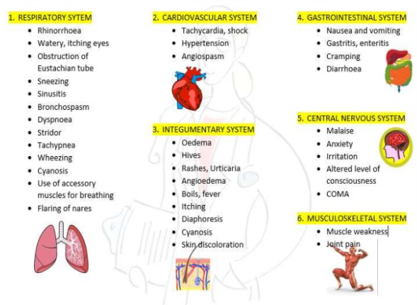
Clinical manifestation

Slide 35
Diagnostic evaluation
History taking- allergic reactions,exposure,changes in environment, symptoms etc
Physical exam- rashes,mouth breathing, flaring of alae nasal, DIB, wheezing, swelling redness etc
Diagnostic tests for allergens; skin prick, intradermal test, radioallergosorbent testing, provocation testing, patch testing, oral food challenges, food elimination
labs- CBCGenetic testing

Slide 36
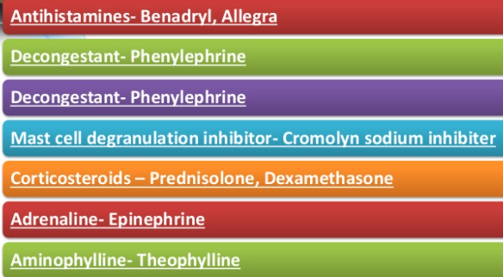
Management

Slide 37
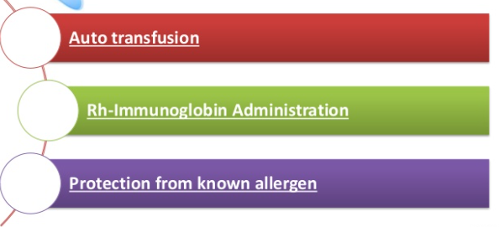
Mnx cont

Slide 38
3.IMMUNODEFICIENCY
A state in which the immune systems ability to fight infectious diseases is compromised or entirely absent.
It’s a group of disorders of specific responses- neutrophils, macrophages and natural killers cells functions are diminished as well as defected hence leading to impaired resistance.

Slide 39
classifications
1. PRIMARY IMMMUNODEFICIENCY DSES( rare)
This disorders usually manifest in early childhood and are almost always genetically determined.
Primary immunodeficincies maybe caused by gene mutations.
Eg. X linked a gammaglobunaemia, severe combined immunodeficiency, Transient hypogammaglobulinaemia of infancy

Slide 40
…
2. SECONDARY IMMUNODEFIENCIES- may arise due to acquired diseases-chronic illnesses or drug effects.
Any factor interfering with normal growth or expression of the immune system can lead to secondary immmunodefiecy. It generally develops later in life.
Examples; severe burns, chemotherapy, radiation, DM, manutrition, AIDS, cancers of immune system, leukaemia,v iral hepatitis, multiple myeloma)

Slide 41
…
Protein deficiency -Lack of protein leads to cell mediated immunity and hypocomplementamia
Hematologic-malignanciesLeukemia and lymphomas where normal functioning cell replaced by neoplastic ones here both humeral and cell mediated immunity are impaired
Acute viral infection-Especially infectious mononucleosis and misels cause temporary impairment of cell-mediated immunity ¾
Chronic renal failure -Probably due to toxic effects of accumulated metabolites that affects both B and T-cell functions
Iatrogenic- Steroids etc for organ transplants, cytotoxic drugs or radiotherapy for the treatment of malignancies.
Splenctomy -After staging operations of lymphomas or traumatic spleen rupture Splenectomy leads to a characteristic immunodeficiency in which the patient is susceptible to infections by phylogenic bacteria especially pneumococal pneumonia.
Acquired immunodeficiency syndrome (AIDS) - As a prototype example of secondary immunodeficiency states, AIDS is discussed in some detail below.

Slide 42
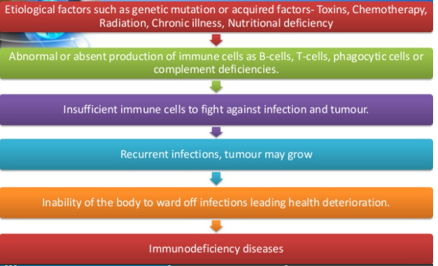
pathophysiology

Slide 43
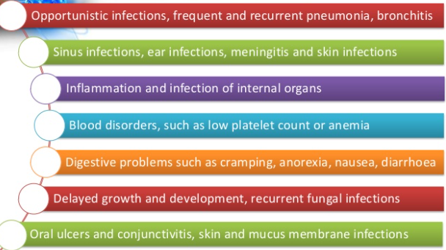
Clinical manifestation

Slide 44
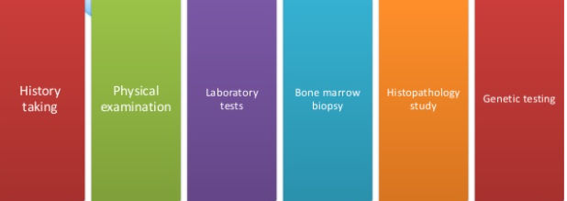
Diagnostic evaluation

Slide 45
…..
THE END…
Q/A
Assignments (group work)
Read on HIV,SLE,ALLERGIES

