Slide 1
Immune deficiency diseases

Slide 2
Introduction
Immune deficiency diseases may be caused by inherited defects affecting immune system development (primary immune deficiency), or they may result from acquired effects of other diseases e.g., infection, malnutrition, aging, immunosuppression, autoimmunity, or chemotherapy (secondary immune deficiency).
Clinically, patients with immune deficiency present with increased susceptibility to infections as well as to certain forms of cancer.
The type of infections in a given patient depends largely on the component of the immune system that is affected.
  Patients with defects in Immunoglobulins, complement, or phagocytic cells typically suffer from recurrent infections with pyogenic bacteria,
  Those with defects in cell-mediated immunity are prone to infections caused by viruses, fungi, and intracellular bacteria.

Slide 3
Primary immune deficiency
Primary immune deficiency diseases are genetically determined and affect either adaptive immunity (i.e., humoral or cellular) or innate host defense mechanisms, including complement proteins and cells such as phagocytes and NK cells.
Most primary immune deficiencies come to attention early in life (between 6 months and 2 years of age), usually because the affected infants are susceptible to recurrent infections

Slide 4
X-Linked Agammaglobulinemia (XLA, Bruton Disease)
X-Linked agammaglobulinemia (XLA), or Bruton disease, is one of the more common forms of primary immune deficiency. It is characterized by the failure of pre-B cells to differentiate into B cells; as a consequence, and as the name implies, there is a resultant absence of gamma globulin in the blood.
During normal B-cell maturation, Ig heavy-chain genes are rearranged first, followed by light-chain rearrangement. At each stage, signals are received from the expressed components of the antigen receptor that drive maturation to the next stage; these signals act as quality controls, to ensure that the correct receptor proteins are being produced.
In XLA, B-cell maturation stops after the initial heavy-chain gene rearrangement because of mutations in a tyrosine kinase that is associated with the pre-B-cell receptor and is involved in pre-B-cell signal transduction.
As a result, Ig light chains are not produced, and the complete Ig molecule containing heavy and light chains cannot be assembled and transported to the cell membrane, although free heavy chains can be found in the cytoplasm.

Slide 5
The disorder is characterized by;
  Absent or markedly decreased numbers of B cells in the circulation, with depressed serum levels of all classes of immunoglobulins.
  The numbers of pre-B cells in the bone marrow may be normal or reduced.
  Underdeveloped or rudimentary germinal centers in peripheral lymphoid tissues, including lymph nodes, Peyers patches, the appendix, and tonsils.
  Absence of plasma cells throughout the body.
  Normal T-cell-mediated responses.
Because BTK maps to the X chromosome, the disorder is seen in males.

Slide 6
XLA does not become apparent until approximately 6 months of age, when maternal immunoglobulins are depleted.
In most cases, recurrent bacterial infections such as acute and chronic pharyngitis, sinusitis, otitis media, bronchitis, and pneumonia suggest an underlying immune defect.
The causal organisms are typically those bacterial pathogens that are cleared by antibody-mediated opsonization and phagocytosis (e.g., Haemophilus influenzae, Streptococcus pneumoniae, or Staphylococcus aureus).
Because antibodies are important for neutralizing viruses, these patients are also susceptible to certain viral infections, especially those caused by enteroviruses. Similarly, Giardia lamblia, an intestinal protozoan usually neutralized by secreted IgA, cannot be efficiently cleared and causes persistent infections.
Fortunately, replacement therapy with intravenous Ig from pooled human serum allows the majority of patients to adequately combat bacterial infections.
Patients with XLA clear most viral, fungal, and protozoal infections, because their T-cell-mediated immunity is intact. For unclear reasons, autoimmune diseases (such as RA and dermatomyositis) occur in as many as 20% of patients with this disease

Slide 7
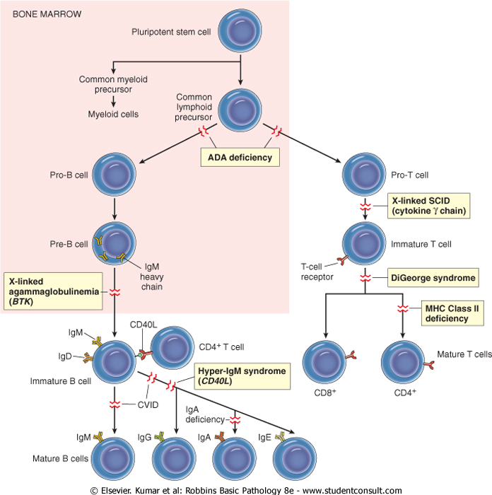

Slide 8
Thymic Hypoplasia: DiGeorge Syndrome
  DiGeorge syndrome results from a congenital defect in thymic development with deficient T-cell maturation. T cells are absent in the lymph nodes, spleen, and peripheral blood, and infants with this defect are extremely vulnerable to viral, fungal, and protozoal infections. Patients are also susceptible to infection with intracellular bacteria, because of defective T-cell-mediated immunity. B cells and serum immunoglobulins are generally unaffected.
  The disorder is a consequence of a developmental malformation affecting the third and fourth pharyngeal pouches-structures that give rise to the thymus, parathyroid glands, and portions of the face and aortic arch. Thus, in addition to the thymic and T-cell defects, there may be parathyroid gland hypoplasia resulting in hypocalcemic tetany, as well as additional midline developmental abnormalities.
  In 90% of cases of DiGeorge syndrome there is a deletion affecting chromosome 22q11.
  Transplantation of thymic tissue has successfully treated some of these infants. In patients with partial defects, immunity may improve spontaneously with age.
Severe Combined Immunodeficiency
  Severe combined immunodeficiency (SCID) represents a constellation of genetically distinct syndromes with the common feature of defects in both humoral and cell-mediated immune responses.
  Affected infants are susceptible to severe recurrent infections by a wide array of pathogens, including bacteria, viruses, fungi, and protozoans; opportunistic infections by Candida, Pneumocystis, CMV, and Pseudomonas also cause serious (and occasionally lethal) disease.

Slide 9
Immune Deficiency with Thrombocytopenia and Eczema: Wiskott-Aldrich Syndrome
  Wiskott-Aldrich syndrome is an X-linked recessive disease characterized by thrombocytopenia, eczema, and a marked vulnerability to recurrent infection, ending in early death; the only treatment is bone marrow transplantation.
  The thymus is initially normal, but there is progressive age-related depletion of T lymphocytes in the peripheral blood and lymph nodes, with concurrent loss of cellular immunity.
  Additionally, patients do not effectively synthesize antibodies to polysaccharide antigens, and are susceptible to encapsulated, pyogenic bacteria.
  Affected patients are also prone to developing malignant lymphomas
  The responsible gene maps to the X chromosome and encodes a protein (Wiskott-Aldrich syndrome protein) that links several membrane receptors to the cytoskeleton

Slide 10
Secondary Immune Deficiencies
Immune deficiencies secondary to other diseases or therapies are much more common than the primary (inherited) disorders.
Secondary immune deficiencies may be encountered in patients with malnutrition, infection, cancer, renal disease, or sarcoidosis.
However, the most common cases of immune deficiency are therapy-induced suppression of the bone marrow and of lymphocyte function.

Slide 11
Acquired Immunodeficiency Syndrome
AIDS is a retroviral disease caused by the human immunodeficiency virus (HIV).
It is characterized by infection and depletion of CD4+ T lymphocytes, and by profound immunosuppression leading to opportunistic infections, secondary neoplasms, and neurologic manifestations.
Transmission of HIV occurs under conditions that facilitate the exchange of blood or body fluids that contain the virus or virus-infected cells.
Thus, the major routes of HIV infection are sexual contact, parenteral inoculation, and passage of the virus from infected mothers to their newborns.

Slide 12
Modes of transmission
Sexual transmission;
  Sexual transmission is by far the major mode of infection worldwide, accounting for more than 75% of all cases of HIV transmission
  The virus is present in semen, both extracellularly and within mononuclear inflammatory cells, and it enters the recipient's body through lacerations or abrasions in mucosa.
  Viral transmission can occur either by direct entry of virus or infected cells into blood vessels breached by trauma or by uptake into mucosal DCs.
  Clearly, all forms of sexual transmission are aided and abetted by the concomitant presence of other sexually transmitted diseases that cause genital ulcerations, including syphilis, chancroid, and herpes simplex virus. Gonorrhea and Chlamydia also act as cofactors for HIV transmission, primarily by increasing the seminal fluid content of inflammatory cells (presumably carrying HIV).
  In addition to male-to-male and male-to-female transmission, HIV is present in the vaginal and cervical cells of infected women and can also be spread from females to males, albeit about eightfold less efficiently.

Slide 13
Parenteral Transmission;
Parenteral transmission of HIV is well documented in three different groups:
  Intravenous drug abusers (the largest group)
  Hemophiliacs receiving factor VIII or IX concentrates
  Random recipients of blood transfusion
  Shared personal items; needles, razor blades and nail clippers
Mother-to-infant vertical transmission; is the major cause of pediatric AIDS.
  Three routes are involved: in utero, by transplacental spread; intrapartum, during delivery; and via breast feeding by ingestion of HIV-contaminated breast milk.
  Of these, the transplacental and intrapartum routes account for most cases

Slide 14
THE BIOLOGY OF THE HUMAN IMMUNODEFICIENCY VIRUS
Basic Virology:
There are two types of HIV.
HIV – 1
  Is found worldwide
  Is the main cause of the worldwide pandemic
HIV – 2
  Is mainly found in West Africa, Mozambique and Angola.
  Less efficiently transmissible rarely causing vertical transmission Less aggressive with slower disease progression
A retrovirus from the Lentivirus family.
Genetic material consists of a single-stranded ribonucleic acid (RNA)
Viral particle is spherical in shape with a diameter of 80-100 nanometers (nm).

Slide 15
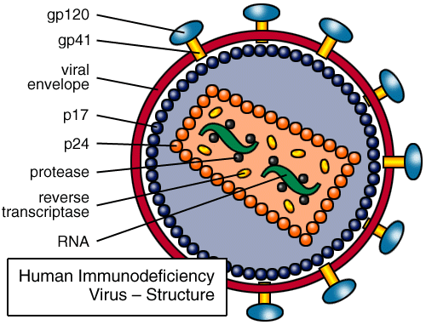
STRUCTURE OF HUMAN IMMUNODEFICIENCY VIRUS
Has an outer double lipid membrane, (derived from the host membrane).
The lipid membrane is lined by a matrix protein.
The lipid membrane is studded with the surface glycoprotein (gp) 120 and the transmembrane gp 41 protein.
These glycoprotein spikes surround the cone-shaped protein core.

Slide 16
Viral Enzymes
Most important: Reverse Transcriptase (RT), Protease and Integrase.
RT converts viral single-stranded RNA into a double stranded deoxyribonucleic acid (DNA).
DNA is incorporated into host nucleus as the proviral DNA.
Integrase facilitates integration of the DNA into the host’s chromosomal DNA.
Protease enzyme splits generated macro-proteins into smaller viral proteins (core, envelope & regulatory proteins and enzymes) which go into forming new viral particles.

Slide 17
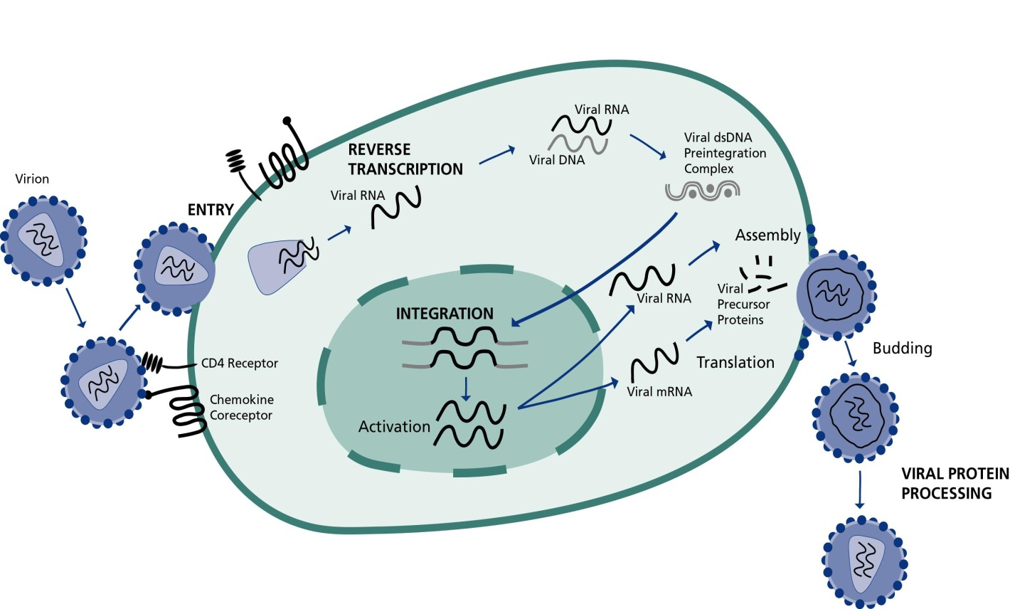
HIV LIFE CYCLE
Binding, Fusion and Entry
Transcription
Integration & Replication
Budding
Maturation

Slide 18
All HIV strains express the envelope protein gp 120 that binds the CD4 molecules, but different viral strains display tissue tropism or specificity based on the co-receptor they recognize.
This co-receptors belong to the chemokine receptor family.
Changes in viral phenotype during the course of HIV infection may lead to changes in tropisms and cytopathology at different stages of the disease.

Slide 19
BINDING
Mechanisms of attachment of the HIV virus
Viral envelope glycoproteins
Chemokine receptors
Non-neutralizing antiviral antibodies
Complement receptors.
Other surface cell receptors like DC-specific C type lectin (DC SIGN) on dendritic cells and mannose binding protein on macrophages.

Slide 20
BINDING
HIV entry can be divided into 3 basic steps:
The first step is the specific binding of HIV gp120 to the CD4 molecule
Following gp120-CD4 binding, a conformational change occurs in gp120. It then binds a co-receptor on the cell surface: a chemokine receptor, either CCR5 or CXCR4 .
This is thought to result in further conformational changes in gp120 that expose the gp41 protein. This protein mediates fusion of the viral and cell membranes.

Slide 21
Viral strains found in the early stages of the infection (e.g. R5 viruses) demonstrate tropism towards macrophages.
X4 strains of HIV are commonly seen in later stgs of disease. They bind to chemokine receptor CXCR4, more broadly expressed on T-cells.
A small % of individuals possessing nonfunctional alleles for the polymorphic chemokine receptor CCR5(found on macrophages) appear to be highly resistant to HIV infection or display delayed progression of disease.

Slide 22
FUSION and ENTRY:
Viral binding to host cell triggers fusion of the viral and host cell membranes. Mediated by gp41
Allows entry of virus core into host cell cytoplasm
Core protein dissolved by host enzymes releasing viral RNA and enzymes
Viral enzymes released include RT, integrase, protease and RNAse-H

Slide 23
INTEGRATION
Reverse transcriptase converts the viral RNA into a DNA molecule
The reverse transcription step of HIV replication is error prone; mutations are frequent and even within an individual patient HIV heterogeneity develops rapidly.
The development of antigenically and phenotypically distinct strains contributes to progression of the disease, clinical resistance, and lack of efficacy of early vaccines.

Slide 24
The DNA enters the host cell nucleus
Integrase catalyses the process of integration of the viral DNA into the host cell’s DNA
Once the viral DNA is integrated into the genetic material of the host, HIV may persist in a latent state for many years.
Major barrier to eradication or cure of HIV

Slide 25
REPLICATION
Integrated viral DNA turns the host cell into a "factory" for manufacturing more viruses.
Viral proteins are produced as a single multi-protein molecule
Viral proteins cleaved by protease enzyme
Directs the synthesis of viral messenger RNA (mRNA)
mRNA leaves the nucleus and enters the cytoplasm where it produces viral proteins (core, envelope, and regulatory proteins and enzymes essential for HIV replication

Slide 26
Budding and Maturation:
Viral proteins together with RNA gather at the membrane of the CD4+ cells
Viral particles are formed which bud off the cell and enter the bloodstream
The CD4 cells are often destroyed by HIV virus infection and replication resulting in profound immunodeficiency.
Budding= virions take the lipid bi-layer of host cell with them and form new virus particles.

Slide 27
The newly produced, immature viruses are non-infectious.
Maturation involves the viral enzyme protease which further structures the viral macro-proteins into functional proteins. Viral particles are then infectious.
CD4 T cells destruction is the hallmark of the immune deficiency caused by HIV infection. It is thought to be due to;
  Large number of viruses budding off,
  Body's immune system will recognize the viral envelope proteins in the cell membrane and destroy the damaged cells
  Apoptosis as a result of chronic stimulation
  Decreased thymic output
  Functional defects
  Defective macrophage and DC functions
  Destruction of architecture of lymphoid tissues (late)

Slide 28

HIV LIFE CYCLE: Enzymes
Transcription:
  Activation of host cell results in transcription of viral DNA into mRNA.
  mRNA translated into viral precursor proteins
Assembly & Budding
Viral precursor proteins processed by protease enzyme into usable forms
  Proteins assembled with RNA to form viral particles which then bud
Reverse Transcription
  The viral enzyme reverse transcriptase converts the single stranded viral RNA into double strand DNA
Integration:
  The viral enzyme integrase inserts the viral DNA (viral genetic material) into the host DNA.
Notes:
Activation of the host cells results in the transcription of viral DNA into messenger RNA (mRNA), which is then translated into viral proteins. The new viral RNA forms the genetic material of the next generation of viruses. The viral RNA and viral proteins assemble at the cell membrane into a new virus. Amongst the viral proteins is HIV protease, which is required to process other HIV proteins into their functional forms. The viral RNA and viral proteins assemble at the cell membrane into a new virus. Following assembly at the cell surface, the virus then buds forth from the cell and is released to infect another cell. CD4 cells are destroyed in this process

Slide 30
CLINICAL PRESENTATION OF HIV/AIDS
Clinical stage 1
  1. Asymptomatic
  2. Persistent generalized lymphadenopathy (PGL)
Clinical stage 2
  1. Unexplained persistent hepatosplenomegaly
  2. Papular pruritic eruptions
  3. Extensive wart virus infection
  4. Extensive molluscum contagiosum
  5. Recurrent oral ulcerations
  6. Unexplained persistent parotid enlargement
  7. Lineal gingival erythema
  8. Herpes zoster
  9. Recurrent or chronic upper respiratory tract infections (otitis media, otorrhoea, sinusitis, tonsillitis)
  10. Fungal nail infections

Slide 31
Clinical stage 3
1. Unexplained moderate malnutrition not adequately responding to standard therapy
2. Unexplained persistent diarrhoea (14 days or more )
3. Unexplained persistent fever (above 37.5°C, intermittent or constant, for longer than one month)
4. Persistent oral Candidiasis (after first 6 weeks of life)
5. Oral hairy leukoplakia
6. Acute necrotizing ulcerative gingivitis/periodontitis
7. Lymph node TB
8. Pulmonary TB
9. Severe recurrent bacterial pneumonia
10. Symptomatic lymphoid interstitial pneumonitis
11. Chronic HIV-associated lung disease including bronchiectasis
12. Unexplained anaemia (<8.0 g/dl ), neutropenia (<0.5x109/L3) or chronic thrombocytopenia (<50 x 109/L3)

Slide 32
Clinical stage 4
1. Unexplained severe wasting, stunting or severe malnutrition not responding to standard therapy
2. Pneumocystis pneumonia
3. Recurrent severe bacterial infections (e.g. empyema, pyomyositis, bone or joint infection, meningitis, but excluding pneumonia)
4. Chronic herpes simplex infection; (orolabial or cutaneous of more than one month’s duration, or visceral at any site)
5. Extrapulmonary TB
6. Kaposi sarcoma
7. Oesophageal candidiasis (or candiadisis of trachea, bronchi or lungs)
8. Central nervous system toxoplasmosis (after the neonatal period)
9. HIV encephalopathy
10. Cytomegalovirus (CMV) infection; retinitis or CMV infection affecting another organ, with onset at age more than 1 month
11. Extrapulmonary cryptococcosis including meningitis
12. Disseminated endemic mycosis (extrapulmonary histoplasmosis, coccidioidomycosis, penicilliosis)
13. Chronic cryptosporidiosis (with diarrhoea)
14. Chronic isosporiasis
15. Disseminated non-tuberculous mycobacterial infection
16. Cerebral or B cell non-Hodgkin lymphoma
17. Progressive multifocal leukoencephalopathy
18. HIV-associated cardiomyopathy or nephropathy

Slide 33
End
Q/A

