Slide 1


Initial assessment Primary survey
Samuel Ngigi K.
KMTC

Slide 2
ATLS way of trauma management
Preparation
Triage
Primary survey (ABCDEs)
Resuscitation
Adjuncts to primary survey and resuscitation
Secondary survey
Adjuncts to secondary survey
Continuous post resuscitation monitoring and re evaluation
Definitive care

Slide 3
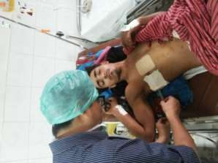
Preparation
Take universal precautions
Check the availability of medicines and functioning of equipments
Designate the role to each team member
Utilize pre hospital information

Slide 4
Initial assessment
Primary survey – Evaluates physiology
Secondary Survey – Evaluates anatomy

Slide 5
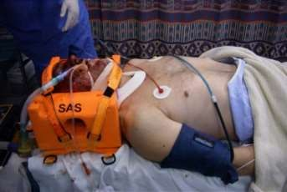
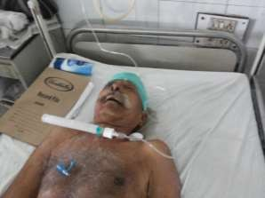
Primary survey
Primary survey and resuscitation of vital functions are done simultaneously using a
team approach

Slide 6
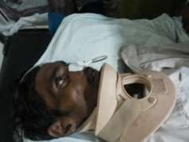
Primary Survey – ATLS way
Airway with c-spine protection
Breathing and ventilation
Circulation with hemorrhage control
Disability: Neuro status
Exposure with environmental control

Slide 7
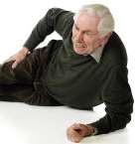
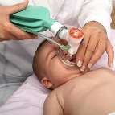
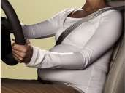
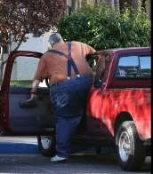
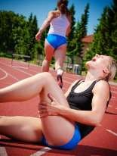
Primary Survey
Always consider physiological variations in special populations
Elderly
Infants and Children
Pregnant Women
Obese
Athletes
The priorities are same for all the patients

Slide 8
Quick Assesment
What is a quick, simple way to assess a patient in 10 seconds?
Ask the patient his or her name?
Ask the patient what happened?

Slide 9
Appropriate Response confirms
– Patent airway
– Sufficient air reserve to permit speech 3 – Sufficient perfusion
4 – Clear sensorium

Slide 10
Primary survey
Airway – Establish patent airway with c-spine protection
Clear the airway using wide bore suction
Chin lift / Jaw thrust manoeuvre
Oropharyngeal / nasopharyngeal airway
Definitive airway
(Cuffed, Secured endotracheal tube)
Surgical airway

Slide 11
15

Slide 12
Primary Survey
Breathing and ventilation – assess and ensure adequate oxygenation and ventilation

Slide 13
Breathing and Ventilation
Assess
Jugular venous distension
Position of trachea
Respiratory rate
Percussion findings of chest
Air entry
Oxygen saturation

Slide 14
Breathing and ventilation
Recognise and treat early –
Tension pneumothorax( is accumulation of air in the pleural space under pressure, compressing the lungs and decreasing venous return to the heart).
Flail chest(is a life-threatening medical condition that occurs when a segment of the rib cage breaks due to trauma and becomes detached from the rest of the chest wall) with pulmonary contusion( pulmonary contusion, also known as lung contusion, is a bruise of the lung, caused by chest trauma.

Slide 15
Breathing and Ventilation
Massive haemothorax
Open pneumothorax(air enters through a lesion in the chest wall (e.g., following penetrating trauma)Air enters the pleural space on inspiration and leaks to the exterior on expiration)
Immediate Chest decompression with
Oxygen delivery

Slide 16
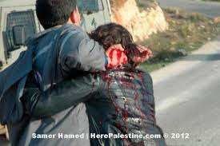
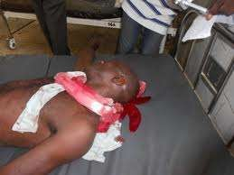
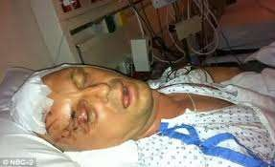
Circulation with haemorrhage control
After excluding tension pneumothorax, cause of hypotension is hypovolemia until proved otherwise

Slide 17
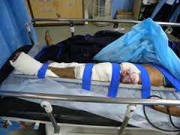
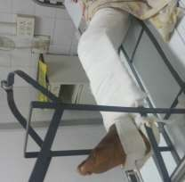
Circulation with haemorrhage control
Look for blood loss
External bleeding
Internal bleeding
  Chest
  Abdomen
  Pelvis
  Long bones

Slide 18
Circulation with haemorrhage control
Assess for organ perfusion
Level of consciousness
Skin color and temperature
Pulse rate and character

Slide 19
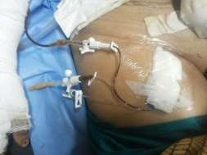
Primary Survey
Circulatory Management
Control hemorrhage
Restore volume
Pitfalls
Elderly
Children
Athletes
Medications
Reassess patient

Slide 20
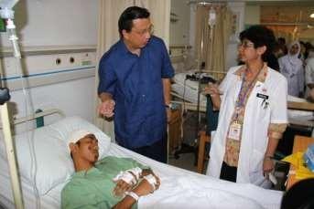
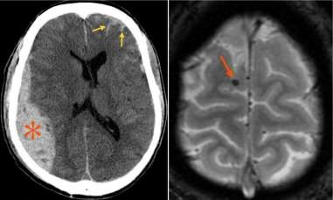
D- Disability : Neurologic status
Rapid neurological examination is done for -
Level of consciousness Glasgow Coma Scale (GCS)
Pupillary size and reaction

Slide 21
Primary survey - E
Expose the patient
Prevent hypothermia
Cover with warm blanket
Patient’s body temperature is more important than comfort of
healthcare providers

Slide 22
TO BE CONTINUED
THANK YOU FOR LISTENING

