Slide 1
Injuries of the knee
P.J. Okoth

Slide 2
Dislocation of the knee
Okoth

Slide 3
Pathology
Caused by high energy trauma e.g. RTA
Tibia is driven backwards and dislocates posteriorly upon the femur.
Can also dislocate:
Anteriorly
Medially
Laterally

Slide 4
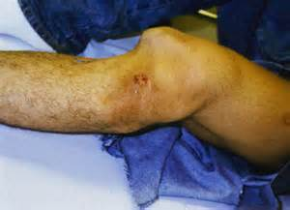
Knee dislocation

Slide 5
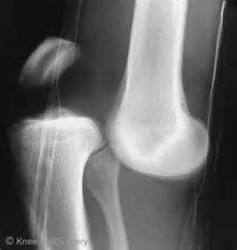
Knee dislocation

Slide 6
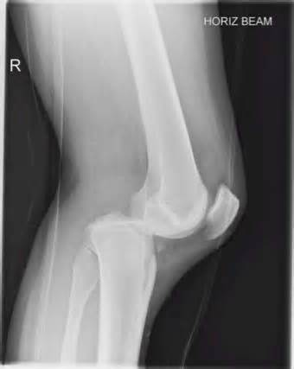
Knee dislocation

Slide 7
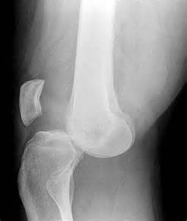
Knee dislocation - anterior

Slide 8
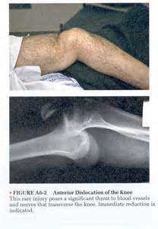
Knee dislocation

Slide 9
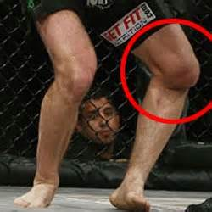
Knee dislocation

Slide 10
Complications
Immediate:
Neurovascular injury
Popliteal artery
Tibial nerve
Common peroneal nerve
This is especially the case in posterior dislocation.

Slide 11
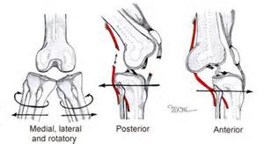
Knee dislocation

Slide 12
Complications …
Late complications:
Persistent instability of the knee (ligament injury with lengthening)
Restriction of knee movement
Osteoarthritis

Slide 13
Treatment
Reduction by traction and manipulation (or operation)
Then full length plaster for 8-10 weeks
Active quadriceps exercises
Thereafter mobilize the limb

Slide 14
FRACTURES OF THE PATELLA
OKOTH

Slide 15
Fractures of the patella
Cause:
May be caused by two types of injury:
A sudden violent contraction of the quadriceps muscle – as in attempting to preserve the balance after stumbling.
A fall or blow directly on the knee cap
Muscular violence usually causes a clean break with separation of the fragments
A direct blow causes a crack fracture or a comminuted fracture

Slide 16
Clinical features
Severe pain localized in the knee over the patella
Swelling of the knee
Haemarthrosis in the knee
Local tenderness over the knee

Slide 17
Diagnosis
Is made from clinical features and radiological findings.
Radiographically the fracture is shown best by:
Postero-anterior and
Lateral views
X-ray will show the fracture type:
Crack fracture without displacement
Clean break with separation of fragments
Comminuted fracture

Slide 18
Fracture of the patella with separation of fragments
Markedly swollen with possible haemarthrosis

Slide 19
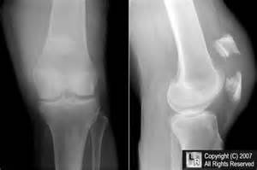
Fracture of the patella P/A and lateral views

Slide 20
Undisplaced fracture patella

Slide 21
Clean break with separation of fragments

Slide 22
Clean break with separation

Slide 23
Comminuted fracture with displacement

Slide 24
Comminuted fracture patella

Slide 25
Differential diagnosis
Ligamentous injuries of the knee
Congenital bipartite patella may be confused radiographically for a fracture.
In this condition the patella ossifies from two centers and the centers fail to coalesce and the gap in between could be confused with a fracture.
It can be differentiated from a fracture fragment by the presence of smooth, non-jugged edges at the gap, which has sclerotic cortical margins on each side. There is also no tenderness.

Slide 26
Treatment
Treatment depends upon the type of fracture and, in some cases upon the age of the patient.
Crack fracture without displacement:
No fear of separation occurring later because the aponeurosis clothing the patella on its anterior and lateral aspects is intact and holds the fragments in position.
Aim of treatment is to relieve pain and to preserve and restore function.

Slide 27
Treatment…
Crack fracture without displacement…:
A painfully tense haemarthrosis should be aspirated.
Protect the knee in a walking plaster (cylinder POP) for 3 weeks.
The plaster extends from the groins to the malleoli, with the knee in a position just short of full extension.
Thereafter active exercises to redevelop the quadriceps and to restore full knee mobility.

Slide 28
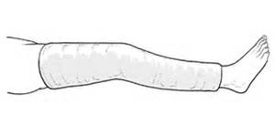
Cylinder cast

Slide 29
Treatment…
Clean break with separation of the fragments:
Operation is required
The fragments may be coapted accurately and fixed together rigidly by tension band wiring or with cannulated lag screws.
Reduction must be perfect and the fragments in intimate contact.
Any residual irregularity in the articular surface will lead to osteoarthritis later.

Slide 30
Treatment…
Clean break with separation of the fragments: …
Where accurate reduction is not possible due to comminution at the fracture site in osteoporotic bone, it is better to excise the patella.
After internal fixation, the knee should be protected in plaster for 2-3 weeks to allow healing of the soft tissues.
Begin active knee flexion and quadriceps exercises
Early walking with elbow crutches can be started
Unprotected weight bearing should be avoided for 6 weeks.

Slide 31
Patellar fracture with separation
See the fragments and forces causing separation

Slide 32
Tension band wiring
Use of K-wires and circlage wire

Slide 33
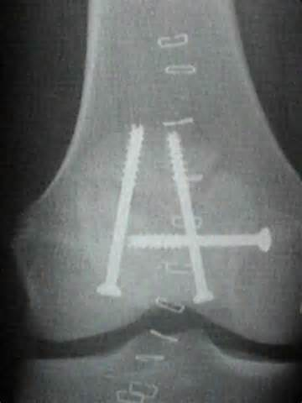
Cannulated lag screws have been used to fix this comminuted fracture

Slide 34
A cannulated lag screw
See that it has a hollow interior

Slide 35
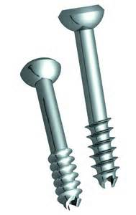
Cannulated lag screws

Slide 36
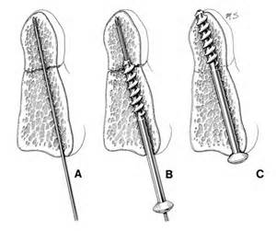
How cannulated lag screws are inserted

Slide 37
Treatment…
Comminuted fracture:
In comminuted fractures with displacement, excise the patella since it is impossible to restore a perfectly smooth articular surface.
Patella excision involves dissection of the bone from the aponeurosis of the quadriceps, and reconstruction of the aponeurosis by absorbable sutures. Tension is relaxed by holding the knee in full extension.
After operation protect knee in POP for 3 weeks with the knee in almost full extension.

Slide 38
Treatment…
Results of patella excision:
Gives excellent results provided the operation and post-operative treatment are carried out efficiently.
Active quadriceps exercises and leg raising exercises while in plaster
Exercises to redevelop the quadriceps and restore knee movement after plaster removal
The power of full extension is slightly impaired
There is some difficulty in ascending and descending stairs or ladders.

Slide 39
Ligament injuries of the knee
Okoth

Slide 40
Classification
Classified into four groups:
Tear of the medial ligament (with or without tear of the cruciate ligaments)
Tear of the lateral ligaments (with or without tear of the cruciate ligaments)
Tears of the cruciate ligaments alone
Strains or incomplete tears

Slide 41
Tear of medial ligament
Cause:
Injury that abducts the tibia upon the femur
Clinical features:
Swollen knee (blood-stained effusion – not tense)
Painful knee
Tenderness marked medially over the medial collateral ligament esp. upper end, close to its attachment to the femur.

Slide 42
Tear of medial ligament…
Diagnosis:
AP view X-ray of the knee joint while an abduction stress is applied to the tibia.
Complete rupture is indicated by the joint opening up on the medial side.
Treatment:
Non-operative (conservative) – for minor injuries
Operative – major tears involving even the capsule

Slide 43
Tear of medial ligament…
Conservative treatment:
Aspiration of the blood-stained effusion
Long leg plaster cast moulded closely to the limb to prevent abduction of the tibia on the femur
Allowed to walk on the plaster
Duration of POP is 6 weeks
Thereafter mobilizing exercises for the knee and to redevelop the quadriceps.

Slide 44
Tear of medial ligament…
Operative treatment:
Inspect joint structures
Remove any torn meniscus
Suture the rent in the capsule and medial ligament
Apply POP for 6 weeks

Slide 45
Tear of lateral ligament
Less common
Due to a force adducting the tibia upon femur
Serious risk of injury to the common peroneal nerve from stretching.

Slide 46
Tears of the cruciate ligaments
Cause:
Anterior cruciate ligament is torn by a force driving the upper end of the tibia forwards relative to the femur, or by hyperextension of the knee.
Posterior cruciate ligament is torn by a force driving the upper end of the tibia backwards.

Slide 47
Tears of the cruciate ligaments…
Diagnosis:
Anterior cruciate tear:
The tibia can be drawn forwards excessively (with knee flexed 90 degrees) compared to the normal side.
Posterior cruciate tear:
Posterior glide of the tibia upon the femur is increased.

Slide 48
Tears of the cruciate ligaments…
Treatment:
Immediate treatment is conservative
Immediate suture is unsatisfactory and ineffective
Later, reconstruction can be attempted using an aponeurosis or tendon as a substitute.
Strengthen the quadriceps by exercises.

Slide 49
Strain of the medial or lateral ligament
Strain = partial tear
Cause:
Medial ligament: abduction force on tibia upon femur
Lateral ligament: adduction force
Strain of medial ligament is much more common.

Slide 50
Strain of the medial or lateral ligament…
Clinical features:
History of an abduction or adduction injury
Painful knee at site of injured ligament
Swelling of the knee
Tenderness over the affected ligament
Applying stress to the ligament causes pain, but the knee is stable
Effusion of fluid within the joint
Flexion and extension of knee are restricted by a few degrees due to pain when the ligament is taut.

Slide 51
Strain of the medial or lateral ligament…
Differential diagnosis:
Torn meniscus
Arthroscopy is needed to differentiate
Course:
Strains tend to heal slowly
May take up to 2 months
Eventually full recovery is expected
Treatment:
If severe pain and tenderness, apply cylinder POP for 2 weeks. Thereafter, active exercises to strengthen the quadriceps muscle.

Slide 52
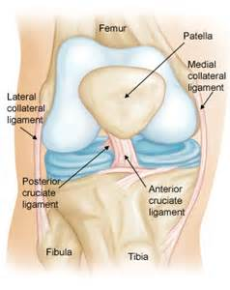
Normal knee

Slide 53
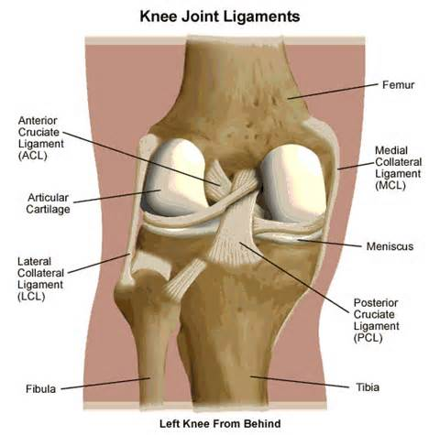
Ligament tears

Slide 54
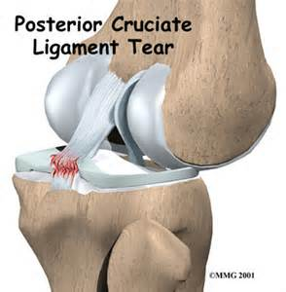
Tear of posterior cruciate lig.

Slide 55
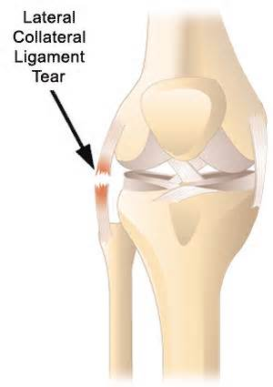
Tear of lateral collateral lig.

Slide 56
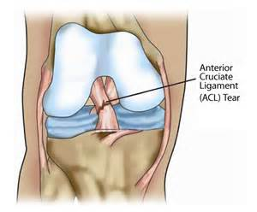
Tear of anterior cruciate ligament

Slide 57
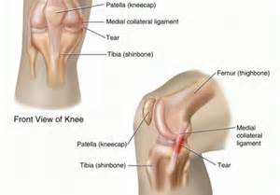
Tear of medial collateral ligament

Slide 58
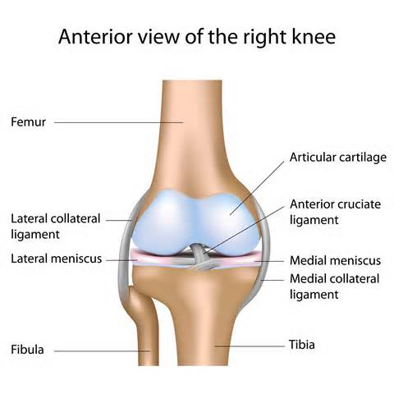
Normal knee

Slide 59
Tears of the menisci of the knee
Okoth

Slide 60
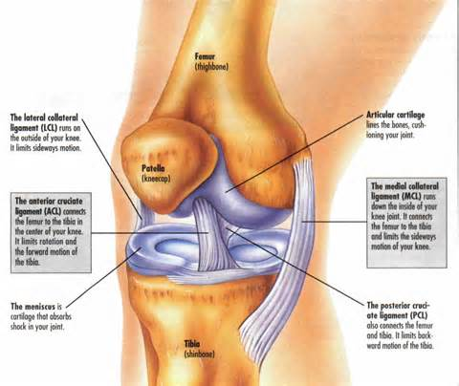
Menisci

Slide 61
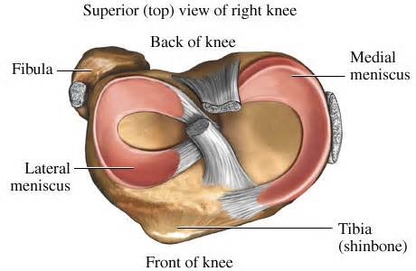
Normal menisci

Slide 62
Tears of the menisci
Cause:
A tear is usually caused by a twisting force with the knee semi-flexed or flexed.
The medial meniscus is torn much more often than the lateral.

Slide 63
Tears of the menisci…
Pathology:
There are three types of tear; all begin as a longitudinal tear.
“Bucket-handle” tear:
Tear extends throughout the length of the meniscus but the fragments remain attached at both ends.
Limits full extension of the knee (locking)
Condyle rolls upon tibia through the rent.

Slide 64
Tears of the menisci…
Posterior horn tear:
The fragment remains attached at its posterior horn
Anterior horn tear:
The fragment remains attached at its anterior horn.
The menisci of the knee are almost avascular; so when they are torn there is no effusion of blood into the joint.
However, there is an effusion of synovial fluid, secreted in response to the injury.

Slide 65
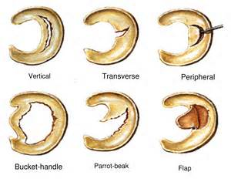
Tears of menisci

Slide 66
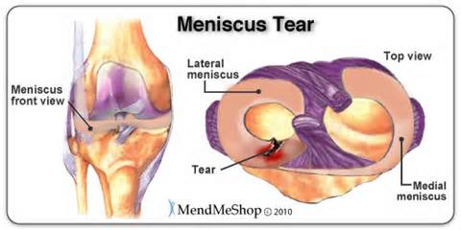
Tear of meniscus

Slide 67
Tears of the menisci…
Clinical features:
Medial meniscus:
History of twisting injury of the leg at the knee
Pain – antero-medial aspect of the knee joint
Unable to straighten knee fully
Next day, knee is swollen
Swelling lessens after about 2 weeks of rest, able to straighten knee and resumes activity.
Within weeks or months, the knee suddenly gives way again during a twisting movement, with symptoms a s above.
Similar incidents occur repeatedly.

Slide 68
Tears of the menisci…
C/F medial meniscal injury:….
On examination:
Effusion of fluid in the knee
Wasting of the quadriceps
Local tenderness in joint line antero-medially
Limitation of last few degrees of extension by a springy resistance
Sharp antero-medial pain if passive extension is forced.

Slide 69
Tears of the menisci…
Lateral meniscus:
Pain at the lateral rather than medial side of the joint, often poorly localized.
Diagnosis:
History (recurrent incidents with effusion)
Arthroscopy
Arthrography (injection of air or contrast then take an X-ray)

Slide 70
Tears of the menisci…
Treatment:
Excise the displaced fragment or whole meniscus
Treatment of locked knee:
Manipulation under anaesthesia
Extends the tear in ‘bucket-handle’ tear, so that the fragment moves further towards the middle of the joint, to the intercodylar region.
This allows for greater freedom of movement.

Slide 71
The end.
Thanks.

