Slide 1

Introduction and Human Communication
Samuel N. Kiurire

Slide 2
PROFESSIONAL OBLIGATIONS
Your professional obligations, the expectations placed upon you by the public, the law and your colleagues, start on your first day as a student and continue throughout your working life.
When you are dealing with patients, always preserve their dignity by observing the following:
Attitude - 'How would I be feeling in this patient's situation?'
Behaviour - Always treat patients with kindness and respect
Compassion - Recognize the human story that accompanies each illness
Dialogue - Acknowledge and understand the individual.

Slide 3
CONFIDENTIALITY AND CONSENT
The qualities that patients look for in a clinician:
Humaneness
Competence
Accuracy
Honesty
Openness
Responsiveness
Involving the patient in the decision-making process
Trustworthiness
Time to listen

Slide 4
CONFIDENTIALITY AND CONSENT
The duties of a clinician:
The care of your patient is your first concern
Protect and promote the health of patients and the public
Provide a good standard of practice and care
Treat patients as individuals and respect their dignity
Work in partnership with the patient
Be honest and open, and act with integrity

Slide 5
PERSONAL RESPONSIBILITIES
Always look after yourself and maintain your own health.
Protect yourself, your patients and your colleagues by being immunized against common but serious communicable diseases where vaccines are available: for example, hepatitis B.
Your professional position is a privileged one and must not be used to establish or pursue a sexual or improper emotional relationship with a patient or someone close to them.
Do not give medical care to anyone with whom you have a close personal relationship.

Slide 6
DRESS AND DEMEANOUR
The way you dress is important in establishing a successful patient-clinician relationship.
Your dress style and demeanour should never make your patient or your colleagues uncomfortable or distract them.
Some medical schools or hospitals require students and medical staff to wear white coats for reasons of professionalism and identification.
Whenever you see a patient or relative, introduce yourself fully and clearly.
A friendly smile helps to put your patient at ease.
Always wear a name badge which is easily visible to the patient.

Slide 7
COMMUNICATION SKILLS
Clinicians who communicate well are able to identify a patient's problem more rapidly and accurately, while their patients benefit from a better understanding of their condition and its management.
Good communication skills are the most important part of being a good clinician.
These should always include:
maintaining good eye contact
checking the patient's prior knowledge or understanding
active listening
encouraging verbal and non-verbal communication
avoiding jargon
ability to discuss difficult issues
going at a pace that is comfortable for the patient.

Slide 8
EXPECTATIONS AND RESPECT
The best doctors are invariably the most humble.
Much of this stems from their recognition that humans are infinitely more complex, demanding and fascinating than one can imagine.
Additionally, they understand that much so-called medical 'wisdom' is at best incomplete, and often simply wrong.

Slide 9
History taking
People visit doctors because something unexpected has happened to them, usually an ongoing problem, a relatively minor complaint or something that 'isn't right‘.
The first and major part of the consultation is talking with the patient.
Communication is integral to the clinical examination and is most important both at the start of the interview, to gather information, and at the end, to find common ground and engage your patients in their management.
These are the principles of patient-centred medicine.

Slide 10
Patient-centred medicine
Patient-centred medicine emphasizes the communication skills that will help you understand the patient as a whole person, and which should be part of any clinical encounter.
Good communication supports the building of trust between doctor and patient and helps you provide clear and simple information.
It allows you and the patient to understand each other and to agree goals together.
Communication means much more than 'taking a history'; it is the only way to effectively involve patients in their healthcare.
Poor communication leads to misunderstanding, conflicting messages and patient dissatisfaction, and is the root cause of complaints.

Slide 11
Effective communication skills
Improve patient satisfaction
Patients understand what is wrong
They understand what they can do to help
Improve doctor satisfaction
Patients are more likely to follow advice when they agree mutual goals with their doctor
Improve health by positive support and empathy
Improving health outcomes
Enhancing the relationship between doctor and patient
Use time more effectively
Active listening helps the doctor recognize what is wrong
Active listening leads to fewer patient complaints

Slide 12
Consulting with patients (BASICS)
Beginning
Setting up
Preparation
Introduction
Active listening
The patient's experience of his illness
Systematic enquiry
Disease-oriented systematic enquiry
Information-gathering
Clinical examination
Context
Understanding your patient as a person
Sharing
Information
Agreeing action and goals

Slide 13
The presenting complaint
The next step is to establish your patient's presenting complaint.
To make a diagnosis, experienced clinicians recognize patterns of symptoms.
By seeing as many patients as possible and observing colleagues, you will, with experience, refine your questions according to the presenting complaint.
After obtaining details of the nature and circumstances of the presenting complaint, you should be able to produce a differential diagnosis before you examine the patient.

Slide 14
Further Readings
Read the following subject for the next class:
History Taking

Slide 15
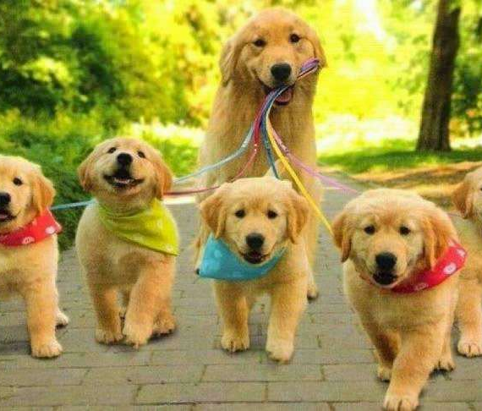
Thank you
END OF PRESENTATION

