Slide 1
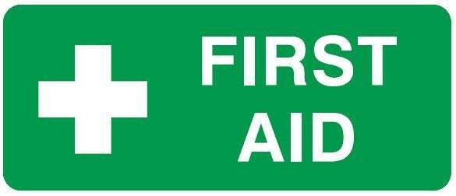
Introduction to First Aid
Samuel Ngigi K.

Slide 2
Introduction to First Aid
First aid is the initial care of a sick or injured person.
First aid can save live in the critical time before emergency services arrive.
The key aims of first aid are:
Preserve life of anyone involved in the incident
Protect any unconscious person
Prevent any further injury or existing injury becoming worse
Promote recovery of casualty

Slide 3
First Aid Legal Obligations
Consent
Before providing first aid you must obtain consent from the casualty or their parent/guardian/carer.
For example: You can say to the casualty. “I am a first aider, can I help you?’’
If the casualty is reluctant to accept your help by it appear obvious they are seriously injured or unwell then you should call an ambulance or the emergency services.
If the casualty is unconscious or is unable to communicate the law assumes that the casualty would give their consent.

Slide 4
First Aid Legal Obligations
Duty of Care
As a first aider you do not automatically have a legal obligation to provide first aid care to any person unless you already have a “duty of care” to that person. People who may have an existing “duty of care” can include workplace first aiders, teachers, carers and family members.
If you start to provide first aid to a casualty, then you have established a voluntary “duty of care” and you should do all you can safely do to care for the casualty until emergency services arrive.

Slide 5
First Aid Legal Obligations
Negligence
As a first aider it is unlikely that you wold be consider negligent when you provide first aid care to a casualty if you follow accepted first aid guidelines.
The following would need to be established for negligence to be proven.
The first aider owed a duty of care to the casualty and did not prove any care
The expected level of first aid care was not provided to the casualty
The casualty suffered further injury as a result of the care given
The was come direct relationship between the first aider’s actions and the injuries sustained

Slide 6
Assessing a sick of injured person
The ability to gather information about the condition of the casualty can help you make an accurate assessment. Collecting as much information as possible about the history, signs and symptoms that relate to an incident will help you in deciding what has happened and how to care for the casualty.

Slide 7
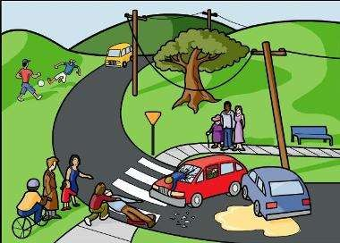
Assessing a sick of injured person
History
Being able to establish what has happened. You can do this by observing the scene and by questioning the casualty, witnesses or bystanders.

Slide 8
Assessing a sick of injured person
Signs
Signs are things you can observe when assessing the casualty’s condition. These can include:
Breathing rate, depth and effort required
Speed, strength and evenness of pulse
Skin colour and/or temperature
Level of consciousness
Visible wounds, injuries or deformities

Slide 9
Assessing a sick of injured person
Symptoms
A symptom is something the casualty usually tells you they are feeling. If the casualty is unconscious you will need to rely on your observations.
Symptoms can include:
Nausea
Discomfort
Pain or tenderness
Feeling hot or cold
Loss of sensation of feeling
Dizziness

Slide 10
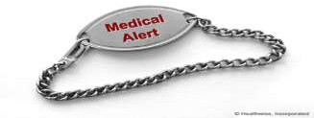
Assessing a sick of injured person
Medical History
A person with an existing medical condition may have information with them about their condition.
Medical information could be:
SOS bracelet or pendant
Medic Alert bracelet or medallion
Other written information
Information from colleagues, family members or witnesses
Any medications they are taking

Slide 11
Assessing a sick of injured person
Assessing a casualty
When assessing a casualty look for and deal with any life threatening injury or illness first.
You should then undertake a secondary assessment of the casualty to identify any other injuries or illnesses you may need to care for until the ambulance or medical care arrives.

Slide 12
Assessing a sick of injured person
Assessing a casualty cont.
Steps
Question the casualty or witness about the history of the incident
Conduct a careful head to toe assessment of the casualty (if the casualty is conscious explain what you are doing and ask for permission)
Look for any signs or symptoms
Care for the most serious injury or illness first
If there is more than one casualty care for the casualty with the most serious injury or illness first
Get any bystanders to assist if needed
Monitor and record casualty’s vital signs until an ambulance or medical aid arrives

Slide 13
Assessing a sick of injured person
Vital Signs
What are vital signs? A casualty’s vital signs can include pulse, breathing, level of consciousness, skin colour and temperature and their eyes can give you a good indication of their overall wellbeing.
You will need to check, monitor and record a casualty’s vital signs every few minutes. This will enable you to
establish if the casualty’s condition is stable, improving
or deteriorating. It will also be very useful information to pass on to the medical personnel when they take over care of the casualty.

Slide 14
What to look for:
Pulse
Fast or slow? Weak or strong?
Regular or irregular?
Breathing
Fast of slow? Deep or shallow?
Easy or hard to breathe?
Consciousnes
s
Fully alert and able to understand questions clearly?
Drowsy or confused?
Unconscious?
Skin
Cold, sweaty, hot or dry?
Pale or flushed?
Eyes
Pupils react to light?
Both pupils react in the same way?

Slide 15
Infection Control
As a first aider you may be concerned that you could catch some kind of infectious disease. In any first aid incident there is a risk of “cross
infection”.
To reduce the risk of cross infection there are some standard precautions that you should always follow. You should always assume that blood and bodily fluids are potential sources of infection.

Slide 16
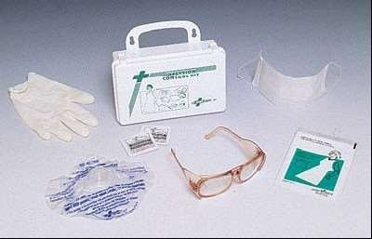
Infection Control
Here are some standard precautions:
Always use Personal Protective Equipment (PPE)
Gloves
Eye protection
Resuscitation mask or face shield
Protective clothing

Slide 17
Infection Control
Always treat every casualty as if there is an infection present
Use sterile or clean dressing whenever possible
Wash hands before and as soon as possible after contact with casualty
Take care when cleaning up blood, bodily fluids and contaminated items
Seek urgent medical advice if exposed to risk of infection

Slide 18
Communicating in an emergency
It is important to be able to communicate clearly in an emergency situation. You will need to be able to gather information about what happened, provide advice and reassurance to the casualty and give accurate information to emergency services.

Slide 19
Communicating in an emergency
Steps
Speak clearly and calmly
Introduce yourself to the casualty and tell them you are a first aider
Ask the casualty their name and use it when talking to them
Keep your communications short and simple
Avoid medical jargon or slang
Listen carefully and watch for non-verbal clues
Do not make assumptions – ask questions if you are not sure of anything
Explain to bystanders what you are doing and why
Follow any instructions given to you by emergency services
Always be away of the casualty’s feelings and feelings of bystanders or family members

Slide 20
First aid care records
First aid care records are important part of managing any first aid incident. Accurate records and incident reports are often legal requirement in workplaces and they can assist in investigations into an incident.
They should be:
Clear and easy to read
Written in ink (do not use correction fluid or tape)
Accurate and include all relevant facts
Signed and dated by the first aider and casualty (if possible)

Slide 21
First aid care records
If possible use an injury or incident report form.
First aid care records should include at least the following information:
Full name and date of birth of casualty
Date, time and location of the incident/assessment
History of illness or injury
Description of incident
Description of illness or injury
Sign, symptoms and observations taken
First aid care of advice given
Method of referral and transport to medical aid
Name and contact details of first aiders and any witnesses

Slide 22
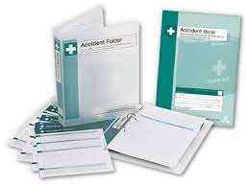
First aid care records
First aid care documents are confidential and the information in them should only be released if requested by an authorised person.

Slide 23
End of Presentation
Thank You

