Slide 1
INTRODUCTION TO PAEDIATRICS AND CHILD HEALTH I
R.IRERI

Slide 3
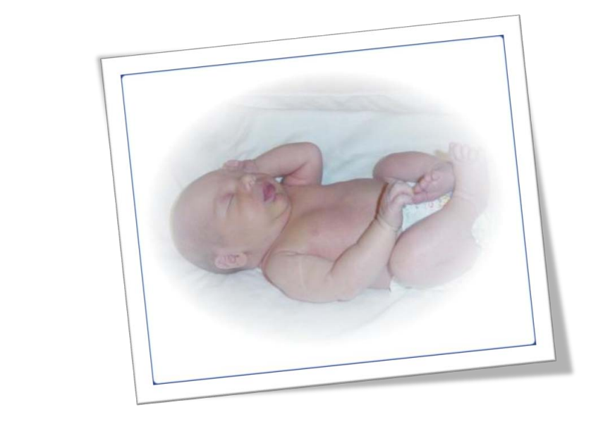

Slide 4
Team around the child

Slide 5
Learning outcomes
By the end of this lesson, the learner should be able to:
Define paediatric terminologies
Explain concepts and principles in Paediatrics
Take a comprehensive pediatrics hx and examination
Examine a sick child

Slide 6
LEARNING OUTCOMES
Manage neonatal conditions
Explain the concept of growth and development
Manage nutritional disorders
Carry out immunization of immunizable diseases
Manage tropical diseases
Manage respiratory conditions and diseases
Integrate the principles of IMCI and ETAT plus in the management of common childhood illness

Slide 7
What do people Say about paediatrics ?
Single most important deals with growth and development of child size, form, complexity of functions
One of broadest and most interesting medical speciality
What do student say?

Slide 8
DEFINATION OF TERMS
Paediatrics-this is a branch of medicine or medical science dealing or concerned with the development, care and diseases of infants, children and adolescents and their treatment. The word “peadiatrics” means “healer of children”; they are derived from two Greek words: (pais = child) and (iatros = doctor or healer). Abraham Jacobi (1830–1919) is known as the father of paediatrics.

Slide 9
Defn. Is the field of medicine that is concerned with the health of infants, children, and adolescents; their growth and development; and their opportunity to achieve full potential as adults.

Slide 10
Neonatology: is a medical specialty of care of newborn babies, sick babies and premature babies Neo-new natal—birth ology---science of

Slide 11
Neonatology-is a subspecialty of paediatrics that consists of the medical care of newborn ,either the ill or premature newborn. Its practiced in neonatal intensive care units (NICU) commonly known as New born units (NBU) in our setup.

Slide 12
Neonate:-This is a newborn aged less than 28 days. Term baby:—a baby born after 37wks completed gestation Low birth weight:—is a baby weighing less than 2.5kgs at birth.

Slide 13
Preterm:- baby born before 37 weeks gestation A preterm can be an (AGA)- appropriate for gestational age small for gestational age(SGA) or LGA –Large for gestational age

Slide 14
Very low birth weight (VLBW) –Is a baby weighing 1.5kgs 0r less Extremely low birth weight– is a baby weighing 1kg or less Incredibly low birth weight-- 750g or less. LGA=Birth wt > 90th centile for gestational age. SGA– Birth wt < 10th centile for gestational age

Slide 15
Infant mortality rate:- number of deaths in the 1st 12months per a 1000 live births Neonatal mortality rate:-no. of deaths in the 1st 28 days per a thousand live births Perinatal mortality rate:- still births and neonatal deaths up to 7 days per 1000 total births

Slide 16
Perinatal mortality =includes all stillbirths &neonatal deaths in the 1st wk of life. It is any death or abortion > 500g or death at 24 wks and more still birth – a baby born after 24 weeks gestation of pregnancy and does not show at any time signs of life (cardiopulmonary activity Neonatal mortality accounts for 50% of infant mortality in developing countries

Slide 17
A normal newborn is a baby born between 37—41wks weighs 2.5kgs—4kgs head circumference 33—37cm APGAR score 7—10 length 50cm, no abnormalities & does not require resuscitation at birth

Slide 18
MUST BE CONTINUALLY AWARE OF:
Difference in maturity (physiological) of new-born, young infant as compared to young child/adolescent.
Function of various organ systems
Degree of immunity to diseases
Response to effect of diseases
Drug dosage and tolerance
Mental and motor emotional response

Slide 19
GENETICS
Genetics governs the seed
First to observe deviations occasioned by defective genes.:genetical disorders
Malformations (Downs syndrome, Turners syndrome)
Enzymatic abnormalities inborn errors of metabolism i.e glycogen storage disorder
Growth & development

Slide 20
PRE-NATAL EVENTS
This is the soil in which the seed grows
Adverse events causes deformity, prematurity, disability i.e.
Maternal malnutrition
Acute or chronic maternal disease
Maternal infections (viral)
Irradiation
Cytotoxic drugs thalidomide
Rhesus incompatibility

Slide 21
LABOUR AND DELIVERY
Launched into the outside world
● A newborn may be profoundly affected by the events of labour and delivery.
Knowledge of:-
Where the baby was born
Mothers health condition
Parity of the mother
Type of delivery
Duration of labour
Rupture of membranes
Drugs used
Maternal haemorrhage
Infants condition at birth
? Resuscitation
Mature of premature

Slide 22
Infant:- 1st year of life
Young infant:- less than 2 months Toddler :- a baby aged 2years Preschooler:- 2--5 years old A school child:- above 5 year— Adolesence:-10—nineteen

Slide 23
NEW BORN PERIOD (FIRST MONTH)
Babies from birth to one month of age
Rapid adaptive adjustment to extra-uterine existence (Anatomy, physiology, behaviour)
size, maturity
Events usually proceed normally
BUT:
Congenital malformations are evident
Birth damage
Infections

Slide 24
NEW BORN PERIOD (FIRST MONTH) cont.
Special problems
Resuscitation
Maintenance of respiration
Special feeding methods
Fluid electrolyte therapy
Drug dosages
Anaemia/Hyperbilirubinemia
Vomiting/diarrhoea
Surgical conditions

Slide 25
INFANCY/ TODDLER PERIOD TO 2 YEARS
ERA OF EXTREME RAPID GROWTH AND
DEVELOPMENT
(Physically, mentally, emotionally)
Organ systems mature rapidly
Better control of physiological and biochemical function
Infant doubles birth weight 6 months, triples by 1 year
Length increases rapidly

Slide 26
INFANCY
Infant gains increasing neuromotor ability passing well defined stages of achievement
First 2 years cardinal to emotional development, formative years in development of personality
Physical growth and development, records are kept. Simple test for motor, language, adaptive personal social fields.

Slide 27
PRESCHOOL
SLOWER RATE OF GROWTH (mental, emotional development, more fixed)
Well established in diet
Chronic malnutrition evident
Leaves confines of home into world – nursery school
Personal adjustments
Common infections – URTI
Malignant conditions
Renal problems
Syndromes of brain damage (cerebral palsy, epilepsy, mental retardation, speech, hearing)

Slide 28
PRESCHOOL
SCHOOL PERIOD
Upper respiratory tract infections
Rheumatic he

Slide 29
UNDERSTANDING CHILD DEVELOPMENT

Slide 30
DEVELOPMENTAL STAGES

Slide 31
DEVELOPMENTAL LINES

Slide 32
MILESTONES

Slide 33
MILESTONES

Slide 34
COGNITIVE DEVELOPMENT

Slide 35
CRITICAL LEARNING PERIODS

Slide 36
COMMUNICATNG WITH CHILDREN

Slide 37
Why is communicating with children important?

Slide 38
Why is communicating with children important?

Slide 39
REMEMBER!!!!

Slide 40
KEY ASPECTS IN COMMUNICATING WITH CHILDREN

Slide 41
KEY ASPECTS IN COMMUNICATING WITH CHILDREN

Slide 42
BARRIERS TO COMMUNICATING WITH CHILDREN

Slide 43
BABIES

Slide 44
0-12 MONTHS

Slide 45
INFANTS 1-12 MONTHS

Slide 46
INFANTS

Slide 47
TODDLERS AND PRESCHOOLERS

Slide 48
TODDLERS: 12-36 MONTHS

Slide 49
TODDLERS: 12-36 MONTHS

Slide 50
PRESCHOOLERS- 3-6 YEARS

Slide 51
PRESCHOOLERS- 3-6 YEARS

Slide 52
PRESCHOOLERS- 3-6 YEARS

Slide 53
SCHOOL GOING CHILDREN

Slide 54
SCHOOL AGED CHILDREN: 6-12 YEARS

Slide 55
SCHOOL AGED CHILDREN: 6-12 YEARS

Slide 56
SCHOOL AGED CHILDREN: 6-12 YEARS

Slide 57
ADOLESCENTS

Slide 58
ADOLESCENTS:12-18 YEARS

Slide 59
PAEDIATRICS CONSISTS OF ENDLESS VARIATIONS REMEMBER: THE CHILD IS NOT A LITTLE ADULT

Slide 60
QUIZ
Why is it important to learn about different categories of infants?
What factors influence infant and neonatal mortality in Kenya?
Define the following terms; LBW, VLBW, Perinatal mortality rate, infant mortality rate, normal newborn, Still birth.
Manage LBW and premature babies

Slide 61
QUESTIONS !!!!!!!!!!!!!!!

