Slide 1
THE PAEDIATRIC HISTORY AND PHYSICAL EXAMINATION IRERI

Slide 2
The difference btn children and adults to be considered during history taking include:- 1) Hx is obtained indirectly from adults. 2) The impact of genetic, environmental & social factors is often more pronounced

Slide 3
The predominant impact of disease may be on the growth and development of children. The growth devpt. Status of children may influence the expression of disease. Clinical norms in children differ with age and from those of adults

Slide 4
Paediatric History
Complete history is necessary and it leads to the correct diagnosis in the vast majority of children
Usually is obtained from the parent, the older child, or the caretaker of a sick child
A short, rapidly obtained history of the events of the immediate past may suffice temporarily, but as soon as the crisis is controlled, a more complete history is necessary

Slide 5
Paediatric History (Continued)
A convenient method of learning to obtain a meaningful history is to ask systematically and directly, however sometimes indirect method is used.
During the interview, it is important to convey to the parent interest in the child as well as the illness
Allow the parent/caretaker to talk freely at first and to express concerns in his or her own words

Slide 6
Paediatric History (Continued)
The interviewer should look directly either at the parent or the child intermittently and not only at the writing instruments
A sympathetic listener who addresses the parent and child by name frequently obtains more accurate information than does a harried, distracted interviewer
Careful observation during the interview frequently uncovers stresses and concerns that otherwise are not apparent

Slide 7
General Information
Identifying data
-Date of interview
-Name of the child
-Age, birth date and sex
Informant
-Religion
-Birth weight and current weight
-Expected weight
-Current height and expected height

Slide 8
Cont…
-Date of admission and date of clerking
-Inpatient no.
Patient bed number
-Referral source if pertinent
-Relationship of the child with the informant
-Contacts: address, telephone numbers of informants
-Next of kin

Slide 9
Chief Complaint
Given in the informant's or patient's own words, the chief complaint is a brief statement of the reason why the patient was brought to be seen
It is not unusual that the stated complaint is not the true reason the child was brought for attention
Expanding the question of "Why did you bring him?" to "What concerns you?" allows the informant to focus on the complaint more accurately
Record them in a chronological order

Slide 10
History of Present Illness
Details of the present illness are recorded in chronologic order
For the sick child, it is helpful to begin: "The child was apparently well until "X" number of days before this visit“
This is followed by a daily documentation of events leading up to the present time, including signs, symptoms, and treatment, if any
Statements should be recorded in number of days before the visit

Slide 11
Review of other Systems
Addresses information about systems that where not touched in the history of present illness
This should be done systematically to avoid omissions
" Questions concerning each system may be introduced with a question such as: "Are there any symptoms related to . . .?"

Slide 12
Birth History
Prenatal/Antenatal History
Questions to be answered include those regarding the health of the mother during this pregnancy
The number of previous pregnancies and their results
Radiographs or medications taken during the pregnancy
Results of serology and blood typing of the mother and baby
If the mother's weight gain has been excessive or insufficient, this also should be noted

Slide 13
Cont..
No. of antenatal visits attended
Immunizations received during antenatal i.e TT
Supplements given i.e iron sulphate and folic acid
Preexisting chronic conditions
ANC Profile

Slide 14
Natal History
Any remarkable events during delivery, length of labour, delivery, nature of labour, type, of delivery, place of birth, color of the baby, cry, birth weight, any immediate problems – resuscitation, incubation, feeding problem, breathing problems

Slide 15
Natal History
The duration of pregnancy, the ease or difficulty of labor, and the duration of labor is important
The type of delivery (spontaneous vertex , forceps-assisted, or caesarean section), type of anesthesia or analgesia used during delivery and presenting part (if known) are recorded
Note the child's birth order (if there have been multiple births) and birth weight

Slide 16
Postnatal History
Many informants are aware of Apgar scores at birth and at 5 minutes, any unusual appearance of the child such as cyanosis or respiratory distress, and any resuscitative efforts that took place and their duration
lf the mother was delayed in seeing the infant after birth, reasons should be sought
Time taken to breastfeed after birth
The time of onset of any abnormal states may be significant

Slide 17
Postnatal History (Continue)
The history of each past illness should include onset, duration, course, and termination
If hospitalization or surgery was necessary, the diagnosis dates, and name of the hospital should he included
Questions concerning allergies including any drug reactions, food allergies, hay fever, and asthma
Accidents, injuries, and poisonings should be noted

Slide 18
Past medical and surgical hx
No. of previous admissions
Hx of previous surgeries
Hx of food and drug allergies
Hx of blood transfusions
hx of chronic illness and chronic medications

Slide 19
Nutritional History/ dietary
Note whether the baby was breast- or bottle-fed and how well the baby took the first feeding
If the infant has been bottle-fed, inquire about the type of formula used and the amount taken during a 24-hour period
Determine the ages at which solid foods were introduced and supplementation, e.g. with vitamins, took place as well as the age at which weaning occurred and the method used to wean

Slide 20
Initiation of breast feeding after birth.
Exclusive breast feeding
Other foods ( type, frequency)
When Complementary feeding started
What, who, when
Feeding problems
Current diet
Any change in appetite in the current illiness

Slide 21
Developmental History
Estimation of physical growth rate is important. Attempt to ascertain the birth weight, subsequent weights and Lengths are desirable
Any sudden gain or loss in physical growth should be noted particularly, because its onset may correspond to the onset of organic or psychosocial illness

Slide 22
Developmental History (Continued)
It may be helpful to compare the child's growth with the rate of growth of siblings
Ages at which major developmental milestones were met aid in indicating deviations from normal
Ages of dressing self, tying own shoes, hopping, skipping, and riding a tricycle and bicycle should be noted, as well as grade in school and school performance

Slide 23
Milestones
Neck support
Sitting
Crawling
Standing
Walking
Speaking
School going (level)
Comment on milestones(up to date, delayed or regressed)

Slide 24
Immunization History
The types of immunizations received, with the number, dates, sites given, and reactions should be recorded as part of the history
Determine missed opportunity or need for booster immunizations

Slide 25
Birth - BCG, OPV°
6/52 - OPV¹, Pentavalent 1 (diphtheria, pertussis, tetanus, H-influenza, hepatitis B)
Pneumococcal 1
Rota virus vaccine 1
10 weeks = OPV 2, Penta2, pneumo 2, rota 2
14 weeks = OPV 3, Penta 3, pneumo 3,
9 months = measles, yellow fever
24 months – measles 2

Slide 26
Family and Social History
The family history provides evidence for considering familial diseases as well as infections or contagious illnesses
A genetic type chart is easy to read and very helpful. It should include parents, siblings, and grandparents, with their ages, health, or cause of death
If a genetic type chart is used, pregnancies should be listed and should include the health of the siblings

Slide 27
Family and Social History (Continued)
Details of the family unit should include the number of people in the habitat and its size, the marital status of the parents, the significant caretaker, the total family income and its source
Sometimes it may be necessary to interview the other parent.

Slide 28
Family history
Position of the child
Siblings A/W, ages
Parents health/ cause of death
Chronic familial diseases (Child’s risk of developing certain chronic diseases

Slide 29
Personal social economic history
Economic status of the parents
Habits of the parents, level of the patient at school.
Living environment – housing
Refuse disposal
Water use
Hobbies of the patient

Slide 30
Physical examination

Slide 31
Requirements
Well lit room
Chair
Examination coach
Stethoscope
sanitizer
Sterile gloves
Tongue depressant
Thermometer

Slide 32
PHYSICAL EXAMINATION
Examination of the infant and young child begins with observing him or her and establishing rapport
The order of the examination should fit the child and the circumstances
It is wise to make no sudden movements and to complete first those parts of the examination that require the child's cooperation
Painful or disagreeable procedures should be deferred to the end of the examination, and these should be explained to the child before proceeding
For the older child and adolescent, examination can begin with the head and conclude with the extremities

Slide 33
PHYSICAL EXAMINATION (Continued)
The approach is gentle, but expeditious and complete
For the child communication frequently permits an orderly examination
Some children are best held by the parent during the examination
For others, part of the examination may require restraint by the parent or assistant

Slide 34
PHYSICAL EXAMINATION (Continued)
When the complaint includes a report of pain in a certain area, this area should be examined last
If the child has obvious deformities, that area should be examined in a routine fashion without undue emphasis, because extra attention may increase embarrassment or guilt

Slide 35
PHYSICAL EXAMINATION (Continued)
Only the part that is being examined needs to be uncovered and then it can be re-clothed
Except during infancy, modesty should be respected and the child should be kept as comfortable as possible
With practice, the examination of the child can be completed quickly even in most critical emergency states

Slide 36
PHYSICAL EXAMINATION (Continued)
Only in those with apnea, shock, absence of pulse, or, occasionally, seizures is the complete examination delayed
Although the method of procedure may vary, the record of examination should be in the same format for all children
This provides easy access to needed information later

Slide 37
General Examination/survey
General condition –state of health how well or sick, conscious level
nutritional status,
pallor, jaundice, cyanosis,
dehydration, oedema, finger clubbing, lymphadenopathy
any other visible abnormalities,
the attitude of the child towards the parent and health professional,

Slide 38
General Appearance
A statement should be recorded about the alertness, distress, general development, and nutrition of the child
Mental status, activity, unusual positions, or apprehension or cooperativeness may direct one to consider an acute or chronic illness or no illness at all
The child who lies quietly, staring into space, may be gravely ill

Slide 39
General Examination
Face-rashes, colour of skin
Head- fontanelle, eyes
Skin colour-pallor,jaundice,hypo/hyperpigmentation,cyanosis(tongue n gums ).
Hands-fingerclubbing
Nails-koilonychias (spoon nails- iron def)
Tremors-liver dse
Feet-ulcers esp in diabetic children

Slide 40
Cont…
Oedema-both feets, sacral oedema
Lymphatics-lymphnodes-cervical,inguinal,submental
Mouth-oral trush,false teeth,gums.
Hair distribution, colour and texture
Fontanelles-anterior and posterior
Capillary refill
Dehydration-skin turgor,eyes (sunken), fontanell

Slide 41
VITAL SIGNS
Temperature
-Measured from the axilla or rectum.
(normal range 36.5°c to 37.4°)
Pulse rate
-Can be obtained at any peripheral pulse (femoral, radial, or carotid)
assess rate, rhythm, character from the radial pulse.
-The normal rate varies from; (80-160) depends with age

Slide 42
VITAL SIGNS (Continued)
Respiratory rate
-Should be determined by counting while observing the movement of the chest for complete one minute. Varies with age
(< 60 newborn/young infant, <50 infants, < 40 1-5years
Blood pressure
-Should be measured with a cuff, with the bladder completely encircling the extremity and the width covering one half to two thirds of the length of the upper arm or upper leg

Slide 43
Checking for cyanosis

Slide 44
Capillary refill

Slide 45
Cont….

Slide 46
Palmar pallor

Slide 47
Skin turgor

Slide 48
ANTHROPOMETIC MEASUREMENTS
These include Length /Height, Weight, Head circumference (OFC-occipital frontal circumference) and MUAC
To obtain height and weight recordings, measure the infant supine up to the age of 2 years, and standing thereafter
Measure head circumference in all infants less than 2 years of age and in those with misshapen heads

Slide 49
SYSTEMIC EXAMINATION
Examine all systems thoroughly
Start with the system that is mostly affected
Examination should be systematic
- Inspection
- Palpation
- Percussion
- Auscultation
Examination should be head to toe

Slide 50
HEENT
Identify the anterior and posterior fontanels and assess them for fullness.
Observation of the head size,shape, and symmetry.
Note facial features, ear size and hair whorls as part of the examination for dysmorphic features
Check red reflex (corneal opacities and intraocular masses)
Check for strabismus via corneal light reflex or cover test.
Assess dentition, oral mucosa and pharynx.
Assess hydration of the mucous membranes.
Examine the tympanic membranes using pneumatic otoscopy.

Slide 51
Neck
Palpate for lymph nodes (knowing anatomic areas they drain)
Recognize and demonstrates maneuvers that test for nuchal rigidity.
In Older children- note thyroid size and texture

Slide 52
Chest
Assess rate, pattern and effort of breathing, recognizing normal variations.
Recognize grunting, nasal flaring, stridor, wheezing, crackles/rales and asymmetric breath sounds.
Distinguish between inspiratory and expiratory sounds.
Interpret less serious respiratory sounds such as transmitted upper airway sounds.

Slide 53
Cardiovascular
Identify the pulses in the upper and lower extremities through palpation.
Observe and palpate precordial activity.
Assess cardiac rhythm, rate, quality of the heart sounds and murmurs through auscultation.
Assess peripheral perfusion by capillary refill.
Assess for systemic signs of heart failure (enlarged liver, edema, JVD)

Slide 54
Use the inverted J
Hand- pallor, cyanosis, oslers nodes, finger clubbing, splinter haemorhages, janeways lesions
Radial pulse, Bp, JVP
Palpate the precordium- apex beat (4th ics) thrills, heaves
Auscultation – as in adults ( s1, s2, aortic area, pulmonary area, mitral area, tricuspid area

Slide 55
Auscultation
Heart rate and rhythm
Heart sounds
Murmurs
Additional sounds – pericardial rub

Slide 56
Abnormal sounds/ murmurs
Site
Timing
Intensity
Character /pitch
Radiation
Relation to respiration, posture and exercises

Slide 57
Abdomen
Palpate for and percuss out liver and spleen.
Examine the umbilical cord in newborns for number of vessels.
Identify granulation tissue and umbilical hernias.
Assess the abdomen for distention, local or rebound tenderness, and masses through observation, auscultation and palpation.
Perform a rectal exam when appropriate.

Slide 58
Abdominal examination
Inspection
Auscultation as adults (bowel sounds
Percussion
Palpation—liver can be felt upto 2cm below costal margin, upto 4yrs

Slide 59
Genitalia & rectal examination
Inspect – external genitalia, vagina cervix
For discharge, penile meatus, foreskin, scrotum.
Palpate - P/R exam where necessary

Slide 60
Genitalia
Recognize the appearance of normal male and female genitalia in the newborn.
Palpate the testes.
Recognize male genital abnormalities including cryptorchidism, hypospadias, phimosis, hernias, hydrocele and testicular mass.
Recognize female genital abnormalities including signs of virilization, imperforate hymen, labial adhesions and signs of injury
Identify Tanner Stage.

Slide 61
Imperforated anus

Slide 63
Musculoskeletal system
Examine hands, arms, shoulders, neck and temporal –mandibular joint
Palpate joints and their range of movement

Slide 64
Extremities
Examine the hips of a newborn for dysplasia using the Ortolani and Barlow maneuvers.
Evaluate gait/limp.
Recognize pathology such as restricted or excessive joint mobility, joint effusions, signs of trauma and inflammation.
Contractures in chronic kids
Check for tibial bowing (rickets)

Slide 65
Back
Assess for abnormalities/defects over spine.
Assess for scoliosis in the older child/adolescent.

Slide 66
Skin
Assess turgor, perfusion, color, pigmented lesions and rashes through observation and palpation.
Identify jaundice, petechiae, purpura, vesicles and urticaria.
Examine the skin for common birthmarks and skin conditions unique to children.

Slide 67
CNS examination
Mental status– conscious level, behaviour, mood, memory, attention, orientation.
Cranial nerves
Motor functions, sensory
Reflexes
Signs of meningeal irritation – neck stiffness, kerning sign, Brudzinkis sign.

Slide 68
Neurologic examination
Elicit primitive reflexes (newborns)
Assess the quality and symmetry of tone, strength and reflexes using age-appropriate techniques.
Assess developmental milestones.

Slide 69
Alert or unconscious?

Slide 70
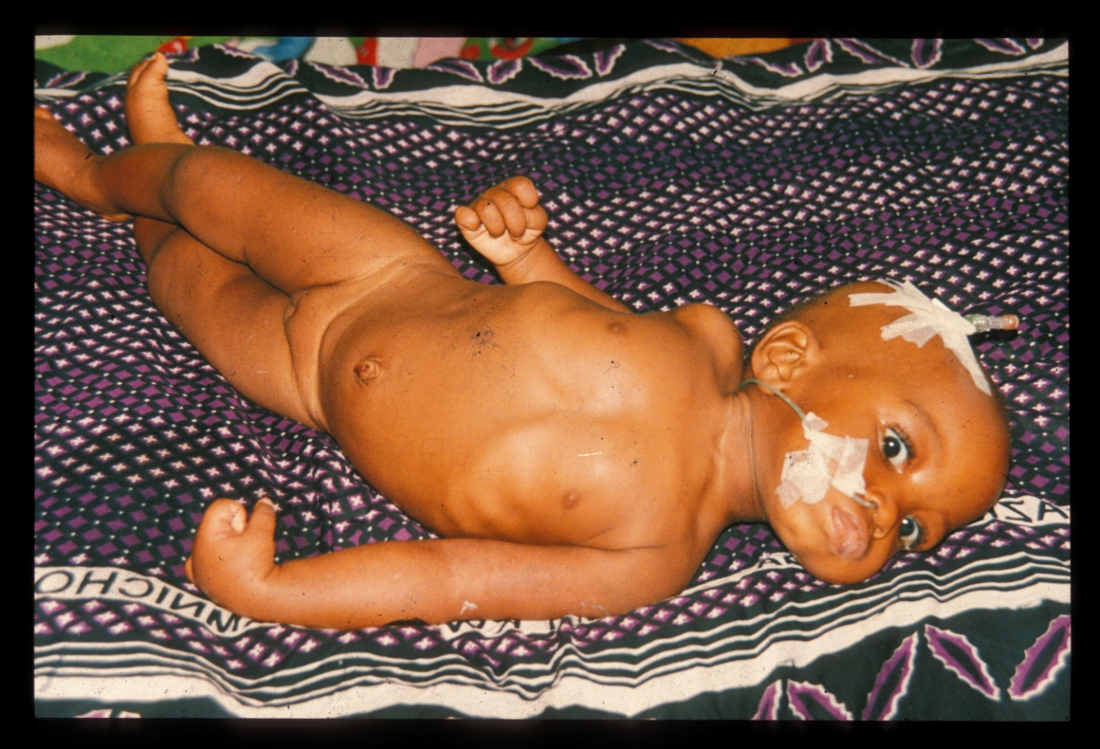
What is wrong with this child?
Notes:
This child obviously has opisthotonus (neck retraction and arching of the back), fisting and scissoring and a decorticate posture
The causes of this are very variable….

Slide 71
Assessment:
List the abnormalities (pertinent positives) of history and physical exam and tie them together in a diagnostic formulation.
If there are several different problem areas, discuss them in sequence and number them to keep them straight.
Include a differential diagnosis

Slide 72
EMERGENCY TRIAGE ASSESSMENT AND TREATMENT(ETAT)
EMERGENCY SIGNS
-Who require immediate emergency treatment
PRIORITY SIGNS,
-Should be given priority, so that they can promptly be assessed and treated without delay
No emergency or priority signs * non-urgent cases.* can wait their turn for assessment and treatment

Slide 73
Progress Notes
Progress notes are your record of the patient's progress - they are intended to be the record of what you thought and did and to be a mode of communication between you and other providers
Subjective: deals with how the patient or parent feels - the status of important symptoms like pain or dizziness, mother's perception of the patient's energy level, and the like.
Objective: is the data you have collected such as vital signs, test results, changes in objective physical findings, and recommendations by consultants. New labs and xrays
Assessment: is the section in which you make sense of the subjective and objective information you have collected. Is the patient responding to therapy? Is the diagnosis still not clear? This is where the academic discussion occurs.
Plan: describes what you will do about the assessment, if anything. It should be very specific so that anyone could write orders from it. This may also describe contingency plans - what you plan to do if a test comes back one way vs. another.

Slide 74
THE END

Slide 75
THANK YOU ALL

Slide 76
Any questions ?

