Slide 1
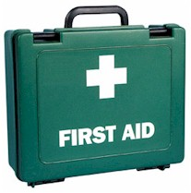
TRAUMA LIFE SUPPORT
Dorcas Mwangi

Slide 2
Lecture 1:
Introduction, Principles and Practice of Trauma Life Support

Slide 3
Objectives
By the end of the lecture students should be able to;
  Define what is first Aid and Emergency medical care
  List the qualifications of a first aider
  List the responsibilities of a first aider
  Outline the Principles of First Aid

Slide 4
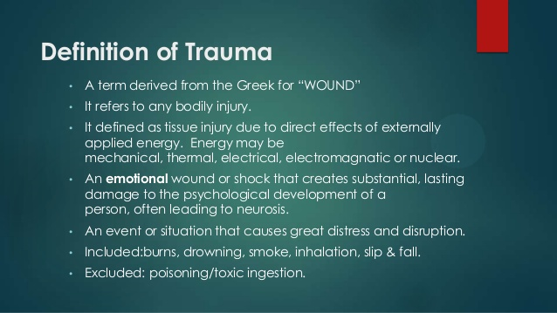

Slide 5
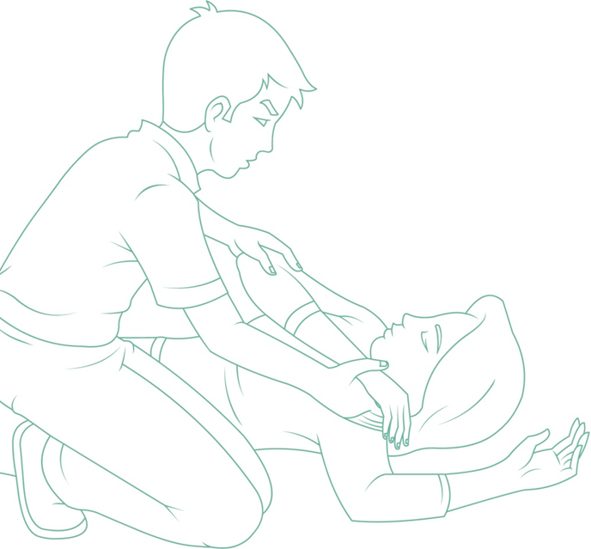
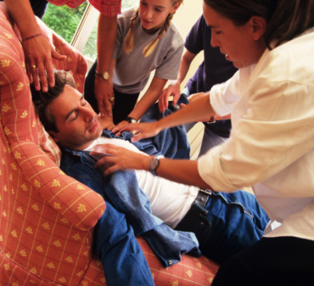
First aid has been as much a part of the culture in the daily life. And now both non-medical and medical personalities should have an idea about it as it is LIFE SAVING
Notes:
5

Slide 6

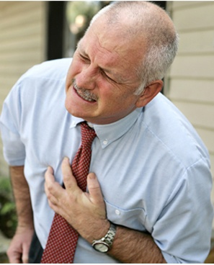
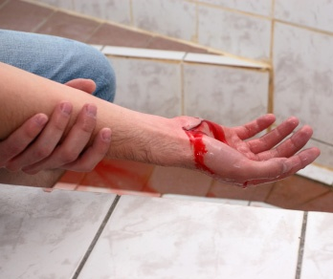
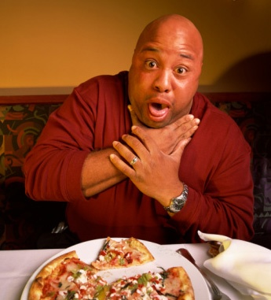
Help! Emergency!
Minutes could
make a difference
Proper first aid can mean the difference between life and death.
Notes:
Slide Show Notes
Just imagine:
A co-worker is hurt in an accident and blood is gushing from the wound.
One of your friends chokes on a piece of food and can’t breathe.
Someone goes into cardiac arrest right at his workstation.
Any one of these things is possible, and it could happen any time. If it did, you’d have to act fast. A few critical minutes one way or the other could make the difference between life and death. Would you be ready to act with speed and competence in a workplace medical emergency?
There are medical emergencies in workplaces across the country every day. Situations calling for first aid range from burns to cuts and amputations, eye injuries, chemical overexposures, and much more.
Do you know how to report a workplace medical emergency? Besides calling 911, you also need to notify a supervisor or manager and provide as much information as you can about the accident.
Describe the procedure for reporting workplace accidents and the information trainees should be prepared to provide about the incident.

Slide 7
Definition of First Aid
The initial assistance or treatment given to a casualty for any injury or sudden illness before the arrival of a qualified medical personnel.
First aid is the initial care of a suddenly sick or injured person.
It is this prompt care and attention prior to the arrival of the ambulance.

Slide 8
Introduction to first aid
First aid is the initial care given to the ill or injured while awaiting help
Medical aid is the secondary care and treatment given by suitably trained health care professionals.
These include paramedics, Clinicians, doctors and nurses

Slide 9
Emergency Health Care
Emergency Health Care can be defined as the episodic and crisis oriented care provided to Victims with serious or potentially life threatening injuries or illness.
Notes:
9

Slide 10
Points to note
First aid saves lives.
First aid has limitations, not everybody is Physician,
So Never do something you're not qualified to do.
Notes:
10

Slide 11
First Aider
A First Aider is someone who has
Undergone a training course in administering first aid, and first aid has a first aid certificate granted by an organization recognized by the law
Condition of necessity, First aider is the person who is put in a situation of responsibility of someone's life and he has to use his basic first aid knowledge to save him.
Notes:
11

Slide 12
Qualities of a first aider
Calm
Confident
Patience
Willing to offer assistance whenever necessary

Slide 13
Aims of a first aider:
3 Ps:
3Ps
Preserve life
Prevent injuries/condition
from worsening
Promote recovery

Slide 14
Principles of first aid: Preserve life
Airway
Breathing
Circulation

Slide 15
Principles of first aid: Prevent deterioration
Stop bleeding
Treat shock
Treat other injuries

Slide 16
Principles of first aid: Promote recovery
Reassure
Treat pain
Handle with care
Protect from harm

Slide 17
Responsibilities as a first aider
Assess the situation quickly, safely and summon appropriate help
Protect casualties and others at the scene from possible danger
To identify, as far as possible, the nature of illness or injury affecting casualty.
To give each casualty early and appropriate first aid, treating the most serious condition first.

Slide 18
Responsibilities of a first aider
To arrange for the casualty’s removal to hospital or into the care of a doctor.
To remain with a casualty until appropriate care is available.
To report your observations to those taking care of the casualty, and to give further assistance if required.

Slide 19
Priority of casualties
Save the conscious casualties before the unconscious ones as they have a higher chance of recovery.
Save the young before the old.
Casualties should always be treated in the order of priority, usually given by the “3 Bs”:
  Breathing
  Bleeding
  Bones

Slide 20
Protecting yourself as a first aider
Remember: One of your aims is to preserve life: so do not endanger your own in the process of rendering First Aid.
It is essential to protect yourself from injury and
Infection
In the event of immediate danger, get out of site immediately.

Slide 21
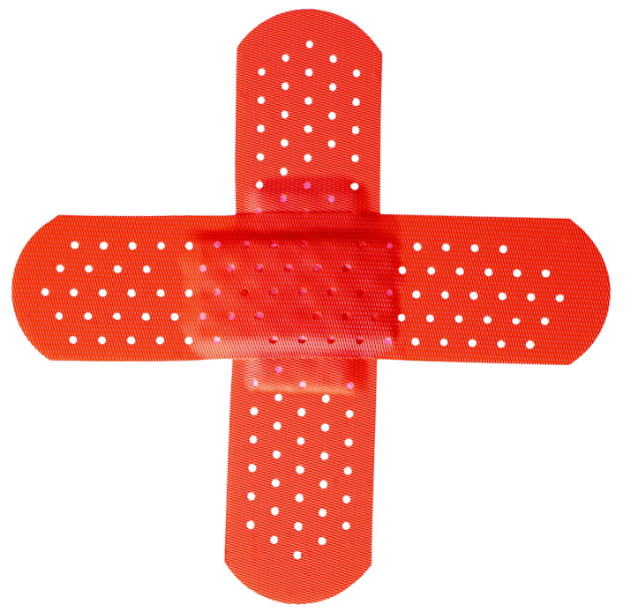

Four Basic Rules
2. Bring help to the victim
1. Call for help immediately
4. Do no further harm
3. Check the ABCs
Notes:
Slide Show Notes
Every medical emergency is different, of course, but there are four basic rules that apply to all medical emergencies.
One, call for medical help immediately. An employee on the scene should call 911 while another certified in first aid and CPR tends to the victim. If you make the call, explain the kind of injury and where the victim is located.
Two, bring help to the victim, don’t bring the victim to help.
In other words, victims should not be moved unless they are in imminent danger where they are.
Three, check the ABCs. “A” stands for airway. “B” stands for breathing. And “C” stands for circulation. That means check to make sure the throat is clear, the victim is breathing, and the victim has a pulse. A first-aid certified employee may be called upon to perform rescue breathing or CPR to keep the victim alive until EMS (emergency medical services) personnel arrive.
And four, do no further harm. Be careful not to cause additional injuries in your attempt to help a victim.

Slide 22
Key points to note
Medical emergencies can happen anytime
Act quickly, calmly, and correctly.
Consider being certified in first aid and CPR.

Slide 23
Questions?

Slide 24
Further reading
First Aid 2016 guidelines by AMREF
Johnson E. (2001) First-aid text book. NewYolk Association Press.

Slide 25
Assignment
Case scenario.
A 15year old man came to your office bleeding profusely having sustained a motorbike accident.
Describe the importance of first Aid measures? 10mks
How would manage this patient? 10mks

