Slide 1
GOOD MORNING
LOVE YOU ALL
By Florence Kwanya

Slide 2
COMMUNITY HEALTH 1
INTRODUCTION

Slide 3
DEFINITION OF TERMS
HEALTH
Health is the condition of being fit in mind, body, and spirit, free from pain or disease, with the ability to adapt to the environment (Floyd, Mimms, and Yelding, 2003).
Also, health is a reflection of your ability to use the intrinsic and extrinsic resources within each dimension of health (physical, emotional, social, intellectual, spiritual, and occupational) in order to participate fully in the activities that contribute to growth and development during each stage of the life cycle.
Health, as defined by the World Health Organization (WHO), is "a state of complete physical, mental and social well-being and not merely the absence of disease or infirmity

Slide 4
CONT,…
Community;
This is a group of people who have common characteristics; communities can be defined by location, race, ethnicity, age, occupation, interest in particular problems or outcomes, or other common bonds.
A community can also be defined as a geographic entity, or a group of people or families sharing common goals, needs and resources.
A community is a social group determined by geographical boundaries and/ or common values and interest. Its members know and interact with each other.

Slide 5
Cont..
Community health;
This is the part of health care that is concerned with the health of the whole populations and the prevention of diseases. It involves the following key things;
COMMUNITY HEALTH- DEFINITION • “Community HEALTH REFERS TO THE HEALTH Status of the members of the community, to the problems affecting their health and to the totality of health care provided to the community”.. WHO (1971).
C.E.A WINSLOW • Is the father of public health. • He defines public health as follows. PROF C.E.A WINSLOW
“Public health is the science and art of preventing diseases, prolonging life and promoting health and efficiency through organized community efforts for the sanitation of environment Cont ….
Cont… • …the control of diseases, the education of individuals in personal hygiene, the organization of medical and nursing services for early diagnosis and preventive treatment of diseases and.. Cont.
Cont… • ..the development of social machinery to ensure for every individual a standard of living adequate for maintenance of health, so organizing these benefits as to enable every citizen to realize the birth right of health and longevity”

Slide 6
CONT..
Community health; includes both private and public efforts of individuals, groups, and organizations to promote, protect, and preserve the health of those in the community. Community health is the health status of a defined group of people and the actions and conditions, both private and public (governmental) to promote, protect, and preserve their health.
Public health is the sum of all governmental efforts to promote, protect, and preserve the people’s health.

Slide 7
Cont,,,
Establishing the health status of the community
Planning and managing of community level services that enhance health and wellbeing. These services include; promotive, preventive, curative, and rehabilitation services.
As a discipline community health focuses on populations and how specific social determinants of health and disease influence wellbeing. The emphasis is on the following;
How well can communities be mobilized to use available resources.
How can communities be empowered to improve on the conditions within their homes, their behavior, social cultural interactions.

Slide 8
OBJECTIVES OF COMMUNITY HEALTH
The objective of community health is to provide need based comprehensive services which include the following.
Promotion and protection of health i.e. PRIMARY LEVEL PREVENTION. 2. Early diagnosis and treatment and control of further spread of disease i.e. SECONDARY LEVEL PREVENTION.
Control of disability and rehabilitation ie. TERTIARY LEVEL OF PREVENTION.
The major emphasis is on primary level prevention with the active involvement of people (as majority of the health problems are preventable by simple measures).
THESE MEASURES ARE : • Safe drinking water. • Safe disposal of waste material. • Maintaining general cleanliness. • Immunization of children Traffic control. • Good nutrition. • Health checkup and mass screening. • Early diagnosis and mass treatment. • Health Education.

Slide 9
COMMUNITY AS A CLINET
In community health the whole community is a client and the services are focused and hence it is important to:
1. Know the community (COMMUNITY IDENTIFICATION).
2. Identify the health needs of the community (COMMUNITY DIAGNOSIS).
3. Understand underlying factors affecting health problems.
4. Plan and implement comprehensive services.

Slide 10
COMMUNITY IDENTIFICATION
Is a process of exploring and knowing a defined community for assessing its health status and determining the possible factors affecting the health of people in the community”
THIS IMPLIES TO EXPLORE & KNOW • Geographical area, housing pattern and climate. • Population characteristics. • Life style of people. • Leadership pattern.
• Family type, family size, & caste group. • Beliefs, attitude, values and customs etc. • Community environment. • Institutional facilities.
• Voluntary organizations. • Channels of communication, telecommunication networks, travel modes.
THESE INFORMATIONS ARE OBTAINED BY: • Making observation visits of the community. • Formal and informal meetings and conversation with community people, leaders, organized groups etc.
Discussion with health personnel and other workers in the community. • Review of records. • Formal sample survey of the community

Slide 11
CONT…
COMMUNITY DIAGNOSIS. Is a written statement of health needs and health problems which are determined by analysis of data collected for community identification.
Following community identification, health needs and problems are prioritized for planning and implementing community health actions/community health treatment.
COMMUNITY TREATMENT/COMMUNITY HEALTH ACTIONS • Refers to “various health and health related activities which are planned and implemented to deal with identified health problems and health needs

Slide 12
COMMUNITY HEALTH ACTIONS ARE PLANNED CONSIDERING
Nature of problems.
Effects of problems on health of people at large.
Felt needs & problems of the community.
Community resources and capabilities.
Health agency’s objectives and policies.

Slide 13
COMMUNITY
COMPONENTS
People
Goals
Environment
Boundaries
Social structure and systems
All these interact to influence a community health

Slide 14
Community entities
Members
Government agencies
FBO
NGO
Private org.
All these work together to improve the prevailing health status.

Slide 15
Community structures
Leadership
Communication
Administrative
Health structures

Slide 16
Functions of a community
Functions of a community refers to what a community does through its people and available resources to better the living conditions of its member. Theses functions include;
Recreation
Procreation
Socialization
Education
IGA
Health and environmental activities.
Administrative
Discipline of rogue members

Slide 17
CONT…OTHER FUNCTIONS
It provides space for housing, shelter, socialization and recreation. 2. It provides means and facilities for livelihood.
Community provides opportunity for employment. 4. It takes care off socialization and education of its members.
It provides safety and security for its members by enforcement of norms and legislation formulated by the society. 6. It provides opportunities for people participation and communication.

Slide 18
CHARACTERISTICS OF A COMMUNITY
Membership: a sense of identity and belonging.
Common symbol systems: similar language, rituals, and ceremonies.
values or norms
Mutual influence: community members have influence and are influenced by each other.
Shared needs and commitment to meeting them
Shared emotional connection: members share common history, experiences, and mutual support

Slide 19
Cont..
The community has a defined geographical boundaries which has the beginning and the end.
The boundaries of a small community such as hamlet, village etc are distinct whereas that of a large community such as town, city etc are indistinct.
The community is composed of people who live together in the defined boundaries of the community.
The community people have common psychological characteristics i.e., there is similarity in language, life style, customs and traditions etc. • They share common interests, values, moral norms and codes.
The people in the community interact with each other and have free communication.
The community has organized social structure and system and common organization which carry various functions such as housing, food, agriculture, animal husbandry, health, education, marketing, banking etc.

Slide 20
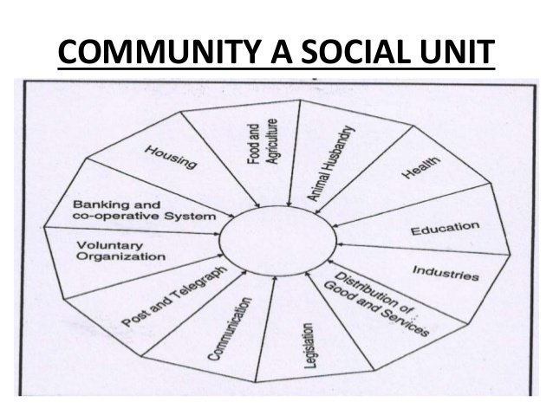
COMMUNITY SOCIAL UNIT

Slide 21
TYPES OF COMMUNITIES
You can classify every type of community by the purpose that brings them together.
Interest. Communities of people who share the same interest or passion.
Action. Communities of people trying to bring about change.
Place. Communities of people brought together by geographic boundaries.
Practice. Communities of people in the same profession or undertake the same activities.
Circumstance. Communities of people brought together by external events/situations.

Slide 22
CONT…

Slide 23
FACTORS AFFECTING THE HEALTH OF A COMMUNITY
These factors differ from one community to another. These include;
Nutrition
Sanitation
Water
Environment
Transport
Communication network
Leadership
Housing and social structures

