Slide 1
LOWER LIMB
BY F.R KURIA

Slide 2
WHY STUDY THE LOWER LIMB
To review the general description of the bones, joints, and origins, insertions and actions of muscles.
To describe the basic anatomy of the vascular supply, lymphatic drainage, and distribution of the nerves
To correlate the anatomy of the lower limb in relation to common clinical conditions

Slide 3
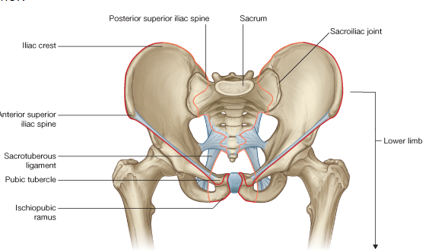
The lower limb is directly anchored to the axial skeleton by a sacroiliac joint and by strong ligaments, which link the pelvic bone to the sacrum I.E
inguinal ligament
sacrotuberous ligament etc

Slide 4
Function of the lower limb
The primary function of the lower limbs is to
support the weight of the body
provide a stable foundation in standing, walking, and running;
locomotion.

Slide 5
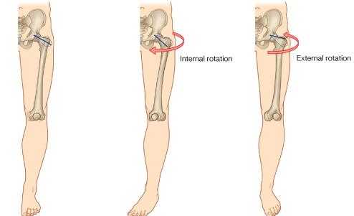
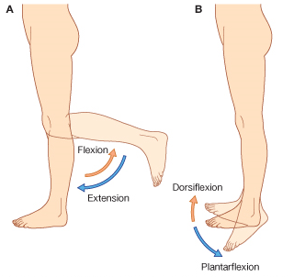
Movements of the legs

Slide 6
The lower limb is divided into the
gluteal region
thigh
knee
leg
ankle
Foot
NB>The thigh and the leg are compartmentalized, each compartment having its own muscles that perform group functions and its own distinct nerve and blood supply

Slide 8
gluteal region is posterolateral and between the iliac crest and the fold of skin (gluteal fold) that defines the lower limit of the buttocks.
thigh is between the inguinal ligament and the knee joint-anteriorly. posterior thigh is between the gluteal fold and the knee.
the leg is between the knee and ankle joint;
the foot is distal to the ankle joint.

Slide 9
Embryology
Gastrula (Gr. gaster, stomach). During gastrulation (transformation of a blastocyst into a gastrula), a three-layered embryonic disc forms (third week).
The three germ layers of the gastrula (ectoderm, mesoderm, and endoderm) subsequently differentiate into the tissues and organs of the embryo.
Neurula (Gr. neuron, nerve). The early embryo during the third and fourth weeks when the neural tube is developing from the neural plate .It is the first appearance of the nervous system and the next stage after the gastrula

Slide 10
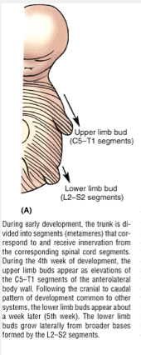
LIMB DEVELOPMENT
Early during development, the paraxial mesoderm divides into segmented parts named mesodermal somites (42-44).
Each somite divides into:
Lower medial part (sclerotome) forms the vertebral column.
Upper lateral part (dermomyotome) forms the dermis of the skin and the trunk skeletal muscles including the limbs.
The upper limb muscles and skin (dermis) develop from segments C.3-8 and T.1&2.
The lower limb develops for L2-S4 somites.

Slide 11
Development ctd’
1.At the end of the 4th week of embryonic development limb buds of mesenchyme core appear at the ventral lateral body wall.
-For the upper limb at the level of C₅, C₆, C₇, C₈ and T₁.
-For the lower limb L3 – S₃.
2. Thickening of distal boarder of the limb occurs to form apical ectodermal ridge (AER).
3. A progress zone induced by apical ectodermal ridge is formed to facilitate growth of the limbs.
.

Slide 12
.
4. Terminal portions of the limb buds becomes flattened to form hand plate and foot plates.
5. a proximal and distal constriction occurs dividing the limb into 3 segments, hand, fore arm and arm and for the lower limb into thigh, leg and foot.
6. Formation of fingers and toes occurs through programmed cell death of the apical ectodermal ridge into five segments.
Notes:
+

Slide 13
.
7. At 7th week rotation occurs in opposite directions.
8. The upper limb rotates 90⁰ laterally so that extensor muscles lie on the lateral and posterior surface and the thumb lie laterally.
9. The lower limb rotates approximately 90⁰ medially placing the extensor muscles on the anterior surface and the big toe medially
(the flexors are now ventral and the extensors are dorsal while the lower limbs rotates medially having the extensors on the front and the flexors on the back of the lower limb)
The hair is found on the back of the upper limb, but, on the front of the lower.
The radius bone and the tibia as well as the ulna and the fibula are homologous bones.
The thumb and the big toe are homologous digits

Slide 14
Development ctd’
(9) The hyaline cartilages models now develop ossification centres and bones are formed through 2 processes: The long bones through endochondral ossification and short bones through intramembranous ossification

Slide 16
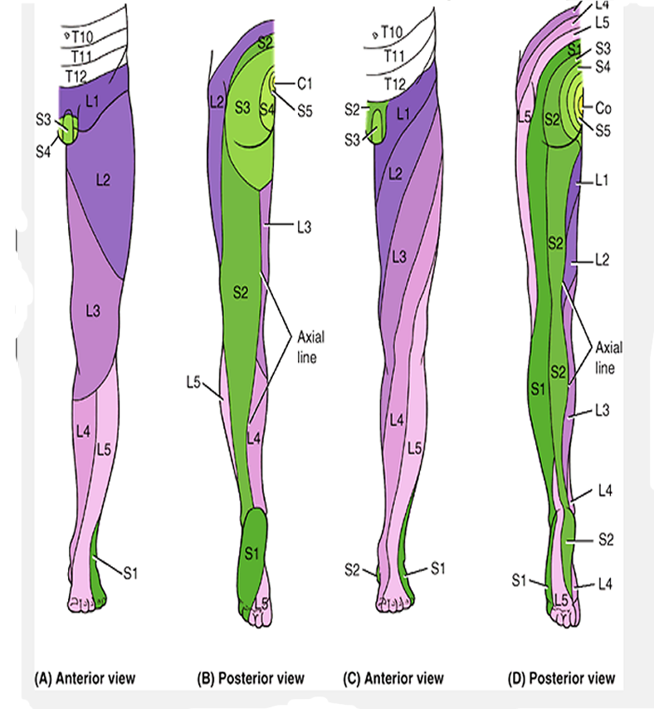
Dermatomes of the upper and lower limb

Slide 17
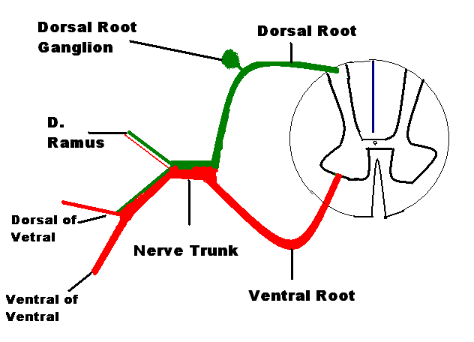
NERVE DISTREBUTION TO THE TRUNK

Slide 18
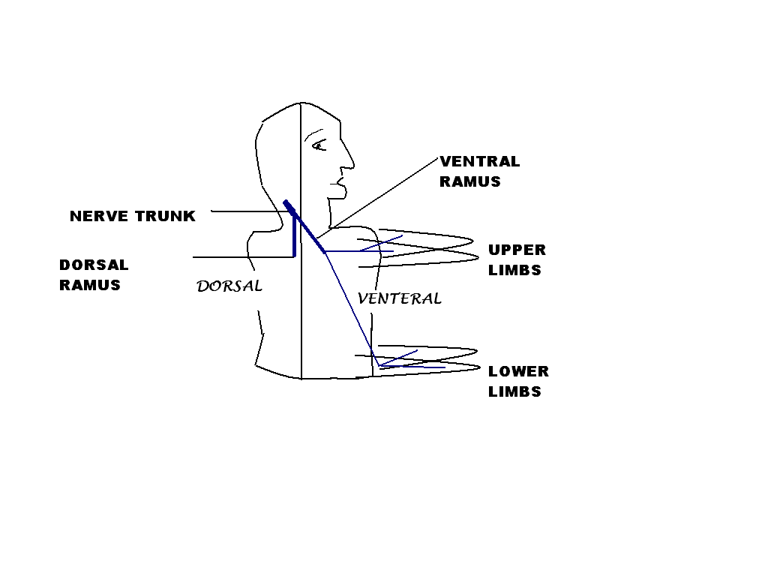
LIMB INNERVATION

Slide 19
Innervation of limbs (cont).
The nerve trunk is formed out of two roots, the ventral root (motor) and the dorsal root (sensory).
Each trunk divides into dorsal and ventral ramus to the dorsal and the ventral halves of the trunk respectively (1st division).
All plexuses of the are formed by ventral rami only, the dorsal rami never form plexuses.
As the limbs develops from the ventral half of the trunk it is supplied by the ventral ramus.
After rotation of the limbs occur, they posses ventral and dorsal aspects. So, the ventral ramus divides into dorsal and ventral branches to both aspects of the limb (2nd division).

Slide 20
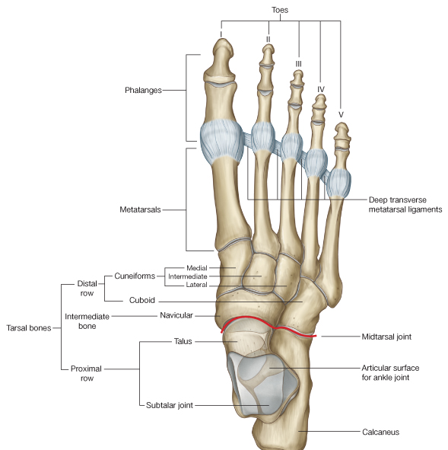
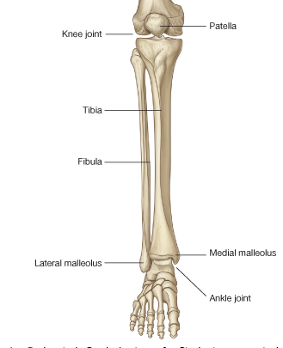
Bones and joints of lower limbs

Slide 21
Bones and joints of lower limbs
The bones of the gluteal region and the thigh are the pelvic bone and the femur .The large ball and socket joint between these two bones is the hip joint.
At the distal end of the femur, it articulates with the tibia and the patella (knee cap) anteriorly . The patella is the largest sesamoid bone in the body and is embedded in the quadriceps femoris tendon.
The joint between the femur, tibia and patella is the knee joint
The leg contains two bones, tibia (medially) fibula(laterally). Fibula does not take part in the knee joint .
The tibia and fibula are linked along their lengths by an interosseous membrane.
Between the leg and the foot is the ankle joint
foot consist of the tarsal bones (7) organised into two rows, the metatarsals, and the phalanges.

Slide 22
HIP BONE
The mature hip bone also called the innominate (unnamed) bone, is a large, flat pelvic bone formed by the fusion of three primary bones ilium, ischium, and pubis

Slide 23
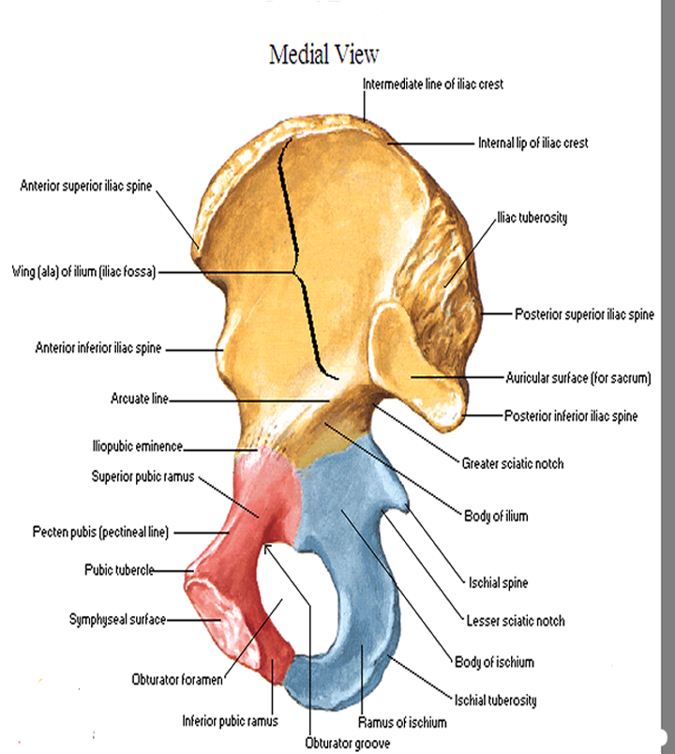
Medial view cocyal bone

Slide 24
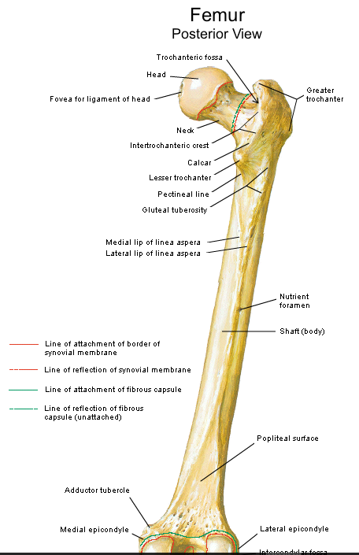
FEMUR
The femur is the longest and heaviest bone in the body.
It transmits body weight from the hip bone to the tibia when a person is standing
The neck of the femur is most frequently fractured because it is the narrowest and weakest part of the bone and it lies at a marked angle to the line of weight bearing (pull of gravity). It becomes increasingly vulnerable with age, especially in females, secondary to osteoporosis

Slide 25
Tibia and fibula
The tibia and fibula are the bones of the leg .The tibia articulates with the condyles of the femur superiorly and the talus inferiorly and in so doing transmits the body's weight.
The fibula mainly functions as an attachment for muscles, but it is also important for the stability of the ankle joint.
The shafts (bodies) of the tibia and fibula are connected by a dense interosseous membrane

Slide 26
The tibial shaft is narrowest at the junction of its middle and inferior thirds, which is the most frequent site of fracture
this area of the bone also has the poorest blood supply. Because its anterior surface is subcutaneous, the tibial shaft is the most common site for a compound fracture

Slide 27
Bones of foot
There are seven tarsal bones, which are organized in two rows with an intermediate bone between the two rows on the medial side.
Tarsal bones articulate with the metatarsals at tarsometatarsal joints, which allow only limited sliding movements
The metatarsal articulate with the phallanges at metatarsophalangeal joints which allow flexion, extension, abduction, and adduction of the digits
The interphalangeal joints are hinge joints and allow flexion and extension

Slide 28
The Gluteal Region
buttock, is bounded superiorly by the iliac crest and inferiorly by the gluteal fold of the buttock.
The region is largely made up of the gluteal muscles and a thick layer of superficial fascia.
The Skin of the Buttock
The cutaneous innervation of the buttocks are derived from posterior and anterior rami of spinal nerves, as follows
The upper medial quadrant is supplied by the posterior rami of the upper three lumbar nerves and the upper three sacral nerves.
The upper lateral quadrant is supplied iliohypogastric (L1) and 12th thoracic nerves
The lower lateral quadrant is supplied by lateral cutaneous nerve of the thigh (L2 and 3)
The lower medial quadrant is supplied by posterior cutaneous nerve of the thigh

Slide 29
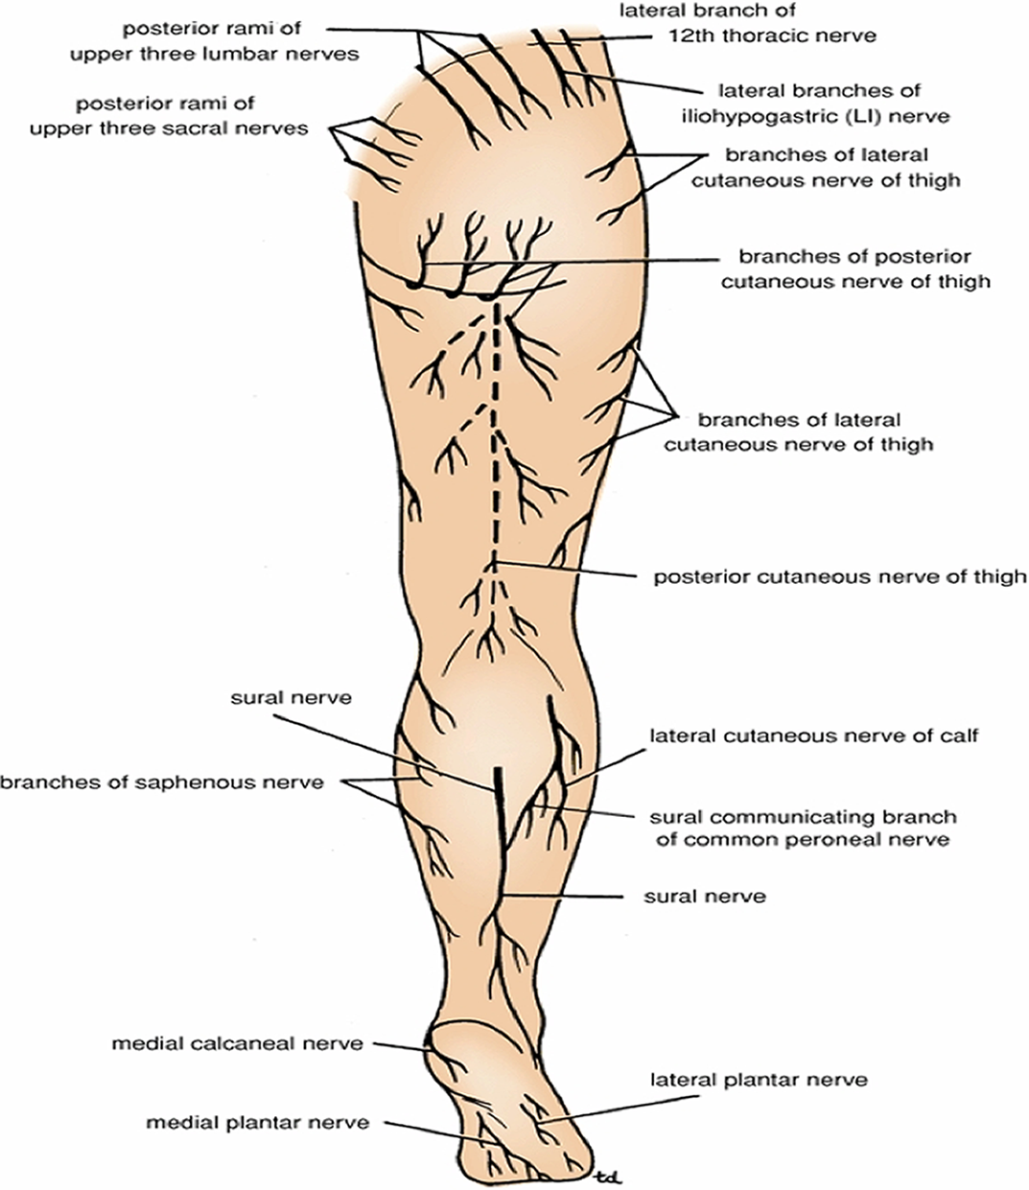
CUTANEOUS innervation

Slide 30
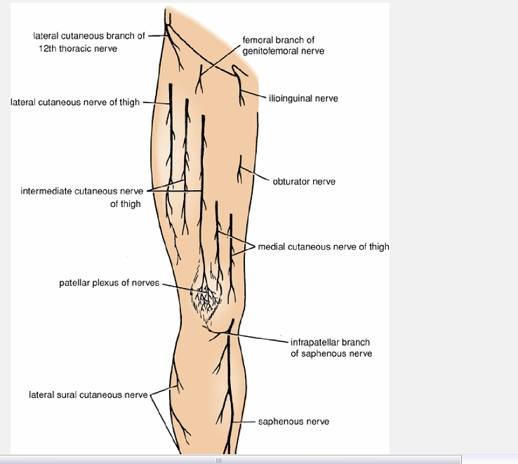
.

Slide 31
The Skin of the Buttock
The cutaneous nerves are derived from posterior and
anterior rami of spinal nerves, as follows:
upper medial quadrant is supplied by the posterior rami of the upper three lumbar nerves and the upper three sacral nerves.
upper lateral quadrant is supplied by the lateral branches of the iliohypogastric (L1) and 12th thoracic nerves (anterior rami).
lower lateral quadrant is supplied by branches from the lateral cutaneous nerve of the thigh (L2 and 3, anterior rami).
lower medial quadrant is supplied by branches from the posterior cutaneous nerve of the thigh (S1, 2, and 3, anterior rami).
skin over the coccyx in the floor of the cleft between the buttocks is supplied by small branches of the lower sacral and coccygeal nerves

Slide 32
Fascia of the Buttock
superficial fascia is thick, especially in women, and is impregnated with large quantities of fat. It contributes to the prominence of the buttock.
deep fascia is continuous below with the fascia lata. In the gluteal region, it splits to enclose the gluteus maximus muscle . Above the gluteus maximus, it continues as a single layer that covers the outer surface of the gluteus medius and is attached to the iliac crest. On the lateral surface of the thigh, the fascia is thickened to form a strong, wide band, the iliotibial tract.

Slide 34
The gluteal region muscles

Slide 36
Superior gemillus
Tendon of obturator internus
Inferior gemillus
Quadratus femoris
Adductor magnus

Slide 41
The greater sciatic foramen
Bounderies: it is formed by the greater sciatic notch of the hip bone and the sacrotuberous and sacrospinous ligaments. It provides an exit from the pelvis into the gluteal region.
The following structures exit the foramen:
Piriformis
Sciatic nerve
Posterior cutaneous nerve of the thigh
Superior and inferior gluteal nerves
Nerves to the obturator internus and quadratus femoris
Pudendal nerve
Superior and inferior gluteal arteries and veins
Internal pudendal artery and vein

Slide 42
The lesser sciatic foramen
Boundaries: is formed by the lesser sciatic notch of the hip bone and the sacrotuberous and sacrospinous ligaments. It provides an entrance into the perineum from the gluteal region. Its presence enables nerves and blood vessels that have left the pelvis through the greater sciatic foramen above the pelvic floor to enter the perineum below the pelvic floor.
The following structures pass through the foramen:-
Tendon of obturator internus muscle
Nerve to obturator internus
Pudendal nerve
Internal pudendal artery and vein

Slide 43
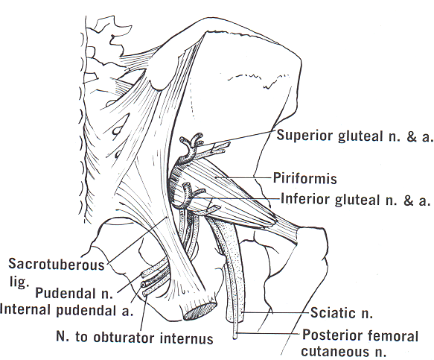
Greater Sciatic Foramen
Structures passing through it:
piriformis Muscle
structure above the piriformis:
superior gluteal nerve
superior gluteal vessels
structures below the piriformis:
Sciatic gluteal nerve
inferior gluteal nerve
inferior gluteal vessels
post. C. n. of the thigh
N. to quadratus femoris
N. to obturator internus
internal pudendal vessels
pudendal nerve
The last three Structures pass from the greater to the lesser sciatic foramen.
2- Lesser Sciatic Foramen:
Structures passing through it:
Tendon of obturator internus
Nerve to Obturator interns
Internal pudental vessels
pudendal nerve

Slide 44
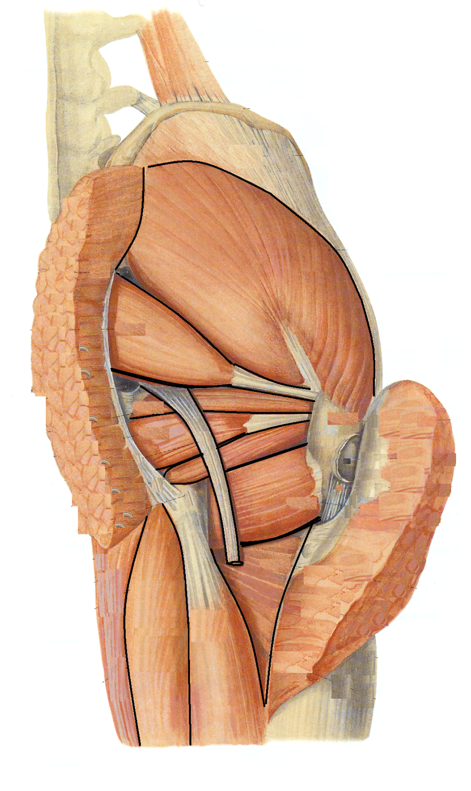
The structures deep to the
sciatic nerve after emerging
from the greater sciatic
foramen as arranged from
above downwards:
The back of the ischium
Superior gemillus
Tendon of obturator internus
Inferior gemillus
Quadratus femoris
Adductor magnus
Gluteus medius
piriformis
Gluteus maximus
1
2
3
4
Semitendinosus
5
Semimembranosus
Gluteus maximus

Slide 45
The posterior compartment of the thigh
It is also called the flexor compartment of the thigh
Contents :-
Muscles: Biceps femoris, semitendinosus, semimembranosus, and a small part of the adductor magnus (hamstring muscles)
Blood supply: Branches of the profunda femoris artery
Nerve supply: Sciatic nerve

Slide 47
Relations of sciatic in the gluteal region:
Following it up it will lead to the greater sciatic foramen, the muscle above is the piriformis, the structures above that muscle are the superior gluteal nerve and the superior gluteal vessels.
Deep to the nerve from above downwards you can identify the following:
the ischium bone
The superior gemillus
The tendon of the obturator internus
The inferior gemillus
The adductor magnus
On the nerve back is:
The inferior gluteal nerve
The inferior gluteal vessels
The posterior c n of the thigh
The nerve to quadratus femoris lies deep to it.
Three structures deep to it will pass from the greater sciatic foramen to the lesser sciatic foramen, they are ( as arranged from medial to lateral):
Pudendal nerve
Internal pudendal vessels
Nerve to obturator internus

Slide 48
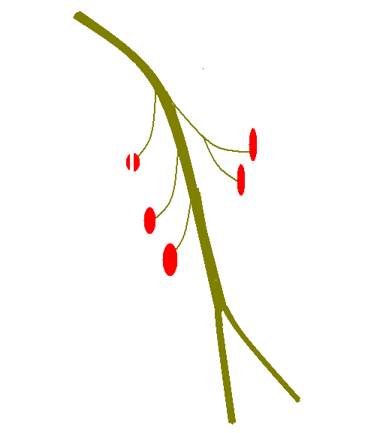
Sciatic Nerve
(L.4,5-S.1,2,3)
Origin: one of the two terminal branches of the sacral plexus
Course and relations:
-Leaves the pelvis through the greater sciatic foramen below the piriformis
- covered by the gluteus maximus in the gluteal region and then by the hamstring muscles in the back of the thigh.
-descends on: ischium,tendom of obturator internus and two gemilli, quadratus femoris and adductor magnus.
- The obturator internus and gemilli and quadratus femoris separate it from the capsule of hip joint.
- In the middle of the thigh it ends by dividing into two teminal branches:
Medial popliteal (tibial) nerve
Lateral popliteal (common peroneal) nerve
Musculae branches
: Semimembranosus, Semitendinosus, biceps femoris and ischial part of adductor magnus.
N.B >Sometimes the siatic nerve is absent. In such a case the two popliteal nerves arise directly from the sacral plexus. The medial popliteal nerve passes below the piriformis, while the lateral popliteal nerve passes through the piriformis. In such a case the medial popliteal nerve supplies the hamstring muscles: while the lateral popliteal nerve supplies the short head of biceps.
The two heads of biceps femoris
Ischial part of adductor magnus
Semitendinosis
semimembranosis
Common peroneal nerve
Tibial nerve

Slide 50
Sciatic nerve

Slide 51
Sciatic nerve :- tibial part

Slide 52
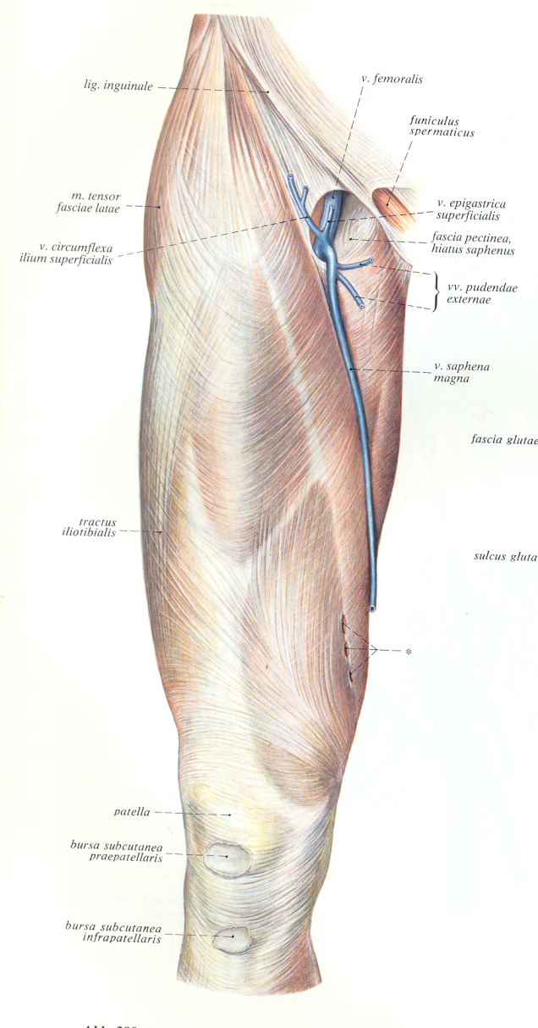
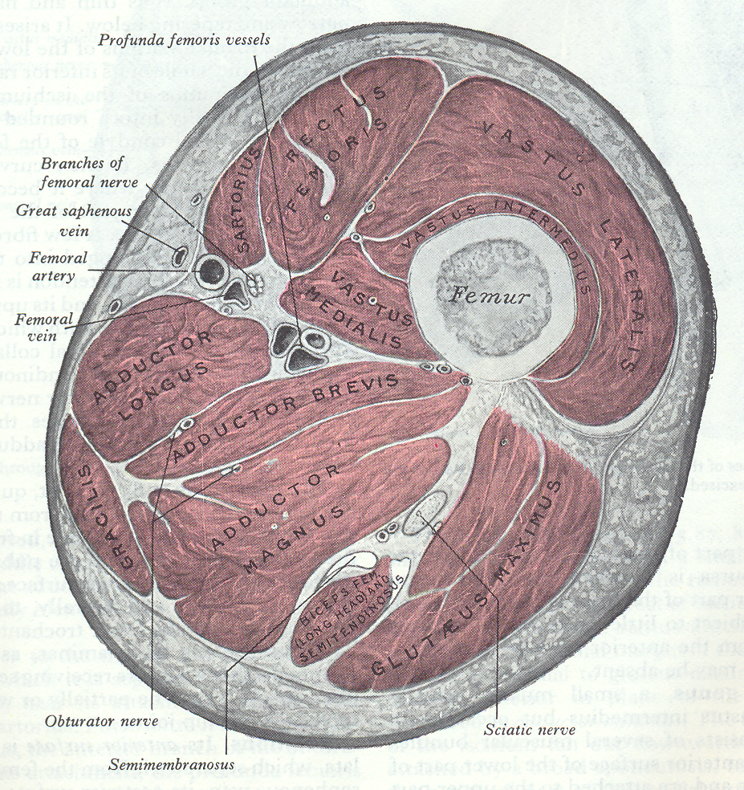
THE THIGH
Layers:
Skin
Superficial fascia
Deep fascia

Slide 53
Facia of the thigh and buttock

Slide 54
.

Slide 55
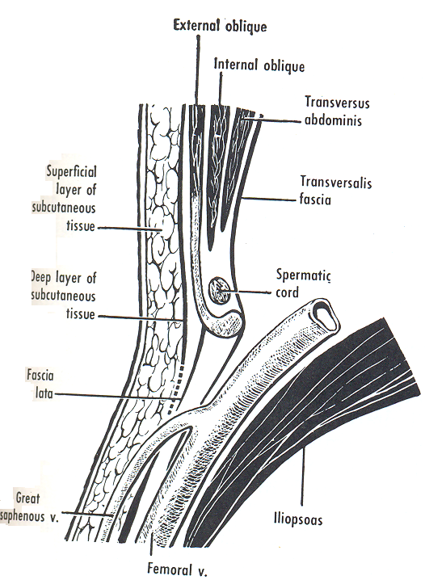
Superficial fascia:
- Arrangement:
Superficial fatty layer: condensation of fat contains cautaneous vessels and nerves
Deep Membranous layer, starts below the level of umbilicus and terminate one inch below and parallel to the inguinal Ligament

Slide 56
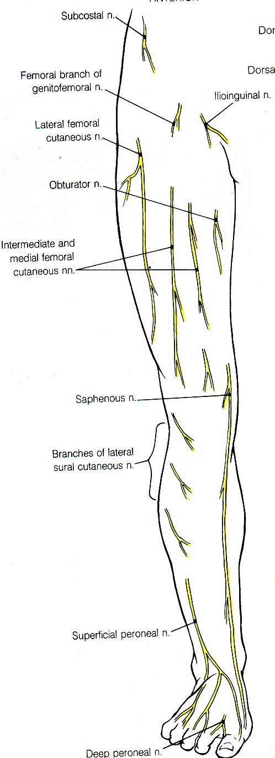
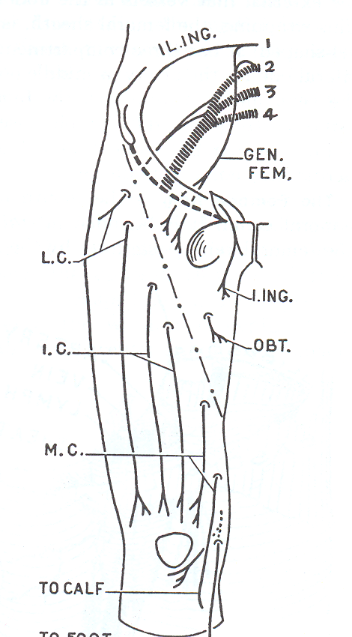
CONTENTS
A-Cutaneous Nerves
Lumber plexus
Lateral N.of the thigh
Ilio- Inguinal Nerve
Femoral branch of the genito-femoral nerve
Femoral Nerve
Intermediate C.N of the thigh
Medial C.N of the thigh
Obturator Nerve.

Slide 57
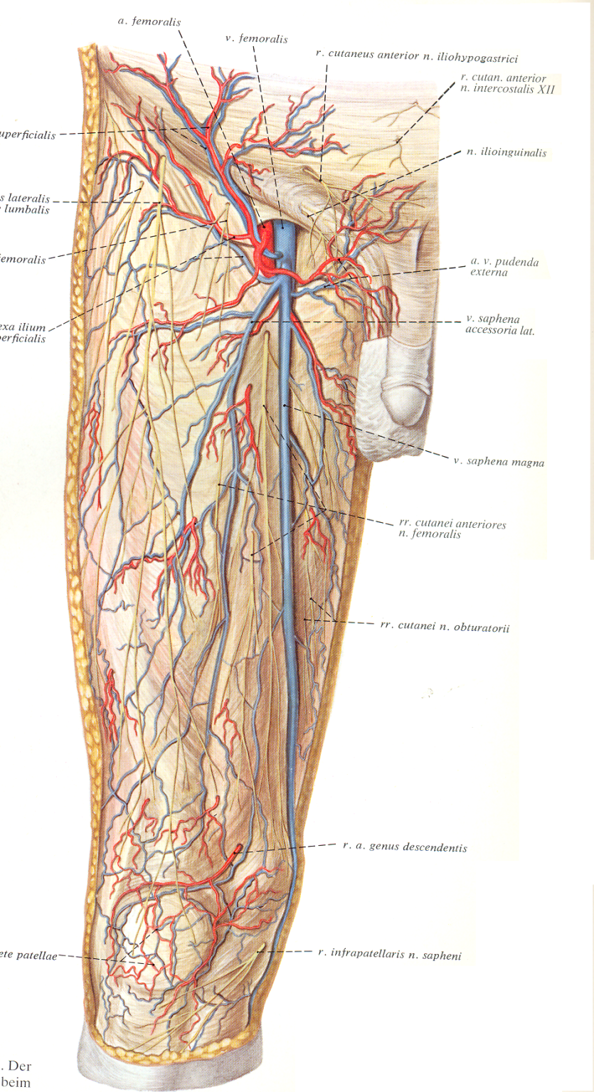
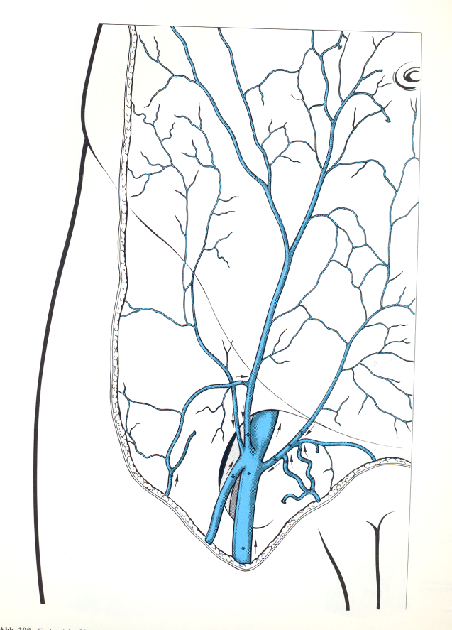
B- Cutaneous Vessels
Arteries :
Superficial branches of the femoral artery
Superficial external pundendal
Superficial epigastric
Superficial Circumflex iliac
Veins
Superficial Veins accompany the arteries
The great Saphenous Vein

Slide 58
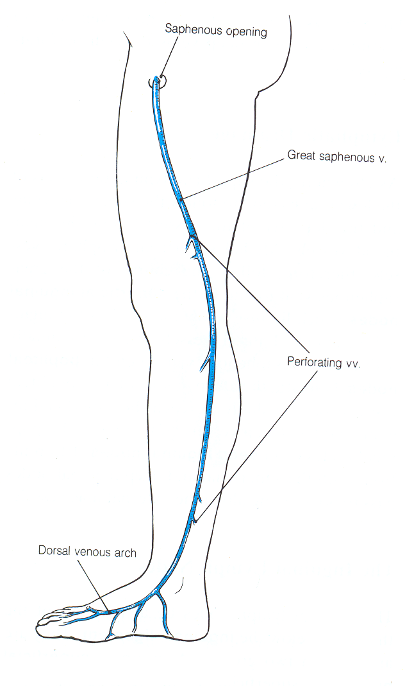
The great Saphenous Vein
Begins from the medial end of the dorsal venous arch on the dorsum of the foot.
Runs backward on the medial side of the foot.
Ascends in front and above the medial malleolus, accompanied by the Saphenous nerve.
Crosses the lower part of the medial surface of the tibia obliquely and ascends along the medial border of the tibia to the posterior part of the medial side of the knee.
In the thigh it deviates anteriorly and laterally as it ascends.
Finally, it hooks on the falciform margin of the Saphenous opening, piercing the cribiform fascia to end in the femoral vein.
It forms communications with the deep (perforating) veins and contains many valves.

Slide 59
The deep fascia (Fascia Lata):
Tough layer, plastic non elastic membrane, which gives the shape of the related part of the body
Attachments: it looks like a cone
Superiorly:
Anteriorly – the inguinal ligament “Pulling on it downwards so it looks concave upwards”
Medially:- to the body of the pubis and the side of the pubic arch and the ramus and tuberosity of the ischium and to the posterior border of the ischiotuberous ligament.
Posteriorly: to the back of sacrum and coccyx then over the glutii to the iliac crest
Laterally:- it splits to surround the fascia lata muscle and attach to the tuberositty of iliac crest and its ventral part.
Inferiorly
To the two condyles of the tibia and the head of the fibula on each side.
To the patella anteriorlly and forms the roof of the popliteal fossa posteriorly.

Slide 60
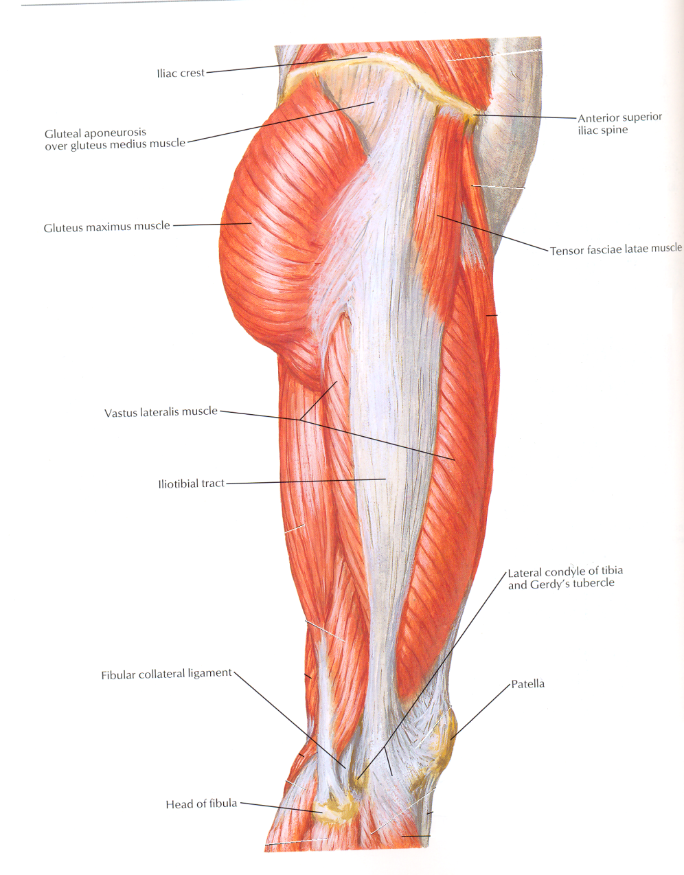
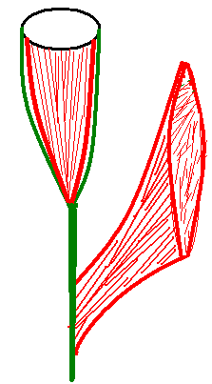
ILIO-TIBIAL TRACT:
This is the thickened lateral par of the fascia lata ( deep fascia of the thigh).
It receives the insertion of the tensor fasciae lata and three-quarters of the gluteus maximus.
Its lower end attached to the lateral condyle of the tibia.
The muscles pull upon it to fix the tibia on the femur during standing.

Slide 61
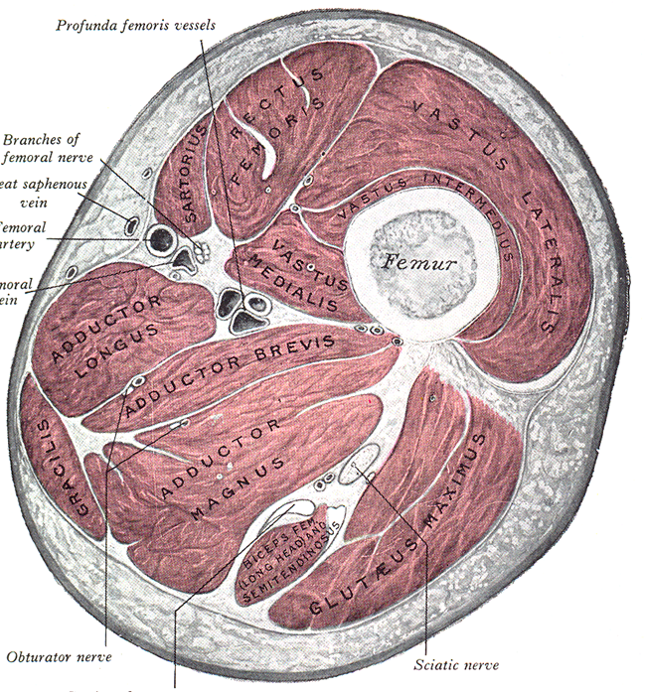
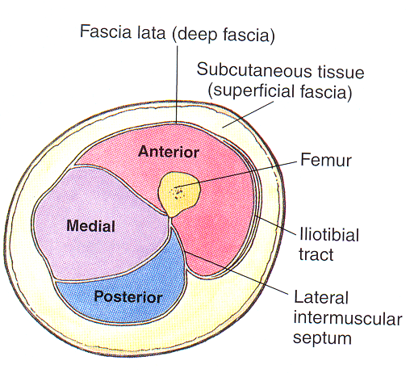
COMPARTMENTS OF THE THIGH
By three intermuscular septa extends from the deep fascia to linea aspera, the thigh is divided into
Anterior compartment (Extensor compartment) supplied by the femoral nerve
Posterior compartment (Flexor compartment) supplied by the sciatic nerve
Medial compartment (Adductor compartment) supplied by the obturator nerve.

Slide 62
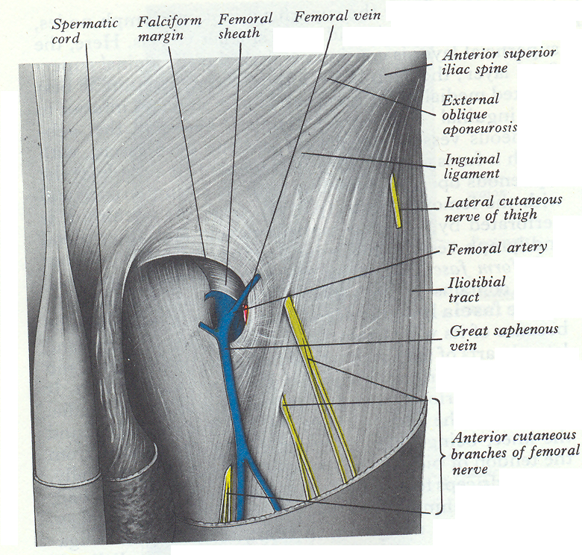
Saphenous opening:
Oval opening in the deep fascia.
It lies ½ inch below the inguinal ligament.
Its centre is 1 ½ inches below and lateral to the pubic tubercle.
It is closed by the cribriform fascia, which is pierced by the by the great Saphenous vein and other superficial vessels.
Its upper lateral and lower margins are sharp and strong is called falciform margin while its medial margin is thin and weak.

Slide 63
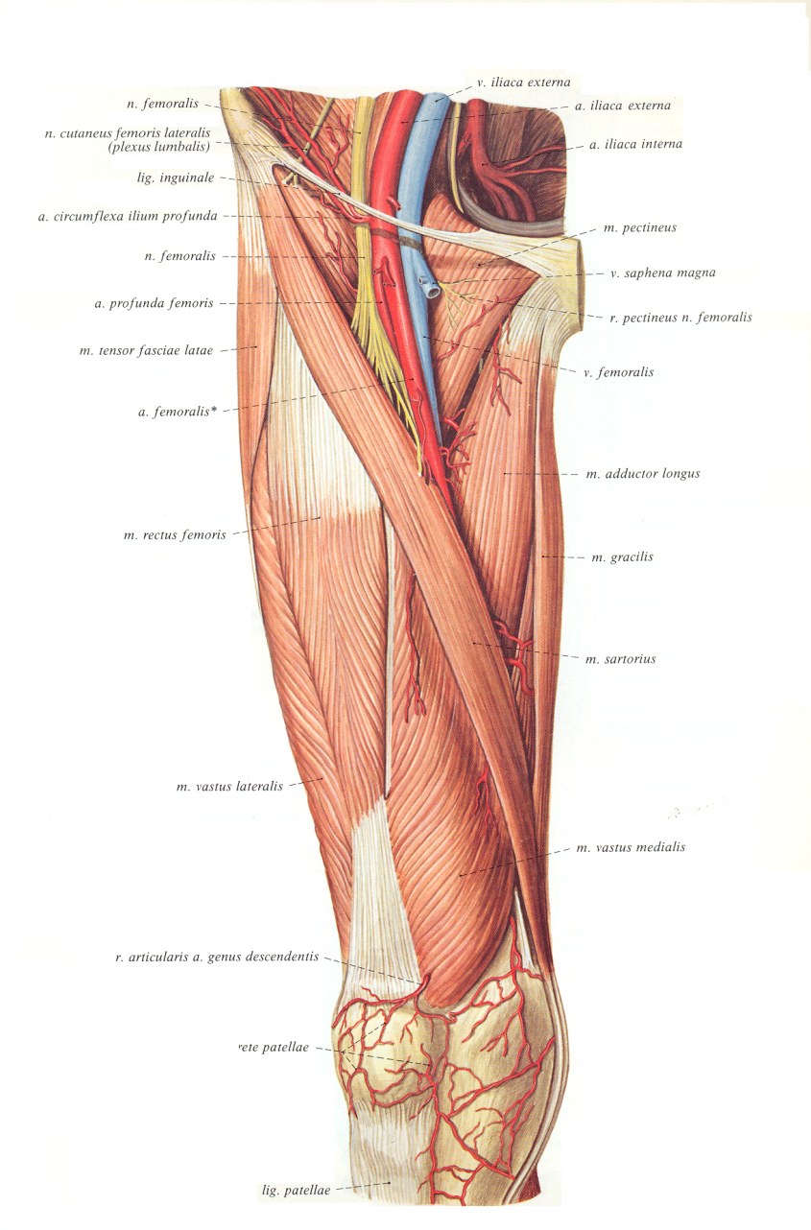
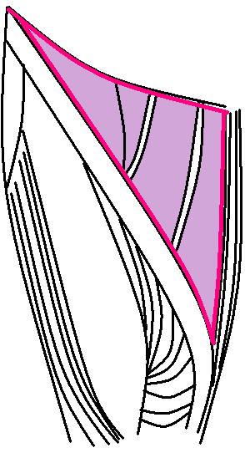
Ing.Lig.
FEMORAL TRIANGLE
This is a triangular space in the front of the upper third of the thigh.
Boundaries:
Above: The Inguinal ligament , forming the base of the triangle
Laterally: The medial border of sartorius
Medially: medial border of adductor longus.
Roof: Skin, superficial fascia and its contents, and deep fascia.
Floor: formed by the following muscles arranged from the medial to lateral side: adductor longus, pectineus, psoas major, and iliacus.
Contents:
Its main contents are the femoral sheath, femoral artery and its branches, femoral vein and its tributaries, femoral nerve, and deep inguinal lymph nodes.
Iliopsoas m.
Pectineus
Add. Longus
Sartorius

Slide 64
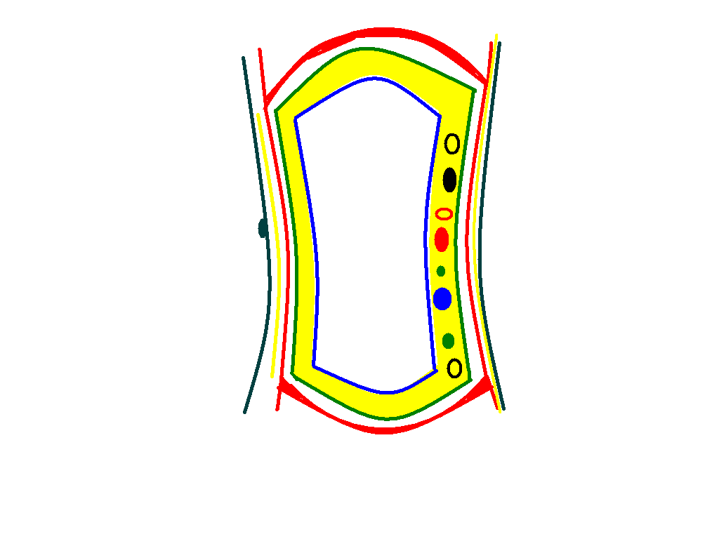
DIAPHRAGM
SKIN
SUBDIAPHRAGMATIC FASCIA
SUP. FASCIA
ANT. ABD. W. MUSCLES
POSTION OF ALL ORGANS,NERVES VESSELES OF THE ABDOMEN
FASCIA TRANSVERSALIS
EXTRAPRET. FATTY TISSUE
FASCIA OF THE BACK
PEROTENEAL SAC
PELVIC MUSCLES
PELVIC FASCIA

Slide 65
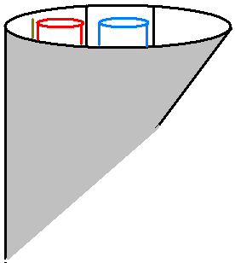
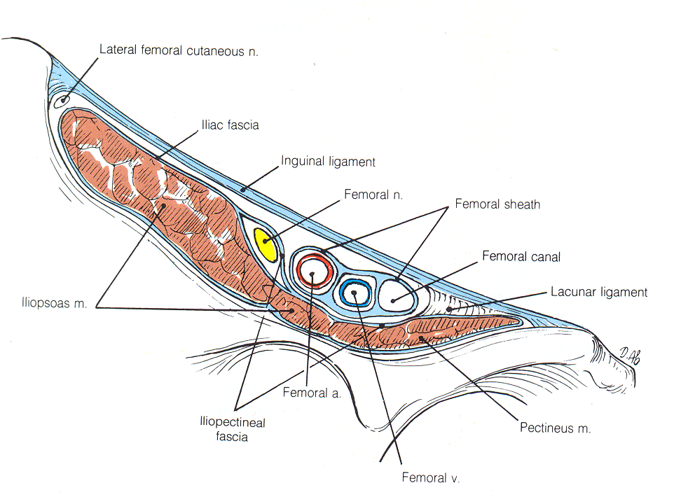
THE FEMORAL SHEATH
A funnel- shaped of deep fascia which surrounds the upper one and half inches of the femoral vessels.
The anterior wall of the sheath is a downward prolongation of the fascia transversails of the anterior abdominal wall.
The posterior wall of the sheath is a downward prolongation of the fascia iliaca of the posterior abdominal wall.
The sheath is divided by two septa into three compartments:
Lateral compartment: Contains the femoral artery and femoral branch of genito-femoral nerve
Intermediate compartment: contains the femoral vein.
Medial Compartment: Called the femoral canal
- contains some areolar fatty tissue and a lymph node
- the canal is half an inch long
- its upper opening is called The femoral ring
Femoral br. of g. f. nerve
Fascia iliaca
A
V
R
Fascia transversalis

Slide 66
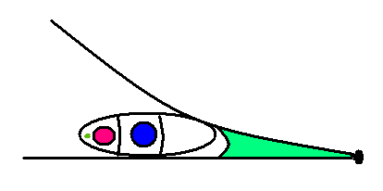
The femoral ring :
is half an inch wide (admits the tip of the little finger). It is closed by a condensation of extraperitoneal fatty tissue called the femoral septum.
Boundaries :
Anteriorly: the inguinal ligament.
Posterorly: the pectineal line.
Laterally: the femoral vein
Medially: the sharp crescentic base of the lacunar ligament
The ring is blocked by the femoral septum , formed of fatty tissue and single lymph node. This septum is covered above by the parietal peritoneum of the abdomen
Ing. Lig.
Lacunar Lig.
Pectineal Lig.
Femoral ring

Slide 67
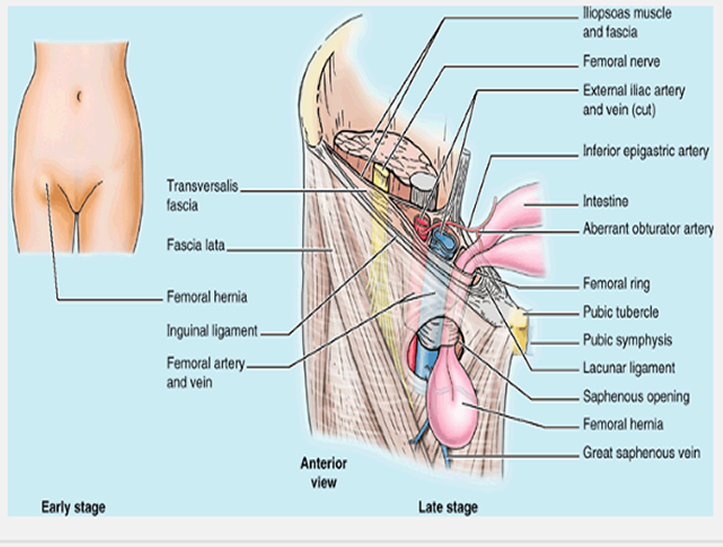
Femoral hernia

Slide 68
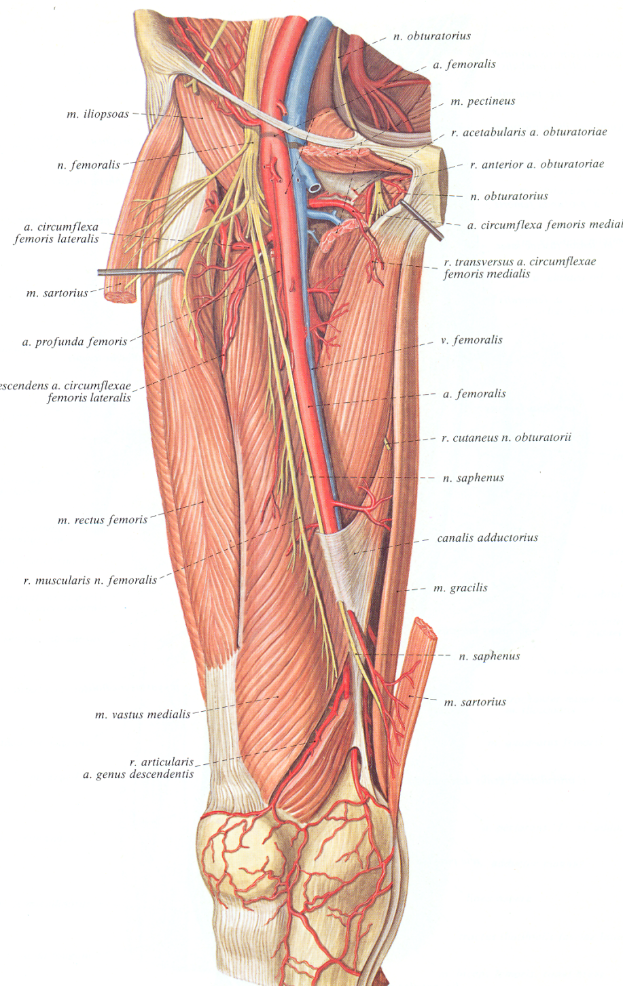
FEMORAL ARTERY
Origin: continuation of the external iliac artery at the mid inguinal point
Termination: Passes through the opening in the adductor magnus where it continues as the popliteal artery.
The upper half of the lies in the femoral triangle while its lower half lies in the adductor canal.
Course and relations in the triangle:
At the base:
Anteriorly: the skin, superficial fascia and deep fascia.
Laterally: the femoral branch of genito-femoral nerve and the femoral nerve.
Medially: the femoral vein.
Posteriorly: the psoas major muscle.
At the middle:
Anteromedial: skin, superficial and deep fascia.
Lateral: the saphenous n. and the medial c. n. of the thigh.
Posterior: the pectineus muscle separated by the femoral v., the profunda v., the profunda a, and its nerve.
At the apex:
Anteromedial: skin, superficial and deep fascia and the medial c. n. of the thigh.
Lateral: the saphenous nerve.
Posterior: the adductor longus separated by the femoral v..

Slide 71
Muscles of the anterior compartment of the thigh

Slide 73
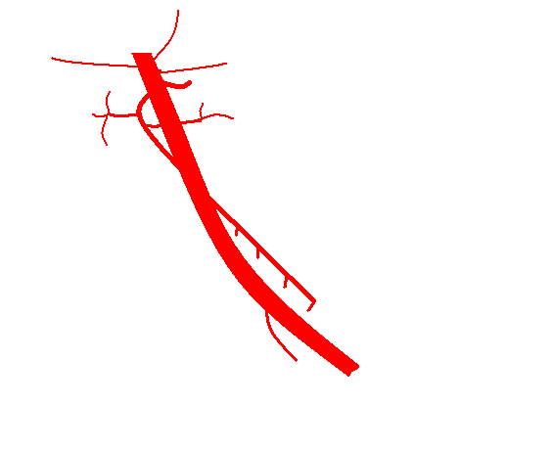
Branches
Three Superficial arteries:
superficial external pudendal.
superficial epigastric
superficial circumflex iliac arteries.
b) Three deep arteries
Deep external pudendal artery: which arises about one inch below the inguinal ligament and passes medially to the external genital organs.
Profunda femoris artery.
Descending genicular artery.
Sup. epigastric
Sup. Circumflex iliac
Sup. Ext. pudendal
Deep External Pud.
Profunda femoris
Descending gen.

Slide 74
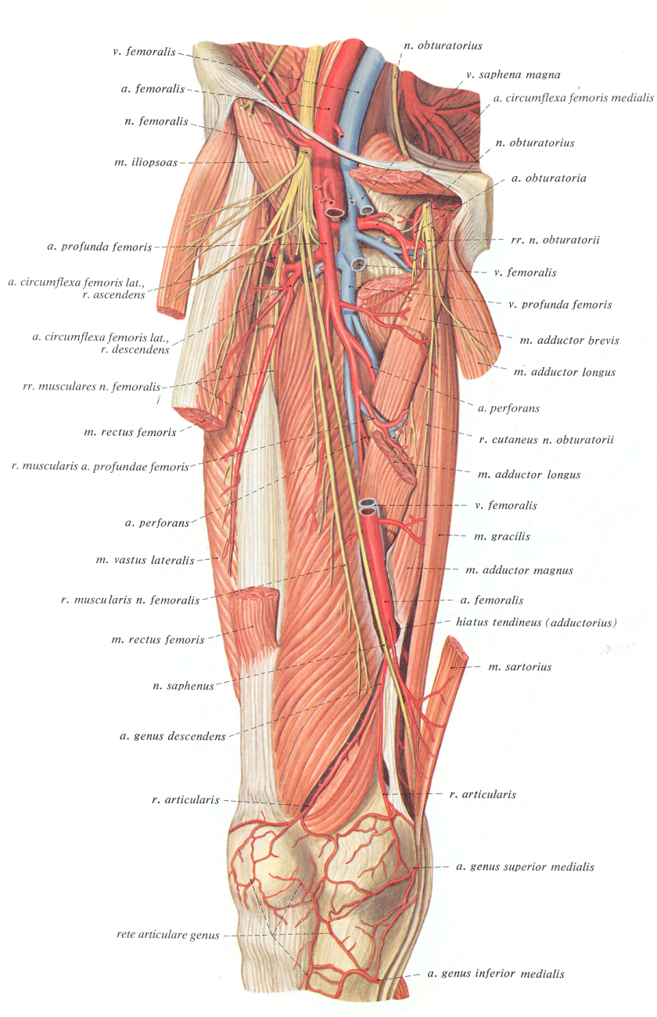
Profunda femoris artery:
-arises one inch below the inguinal ligament from the posterolateral aspect of the femoral artery.
-descends behind the femoral artery, passes between the adductor longus which separates the profunda vessels from the femoral vessels.
-at the apex of the triangle the order of structures from anterior to posterior is as follows: femoral artery, femoral vein, adductor longus, profunda vein and profunda artery.

Slide 75
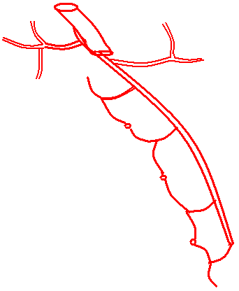
Femoral artery
Branches
The profunda femoris artery is the main source of blood supply to the thigh. It gives the following branches:
Lateral Circumflex femoral artery:
Runs laterally through the branches of the femoral nerve.
Disappears under cover of the sartorius and rectus femoris where it divides into: ascending ,transverse and descending branches
Medial circumflex femoral artery: passes backwards between the psoas major and pectineus to reach the back of the thigh where it ends by dividing into ascending and transverse branches.
Perforating arteries:
Four in number. The profunda gives three perforating arteries and ends as the fourth perforating artery. (The perforating arteries cross the linea aspera deep to the insertion of the adductor Magnus).
A
A
T
Med. circumflex
T
D
Profunda femoris
Lat. circumflex
1st perforating
2nd perforating
3rd perforating
4th perforating

Slide 76
Trochanteric and cruciate anatomosis
The Trochanteric Anastomosis:-It provides the main blood supply to the head of the femur.
It is formed by: the superior gluteal artery, the inferior gluteal artery, the medial femoral circumflex artery, and the lateral femoral circumflex artery.
The Cruciate Anastomosis: It is situated at the level of the lesser trochanter of the femur
It is formed by:- the inferior gluteal artery, the medial femoral circumflex artery, the lateral femoral circumflex artery, and the first perforating artery, at times second perforating branch a branch of the profunda artery
NB>: the trochanteric and cruciate anastomosis, provides a connection between the internal iliac and the femoral arteries.

Slide 77
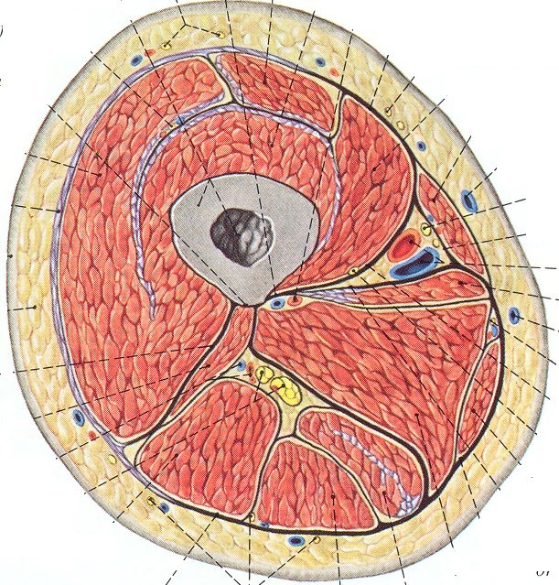
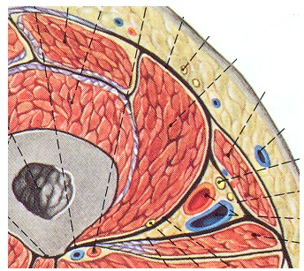
Adductor Canal (subsartorial Canal)
Position:
in the medial side of the middle third of the thigh
it begins at the apex of the femoral triangle
it ends at the opening in the adductor magnus where it becomes continuous with the popliteal fossa
Boundaries:
Anterolaterally: Vastus medialis.
Posteriorly (Floor): adductor longus above and magnus below
Anteromedially: a fibrous roof covered by the sartorius.
Contents:
femoral artery, femoral vein,
saphenous nerve and nerve to
vastus medialis.
Vastus Medialis
Sartorius
Adductor Longus
Vastus Medialis
Fibrous Roof
The Canal
Adductor Longus

Slide 78
How the structures enter and leave the canal
Femoral artery: enters the canal through its upper end and leaves the canal through the opening in the adductor magnus where it continues as the popliteal artery.
Femoral Vein: enters the canal through the opening in the adductor magnus as the continuation of the popliteal vein. In the lower part of the canal it is posterolateral to the femoral artery. In the upper part of the canal through its upper end to the apex of the femoral triangle.
Saphenous nerve: enters the canal through its upper end. It crosses in front of the femoral vessels. In the lower part of the canal it pierces the fibrous roof and becomes subcutaneous where it descends to the leg.
Nerve to vastus medialis : enters the canal through its upper end. In the middle of the canal it enters the vastus medialis

Slide 79
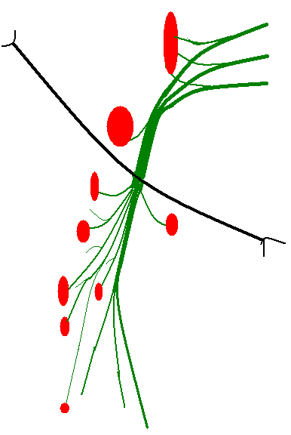
Femoral Nerve
Origin: branch of the lumber plexus, from dorsal divisions of the ventral rami of 2,3 and 4 lumbar nerves.
Course:
- the nerve descends in the groove between the psoas major and iliacus in the abdomen.
-it passes behind the inguinal ligament it ends by dividing into terminal branches.
Branches:
A.Cutaneous:
1.Medial c. n. of the thigh
2.Intermediate c. n. of the thigh
3.Saphenous n.
B.Muscular: to
1.Quadriceps femoris: rectus femoris, vastus medialis vastus intermedius and vastus lateralis.
2.Sartorius.
3.Pectineus.
C.Articular:
1.To the hip joint: throygh the upper nerve to the rectus femoris.
2.To the knee joint through the nerves to the vasti.
Psoas major
Iliacus
Sartorius
Inguinal lig.
Rectus Femoris
To hip joint
Pectineus
To knee joint
Vastus Lateralis
Vastus Medialis
Vastus intermedius
Saphenous nerve
Medial c n of thigh
Articularis genu
Intermediate c. n. of thigh

Slide 80
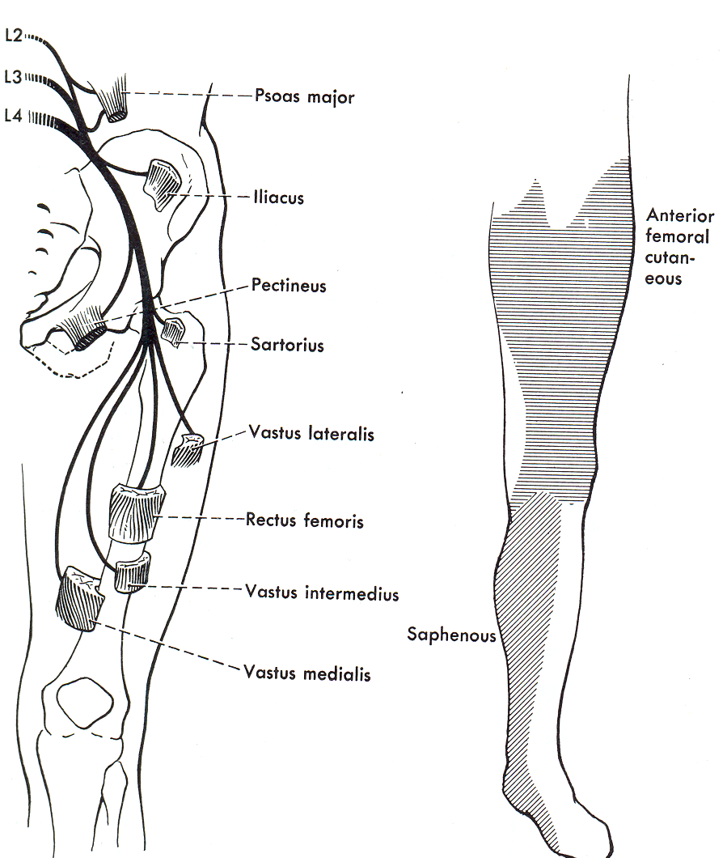
Femoral Nerve
Origin: branch of the lumber plexus, from dorsal divisions of the ventral rami of 2,3 and 4 lumbar nerves.
Course:
- the nerve descends in the groove between the psoas major and iliacus in the abdomen.
-it passes behind the inguinal ligament it ends by dividing into terminal branches.
Branches:
A.Cutaneous:
1.Medial c. n. of the thigh
2.Intermediate c. n. of the thigh
3.Saphenous n.
B.Muscular: to
1.Quadriceps femoris: rectus femoris, vastus medialis vastus intermedius and vastus lateralis.
2.Sartorius.
3.Pectineus.
C.Articular:
1.To the hip joint: throygh the upper nerve to the rectus femoris.
2.To the knee joint through the nerves to the vasti.
Skin areas supplied by the femoral n.

Slide 81
THE MEDIAL COMAPRTMENT OF THE THIGH
Contents of the Medial Fascial Compartment of the thigh includes:-
Muscles: Gracilis, adductor longus, adductor brevis, adductor magnus, and obturator externus
Blood supply: Profunda femoris artery and obturator artery
Nerve supply: Obturator nerve

Slide 82
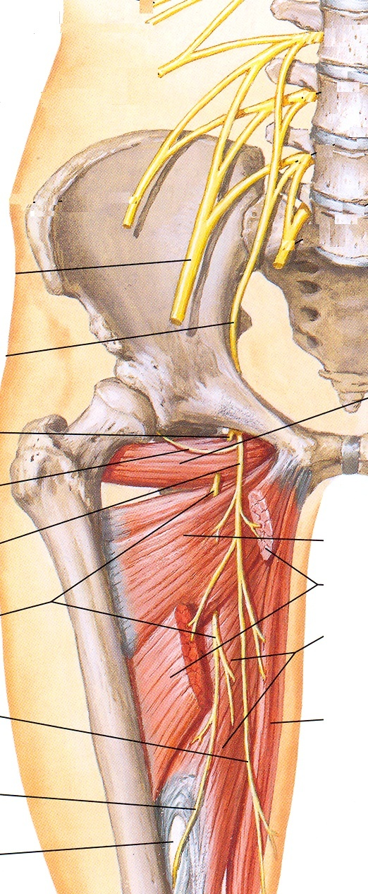
Obturator nerve
Origin: branch of lumber plexus
from the ventral divisions L2,3,4 ventral rami
Course:
-its origin is inside the substance of psoas major
-appears at the medial border of the psoas major
-Runs on the side wall of the pelvis
-Then it leaves the pelvis by passing through the obturator canal
-Just outside the canal it divides into anterior and posterior divisions
-The anterior division descends in front of the adductor brevis
-The posterior division descends behind the adductor brevis
Branches:
Anterior division: gives an articular branch to hip joint and muscular branches to the adductor longus adductor brevis and gracilis.
Posterior division: give muscular branches to the obturator externus and pubic part of adductor magnus. It also gives a genicular branch to the knee joint.
Obturator n.
Obt. externus
To hip joint
Ant. division
Add. brevis
Add. longus
Post. division
Add. magnus
Cut. branch
gracilis
To knee joint
Add. opining

Slide 84
Muscle of the medial compartment of the thigh

Slide 86
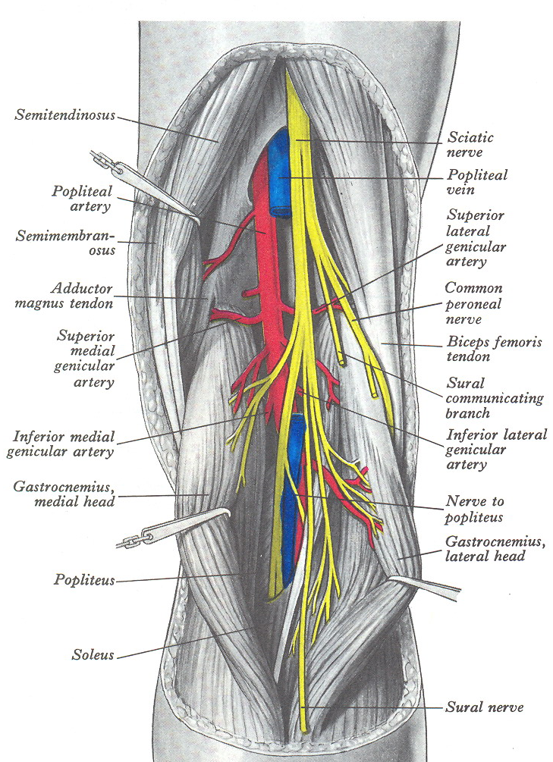
The popliteal fossa
Position: on the back of the knee
Boundaries:
Upper medial:
semitendinosus and semimembranosus
upper lateral:
biceps femoris
Lower medial:
medial head of gastrocnemius
Lower lateral:
lateral head of gastrocnemius and plantaris
Floor: from above downwards,
the fat over the popliteal surface of the femur
The capsule of knee joint
The fascia covering the popliteus muscle
Roof: the deep fascia

Slide 87
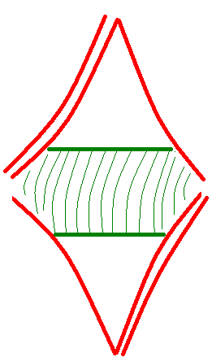
Boundaries
Biceps femoris
Semitendinosus &
semimembranosus
Popliteal surface
of the femur
Capsule of knee joint
Fascia covering
The popliteus m
Medial head of gastrocnemius
Lateral head of gastrocnemius &
Plantaris m

Slide 88
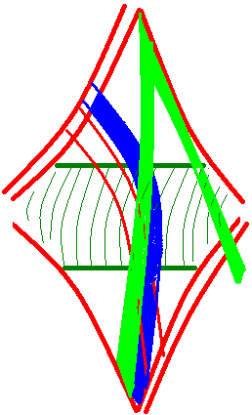
Contents
4 small structures:
Popliteal lymph nodes
Small saphenous vein
Posterior c n of the thigh
Genicular br. Of obturator n.
4 large structures:
Tibial nerve
Common peroneal nerve
Popliteal artery
Popliteal vein

Slide 89
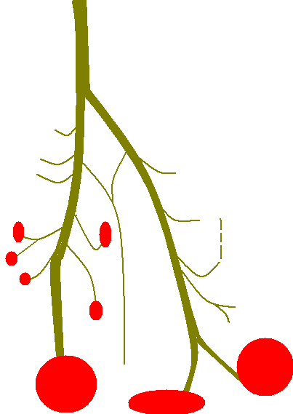
Nerves of the fossa
Tibial nerve
Common peroneal nerve
Upper medial genicular
Sural communicating
Middle genicular
Upper lateral genicular
Lower medial genicular
popliteus
Lower lateral genicular
Gastrocnemius
Recurrent genicular
Plantaris
Lateral c n of the calf
Lateral compartment
Soleus
Sural n.
Posterior compartment
Anterior compartment

Slide 90
POPLITEAL ARTERY
Continuation of femoral A. at adductor hiatus.
Terminates at lower border of popliteus by dividing into anterior and posterior tibial arteries.
Relations:
Anterior (deep):
Fat over popliteal surface of the femur
Capsule of the knee joint
Fascia over the popliteus muscle
Posterior superficial):
Skin, superficial and deep fascia
Posterior c n of the thigh and small saphenous vein
The popliteal vein and tibial nerve crossing it from lateral to medial
Lateral:
above, biceps femoris, popliteal vein, tibial nerve andlateral condyle of femur
Below, lateral head of gastrocnemius and plantaris.
Medial:
Above, semimembranosus and medial femoral condyle
Below tibial nerve popliteal vein and medial head of gastrocnemius,
BRANCHES
Cutaneous
Muscular
Genicular
superior medial and lateral genicular
middle genicular
inferior medial and lateral genicular
Superior lateral genc.
Superior medial genc.
Middle genc.
Inferior lateral genc.
Inferior medial genc.

Slide 91
Deep fascia of the leg
Two septa from the anterior and posterior borders of the fibula divides the leg into three compartments:
The anterior compartment = extensor compartment its muscles are supplied by the deep peroneal nerve.
The lateral compartment = peroneal compartment, its muscles are supplied by the superficial peroneal nerve.
Posterior compartment = flexor compartment, its muscles are supplied by the tibial nerve
Ant. Comp.
T
F
Lat.
Comp.
Post. Comp.
T
(deep)
(superficial)
COMPARTMENTS OF THE LEG

Slide 92
ANTERIOR COMPARTMENT:
Tibialis anterior
Extensor digitorum longus
Extensor hallucis longus
Peroneus tertius
EX. D. L
T A
EX
H
L
P
B
P
L
LATERAL COMPARTMENT:
Peroneus longus
Peroneus brevis
F
T P
FLX. D L
FLX. H L
SOL
GAST
POSTERIOR COMPARTMENT:
DEEP:
Tibialis posterior
Flexor digitorum longus
Flexor hallucis longus
SUPERFICAIL:
Soleus
Gastrocnemius
plantaris

Slide 93
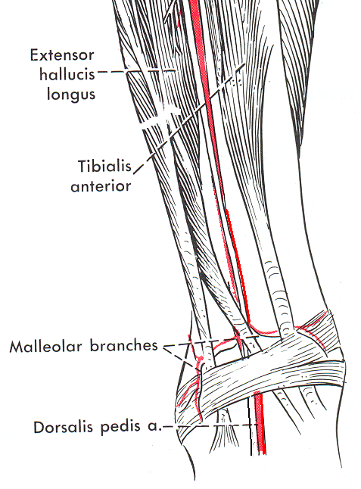
THE ANTERIOR COMPARTMENT
THE SUPERIOR EXTENSOR RETINACULUM:
Attachments:
Medially: to the lower part of the medial border of the tibia
Laterally: to the subcutaneous triangle of the fibula
The structures passing deep to it as arranged from medial to lateral are:
Tibialis posterior
Extensor hallucis longus
Anterior tibial vessels
Deep peroneal nerve
Extensor digitorum longus
Peroneus tertius
Deep peroneal n.
Anterior tibial a.
Superior Extensor
retinaculum

Slide 94
THE INFERIOR EXTENSOR RETINACUUM:
Attachments: It is Y-shaped
The stem is attached laterally to the anterior part of the superior surface of the calcaneus
Medially, the upper band is attached to the medial malleous, the lower band to the deep fascia on the medial side of the foot
Structures passing deep to it as arranged from medial to lateral:
Tibialis posterior
Extensor hallucis longus
Dorsalis pedis vessels
Deep peroneal nerve
Extensor digitorum longus
Peroneus tertius

Slide 95
Structures of the anterior and lateral compartments
ANTERIOR COMPARTMENT
LATERAL COMPARTMENR
Peroneus longus
Superficial peroneal nerve
Peroneus brevis
Tibialis anterior
Anterior tibial artery
Deep peroneal nerve
Extensor digitorum longus
Extensor hallucs longus
Peroneus tertius
Superior extensor retinaculum

Slide 96
Nerves of the anterior and lateral compartments
Common peroneal n
Deep peroneal n.
Superficial peroneal n.
Tibialis anterior
Peroneus longus
Extensor digitorum longus
Peroneus brevis
Extensor hallucis longus
Peroneus tertius
Extensor digitorum brevis

Slide 97
FLEXOR RETINACULUM
Attachments:
Extends from the medial malleolus to the medial tubercle of calcaneus
Structures passing deep to it as arranged from medial to lateral:
Tibialis posterior
Flexor digitorum longus
Termination of posterior tibial vessels and beginning of medial and lateral planter vessels
Termination of tibial nerve and beginning of medial and lateral planter nerves
Flexor hallucis longus

Slide 98
POSTERIOR TIBIAL ARTERY
Popliteal artery
Anterior tibial a
Circumflex fibular a.
Posterior tibial a.
Peroneal a
Communicating br.

Slide 99
The planter aponeurosis
The superficial transverse metatarsal lig
Digital nerves and vessels in the web spaces
Two slips from each process
4 Processes
The planter
aponeurosis

Slide 100
FIRST LAYER
THREE MUSCLES:
TWO ABDUCTORS
ONE FLEXOR
ABDCTOR HALLUSIS
ABDUCTOR DIGITI MINIMI
FLEXOR DIGITORUM BREVIS
Abductor
hallucis
Abductor digiti minimi
Flexor digitorum brevis

Slide 101
SECOND LAYER
TWO TENDONS + SMALL MUSCLES
TWO TENDONS:
TENDON OF FLEXOR DIGITORUM LONGUS
TENDON OF FLEXOR HALLUSIS LONGUS
SMALL MUSCLES:
FLEXOR DIGITORUM ACCESORUS
LAMBERICAL MUSCLES

Slide 102
THIRD LAYER
THREE MUSCLES: TWO FLEXORS AND ONE ADDUCTOR
TWO FLEXORS:
FLEXOR HALLUSIS BREVIS
FLEXOR DIGITI MINIMI
ONE ADDUCTOR:
ADDUCTOR HALLUSIS

Slide 103
FOURTHLAYER
TWO TENDONS + SMALL MUSCLES:
TWO TENDONS:
TENDON OF TIBIALIS POSTERIOR
TENDON OF PERONEUS LONGUS
SMALL MUSCLES
THREE PLANTER INTEROSSEI
FOUR DORSAL INTEROSSEI

Slide 104
THE INTEROSSEI MUSCLES
Plantar Interossei:
Three in number
Arise by one head
Are adductors for the toes
Middle line of the foot (second toe)
B.Dorsal Interossei:
Four in number
Arise by two heads
Are abductors for the toes

Slide 105
BLOOD SUPPLY

Slide 106
NERVES OF THE SOLE OF THE FOOT
The lateral three lumbricals
First lumbrical
Planter and Dorsal Interossei
Flexor hallucis brevis
Flexor digiti minimi
Adductor hallucis
Abductor Hallucis
Flexor digitorum accessorius
Flexor digitorum brevis
Abductor digiti minimi
Lateral planter nerve
Medial planter Nerve

Slide 107
ARTERIES OF THE SOLE
The lateral planter anastomose with the dorsalis pedis artery (deep planter) to form the planter arch. Out of the arch arises the common digital arteries which will supply the toes through the digital arteries

