Slide 1
LUMBAR PUNCTURE

Slide 2
LUMBAR PUNCTURE(SPINAL TAP)
Lumbar puncture is done by inserting a needle into the subarachnoid space to withdraw CSF.
The needle is usually inserted into the subarachnoid space either between L3-L4 or L4-L5.
Rationale: the spinal cord ends at the level of L1. Therefore, insertion of the needle below L3 prevents puncture of the spinal cord

Slide 3
Note:
The patient should be relaxed and breathing normally.
Rationale: hyperventilation in a tensed patient increases pressure readings on the manometer
Normal CSF pressure is 50-200mmH2O
L.P is risky incase of intracranial mass lesion because spinal pressure is decreased by the removal of CSF & the brain may herniate downwards through foramen magnum.

Slide 4
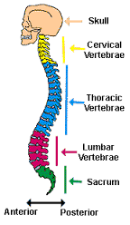

Slide 5
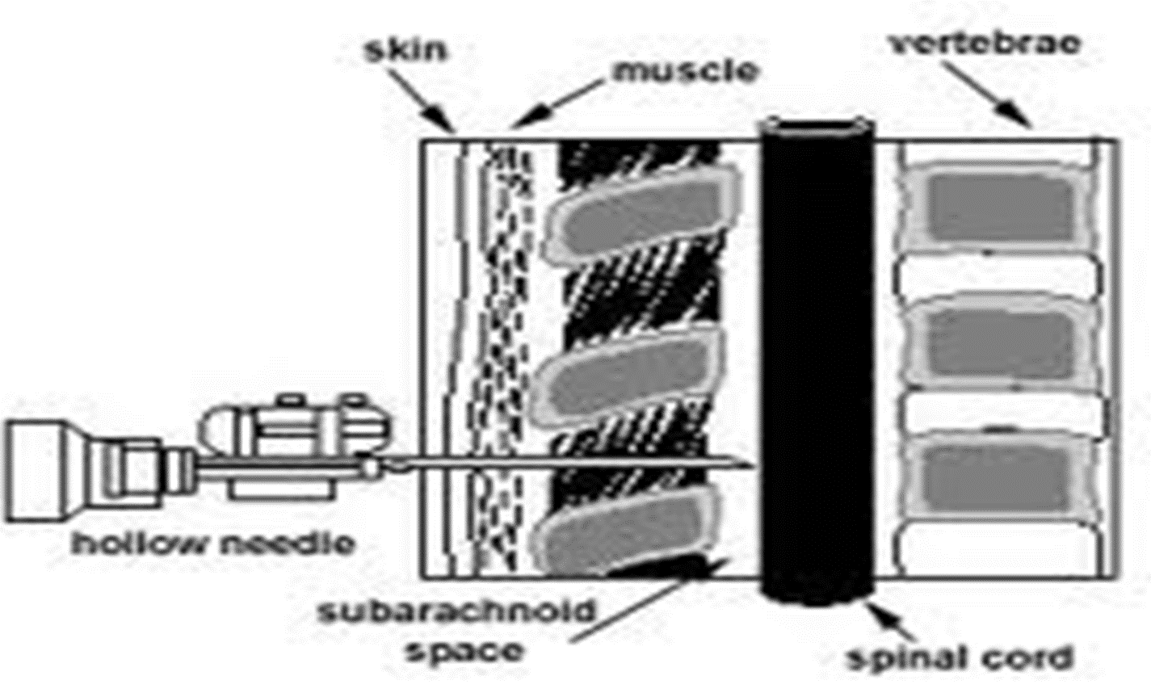

Slide 6
Indications
A needle is inserted into the lumbar subarachnoid space to withdraw CSF for:
Measuring or reducing CSF pressure- normal: 50-200 mmH2o (8-15mmHg)
Obtain CSF for examination e.g cytological purpose in case of cancer or if meningitis is suspected
Examination- normal is clear and colorless. The specimen should be sent to the lab immediately because changes will take place and alter the specimen if allowed to stand. Specimens are obtained for cell count, culture, glucose, protein and others
Determine presence or absence of blood or pus in CSF
To administer medications intrathecally- into the spinal canal e.g. cytotoxic agents
Inject dye (myelography) or radioactive substances (cisternography) into cerebrospinal fluid to make diagnostic images of the fluid's flow

Slide 7
Contraindications
Suspicion of raised intracranial pressure
Anticoagulant therapy (i.e. Warfarin)
Thrombocytopenia or other clotting disorders
Suspicion of a spinal abscess
Risk of herniation (i.e. Arnold-Chiari malformation)
Acute spinal cord trauma
Congenital spinal abnormalities

Slide 8
CSF analysis
Normal
CSF should be clear and colorless
2. Abnormal
Pink, blood tinged or grossly blood CSF can indicate subarachnoid hemorrhage.
NB CSF may be blood tinged initially but become clear as fluid is drained.
Uses;
Cell count, culture, glucose, protein analysis
Specimen must be sent to lab immediately before changes occur

Slide 9
Equipment
Sterile dressing.
Sterile gloves.
Sterile drape.
Antiseptic solution with skin swabs.
Chlorhexidine cleaning solution (0.5 % in alcohol 70%) or alternatively iodine
Lidocaine 1% without epinephrine.
Syringe, 3 mL.
Syringe (5-10ml) and needles for local anaesthetic administration (usually need one for drawing up anaesthetic and one for administration)
Needles, 20 and 25 gauge.
Spinal needles, 20 and 22 gauge.
Manometer: to measure the opening pressure
Sample collection containers
Dressing to apply after the lumbar puncture is complete
Pen for marking the planned insertion site

Slide 10
Nursing care responsibilities in LP
Pre- procedure
Explain the procedure to the pt
obtain informed written consent
Instruct the pt to void
Answer any Qs the pt may have
Reasure the pt

Slide 11
Nursing care responsibilities in LP…
Procedure
Position the pt on one side at the edge of the bed or examining table with back toward the physician
The thighs and legs are flexed as much as possible – this increases the space between the spinous processes of the vertebrae, for easier entry into the subarachnoid space.
A small pillow may be placed under the pts head to maintain the spinal horizontal possition, a pillow may be placed btwn the legs to prevent the upper leg from rolling forward.

Slide 12
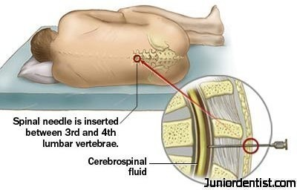

Slide 13
Assisting in sitting position

Slide 15
LP procedure….
The physician cleanses the puncture site with an antiseptic agent solution and drapes the site; then injects local anesthetic agent inserts a spinal needle into the subarachnoid space though 3rd&4th or 4th &5th lumbar vertebrae.
A pressure reading may be obtained.
A specimen of CSF is removed and usually collected in three test tubes, labeled in order of collection. The needle is withdrawn.
The physician applies a small dressing to the puncture site
The tubes of CSF are sent to the lab immediately for analysis.

Slide 16
Nursing care responsibilities in LP
Instruct the patient to lie prone for 2 to 3 hours to separate the alignment of the dural and arachnoid needle punctures in the meninges, to reduce leakage of CSF.
The nurse assist the pt to maintain position to avoid sudden movement which may produce traumatic tap
Encourage pt to relax and to breath normal, because hyperventilation may cause changes in CSF pressure
Monitor the patient for complications of lumbar puncture
Encourage increased fluid intake to reduce the risk of post procedure headache.
Label specimens and send to the lab immediately

Slide 17
Complications
Post lumbar puncture headache:
Results from leakage of csf at the puncture site hence insufficient supply to the cranium
May occur beginning a few hours post procedure to several days
It is throbbing, bifrontal or occipital and dull and deep in character
Severe on standing or sitting
Management:
Bed rest
Analgesics
Hydration with liberal administration of fluids especially those that contain caffeine E.g coffee, tea, some sodas

Slide 18
Prevention of leakage
Needle with a small gauge should be used for puncture
Patient should remain prone for 3hrs
If larger amounts of CSF has been withdrawn(more than 20mls) then the patient should lie:
Prone for 2hrs
Lateral for 2hrs
Prone or supine for 6hrs

Slide 19
B. Herniation of cranial contents
Common in the presence of intracranial mass
D. Epidural abscess : collection of pus in tissues causing swelling and inflammation around it.
E. Spinal epidural haematoma : localized collection of blood within tissues
F. Meningitis,
G. Others: temperature elevations, backache or spasms, neck stiffness and voiding problems

Slide 20
Nurses role
Consent and explain procedure
Pts privacy
Help prepare equipment
Take & record vital signs before and after the procedure
Help to position pt
Reassure the pt throughout the procedure

Slide 21
Nurses role
Observe the general condition throughout the procedure
Encourage pt to breath quietly
Hold test tubes to collect CSF
Cover the punctured site with sterile procedure
Assist pt to comfortable position after the procedure.
Dispose the equipment properly
Document the procedure.

Slide 26
https://www.youtube.com/watch?v=WpXGUn7eGZE
https://www.youtube.com/watch?v=9kckrlBIR2E

