Slide 1
Lateral and medial epicondyle fractures
KELVIN

Slide 2
Epidemiology
Lateral condyle fractures of the elbow are the second most common paediatric elbow fracture after supracondylar fractures.
They account for 12-20% of elbow fractures in children. The peak age of incidence is six years.
They usually occur as a result of indirect forces being applied to the elbow following a fall on an outstretched hand.
Angular and rotational forces are thought to contribute.

Slide 3
Clinical
The child will present with pain, limited elbow range of motion (ROM) and swelling at the lateral aspect of the elbow.
Lateral condyle fractures can frequently look benign with minimal swelling and minimal deformity, which can lead to delays in presentation and recognition of the fracture.

Slide 4
Milch classification
Type I: rare
Type II: most common

Slide 5
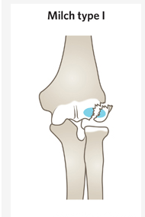
Type I
The fracture line goes through the capitellar ossification centre
Equivalent to a Salter-Harris type IV fracture

Slide 6
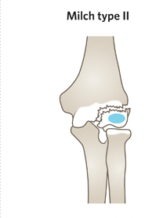
Type II
The fracture line runs medial to the capitellar ossification centre
Equivalent to a Salter-Harris type II fracture

Slide 7
Investigations
Anteroposterior (AP) and lateral x-rays of the elbow should be obtained without splinting.
If there is clinical suspicion of injury in the forearm or wrist then separate films of these areas should be ordered.
If a lateral condyle fracture is suspected or minimally displaced on x-rays, then oblique views are often useful.
These fractures do not require splinting prior to imaging as there is usually less pain and swelling. This allows subtle fracture lines to be more visible on x-ray.

Slide 8
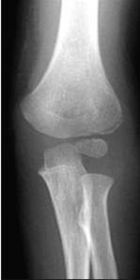
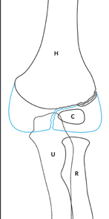
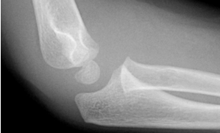
Radiology
An undisplaced lateral condyle fracture may be difficult to see on plain x-ray. The presence of anterior and posterior fat pad signs may be the only clue. Oblique views may be useful in undisplaced lateral condyle fractures.

Slide 9
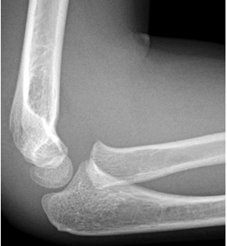
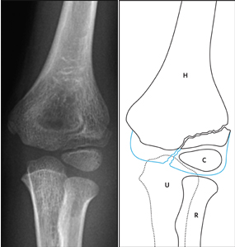
Image
Minimally displaced lateral condyle fracture (<2 mm gap). In the AP view, a metaphyseal fracture line can be observed just proximal to the growth plate above the capitellum. On the lateral view, a minimally displaced fracture appears as a second line visible above capitellum.

Slide 10
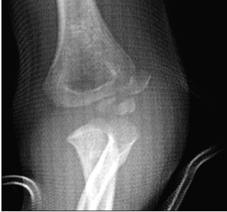
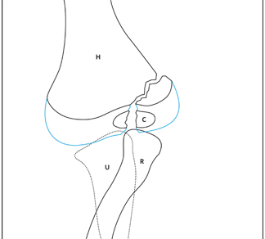
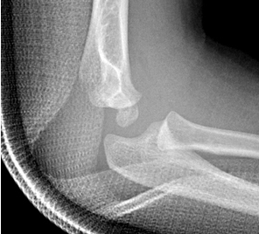
Image
The AP in this instance provides the most useful information. It shows a displaced fracture fragment (>2 mm). The ulna is laterally subluxated. Notice that the majority of the soft tissue is located laterally.

Slide 11
Management
Undisplaced fractures can be immobilised in an above-elbow backslab with the elbow flexed to 90 degrees and supported in a sling.
For undisplaced fractures, follow-up in the fracture clinic within 7 days with repeat x-ray is required.
It is usually necessary to remove the backslab to obtain adequate views of the fracture at review.
Minimally displaced (<2 mm gap) can be managed with either immobilisation only or closed reduction with percutaenous pinning.
All displaced fractures (>2 mm gap and/or angulation of the lateral condyle) will need to go to theatre either for closed reduction and percutaneous pinning or open reduction.

Slide 12
Complications
a) Delayed union
b) Nonunion: this is a common outcome for nonoperative treatment of displaced lateral condyle.
The risks of nonunion increase with increased degree of displacement or angulation of the fragment.
c) Growth disturbance
d) Elbow stiffness
e) Overgrowth at the lateral condyle can cause an unsightly bump on the outside of the elbow

Slide 13
Medial epicondyle
Medial epicondyle fractures are common and account for 10% of all elbow fractures in children.
They occur between the ages of 7-15 years.
They are usually a result from an avulsion (pull off) injury caused by a valgus stress at the elbow and contraction of the flexor muscles.
A medial epicondyle fracture is an avulsion injury of the attachment of the common flexors of the forearm. The injury is usually extra-articular but can be sometimes associated with an elbow dislocation.
These fractures can be classified based amount of displacement and whether the medial epicondyle is incarcerated within the joint.

Slide 14
Medial epicondyle fractures
Fifty percent of medial epicondyle fractures are associated with an elbow dislocation.
It is important to distinguish a medial epicondyle fracture (common) from a medial condyle fracture (very rare).
Medial condyle fractures are intraarticular, extending into the elbow joint and require urgent open reduction internal fixation (ORIF).

Slide 15
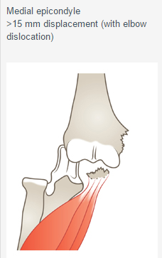
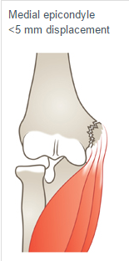
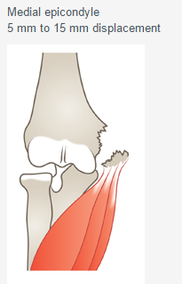
Classification

Slide 16
Clinical
A child presenting with a medial epicondyle or condyle fracture of humerus presents with tenderness and swelling at the medial aspect of the elbow.
There may be a dislocation of the elbow.

Slide 17
radiology
AP and lateral x-ray of a minimally displaced (< 5mm) medial epicondyle
Undisplaced or minimally displaced fractures may be difficult to see on x-ray.
Soft tissue swelling may be the only finding.
Later an injury can be identified by the formation of fracture callus, periosteal reaction along the medial border of the humerus.

Slide 18
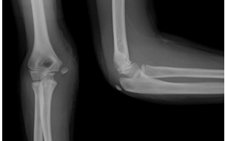
Non displaced

Slide 19
Class
The medial epicondyle is separated >5 mm (red arrow).
This is evident on the AP view.
It is more difficult to see on the lateral view due to the splint. B) Due to the child's age and type of sporting activity, management was open reduction and internal fixation.

Slide 20
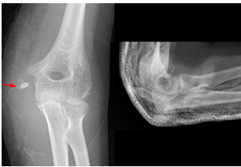
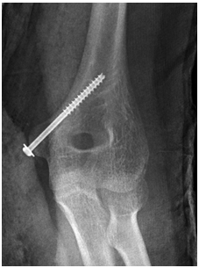
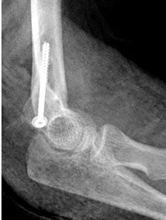
Displaced

Slide 21
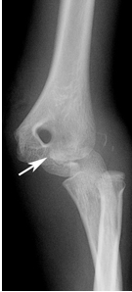
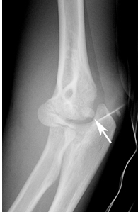
elbow dislocation and fracture of the medial epicondyle (white arrow).

Slide 22
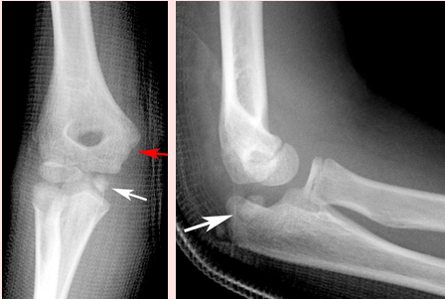
Medial epicondyle trapped in elbow joint

Slide 23
Imaging
With an elbow dislocation, the medial epicondyle can be incarcerated in the joint (white arrow) following reduction.
This can be difficult to identify on x-ray.
It is important to check that the medial epicondyle is present in its anatomical position.
On the AP view, the medial epicondyle may be missing. On the lateral view, the fragment may appear as an additional bony opacity interposed between trochlea and olecranon.
Joint surfaces of the olecranon and trochlea are not congruent.
Always do repeat x-rays to check that the medial epicondyle is not incarcerated in the joint.
If there is any doubt that the medial epicondyle is trapped in the joint, an urgent open reduction and internal fixation is needed.

Slide 24
Non operative treatment
Indications
Relative indications for closed treatment versus operative treatment in medial epicondyle fractures displaced 5 mm to 15 mm.
 | Closed treatment | Operative treatment
Age | ≤8 years | ≥ 8 years
Dominance | Non-dominant arm | Dominant arm
Sports | Nil/little sports | Athlete - throwing activities or gymnastics

Slide 25
Operative
Absolute indication for urgent open reduction and internal fixation:
Elbow dislocation with incarceration of medial epicondyle
Relative indications for open reduction and internal fixation:
Displacement >10 mm-15 mm
Ulnar nerve palsy
Dominant upper limb in throwing athlete or gymnast
Following reduction, <15 mm of displacement is considered acceptable.

Slide 26
Less than 5 mm displacement
No reduction required
Above-elbow backslab at 90 degrees elbow flexion for 3 weeks with sling.
The backslab and sling should be worn under clothing (e.g. loose fitting shirt) and not through the sleeve.
Backslab is removed at 3 weeks and child is then placed in collar and cuff for three weeks

Slide 27
5 mm to 15 mm displacement
Treatment choice dependent on number of factors such as child's age and sporting activities

Slide 28
More than 15 mm displacement (with elbow dislocation)
Requires reduction +/- ORIF

