Slide 1
THE HEART
C.M.GARAMA

Slide 2
Objective
Be able to understand normal structure of the heart
Understand brief physiology of the heart
To be cognizant of disease patterns of the heart

Slide 3
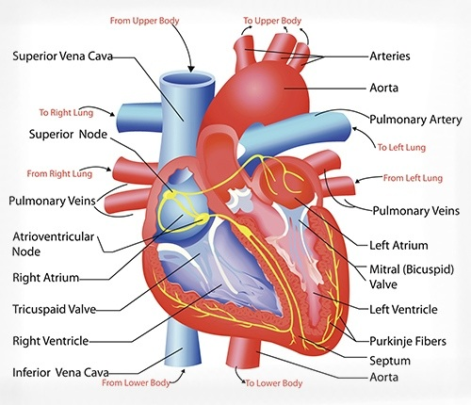

Slide 4
NORMAL STRUCTURE
The heart is a muscular pump that ejects blood into the vascular tree with sufficient pressure to maintain optimal circulation
Average weight of the heart
in an adult male is 300-350 gm
adult female is 250-300 gm
Heart is divided into four chambers:
a right and a left atrium both lying superiorly,
a right and a left ventricle both lying inferiorly and are larger.

Slide 5
HEART PHYSIOLOGY
The blood in the heart chambers moves in a carefully prescribed pathway:
venous blood from systemic circulation → right atrium → right ventricle → pulmonary arteries → lungs → pulmonary veins → left atrium → left ventricle → aorta → systemic

Slide 6
CARDIAC VALVES
The transport of blood is regulated by cardiac valves:
two loose flap-like atrioventricular valves,
tricuspid on the right and
mitral (bicuspid) on the left; and
two semilunar valves with three leaflets each,
pulmonary and aortic valves, guarding the outflow tracts

Slide 7
LAYERS OF HEART MUSCLES
They are mainly 3 layers
Epicardium
Outer layer
Myocardium
Middle layer composed of Muscle tissue
Endocardium
Inner layer

Slide 8
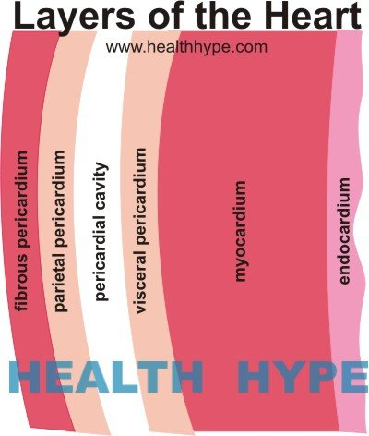

Slide 9
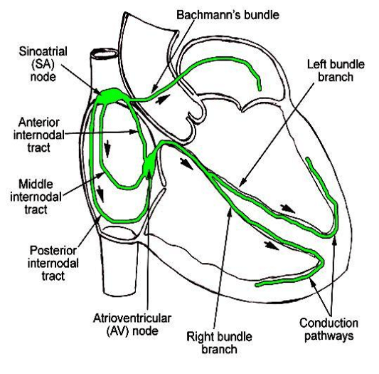
CONDUCTING SYSTEM of heart

Slide 10
CONDUCTING SYSTEM of heart
The conduction system of the heart located in the myocardium is responsible for regulating rate and rhythm of the heart.
It is composed of specialised Purkinje fibres which contain some contractile myofilaments and conduct action potentials rapidly.
The conduction system consists of 4 major components:
The sinoatrial (SA) node
The atrioventricular (AV) bundle
The atrioventricular (AV) node
The bundle of His

Slide 11
MYOCARDIAL BLOOD SUPPLY
Cardiac muscles require adequate supply of oxygen and nutrients to function properly
Blood is transported to myocardial cells by the coronary arteries which originate immediately above the aortic semilunar valve.
Most of blood flow to the myocardium during diastole.

Slide 12
Major coronary trunks, supplying blood to heart muscles
The anterior descending branch of the left coronary artery
Supply the Apex, anterior surface of right ventricle
The circumflex branch of the left coronary artery
Supplies the left atrium and lateral left ventricle
The right coronary artery
Supplies right atrium, part of right ventricle, and part of posterior ventricle

Slide 13
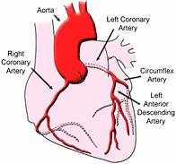

Slide 15
PATTERNS AND CLASSIFICATION OF HEART DISEASES
They are categorised on the basis of anatomic region involved and the functional impairment.
Accordingly, heart diseases maybe classified as;
Heart failure
Congenital heart diseases
Ischaemic heart disease
Hypertensive heart disease
Cor pulmonale
Rheumatic fever and rheumatic heart disease
Non-rheumatic endocarditis
Valvular diseases and deformities
Myocardial disease
Pericardial disease
Tumours of the heart
Pathology of cardiovascular interventions.

Slide 16
END
Reference
HARSH MOHAN BOOK OF PATHOLOGY,
6th Edition

Slide 17
Assignment
Discuss the clinical findings of a patient suspected to have a heart disease ( 10 mks)
INSTRUCTION
Assignment should be 300 words (+/- 10%), excluding topic and referencing
Use new times roman, double spacing
Include your email, student number on the topic
Send to:
cgarama@kmtc.ac.ke

