Slide 1
Maternal And Newborn Health 1
BY NJIRU

Slide 2
OBJECTIVES
By the end of this module the learner should be able to:
Define normal labour
Describe the physiology and mechanism of all stages of normal labour
Describe the management of all stages of normal labour
Describe the management of normal puerperium
Describe the management of a normal baby

Slide 3
Introduction Definition Of Terms Used In Midwifery
Presentation: is the fetal part lying at the pelvic brim
Lie: is the relationship of the foetal long axis and the uterine long axis.
Attitude: is the relationship of the fetal head and limbs to its trunk. Normal labour the attitude is complete flexion and the occiput is presenting. it could be slightly flexed ,deflexed in or extended in face presentation
Position: is the relationship of the denominator to the six areas of the pelvis. E.g. Positions in normal labour LOA, ROA,LOL, ROL, AP,
Denominator: is the part of foetal presentation that is used when referring to foetal position. E.g. in a vertex presentation the denominator is the occiput, denominator in breech presentation is the sacrum
Presenting part: is the part of the foetus which lies at the pelvic brim.

Slide 4
INTRODUCTION
Changes during the last few weeks of pregnancy
Mood swings are common with increase in energy
2-3 weeks before onset of labour there is lightening with its effects of:
Breathing becomes easier
Symphysis pubis widens
Pelvic floor widens and relaxes
There is engagement of the foetal head
Difficult in walking is experienced as well as backache
Increased pressure in the pelvis results in increase in vaginal secretions, frequency in micturition with some degree of stress incontinence
The cervix becomes soft and able to dilate

Slide 5
NORMAL LABOUR
Labour is the process whereby the foetus, placenta and membranes are expelled through the birth canal after 28 weeks of gestation.
Labour can be either normal or abnormal.
Normal labour occurs between 37-42 week’s of gestation. Traditionally a human pregnancy lasts approximately 40 weeks.
Normal labour : Is the process by which the foetus placenta and membrane are expelled spontaneously at term (37– 42 weeks) completed weeks of pregnancy by an aided maternal effort; foetus presenting by vertex, time doesn’t exceed 18 hours and no complication arise to the mother and baby and the newborn requires minimal or no resuscitation.

Slide 6
Normal labour has several important characteristics, which you should always remember.
These are:
Duration - completed within 18 hours
Occurs at term between 38 and 40 weeks
Is spontaneous
The foetus presents by the vertex
Has no complications to either mother or baby
The newborn child requires minimal or no resuscitation

Slide 7
Signs and symptoms of labour
Contractions of the uterus, which are increasingly strong, painful and regular
The cervix is taken up into the lower uterine segment causing dilatation of the cervix
Show: This is a mucoid blood stained discharge, which is called show
Rupture of membranes: Sometimes there is rupture of membranes with drainage of liquor amnii (amniotic fluid)

Slide 8
Distinguishing true labour from false labour
Factors | True Labour | False Labour
1. Contractions | Regularly spaced | Irregularly spaced
2.Interval between contractions | Gradually shortens | Remains long
3.Intensity of contractions | Gradually increases | Stays the same
4.Location of pain | Back and abdomen | Mostly lower abdomen
5.Effect of analgesics | Do not abolish the pain | Often abolish the pain
6.Cervical changes | Progressive effacement and dilatation | No changes

Slide 9
Onset Of Labour
The woman herself diagnosis labour
She will experience regular rhythmic uterine contractions which are uncomfortable or painful and occurs at intervals, these contractions are a companied or preceded by show (blood stained mucoid discharge).
During the last weeks of pregnancy the woman will experience a number of changes in preparation for labour these known as pre labour or presumptive signs of labour

Slide 10
Pre-Labour or Premonitory Signs of Labor
This is the period two to three weeks prior to the onset of labour when a number of changes take place.
These are :lightening, frequency in micturition, taking up of the cervix, spurious labour (false labour), late pregnancy feeling,
Lightening :
The lower uterine segment expands allowing the foetal head to sink deep.
The descent of the head and the body of the baby gives space to the lungs, heart and stomach, which enables these organs to function easily.
The symphysis pubis widens and the pelvic floor softens and becomes more relaxed, allowing further descent of the uterus into the pelvis.

Slide 11
Lightening ………….
In a primigravida woman the abdominal muscles are in good tone which braces the uterus into an upright position and helps the head to engage.
In a multigravida the abdominal muscles tend to be more lax, as a result, the abdomen becomes somewhat pendulous so that the fetal head may not engage (bends downwards)
Walking is more difficult because the symphysis pubis is more mobile and relaxation of the sacro-iliac joint may give rise to backache.
Lightening results in increase of pressure within the pelvis which may be accounted by: The presence of the fetal head, venous congestion of the whole area, relaxation of the pelvic joints and vaginal discharge become more profuse.

Slide 12
2. Frequency of Micturition
The descent of the foetal head increases pressure within the pelvis.
This limits the capacity of the bladder, which can cause irritation.
The laxity of the pelvic floor muscles gives rise to poor sphincter control causing a degree of stress incontinence.
3. Spurous labour (false labour)
Many women experience contraction before the onset of true labour which may be painful and may even be regular for a time but there is no cervical dilatation and retraction

Slide 13
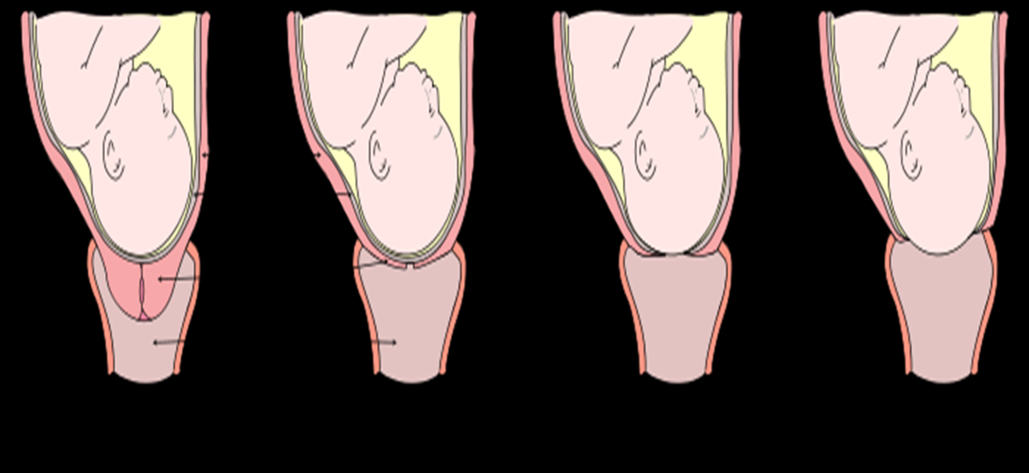
4. Taking up of the cervix:
the cervix is drawn up and mergers with the lower uterine segment.
In a primigravida this may result in complete effacement but in a multigravida a perceptible canal remains

Slide 14
5. Late pregnancy feeling:
Toward the end of pregnancy many women feel large and clumsy and are impatient for pregnancy to end.
They experience a surge in energy and a compulsion to clean everything in sight.
As labour draws nearer they experience mood swings ( elation and depression. ( just reassure her that all this is normal)

Slide 15
Causes Of Onset Of Labour
The exact cause of labour remains uncertain but it is believed to be both hormonal and mechanical factors.
Hormonal Factors
Hormonal factors is believed to be multifactoral in origin.
Oxytocin: as pregnancy advance the uterus becomes sensitive to oxytocin and reaches surge at 36 weeks and stimulates contraction of the uterus.
progesterone: It is believed that close to term progesterone levels in the body fall due to declining placental sufficiency, while at the same time levels of oestrogen (which is responsible for sensitizing the uterine muscles) rise. The fall in progesterone levels is important because it has effect on muscle contractions. The rise in oestrogen levels meanwhile triggers the release of oxytocin, which causes uterine contractions.

Slide 16
The foetal hypothalamus is believed to produce releasing factors, which stimulate the anterior pituitary gland to produce adrenocorticotrophic hormone (ACTH). ACTH stimulates the foetal adrenal glands to secrete cortisol, which causes relative levels of placental hormones to rise .there is increase in oestrogen and fall of progesterone. This causes oxytocin to be release by the maternal posterior pituitary gland and thus stimulating the uterus to contract.
Prostagladins : Rise in oestrogen are responsible for the release of prostagladin from the placenta and decidua.
Prostagladin and oxytocin are responsible for uterine contractions
NB; Progesterone hormone inhibits muscular contractions

Slide 17
2. Mechanical factors
Increase in contractility of the uterus
Over-distension of the uterus increases contractility and this is why multiple pregnancy goes in to premature labour.
Pressure of the presenting part stimulates nerve endings in the cervix and initiate labour.
Other factors:
hyperpyrexia, emotional stress.

Slide 18
Factors that determine outcome of labour
These are : 4ps
Passageway
Passenger
Powers
Person/Psyche
1. Passageway (Pelvic Dimensions)
Adequate pelvic inlet (anteroposterior diameter; normal shape).
Adequate midpelvis (ischial spines do not protrude into bony canal).
Adequate outlet (adequate distance between tuberosities; mobile coccyx).
Adequacy of pelvic dimensions determined by pelvic examination during pregnancy and again with the onset of labor.

Slide 19
Diameters of the female pelvis
 | Anterior posterior | oblique | transverse
BRIM | 11 | 12 | 13
CAVITY | 12 | 12 | 12
OUTLET | 13 | 12 | 11

Slide 20
2. Passenger (Fetal dimensions)
Important fetal dimensions influenced by
fetal size: normal size is 2500 -3500g
Posture( attitude), The fetal head is flexed, back is rounded, and extremities are flexed. Flexed head allows smallest diameter of fetal head (occiput) to present and pass through the birth canal. Normal Posture Is That of Complete Flexion
Lie: Foetus assumes a lie that is either transverse, longitudinal, or oblique. In Normal Labour Lie Is Longitudinal
Presentation . whichever portion of the fetus is deepest in the birth canal and is felt on vaginal examination is referred to as the presenting part; Presentation can be cephalic (occiput, sinciput, brow, face, or chin [mentum]), breech (frank, complete, or footling [single or double]), shoulder, or compound (hand/arm presenting same time as vertex [head] or hand presenting same time as breech). Normal Presenting Part in cephalic presentation Is Occiput.

Slide 21
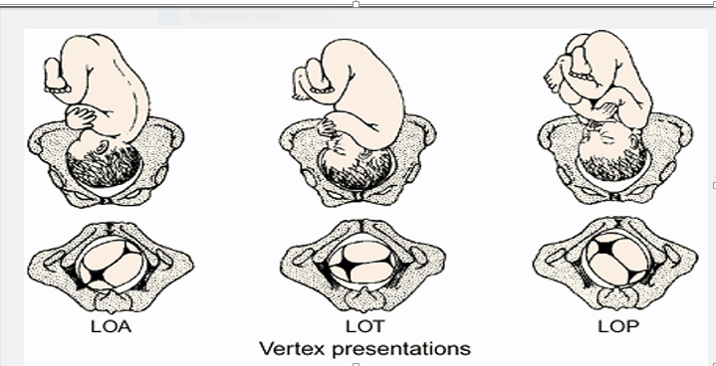
Position: Foetal position is designation of landmark of fetal presenting part (occiput, mentum, sacrum, scapula) to right or left, and anterior, posterior, or transverse portion of the woman's pelvis. For example, a fetus presenting by the vertex with occiput on the left anterior part of the woman's pelvis would have presentation and position described as LOA, or left occiput anterior (see Figure below). The first and third letters relate to the pelvis, and the second letter relates to the fetus.

Slide 22
3. Powers (Uterine Contractions)
Successful labor also depends on uterine contractions occurring at regular intervals and having adequate intensity.
Uterine contractions are involuntary, rhythmic, and intermittent.
Uterine contractions cause vasoconstriction of the umbilical cord vessels; considered normal.
Uterine contractions increase in intensity, frequency, and duration as labor progresses due to stretching of the cervix.

Slide 23
4. Person /psyche
This refers to the emotional state of the woman during labour.
If the mother is afraid, tense, stressed out, angry ,feel unsafe or unsupported, she is likely not to progress well during birth.
It may prevent cervical dilatation, fetal descent, or prevent the woman in labour from pushing effectively.
Good emotional state helps the woman in labour to cope with the pain effectively and allows the other Ps to sync up effectively

Slide 24
Summary of the 4Ps
There is no one P that can work without the other, all 4Ps must be working properly for the baby to join the world in the way they are intended.
Therefore Normal labour assumes that the powers are sufficient, the pelvis is adequate and the passenger is of average size and is in normal position.
Complications of labour occur when there are problems with one of the P’s. (as will be discussed later on)

Slide 25
STAGES OF LABOUR
There are four stages of labour:
1st stage of labour: This is a stage of cervical dilatation begins with first true labor contractions (regular painful contraction) and ends with complete effacement and dilation of the cervix (10 cm dilation).
2nd stage of labour ( stage of fetal expulsion) It begins with full cervical dilatation (10cm) till the birth of the baby.
3rd stage of labour ( placental stage) Third stage of labour is the period from birth of the baby upto delivery of the placenta.
4th stage of labour: Fourth stage of labour Lasts from delivery of the placenta until the postpartum condition of the woman has become stabilized (usually 1 hour after delivery). The uterus makes its initial readjustment to the nonpregnant state.

Slide 26
1st stage of labour (stage of cervical dilatation)
First stage of labour begins with the first true labor contractions (regular painful contraction) and ends with complete effacement and dilation of the cervix (10 cm dilation).
The first stage of labor averages about 13 ½ hours for a primigravida and about 7½ hours for a multipara.
This stage has three phases:
1. Latent phase (early):
Dilates from 0 to 3 cm.
Contractions are usually every 5 to 20 minutes, lasting 20 to 40 seconds, and of mild intensity.
The contractions progress to about every 5 minutes and establish a regular pattern.

Slide 27
Latent phase

Slide 28
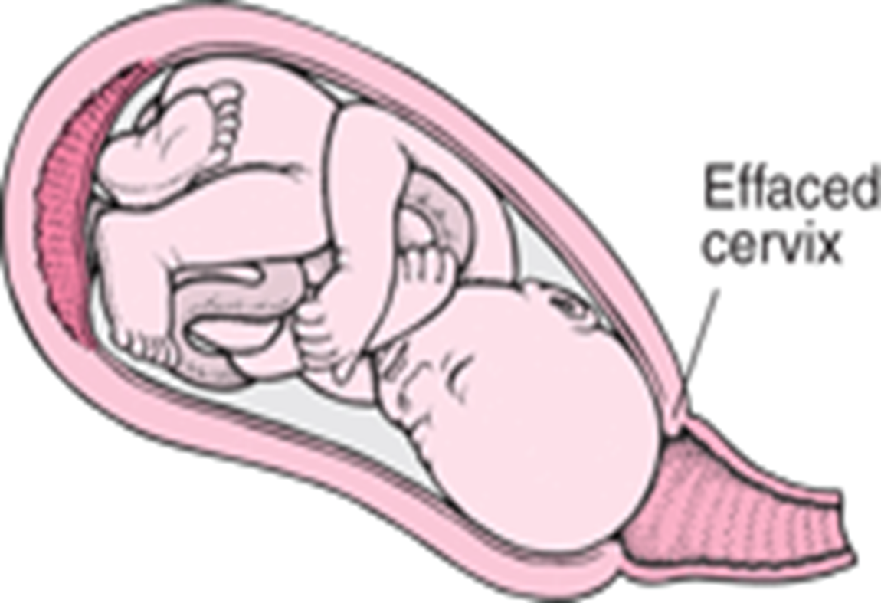
phases of 1st stage of labour
2. Active phase:
Dilates from 4 to 7 cm.
Contractions are usually every 2 to 5 minutes; lasting 30 to 50 seconds and of mild to moderate intensity.
After reaching the active phase, dilation averages 1.2 cm/hour in the primigravida and 1.5 cm/hour in the multipara.

Slide 29
3. Transitional Phase: when the cervix is around 8cm dilated until it is fully dilated.
In this phase, the contractions are sharp, more intensified, and last from 60 to 90 seconds. The frequency is from 2 to 3 minutes.
The cervix dilates from 8 to 10 cm. Completion of this phase marks the end of the first stage of labor.
The mother may express feelings of frustration, loss of control, and/or irritability. Her focus becomes internal. She has difficulty comprehending surroundings, events, and instructions.
There is an increase in bloody show as a result of the rupture of capillary vessels in the cervix and the lower uterine segment.
The mother feels an urge to push or to have a bowel movement. This is considered the most severe and difficult phase for the mother

Slide 30
Physiology of 1st stage of labour
These are: 1. Fundal Dominance, 2. Polarity, 3. Contraction And Retraction, 4.Retraction Ring, 5. Cervical Effacement, 6. Shortening And Dilatation Of The Cervix, And 7. Show.
Fundal Dominance
During a contraction the uterus feels hard to touch. At the beginning of the process, contractions are painless and involuntary, and are controlled by the nervous system under the influence of endocrine hormones.
The contraction starts near one of the cornua & spreads across & downwards the fundus
Contractions last longer on the fundus and are very intense.
The peak of the contraction is reached simultaneously over the whole uterus and fades from all parts together.
This pattern allows the cervix to dilate and the contracting fundus to expel the foetus.

Slide 31
2. Polarity
Polarity describes the neuromuscular harmony between the two poles or segments of the uterus throughout labour.
The upper pole contracts strongly and retracts to expel the foetus.
The lower pole contracts slightly and dilates to allow expansion for the foetus to get its way out. If polarity is disorganized, the process of labour will be inhibited
3. Contraction & Retraction
This is the shortening of the muscle fibers instead of relaxing completely. It assists in progressive expulsion of the fetus During labour, contraction does not pass off entirely but muscle fibres shorten instead of completely relaxing(retraction)

Slide 32
Contraction And Retraction

Slide 33
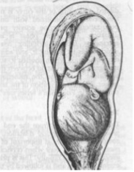
4. Retraction ring
The retraction ring which is an imaginary ridge, forms between the upper and the lower uterine segment. It is present in every labour and is perfectly normal as long as it is not marked enough to be visible above the symphysis pubis.
it is a physiological ring that gradually rises as upper segment contracts & retracts & the lower segment thins to accommodate the descending fetus.

Slide 34
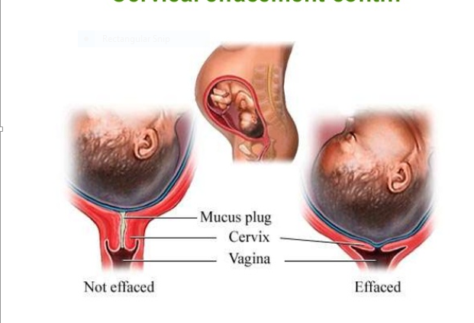
5. Cervical effacement
It is the inclusion of cervical canal into the lower uterine segment. It may occur in late pregnacy or delay till labour begins. In nulliparous, the cervical dilatation doesn’t take place until effacement is complete. On the other hand, in parous women effacement and dilatation may occur simultaneously.

Slide 35
6. The Shortening and Dilation of The Cervix
Before labour begins, the cervix of a primagravida is a thick hard cone which protrudes into the vagina. The canal is at least one inch long.
When labour begins the strongly contracting upper segment of the uterus starts retracting and getting shorter, while the thinner lower segment of the uterus gets pulled away from the presenting part. This stretches the lower segment. The latter, in turn pulls the internal Os.

Slide 36
Cervical dilatation

Slide 37
This dragging away of the internal Os from the presenting part starts dilating the upper part of the cervical canal. This goes on until the canal is shorter and shorter and finally there is no canal at all. The canal becomes part of the uterine cavity with only the undilated external Os and the thinly stretched cervix separating this cavity from the vagina. When this happens, we say the cervix has been 'effaced' or 'taken up'
7. Show
Throughout pregnancy the cervical canal is sealed by a plug of mucus known as an operculum. Together with the intact membranes this prevents organisms ascending into the uterine cavity.
When the cervix dilates, the operculum is lost
When labour starts, the internal Os is pulled away from the foetal membranes and the canal is opened up. This releases the mucous plug which oozes out of the vagina mixed with a little blood. This is called the 'show'.

Slide 38
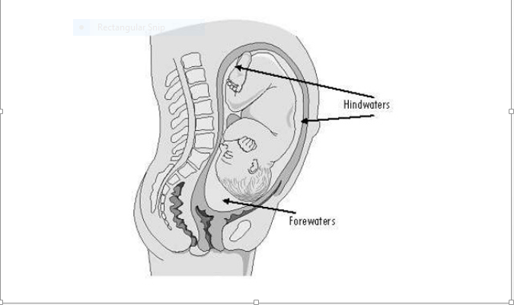
Mechanical factors in first stage of labour
These are: formation of the fore waters, general fluid pressure, rupture of membranes and fetal axis pressure
1. Formation of forewaters
At the initial stage of cervical dilatation, the membranes near the internal os are detached & slip into the dilating cervical canal. Forewaters- liqour amni that collected in the membranes in front of the presenting part. Hind waters- liqour amni behind the membrane.

Slide 39
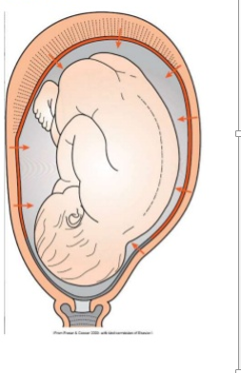
2. General fluid pressure
While the membrane remain intact, the pressure of the uterine contractions is exerted on the fluid & as fluid is not compressible, the pressure is equalized throughout the uterus and over the fetal body.
.

Slide 40
3. Rupture of membranes
When membranes rupture, the fetal head, placenta, umbilical cord are compressed between the uterine wall during contractions hence ↓ 02 supply to the fetus. The optimum physiological time for ROM spontaneously is at end of 1st stage after the cervix is fully dilated

Slide 41
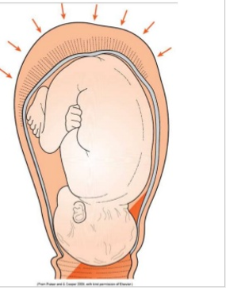
4. fetal axis pressure:
During each contraction the uterus rears forward and the force of the fundal contraction is transmitted to the upper pole of the foetus and is applied to the presenting part in the cervix.
This is more significant after rupture of membranes and during second stage of labour.

Slide 42
Management Of A Woman In First Stage Of Labour
The proper management of labour is essential, if you are to avoid problems or to detect them early when they occur.
You should be able to assess and decide whether the woman is in labour or not. The patient may be in early labour, but often she might arrive in the late second or even third stage.
If you are sure she is not in labour send her home to wait.
If she is in labour, keep her in the ward and continue monitoring her progress. Danger, especially to the foetus, can arise suddenly and unexpectedly
This care include: (Emotional support, consent and information giving, prevention of infection, analgesia, nutrition, bladder care, fetal monitoring, maternal monitoring, monitoring labour progress.)

Slide 43
1. Emotional support
This is provided by imparting confidence, expressing caring and dependability as well as being an advocate for the mother.
The midwife should display a tolerant non-judgmental attitude, ensuring the woman is accepted no matter what her reaction to labor might be.
Companion in labor: A supportive companion can help reduce anxiety, keep the woman company, walk with her if she’s ambulant, and encourage her with whatever she has chosen as her coping mechanism.

Slide 44
2. Consent and information giving:
Midwives must give information that ensures the woman understands events, feels free to ask questions and is aware of how labor is progressing.
Before any procedure, verbal consent should be sought and explanations should be given on what is about to be done.
Following the procedure the midwife should provide feedback and verbal reinforcement.

Slide 45
3. Prevention of infection
Personal hygiene should be maintained
Encourage women with normal labor to stay in their own environment as much as possible to avoid the length of time spent in the hospital.
Invasive procedures should be kept to a minimum
Vaginal examinations should be minimized.
Pre-labor rupture of fetal membranes at term.
Most women with PROM will labor within 24hrs.
Following PROM with no signs of labor and no obvious liquor draining, digital examination should be avoided to avoid ascending infection.

Slide 46
4. Pain relief
Pharmacological and non pharmacological
Analgesics may be given during labor as needed, but as little as possible should be given because they cross the placenta and may depress the neonate's breathing.
Neonatal toxicity can occur because after the umbilical cord is cut, the neonate, whose metabolic and excretory processes are immature, clears the transferred drug much more slowly, by liver metabolism or by urinary excretion. Preparation for and education about childbirth lessen anxiety, markedly decreasing the need for analgesics.
Non pharmacological breathing exercise, massaging the lower back, music , physical contact and support. All these will be covered in details

Slide 47
5. Position and mobility
The mother should adopt the position she feels most comfortable.
In early labour ambulation is encouraged it aids in descent of the foetus.
During a contraction the woman finds it comforting to lean forward, supporting her weight on a table or on her partners shoulder.
She may wish to walk up and down or to sit on a bean bag.
If she wants to rest lying down, left lateral position is prevered so as to avoid compression of the inferior vena cava.
All- fours position may be comfortable in occipital posterior positions as it relieves associated backache.
Note: changing position not only improves comfort but also helps in progress

Slide 48
6. Nutrition
Most women in established labor have no desire to eat. They should be encouraged to eat in the latent phase. Fluids may be taken freely
The vigorous muscle contractions during labor demand a continuous supply of glucose. If this is not obtained from diet the body will start metabolizing protein and fat store s in an effort to provide glucose. This will result to ketoacidosis.
High concentrations of glucose might increase the fetal blood glucose levels artificially causing fetal hyperinsulinism and resulting in hypoglycemia of the newborn baby after delivery.

Slide 49
7. bladder care
The woman should be encouraged to empty her bladder every 1-2 hrs. The midwife should not rely on the mother to request to use the toilet because her sensation of needing to use the toilet may be reduced.
Urine in the bladder may interfere with the descent of the baby or cause the uterus not to contract (uterine atony) after delivery thereby causing post partum hemorrhage. A full bladder may be bliused leading to vescico vagina fistula.

Slide 50
8. Fetal Monitoring
The main parameters are fetal heart rate (HR) and fetal HR variability, particularly in as it relates to uterine contractions and maternal movement. A normal pattern is a baseline HR with the following characteristics:
120 to 160 beats/min at baseline
Varies by 6 to 25 beats with movement or contractions (normal HR variability)
Accelerates appropriately for gestational age
Does not decelerate during contractions
Patterns that indicate possible non reassuring fetal heart status include the following:
Late decelerations: HR gradually decreases and returns to baseline with contractions, but the decrease begins late, and most of it occurs (and HR is slowest) after contractions peak.
Variable decelerations: HR decreases abruptly by ≥ 15 beats/min; the decrease may or may not occur simultaneously with contractions and varies in onset, depth, and duration (≥ 15 sec but < 2 min).
Tachycardia >160 beats/ minute
Bradycardia <120 beats/minute
Severe bradycardia: HR is <110 beats/min

Slide 51
Nonreassuring patterns require more intensive monitoring.
For low-risk pregnancies with normal labor, fetal HR must be checked after each contraction or at least every 30 min during the 1st stage of labor and every 15 min during the 2nd stage.
For high-risk pregnancies, fetal HR must be checked every 15 min during the 1st stage and every 3 to 5 min during the 2nd stage. Listening for at least 1 to 2 min beginning at a contraction's peak is recommended to check for late deceleration.
If a problem (e.g., fetal HR decelerations or lack of normal HR variability) is detected during labor, intrauterine fetal resuscitation is tried; women may be given O₂ by a face mask or rapid IV fluid infusion or may be positioned laterally. If fetal heart pattern does not improve in a reasonable period and delivery is not imminent, urgent delivery by cesarean section is needed.

Slide 52
9. Maternal monitoring
Assess the mothers reaction to labour and be supportive by giving her accurate and easily understood information. Encourage her and praise her. Assess her need for analgesics.
Pulse rate: every 30 min, a rise is an indication of infection, ketosis or haemorrhage.
Respiratory rate: every 4hrs
Temperature: 2 hrly arise is an indication of infection or ketosis
Blood pressure: 2-4hrly hypotension may be caused by supine position, shock or a result of epidural anaesthesia.
Urinalysis: check volume, glucose, ketones and protein
Fluid balance maintain an accurate input and output record.

Slide 53
10. monitoring labour progress
Abdominal examination
Contractions: frequency, length and strength
Descent of the presenting part: level presenting part above pelvic brim.
10. Vaginal examination in progress in labor
Effacement and dilatation of the cervix
Descent
Flexion: If head is flexed the posterior fontanelle becomes almost central.
Rotation: palpate sutures and fontanelles periodically to determine position

Slide 54
Indications For Performing A Vaginal Examination
To make a positive diagnosis of labour
To make a positive identification of the presenting part
To confirm if the head is engaged if in doubt
To establish if the fore waters have rupture or not or to rupture them.
To rule out cord presentation if membranes are intact or cord prolapse if the membrane are ruptured.
To assess progress of labour i.e cervical dilatation.
To confirm full dilatation of the cervix.
To determine station of the presenting part
In multiple pregnancy to confirm the lie and presentation of a second twin and in order to puncture the second sack.

Slide 55
Features to note on vaginal examination
The condition of external genitalia is noticed e.g. varicosities in the labia, oedema, warts, scars, discharge
Cervix
Position is recorded. usually posterior position indicates early or no labour
dilatation and effacement
Consistency: should be soft, elastic and well applied to the presenting part.
Dilatation is usually expressed in centimeters, as general the fingers can estimate the cervical dilatation:
1.5cm: one finger fits tightly through the cervix and touches the fetal head
2cm: one finger fits loosely inside the cervix, but cervix can not fit two fingers
3cm: two fingers fit tightly inside the cervix
4cm: two fingers fit loosely inside the cervix
6cm: there is still 2cm of cervix still palpable on both sides of the cervix

Slide 56
8cm: there is only 1cm of the cervix still palpable on both sides of the cervix
9cm: Not even 1cm is left laterally, or there is an anterior lip of the cervix
10cm: cervix not be felt anywhere around the fetal head.
4. Membranes should be felt between fingers and recorded if intact or ruptured. If ruptured the color and consistency of Amniotic Fluid should be noted.
5. Presenting Part:
Nature e.g. vertex, buttock..etc
Position e.g. LOA, ROA..etc
Moulding. the overlap of bones of the skull +, ++, +++
Caput. Edema of the scalp..indicates some degree of cephalopelvic dispropotion
Abnormalities e.g. cord presentation or prolapse, tumor, etc.
Assessment of pelvic adequacy: promontory of the sacrum (not tipped) and sacral curvatures (should be well curved), ischial spines (should be blunt), sub pubic angle ( accommodate two examining finger, intertuberosity ( should accommodate four knucles)
Examine fingers for any discharge, smell, liquor and its colour, or any blooding.

