Slide 1
MICROBIOLOGY & IMMUNOLOGY
MR. CHERUIYOT AMOS
KAPTUMO CAMPUS

Slide 2
Introduction
Def:
Microbiology
is the study of living organisms/microbes of microscopic size that cause infection.
It is the study of the structure, body functions and physiological processes of microorganism
The process of microbial inversion of the body is called infection.

Slide 3
Terminologies
Binary fission
Capsule
aerobe
Facultative anaerobe
Genus
Saprophytic
Spores
Opportunistic

Slide 4
Historical dev’t of micro B
Some of the pioneers who are credited for the development of microB include:
Antony Van Leeuwenhock (1675), the dutch scientist who was the first person to see micro-organism using a microscope. He was the first man to build a microscope. He is credited for coming up with a bacteria drawing that we see today.
In 1796 Edward Jenner showed that small pox could be prevented by inoculation with cowpox.

Slide 5
Cont’d
Louis Pasteur (1864-1888)
Is credited for the development of modern microbiology. He demonstrated that fermentation was caused by growth of microorganisms.
Robert Koch (1877)
Described easy methods for bacteriological exams and also devised simple methods for isolating bacteria.

Slide 6
Cont’d
Pasteur's work led to an effective sterilization method
He developed vaccines for diseases; anthrax, fowl cholera and rabies
Beginning with Pasteur’s work, discoveries included the relationship between microbes and disease, immunity, and antimicrobial drugs
He postulated the Germ Theory of Disease which states that microorganisms are the causes of infectious diseases

Slide 7
For an organism to be said to have caused a particular disease then;
The micro-organism must be found in all cases of disease
The micro-organism must be able to be cultured outside the body for several generations
The micro-organism must reproduce a disease on inoculation into susceptible animals
The antibody to the organism develops during the course of infection

Slide 8
Assignment
Explain Anthony van Leuweenhoeks contribution to the discovery of microorganisms.
How did Louis Pasteur defeat the theory of spontaneous generation

Slide 9
Importance of micro-organisms to man
They cause decaying which is essential for the organic cycle
Causes disease to both plant and animals
Used in fermentation

Slide 10
Categories of infectious agents:
    Bacteria
    Viruses
    Fungi
    Parasites (protozoa)

Slide 11
Bacteria
Are unicellular/single celled organisms
They lack membrane bound nucleus and organelles.
Double stranded DNA lies loose in the cytoplasm with arigid peptidoglycan cell wall
Divide by binary fission
Some are harmful while others are beneficial to man

Slide 12
viruses
Smaller than bacteria
Contain either DNA or RNA as agenome

Slide 13
Fungi
Are eukaryotic with rigid cell wall
May replicate asexually or sexually
They form spore like structure
Parasites
Comprise of worms, malaria parasite etc

Slide 14
1. Bacteriology
This is the study of bacteria.
Bacteria is a minute unicellular organism.
Has rigid peptidoglycan cell-wall and divides by binary fission

Slide 15
Cont’d
Bacteria are characterized based on
structure cell arrangement
size
the cell shape
staining reactions
motility
flagella arrangement.

Slide 16
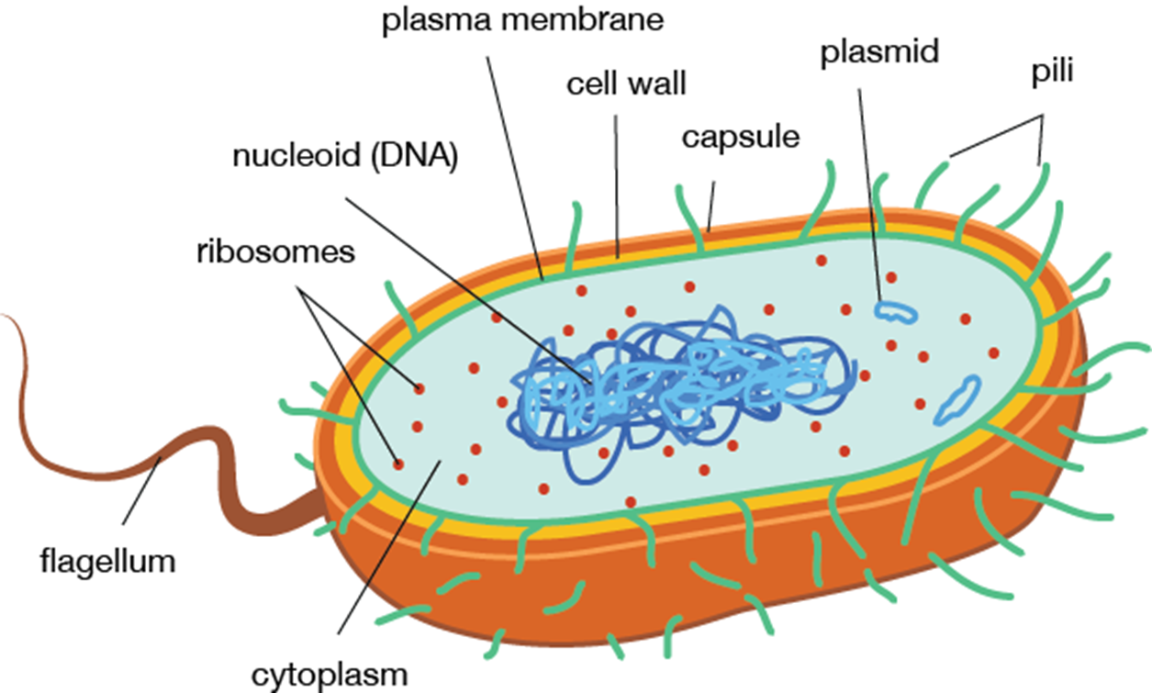
Bacteria structure

Slide 17
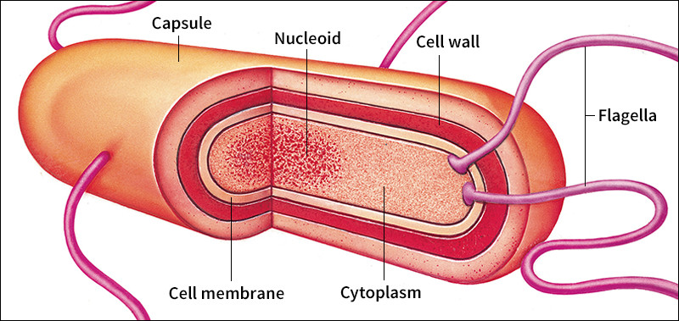
Cont’d

Slide 18
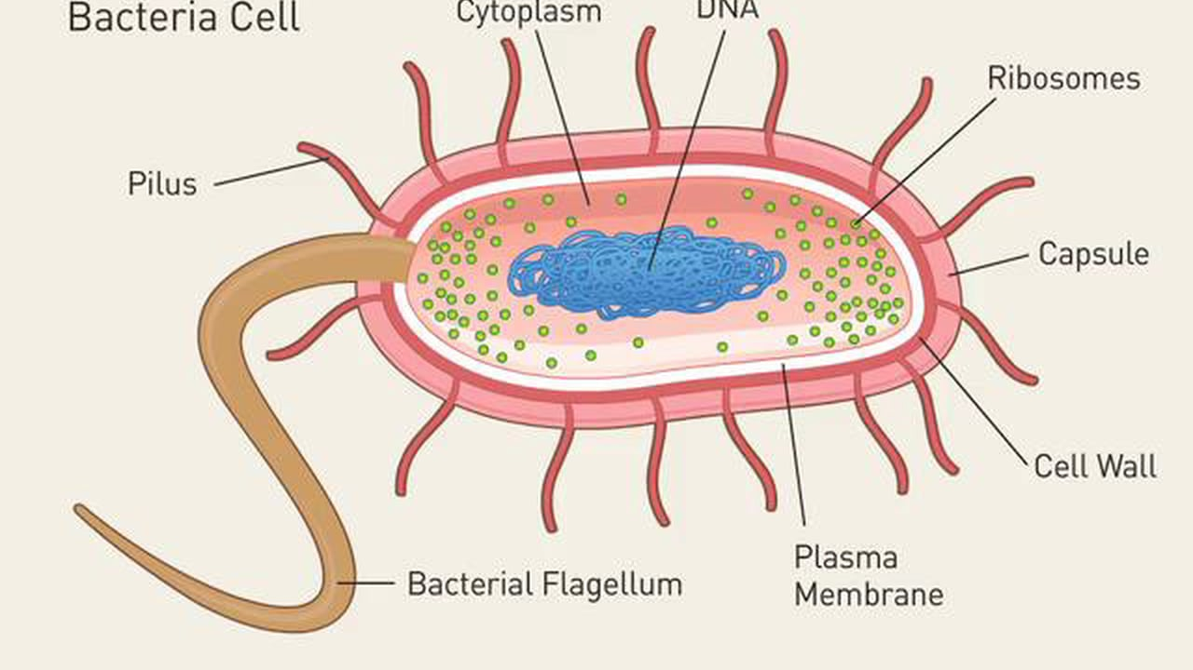
Cont’d

Slide 19
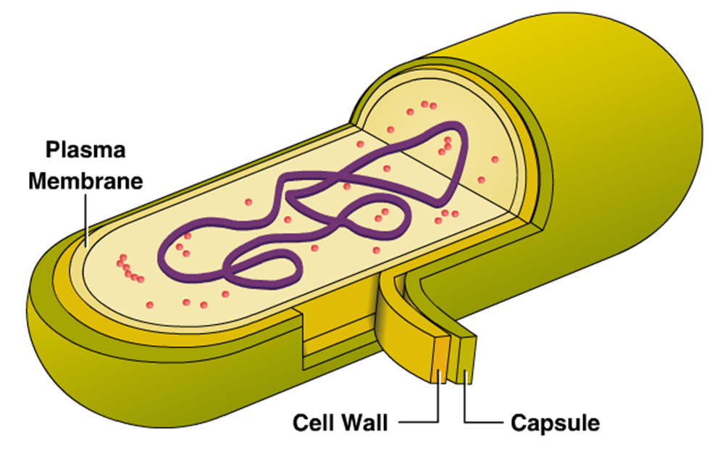
Cont’d

Slide 20
Cont’d
Capsule
Is amorphous material which forms the outermost layer of bacteria
Composed of polysaccharide and proteins
It inhibits phagocytosis and hence correlates with bacterial virulence
Cell wall
Tough rigid structure strengthened by peptidoglycan layers.
Protects the bacteria against osmotic changes.

Slide 21
Cont’d
Differences in composition of bacterial cellwall leads to differences in the staining of bacteria, thus Gram +Ve and Gram –Ve bacteria.
  Gram +ve thick wall, large amount of peptidoglycan (purple)
  Gram –ve thin wall, small amount of peptidoglycan (red/pink)
  Cytoplasmic membrane
  Is a selective barrier, semipermeable membrane controlling water, nutrients, ions, electrolytes movement in and out of bacteria.
  Also site for enzymes involved in active transport of nutrients and other metabolic processes

Slide 22
Cont’d
Mesosome
Are convoluted invaginations of cytoplasmic membrane
Site for septum formation and involved in DNA segregation during cell division
Nuclear material/nucleuos- for replication of DNA and RNA
Ribosomes- site for protein synthesis
Flagella- long filaments structures for bacterial motility

Slide 23
Cont’d
Function of Flagella
Bacterial propel themselves by rotating their helical flagella.
Based on their location on the cell, flagella may be polar or lateral.
(i) Polar: At one or both ends of bacterium.
(ii) Lateral: Along the sides of the bacterium.

Slide 24
Types of flagella
Monotrichous: A single polar flagellum.
Many that appears and function as monopolar or bipolar flagella consists of bundles of 2 to 50 single units (polytrichous).
* Lophotrichous: A cluster of polar flagella.
* Amphitrichous: Flagella, either single or clusters at both cell poles.
* Peritrichous: Cell surrounded by lateral flagella.

Slide 25
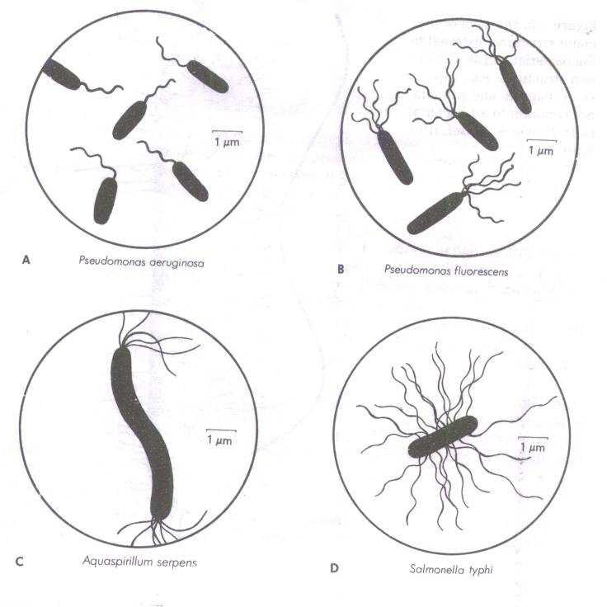
Cont’d

Slide 26
Size
Bacteria are very small, 0.5 to 1.0 NM in diameter.
Because of their small size they have high surface area/volume ratio which results in a high growth and metabolism rate.

Slide 27
Classification of bacteria
Bacteria classification is based on;
  Morphology
  Biochemical characteristics
  Lab identification
  Growth requirement/cultural characteristics

Slide 28
1. Morphological
Spherical-cocci eg S. pneumonia
Cylindrical-bacilli or rods
Helical- spirochaetes, flexible,coiled and motile e.g Trepanoma pallidum
Vibrios-coma like

Slide 29
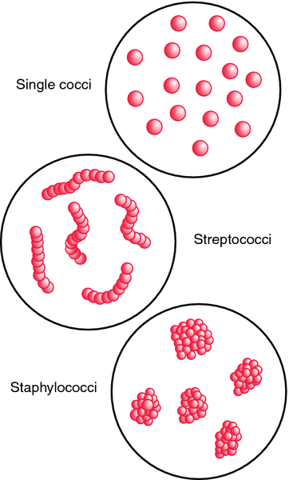
cont

Slide 30
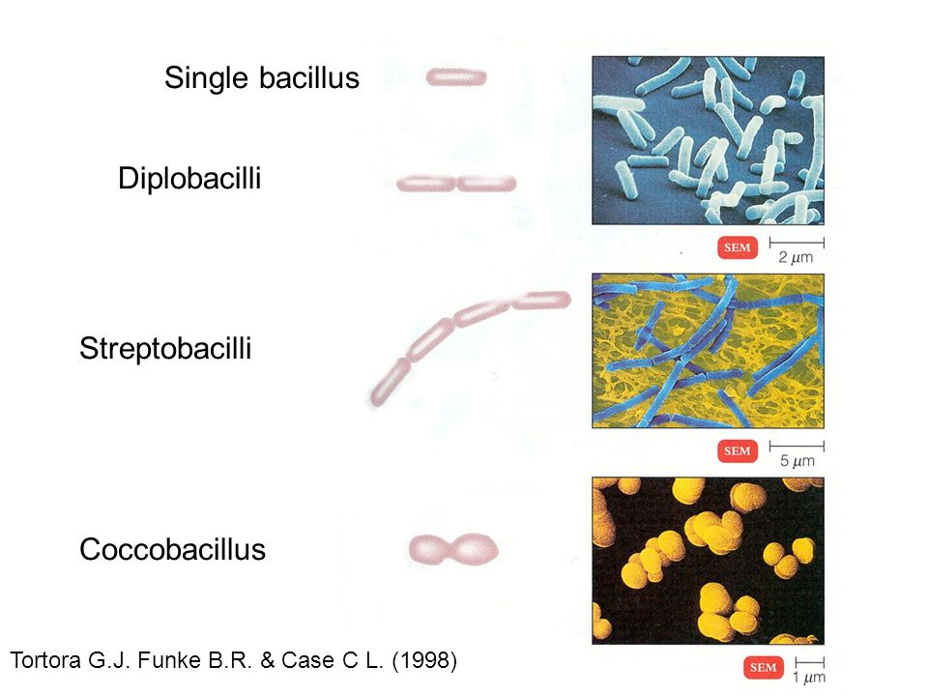
Cont’d

Slide 31
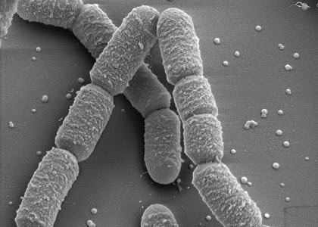
Cont’d

Slide 32
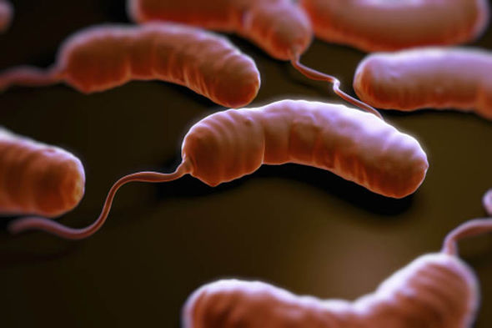
vibrios

Slide 33
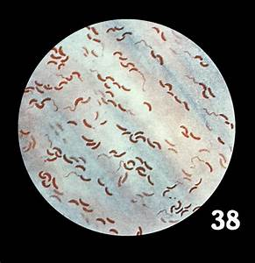
Vibrios

Slide 34
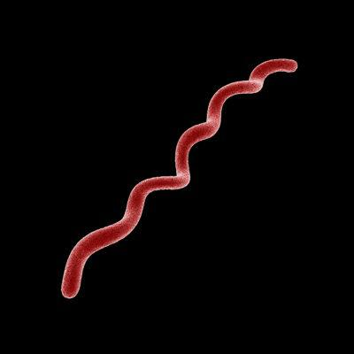
spirilla

Slide 35
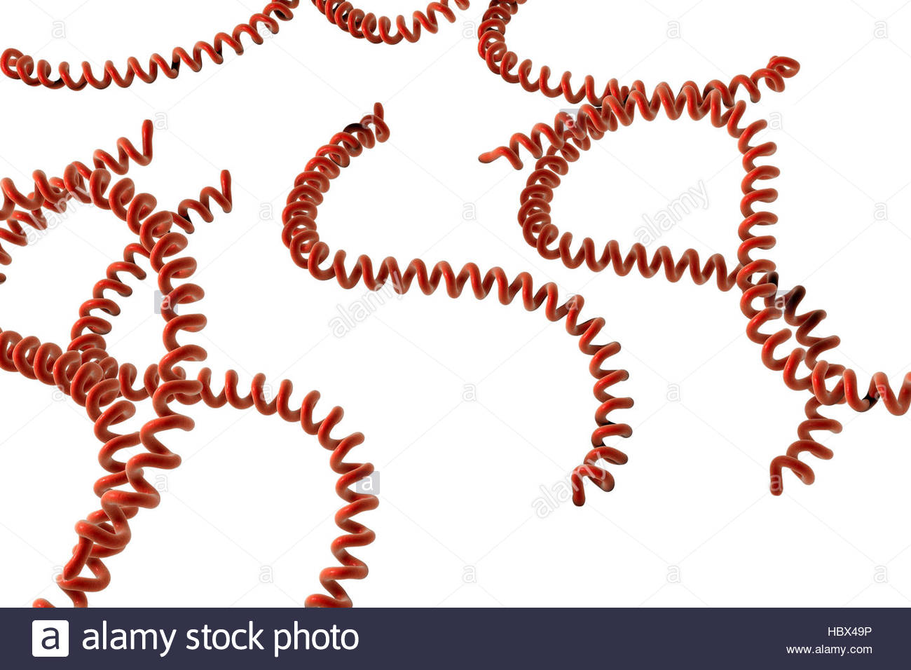
Spirochetes

Slide 36
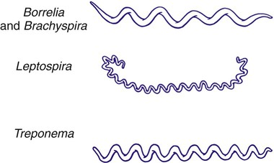
Cont’d

Slide 37
2. biochemical
Coagulase-the enzyme that clots/coagulates plasma and fibrin
Hyalurodinase-breaks hyaluronic acid the cement of connective tissue, causing increased permeability
Production of toxin-exotoxins and endotoxins

Slide 38
3. Lab identification
Gram staining
Giemsa staining-histopathological diagnosis of malaria and other parasites
Elisa (HIV) Ziehl Neelsen test- for acid fast bacilli eg mycobacteria AFB
Urinalysis- E. coli
CSF analysis
Field staining for malaria parasite

Slide 39
4. Growth requirement/cultural characteristics.
Binary fission
Generation time
Phases of growth

Slide 40
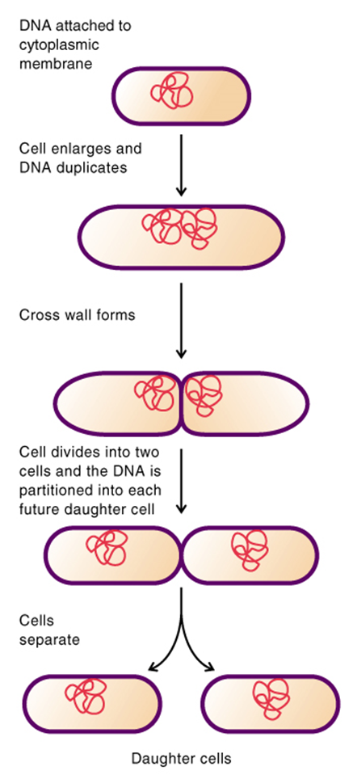
Binary fission
Prokaryote cells grow by increasing in cell number (as opposed to increasing in size).
Replication is by binary fission, the splitting of one cell into two
Therefore, bacterial populations increase by a factor of two (double) every generation time.

Slide 41
Generation time
The time required to for a population to double (doubling time) in number. eg
Ex. Escherichia coli (E. coli) double every 20 minutes
Ex. Mycobacterium tuberculosis double every 12 to 24 hours

Slide 42
Growth in Batch Culture
Bacteria growing in batch culture produce a growth curve with up to four distinct phases.
Batch cultures are grown in tubes or flasks and are closed systems where no fresh nutrients are added or waste products removed

Slide 43
Phases of growth
Lag phase occurs when bacteria are adjusting to them medium. For example, with a nutritionally poor medium, several anabolic pathways need to be turned on, resulting in a lag before active growth begins.
In log or exponential phase, the cells are growing as fast as they can, limited only by growth conditions and genetic potential. During this phase, almost all cells are alive, they are most nearly identical, and they are most affected by outside influences like disinfectants.

Slide 44
CONT’D
Due to nutrient depletion and/or accumulation of toxic end products, replication stops and cells enter a stationary phase where there is no net change in cell number.
Death phase occurs when cells can no longer maintain viability and numbers decrease as a proportion.

Slide 45
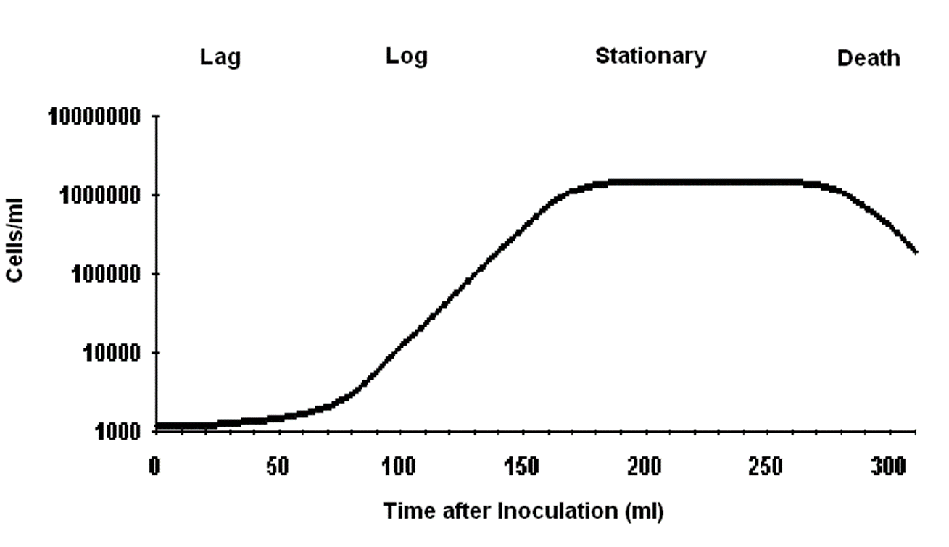
Growth curve

Slide 46
Environmental factors
Temperature
Oxygen requirement
Ph
Water availability

Slide 47
Bacteria classification
ASSIGNMENT!!!!!!!!!!!
Gram +ve Bacteria
Gram –ve bacteria

Slide 48
concept of infection
Objectives
By the end of this session, the learner will be
able to:
Describe the stages of development of an infection
Define various terms related to infection
Describe the phases of an infectious d’se

Slide 49
Infection
is invasion by and multiplication of
pathogenic microorganisms in a body
part or tissue
This invasion may produce subsequent
tissue injury and progress to disease
through a variety of toxic mechanisms.

Slide 50
Stages in development of infection
Acquisition
Adhesion to host cells
Penetration of cells
Multiplication in tissues
Damage to tissues
Spread to other tissues
Resolution or death

Slide 51
1. Acquisition, Adhesion & Penetration
The microorganism must adhere to the cell, then penetrate it.
The microbe may use various methods to:
Special hairs on their surface,
  Fimbriae (thin appendages used in attachment) or Pilli (thin appendages used in genetic exchange),
Secrete sticky substances (e.g. dextran)
Produce slime. (e.g. biofilm)

Slide 52
4. Multiplication in the host
The microbe multiplies in the host cell & overpowers the host’s defenses so as to cause disease.
The virus has the ability to switch the metabolism of the cell to the production of viral components.

Slide 53
5. Tissue damage
Pathogenic microorganisms cause disease by damaging the host’s tissue.
Damage occurs due to release of enzymes or substances that destroy cells or tissues in the local area.

Slide 54
6. Spread to other tissues
Some infections remain at the site of invasion, causing symptoms related to invasion of epithelial tissue at the particular site.(e.g. Shigella invades the GIT)
Some microorganisms spread once they have been established in a particular site. (e.g. salmonella typhi establishes itself in the GIT, then spreads through blood and causes fever)

Slide 55
7. Resolution or death
The function of the cell may be disrupted
OR the cell may be destroyed when new microbes are released.
The effects depend on the particular microbe and the location of the infected cells. (e.g. Polio virus infects motor neuron cells and shuts down protein synthesis causing the death of neurons and paralysis of the muscles that they innervate)

Slide 56
Resolution or death cont..
The infection may resolve (death of the pathogen) due to;
  Improved host defenses
  Antibiotic therapy

Slide 57
Definitions related to infection

Slide 58
Pathogenicity
Pathogens are microbial species that invade and damage tissue to cause disease.
Pathogenicity is the capacity of microorganism to cause disease.

Slide 59
Pathogenicity cont’d….
Some microorganisms cause a single disease (e.g. clostridium tetani-tetanus)
Others cause a range of diseases:
e.g. Staphylococcus aureus can cause: skin infections, wound infection, pneumonia and Osteomyelitis.

Slide 60
Pathogenicity cont’d….
Some pathogens cause infections that become severe in debilitated people.
Opportunistic pathogens cause disease in individuals with impaired defenses.
(e.g. Pneumocystis carinii, a normal flora in healthy people but causes PCP in immune-compromised people)

Slide 61
Primary vs.Secondary Infection
Primary Infection
  An infection that develops in an otherwise healthy individual
Secondary Infection
  An infection that develops in an individual who is already infected with a different pathogen

Slide 62
Acute Vs. Chronic Infection
Acute Infection
  An infection characterized by sudden onset, rapid progression, and often with severe symptoms
Chronic Infection
  An infection characterized by delayed onset and slow progression

Slide 63
Localized vs. systemic infection
Localized Infection
  An infection that is restricted to a specific location or region within the body of the host
Systemic Infection
  An infection that has spread to several regions or areas in the body of the host

Slide 64
Clinical vs. subclinical infection
Clinical Infection
  An infection with obvious observable or detectable symptoms
Subclinical Infection
  An infection with few or no obvious symptoms

Slide 65
Opportunistic infection
An infection caused by microorganisms that are commonly found in the host’s environment (normal flora)

Slide 66
Nosocomial Infections
Also called Hospital Acquired Infections (HAI’s)
Infection which was neither present nor incubating at the time of admission
Infection that appears between 48 hours & 4 days following admission to a hospital or other health-care facility.

Slide 67
Nosocomial cont’d…
36% of these infections are preventable
through the adherence to strict guidelines by health care workers when caring for patients
Occurs in most modern hospitals
Most common HAI’s:
Urinary tract infections (UTI’s).
Ventilator-associated pneumonia (VAP)
Surgical wound infections

Slide 68
HAI’s - common bacteria
Staphylococci - wound, respiratory
GIT infections
Eschericia coli (E.coli) – wound & UTI’s
Salmonella - food poisoning
Streptococci - wound, throat & UTI’s
Proteus - wound & UTI’s

Slide 69
HAI’s - common viruses
Hepatitis A - infectious hepatitis
Hepatitis B - serum hepatitis
Human immunodeficiency virus (HIV)- acquired immunodeficiency syndrome

Slide 70
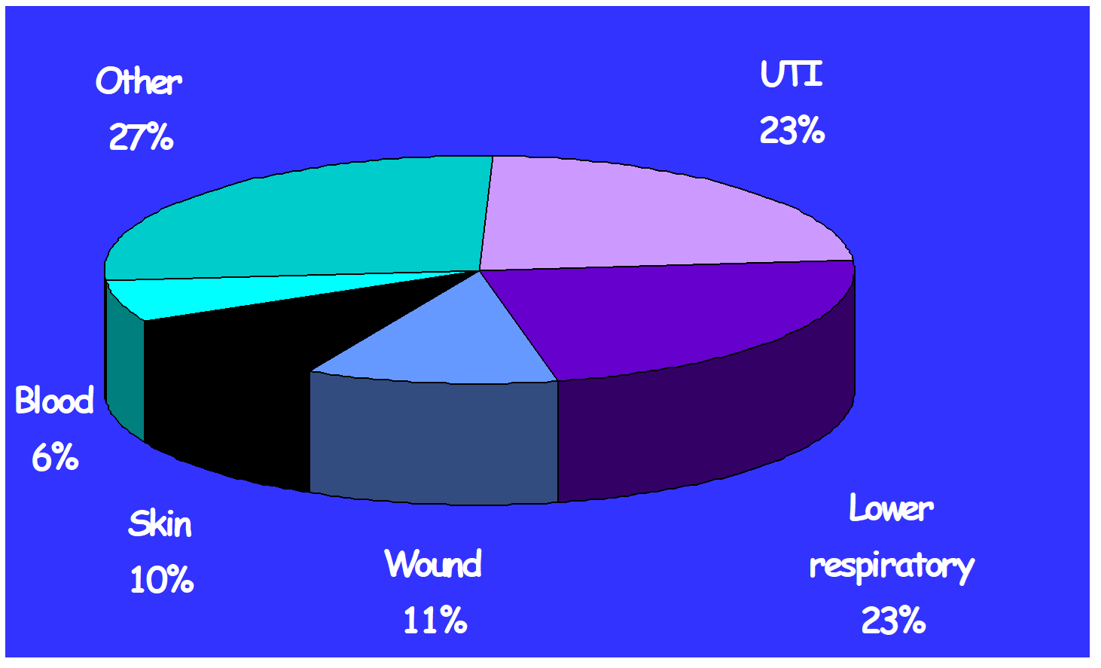
Common types of HAI’s

Slide 71
Effects Of Nosocomial Infections
Patient:
Prolonged hospital stay
Increased hospital cost
Psychological and emotional trauma
Complications (MRSA/MDRO/Death)
Hospital :
Economic impact (staff absent from work d/t infection)
Demotivated staff due to recurrent infection
Reduced bed availability
Bad publicity & Litigation

Slide 72
Phases of an infectious disease
Incubation period
Refers to the time between infection and appearance of signs and symptoms.
Prodromal phase
A stage in which the pathogens begin to invade tissues;
marked by early non specific symptoms.
Invasive phase
When the individual begins to experience the typical signs and symptoms of the disease

Slide 73
Phases….cont’d…
Decline phase
Is when the host defenses overcome pathogens;
signs and symptoms subside
Convalescence period
the stage during which tissue damage is repaired and the patient regains strength. Recovering
individuals may transmit pathogens to others.

Slide 74
STERILIZATION
AND
DISINFECTION

Slide 75
S & D
Sterilization: Destruction of all forms of microbial life including spores.
Disinfection: Destruction of microbes that cause disease; may not be effective in killing spores.
Antiseptic: chemical agent used to kill organisms on the surface of the skin and mucous membranes

Slide 76
CONT’D
Sterilizing and disinfecting agents are divided into two groups;
1. Chemical methods
2. Physical methods

Slide 77
1. Chemical methods
Chemical agents destroy any type of microbes without showing any form of selectivity unlike antibiotics.
The efficacy of these agents depends on the following factors.
1. Concentration of the agent -There is a relationship between the concentration of the agent and the time required to kill a given fraction of the microbial population.

Slide 78
CONT’D
2. Time of exposure Microbes are killed with a reasonable length of time with chemical agents.
3. pH of the medium where action is to take place Hydrogen ion concentration determines degree of ionization of the chemical and bacterial surface charge. The non-ionized form passes through the bacterial cell membrane more readily than the ionized form

Slide 79
CONT’D
4.Temperature Bactericidal potency of the chemical agent increases with an increase in temperature. An increase in 100c doubles the bacterial death rate.
5. Nature of the organism . Species of the bacteria . Growth phase of bacteria in culture . Presence of capsule, spore and other special structures . Number of bacteria in test system

Slide 80
CONT’D
6. Presence of extraneous materials Organic materials like serum, blood or pus makes chemicals inert that are highly active in their absence.

Slide 81
Classification of chemical methods of S & D
Chemical agents that damage the cell membrane .
-Surface active agents .
-Phenols .
-Organic solvents
2. Chemical agents that denature proteins,
-Acids and Alkaline

Slide 82
CONT’D
3. Chemical agents that modify functional groups of proteins and nucleic acids .
-Heavy metals .
-Oxidizing agents .
-Dyes .
-Alkylating agents

Slide 83
2. Physical method
Heat: Denature proteins, membranes demage or DNA cleavage;
Moist heat:-boiling
-Autoclaving (Steam under pressure)
121c (15-20mns)
-Pasteurization i.e 62c for 30mins
B) Dry heat;- open flames
- inceneration
-hot air oven

Slide 84
CONT’D
2) Radiation:-x-rays, gamma rays which produces free radicals
3) filtration:-preferred for certain liquids that heat sensitive like serum and enzymes solution, membrane filters up to 0.22um
4) Freezing: Inactivation of living bacteria by cold. It prevents active multiplication of bacteria by decreasing the metabolic activity of bacteria.

Slide 85
Methods of controlling sterilization
Recording of temperature and time of each sterilizing cycle.
Heat-sensitive autoclave tape fixed to the outside of each pack. Color change of autoclave tape from blue to brown-black indicates complete sterilization.
Biological indicator : Use of paper strips impregnated with spores of Bacillus stereo thermophilus

Slide 86
END

