Slide 1
STAINS AND STAINING
P.MACHARFIA

Slide 2
IMPORTANCE OF STAINING
Improves visibility between the organism and the background.
Differentiate various morphological types (by shape, size, arrangement, etc.)
Determine the staining characteristic of organism and direct diagnosis of disease
Demonstrate the purity of culture.
Observe certain structures (flagella, capsules, endospores, etc.),

Slide 3
STAINS AND DYES
A dye is a general-purpose coloring agent
A stain is used for coloring biological material.
A stain is an organic compound containing a benzene ring plus a chromophore and an auxo-chrome group.
    Chromophore is a chemical group that imparts color to benzene.
    Auxo-chrome group is a chemical compound that conveys the property of ionization of chromogen (ability to form salts) and bind to fibers or tissues.

Slide 4
REQUIREMENTS FOR STAINING
Stain
Many stains used for staining bacteria are of the basic type as nucleic acid of bacterial cells attract the positive ions, e.g. methylene blue, crystal violet.
Acidic stains are used for background staining.
Mordant
It is a chemical that forms an insoluble complex with the stain and fixes it or causes the stain to penetrate more deeply into the cell.
These are used in indirect staining .
For example, Gram’s iodine in Gram staining and phenol in Ziehl Neelson’s staining.

Slide 5
Accentuater
It is a chemical which is added to a stain to make the reaction more selective and intense .
For example , potassium hydroxide added in Loeffler’s methylene blue.
Decolorizer
It is a chemical used to remove the excess stain in indirect regressive staining.
For example, ethanol in Gram’s staining.

Slide 6
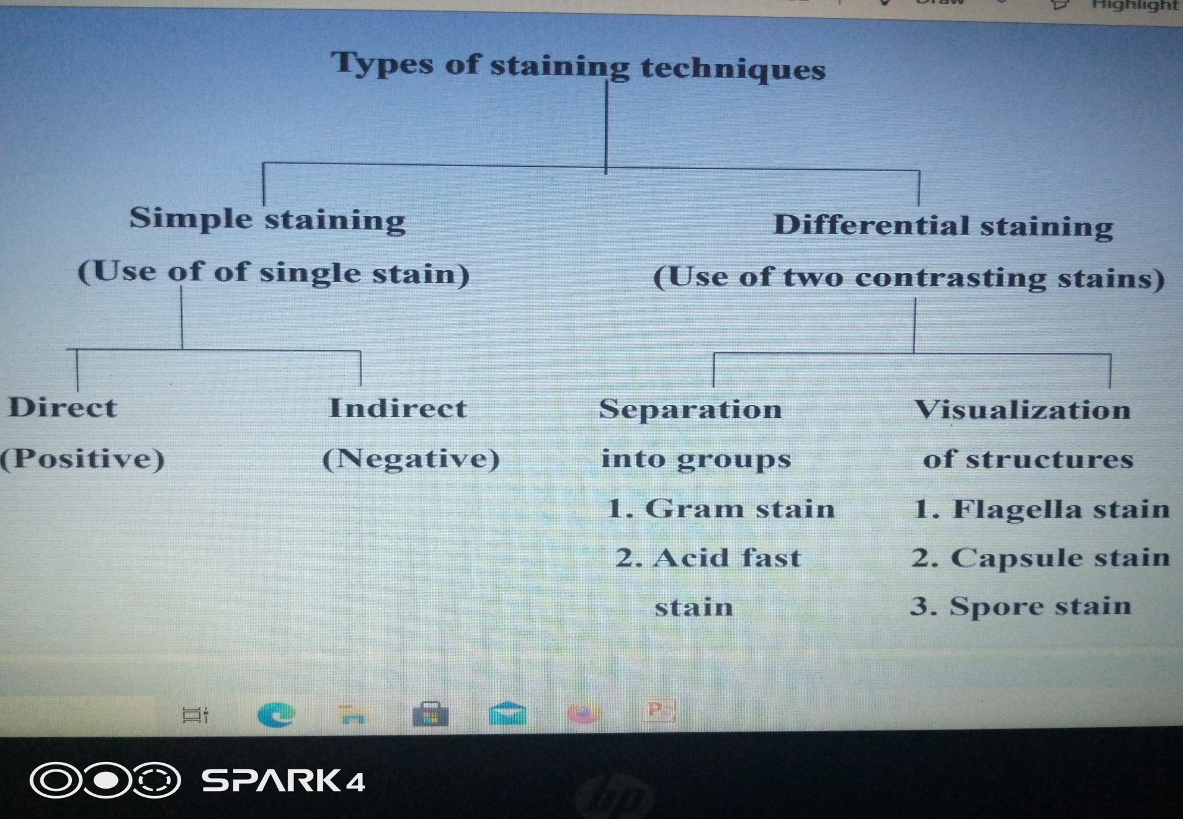

Slide 7
SIMPLE STAINING
Staining method that uses only a single dye which does not differentiate between different types of organisms
There is only a single staining step and everything is stained with the same color.
Simple stains are used to stain whole cells or to stain specific cellular components.
Types of simple staining:
      Direct / positive staining : stain object
      Indirect / negative staining: stain background .

Slide 8
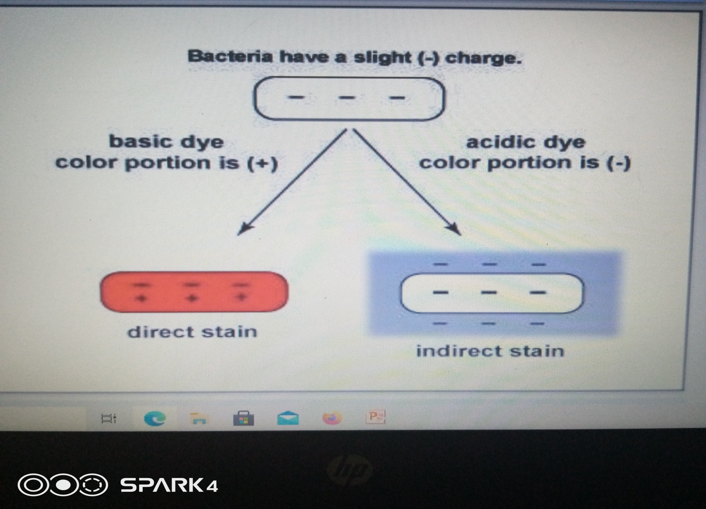

Slide 9
)
DIRECT STAINING (POSITIVE STAINING
A simple staining technique that stains the bacterial cells in a single color.
Many of the bacterial stains are basic chemicals; these basic dyes react with negatively charged bacterial cytoplasm (opposite charges attract) and the organism becomes directly stained.
Examples are methylene blue, crystal violet, and basic fuchsin .

Slide 10
)
INDIRECT STAINING (NEGATIVE STAINING
It is the background that is stained.
Here, an acidic dye like nigrosin or Indian ink is used.
Acidic stain carries a negative charge and is repelled by the bacteria, which also carry a negative charge on their surface.
Hence, an acidic dye do not stain bacteria
Instead, it forms a deposit around the organism, leaving the organism itself colorless or transparent upon examination.

Slide 11
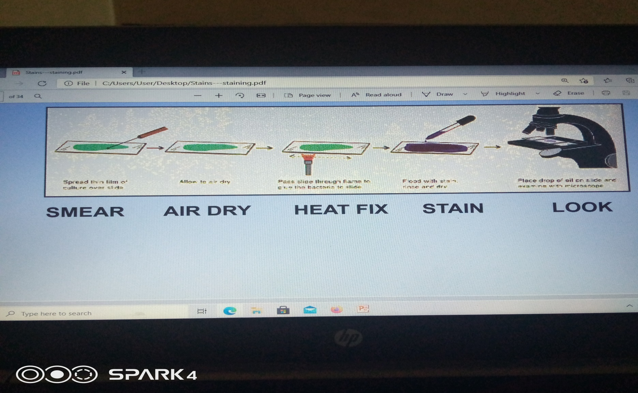
Simple guidance on steps followed when staining

Slide 12
Importance of fixing the smears
“Fixation accomplishes three things:
it kills the organisms;
it causes the organisms to adhere to the slide
it alters the organisms so that they more readily accept stains, (dyes).

Slide 13
Differential staining
GRAM’S STAINING
History
In the late 1800’s, Christian Gram observed that some genera of bacteria retained a dye-Iodine complex when rinsed with alcohol, while other genera were easily decolorized with alcohol and could be then visualized by a contrasting counter stain.

Slide 14
This staining procedure defines two bacterial groups:
Those which retain the primary dyes (“positive by gram’s method” or “gram-positive”)
Those which are easily decolorized (“negative by gram’s method” or “gram-negative”).
This is the starting point for bacterial identification procedures

Slide 15
The difference in dye retention is dependent on such physical properties as thickness, density, porosity, and integrity of the bacterial cell wall and chemical composition.
Gram-Positive bacteria have thick, dense, relatively non-porous walls
Gram-Negative bacteria have thin walls surrounded by lipid-rich membranes.
Some non-bacterial organisms with thick cell walls (e.g., some yeasts) also stain Gram-Positive.
Gram-Positive bacteria which have lost wall integrity through aging or physical or chemical damage may stain Gram-Negative.

Slide 16
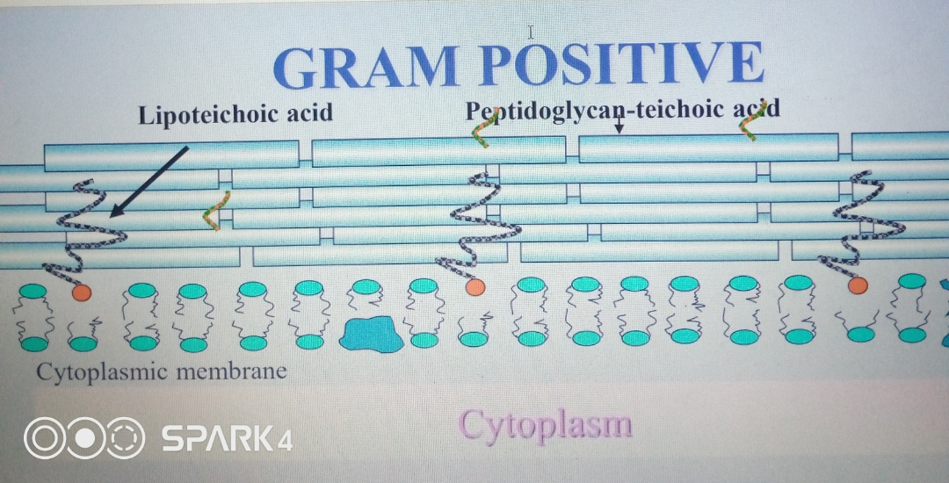

Slide 17
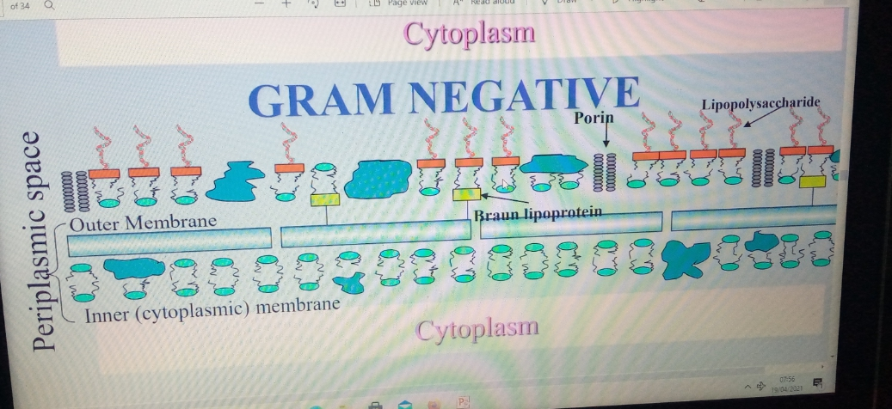
GRAM NEGATIVE

Slide 18
Gram staining – Requirements
Gram-staining is a four part procedure.
The specimen is mounted and heat fixed on a slide before proceeding to stain it.
The reagents required are:
          Crystal Violet (the Primary Stain)
          Iodine Solution (the Mordant)
          Decolorizer (ethanol)
          Safranin (the Counter stain)
          Water.

Slide 19
Gram staining – Procedure
The bacteria are first stained with the basic dye crystal violet (primary stain).
    Both gram-positive and gram-negative bacteria become directly stained and appear purple after this step
The bacteria are then treated with gram's iodine solution (mordant).
This allows the stain to be retained better by forming an insoluble crystal violet-iodine complex i.e ‘iodine lake’.
      Both gram-positive and gram-negative bacteria remain purple after this step.

Slide 20
3)Gram's decolorizer , a mixture of ethyl alcohol and acetone, is then added.
This is the differential step.
Gram-positive bacteria retain the crystal violet-iodine complex while gram-negative are decolorized.
4) Finally, the counter stain safranin (also a basic dye) is applied.
Since the gram-positive bacteria are already stained purple, they are not affected by the counter stain.
Gram-negative bacteria, that are now colorless, become directly stained by the safranin.
Thus, gram-positive appear purple, and gram-negative appear pink

Slide 21
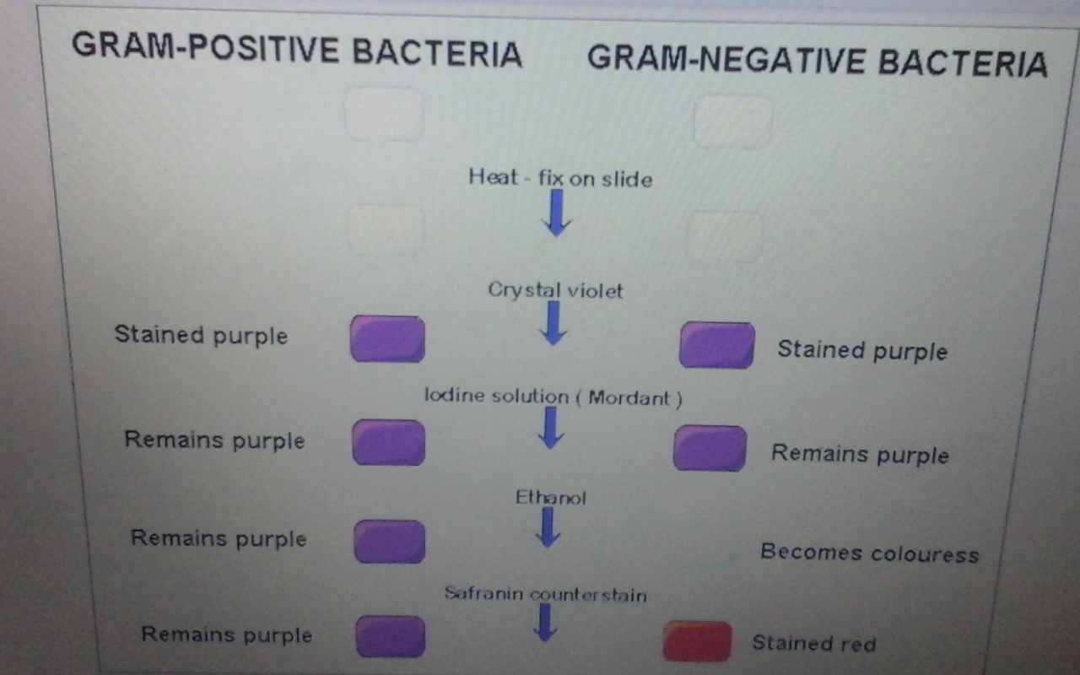

Slide 22
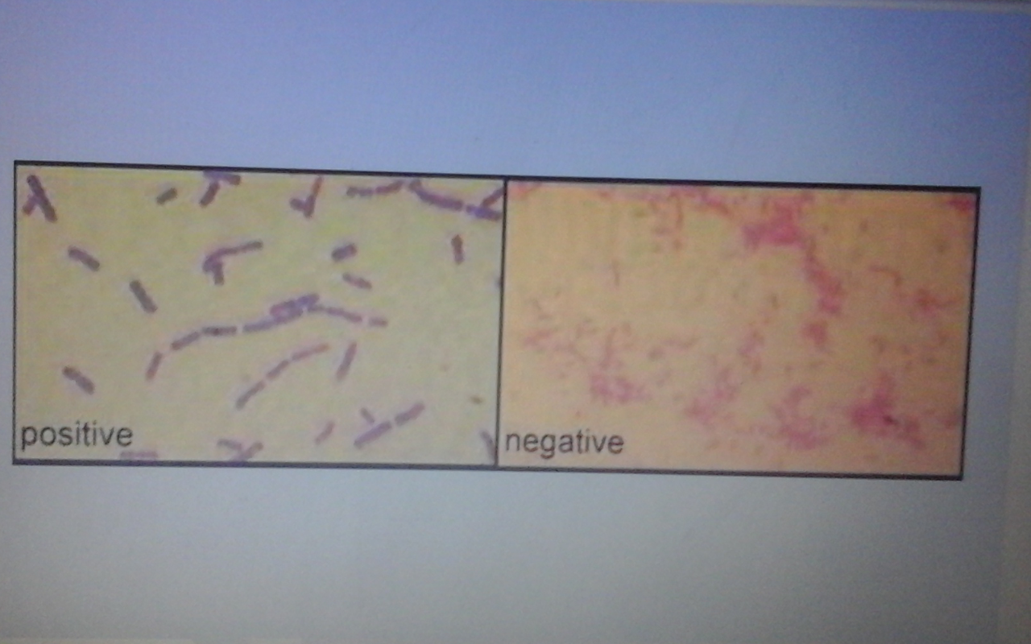

Slide 23
ACID FAST STAINING
Acid fast staining – theory
Once stained the acid fast bacterial cells resist decolorization with acidified organic solvents, e.g acid alcohol and are therefore called ACID FAST.
Acid fast staining property of the genus Mycobacteria, depends upon their lipid-rich cell walls which are relatively impermeable to various basic dyes unless the dyes are combined with phenol

Slide 24
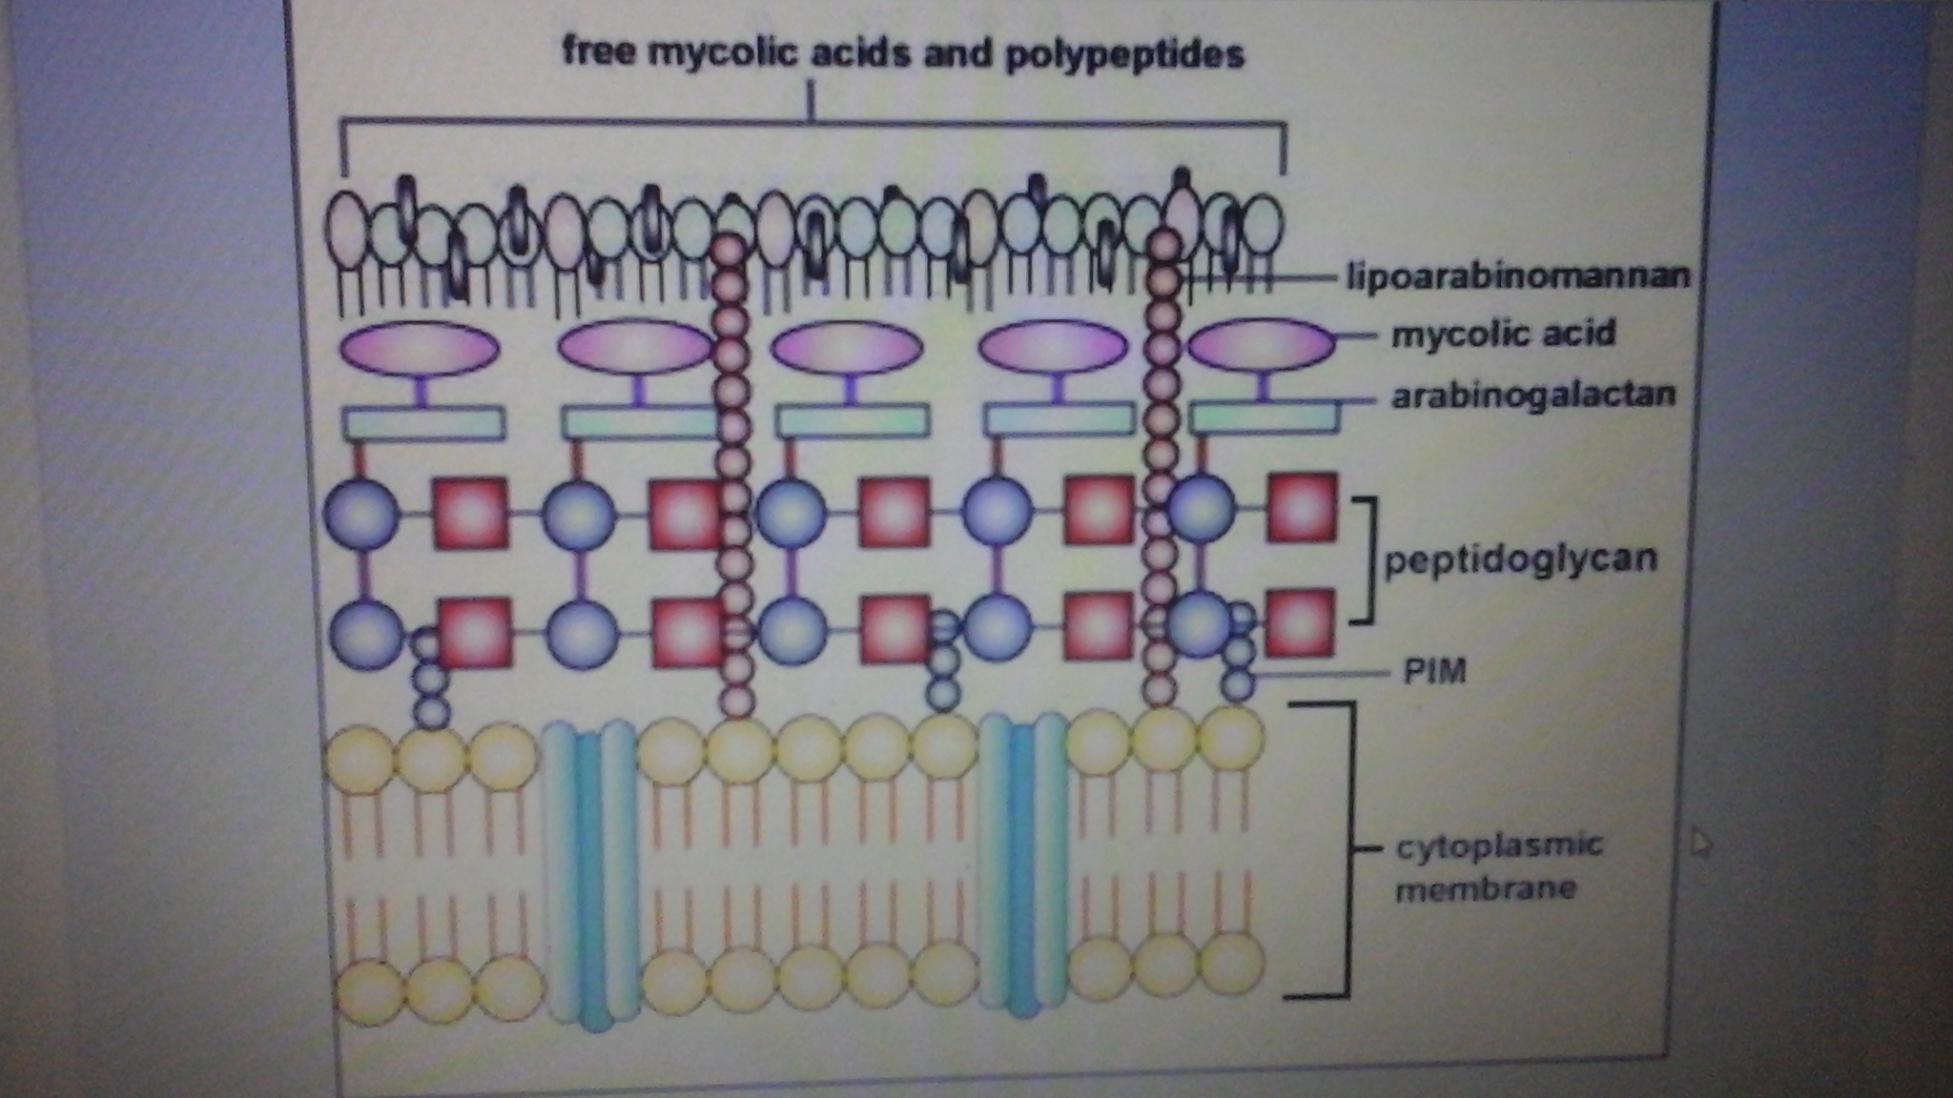
Structure of an Acid-Fast Cell Wall

Slide 25
The exact method by which the stain is retained is unclear but it is thought that some of the stain becomes trapped within the cell and some forms a complex with the mycolic acids.
This is supported by the finding that shorter chain mycolic acids or mycobacterial cells with disrupted cell walls stain weakly acid-fast, e.g. Nocardia

Slide 26
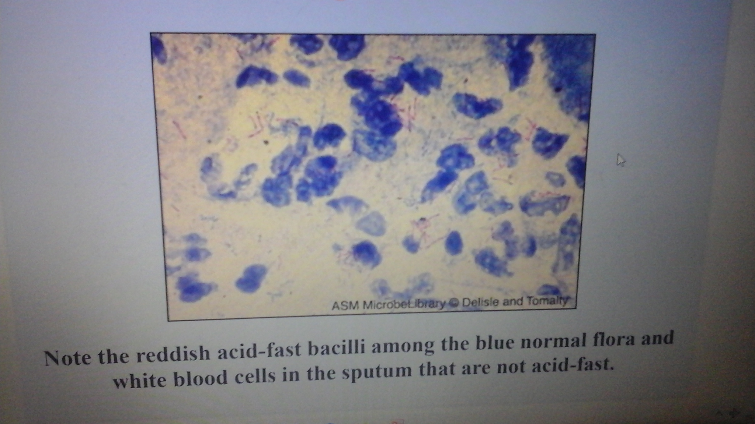
Acid-Fast Stain of Mycobacterium tuberculosis in Sputum

Slide 27
SPECIAL STAINING
CAPSULE STAINING
Capsule staining is diagnostically useful since it is a virulent factor(e.g. pneumococci).
Bacterial capsules are non-ionic, so neither acidic nor basic stains will adhere to their surfaces.
Capsules are demonstrated either by negative staining (Nigrosin or India ink) or by special staining, e.g. Hiss’ method, Anthony’s method
Hiss Method
The capsule is non-ionic in nature so it doesn't get stain by a acidic stain but a basic stain, such as crystal violet, stains the cell as well as the capsule.

Slide 28
This is followed by treatment with hypertonic solution - 20% Copper sulphate solution, which serves dual role of both the decolorizing agent and counter stain.
Copper sulphate solution, being hypertonic, causes diffusion of stain towards outer surface of cell.
After drying of slide, the stain which is not passed from the capsular layer during diffusion retains in the capsular layer.
Copper sulphate then decolorizes the capsule
Capsule appears as a faint blue halo around a purple cell

Slide 29
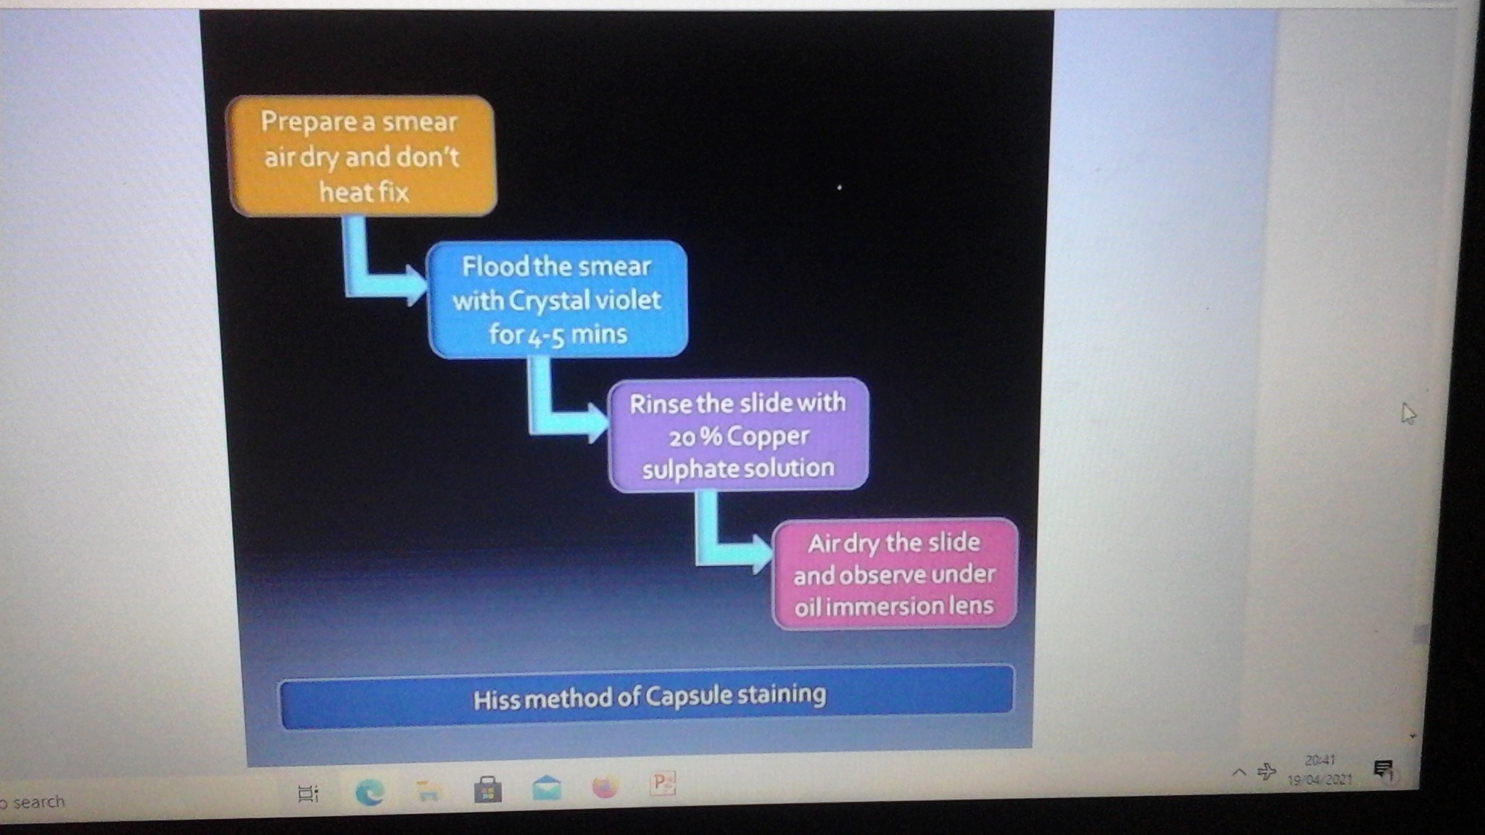

Slide 30
ENDOSPORE STAINING
Spores are normally impervious to stains.
Under the light microscope endospores have a high light refractivity indicative of high protein content.
Endospores can be stained by:
      Modified Zeihl-Nelson's method using 0.25-0.5% sulphuric acid as decolorizing agent,
      Barthelomew-Mittwar’s method
      Schaeffer-Fulton stain technique

Slide 31
Schaeffer-Fulton method
Malachite green is used to stain the endospores (primary stain)
The malachite green is forced to permeate the spore wall by heating (mordant).
Washing with water remove stain from vegetative cells, but not from spore wall.
The endospores thus retain the primary dye while the vegetative cells lose the primary stain and take the red color of secondary stain (safranin).

