Slide 1
MICROBIOLOGY 3

Slide 2
Nutritional Requirements for Bacterial growth
Varies according to Bacteria
Hydrogen and oxygen – these are provided in water.
Carbon – for the synthesis of compounds and some organisms. Obtain it from atmosphere, air, (Co₂.) Others get it from fatty acids and most pathogenic bacteria belong here.
Nitrogen – obtained from Ammonia which is incorporated is also from deamination.

Slide 3
4. Inorganic salts and minerals – acts as enzyme activators and include K, Na, Ca, Mg, PO₄
5. Organic compounds – Amino acid, monosacharides, lipids. These provide growth factors and also used in biosynthesis to larger molecules.

Slide 4
Classification of bacteria
Strict or obligate aerobes – Require O₂ to remain viable. O₂ is final electron acceptor in the energy production pathways. Waste products are CO₂, H₂O and energy – stored by conversion of ADP to ATP. This is the oxidative phosphorylation
Strict anaerobes – grow and remain viable in absence of O_{2.} They are easily killed in presence of O₂.The end products are lactic acid, Co₂, Hydrogen and Alcohol.

Slide 5
Energy is produced and stored in the granules. This is known as substrate level phosphorylation
Facultative anaerobes – can utilize either method to obtain energy.

Slide 6
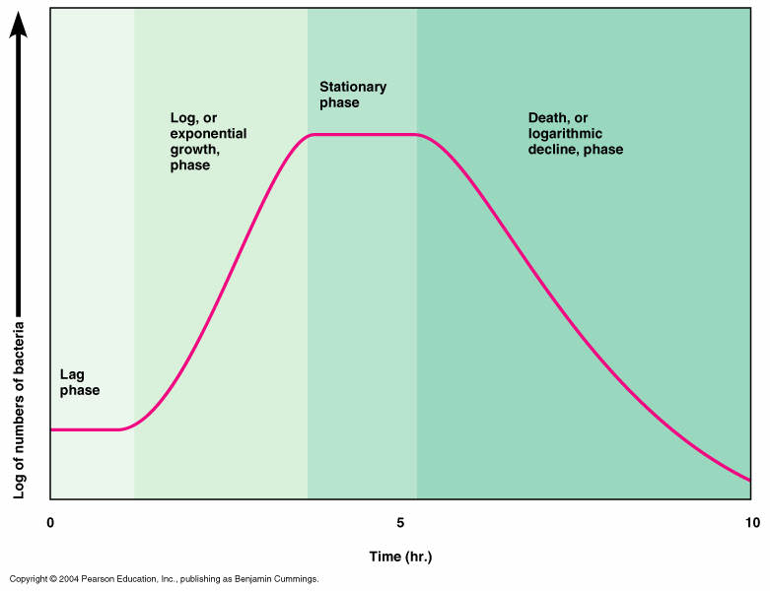
Bacteria Growth curve

Slide 7
 | Phase | Growth rate
 | Lag | Zero
 | Acceleration | Increasing
 | Exponential | Constant
 | Retardation | Decreasing
 | Maximum stationary | Zero
 | Decline | Negative (death)

Slide 8
Exponential Phase
It is the phase of maximum growth.
Cells divide at a constant rate. New cell material is being synthesized at a constant rate, but the new material is itself catalytic and the mass increases in an exponential manner.
This continues until one of 2 things happens: either one or more nutrients in the medium become exhausted, or toxic metabolic products accumulate and inhibit growth.

Slide 9
For aerobic organisms, the nutrient that becomes limiting is usually oxygen. There is a linear relationship between time and number of cells growth.
In the human body, bacteria at this time cannot be killed easily, and can easily overwhelm the body.

Slide 10
Maximum Stationary phase
There is neither growth nor death
Growth ceases because of exhaustion of nutrients or the accumulation of toxic waste products .In most cases, however, cell turnover takes place in the stationary phase: there is a slow loss of cells through death, which is just balanced by the formation of new cells through growth and division
Cells can exhibit variation difference in their morphology.
Some form spores, others produce exotoxins.

Slide 11
Death phase
After a period of time in stationary phase, which varies with the organism and with the culture conditions, the death rate increases until it reaches a steady level
Organisms are non viable, incapable of growing even if transferred to another culture. They lose selective permeability .
Accumulation of toxic material occurs and eventually lysis takes place.

Slide 12
INHERITANCE
Genetic material in microorganism is in the nucleus
The bacterial chromosome is a continuous DNA structure approximately 1nm long.
The DNA molecule consists of a double helix made up of 2 complementary polynucleotide strands in each of which Purine and Pyrimidine bases are arranged along a backbone made of alternating deoxyribose and phosphate groups.

Slide 13
The 2 strands are held together by hydrogen bonds between neighboring bases; the stereochemistry is such that hydrogen bonds can be formed only between adenine and thymine (A-T pair) and between guanine and cytosine (G-C pair). Thus a sequence of bases along one strand such as G-C-C-A-C-T-C-A must be matched on the opposite strand by the complimentary sequence of C-G-G-T-G-A-G-T-

Slide 14
The segment that comprises of a full sequence which could code for an enzyme is called a gene. That is;
A gene is a DNA segment that can code for an enzyme .
Codon – is a three base pair which could code a specific amino acid
Genome – full complimentary set of gene found in any bacteria. They range from 1000 – 3000 normally.

Slide 15
When the genetic material is undergoing replication it starts from a specific point which is initiated by the enzyme DNA polymerase.
This enzyme initiates cleavage and runs along the DNA molecule and divides it into 2 complimentary parts which quickly synthesize the other complementary molecule.
There are processes which lead to complete different DNA but most times the daughter cells are similar to the original.

Slide 16
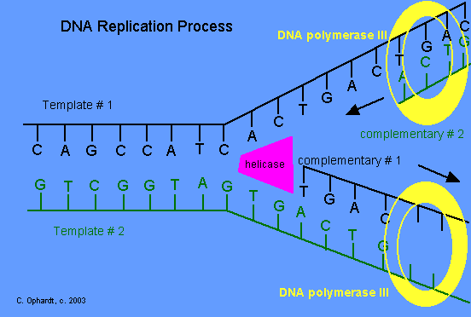

Slide 17
The 2 major processes leading to different daughter cells are
Mutation
Gene transfer
1. Mutation
Any change in genetic material which changes the structure and hence the function of a specific protein constitutes mutation.
Mutation can be due to sequence changes due to base-pair substitution.

Slide 18
This can be spontaneous whereby most changes are reversible.
It can also be induced by mutagenic agents. Mutagenic agents include:
Radiations e.g. x-rays, ultraviolet light etc
Chemical agents such as nitrous acid, alkylating agents( e.g ethylmethane-sulfonate) proflavine dye
2. Mutation can also be due to breakage of sugar phosphate linkages

Slide 19
Mutations occur by different mechanisms e.g
Deletion- it is a process whereby a base pair of the genome is deleted e.g.
T –A- T- C T-A-C
A –T- A- G A-T-G
Insertion – A segment of the base pairs is inserted in a new place e.g.
T-A-T-C-G-A Insert T-A T-A-T-T-G
A-T-A-G-C-T A-T-A-A-C

Slide 20
Insertion sequences
Capsulated org. non capsulated
Frame shift – may involve folding over, overlap and thus cause a new gene arrangement.
Mutation is a process which can be reversible but some are irreversible.
Example of reversible mutation
Fimbriated organism Non fimbriated org.
Example of irreversible (this is also referred to as smooth- rough mutation)
Capsulated org Non capsulated

Slide 21
An organism undergoing from smooth – rough mutation also loses its virulence
Mutation affects lots of activities in the bacterial cell.
It can give rise to observable effects e.g. Appearance staining characteristics metabolic activities.
EFFECTS OF MUTATION
Nonsense mutations – do not influence any activity in an organism.

Slide 22
Lethal mutations affect key functions in the organism and organism dies
Conditionally lethal mutations – may affect ability of organism to utilize certain materials but if placed in a condition….where we have the substance it can still grow.

Slide 23
2. Gene transfer
Takes place in 3 ways
Transformation
Transduction
Conjugation
a) Transformation
Refers to the uptake of DNA form environment that is usually released to the environment by already dead bacteria.

Slide 24
In transformation, the recipient cell takes up soluble DNA released from the donor cell .it occurs in both gram +ve and gram –ve bacteria
It was demonstrated by Griffin (read about it)
b) Transduction
In this process, a fragment of donor chromosomes is carried to the recipient by a temperate bacteriophage.
Bacteria acquire new genetic material as a result of transfer by bacteriophages.

Slide 25
Bacteriophages are virus specialized in infecting bacteria They can cause-- 2 major effects.
Lysis
Insert their genetic material into the bacteria which is transferred during division i.e. Temperate
Both are capable of co-existing with the bacteria for some time.
Bacteria virulence can be influenced by the bacterial phage e,g, the Diptheria in man.

Slide 26
c) Conjugation
Involves two closely related organisms.
Conjugation refers to transfer of genetic material from one bacterium which is donor (male) to another bacterium which is the recipient (Female) through contact.
It occurs as follows: the cell exudes a special protein thread, called a sex pilus, which is coded for by plasmid genes.

Slide 27
This thread, which may be several times the length of the cell, has a tip which adheres to gram-negative cell walls. Any gram –negative cell which touches it becomes tethered to the plasmid-containing cell
Requirements for conjugation
2 bacteria cells
Plasmid
Sex pili
Fertility factor (F) (allows genes to be transferred from one bacterium to another)

Slide 28
Transfer factor sex pili (Fimbriae)
Resistance factor
Clumping factors
Plasmid is an extra chromosomal material which is capable of dividing, is transmissible, and has transfer factors.
Others help in providing resistance to antibiotics and are referred to as Resistance factors (R factors)

Slide 29
During conjugation the 2 organisms come into contact.
This influences, virulence, sensitivity to antibiotics, and other activities
Restriction endonucleases( Restriction enzymes)
These are unique enzymes that cut DNA at or near specific recognition nucleotide senquences kwown as restriction sites.
They find their application in genetic engineering (used in synthesizing some hormones)

Slide 30
HOW MICROBES INTERACT WITH HUMANS
Microbes
Vs
Human Beings

Slide 31
Many infections and diseases are caused by the growth of pathogens on and in living tissues
Infections or diseases have terminologies in common i.e.
Virulence
Virulent pathogen
Avirulent
Pathogens
Susceptibility
Infection

Slide 32
Communicable diseases
Contagious diseases
Equation of infection
a) Virulence involves a pathogen infecting the body ,and the end result is production of a disease. Therefore virulence measures the degree of infection
b) Pathogenicity is the ability of a pathogen to cause diseases

Slide 33
virulent pathogens are pathogens that cause diseases
d) Avirulent pathogens are the ones that cannot cause diseases except in rare situations.
e) Susceptibility is the vulnerability of an organism to get infected by a disease.
f) Infection is caused by pathogenic microbes which are capable of multiplying.

Slide 34
g) Communicable diseases are diseases that can be transferred from one person to another e.g. measles, gonorrhoea
h) Contagious diseases is a communicable diseases which are easily transmitted via droplets in the air by either a cough, sneeze, nose blowing e.g. common cold, influenza, swine flu.
i) Equation of infection is the degree of infection. Thus;
Host defences = Microbial virulence

Slide 35
The above equation translates that the severity of an infection and the damage inflicted by a pathogen is dependedent on the whole system of being able to resist infection and to neutralize the damaging enzymes/toxins from the pathogen
In some cases, infection does not occur in some individuals despite occurring in others.
This is due to the following:

Slide 36
The site of infection and multiplication is not suitable for the pathogen to multiply
Pathogens do not attach to specific host receptors sites
Presence of lysosomes and antibacterial factors
Presence of normal flora - They don’t allow growth of other organisms
Bacteriocidins - These are chemicals with antibiotic effects and if produced by for example pathogen A they inhibit growth of pathogen B

Slide 37
Presence of antibodies
Presence of phagocytes especially in mucous membranes. They engulf and destroy microbes
Development of infection
For an infection to occur, the pathogens should be able to:
Enter to the host
Attach and adhere to mucous membranes
Multiply and damage tissues

Slide 38
The host body reacts by five cardinal signs of inflammation which were discussed by Celsius Ad as follows:
Oedema(swelling)
Redness
Fever (due to heat)
Pain
Tissue dysfunctions

Slide 39
Disease process;
When the condition appears in a local area, it is said to be localized e.g. a sore throat
Other infections are generalized or systemic. They can be acute whereby they have a quick onset and quick recovery or chronic where they have a slow onset and they take a long duration in the body.
Both acute and chronic infections cause tissue damage

Slide 40
Some diseases can be asymptomatic ig. Gonorrhoea in women.
Some diseases undergo various stages of infection i.e. primary, secondary, tertiary and terminal stages e.g AIDS and syphilis
Mechanisms of how diseases are caused
a) Ability to infect the host and protect themselves against body defenses

Slide 41
b) Ability of microbes to invade and multiply in the tissues
c) Microbes causing damage and destruction to the tissues
The above 3 constitute virulence.
Bacterial morphology may be associated with infectivity and it accounts for the structural aspect of the pathogen.
Some structural features associated with morphology of bacteria enabling them to cause diseases are such as:

Slide 42
Capsules i.e, encapsulated bacteria have their capsules containing polysaccharides and proteins are vital for the bacteria to attach to the tissue and enable it to resist phagocytosis
Flagella are motile structures and aid bacteria to invade different tissues of the body
Pili and fimbriae allow bacteria to adhere to the mucous membranes

Slide 43
Enzymes and toxins associated with causing of diseases. Enzymes are such as coagulase, streptokinase, hyalurodinase and collagenase.
There are two types of toxins; endotoxins and exotoxins.
Exotoxins are secreted by bacteria and target tissues. E.g neurotoxins target neurons, enterotoxins affect the intestines, erythrotoxins target erythrocytes, cardiotoxins target the heart

Slide 44
Endotoxins form a constituent of bacterial cell walls. They are in form of lipopolysaccharides , proteins and affect tissues of the host by :
They destroy phagocytes
Upset water and electrolyte balance
Dehydrate the host hence become weak and susceptible to secondary diseases. E.g cholera, dysentery etc

Slide 45
Differences between Endotoxins and Exotoxins
Property | Exotoxin | Endotoxin
Source | Gm +ve and some Gm -ve | Most Gm –ve
Secreted from cell | Yes | No
Chemistry | Polypeptide | Lipopolysaccharide
Location of genes | Plasmid or bacteriophage | Bacterial chromosome
Toxicity | High | Low
Clinical effects | Various effects | Fever, shock
Mode of action | Various modes | Includes TNF and interleukin 1
Antigenicity | High titer antibodies | Poorly antigenic
Vaccines | Toxoids used as vaccines | No toxoids formed
Heat stability | Destroyed rapidly at 60oC | Stable at 1000 C for 1 hr

Slide 46
Epidemiology (mode of transmission of disease)
Epidemiology is defined as the science that deals with the frequency and distribution of diseases and factors that contribute to the spread of the disease. i.e.
Frequency (no. of cases)
Distribution( source)
Factors ( water source etc)
Mode of transmission of disease is the method through which the diseases are transferred

Slide 47
Epidemiology catches the number of cases from a particular source and the time.
Factors that contribute to epidemiology include water sources, patient transfer, persons movement, virulence of the organisms, susceptibility, behavior, lack of immunization, overcrowding, inadequate sanitation, mode of transmission of the disease.

Slide 48
There are different scales of disease spreading i.e
Endemic diseases localized in certain areas and does not get eradicated e.g jiggers disease
Epidemic diseases covers a big area and is above normal cases at a particular time e.g cholera outbreak in Haiti
Pandemic disease is a disease that covers the whole world e.g HIV/AIDS, swine flu…

Slide 49
Reservoirs of infections
These are places which one is vulnerable to get a disease. Living hosts, inanimate objects and material can act as sources of infection.
a) Living animal reservoirs. These include horses, pigs, human, cattle, dogs and wildlife.
b) Carriers - There are 3 carriers. i.e. active, passive and convalescent carriers.

Slide 50
Active carriers are people that have undergone treatment but carry the pathogen
Passive carriers carry the pathogen but do not show the symptoms
Convalescent carriers are people who have been sick and are recovering from the disease but they still carry the pathogens
c) Inanimate factors include air, soil, water food, milk…

Slide 51
d) Personnel in hospital
e) Used hospital equipment e.g. syringes
f) Patients

