Slide 1
MICROBIOLOGY AND IMMUNOLOGY

Slide 2
Learning outcomes :
Upon completion of the course , students should be able to ;
1 .To demonstrate the ubiquity and diversity of microorganisms in human body and the environment.
2.To illustrate the characteristic features of microorganisms and the diseases they cause.
3.To explore mechanisms by which microorganisms cause diseases .

Slide 3
4.To show how the human immune system counteracts infections by specific and non-specific mechanisms.
5To explore the routes of transmission of infections in hospitals ,communities and populations ,and the methods that are used to control the infections .

Slide 4
6.To demonstrate the principles of vaccines preparations and the use of vaccines in immunization.
7.To show the reasons for ,and the methods for sterilization of equipments and medical preparations from the microbiological point of view.

Slide 5
8. To show the microbial activity of disinfectants in the context of the patient and the environment.
9.To illustrate the microbiological reasons for ,and the importance of aseptic techniques in patient management.
10.To demonstrate the contribution of microbiologists and the microbiology laboratory to the diagnosis of infections including ,specimen collection and the role of a nurse in carrying this out.

Slide 6
Microbiology
What is microbiology ?
Microbiology is the study of microorganisms and how they affect life.

Slide 7
Scope of microbiology
The specialized fields of microbiology include ;
1. Medical microbiology
2. Environmental microbiology

Slide 8
3. Food microbiology
4. Biotechnological microbiology
5. Molecular biology
6. Forensic microbiology

Slide 9
TYPES OF MICRO-BIOLOGY
Medical microbiology- is a branch of microbiology which is concerned with the prevention and control, diagnosis and treatment of infectious diseases. This field of science studies various clinical applications of microbes for the improvement of health.

Slide 10
Environmental microbiology
Is the study of the composition and the physiology of microbial communities in the environment .The environment in this case can mean ,soil, water, air and sediments covering the planet which also include ;animals and plants which inhabit these areas.

Slide 11
Food microbiology
Is the study of microorganisms that inhibit ,create or contaminate foods, including the study of microorganisms causing food spoilage, pathogens that may cause diseases especially if food is improperly cooked or stored like those used to produce fermented foods such as cheese,yoghurt,bread,beer,and wine, those with useful roles such as producing probiotics.

Slide 12
History of microbiology
Anton Van Leeuwenhoek(1674) – Dutch biologist – was the first man to observe bacteria and other microorganisms using a single lens microscope of his own design. He called them ‘animalcules’ and drew and documented them. This formed the basis of microbiology.
Edward Jenner ( 1796) - using ancient Chinese technique for small pox vaccination developed a method of using cowpox to immunize a child against small pox. The same principles are used for developing vaccines today.
Friedrich Henle (1840) - proposed a criteria for proving that microorganisms caused human diseases (the ‘germ 'theory of disease).
Koch and Pasteur (1870s) confirmed the theory by proving that microorganisms caused anthrax, plague, cholera and tuberculosis. (Koch’s Postulates)

Slide 13
Louis pasteur (1857 )- designed vaccines against anthrax, cholera and rabies as well as pasteurization for food preservative. He is considered the father of modern medicine.
Joseph lister (1867) – Father of antiseptic surgery – 1st to sterilize surgical instruments and reduced infections
Hans Christian Gram (1884) – developed a method of staining bacteria to make them visible under a. microscope

Slide 14
Medical microbiology
A branch of medicine concerned with the prevention, diagnosis and treatment of infectious diseases.
It also deals with various clinical applications of microbes for the improvement of health.
There are four kinds of microorganisms that cause infectious diseases . These are ; Bacteria Fungi, viruses, and parasites.

Slide 15
Classification of Medical Microbiology
Bacteriology – The study of bacteria.
Mycology- The study of fungi.
Virology – The scientific study of viruses.
Parasitology – It is the study of parasites, their hosts and the relationship between them.
Immunology – It is a branch of biomedical sciences that covers the study of the immune system in organisms.

Slide 16
Types of medical microbiology
Bacteriology – is the study of bacteria It studies the morphology , ecology, genetics and biochemistry of bacteria as well as many other aspects related to bacteria. It involves the identification ,classification and characterization of bacterial species.
Mycology –is the study of fungi . It includes the study of their genetic and biochemical properties ,their taxonomy and their use to humans as a source for tinder ,medicine , food and entheogens , as well as their dangers ,such toxicity or infection.

Slide 17
Virology - refers to the study of viruses . The study of submicroscopic parasitic particles contained in a protein coat ,and viruses- like particles.
Parasitology - is the study of parasitic organisms , their hosts and the relationships between them . The scope of parasitology is not determined by the organism or environment in question but by their way of life.
Medical parasitology - is the study of three major groups of organisms ; parasitic protozoa , parasitic helminthes and those arthropods that cause disease or vectors of various pathogens.

Slide 18
A Medical microbiologist studies the following:
characteristics of pathogens ( micro-organisms that causes disease).
Their modes of disease transmission
Mechanisms of transmission of infections
Their growth and development .

Slide 19
Importance of medical microbiology
1.Health risks can be identified and prevented.
2. Monitoring of virulent or resistant strains of microbes and instituting relevant interventions.
3. Educating the community and helping in designing of good health practices.
4. Preventing or controlling epidemics and outbreaks of diseases.
5. Development of antibiotics and other treatment methods.
6.Microorganisms found in the body as normal flora prevents potential pathogens from gaining access to our body, help in processes such as digestion, production of Vitamin K and B

Slide 20
Significance of microbiology to nurses
Knowledge of microbiology and infection prevention and control provides nurses with the skills and knowledge to prevent the transmission of pathogens in health care setting .
Student nurses will gain knowledge of the most important bacteria ,fungal ,parasitic and viral infections .
It enables nurses to establish and maintain a sterile field (environment )free from pathogens.
Nurses will gain knowledge of putting on personal protection to prevent the transmission of pathogens.
It enables nurses gain knowledge on the roles of the immune system in the defense of the human body against disease-causing organisms.

Slide 21
Importance continued…………………….
7.Industrial processes such as fermentation e.g breweries, wastewater treatment and preservation are related to microorganisms. Production of various food products; cheese, pickles, sauerkraut, green olives, yoghurt, soy sauce, vinegar, bread, Beer, Wine, Alcohol
8.In agriculture – plant microorganisms, animal microorganisms, soil microorganisms applied in agro and veterinary medicine
Using bacteria to control the growth of insects e.g Bacillus thuringiensis to control caterpillars, bollworms, corn borers
9.Cause biodegradation of wastes, Bacteria are primary decomposers - recycle nutrients back into the environment (sewage treatment plants)
10.Form part of food chain

Slide 22
MICRO-ORGANISMS
These are living things which individually are too small to be seen with the naked eye. They are also referred to as microbes .
All of the following may be considered micro-organisms ; Bacteria , Fungi ,protozoa , microscopic algae ,viruses and various parasitic worms.
Microorganisms are everywhere ,almost every natural surface is colonized by microbes , from body to ocean .Some microorganisms can live in hot springs ,and others can live in frozen sea ice.
Most microorganisms are harmless to human ; we swallow millions of microbes every day with no ill effects . In fact ,we are dependent on microbes to help us digest our food.

Slide 23
Microorganisms are either;
Eukaryotic microorganisms – organisms whose cells contain a nucleus and other structures enclosed within membranes e.g. fungi, protozoa
Prokaryotic microorganisms – are single-celled organism that lacks a membrane-bound nucleus , mitochondria, or any other membrane-bound organelle

Slide 25
Prokaryotic cell; bacteria

Slide 26
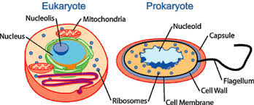
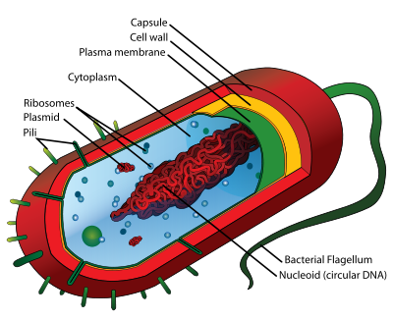
Eukaryote cell vs prokaryote cell
Prokaryote

Slide 27
Ecology of microorganisms
Saprophytes – a term used for plants, fungi or bacteria which obtain nutrients from dead organic matter
Symbiosis – the relationship between 2 different kinds of organisms living in close physical association to the advantage of both. ( sometimes referred to as mutualism) e.g gut protozoa in herbivores – receive nutrients, help animals digest, nitrogen fixing bacteria that live in the roots of legumes, lactobacillus in stomach
Commensal - an organism living with, or in another organism without causing injury.
It is a relationship in which one organism derives food and other benefits from another without hurting or helping it . Eg, normal flora in the mouth.

Slide 28
Parasite – is an organism that obtains shelter and nourishment on another organisms (host). It is a non mutual relationship where one species benefits at the expense of the other . They are capable of causing harm and disease to their host and are generally much smaller than their host e.g Macro-parasites -ticks, lice, tapeworm or micro-parasites- bacteria, viruses, fungi
Pathogen – microorganism capable of causing disease
Virulence – the degree of pathogenicity of an organism or measure of the ability of an organism to cause disease

Slide 29
Factors promoting growth and development of microorganism
Nutrients: All microorganisms need food primarily from carbon and nitrogen form substances e.g carbohydrates, proteins, fats and air
Temperature: The higher the temperature, the more easily microorganisms can grow to a certain point. Very high or very low temperatures obstruct enzyme activities in Microorganisms. Can be divided to :
Psychrophilles-prefer temperature of 0-5 degrees
Mesophilles-prefer temperature of 20-45 degrees
Thermophilles-prefer temperature of above 55 degrees

Slide 30
PH levels : Most prefer a neutral PH, some a high PH. Acidic PH tends to break down their enzymes
Moisture : Free flow of water is important to microorganisms tor their cells to exchange nutrients and for metabolic processes. All microorganisms require water, some less. The more moisture, the more microorganisms will be found
Oxygen and nitrogen: Many microorganism require an oxygen rich environment (aerobic) but others flourish in low oxygen surroundings (anaerobic) or some can survive in either

Slide 31
Classification of microorganisms
Classification is the arrangement of organisms into taxonomic groups based on similarities or relationships .Such classifications can be made possible by either carrying out an experiment or just observation .

Slide 32
BACTERIA

Slide 33
Structure Of Bacteria
Bacteria are the smallest cells and can only be viewed by a microscope – approx. 1um and are visible via a light microscope that has a resolution of 0.2um
Animal and plant cells are much larger ranging from 7um(diameter of RBC)
Each cell has genetic material in its DNA that transcribes genetic information to mRNA and translates mRNA to proteins.
Each cell also has mechanisms for producing energy enclosed within the membrane
Bacteria can survive and grow in hostile environments e.g low osmotic pressures, extreme temperatures, dry areas where most eukaryotic cells would not survive. They have evolved structures and functions to survive.

Slide 34
.
Bacteria are prokaryotes : Bacteria are prokaryotic organisms – simple, unicellular, no clear nuclear membrane no Golgi apparatus and no endoplasmic reticulum.
They reproduce via asexual division
All bacteria have a cell wall encircling the cell membrane made of peptidoglycans. Some bacteria lack this and compensate by surviving only inside host cells or in a hypertonic environment.
The size (0.5 - 5um), shape (spheres, rods, spirals), and arrangement (single cells, chains, clusters are used for preliminary classification. The phenotypic(observable physical and biochemical properties) and genotypic properties form the basis of definitive classification.
We are surrounded by bacteria in our environment

Slide 35
Classification of bacteria
1. Morphology
Size
Shape – cocci, bacillus, curved or spiral
Staining characteristics
Appearance of colonies – some are hemolytic, some form chains, clusters
Metabolic characteristics
2. Biochemical tests
can identify a microorganism with precision. E.g
Coagulase test , catalase test

Slide 36
3.Serological tests
Refers to determining an organism by their specific antigen. Used to identify organisms that are biochemically inert. E.g Treponema pallidum – cannot grow colonies or cannot run tests
4. Analyzing patterns of susceptibility to different antibiotics
5.Genotyping – Refers to use of DNA sequence to define an organism or defining an organism using its genetic characteristics

Slide 37
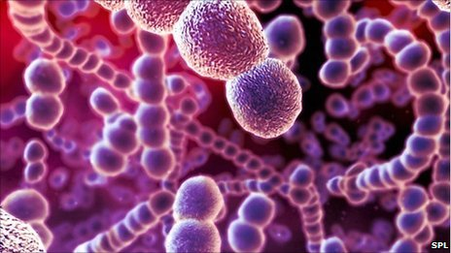
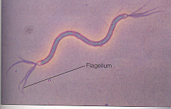
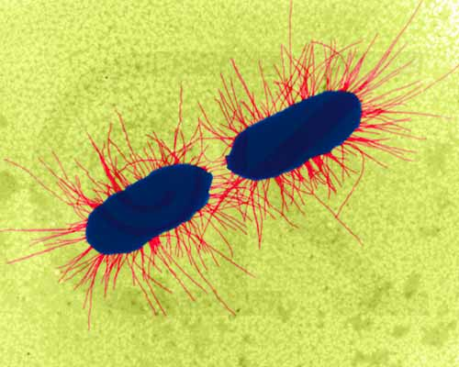
Morphology continues
A spherical bacteria is a coccus – staphylococcus
A rod shaped bacteria is a bacillus – e.g Escherichia coli
A snake like bacteria is a spirillum – e.g Treponema pallidum
Filaments – some species have a branched filamentous appearance e.g Escherichia coli , Actinomyces
Arrangement of colonies
Some bacteria form aggregates or clusters - Staphylococcus aureus
Some are 2 cells – Most Streptococcus and Nesseria species
Some form chains – Streptococcus pyogenes
cocci
bacilli
spirillum
Filaments

Slide 39
Classification of organisms by staining
Commonly used stains are Gram staining and Acid fast staining
1. Gram stain
A powerful easy test that allows one to distinguish between 2 classes of bacteria – Gram +ve and Gram -ve.
It uses the properties of the peptidoglycan cell wall to distinguish the gram + and gram – bacteria. Takes 10minutes
Common stains used are crystal violet, gram iodine and safranin
Gram +ve bacteria - turns purple (Retain crystal violet) – the stain gets trapped in a thick, mesh like peptidoglycan layer surrounding the cell (P-Purple-positive)
Gram –ve – turn red – do not retain the crystal violet and are counterstained by safranin – they have a thin peptidoglycan layer that does not retain crystal violet and has to be counterstained by safranin.

Slide 40
Not dependable for starved ,old ,or stationary bacteria.
Gram- and gram + bacteria have similar internal but very different external structures.
Staining

Slide 41
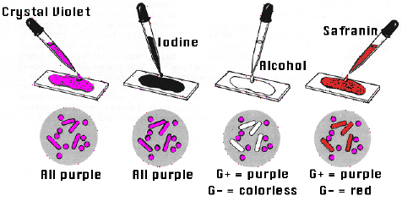
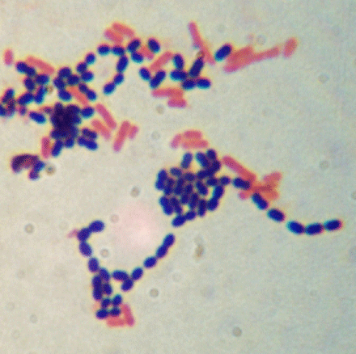
.
Staining
mordant
decolourization
Counterstain

Slide 42
Bacterial cell wall
Cytoplasmic membrane of most bacteria/ prokaryotes are surrounded by a rigid peptidoglycan layer (cell wall). The exceptions are Archeabacteria and mycoplasma. The cell wall provides rigidity that determines the shape of cell
It is the Target for drugs that can attack and kill bacteria without harming the host cell

Slide 43
Gram +ve bacteria cell wall
Cell wall is composed of thick peptidoglycan, techoic and lipotechoic acid
The cell wall is porous to allow diffusion
It helps in replication and survival in hostile environment
During infection, it interferes with phagocytosis and is pyrogenic.
It is susceptible to degradation by lysozyme. Without the cell wall, bacteria lyses due to large osmotic pressure differences

Slide 44
Lysozyme is a Digestive enzyme found in tears, saliva & mucus that damages bacterial cell walls
Techoic and lipotechoic acid are surface antigens that help in serotyping – they are important factors in virulence – can attach to host receptors and initiate toxic activities.

Slide 45
Gram – ve bacteria
Have a thin peptidoglycan layer with no techoicoic and lipotechoic acid
Have an outer membrane outside the peptidoglycan layer – unique to gram –ve bacteria
The periplasmic space has hydrolytic enzymes for metabolism and lysis in cases of pathogenesis.
The outer membrane is stiff and maintains shape and is a permeability barrier to large molecules e.g lysozymes
outer membrane protects the cell from adverse environment
The outer membrane also has lipopolysaccharides (lipid A and O antigen) that acts as a powerful endotoxin – stimulates immune response to activate B cells, macrophages that result in fever and shock e.g Nesseria menengitidis
Disruption of the outer membrane by antibiotics weakens the bacteria

Slide 46
Cell wall cont’
Other components of bacterial cell wall common in both gram + and – include
NAM (N-acetyl-muramic acid)
NAG (N- acetyl glucosamine)
Tetra peptide side chains
Penta glycine cross bridges
MANY ANTIBIOTICS are specifically directed at Cell Wall Synthesis
Penicillin
works by damaging the Penta glycine cross bridges of the peptidoglycan layer
Works best against Gram (+) bacteria

Slide 47
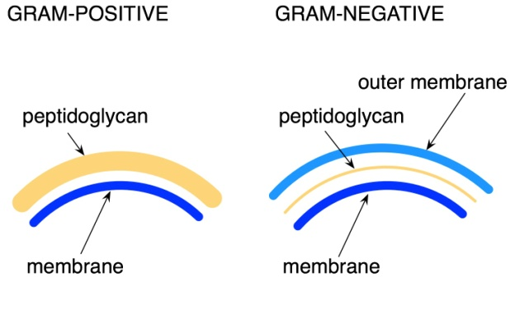
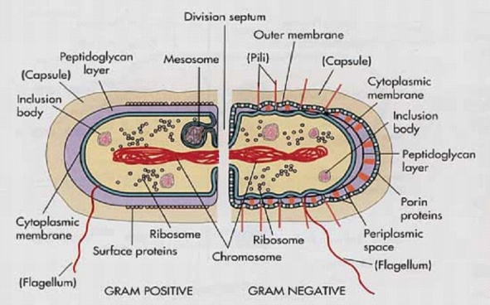
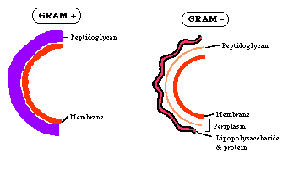
.

Slide 48
Acid - Fast Stain
Differential Stain - divides bacteria into 2 groups
Acid - Fast
Non Acid - Fast
Used to identify organisms in the Genera Mycobacterium (high lipid and wax content in cell wall)
Mycobacterium tuberculosis and Mycobacterium leprae
Mycobacteria have a peptidoglycan with a different structure (made of mycolic acid) and are described as acid – fast (AAFB – acid alcohol fast bacilli) staining. The coat is responsible for virulence and is anti phagocytic

Slide 50
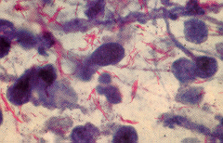
Acid fast staining involves;
Carbolfuchsin (Red)
Acid Alcohol
Counterstain with Methylene Blue
Acid - Fast Cells Red
Non Acid - Fast Blue

Slide 51
Cell Membrane (Plasma Membrane)
2 structural component
-double layer of phospholipids
-Proteins
Can Not Undergo Phagocytosis
Functions
-Selective barrier (selectively permeable)
-Enzymes for cell wall synthesis
-Secretes exo-enzyme : Amylases, lipases, peptidases

Slide 52
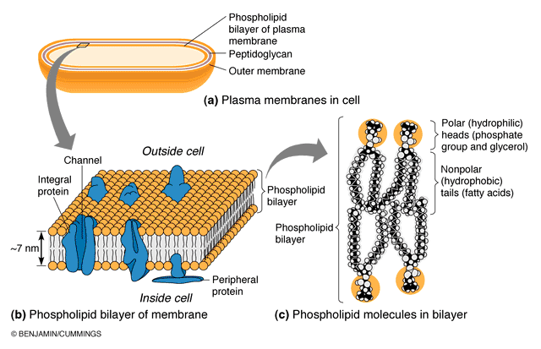

Slide 53
External Structures
Capsule: Some bacteria (gram +or-) are surrounded by a capsule made of loose polysaccharide or protein layer
In cases where it is loose, non adherent and non uniform in density, it is referred to as a slime layer.( capsule and slime layer are also called glycocalyx).
The capsule and slime layer do not participate in bacterial growth but are important for survival in the host.
It is poorly antigenic and ant phagocytic and is a major virulence factor.e.g Streptococcal Pneumonia
The capsule also acts as a barrier to hydrophobic molecules e.g detergents and promotes adherence to other bacteria and host tissue.

Slide 54
Flagella
Are rope like propellers anchored on the bacterial membrane. May be one or several
They provide motility for bacteria allowing them to swim towards food and away from poison (Chemot-axis).
The flagella also express antigenic and strain determinants

Slide 55
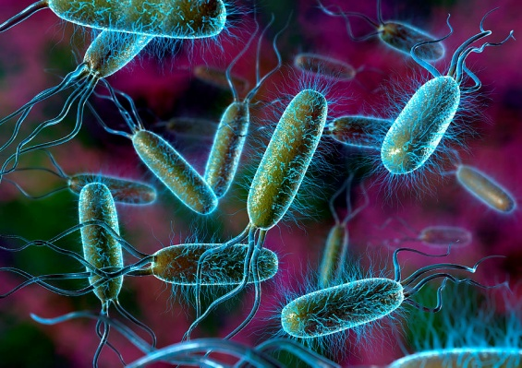
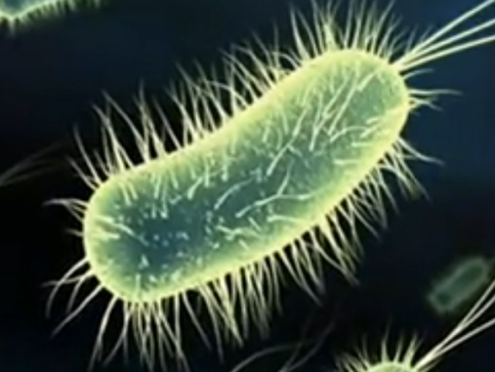
Flagella
Fimbriae or pili
Hair like structures outside the bacteria. They are smaller and not coiled (unlike the flagella). They are arranged uniformly around the bacteria.
They promote adherence to other bacteria or to host. This is an important virulence factor e.g Nesseria gonorrhea. Adherence is also important for Eschericia coli colonization and infection of the urinary tract
Some pili have chromosomes that allow transfer of genetic material between bacteria
Flagella
.
pili

Slide 56
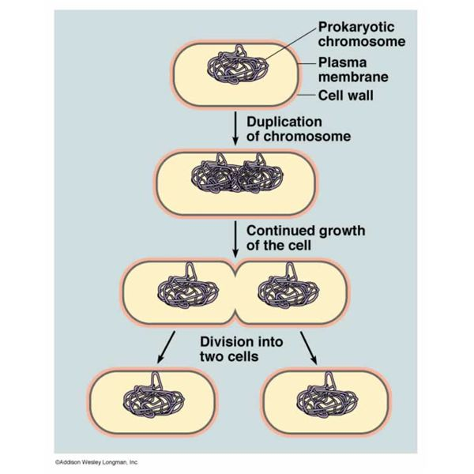
Bacterial Cell Division
1. Bacteria reproduce asexually via binary fusion
Replication of bacterial chromosome triggers initiation of cell division
Cell wall extends, septum is formed
Septum grows and cleaves the daughter cell. Incomplete cleavage of the septum can cause bacteria to remain linked forming chains – streptococcus or clusters – Staphylococcus

Slide 57
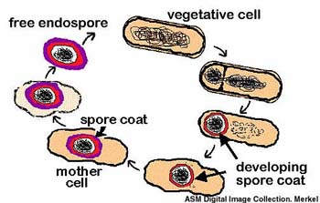
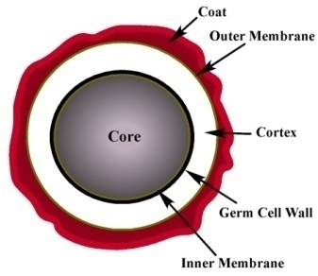
Bacterial cell division cont…’
2. spore formation
Some gram +ve bacteria species form spores e.g Bacillus sp. and Clostridia Sp. Especially in harsh environment such as lack of nutrients
Gram –ve bacteria do not form spores
The spore has a copy of the chromosome, ribosomes and essential proteins, outer membrane, 2 peptidoglycan layers and an outer keratin like protein layer.
The spore protects bacterial DNA from desiccation, intense heat, radiation and attack by enzymes and chemicals
Are so resistant that they can remain viable for centuries
They are difficult to decontaminate with standard disinfectants.
.

Slide 58
Bacterial metabolism
In general, bacteria require a source of carbon, nitrogen, an energy source, water and various ions for growth. Pathogenic bacteria derive energy from metabolizing sugars, fats and proteins.
Not all bacteria require oxygen for growth:
Obligate anaerobes – cannot grow in the presence of oxygen e.g clostridium perfringes
Obligate aerobes – require oxygen for growth e.g Mycobacterium tuberculosis
Facultative anaerobes – grow in either the presence or absence of oxygen

Slide 59
Bacterial growth
For bacterial growth to occur, there must be sufficient metabolites to support synthesis of bacterial components.
When bacteria are added to a medium, they require time to adapt to the new environment before they start dividing. This is the lag phase
They then grow and divide during the log or exponential phase
Eventually the culture runs out of metabolites and toxins build up . the bacteria stop growing and enter the stationary phase.

Slide 60
List of common bacteria
GRAM –ve | GRAM +ve
Borellia – spirochete | Streptomyces
Bordetella – Rod | Streptococcus – cocci in chains
Campylobacter – curved rod | Staphylococcus – cocci in clusters
Treponema – spirochete | Nocardia
Vibrio – rod | Listeria – rods
Yersinia – rod | Lactobacillus
Chlamydia | Gardnerella – rods
Enterobacter | Enterococcus
Escherichia – Rods | Corynebacterium
Helicobacter – curved Rods | Clostridium- spore forming
Hemophillus – Rods | Bacillus – rods, some spore forming
Klebsiella – rods | Actinomyces
Legionella – rods
Leptospira – spirochete | EXCEPTIONS
Nesseria – diplococcus | Mycoplasma – No cell wall
Pseudomonas - rod | Mycobacteria – Acid fast bacilli
Ricketssia
Salmonella – rod
Shigella – rod

Slide 61
FUNGI
Study of fungi is referred to as mycology
Fungi cause diseases in humans
They also contribute to food spoilage, are a major cause of plant disease and destroy timber, textiles and several synthetic materials
They play a role in the decay of plant and animal remains in the soil
Fungi are also beneficial to humans in that they are used in production of antibiotics, steroids, products of fermentation – alcohol, cheese, wine, bread making
They occupy many niches in the environment

Slide 62
They are free living and abundant in nature, only few exist as normal flora in humans
Fewer of them are associated with human disease
Fungi do not need to colonize or infect tissues of animals or man to perpetuate or preserve the species ( with the exception of candidiasis and tinea versicolor)

Slide 63
Structure
Have a typical eukaryotic cell
They have a cell wall made of chitin
Some fungi have a polysaccharide capsule around the cell wall to isolate it from the environment. This helps in virulence if the fungi are pathogenic
Most fungi respire aerobically, others are strict anaerobes and others are facultative anaerobes
They have special staining to identify them
fungi are heterotrophic ( “other feeding,” must feed on preformed
organic material), not autotrophic ( “self feeding,” make their own food by photosynthesis).

Slide 64
- Unlike animals (also heterotrophic), which ingest then digest, fungi digest then ingest they produce exoenzymes to accomplish this
Most fungi store their food as glycogen (like animals). Plants store food as starch.
Fungal cell membranes have a unique sterol, ergosterol, which replaces cholesterol found in mammalian cell membranes

Slide 65
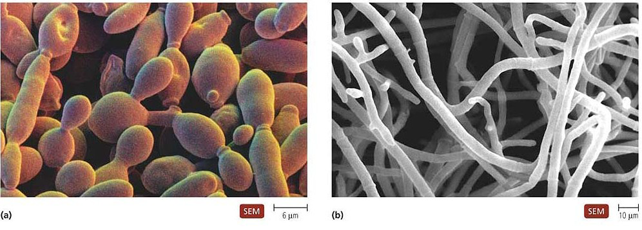
Structure cont’
The body of fungi is termed thallus (nonr-eproductive)
The thalli of yeast are small, globular and are single celled
The thalli of mold are composed of long, branched tubular filaments called hyphae.

Slide 66
Classification of fungi
Fungi can be divided into 2 basic morphological forms:
Yeast – unicellular, reproduce asexually by budding or fission
Molds (Hyphae) – branching, thread like, tubular filaments.they elongate at their tips by a process called apical extension. A mass of hyphae forms a mycelium ( commonly known as mold)
The morphology of fungi is not fixed. Some can exist in hyphae or yeast form (dimorphic) depending on the environment (i.e in soil, decaying tissue or in host tissue)
Most pathogenic fungi are dimorphic fungi
At 37o C yeast-like
At 25o C mold-like
Can also occur with changes in CO2

Slide 67
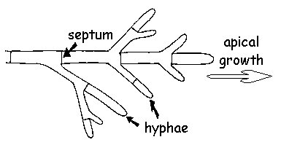
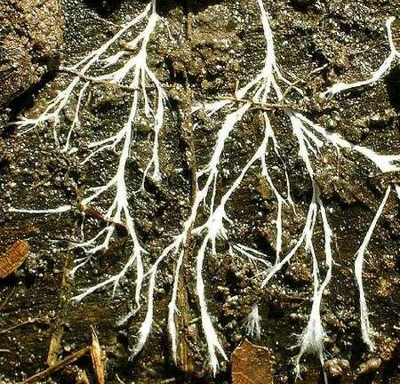
Hyphae

Slide 68
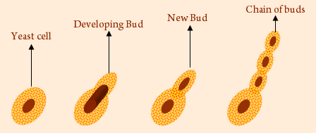
Most reproduce by budding

Slide 69
Examples
Candida albicans – part of the normal flora of mouth, GIT and vaginal wall
Malassezia furfur – causes skin infection
HIstoplasma capsulatum
Blastomyces dermatitidis
Coccidiodes immitis
Trichophyton and Microsporum sp. – cause ring worm
Cryptococcus neoformans – cryptococcal meningitis in ISS

Slide 70
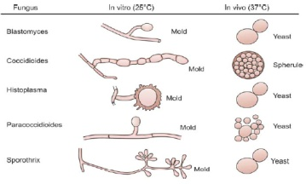

Slide 71
Human pathogenic fungi
The majority of most human pathogenic fungi appear to be soil inhabiting species where they live as saprobes, but given the appropriate conditions, i.e. if the person is not healthy, an open wound is present, direct injection of fungus into your system, a particular life-style, AIDS, etc., they will aggressively attack people

Slide 72
1.Superficial infections/ cutaneous
Are caused by fungi that attack the skin or its appendages (nail, feathers and hair). Some examples of these infections include; Ringworms, Jock-itch and Athlete's foot.
These fungi are known as dermatophytes
Ringworm and Related Dermatophytes
Ringworm usually occurs on the exposed parts of the body, forming circular growths that may appear darker or lighter than the normal skin color, with symptoms that include skin lesion, rash and itching of the infected area

Slide 73
Caused by Trichophyton and Microsporum sp
They include;
Tinea capitis: Ringworm of the scalp, eyebrow and Eye lashes.
Tinea corporis: Ringworm of the body.
Tinea cruris: Ringworm of the groin, perineum and perianal region. Infections by these type of ring worm are commonly referred to as "jock itch".
Tinea unguium: Ringworm of the nail.
Tinea barbae: Ringworm of the beard.
Tinea pedis: Ringworm of the feet. Infections are commonly referred to as Athlete's foot.
Tinea manuum: Ringworm of the hand.

Slide 74
2.Systemic or Deep-Seated Mycoses
a.Coccidioides immitis, the cause of Coccidioidomycosis (Valley Fever)
Coccidioides immitis is contracted by inhalation of spores and primarily causes a respiratory disease in animals and people, but from the lungs it may spread throughout the body by way of the bloodstream
b.Histoplasma capsulatum and Histoplasmosis
Histoplasmosis occurs in people and dogs, rarely has it occurred in other domestic or wild animals. Infection occurs through inhalation of spores from this fungus.

Slide 75
c.Blastomyces and Blastomycosis
There are two species of this genus, Blastomyces dermatitidis and B. brasiliensis Infection apparently comes from spores or mycelium in the soil and any part of the body may be invaded. Infections usually are first detected as skin lesions; the lesions may remain localized or may gradually enlarge. In some case the fungus can spread throughout the whole body, resulting in extensive ulceration.

Slide 76
3.Intermediate Infections (subcutaneous)
These are diseases that are intermediate between the first two categories. These fungal infections may extend to a considerable depth within the tissue, but unlike the systemic diseases will not be distributed to the rest of the body. One of the most common intermediate infection is Candida albicans.
Candida albicans and Candidiasis
Candida albicans is a dimorphic fungus. That is, it grows as both mycelium and yeasts..
This fungus normally occurs in the mouth, digestive tract, and vagina of perfectly healthy people, but under some circumstances, and for reasons unknown, it may cause severe and even fatal infections, with lesions and eruptions of the skin, nails, mouth, bronchial tubes and lungs. Oral infections known as thrush is relatively common..

Slide 77
Aspergillus fumigatus and Aspergillosis
Aspergillus fumigatus sometimes parasitizes animals, especially birds, infecting mainly lungs and causing heavy mortality in birds.
In people, the disease can lead to a chronic lung infection which is apparently very contagious. The fungus is thought to cause death, but that is not certain. In patients that have died and A. fumigatus has been isolated, many have also had underlying disease that possibly lowered their resistance to the fungus.

Slide 78
PARASITES
Classification and structure
They belong to the animal kingdom.
They are divided into two sub-kingdoms:
1.Protozoa –Are animals which all life functions occur in a single cell.
2.Metazoa – multicellular animals which have organized tissues and organs.

Slide 79
Protozoa
Are Simple microorganisms – They eukaryotic.
They have organs for motility – pseudopodia, flagella or cilia
They reproduce by simple binary fusion but some have periods of sexual reproduction.
To ensure survival under harsh environments, some parasitic protozoans, develop into a cyst form that is less metabolically active.
The cyst has a thick external cell wall for protecting the organism. The cyst form is an integral part in the lifecycle of the protozoa and facilitates its transmission from host to host in the external environment.

Slide 80
Parasites that cannot form cysts must rely on direct transmission from host to host or require a vector to complete its cycle.
Examples of genuses include; - Amebae, flagellates, sporozoa , coccidia, microsporidia, plasmodium
Plasmodium falciparum
Giardia lamblia
Enamoeba histolytica
Trichomonas vaginalis
Trypanosoma sp

Slide 81
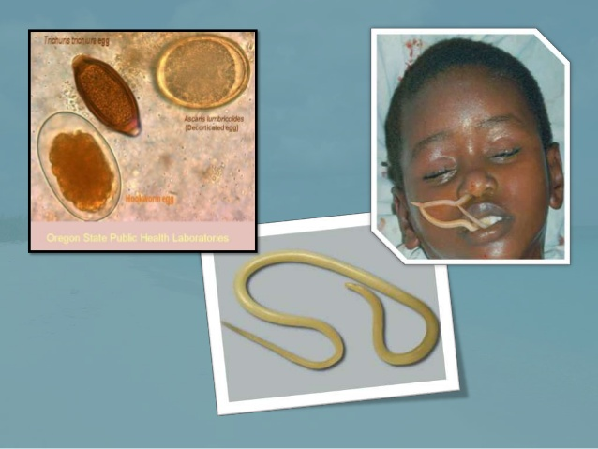

Slide 82
Metazoa
All parasites that are not protozoans. They have bodies composed of cells differentiated into tissues and organs and usually a digestive cavity lined with specialized cells .
They are divided into groups :
Helminths – worms
Arthropods - insects, ticks

Slide 83
Helminthes (Worms)
Are multicellular organisms
Their external surface is covered by a cuticle which is protective
They have attachment structures such as hook, suckers, teeth or plates
Can be separate sexes (roundworms) or hermaphroditic (tapeworms)
Some have complete digestive systems (roundworms) or incomplete digestive systems (flukes) while others lack a digestive system (tapeworm)

Slide 84
Can be intestinal parasites, some affect blood and others tissue.
Nutritional requirements are met by ingesting host tissue and fluids resulting in tissue damage or by absorbing nutrients from surrounding fluids and intestinal contents
They require energy for movement and reproduction – are very prolific and lay eggs that must undergo several developmental stages.
E.g roundworms, flukes, tapeworms

Slide 85
Arthropods
Multicellular organisms
Can be involved directly in causing a disease (infestation) or indirectly as an intermediate host and vector of an infectious agent.
Examples – mites, ticks, jiggers, mosquitoes, fleas, lice, bugs
Conclusion
There is higher risk of parasitic diseases in immunosuppressed persons
Modes of transmission are discussed in tropical diseases

Slide 86
Human Pathogenic Bacteria | Pathogenic Disease | Human Pathogenic Bacteria | Pathogenic Disease
Bacillus anthracis | • Cutaneous anthrax • Pulmonary anthrax • Gastrointestinal anthrax | Leptospira interrogans | Leptospirosis
Bordetella pertussis | • Whooping cough • Secondary bacterial pneumonia (Complication) | Listeria monocytogenes | Listeriosis
• Brucella abortus • Brucella canis • Brucella melitensis • Brucella suis | Brucellosis | Mycobacterium leprae | Leprosy (Hansens disease)
Borrelia burgdorferi | Lyme disease | Mycoplasma pneumoniae | Mycoplasma pneumonia
Campylobacter jejuni | Acute enteritis | Neisseria gonorrhoeae | • Gonorrhea • Ophthalmia neonatorum • Septic arthritis

Slide 87
Campylobacter jejuni | Acute enteritis | Neisseria meningitidis | • Meningococcal disease including meningitis • Waterhouse-Friderichsen syndrome
Chlamydia pneumoniae | Community-acquired respiratory infection | Pseudomonas aeruginosa | • Localized infection of eye, ear, skin, urinary, respiratory • Gastrointestinal tract infection • Central Nervous System infection • Systemic infection with bacteremia • Secondary pneumonia • Bone and joint infections • Endocarditis
Chlamydia psittaci | Psittacosis | Rickettsia rickettsii | Rocky mountain spotted fever
Chlamydia trachomatis | • Nongonococcal urethritis (NGU) • Trachoma • Inclusion conjunctivitis of the newborn (ICN) • Lymphogranuloma venereum (LGV) | Salmonella typhi | • Typhoid fever type salmonellosis • Dysentery • Colitis
Clostridium botulinum | Botulism | Shigella sonnei | Bacillary dysentery/Shigellosis

Slide 88
Clostridium difficile | Pseudomembranous colitis
Clostridium perfringens | • Gas gangrene • Acute food poisoning • Anaerobic cellulitis | Leptospira interrogans | Leptospirosis
Clostridium tetani | Tetanus | Listeria monocytogenes | Listeriosis
Corynebacterium diphtheria | Diphtheria • | Mycobacterium leprae | Leprosy (Hansens disease)
Enterococcus faecalis Enterococcus faecium | Nosocomial infections | Mycoplasma pneumoniae | Mycoplasma pneumonia
Escherichia coli | • Urinary tract infections (UTI) • Diarrhea • Meningitis in infants | Neisseria gonorrhoeae | • Gonorrhea • Ophthalmia neonatorum • Septic arthritis
Enterotoxigenic Escherichia coli (ETEC) | Traveler's diarrhea | Neisseria meningitidis | • Meningococcal disease including meningitis • Waterhouse-Friderichsen syndrome

Slide 89
Streptococcus pyogenes | • Streptococcal pharyngitis • Scarlet fever • Rheumatic fever • Impetigo and erysipelas • Puerperal fever • Necrotizing fasciitis | Neisseria meningitidis | • Meningococcal disease including meningitis • Waterhouse-Friderichsen syndrome
Treponema pallidum | • Syphilis • Congenital syphilis | Pseudomonas aeruginosa | • Localized infection of eye, ear, skin, urinary, respiratory • Gastrointestinal tract infection • Central Nervous System infection • Systemic infection with bacteremia • Secondary pneumonia • Bone and joint infections • Endocarditis
Vibrio cholerae | Cholera | Rickettsia rickettsii | Rocky mountain spotted fever
Yersinia pestis | • Plague • Bubonic plague Pneumonic plague | Salmonella typhi | • Typhoid fever type salmonellosis • Dysentery • Colitis
 |  | Shigella sonnei | Bacillary dysentery/Shigellosis
 |  | Leptospira interrogans | Leptospirosis

Slide 90
Staphylococcus aureusa | Coagulase-positive staphylococcal infections: • Localized skin infections • Diffuse skin infection (Impetigo) • Deep, localized infections • Acute infective endocarditis • Septicemia • Necrotizing pneumonia • Toxinoses • Toxic shock syndrome • Staphylococcal food poisoning | Leptospira interrogans | Leptospirosis
Staphylococcus epidermidis | Infections of implanted prostheses e.g. heart valves and catheters | Listeria monocytogenes | Listeriosis
Staphylococcus saprophyticus | Cystitis in women | Mycobacterium leprae | Leprosy (Hansens disease)
Streptococcus agalactiae | • Meningitis and septicemia in neonates • Endometritis in postpartum women • Opportunistic infections with septicemia and pneumonia | Mycoplasma pneumoniae | Mycoplasma pneumonia
Streptococcus pneumoniae | Acute bacterial pneumonia & meningitis in adults • Otitis media and sinusitis in children | Neisseria gonorrhoeae | • Gonorrhea • Ophthalmia neonatorum • Septic arthritis

Slide 91
Enteropathogenic E. coli | Diarrhea in infants | Pseudomonas aeruginosa | • Localized infection of eye, ear, skin, urinary, respiratory • Gastrointestinal tract infection • Central Nervous System infection • Systemic infection with bacteremia • Secondary pneumonia • Bone and joint infections • Endocarditis
Francisella tularensis | Tularemia | Rickettsia rickettsii | Rocky mountain spotted fever
Haemophilus influenzae | • Bacterial meningitis • Upper respiratory tract infections • Pneumonia • Bronchitis | Salmonella typhi | • Typhoid fever type salmonellosis • Dysentery • Colitis
Helicobacter pylori | • Peptic ulcer • Risk factor for gastric carcinoma • Gastric B-cell lymphoma | Shigella sonnei | Bacillary dysentery/Shigellosis
Legionella pneumophila | • Legionnaire's Disease • Pontiac fever

Slide 92
VIRUSES
Viruses are the smallest microorganism – smaller than bacteria.
The smallest viruses are about 0.02 μm (20 nanometers), while the large viruses measure about 0.3 μm (300 nanometers). Smallpox viruses are among the largest viruses; polio viruses are among the smallest.
Viruses are non-cellular genetic elements that use a living cell for their replication and have an extracellular state.
Viruses are ultramicroscopic particles containing nucleic acid surrounded by protein, and in some cases, other components such as a membrane like envelope.

Slide 93
Viruses are obligate intracellular parasites – depend on the host cell for replication. Viruses cannot make energy, proteins or replicate their genome outside the host cell.
The virus therefore must adapt to the biochemical nature of the host cell to use its systems. They therefore must be infectious to survive.
Outside the host cell, the virus particle is also known as a virion. The virion is metabolically inert and does not grow or carry on respiratory or biosynthetic functions.

Slide 94
CLASSIFICATION OF VIRUSES
Viruses can be classified according to :
Structure – size, morphology
Genome – mode of replication – DNA or RNA
Disease they cause
Means of transmission e.g air, waterborne
Host cell – plant animals and bacteria
For our level, viruses will be classified according to their genetic material or means of replication.

Slide 95
DNA viruses |  | RNAViruses
Family | Members | Family | Members
Poxviridae | Smallpox, Herpes simplex, Varicella zoster virus Cytomegalovirus | paramyxoviridae | measles virus mumps virus
Adenoviridae | Adenovirus | Orthomyxoviridae | Influenza virus
Hepadnaviridea | Hepatitis B virus | Rhabdoviridae | Rabies virus
Papoviridae | Human papilloma virus | Filoviridae | Ebola virus Marbug virus
 |  | Retroviridae | Human immunodeficiency virus (HIV) Human T cell leukemia virus
 |  | Reoviridae | Rotavirus
 |  | Picornaviridae | Polio virus Rhinoviruses
 |  | Togaviridae | Rubella virus

Slide 96
Viral Structure and Replication
Certain viruses contain ribonucleic acid (RNA), while other viruses have deoxyribonucleic acid (DNA). The nucleic acid portion of the viruses is known as the genome.
The nucleic acid may be single-stranded or double-stranded; it may be linear or a closed loop; it may be continuous or occur in segments.
The genome of the virus is surrounded by a protein coat known as a capsid, which is formed from a number of individual protein molecules called capsomeres. Capsomeres are arranged in a precise and highly repetitive pattern around the nucleic acid. The combination of genome and capsid is called the viral nucleocapsid. A number of kinds of viruses contain envelopes. An envelope is a membrane like structure that encloses the nucleocapsid and is obtained from a host cell during the replication process. The envelope contains viral-specified proteins that make it unique. Among the envelope viruses are those of herpes simplex, chickenpox, and infectious mononucleosis

Slide 97
.
Viral Structure

Slide 98
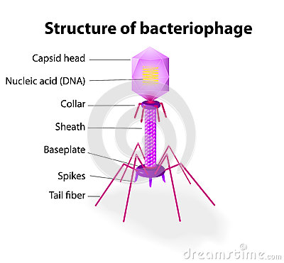
Nucleocapsids may have different shapes
Bacteriophages are viruses that multiply within bacteria. Have DNA
An array of viruses. (a) The helical virus of rabies. (b) The segmented helical virus of influenza. (c) A bacteriophage with an icosahedral head and helical tail. (d) An enveloped icosahedral herpes simplex virus. (e) The unenveloped polio virus. (f) The icosahedral human immunodeficiency virus with spikes on its envelope

Slide 99
Viral replication
Attachment. , the virus adsorbs to a susceptible host cell using spikes. Cell surface receptors may exist on bacterial pili or flagella or on the host cell membrane.
Penetration of the virus or the viral genome into the cell. May occur by phagocytosis; or the envelope of the virus may blend with the cell membrane

Slide 100
Replication
The protein capsid is stripped away from the genome, and the genome is freed in the cell cytoplasm where it either act as a messenger RNA (in RNA viruses)or synthesize messenger RNA from DNA (in DNA viruses)that provides codes for synthesis of enzymes
for the synthesis of enzymes and viral components.

Slide 101
If the genome consists of RNA, the genome acts as a messenger RNA molecule and provides the genetic codes for the synthesis of enzymes.
The enzymes are used for the synthesis of viral genomes and capsomeres and the assembly of these components into new viruses.
If the viral genome consists of DNA, it provides the genetic code for the synthesis of messenger RNA molecules, and the process proceeds.
In HIV infection the RNA of the virus serves as a template for the synthesis of a DNA molecule (reverse transcription). The enzyme reverse transcriptase catalyzes the DNA's production. The DNA molecule then remains as part of the host cell's chromosome for an unspecified period. From this location, it encodes messenger RNA molecules

Slide 102
Viral replication cont’
lytic cycle
Viral protein synthesis – carried out on host cell ribosomes
Assembly - viral parts come together and enclose viral genome in a functional package
Release of new viral particles;
The host cell may be “biochemically exhausted,” and it may disintegrate, thereby releasing the virions.
For enveloped viruses, the nucleocapsids move toward the membrane of the host cell, where they force themselves through that membrane in a process called budding. During budding, a portion of cell membrane pinches off and surrounds the nucleocapsid as an envelope.
NB; The replication process in which the host cell experiences death is called the lytic cycle of reproduction.
The viruses so produced are free to infect and replicate in other host cells in the area.

Slide 103
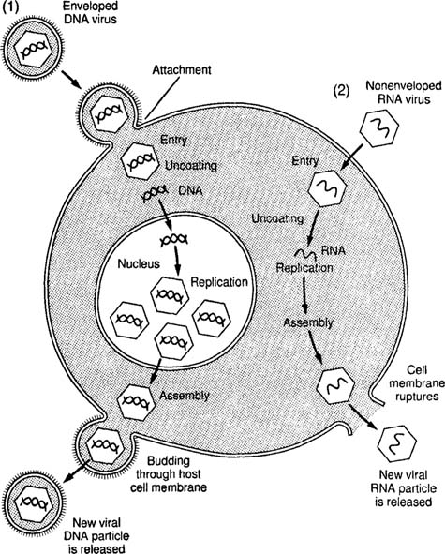
Replication cont’
.

Slide 104
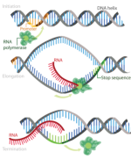

Slide 105
Lysogeny
Not all viruses multiply by the lytic cycle of reproduction.
Certain viruses remain active within their host cells for a long period without replicating. This cycle is called the lysogenic cycle.
The viruses are called temperate viruses, or proviruses, because they do not bring death to the host cell immediately.
The temperate virus exists in a latent form within the host cell and is usually integrated into the chromosome.
An example of lysogeny occurs in HIV infection. In this case, the human immunodeficiency virus remains latent within the host T-lymphocyte. An individual whose infection is at this stage will not experience the symptoms of AIDS until a later date

Slide 106
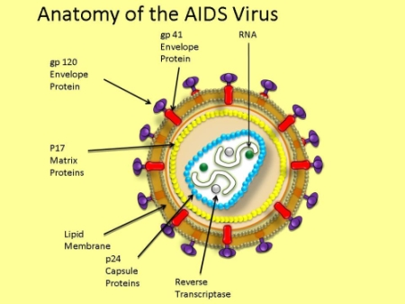

Slide 107
Methods of identifying microorganisms
Microscopy by use of a microscope
1. Direct examination or staining
2. Culture of microorganisms on culture media
A growth medium or culture medium is a liquid or gel designed to support the growth of microorganisms or cells
Most common growth media for microorganisms are nutrient broths and agar plates.others include selective, enriched and differential media

Slide 108
Biochemical tests used to identify bacteria in Microbiology laboratory
Beta-glucuronidase test (MUG Test) : To identify Escherichia coli. Escherichia coli produces the enzyme beta-D-glucuronidase
Bile solubility test : To differentiate Streptococcus pneumoniae from other alpha hemolytic streptococci. Bile or a solution of a bile salt rapidly lyses pneumococcal colonies.
Catalase test: To differentiate Staphylococci (catalse positive) from Streptococci (catalase test negative)
Citrate utilization test: To differentiate members of Enterobacteriaceae family.
Coagulase test: To identify Staphylococcus aureus. Coagulase test differentiates Staphylococcus aureus (positive) from coagulase negative staphylococci (CONS), such as S. epidermidis, S. saprophyticus.

Slide 109
DNase test: This test is used to determine the ability of an organism to hydrolyze DNA. It is primarily used to identify Staphylococcus aureus
Litmus milk discoloration test: To help identify Enterococcus and some Clostridia which have ability to metabolize litmus milk.
Lysine Decarboxylase test: To assist in the identification of salmonellae and shigellae
Oxidase test: To help identify Neisseria, Pasteurella, Vibrio, Pseudomonas. This test is used to determine the presence of bacterial cytochrome oxidase.
Urease test: Urease test is used to determine the ability of an organism to produce the enzyme urease which hydrolyzes urea. This test is done to help identify Proteus, Morganella, Yersinia enterocolitica, Helicobacter Pylori

Slide 110
Tests cont’
Serological Tests to identify antibodies in the serum. Antibodies are produced in response to an infection by a given microorganism
ELISA – Enzyme linked immunosorbent assay – a test that uses antibody and colour change to identify an antigen.
Agglutination; patient's serum with its antibodies is mixed with a lab prepared solution the killed disease organism and observed for clumping.
Precipitation,
Complement-fixation, and
Fluorescent antibodies

