Slide 1
CONTENT
MICROBIOLOGY

Slide 2
CONTENT
Competence:
To enable students manage patients suffering from manage patients suffering from micro-organisms, parasites and immune suppression.

Slide 3
Objectives
Identify various classes of micro-organisms
Appreciate the significance of microbiology
Explain the immunological process
Units
Microorganisms, parasites and vectors
Immunological process

Slide 4
Content
Micro-organisms: classes, characteristics/structure, infection process, bacteria, viruses
Parasites infection: fungi (yeast), Rickettisia and clamydiae, helminthes, algae, slime, mould: amoeba, Parasitology-source of parasites: modes of transmission. Classifications, life cycle and their clinical importance, includes- intestinal worms, include nematodes: trematodes:

Slide 5
content
3. Immunological process: immunology- body defence mechanisms, humoral immunity, antibodies, complement systems, cell mediated immunity, hypersensitivity, anaphylactic shock, delayed hypersensitivity, immunological tolerance, auto immune disease.

Slide 6
Teaching and learning methods
Group discussion
Lecture
Assignments
Self directed learning
Demonstrations
Video show

Slide 7
resources
Flip charts
Flip chart stand
Procedure manuals
Models
Text books
Computers
Manuals
DVD player
DVD

Slide 8
objectives
The students will be able to acquire knowledge, skills, and attitude to be able to promote health, prevent illness, diagnose and manage patients/clients suffering from microbial infections, parasites, and immunosuppression.

Slide 9
Specific objectives
The student will be able to explain historical development of microbes and its relevance in nursing.
The student will be able to identify various classes of microorganisms and parasites
The student will be able to explain immunological process

Slide 10
Content
Introduction to microbiology
Historical background of microbiology
relevance of microbiology to nursing
Micro-organisms:
Sources of microbes
Properties of microbes
Infection process
Mode of transmission of infections

Slide 11
Micro-orgnisms
Structure
Morphology <shape>
Classification of micro-organisms
Bacteria
Viruses
Fungi <yeast>
Rickettsia and clamydiae
Protozoa
Helminthes

Slide 12
Immunology
Body defence mechanisms
Humoral immunity
Antibodies
Complement systems
Cell mediated immunity
Hypersensitivity

Slide 13
Immunology
Anaphylaxis
Delayed hypersensitivity
Immunological tolerance
Auto-immune diseases

Slide 14
Microbiology
Microbiology is derived from a greed word
Micro= small, tiny, minute
Bio= life
Ology= study
Micro-biology is the study of micro-organisms which very small and cannot be seen by naked eye.

Slide 15
Definition of terms
Pathogens/the infectious or causative agent: Microbes that are capable of causing disease (ie., pathogenic) are called
Infectious disease process: The interaction between the pathogen microorganism, the environment and the host

Slide 16
Definition of terms
An infection: when pathogen invades the body and the conditions are favorable for it to multiply and cause injurious effects or disease, the resulting condition is called an infection

Slide 17
Definition of terms
Infectivity:
Multiplication of an infectious agent within the body.
Pathogenicity:
The ability of an infectious agent to cause disease.
Virulence:
The quantitative ability of an agent to cause disease.
Virulence involves invasiveness and toxigenicity.

Slide 18
Definition of terms
Toxigenicity:
The ability of a microorganism to produce a toxin that contributes to the development of disease
Invasion:
The process which bacteria, parasites, fungi and viruses enter the host cells or tissues and spread in the body.

Slide 19
Definition of terms
Many factors determine the virulence of bacteria, or their ability to cause infection and disease.
Toxins: Endotoxin, Exotoxins
Enzymes
Antiphagocytic factors
Adherence factors

Slide 20
Definition of terms
Toxins produced by bacteria are generally classified into two groups:
Endotoxins:derived from bacterial cell walls and are often eliberated when the bacteria lyse.
Endotoxemia: is the the presence of endotoxins in the blood.

Slide 21
Definition of terms
Exotoxins: are biological poisons secreted by microorganisms
Can cause damage to the host by destroying cells or disrupting normal cellular metabolism

Slide 22
Definition of terms
Vaccine: an antigenic substance prepared from the causative agent of a disease or a synthetic substitute, used to provide immunity against one or several diseases
Incubation period – the time between exposure to a pathogenic organism and when first symptoms apparent
Opportunistic- a pathogen
becomes a pathogenic when host is compromised

Slide 23
Branches of micro-biology
It is divided into branches according to the types of micro-organisms
Parasitology; the study of parasites
Mycology ; study of fungi/yeast
Bacteriology; bacteria
Virology; viruses
Protozoology; protozoa

Slide 24
Historical development of micro-biology
In ancient times, men associated illnesses with sorts of will and hypothetical factors e.g. Gods wrath, ancestral spirits, demons, witchcrafts, bad weather e.t.c

Slide 25
Evolution of micro-biology
Antony Leeuwenhoek (1632-1723); discovered bacteria using primitive microscope.
He help described many microorganisms

Slide 26
Evolution of micro-biology
Robert hook (1822-1895)
He developed compound microscope in 1672 and confirmed Leeuwenhoek observation.

Slide 27
Evolution of micro-biology
Louis Pasteur (1822-1895)
Was a French chemist who contributed much to medical knowledge.
He disapproved that life arose from decomposing non-living material but proved that it arose from pre-existing life (biogenesis)

Slide 28
Evolution of micro-biology
Louis Pasteur
She demonstrated that boiling of substances (fluids) rendered them sterile.
He added that such sterilized fluids can be contaminated by particles form air.

Slide 29
Evolution of micro-biology
Louis Pasteur
He discovered that fermentation involved in the production of beer and wine is the results yeast.
He showed that it is possible to weaken (attenuate) pathogenic micro-organisms or microbes and use then for immunization.

Slide 30
Evolution of micro-biology
Louis Pasteur
He introduced 4 vaccines (for; small pox, cholera, anthrax, and rabies)
He also discovered many pathogenic micro-organisms and invented means of culturing them in the lab.

Slide 31
Evolution of micro-biology
Joseph Lister (1827-1912)
He was a surgeon.
As a surgeon, he observed that wound suppuration mortality rate following surgery was alarming.
He concluded that if micro-organisms caused fermentation, they wound also cause suppuration of wounds.

Slide 32
Evolution of micro-biology
Joseph Lister
He introduced aseptic technique and recommended:
Washing of wounds with disinfectants
Spraying operating theatre environment with disinfectants
Application of protective dressing on the wounds to prevent entry of micro-organisms
There was marked reduction of death among operated patients.

Slide 33
Evolution of micro-biology
Robert Koch 1843-1910
He was a German physician who had a lot of interest in the study of bacteria.
In 1870, he cultured Bacillus anthraxis
He showed that anthrax is caused by a bacteria found in animals

Slide 34
HISTORY OF MICROBIOLOGY cted
OTHERS
Hansen (1874) described leprosy bacillus
Neisser (1879) ,, gonococcus
Ogoston (1881) discovered staphylococcus
Loeffler (1884) isolated diphtheria bacillus
Nicolaire (1884) observed tetanus bacillus in the soil
Fraenuel (1886) described pneumococcus

Slide 35
HISTORY OF MICROBIOLOGY cted
Schaudin & Hoffman discovered spirocheate of syphilis.
Roux & Yersin (1888) described mechanism of pathogenesis when they discovered diphtheria toxin
Loeffler & Frosch (1898) observed that foot & mouth disease of cattle was caused by a microbe ie filter passing virus

Slide 36
HISTORY OF MICROBIOLOGY cted
Walter Reed (1902) observed yellow fever was caused by a filtrate virus which was transmitted thru’ mosquito bites
Towert (1951) & Herelle (1917) discovered Red Lytic phenomenon in bacterial culture which the agent responsible was termed as bacteriophage (viruses that attack bacteria)

Slide 37
HISTORY OF MICROBIOLOGY cted
Landsteiner & Popper (1909) showed poliomyelitis was caused by filterable virus
Fleming (1925) made an accidental discovery that the fungus Penicillin produces a substance which destroys staphylococci
Ruska (1934) introduced electron microscope & hence detailed study morphology of virus

Slide 38
SOURCES AND SPREAD OF INFECTION
Sources of infection
Environmental sources | Person- to-person | Medical or surgical procedures | Self-infection
Inanimate objects Water, food, soil, etc. Animals (bites and scratches; zoonoses) Arthropod vectors | Airborne infection Direct contact (touching, kissing, etc.) Maternal transmission (intrauterine, transplacental) Sexual transmission | Instrumentation, operations Transfusion (blood and blood products) Transplants (tissues, organs) | Endogenous sources (normal flora) Shared needles Needlestick injuries
 | Infected person or healthy carriers

Slide 39
Inanimate objects (fomites) may act as passive vehicles
In the late 19th century it was discovered that blood-sucking arthropods spread certain diseases.
For example in 1898 it was shown that malaria was transmitted by Anopheles mosquitoes, yellow fever by mosquitoes (1900).

Slide 40
Relevance of microbiology to nursing
Nurse becomes familiar with the source of potentially dangerous microorganisms e.g. animal transmit anthrax, insects like mosquito transmit malaria, drinking contaminated water causes diarrhea.
Nurse is able to describe the effect of pathogenic and non pathogenic microorganisms in the human body.

Slide 41
Relevance of microbiology to nursing
Nurse is able to apply the knowledge in management of disease conditions
She gets to understand the various roots of entry and port of exit
With this knowledge he/she is able to arrest spread of infection b4 they occur.
He/she is able to participate in epidemiological research that enhances future discoveries and management of disease condition.

Slide 42
Classification of microorganisms
Pathogens or microbes are organisms that cause disease.
micro-organisms can be divided into various types depending on their: shape; characteristics; and structure.

Slide 43
Classification of micro-organisms
Bacteria
Viruses
Fungi <yeast>
Rickettsia and
clamydiae
Protozoa
Helminthes

Slide 44
Classification of microorganisms
Micro-organisms can either be pathogenic or non pathogenic
Can be further classified into 2
Unicellular- single cell, prokaryotes. fungi, bacteria,
Multicellular (eukaryotes)

Slide 45
Differences between Prokaryotes and eukaryotes
Prokaryotes: bacteria
eukaryotes
Less complex
Circular chromosomes
Lack nuclear membrane
Lack membrane bound organelles (mitochondrial, lysosomes
Divides through binary fission
More complex
True nuclears with nuclear membrane
Membrane bound organelles
Contain multiple chromosomes and mitotic apparatus
E.gs of eukaryotic cells: plant; animal; protozoa, human; fungi; algae
Divides by mitosis

Slide 46
Typical eukaryotic cell diagram

Slide 47
Typical prokaryotic cell diagram

Slide 48
Replication of microorganisms
Viruses disassemble, reproduce many copies of their nucleic acid and then reassemble into many progeny viruses.
Viruses must replicate within host cells because they lack protein synthesizing machinery and energy generating systems.

Slide 49
Nomenclature
According to binomial Linear system that classifies and names animals and plants according to their natural relationship using both genus (generic) and the species name.
The 1st name is generic and 1st letter written in caps
2rd name is the species and is written in small letters e.g. Salmonella typhi, Mycobacterium tubercle, Candida albicans, Escherichia coli.

Slide 50
Reason for classifying micro-organisms
For purpose of grouping (how they are alike and how they are different.
For identification and determination of pathogens
To make treatment possible

Slide 51
bacteria
Structure and characteristics:
Are unicellular/some are Multicellular
Their cytoplasm contain both DNA and RNA
They produce by binary fission
Have no defined nucleus
Shape: can be divided into various classes depending on their shapes, size, and characteristics.

Slide 52
Bacteria
They survive in two forms;
Free living- capable of growing on lab media in absence of human or other animal
Obligate intracellular- survive only within human or other animal cells
NB: ASSIGNMENT- DRAW A DIAGRAM OF BACTERIA AND DESCRIBE VAROUS ORGANELLES

Slide 53
BACTERIA ENDOSPORES

Slide 54
BACTERIA SPORES
Resistant dormant state of the bacteria when under conditions of limited supply of nutrition vegetative forms
Eg. Bacillus, clostridium, rickettsial agent
Not destroyed by ordinary methods of boiling but autoclaving under very high temperatures of 121º C for 20 min
This is due to impermeability of the spores, cortex & coat, low H₂0 content, low metabolic & enzymatic activities

Slide 55
FUNCTIONS OF SPORES
Facilitate survival of certain organisms under unfavourable conditions
Resistant to heating, drying, freezing & toxic chemicals
For laboratory applications whereby spores are used as sterilization control

Slide 56
GERMINATION OF SPORES
Germination is the process of converting a spore into a vegetative cell.
In a bacteria, it takes less than 2 hours & in 3 stages
Activation
Growth is spontaneous or may be through activators like heat, low PH etc

Slide 57
GERMINATION OF SPORES
2. Germination proper
This requires water & a trigerring germination agent like manganese or alanine
3. Outgrowth
Occurs following germination in a nutrient medium after which gradual resumption of life of bacteria begins

Slide 58
NUTRITIONAL REQUIREMENTS OF BACTERIA
For optimal growth, the bacteria require the following:-
GAS- 4 types
Obligate Anaerobes- only grow in absence of O₂ EG Clostridium
Falcultative Anaerobes- can grow in presence or absence of O₂

Slide 59
NUTRITIONAL REQUIREMENTS OF BACTERIA
C). Obligatory Aerobes- cannot grow in absence of O₂ eg Pseudomonas
d). Microphilic organisms- grow under conditions with low O₂ tension eg clostridium tetani
e). Some will require CO₂ for their growth eg Nisseria gonorrheae & Brucella Arbotus

Slide 60
NUTRITIONAL REQUIREMENTS OF BACTERIA
2). Temperature
3 types of bacteria
a). Psychrophilic – grow in temperature range of 5- 30⁰C but average of 10- 20⁰C
b). Mesophilic- grow in 20- 40⁰C bu a range of 10- 40⁰C
c). Thermophilic- require temp of 25- 80⁰C but grow well at 50- 60⁰C

Slide 61
NUTRITIONAL REQUIREMENTS OF BACTERIA
3). PH – most bacteria require a PH of 7.2- 7.6 for optimal growth
4). Moisture – water is required for growth
5. Ionic strength and osmotic pressure. 6. Light. Optimum condition for growth is darkness

Slide 62
BACTERIAL GROWTH CURVE
1. There is increase in size of bacteria without multiplication for some time – LAG PHASE
Has short duration with the following:-
Increase in size of cell
Increase in metabolic rate
Adaptation to new environment

Slide 63
BACTERIAL GROWTH CURVE
2. LOG PHASE
The cells start to divide
Numbers increase
High metabolic rate
Bacteria are more sensitive to antibiotics

Slide 64
3. STATIONARY PHASE
Rate of multiplication & death are almost equal
This is due to depletion 0f nutrients
Accumulation of toxic materials
Sporulation may occur

Slide 65
4. DECLINE PHASE
Cells die hence decrease of bacteria
This is due to:-
Nutritional
Accumulation of toxic materials
Autolysis of enzymes

Slide 66
5. SURVIVAL PHASE
Many organisms have died
A few survive for months or years

Slide 67
Bacterial Growth Curve

Slide 68
Bacteria cell

Slide 69
Microscopic structure of bacteria cell
Capsule: Is the outermost, slimy coating over the bacterial surface.
It provides protection against phagocytosis by host cells
It confers increased virulence of bacteria possessing them.
It helps in reliable means of diagnosis in bacterial infections

Slide 70
Microscopic structure of bacteria cell
Cell wall
It contributes to the ultimate shape of the organism
Helps in bacterial identification
Gives rigidity to the organism

Slide 71
Microscopic structure of bacteria cell
Flagella
Are long helical filaments extending from the cell surface
Aids in bacterial motility
Flagella are built of protein components (flagellum) which are strong antigenic. These antigens are important targets of protective antibody responses.

Slide 72
Microscopic structure of bacteria cell
Pilli
A very thin hair like external appendages of a cell protruding from the Capsule.
Aid in bacterial attachment.
Motility and DNA exchange.

Slide 73
Microscopic structure of bacteria cell
NUCLEA
It contains the genetic material of the cell.
It stores hereditary materials in the form of DNA strands.
Also stores ribonucleic acid RNA in the Nucleas.
It is responsible for protein synthesis, cell division and growth.

Slide 74
CLASSES OF BACTERIA ACCORDING TO SHAPES
COCCI-
spherical

Slide 75
Types of Cocci
Diplococci- double
Staphylococci- cluster
Streptococci – chain
Tetrad – in fours
Sarcina – in goups of eight

Slide 76
CLASSES OF BACTERIA ACCORDING TO SHAPES
2. Bacilli
Rod shaped or cylindrical

Slide 77
CLASSES OF BACTERIA ACCORDING TO SHAPES
3. Vibrio
Comma shaped or curved rods
4. Spirochaetes
Spiral or coiled
5. Actinomycetes
Branching filaments

Slide 78
CLASSES OF BACTERIA ACCORDING TO SHAPES
6. Mycoplasma
Round or oval bodies with interlacing filaments

Slide 80
A) COCCI
1). Diplococci –
a). Eg. pneumococcus
Gram –ve
Capsulated & flame shaped
Normally in human throat
Require medium with blood, serum or ascitic fluid to grow
Sensitive to sulphonamides

Slide 81
Diseases caused by Pneumococcus
Lobar pneumonia
Broncho pneumonia
Pneumococcal meningitis
Suppurative lesions like emphyma, pericarditis, otitis media, sinusitis, conjuctivitis & peritonitis

Slide 82
b). Neisseria
Gram negative aerobic
Aerobic
Non spore
Non motile
Oxidase positive
TYPES
N. Meningitidis- meningococci from nasopharynx
N. Gonorrhoeae- Gonorrhoea-

Slide 83
2). Streptococcus
Gram positive & arranged in chains
Non motile & non sporing
Cause pyogenic infections with tendency to spread
Cause non suppurative lesions eg Rheumatic fever & glomerulonephritis
Require media of blood, serum or ascitic fluid

Slide 84
Eg. Streprococcal Pyogenes causing
Respiratory infections like sore throat, tonsilitis, pharyngitis, Otitis Media, mastoiditis, suppurative adenitis
Endocarditis
Skin/ wound infections eg in burns, lymphangitis, cellulitis, impentigo
Meningitis

Slide 85
Broncho Pneumonia from influenza
Genital Tract – Puerperal sepsis fron nasopharynx of Drs’ & nurses
Abscess of organs eg lung, liver, brain, kidney
Rheumatic fever (Acute)
Acute glomerulonephritis

Slide 86
Alpha – Haemolytic eg Viridans
This is present in the mouth mucosa- non pathogenic
Sometimes it causes :-
sub acute bacterial endocarditis
Formation of plaque on teeth leading to dental caries

Slide 87
3) Staphylococcus
Gram Positive
Non motile & arranged in groups like grapes
Produce pus in lesion
Are lysed or changed to L- forms by Penincillin
Not affected by bile salts

Slide 88
Examples of staphylococcus
a). Aureus which is pathogenic
Mostly forms resistance to Penicillin eg Methicillin Resistance Staphylococcus Aureus (MRSA)
b). Staphylococcal Epidermis & Albus (may cause acne, pustules & even septicaemia)

Slide 89
Infections caused by Staphylococcus
1. CUTANOUS LESIONS
Abscesses
Styes
Boils
Pemphigus Neonatorum
Impetigo( produces blisters and sores on the skin)

Slide 90
Infections caused by Staphylococcus
2. DEEP INFECTION
Acute osteomyelitis - Pulmonary Abscess
Tonsilitis - Breast ,,
Sinusitis -Pharyngitis
Pneumonia - Endocarditis
Meningitis -Renal abscess
Toxic shock syndrome (TSS) due to staphylococcal Aureus toxins

Slide 91
S & S of TSS
Sudden onset of high fever
Vomiting
Diarrhoea
Myalgias
Rash
Hypotension with cardiac & renal failure

Slide 92
3) STAPHYLOCOCCAL FOOD POISONING
Food contaminated with enterotoxin from staphylococcus eg in meat, milk & milk products, fish
Diarhoea & vomiting start within 6 hours after consumption

Slide 93
B) BACILLI
CORYNEBACTERIUM
Gram positive
Non- acid fast
Non motile
Club shaped with swelling at the ends
Produces powerful exotoxins

Slide 94
a). CORYNEBACTERIUM DIPHTHERIAE
Non sporing Bacilli
Non motile
Non capsulated
Gram positive

Slide 95
b). MYCOBACTERIA
Acid- Fast Bacilli
Aerobic non motile
Non capsulated
Non sporing
Require media with egg albumin to grow
Examples:- M. Tuberculae, M. Leprae, M. Bovis

Slide 96
c) BACILLUS
Spore forming
Gram positive
Aerobic or anaerobic
Examples:
B. Anthracis
B. Cereus- food poisoning
B. Subtilus – an opportunist

Slide 97
d) CLOSTRIDIUM
Gram positive - Some are motile
Anaerobic - Spindle shaped
Spore forming - Highly pleomorphism
Examples
C. Welchi- gas gangrene & food poisoning
C. Tetani- tetanus
C. Botulinum- food poisoning

Slide 98
E) ENTEROBACTERIAE
Gram negative rods
May be motile or non motile
Non sporing
Non Acid fast
Aerobic or Anaerobic
Classified in five tribes with common ones being Escherichia, Klebsiella, Yersinia,

Slide 99
C) PSEUDOMONAS
Mostly saprophytes eg
Pseudomona Aeroginosa
Gram negative
Mostly motile
Non capsulated
Aerobic
Resistant to antiobiotics & common antiseptics
Mostly cause Nasocomial infections

Slide 100
E) ENTEROBACTERIAE
Gram negative rods
May be motile or non motile
Non sporing
Non Acid fast
Aerobic or Anaerobic
Classified in five tribes with common ones being Escherichia, Klebsiella, Yersinia,

Slide 101
C) PSEUDOMONAS
Mostly saprophytes eg
Pseudomona Aeroginosa
Gram negative
Mostly motile
Non capsulated
Aerobic
Resistant to antiobiotics & common antiseptics
Mostly cause Nasocomial infections

Slide 102
D) VIBRIO
Comma shaped
Gram negative
Rigid & actively motile
Example vibrio cholerae which
Examples like:-
Vibrio cholerae

Slide 103
3. Spirochaetes
These organisms differ from the ‘true’ bacteria in being slender flexuous spiral filaments, which, unlike the spirilla, are motile without possession of flagella
Gram-negative
Vary in size, shape, waveform and refractility,

Slide 104
3. Spirochaetes
These organisms differ from the ‘true’ bacteria in being slender flexuous spiral filaments, which, unlike the spirilla, are motile without possession of flagella
Gram-negative
Vary in size, shape, waveform and refractility,

Slide 105
3. Spirochaetes cntd.
Spirochaetes, such as Treponema pallidum, the causative agent of syphilis, have a flexible cell wall enabling them to move readily through tissues
Other examples are Borellia, Leptospira

Slide 106
4. Mycoplasmas
Are prokaryotes that differ from ‘true’ bacteria in their smaller size and their lack of a rigid cell wall
which leads to extreme pleomorphism (they appear in various shapes) and sensitivity to external osmotic pressure.

Slide 107
4. Mycoplasmas contd.
are the smallest and simplest organisms capable of autonomous growth
have no rigid cell shape
reproduce slowly, are relatively fragile, and are resistant to antibiotics that deter cell wall synthesis.

Slide 108
5. Ricketssiae and Chlamydiae
Are rod-shaped, spherical or pleomorphic Gram-negative organisms
are generally smaller than ‘true’ bacteria, but can be seen under the light microscope
Most are strict parasites that can grow only in the living tissues of a suitable animal host intracellularly (e.g. Ricketssia prowazekii).

Slide 109
5. Ricketssiae and Chlamydiae
Chlamydiae are similar to rickettsiae, but have a more complex intracellular cycle (e.g. Chlamydia trachomatis)
Ricketssiae, chlamydiae and mycoplasmas are rudimentary forms of bacteria
They are so small and difficult to isolate, they were formerly thought to be viruses.

Slide 110
Rigid thick walled cells
Flexible, thin walled cells
Wall –less cells
Free living(Extracellular bacteria)
Non free living(Obl.I.P)
Gram positive
Acid fast
Gram negative
Cocci
Spore forming rods
Non spore forming rods
Aerobic
Anaerobic
Non filamentous
filamentous
Rods
cocci
Facultative
Aerobic
Anaerobic
Resp. organisms
Zoonotic org.
Enteric & related org

Slide 111
Classification of medically important bacteria
Rigid, thick-walled cells
Flexible, thin-walled cells
Wall-less cells

Slide 112
Classification of medically important bacteria
Rigid, thick-walled cells
Free living (extracellular bacteria)
Non-free-living (obligate intracellular parasites)

Slide 113
Classification of medically important bacteria
Free living (extracellular bacteria)
Gram-positive bacteria
Gram negative bacteria
Acid fast bacteria

Slide 114
Classification of medically important bacteria
Gram positive:
Cocci:
-genus- streptococcus. It causes pneumonia, pharyngitis, cellulitis
-genus-staphylococcus. It causes abscess of skin and other organs
b. Spore Forming Rods:
-aerobic e.g. bacillus, it causes anthrax
-anaerobic e.g. clostridium, it causes tetanus, gas gangrene, botulism

Slide 115
c. Non Spore Forming Rods;
Non filamentous e.g.
-Corynbacterium, it causes diphtheria
-Listeria, it causes meningitis
Filamentous e.g.
-Actinomyces, it causes actinomycosis
-Nocardia, it causes nocardiosis

Slide 116
2. Gram Negative Bacteria
Cocci: genus; Nesseria. It causes; gonorrhea, meningitis,
Rods
-facultative
-aerobic
-anaerobic

Slide 117
FACULTATIVE:
Respiratory organisms;
-Haemophilus which cause meningitis
-Borditella: causes Whooping cough
-Legionella: causes pneumonia
Zoonotic organisms
-Brucella: causes Brucellosis
-Pasteurella: causes Cellulitis
-Yersinia: causes Plague

Slide 118
Enteric and related organisms
-Escherichia: it causes UTI, Diarrhea
-Enterobacter: it causes UTI
-Klebsiella: Pneumonia, UTI
-Salmonella: Enterocolitis, Typhoid fever
-Shigella: Enterocolitis
-Proteus: UTI
-Campylobacter: Enterocolitis
-Helicobacter: Gastritis, Peptic ulcer
-Vibrio: Cholera

Slide 119
ii. AEROBIC
Pseudomonas: Pneumonia, UTI
iii. Anaerobic
Bacteroides: Peritonitis
3. Acid fast bacteria
-Mycobacterium: TB, leprosy

Slide 120
NON FREE LIVING (obligate intracellular parasites)
-Rickettsia: Typhus fever
-Chlamydia: Urethritis, Trachoma

Slide 121
Flexible, thin-walled cells bacteria
(Spirochetes)
-Borrelia: Lyme disease
-Treponema: Syphilis
-Leptospira: Leptospirosis
Wall-less cells bacteria
-Mycoplasma: Pneumonia

Slide 122
Chlamydiae
Are obligate intracellular bacteria
Are agents of common sexually transmitted diseases: urethritis, cervicitis, lymphogranuloma venereum
It also causes: trachomatis (conjunctivitis, trachoma), and pneumonia

Slide 123
Rickettsiae
Are obligate intracellular
Agents of typhus fever, spotted fevers, & Q fever.
Transmitted by arthropods such as ticks, lice, fleas, mites
R. prowazeki is transmitted by human body louse leading to epidemic typhus fever disease

Slide 124
Pathogenic bacteria
Spore forming bacteria
Some bacteria especially rods / bacilli form a thin keratin like coat that allows bacteria to survive for years in the soil.
Spores are formed when nutrients are in short supply but when nutrients are formed, spores germinate to form bacteria can cause disease. Spore forming bacteria are highly heat resistant
Non spore forming bacteria have no spores.

Slide 125
Pathogenic bacteria
Staining properties
Through staining (exposure to dyes) bacteria can be divided into 2, i.e.
Gram positive bacteria: takes a blue dye i.e. it stains blue
Gram negative bacteria stains red.

Slide 126
Pathogenic bacteria cont..
Obligatory anaerobes cannot grow in presence of O2 E.g. clostridium tetani.

Slide 127
Pathogenic bacteria
Gram positive Cocci
Streptococcus
Mostly exist as normal commensal cell in humans e.g. the skin, mouth, nasophalynx.
When they become pathogenic they cause pyogenic (pus forming) diseases ranging from boils to septicaemia

Slide 128
Pathogenic bacteria
Pathogenic streptococcus include:
Beta Haemolytic streptococcus- it causes sore throat, pharyngitis, .e.t.c
Streptococcal pneumonia- causes pneumonia, tooth abscess, meningitis
Streptococcal faecalis (enterococcus faecalis), streptococcal viridans- causes endocarditis, urinary tract infections.

Slide 129
Pathogenic bacteria
Staphylococcus
They are normal flora of in the skin, mouth, and nasophalynx.
They causes boils, toxic shock, pneumonia, pemphigus neonatorium, food poisoning, and surgical wound infections.
e.g. staphylococcus aureus, staphylococcus epidermidis, e.t.c.
NB: Streptococcus and staphylococcus are very common causes of hospital acquired infection (nosocomial infections)

Slide 130
Pathogenic bacteria
Gram negative Cocci
Nesseria
Genus Nesseria contains two important human pathogens.
They contain endotoxin: causes- fever, chock, and other pathological changes.
The 2 common infection caused by bacteria are:

Slide 131
Pathogenic bacteria
Nesseria meningitidis
Causes meningococcal meningitis
Is transmitted via airborne droplets
Easily causes outbreak of meningococcal disease in colleges and schools and students live in dormitories
It causes pyogenic type of infection

Slide 132
Pathogenic bacteria
Nesseria gonorrhoeae
Causes gonorrhea and ophthalmia neonatorum in newborns
Transmitted sexually, newborns are infected during child birth.

Slide 133
Pathogenic bacteria
Bacilli
These can be:
Gram positive, spore forming
Gram positive, non spore forming
Gram negative
Acid fast

Slide 134
Pathogenic bacteria
Gram positive spore forming bacilli (rods)
Bacillus anthracis
A spore forming bacillus
Anaerobic
Found in herbivals and is also a Zoonotic disease <animals and their products: wool, carcasses, meat, hides
Causes anthrax disease via eating of infected meat or contact with their products

Slide 135
Pathogenic bacteria
Clostridium species
Are spore forming gram positive. Examples includes:
Clostridium tetani
Found in soil
Produces toxins <tetanospasmin> a neurotoxin
Causes tetanus: a disease characterized by painful muscular spasms that can lead to respiratory failure
Newborn babies can get infected via umbilical stump.

Slide 136
Pathogenic bacteria
Clostridium perfringen <welchii>
Found in the soil and normal flora of the colon and vagina
Produces enterotoxin: causes- food poisoning, myonecrosis, gas gangrene, cellulitis, necrotizing fascitiis
Clostridial food-borne disease

Slide 137
Pathogenic bacteria
Clostridium perfringen <welchii>
heat resistance spores survive cooking and germinates. Causes diarrhoea.
It can also cause septic abortion

Slide 138
Pathogenic bacteria
Clostridium botulinum
Anaerobic, spore forming
Wide spread in soil, contaminated vegetables and meat especially canned food.
Toxin contamination occurs in inadequately cooked food.
Causes botulism <toxin>:
food poisoning

Slide 139
Pathogenic bacteria
Gram positive non-spore forming bacilli.
There are 2 types of medical importance
Corynbacterium diphtheriae
Corynebacteria : aerobic, rod-shaped bacteria
Causes diphtheria disease; an upper respiratory tract infection.
Diphtheria toxin produced by C. diphtheriae, can cause myocarditis, polyneuritis, and other systemic toxic effects

Slide 140
Pathogenic bacteria
Listeria monocytogenes
Gram +ve rod, individually or in short chains non-spore forming

Slide 141
Pathogenic bacteria
There4 storage of contaminated food in refrigerators enhances growth of the bacteria.
Causes: G/E, menengitis, sepsis in newborns, pg women, and iss pts.
It is found in animals, plants and in soil from where it is transmitted into humans primarily by ingestion or raw vegetables.

Slide 142
Pathogenic bacteria
Acid fast bacilli
This group of rod‐shaped bacteria possesses large amounts of mycolic acid in the cell wall: makes the bacteria very difficult to stain, the bacteria resist decolorization with a dilute acid‐alcohol solution. Therefore, they are said to be acid‐fast.

Slide 143
Pathogenic bacteria
Acid fast bacilli
Mycobacterium tuberculosis <tubercle bacilli>
Commonest of AFM and causes TB in man
Transmitted through droplets
It is obligate aerobe

Slide 144
Pathogenic bacteria
ii. Mycobacterium leprae
Transmitted via direct skin contact
It causes liprosy

Slide 145
Pathogenic bacteria
iii. Mycobacterium bovis
Mainly found in cows and humans
Causes milliary tuberculosis
In human it is spread by droplet infection
Also spread via contaminated/ infected cattle products

Slide 146
Pathogenic bacteria
Gram negative non-spore forming rod
Usually affect the GIT
Enterobacteria: a large family of gram negative rods in the colon of human and other animals
many of which are normal flora.
They are the major facultative aerobes in he large intestines

Slide 147
Pathogenic bacteria
Escherichia coli:
Normal flora in the colon.
It colonizes the vagina and the urethra
Also causes diarrhoea acquired via fecal-oral route and neonatal sepsis acquired during child birth.
Women are predisposed to UTI coz of proximity of anus to urethra and vagina.

Slide 148
Pathogenic bacteria
Salmonella typhi
Live the human colon
It is a motile, facultative anaerobe
Causes typhoid fever
The disease is transmitted via oral-fecal route

Slide 149
Pathogenic bacteria
Salmonella enteritis <enterica>
It invades mucosa of small and large intestines
It causes salmonellosis
It also causes entero-colitis and sepsis

Slide 150
Pathogenic bacteria
Shigella species
Causes enterocolitis called bacillary dysentery <bloody diarrhoea>
Species that commonly cause diarrhoea are:
Shigella dysenteriae
Shigella sonnei
Are transmitted via oral fecal route.

Slide 151
Pathogenic bacteria
Vibrio cholerae
Coma shaped
Causes cholera
Habitat is the human colon
Transmitted via fecal oral route

Slide 152
Pathogenic bacteria
Helicobacter pylori
Habitat is human stomach
Causes gastritis, stomach and duodenal ulcers
A risk factor for gastric CA

Slide 153
Pathogenic bacteria
Klebsiella
Habitat is human upper respiratory tract and GIT
Causes pneumonia through inspiration of the organism, urinary tract infection via inoculation with fecal matter

Slide 154
Pathogenic bacteria
Gram negative rods affecting respiratory tract
Haemophilus influenzae
Causes sinusitis, otitis media, and pneumonia
Transmitted via droplet
Bordetella pertussis
Inhibits human respiratory tract
Causes whopping cough or pertussis
Transmitted via droplet.

Slide 155
Mycology
Fungi are eukaryotic organisms
There are two types of fungi: Yeast and molds
Yeast grow as single cells while molds grow as long filaments
Most are obligate anaerobes
Candida albicans is part of normal human flora
Intact skin is an effective host defense mechanism against certain fungi (Candida, dermatopytes)
Normal flora of skin and mucous membrane suppress fungi. Antibiotics can inhibit normal flora and overgrowth of fungi e.g. Can. albicans can occur.

Slide 156
Mycology
GENUS | HABITAT | PORTAL OF ENTRY | DISEASE
Histoplasma | Soil (associated with bird’s faeces) | Inhalation into lungs | hisostoplasmis
Cryptococcus | Soil (ass with pigeon droppings | inhalation | Cryptococcal meningitis
Aspergillus | Soil and vegetation | Inhalation into lungs | Aspergillosis
Candida | Human body | N. Flora of skin, GIT, & vagina | Candidiasis

Slide 157
Cutaneous, subcutaneous, and Opportunistic Mycosis
Medical mycosis can be divided into 4
Cutaneous
Subcutaneous
Systemic
Opportunistic

Slide 158
Cutaneous, subcutaneous, and Opportunistic Mycosis
Type | Anatomical location | -Representative diseases | Seriousness of disease | genus/ causative org.
Cutaneous | Dead layer of skin Epidermis, hair, nails | -Tinea versicolor -Dermatopytosis (ringworm) | 1+ 2+ | -Malassezia Epidermophyton
Subcutaneous | Subcutis | Sporotrichosis Mycetoma | 2+ 2+ | Sporothrix Several genera
Systemic | Internal organs | -Histoplasmosis -Blastomycosis | 4+ 4+ | Histoplasma Blastomyces
Opportunistic | Internal organs | -Cryptococcosis -Candidiasis -Aspergillosis -Mucormycosis | 4+ 4+ 4+ 4+ | Cryptococcus Candida Aspergillus Mucor, Rhizopus

Slide 159
Cutaneous Mycosis
Dermatopytosis (Tinea, rings worms)
Are chronic infections often in warm humid areas of the body
Lesions have inflamed circular border containing papules & vesicles.
Tinea capitis
Tinea cruris
Tinea unguium
Tinea barbae
Tinea pedis
Tinea corporis

Slide 160
Fungi and Yeast
These are eukaryotes that lack chlorophyl
Reproduce by budding or by forming spores
Have rigid cell wall
Are either simple oval cells or long tubular septate hyphae (with true lateral branching)
They need organic compounds as nutrients

Slide 161
They break down complex carbohydrates & proteins of dead bodies of other organisms (scavangers)
Useful in fermentation, baking bread, making antibiotics

Slide 162
CLASSIFICATION
Morphologically, Fungi is divided into four
Moulds
Filamentous & mycelial fungi- long filaments or hyphae which branch & interlace
Reproduce by forming spores
2. Yeasts
Spherical in shape & unicellular
Reproduce by budding
Example- cryptococcal neoforms

Slide 163
3. Yeast like Fungi
Grow partly as fungi & partly as long filamentous cells forming pseudo- mycelin
Form creamish colonies on the substances
Example- Candida Albicans
4. Dimorphic Fungi
Grow like mycelin but in low temp of 22ºC
Pathogens are- Histoplasma Capsulatum, Blastomyces etc

Slide 164
Systematic classification- This is based on sexual spore formation
Phycomyecetes-
Non septate hyphae
Form endogenous asexual spore (sporangiospore) in a sac- like structure called sporangia
Sexual spores like oospore & zygospore

Slide 165
2. Ascomycetes –
Form sexual spores (ascospore) within a sac called ascus
Include yeasts & filamentous fungi
They form septate hyphae

Slide 166
3. Basidiomycetes
Reproduce sexually
Form basidiospores at the tip of basidium
Form septate hyphae
4. Fungi imperfecti
Group of fungi whose sexual phases have not been identified
Example is sporothrix schenkii

Slide 167
CLASSIFICATION
SUPERFICIAL MYCOSIS
Pityriasis versicolor – skin of the trunk
Tinea Nigra – palms
Black Piedra- hair shaft
White Piedra – scalp or beard

Slide 168
VIRUSES

Slide 169
Viruses
Objectives: students should be able to:
State general properties of viruses
Correctly classify viruses
Describe viral replication process
Give examples of DNA & RNA viruses plus the associated diseases

Slide 170
VIRUS

Slide 171
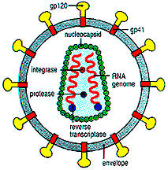

Slide 172
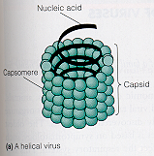
Viral Morphology
1. Helical

Slide 173
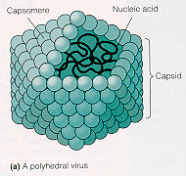
Viral Morphology
2. Polyhedral
icosahedral

Slide 174
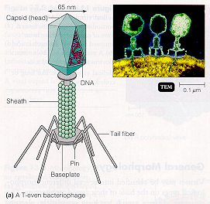
Viral Morphology
4. Complex

Slide 175
VIRUS
GENERAL PROPERTIES
Do not possess cellular organization
Contain either DNA or RNA but not both
Lack enzymes that synthesize protein & nucleic acid but depends on the host
Multiply by complex process but not binary fission
Not affected by antibiotics
Sensitive to interferon produced by the host

Slide 176
MORPHOLOGY OF VIRUS
Vary according to:-
Size – smaller than other micro organisms
Shape- bullet eg rabies
brick eg smallpox or chickenpox
Bacteriophage has head & tail
Spherical eg influenza & polio

Slide 177
Structure-
some have RNA & others have DNA
Core of nucleic acid is coated by a protein CAPSID
Capsid is composed of capsomeres
A viron may be enveloped or non enveloped

Slide 178
REACTION TO PHYSICAL & CHEMICAL AGENTS
Heat & cold- mostly destroyed by heating at 60ºc for 30 minutes except Hepatitis virus & Adeno viruses. Some are preserved in very low temp -20 to -70ºc
PH- stable at 5- 9
Ether- some are destroyed by ether like Arbo, Myxo & Herpes
Radiation- UV light, X- Rays inactivate viruses

Slide 179
REACTION TO PHYSICAL & CHEMICAL AGENTS
SALT- magnesium chloride & sulphate stabilize some viruses inorder to resist heat at 50ºC
Disinfectants- lysol & Dettol are not effective against viruses but higher concentration of chlorine & iodine may kill them
Antiviral agents- specific drugs will destroy or kill specific viruses.

Slide 180
VIRAL MULTIPLICATION
Adsorption- Attaches on the receptor site of the host cell (key & lock)
Penetration- The virus particles are engulfed by the host cell thru’ Viropexia (phangocytosis)
Uncoating- the virus loses its outer layer & capsid
Biosynthesis- synthesis of the viral nucleic acid &capsid protein stopping the normal host cell function

Slide 181
VIRAL MULTIPLICATION
This is done through:-
Transcription of mRNA from viral nucleic acid
Translation of mRNA into early proteins which initiate & maintain the synthesis of the virus component hence stopping the normal function of the host cell
Replication or the viral nucleic acid
Synthesis of late proteins(components of daughter virion capsids)

Slide 182
5. Maturation- Assembly of daughter virions. The enveloped virus develops them from host cell membrane but non enveloped virus are fully developed
6. Release – from the destroyed host cell to other healthy cells
NB: Antiviral drugs will interfere with the stages of development

Slide 183
Properties of viruses
Consist either RNA or DNA but never both
Obligate intracellular parasites
Fail to grow on artificial media
Smallest infectious agents
Nucleic acid is enclosed in a protein shell
Entire infectious unit is also called a Virion
Not inactivated by antibiotics
Divide by replication

Slide 184
Classification of human viruses
Human viruses can be classified:
Depending on area/body system affected i.e.
Respiratory viruses
Enteric viruses
2. RNA or DNA (Kind of nucleic acid)
3. Single strand or double strand
4. Enveloped or no enveloped

Slide 185
DNA viruses
Adenoviruses
Poxviruses
Papovaviruses
Parvoviruses
Herpes simplex viruses
Varicella-zoster virus
Cytomegalovirus (CMV)
Epstein-barr (EB) virus

Slide 186
RNA VIRUSES
Immune deficiency virus
Arboviruses
Rubella virus
Picornaviridae
Orthomyxoviridae
Paramyxoviridae
Rhabdoviridae
Rotavirus

Slide 187
Replication of viruses
Viruses are obligatory intracellular parasites
Lacks machinery of self propagation
They make use of the metabolic machinery of the host cell to synthesize their nucleic acids or proteins

Slide 188
Replication of viruses
1. Attachment of virus to host cells (binding/adsorption)
It is a specific process and requires presence of receptors on the host’s cell surface

Slide 189
Replication of viruses
2. Penetration: occurs by any of the following methods
Translocation: who nonenveloped virus enters host cell b y moving across the cell membrane
Endocytosis: engulfment of the virus by the invagination of section of plasma membrane
Fusion: endocytosis of enveloped viruses: fuses with membrane of endosome.
Direct fusion: of the viral envelope with surface membrane of the cell.

Slide 190
Replication of viruses
3. Uncoating: Uncoating of Virion occurs to release the viral genome into the host cell nucleus.

Slide 191
Replication of viruses
4. Transcription: viral genome utilizes host machinery to direct viral proteins synthesis
5. Translation: viral mRNA uses host Ribosomes to synthesize in the same way as host mRNA
6. Genome replication: viruses reproduce from their own nucleic acid, which direct both its own replication and also the synthesis of virus specific proteins.

Slide 192
Replication of viruses
7. Assembly
Virion assembly takes place mostly in the cytoplasm
Acquisition of envelope is through the process of budding through the cellular membrane

Slide 193
Replication of viruses
8. Release: mature virion can escape from the host cell by three mechanisms and start their life-cycle again in new host
Cell lysis:
Cell degeneration
Budding
Duration of viral replication varies.

Slide 194
DNA viruses
Adenovises
Characteristics
Are double stranded DNA genome
Inactivated by chlorine
No effective chemotherapy
NB: adenovirus infection occur throughout the world, by age of 5yrs all children have been infected.

Slide 195
DNA viruses
Adenovirus infections of human
Acute resp. disease
Sore throat
Epidemic keratoconjuctivities
Pneumonia
Acute hemorrhagic cystitis
Meningoenchophalitis
Swimming pool conjunctivitis
Febrile cold

Slide 196
DNA viruses
Poxvirus
The family poxvirus belongs to the causative agent of small pox (has been eradicated from the earth)
Characteristics
Large, brick shaped
Double stranded DNA
Contains 20 antigens

Slide 197
DNA viruses
Other diseases associated with poxviridae
Buffalo pox
Cowpox
Monkey pox
Tanapox
Molluscum contagiosum

Slide 198
DNA viruses
Papovaviruses
Characteristics
Non enveloped DNA
ds DNA genome
No effective chemotherapy
The family papovavirus consist of 3 genera.
HPV has 80 serotypes: cause warts at different sites of human body

Slide 199
DNA viruses
Parvovirus
The family has 3 genera
Infection in the 1st trimester leads to missed & spontaneous abortions
Infection during 2rd trimester is associated with hydrops fetalis
No specific antiviral rx

Slide 200
DNA viruses
Herpesviruses
Family herpesviridae consist of more than 80 viruses.
Is double stranded linear DNA
There is great diversity in pathology & biology of herpes viruses
Common feature of herpes viruses: property of establishing latent infection lasting throughout life of the victim
7 different herpes viruses whose natural host is man

Slide 201
DNA viruses
Herpes simplex virus
Exist in 2 types: type 1 virus (HSV-1): affects regions of body above the waist
Type 2 virus (HSV-2): affects genital & anal regions
Diseases caused by herpes simplex virus
Stomatitis, herpes labialis, keratitis, proctitis, acute necrotic cervicitis, neonatal herpes, meningitis, encephalitis, genital lesions

Slide 202
DNA viruses
Varicella zoster virus
Agent of 2 diseases: Varicella & herpes zoster
Varicella follows primary exogenous contact with causative virus
Zoster reflects endogenous activation of Varicella zooster virus infection that has survived in latent form following an attack of Varicella

Slide 203
DNA viruses
Varicella zoster virus
Varicella is a contagious generalized exanthematous disease of seasonal epidemic
Commonly known as chickenpox
Common in children
Herpes zoster (shingles), common in elderly people.
Characterized by unilateral painful, vesicular eruption localized to dermatome innervated by specific dorsal root of extramedullary cranial ganglion

Slide 204
DNA viruses
Cytomegalovirus (CMV)
Most common virus that affect man
Are found in salivary glands or renal tubules of many asymptomatic children’
Most or the infections remain asymptomatic but in rare cases, when disease manifest, the outcome is usually fatal.
Various manifestation include those that cause permanent damage to the brain.
Vertical transmission is possible

Slide 205
DNA viruses
Epstein-Barr (EB) virus
Was discovered by Epstein & Barr
Features are same as for other members of family herpesviridae
Cause glandular fever (infectious mono-nucle osis): s & s- fever, lymphadenopathy, sore throat, malaise, fatigue
In ISS pts it may trigger Burkitt’s lymphoma

Slide 206
RNA viruses
Human immunodeficiency virus
HIV is a retrovirus that cause AIDS
In all organisms, DNA, is the store house of genetic information where its then transmitted into RNA
Sequence is reversed in HIV, genetic information is passed on from RNA to DNA with help of reverses transcriptase enzyme

Slide 207
RNA viruses
HIV has 3 antigens;
The core antigen
The envelope antigen
The RT (reverse transcriptase) enzyme
HIV has 2 sub-types designated as HIV-1 and HIV-2
Once infected with HIV, the virus gets integrated into the host chromosomes and the infection persist making the person at risk for dvp virus associated disease throughout his life.

Slide 208
RNA viruses
HIV:
Presence: various body fluids e.g. blood, semen, tears, saliva, vaginal fluids, breast milk, and urine, childbirth
Transmission: sexually (hetero and homosexual), blood transfusion, IV drug, breast milk, accidental needle stick injury
Incubation period: 1-10 years

Slide 209
RNA viruses
Arboviruses
Are viruses which multiply in blood sucking arthropods and are transmitted to vertebrates by bite.
There are more than 500 Arboviruses
Most do not produce clinical disease in human
About 50 types produce serious ailment

Slide 210
RNA viruses
Arboviruses
Classification of Arboviruses based on clinical syndrome
Causing fever, rash, arthralgia: dengue, sandfly fever, West Nile
Causing haemorrhagic fever: yellow fever, dengue,
Causing haemorrhagic fever with hepatitis and nephritis: yellow fever
Causing encephalitis: tick-borne encephalitis, west Nile encephalitis
No specific rx, usually asymptomatic
Vaccines are available

Slide 211
RNA viruses
Rubella virus
It causes German measles
The disease is important because it causes severe congenital malformations
Clinical manifestation: rash, lymphadenopathy, fever.

Slide 212
RNA viruses
Rubella
Congenital rubella: microcephaly, retinopathy, cataract, deafness, pulmonary stenosis, PDA, ventricular septa defect, DM
PREVENTION: through vaccination prior to attainment of reproductive age

Slide 213
RNA viruses
Picornaviridae
One of the largest and most important family of human pathogens
These viruses are also the smallest (pico-small)
Members of this family: polio virus, coxsackie viruses, hepatitis A virus

Slide 214
RNA viruses
Picornaviridae
Characteristics: single stranded, nonenveloped, No effective rx.
Poliovirus: causes paralytic polio, aseptic meningitis
Coxsackievirus: causes conjunctivitis, myocarditis, aseptic meningitis
Entelovirus: conjunctivitis
Rhino virus: transmitted via droplet, causes resp. infections

Slide 215
RNA viruses
Orthomyxoviridae
Is a family of influenza viruses
Grouped into 3 genera: influenza A, B, & C

Slide 216
RNA viruses
Paramyxoviridae
Comprises of 3 genera which have viruses pathogenic to man
Genus | Virus | Disease
Paramyxovirus | Parainfluenza virus | URTI esp in children
 | Mumps virus | Mumps
Morbilivirus | Measles virus | Measles
Pneumovirus | Respiratory syncytial virus | Bronchiolitis , pneumonia in infancy

Slide 217
RNA viruses
Rhabdoviridae
Rabies virus belongs to this class
Rabies causes hydrophobia in man
One of the most terrifying of all communicable diseases and is invariably fatal
Characteristics rabies virus: singe stranded RNA genome, enveloped, bullet shaped, resistant to drying, cold.

Slide 218
RNA viruses
Rabies virus
Primarily a disease of animals who transmit it to man through their bite
The virus has high affinity for CNS and travels to that destination irrespective of site of inoculation.
It has no cure once the disease has set in.
The long incubation period of disease permits post exposure immunoprophylaxis.

Slide 219
RNA viruses
Rotaviridae, genus: Rota virus
Rotavirus is spherical in shape (rota)
Single most important agent of infantile gastroenteritis occasionally accompanied by vomiting and fever.
Manifest after incubation of 2-3 days and last 4-7days
May cause dehydration and convulsions in children
In developing world, ↑ 123m cases or rotavirus associated diarrhoea occur annually & results in ~1m deaths

Slide 220
Viral hepatitis
Viral hepatitis refers specifically to a primary infection of the liver by one of the 4 etiologically associated but different hepatotropic viruses

Slide 221
HEPATITIS
PRIMARY LIVER INFECTION
LIVER INVOLVED AS A PART OF GENERAL INFECTION
BLOOD-BORNE
ENTERICALLY TRANSMITTED
HBV
HDV
HCV
HAV
HEV
Yellow fever
Cytomegalovirus
Rubella virus
Mumps virus
EB virus
Herpes simplex virus

Slide 222
Hepatitis A virus
Belongs to family of Picornaviridae
Transmission is by fecal oral route
It survives for long periods in water and wet environments.
Occasionally HAV infection can be transmitted by blood or blood products

Slide 223
Hepatitis A virus
Prevention:
maintaince of hygiene, food handlers with HAV must be kept away from work for 2weeks
patients should be nurses with appropriate precautions
safe disposal of faeces during the infective period.

Slide 224
Hepatitis B virus
Belongs to a new family called Hepadnaviridae
The virus is stable at -20 degrees Celsius for more than 20 years
Incubation period is 4-6 months
Clinical manifestation is similar to those of HAV
It may give rise to persistent infection, prolonged carrier state, and progression to chronic liver disease
It is also associated with hepatocellular carcinoma

Slide 225
Hepatitis B virus
Prevention
Screening of blood donors and blood products can reduce risk of transmission.
Following group of people are recommended to undergo active immunizations with hepatitis B vaccine:
health care workers handling blood & blood products
Medical and paramedics working in dialysis units or haemophilia centres

Slide 226
Hepatitis B virus
Individuals receiving prolonged inpatient treatment
Pts requiring repeated blood transfusions
Immunodeficient individuals
Ca patients
Prostitutes
Spouses and sexual contacts of patients with acute hepatitis B-carriers of HBV

Slide 227
Hepatitis D virus
HDV belongs to a genus- Deltavirus
It is a defective virus and can only survive in the presence of HBV
The agent is transmitted along with HBV either at the time of first infection (co-infection) or during any subsequent exposure
It may have little of no effect on the associated HBV infection
Sometimes it causes fulminant hepatitis and death

Slide 228
Hepatitis C virus
HCV is a flavirus
Transmitted in a fashion similar to HBV
Most prevalent in injectable drug users
HCV causes chronic hepatitis and eventually liver cirrhosis
Sometimes HCV infection leads to hepatocellular carcinoma
Screening of blood donors and blood products can reduce risk of transmission.

Slide 229
Hepatitis E virus
HEV is a calcivirus.
Clinically and epidemiologically HEV infection resembles those due to HAV but are severe in pregnant women and more likely to cause fulminant disease.
At present no vaccine is available against this agent.
Control measures: maintenance of clean water supply.
Other preventive measures are the same as those for HAV

Slide 230
Examples of viruses + diseases
Herpesviruses
All herpesviruses have a core of double-stranded DNA
Common and important herpesviruses of humans include herpes simplex virus types 1 and 2, varicella-zoster virus, Epstein-Barr (EB) virus, and cytomegalovirus

Slide 231
Examples of viruses + diseases
Varicella zooster viruses
Varicella: commonest childhood axenthemata. Portal of entry is resp tract.

Slide 232
Examples of viruses + diseases
Zooster virus <shingles>
Activation <2⁰ ↓immunity to ineffective levels>.
produces painful vesicles in areas of skin.
Common in pts 60yrs>, ca pts, iss pts,….

Slide 233
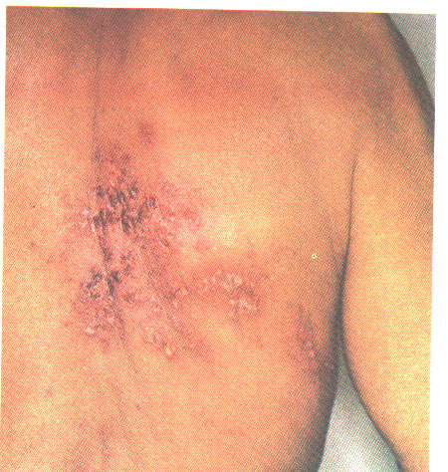
Zoster
Shingles

Slide 235
Examples of viruses + diseases
Human Herpesvirus 1 (Herpes Labialis) &
Human Herpesvirus 2 (Herpes Genitalis).
Infection is sometimes seen as severe keratitis, meningoencephalitis, and a disseminated illness of the newborn.

Slide 236
Examples of viruses + diseases
Herpesviruses have been linked with malignant diseases in humans : herpes simplex virus type 2 with cervical and vulvar carcinoma

Slide 237
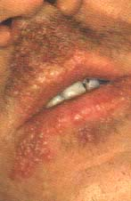
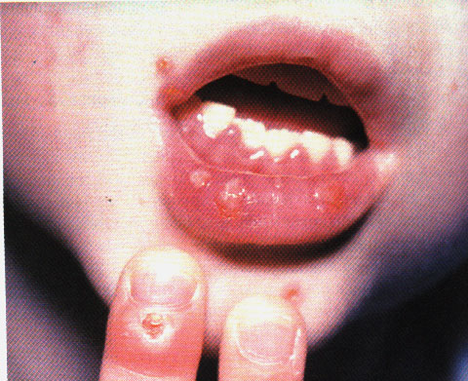
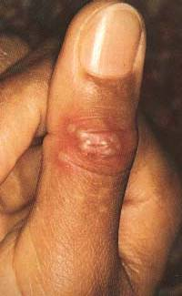
Herpes labialis

Slide 240
Examples of viruses + diseases
Cytomegalovirus
Cytomegalic inclusion disease is a generalized infection of infants caused by intrauterine or early postnatal infection with the cytomegaloviruses. The disease causes severe congenital anomalies. Most fatalities occur in children under 2 years of age
Severe cytomegalovirus infections are frequently found in adults receiving immunosuppressive therapy

Slide 241
Examples of viruses + diseases
Epstein-Barr (EB) virus
(Epstein-Barr) virus associated with Burkitt's lymphoma and nasopharyngeal carcinoma
The virus is transmitted by intimate contact.

Slide 242
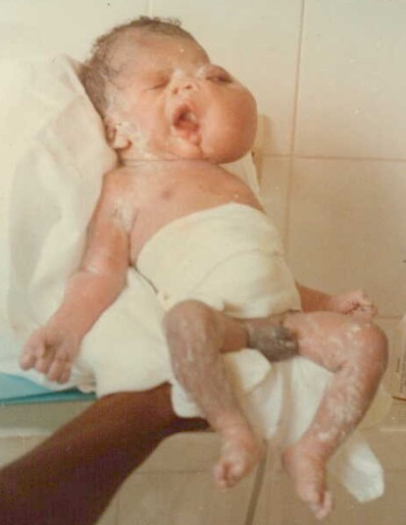
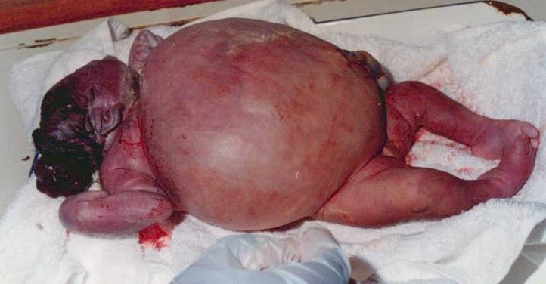
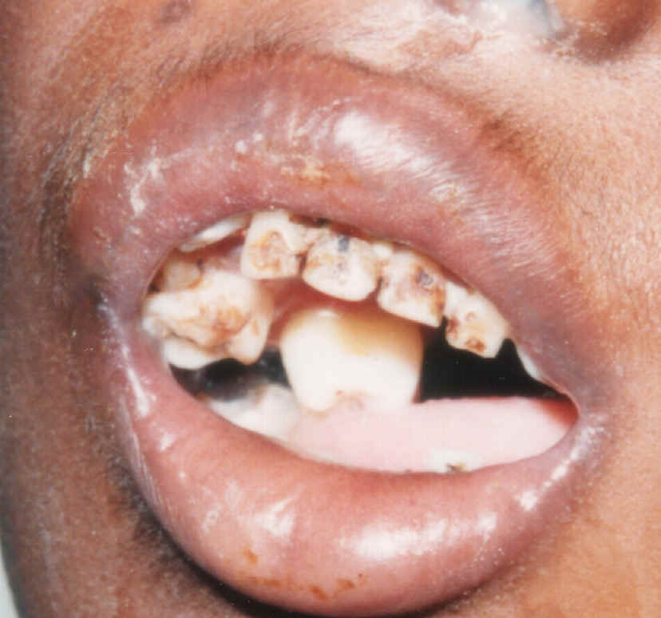
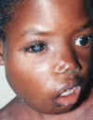
Burkitt's lymphoma

Slide 243
Examples of viruses + diseases
Polio virus
Droplet infection, no intermediate host
Causes poliomyelitis
Prevention <prophylaxis>: inactivated polio vaccine

Slide 244
Examples of viruses + diseases
Rhino-virus
Major cause of common cold <accounts for ~ ½ of all colds.
Transmission: via inhalation of infected drops, hand contact= primary mode of transmission.

Slide 245
Examples of viruses + diseases
Rabies virus
Host is all warm blooded animals.
Pathogenesis: rabies is a natural infection of dogs, foxes, skunks, cats, wolves, and bats
Virus is excreted in saliva of infected animals.
Man gets via bites by infected animals.

Slide 246
Examples of viruses + diseases
Paramyxoviruses < parainfluenza, mumps, and measles viruses>. Are indistinguishable in the e. microscope.
Parainfluenza virus: types 1-4,
Highly transmissible & are acquired by droplets,
They causes URTI & in children may cause pneumonia.
In kids (6/12-5yrs) may get larnyngotracheo-bronchitis (croup)

Slide 247
Examples of viruses + diseases
Mumps virus
Respiratory tract is the portal of entry via resp and oral secretions
Causes mumps a predominantly childhood disease
Major manistation is painful, swelling of parotid gland (unilateral or bilateral
May cause: encephalitis, orchitis, oophoritis, pancreatitis, arthritis, myocarditis, renal dysfunction.

Slide 248
Examples of viruses + diseases
Measles virus
Commonest cause of highly contagious childhood disease- measles
Spread is via resp secretions, multiplies locally and spread to regional lymphoid tissue then into blood <viraemia>.
It causes URTI, fever, rhinitis, cough, conjunctivitis, koplik’s spots <rash>.

Slide 249
Examples of viruses + diseases
It also causes sinusitis, otitis media, bronchitis, croup, bronchopneumonia, encephalitis etc
Prevention: measles vaccine

Slide 250
Examples of viruses + diseases
yellow fever virus
Causes yellow fever disease
Transmitted by mosquitoes from monkeys and man to man.
Liver is the major target organ
Prevention is via eradication of Aedes aegypti mosq, vaccination with 17D vaccine-provides protection for 10yrs.

Slide 251
Examples of viruses + diseases
HIV virus
Retrovirus
Causes AIDS
ssRNA
Transmission: sexual, vertical, parenteral.

Slide 252
Examples of viruses + diseases
Hepatitis viruses
Causes viral hepatitis <liver infection>
Strains: HAV, HBV (dsDNA), HCV, HDV, HEV, and HGV.

Slide 253
Examples of viruses + diseases
Hepatitis viruses
Causes viral hepatitis <liver infection>
Strains: HAV, HBV (dsDNA), HCV, HDV, HEV, and HGV.

Slide 254
Parasite
Protozoa
Metazoa
(helminthes)
Sarcodina
(amoebas)
Sporozoa
(sporozoans)
Mastigophora
(flagellates)
Ciliata
(ciliates)
Platyhelminthes
(Flatworms)
Nemathelminthes
(Round worms)
Trematoda
(flukes)
Cestoda
(tapeworms)

Slide 255
PARASITES
They are organisms that survive at the expense of another organism.

Slide 256
Definitions of terms
Medical Parasitology: deals with parasites which infect man and diseases produced by them
Parasite: organism which is dependent on another organism for survival. Obtains nourishment and shelter from the organism on which it thrives

Slide 257
Definitions of terms
Host: organism which harbors the parasite and is usually larger than the parasite
Ectoparasite: Thrives on the outer surface of the host
Endoparasite: lives within the body of the host
Commensal: a parasite which does not damage the host while deriving its advantages.
Obligate parasite: a parasite which is completely dependent upon the host
Pathogen: a parasite capable of producing disease

Slide 258
PARASITES
1. Those living inside the host are endoparasite.
These are like tapeworm, plasmodium (malarial parasite)
2. Those living on the host are ectoparasite eg. Lice
3. Obligate parasites must spend some part of their life cycle in or on a host eg plasmodium

Slide 259
PARASITES
4. Facultative parasites may be free living but can obtain their nutrition from a host too.
5. Accidental parasites are the parasites that will attack unnatural host
6. Aberrant parasite are the parasites that come to a site during migration where they cannot develop or live

Slide 260
PARASITES
Parasites include:-
PROTOZOA
HELMINTHS
PROTOZOA are like:-
Amoeba- Entamoeba Histolytica
Flagellates – Leishmania, Trypanosoma, Girdia, Trichomona Vaginalis
Sporozoa- Plasmodium, Toxoplasma
Ciliates- Balantidium

Slide 261
PARASITES
HELMINTHS
Trematodes- schistosoma (leaf like un-segmented)
Cestodes- Taenia (tape like segmented)
Nematodes – hookworm, roundworm, Threadworm (Elongated cylindrical un-segmented)

Slide 262
PARASITES
Host- an organism that harbours a parasite
TYPES OF HOSTS
Definitive- Harbours an adult parasite & the parasite utilizes sexual reproduction within it.
Intermediate- Harbours larval stages of parasite
Paratenic- harbours parasites exhibiting no development but the parasite remains viable

Slide 263
PARASITES
Association btw a parasite & a host
Symbiosis (Mutalism)- both are dependent on each other ie one cannot live without the other & none is harmful to the other
Commensalism- parasite is benefiting without causing harm to the host
Parasitism- the parasite benefits while the host does not get any benefit

Slide 264
HOW PARASITES CAUSE DISEASE TO MAN
1. Mechanical injury-
Pressure on the tissues as the parasite grow larger eg hydatid cyst
Blocking the blood vessels (strongyloides) or lymphatic vessels (elephantiasis) causing oedema
Intestinal obstruction, perforation & necrosis (Ascaris Lumbricoides)
Destruction of of human Red blood cells (plasmodium)

Slide 265
HOW PARASITES CAUSE DISEASE TO MAN
2. Release of toxic substances
Plasmodium falciparum produces toxic substances that cause rigors & other malarial symptoms
Entamoeba Histolytica- cause lesionsdue to the histolytica enzymes produced ie they dissolve tissues

Slide 266
HOW PARASITES CAUSE DISEASE TO MAN
3. Deprivation of nutrients, fluids & metabolites
The parasite competes for nutrients with the host eg
Diphylobothrium Latum (fish tapeworm copmetes for vit. B₁₂ causing megaloblastic Anaemia)
Ancylostoma Duodenale & other blood sucking arthropods lead to severe iron deficiency Anaemia

Slide 267
HOW PARASITES CAUSE DISEASE TO MAN
4. Introduction of pathogenic micro organisms
Lesions produced by parasites may later have bacterial infection eg. High incidence of schistosoma haematobium in human blood could cause one to be a carrier of salmonella typhi

Slide 268
Protozoa
Sporozoa: plasmodium
Objectives
State plasmodium species
Life cycle of malaria parasite (sexual & asexual
Effects of plasmodium in the body

Slide 269
Plasmodium: The Agent of Malaria
Dominant protozoan disease
Obligate intracellular sporozoan
4 species: P. malariae, P. vivax,
P. falciparum and P. ovale
Female Anopheles mosquito is the primary vector; blood transfusions, mother to fetus
300-500 million new cases each year
2 million deaths each year

Slide 270
2 distinct phases of malarial parasite development:
asexual phase – human host
Infected female mosquito injects asexual sporozoite which localizes in liver; it then undergoes schizogony generating 2,000-40,000 merozoites which enter circulation in 5-16 days depending on species.
Merozoites attach to and enter red blood cells, convert to trophozoites and multiply; red cell bursts releasing merozoites that differentiate into gametes.

Slide 271
Sexual phase – mosquito host
Mosquito draws infected RBCs; gametes fertilize forming diploid cell which forms sporozoites in stomach.
Sporozoites lodge in salivary glands; available to infect human host

Slide 272
Plasmodium
Symptoms include episodes of chills-fever-sweating, anemia, and organ enlargement.
Symptoms occur at 48-72 hour intervals as RBCs rupture; interval depends on species.
P. falciparum most malignant type; highest death rate in children
Diagnosis by presence of trophozoite in RBCs, symptoms
Increasing drug resistance

Slide 273
Helminthes
Objectives
Classify helminthes of medical importance
Brief life-cycle & characteristics
Effects/diseases associated with each

Slide 274
Helminthes
Pathology arises from worms feeding on and migrating through tissues, accumulation of worms and worm products.
Diagnosis based on blood cell count (eosinophilia), serological tests; eggs, larvae, or adult worms in feces; sputum, urine, blood, or tissue biopsies.
Antihelminthic drugs suppress a helminthic metabolic process that differs from the human process, inhibit the worm’s movement, prevent it from holding position, and act locally in the intestine.

Slide 275
Nematode (Roundworm) Infestations
Most abundant animal groups; 50 species that affect humans
Enlongated, cylindrical worms with protective cuticles, circular muscles, a complete digestive tract, and separate sexes
Ascaris lumbricoides, Trichuris trichiura, Enterobius vermicularis, hookworms, Strongyloides stercoralis, Trichinella spiralis, filarial worms

Slide 276
Ascaris lumbricoides
A large intestinal roundworm
Most cases in the U.S. occur in the southeastern states
Indigenous to humans
Ascaris spends its larval and adult stages in humans; release embryonic eggs in feces, and are spread to other humans; food, drink, or contaminated objects
Ingested eggs hatch into larvae and burrow through the intestine into circulation and travel to the lungs and pharynx and are swallowed.
Adult worms complete cycle in intestines and reproduce – 200,000 eggs/day.

Slide 277
Ascaris lumbricoides
Worms retain motility, do not attach.
Severe inflammatory reactions mark the migratory route.
Allergic reactions can occur.
Heavy worm loads can retard physical and mental development.

Slide 278
Trichuris trichiura and Whipworm Infection
Whipworm
Humans sole host
Trichuriasis has its highest incidence in the tropics.
Eggs hatch in intestines, larvae attach, penetrate the outer wall and develop into adults.
Females lay 3,000-5,000 eggs daily.
Worms can pierce capillaries, cause localized hemorrhage, and allow bacteria to leave intestine.
Heavy infestations can cause dysentery, rectal prolapse – can be fatal in children.

Slide 279
Enterobius vermicularis and Pinworm Infection
Pinworm or seatworm
Enterobiasis most common worm disease of children in temperate zones
Eggs are picked up from surroundings and swallowed.
After hatching in the small intestine, they develop into adults.
Anal itching occurs when mature females emerge from intestine to release eggs.
Self-inoculation is common.
Tape test

Slide 280
Hookworms
Characteristic curved ends and hooked mouths
Necator americanus and Ancylostoma duodenale
Humans shed eggs in feces, which hatch into filariform larvae and burrow into the skin of the lower legs.
Larvae travel from blood to lungs, proceed up bronchi and throat and are swallowed.
Worms mature and reproduce in small intestine and complete, the cycle.
May cause pneumonia, nausea, vomiting, cramps and bloody diarrhea
Blood loss is significant – anemia.

Slide 281
Strongyloides stercoralis and Strongyloidiasis
Threadworm
Tiny roundworms completes life cycle in humans or moist soil.
Larvae penetrate skin and migrate to lungs, are swallowed and complete development in the intestine.
Can reinfect the same host without leaving the body
Heavy worm loads can cause pneumonitis and eosinophilia, bloody diarrhea, liver enlargement, bowel obstruction and malabsorption.

Slide 282
Tissue Nematodes
Complete their life cycle in human blood, lymphatics, or skin
Filarial worms; elongate, filamentous bodies, spread by biting arthropods
Cause chronic, deforming disease
Wuchereria bancrofti – elephantiasis
Onchocerca volvulus – river blindness
Loa loa – eye worm

Slide 283
Wucherereia bancrofti and Bancroftian Filariasis
Tropical infection spread by mosquitoes
Vector deposits larvae which move into lymphatics and develop into adults.
Chronic infection causes blockage of lymphatic circulation and elephantiasis, massive swelling in the extremities.

Slide 284
Onchocerca volvulus and River Blindness
Transmitted by biting black flies
Larvae develop into adults in subcutaneous tissues.
Adult females migrate via the blood to the eyes, provoking inflammatory reactions.
Coinfection with Wolbachia bacteria causes river blindness.
Treatment: tetracycline and ivermectin

Slide 285
Loa loa: The African Eye Worm
Spread by bite of small flies
Temperature-sensitive worm migrates around/under the skin and may enter the eye.
Treatment – pull worm from a small hole in conjunctiva or diethylcarbamazine

Slide 286
Trematodes or Flukes
Flatworms with ovoid leaflike bodies
Have digestive, excretory, neuromuscular, and reproductive systems
Lack circulatory and respiratory systems
Animals such as snails or fish are usually the intermediate hosts and humans are the definitive hosts.

Slide 287
Blood Flukes: Schistosomes
Schistosomiasis - prominent parasitic disease
Schistosoma mansoni, S. japonicum,
S. haematobium
Adult flukes live in humans who release eggs into water; early larva (miracidium) develops in freshwater snail into a 2nd larva (cercaria).
This larva penetrates human skin and moves into the liver to mature; adults migrate to intestine or bladder and shed eggs, giving rise to chronic organ enlargement.

Slide 288
Cestode (Tapeworm) Infestations
Flatworms
Long, very thin, ribbonlike bodies composed of sacs (proglottids) and a scolex that grips the intestine
Each proglottid is an independent unit adapted to absorbing food and making and releasing eggs.
Taenia saginata
Taenia solium

Slide 289
Taenia saginata
Beef tapeworm
Very large, up to 2,000 proglottids
Humans are the definitive host.
Animals are infected by grazing on land contaminated with human feces.
Infection occurs from eating raw beef in which the larval form has encysted.
In humans, larva attaches to the small intestine and becomes an adult.
Causes few symptoms; vague abdominal pain and nausea; proglottids in stool

Slide 290
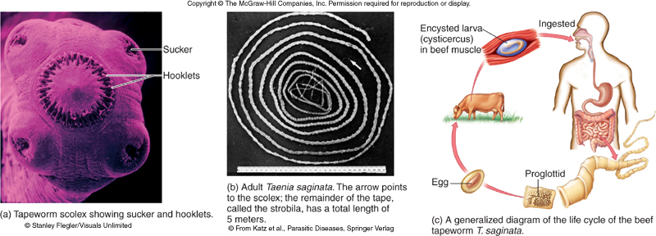

Slide 291
Taenia solium
Pork tapeworm
Infects humans through ingesting cysts or eggs
Eggs hatch in intestine, releasing tapeworm larva that migrate to all tissues and encyst.
Most damaging if they lodge in heart muscle, eye, or brain
May cause seizures, psychiatric disturbances

Slide 292
The Arthropod Vectors of Infectious Disease
Arthropods – exoskeleton and jointed legs; includes arachnids and crustaceans; many must feed on blood and tissue fluid of host during life cycle; ectoparasites
Those of medical importance transmit infectious microbes in the process of feeding – biological vectors

Slide 293
Insects
Mosquitoes – require an aquatic habitat; females take blood meal transmitting disease: malaria, filariasis, zoonoses
Fleas – highly motile, flattened bodies; feed on warm-blooded animals; carry zoonotic diseases: plague, murine typhus
Lice – small, soft; attach to head and body hair feeding inconspicuously on blood and tissue fluid; release feces that contaminate wound; epidemic typhus, relapsing fever
Flies – tsetse fly, sand fly

Slide 294
Arachnids
Ticks – cling on vegetation and attach to host on contact; larvae, nymph and adults get blood meal by piercing skin of host
hard ticks – Dermacentor, Ixodes – small compact, rigid bodies; transmit rickettsial, borrelial, and viral diseases
soft or argasid ticks – Ornithodoros- flexible outer bodies; transmit relapsing fever

Slide 295
Medically important protozoa
Intestinal and urogenital protozoa
Organism | mode of transmission | Disease
Entamoeba histolytica | Ingestion of cyst | Amoebic dysentery, liver abscess
Giardia lamblia | Ingestion of cyst in food | Giardiasis
Cryptosporidium | Ingestion of cyst in food | Cryptosporidiosis (sympt= diarrhoea, severe in ISS
Trichomonas vaginalis | Sexual | Trichomoniasis

Slide 296
Blood and tissue protozoa
Organisms | Mode of transmission | diseases
Plasmodium: vivax, ovale, malariae, falciparum | Anopheles mosquito | Malaria
Leishmania donovani | Sandfly (phlebotomus) | Kala-azar (visceral leishmaniasis
Leishmania tropica, L.mexican, & L.braziliensis | Sandfly (vector) | Cutaneous leishmaniasis
Trypanasoma gambiense & T. rhodesiense | Tsetse fly (glossina) | Sleeping sickness
Trypanasoma cruzi | Reduviid bug | Chagas’ disease
Toxoplasma gondii | Cyst in raw meat, cat feces | Toxoplasmosis
Pneumocystis jiroveci | Inhalation | Pneumonia esp in ISS

Slide 297
Cestodes (Tape worms) NB: has no insect vector
Organism | Intermediate host | Stage that infects human | Disease
Taenia solium | Pigs | -Larvae in <cooked pork -Eggs in food or water cont’ with human faeces | -Adult form= Taeniasis (intestines) -larvae= cysticercosis (brain & eyes)
Taenia saginata | Cattle | Larvae in < cooked beef | -Taeniasis (adult tape in intestine
Diphyllobothrium latum | Fish | Larvae in <cooked fish | -diphyllobothriasis
Echinococcus granulosus (dog tape worm) | Sheep | Eggs in food or water contaminated with dog faeces | - Hydatid cyst disease (in liver and lungs)

Slide 298
Trematodes (flukes)
Schistosoma: they cause schistosomiasis
Trematode | Intermediate host | mode of transmission | Main sites affected
Schistosoma mansoni | Snail | Penetrate skin | Veins of colon
Schistosoma haematobium | Snail | Penetrate skin | Veins of urinary bladder
Schistosoma japonicum | Snail | Penetrate skin | Veins of intestine, liver
Clonorchis sinensis | Snail &fish | Ingested with raw fish | Colon

Slide 299
Nematodes (Nemathelminthes): are round worms
Intestinal nematodes
Genus & species | Common name /disease | Mode of transmission
Enterobius vermicularis | Pinworm infection | Ingested eggs, dvp into adult in gut , lay eggs on anal skin=reinfection
Ascaris lumbricoides | Ascariasis | Eggs=ingested, from larvae in gut, larvae migrate via bld to lungs, then via trachea, swallowed. Bcome adults, lay eggs, pass in stool , embryonate in soil
Strongyloides stercoralis | Strongyloidiasis | Larvae pen’ skin, into bld, to lungs, trachea, swallowed, bcome adults, enter mucosa-fem lay eggs, hatch in colon into non infectious larv, passed in stool
Trichuris trichiura | Whipworm infection | Human ingest eggs, dvp in gut into adult, eggs passed in stool, embryonate in soil

Slide 300
Nematodes
Genus & species | Common name /disease | Mode of transmission
Ancylostoma duodenale & A. americanus | Hookworm | Larvae pen’ skin, inter bld, migrate to lungs, trachea, swallowed, adults in small int, attach to walls, eggs passed in stool, form non inf’ larvae, then inf’ filariform larvae
Trichinella spiralis | Trichinosis | Larvae ingested in <cooked pork, mature into adult in small int, fem release larvae- enter bld, migrate to skeletal muscle or brain (they encyst)

Slide 301
Immunology
Objectives
Definition of terms
Review of relevant A & P
Describe the levels of body defence mechanisms against infections
1st line, 2rd line, 3rd line
4. Describe the cells of immune system
5. Describe Humoral and cell mediated immune system.
6. Describe the hypersentivity reactions, autoimmunity

Slide 302
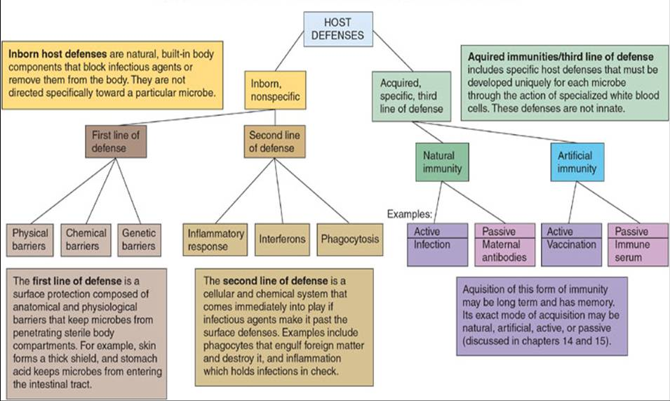
HOST DEFENSE MECHANISMS

