Slide 1
MINOR SURGICAL PROCEDURES
BY MISS IRENE MUMO

Slide 2
INCISION AND DRAINAGE
Incision and drainage (I&D) is a widely used procedure in various care settings, including emergency departments and outpatient clinics.
It is the primary treatment for skin and soft tissue abscesses, with or without adjunctive antibiotic therapy

Slide 3
An abscess is a confined collection of pus surrounded by inflamed tissue. Most abscesses are found on the extremities, buttocks, breast, axilla, groin, and areas prone to friction or minor trauma, but they may be found in any area of the body.
Abscesses are formed when the skin is invaded by microorganisms.
Cellulitis may precede or occur in conjunction with an abscess. The two most common microorganisms leading to abscess formation are Staphylococcus and Streptococcus. Perianal abscesses are commonly caused by enteric organisms. Gram-negative organisms and anaerobic bacteria also contribute to abscess formation.

Slide 4
Treatment of an abscess is primarily through incision and drainage (I&D). Smaller abscesses (<5 mm) may resolve spontaneously with the application of warm compresses and antibiotic therapy.
Larger abscesses will require I&D as a result of an increase in collection of pus, inflammation, and formation of the abscess cavity, which lessens the success of conservative measures.

Slide 5
Untreated abscesses may follow one of two courses. The abscess may remain deep and slowly reabsorb, or the overlying epithelium may attenuate (i.e., pointing), allowing the abscess to spontaneously rupture to the surface and drain

Slide 6
equipment
Universal precaution materials (gown, gloves, protective eyewear)
Sterile draping towels and sterile gloves
Local anesthetic (1% or 2% lidocaine with or without epinephrine)
10-cc syringe and 25- to 30-gauge needle
Skin prep material (chlorhexidine [Hibiclens] or iodine swabs)
)

Slide 7
No. 11 or 15 blade and scalpel
Curved hemostats
Scissors
Packing (plain or iodoform) ribbon gauze
Dressing (4- × 4-inch gauze pads and tape)

Slide 8
indications
Palpable, fluctuant abscess
An abscess that does not resolve despite conservative measures
Large abscess (>5 mm)

Slide 9
contraindications
Extensively large or deep abscesses or perirectal abscesses that may require surgical debridement and general anesthesia
Facial abscesses in the nasolabial folds (risk of septic phlebitis secondary to abscess drainage into the sphenoid sinus)
Hand and finger abscesses should receive surgical or orthopedic consultation

Slide 10
Procedure
Step 1
Prep the surface of the abscess and surrounding skin with povidone-iodine or chlorhexidine solution and drape the abscess with sterile towels.
Perform a field block by infiltrating local anesthetic around and under the tissue surrounding abscess.

Slide 11
Step 2
Make a linear incision with a no. 11 or 15 blade into the abscess.
Step 3
Allow purulent material from the abscess to drain.
Gently probe the abscess with the curved hemostats to break up loculations.
Attempt to manually express purulent material from the abscess.

Slide 12
Step 4
Insert packing material into the abscess with hemostats or forceps. Dress the wound with sterile gauze and tape

Slide 13
Complications
Inadequate anesthesia
Pain during and after the procedure
Bleeding
Reoccurrence of abscess formation
Septic thrombophlebitis
Necrotizing fasciitis
Fistula formation
Damage to nerves and vessels
Scarring

Slide 14
Post procedure instructions
The patient should be instructed to keep the wound clean, dry, and covered with absorbent material. If the abscess contains packing gauze, instruct the patient to remove packing material and repack the abscess every 1 to 2 days until the abscess cavity has resolved and packing materials can no longer be inserted into the abscess.
If the patient does not feel comfortable with repacking, direct the patient to a medical facility for repacking of the abscess every 1 to 2 days.
Instruct the patient to change the overlying dressing once a day. Inform the patient that he or she may take over-the-counter pain relievers or prescription pain relievers as directed for pain.

Slide 15
CATHETIRIZATION
In urinary catheterization a latex, polyurethane, or silicone tube known as a urinary catheter is inserted into the bladder through the urethra.
Catheterization allows urine to drain from the bladder for collection.
A clinician, often a nurse, usually performs the procedure, but self-catheterization is also possible.
A catheter may be in place for long periods of time (indwelling catheter) or removed after each use (intermittent catheterization).

Slide 16
TYPES
A Foley catheter (indwelling urinary catheter) is retained by means of a balloon at the tip that is inflated with sterile water. The balloons typically come in two different sizes: 5 cm and 30 cm.
They are commonly made in silicone rubber or natural rubber.

Slide 17
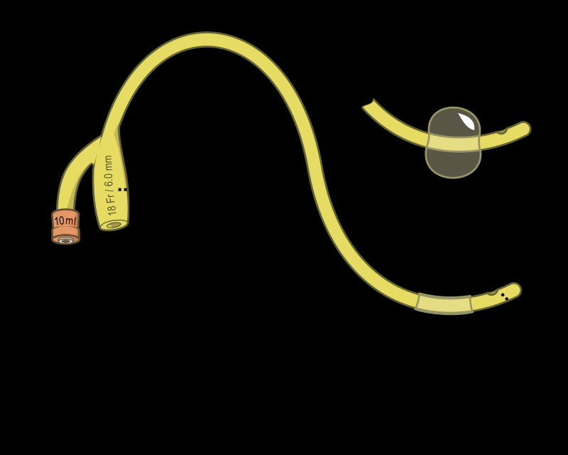

Slide 18
An intermittent catheter/Robinson catheter is a flexible catheter that is removed after each use.
Unlike the Foley catheter, it has no balloon on its tip and therefore cannot stay in place unaided.

Slide 19
A coudé catheter, including Tiemann's catheter, is designed with a curved tip that makes it easier to pass through the curvature of the prostatic urethra
A hematuria (or haematuria) catheter is a type of Foley catheter used for Post-TURP hemostasis. This is useful following endoscopic surgical procedures, or in the case of gross hematuria. There are both two-way and three-way hematuria catheters (double and triple lumen)

Slide 20
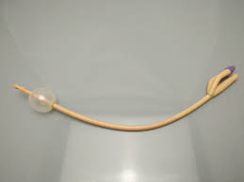
THREE WAY FOLEY CATHETER

Slide 21
A condom catheter can be used by males and carries a lower risk of infection than an indwelling catheter

Slide 22
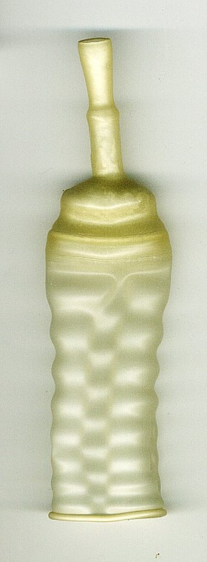
CONDOM CATHETER

Slide 23
Catheter diameters are sized by the French catheter scale (F). The most common sizes are 10 F (3.3mm) to 28 F (9.3mm).
The clinician selects a size large enough to allow free flow of urine, and large enough to control leakage of urine around the catheter.
A larger size is necessary when the urine is thick, bloody, or contains large amounts of sediment. Larger catheters, however, are more likely to damage the urethra.
Some people develop allergies or sensitivities to latex after long-term latex catheter use making it necessary to use silicone or Teflon types

Slide 24
Catheters are color-coded based on their french sizes:
Size 10 french: black
Size 12 french: white
Size 14 french: green
Size 16 french: orange
Size 18 french: red
Size 20 French: yellow

Slide 25
indications
Common indications for urinary catheterization include acute or chronic urinary retention (which can damage the kidneys),
orthopaedic procedures that may limit a patient's movement,
the need for accurate monitoring of input and output (such as in an ICU),
benign prostatic hyperplasia,
incontinence,
and the effects of various surgical interventions involving the bladder, prostate or bowel.

Slide 26
Intermittent self-catheterization may be indicated in cases of neurogenic bladder due to damage to the spinal cord or brain. This can be performed by the patient four to six times a day, using a clean technique

Slide 27
technique
Explanation and Consent
Confirm the patients identification
Check full name, DOB, and hospital number
Describe the procedure
State the importance of the procedure

Slide 28
Preparation
Chose the correct catheter size, based upon sex of the patient, length of time of insertion, and any allergies to latex
Patients with urine debris or clots may require a larger diameter catheter

Slide 29
Gather equipments which include
Appropriate catheter
Urine bag
Lubricant
Sterile gloves
Cotton swabs
10-20cc of sterile water for injection

Slide 30
Expose the patient from the waist down
Throughout the procedure, ensure the patients dignity is maintained

Slide 31
Procedure
Put the sterile gloves on
Using at least 5 cotton wool balls, clean the glans of the penis and penile shaft from tip to base.
If alone, make sure you change gloves
Take the catheter, from your assistant instill the lubricant and advance the catheter into the urethra until urine flows
Take the 10-20 ccs of water for injection and inflate
Connect the urine bag

Slide 32
complications
Pain
Bleeding
Urethral injury
Urinary tract infections
Sepsis
Hematuria
Bladder spasm

Slide 33
Suprapubic catheterization
A suprapubic catheter is a hollow flexible tube that is used to drain urine from the bladder.
It is inserted into the bladder through a cut in the tummy, a few inches below the navel (tummy button).
This is done under a local anaesthetic or a light general anaesthetic.

Slide 34
indications
Acute or chronic urinary retention following unsuccessful attempts at urethral catheterization
Unable or unwilling to perform intermittent self catheterisation
Patient preference e.g. wheel chair bound, sexual function related issues
Long term bladder drainage for patients with neurological disease
Anatomical problems in the urethra e.g. stricture, obstruction, trauma

Slide 35
Complications of long term urethral catheterisation egg penile meatal ulcer or catheter induced urethritis
When urethral or pelvic floor trauma is suspected
Post operatively following complex urethral, genitourinary or abdominal surgery
To decrease risk of contamination with organisms from faecal material
Acute prostatitis
Patient comfort

Slide 36
contraindications
Previous lower abdominal surgery with associated scar tissue/adhesions
Pelvic cancer with or without radiation with increased risk of adhesions
Unexplained haematuria

Slide 37
Severe obesity
Pregnancy
Ascites
Known or suspected carcinoma of the bladder
Anti coagulation therapy or blood clotting disorders
In the presence of vascular grafts/mesh in the supra pubic region

Slide 38
acute complications
Bleeding
Bowel injury which is more common if insertion performed when the bladder is not fully distended

Slide 39
FASCIOTOMY
Fasciotomy is a surgery to relieve swelling and pressure in a compartment of the body. Tissue that surrounds the area is cut open to relieve pressure.
Fasciotomy is most often needed in the leg, but it may also be done in the arm, hand, foot, or abdomen.

Slide 40
Muscles, nerves, and blood vessels are separated into areas called compartments.
The compartments are wrapped in a strong sheet of tissue called fascia.
Fluid buildup or swelling can increase pressure in the compartment. This can slow or block the flow of blood in the area and damages nerves.
The loss of blood flow can also cause the death of tissue in the area.
The pressure can also painfully squeeze tissue including nerves.
Fasciotomy is used to immediately release the pressure in these compartments. Releasing the pressure will improve blood flow and stop or slow damage to the local tissue. It may be used to treat:

Slide 41
Indications
Acute compartment syndrome —Sudden, dangerous increase in pressure. Often due to trauma or accident., snake bites, limb casts, constricting bandages, burns
Chronic compartment syndrome —Pressure that tends to build slowly and recur. Fasciotomy may be used if other treatments do not work.

Slide 42
contraindication
When diagnosis is made late as it may lead to infection and kidney failure in a setting of devascularized and necrotic muscle

Slide 43
Diagnosis
Done through hx and PE
Compartment pressures of more than 30mmhg
Pre op tests include CBC, UEC,LFT,RBS, SEROLOGY TESTS(HEP B AND C, HIV), U/A, CXR, ECHO

Slide 44
equipment
Sterile gloves
Sterile drapes
Soft tissue retractors
Scalpel
Dissecting scissors
Electrocautery
Bulky dressings

Slide 45
PROCEDURE
Patient is usually under general or regional anesthesia
Procedure depends on the part of the body

Slide 46
Post procedure
Elevate affected limb 24-48 hrs after surgery
If necrotic tissue develops, return to operating room for excision of tissues
Perfom dressing changes at bedside
Perfom delayed primary skin closure once swelling subsides or split thickness skin grafting

Slide 47
complications
long hospital stay,
wound infection
osteomyelitis
need for further surgery for delayed wound closure or skin grafting
scarring
delayed bone healing
pain and nerve injury
permanent muscle weakness
chronic venous insufficiency
cosmetic problems
overall increased cost of care.

Slide 48
Escharotomy
Full-thickness circumferential and near-circumferential skin burns result in the formation of a tough, inelastic mass of burnt tissue (eschar).
The eschar, by virtue of this inelasticity, results in the burn-induced compartment syndrome.
This is caused by the accumulation of extracellular and extravascular fluid within confined anatomic spaces of the extremities or digits.
The excessive fluid causes the intracompartmental pressures to increase, resulting in collapse of the contained vascular and lymphatic structures and, hence, loss of tissue viability.

Slide 49
Escharotomy is the surgical division of the nonviable eschar, which allows the cutaneous envelope to become more compliant.
Hence, the underlying tissues have an increased available volume to expand into, preventing further tissue injury or functional compromise
Escharotomy is usually done within the first 2 to 6 hours of a burn injury. Unlike fasciotomies, where incisions are made specifically to decompress tissue compartments, escharotomy incisions do not breach the deep fascial layer.

Slide 50
Indications for emergency escharotomy are the presence of a circumferential eschar with one of the following:
Impending or established vascular compromise of the extremities or digits.
Impending or established respiratory compromise due to circumferential torso burns or neck burns
Severely burned extremities should be elevated and range of motion exercises performed every minutes as tolerated by the patient. This can help to minimize tissue edema and elevated tissue pressures.

Slide 51
Equipment
Sterile drapes
Cleansing solution, such as povidone-iodine or chlorhexidine
25- and 21-gauge needles
10-mL syringes
Local anesthetic, such as 1% lidocaine
#11 scalpel and/or electrocautery device
Sterile gauze
Topical antimicrobial such as bacitracin or mupirocin*
Sterile gloves

Slide 52
complications
Bleeding
Infection
Damage to underlying neurovascular structures
Inadvertent fasciotomy

Slide 53
Ganglion cyst removal
Ganglion cysts are noncancerous lumps that most commonly develop along the tendons or joints of your wrists or hands.
They also may occur in the ankles and feet.
Ganglion cysts are typically round or oval and are filled with a jellylike fluid.

Slide 54
symptoms
The lumps associated with ganglion cysts can be characterized by:
Location. Ganglion cysts most commonly develop along the tendons or joints of your wrists or hands. The next most common locations are the ankles and feet. These cysts can occur near other joints as well.
Shape and size. Ganglion cysts are round or oval and usually measure less than an inch (2.5 centimeters) in diameter. Some are so small that they can't be felt. The size of a cyst can fluctuate, often getting larger when you use that joint for repetitive motions.

Slide 55
Pain. Ganglion cysts usually are painless. But if a cyst presses on a nerve — even if the cyst is too small to form a noticeable lump — it can cause pain, tingling, numbness or muscle weakness.

Slide 56
Risk factors
sex and age. Ganglion cysts can develop in anyone, but they most commonly occur in women between the ages of 20 and 40.
Osteoarthritis. People who have wear-and-tear arthritis in the finger joints closest to their fingernails are at higher risk of developing ganglion cysts near those joints.
Joint or tendon injury. Joints or tendons that have been injured in the past are more likely to develop ganglion cysts.

Slide 57
Diagnosis
Through hx and PE
Pressing on the cyst to elicit pain or tenderness
Illuminate the cyst with a torch to determine whether its solid or filled with fluid
Tests may include xray, u/s, MRI scans to rule out joint diseases

Slide 58
Cyst fluid aspiration is done- usually thick, clear or translucent

Slide 59
Treatment
Ganglion cysts are often painless, requiring no treatment.
a watch-and-wait approach
If the cyst is causing pain or interfering with joint movement, the following can be done
Immobilization. Because activity can cause the ganglion cyst to get larger, it may help to temporarily immobilize the area with a brace or splint. As the cyst shrinks, it may release the pressure on your nerves, relieving pain.
Avoid long-term use of a brace or splint, which can cause the nearby muscles to weaken.

Slide 60
Aspiration. In this procedure, the doctor uses a needle to drain the fluid from the cyst.
The cyst may recur
Surgery. This may be an option if other approaches haven't worked.
During this procedure, the doctor removes the cyst and the stalk that attaches it to the joint or tendon.
Rarely, the surgery can injure the surrounding nerves, blood vessels or tendons.
And the cyst can recur, even after surgery.

Slide 61
open surgery – where the surgeon makes a medium-sized cut, usually about 5cm (2in) long, over the site of the affected joint or tendon
arthroscopy – a type of keyhole surgery where smaller cuts are made and a tiny camera called an arthroscope is used by the surgeon to look inside the joint; using the arthroscope as a guide, they then pass instruments through the cut to remove the cyst

Slide 62
complications
Infection
Damage to nerves, tendons or cartilage
Stiffness or loss of joint motion
Ganglion may reappear, though this is uncommon

Slide 63
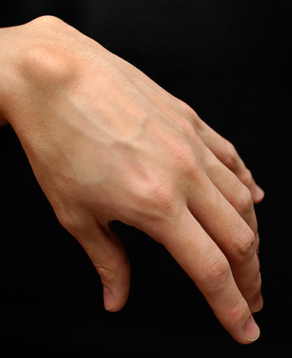

Slide 64
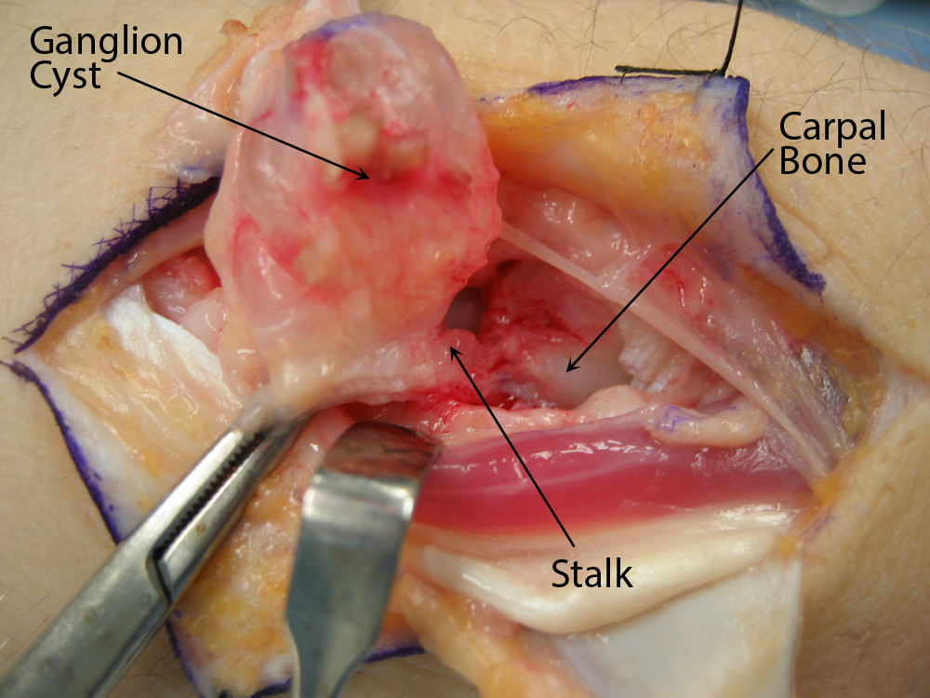

Slide 65
Underwater seal drainage
Chest drains also known as under water sealed drains (UWSD) are inserted to allow draining of the pleural spaces of air, blood or fluid, allowing expansion of the lungs and restoration of negative pressure in the thoracic cavity.
The underwater seal also prevents backflow of air or fluid into the pleural cavity.
Appropriate chest drain management is required to maintain respiratory function and haemodynamic stability.
Chest drains may be placed routinely in theatre, PICU and NICU; or in the emergency department and ward areas in emergency situations.

Slide 66
Definition of terms
Chylothorax: Collection of lymph fluid in the pleural space
Haemothorax: Collection of blood in the pleural space
Pneumothorax: Collection of air in the pleural space
Pleural effusion: Exudate or transudate in the pleural space

Slide 67
Tension Pneumothorax: One way valve effect which allows air to enter the pleural space, but not leave. Air builds up and forces a mediastinal shift.
This leads to decreased venous return to the heart and lung collapse/compression causing acute life-threatening respiratory and cardiovascular compromise.

Slide 68
Indications
Post operatively e.g. cardiac surgery, thoracotomy
Pneumothorax
Haemothorax
Chylothorax
Pleural effusions

Slide 69
contraindications
Coagulopathy.
Diaphragmatic hernia.
Scarring of pleural space (adhesion)

Slide 70
Pre procedure
Assess patient for pneumothorax, hemothorax or
presence of respiratory distress.
Obtain a chest X-ray.
Assemble drainage system.
Reassure the patient.
Explain to patients the steps of the procedure. Tell
the patient to expect a needle prick and a sensation
of slight pressure during infiltration anesthesia.
Position the patient according to physician preference.

Slide 71
Equipments
Tube thoracotomy tray.
Suture material.
Local anaesthetic.
Chest tube.
Syringes.
Needles.
Iodine
Sterile water.
Sterile scalpel and gloves.
Two large clamps.
Chest drainage system ,collection bottles

Slide 72
Free air in the pleural space (Pneumothorax) rises >>> tube is placed above the 2nd intercostal space.
Fluids (e.g.: Hemothorax ,pleural effusion) gravitate to the most dependent point >>>tubes places at the 4th to 5th intercostal space.
Mediastinal tubes are put in place after cardiac surgery to drain fluid from around heart.

Slide 74
Triangle of safety
The triangle of safety is an anatomical region in the axilla that forms a guide as to the safe position for intercostal catheter (ICC) placement. With the arm abducted, the apex is the axilla, and the triangle is formed by the:
lateral border of the pectoralis major anteriorly
lateral border of the latissimus dorsi posteriorly
inferiorly, by a horizontal line from the nipple (commonly the 5th intercostal space)

Slide 75
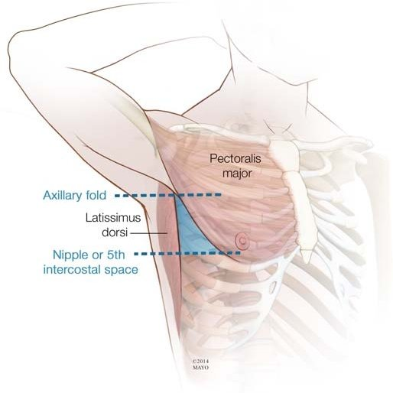

Slide 76
procedure
The skin is prepared and anesthetized using local anesthetic with a short 25 G needle.
The needle catheter is inserted through the needle into the pleural space.
A small incision through the muscle in the intercostal space is performed.
chest tube is inserted into the pleural space and connected to a drainage system

Slide 77
The catheter is attached to a connector/tubing and attached to drainage system (underwater-seal or commercial system).
The tube is sutured in place and covered with a sterile dressing.

Slide 79
Single bottle water seal system
Connecting or drainage tubing joins the patient's chest tube with a drainage tube that enters the drainage bottle.
The end of the glass rod is submerged in water, extending about 2-3 cm below the water level(The higher the fluid level, the more pressure it takes to push air through the fluid as it leaves the chest).
The water seal provides a low-resistance, one-way valve that allows air to leave the chest while preventing atmospheric air from being pulled into the chest during breathing.

Slide 80
Drainage depends upon gravity.
The second tube in the drainage bottle is a vent for the escape of any air drained from the lung. The air will bubble through the water and leave the chest drain system through the atmospheric vent.
Bubbling at the end of the drainage tube may or may not be visible. Bubbling may mean persistent air leaking from the lung or a leak in the system.
The water level in the bottle fluctuates as the patient breathes. It rises when the patient inhales and lowers when the patient exhales. Continuous bubbling in this bottle indicates air leakage.
Since fluid drains into this bottle, be certain to mark the water level prior to opening the system to the patient. This will allow correct measurement of patient drainage.

Slide 82
Acute complications
Hemothorax, usually from laceration of intercostals
vessel (may require thoracotomy)
Lung laceration (placed too deep).
Diaphragm / Abdominal cavity penetration (placed too low)
Tube placed subcutaneously (not in thoracic cavity)
Tube placed too far (pain)
Tube falls out (not secured)

Slide 83
Late complications
Blocked tube (clot).
Empyema (collection of pus within a naturally existing
anatomical cavity, such as the lung pleura)>> infection.
Pneumothorax after removal (poor technique)

Slide 84
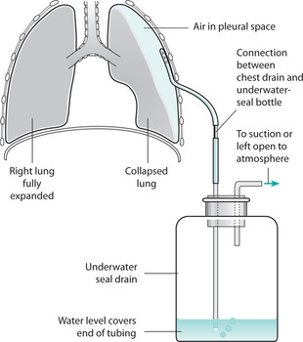

Slide 85
Surgical toileting
CLEAN-Wound with normal tissue
CLEAN CONTAMINATED-Wound with normal tissue that is colonized
CONTAMINATED-Wound contains foreign/infected material
INFECTED-Wound with pus present

Slide 86
Surgical debridement involves:
Gentle handling of tissues to minimize bleeding
Control of residual bleeding with compression, ligation or cautery
Recognition of dead or devitalized muscle: dark in colour, soft, easily damaged and it does not contract when pinched
Excising only a very thin margin of skin from the wound edge

Slide 87
Surgical toileting involves wound irrigation and debridement
Wound irrigation involves the continuous flow of a solution across an open wound surface to achieve wound hydration, to remove deeper debris, remove surface pathogens contained in exudates and to assist with visual exam

Slide 88
indications
Wound irrigation is indicated in the management of both acute and chronic wounds, and especially those that will be undergoing suturing, surgical repair, or debridement

Slide 89
contraindication
Irrigation may not be necessary for certain highly vascular areas such as the scalp.
Wounds with fistulas or sinuses with unknown depth should undergo careful evaluation before irrigation is performed to avoid forcing bacteria and debris containing fluids further into the wound or other body spaces.

Slide 90
Toileting includes
Cleaning of the skin around the wound with antiseptics
Irrigate the laceration using sterile saline in a 30-60ml syringe
Use tissue forceps or probe to expose the tissue and irrigate the entire depth and full extent of the wound
Press down the plunger with the thumbs of both hands to produce enough pressure to remove particulate matter and bacteria

Slide 91
Continue irrigation until the wound is visibly clean
Scrub the wound gently using a fine pore sponge to avoid damage of tissues and inflammation
After scrubbing, irrigate the wound
Debride all devitalized and necrotic tissue
Irrigate the wound again after debridement

Slide 92
After toileting , the wound is prepared for closure and dressing

Slide 93
Wound closure
The suturing of any incision or wound needs to take into consideration the site and tissues involved and the technique for closure should be chosen accordingly
Wound closure is done to facilitate wound healing and avoid scarring

Slide 94
Types of healing
Healing by primary intention occurs in wounds with dermal edges that are close together (e.g a scalpel incision). It is usually faster than by secondary intention, and occurs in four stages:
Hemostasis -the action of platelets and cytokines forms a haematoma and causes vasoconstriction, limiting blood loss at the affected area
Inflammation-a cellular inflammatory response acts to remove any cell debris and pathogens present

Slide 95
Proliferation – cytokines released by inflammatory cells drive the proliferation of the fibroblasts and the formation of granulation tissue
Remodelling – collagen fibres are deposited within the wound to provide strength in the region, with the fibroblasts subsequently undergoing apoptosis
The end result of healing by primary intention is (in most cases) a complete return to function, with minimal scarring and loss of skin appendages

Slide 96
Healing by secondary intention occurs when the sides of the wound are not opposed, therefore healing must occur from the bottom of the wound upwards.
It occurs in the same four stages as primary intention

Slide 97
staples
For many minor wounds, sutures are the gold-standard method for closure.
In a case where you have a linear laceration located on the scalp or extremities, it is a reasonable alternative to use staples.
The advantage is that they can be placed quickly. This is immensely useful in situations where there is brisk bleeding and in mass casualty settings where there are multiple wounds to which to attend.
They are also widely used to close postoperative incised wounds.
Staples are cost-effective, easily placed, require minimal training, and have similar healing times and infection rates as sutures.

Slide 98
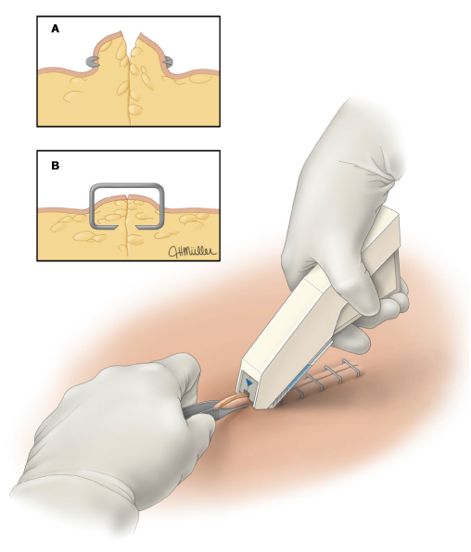

Slide 99
Adhesives
In percutaneous wounds or simple pediatric cases, skin glues are particularly useful as they are quick and relatively painless.
tapes and skin glues are a useful adjunct to deeper sutures too.
They are cause minimal wound inflammation, have a lower infection rate than sutures, and are removed easily.

Slide 100
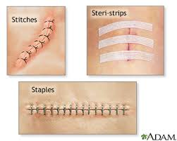

Slide 101
Sutures and techniques
Discussed in another presentation

