Slide 2
BIOCHEMISTRY

Slide 3
Biochemistry: Basic Concepts
Molecules of Life
Many of the most important molecules in your body are polymers.
Proteins, carbohydrates, and nucleic acids, all extremely large molecules, are formed from small monomer subunits.
Although lipids are usually not considered to be polymers, they, too, are formed from smaller molecules that have been linked together.

Slide 4
Biochemistry: Basic Concepts
Molecules of Life
You need relatively large amounts of proteins, carbohydrates, and lipids in your diet.
Complex reactions in your cells use some of these molecules and a few others to make a fourth group of biomolecules, the nucleic acids.

Slide 5
Biochemistry: Basic Concepts
Biochemistry
The study of the chemistry of living things is called biochemistry.
This science explores the substances involved in life processes and the reactions they undergo.
Other than water, which can account for 80 percent or more of the weight of an organism, most of the molecules of life—the biomolecules—are organic.

Slide 6
Biochemistry: Basic Concepts
Proteins
A protein is an organic polymer composed of amino acids bonded together in one or more chains.
An amino acid has a central carbon atom, to which are bonded a carboxyl group, an amino group, a hydrogen atom, and a variable side chain designated as R, as shown in the following structural formula.

Slide 7
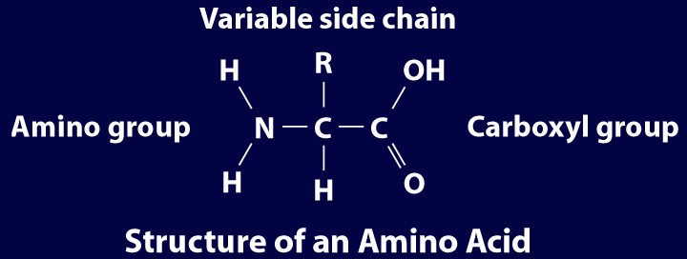
Biochemistry: Basic Concepts
Structure of an Amino Acid

Slide 8
Biochemistry: Basic Concepts
Structure of an Amino Acid
Amino acids bond to each other by forming a peptide bond, an amide group formed by a condensation reaction between the carboxyl group of one amino acid and the amino group of another.

Slide 9
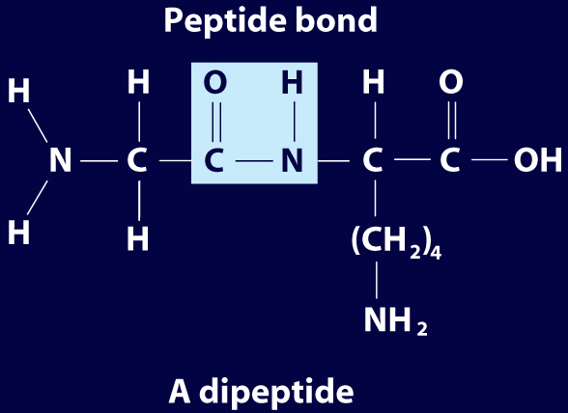
Biochemistry: Basic Concepts
Structure of an Amino Acid
Two amino acids linked by a peptide bond form a dipeptide.

Slide 10
Biochemistry: Basic Concepts
Structure of an Amino Acid
A chain of two or more amino acids linked by peptide bonds is called a peptide.
The term polypeptide is applied to a chain of ten or more amino acids.
Proteins may have one or several polypeptide chains, and each chain must have an exact sequence of amino acids.

Slide 11
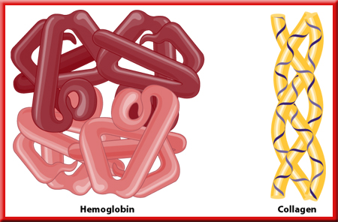
Biochemistry: Basic Concepts
Structure of an Amino Acid
Proteins can fold into either round, globular structures or long, fibrous structures.

Slide 12
Biochemistry: Basic Concepts
Structure of an Amino Acid
The amino acid chains are held in place in three-dimensional structures by attractive forces between the side chains of different
amino acids, which have been brought close together by the bending and folding of the polypeptide chains.

Slide 13
Biochemistry: Basic Concepts
Enzymes
Many of the proteins in an organism act as enzymes. These proteins catalyze chemical reactions—speeding up reactions or allowing the reactions to take place at a low temperature.

Slide 14
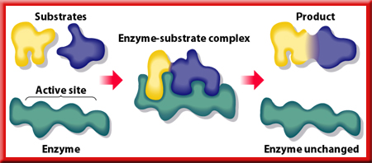
Biochemistry: Basic Concepts
Enzyme Action
Substrates are brought close together in the active sites of an enzyme, which lowers the activation energy of the reaction by facilitating the bonding together of the substrates to form a product.

Slide 15
Biochemistry: Basic Concepts
Carbohydrates
Familiar carbohydrates include sugars, starches, and cellulose.
Carbohydrates contain Carbon, Hydrogen and Oxygen in a 1:2:1 ratio.

Slide 16
Biochemistry: Basic Concepts
Monosaccharides
The simplest carbohydrates are the simple sugars, or monosaccharides, which commonly have five or six carbon atoms.
Glucose, the main ingredient in corn syrup, is a familiar monosaccharide.

Slide 17
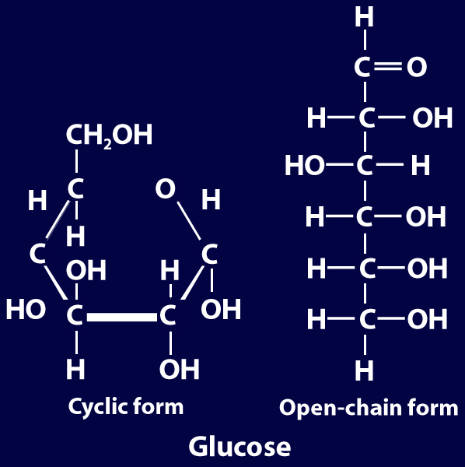
Biochemistry: Basic Concepts
Monosaccharides
Glucose has the molecular formula C₆H₁₂O₆ and can be represented by the following structures.

Slide 18
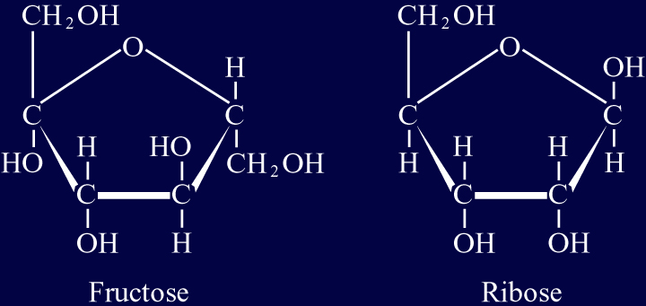
Biochemistry: Basic Concepts
Monosaccharides
The most common simple sugars are glucose, fructose, and ribose.

Slide 19
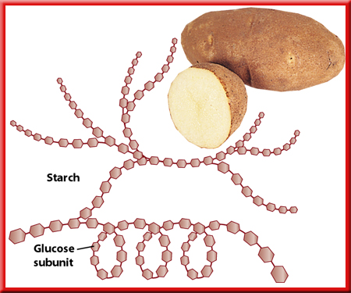
Biochemistry: Basic Concepts
Polysaccharides
A polymer of many monosaccharides bonded into a chain is called a polysaccharide.
Starch is a polysaccharide that consists only of glucose units.

Slide 20
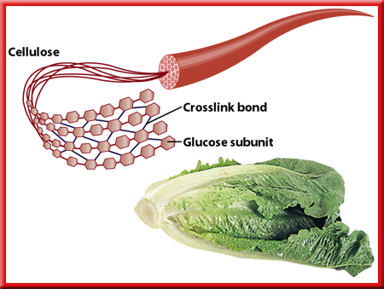
Biochemistry: Basic Concepts
Polysaccharides
Plants also link glucose units together in a different way to form the polysaccharide
cellulose, which forms plant cell walls.

Slide 21
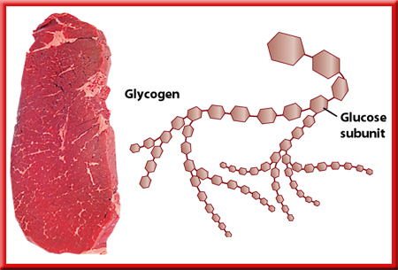
Biochemistry: Basic Concepts
Polysaccharides
Animals store glucose as a polysaccharide called glycogen, which is similar to starch.

Slide 22
Biochemistry: Basic Concepts
Lipids
Lipids are the nonpolar substances—fats, waxes, and oils—produced by living things.
Lipids are not polymers, and their chemical structures vary widely.
Lipids contain Carbon and Hydrogen in a 1:2 ratio, with only a small amount of Oxygen.

Slide 23
Biochemistry: Basic Concepts
Fatty Acids
The most familiar lipids are the plant oils and animal fats.
These lipids are esters of fatty acids, which are carboxylic acids with long, straight hydrocarbon chains usually having between 12 and 24 carbon atoms.

Slide 24
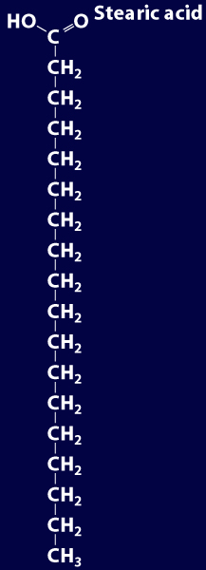
Biochemistry: Basic Concepts
Saturated Fatty Acid
The simplest fatty acids are the saturated fatty acids, which have no double bonds between carbon atoms.
Stearic acid is found in pork and beef tissue.

Slide 25
Biochemistry: Basic Concepts
Monounsaturated Fatty Acid
Many other fatty acids have one or more double bonds between carbon atoms and, as a result, are unsaturated fatty acids.
Oleic acid is a major component of olive oil.

Slide 26
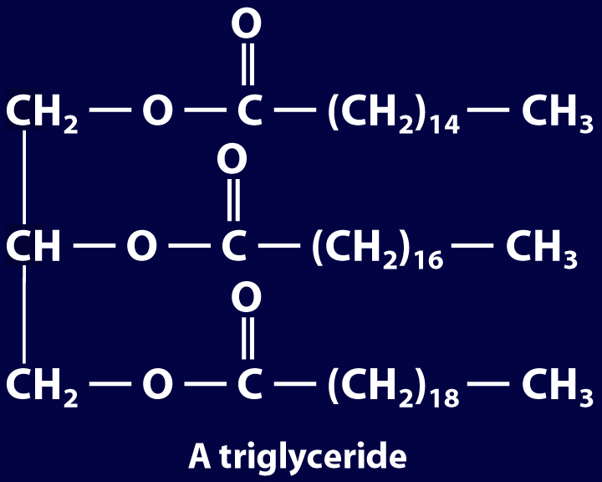
Biochemistry: Basic Concepts
Triglycerides
Animal fats and plant oils are made up primarily of triglycerides, molecules in which three fatty acids are bonded to a glycerol
molecule by ester linkages, as shown in the following diagram.

Slide 27
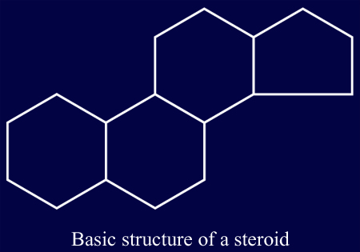
Biochemistry: Basic Concepts
Other Lipids
Another class of lipids, steroids, consists of compounds whose basic structure is very different from those of other lipids, as shown below.
Cholesterol, vitamin D, and some hormones are steroids.

Slide 28
Biochemistry: Basic Concepts
The Functions of Lipids
Lipids have two major biochemical roles in the body.
Excess energy absorbed by an organism can be stored as lipids. This is why humans store body fat if they eat too much or move to little.
The second use is as a chemical messenger (hormone). Many steroids are hormones.

Slide 29
Biochemistry: Basic Concepts
Nucleic Acids
The sequence of amino acids in a protein is determined by the genetic information coded into long-chain polymers called nucleic acids.
The monomers that make up nucleic acids are called nucleotides.

Slide 30
Biochemistry: Basic Concepts
Nucleic Acids
Each nucleotide is made up of three parts: a phosphate group, a five-carbon sugar, and a nitrogen-containing cyclic compound called a nitrogen base.
The structure of a nucleotide is shown.

Slide 31
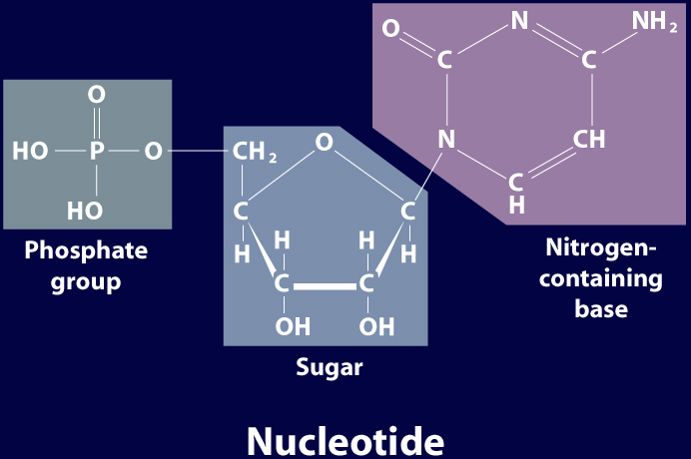
Biochemistry: Basic Concepts
Nucleic Acids

Slide 32
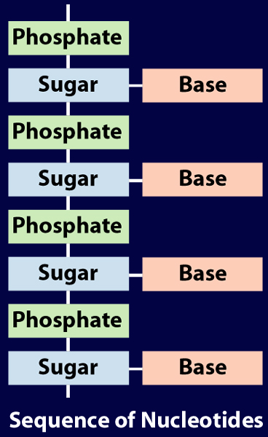
Biochemistry: Basic Concepts
Nucleic Acids

Slide 33
Biochemistry: Basic Concepts
Nucleic Acids
The common nucleic acids are DNA (deoxyribonucleic acid) and RNA (ribonucleic acid).
DNA contains the sugar deoxyribose and RNA contains the sugar ribose.
In DNA, the base Thymine bonds with Adenine; in RNA, Thymine is replaced with Uracil.
DNA is a double strand, RNA is a single strand.

Slide 34
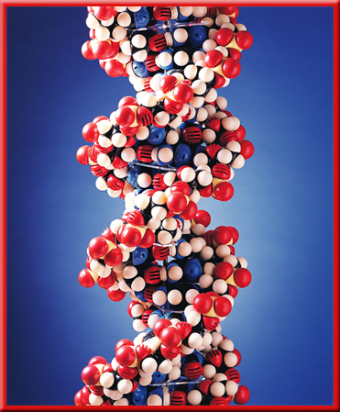
Biochemistry: Basic Concepts
The Structure of DNA
This model of a portion of a DNA molecule clearly shows its complexity.
A single DNA molecule contains many thousands of nucleotides.

Slide 35
Biochemistry: Basic Concepts
Base Pairing
The two chains of DNA are held together because the nitrogen bases of one chain are hydrogen-bonded to the nitrogen bases of the other chain.

Slide 36
Biochemistry: Basic Concepts
Base Pairing
Four different nitrogen bases are found in DNA: adenine, guanine, cytosine, and thymine.
Adenine hydrogen bonds to thymine, and guanine hydrogen bonds to cytosine.

Slide 37
Biochemistry: Basic Concepts
Base Pairing
The order of these four nitrogen bases along one of the DNA chains provides the information for the sequences of amino acids in proteins.
Cell mechanisms “read” the DNA sequence in groups of three bases called triplets.
Each triplet codes for a specific amino acid or tells the cell to start or stop making a protein.

Slide 38
Basic Assessment Questions
Question 1
Label the amino group and the carboxyl group of the dipeptide.

Slide 39
Basic Assessment Questions
Answer

Slide 40
Basic Assessment Questions
Question 2
Draw an arrow pointing to the peptide bond.

Slide 41
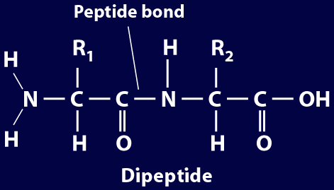
Basic Assessment Questions
Answer

Slide 42
Basic Assessment Questions
Question 3
Draw a square around each variable side chain.

Slide 43
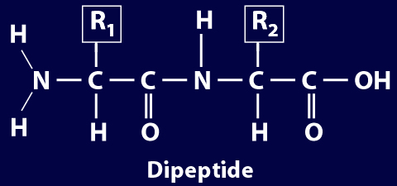
Basic Assessment Questions
Answer

Slide 44
Basic Assessment Questions
Question 4
Glucose is a(n)
a. polysaccharide.
b. amino acid.
c. part of cellulose.
d. 6-carbon sugar.

