Slide 1
Anatomy [HAT 116]
T.N WAWERU
BSC[CMED & SURG]

Slide 2
MusculoSkeletal System
Divided into two functional parts :
axial skeleton :
consists of the bones of the head (cranium or skull), neck (hyoid bone and cervical vertebrae), and trunk (ribs, sternum, vertebrae, and sacrum).
appendicular skeleton :
consists of the bones of the limbs, including those forming the pectoral (shoulder) and pelvic girdles

Slide 4
Cartilage and Bones
Cartilage
is a resilient, semirigid form of connective tissue that forms parts of the skeleton where more flexibility is required eg costal cartilages attach the ribs to the sternum
Blood vessels do not enter cartilage (i.e., it is avascular); consequently, its cells obtain oxygen and nutrients by diffusion.
The proportion of bone and cartilage in the skeleton changes as the body grows; the younger a person is, the more cartilage her or she has.
The bones of a newborn are soft and flexible because they are mostly composed of cartilage.

Slide 5
Bone
a living tissue, is a highly specialized, hard form of connective tissue that makes up most of the skeleton.
Functions :
Support for the body and its vital cavities.
Protection for vital structures.
The mechanical basis for movement (leverage).
Storage for salts (e.g., calcium).
A continuous supply of new blood cells (produced by the marrow contained within many bones).

Slide 10
Definition of terms in bones
Periosteum –
fibrous connective tissue covering surrounds each skeletal element like a sleeve, except where articular cartilage
perichondrium-
around cartilage
The periosteum and perichondrium nourish the external aspects of the skeletal tissue.
They are capable of laying down more cartilage or bone (particularly during fracture healing) and provide the interface for attachment of tendons and ligaments.

Slide 12
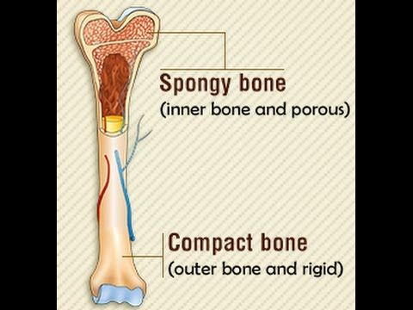
TYPES OF BONES
compact bone
spongy (trabecular or cancellous) bone
All bones have a superficial thin layer of compact bone around a central mass of spongy medullary bone.

Slide 16
Classification of Bones
Long bones are tubular (e.g., the humerus in the arm).
Short bones are cuboidal and are found only in the ankle (tarsus) and wrist (carpus).
Flat bones usually serve protective functions (e.g., those forming the cranium protect the brain).
Irregular bones (e.g., in the face) have various shapes other than long, short, or flat.
Sesamoid bones (e.g., the patella or knee cap)

Slide 18
Bone Markings and Formations
Capitulum: small, round, articular head (e.g., the capitulum of the humerus).
Condyle: rounded, knuckle-like articular area, usually occurring in pairs (e.g., the lateral femoral condyle).
Crest: ridge of bone (e.g., the iliac crest).
Epicondyle: eminence superior to a condyle (e.g., the lateral epicondyle of the humerus).
Facet: smooth flat area, usually covered with cartilage, where a bone articulates with another bone (e.g., the superior costal facet on the body of a vertebra for articulation with a rib).

Slide 19
Foramen: passage through a bone (e.g., the obturator foramen).
Fossa: hollow or depressed area (e.g., the infraspinous fossa of the scapula).
Groove: elongated depression or furrow (e.g., the radial groove of the humerus).
Head (L. caput): large, round articular end (e.g., the head of the humerus).
Line: linear elevation (e.g., the soleal line of the tibia).
Malleolus: rounded process (e.g., the lateral malleolus of the fibula).
Notch: indentation at the edge of a bone (e.g., the greater sciatic notch).
Protuberance: projection of bone (e.g., the external occipital protuberance).

Slide 20
Spine: thorn-like process (e.g., the spine of the scapula).
Spinous process: projecting spine-like part (e.g., the spinous process of a vertebra).
Trochanter: large blunt elevation (e.g., the greater trochanter of the femur).
Trochlea: spool-like articular process or process that acts as a pulley (e.g., trochlea of the humerus).
Tubercle: small raised eminence (e.g., the greater tubercle of the humerus).
Tuberosity: large rounded elevation (e.g., the ischial tuberosity).

Slide 21
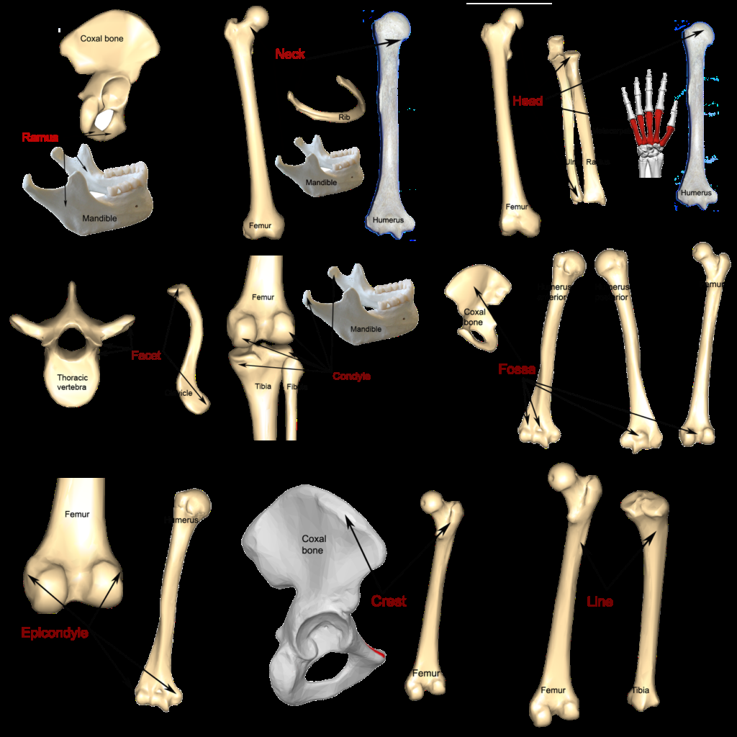

Slide 22
BONE DEVELOPMENT
In early stages of embryonic development embroys skeleton consist of fibrous membrane and hyaline cartilage.
By the six or seventh week actual bone development happens ossification[osteogenesis] begins.
There are two osteogenic pathway:
intramembraneous ossification - mesenchymal models of bones form during the embryonic period, and direct ossification of the mesenchyme begins in the fetal period.
Endochondral ossification

Slide 23
Endochondral ossification
The mesenchymal cells condense and differentiate into chondroblasts, dividing cells in growing cartilage tissue, thereby forming a cartilaginous bone model.
In the midregion of the model, the cartilage calcifies (becomes impregnated with calcium salts), and periosteal capillaries (capillaries from the fibrous sheath surrounding the model) grow into the calcified cartilage of the bone model and supply its interior.
These blood vessels, together with associated osteogenic (bone-forming) cells, form a periosteal bud

Slide 24
The capillaries initiate the primary ossification center, so named because the bone tissue it forms replaces most of the cartilage in the main body of the bone model.
The shaft of a bone ossified from the primary ossification center is the diaphysis, which grows as the bone develops.
secondary ossification centers appear in other parts of the developing bone after birth; the parts of a bone ossified from these centers are epiphyses.

Slide 25
The chondrocytes in the middle of the epiphysis hypertrophy, and the bone matrix (extracellular substance) between them calcifies.
Epiphysial arteries grow into the developing cavities with associated osteogenic cells.
The flared part of the diaphysis nearest the epiphysis is the metaphysis.

Slide 26
For growth to continue, the bone formed from the primary center in the diaphysis does not fuse with that formed from the secondary centers in the epiphyses until the bone reaches its adult size.
Thus, during growth of a long bone, cartilaginous epiphysial plates intervene between the diaphysis and epiphyses
These growth plates are eventually replaced by bone at each of its two sides, diaphysial and epiphysial.

Slide 27
When this occurs, bone growth ceases, and the diaphysis fuses with the epiphyses.
The seam formed during this fusion process (synostosis) is particularly dense and is recognizable in radiographs as an epiphysial line.
The epiphysial fusion of bones occurs progressively from puberty to maturity.
Ossification of short bones is similar to that of the primary ossification center of long bones, and only one short bone, the calcaneus (heel bone), develops a secondary ossification center.

Slide 29
BLOOD AND NERVE SUPPLY OF BONES
The large nutrient artery (or arteries) supplies the marrow, spongy bone, and deeper compact bone of the diaphysis and metaphyses.
Small branches from the periosteal arteries supply most of the compact bone from the superficial aspect.
The haversian canal systems enable blood to penetrate the compact bone to nourish the osteocytes (bone cells).
Epiphysial and metaphysial arteries supply the ends of long bones.
The periosteum is also rich in sensory (periosteal) nerves.

Slide 39
JOINTS
Definition:is a union or junction between two or more bones or rigid parts of the skeleton.

Slide 41
CLASSIFICATION OF JOINTS
based on the manner or type of material by which the articulating bones are united.
synovial joints are united by a joint (articular) capsule spanning and enclosing an articular cavity. Have synovial fluid between the joint. Eg knee joint.
fibrous joints are united by fibrous tissue. Eg structure of the cranium
cartilaginous joints are united by hyaline cartilage or fibrocartilage. Eg early development of bones .

Slide 43
major types of synovial joints
Plane joints permit gliding or sliding movements in the plane of the articular surfaces. Eg acromioclavicular joint
Hinge joints permit flexion and extension only
Saddle joints permit abduction and adduction as well as flexion and extension, movements occurring around two axes at right angles to each other; thus saddle joints are biaxial joints that allow movement in two planes, sagittal and frontal. carpometacarpal joint at the base of the 1st digit (thumb) is a saddle joint.

Slide 44
Condyloid joints permit flexion and extension as well as abduction and adduction; thus condyloid joints are also biaxial. However, movement in one plane (sagittal) is usually.eg metacarpophalangeal joints (knuckle joints)
Ball and socket joints allow movement in multiple axes and planes: flexion and extension, abduction and adduction, medial and lateral rotation, and circumduction; thus ball and socket joints are multi-axial joints. Eg hip joint,shoulder joint
Pivot joints permit rotation around a central axis; thus they are uniaxial

Slide 57
Joint Vasculature and Innervation
Joints receive blood from articular arteries that arise from the vessels around the joint.
The arteries often anastomose (communicate) to form networks (periarticular arterial anastomoses) to ensure a blood supply to and across the joint in the various positions assumed by the joint.
Articular veins are communicating veins that accompany arteries (L. venae comitantes) and, like the arteries, are located in the joint capsule, mostly in the synovial membrane.

Slide 58
Nerve supply
Joints have a rich nerve supply; the nerve endings are in the joint capsule.
In the distal parts of the limbs (hands and feet), the articular nerves are branches of the cutaneous nerves supplying the overlying skin.
However, most articular nerves are branches of nerves that supply the muscles that cross and therefore move the joint.
Hilton's Law states that the nerves supplying a joint also supply the muscles moving the joint or the skin covering their distal attachments.

Slide 59
Joints transmit a sensation called proprioception, which provides an awareness of movement and position of the parts of the body.
The synovial membrane is relatively insensitive.
Pain fibers are numerous in the fibrous layer and associated ligaments, causing considerable pain when the joint is injured.
The sensory nerve endings respond to the twisting and stretching that occurs during sports activities such as basketball.
People with arthritis will confirm that joints are well supplied with pain endings.

