Slide 1
Mechanisms of cell transport across the cell membrane
Samuel N. Kiurire

Slide 2
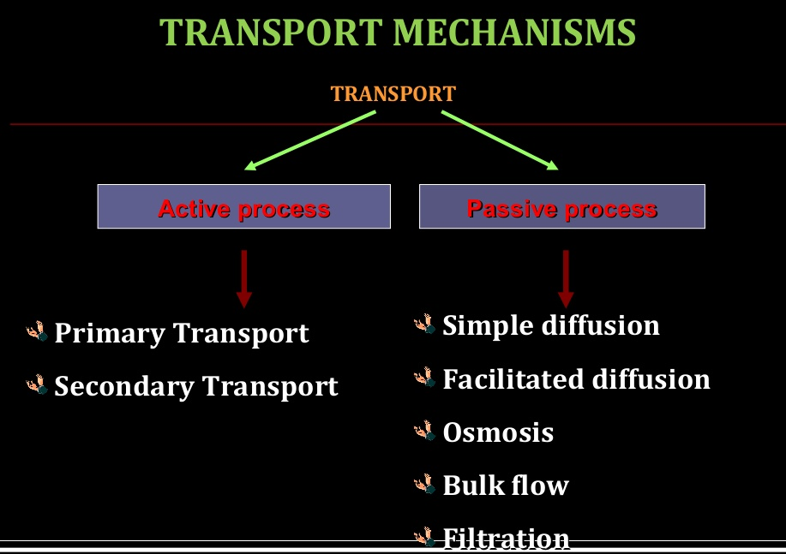
There are several mechanisms of transport across cellular membranes. Primary pathways include exocytosis, endocytosis, movement through ion channels, and primary and secondary active transport.

Slide 3
Passive Transport
Passive transport is the movement of molecules in or out of the cell without the use of energy
Can only occur if the molecules moving in and out of the cell are:
  Small
  Uncharged (meaning they contain NO + or – which are ions)
  Move from an area of high concentration to an area of low concentration
There are three types of passive transport: diffusion, osmosis, and facilitated diffusion

Slide 4
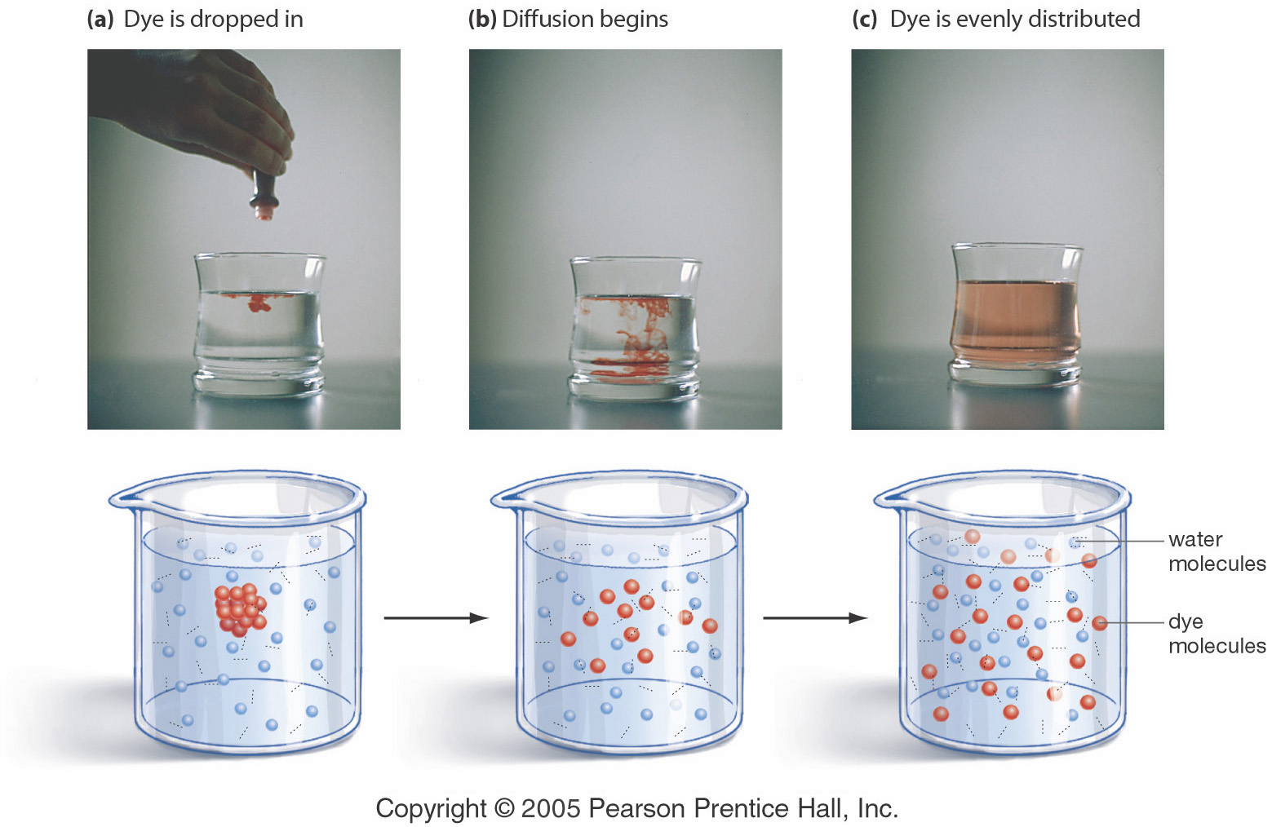
Diffusion
Movement of particles from an area of higher concentration to an area of lower concentration until an equilibrium is established
Doesn’t require energy
In the cell membrane if a substance has an unequal concentration on either side the particles will move to the area of low concentration until an equilibrium is established

Slide 5
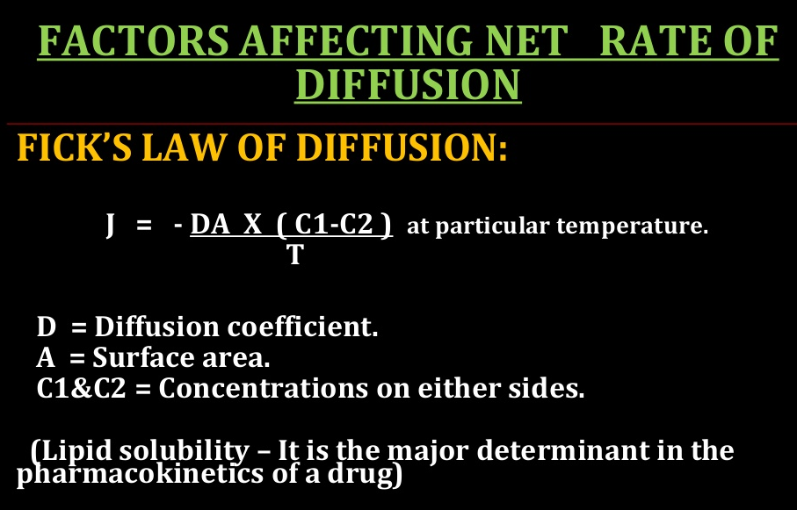

Slide 6
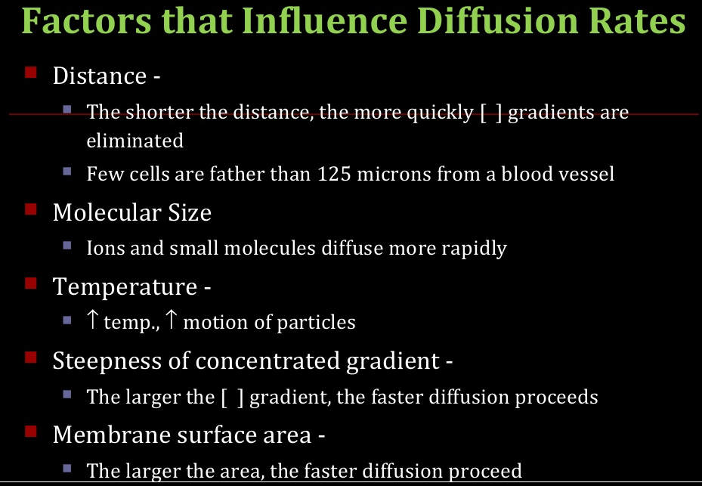

Slide 7
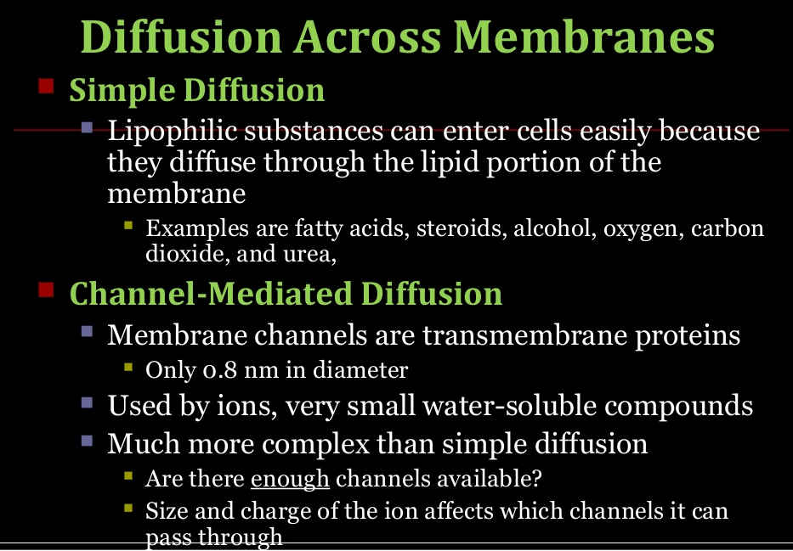

Slide 8
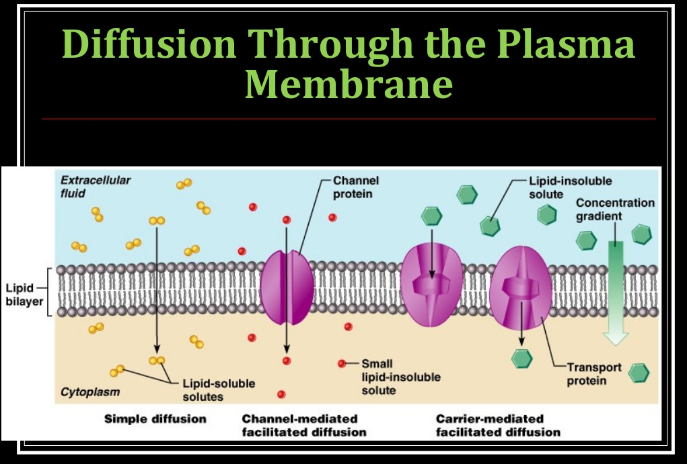

Slide 9
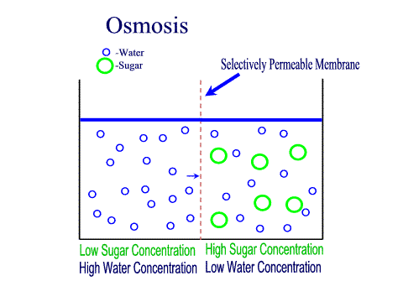
Osmosis
Diffusion of water across a selectively permeable membrane (some substances can pass through and some can’t)
  Moves from HIGH water concentration to LOW water concentration
    Water is attracted to solutes (like salt) so it will also travel to areas of low solute concentration to high solute concentration.
Notes:
Semi-permeable membrane is permeable to water, but not to sugar

Slide 10
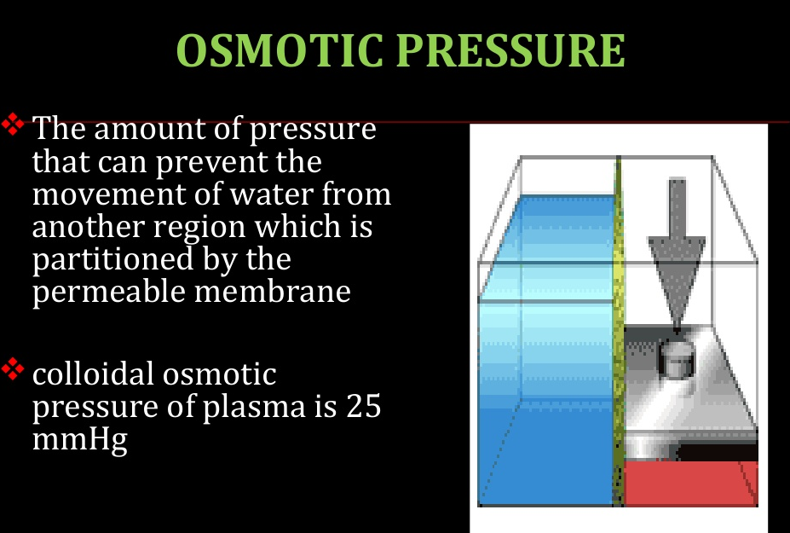

Slide 11
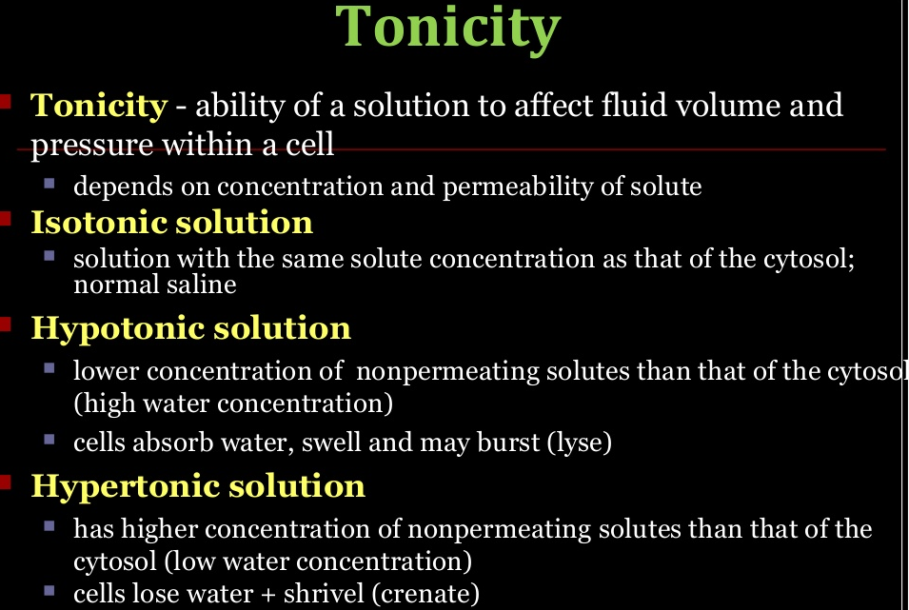
Notes:
Cytosol: the aqueous component of the cytoplasm of a cell, within which various organelles and particles are suspended.

Slide 12
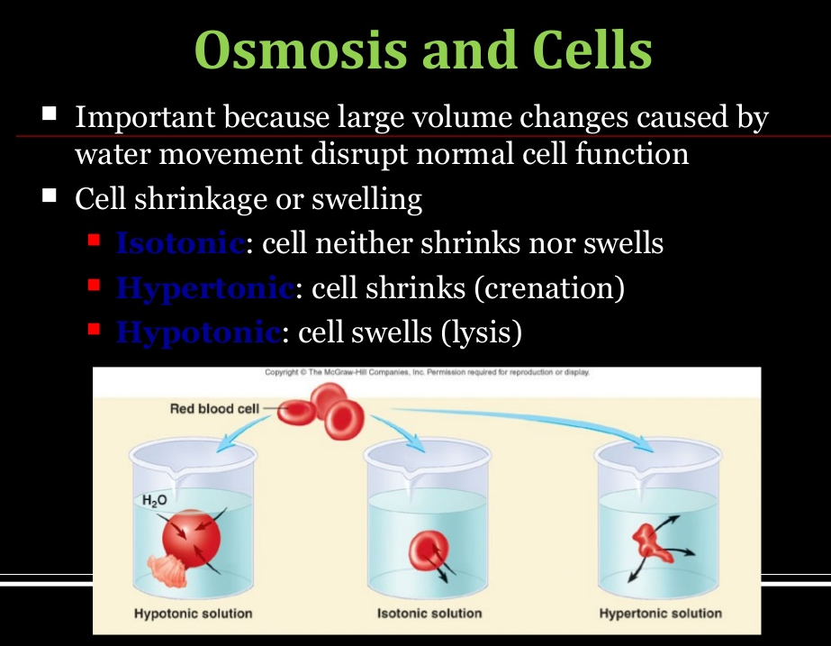

Slide 13
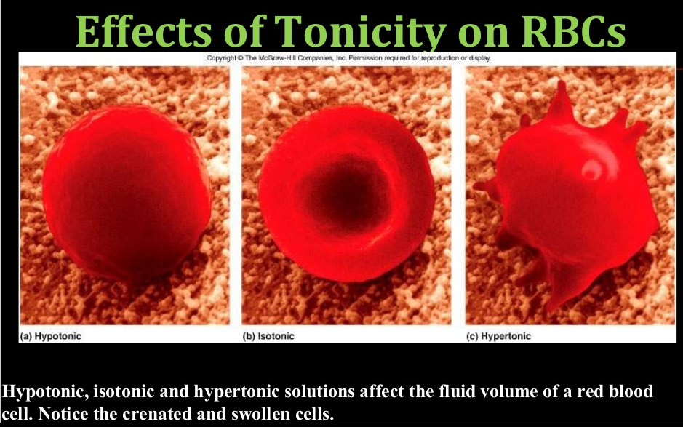

Slide 14
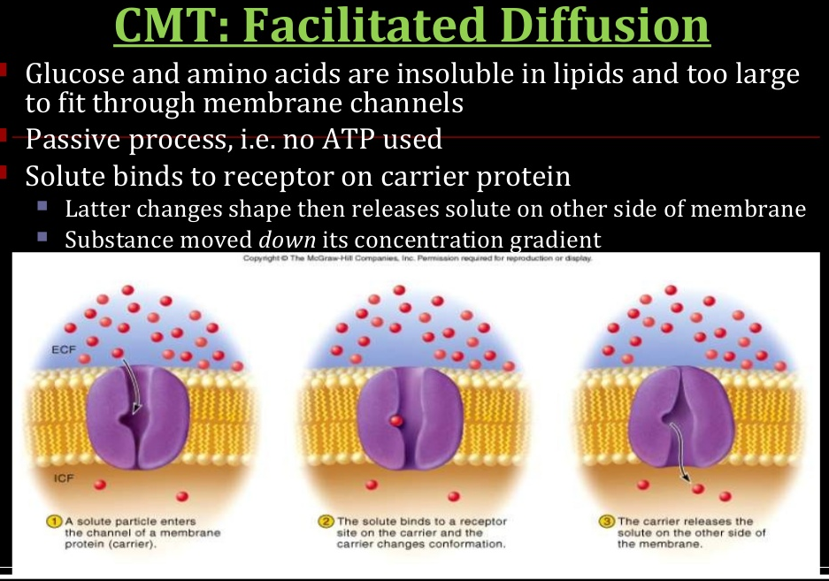

Slide 15
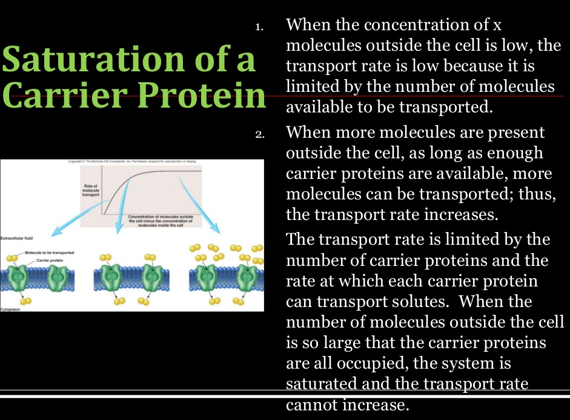

Slide 16
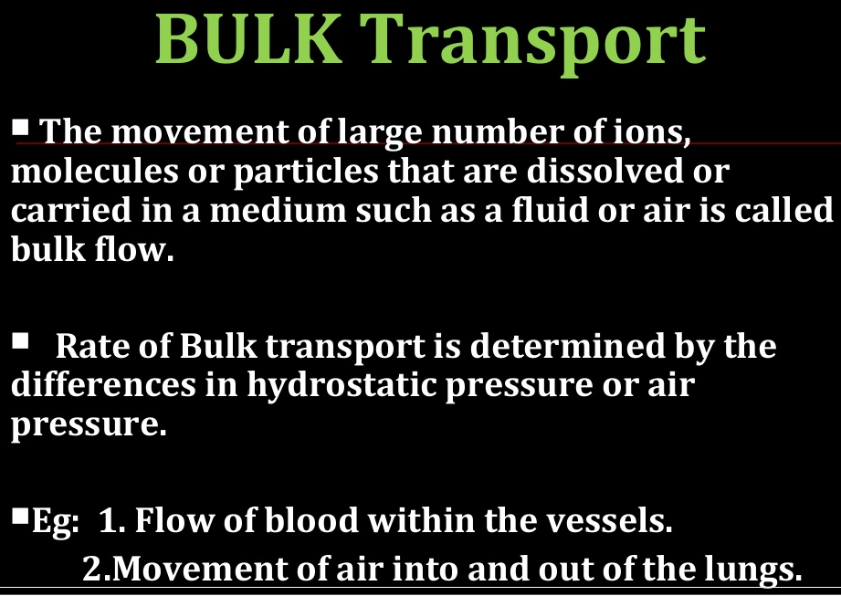

Slide 17
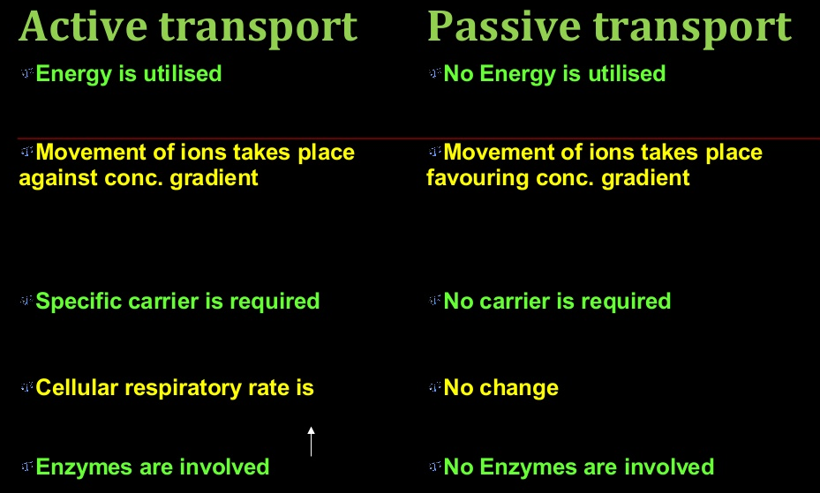

Slide 18
Further Reading
Active Transport

Slide 19
To Be Continued
Thank you

Slide 20
Active Transport
Active Transport
Active transport is the movement of molecules from LOW to HIGH concentration.
Energy is required as molecules must be pumped against the concentration gradient.
Proteins that work as pumps are called protein pumps.

Slide 21
Active Transport cnt’d…
Ex: Body cells must pump carbon dioxide out into the surrounding blood vessels to be carried to the lungs for exhale. Blood vessels are high in carbon dioxide compared to the cells, so energy is required to move the carbon dioxide across the cell membrane from LOW to HIGH concentration.
outside of cell
Carbon Dioxide molecules
inside of cell

Slide 22
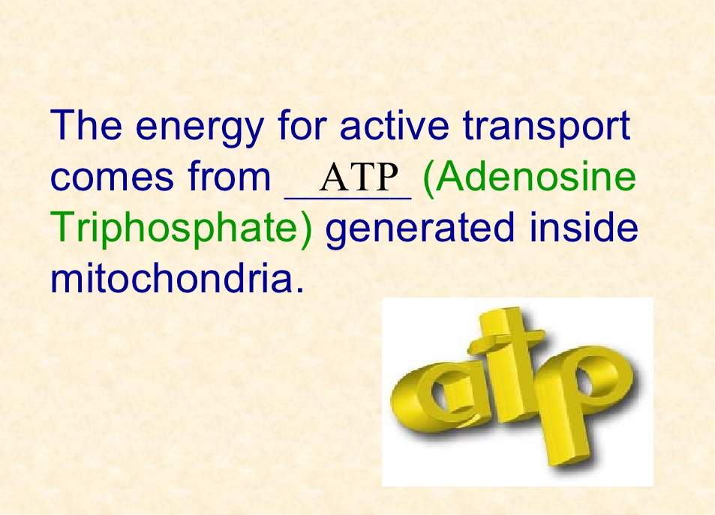

Slide 23
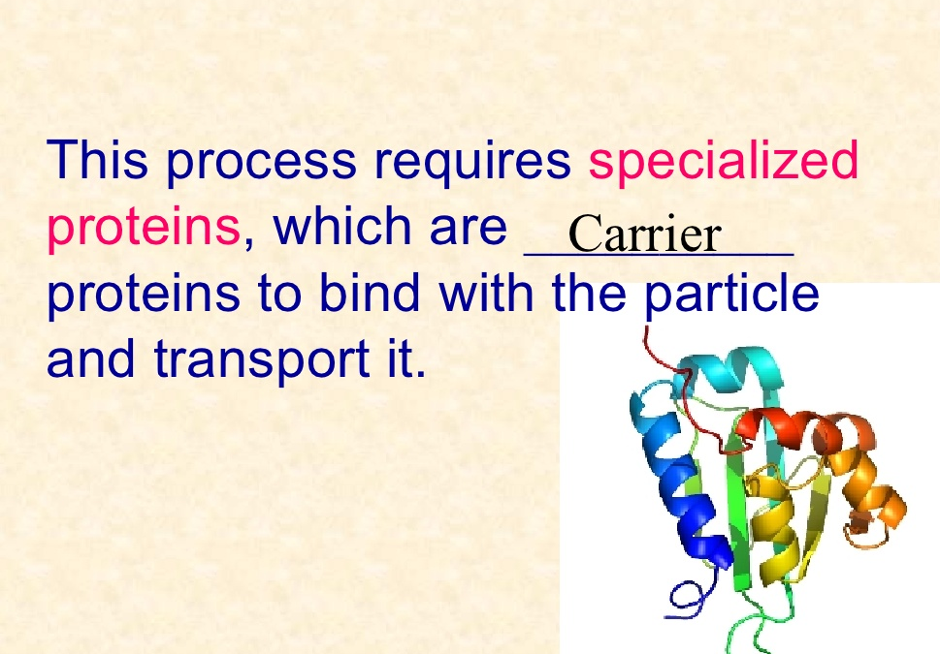

Slide 24
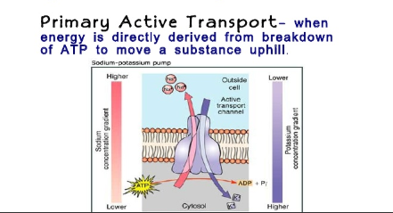

Slide 25
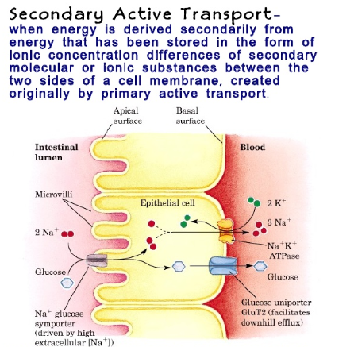

Slide 26
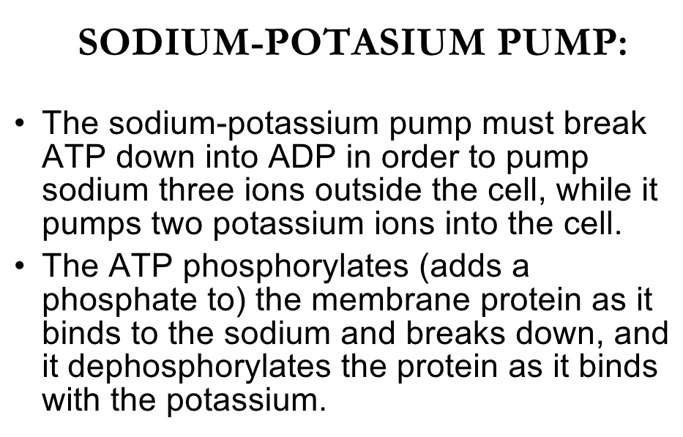
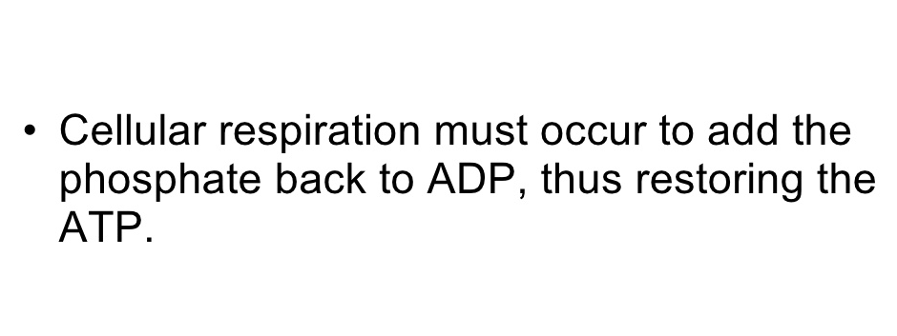

Slide 27
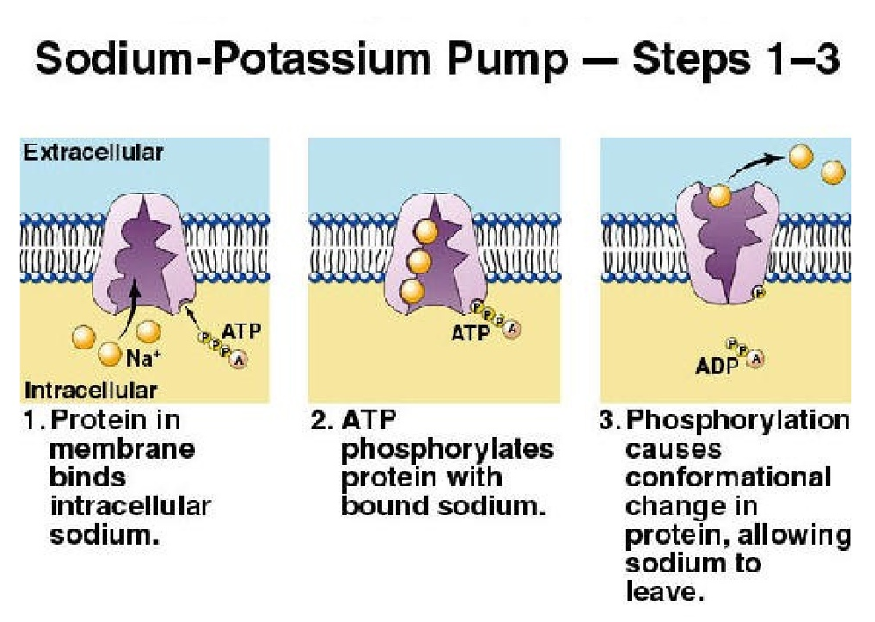

Slide 28
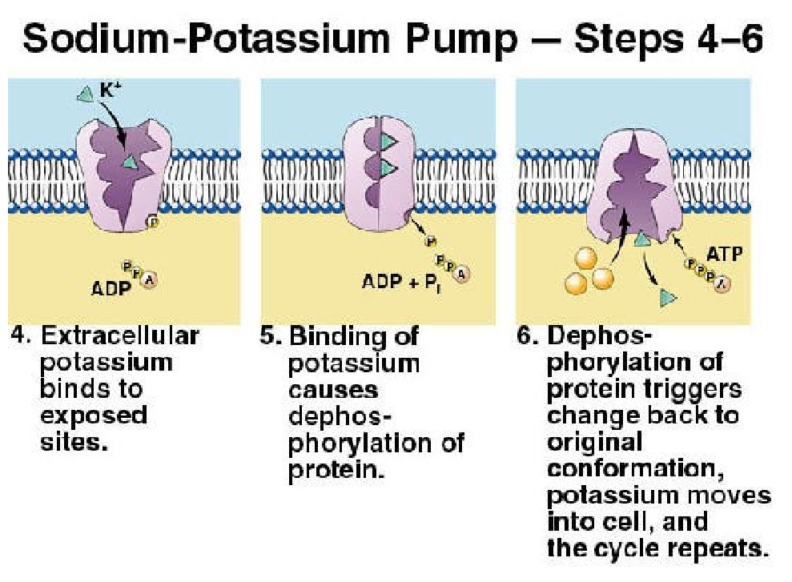

Slide 29
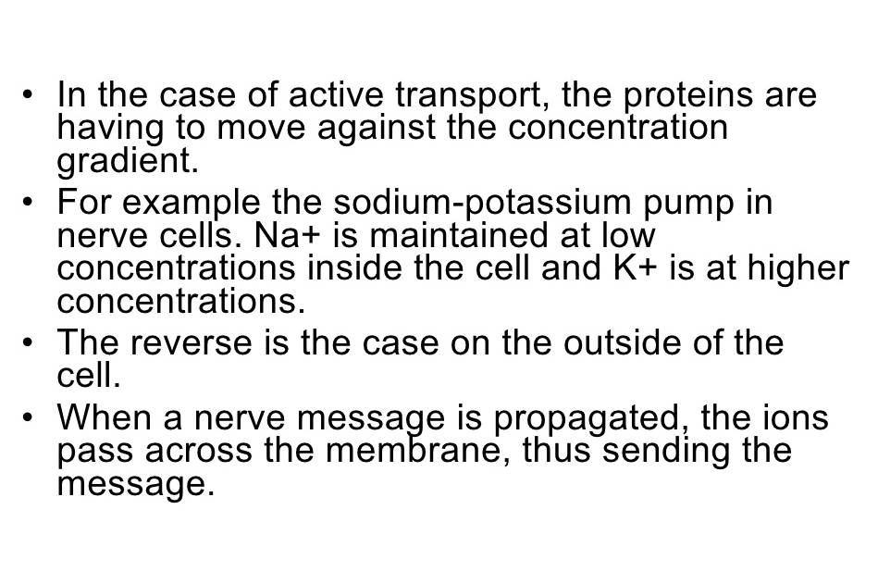

Slide 30
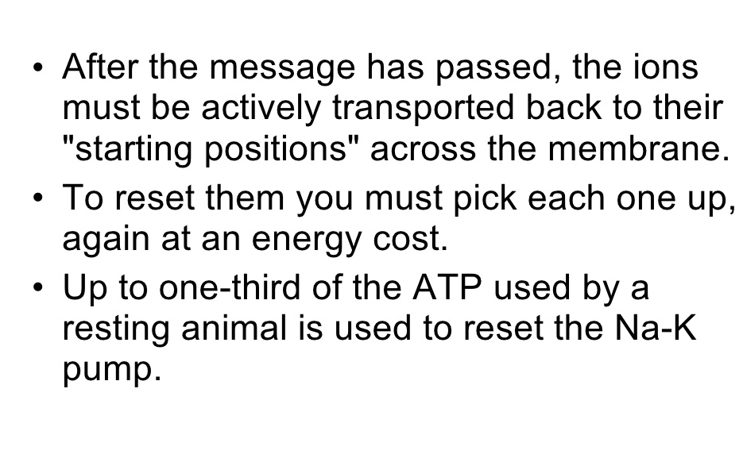

Slide 31
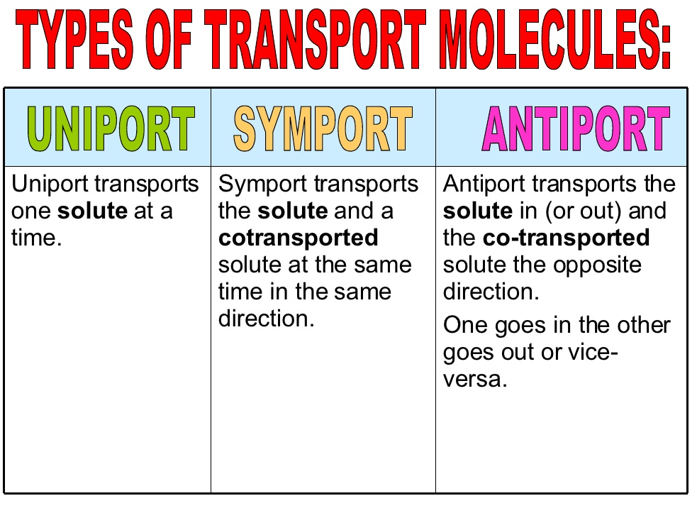

Slide 32
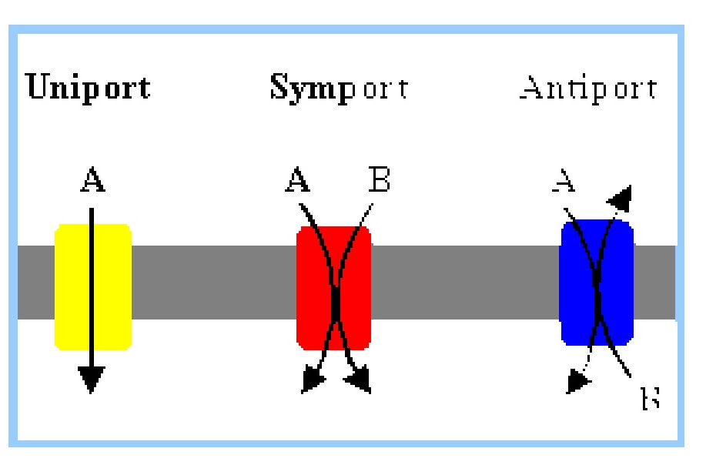

Slide 33
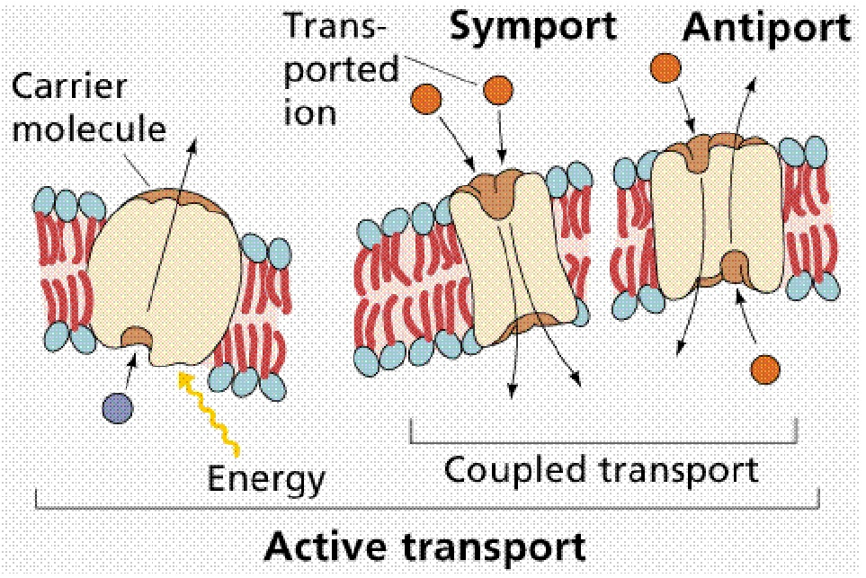

Slide 34
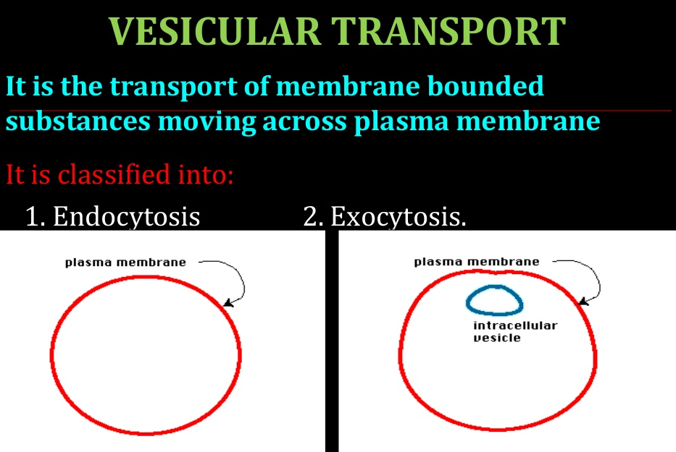

Slide 35
EXOCYTOSIS
Vesicles containing material for export are targeted to the cell membrane, where they bond with cell membrane.
The area of fusion then breaks down, leaving the contents of the vesicle outside and the cell membrane intact.
Note that secretion from the cell occurs via two pathways.
In the nonconstitutive pathway, proteins from the Golgi apparatus initially enter secretory granules, where processing of prohormones to the mature hormones occurs before exocytosis.
The other pathway, the constitutive pathway, involves the prompt transport of proteins to the cell membrane in vesicles, with little or no processing or storage.

Slide 36
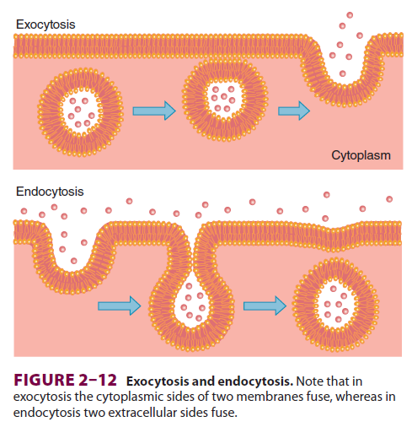

Slide 37
ENDOCYTOSIS
Endocytosis is the reverse of exocytosis.
There are various types of endocytosis named for the size of particles being ingested as well as the regulatory requirements for the particular process.
These include phagocytosis, pinocytosis, clathrin-mediated endocytosis, etc.

Slide 38
ENDOCYTOSIS cnt’d…
Phagocytosis (“cell eating”) is the process by which bacteria, dead tissue, or other bits of microscopic material are engulfed by cells such as the polymorphonuclear leukocytes(WBC) of the blood.
Pinocytosis (“cell drinking”) is a similar process with the vesicles much smaller in size and the substances ingested are in solution.

Slide 39
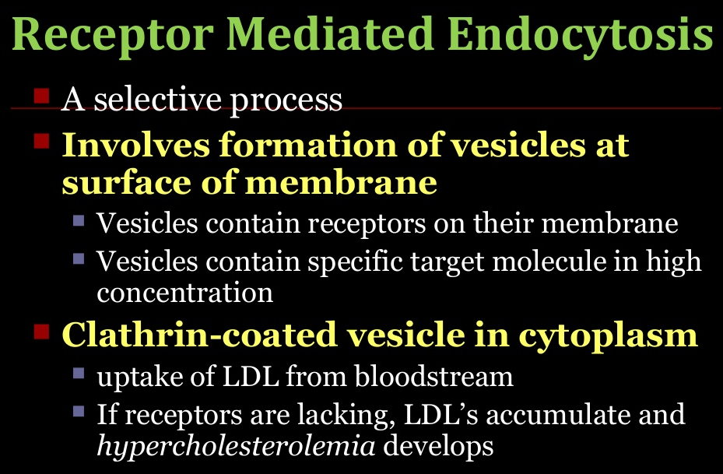
ENDOCYTOSIS cnt’d…

Slide 40
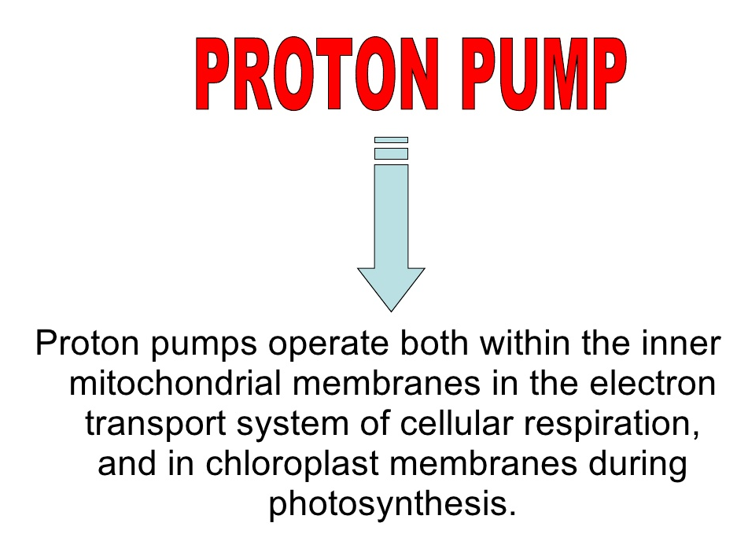

Slide 41
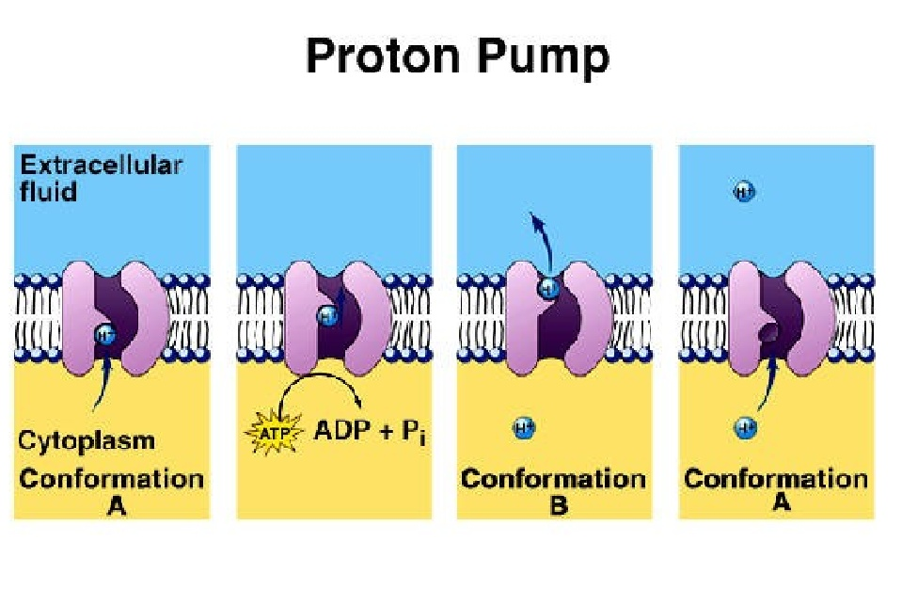

Slide 42
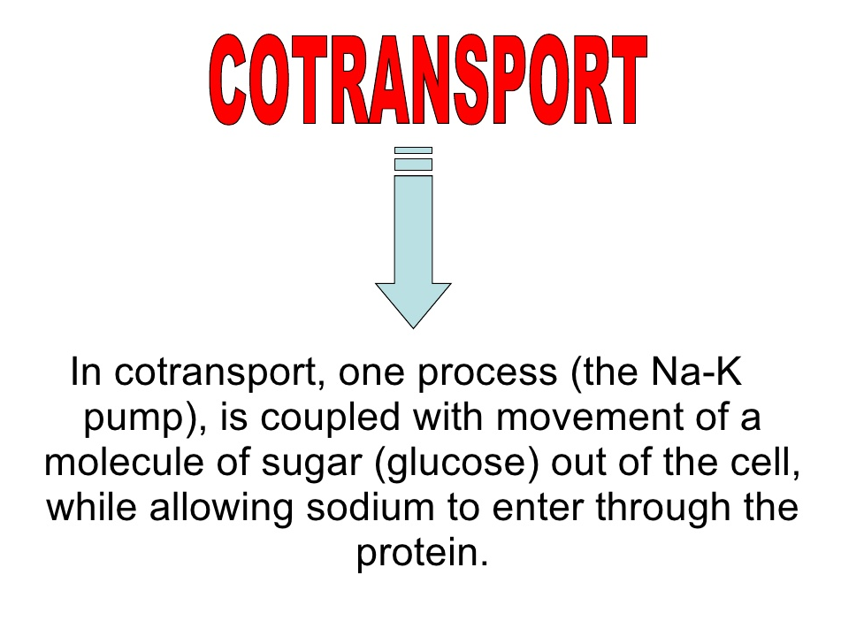

Slide 43
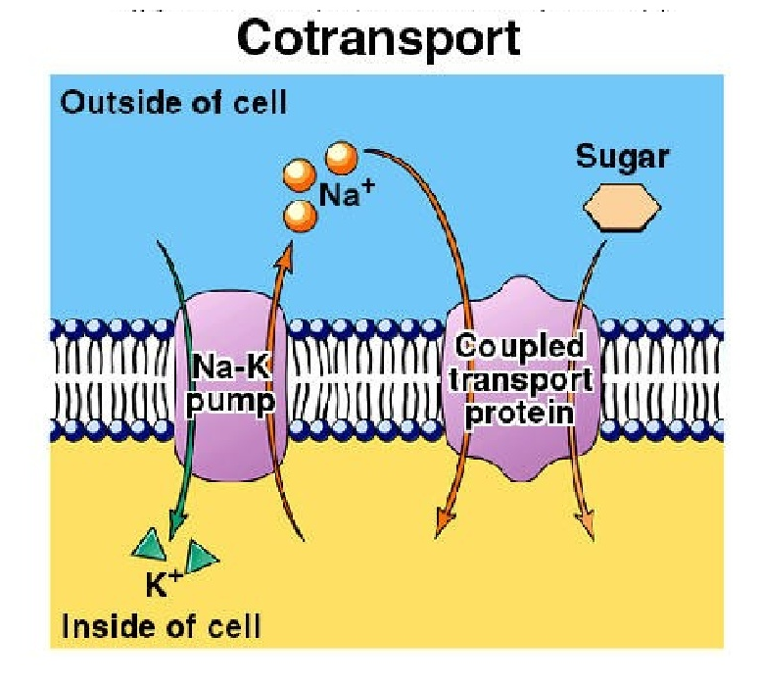

Slide 44
End of Presentation
Thank you

