Slide 1
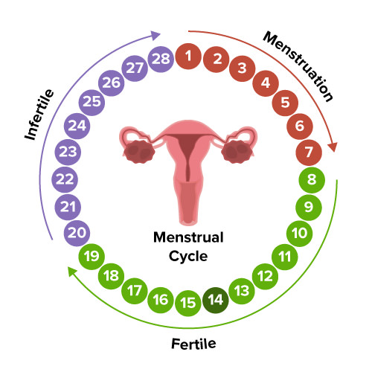
Hormonal cycle
By Rachel Nyamu
Agkhan university
BscN 2022 Dec
558531

Slide 2
Outline
By the end of the topic the students will be able to:
Describe the stages of endometrial/ovulation cycle and the hormones involved
Will be able to identify the hormones involved in the hormonal cycle and their functions

Slide 3
Hormones and their functions

Slide 4
Menstrual /Endometrial cycle
Definition
Menstrual cycle is the physiological changes that occur in the uterus to receive a fertilized oocyte
Characterized by the fall of estrogen and progesterone hormone levels.

Slide 5
Phase of Menstrual flow
1. Menstrual phase days 1-5
Often called the menstruation, bleeding, or periods phase
The menstrual phase is the first stage of the menstrual cycle
It begins at puberty, ranging from the ages of 10 to 16, and ends at menopause at an average age of 51
The usual duration of the menstrual flow is 3-5 days, but flows as shorts as 1 day and as long as 8 days can occur in a normal female.

Slide 6
Conti………………..
The amount of blood loss can range from slight spotting to 80 mL and the average being 30 mL. Loss of more than 80 mL of the blood is considered abnormal
Various factors can affect the amount of blood flow, including medications, the thickness of the endometrium, blood disorders, and disorders of blood clotting
The spiral arteries of the endometrium goes into spasm withdrawing blood from it and it becomes necrosed(dies)
Endometrium is shed down to the to the basal layer along with the unfertilized oocyte

Slide 7
menstrual problems
Premenstrual syndrome (PMS) – hormonal events before a period can trigger a range of side effects in women at risk, including fluid retention, headaches, fatigue and irritability.
Dysmenorrhea–Certain hormones are thought to cause the uterus to contract stronger than normal in order to expel its lining..
Menorrhagia – Heavy bleeding. if left untreated, this can cause anemia.
Amenorrhea – or absence of menstrual periods. This is considered abnormal, except during pre-puberty, pregnancy, lactation and post menopause. Possible causes include low or high body weight and excessive exercise

Slide 8
Phase 2
The proliferative phase day 6-14
It follows the menstrual phase and lasts until ovulation
There is formation of a new layer of endometrium
During this phase, a primordial follicle begins to mature into a Graafian follicle
The main hormone during this phase is estrogen secreted by the graffian follicle
By the end of this phase the endometrium consists of three layer
Basal layer: lies immediately after the myometrium 1mm thick
The functional layer: lies on top of the basal layer2.5mm thick. Change constantly depending on hormonal influence
Layer of cuboidal ciliated epithelium: covers the functional layer

Slide 9
Endometrium layers

Slide 10
Phase 3
The Secretory phase day 15-28(post ovulatory phase
Follows proliferative phase and is simultaneous with ovulation
It is the final phase of the uterine cycle and it corresponds to the luteal phase of the ovarian cycle
Under the influence of progesterone and oestrogen secreted by the corpus luteum
progesterone, which plays a vital role in making the endometrium receptive to the implantation of a a fertilized egg

Slide 11
Cont………………
Functional layer of endometrium thickens to approx. 3.5mm
It becomes spongy the cervical mucus thickens
Blood supply to the area is increased and more nutritive secretions are produced
Lasts 7 days awaiting the fertilized oocyte

Slide 12
The three stages of uterine cycle

Slide 13
Ovarian cycle
The series of changes in the ovary during which the follicle matures, the ovum is shed, and the corpus luteum develops
Has three phases
Follicular
Ovulation
Luteal phase

Slide 14
1. Follicular phase maturation phase
This process is guided via hormones released by the hypothalamus and the pituitary gland.
The follicular phase describes the development of the follicle in response to follicle stimulation hormone ( FSH ). As luteinizing hormone ( LH ) and FSH levels increase they stimulate ovulation, or the release of a mature oocyte into the fallopian tubes.
The pituitary gland releases the follicle-stimulating hormone (FSH), which stimulates the growth of around 5-20 follicles. After that, one or two of those growing follicles become dominant, resulting in the rest of them dying out and be reabsorbed by the ovary.
Dominant follicles grow until the egg is mature enough to be ovulated.

Slide 15
Conti…………………
Low levels of oestrogen and progesterone stimulate hypothalamus to produce gonadotrophin releasing hormone(GnRH)
GnRH causes production of follicle stimulating hormone and luteinizing hormone by anterior pituitary hormone
FSH controls the growth and maturity of the graffian follicle
Graffian follicles begin to secrete oestrogen
Raise in oestrogen causes increase in luteinizing hormone
When Oestrogen raises to maximum secretion of FSH is inhibited

Slide 16
Cont………
Decrease in FSH leads to slowing of follicle growth leading to death
The dominant follicle prevails and later becomes ready to ovulate
The duration from the growth to the maturity of graffian follicles is 5-14 days

Slide 17
Phase 2
Ovulation phase
Ovulation is the phase in which a mature ovarian follicle ruptures and discharges an ovum (also known as an oocyte, female gamete, or egg).
The ovum is discharged into the uterine tube awiting fertilization
There is sudden Increase of the LH which helps oocyte to mature and weaken the wall of the follicle
The increase in LH is between day 12-13of a 28 cycle and last for 48hours
Stringy mucus appears in the cervix ready to accept the sperm
Following fertilization the fertilized oocyte travels to the uterus

Slide 18
Phase 3
LUTEAL PHASE
It begins with the formation of the corpus luteum and ends in either pregnancy or luteolysis. (Corpus luteum undergo cell death).
The corpus luteum produces oestrogen and progesterone hormones for approx. 2 weeks to develop the endometrium
The corpus luteum continues it role until the placenta is adequately developed
If no fertilization that occurs corpus luteum degenerates and progesterone and oestrogen hormones decreases
In response to low oestrogen and progesterone hypothalamus produce GnRH which stimulate the anterior pituitary gland to produce FSH and the ovarian cycle begins again

Slide 19
Which of the following statements about the menstrual cycle is false?
Progesterone levels rise during the luteal phase of the ovarian cycle and the secretory phase of the uterine cycle.
Menstruation occurs just after LH and FSH levels peak.
Menstruation occurs after progesterone levels drop.
Estrogen levels rise before ovulation, while progesterone levels rise after.

Slide 20
Select all the functions of the luteinizing hormone: a. Forming the corpus luteum b. Thickening the endometrium layer for implantation c. Breaking down the wall of the graffian follicle to allow for release of the ovum d. Thinning cervical mucous

Slide 22
References
Thiyagarajan, D. K., Basit, H., & Jeanmonod, R. (2020). Physiology, menstrual cycle. In StatPearls [Internet]: StatPearls Publishing.
Marshall, J. E., Raynor, M. D., & Nolte, A. (2016). Myles Textbook for Midwives 3E African Edition E-Book: Myles Textbook for Midwives: Elsevier Health Sciences.

