Slide 1
STI MANAGEMENTS
Notes:
INTRODUCE Session 1 to participants.
TELL participants that the session will take 1 hour.
ENCOURAGE participants to ask questions for clarification at any point of the session.
REFER participants to page XXX of their packets for Session 1.

Slide 2
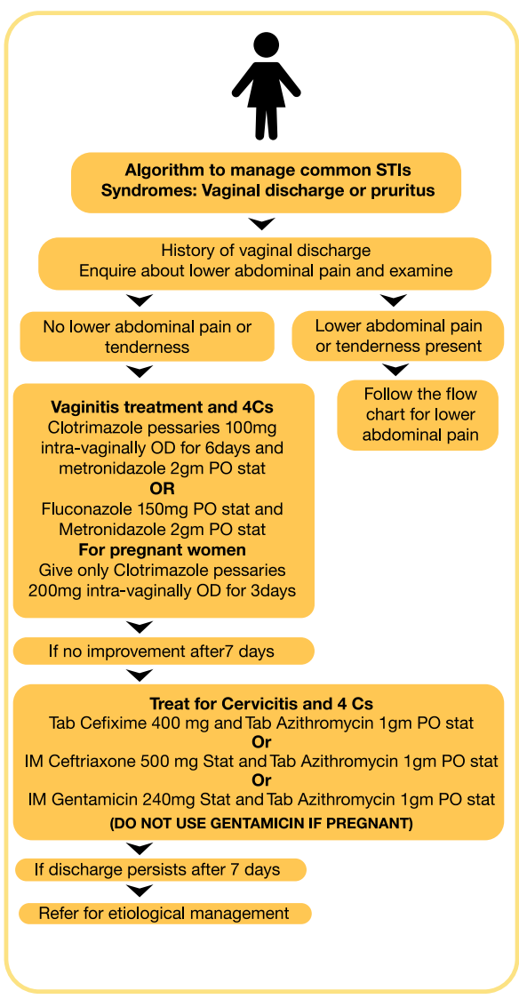
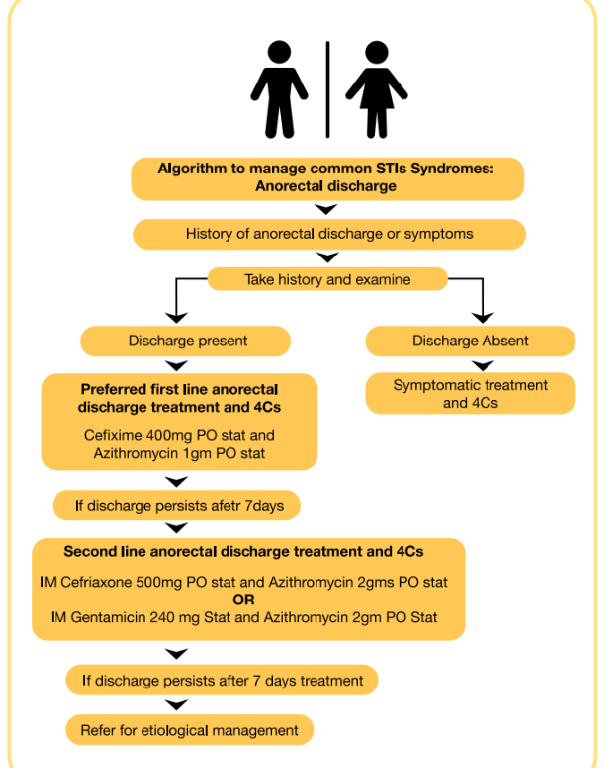
algorithms for managing common STI syndromes

Slide 3
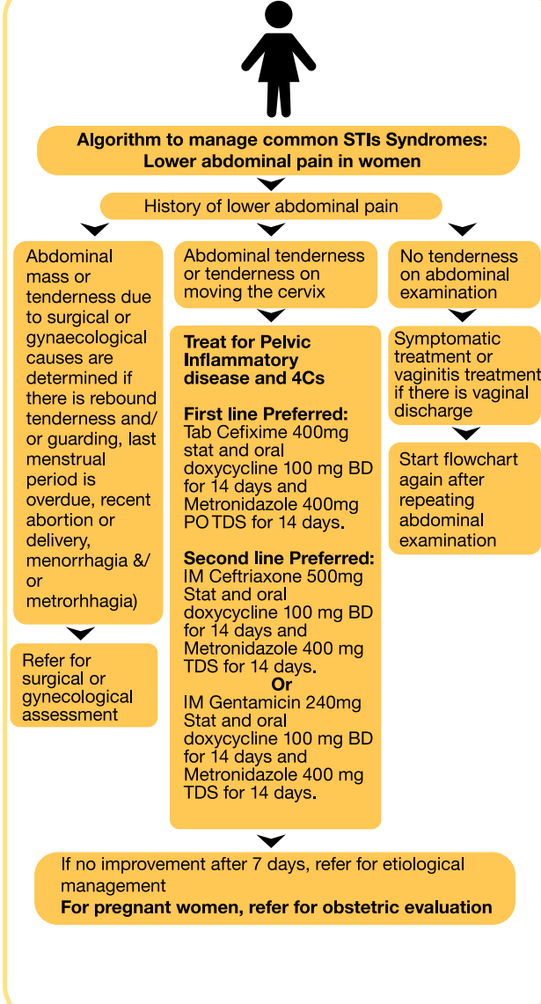
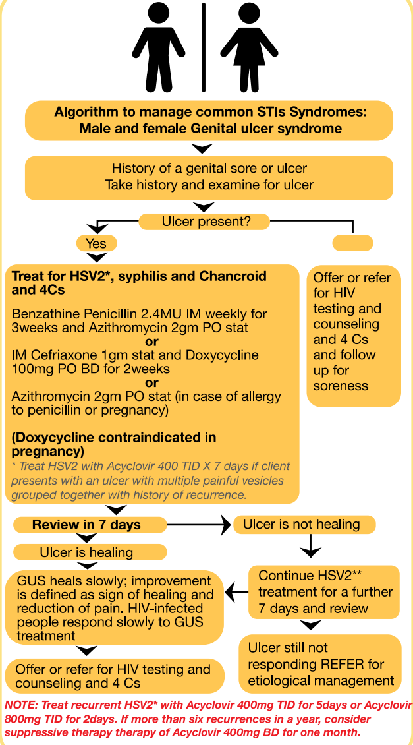

Slide 4
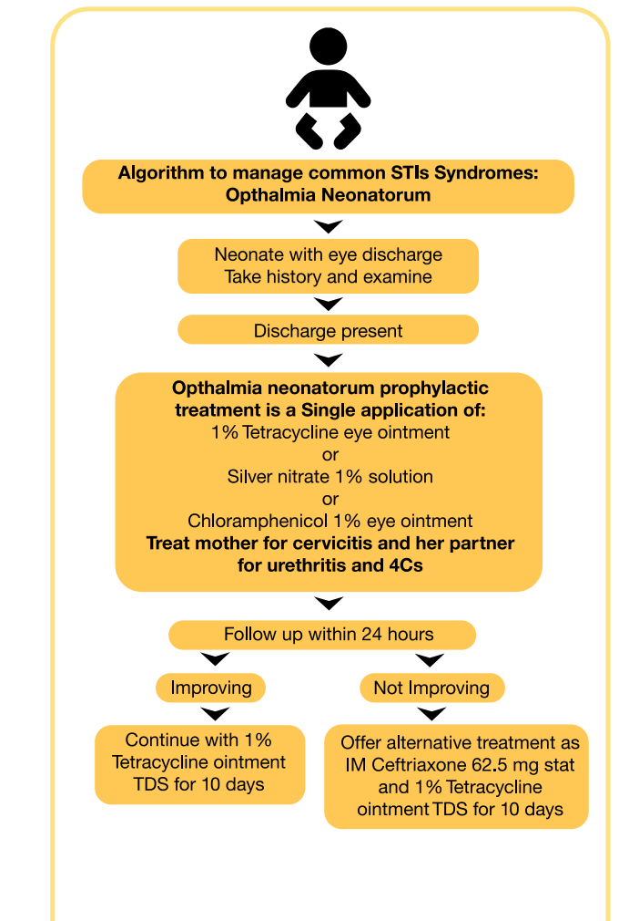
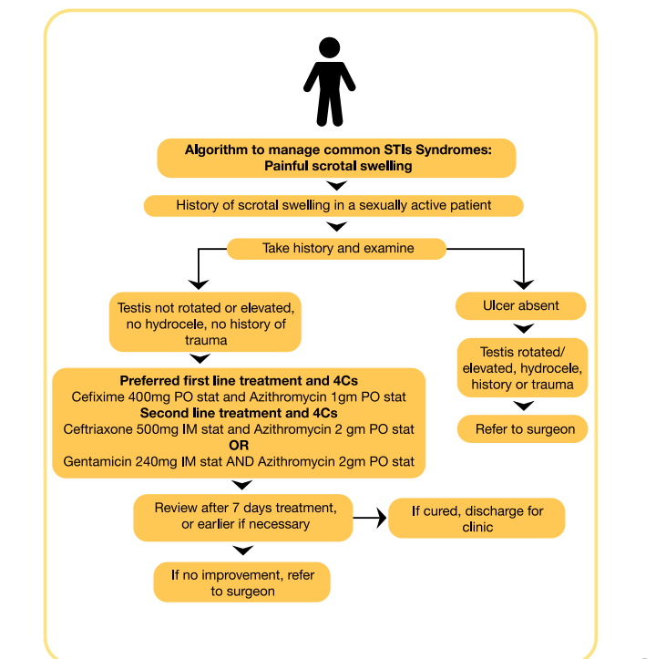

Slide 5
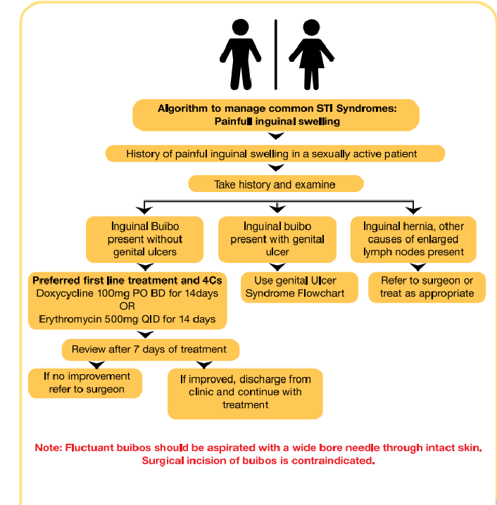
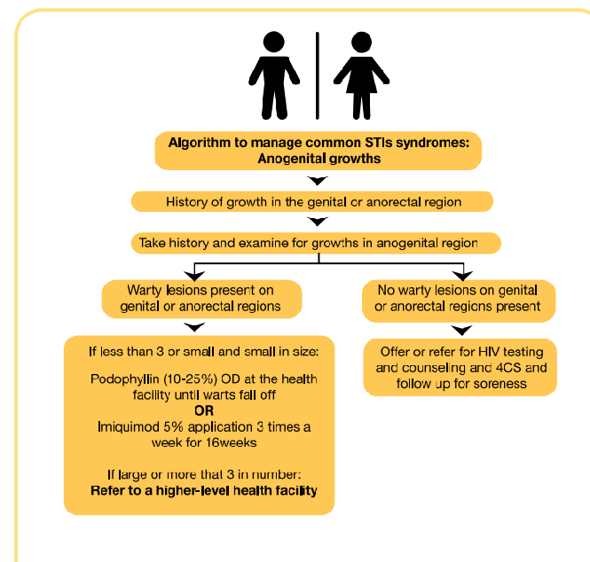

Slide 6
Fight AIDS remember the 4Cs of Good STI managements
COUNSELING
Emphasize on the risk of STIs including HIV
Discuss other 3Cs
Offer HIV testing and counselling
COMPLIANCE
Your patient should
Avoid self medication
Take the full course of medication and not to share or keep it

Slide 7
Follow other Instructions
CONDOMS
Proper use of condoms is the only other alternative to abstinence to protect from STIs
Give condoms to your patients
Explain and demonstrate the correct use of condoms

Slide 8
CONTACT TRACING
Your patients should:
Tell all his/her sexual partners to seek medication

