Slide 1
MUSCULAR TISSUE
SAMUEL NGIGI KIURIRE

Slide 2
The Muscular System
Muscles are responsible for all types of body movement
Three basic muscle types are found in the body
Skeletal muscle
Cardiac muscle
Smooth muscle

Slide 3
Characteristics of Muscles
Muscle cells are elongated (muscle cell = muscle fiber)
Contraction of muscles is due to the movement of microfilaments
All muscles share some terminology
Prefix myo refers to muscle (myocardial)
Prefix mys refers to muscle (myastenia gravis)
Prefix sarco refers to flesh (sarcolema)

Slide 4
Skeletal Muscle Characteristics
Most are attached by tendons to bones
Cells are multinucleate
Striated – have visible banding
Voluntary – subject to conscious control
Cells are surrounded and bundled by connective tissue

Slide 5
Connective Tissue Wrappings of Skeletal Muscle
Endomysium – around single muscle fiber
Perimysium – around a fascicle (bundle) of fibers
Epimysium – covers the entire skeletal muscle
Fascia – on the outside of the epimysium
Figure 6.1

Slide 6
Skeletal Muscle Attachments
Epimysium blends into a connective tissue attachment
Tendon – cord-like structure
Aponeuroses – sheet-like structure
Sites of attachment
Bones
Cartilages
Connective tissue coverings

Slide 7
Smooth Muscle Characteristics
Has no striations
Spindle-shaped cells
Single nucleus
Involuntary – no conscious control
Found in walls of hollow organs
Figure 6.2a

Slide 8
Cardiac Muscle Characteristics
Has striations
involuntary
Usually has a single nucleus
Joined to another muscle cell at an intercalated disc
Found only in the heart
Figure 6.2b

Slide 9
Function of Muscles
Produce movement
Maintain posture
Stabilize joints
Generate heat

Slide 10
Function of Muscles
Produce movement
Maintain posture
Stabilize joints
Generate heat

Slide 11
Microscopic Anatomy of Skeletal Muscle
Cells are multinucleate
Nuclei are just beneath the sarcolemma
Sarcolemma–specialized plasma membrane
Figure 6.3a

Slide 12
Microscopic Anatomy of Skeletal Muscle
Myofibril
Bundles of myofilaments
Myofibrils are aligned to give distinct bands
I band =
light band
A band = dark band
Figure 6.3b

Slide 13
Microscopic Anatomy of Skeletal Muscle
Sarcomere
Contractile unit of a muscle fiber
Figure 6.3b

Slide 14
Microscopic Anatomy of Skeletal Muscle
Organization of the sarcomere
Thick filaments = myosin filaments
Composed of the protein myosin
Figure 6.3c

Slide 15
Microscopic Anatomy of Skeletal Muscle
Myosin filaments have heads (extensions, or cross bridges)
Myosin and actin overlap somewhat
Sarcoplasmic reticulum (SR) – stores calcium

Slide 16
Properties of Skeletal Muscle Activity
Irritability – ability to receive and respond to a stimulus
Contractility – ability to shorten when an adequate stimulus is received

Slide 17
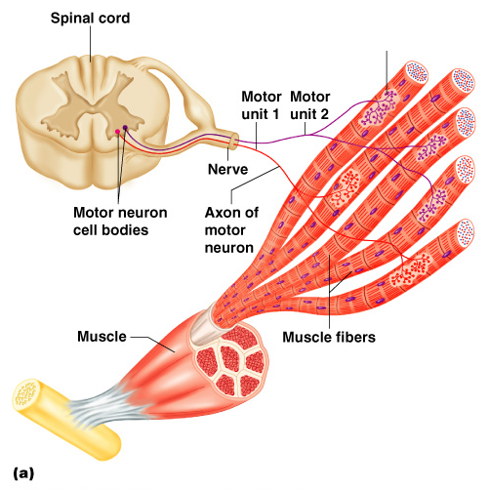
Muscle is Stimulated by Nerve
Skeletal muscles must be stimulated by a nerve to contract
Motor unit
One neuron
Muscle cells stimulated by that neuron
Figure 6.4a

Slide 18
Nerve Stimulus to Muscles
Neuromuscular junctions – the site of nerve and muscle association
Figure 6.5b

Slide 19
Nerve Stimulus to Muscles
Synaptic cleft – gap between nerve and muscle
Nerve and muscle do not make contact
Area between nerve and muscle is filled with interstitial fluid
Figure 6.5b

Slide 20
Transmission of Nerve Impulse
Neurotransmitter – a chemical released by the nerve upon arrival of nerve impulse
The neurotransmitter - acetylcholine
Neurotransmitter attaches to receptors on the sarcolemma
Sarcolemma becomes permeable to sodium (Na⁺)
Sodium enters the cell and generates an action potential
Once started, muscle contraction cannot be stopped

Slide 21
The Sliding Filament Theory of Muscle Contraction
This action causes the myosin to slide along the actin
The result is shortening of the muscle – a contraction
Figure 6.7

Slide 22
Contraction of a Skeletal Muscle
Muscle fiber contraction is “all or none”
Within a skeletal muscle, not all fibers may be stimulated during the same interval
Different combinations of muscle fiber contractions may give differing responses
Graded responses – different degrees of skeletal muscle shortening

Slide 23
Types of Graded Responses
Twitch
Single, brief contraction
Not a normal muscle function
Tetanus (summing of contractions)
One contraction is immediately followed by another
The muscle does not completely return to a resting state
The effects are added
Figure 6.9a–b

Slide 24
Types of Graded Responses
Unfused (incomplete) tetanus
Some relaxation occurs between contractions
The results are summed
Fused
No evidence of relaxation before the following contractions
The result is a sustained muscle contraction
Figure 6.9c–d

Slide 25
Muscle Response to Strong Stimuli
Muscle force depends upon the number of fibers that are stimulated
More fibers contracting results in greater muscle tension
Muscles can continue to contract unless they run out of energy

Slide 26
Energy for Muscle Contraction
Muscles use stored ATP for energy
Bonds of ATP are broken to release energy
After this initial use, other pathways must be utilized to produce ATP
Direct phosphorylation
Muscle cells contain creatine phosphate
After ATP is depleted, ADP is left
CP transfers energy to ADP, to regenerate ATP

Slide 27
Energy for Muscle Contraction
Aerobic Respiration (Cellular respiration)
Series of metabolic pathways that occur in the mitochondria
Glucose is broken down to carbon dioxide and water, releasing energy
This is a slower reaction that requires continuous oxygen
Figure 6.10b

Slide 28
Energy for Muscle Contraction
Anaerobic glycolysis
Reaction that breaks down glucose without oxygen
Glucose is broken down to pyruvic acid to produce some ATP
Pyruvic acid is converted to lactic acid

Slide 29
Muscle Fatigue and Oxygen Debt
When a muscle is fatigued, it is unable to contract
The common reason for muscle fatigue is oxygen debt
Oxygen must be placed
Oxygen is required to rid of accumulated lactic acid
Increase acidity (from lactic acid) and lack of ATP causes the muscle to contract less

Slide 30
2 Types of Muscle Contractions
Isotonic contractions
Myofilaments are able to slide past each other during contractions
Tension in the muscles increases
The muscle shortens
Isometric contractions
Tension in the muscles increases
The muscle is unable to shorten

Slide 31
Effects of Exercise on Muscle
Results of increased muscle use
Increase in muscle size
Increase in muscle strength
Increase in muscle efficiency
Muscle becomes more fatigue resistant

Slide 32
End of Presentation Thank You

