Slide 1
NECROSIS
General Pathology 2.
March 2020
Prepared by Mr. Ephraim.

Slide 2
Definitions
Necrosis is the death of a cell or groups of cells while they still form part of the living body and implies permanent cessation of normal function.
It’s a spectrum of morphologic changes that follows cell death in living tissues.
Necrosis can be sudden or gradual.
Brains storm; what can cause Necrosis????

Slide 3
pictorial
NECROSIS APOPTOSIS
NORMAL CELL
CELL ADAPTATION
Reversible cell injury
IREEVERSIBLE CELL INJURY

Slide 4
Causes
Ischemia
Physical agents
Chemical agents
Immunological injury
Further;>
Blood supply-cells are cut of from 02.
Toxins-bacteria, poisons, cyanide
Antibody antigen reactions
Severe infections-viruses
Extreme temperatures or very cold(Frost)
Mechanical pressure
Ionizing radiation

Slide 5
Characteristics of a necrotic cell
Increased membrane permeability
Hydrolysis of nucleus
Nuclear disruption and disappearance
Loss of all the physiological functions and processes.
Assignment; define:
Kayolysis
Pyknosis
Karyorrhexis

Slide 6
Types of Necrosis
Coagulative Necrosis> whercell death leaves the tissue hardened(MUMIFIED) –same shape-heart, spleen and kidney
Colliquative necrosis- cell death with softening of the tissue affected( Liquafactive)>the tissue becomes liquid viscous mass,creamy yellow; Brain, abscess.
Causeous Necrosis- firm cheese mass-TB- LUNG
Fat Necrosis- seen in pancrease,breast-Visible white chalky areas.
Fibrinoid Necrosis- Deposition of fibrin like material, seen in immunologic cell injury- HTN, Peptic ulcer.

Slide 7
Cont…
Gangrenous Necrosis; Death of a cell tissue as a resultant to acute ischemia and infection- green black change of tissue with foul smelling gas- hydrogen sulpoide is released.
TYPES;
Wet gangrene> Venous obstruction, Mist, no clear line of demarcation,bacteria is present, poor prognosis,occurs in most tissue like mouth, bowel cervix, diabetic foot, Bed sores- caused by gram positive
Dry gangrene > Arterial obstruction, limbs, toes due to feet arteriosclerosis, trauma, dry shrunken, black-presence of a clear demarcation, better prognosis
Gas gangrene; caused by gram positive, seen in muscle and in colon.

Slide 8
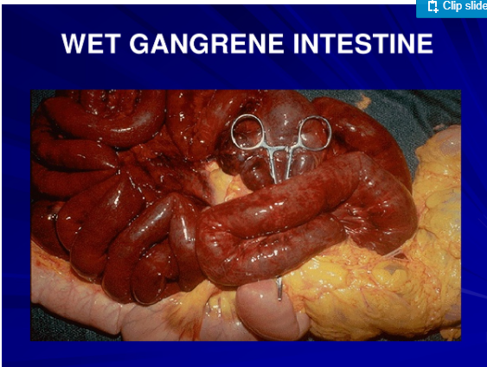
Wet Gangrene

Slide 9
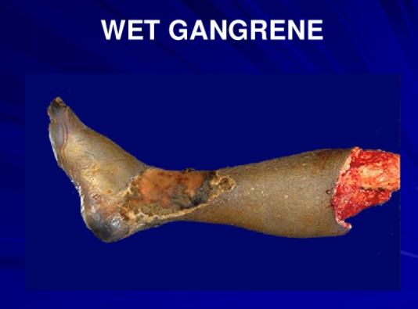

Slide 10
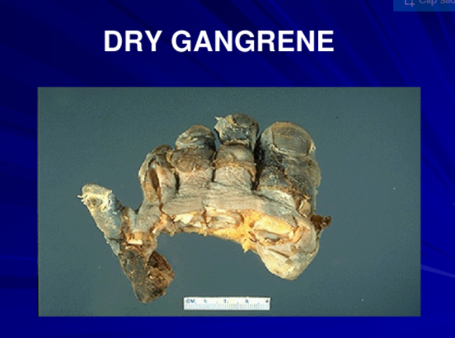
DRY gangrene

Slide 11
Effects of necrosis..
Loss of function of the affected cell,tissue, organ.. Depends on the number of cells involved.
Release of cellular enzymes into the blood stream-ie. Transaminases-sgot and sgpt when the liver, heart muscles undergo necrosis as seen in severe hepatitis and M.I
Somatic death- complete cessation of respiration and circulation with extensive and irreversible brain damage.

Slide 12
The END..
Questions???

