Slide 1
NERVOUS SYSTEM
By Nelly Chepkong’a

Slide 2
INTRODUCTION
It detects and responds to changes inside and outside the body.
Together with the endocrine system it controls important aspects of body function and maintains homeostasis.
It consists of the:
brain
spinal cord and
peripheral nerves.

Slide 3
Functions
Sensory input (afferent)– monitoring stimuli occurring inside and outside the body
Integration – interpretation of sensory input
Motor output (efferent)– response to stimuli by activating effector organs

Slide 5
Organization of the nervous system
1. The central nervous system (CNS)
consist of the brain and the spinal cord
Integration and command center
2. The peripheral nervous system (PNS)
The largest
consist of all the nerves outside the brain and spinal cord.
Carries messages to and from the spinal cord and brain

Slide 6
Peripheral nervous system (PNS)
Comprises paired cranial and sacral nerves —
some of these are sensory (afferent), some are motor (efferent) and some mixed.
It has two functional divisions:
the sensory division
the motor division

Slide 7
Sensory (afferent) division
Sensory afferent fibers – carry impulses from skin, skeletal muscles and joints to the brain
Visceral afferent fibers – transmit impulses from visceral organs to the brain
Motor (efferent) division
Transmits impulses from the CNS to effector organs

Slide 8
Motor division: 2 main parts
Somatic nervous system (SNS) [voluntary activity]
Conscious control of skeletal muscles
Autonomic nervous system (ANS) [involuntary activity]
Regulates smooth muscle, cardiac muscle, and glands
Divisions – sympathetic and parasympathetic
Sympathetic nervous system – “flight or fight”
Times of stress – emergency situations – stimulates for greater activity except for the digestive systems which stops or shuts down.
Parasympathetic – “rest and digest”

Slide 9
Histology of nerve tissue
The two principal cell types of the nervous system are:
Neurons – excitable cells that transmit electrical signals
Neuroglia (supporting cells ) – cells that surround and wrap neurons

Slide 10
Neurones/ nerve cells
Structural units of the nervous system
100 billion neurons in brain, 100 million in spinal cord
Composed of a body, axon, and dendrites
Long-lived, amitotic (do not divide) - no new neurons after birth
Have a very high metabolic rate – lots of ATP
can synthesise chemical energy (ATP) only from glucose.
Their plasma membrane functions in:
Electrical signaling
Cell-to-cell signaling during development

Slide 12
Properties of neurones
Have the characteristics of irritability and conductivity.
Irritability: the ability to initiate nerve impulses in response to stimuli from outside the body and inside the body
Conductivity: the ability to transmit an impulse.

Slide 13
Cell bodies
They form the grey matter of the nervous system
Are found at the periphery of the brain and in the centre of the spinal cord.
Groups of cell bodies are called nuclei in the central nervous system and ganglia in the peripheral nervous system.
Contains the nucleus and a nucleolus
Has no centrioles (hence its amitotic nature)
Has well-developed Nissl bodies (rough ER)
Important for growth and regeneration

Slide 14
Axons and dendrites
Are extensions of cell bodies
They form the white matter of the nervous system.

Slide 15
Axons
Are found deep in the brain
Bundles of axons are called tracts in the CNS and nerves in the PNS
Each nerve cell has only one axon
An axon carry nerve impulses away from the cell body.
They are usually longer than the dendrites, sometimes as long as 100 cm.
Axonal terminal – branched terminus of an axon

Slide 16
Axons: Function
Generate and transmit action potentials
Secrete neurotransmitters from the axonal terminals

Slide 17
Axon structure
Its membrane is called axolemma and it encloses the cytoplasmic extension of the cell body.
Large axons and those of peripheral nerves are surrounded by a myelin sheath.
Myelin sheath consists of a series of Schwann cells arranged along the length of the axon.
Each one is wrapped around the axon so that it is covered by a number of concentric layers of Schwann cell plasma membrane.
Between the layers of plasma membrane there is a small amount of fatty substance called myelin.

Slide 18
The outermost layer of Schwann cell plasma membrane is sometimes called neurilemma.
Neurilemma – remaining outer portion of a Schwann cell that contains the nucleus and cytoplasm – aids in regeneration of injured axon – only in PNS
There are tiny areas of exposed axolemma between adjacent Schwann cells, called nodes of Ranvier, which assist the rapid transmission of nerve impulses.
Postganglionic fibres and some small fibres in the central nervous system are non-myelinated.

Slide 19
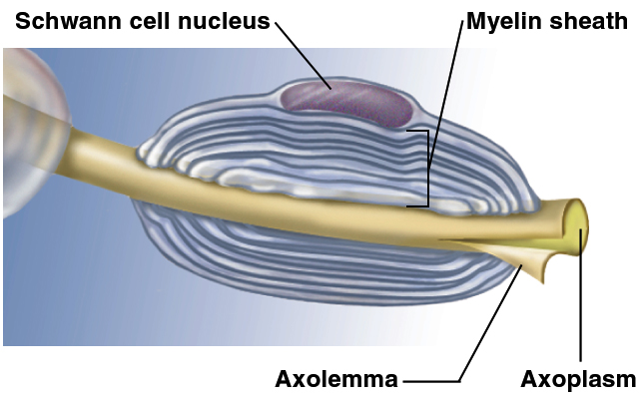
Myelin Sheath
Note: Node of Ranvier between Schwann cells

Slide 20
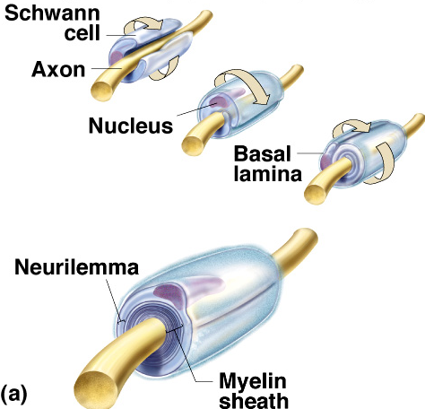
Myelin Sheath Formation
Myelination begins during fetal development, but proceeds most rapidly in infancy.

Slide 21
Unmyelinated Axons
A Schwann cell surrounds nerve fibers but coiling does not take place
The adjacent Schwann cells are in close association and there is no exposed axolemma.
The speed of transmission of nerve impulses is significantly slower in non-myelinated fibres.

Slide 22
Axons of the CNS
Both myelinated and unmyelinated fibers are present
Myelin sheaths are formed by oligodendrocytes
Nodes of Ranvier in the CNS are more widely spaced than in PNS
There is no neurilemma in the CNS and therefore no regeneration

Slide 23
Dendrites
Are the many short processes that receive and carry incoming impulses towards cell bodies.
They have the same structure as axons but they are usually shorter and branching.
In motor neurones they form part of synapses and in sensory neurones they form the sensory receptors that respond to stimuli.

Slide 24
The nerve impulse (action potential)
Are electrical impulses carried along the length of axons
An impulse is initiated by stimulation of sensory nerve endings or by the passage of an impulse from another nerve.
Transmission of the impulse is due to movement of ions across the nerve cell membrane.

Slide 25
In the resting state the nerve cell membrane is polarised due to differences in the concentrations of ions across the plasma membrane.
This means that there is a different electrical charge on each side of the membrane that is called the resting membrane potential.
At rest the charge on the outside is positive and inside it is negative.
The principal ions involved are:
• sodium (Na+) the main extracellular cation
• potassium (K+) the main intracellular cation.

Slide 26
In the resting state there is a continual tendency for these ions to diffuse along their concentration gradients, i.e. K+ outwards and Na+ into cells.
When stimulated, the permeability of the nerve cell membrane to these ions changes.
Initially Na+ floods into the neurone from the ECF causing depolarisation, creating a nerve impulse or action potential.
Depolarisation is very rapid, enabling the conduction of a nerve impulse along the entire length of a neurone in a few milliseconds (ms).
It passes from the point of stimulation in one direction only, i.e. away from the point of stimulation towards the area of resting potential.

Slide 27
The one-way direction of transmission is ensured because following depolarisation it takes time for repolarisation to occur.
During this process K+ floods out of the neurone and the movement of these ions returns the membrane potential to its resting state.
This is called the refractory period during which restimulation is not possible.
As the neurone returns to its original resting state, the action of the sodium pump expels Na+ from the cell in exchange for K+

Slide 28
In myelinated neurones, the insulating properties of the myelin sheath prevent the movement of ions.
Therefore electrical changes across the membrane can only occur at the gaps in the myelin sheath, i.e. at the nodes of Ranvier.
When an impulse occurs at one node, depolarisation passes along the myelin sheath to the next node so that the flow of current appears to 'leap' from one node to the next.
This is called saltatory conduction

Slide 29
The speed of conduction depends on the diameter of the neurone: the larger the diameter, the faster the conduction.
Myelinated fibres conduct impulses faster than unmyelinated fibres because saltatory conduction is faster than the complete conduction, or simple propagation
The fastest fibres can conduct impulses to, e.g., skeletal muscles at a rate of 130 metres per second while the slowest impulses travel at 0.5 metres per second.

Slide 30
Types of nerves
Sensory or afferent nerves
Motor or afferent nerves
Mixed nerves

Slide 31
The synapse and neurotransmitters
There is always more than one neurone involved in the transmission of a nerve impulse from its origin to its destination, whether it is sensory or motor.
There is no physical contact between these neurones.
The point at which the nerve impulse passes from one to another is the synapse .
At its free end the axon of the presynaptic neurone breaks up into minute branches which terminate in small swellings called synaptic knobs, or terminal boutons.
These are in close proximity to the dendrites and the cell body of the postsynaptic neurone.
The space between them is the synaptic cleft.
In the ends of synaptic knobs there are spherical synaptic vesicles, containing a chemical, the neurotransmitter, which is released into synaptic clefts.

Slide 32
Neurotransmitters are synthesised by nerve cells, actively transported along the axons and stored in the synaptic vesicles.
They are released by exocytosis in response to the action potential and diffuse across the synaptic cleft.
They act on specific receptor sites on the postsynaptic membranes.
Their action is short lived as immediately they have stimulated the postsynaptic neurone or effector organ, such as a muscle fibre, they are either inactivated by enzymes or taken back into the synaptic knob.
Usually neurotransmitters have an excitatory effect at the synapse but they are sometimes inhibitory.

Slide 33
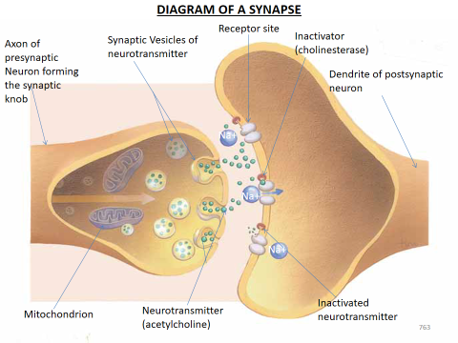

Slide 34
Chemical Neurotransmitters
Acetylcholine (ACh) - Cholinergic
Biogenic amines
Amino acids
Peptides
Novel messengers: ATP and dissolved gases NO (nitric oxide) and CO (carbon monoxide)

Slide 35
Neurotransmitters: Acetylcholine
First neurotransmitter identified, and best understood
Released at the neuromuscular junction
Synthesized and enclosed in synaptic vesicles
Degraded by the enzyme acetylcholinesterase (AChE)
Released by:
All neurons that stimulate skeletal muscle
Some neurons in the autonomic nervous system

Slide 36
Neurotransmitters: Biogenic Amines
Include:
Catecholamines – dopamine, norepinephrine (NE) - also known as noradrenaline, and epinephrine - also known as adrenaline
Indolamines – serotonin and histamine
Broadly distributed in the brain
Play roles in emotional behaviors and our biological clock

Slide 37
Neurotransmitters: Amino Acids
Include:
GABA – Gamma (γ)-aminobutyric acid
Glycine
Aspartate
Glutamate
Found only in the CNS

Slide 38
Neurotransmitters: Peptides
Include:
Substance P – mediator of pain signals
Beta endorphin, dynorphin, and enkephalins
These act as natural opiates, reducing our perception of pain
Bind to the same receptors as opiates and morphine
Gut-brain peptides – somatostatin, and cholecystokinin (CCK) (kō"lu-sis"tu-kī'nin)

Slide 39
Cholecystokinin
CCK is secreted by the duodenum, the first segment of the small intestine, and causes the release of digestive enzymes and bile from the pancreas and gallbladder, respectively.
CCK acts as a hunger suppressant.
Recent evidence has suggested that it also plays a major role in inducing drug tolerance to opioids like morphine and heroin, and is partly implicated in experiences of pain hypersensitivity during opioid withdrawal.

Slide 40
Functional Classification of Neurotransmitters
Two classifications: excitatory and inhibitory
Excitatory neurotransmitters cause depolarizations (e.g., glutamate, aspartate, ATP)
Inhibitory neurotransmitters cause hyperpolarizations (e.g., GABA and glycine)

Slide 41
Some neurotransmitters have both excitatory and inhibitory effects
Determined by the receptor type of the postsynaptic neuron
Example: acetylcholine
Excitatory at neuromuscular junctions with skeletal muscle
Inhibitory in cardiac muscle

Slide 42
Dopamine
A “feel good” neurotransmitter
Release enhanced by L-dopa and amphetamines
Reuptake blocked by cocaine
Made from the amino acid tyrosine
When not balanced by proper amounts of serotonin can cause addictive, compulsive behavior: “got to have it”
Drug abuse, compulsive shopping, eating, sex
May be involved in schizophrenia
Deficient in Parkinson’s disease

Slide 43
GABA
Principle inhibitory neurotransmitter
Inhibitory effects augmented by alcohol
Valium (benzodiazepine) increase GABA
Valerian Root (herb) and B6 increase GABA

Slide 44
Glutamate
Generally an excitatory neurotransmitter
Important in learning and memory

Slide 45
Norepinephrine
A “feel good” neurotransmitter
Release enhanced by amphetamines
Removal from synapse blocked by tricyclic anti depressants and cocaine

Slide 46
Serotonin
“Who cares” neurotransmitter
Balances dopamine to offset addictive/compulsive behavior
Low levels of serotonin have been associated with uneasiness, carbohydrate cravings and weight gain, mood, sleep disorders and substance dependence.

Slide 47
CONT’ Serotonin
Drugs that block its uptake (selective serotonin reuptake inhibitors – SSRI) such Prozac, raise serotonin levels
L-Tryptophan is used by the body to produce serotonin. The best dietary sources for Tryptophan are cottage cheese, brown rice, meat, peanut and soy protein.
5-HTP (5-Hydroxytryptophan) L-Tryptophan is an essential amino acid that is converted into 5-HTP in the body. 5HTP is then converted into serotonin and melatonin.

Slide 48
CENTRAL NERVOUS SYSTEM
Consists of the:
brain
spinal cord.

Slide 49
Supporting Cells: Neuroglia
The supporting cells (neuroglia or glial cells):
90% of the CNS by number, 50% by volume
Provide a supportive scaffolding for neurons
Segregate and insulate neurons
Guide young neurons to the proper connections
Promote health and growth
Unlike nerve cells these continue to replicate throughout life.
Six types of glial cells

Slide 50
Astrocytes
Most abundant, versatile and highly branched glial cells
Functionally, they:
Support and brace neurons
Anchor neurons to their nutrient supplies
Guide migration of young neurons
Control the chemical environment
They are star-shaped with fine branching processes
At the free ends of some of the processes there are small swellings called foot processes.

Slide 51
They are found in large numbers adjacent to blood vessels with their foot processes forming a sleeve round them.
This means that the blood is separated from the neurones by the capillary wall and a layer of astrocyte foot processes which together constitute the blood-brain barrier .
The blood-brain barrier is a selective barrier that protects the brain from potentially toxic substances and chemical variations in the blood, e.g. after a meal, Oxygen, carbon dioxide, alcohol, barbiturates, glucose and lipophilic substances quickly cross the barrier into the brain.
Some large molecules, drugs, inorganic ions and amino acids pass slowly from the blood to the brain.

Slide 52
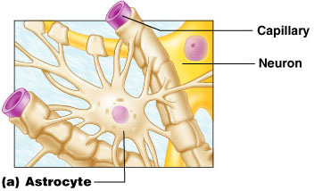
Astrocytes

Slide 53
Microglia
Are small, ovoid cells with spiny or thorny processes from the blood
Phagocytes that monitor the health of neurons by scavenging and engulfing debris. Generally stationary, they may become active and migrate to the site of injury or infection
Are derived from monocytes that migrate from the blood into the nervous system before birth.
They are found mainly in the area of blood vessels.

Slide 54
Ependymal Cells
They range in shape from squamous to columnar with cilia
They line the central cavities of the brain (ventricles) and spinal column (central canal) and play an active role in moving the cerebrospinal fluid

Slide 55
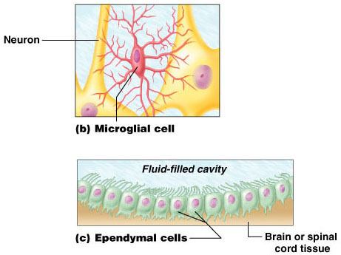
Microglia and Ependymal Cells
Figure 11.3b, c

Slide 56
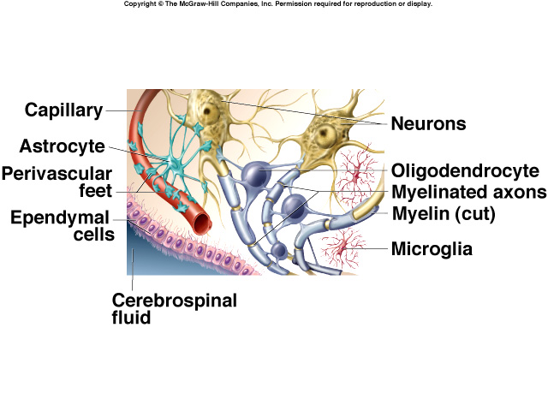
Microglia and Ependymal Cells

Slide 57
Oligodendrocytes, Schwann Cells, and Satellite Cells
Oligodendrocytes – branched cells that wrap CNS nerve fibers with myelin sheaths.
They are found:
in clusters round nerve cell bodies, the grey matter where they are thought to have a supportive function
adjacent to, and along the length of, myelinated nerve fibres.
They form and maintain myelin, having the same functions as Schwann cells in peripheral nerves.

Slide 58
Schwann cells (neurolemmocytes) – produce myelin sheaths that surround neurons of the PNS
Satellite cells surround and support neuron cell bodies in PNS ganglia
Ganglia is group of cell bodies in the PNS
Nuclei is a group of cell bodies in the CNS
Most cell bodies are located in the CNS

Slide 59
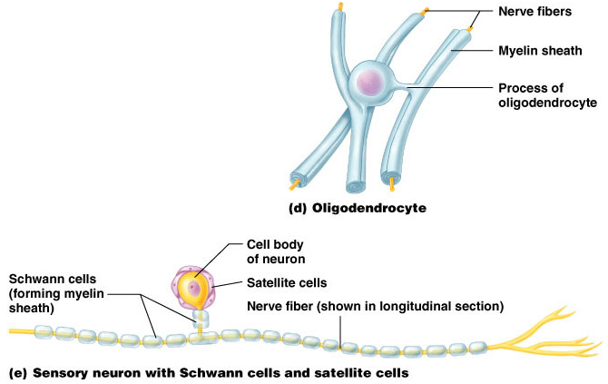
Oligodendrocytes, Schwann Cells, and Satellite Cells

Slide 60
Protection of the Brain
The brain is protected by bone, meninges, and cerebrospinal fluid
Harmful substances are shielded from the brain by the blood-brain barrier
Protects against metabolic wastes such as urea but other substances can pass through like alcohol, nutrients such as glucose and anesthetics

Slide 61
MENINGES
Are membranes covering the brain and the spinal cord.
The meninges are three in number (connective tissue) and they completely surround the brain and spinal cord
They lie between the skull and the brain and between the vertebrae and the spinal cord.
Named from outside inwards they are:

Slide 62
dura mater
arachnoid mater
pia mater.
The dura and arachnoid maters are separated by a potential space, the subdural space.
The arachnoid and pia maters are separated by the subarachnoid space, containing cerebrospinal fluid.

Slide 63
Functions of the meninges
Cover and protect the CNS
Protect blood vessels and enclose venous sinuses
Contain cerebrospinal fluid (CSF)
Form partitions within the skull

Slide 64
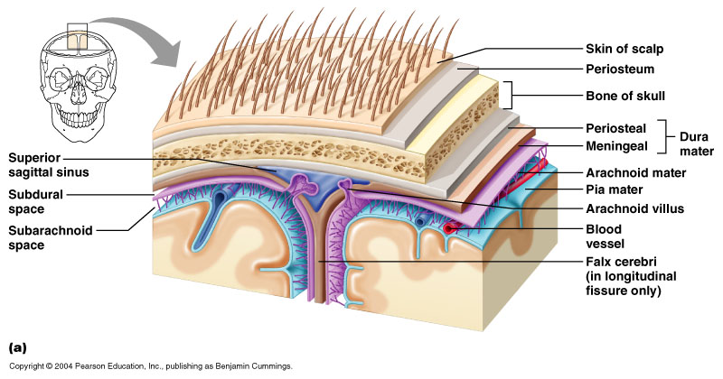
Meninges

Slide 65
Dura mater
The cerebral dura mater consists of two layers of dense fibrous tissue.
The outer layer takes the place of the periosteum on the inner surface of the skull bones and the inner layer provides a protective covering for the brain.
There is only a potential space between the two layers except where the inner layer sweeps inwards:
between the cerebral hemispheres to form the falx cerebri
between the cerebellar hemispheres to form the falx cerebelli
between the cerebrum and cerebellum to form the tentorium cerebelli

Slide 66
Venous blood from the brain drains into venous sinuses between the layers of dura mater.
The superior sagittal sinus is formed by the falx cerebri, and the tentorium cerebelli forms the straight and transverse sinuses
Spinal dura mater forms a loose sheath round the spinal cord, extending from the foramen magnum to the second sacral vertebra.
Thereafter it encloses the filum terminole and fuses with the periosteum of the coccyx.
It is an extension of the inner layer of cerebral dura mater

Slide 67
It is separated from the periosteum of the vertebrae and ligaments within the neural canal by the epidural or extradural space, containing blood vessels and areolar tissue.
It is attached to the foramen magnum and, by a number of fibrous slips, to the posterior longitudinal ligament at intervals along its length.
Nerves entering and leaving the spinal cord pass through the epidural space.
These attachments stabilise the spinal cord in the neural canal.
Dyes, used for diagnostic purposes, and local anaesthetics or analgesics to relieve pain, may be injected into the epidural space.

Slide 68
Arachnoid mater
Delicate serous membrane
lies between the dura and pia maters.
It is separated from the dura mater by the subdural space, containing interstitial fluid and from the pia mater by the subarachnoid space, containing cerebrospinal fluid and large blood vessels.
The arachnoid mater passes over the convolutions of the brain
Accompanies the inner layer of dura mater in the formation of the falx cerebri, tentorium cerebelli and falx cerebelli.
Arachnoid villi protrude superiorly and permit CSF to be absorbed into venous blood
It continues downwards to envelop the spinal cord and ends by merging with the dura mater at the level of the 2nd sacral vertebra.

Slide 69
Pia mater
It is a fine connective tissue containing many minute blood vessels.
It adheres to the brain, completely covering the convolutions and dipping into each fissure.
It continues downwards surrounding the spinal cord.
Beyond the end of the cord it continues as the filum terminale, pierces the arachnoid tube and goes on, with the dura mater, to fuse with the periosteum of the coccyx.

Slide 70
Ventricles of the brain and the cerebrospinal fluid
Within the brain there are four irregular-shaped cavities (ventricles) containing cerebrospinal fluid (CSF)
They are:
right and left lateral ventricles
third ventricle
fourth ventricle.

Slide 71
The lateral ventricles
These cavities lie within the cerebral hemispheres,
One on each side of the median plane just below the corpus callosum.
They are separated from each other by a thin membrane, the septum lucidum, and are lined with ciliated epithelium.
They communicate with the third ventricle by interventricular foramina.

Slide 72
The third ventricle
The third ventricle is a cavity situated below the lateral ventricles between the two parts of the thalamus.
It communicates with the fourth ventricle by a canal, the cerebral aqueduct or aqueduct of the midbrain.

Slide 73
The fourth ventricle
is a diamond-shaped cavity
situated below and behind the third ventricle, between the cerebellum and pons.
It is continuous below with the central canal of the spinal cord and
communicates with the subarachnoid space by foramina in its roof.
Cerebrospinal fluid enters the subarachnoid space through these openings and through the open distal end of the central canal of the spinal cord.

Slide 75
Cerebrospinal fluid (CSF)
CSF is secreted into each ventricle of the brain by choroid plexuses.
Choroid plexuses are vascular areas where there is a proliferation of blood vessels surrounded by ependymal cells in the lining of ventricle walls.
CSF passes back into the blood through tiny diverticula of arachnoid mater, called arachnoid villi (arachnoid granulations).
The movement of CSF from the subarachnoid space to venous sinuses depends upon the difference in pressure on each side of the walls of the arachnoid villi, which act as one-way valves.

Slide 76
When CSF pressure is higher than venous pressure CSF passes into the blood and when the venous pressure is higher the arachnoid villi collapse, preventing the passage of blood constituents into the CSF.
There may also be some reabsorption of CSF by cells in the walls of the ventricles.
From the roof of the fourth ventricle CSF flows through foramina into the subarachnoid space and
completely surrounds the brain and spinal cord.
There is no intrinsic system of CSF circulation but its movement is aided by pulsating blood vessels, respiration and changes of posture.

Slide 77
CSF Flow

Slide 78
CSF is secreted continuously at a rate of about 0.5 ml per minute, i.e. 720 ml per day.
The amount around the brain and spinal cord remains fairly constant at about 120 ml, which means that absorption keeps pace with secretion.
CSF pressure may be measured using a vertical tube attached to a lumbar puncture needle.
It remains fairly constant at about 10 cmH2O when the individual is lying on his side and about 30 cmH2O when sitting up.
If the brain is enlarged by, e.g. haemorrhage or tumour, some compensation is made by a reduction in the amount of CSF.
When the volume of brain tissue is reduced, such as in degeneration or atrophy, the volume of CSF is increased.

Slide 79
CSF is a clear, slightly alkaline fluid with a specific gravity of 1.005
It consists of:
water
mineral salts
glucose
plasma proteins: small amounts of albumin and globulin
Creatinine small amounts
Urea
a few leukocytes.

Slide 80
Functions of cerebrospinal fluid
• It supports and protects the brain and spinal cord.
• It maintains a uniform pressure around these delicate structures.
• It acts as a cushion and shock absorber between the brain and the cranial bones.
• It keeps the brain and spinal cord moist and there may be interchange of substances between CSF and nerve cells, such as nutrients and waste products.

Slide 81
BRAIN
The brain constitutes about one-fiftieth of the body weight and lies within the cranial cavity.
Composed of wrinkled, pinkish gray tissue
100 billion neurons, weight about 3.5 pounds
"At any given moment the brain has 14 billion neurons firing at speeds of 450 miles per hour.“

Slide 82
Blood Supply to the Brain
Brain is 2% of body weight but utilizes 20% of body’s oxygen
When blood circulation to brain cells is interrupted:
1-2 minutes – weakens cells
4 minutes – permanently injures cells
Brain cells have limited ability to store glucose, continuous supply is needed to support metabolism in cells

Slide 83
The circulus arteriosus and its contributing arteries maintain a constant supply of oxygen and glucose to the brain even when a contributing artery is narrowed or the head is moved.
The brain receives about 15% of the cardiac output, approximately 750 ml of blood per minute.
Autoregulation keeps blood flow to the brain constant by adjusting the diameter of the arterioles across a wide range of arterial blood pressure (about 65-140 mmHg) with changes occurring only outside these limits.

Slide 84
Blood-Brain Barrier
Protective mechanism that helps maintain a stable environment for the brain
Bloodborne substances are separated from neurons by:
Continuous endothelium of capillary walls
Relatively thick basal lamina
Bulbous “feet” of astrocytes

Slide 85
Blood-Brain Barrier: Functions
Selective barrier that allows nutrients to pass freely
Is ineffective against substances that can diffuse through plasma membranes
Absent in some areas (vomiting center and the hypothalamus), allowing these areas to monitor the chemical composition of the blood
Stress increases the ability of chemicals to pass through the blood-brain barrier

Slide 86
PARTS OF THE BRAIN
The parts are:
Cerebrum
The brain stem – midbrain, Pons, medulla oblongata
Diencephalon – Thalamus, hypothalamus, pineal gland
cerebellum.

Slide 88
Cerebrum
Form the superior part of the brain and make up 83% of brain’s mass (largest part of the brain)
Seat of intelligence, “the executive suite”
Contain ridges (gyri) and shallow grooves (sulci)
Contain deeper grooves called fissures

Slide 89
It is divided by a deep cleft, the longitudinal cerebral fissure,
into right and left cerebral hemispheres, each containing one of the lateral ventricles.
Deep within the brain the hemispheres are connected by a mass of white matter (nerve fibres) called the corpus callosum.
Transverse fissure separates cerebrum from cerebellum

Slide 90
Cerebral Hemispheres
Cerebral Hemispheres have three basic regions:
(1) superficial - cerebral cortex (gray matter)
(2) more internal - cerebral white matter
(3) the deeper - basal nuclei

Slide 91
Major Lobes of the Cerebral Hemisphere
Deep sulci divide the hemispheres into five lobes:
Frontal – primary motor area
Parietal – somatosensory – touch, pressure
Temporal - primary auditory area
Occipital - primary visual area
Insula - part of the floor of the lateral sulcus, under frontal, parietal and temporal lobes
Central sulcus – separates the frontal and parietal lobes

Slide 93
Functions of the cerebrum
There are three main varieties of activity associated with the cerebral cortex:
mental activities involved in memory, intelligence, sense of responsibility, thinking, reasoning, moral sense and learning are attributed to the higher centres
sensory perception, including the perception of pain, temperature, touch, sight, hearing, taste and smell
initiation and control of skeletal (voluntary) muscle contraction.

Slide 94
Cerebral cortex
Each hemisphere acts contralaterally (controls the opposite side of the body)
The two hemispheres are not equal in function
No functional area acts alone; conscious behavior involves the entire cortex

Slide 95
Functional areas of the cerebral cortex
Motor: direct skeletal (voluntary) muscle movements
Sensory: receive and decode sensory impulses enabling sensory perception
Association: are concerned with integration and processing of complex mental functions such as intelligence, memory, reasoning, judgement and emotions.
NB: areas of the cortex lying anterior to the central sulcus are associated with motor functions, and those lying posterior to it are associated with sensory functions.

Slide 96
1. Motor areas of the cerebrum
The precentral (primary motor) area.
It lies in the frontal lobe immediately anterior to the central sulcus.
The cell bodies are pyramid shaped (Betz's cells) and they initiate the contraction of skeletal muscles.
A nerve fibre from a Betz's cell passes downwards through the internal capsule to the medulla oblongata where it crosses to the opposite side then descends in the spinal cord.
Hence:

Slide 97
The motor area of the right hemisphere of the cerebrum controls voluntary muscle movement on the left side of the body and vice versa.
In the motor area of the cerebrum the body is represented upside down, i.e. the cells nearest the vertex control the feet and those in the lowest part control the head, neck, face and fingers.
The sizes of the areas of cortex representing different parts of the body are proportional to the complexity of movement of the body part, not to its size.
In comparison with the trunk, the hand, foot, tongue and lips are represented by large cortical areas.

Slide 98
A. The motor homunculus B. The sensory homunculus
Notes:
Functional areas of the cerebral cortex. A. The motor homunculus showing how the body is represented in the motor area of
the cerebrum. B. The sensory homunculus showing how the body is represented in the sensory area of the cerebrum

Slide 100
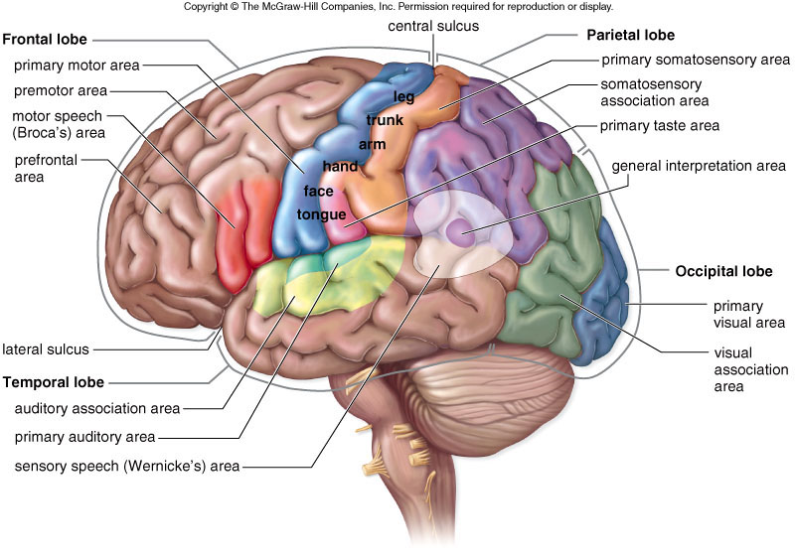

Slide 101
Functional Areas of the Brain
f
k
f
k

Slide 102
Motor speech (Broca’s) area
It is situated in the frontal lobe just above the lateral sulcus.
It controls the muscle movements needed for speech.
It is dominant in the left hemisphere in right-handed people and vice versa.

Slide 103
2. Sensory areas of the cerebrum
The postcentral (sensory) area/ somatosensory
It is the area behind the central sulcus.
Sensations of pain, temperature, pressure and touch, knowledge of muscular movement and the position of joints are perceived here.
The sensory area of the right hemisphere receives impulses from the left side of the body and vice versa.
The size of the areas representing different parts of the body is proportional to the extent of sensory innervation, e.g. the large area for the face is consistent with the extensive sensory nerve supply by the three branches of the trigeminal nerves (5th cranial nerves).

Slide 104
The auditory (hearing) area. It lies immediately below the lateral sulcus within the temporal lobe.
The cells receive and interpret impulses transmitted from the inner ear by the cochlear (auditory) part of the vestibulocochlear nerves (8th cranial nerves).
The olfactory (smell) area. It lies deep within the temporal lobe where impulses from the nose via the olfactory nerves (1st cranial nerves) are received and interpreted.

Slide 105
The taste area. lie just above the lateral sulcus in the deep layers of the sensory area.
It is the area where impulses from special nerve endings in taste buds in the tongue and in the lining of the cheeks, palate and pharynx are perceived as taste.
The visual area. It lies behind the parieto-occipital sulcus and includes the greater part of the occipital lobe.
The optic nerves (2nd cranial nerves) pass from the eye to this area which receives and interprets the impulses as visual impressions.

Slide 106
3. Association areas
The premotor area
It lies in the frontal lobe immediately anterior to the motor area.
The cells have controlling influence over the motor area, ensuring an orderly series of movements. For example, in tying a shoe lace or writing, many muscles contract but the movements must be coordinated and carried out in a particular sequence.
Such a pattern of movement, when established, is described as manual dexterity.

Slide 107
The frontal area/ prefrontal area
It extends anteriorly from the premotor area to include the remainder of the frontal lobe.
It is a large area and is more highly developed in humans than in other animals.
Communications between this and the other regions in the cerebrum are responsible for the behaviour, character and emotional state of the individual.
NB: No particular behaviour, character or intellectual trait has, so far, been attributed to the activity of any one group of cells.

Slide 108
The sensory speech (Wernicke’s) area
It is situated in the lower part of the parietal lobe and extends into the temporal lobe.
Spoken word is perceived here.
Comprehension and intelligence are based here.
There is a dominant area in the left hemisphere in right handed people and vice versa.

Slide 109
The parieto-occipitotemporal area
It lies behind the postcentral area
It includes the greater part of the parietal lobe of the cerebrum.
Its functions are believed to be associated with obtaining and retaining accurate knowledge of objects.
It has been suggested that objects can be recognised by touch alone because of the knowledge from past experience (memory) retained in this area.

Slide 110
Diencephalon
It connects the cerebrum and the midbrain.
It consists of several structures situated around the third ventricle.
They are thalamus, hypothalamus, pineal gland and optic chiasma.

Slide 111
Thalamus
It consists of two masses of nerve cells and fibres situated within the cerebral hemispheres just below the corpus callosum,
one on each side of the third ventricle.
Sensory input from the skin, viscera and special sense organs is transmitted to the thalamus before redistribution to the cerebrum.

Slide 112
Hypothalamus
It is composed of a number of groups of nerve cells.
It is situated below and in front of the thalamus, immediately above the pituitary gland.
It is linked to the posterior lobe of the pituitary gland by nerve fibres and to the anterior lobe by a complex system of blood vessels.
Through these connections, the hypothalamus controls the output of hormones from both lobes of the gland.

Slide 113
Functions of hypothalamus: it controls
The autonomic nervous system
appetite and satiety
thirst and water balance
body temperature
emotional reactions, e.g. pleasure, fear, rage
sexual behaviour including mating and child rearing
biological clocks or circadian rhythms, e.g. sleeping and waking cycles, body temperature and secretion of some hormones.

Slide 114
Brain stem
Midbrain
It is the area of the brain situated around the cerebral aqueduct between the cerebrum above and the pons below.
It consists of groups of cell bodies and nerve fibres (tracts) which connect the cerebrum with lower parts of the brain and with the spinal cord.
The cell bodies act as relay stations for the ascending and descending nerve fibres.

Slide 115
Pons
It is situated in front of the cerebellum, below the midbrain and above the medulla oblongata.
It consists mainly of nerve fibres which form a bridge between the two hemispheres of the cerebellum, and of fibres passing between the higher levels of the brain and the spinal cord.
There are groups of cells within the pons which act as relay stations and some of these are associated with the cranial nerves.
The anatomical structure of the pons differs from that of the cerebrum in that the cell bodies (grey matter) lie deeply and the nerve fibres are on the surface.

Slide 116
Medulla oblongata
It extends from the pons above and is continuous with the spinal cord below.
It is about 2.5 cm long and it lies just within the cranium above the foramen magnum.
Its anterior and posterior surfaces are marked by central fissures.
The outer aspect is composed of white matter which passes between the brain and the spinal cord, and grey matter lies centrally.
Some cells constitute relay stations for sensory nerves passing from the spinal cord to the cerebrum.

Slide 117
The vital centres, consisting of groups of cells associated with autonomic reflex activity, lie in its deeper structure.
These are the:
cardiac centre
respiratory centre
vasomotor centre
reflex centres of vomiting, coughing, sneezing and swallowing.

Slide 118
The medulla oblongata has several special features:
1. Decussation (crossing) of the pyramids. In the medulla motor nerves descending from the motor area in the cerebrum to the spinal cord in the pyramidal (corticospinal) tracts cross from one side to the other.
This means that the left hemisphere of the cerebrum controls the right half of the body, and vice versa.
These tracts are the main pathway for impulses to skeletal (voluntary) muscles.
2. Sensory decussation. Some of the sensory nerves ascending to the cerebrum from the spinal cord cross from one side to the other in the medulla. Others decussate at lower levels, i.e. in the spinal cord.

Slide 119
3. The cardiovascular centre controls the rate and force of cardiac contraction. Sympathetic and parasympathetic nerve fibres originating in the medulla pass to the heart. Sympathetic stimulation increases the rate and force of the heartbeat and parasympathetic stimulation has the opposite effect.
4. The respiratory centre controls the rate and depth of respiration.
From this centre, nerve impulses pass to the phrenic and intercostal nerves which stimulate contraction of the diaphragm and intercostal muscles, thus initiating inspiration.
The respiratory centre is stimulated by excess carbon dioxide and, to a lesser extent, by deficiency of oxygen in its blood supply and by nerve impulses from the chemoreceptors in the carotid bodies.

Slide 120
5. The vasomotor centre controls the diameter of the blood vessels, especially the small arteries and arterioles which have a large proportion of smooth muscle fibres in their walls.
Vasomotor impulses reach the blood vessels through the autonomic nervous system.
Stimulation may cause either constriction or dilatation of blood vessels depending on the site.
The sources of stimulation of the vasomotor centre are the arterial baroreceptors, body temperature and emotions such as sexual excitement and anger.
Pain usually causes vasoconstriction although severe pain may cause vasodilatation, a fall in blood pressure and fainting.

Slide 121
6. Reflex centres. When irritating substances are present in the stomach or respiratory tract, nerve impulses pass to the medulla oblongata, stimulating the reflex centres which initiate the reflex actions of vomiting, coughing and sneezing to expel the irritant.

Slide 122
Reticular formation
It is a collection of neurones in the core of the brain stem, surrounded by neural pathways which conduct ascending and descending nerve impulses between the brain and the spinal cord.
It has a vast number of synaptic links with other parts of the brain and is therefore constantly receiving 'information‘ being transmitted in ascending and descending tracts.

Slide 123
Functions (involved in)
• coordination of skeletal muscle activity associated with voluntary motor movement and the maintenance of balance
• coordination of activity controlled by the autonomic nervous system, e.g. cardiovascular, respiratory and gastrointestinal activity
• selective awareness that functions through the reticular activating system (RAS) which selectively blocks or passes sensory information to the cerebral cortex, e.g. the slight sound made by a sick child moving in bed may arouse his mother but the noise of regularly passing trains may be suppressed.

Slide 124
Cerebellum
It is situated behind the pons and immediately below the posterior portion of the cerebrum
occupy the posterior cranial fossa.
Ovoid in shape
Has two hemispheres, separated by a narrow median strip called the vermis.
Grey matter forms the surface of the cerebellum, and the white matter lies deeply.

Slide 125
Functions
It is concerned with the coordination of voluntary muscular movement, posture and balance.
Cerebellar activities are not under voluntary control.
It controls and coordinates the movements of various groups of muscles ensuring smooth, even, precise actions.
It coordinates activities associated with the maintenance of the balance and equilibrium of the body.
The sensory input for these functions is derived from the muscles and joints, the eyes and the ears.

Slide 126
Proprioceptor impulses from the muscles and joints indicate their position in relation to the body as a whole and those impulsesnfrom the eyes and the semicircular canals in the ears provide information about the position of the head in space.
Impulses from the cerebellum influence the contraction of skeletal muscle so that balance and posture are maintained.
Damage to the cerebellum results in clumsy uncoordinated muscular movement, staggering gait and inability to carry out smooth, steady, precise movements.

Slide 127
LIMBIC SYSTEM

Slide 128
Limbic System
The limbic system is a collection of structures involved in processing emotion and memory, including the hippocampus, the amygdala, and the hypothalamus.
The limbic system is located within the cerebrum of the brain, immediately below the temporal lobes, and buried under the cerebral cortex
Hippocampus
Episodic memories are formed and catalogued to be filed away in long-term storage across other parts of the cerebral cortex.
Connections made in the hippocampus also help us associate memories with various senses. The hippocampus is also important for spatial orientation and our ability to navigate the world.

Slide 129
Amygdala
Located right next to the hippocampus, the left and right amygdalae play a central role in our emotional responses, including feelings like pleasure, fear, anxiety and anger.
The amygdala also attaches emotional content to our memories, and so plays an important role in determining how robustly those memories are stored. Memories that have strong emotional meaning tend to stick.

Slide 130
Spinal cord
It is the elongated, almost cylindrical part of the central nervous system
It is suspended in the vertebral canal surrounded by the meninges and cerebrospinal fluid.
It is continuous above with the medulla oblongata
It extends from the upper border of the atlas to the lower border of the 1st lumbar vertebra.
It is approximately 45 cm long in an adult male, and about the thickness of the little finger.

Slide 131
When a specimen of cerebrospinal fluid is required it is taken from a point below the end of the cord, i.e. below the level of the 2nd lumbar vertebra.
This procedure is called lumbar puncture.
Except for the cranial nerves, the spinal cord is the nervous tissue link between the brain and the rest of the body .
Nerves conveying impulses from the brain to the various organs and tissues descend through the spinal cord.
At the appropriate level they leave the cord and pass to the structure they supply.
Similarly, sensory nerves from organs and tissues enter and pass upwards in the spinal cord to the brain.

Slide 132
Some activities of the spinal cord are independent of the brain, i.e. spinal reflexes.
To facilitate these there are extensive neurone connections between sensory and motor neurones at the same or different levels in the cord.
The spinal cord is incompletely divided into two equal parts, anteriorly by a short, shallow median fissure and posteriorly by a deep narrow septum, the posterior median septum.
Spinal cord is composed of grey matter in the centre surrounded by white matter supported by neuroglia.

Slide 134
Grey matter
The arrangement of grey matter in the spinal cord resembles the shape of the letter H, having two posterior, two anterior and two lateral columns.
The area of grey matter lying transversely is the transverse commissure and it is pierced by the central canal, an extension from the fourth ventricle, containing cerebrospinal fluid.

Slide 135
The cell bodies may be:
sensory cells, which receive impulses from the periphery of the body
lower motor neurones, which transmit impulses to the skeletal muscles
connector neurones, linking sensory and motor neurones, at the same or different levels, which form spinal reflex arcs.
At each point where nerve impulses are passed from one neurone to another there is a synaptic cleft and a neurotransmitter.

Slide 136
A section of the spinal cord showing nerve roots on one side.

Slide 137
Posterior columns of grey matter
These are composed of cell bodies which are stimulated by sensory impulses from the periphery of the body.
The nerve fibres of these cells contribute to the formation of the white matter of the cord and transmit the sensory impulses upwards to the brain.

Slide 138
Anterior columns of grey matter
These are composed of the cell bodies of the lower motor neurones which are stimulated by the axons of the upper motor neurones or by the cell bodies of connector neurones linking the anterior and posterior columns to form reflex arcs.
The posterior root (spinal) ganglia are composed of cell bodies which lie just outside the spinal cord on the pathway of the sensory nerves.
All sensory nerve fibres pass through these ganglia.
The only function of the cells is to promote the onward movement of nerve impulses.

Slide 139
White matter
The white matter of the spinal cord is arranged in three columns or tracts; anterior, posterior and lateral.
These tracts are formed by sensory nerve fibres ascending to the brain, motor nerve fibres descending from the brain and fibres of connector neurones.
Tracts are often named according to their points of origin and destination, e.g. spinothalamic, corticospinal.

Slide 140
Sensory nerve tracts (afferent or ascending) in the spinal cord
There are two main sources of sensation transmitted to the brain via the spinal cord.
1. The skin. Sensory receptors (nerve endings) in the skin, called cutaneous receptors, are stimulated by pain, heat, cold and touch, including pressure.
Nerve impulses generated are conducted by three neurones to the sensory area in the opposite hemisphere of the cerebrum where the sensation and its location are perceived.
Crossing to the other side, or decussation, occurs either at the level of entry into the cord or in the medulla.

Slide 141
2. The tendons, muscles and joints. Sensory receptors are nerve endings in these structures, called proprioceptors, and they are stimulated by stretch.
Together with impulses from the eyes and the ears they are associated with the maintenance of balance and posture and with perception of the position of the body in space.
These nerve impulses have two destinations:
by a three-neurone system the impulses reach the sensory area of the opposite hemisphere of the cerebrum
by a two-neurone system the nerve impulses reach the cerebellar hemisphere on the same side.

Slide 142
Motor nerve tracts (efferent or descending) in the spinal cord
Neurones which transmit nerve impulses away from the brain are motor (efferent or descending) neurones.
Motor neurone stimulation results in:
contraction of skeletal (striated, voluntary) muscle
contraction of smooth (involuntary) muscle, cardiac muscle and the secretion by glands controlled by nerves of the autonomic nervous system

Slide 143
Voluntary muscle movement
The contraction of the muscles which move the joints is, in the main, under conscious (voluntary) control, which means that the stimulus to contract originates at the level of consciousness in the cerebrum.
However, some nerve impulses which affect skeletal muscle contraction are initiated in the midbrain, brain stem and cerebellum.
This involuntary activity is associated with coordination of muscle activity, e.g. when very fine movement is required and in the maintenance of posture and balance.

Slide 144
Efferent nerve impulses are transmitted from the brain to the body via bundles of nerve fibres or tracts in the spinal cord.
The motor pathways from the brain to the muscles are made up of two neurones.
These tracts are either:
pyramidal (corticospinal)
extrapyramidal.
The motor fibres that form the pyramidal tracts travel through the internal capsule and are the main pathway for impulses to voluntary (skeletal) muscles.
Those motor fibres that do not pass through the internal capsule form the extrapyramidal tracts and have connections with many parts of the brain including the basal nuclei and the thalamus.

Slide 145
The upper motor neurone
This has its cell body (Betz's cell) in the precentral sulcus area of the cerebrum.
The axons pass through the internal capsule, pons and medulla.
In the spinal cord they form the lateral corticospinal tracts of white matter and the fibres terminate in close association with the cell bodies of the lower motor neurones in the anterior columns of grey matter.
The axons of these upper motor neurones make up the pyramidal tracts and decussate in the medulla oblongata, forming the pyramids.

Slide 146
The lower motor neurone
This has its cell body in the anterior horn of grey matter in the spinal cord.
Its axon emerges from the spinal cord by the anterior root, joins with the incoming sensory fibres and forms the mixed spinal nerve which passes through the intervertebral foramen.
Near its termination in muscle the axon branches into a variable number of tiny fibres which form motor end-plates, each of which is in close association with a sensitive area on the wall of a muscle fibre.

Slide 147
The motor end-plates of each nerve and the muscle fibres they supply form a motor unit.
The neurotransmitter that conveys the nerve impulse across the synapse to stimulate the muscle fibre is acetylcholine.
Motor units contract as a whole and the strength of contraction of a muscle depends on the number of motor units in action at a time.
The lower motor neurone has been described as the final common pathway for the transmission of nerve impulses to skeletal muscles.
The cell body of this neurone is influenced by a number of upper motor neurones originating from various sites in the brain and by some neurones which begin and end in the spinal cord.
Some of these neurones stimulate the cell bodies of the lower motor neurone while others have an inhibiting effect.
The outcome of these influences is smooth, coordinated muscle movement, some of which is voluntary and some involuntary.

Slide 148
Involuntary muscle movement
Upper motor neurones.
These have their cell bodies in the brain at a level below the cerebrum, i.e. in the midbrain, brain stem, cerebellum or spinal cord.
They influence muscle activity in relation to the maintenance of posture and balance, the coordination of muscle movement and the control of muscle tone.

Slide 149
Spinal reflexes
These consist of three elements:
sensory neurones
connector neurones in the spinal cord
lower motor neurones.
In the simplest reflex arc there is only one of each. A reflex action is an immediate motor response to a sensory stimulus.
Many connector and motor neurones may be stimulated by afferent impulses from a small area of skin, e.g. the pain impulses initiated by touching a very hot surface with the finger are transmitted to the spinal cord by sensory nerves.

Slide 150
These stimulate many connector and lower motor neurones in the cord which results in the contraction of many skeletal muscles of the hand, arm and shoulder, and the removal of the finger.
Reflex action takes place very quickly, in fact, the motor response may have occurred simultaneously with the perception of the pain in the cerebrum.
Reflexes of this type are invariably protective but they can on occasion be inhibited. For example, if it is a precious plate that is very hot when lifted every effort will be made to overcome the pain to prevent dropping it!

Slide 151
A simple reflex arc involving one side only

Slide 152
Stretch reflexes
Only two neurones are involved.
The cell body of the lower motor neurone is stimulated by the sensory neurone.
There is no connector neurone involved.
The knee jerk is one example, but this type of reflex can be demonstrated at any point where a stretched tendon crosses a joint.
By tapping the tendon just below the knee when it is bent, the sensory nerve endings in the tendon and in the thigh muscles are stretched.
This initiates a nerve impulse which passes into the spinal cord to the cell body of the lower motor neurone in the anterior column of grey matter on the same side.
As a result the thigh muscles suddenly contract and the foot kicks forward.
This is used as a test of the integrity of the reflex arc. This type of reflex has a protective function —it prevents excessive joint movement that may damage tendons, ligaments and muscles.

Slide 153
Autonomic reflexes
Include pupillary light reflex when the pupil immediately constricts, in response to bright light, preventing retinal damage.

Slide 154
PERIPHERAL NERVOUS SYSTEM
It consists of:
31 pairs of spinal nerves
12 pairs of cranial nerves
the autonomic part of the nervous system
Most of the nerves of the peripheral nervous system are composed of sensory nerve fibres conveying afferent impulses from sensory end organs to the brain, and motor nerve fibres conveying efferent impulses from the brain through the spinal cord to the effector organs, e.g. skeletal muscles, smooth muscle and glands.

Slide 155
Each nerve consists of numerous nerve fibres collected into bundles.
Each bundle has several coverings of protective connective tissue.
Endoneurium is a delicate tissue, surrounding each individual fibre, which is continuous with the septa that pass inwards from the perineurium.
Perineurium is a smooth connective tissue, surrounding each bundle of fibres.
Epineurium is the fibrous tissue which surrounds and encloses a number of bundles of nerve fibres. Most large nerves are covered by epineurium.

Slide 156
Spinal nerves
There are 31 pairs of spinal nerves that leave the vertebral canal by passing through the intervertebral foramina formed by adjacent vertebrae.
They are named and grouped according to the vertebrae with which they are associated:
8 cervical
12 thoracic
5 lumbar
5 sacral
1 coccygeal.

Slide 158
Although there are only seven cervical vertebrae, there are eight nerves because the first pair leave the vertebral canal between the occipital bone and the atlas and the eighth pair leave below the last cervical vertebra.
Thereafter the nerves are given the name and number of the vertebra immediately above.

Slide 159
The lumbar, sacral and coccygeal nerves leave the spinal cord near its termination at the level of the first lumbar vertebra, and extend downwards inside the vertebral canal in the subarachnoid space, forming a sheaf of nerves which resembles a horse's tail, the cauda equina.
These nerves leave the vertebral canal at the appropriate lumbar, sacral or coccygeal level, depending on their destination.
The spinal nerves arise from both sides of the spinal cord and emerge through the intervertebral foramina.
Each nerve is formed by the union of a motor and a sensory nerve root and is, therefore, a mixed nerve.
Each spinal nerve has a contribution from the sympathetic part of the autonomic nervous system in the form of a preganglionic fibre.

Slide 160
Nerve roots
The anterior nerve root consists of motor nerve fibres which are the axons of the nerve cells in the anterior column of grey matter in the spinal cord and, in the thoracic and lumbar regions, sympathetic nerve fibres which are the axons of cells in the lateral columns of grey matter.
The posterior nerve root consists of sensory nerve fibres.
Just outside the spinal cord there is a spinal ganglion (posterior root ganglion), consisting of a little cluster of cell bodies.
Sensory nerve fibres pass through these ganglia before entering the spinal cord.
The area of skin supplied by each nerve is called a dermatome

Slide 161
For a very short distance after leaving the spinal cord the nerve roots have a covering of dura and arachnoid maters.
These terminate before the two roots join to form the mixed spinal nerve.
The nerve roots have no covering of pia mater.
Immediately after emerging from the intervertebral foramen each spinal nerve divides into a ramus communicans, a posterior ramus and an anterior ramus.
The rami communicans are part of preganglionic sympathetic neurones of the autonomic nervous system

Slide 162
The posterior rami pass backwards and divide into medial and lateral branches to supply skin and muscles of relatively small areas of the posterior aspect of the head, neck and trunk.
The anterior rami supply the anterior and lateral aspects of the neck, trunk and the upper and lower limbs.
In the cervical, lumbar and sacral regions the anterior rami unite near their origins to form large masses of nerves, or plexuses, where nerve fibres are regrouped and rearranged before proceeding to supply skin, bones, muscles and joints of a particular area.

Slide 163
This means that these structures have a nerve supply from more than one spinal nerve and therefore damage to one spinal nerve does not cause loss of function of a region.
In the thoracic region the anterior rami do not form plexuses.
There are five large plexuses of mixed nerves formed on each side of the vertebral column.
They are the:
cervical plexuses
brachial plexuses
lumbar plexuses
sacral plexuses
coccygeal plexuses.

Slide 164
Cervical plexus
This is formed by the anterior rami of the first four cervical nerves.
It lies opposite the 1st, 2nd, 3rd and 4th cervical vertebrae under the protection of the sternocleidomastoid muscle.
The superficial branches supply the structures at the back and side of the head and the skin of the front of the neck to the level of the sternum.
The deep branches supply muscles of the neck, e.g. the sternocleidomastoid and the trapezius.
The phrenic nerve originates from cervical roots 3,4 and 5 and passes downwards through the thoracic cavity in front of the root of the lung to supply the muscle of the diaphragm with impulses which stimulate contraction.

Slide 165
Brachial plexus
The anterior rami of the lower four cervical nerves and a large part of the first thoracic nerve form the brachial plexus.
The plexus is situated in the neck and shoulder above and behind the subclavian vessels and in the axilla.
The branches of the brachial plexus supply the skin and muscles of the upper limbs and some of the chest muscles.

Slide 166
Five large nerves and a number of smaller ones emerge from this plexus, each with a contribution from more than one nerve root, containing sensory, motor and autonomic fibres:
axillary (circumflex) nerve: C5, 6
radial nerve: C5, 6, 7, 8, Tl
musculocutaneous nerve: C5, 6, 7
median nerve: C5, 6, 7, 8, Tl
ulnar nerve: C7, 8, Tl
medial cutaneous nerve: C8, Tl.

Slide 167
The axillary (circumflex) nerve winds round the humerus at the level of the surgical neck.
It then breaks up into minute branches to supply the deltoid muscle, shoulder joint and overlying skin.
The radial nerve is the largest branch of the brachial plexus.
It supplies the triceps muscle behind the humerus, crosses in front of the elbow joint then winds round to the back of the forearm to supply extensors of the wrist and finger joints.
It continues into the back of the hand to supply the skin of the thumb, the first two fingers and the lateral half of the third finger.

Slide 168
The musculocutaneous nerve passes downwards to the lateral aspect of the forearm.
It supplies the muscles of the upper arm and the skin of the forearm.
The median nerve passes down the midline of the arm in close association with the brachial artery.
It passes in front of the elbow joint then down to supply the muscles of the front of the forearm.
It continues into the hand where it supplies small muscles and the skin of the front of the thumb, the first two fingers and the lateral half of the third finger. It gives off no branches above the elbow.

Slide 169
The ulnar nerve descends through the upper arm lying medial to the brachial artery.
It passes behind the medial epicondyle of the humerus to supply the muscles on the ulnar aspect of the forearm.
It continues downwards to supply the muscles in the palm of the hand and the skin of the whole of the little finger and the medial half of the third finger.
It gives off no branches above the elbow.

Slide 170
Lumbar plexus
The lumbar plexus is formed by the anterior rami of the first three and part of the fourth lumbar nerves.
The plexus is situated in front of the transverse processes of the lumbar vertebrae and behind the psoas muscle.
The main branches, and their nerve roots are:
iliohypogastric nerve: L1
ilioinguinal nerve: L1
genitofemoral: L1, 2
lateral cutaneous nerve of thigh: L2, 3
femoral nerve: L2, 3,4
obturator nerve: L2, 3, 4
lumbosacral trunk: L4, (5).

Slide 171
The iliohypogastric, ilioinguinal and genitofemoral nerves supply muscles and the skin in the area of the lower abdomen, upper and medial aspects of the thigh and the inguinal region.
The lateral cutaneous nerve of the thigh supplies the skin of the lateral aspect of the thigh including part of the anterior and posterior surfaces.

Slide 172
The femoral nerve is one of the larger branches. It passes behind the inguinal ligament to enter the thigh in close association with the femoral artery.
It divides into cutaneous and muscular branches to supply the skin and the muscles of the front of the thigh.
One branch, the saphenous nerve, supplies the medial aspect of the leg, ankle and foot.
The obturator nerve supplies the adductor muscles of the thigh and skin of the medial aspect of the thigh.
It ends just above the level of the knee joint.
The lumbosacral trunk descends into the pelvis and makes a contribution to the sacral plexus.

Slide 173
Sacral plexus
The sacral plexus is formed by the anterior rami of the lumbosacral trunk and the first, second and third sacral nerves.
The lumbosacral trunk is formed by the fifth and part of the fourth lumbar nerves.
It lies in the posterior wall of the pelvic cavity.
The sacral plexus divides into a number of branches, supplying the muscles and skin of the pelvic floor, muscles around the hip joint and the pelvic organs.
In addition to these it provides the sciatic nerve which contains fibres from L4, 5, S1, 2, 3.

Slide 174
The sciatic nerve is the largest nerve in the body.
It is about 2 cm wide at its origin.
It passes through the greater sciatic foramen into the buttock then descends through the posterior aspect of the thigh supplying the hamstring muscles.
At the level of the middle of the femur it divides to form the tibial and the common peroneal nerves.
The tibial nerve descends through the popliteal fossa to the posterior aspect of the leg where it supplies muscles and skin.
It passes under the medial malleolus to supply muscles and skin of the sole of the foot and toes.
One of the main branches is the sural nerve which supplies the tissues in the area of the heel, the lateral aspect of the ankle and a part of the dorsum of the foot.

Slide 175
The common peroneal nerve descends obliquely along the lateral aspect of the popliteal fossa, winds round the neck of the fibula into the front of the leg where it divides into the deep peroneal (anterior tibial) and the superficial peroneal (musculocutaneous) nerves.
These nerves supply the skin and muscles of the anterior aspect of the leg and the dorsum of the foot and toes.
The pudendal nerve (S2, 3, 4). The perineal branch supplies the external anal sphincter, the external urethral sphincter and adjacent skin.

Slide 176
Coccygeal plexus
The coccygeol plexus is a very small plexus formed by part of the fourth and fifth sacral and the coccygeal nerves.
The nerves from this plexus supply the skin in the area of the coccyx and the levators ani and coccygeus muscles of the pelvic floor and the external anal sphincter.

Slide 177
Thoracic nerves
The thoracic nerves do not intermingle to form plexuses.
There are 12 pairs and the first 11 are the intercostal nerves.
They pass between the ribs supplying them, the intercostal muscles and overlying skin.
The 12th pair are the subcostal nerves.
The 7th to the 12th thoracic nerves also supply the muscles and the skin of the posterior and anterior abdominal walls

Slide 179
Cranial nerves
There are 12 pairs of cranial nerves originating from nuclei in the inferior surface of the brain, some sensory, some motor and some mixed.
Their names and numbers are:
I. Olfactory: sensory
II. Optic: sensory
III. Oculomotor: motor
IV. Trochlear: motor
V. Trigeminal: mixed
VI. Abducent: motor
VII. Facial: mixed
VIII. Vestibulocochlear (auditory): sensory
IX. Glossopharyngeal: mixed
X. Vagus: mixed
XI. Accessory: motor
XII. Hypoglossal: motor.

Slide 180
I. Olfactory nerves (sensory)
These are the nerves of the sense of smell.
Their nerve endings and fibres originate in the upper part of the mucous membrane of the nasal cavity, pass upwards through the cribriform plate of the ethmoid bone and then go to the olfactory bulb
The nerves then proceed backwards as the olfactory tract, to the area for the perception of smell in the temporal lobe of the cerebrum.

Slide 181
II. Optic nerves (sensory)
These are the nerves of the sense of sight.
The fibres originate in the retinae of the eyes and they combine to form the optic nerves.
They are directed backwards and medially through the posterior part of the orbital cavity.
They then pass through the optic foramina of the sphenoid bone into the cranial cavity and join at the optic chiasma.
The nerves proceed backwards as the optic tracts to the lateral geniculate bodies of the thalamus.
Impulses pass from these to the centre for sight in the occipital lobes of the cerebrum and to the cerebellum.
In the occipital lobe sight is perceived, and in the cerebellum the impulses from the eyes contribute to the maintenance of balance, posture and orientation of the head in space.
The central retinal artery and vein enter the eye enveloped by the fibres of the optic nerve.

Slide 182
III. Oculomotor nerves (motor)
These nerves arise from nerve cells near the cerebral aqueduct.
They supply:
four extraocular muscles, which move the eyeball, i.e. the superior, medial and inferior recti and the inferior oblique muscle
intraocular muscles:
— ciliary muscles which alter the shape of the lens, changing its refractive power
— circular muscles of the iris which constrict the pupil
the levator palpebrae muscle which raises the upper eyelid.

Slide 183
IV. Trochlear nerves (motor)
These nerves arise from nerve cells near the cerebral aqueduct.
They supply the superior oblique muscles of the eyes.

Slide 184
V. Trigeminal nerves (mixed)
These nerves contain motor and sensory fibres
Are among the largest of the cranial nerves.
They are the chief sensory nerves for the face and head (including the oral and nasal cavities and teeth), receiving impulses of pain, temperature and touch.
The motor fibres stimulate the muscles of mastication.
There are three main branches of the trigeminal nerves.
The ophthalmic nerves are sensory only and supply the lacrimal glands, conjunctiva of the eyes, forehead, eyelids, anterior aspect of the scalp and mucous membrane of the nose.
The maxillary nerves are sensory only and supply the cheeks, upper gums, upper teeth and lower eyelids.
The mandibular nerves contain both sensory and motor fibres. These are the largest of the three divisions and they supply the teeth and gums of the lower jaw, pinnae of the ears, lower lip and tongue. The motor fibres supply the muscles of mastication.

Slide 185
VI. Abducent nerves (motor)
These nerves arise from a group of nerve cells lying under the floor of the fourth ventricle.
They supply the lateral rectus muscles of the eyeballs.

Slide 186
VII. Facial nerves (mixed)
These nerves are composed of both motor and sensory nerve fibres, arising from nerve cells in the lower part of the pons.
The motor fibres supply the muscles of facial expression.
The sensory fibres convey impulses from the taste buds in the anterior two-thirds of the tongue to the taste perception area in the cerebral cortex.

Slide 187
VIII. Vestibulocochlear (auditory) nerves (sensory)
These nerves are composed of two distinct sets of fibres, vestibular nerves and cochlear nerves.
The vestibular nerves arise from the semicircular canals of the inner ear and convey impulses to the cerebellum.
They are associated with the maintenance of posture and balance.
The cochlear nerves originate in the organ of Corti in the inner ear and convey impulses to the hearing areas in the cerebral cortex where sound is perceived.

Slide 188
IX. Glossopharyngeal nerves (mixed)
These nerves arise from nuclei in the medulla oblongata.
The motor fibres stimulate the muscles of the tongue and pharynx and the secretory cells of the parotid (salivary) glands.
The sensory fibres convey impulses to the cerebral cortex from the posterior third of the tongue, the tonsils and pharynx and from taste buds in the tongue and pharynx.
These nerves are essential for the swallowing and gag reflexes.

Slide 189
X. Vagus nerves (mixed)
These nerves have a more extensive distribution than any other cranial nerves.
They arise from nerve cells in the medulla oblongata and other nuclei, and pass down through the neck into the thorax and the abdomen.
These nerves form an important part of the parasympathetic nervous system.
The motor fibres supply the smooth muscles and secretory glands of the pharynx, larynx, trachea, heart, oesophagus, stomach, intestines, pancreas, gall bladder, bile ducts, spleen, kidneys, ureter and blood vessels in the thoracic and abdominal cavities.
The sensory fibres convey impulses from the lining membranes of the same structures to the brain.

Slide 190
XI. Accessory nerves (motor)
These nerves arise from cell bodies in the medulla oblongata and in the spinal cord.
The fibres supply the sternodeidomastoid and trapezius muscles.
Branches join the vagus nerves and supply the phanyngeal and laryngeal muscles.

Slide 191
XII. Hypoglossal nerves (motor)
These nerves arise from cells in the medulla oblongata.
They supply the muscles of the tongue and muscles surrounding the hyoid bone and contribute to swallowing and speech.

Slide 192
AUTONOMIC NERVOUS SYSTEM
The autonomic or involuntary part of the nervous system controls the functions of the body carried out 'automatically', i.e. initiated in the brain below the level of the cerebrum.
Although stimulation does not occur voluntarily the individual may be conscious of its effects, e.g. an increase in the heart rate.
The effects of autonomic control are rapid and essential for homeostasis.

Slide 193
The effector organs are:
smooth muscle
cardiac muscle
glands
Efferent (motor) nerves of ANS arise from nerve cells in the brain and emerge at various levels between the midbrain and the sacral region of the spinal cord and travel together with the peripheral nerves.
The effectors of the SNS are skeletal muscles

Slide 194
Efferent Pathways
Heavily myelinated axons of the somatic motor neurons extend from the CNS to the effector
Axons of the ANS are a two-neuron chain
The preganglionic (first) neuron has a lightly myelinated axon
The ganglionic (second) neuron extends to an effector organ

Slide 195
Neurotransmitter Effects
All somatic motor neurons release Acetylcholine (ACh), which has an excitatory effect
In the Autonomic Nervous System (ANS):
Preganglionic fibers release Acetylcholine (Ach)
Postganglionic fibers release norepinephrine (a.k.a. noradrenaline) or ACh and the effect is either stimulatory or inhibitory
Autonomic Nervous System (ANS) effect on the target organ is dependent upon the neurotransmitter released and the receptor type of the effector

Slide 196
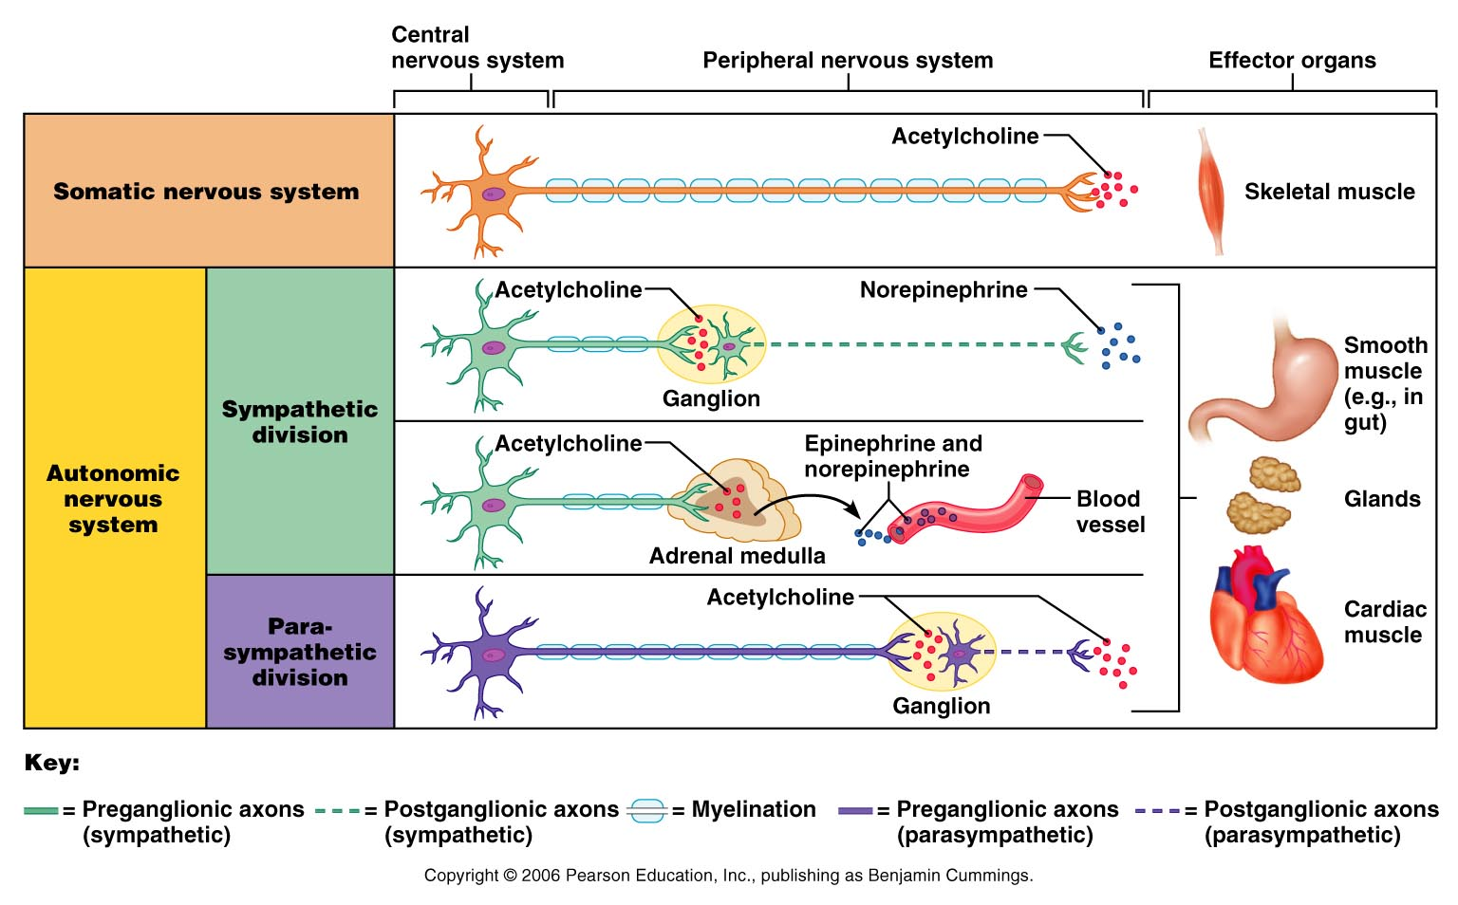
Comparison of Somatic and Autonomic Systems
Figure 14.2

Slide 197
ANS is divided into 2 divisions; having both structural & functional differences.
sympathetic (thoraco-lumbar outflow)
parasympathetic (cranio-sacral outflow).
They normally work in an opposing manner.
Sympathetic activity tends to predominate in stressful situations and parasympathetic activity during rest.
Each division has 2 efferent neurones in its peripheral pathways between the CNS & effector organs.
These are:
the preganglionic neurone
the postganglionic neurone.

Slide 198
Cell body of the preganglionic neurone is in the brain or spinal cord.
Its axon terminals synapse with the cell body of the postganglionic neurone in an autonomic ganglion outside the CNS.
The postganglionic neurone conducts impulses to the effector organ.

Slide 199
SYMPHATHETIC NERVOUS SYSTEM
The preganglionic neurone.
Has its cell body in the lateral column of grey matter in the spinal cord between the levels of the 1st thoracic & 2nd or 3rd lumbar vertebrae.
Nerve fibre leaves the cord by the anterior root & terminates either in the lateral chain of sympathetic ganglia or passes through it to one of the prevertebral ganglia.
Acetylcholine is the neurotransmitter.
The postganglionic neurone.
Has its cell body in a ganglion and terminates in the organ or tissue supplied.
Noradrenaline is usually the neurotransmitter.

Slide 200
Sympathetic ganglia
a) The lateral chains of sympathetic ganglia.
Chains of ganglia which extend from the upper cervical level to the sacrum, one chain lying on each side of the bodies of the vertebrae.
The ganglia are attached to each other by nerve fibres.
There is no parasympathetic supply to the
sweat glands,
skin and
blood vessels of skeletal muscles.

Slide 201
b) Prevertebral ganglia.
3 in number;
Situated in the abdominal cavity close to the origins of arteries of the same names:
coeliac ganglion
superior mesenteric ganglion
inferior mesenteric ganglion.
Consist of nerve cell bodies rather diffusely distributed among a network of nerve fibres which form plexuses.
Preganglionic sympathetic fibres pass through the lateral chain to reach these ganglia.

Slide 202
Sympathetic outflow; Solid red lines - preganglionic fibres; broken lines - postganglionic fibres.

Slide 203
PARASYMPHATHETIC NERVOUS SYSTEM
Has two neurons (pre and postganglionic) and the primary neurotransmitter at both synapses is acetylcholine.
The preganglionic neurone.
Has its cell body either in the brain or in the spinal cord.
Those originating in the brain are the cranial nerves III, VII, IX and X, arising from nuclei in the midbrain and brain stem, and their nerve fibres terminate outside the brain.
Cell bodies of the sacral outflow are in the lateral columns of grey matter at the distal end of the spinal cord. Their fibres leave the cord in sacral segments 2, 3 and 4 and synapse with postganglionic neurones in the walls of pelvic organs.
The postganglionic neurone.
Has its cell body either in a ganglion or in the wall of the organ supplied.

Slide 204
Parasympathetic outflow; Solid blue lines-preganglionic fibres; broken lines-postganglionic fibres

Slide 205
Functions of ANS
Sympathetic stimulation prepares the body to deal with exciting and stressful situations. Mobilizes the body for 'fight or flight’.
Parasympathetic stimulation tends to slow down body processes except digestion and absorption of food and the functions of the genitourinary systems.
The 2 systems function together maintaining
regular heartbeat,
normal temperature &
an internal environment compatible with the immediate external surroundings.

Slide 206
Effects of ANS
a) Cardiovascular system
Sympathetic | Parasympathetic
HR and heart contraction Dilates coronary arteries Vasodilation of vessels in skeletal muscle PR and thus BP Accelerates blood coagulation | HR and force of contraction Constricts coronary arteries

Slide 207
b) Respiratory system
Sympathetic stimulation
Causes dilatation of the airways (bronchodilation)
Increases oxygen intake and carbon dioxide output
Parasympathetic stimulation
Produces constriction of the bronchi.

Slide 208
c) Digestive and urinary systems
Sympathetic stimulation
Liver: increased conversion of glycogen to glucose
Adrenal glands are stimulated to secrete adrenaline & noradrenaline.
Stomach and small intestine: inhibits peristalsis and production of digestive juices
Urethral and anal sphincters: the muscle tone of the sphincters is increased, inhibiting micturition and defecation.
Bladder wall relaxes.
Metabolic rate is greatly increased.

Slide 209
Parasympathetic stimulation
Stomach and small intestine: rate of digestion & absorption of food is increased.
Pancreas: increased secretion of pancreatic juice & insulin .
Urethral and anal sphincters; Relaxation of internal sphincters thus allowing micturition and defecation to occur.in both cases there is voluntary relaxation of the external sphincters.
Liver: increased secretion of bile
No effect on adrenal glands and metabolic rate

Slide 210
d) Eye
Sympathetic stimulation
Dilatation of the pupil.
Causes retraction of the levator palpebral muscles thus opening the eyes wide and giving the appearance of alertness and excitement.
Slight relaxation of the ciliary muscle that adjusts the thickness of the lens.
Parasympathetic stimulation
Pupillary constriction
Eyelids tend to close, giving the appearance of sleepiness.
Ciliary muscles contracts facilitation near vision

Slide 211
e) Skin
Sympathetic stimulation
Causes increased secretion of sweat
Produces contraction of the arrector pili (the muscles in the hair follicles of the skin), giving the appearance of 'goose pimples/flesh'.
Causes constriction of the blood vessels preventing heat loss.
There is no parasympathetic nerve supply to the skin.
Some sympathetic fibres are adrenergic, causing vasoconstriction, and some are cholinergic, causing vasodilatation

Slide 212
AFFERENT IMPULSES FROM VISCERA
Impulses transmitted by autonomic afferents are associated with:
visceral reflexes, usually at an unconscious level, e.g. cough, blood pressure
sensation of, e.g., hunger, thirst, nausea, sexual sensation, rectal and bladder distension
visceral pain.
Visceral pain
Def: A sensation of dull, poorly located pain from the viscera (internal organs)
Experienced when:
visceral nerves are stretched
large number of fibres are stimulated
there is ischaemia and local accumulation of metabolites
the sensitivity of nerve endings to painful stimuli is increased, e.g. during inflammation.

Slide 213
Referred pain
Def: Refers to visceral pain that is projected and felt as cutaneous pain.
Occurs when sensory fibres from the viscera enter the same segment of the spinal cord as somatic nerves, i.e. those from the superficial tissues.
Sensory nerve from this organs stimulates the closely associated nerve in the spinal cord and it transmits the impulses to the sensory area in the cerebral cortex where the pain is perceived as originating in the area supplied by the somatic nerve.

Slide 214
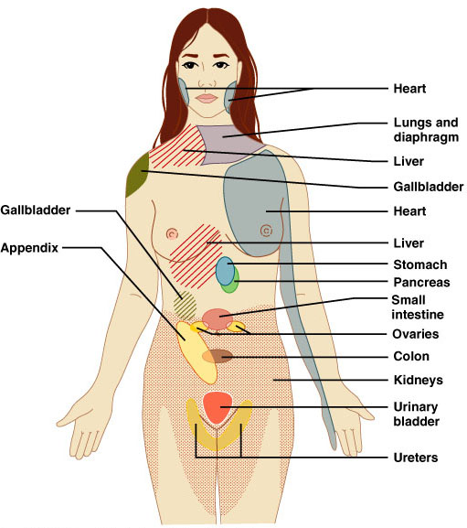
Referred Pain
Pain stimuli arising from the viscera are perceived as somatic in origin
This may be due to the fact that visceral pain afferents travel along the same pathways as somatic pain fibers
Figure 14.8

Slide 215
