Slide 1


PRESENTATION ON NATIONAL LIVESTOCK MARKETING INFORMATION SYSTEM(NLMIS)
PRESENTATION TO NDMA/RPLRP EARLY WARNING TRAINING AT GHELIAN HOTEL ON 12/JUNE/2018
MAURICE OUMA
PROJECT MARKET ACCESS AND TRADE OFFICER

Slide 2
Country Information
Agriculture, forestry and fishing contributes 32.5% of the country’s GDP
Livestock sector employs50% of the agricultural labour force
Value of marketed livestock and livestock products was Ksh 124,999 million in 2016
Population is estimated at (M) cattle,beef-16.0; dairy-4.5; sheep-17.9; goats-26.9; camels-3.0; ind.chickens-36.6; layers-4.2; broilers-3.1; among others
Nearly 80% of the country is ASAL and holds majority of livestock

Slide 3
The NLMIS-Objective
Provide a near real-time data reporting and information dissemination system.
Establish a livestock marketing database for planning, research and monitoring of marketing trends.
Avail information through various media to all stakeholders in livestock marketing for decision making.

Slide 4
Need for Marketing Information
Marketing information helps market actors to know;
            What livestock are in demand
              Where to buy and sell livestock
                Prevailing prices at different outlets
                Available volumes in the market
Market info helps business planning for traders to mobilize resources, planning of interventions by policy makers, and avails data for research needs

Slide 5
NLMIS Coverage
NLMIS was launched in 2003
Covered meat animals trade in ASAL areas Camel, cattle, goats and Sheep.
Other meat source animals especially poultry, pig and rabbits were not included.
Covered aspects of animal type, class, grade, price and volume.
Information was obtained from 44 local markets
Animal products such as meat, milk, eggs, hides and skins and honey missed in the system.

Slide 6
Current Status
The NLMIS is functional.
82 data monitors and 14 supervisors from 14 ASAL counties were trained in November 2016.
Data collection resumed in December 2016 and is available through the system.
County monthly market bulletins are produced.

Slide 7
NLMIS METHODOLOGY
Use cell phones to send data from markets to make information more timely
Use of a central server for access of data via cell phone SMS, internet, and other methods
  Allows access by all stakeholders
  Provides transparency in the marketplace
  Storage of data allows time series analyses and spatial/temporal comparisons
Training of market monitors and stakeholders in use of the system

Slide 8
LMIS Architecture
Internet
Country
Country LMIS
Country Analysis
Data
Data
and Reporting
Mirror Server
Main Server
Computer
Smart
phone
Cell
Cell
Smart
phone
Computer
(
Web
/
Email
)
(
Web
/
Email
)
Data Collection
Information Delivery
Notes:
8

Slide 9
Livestock Market Information System Data Flow
Livestock Market Information System Data Flow
Return SMS that Data Received OK
SMS
Send
Module
Requested Market Data Returned via SMS
Market
Data
Requestor
Market
Trend
Analysis
SMS Error Message
SMS
Parser
No
Web User
Interface
Data
Transfer
and
Mining
Engine
Market
Chain
Analysis
Did
SMS
Parse?
Market
Data
Collector
Yes
Market
Reports
No
SMS Error Message
Data Return to Interface
Data Entry from Interface
Regional/
Global
LMIS
Database
Local
LMIS
Database
Local
Replicate
LMIS
Database

Slide 10
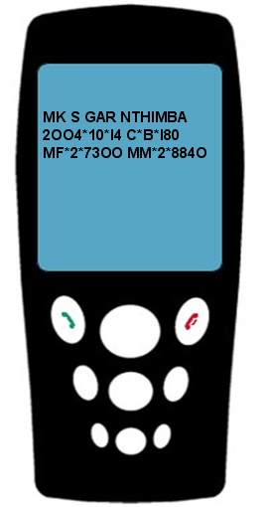
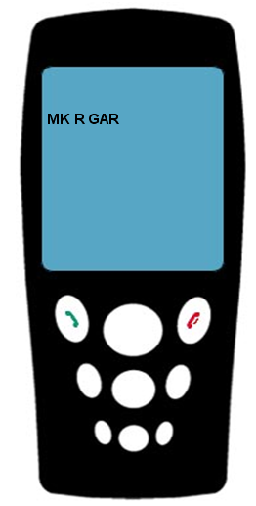
SMS Send/Receive
Send
Information
Request
Information
MK R = Market Receive
MK S = Market Send
MP R = Product Receive
MP S = Product Send
MC R = Market Chain Receive
MC S = Market Chain Send
Notes:
10

Slide 11
LMIS Coding
Unified coding to streamline data entry to LMIS
Specific codes are established to distinguish between:
  Animal Kind
  Breed
  Age
  Sex
  Grade

Slide 12
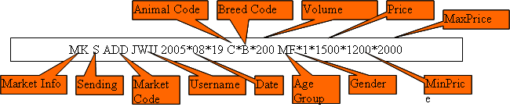

SENDING DATA
REQUESTING DATA

Slide 13
Livestock Market Information Systems
Ethiopia: http://www.lmiset.net
Kenya: http://www.lmiske.go.ke
Tanzania: http://www.lmistz.net
Mali: http://www.malibetail.net
Notes:
13

Slide 14
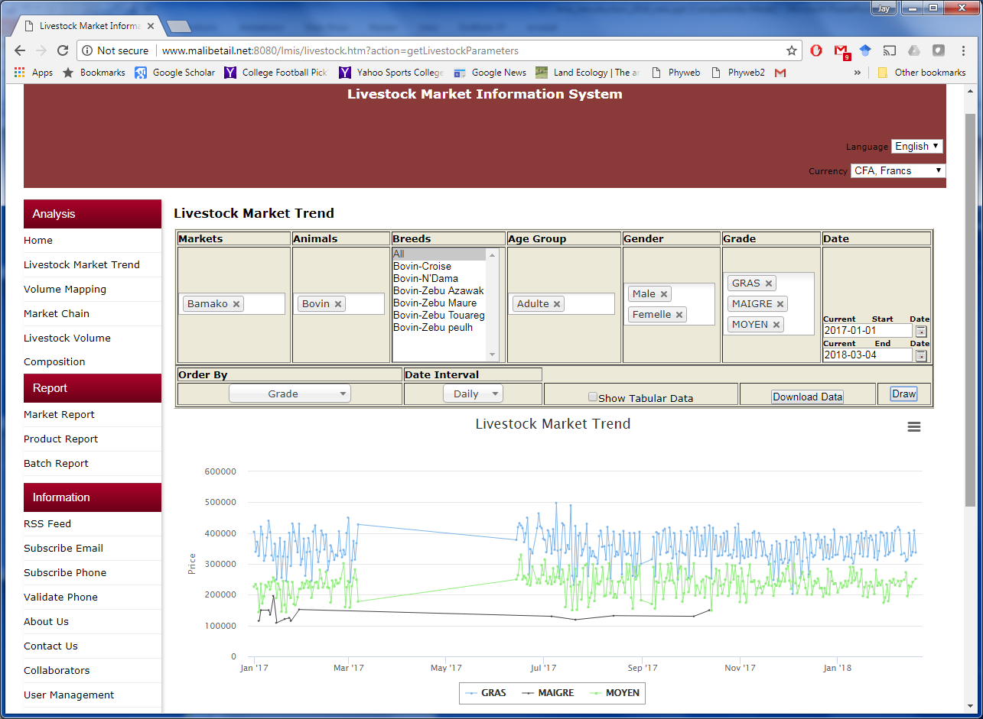

Slide 15
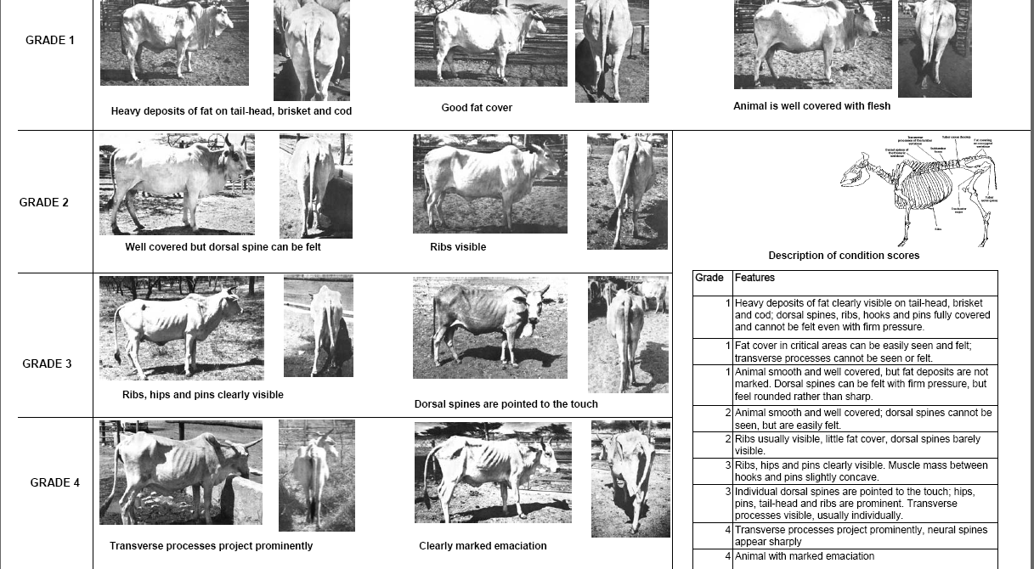
GRADING SYSTEM

Slide 16
Challenges
Non-standardized data gathering methods for organizations with information systems;
Sustainability issues- data monitors, maintenance of servers and software renewal;
Inadequate capacity of system operators;
Internet stability;
Poor linkages of institutions in livestock marketing information;
Program driven activity-sustainability is low;
Market shifts, fragmentation and closure due to factors like insecurity;
Weak intergovernmental linkages to support the LMIS.

Slide 17
Thank you for Listening

