Slide 1
NORMAL LABOUR
Lecture guide notes

Slide 2
Course objectives
By the end of the unit the student should be able to:
Define normal labour
Diagnose normal labour
Perform vaginal examination using a dummy
Identify the stages of normal labour
Describe the process of normal labour
Describe the physiological changes which occur in normal labour
Describe the management of a woman in normal labour
Describe the physiologic adjustments of the newborn
Describe the care of a newborn

Slide 3
CHANGES IN LAST FEW WEEKS OF PREGNANCY
Mood swings are common and a surge of energy may be experienced.
Lower uterine segment expands and allows the fetal head to sink lower and engage in the pelvis particularly in the first time mothers (2 to 3 weeks)
The fundus of the uterus descends
Engagement takes place.
Walking may become more difficult for some women at the end of pregnancy
Increase in pressure within the pelvis

Slide 4
Definitions
LABOUR
The process by which the fetus, placenta and membranes are expelled from the uterus through the birth canal after 24 weeks of gestation
Normal labour
The process by which the fetus is born spontaneously at term, presents with the vertex, is born with maternal unaided effort and the duration does not exceed 18 hours and there is no complication to the mother and the baby after delivery.

Slide 5
Normal labor
Is the process by which the fetus, placenta and membranes are expelled through the birth canal,
It occurs between 37 and 42 weeks’ gestation,
Its spontaneous on onset,
Low risk throughout,
Fetus presents by vertex,
Culminates in the mother and infant in good condition following birth.

Slide 6
Causes of onset of labour
Many theories have been advanced to explain the cause of onset of labour, however the cause is thought to be multifactorial: mechanical, nervous and hormonal influences
1. When the presenting part presses on the cervix, the nerves innervating the cervix are stimulated to start the onset of labour- NERVOUS

Slide 7
Some of the theories include:
2. Labour starts at term due to overstretching and over-distension of the uterus. MECHANICAL
Multiple pregnancy or polyhydramnios tend to be premature labour
3. Placental efficiency is diminished towards term resulting in the reduction in the levels of estrogen and progesterone. HORMONAL
This makes the uterus to be more sensitive to oxytocin hence labour
4. There is increased contractibility of the uterus towards term due to increased oxytocin receptors. MECHANICAL, HORMONAL
5. Emotional and physical stress

Slide 8
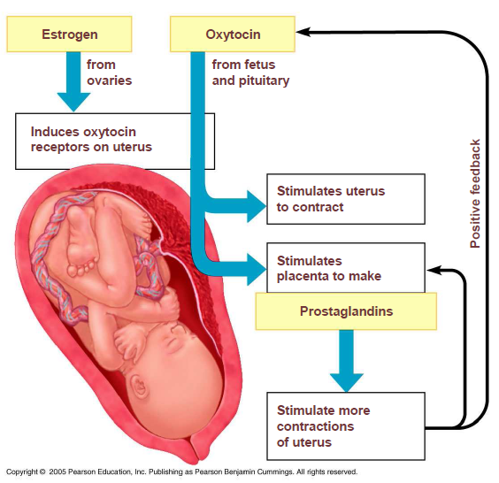

Slide 9
Signs and symptoms of labour
Premonitory signs and symptoms
Feeling of uneasiness
Mild pains
Contractions of the uterus which are mild and irregular (Braxton hicks)
Frequency of micturition
Lightening
Decrease in weight gain towards term

Slide 10
Lightening: occurs when the fetal presenting part begins to descend into the maternal pelvis. The uterus lowers and moves into a more anterior position. this change will cause:
Breathing to become easier
Increased pelvic pressure
Cramping and low backache
Lower extremities edema
Increased vaginal secretion
More frequent urination
In primigravida it occurs 2 weeks or more before labor.
In multigravida it can occur during labor

Slide 11
True (positive) signs of labour
Uterine contractions that are painful, rhythmic and regular
The uterus is tense on palpation and the woman complains of backache
There is dilatation of the cervix as a result of the contractions
Show
Rupture of membranes

Slide 12
True versus false labor:
Factors | True labor | False labor
Contractions timing | Regular intervals, becoming more frequent, usually 4-6 minutes apart, each lasting 30-60 seconds. | Irregular intervals, not occurring close together
Contraction strength | Becomes stronger with time, vaginal pressure is usually felt | Frequently weak, not getting strong with time
Contraction discomfort | Start in the back and radiates around toward the front of the abdomen | Usually felt in the front of the abdomen
Position changes | Contractions continue no matter what positional change is made | Contraction may stop or slow down with walking or changing position
Effect of analgesia | Not terminated by sedation | Frequently abolished by sedation
Cervical change | Progressive effacement and dilation | No dilatation/ effacement

Slide 13
Characteristics of normal labor
Characteristic | Primipara | Multipara
Duration of first stage | 6-18 hr | 2-10 hr
Rate of cervical dilatation during active phase | 1 cm/hr | 1.5 cm/hr
Duration of second stage | 30 min to 1 hr | 5-30 min
Duration of third stage | 0-30 min | 0-30 min

Slide 14
STAGES OF LABOUR
Labour is divided into four stages:
1st stage
Latent phase
Active phase
2nd stage
3rd stage
4th stage

Slide 15
First stage
Latent phase is prior to active first stage of labor and may last 6-8 hours in primigravidas when the cervix dilates from 0 cm to 3-4 cm dilated and the cervical canal shortens from 3 cm long to less than 0.5 cm long.
Active phase the cervix undergoes more rapid dilatation. It begins when the cervix is 3-4 cm dilated in the presence of rhythmic contractions, and its complete when the cervix is fully dilated (10 cm).

Slide 16
First stage cont…
Transitional phase : the stage of labor when the cervix is from around 8 cm dilated until it is fully dilated (or until expulsive contractions during second stage are felt by the woman): there is often a brief lull in the intensity of uterine activity at this time.

Slide 17
Second stage
Expulsion of the fetus takes place.
It begins when the cervix is fully dilated and the woman feels the urge to expel the baby.
It is complete when the baby is born.

Slide 18
Third stage
There is separation and expulsion of the placenta and membranes.
It involves control of bleeding.
It lasts from the birth of the baby until the placenta and membranes have been expelled.

Slide 19
Duration of labor
The length of labor is influenced by:-
Parity
Birth interval
Psychological state
Presentation and position of the fetus
Maternal pelvic shape and size
Character of uterine contractions

Slide 20
Physiology of first stage of labour
Uterine action/ factors
Fundal dominance
Polarity
Contraction and retraction of the uterine muscle fibres
Formation of upper and lower uterine segments
Development of the retraction ring
Dilatation of the cervix
Effacement of the cervix (taking up of the cervix)
Show

Slide 21
Fundal dominance
Each uterine contraction starts in the fundus near one of the cornua and spreads across and downwards.
The contraction lasts longest in the fundus where it is also most intense, but the peak is reached simultaneously over the whole uterus and the contraction fades from all parts together.
This pattern permits the cervix to dilate and the strongly contracting fundus to expel the fetus.

Slide 22
Polarity
This is the neuromuscular harmony that prevails between the poles or segments of the uterus throughout labor.
During each uterine contraction these two poles act harmoniously.
The upper pole contracts strongly and retracts to expel the fetus; the lower pole contracts slightly and dilates to allow expulsion to take place.
If polarity is disorganized then the progress of labor is inhibited.

Slide 23
Contraction and retraction
During labor the contraction does not pass off entirely, but muscle fibres retain some of the shortening of contraction instead of becoming completely relaxed. This is termed retraction.
It assists in the progressive expulsion of the fetus; the upper segment of the uterus becomes gradually shorter and thicker and its cavity diminishes.

Slide 24
Formation of upper and lower uterine segments
The upper uterine segment, is formed from the body of the fundus, and is mainly concerned with contraction and retraction; it is thick and muscular.
The lower uterine segment is formed of the isthmus and the cervix, and is about 8-10 cm in length. The lower uterine segment is prepared for distension and dilatation.
When labor begins, the retracted longitudinal fibres in the upper segment pull on the lower segment causing it to stretch; this is aided by the force applied by the descending presenting part.

Slide 25
The retraction ring
A ridge forms between the upper and lower uterine segments; known as the ‘retraction’ or ‘bandl’s ring’.
The physiological ring gradually rises as the upper uterine segment contracts and retracts and the lower uterine segment thins out to accommodate the descending fetus.
Once the cervix is fully dilated and the fetus can leave the uterus, the retraction ring rises further.

Slide 26
Cervical effacement
Effacement is the inclusion of the cervical into the lower uterine segment.
Effacement may occur late in pregnancy, or it may not take place until labor begins.
In the nulliparous woman the cervix will not usually dilate until effacement is complete, whereas in the parous woman effacement and dilatation may occur simultaneously and a small canal may be felt in early labor (multips os)

Slide 27
Cervical dilatation
Dilatation of the cervix is process of enlargement of the os uteri from a tightly closed aperture to an opening large enough to permit passage of the fetal head.
Dilatation is measured in centimetres and full dilatation at term equates to about 10 cm.
Dilatation occurs as a result of uterine action and the counterpressure applied by either the intact bag of membranes or the presenting part, or both.

Slide 28
Cervical dilatation cont…..
A well flexed fetal head closely applied to the cervix favors efficient dilatation.
Pressure applied evenly to the cervix causes the uterine fundus to respond by contraction and retraction.

Slide 29
Show
It a bloodstained mucoid discharge seen a few hours before, or within a few hours after, labor starts.
The blood comes from ruptured capillaries in the parietal decidua where the chorion has become detached from the dilating cervix.

Slide 30
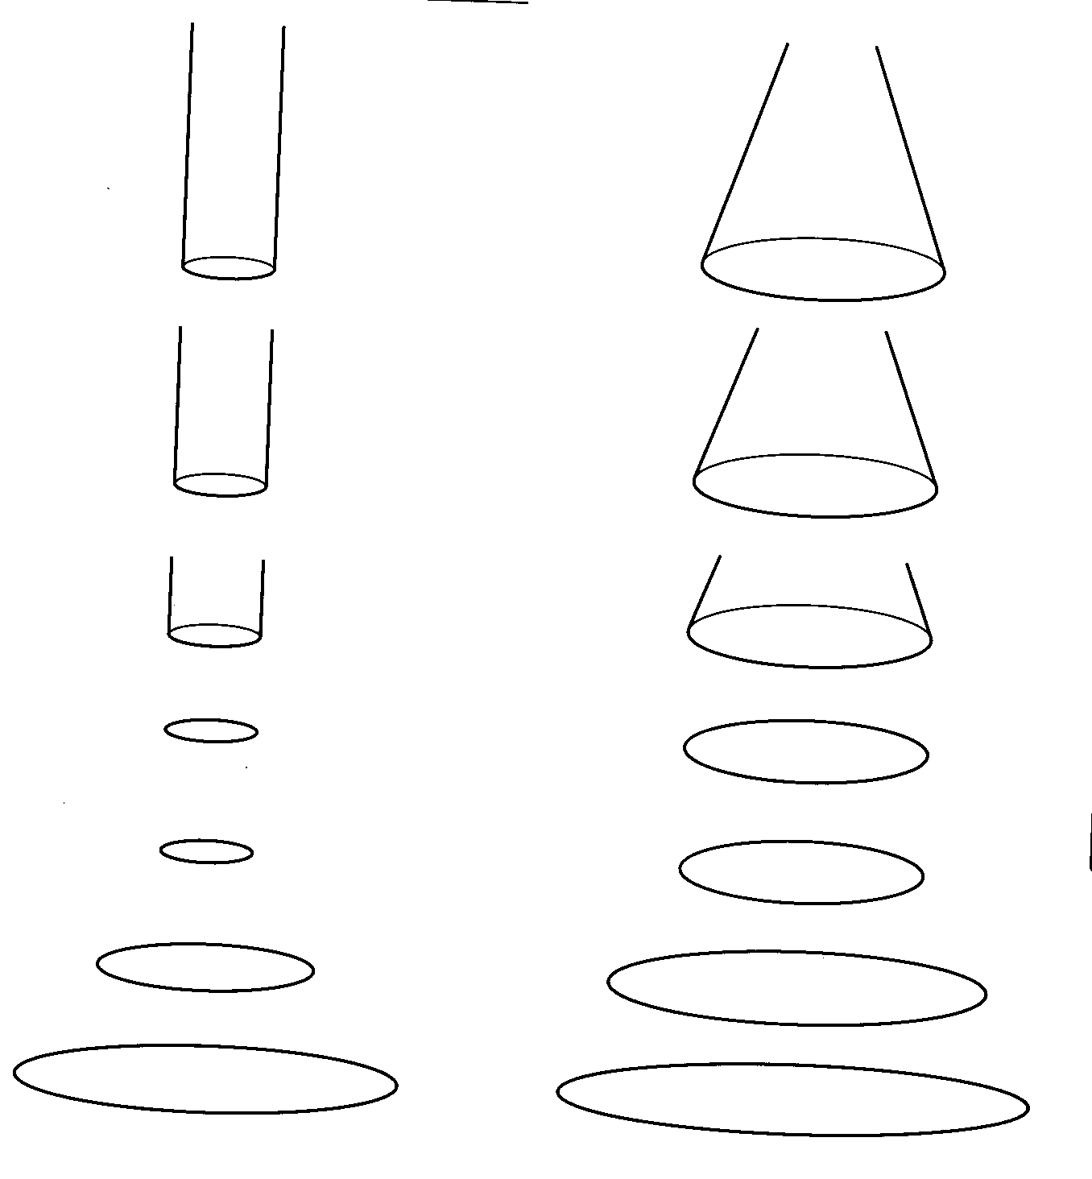
Effacement and dilatation
Nulliparous
Parous

Slide 31
Cervical effacement
vs
cervical dilation
Cervix closed,
3 cm long
Cervix effaced,
1 cm dilated
Cervix
5 cm dilated
Cervix
fully dilated

Slide 32
Mechanical factors
Formation of fore waters (bag of waters)
General fluid pressure
Fetal axis pressure
Rupture of the membranes

Slide 33
Formation of the forewaters
As the lower uterine segment forms and stretches, the chorion becomes detached from it and the increased intrauterine pressure causes this loosened part of the sac of fluid to bulge downwards into the internal os, to the depth of 6-12mm.
The well-flexed head fits snugly into the cervix and cuts off the fluid in front of the head from that which surrounds the body.
The former is known as the ‘forewaters’ and the latter ‘hindwaters’.

Slide 34
Formation of the forewaters
The effect of separation of the forewaters prevents the pressure that is applied to the hindwaters during uterine contractions from being applied to the forewaters.
This helps keep the membranes intact during the first stage of labor and the natural defence against infection.

Slide 35
General fluid pressure
While the membranes remain intact, the pressure of the uterine contractions is exerted on the fluid and, as fluid is not compressible, the pressure is equalized throughout the uterus and over the fetal body.
When the membranes rupture and a quantity of fluid emerges, the placenta and umbilical cord are compressed between the uterine wall and the oxygen supply to the fetus is diminished.

Slide 36
General fluid pressure cont…
Preserving the integrity of the membranes, therefore optimizes the oxygen supply to the fetus and also helps to prevent intrauterine and fetal infection especially in longer labors.

Slide 37
Fetal axis pressure
During each contraction the uterus rises forward and the force of the fundal contractions is transmitted to the upper pole of the fetus, down the long axis of the fetus and applied by the presenting part to the cervix.
It becomes more significant after rupture of membranes and during the second stage of labor.

Slide 38
Rupture of membranes
The optimum physiological time for the membranes to rupture spontaneously is at the end of the first stage of labor after the cervix becomes fully dilated and no longer supports the bag of forewaters. Uterine contractions are applying increasing force at this time.
Occasionally the membranes do not rupture even in the second stage and appear at the vulva as a bulging sac covering the fetal head as it is born; this is known as ‘caul’.

Slide 39
Recognition of the first stage of labour
Show
Uterine contractions: increase in frequency, intensity and regularity as labour progresses
Backache
Spontaneous rupture of the membranes and draining of liquor.
Confirmation by midwife:
Assess uterine contractions
Perform vaginal examination

Slide 40
Factors that influence the outcome of labour
Passageway (maternal pelvis)
Bony pelvis, joints and ligaments
Soft tissues-pelvic floor muscles, cervix and vagina
Passenger(fetus and placenta)
Fetal skull, lie, attitude, presentation, engagement, position
Powers (primary and secondary)
Intensity, frequency and duration of contraction
Intra-abdominal pressure
Psychology (maternal)
Position (maternal)

Slide 41
Psychological responses:
The birth experience influence the woman's self confidence, self esteem, and her view of life, her relationships, and her children.
Factors influencing a positive birth experience include:
clear information on procedure
positive support, not being alone
sense of mastery, self- confidence
trust in staff caring for her
positive reaction to the pregnancy
Preparation for childbirth experience.

Slide 44
Maternal position:
Changing positions and moving around during birth facilitate fetal descend and rotation
Squatting position enlarges the pelvic outlet by approximately 25% .
The use of upright or lateral position compared with supine or lithotomy positions may:
reduce the duration of the second stage of labor
reduce the number of assisted deliveries( vacuum and forceps)

Slide 45
Physiologic responses to labor:

Slide 46
Maternal responses:
Increased heart rate by 10 to 18 bpm
Increased cardiac output by l 0 to 15% during the first stage of labor and increased by 30 to 50% during the second stage of labor
Increased blood pressure by 10 to 30 mm Hg during uterine contractions in all labor stages
Increase in white blood cell count to 25,000 to 30,000 cells/mm³ perhaps as a result of tissue trauma
Increased respiratory rate along with greater oxygen consumption related to the increase in metabolism

Slide 47
Maternal responses:
Decreased gastric motility and food absorption, which may increase the risk of nausea and vomiting during the transition stage of labor
Decreased gastric emptying and gastric pH which increase the risk of vomiting and aspiration
Slight elevation in temperature possibly as a result of an increase in muscle activity.
Muscular aches/cramps as a result of a stressed musculoskeletal system involved in the labor process.
Increased BMR and decreased blood glucose level because of the stress of labor.

Slide 48
Fetal responses
Periodic fetal heart rate accelerations and slight decelerations related to fetal movement, fundal pressure, and uterine contractions.
Decrease in circulation and perfusion to the fetus secondary to uterine contractions.
Increase in arterial carbon dioxide pressure(pCO₂)
Decrease in fetal breathing movements throughout labor.
Decrease in fetal oxygen pressure with a decrease in the partial pressure of oxygen (pO₂).

Slide 49
Non-pharmacological methods of pain control
Homeopathy
Hydrotherapy
Music therapy
TENS
Distraction
Relaxation and breathing techniques
Superficial heat and cold
Touch and massage
Acupunture
Hypoisis
Aromatherapy

Slide 50
Pharmacological methods of pain control
Opiate drugs
Inhalation analgesia
Regional(epidural) analgesia

Slide 51
QUESTIONS…

Slide 52
ADMISSION OF A WOMAN IN LABOUR (1ST STAGE)
Welcome the woman in a friendly manner together with the birth partner and relatives.
Assess the mothers general condition and the progress of labour
Comprehensive history (chief complaint, history of the presenting complaint, obstetric, gynaecological, past medical and surgical history, family history and ANC attendance. History of the onset of labour: onset of the uterine contractions, presence of show and rupture of membranes.

Slide 53
Vital signs
Perform a general head to toe exam
Abdominal examination: inspection, palpation and auscultation; Uterine contractions
Explain to the woman the need to fill an informed consent form.
Conduct a vaginal examination to confirm labour, assess its progress and adequacy of the pelvis.
Obtain a urine sample and test for glucose, acetone and protein.

Slide 54
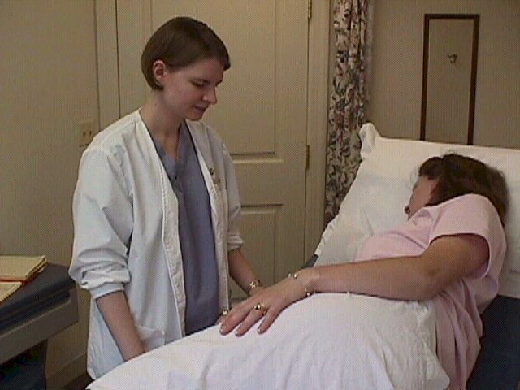
MANAGEMENT OF A WOMAN IN 1ST STAGE OF LABOUR
Admission of a woman in labour (1st stage of labour)
Specific management
partograph

Slide 55
Specific management (1st stage)
General comfort of the woman: changing linen when soiled, provision of sanitary pads e.t.c
Encourage ambulation
Pain management: non-pharmacological methods are encouraged such as massaging the lower back, ambulation, having a familiar companion during labour.
Pethidine and other narcotic analgesics should be avoided as they may depress the respiratory centre of the fetus

Slide 56
Feeding: maintain hydration by offering small sips of warm water as labour process causes sweating and loss of fluid. Glucose solution or powder should be provided to replenish the energy spent during labour
Monitoring the progress of labour using a partograph
Provide health messages on:
Breathing exercises during a contraction
Personal hygiene and handling of used pads
Role of the labouring woman in the second stage of labour

Slide 57
Management of labour
The Modified WHO Partograph

Slide 58
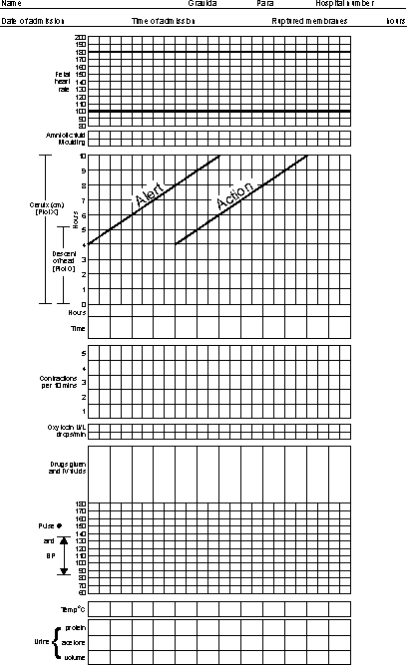

Slide 59
Partograph
What is it?
Graphic and visual record of progress of labour and all observations made concerning maternal and fetal wellbeing.
At what stage should we start using it?
Only when a woman is in established labour i.e. active phase of labour (dilatation of ≥4 cm)

Slide 60
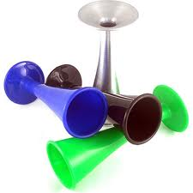
Using the partograph
Patient information
Fetal heart rate
Record every 30 minutes
Make the first entry on the “0” hours timeline
Amniotic fluid
Record the colour of amniotic fluid at every vaginal examination (4 hourly)
I: membranes intact
C: clear
M: meconium stained
B: blood stained

Slide 61
Moulding
1:sutures apposed
2: sutures overlapped but reducible
3: sutures overlapped and not reducible
Cervical dilatation
Assess at every vaginal examination and marked with a cross (X)
Begin plotting on the partograph at 4 cm dilatation

Slide 62
Alert line
Starts at 4cm dilatation to the point of expected full dilatation at the rate of 1cm/hour
Action line
Parallel and 4 hours to the right of the alert line

Slide 63
Descent
Assessed through abdominal palpation
Refers to the part of the head (divided into 5 parts) palpable above the symphysis pubis.
Recorded as a circle (o) at every vaginal examination
5/5: sinciput and occiput completely above
4/5:sinciput high, occiput easily felt
3/5:sinciput easily felt, occiput felt
2/5:sinciput felt, occiput just felt
1/5:sinciput felt, occiput not felt
0/5:none of head is palpable; Sinciput and occiput below or at the level of symphysis pubis

Slide 64
Hours
Time elapsed since the onset of active phase of labor (observed or extrapolated)
Time
Record the actual time
Contractions
Chart every 30 minutes
Palpate the number of contractions in 10 minutes and their duration in seconds
Less than 20 seconds:
Between 20 and 40 seconds:
More than 40 seconds:

Slide 65
Oxytocin
Record the amount of oxytocin/volume intravenous fluid in drops per minute every 30 minutes when used
Drugs given
Record any additional drugs given
Pulse
Record every 30 minutes and mark with a dot (.)

Slide 66
Blood pressure
Record every 4 hours and mark with arrows ( )
Temperature
Record every 2 hours
Protein, acetone and volume
Record every time urine is passed

Slide 67
Vaginal examination
Done following abdominal examination. It is the only method used in determining the dilatation of the cervix.
Indications of VE
To confirm labour
To assess progress of labour (done every 4 hours)
To rule out cord prolapse when membranes are ruptured
To confirm the second stage of labour
In multiple pregnancy to confirm the presentation of the second twin
Contraindications
Antepartum hemorrhage
Procedure: procedure manual

Slide 68
Findings on VE
External genitalia: congestion of the vulva, warts, varicose veins, discharge (colour, smell and amount), liquor e.t.c
Vagina: should be soft, warm and moist. It should feel distensible.
Cervix: state of the cervix- thick or thin, effaced or not
Cervical os: dilatation in centimetres
Membranes and fore waters: have a slippery feeling to touch but during contractions they become hard.
Report whether intact or ruptured
Cord: check for the presence of the cord and its location in relation to presenting part
Presenting part: in cephalic presentation, feel the sutures, fontanels and skull bones. Assess the station of the presenting part, degree of moulding and presence of caput succedaneum
NB: REPORTING OF THE FINDINGS IS FROM THE FURTHEST TO THE NEAREST

Slide 69
Pelvis: assess five important landmarks:
Sacral promontory: this should not be reached in normal circumstances
Hollow of the sacrum: should be well curved
Ischial spines: should not be prominent
Pubic arch: should accommodate two finger breadths
Intertuberous diameter: should accommodate four knuckles
Note the colour and smell of the discharge on withdrawing the examining fingers

Slide 70
2nd stage of labour
Physiological events
Uterine contractions: the contractions are stronger, last longer and occur more frequent. The mother feels a compelling urge to push.
The abdominal muscles and diaphragm are expulsive in action and help the fetus to descent.
At first, the action of pushing is voluntary but when the presenting part reaches the pelvic floor, it becomes involuntary (Ferguson reflex)
Soft tissue displacement: bladder, urethra, rectum
The presenting part pushes down and there is crowning of the fetal head

Slide 71
Signs of 2nd stage
Presumptive signs of second stage
Expulsive uterine contractions: woman has an urge to push and bear down
These type of contractions can also occur before the cervix is fully dilated in occipito-posterior position; full rectum and in high parous woman
Dilatation and gaping of the anus:
may occur in 1st stage if there is deep engagement of presenting part
Show: this must be distinguished from bleeding due to partial separation of the placenta
Rupture of the membranes:
may occur at any time in labour
Appearance of the presenting part at the vulva:
excessive moulding may cause the appearance of the caput succedaneum
Bulging of the perineum or congestion of the vulva:
this may also be caused by premature pushing.

Slide 72
Confirmation of second stage (positive sign)
Done via VE to assess cervical dilatation.
In second stage, there should be no cervical rim felt and the cervix should be fully dilated (10 cm)

Slide 73
Mechanisms of normal labour
Series of passive movements of the fetus during second stage
Common principles:
Descent takes place throughout
Whichever part leads and first meets the resistance of the pelvic floor will rotate forward until it comes under the symphysis pubis.
Whatever emerges from the pelvis will pivot around the pubic bone.

Slide 74
During the mechanism of labor the fetus turns slightly to take advantage of the widest available space in each plane of the pelvis.
The widest diameter of the pelvic brim is the transverse; at the pelvic outlet the greatest space lies in the anteroposterior diameter.
At the onset of labor, the commonest presentation is the vertex and the most common position either left or right occipitoanterior.

Slide 75
The lie is longitudinal
The presentation is cephalic
The position is right or left occipitoanterior
The attitude is one of good flexion
The denominator is the occiput
The presenting part is the posterior of the anterior parietal bone

Slide 76
Mechanisms of normal labour
Movements
Descent
Flexion of the head
Internal rotation of the head
Crowning of the head
Extension of the head
Restitution of the head
Internal rotation of the shoulders and external rotation of the head
Lateral flexion of the body

Slide 77
Descent
Descent. Descent of the head into the pelvis often begins before the onset of labor. The fetus of a nulliparous woman usually descends into the pelvis during the latter weeks of pregnancy. In multigravid women the muscle tone is often more lax and therefore engagement may not occur until labor actually begins.

Slide 78
Descent cont…
Throughout the first stage of labor the contraction and retraction of the uterine muscles allow less room in the uterus , exerting pressure on the fetus to descend.
Following rupture of the forewaters and the exertion of maternal effort, progress speeds up.

Slide 79
Flexion
It increases through out labor. The fetal spine is attached nearer the posterior part of the skull; pressure exerted down the fetal axis will be more forcibly transmitted to the occiput than to the sinciput.
The effect is to increase flexion, resulting in smaller presenting diameters, which will negotiate the pelvis more easily.

Slide 80
Flexion cont…
At the onset onset of labor the suboccipitofrontal diameter, 10cm is presenting; with greater flexion the suboccipitobregmatic 9.5cm diameter presents. The occiput becomes the leading part.

Slide 81
Internal rotation of the head
During a contraction the leading part is pushed downwards on to the pelvic floor. The resistance of this muscular diaphragm brings about rotation. As the contraction fades, the pelvic floor rebounds causing the occiput to glide forwards.
Resistance is an important determinant of rotation. During epidural analgesia rotation is delayed because of relaxation of pelvic floor muscles.

Slide 82
Internal rotation of the head cont..
In a well-flexed vertex presentation the occiput leads and meets the pelvic floor first and rotates anteriorly through 1/8 of a circle. This causes a slight twist in the neck of the fetus as the head is no longer in direct alignment with the shoulders. The anteroposterior diameter of the head now lies in the widest (anteroposterior) diameter of the pelvic outlet.

Slide 83
Internal rotation of the head cont..
The occiput slips beneath the subpubic arch and crowning occurs when the head no longer recedes between contractions and the widest transverse diameter (biparietal) is born. If flexion is maintanied, the suboccipitobregmatic diameter 9.5 cm, distends the vaginal orifice.

Slide 84
Extension of the head
Once crowning has occurred the fetal head can extend, pivoting on the suboccipital region around the pubic bone.
This releases the sinciput, face and chin, which sweep the perineum and are born by a movement of extension.

Slide 85
Restitution
The twist in the neck of the fetus that resulted from internal rotation is now corrected by slight untwisting movement.
The occiput moves 1/8 of a circle towards the side from which it started.

Slide 86
Internal rotation of the shoulders
The shoulders undergo a similar rotation to that of the head to lie in the widest diameter of the pelvic outlet (anteroposterior).
The anterior shoulder is the first to reach the levator ani muscles and it therefore rotates anteriorly to lie under the symphysis pubis.
This movement can be clearly seen as the head turns at the same time (external rotation of the head).
It occurs in the same direction as restitution, and the the occiput of the fetal head now lies laterally.

Slide 87
Lateral flexion
The shoulders are usually born sequentially enabling a smaller diameter to distend the vaginal orifice than if both shoulders were born simultaneously.

Slide 88
Monitoring a woman in 2nd stage
Fetal heart rate after each contraction
Maternal pulse every 10 minutes
Descent of the presenting part per vagina
Nature of the contractions which should remain strong and expulsive
The perineum to determine adequacy (flexibility) for delivery
The urinary bladder should be emptied during the 1st stage of labour
Catheterisation in second stage if bladder full
The delivery trolley should be ready before the 2nd stage of labour

Slide 89
Delivery procedure
Procedure manual:
Preparation for delivery:
labour ward
mother for delivery
Equipment and supplies required for delivery
The conduct of delivery

Slide 90
Immediate care (needs) of the baby
Clearing of the airway should be done as soon as the baby’s face is delivered. This is because the baby can inhale amniotic fluid
APGAR scoring (see next slide)
Warmth: dry and wrap with warm blankets.
Umbilical cord: cord is clipped as soon as possible.
Breastfeeding: as soon as possible
For bonding and facilitating uterine contraction.

Slide 91
Rest: allow the baby to rest after birth, handle it gently
Identification tag to the baby.
General assessment of the infant to exclude any congenital anomalies.
Measurement of weight

Slide 93
Episiotomy & perineal tears

Slide 94
Definition
An incision through the perineal tissues designed to enlarge the vulval outlet during delivery (2nd stage).
This should not be a routine practice.

Slide 95
Timing of episiotomy
Performed when the head is visible during a contraction therefore the advancing fetal head compresses the surrounding blood vessels minimizing blood loss.
Timing of the Repair of Episiotomy - episiotomy repair is deferred until the placenta has been delivered.

Slide 96
Types of incisions
Median or midline episiotomy - The incision is made in the midline. The incision is made in the middle of the vaginal opening, straight down toward the anus.
The advantages of a midline episiotomy include easy repair and improved healing. This type of episiotomy is also less painful and is less likely to result in long-term tenderness or problems with pain during sexual intercourse. There is often less blood loss with a midline episiotomy as well.

Slide 97
Midline episiotomy
The main disadvantage of a midline episiotomy is the increased risk for tears that extend into or through the anal muscles. This type of injury can result in long-term problems, including fecal incontinence, or the inability to control bowel movements.

Slide 98
Types of incisions- Mediolateral episiotomy
The incision begins in the midline but is directed 45º laterally and downward away from the rectum.
The primary advantage of a mediolateral episiotomy is that the risk for anal muscle tears is much lower. disadvantages associated with this type of episiotomy, including:
increased blood loss
more severe pain
difficult repair
higher risk of long-term discomfort, especially during sexual intercourse

Slide 100
Types of incision
J-incision: rarely used

Slide 102
Comparison/differences
Characteristic | Type of incision
 | Midline | Mediolateral
Surgical repair Faulty healing Post operative pain Blood loss Dyspareunia Extensions | Easy Rare Minimal Less Rare Common (3rd & 4th degree tears) | More difficult More common Common More Occasional Uncommon

Slide 103
Perineal tears
Classification (degrees) of perineal tears:
First-degree lacerations - involve part of labia minora, perineal skin, and vaginal mucous membrane
Second-degree lacerations - involve, in addition to skin and mucous membrane, the fascia and underlying muscles.
Third-degree lacerations - extend through the skin, mucous membrane, and perineal body and involve the anal sphincter.
Fourth-degree laceration - extends through the rectal mucosa to expose the lumen of the rectum.

Slide 104
Questions?

Slide 105
Third stage of labour
Period from delivery of the baby to the delivery of the placenta and membranes and the physiological control of bleeding.
Separation of the placenta is brought about by the contraction and retraction of the uterine muscle fibres which reduces the placental site when they thicken and shorten.
Administration of oxytocin shortens the third stage of labour as it facilitates uterine contraction.

Slide 106
Physiological control of bleeding
Bleeding from the torn blood sinuses is controlled even as the placenta is separating.
Contraction and retraction of the oblique uterine muscle fibres prevent bleeding from the sinuses.
The oblique uterine muscle fibres of the uterus are believed to play the most important role in constricting the uterine sinuses and arresting bleeding. Due to their action, they are referred to as living ligatures.

Slide 107
In the third stage of labour, there is transitory activation of the coagulation and fibrinolytic activity leading to intensified clot formation.
Blood loss in the third stage of labour should not exceed 500 mls.

Slide 108
Separation and expulsion of the placenta
Once separation has occurred, the uterus contract strongly forcing the placenta and membranes to fall in to the lower uterine segment and then to the vagina. The fundus:
Becomes hard, firm and globular in shape.
Rises above the umbilicus.

Slide 109
Types/methods of placenta separation
Schultze method
Separation begins centrally so that a retro-placental clot is formed. The placenta is delivered with the fetal surface on the lead.
The membranes trail behind it like an inverted umbrella. The maternal surface of the placenta is thus enclosed by these membranes and any blood loss or clot collects here.
This indicates fundal insertion of the placenta.

Slide 110
Mathew Duncan’s method
The placenta begins to detach asymmetrically at one side of its lateral borders.
The blood loss escapes so that separation is unaided by the formation of a retro-placental clot. The placenta descends, sloping sideways, maternal surface first.
The process takes longer and is associated with ragged, incomplete expulsion of the membranes and a higher fluid blood loss.

Slide 111
Signs of placental separation
The fundus becomes hard, firm and globular. It rises above the umbilicus and can be balloted.
Lengthening of the cord at the vulva
A gush of blood about 30-60 mls
There is no retraction of the cord on applying fundal pressure.

Slide 112
ACTIVE MANAGEMENT OF THE 3RD STAGE OF LABOUR (AMSTL)
This is the recommended approach to manage third stage of labour because it has been shown to prevent postpartum hemorrhage.
AMSTL includes the following:
Early clamping and division (cutting) of the umbilical cord
Prophylactic use of oxytocin
Controlled cord traction for delivery of the placenta

Slide 113
AMSTL
Prophylactic use of oxytocin to prevent postpartum
hemorrhage
Within 1 minute of delivery of the baby, palpate the abdomen to rule out the presence of an additional baby(s) and give oxytocin 10 units IM.
Oxytocin is preferred because it is effective 2-3 minutes after injection, has minimal adverse effects and can be used in all women.
Ergometrine 0.2 mg IM can also be given if oxytocin is not available (don’t give in women with hypertension, pre-eclampsia).

Slide 114
AMSTL
Controlled cord traction (CCT)
Clamp the cord close to the perineum using sponge forceps. Hold the clamped cord and the end of forceps with one hand.
Place the other hand just above the woman’s pubic bone and stabilise the uterus by applying counter traction during controlled cord traction. This helps prevent inversion of the uterus.
Keep slight tension on the cord and await a strong uterine contraction (2-3 minutes wait)
When the uterus becomes rounded or the cord lengthens, very gently pull downward on the cord to deliver the placenta. Do not wait for a gush of blood before applying traction on the cord. Continue to apply counter traction to the uterus with the other hand.

Slide 115
If the placenta does not descend during 30-40 seconds of controlled cord traction, do not continue to pull on the cord.
Gently hold the cord and wait until the uterus is well contracted again. If necessary, use a sponge forceps to clamp the cord closer to the perineum as is it lengthens.
NB: never apply cord traction (pull) without applying counter traction (push) above the pubic bone with the other hand.
As the placenta delivers, the thin membranes can tear off. Hold the placenta in two hands and gently turn it until the membranes are twisted. Slowly pull to complete the delivery.
If the membranes tear, gently examine the upper vagina and cervix wearing high-level disinfected gloves and use a sponge forceps to remove any pieces of membrane that are present.

Slide 116
Care of the woman in the fourth stage of labour (postpartum)
Expel the blood clots from the uterus by gently rubbing the uterus for a contraction. Remove all blood clots from the vaginal canal.
Clean the woman’s vulva then examine the perineum, posterior and anterior cervix, vaginal walls and vulva for lacerations and tears. If any, repair them.
Clean the woman’s perineum, buttocks and thighs (with soapy water) and apply a pad. Change the linen, let her lie on the back with legs adducted (close together) and make her comfortable.

Slide 117
Observations in the fourth stage of labour include the following:
Vital observations: TPR and BP
Regular monitoring for vaginal blood loss. Inform the woman to report any active bleeding.
Examine the uterus for contraction: the uterus should remain contracted to prevent postpartum hemorrhage
Fundal height: it should be below the umbilicus
Encourage the woman to frequently empty the bladder since a full bladder affects contraction of the uterus hence bleeding.

Slide 118
Examination of the placenta
This is done as soon as possible after its delivery to determine its completeness.
First, the blood loss is estimated by measuring the volume of blood and blood clots using a measuring jar.
Estimate the length of the umbilical cord and note the insertion of the cord. Identify any true and false knots on the cord. Identify the cord blood vessels (arteries and vein).
Holding the placenta by the cord like an inverted umbrella, inspect the membranes for completeness. If the membranes are rugged, indicate that in the patient’s cardex or notes.

Slide 119
Identify the amnion and chorion by their characteristics.
The maternal surface is cleaned and placenta is placed on a flat surface and cotyledons are fitted together. Note their number and any missing lobes.
Feel for the consistency of the placenta: healthy placenta feels firm and unhealthy placenta is soft and mushy.
Inspect the maternal surface for any infarcts.
Document all the relevant findings and dispose the placenta in the respective colour coded bin.

Slide 120
The end
Questions?

Slide 121
If we hope to create
a non-violent world
where respect and kindness
replace fear and hatred
We must begin
with how we treat each other
at the beginning of life.
For that is where
our deepest patterns are set.
From these roots
grow fear and alienation
~or love and trust.
~Suzanne Arms
If we want to create a less violent world, we must begin with birth

