Slide 1
NORMAL MIDWIFERY
Introduction

Slide 2
MIDWIFERY
WHAT IS MIDWIFERY?

Slide 3


Slide 4
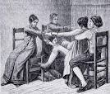

Slide 5


Slide 6
Midwifery definitions
Obstetrics
This is a branch of medicine that deals with pregnancy, labour and care after birth.
Midwifery
It’s a course that deals with care of a woman during the events which concern childbearing. i.e. the care of a woman before she conceives, during pregnancy and in the period of adjustments after birth.

Slide 7
Definitions cont……
Midwife
It’s a person (male or female) who has been regularly admitted to a midwifery education programme that is fully recognised in that country in which it is located. Has successfully completed the prescribed course of studies and acquired the required qualification to be registered (enrolled) and licenced legally to practice midwifery.

Slide 8
Responsibilities of a midwife
To observe,examine and teach a woman during pregnancy, labour and puerperium.
To care for the mother and the baby after delivery
To act promptly and appropriately to save the life of the woman or the baby

Slide 9
Aims of a midwife
To promote and maintain the physical and psychological health of the pregnant woman in order to ensure birth of a normal healthy baby without any complications to either the mother or the baby
To ensure a live healthy baby through fetal supervision
To prepare the mother through health messages for, lactation and subsequent care of the baby.

Slide 10
Aims ct…
4. to detect early and correct or treat appropriately and promptly any risk conditions(medical or obstetrical) that might interfere or endanger the health of the mother or fetus.
5. To involve the husband and other members of the family in the care of the pregnant woman and that of the baby after birth.

Slide 11
Code of ethics- moral principles
This should govern the midwife behavior with women and partners or relatives
      Respect for life
      Be respectful to others and polite
      Confidentiality- keep information given in trust by the patient secret
      To be calm, obedient and control their tempers

Slide 12
Principles
  Trustful- the midwife should behave and act in a way that the client can believe in him/her all through the provision of care.
  Good communication to colleagues, team members, client and relatives.
  Punctuality- both on duty and taking actions because delays can cause irreversible damages.

Slide 13
Principles
  Maintain own and others dignity through good moral behavior and respect for life.
  Exercise equity to all irrespective of their social background and status, religion, race or beliefs.

Slide 14
Students objectives
To describe the anatomy and physiology of female and Male reproductive system
Develop knowledge, skills and attitude towards caring of a pregnant woman and mothers in labor.
Acquire knowledge, skills and positive attitude towards caring of a woman after birth.

Slide 15
Objectives ct…
Acquire knowledge, skills and positive attitude towards caring of babies at risk
Acquire knowledge, skills and positive attitude in management of obstetrical complications.

Slide 16
ANATOMY AND PHYSIOLOGY OF FEMALE REPRODUCTIVE SYSTEM

Slide 17
A &P
The female reproductive system is divided into :-
  External organs or genitalia(vulva)
  Internal organs or genitalia

Slide 18
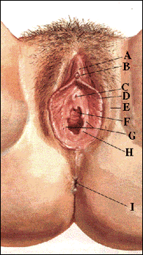
Female external genitalia
Prepuce (Hood) of Clitoris
B: Clitoris
C: Opening of Urethra (urinary tract)
D: Labia minora
E: Labia majora
F: Opening of Vagina
G: Vestibule
H: Hyman tissue (residual)
I: Opening of Anus

Slide 19
The female external genetalia
Its composed of :-
  The mons pubis
  The labia majora
  The labia minora
  The vestibule
  The urethral opening/meatus
  The vagina opening/meatus
  The bartholin glands opening
  The paraurethral opening
  The clitoris

Slide 20
Female external genital organs
The Mons Pubis
The mons pubis is a rounded fatty elevation located anterior to the symphysis pubis and lower pubic region.
It consists mainly of a pad of fatty connective tissue deep to the skin.
The amount of fat increases during puberty and decreases after menopause.

Slide 21
External genital organs ct…
The mons pubis becomes covered with coarse pubic hairs during puberty, which also decrease after menopause.
The typical female distribution of pubic hair has a horizontal superior limit across the pubic region.

Slide 22
External genital organs ct…
The Labia Majora
The labia (L. large lips) are two symmetrical folds of skin, which provide protection for the urethral and vaginal orifices.
These open into the vestibule of the vagina.
Each labium majus, largely filled with subcutaneous fat, passes posteriorly from the mons pubis to about 2.5 cm from the anus.

Slide 23
External genital organs ct…
They are situated on each side of the pudendal cleft, which is the slit between the labia majora into which the vestibule of the vagina opens.
The labia majora meet anteriorly at the anterior labial commissure.
They do not join posteriorly but a transverse bridge of skin called the posterior labial commissure passes between them.

Slide 24
External genital organs ct…
The Labia Minora
The labia minora (L. small lips) are thin, delicate folds of fat-free hairless skin.
They are located between the labia majora.
The labia minora contain a core of spongy tissue with many small blood vessels but no fat.

Slide 25
External genital organs ct…
The internal surface of each labium minus consists of thin skin and has the typical pink colour of a mucous membrane.
It contains many sensory nerve endings.
Sebaceous and sweat glands open on both of their surfaces.
The labia minora enclose the vestibule of the vagina and lie on each side of the orifices of the urethra and vagina.

Slide 26
External genital organs ct…
They meet just superior to the clitoris to form a fold of skin called the prepuce (clitoral hood).
Posteriorly they fuse forming the fourchete

Slide 27
External genital organs ct…
The Vestibule
The vestibule is the space between the labia minora.
The urethra, vagina, and ducts of the greater vestibular glands open into the vestibule.

Slide 28
External genital organs ct…
The External Urethral Orifice
This median aperture is located 2.5cm posterior to the clitoris and immediately anterior to the vaginal orifice.
On each side of this orifice are the openings of the ducts of the paraurethral glands (Skene's glands).

Slide 29
External genital organs ct…
The Vaginal Orifice
This large opening is located inferior and posterior to the much smaller external urethral orifice.
The size and appearance of the vaginal orifice varies with the condition of the hymen, a thin fold of mucous membrane that surrounds the vaginal orifice.

Slide 30
External genital organs ct…
The Greater Vestibular Glands
These glands are about 0.5 cm in diameter.
They are located on each side of the vestibule of the vagina, posterolateral to the vaginal orifice.
they secrete a small amount of lubricating mucus into the vestibule of the vagina during sexual arousal.
Bartholin's glands are homologous with the bulbourethral glands in the male

Slide 31
External genital organs ct…
The Clitoris
The clitoris is 2 to 3 cm in length.
It is homologous with the glans of penis and is an erectile organ.
Unlike the penis, the clitoris is not traversed by the urethra; therefore it has no corpus spongiosum.

Slide 32
External genital organs ct…
The clitoris is located posterior to the anterior labial commissure, where the labia majora meet.
It is usually hidden by the labia when it is flaccid.
The clitoris, like the penis, it will enlarge upon tactile stimulation, but it does not lengthen significantly.
It is highly sensitive and very important in the sexual arousal of a female.

Slide 33
External genital organs ct…
Arterial Supply of the Female External Genitalia
The rich arterial supply to the vulva is from two external pudendal arteries and one internal pudendal artery on each side.
The internal pudendal artery supplies the skin, sex organs, and the perineal muscles.
The labial arteries are branches of the internal pudendal artery, as are the dorsal and deep arteries of the clitoris.

Slide 34
External genital organs ct…
Venous Drainage of the Female External Genitalia
The labial veins are tributaries of the internal pudendal veins and venae comitantes of the internal pudendal artery.

Slide 35
External genital organs ct…
Lymph Drainage of the Female External Genitalia
The vulva contains a very rich network of lymphatic channels.
Most lymph vessels pass to the superficial inguinal lymph nodes and deep inguinal nodes.

Slide 36
External genital organs ct…
innervation of the Female External Genitalia
The nerves to the vulva are branches of:
  The ilioinguinal nerve;
  The genital branch of the genitofemoral nerve;
  The perineal branch of the femoral cutaneous nerve;
  And the perineal nerve.

Slide 37
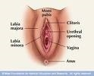
External genital organs ct…

Slide 38
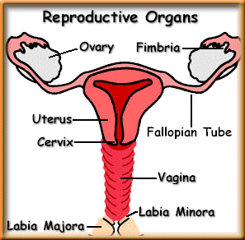
The internal organs
Includes:-
  The vagina
  The uterus
  Two fallopian tubes
  Two ovaries

Slide 39
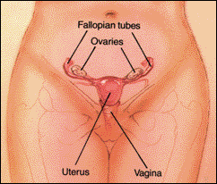
Internal female reproductive organs

Slide 40
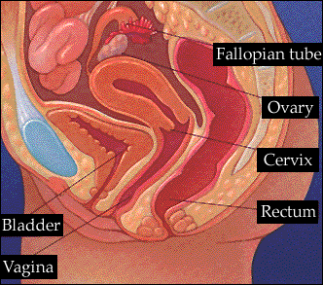
Longitudinal section of female reproductive system

Slide 41
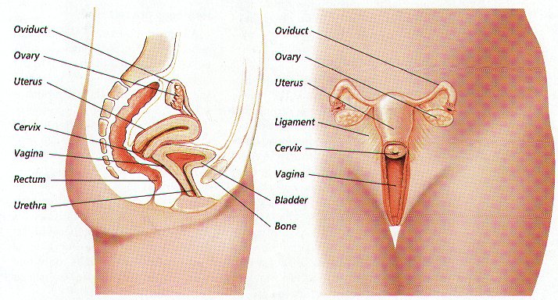

Slide 42
THE INTERNAL GENITALIA
Vagina
This is a fibromascular tube covered with stratified squamous epithelium that connects the uterus and the vestibule.
It is made of the following layers:-
Mucous coat lined with squamous epithelium
Submucous layer of loose areolar vascular tissue
Muscular layer
Fibrous coat

Slide 43
The vagina
The inner membrane is thrown into convolutions called rugae that allows stretching
The anterior wall is about 7.5 cm long and posterior wall 10 cm long. This is because the cervix projects into the vagina at an angle.
It has no secretory glands but it is kept moist my cervical secretions

Slide 44
The vagina
Although the cervical mucous is alkaline, the breakdown of glycogen by Doderlin bacilli (Lactobacillus acidophilus) into lactic acid maintain the vagina PH at 4.5.

Slide 45
Relations of the vagina
Anteriorly- the urethra and urinary bladder and urethra
Posteriorly-Pouch of Douglas,rectum & perineal body
Laterally- upper 2/3 pelvic fascia and ureters, the lower 1/3 muscles of the pelvic floor
Superiorly- uterus
Inferiorly-the external genitalia

Slide 46
The vagina
Arterial blood supply to the vagina is from the vaginal artery and a descending branch of uterine artery. Venous drainage is via corresponding veins.
Lymphatic drainage is via the inguinal, internal iliac and sacral lymph nodes
Inervation is from the Lee Frankehauser plexus

Slide 47
Functions of vagina
Allows the escape of menstrual flow
Receives the penis and sperms during copulation
Provides a passage way for the fetus during delivery

Slide 48
UTERUS
The uterus in non-pregnant state is a hollow, muscular pear-shaped organ situated in the cavity of true pelvis
It is about 7.5cm long and 5cm wide and 2.5cm in depth.
It lies behind the urinary bladder and in front of the rectum.
The uterus leans forward(anteversion) and bends on itself(anteflexion)

Slide 49
The uterine parts
Its divided into 3 main parts:-
  a) The body
  b) The Isthmus
  c) The cervix
BODY (Corpus)
It’s the upper part which is about 5cm in length and forms the major part of the uterus
The rounder doom shaped part above the fallopian tubes is called the fundus, while the upper outer angles where the fallopian tubes join the uterus are known as the cornua
The cavity is the triangular shaped space.

Slide 50
Parts of the uterus ct….
ISTHMUS
It’s the shortest segment of the uterus that lies between the body and the cervix. Its about 7mm in length.
CERVIX
It’s the lowest part of the uterus about 2.5cm long. It protrudes into the vagina with the upper ½ above the vagina being the supra-vaginal portion and the lower ½ the infra- vaginal portion. The internal OS is the narrow opening between the isthmus and the cervix and external OS is the portion that meets the vagina.

Slide 51
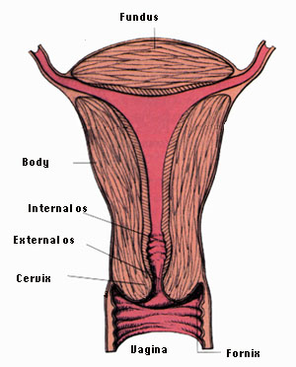
Parts of the uterus

Slide 52
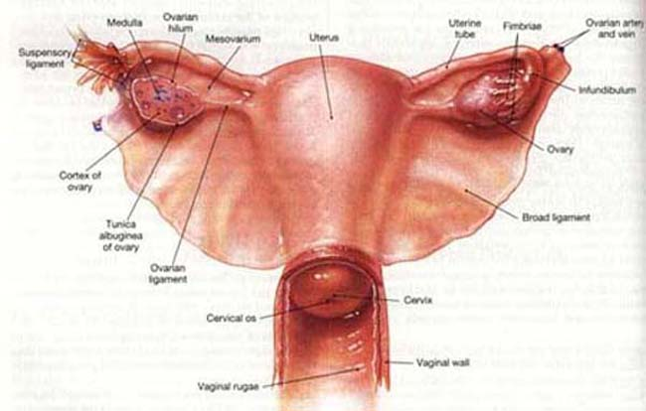

Slide 53
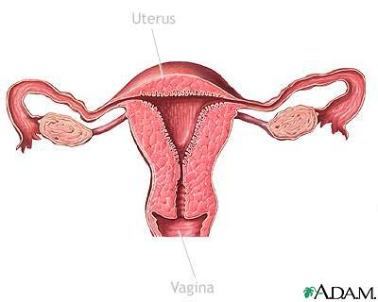
Layers of the uterus
The uterus consist of three layers:-
  The endometrium
  The myometrium
  The perimetrium
Fallopian tube
Ovary
Endometrium
Myometrium
vagina
Perimetrium
Cervix

Slide 54
The endometrium
It is the inner layer of mucus membrane formed by ciliated epithelium on a base of connective tissue.
The epithelial cells are cubical in shape and dip down to form glands that secrete alkaline mucus
The cervical endometrium is thinner than that of the body of uterus and is folded into a pattern known as arbor vitae(tree of life) that is thought to aid the passage of sperms

Slide 55
myometrium
The middle muscular layer of uterus
Thicker towards the fundus
It fibers are arranged in all conceivable directions
After delivery, these fibers act as ligatures of vessels to stop bleeding

Slide 56
perimetrium
The outermost layer consisting of double serous membrane.
Anteriorly, it covers the fundus and the body and then it is reflected over the urinary bladder to form vesico-uterine pouch
Posteriorly, the peritoneum extends over fundus, body and cervix and then reflected to the rectum forming recto-uterine pouch
Laterally, it only covers the fundus

Slide 57
Blood supply and drainage
arterial supply- uterine arteries which are branches of internal iliac arteries
Venous drainage is through the uterine veins that joins the internal iliac veins
the lymph drains into the internal iliac and aortic lymph glands

Slide 58
Support of the uterus
The uterus is well supported by the surrounding organs, muscles of the pelvic floor and ligaments that suspend it from the walls of the pelvis
Ligaments supporting the uterus
Two broad ligaments- they are formed by double fold of peritoneum on either side of the uterus. They hang from the fallopian tubes like curtains to attach the uterus to the side walls of the pelvis

Slide 59
Support of the uterus
Round ligament- these are bands of fibrous tissue between the layers of broad ligament, one on each side of uterus. They pass to the sides of the pelvis then through the inguinal canal and then fuse with the labia majora.
Uterosacral ligaments- they originate from the posterior wall of cervix and vagina and move backwards, one on each side of the rectum, to the sacrum

Slide 60
Support of the uterus
The pubocervical fascia – they pass forward from the transverse cervical ligament on the side of the bladder and attaches to the posterior surface the pubic bones
Transverse cervical ligaments(cardinal ligaments- extends from the sides of the cervix and vagina to the side walls of the pelvis

Slide 61
Functions of uterus
It receives a fertilized ovum from the fallopian tubes
It provides favorable environment for implantation and sheltering of embryo till delivery
It helps in expulsion of fetus, placenta and membranes during delivery
The cervix produces mucus which is essential and favorable for sperms survival and mobility

Slide 62
Fallopian tubes [uterine tubes]
Stretch from the uterus to the ovaries and measure about 10cm in length.
Range in width from about one inch at the end next to the ovary, to the diameter of a strand of thin spaghetti.
The ends of the fallopian tubes lying next to the ovaries feather into ends called fimbria
Millions of tiny hair-like cilia line the fimbria and interior of the fallopian tubes. The cilia beat in waves hundreds of times a second catching the egg at ovulation and moving it through the tube to the uterine cavity.
Fertilization typically occurs in the fallopian tube
Notes:
(4 to 6 inches) = length
called fimbria (Latin for "fringes" or "fingers").each tube has about about 20 to 25
Millions of tiny hair-like cilia line the fimbria and interior of the fallopian tubes. The cilia beat in waves hundreds of times a second catching the egg at ovulation and moving it through the tube to the uterine cavity. Other cells in the tube's inner lining or endothelium nourish the egg and lubricate it's path during its stay inside the fallopian tube. Once inside the fallopian tube, the egg and sperm meet and the egg is fertilized. If an egg doesn't become fertilized within 24 to 36 hours after ovulation, it will deteriorate and be removed by the body's immune system like any other dead cell in the body.

Slide 63
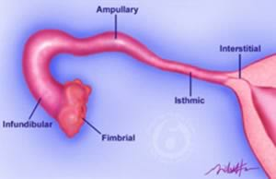

Slide 64
OVARIES
Are the female gonads, equivalent to testis in males
They produce the ova and female hormones
They are about 3cm long, 2cm wide and 1cm thick

Slide 65
Structure of the ovaries
They are made of the medulla and the cortex
Medulla is the central part consisting of fibrous tissue, blood vessels and nerves
Cortex surrounds the medulla
It is made of a framework of connective tissue(stroma) covered by germinal epithelium which contains follicles in their various stages of development.

Slide 66
ovaries
Ovaries receive blood supply via ovarian arteries and drains into corresponding veins
Lymphatic drainage is into the lumbar glands
Nerve supply- parasympathetic supply comes from the sacral outflow and sympathetic nerves from lumbar outflow

Slide 67
FEMALE BREASTS
Also known as the mammary glands
They are considered accessory glands of the female reproductive system
They are modified sweat glands.
They influenced greatly by hormonal changes during the menstrual cycle and pregnancy.
Before puberty, they are immature and then grows under the influence of estrogen and progesterone

Slide 68
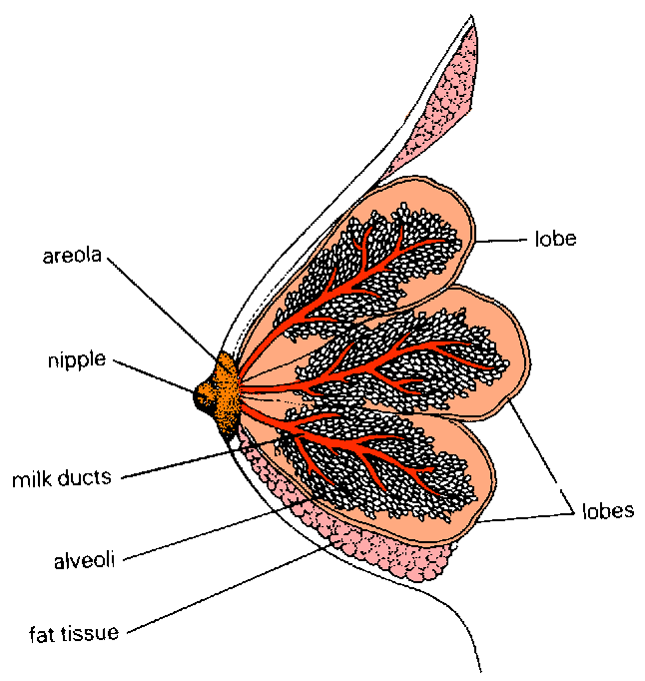

Slide 69
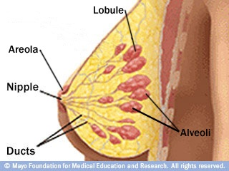
Female breast

Slide 70
Structure of the breast
Made of connective tissue, glandular tissue and fatty tissue.
It has a conical central eminence called the nipple surrounded by a hyperpigmented area, the areola.
On areola are numerous sebaceous glands called montgomery’s tubercles.

Slide 71
Structure of the breast ct…
Each breast is made up of about 20 lobes
Each lobe is made of several lobules that radiate around the nipple
Lobules consist of cluster of alveoli
Alveoli open into small ducts which then unites to form lactiferous ducts.
Lactiferous ducts unite to form lactiferous sinuses, the dilatations that serve as reservoir of milk is known as the ampulla.

Slide 72
Structure of the breast cont…
Narrow ducts that open on the surface of the nipple are known as lactiferous sinuses
Alveoli are lined with a secretory membrane that secretes the milk
Functions
Production of milk for nourishing the baby
Adds on female sexual stimulation
For cosmetic purpose

Slide 73
Blood, lymph supply to the breast
Arterial supply- axillary arteries, internal mammary and intercostal arteries
Venous drainage- axillary and mammary veins
Lymphatic drainage- superficial axillary lymph nodes and parasternal lymph nodes

Slide 74
THE MENSTRUAL CYCLE
Divided into two phases that take place concurrently in the uterus and the ovaries.
Both phases are under the influence of hormones
  - The ovarian cycle
  - The uterine cycle

Slide 75
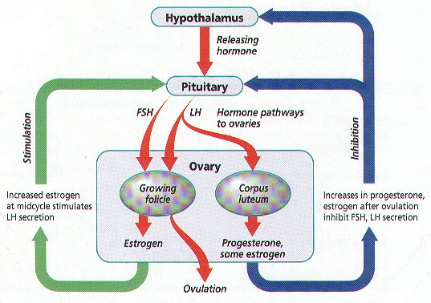

Slide 76
THE OVARIAN CYCLE
The ovarian cycle starts on the first day of the menstrual cycle.
The menstrual cycle begins on the first day of the periods - which is the first day of bleeding.
At this time, the levels of all the hormones - estrogen, progesterone , FSH and LH - which are primarily responsible for maintaining menstruation, are at the baseline levels.

Slide 77
The ovarian cycle
The low level of estrogen in the blood at this time, stimulates the pituitary gland in the brain to start producing Follicle Stimulating Hormone (FSH).
The level of FSH rises and stimulates the Graafian follicles in the ovaries to develop. This indicates the start of the ovarian cycle in menstruation
The ovarian cycle is divided into three phases

Slide 78
The follicular phase
The hypothalamus release Gonadotropin Releasing Hormone.
GnTRH acts on the anterior pituitary gland to release Follicle Stimulating Hormone(FSH)
FSH stimulates growth of about 20 Graafian follicles. They enlarges rapidly and produces hormone estrogen in the blood stream

Slide 79
Ovulatory phase
At around the 10th day of the follicular phase, one of the follicles becomes distinctly larger than the others.
It continues to grow, becoming larger and larger (‘dominant follicle’) to become mature, while the growth of the others are arrested. These eventually die out.
The estrogen released by the follicles, acts on the endometrium of the uterus and stimulates it to proliferate.

Slide 80
Ovulatory phase
The dominant follicle usually ruptures when it is about 18 – 20 mm in size and releases an ovum at about the 14-16th day of the menstrual cycle.
This process is called ‘ovulation’. The follicular phase ends at this stage and the Luteal Phase begins.

Slide 81
Luteal phase
As the levels of estrogen rises, they inhibit the production of FSH by anterior pituitary gland and instead LH is produced.
As soon as the Graafian follicle ruptures and releases the ovum (‘ovulation’) the cells of the follicle itself undergoes certain changes.
Fat globules get deposited in them, they grow larger, and they assume a yellowish color. These cells are called luteal cells and the follicle now forms the 'corpus luteum'

Slide 82
Luteal phase ct…
The cells of the corpus luteum are capable of producing the hormone ‘progesterone’ which, like estrogen, acts on the uterine endometrium.
Hence this phase is also called the progestogenic phase. The level of progesterone reaches a peak at 22 – 26th day of the cycle.
The changes in the uterine endometrium is dependent on the hormones secreted by the ovaries.

Slide 83
Ovarian cycle ct…
If pregnancy does not take place, the corpus luteum start to decrease in size and eventually atrophies
The level progesterone falls in tandem with the activity of corpus luteum and when a critical level is reached, the endometrium is shed off.
This signifies a begining of a new cycle

Slide 84
THE UTERINE CYCLE
Describes the cyclic changes that takes place in the female uterus every month
It is under the influence of ovarian hormones
Consist of three phases
    Menstrual phase
    Proliferative phase
    Secretory phase

Slide 85
Menstrual phase
Involves the shedding of the endometrium.
Menses consist of blood, endometrial cells, endometrial secretions and the unfertilized ovum
It occurs when the levels of progesterone are low because it trophic effect on the endometrium is withdrawn

Slide 86
Proliferative phase
it follows the mensturation and lasts until ovulation.
It is under the influence of estrogen which stimulates proliferation of the endometrium
The endometrium thickens, and become highly vascularized as the number of capillaries increase
All this takes place to prepare the uterus for a possible implantation

Slide 87
When levels of estrogen reaches the peak, ovulation occurs and this stage comes to an end.
Increased levels of estrogen stimulates the cervix to produce lubricative mucus that becomes watery towards ovulation

Slide 88
Secretory phase
It follows ovulation and is under influence of progesterone hormone and to some extent estrogen
Progesterone causes further thickening of the endometrium, the endometrial glands become more tortuous and endometrium becomes more vascular.

Slide 89
If fertilization does not occur, the corpus luteum degenerates and the levels of progesterone goes down
With the withdrawal of the maintenance effects of progesterone, the endometrium eventually breaks down leading to menses

Slide 90
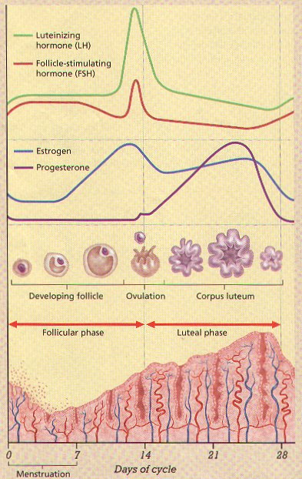

Slide 91
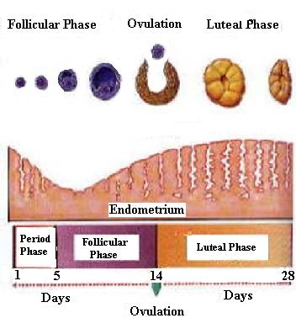
Ovarian cycle

Slide 92
Functions of estrogen
Structural
promote formation of female secondary sex characteristics
stimulate endometrial growth
increase uterine growth
maintenance of vessels and skin
reduce bone reabsorption, increase bone formation

Slide 93
increase hepatic production of binding proteins
Coagulation- increase circulating level of factors 2,7,9,10, antithrombin III, plasminogen
increase platelet adhesiveness
Lipid -increase HDL, triglyceride, fat depositition
decrease LDL

Slide 94
Functions of progesterone
converts the endometrium to its secretory stage to prepare the uterus for implantation
During implantation and gestation, progesterone appears to decrease the maternal immune response to allow for the acceptance of the pregnancy.
Progesterone decreases contractility of the uterine smooth muscle

Slide 95
4. In addition progesterone inhibits lactation during pregnancy.
5. The fetus metabolizes placental progesterone in the production of adrenal steroids.
6. Females Breasts, it Stimulates development of alveoli for milk production.
7. Increases the body temp by 0.5°c

Slide 96
MALE REPRODUCTIVE SYSTEM
Consists of:-
  2 testes
  2 epididymis
  2 vas deferens
  2 seminal vesicles
  1 prostate gland
  1 cowper’s gland
  1 penis

Slide 97
a) scrotum
A deeply pigmented pouch made of skin that lies below the symphysis pubis and behind the penis.
It is made of connective tissue, fibrous tissue and smooth muscles
It is divided into two compartments, each containing a testis, epididymis and testicular end of a spermatic cord.
It main function is to maintain testicular temperatures below the core body temperatures

Slide 98
b) testes
They are the male reproductive glands, equivalent to ovaries in females
Each is about 4 cm long, 2.5cm wide and 3 cm thick.
They are suspended in the scrotum by the spermatic cords.
They are surrounded by three layers of tissues:-

Slide 99
  Tunica vaginalis(outer)- which originates from abdominal and pelvic peritoneum
  Tunica albuginea(middle)- fibrous covering and the outer layer derived from the septum that divides the scrotum
  Tunica vasculosa(inner)- consist of connective tissues and capillary network.

Slide 100
Structure of the testis
Each testis is made up of about 200-300 lobules
Each lobule has between 1-4 convoluted loops composed of germinal epithelium, called seminiferous tubules
Between the tubules are cells interstitial cells of Leydig which produces hormone testosterone.

Slide 101
The tubules combine at the upper pole to form a single tubule, the epididymis which leaves the scrotum as the deferent duct in the spermatic cord
Blood and lymphatic vessels pass to the testes through the spermatic cord.

Slide 102
Spermatic cords
they are two, one on each side.
They consist of one testicular artery, one testicular vein, 1 deferent duct, nerves and lymph vessels within a sheath of fibrous connective tissue and smooth muscles.
It serves to suspended the testes
The vas deferens passes through the inguinal canal and ascends medially towards the posterior wall of bladder.

Slide 103
They join with ducts from seminal vesicles which together form the ejaculatory duct.

Slide 104
Seminal vesicles
are two fibromascular pouches lined with columnar epithelium in the posterior aspect of bladder.
Produce 60% of alkaline semen including fructose to provide energy for sperm.

Slide 105
Ejaculatory ducts
Are two tubes about 2cm long formed from the union of deferent duct and seminal vesicles
They pass through the prostate gland and join the prostatic urethra.
It carries the spermatic fluid and spermatozoa to the urethra

Slide 106
Prostate gland
Lies in the pelvic cavity in front of rectum and behind the symphysis pubis, surrounding the first part of urethra
It consist of an outer fibrous covering, a layer of smooth muscle and glandular tissue
Produces up to 1/3 of the semen & includes nutrients & enzymes to activate sperm.

Slide 107
Cowper’s gland
A small gland just below the prostate gland.
Secretes mucous & alkaline buffers to neutralize acidic conditions of urethra.

Slide 108
urethra
It is a tubular passage about 19-20 cm long
It consist of three parts:-
  Prostatic urethra- from the urethral orifice of bladder through the prostate gland.
  Membranous urethra- shortest and narrowest part extending from the prostate gland to the bulb of the penis
  Spongiose urethra- lies within the penis and terminates at external urethra orifice.

Slide 109
penis
Formed by erectile tissue and involuntary muscles.
The erectile tissue is supported by fibrous tissue and covered by skin. It is highly vascular
The penis has two lateral columns of tissues made of corpora carvenosa and a medial column, the corpus spongiosum that contains the urethra
At the tip, it is expanded into a triangular structure known as glans penis.

Slide 110
Glans penis is well supplied by autonomic and somatic nerves.
Parasympathetic stimulation leads to engorgement with blood and erection of penis

Slide 111
Male hormones
Unlike in females, male reproductive hormones are not produced in cyclical fashion.
Follicle stimulating hormone is produced by the anterior pituitary gland under the influence of gonadotropin releasing hormone
It causes spermatogenesis in seminiferous tubules.

Slide 112
Luteinizing hormone is also produced by anterior pituitary gland and is carried through blood stream to the testis.
It stimulates the interstitial cells(leydig) to produce the hormone testosterone, the chief male sexual hormone

Slide 113
testosterone
Produced by the interstitial cells
It Is responsible for development of male secondary characteristics.
  Deepening of voice
  Maturation of genitalia
  Growth of hair on the pubis, axilla, face and chest

Slide 114
Spermatogenesis begins at puberty and continues throughout adult life.
It is stimulated by changes in pituitary gland secretion when it starts releasing follicle stimulating hormone.
The mature sperms are stored in the epididymis and released during ejaculation.
At each ejaculation, between 2-4mls of semen is released, each ml containing about 100million sperms

Slide 115
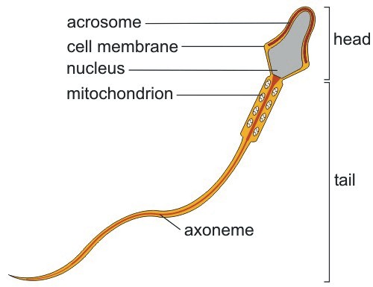
Structure of the sperm

Slide 116
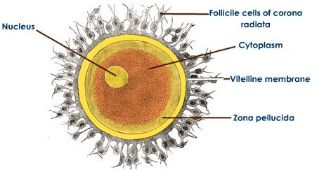
Structure of the ovum

Slide 117
THE PELVIS
Acquired/deformed pelvis
Results from intrauterine abnomalities
Dietry deficiency,disese during chldbirth
*rachitic_caused rickets
*osteomalacic_caused calcium
*asymetrial(nuegeles) _intrauterine abnormalities
*roberts_conjenital absence or poor dvlpt of alae bilaterally leading to too small pelvis

Slide 118
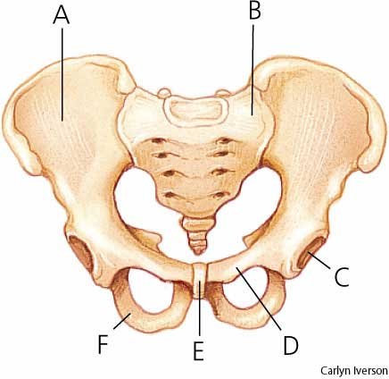
The pelvis
ilium
sacrum
G
a
acetabulum

Slide 119
Android Pelvis (Male type)
Pelvic brim is triangular/heart shaped
Convergent Side Walls (widest posteriorly)
Prominent ischial spines
Narrow subpubic arch
More common in white women
Anterior aspect is angulaed while posterior is spacious
Cavity is funnel shaped and deep
Sciatic notch is narrow and deep
Sacrum isstraight

Slide 120
types of pelvis
Gynecoid Pelvis (50%)
Pelvic brim is a transverse ellipse (nearly a circle)
Rounded brim
Generous fore-pelvis
Straight side-walls
Shallow cavity and round
Well curved sacrum and broad
Sub-pubic arch of 90
Most favorable for delivery
Normal pelvis
Ischial spine re blant
Siatic notch is round or wide

Slide 121
Anthropoid Pelvis
Pelvic brim is an anteroposterior ellipse/long and oval in shape
  Gynecoid pelvis turned 90 degrees
Narrow ischial spines
Sidewalls diverge as the sacrum is long ad deeply concave
Much more common in tall women with narrow shoulders

Slide 122
Platypelloid Pelvis (3%)
Pelvic brim is transverse kidney shape
Sacrum is flat
Cavity is shallow
Ischial spines are blunt
Flattened gynaecoid shape
Side walls re deverged
Labour is prolonged and is aided by instruments

Slide 123
THE FEMALE PELVIS
The bony pelvis is a basin-like structure which connects the vertebral column with the lower limbs.
Justo minor
All diameters re reduced propotionaly
Common in women less than 150cm&4cm shoes size

Slide 124
functions
Transmits the weight of the body from the spinal column to the lower limbs
It contains and protects the pelvic organs
Provides attachment for the abdominal muscles and pelvic floor muscles
It allows the passage of fetus during labor
It allows the person to sit and kneel

Slide 125
Structure of the pelvis
It Is formed by four bones
  Two innominate bones
  One sacrum
  One coccyx

Slide 126
Innominate bones
Also referred to as hip bones
They are two in number, each made of three fused bones.
  The ilium
  Ischium
  Pubic bones
The three bones articulate with each other at the acetabulum.

Slide 127
ilium
It forms the flared out superior part of the pelvis
The anterior surface is concave and called the iliac fossa
The upper border is called the iliac crest
In front of the iliac crest is a bony prominence called anterior superior iliac spine and below this, anterior inferior iliac spine.

Slide 128
Ilium
On the posterior aspect are two corresponding spines, the posterior superior and posterior inferior iliac spines
The iliac bones on each side articulate with the sacrum at a joint called sacro-iliac joint

Slide 129
ischium
It is the thick, lower bone posteriorly
It has a large prominence, the ischial tuberosity which we sit on
Posterior inward projection above the tuberosity are known as the ischial spines

Slide 130
The pubic bone
Forms the anterior part of the pelvis
It has a body, and two projections, the superior and inferior ramus.
The inferior rami form the pubic arch
The space between the rami and ischium is known as the obturator foramen
On the lower border of the innominate bone are found two curves, the greater and lesser sciatic notches

Slide 131
The sacrum
It is a wedge shaped bone
It is made of five fused vertebral bones
The upper boarder of the first sacral vertebra is pushed forwards and is known as the sacral promontory
The concave anterior surface is called the hollow of the sacrum

Slide 132
The sacrum
On the sides, the sacrum extends into a wing or ala.
Four pairs of foramina pierce the sacrum, allowing the nerves to pass through them to supply the pelvic organs

Slide 133
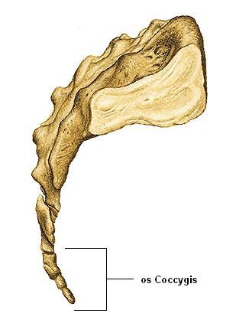
coccyx
It is a triangular bone formed by four fused coccygeal bones.

Slide 134
Pelvic joints
Two sacro-iliac joints- the strongest joints in the body, where the sacrum articulate with the ilium. Strain due to pregnancy on the ligaments of these joints lead to back pains
Symphysis pubis joint- this is the joint between the pubic bones. It widens in late pregnancy causing pain while walking. In severe case, it can cause pelvic dysfunction

Slide 135
Pelvic joints
Sacro-coccygeal joint- found where the sacrum articulates with the coccyx. It allows for the coccyx to be displaced posteriorly during labor.
Each pelvic joint is held together by ligaments that strengthen it.

Slide 136
Pelvic ligaments
Inter pubic ligaments found at the symphysis pubis
Sacro-iliac ligaments attach the sacrum and the ilium
Sacrococcygeal ligaments are found at the sacro-coccygeal joint
Sacro tuberous ligaments attach the sacrum and ischial tuberosities
Sacrospinous ligaments connect the sacrum and the posterior ischial spines

Slide 137
Pelvic ligaments
Nb: the sacrotuberous and Sacrospinous ligaments form the posterior wall of pelvic outlet

Slide 138
PARTS OF THE PELVIS
The bony pelvis is divided into two parts:
  False pelvis
  True pelvis
False pelvis
It is the part above the brim formed by the flared out part of iliac bones. it is bordered by the iliac crest and the 5th lumbar vertebra. It is of little obstetrical significance

Slide 139
True pelvis
It is the curved bony canal that the fetus pass through during labor
It is divided into:-
        The brim
        The cavity
        The outlet
True pelvis is of obstetrical importance

Slide 140
The brim
In females, it is rounded except where the sacral promontory projects in it
It borders are:-
Posteriorly, sacral promontory and the wings of sacrum
Laterally- iliac bones
Anteriorly- pubic bones

Slide 141
Landmarks of pelvic brim
The brim has important fixed points known as the landmarks of the brim
  Sacral promontory
  Sacral ala or wings
  Sacro-iliac joint
  Iliopectineal line
  Iliopectineal eminence
  Superior ramus of the pubic bone
  Upper inner boarder of the body of pubic bone
  Upper inner boarder of the symphysis

Slide 142
The pelvic cavity
Extends from the pelvic brim above to the outlet below
Its anterior wall is formed by symphysis pubis and is about 4cm long.
The posterior wall is formed by the curve of sacrum and is about 12cm long.
The lateral border is formed by the wall of the pelvis which is covered by obturator internus muscle.

Slide 143
The outlet
It is diamond shaped.
Borders
Anteriorly- pubic arch
Laterally- ischial tuberosities
Posteriorly- coccyx and sacral tuberous ligaments

Slide 144
DIAMETERS OF THE TRUE PELVIS a) the inlet
Antero -posterior diameters:
Anatomical antero-posterior diameter (true conjugate) = 12cm
  from the tip of the sacral promontory to the upper border of the symphysis pubis.
Obstetric conjugate = 11 cm
  from the tip of the sacral promontory to the most bulging point on the back of symphysis pubis which is about 1 cm below its upper border. It is the shortest antero-posterior diameter.

Slide 145
Brim
Diagonal conjugate = 12.5 cm
  i.e. 1.5 cm longer than the true conjugate. From the tip of sacral promontory to the lower border of symphysis pubis.

Slide 146
Brim
Transverse diameters:
Anatomical transverse diameter =13cm
  between the farthest two points on the iliopectineal lines.
  It lies 4 cm anterior to the promontory and 7 cm behind the symphysis.
  It is the largest diameter in the pelvis.

Slide 147
Oblique diameters of the brim:
Right oblique diameter =12 cm
  from the right sacroiliac joint to the left iliopectineal eminence.
Left oblique diameter = 12 cm
  from the left sacroiliac joint to the right iliopectineal eminence.

Slide 148
Brim
Obstetric transverse diameter:
  It bisects the true conjugate and is slightly shorter than the anatomical transverse diameter

Slide 149
Diameters of the cavity
It is circular and all diameters are estimated to be 12cm
They cannot be measured exactly

Slide 150
Diameters of the outlet
Anteroposterior diameter- measured from the lower boarder of the symphysis pubis to sacrococcygeal joint. It is approximately 13 cm.
Oblique diameter- estimated between obturator foramen and sacrospinous ligaments. Estimated to be 12 cm
Transverse diameter- measured between the ischial spines and is about 11 cm(10-11cm)

Slide 151
Diameters
Diameters
anteroposterior
oblique
transverse
Brim
11cm
12cm
13cm
Cavity
12cm
12cm
12cm
outlet
13cm
12cm
11cm

Slide 152
The Ideal Obstetric Pelvis
Brim
Round or Oval transversely
No undue projection of sacral promontory.
AP diameter: 12 cm.
Transverse diameter: 13 cm
The plane of pelvic inlet not more than 55°.
Cavity
Shallow with straight side-walls.
No great projections of ischial spines.
Smooth sacral curve
Outlet
Pubic arch rounded
Subpubic angle >90°.
Intertuberous diameter of at least 10 cm.

Slide 153
Pelvic floor
It is formed by soft tissues which fill the outlet of the pelvis
It is made up of:-
  Skin and subcutaneous fat
  Superficial muscles
  Deep pelvic muscles
  Pelvic ligaments and peritoneum

Slide 154
Muscle layer of the pelvic floor
Superficial layer
The external anal sphincter- surrounds the anus and is attached to the coccyx
The transverse perineal muscles passes from the ischial tuberosities to the centre of the perineum.
The bulbo-carvenosus muscle passes from the perineum, surrounds the vagina and is inserted to the corpora carvenosa of the clitoris

Slide 155
Superficial layer
the ischial-carvenosus muscles pass from the ischial tuberosities to the corpora carvenosa
Membranous sphincter of the urethra- muscle fibers pass above and below the urethra to attach to the pubic bones

Slide 156
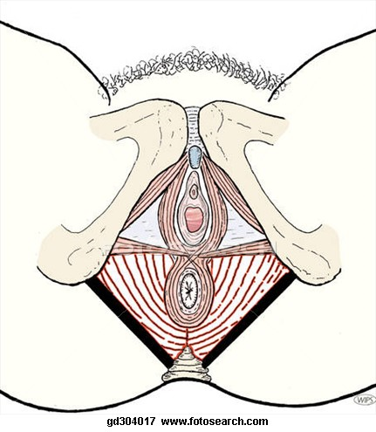
Superficial layer

Slide 157
The deep layers
Composed of three layers of muscles which are collectively known as levator ani muscles.
Pubococcygeus muscle passes from the pubis to the coccyx
Iliococcygeus muscle passes from the fascia covering the obturator internus muscle to the coccyx.
Ischio-coccygeus muscle passes from the ischial spines to the coccyx.

Slide 158
The perineal body
This is a pyramidal fibromascular structure which lies between the vagina and the anal canal.
It gives attachment to perineal muscles.
During the second stage of labor, the perineal body is flattened by the descending head and perineum elongates becoming more liable to tear.

Slide 159
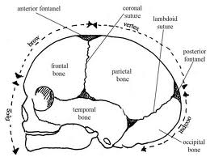
THE FETAL SKULL.

Slide 160
The fetal head consist of:
  The scalp-: which is the soft outer part made of skin and muscles.
  The periosteum-: which covers the bone
  The skull-:the bony structure that contains the brain.
The skull is larger in comparison with the space of the pelvis. Therefore, some modifications must occur between the two delivery to take place.

Slide 161
Development of fetal skull
The fetal skull has both membranous and cartilaginous origin.
The bones of the face develops from a cartilage while those of the vault are laid down in a membranous frame work.
The original centres of ossification of the skull bones are known as eminences of the skull. The one behind is the occipital protuberance. Laterally the parietal eminences and frontal eminences on frontal bones

Slide 162
Bones of the vault
Formed by 5 bones:
  The occipital bone
  Two parietal bones
  Two frontal bones
The occipital bone-: it lies at the back of the head and forms the region of the occiput. At its centre is the occipital protuberance.

Slide 163
Bones of the vault ct….
Parietal bones lie on either side of the skull. The ossification centre of each is called parietal eminence.
The frontal bones forms the forehead or the sinciput. At the centre of ossification is the frontal eminence or frontal boss. These bones fuse into a single bone by the 8th year.
The upper part or temporal bone contributes to the vault.

Slide 164
sutures
Sutures are cranial joints.
They are formed where two bones meet.
Sutures are important landmarks used to determine positions and presentations on vaginal examination.
They also allow moulding to take place during labor.
There are four sutures of obstetrical importance.

Slide 165
Sutures ct….
Saggital suture:- is between the two parietal bones, and joins the anterior and posterior fontanels.
Coronal suture:- it runs transversely between the parietal and frontal bones. Passing from one temple to another.
Frontal suture:- separates the two frontal bones and extends from the roof of the nose to the anterior fontanel.
Lambdoidal suture:- separates the occipital and parietal bones and is shaped like the Greek letter lambda (λ).

Slide 166
FONTANELS
These are membranous spaces where two or more sutures meet.
There are two fontanels of obstetrical importance:-
  The anterior fontanel (bregma)
  Posterior fontanel (lambda)

Slide 167
bregma
Found at the junction of saggital, coronal and frontal sutures.
It is diamond shaped and measures 3-4 cm long and 1.5-2 cm wide.
It is recognizable per vagina because a suture leaves from each of the four corners.
Pulsation of cerebral vessels can be felt and seen through it. It closes by the time the child reaches 18 months age.

Slide 168
b)lambda
Found at the junction of lambdoidal and saggital sutures.
It is small and triangular in shape.
It is recognizable per vaginal as a suture leaves from each of the three angles.
It normally closes at the age of 6 weeks.

Slide 169
Regions of the fetal skull
The skull is the bony part of the head and consists of the following regions.
  Vault
  Base
  Face
The base consists of sphenoid, ethmoid and temporal bones fused together to protect the medulla.

Slide 170
Face and vault
The face consist of 14 small firmly united bones. It extends from the orbital ridges and the root of the nose to the junction of the chin and neck. The point between the eyes is called glabella. The chin is called the mentum and is an important landmark.
The vault is the large, dome shaped part at the top of the skull. its bones are relatively thin and pliable at birth.

Slide 171
The vault
This allows slight alteration in shape of the skull at birth. It is made by the occiput, two parietal and two frontal bones. It extends from the bridge of the nose to the nape of the neck. It has three significant landmarks which are:-
  Occiput
  Sinciput
  vertex

Slide 172
The vault
The occiput:- lies between the foramen magnum and the posterior fontanel. The part below the occipital protuberance is called the suboccipital region.
The vertex:- it is bordered by the posterior fontanel, the two parietal eminences and the anterior fontanel. 95% of the babies born head first present by vertex.
Sinciput/brow:- extends from the anterior fontanel and coronal suture to the orbital ridges.

Slide 173
Landmarks of the fetal skull
These are important in determining the position on vaginal examination.
Four suture.
Two fontanels
The sinciput
The occiput.
The mentum (chin)

Slide 174
Diameters of the fetal skull
Knowledge of these diameters enables us to determine the relationship with the pelvis
There are six longitudinal diameters and two transverse diameters
The transverse diameters
The bi-temporal diameter – 8.2cm
The bi-parietal diameter – 9.5cm

Slide 175
Diameters of the skull
The longitudinal diameters
  The sub-occipital bregmatic (SOB) – 9.5cm
  The sub-occipital frontal (SOF) – 10cm
  The occipital frontal (OF) – 11.5cm
  The mento vertical (MV) – 13.5cm
  The sub – mento vertical (SMV) - 11.5cm
  The sub – mento bregmatic (SMB) – 9.5cm

Slide 176
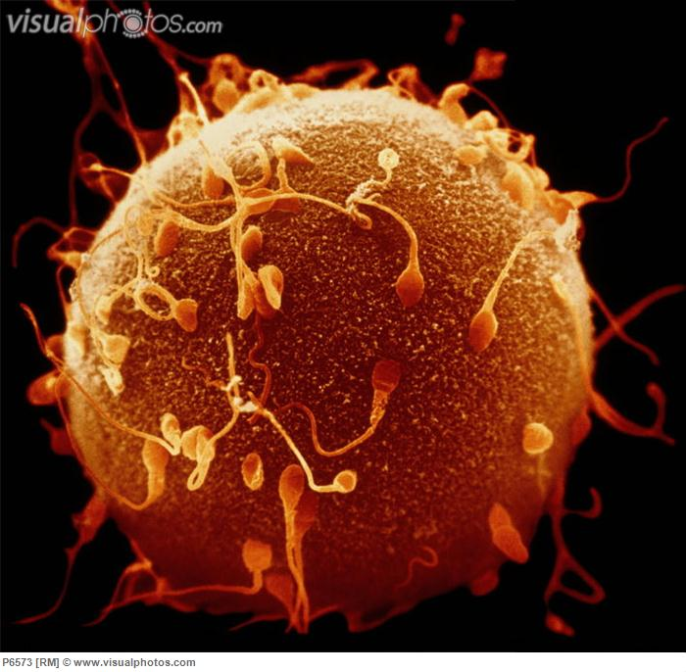
fertilization

Slide 177
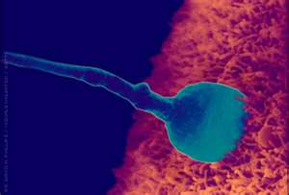
Fertilization ct.

Slide 178
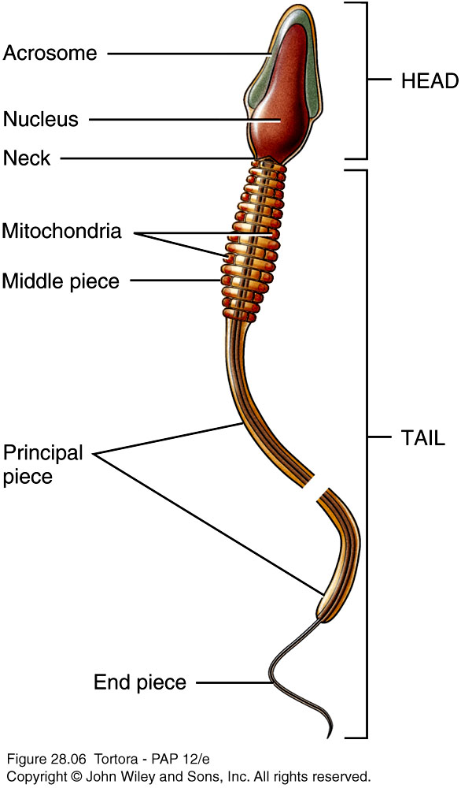
SPERM
  Each day about 300 million sperm complete spermatogenesis
  Head
    Nucleus with 23 chromosomes (haploid or n)
    Acrosome – vesicle filled with oocyte penetrating enzymes
  Tail
    Neck – contains centrioles forming microtubules that comprise remainder of tail
    Middle piece – contains mitochondria
    Principal piece – longest portion of tail
    End piece – terminal, tapering portion of tail
  Once ejaculated, sperm do not survive more than 48 hours in female reproductive tract

Slide 179

THE OVUM

Slide 180
fertilization
The process by which the sperm fuses with an ovum to form a new diploid cell called a zygote
The oocyte reaches the peritoneal cavity after it is released.
Fimbria ovarica together with infundibulo-pelvic ligament of the ovary draws the tube over the ovary by their contraction.

Slide 181
Fertilization ct.
The oocyte is then directed into the tube and transported by the cilliary movement and peristaltic contractions.
The oocyte reaches the upper third of ovarian tube where fertilization usually takes place within 24 hours

Slide 182
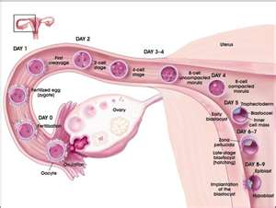
Fertilization ct.

Slide 183
Fertilization ct…..
After fertile coitus, the sperms reaches the uterine tubes after approximately one hour.
The viability of ovum after ovulation is about 12-14 hrs, while the sperms is about 3-4 days. This is the period which fertilization can take place.

Slide 184
Fertilization ct…..
On reaching the ovum, the sperms releases hyaluronic acid which digests the corona radiata enabling the sperm to penetrate the ovum
Only one sperm can penetrate the ovum
After penetration, the head of the sperm becomes the male nucleus and the tail degenerates

Slide 185
Fertilization ct…..
The oocyte then completes the second meiotic division
The two nucleus approach and fuse resulting to formation of a diploid cell, the zygote(23+23)

Slide 186
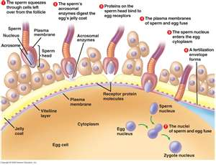
Fertilization ct…..

Slide 187
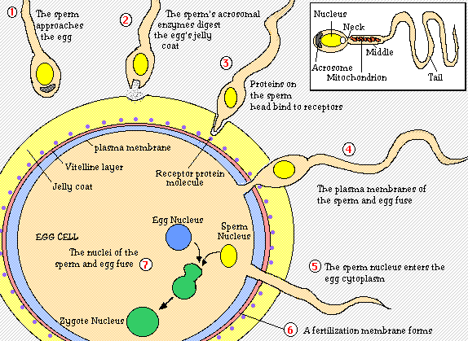
FERTILIZATION

Slide 188
Effects of fertilization
Effects of fertilization
Restoration of the full number of diploid chromosomes
Determination of the sex of the new individual
Initiation of cleavage phase or segmentation

Slide 189
Development of the zygote
After fertilization, the zygote moves towards the uterus and reaches there within 3-4 days
During this time, the zygote enters a period of rapid mitotic division, dividing into 2, 4, 8 and so on until a cluster of cells called morula forms

Slide 190
Development of the zygote
As the morula enters the uterus, it becomes more infiltrated with fluid and a cavity called blastocele forms.
The zona pellucida disappears and the cells surrounding the cavity rapidly differentiate into an outer layer, the trophoblast, and an inner cell mass or embryoblast

Slide 191
Development of the zygote
The inner cell mass located at the embryonic pole, forms the body of the embryo and contributes to the formation of the amnion and the yolk sac.
The trophoblast later develops into placenta and chorion

Slide 192
Implantation or nidation
The blastocyst attach to the endometrium for nourishment
The trophoblastic cells divides rapidly and differentiate into two layers.
The inner layer is termed cytotrophoblast and the outer syncytiotrophoblast
The syncytiotroblasts are highly invasive and expands within the endometrium

Slide 193
implantation
At this stage, the uterine mucosa is called the decidua.
The layer of the decidua that covers the blastocyst is called decidua capsularis, where the blastocyst rests decidua basalis and the rest is decidua parietalis

Slide 194
Embryo development
10-14 days post conception, the inner cell mass continues to proliferate and segregates into three primitive germ layers. All the organs and body tissues develop from these layers
  ectoderm- forms the epidermis, nails, lens of the eye, central and peripheral nervous system, sensory epithelium, mammary glands etc

Slide 195
Mesoderm- forms the dermis, digestive tract walls, kidneys, reproductive glands, skeleton, connective tissues and muscles
Endoderm- forms the respiratory tract, urinary tract system, digestive tract lining etc.

Slide 196
Development of the placenta
The trophoblast develops into the placenta from about three weeks after fertilization
The chorionic villi forms and proliferate mostly at the area where blood supply is high, ie, basal decidua
They form the chorionic frodosum that later forms the placenta
The villi erode the walls of maternal vessels as they penetrate the decidua forming the pool of blood inn which they float

Slide 197
Chorionic villus
Is a branching structure arising from one stem with a centre consisting of mesoderm and blood vessels that are branches of umbilical arteries and vein.
The villus divides and subdivides until it ends as fine filaments that are embedded in the decidua basalis.
By their selective action, they absorb substances for the developing embryo from the maternal blood

Slide 198
Embryonic membranes/ fetal sac
Consist of two membranes:
  Chorion
  Amnion
They begin to form at the time of implantation

Slide 199
chorion
It is the outer membrane and encloses the amnion, embryo and the yoke sac
Has the following features
  It is opaque
  It is thick
  It is friable (easy to tear)
  Found on the maternal side of the placenta
  Can be peeled to the margin of placenta

Slide 200
amnion
It originates from the ecto derm and it contains the amniotic fluid.
Has the following characteristics
  It is smooth and tough to tear
  It is translucent
  Peels up to the insertion of the cord
  And found on the fetal side of the placenta

Slide 201
Amniotic fluid
Also known as bag of waters or the liquor amnii
It is the fluid found in the fetal sac that protects the floating embryo
It is clear, pale, straw colored fluid secreted by the amnion
Some fluid also exudes from the fetal and maternal blood, and after 10 weeks, fetal urine contributes to the volume
Normal amount ranges from 500-1500mls

Slide 202
Constituents of the amniotic fluid
It is slightly alkaline and contains:
  99% water
  1% is composed of
    Albumin
    Uric acid
    Creatinin
    Lecithin
    Sphingomyelin
    Vernix
    Lanugo
    Epithelial cells
    enzymes

Slide 203
Functions of the amniotic fluid
Acts as a cushion to protect against mechanical injury
It distends the amniotic sac allowing for growth and movement of fetus
It controls the uterine embryo temperatures to about 37.2

Slide 204
Functions of amniotic fluid ct.
4. Prevents adherence of amnion and allows freedom of movement to the fetus
5. It equalizes uterine pressure during labor
6. Assists in cervical dilatation especially when the presenting part is poorly applied
7. Provides some amounts of nutrients.

Slide 205
The mature placenta
The placenta at term is a flat mass about 20 cm in diameter and 2.5cm thick.
It weighs approximately 1/6 of the baby’s weight.
The placenta has two surfaces ie;
  Maternal surface
  Fetal surface

Slide 206
Maternal surface
It is usually dark red in color
It is made up of chorionic villi arranged in cotyledons(lobes) which are about 20 in number
Between the lobes are furrows called sulci.
The lobes are further divided into lobules

Slide 207
The fetal surface
It appears whitish, shinny and smooth
It has branches of the blood vessels spreading outwards from the insertion of the cord
The cord is inserted on this side

Slide 208
Functions of placenta
Nutrition-:all the food substances required by the fetus pass through the placenta maternal blood.
Respiration-:gaseous exchange of the fetus takes place through placenta by simple diffusion
Storage-:the placenta stores glucose inform of glycogen and reconverts it as need arises.

Slide 209
excretion-:it excretes carbon dioxide, bilirubin, urea and uric acid. These substances diffuse into the maternal blood from the placenta
Protection-:it provides a limited barrier by preventing the microorganism from the maternal side from reaching the fetus. A few microorganisms such as those causing TB, syphilis and all virus cross this barrier

Slide 210
Endocrine function-: the placenta synthesizes and secrets several hormones:
  Human chorionic gonadotropin
  Estrogen
  Progesterone
  Human placental lactogen

Slide 211
Anatomical variations of placenta
Succenturiate lobe-: this is an extra lobe situated in the membranes. The blood vessels run through membranes to supply it.
Bipartate/ tripartite placenta-: this is a placenta with two or three lobes
Circumvalate placenta-: this is a placenta with an opaque ring on the fetal side. This is formed by doubling of the chorion and the amnion

Slide 212
Velamentous cord insertion-: the cord is inserted in the fetal membranes and the vessels run through the membranes to reach the placenta
Battledore cord insertion of the cord-: the cord is inserted at the very edge of the placenta

Slide 213
Summary of fetal development 0-4 wks
The embryo is curved like a bean and is the size of the pigeon's egg. There is rapid growth as the embryonic plate forms
The primitive cns forms, the heart dvps and begins to beat, the limb bud forms and the embryo is about 1 cm long

Slide 214
4-8 weeks
The embryo is the size of the chicken’s egg. There is very rapid growth and head and facial features develop. All the major organs are laid down in their primitive forms. The external genitalia are present but undistinguishable. Early movements are present and fetus is visible on ultrasound. The embryo is about 3cm long, weighs 4gms and amniotic fluid is between 5-10mls

Slide 215
8-12 weeks
The fetal sac is about the size of the goose egg. The eyelids fuse and kidneys begin to function and the fetus begin to pass urine at 10 wks. Fetal circulation is functional, sucking and swallowing begins and sex is apparent. Some primitive reflexes are present.
The baby is about 10 cm long, weighs just under 60gms and moves freely although not felt by the mother

Slide 216
12-16 weeks
There is rapid skeletal development and the fetus is now visible on x-ray. Meconium is present in gut, lanugo appears and the nasal septum and palate fuse.
The fetus is 15cm long and weighs about 170gms

Slide 217
16-20 weeks
Quickening is present and fetal heart rate is heard on auscultation. Vernix caseosa appears, fingernails appear and skin cells begin to be renewed
The fetus is about 20cm long and weighs about 400gms

Slide 218
20-24 weeks
Most organs are capable of functioning and the fetus adapts periods of sleep and activity. The skin is red and wrinkled and the fetus can respond to sound.
The fetus is 20 cm long, and weighs about 700gms

Slide 219
25-28 weeks
Eyelids reopen and slight respiratory movements are present
Survival may be possible if born
The fetus is about 36cm long and weighs about 1kg

Slide 220
28-32 weeks
The fetus begin to store fat and testis descend into the scrotum.
Lanugo disappear from the face and the skin becomes paler and less wrinkled
The fetus is about 40cm long and weighs about 1.5kgs

Slide 221
32-36 weeks
There is increased fat deposition that makes the body appear more round. Lanugo disappear from the body and the hair lengthens. The ear cartilage is soft and the nails reach the tip of the fingers. Planter creases are visible
The fetus is approximately 46cm long and weighs about 2.5kgs

Slide 222
36-40 weeks
Term is reached and birth is due. The skull is firm, contours rounded and the body well covered with subcutaneous fat
The fetus is approximately 50cm long and weighs between 3-3.5kgs

Slide 223
FETAL CIRCULATION
In utero, the fetus derives it nutrients and oxygen from the maternal blood via the placenta. Waste products are also eliminated through the placenta.
There are various temporary structures that enable fetal-placenta circulation to take place. These structures must cease functioning immediately at birth
These are:

Slide 224
The umbilical vein-:it leads from the umbilical cord to the underside of the liver. It carries oxygenated blood rich in nutrients from the placenta.
Ductus venosus-:it connects the umbilical vein to the inferior vena-cava. Here, there is mixing of deoxygenated blood from the lower part of the body with oxygenated blood from the placenta.

Slide 225
Foramen ovale-: this is a opening between the atria which shunts most blood entering the right atrium to the left atrium.
Ductus arteriosus-:this leads from pulmonary artery to the aorta
Hypogastric arteries-:these are branches of hypogastric arteries. They become umbilical arteries when they enter the umbilical cord.

Slide 226
Blood flow in fetal circulation
The umbilical vein carries highly oxygenated blood from the placenta to the underside of the liver.
The blood is carried through the ductus venosus to the inferior vena-cava where it mixes with deoxygenated blood from the lower parts of the body.
The blood enters the right atrium and then most of it is directed to the left atrium through foramen ovale.

Slide 227
The blood then follows it normal route. It is enters the left ventricle and then pumped through aorta. The heart, the brain and upper limbs receives well oxygenated blood since the arteries that supply them are early branches of aorta.
The blood from the upper part of the body returns to the right atrium through the superior vena cava.

Slide 228
This blood crosses the stream from the inferior vena cava and enters the right ventricle. There is mixing of about 25% of the blood.
The blood is then pumped to the pulmonary artery. Ductus arteriosus shunts most of this blood to the aorta for distribution to the rest of the body. This is because lungs require only little of this blood for their development

Slide 229
The blood continues circulation through the abdominal aorta and into the internal iliac arteries. This leads into the hypogastric arteries which return the blood to the placenta as umbilical arteries

Slide 230
Points on fetal circulation
  Umbilical arteries carry deoxygenated blood from the fetus to the placenta
  Umbilical vein carries oxygenated blood from the placenta to the fetus.
  Umbilical vein is the only vessel in the fetus that carry purely oxygenated blood.
  At birth, the upper limbs are more developed than the lower limbs because they receive more oxygenated blood than the lower limbs.

Slide 231
CHANGE AND ADAPTATION IN PREGNANCY
Anatomical and physiological adaptations occuring throughout pregnancy.

Slide 232
PHYSIOLOGICAL CHANGES IN PREGNANCY
Skin
deep pigmentation of the skin occurs.
Patchy pigmentation of the face gives it mask-like appearance known as chloasma
A pigmented line that usually runs from the symphysis pubis to the umbilicus extends further towards the sternum
Striae gravidarum appears on the abdomenhi
There is increased sweating and feeling hot because basal body temperature rises by about 0.5 degrees Celsius

Slide 233
Changes in the GI system
Gums becomes edematous, spongy and soft. This can lead to bleeding
Ptyalism, pica, nausea and vomiting occurs
Later in pregnancy, the stomach and intestines are displaced upwards leading to heartburn.
Intestinal motility is reduced and this predisposes mothers to constipation.

Slide 234
Urinary system
Frequency of micturation increases during the first and last trimesters
There is a net increase in glomerular filtration rate and lowered renal glucose threshold leading to glucosuria
The ureters becomes kinked causing urine stasis. This predisposes mothers to phylonephritis.
There is relaxation of urinary sphincters

Slide 235
Changes in the breast
Montgomery tubercles becomes more prominent on areola
There is darkening of areola
There is tingling and prickling sensation due to increased blood supply
Breast enlarges, become tense and painful
Colostrum can be expressed after 16 weeks
( Check chronological order of change)

Slide 236
Changes in weight
During pregnancy, the weight changes as follows in a primigravida:-
  2-4 kg in the first 20 wks
  0.4-0.5kgs per week until term
  Weight increases by appproximately 12- 12.5 kgs in pregnancy
  Weight is distributed as follows
  Breast 0.4-0.5kgs
  Fat 3.5kgs
  Placenta 0.6 kgs

Slide 237
    Fetus 3.4- 3.5kgs
    Amniotic fluid 0.6 kgs
    Uterus increase 0.9- 1kg
    Blood increase 1.5 kgs
    Extracellular fluid 1.5 kgs

Slide 238
Changes in cardiovascular system
Total blood volume is increased by 20-100%.
Red blood cells increases as a result of accelerated production in response to increased oxygen demand.
The plasma volume increases as water is retained in the body leading to hemodilution and physiological anemia despite high levels of red blood cells

Slide 239
Cvs changes ct….
The white blood cells only increases slightly.
Platelets and clotting factors increases resulting in increased rate of thrombosis and embolism.
Increased blood volume increases cardiac workload. This causes slight hypertrophy of the heart.

Slide 240
Cvs changes ct….
Cardiac output increases by about 40-50% from the sixteenth week and remain elevated through out the pregnancy.
The heart rate goes up by about 10-15 beats per minute.
Blood pressure remains the same or falls slightly.
Blood vessels relax due to effects of progesterone on the smooth muscles on their walls. This predisposes

Slide 241
Cvs changes ct….
pregnant women to varicose veins.
Blood flow increases towards the uterus, breasts, kidneys and skin but there is no increase in blood flow to the brain and the liver.

Slide 242
Changes in the respiratory system
This system is not much stressed.
The mucosa of the system becomes hyperemic and edematous with hypersecretion of mucus which can lead to stuffiness and epistaxis. It can also cause progressive running nose with blocked nostrils that disappears after delivery.
The shape of the chest changes and circumference increases

Slide 243
The diaphragm is elevated and rib cage displaced upwards.
Respiratory rate remains the same but breathing becomes more diaphragmatic and deeper.
Tidal volume increases by 40%

Slide 244
Changes in the skeletal system
there is relaxation of joint ligaments by progesterone resulting to
  Back pain
  Symphysis pubis dysfunction
  Backward curvature.

Slide 245
Changes in the endocrine system
High levels of estrogen and progesterone produced by the placenta inhibits production of LH and FSH.
There is increased production of prolactin secretion but the effects of the hormone are inhibited by estrogen.
There is increased secretion of oxytocin but it’s effects are not felt until the onset of labor

Slide 246
Endocrine system ct.
There is increased production of adrenal corticosteroids
Basal metabolic rate increases due to increased oxygen consumption and production of thyroid hormones.
Human placental lactogen causes maternal tissue resistance to hormone insulin leading to elevated levels of glucose. This can cause pregnancy induced DM.

Slide 247
CHANGES IN THE REPRODUCTIVE SYSTEM
The endometrium becomes more thicker and vascular in the upper segment which is mostly often the site of implantation.
In preparation for labor, the myometrium develops to a remarkable degree. Each muscle fiber increases 10 times in length and 5 times in thickness. New muscle fibers are also formed.

Slide 248
Reproductive system ct.
The uterus increase in size from 7.5×5cm×2.5cm to 30cm×23cm×20cm. Its weight increases from 60gms to 900gms.
The uterus changes in position from being a pelvic organ to an abdominal organ.
It also changes from the state of anteversion and anteflexion to straightening up and leaning to the right

Slide 249
Reproductive system ct.
From about the 8th week, despite the fact that the uterus is relaxed by effects of progesterone, small waves of painless contractions called Braxton-Hicks contractions begin to be generated. These lasts throughout the pregnancy.
There is regular growth in uterine size leading to changes in fundal height. This allows for its estimation of period of gestation (refer to text books for discussion)

Slide 250
Reproductive system ct.
The cervix becomes softer and its racemose glands produces tenacious mucus that forms a pug known as the operculum which occludes the cervical canal and prevent ascending infections
Towards the end of pregnancy, effacement takes place and the cervix becomes part of the lower uterine segment. The cervix is said to be ripe when it is soft, shortened and admits a tip of a finger

Slide 251
Reproductive system ct.
The muscle coat of the vagina hypertrophies in readiness for distention during the second stage of labor.
The vagina also becomes bluish-purple in color with pulsation in the fornices due to increased blood supply.
A whitish vaginal discharge known as leucorrhea is common. It results from the effects of estrogen on squamous epithelium tissues

Slide 252
Reproductive system ct.
The vagina also becomes more acidic due to action of Doderlin’s bacillus on increased glycogen in the epithelial cells.

Slide 253
DIAGNOSIS OF PREGNANCY
How do you diagnose a pregnancy?

Slide 254
Signs and symptoms of pregnancy
Presumptive signs/subjective
These are the symptoms that the woman experiences and reports. They can not be considered as proof of pregnancy
Ammenorhea- absence or missing of more than one menstrual period especially in a woman whose cycle is regular.

Slide 255
Presumptive signs cont’
Nausea and Vomiting (Morning Sickness).
  (1) Usually occurs in early morning during the first weeks of pregnancy.
  (2) Usually spontaneous and subsides in 6 to 8 weeks or by the twelfth to sixteenth week of pregnancy.
  (3) Hyperemesis gravidarum. This is referred to as nausea and vomiting that is severe and lasts beyond the fourth month of pregnancy. It causes weight loss and upsets fluid and electrolyte balance of the patient.

Slide 256
Presumptive signs cont’
Frequent Urination.
(1) Frequent urination is caused by pressure of the expanding uterus on the bladder.
(2) It subsides as pregnancy progresses and the uterus rises out of the pelvic cavity.
(3) The uterus returns during the last weeks of pregnancy as the head of the fetus presses against the bladder.
(4) Frequent urination is not a definite sign since other factors can be apparent (such as tension, diabetes, urinary tract infection, or tumors).

Slide 257
Presumptive signs cont’
Breast Changes.
(1) In early pregnancy, changes start with a slight, temporary enlargement of the breasts, causing a sensation of weight, fullness, and mild tingling.
Development of montgomery’s tubercle
Darkening of ariola

Slide 258
Presumptive signs cont’
Quickening (Feeling of Life).
(1) This is the first perception of fetal movement within the uterus. It usually occurs toward the end of the fifth month because of spasmodic flutter.
(a) A multigravida can feel quickening as early as 16 weeks.
(b) A primigravida usually cannot feel quickening until after 18 weeks.

Slide 259
Objective/probable signs of pregnancy
(1) Chadwick's sign. The vaginal walls have taken on a deeper color caused by the increased vascularity because of increased hormones. It is noted at the sixth week when associated with pregnancy.
(2) Leukorrhea. increase in the white or slightly gray mucoid discharge that has a faint musty odor. It is due to hyperplasia of vaginal epithelial cells of the cervix because of increased hormone level from the pregnancy. Leukorrhea is also present in vaginal infections.

Slide 260
Objective/probable signs
Hegar’s sign- softening of the cervix.
McDonald’s sign-increased ease of flexing the body of the uterus against the cervix.
Progressive increase in fundal height
Braxton-Hicks contractions can be palpated.
Positive immunological pregnancy test in early morning specimen from the 14th day after fertilization.

Slide 261
Positive(diagnostic) changes
Fetal heart is heard and is regular on auscultation
Fetal movements are reported by the mother or seen through the abdomen.
Ultrasound and x-ray-the baby is seen as early as 6 weeks.
Palpable fetal parts.

Slide 262
Minor disorders of pregnancy
pica
It is a desire to eat certain foods or non-food substances such as soil, charcoal, clay, chalk, glue, etc
It may be due to hormonal changes or lack of enough minerals such as iron and calcium.
Advice
The mother should ensure the substances craved for are not harmful. She should try take food rich in calcium and iron

Slide 263
constipation
This is delayed passage of food through the bowel.
It is characterized by infrequent bowel action and passage of hard stool.
It occurs due to relaxing effects of progesterone on smooth muscles of intestinal wall, or due to pressure on the intestines from the growing uterus.
Advice
Take more fluids, increase intake of fruits and vegetables, carryout antenatal exercises and if persistent, prescribe some laxatives

Slide 264
Back pain
This is more common in multiparous women
It is mostly due to relaxation of pelvic joints and an attempt by the woman to adopt a more comfortable posture to balance the weight.
Advice
Try and walk upright, have adequate rest, wear flat shoes, sleep on a firm bed. Also exclude other causes of back pain such as labor.

Slide 265
cramps
These are painful spasmodic muscular contractions in the legs that are more common during pregnancy. They may be due to ischemia or deficiency of vitamins B,C and calcium.
Advice
The mother to do more exercises and elevate the foot of the bed at night.
Provide more vitamins and calcium, advise on foods rich in these substances.

Slide 266
Increased frequency of micturation
Increased frequency of urination occurring in the first and last trimester due to uterine pressure on the urinary bladder.
It should not be associated with pain or dysuria
Advice
Reassure the mother that this is normal and will pass with time.

Slide 267
fainting
Can occur due to several reasons
  Anemia
  Cardiac conditions
  Change in position
  Ruptured ectopic pregnancy
  Supine hypotension
  Fasting
  Standing for long especially in overcrowded places

Slide 268
Advice
Avoid standing for long periods
Avoid stuffy rooms.
Have regular meals
Avoid sudden change of posture
In late pregnancy, avoid lying flat on the back.
Use pillows and feeling like fainting, to lie on lateral position.

Slide 269
Varicose veins
These are engorged superficial veins of the legs, vulva and anus.
They are due to effects of progesterone on the wall of the vessels.
The valves become inefficient and allows backflow of blood. This results to distended painful veins.
Advice
Avoid standing for long periods.
Rest the legs raised on a chair to relieve pain.

Slide 270
Wear elastic stockings during the day to provide support.
Placing a pillow under the legs at night relieves the pain and symptoms.
Explain the condition increases the risk of thrombosis, and any dull ache on the legs should be reported immediately.
Use pad to support varicose veins of the vulva.
The mother should deliver in hospital because the affected vessels may rupture during delivery

Slide 271
Pruritis vulvae
It is the itching of the vulva
It may be due to poor hygiene or infections such as candidiasis or trichomoniasis.
Advise the mother based on the cause.

Slide 272
insomnia
It is the in ability to sleep.
It is common early and late in pregnancy .
It may be due to anxiety, nightmares, and increased frequency of micturation or discomfort from fetal movement.
Advice
Allay anxiety and reassure the woman.
NB: the woman should be advised to report the following to the hospital immediately:
Vaginal bleeding, frontal or severe headache, PRM, reduced fetal movements, edema or sudden swelling, premature labor.

Slide 273
Antenatal, antepartum or perinatal care
What is the meaning of above terms?

Slide 274
Focused antenatal care (FANC)
Refers to the care given to a pregnant woman from the time she realizes she is pregnant until the birth of the baby.
FANC is aimed at ensuring that the mother and fetus are in good health and that any problem during pregnancy is recognized, treated and referred promptly.

Slide 275
Focused Antenatal Care
An approach to ANC that emphasizes:
Evidence-based, goal-directed actions
Individualized, woman-centered care
Quality vs. quantity of visits
Care by skilled providers

Slide 276
Focused Antenatal Care Services
Evidence-based, goal-directed actions:
Address most prevalent health issues affecting women and newborns
Adjusted for specific populations/regions
Appropriate to gestational age
Based on firm rationale

Slide 277
Focused Antenatal Care Services (cont’d.)
Individualized, woman-centered care based on each woman’s:
Specific needs and concerns
Circumstances
History, physical examination, testing
Available resources

Slide 278
Focused Antenatal Care Services (cont’d.)
Quality vs. quantity of ANC visits:
WHO multi-center study
  Number of visits reduced without affecting outcome for mother or baby
Recommendations
  Content and quality vs. number of visits
  Goal-oriented care
  Minimum of four visits

Slide 279
Focused Antenatal Care Services (cont’d.)
Care by a skilled provider who:
Has formal training and experience
Has knowledge, skills, and qualifications to deliver safe, effective maternal and newborn healthcare
Practices in home, hospital, health center
May be a midwife, nurse, doctor, clinical officer, etc.

Slide 280
Elements or Aims of FANC
to promote and maintain good physical, mental and social health during pregnancy. This is done by education on:-
How to recognize danger signs,
what to do, and where to get help
Good nutrition and the importance of rest
Hygiene and infection prevention practices
Risks of using tobacco, alcohol, local drugs, and traditional remedies
Breastfeeding
Postpartum family planning and birth spacing.

Slide 281
FANC . . .
2. To detect early and treat any arising complications during pregnancy (medical, surgical or obstetrical)
This is done through good history taking, observations, investigations, examination and follow-up care.
3. To promote safe delivery of a healthy baby with minimal stress and injury to the mother and the baby.
This is possible through monitoring, encouraging pregnant women in ANC,

Slide 282
FANC . . .
monitoring fetal growth and well being during pregnancy, advising mothers to avoid harmful substances and promoting rest.
4. To prepare mothers for labor, lactation and normal puerperium- teach the woman about labor, child care and events that follows child birth
5. To ensure that the pregnant woman makes an individual birth plan-counsel and educate the woman on delivery, need to plan for delivery ie emergency preparedness, where she plans to deliver, mode of transport, financial arrangement, etc

Slide 283
Birth Preparedness and Complication Readiness: Objectives
Develop birth plan—exact plan for normal birth and possible complications:
  Arrangements made in advance by woman and family (with help of skilled provider)
  Usually not a written document
  Reviewed/revised at every visit
Minimize disorganization at time of birth or in an emergency
Ensure timely and appropriate care

Slide 284
Essential Elements of a Birth Plan
Facility or Place of Birth: Home or health facility for birth, appropriate facility for emergencies
Skilled Provider: To attend birth
Provider/Facility Contact Information
Transportation: Reliable, accessible, especially for odd hours
Funds: Personal savings, emergency funds
Decision-Making: Who will make decisions, especially in an emergency

Slide 285
Essential Elements of a Birth Plan (cont’d.)
Family and Community Support: Care for family in woman’s absence and birth companion during labor
Blood Donor: In case of emergency
Needed Items: For clean and safe birth and for newborn care
Danger Signs/Signs of Advanced Labor

Slide 286
Danger Signs of Pregnancy
Vaginal bleeding
Difficulty breathing
Fever
Severe abdominal pain
Severe headache/blurred vision
Convulsions/loss of consciousness
Labor pains before 37 weeks

Slide 287
FANC. . . .
FANC emphasizes that a woman should have at least four visits to the clinic during pregnancy.
FANC is therefore:-
Care that is timely, friendly, simple, beneficial and safe to pregnant women.
It is care provided to pregnant women which emphasizes on the woman’s overall health, her preparedness for child birth and readiness for complications(emergency care)

Slide 288
Booking visit
This is the first visit a pregnant woman makes to the antenatal clinic.
Objectives of the visit
to assess the level of health by taking a detailed history and employing screening tests or appropriate tests that are necessary.
to make baseline recordings of weight, height, blood pressure and hb levels in order to assess normality. These values are used for comparison in subsequent visits

Slide 289
Objectives . …
3. To indentify risk factors by taking accurate details of past and present obstetric and medical history.
To provide an opportunity for the woman and her family to express any concerns they might have regarding the pregnancy and previous obstetrical experience.
To give advice on general health matters and those pertaining to pregnancy in order to maintain the health of the mother and development of the fetus.

Slide 290
Steps in ANC
To begin building a trusting relationship in which realistic plans of care are discussed.
Steps in antenatal care.
Also referred to as antenatal profile. It is carried out in the following steps.
History taking
Observations
Investigations
General physical examination(head to toe)

Slide 291
History taking
Welcome the woman, create good rapport and then take history in a quite, private way.
Several forms of history are taken:-
Personal and social history- name, age, address, religion, educational background, occupation, marital status, spouses name and address, tribe, chief or sub-chief, hobbies and habits such as smoking.
Family history- history of illness(s) running in the family such as epilepsy, psychiatric disorders, hypertension, DM, asthma, multiple pregnancies, etc

Slide 292
History ct. . .
Past medical/ surgical history- any past serious illness warranting medical attention or admission in an hospital such as poliomyelitis, cardiac conditions, UTI, STI, Anemia, hypertension, DM, asthma, blood transfusion, and any kind operations involving pelvic organs or accidents involving the pelvic region
Past obstetrical/ gynecological history- ask her parity- the number of times she has delivered, gravida-the number of times she has ever been pregnant,

Slide 293
History ct. . .
Abortions- when it occurred, how many times, was it complete or incomplete? was the cause known or identified, and was action or treatment was given.
Ask about complications of previous pregnancies, labor and purperium.
Ask whether the labor was spontaneous or induced, duration of labor and type of deliveries.
Ask the weight of the babies and their fate, sex and any complications of the babies.

Slide 294
Past obstetric history ct…..
Gravidity and parity:
Gravidity is the number of confirmed pregnancies; a pregnant woman is a gravida. Parity is the number of deliveries after 20 wk. Multifetal pregnancy is counted as one in terms of gravidity and parity. Abortus is the number of pregnancy losses (abortions) before 20 wk regardless of cause (eg, spontaneous, therapeutic, or elective abortion; ectopic pregnancy). Sum of parity and abortus equals gravidity.

Slide 295
History ct. . .
present obstetrical history- ask about last menstrual period (LMP) and calculate the Expected Date of Delivery (EDD) so as to compare the actual fetal size and uterine size. EDD =first day of LMP+ 7 days + 9 months or – 3 months.
note history of pregnancy related illnesses, other risks such as multiparity, age above 35 years or below 16 years and any history of harmful habits such as smoking
Calculate the maturity by date

Slide 296
observations
Take the height at first visit only and record it in the clinic card. Women of 150 cm and below, those who are limping or have abnormal gait are at risk of having contracted pelvis.
Weight- should be taken as early as possible in pregnancy and then compared with that of subsequent visits
Blood pressure- should be recorded as early as possible and then comparison done during subsequent visits.

Slide 297
Laboratory investigations
Urinalysis- test urine for proteins, sugar, ketone bodies and ph to identify or excludes conditions such as pre-eclampsia and DM.
Blood tests- blood grouping, rhesus factor, hemoglobin level, VDRL, HIV/AIDS, and sometimes malaria.
PMTCT counseling is essential

Slide 298
examination
A general head to toe examination is carried out to:-
Help detect abnormalities and take appropriate action.
Help give advice, health education, psychological support and reassurance in line with the findings.
To help students develop competency in the examination.
Refer to procedure manual for general examination procedure.

Slide 299
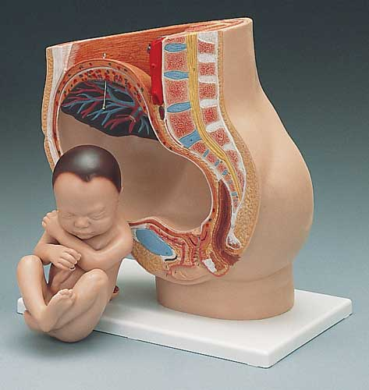
Obstetric physical examination
In the initial presentation, full physical examination should be done.
Abdominal & pelvic examination remains important exam for pregnant women because it is the easiest method of fetal monitoring.

Slide 300
Abdominal examination
Aims:
To observe signs of pregnancy
To assess fetal size and growth
To diagnose the location of fetal parts
To detect any deviation from normal
Preparation.
Conduct general examination first. Abdominal examination is done with mother lying in a supine position. She should empty the bladder first and privacy maintained

Slide 301
method
Inspection.
Inspect the abdomen for:
Size-
Shape
Fetal movements
Contour of the abdominal wall
Skin changes- note any stretch marks, presence of linea nigra, fenesteal scars etcdo

Slide 302
Method ct. . .
Palpation
It is done in three parts with clean and warm hands.
Fundal palpation
Done to estimate fundal height and thus, gestation
Place your hand below the xiphisternum, pressing gently and move down until you feel the curved upper boarder of the fundus. note the number of finger breaths that can be accommodated between the two surfaces.

Slide 303
Method ct. . .
To determine the presentation, the fundus will contain either the head or breech. The head is distinctive in shape and more firm than the breech.
Lateral palpation.
To determine the position, the fetal back should be located and this is achieved through lateral palpation.
The midwife places her hands at either side of uterus at the level of umbilicus

Slide 304
Method ct. . .
Apply pressure with alternate hands in order to determine which side of the uterus offers greater resistance.
The back is marked out as a smooth continuous resistant mass from the breech to the neck and the limbs as parts that slip about under the examining fingers. One hand should steady the uterus while the other palpates

Slide 305
Method ct. . .
Pelvic palpation.
This is to ascertain presentation, engagement and attitude.
Ask the woman to relax and slightly bend her knees, and steadily breath through open mouth.
Grasp the sides of uterus just below the umbilicus between the palms of the hand with fingers held close together pointing downwards and inwards.
The head is felt as a hard mass with a distinctive round smooth surface.

Slide 306
Method ct. . .
To estimate the engagement, feel how much of the head is palpable above the pelvic brim. Alternatively, Pawliks maneuver is used- grasp the head between the fingers and the thumb and find if it is movable.
(Which palpation begins?)
Auscultation.
Used to assess fetal well-being.
Done using Pinard’s fetal scope.
Move the fetal scope around until the point of maximum intensity is determined.

Slide 307
Method ct. . .
The fetal heart beats are more rapid than the mother’s.
Ask the mother about fetal movements. Cover the mother and explain the findings to her.

Slide 308
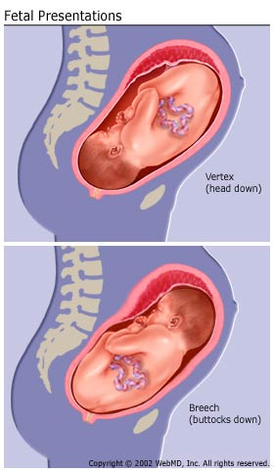
Essential definitions that you should know to understand the physical examination findings:
The presentation: is the part of the fetus in the lower pole of the uterus overlying the pelvic brim (cephalic, breech)

Slide 309
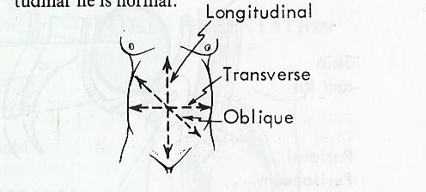
The lie of the fetus: is the relation of the long axis of the fetus to the uterus (could be longitudinal, oblique or transverse. only longitudinal lie is normal)

Slide 310
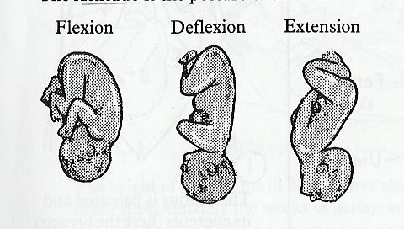
The attitude: is the posture of the fetus (flexion, deflexion, extension)

Slide 311
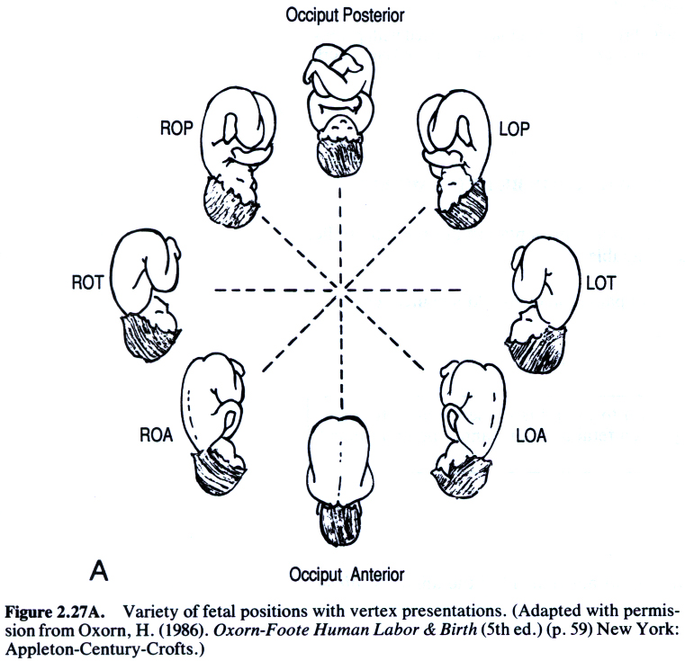
The position: of the baby in relation to the presenting part of the mother’s pelvis. It is expressed according to the denominator which is :
occiput in vertex presentation
sacrum in breech presentation
mentum in face presentation

Slide 312
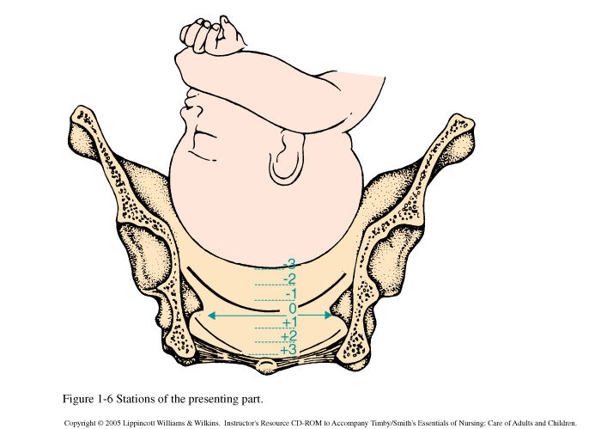
Station & engagement
Station: is the relation of the presenting part to the ischial spine. If the presenting part is at the level of ischial spine, station =0
Engagement: the descent of the biparietal diameter through pelvic brim. If the head is at the level of ischial spine the head must be engaged.

Slide 313
Method of abdominal exam
Inspection:
  Size of the uterus: assess
    If the length & breadth are both increased → multiple pregnancies, polyhydramnios
    If the length is increased only → large baby
  Shape of the uterus: length should be larger than broad this indicates longitudinal lie. But if the uterus is low and broad indicates transverse fetus lie.
  Fetal movement
  Contour of the abdomen: full bladder may be visible in late pregnancy. Umbilicus may become everted
  Skin changes: look for stretch marks, linea nigra, scars that indicates previous surgeries

Slide 314
Method of abdominal exam
Palpation: by Leopold maneuver-4 maneuvers
  Palpate the fundus (to determine if it contains breech, head)
    By gentle pressure:
      if soft consistency/ indefinite outline → breech
      If hard, smooth, well defined → head
    Move your fingertips over the fetal mass to determine mobility and size
      If can’t move independent from the body → breech
      If moves freely between fingertips → head

Slide 315
Method of abdominal exam
Lateral palpation: (determine the position of the fetal back and small parts)
Hands are placed on each side of the umbilicus. The fetal spine will palpate as firm, flat and linear. The fetal extremities are palpable by their varying contour and movements. The purpose of this maneuver is to determine whether the fetal back is left or right.

Slide 316
Method of abdominal exam
Pelvic palpation: 2 maneuvers
Grasp the lower poles of the uterus between fingers and thumbs and comment of the size, flexion and mobility of the head.
To determine the position of the vertex presentation: try to palpate the prominences (occiput @ the same side of the back & sincipital @ the opposite side of the back)
  If the sinciput is higher the occiput → well flexed
  If both prominances are at the same level → deflexed
  If can’t palpate the prominances, and the bulk of the head is felt at the same side of the back → extended

Slide 317
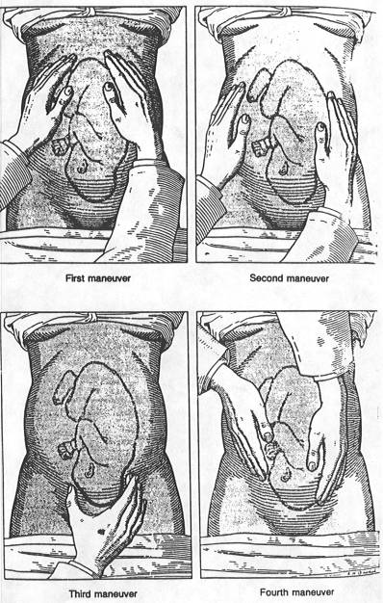
occiput
siniciput)

Slide 318
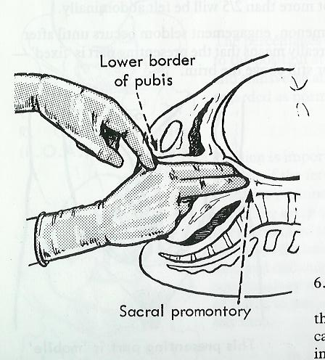
Method of abdominal exam
Auscultation: help assess fetal well being
Auscult the whole abdomen trying to locate the point of maximum intensity
Don’t forget to perform a pelvic exam (details of pelvic exam will be discussed in gynecological exam) but important landmarks to notice during pelvic exam are
  Pubis symphasis
  Ischial spine

Slide 319
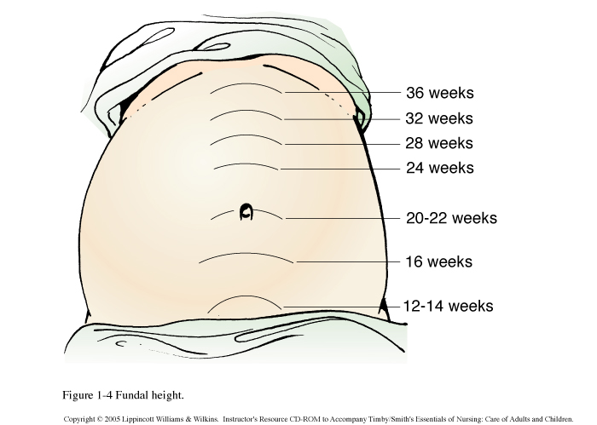
After you examine a pregnant women you should answer the following questions
1. What is the fundal height?
It is estimated by centimeters from upper border of the fundus to the pubis symphasis by taping measure. The height of the fundus correlates well with the gestational age especially during the weeks of pregnancy.

Slide 320
After you examine a pregnant women you should answer the following questions
2. Lie of the fetus: only longitudinal lie is normal
3. Attitude: normally it is full flexion and every fetal joint is flexed.
4. Presentation: normally cephalic
5. Position: according to the dominator
6. Is the vertex engaged?

Slide 321
Recording the findings (documentation)
Recording should be done on ANC card and clinic book.
The mother should carry the card home and instructed to always carry it to the clinic.
Gestation age- predicted gestational age should correspond to the fundal height. In singleton pregnancy, the uterus reaches the level of umbilicus at 22-24 weeks and sternum at 36 weeks. multiple pregnancy should be diagnosed by 24th week

Slide 322
DOCUMENTATION ct. . .
Lie
It is the relationship between the long axis of the fetus and the long axis of the uterus.
The lie may be:-
Longitudinal-the fetus lies along the uterine long axis. occurs in 99.5%
Oblique- the fetus lies diagonally across the long axis of the uterus
Transverse- the fetus lies at right angles to the long axis of the uterus

Slide 323
DOCUMENTATION ct. .
Attitude
This is the relationship of the fetal head and limbs to its trunk.
the attitude can be that of flexion or extension.

Slide 324
DOCUMENTATION ct. .
Presentation
Refers to the part of the fetus that lies at the pelvic brim or in the lower uterine pole
Presentation can be:-
  Vertex- 96.8%
  Breech- 2.5%
  Shoulder-0.4%
  Face-0.2%
  Brow- 0.1%
Brow, face and vertex are all cephalic presentations.

Slide 325
Documentation ct…
Denominator
It is the name given to the part of the presentation which is used when referring to the fetal position. Each presentation has a different denominator.
  Presentation denominator
  Vertex occiput
  Breech sacrum
  Face mentum
  Shoulder acromion/dorsum

Slide 326
DOCUMENTATION ct….
Position
It is the relationship between the denominator and the fixed six positions (land marks) of the pelvic brim eg in the left occipital anterior (LOA), the occiput points to the left iliopectineal eminence and the saggital suture lies in the oblique diameter of the pelvis
Assignment- read and make notes on other positions ie, ROA, ROP, ROL, LOP, ROL

Slide 327
DOCUMENTATION
PRESENTING PART
The part that lies over the cervical os during labor
Engagement
Said to occur when the largest diameter has passed the pelvic brim. It can be assessed as descent abdominally or in relation to the ischial spines.

Slide 328
DOCUMENTATION
All the findings are recorded and appropriate action taken according to the findings.
The woman also receives the following in the process of profiling
  Malaria prophylaxis
  Hematinics, iron and folate supplements
  Tetanus toxoid according to the schedule
  Date of the next visit is written down and well communicated.
  Health education and relevant advice.

Slide 329
PHYSIOLOGY OF LABOUR
LABOUR

Slide 330
Normal labour
LABOUR
It’s the process by which the fetus, placenta and membranes (Conceptus) are expelled through the birth canal
NORMAL LABOUR
Is the process by which the conceptus are expelled spontaneously at term (38-40weeks) with the fetus presenting by vertex and the process being accomplished within 18hours from onset of true labour, without any complications to the woman or the baby.

Slide 331
CAUSES OF NORMAL LABOUR
The cause of labour is unknown but there are important aspects attributed to the occurrence. They include:
Overstretching and over-distension of the uterus
Placental sufficiency is diminished towards term
Uterine contractibility increases towards term (refer to myles textbook on oxytocin)
Cervical nerves are irritated by pressure from the presenting part, stimulating cervical dilatation
Stressful situations such as fever or emotional uproar

Slide 332
CLINICAL PRESENTATION OF LABOUR
HOW DO YOU THINK LABOUR PRESENTS?

Slide 333
Premonitory signs of labour
  There are changes that occur in last few weeks of pregnancy (pre-labour period). They occur all or just a few and include:
  Mood swings
  Energy surge
  Difficult in walking (symphyisis pubis dysfunction)
  Cervix softens and has the ability to dilate
  Increased lekorrhoea

Slide 334
Premonitory signs ct…..
Lightening
Braxton hicks contractions
Frequency of micturation
Cervical changes
Late pregnancy feelings
Assignment:
Differentiate TRUE and FALSE labour

Slide 335
STAGES OF LABOUR
These are theoritical representations of the process of labour which are developed to subdivide the continuous process into phases.
First stage – stage of cervical dilation
Its dividend into latent and active phases
Second stage – stage of fetal expulsion, begins from full cervical dilatation and ends when the baby is born.
Third stage – stage of separation and expulsion of the placenta
Fouth stage – stage of observation following birth, lasts 1-2 hours.

Slide 336
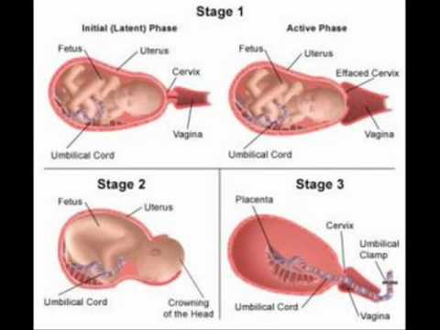
STAGES OF LABOUR

Slide 337
PHYSIOLOGY OF LABOUR
Physiological changes that occur during labor are divided into three stages
The duration of first stage of labor determines the duration of labor because it takes the most time. The duration of labor is determined by:
  Parity
  Birth interval
  Psychological state of the mother

Slide 338
Labour ct. .
  Presentation and position of the fetus
  Pelvic shape and size
  Character of uterine contractions

Slide 339
Physiology of first stage
Physiology of first stage is divided into two categories.
        Uterine action
        Mechanical factors

Slide 340
Uterine action
Fundal dominance
Contractions begins at the fundus and spread downwards lasting at the fundus where it is most intense but the peak is reached simultaneously over the whole uterus and fades from all parts together. This permits cervical dilatation and allows strongly contracting fundus to expel the fetus.

Slide 341
Uterine action ct. . .
b) Polarity
The term used to describe the neuromuscular harmony that exist between the upper and lower uterine segments
The upper uterine segment contracts strongly and retracts to expel the fetus while lower segment contracts slightly and dilates to allow expulsion of the fetus

Slide 342
Uterine action ct. . .
Contraction and retraction
The uterus contracts and retracts in labor. The contractions do not fade completely but muscle fibers retain some of the shortening of contraction and therefore do not relax completely. This is known as retraction.
During contractions, the upper segment becomes thicker and shorter; the cavity diminishes gradually while the lower segment becomes thinner.

Slide 343
Uterine action ct. . .
Formation of the upper and lower uterine segment
This is a functional division that occurs ton the uterus at term. The uterus is divided into the upper and lower segment.
The upper segment is thick and muscular concerned with contraction when the lower segment is thin prepared for distention and dilatation.

Slide 344
Uterine action ct. . .
Development of the retraction ring.
The upper segment is functionally separated from the lower segment by a ridge known as retraction ring. it rises with the increase in contractions until full cervical dilatation is achieved
It is not seen abdominally but if it does, it known as Bandl’s ring and denotes obstructed labor.

Slide 345
Uterine action ct. . .
Cervical effacement
It denotes the “taking up” or shortening of the cervix that takes place during the last few days of pregnancy.
The muscle fibers surrounding the internal os are drawn upwards by the retracting upper segment thus allowing the cervix to become shorter as it gets absorbed into the lower uterine segment

Slide 346
Uterine action ct. . .
Cervical dilatation
This is brought about by the upward traction exerted by the retracted muscle fibers of the upper segment. It is also aided by the pressure from a well-fitting presenting part

Slide 347
Uterine action ct. . .
Show
This is the blood stained mucous discharge that is seen within few hours after the labor starts.
This is the mucous that was forming the cervical plug.
The blood is from the ruptured capillaries as the chorion detaches from the decidua

Slide 348
B) Mechanical factors
Formation of the fore waters.
Increased intrauterine pressure causes the detached part of chorion to bulge into the dilating os. Well-fitting presenting part fits into the cervix and cuts off the fluid in front of the head from the reminder of the amniotic fluid. This fluid in front is called the fore waters and the reminder is hind waters. This is the nature’s way of keeping the membranes intact since the pressure is only applied to the hind waters.

Slide 349
Mechanical factors
Rupture of membranes
Membranes may rupture at any stage in labor.
Towards the end of first stage the membranes ruptures due to extensive cervical dilatation. In poorly fitting presenting part the waters are not cut off effectively and is subjected to intense pressure leading to early rupture of membranes.

Slide 350
Mechanical factors
General fluid pressure
When the membranes are intact, the pressure from uterine contractions is exerted on the fluid. Since the fluid is incompressive, the pressure is equalized throughout the uterus and over the fetal body. This is known as general fluid pressure
After membranes rupture, the pressure is felt between the uterus and the fetus, with placenta compressed between them. This causes diminished oxygen supply to the fetus

Slide 351
Mechanical factors
d) Fetal axis pressure.
During labor, the force of contraction is transmitted to the upper pole of the fetus down the long axis and is applied by the presenting part to the cervix. This pressure is more significant after the rupture of membranes.

Slide 352
PHYSIOLOGICAL CHANGES IN THE SECOND STAGE
Contractions
The strength of contractions increases once the cervix is fully dilated.
They are more stronger and frequent due to irritation of the uterus.
As the vagina is being stretched by the fetus, the reflex stimulates the uterus causing more labor pains

Slide 353
2nd stage physiology
Membranes often rupture spontaneously towards the end of 1st stage, the drainage of liquor allows the hard, round fetal head to be directly applied to the vaginal tissues. This pressure aids in distension.
Increased flexion of the head results in smaller presenting diameters. The physiological stages are:-
a) Contractions become expulsive as the fetus descends further into the vagina. Pressure from presenting part stimulates nerve receptors (Ferguson reflex) and the woman experiences the urge to push.

Slide 354
2nd stage physiology
Abdominal and diaphragmatic muscles (secondary powers)
These muscles becomes more active and expulsive in action. This is known as pushing or bearing down.
The expulsion becomes involuntary when the presenting part reaches the pelvic floor and distends it.

Slide 355
2nd stage physiology
c) Displacement of the pelvic floor
The pelvic floor organs are displaced to allow the fetus to pass through:
  The bladder is drawn up into the abdomen.
  The vagina dilates
  The posterior part of the pelvic floor is pushed downwards in front of presenting part. If there is any fecal matter in the rectum it is expelled

Slide 356
2nd stage physiology
  The anus gapes until the anal opening is about 2.5 cm in diameter.
  The triangular perineal body is flattened . It becomes thin, almost transparent and lengthens the vaginal canal.
At this point, the presenting part is seen at the vulva advancing with each contraction and receding between contractions until crowning takes place. The presenting part is born by extension as the shoulders and body follow

Slide 357
MECHANISM OF NORMAL LABOR
This describes a series of movements done by the fetus as it moves through the birth canal during delivery.
Knowledge and recognition of the normal mechanisms enables the midwife anticipate the next step in the process of descent, which in turn will dictate her response to the birth as it progresses. This ensures that normal progress is recognized, and abnormalities are detected and dealt with appropriately early.

Slide 358
Principles of mechanism
The principles common to all mechanisms are:-
  Descent takes place
  Whichever part leads and meet the resistance of the pelvic floor will rotate forwards until it comes under the symphysis pubis.
  Whatever emerges from the pelvis will pivot around the pubic bone.

Slide 359
Mechanism ct. . .
During the mechanism of normal labor, the fetus turns slightly to take advantage of the widest available space in each plane of the pelvis. The widest diameter of the pelvic brim is the transverse, and the outlet greatest diameter is the antero- posterior.
In normal vertex presentation, the fetus is situated as follows:

Slide 360
Mechanism ct. . .
  The lie is longitudinal.
  The presentation is cephalic
  Position is right or left occipitoanterior.
  The attitude is one of good flexion.
  The denominator is the occiput
  The presenting part is the posterior part of the anterior parietal bone.

Slide 361
Main movements
Descent:- this takes place throughout labor.
Flexion:- it increases throughout labor. It ensures that a small diameter, suboccitobrematic, is presenting.
Internal rotation of the head:- the leading part(occiput) meets the pelvic floor and rotates anteriorly through 1/8th of a circle. This causes a slight twist in the neck of the fetus and head is no longer in direct alignment with the shoulders.

Slide 362
Main movements
The anteroposterior diameter of the head now lies in the widest outlet diameter, the anteroposterior diameter.
Crowning then occurs when the occiput slips beneath the subpubic arch.
Extension of the head:- after crowning the fetal head extends pivoting on the subpubic arch. This releases the sinciput, face and chin which sweeps the perineum and are born by a movement of extension

Slide 363
Main movements
Restitution:- the twist in the neck of the fetus resulting from the internal rotation of the head is corrected by a slight untwisting movement. The occiput moves 1/8th of a circle towards the side from which it started.
Internal rotation of the shoulders:- the anterior shoulder reaches the pelvic floor and rotates anteriorly to lie under the symphysis pubis. It occurs in the same direction as restitution, and the occiput now lies laterally.

Slide 364
Main movements
Lateral flexion:- the anterior shoulder escapes beneath the subpubic arch and the posterior shoulder sweeps the perineum. The reminder of the body is born by lateral flexion as the spine bends sideways through the curved birth canal.

Slide 365
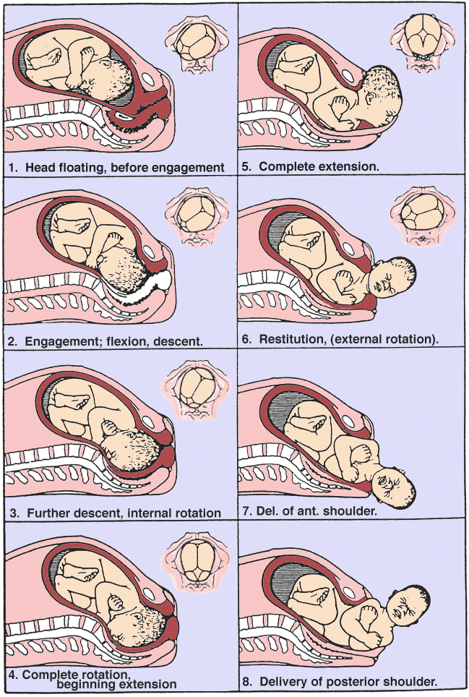

Slide 366
Management of labour
Is the care given through out the stages of labour
A. Admission procedure
Well coming the mother and her partner
On Arrival
Greet the mother
Introduce your self
Inform relative to wait

Slide 367
Management cont…..
B. Admission criteria
Check - show
- rupture of membrane
- regular uterine contraction with progressive cervical dilatation
VE – it may be done first or last depending on how the woman presents herself.

Slide 368
Management cont…..
History
past, present, med/surg and all other relevant history
  Information from the mother
  Ask the mother on set of contraction
  Rupture of membranes / passage of liquor
  Show or any other bright red bleeding
  Physical examination
  The general condition
  Exhausted, anemic, pain, dehydrated general edema
  Vital sign: Blood Pressure, Temperature, pulse, respiration

Slide 369
Care in first stage cont……
Abdominal examination
1. Inspection
2. Palpation lie, presentation, attitude engagement, Fundal height
3. Auscultation fetal heart rate & rhythm
Vaginal examination
To cheek if the mother is in true labour
- Cervical dilatation
- Membrane intact or not
To assess progress of labour
- Station, Position
- presenting part; moulding, caput and station

Slide 370
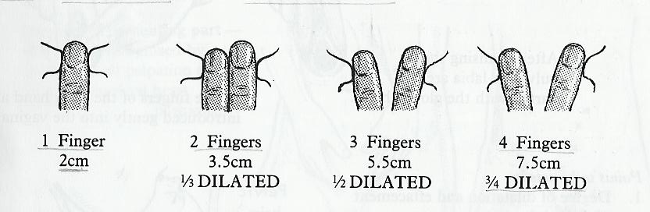
Examination during labor
Palpate uterine contractions
Assessment of the cervix dilatation
  1 finger → 1-2 cm dilated
  2 fingers → 3-4 cms dilated
  3 fingers → 5-6 cms dilated
  4 fingers → 7-10 cms dilates

Slide 371
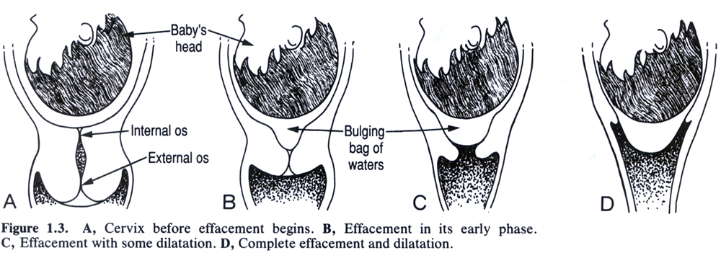
3. Effacement of the cervix: thinning of the cervix (%) or length (cm). The cervix is normally 3-5 cms. If cervix is about 2 cm from external to internal os → 50% effaced
50% effaced
100% effaced

Slide 372
4. Consistency of the cervix: soft vs. hard. During labor the cervix becomes soft.
5. Position of the cervix: posterior vs. anterior. During labor the cervix changes from posterior to anterior.
6. Membrane is intact or ruptured: assessed by fluid collection in the vagina

Slide 373
Care in 1st stage
Investigations
. Hematology
- Hematocrit
- Hemoglobin
- Blood Group, Rh, cross- match
. Urine analysis
- Protein (Albumin)
- Sugar
- Ketone
Write on patient chart and inform relatives. Use partograph
and record on it.
NB – if the woman is in true labour i.e 4cm dilated start a partograph and continue with care as follows.

Slide 374
MANAGEMENT OF THE FIRST STAGE OF LABOR
INFECTION PREVENTION
Admit the woman in a clean environment.
Control the no number of visitors in a birthing unit.
Clean beds and rooms thoroughly after use.
Encourage the woman to bathe and wash as she wishes.

Slide 375
Management ct. . .
Wash your hands before and after attending the client.
Wear gloves when handling used sanitary pads, blood stained linen or body fluid.
Invasive procedures should be kept to the minimum
Artificial rupture of membranes should be avoided unless there is a good indication of the same.

Slide 376
Management ct. . .
Observe the aseptic technique every time you are doing a sterile procedure
Avoid unnecessary frequent vaginal examinations.

Slide 377
Emotional support
Encourage the birth companion to support the woman emotionally during labor.
Explain the process of labor to the woman and lay down expectations to relieve anxiety.
Keep on encouraging the woman.
Express care and dependability to the client to boost her confidence.
As a midwife, display tolerant non-judgemental attitude in provision of care.

Slide 378
Observations/partographing
Observations about the condition of the pregnant woman, her unborn baby and progress of labor should be monitored regularly.
Partograph should only be started when the mother is in active labor, ie cervical dilatation of 4cm has been achieved.
The following observations are done:-

Slide 379
Observations ct . .
Pulse rate:-recorded every 30 minutes when the woman is in active labor. Pulse rate of above 100b/m are indicative of anxiety, infections, ketosis or hemorrhage.
Temperatures:- should be recorded every 4 hours. Pyrexia is indicative of infections or hypoglycemia.
Blood pressure:- measured every four hours, unless it is abnormal. Hypotension may be due to supine position, shock or epidural anaesthesia.

Slide 380
Observations ct. .
Blood pressures may be further aggravated by labor on women who had hypertensive disorders in pregnancy.
Urinalysis:- urine is tested for glucose, ketones and proteins. The volume of the urine is also measured.
Contractions:- assessed ½ hrly
Descent of the presenting part:- assessed 4 hourly
Cervical dilatation:- assessed 4 hourly

Slide 381
Observations ct. .
Fetal heart rate:- to assess fetal well being its assessed ½ hourly
Amniotic fluid:- It also determines the fetal reaction to labour and its assessed ½ hourly
Observe the maternal general status and her fortitude.

Slide 382
Care of the bladder
Encourage the woman to empty her bladder every 1-2 hours.
If the woman is not able to visit the toilet, offer privacy and provide with a bed pan.
A catheter is passed if the woman is unable to empty the bladder completely.

Slide 383
nutrition
Offer the woman light foods rich in carbohydrates to provide energy during labor eg. Biscuits, toast, yoghurt, breakfast cereal, fruit juice, tea etc.
Fluids intake will reduce the risk of dehydration during labor.

Slide 384
Relieving pain and comfort
Rub the woman’s back during contractions to increase sensory input and thus reduce sensation of pain.
Ensure the woman assumes a comfortable position.
Encourage the woman to walk around to aid in descent and shorten labor.
Encourage the woman to anticipate positively the birth of her child.

Slide 385
VAGINAL EXAMINATION IN LABOUR
When Doing Vaginal Examination Always Remember:-
1. The vaginal is not a sterile cavity, - the Uterus is. Every
vaginal examination increases the danger of intrauterine
infection, if carelessly performed.
2. A vaginal examination is uncomfortable and embarrassing
for the patient.
3. Careful abdominal examination gives a lot of information.
Do it always before vaginal examination.
4. When doing a vaginal examination, find out all the
information you can, this may save it having to be
repeat

Slide 386
INDICATIONS FOR VE
1. When in doubt about the presentation, dilatation, or
position and to assess progress.
2. To assess the shape and size of the pelvis.
3. To know the cause in fetal or maternal distress.
4. When the membranes rupture and the head is high or there is Malpresentation, to make sure there is not
prolapsed cord

Slide 387
VE cont……
Information: To be got on Vaginal Examination
1. Presenting Part
Presentation
Level of presenting Part
Caput
Sutures and Fontanelles.
Overlapping or moulding
2. Membranes
Intact - Bulging or flat?
Ruptured - Color of liquor

Slide 388
VE cont….
3. Cervix:
RIPE - firm or soft
EFFACEMENT - long or short - taken up.
OEDEMATOUS- thick or thin
APPLIED to the presenting part- Loose or well applied.
DILATION- Measure in cm.
4. Vagina:
Lax or tight, Warm or hot, Moist or Dray

Slide 389
VE cont…
5. Pelvis:
Cavity, sacral promontory
Curve of the sacrum, ischeal spine
Lateral pelvic side walls- parallel or convergent
Now Co-relate your findings, after recording them and determine the stage of labour.

Slide 390
THE SECOND STAGE OF LABOUR
Definition:
It is the stage from full dilatation of the cervix (i.e no cervix felt on V.E) until the Baby is born:-
Duration:
Primigravida 45 min – 1 hour, as long as 2 hrs
Multigravida 1/2 hour can be as little as 5 minutes.
N.B. there should always be advance or descent in this stage

Slide 391
Signs of second stage
Presumptive signs
Dilatation and Gaping of the anus
Expulsive uterine contractions
Rupture of the forewaters
Show, appearance of the presenting part
Confirmatory signs
1. No cervix felt on Vaginal examination

Slide 392
MANAGEMENT OF SECOND STAGE
Once the patient is in the second stage the nurse must not
LEAVE HER, and a constant and careful supervision must be kept on her:
1. General condition, pulse, uterine contractions & Vulva
2. Bladder should be empty
3. Fetal heart more frequently (after every contraction)
4. Descent of the presenting part and progress.
5. Membrane should be ruptured
NB – see procedure manual for further care.

Slide 393
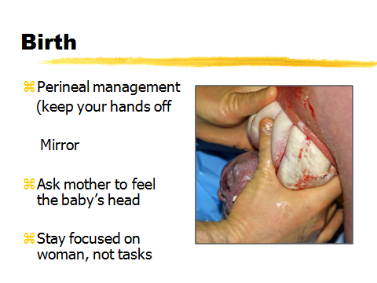
Birth

Slide 394
EPISIOTOMY
Definition: The making of an incision into the perinium to enlarge the vaginal orifice.
Indications for Episiotomy
1. Delay due to rigid perineum, disproportion between fetus and vaginal orifice.
2. Fetal distress due to prolapsed cord in second stage.
3. To facilitate vaginal or intra uterine manipulation
Eg. Forceps, breach delivery
4. Preterm baby in order to avoid intracranial damage
5. Previous 3rd degree repair of the perineum.

Slide 395
EPISIOTOMY
Advantages of episiotomy
1. Fetal acidosis and hypoxia are reduced
2. Over stretching of the pelvic floor is lessened
3. Bruising of the urethra is avoided.
4. In sever pre - eclampsia or cardiac disease to reduce the effort bearing down.
5. A previous third degree tear which may occur again because of the scar tissue which does not stretch well is prevented.

Slide 396
EPISIOTOMY
Types of Episiotomy
1. Medio- lateral
2. Median
3. J- shaped
4. Lateral

Slide 397
EPISIOTOMY
1. Medio – Lateral
The incision is begun in the center of the fourchette and directed posterio laterally, usually to the woman’s right. Not more than 3cm long & directed diagonally in straight line which runs 2.5cm distance from the anus.
Advantages –
- Barthlion glands are not affected
- Anal sphincters are not injured

Slide 398
EPISIOTOMY
2. Median:
The incision begun in the center of the fourchette and directed posteriorly for approximately 2.5cm in the midline of the perineum.
Advantage:
- Less bleeding
- More easily and successfully repaired
- Greater subsequent comfort for the women

Slide 399
EPISIOTOMY
3. J – Shaped :
The incision is began in the center or the fourchette and directed posteriorly in the midline for about 2cm and then directed towards 7 on the clock to avoid the anus.
Disadvantage
- The suturing is difficult
- Shearing of the tissue occurs
- The repaired wound tends to be pucked.

Slide 400
EPISIOTOMY
4. Lateral:
The incision is begun one or more cm in distant from the anus.
Disadvantages
- Bartholins duct may be saved
- The levator-ani muscle is weakened
- Bleeding is more profuse
- Suturing is more difficult
- The woman experiences subsequent discomfort

Slide 401
EPISIOTOMY
Timing the incision
1. The head should be well down on the perineum, low enough to keep it stretched and thinned
2. In breech presentation the posterior buttock would be distending the perineum
3. It must be made neither too soon nor too late

Slide 402
EPISIOTOMY
REMEMBER:
1. Do not tie the sutures too tightly
2. The last stitches are important for they prevent excessive
Scar formation
3. Press firmly on suture line with a pad to see if bleeding
has stopped.
4. Remove perineal pad or suture pack from vagina. Rub up
fundus put clean pad on perineum
5. Put gloved finger in to the rectum – to make suture that no
stitch has gone through the rectum
6. Make the women comfortable, clean and dry.

Slide 403
EPISIOTOMY
After care of episiotomy
1. Hot bath, cleanliness and wound care
2. If pus or foul smelling discharge develop report to health personnel
3. Advise not to strain and avoid constipation

Slide 404
THIRD STAGE OF LABOUR
The Third Stage of Labour
It begins immediately after the baby is born, until the placenta is delivered. The third stage lasts between 5-15 minutes but any period up to 1 hour is normal. If it lasts more than 1 hr it is considered as retained placenta.
Physiology of the third stage of labour
1. Separation of the placenta
2. Descent of the placenta
3. Expulsion of the placenta
4. Control of bleeding

Slide 405
PHYSIOLOGY OF 3RD STAGE
1. Separation of the placenta
Mechanism of placental separation
It is brought by the contraction and retraction of the uterine muscles. Separation usually begins in the center of the placenta. At the area of the separation the blood sinuses are torn across. 30to 60ml of blood is connected between maternal surface of the placenta and the decidual basalis.
The uterine contractions detaches the placenta from the uterus and the placenta forced out of the upper uterine segment into the lower uterine segment.

Slide 406
PHYSIOLOGY OF 3RD STAGE
Signs for placental separation
1. Gush of blood
2. The fundus rises at the level of umbilicus
3. Uterus becomes globular
4. Cord lengthens and does not recend on supra-pubic pressure
The uterus contracts during & after the birth of the baby. This causes the uterus to become smaller, the placenta remains the same size & is pushed off the uterine wall.

Slide 407
PHYSIOLOGY OF 3RD STAGE
2. Descent of the placenta
When the placenta has completely separated, the
contracting uterus pushes it down into the lower uterine segment and into the vagina. The weight of the placenta itself pulls the chorion off the uterine wall.
Sign of placental descent
1. The uterus becomes hard, round and movable.
2. The fundus rises to the level of the umbilicus.
3. The cord seems to lengthen.
4. There is a gush of blood
5. When you apply suprapubic pressure the cord will not
reced back
6. Placenta can be felt on vaginal examination.

Slide 408
PHYSIOLOGY OF 3RD STAGE
3. Expulsion of the placenta
Method of placental expulsion
a). Using the fundus as a piston
The contracted fundus is used as apposition to push the placenta out.
b). Controlled cord traction with out oxytocin drugs (Brandit Andrews method)
c). Fundal pressure
d). Traditional method/Bearing down by the woman

Slide 409
METHODS OF PLACENTA EXPLUSION
1. ACTIVE MANAGEMENT OF LABOUR
An oxytocic drug is given, if pregnancy is not multiple as soon as anterior shoulder is delivered.
The cord is clamped and cut, wait for contraction.
Do not wait for the sign of placental separation and
descent
As soon as the uterus contracts the left hand is placed
above the symphysis pubis push and the uterus upwards
towards the umbilicus. At the same time the right hand
grasps the umbilical cord and apply traction in “a down
ward direction” out ward when the placenta is visible traction is
exerted in an upward direction following the curves of then birth
canal and then deliver the placenta.

Slide 410
AMTL
If the membranes are not complete twisting the placenta to form the membranes into a rope or grasping the membranes with artery forceps and moving gently up and down to remove it.
It is done for high risk mothers.
Recommendations – When active management of the third stage is used clamp the cord.

Slide 411
METHODS OF PLACENTA EXPLUSION Cont…
2. Controlled cord traction with out oxytocic drugs /Brandit Andrews method/ passive management of third stage of labour
Signs of placental separation and descent are awaited. The left hand is placed above the symphysis pubis push the uterus upwards towards the umbilicus. At the same time the right hand grasps the umbilical cord and apply traction in “a down ward direction” out ward when the placenta is visible traction is exerted in an upward direction following the curves of the birth canal then deliver the placenta.
Cord traction should not be applied when the fetus is macerated or if the baby is preterm.
Danger: Breaking of the cord. If the cord is snap manual removal is indicated.

Slide 412
METHODS OF PLACENTA EXPLUSION Cont
Advantage: It allows the placenta to separate and descend with out interference
Danger: The third stage may be longer Haemorrhage and infection may happen.
3. Maternal effort: When the uterus is well contracted ask the mother to push as she did during the birth of the baby. If she is not successful, the midwife or nurse may put a hand flat on the abdomen while the mother pushes, thus provides counter pressure to compensate the poor abdominal muscle tone.

Slide 413
METHODS OF PLACENTA EXPLUSION Cont…
4. Fundal pressure: The midwife or nurse puts her left hand
on the fundus of the well contracted uterus and pushes down
wards and back wards. The uterus is pushed against theplacenta
and the placenta emerges from the vagina, receive the placenta,
massage the uterus to make it contract, and give Ergometrine.
Indication:- Preterm labour, still birth
Danger- Pain
N.B
Fundal pressure and cord traction must never be combined because of the risk of inversion of the uterus.

Slide 414
METHODS OF PLACENTA EXPLUSION Cont…
5. Traditional method
Up right kneeling/ squatting positions should be recommended when the third stage is passively managed.
Gravity and intra abdominal pressure aid & speed the process
Advantage – Blood loss can be easily observed
About 500-.800ml blood flows through the placental site each
minute. Following delivery of the placenta the oblique muscle
fibers of the myometrium contract very strongly to compress
the blood vessels.
All average blood loss after the delivery of the placenta is
150ml.
Blood loss should never be more than 500ml. All blood should
be measured including clots from the placental surface.

Slide 415
PHYSIOLOGY OF 3RD STAGE ct….
4. Control of bleeding
Methods:-
- Contraction & relaxation of uterine muscles
- The actions of living ligatures
- Extra clotting power in the blood
The third stage is the shortest and easiest but the most dangerous stage. Bleeding after third stage of labour stops spontaneously, because of:
1. “Living ligatures” The oblique muscles fibers of the uterus run in and out between the blood vessels when the uterus is contracted they clump the blood vessels very securely and the bleeding stops.
2. Extra clotting power: The mother has extra clothing power
in her blood at this time the clotting mechanism is very powerful.

Slide 416
3rd stage ct…..
At the end of the third stage
1. The uterus should be hard, round and movable
2. The uterus should be mid way between the umbilicus and symphysis pubis
3. There should be no excessive bleeding
4. The bladder should be empty

Slide 417
THE OXYTOCIC DRUGS
These drugs stimulate the uterus to contract. It is used before, during & after the third stage of labour.
Advantages:
1. It speeds up the delivery of the placenta
2. Lessen the blood loss
3. Contract the uterus
The oxytocic drugs are:-
1. Syntocinon, orastinon, pitocin, oxytocin - one ampule contains 5 or 10 units
2. Ergometrine ampules – 0.5 mg or 0.25mg, Ergometrine 0.25 or 0.5mg tablet form
3. Syntometrine - 1ml contains 0.5mg Ergometrine and 5
unites of oxytocin.

Slide 418
4th STAGE OF LABOUR
Immediate Care of Mother and Baby
The mother and the baby has to remain in the delivery room for an hour after delivery.
Immediate care of mother:
Give oxytocin 5-10 iu, massage the uterus and expel
the clots.
The vulva is swabbed and a sterile pad placed in position
Buttocks should be dry and any wet sheet is removed the
sterile towel is removed over the lower abdomen and
thighs and cover with warm blanket.

Slide 419
4th STAGE OF LABOUR
Careful observation
Check the maternal pulse (60-70)minute is the normal range
Take body temperature – subnormal due to loss of body heat, as high as 37.2°c due to reactions of prolonged labour.
Encourage her to pass urine
Blood pressure is taken ½ hourly.
Give her a hot drink and place the baby on the breast

Slide 420
4th STAGE CARE
Immediate care of baby
Observe:
The general well being of the baby
Check the security of the cord clamp
Check APGAR score
Promote bonding and breast feeding
Put on ID (identification) band
Check weight, height, head circumference and any drug (s)
given to the baby

Slide 421
RECORD KEEPING
Record your observations during labour
Method of delivery- spontaneous or accelerated, forceps, cesarean section or vacuum.
Anaesthetic – General, epidural, local
Blood loss- amount
Placenta and membranes- complete, incomplete
Perineum- laceration, episotomy
Drugs given for the mother
Baby – Sex, weight, APGAR score, alive or stillbirth. Date and time of delivery
N.B .The chart should present a clear, concise, reliable record.
The legal aspect of record keeping is also important during
labour.

Slide 422

Postpartum Physiology

Slide 423

Postpartum Care

Slide 424
Objectives
1-To describe the anatomic and physiologic changes that occur during the postpartum period
2-To identify characteristics of uterine involution and lochial flow.
3-To compare expected values for vital signs and blood pressure.
4-To identify the priorities of maternal care during the first stage of labor.
5-To identify common selection criteria for safe early postpartum discharge

Slide 425
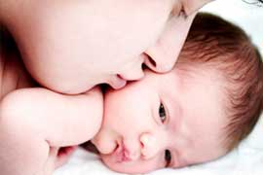
Postpartum period
Is the interval between the birth of the placenta and the return of the reproductive organs to their normal nonpregnant state
It lasts for 6 weeks, with some variation among women.

Slide 426
Anatomic and physiologic changes
Reproductive system:-
Uterus
Involution:-is the return of the uterus to a nonpregnant state after childbirth
Involution process begins immediately after expulsion of the placenta with contraction of uterine smooth muscles

Slide 427
Cont….
At the end of third stage of labor, the uterus is in the midline, about 2cm below the level of the umbilicus and weighs 1000g
By 24 hours postpartum the uterus is about the same size it was at 20 gestational weeks

Slide 428
Cont…
-The fundus descends about 1 to 2cm every 24 hours, and by the sixth postpartum day it is located halfway between the symphysis pubis and the umbilicus.
-The uterus lies in the true pelvis within 2 weeks after childbirth.

Slide 429
-It involutes to about 500g by 1 week after birth, 350g by 2 weeks, and at 6 weeks it has returned to its nonpregnant size 50-60g

Slide 430
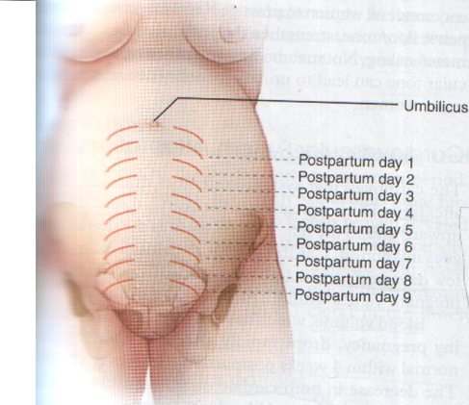

Slide 431
Cont…
-Autolysis:-it is a self destruction of excess hypertrophied tissue.
-Subinvolution:-is the failure of the uterus to return to a nonpregnant state.
-The most common causes of subinvolution are retained placenta fragments and infection

Slide 432
Cont…
Contraction
The hormone oxytocin strengths and coordinates uterine contraction, which compress blood vessels and promotes homeostasis
During the first 1 to 2 postpartum hours, uterine contractions may decrease in intensity and become uncoordinated

Slide 433
Cont…
Exogenous oxytocin is usually administered immediately after expulsion of the placenta to maintain the uterus firm and contracted.
Mothers are encouraged to put the baby to breast immediately after birth to stimulate the release of oxytocin.

Slide 434
Cont…
Afterpains
-Are uncomfortable cramping that persist throughout the early puerperium
-Afterpains are more noticeable after births in which the uterus was greatly distended (e.g., large baby, multifetal gestation)
-Breastfeeding and exogenous oxytocin cause these afterpains to intensify.

Slide 435
Cont…
Placental site
-Immediately after the expulsion of the placenta and membranes, vascular constriction and thrombosis cause the placental site to be reduced to an irregular nodular and elevated area.

Slide 436
cont…
Upward growth of endometrium causes the sloughing of necrotic tissues and prevents scar formation.
Endometrial regeneration is completed by postpartum day 16, except the placental site is not completely healed until 6 weeks after birth.

Slide 437
Cont…
Lochia
-It is the uterine discharge that occurs after birth.
Lochia is initially bright red changing later to a pinkish red or reddish brown
-For the first 2 hours after birth the amount of lochia should be about that of a heavy menstrual period, after that time the lochial flow should steadily decrease.

Slide 438
Cont…
Lochia passes through 3 stages:-
1-lochia rubra:-it consists of blood, decidual and trophoplastic debris
It lasts 3-4 days after childbirth
.
2-lochia serosa:-it consists of old blood, serum, leukocytes, and tissue debris. the flow becomes pink or brown.
It is expelled day 4-9 postpartum

Slide 439
Cont…
3-lochia alba:-it consists of leukocytes, decidua, epithelial cells, mucus, and bacteria. it is yellow to white in color.
Lochia alba may continue to drain for up to and beyond 6 weeks after childbirth.
The amount of lochia usually increases with emptying the bladder, ambulation and breastfeeding.

Slide 440
Cont…
Persistence of lochia rubra early in the postpartum period suggests continued bleeding as a result of retained fragments of the placenta or membranes.
The other common source of vaginal bleeding is vaginal or cervical laceration.

Slide 441
Cont…
Nonlochial bleeding
Lochial bleeding
Bloody discharge spurts from the vagina
The amount of bleeding continues to be excessive and bright red
Lochia usually trickles from the vaginal opening, the steady flow is greater as the uterus contracts
A gush of lochia may result as the uterus is massaged

Slide 442
Cont…
Cervix
-It is soft immediately after birth
-The cervix up to the lower uterine segment remains edematous, and thin for several days after birth.
The cervical os which is dilated to 10cm during labor closes gradually, it may still possible to introduce 2 fingers into cervical os for the first 4-6 postpartum days.

Slide 443
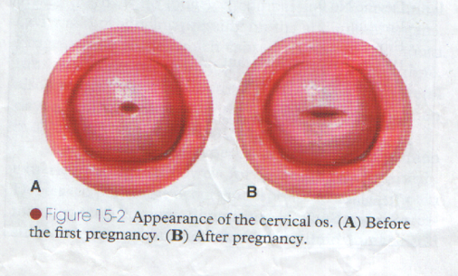
Cont…
The external cervical os never regains its prepregnancy appearance, it is no longer shaped like a fish mouth.

Slide 444
Cont…
Vagina and perineum
-The greatly distended, smooth walled vagina gradually returns to its prepregnancy size by 6-10 weeks after childbirth.
-The mucosa remains atrophic in lactating woman at least until menstruation begins again.
-Thickening of vaginal mucosa occurs with the return of ovarian function.

Slide 445
Cont…
-The reduced estrogen levels also responsible for causing a decreased amount of vaginal lubrication, so localized dryness and dyspareunia may persist until ovarian function returns and menstruation
resumes.
-Initially the introitus is erythematous and edematous especially in the area of the episiotomy or laceration repair.

Slide 446
Cont…
- If episiotomy and laceration have been carefully repaired, hematomas are prevented or treated early.
- usually healing should occur within 2-3 weeks
- Hemorrhoids usually decrease in size within 6 weeks of childbirth.

Slide 447
Cont…
Pelvic muscular support
The supporting structure of the uterus and vagina may be injured during childbirth.
The supportive tissues of the pelvic floor that are torn or stretched during childbirth may require up to 6 months to regain tone
Women are encouraged to do kigel exercises after birth to strengthen perineal muscles and promote healing

Slide 448
Endocrine system
Placental hormones
Expulsion of the placenta results in dramatic decreases of hormones produced by placenta.
The placental enzyme insulinaze causes the diabetogenic effects of pregnancy to be reversed, resulting in significantly lower blood sugar levels in the immediate postpartum period

Slide 449
Cont…
- Estrogen and progesterone levels decrease markedly after expulsion of the placenta, reaching their lowest levels 1 week into the postpartum period.
2- Decreased estrogen level associated with; breast engorgement, and diuresis of excess extracellular fluid that has accumulated during pregnancy.

Slide 450
Cont…
-The estrogen levels in nonlactating women begin to increase by 2 weeks after birth, and higher by postpartum day 17.
Pituitary hormones and ovarian function:-
-Lactating and nonlactating women differ in the time of the first ovulation.
-The persistence of elevated serum prolactin levels in breast feeding women appears to the responsible for suppressing ovulation

Slide 451
Cont…
-In women who breast feed, prolactin levels remain elevated into the sixth week after birth.
Serum prolactin levels are influenced by the frequency of breastfeeding, the duration of each feeding, and the degree to which supplementary feedings are used.
Prolactin levels decline in nonlactating women, reaching the prepregnant range by third week
About 70% of nonlactating women resume menstruation by 3 months after birth.

Slide 452
Cont…
-The mean time to ovulation in women breast feed is about 6 months.
-The resumption of ovulation and the return of menses in lactating women are determined by breastfeeding patterns.
-The first menstrual flow after childbirth is usually heavier than normal, within 3-4 cycles, the amount of menstrual flow returned to woman’s prepregnant volume

Slide 453
abdomen
-Abdominal muscles protrude during the first days after birth.
-During the first 2 weeks after birth the abdominal wall is relaxed and it takes approximately 6 weeks to return almost to its nonpregnant state
-The skin regains most of its previous elasticity, but some striae may present
-The return of muscle tone depends on previous tone, proper exercise, and the amount of adipose tissue.

Slide 454
Urinary system
The diminishing steroids levels after birth may explain the reduced renal function that occurs during the pueperium.
Urine components
BUN level increases during pueperium as autolysis of the involuting uterus occurs. This breakdown of excess protein in the uterine muscle cells results in a mild (+1)proteinurea for 1-2 days after childbirth

Slide 455
Cont…
Postpartal diuresis
-Within 12 hours of birth, women begin to lose the excess tissue fluid that has accumulated during pregnancy.
-One mechanism responsible for reducing these retained fluids is the profuse diaphoresis that often occurs for the first 2-3 days after childbirth
-The fluid loss through increased urinary output accounts for weight loss of approximately 2.25kg during the puerperium

Slide 456
Cont…
Urethra and bladder
If trauma to the urethra and bladder occur during the birth process, the bladder wall becomes hyperemic and edematous, often with small areas of hemorrhage.
Birth-induced trauma increased bladder capacity and the effects of conduction anesthesia combine to cause a decrease in the urge to void. In addition to pelvic soreness from the forces of labor, vaginal laceration, or an episiotomy which may reduce the voiding reflex.

Slide 457
Cont…
-Decreased voiding, along with postpartal diuresis may result in bladder distention.
-Distended bladder pushes the uterus up and to the side and this prevents the uterus from firmly contracting which may cause excessive bleeding.
-Bladder tone is usually restored 5-7days after childbirth .

Slide 458
Gastrointestinal system
Appetite
The mother is usually hungry shortly after giving birth.
Bowel evacuation
A spontaneous bowel evacuation may be delayed until 2-3 days after childbirth. This can be explained by decreased muscle tone of the intestines during labor and the immediate puerperium, prelabor diarrhea, lack of food, or dehydration

Slide 459
GI/hepatic function
-GI tone and motility decreases in the early postpartum period, commonly causing constipation.
-Normal bowel function returns approximately 2 to 3 days postpartum.
-Liver function returns to normal approximately 10 to 14 days postpartum.
-Gall bladder contractility increases to normal, allowing for expulsion of small gallstones

Slide 460
Breasts
Breastfeeding mothers
Before lactation begins the breast feel soft and yellowish fluid (colostrums) can be expressed from the nipple .
After lactation the breast feel warm and firm. Tenderness may persist for about 48 hours after the start of lactation.
The nipples are examined for erectility and signs of irritation such as cracks, blisters.

Slide 461
Cont…
Nonbreastfeeding mothers
-Prolactin levels decline rapidly, colostrum is expressed for the first few days after childbirth.
-On the third or fourth postpartum day engorgement may occur; the breasts become distended, firm, tender, and warm to touch.
-Engorgement resolves spontaneously, and discomfort usually decreases within 24 to 36 hours
-A tight bra, icepacks, or mild analgesics may be used to relieve discomfort

Slide 462
Cardiovascular function
Most dramatic changes occur in this system
Cardiac output decreases rapidly and returns to normal by 2 to 3 weeks postpartum
Hematocrit increases and increased red blood cell (RBC) production stops
Leukocytosis with increased white blood cells (WBCs) common during the first postpartum week.

Slide 463
Cardiovascular system
Blood volume
The blood volume which increase during pregnancy is eliminated within the first 2 weeks after birth, with return to nonpregnant values by 6 weeks postpartum.

Slide 464
Cont…
Cardiac output
Immediately after the birth, the pulse rate, stroke volume and cardiac output remain elevated or increase for 30 to 60 minutes as the blood that shunted through uteroplacental circuit suddenly returns to the maternal systemic venous circulation

Slide 465
Cont…
Vital signs
-Temperature, may increase to 38c during first 24 hours as a result of dehydration.
After 24 hours the woman should be afebrile
-Respiratory function returns to nonpregnant state by 6-8 weeks after birth.
-A small transient increase in both systolic and diastolic blood pressure lasting about 4 days after birth

Slide 466
Cont…
-Pulse, it returns to nonpregnant rate by 8-10 weeks after childbirth.
-Hematocrit and hemoglobin, they increased in level by the seventh day afterbirth.
-WBCs, they increased in values of between 20.000 and 25.000/mm,during the first 10-12 days after childbirth

Slide 467
Blood and fluid changes
Marked leukocytosis and thrombocytosis occur during and after labor.
The leukocyte count sometimes reaches 30,000L, with the increase.
There is also a relative lymphoctytopenia and an absolute eosinopenia.
Normally, during the first few postpartum days, hemoglobin concentration and hematocrit fluctuate moderately.
If they fall much below the levels present just prior to labor, a considerable amount of blood has been lost.
By 1 week after delivery, the blood volume has returned nearly to its non-pregnant level.

Slide 468
Respiratory Function
-Returns to normal by approximately 6 to 8 weeks postpartum
-Basal metabolic rate increases for 7 to 14 days postpartum, secondary to mild anemia, lactation, and psychological changes

Slide 469
Neurological Function
Discomfort and fatigue are common.
After-pains and discomfort from the delivery, lacerations, episiotomy, and muscle aches are common
Frontal and bilateral headaches are common and are caused by fluid shifts in the first week postpartum

Slide 470
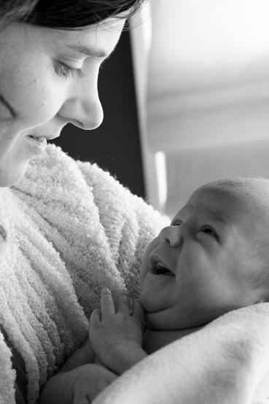
Neurological system
The elimination of physiologic edema through the diuresis that occurs after childbirth relieves carpal tunnel syndrome by easing the compression of the median nerve.

Slide 471
Musculoskeletal function
-Generalized fatigue and weakness is common
-Decreased abdominal tone is common
-Diastasis recti abdominis heals and resolves by the 4th to 6th week postpartum.
-Until healing is complete, abdominal exercises are contraindicated

Slide 472
Integumentary system
Chloasma of pregnancy usually disappears at the end of pregnancy.
- Hyperpigmentation of the darken of the areola and linea nigra may not regress completely after childbirth, and it may be permanent in some women.

Slide 473
Cont…
- Stretch marks on breasts, abdomen, hips, and thighs may fade but usually do not disappear
- Hair growth slows during postpartum period, and some women may actually experience hair loss.

Slide 474
Integumentary System: Stretch marks
[striae gravidarum] appear reddened on
abdomen. Fade by 3-6 months;
Pearly white marks may remain in lighter
skinned women & darker marks in darker skinned pts.
Modified sit-ups strengthen abdomen
Immune system
No significant changes occur during pp.
Notes:
#

Slide 475
Weight Loss:
Average wt. loss 5.5kgs. [infant & placenta]
2.5kgs- diuresis & diaphoresis in wk. that follows.
Lochial flow - 900-1300g.
Total = approx. 8.5-10kgs. {depends on total wt. gain}
At 6 wks. weight may still be above pre-preg. weight.
Return of Menses: > delivery FSH levels rise causing ovulation
No Breastfeeding.- menses resumes ~ 6 wks.
Lactation delays menses for several months (6 months)
Notes:
#

Slide 476
  PSYCHOLOGICAL CHANGES OF POST PARTUM PERIOD: ADJUSTMENTS
    Taking-In Phase:
    time of reflection for client regarding new role
    may be passive or excited
    talks at length about birth experience
    on phone with family/friends recounting birth experience.
    Usually lasts 1-2 days.
    Delayed d/t pain r/t vaginal or C/S.
    Taking-Hold Phase:
    woman makes own decisions regarding self & infant care.
    Usually day 2 - 3. Occur on day 1 esp. if woman is multip.
    Can occur later, depends on recovery process or cultural beliefs.
Notes:
#

Slide 477
Letting Go Phase:
Woman gives up fantasy image of baby and accepts
real child.
Occurs within few weeks of getting home
Needs time to adjust to new experience.
Bonding:
Expressing maternal love & attachment toward new baby. Develops gradually.
Enface position: close eye contact with infant.
Healthy bonding - kissing, touching, counting fingers & toes, etc.
Factors Interfering with Bonding: difficult labor, separation @ birth (NICU)
Notes:
#

Slide 478
Other Maternal Feelings of Post Partum Period
    Abandonment: feelings that occur following birth of child; woman no longer center of attention.
    Disappointment: infant does not meet expectations of mother/father. Eg. eye color; sex .
    Post Partum Blues: due to normal hormonal changes; Drop in estrogen/progesterone; lasts 1st few days of Post Partum period. Occurs in 50% of women.
Notes:
#

Slide 479
Development of Parental Love & Positive Family Relationships:
Rooming In: most hospitals offer this; infant stays in room with mom 24hrs. (partial or complete)
Sibling Visitation: encourage siblings to visit to promote family togetherness.
Notes:
#

Slide 480
LACTATION & BREAST FEEDING
Lactation starts regardless if the mother is breastfeeding or not. This is entirely up to mother and she must feel comfortable doing so.
Advantages to Breast Feeding:
Promotes bonding between mother & baby.
High nutritional value for infant.
Promotes uterine involution thru release of
oxytocin from posterior pituitary.
Reduces cost of feeding & preparation time.
Notes:
#

Slide 481
Contraindications to Breast Feeding:
Mom receiving meds not appropriate for Breast feeding. E.g. Lithium
Exposure to radioactive compounds e.g.thyroid testing; pump & dump breast milk x 48 hrs. Flush in toilet.
Breast Cancer; HIV
Notes:
#

Slide 482
Physiology of Lactation
Body prepares for lactation during pregnancy; stores fat
& nutrients; provide energy, vitamins, minerals in breast milk.
  Early pregnancy, estrogen (placenta) stimulates growth of milk glands & size of breasts.
  Colostrum: middle of pregnancy & day 1-3 Postpartum period Thin, watery pre-lactation secretion. Rich in antibodies; passes to baby in 1-3 days.
  Breasts begin to get tender; fill up with milk.
Notes:
#

Slide 483
  Breast milk by 3rd to 4th day in response to:
  falling levels of estrogen & progesterone > delivery of placenta.
  increased production of prolactin by anterior pituitary
  Milk ducts become distended & fluid turns bluish-white

Slide 484
Physiology cont.
  Infant suckling on breast produces more prolactin, which in turn stimulates more milk production.
  Finally, oxytocin released > delivery of placenta causing mammary glands to send milk to nipples [let down reflex].
  Progesterone levels drop after delivery which leads to ↑ milk production.
Notes:
#

Slide 485
Anatomy of Lactation
  Colostrum contains: protein, sugar, fat, water, minerals, vitamins, maternal antibodies.
  Provides total nutrition for infant
  Transitional breast milk by 3 – 4th day.
  Mature breast milk by 10th day.
  Each breast - 15-20 lobes of glandular tissue -alveoli.
  Acinar or alveolar cells of glands form milk.
  Each alveolus ends in a ductule.
  Each alveoli produces milk, ejects it into ductules i.e let down reflex; milk transported to lactiferous sinus and ejected into infant’s mouth.
Notes:
#

Slide 486
Foremilk: constantly accumulating.
“Let-down reflex” –lets foremilk be available right away.
Triggered by sound of baby crying
Hind milk: forms after let-down reflex. Has most calories;
Feed until breast empty.
Breast Milk: Provides complete nutrition for 1st 6 mos of life.
> 6 months, iron-fortified cereal.
Breast milk easier to digest than formula.
Iron in breast milk absorbed better than iron in formula.
Notes:
#

Slide 487
Supply & Demand Response - Every time woman breast
feeds, more prolactin produced which thenincreases the milk production.
Time Interval to increase milk volume. It takes approx. 30-60 min. to fill up breast after nursing.
Breast complications
Engorgement : this is congestion in the breast on 3rd - 4th day after establishment of lactation. The breasts are hard, painful to touch.
Management –warm compression, advice the mother to BF frequently, or express the milk manually. Use the nursing bra to relieve pain and give analgesics where necessary.
Notes:
#

Slide 488
Sore/Cracked/Bleeding Nipples
Common - from improper attachment and positioning of the baby during breast feeding.
Management
Rest the nipple; apply lanolin ointment prn.
Apply tea bag [tanic acid] natural healing property.
Proper positioning and attachment of the infant to the breast.
Sings a of good positioning of the baby on the breast
infant head and body straight
Infant facing the mother with nose opposite the nipple
Infant body close to the mothers body
Mother supporting infants whole body an neck and shoulder.
Notes:
#
Constrict ducts & stop flow & production of breast milk.

Slide 489
Attachment of the baby on the breast
Touch the babies upper lip with your nipple
Wait until the babies mouth is open wide
Move the baby quickly into your breast, aiming the babies lower lip well below the nipple.
Sings of effective suckling
Slow deep sucks,sometimes pausing
Chicks round when suckling
Baby release breast when milk is finished or satisfied
Mother feels relaxed

Slide 490
Mastitis –
“inflammation”; milk duct/gland becomes infected. Poss. antibiotic therapy. Manual expression, continue to breast feed, frequent warm compresses.
Infective type
Predsposing factors to infective mastitis
Caused by micro organisms
Infected baby eyes,mouth,
Cracked nipples
Mestastasise of micro organism in milk,inadequet empting of the breast
Notes:
#

Slide 491
cont
Sick baby not able to empty the breast
Breast engogement
Sings and symptoms
Raise in body temp to 40oc
Rapid pulse rate
Thrombing breast pain
Breast tenderness
On exam breast appears welged shaped indurated reddened.
Sever rigous and shivering.

Slide 492
Management of acute infective type
If no pus give anagesics
Express gently to reduce engogement
Use firm bra
Put on atibiotics ie amoxyl,ergometrine,or augumentine tabs
Psychotherapy.
If the treatment fails it can lead to breast abscess.

Slide 493
Breast abscess
It is pus formation on the breast
The abscess is painful,redi n colour,tender axillary glands enlarged.
Mnx
Put the patient on atibiotics and strong analgesics
If the abscess is ripe do insincion and drainage/I$C
Emphasis on personal and the environmental hygiene.
H/educate on complete emptying of the breast.

Slide 494
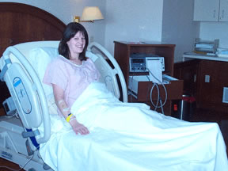
Midwife care of the postpartum woman
It is the first 1-2 hours after birth is a crucial time for the mother and newborn.
Both not only are recovery from physical process of birth, but also are becoming acquainted with each other and with additional family members

Slide 495
Objectives of immediate postpartum care
The goal of immediate care is to arest any problem of the mother and prevent complication by dealing with the problem early.
To provide individual care according to the individual need and not routeen.
To provide for adeqaut rest which is stress free
To indentify potential problem ie emotional,physical and give appropreat care.
To have good communication amongest the family members concerning the care of the baby and the mother.
To have good time for learning and have time for discussion with the mother.

Slide 496
Immediate care
Check the uterine contractions .if the uterus is hard it means that the uterus is well contracted.
If the uterus is boggy spongy fundus deviated to one side, a special care is to be given to this mother.
Expel the blood clots for the uterus to contract well
Ask the mother to breast feed the baby immediatly to assist in the uterine contraction.
Assess the lochia to ensure that the mother has the correct blood lose.
Advice her to pass urine .
Check the birth canal and the cx for any tear, if any tear parck awaiting for suturing.

Slide 497
observations
Take the vital signs of the mother ie TPR/BP if the BP is low with weak thready pulse rate these as sign of blood lose and know that the mother is going into shock.if low give the mother the intravenous fluids.
Check the general codantion of the mother, if the mother is weak feed her with plenty of oral fluids eg porradge made with mixed things such as wimbi,sorgam, wheat groundnuts etc
Advice the mother to take a balanced diet to facilatate recovery from the pregnancy state.

Slide 498
hygiene
Hygiene is very important
Wipe the vulva area before putting a pad .advice the mother on sitz bath in case of perineal tear or sutured episiotomy.
Advice on the cleaning of the hards after visiting the toilet and changing the pad and before feeding the baby.
Advice the mother to report any problem that may occur immediatery.
Check the condition of the mother every four hours if the condition is poor check every 15 minutes
Record the summary of 1st 2rd 3rd and the fourth stage.

Slide 499
Care in the postnatal ward
Do daily Prn examination.
Take TPR/BP , check general condition of the mother,breast,c/s scar involution of the uterus, condition of the episiotomy,lochia, haemoglobine and give folic acid if anemic.

Slide 500
Care on discharge
Register the birth before discharge and give the mother birth notification form.
Explain the mother the use and importance of birth notification card.
Give the mother a discharge note writen what has been done to her.
Immunize the baby with the BCG and the birth OPV
Advice the mother to come back to the hospital for the postnatal clinic at 6 weeks and for the baby immunization and growth monitoring clinic.

Slide 501
cont
Teach the mother about infection prenvetion
Check if she has varicos vain,calf muscles or DVT
Advice the mother on excersise to increase lochia drainage.
Teach the mother on breast care proper attachment and positioning of the baby on breast.
Remid her on the use of the balanced diet and use of food rich in iron
Discharge home with a return date after 6wks

Slide 502


Minor complaints during puerperium and there management

Slide 503
minor complications
Perineum sore –The Mnxt is to maintain hygiene of the perineum by cleaning with zitsh bath avoid dirt contamination of the perineum and if tear is not sutured you suture and give mild analgesics.
Stress incontinence - This is where the mother is not able to control bladder due to lose of bladder muscle tone as a result of birth trauma.Mnxt -encourage the mother to pass urine frequently and take a lot of fluids . You can put the mother catheter till she is recovered.
Haemorrhoids – dilated veins as a result of constipation (passage of hard stool)
Mnxt – advice the mother to take a plenty of fluids if they do not clear the mother is taken for haemorrhoidectomy.

Slide 504
Minor complications
Backache:
This may persist after the birth and affects approx. a quarter of women
Pain may be considerable and last for several months.
Third day blues': on days 3-5, a large proportion of women become temporarily sad and emotional;
approximately 10% of women suffer from postnatal depression which may present at any time during the first year after delivery.
The precise cause of this is unknown and may involve hormonal changes, and doubts by the mother about her ability to care for the child.
Management consists of talking to the mother and explaining what is happening.

Slide 505

Post-Natal care

Slide 507
Aims of Postnatal care:

Slide 508
Postnatal care visit:
The immediate postpartum care during the first 6-24 hours after delivery needs to be viewed as part of care during delivery.
The recommended visits at the 2nd, 4th, 6th, 14th, 21st, and 40th day after delivery.
The least number of visits is 3 visits at: 6hours, 6days and 6 weeks to meet the needs of the mother and newborn.

Slide 509
Components of post-natal care

Slide 510
1- History:
a) Any complications during pregnancy or labour.
b) Any abnormal symptoms or signs of complications,(hemorrhage, infections and eclampsia):
  Vaginal bleeding, normally it is blood in the few days after delivery, later it becomes brownish then pink, and it becomes colorless only by 24th day.
  Bad smelling vaginal discharge.
  Pain or tenderness in the abdomen or breast.
  Fever.
c) Diet: What she is eating.

Slide 511
2- physical examination:
The Mother
Measuring temperature, blood pressure…
Abdomen for swelling, distended bladder, for cesarean incision and for determining the size and firmness (involution) of the uterus.
Perineum for swelling, discharge, tears & episiotomies.
NB No vaginal examination should be performed early in
puerperium except when it is absolutely indicated.
breast for cracked nipples, engorgement or abscess.
Leg for thrombosis.
Checking for signs of anemia.
The newborn for vital signs, umbilical stump, suckling power, respiratory
distress (cyanosis), tremors, convulsion and jaundice. Ask about
vomiting, constipation or anuria.

Slide 512
3- Give the proper treatment if needed, give 200 000 IU of vitamin A orally & iron
4- Refer the post-partum cases requiring special treatment.
5- Record the finding on the maternal card.

Slide 513
6- Health education.
The key messages that should be covered are the followings:
1- Avoid puerperal infection:
Personal hygiene particularly that after urination and defecation
No person with any upper respiratory tract infection or hand infection should be attending during exposure of the genitalia.
2- Care for the episiotomy or first degree perineal tear:
The woman has to be trained to clean the wound daily in the morning and each time after she passes any urine or stools using warm water and soap.
3- Sleep and rest:
The mother should have periods of rest
Gradual return to household duties is advisable starting by the end of the fist week. She should avoid any strenuous activity for about 4 weeks.

Slide 514
4- Diet
She should be aware that all her nutritional needs are increased during the first six months of lactation together with fluid intake &iron supplementation.
5- Advice and counseling on breastfeeding:
The woman should be instructed about:
Advantages of breast feeding
Importance of early initiation of breast feeding (within ½ -1 hr)
Encourage breast feeding on demands.
Personal hygiene after feeding. Only water is recommended for washing
nipples and allowed to dry in air after feeding and then covered with
clean pads. Drying agents as boric acid & alcohol must be avoided.

Slide 515
6- Psychological changes:
The postpartum woman may show normally minor psychological instability as mood swing, and body image changes. It is important for the woman and her husband to understand these changes
7- Postnatal exercises:
These exercises should be continued for a minimum of six weeks to help normal involution of muscles, organs and sphincters. These include respiratory exercises, ankle muscle exercises, pelvic muscle strengthening and squatting

Slide 516
summary
-Postpartum physiologic changes allow the woman to tolerate considerable blood loss at birth
-The uterus involutes rapidly after birth returning to true pelvis within 2 weeks
-The rapid decrease in estrogen and progesterone levels after the expulsion of the placenta is responsible for triggering many of anatomic and physiologic changes in postpartum

Slide 517

THE NEONATE

Slide 518
Physiology of the Newborn
Knowledge on the physiology of a newborn is necessary to ensure appropriate care of the neonate
Immediately at birth, there are three main adjustments that take place involving the lungs, the cardiovascular system and the temperature regulating centre to allow for the independent existence of the newborn baby.

Slide 519
1. Changes in the Lungs
The onset of respiration in a newborn confirms life. The start of pulmonary respiration is due to physiological and mechanical reasons. Lack of oxygen and high levels of carbon dioxide in the circulation occur when placental circulation ceases. This stimulates the respiratory centre in the medulla to initiate normal respiration.

Slide 520
Mechanically, respiration is stimulated when the chest wall, which was compressed during the passage of the baby in the birth canal, allows the fluid to drain from the lungs. Consequently, the cool air on the baby’s face and handling during birth will stimulate the baby to cry as soon as they are born. After the baby takes in their first breath, the blood vessels in the lungs expand to initiate respiration.
At first the baby’s breathing may be rapid and irregular. It is mainly abnormal at a rate of 40 - 50 respirations per minute.

Slide 521
2. Circulatory Changes
Foetal type of circulation ceases as the respiration commences
Normal circulation starts when the temporary structures stop functioning
As the placental circulation ceases soon after birth when the umbilical cord is ligated, the blood flow to the right side of the heart decreases and the blood on the left side increases causing the foreman ovale to close.
With the establishment of pulmonary respiration, the ductus arteries close. Complete closure happens within eight to ten hours of birth.
The cessation of placental circulation will result in the collapse and subsequently drying of the umbilical veins, the ductus venosus and the hypogastric arteries.

Slide 522
3. Thermo (Heat) Regulation
The neonate leaves a thermo constant environment of 37.1 degrees Celsius, where they have survived for nine months and enters a much cooler atmosphere at delivery. This affects the neonate in various ways.
Firstly, heat regulation in the neonate is poor because of their inefficient heat regulating centre. The subcutaneous fat layer of the neonate is thin and provides poor insulation, allowing the transfer of core heat to the environment and also cooling of the baby’s blood

Slide 523
In addition to evaporation, further heat will be lost by conduction when the baby is in contact with cold surfaces, by radiation to cold objects in the environment and by convection caused by currents of cool air passing over the surface of their body.
Incidences of the latter may be substantially increased by air conditioning systems in some of our modern delivery rooms. Since the neonate’s temperature regulating centres are not very efficient, there is a risk of either overheating or chilling.

Slide 524
Other Physiological Changes In a Newborn
4. Liver Function
Physiological jaundice is usually seen in 50% of normal neonates from the third to the sixth day of life. This is due to excessive break down of red blood cells resulting from a high haemoglobin level (Hb of 14 - 18mgs/100mls).
The process of breaking down red blood cells leads to formation of bilirubin. The liver is not able to conjugate the excess bilirubin to enable its secretion through the kidneys. This leads to jaundice. You will see more details on conjugation later in this section.

Slide 525
5. Digestion
The neonate is capable of passing the first stool, known as meconium, within the first two to three days of life. This is because the foetus swallows liquor amnii in utero. Thus, their sucking and swallowing reflexes are usually present at birth.
The colour of the meconium is dark greenish and later changes to a mustard (yellowish) colour. The bowels may be opened three to five times daily.

Slide 526
6. Weight
The average normal birth weight ranges from 2.5 - 3.5 kilograms. During the first three days of life, the baby loses approximately 10 - 20% of their birth weight but regains it again within one to two weeks.
possible reasons for weight loss in a newborn
Due to tissue fluid loss during the heat loss when the baby is born
When the baby opens their bowels, the meconium which was present in the gut is lost, leading to weight reduction
Poor sucking on the breast due to tiredness incurred during the baby’s passage through the birth canal during labour will affect the baby’s weight since they are not getting enough fluid intake

Slide 527
7. Skin
The skin of a newborn is covered with vernix caseosa in utero to protect and help retain heat and also act as a lubricant during delivery.
The sebaceous glands cease to produce vernix after birth, which may lead to dryness of the skin. The vernix caseosa will peel off within three days of delivery if left alone. There is also plenty of fine hair (lanugo) on the skin which falls off in the first month of life.

Slide 528
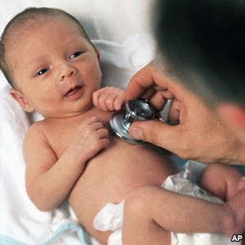
The neonate

Slide 529
Care of a Newborn
Neonatal care is designed to provide an environment conducive to the well being of the baby and to prevent complications.
As a midwife, you should realise that the neonatal period is a very hazardous period. Statistics show that two thirds of infantile deaths occur in the neonatal period. More than half of these deaths occur in the first 48 hours and three quarters in the first week of life.
Therefore, the midwife’s responsibility is to minimise these deaths through efficient management of the infant.

Slide 530
Immediate Care of a Newborn
Clearing the airway
During the delivery of the baby’s head, excess mucus may be wiped gently from the mouth.
Immediately the baby is born, they should be held slanting with the head at a lower angle for a short period to allow drainage of mucus and liquor amnii, which may have been swallowed.
The baby is stimulated to cry in order to take its first breath.

Slide 531
Immediate care ct…d
Clamping and cutting of the cord
The baby is laid across the mother’s abdomen as the cord is clamped, ligated and cut. The timing of the clamping of the cord is not crucial unless asphyxia, prematurity, HIV or rhesus incompatibility is present.
Provision of warmth
Wrap the baby with a towel and place them in a warm cot with their head to one side. All doors and windows should be closed and all equipment should be warmed

Slide 532
Immediate care cont…d
identification
Ensure that the baby has an identification wristlet, which should be put on before the baby leaves the delivery couch/bed.
Weighing and 1st examination
It can be done immediately or be delayed depending on the hospital policy. Sometimes let the infant rest then weigh and examine the baby after one hour

Slide 533
Immediate care cont…d
Assessment of the newborn
Assessment of the newborn is done by scoring at one minute after birth. Repeat at five minutes and then ten minutes. This is known as the APGAR score
Five vital signs are observed and recorded they are: heart rate, respiratory effort, muscle tone, reflex response, and colour. Each is given a score of 0, 1 or 2 points.
Each vital sign is represented by a letter, forming the word APGAR that is:
A = Appearance A = Activity P = Pulse or apex beat R = Respiration G = Grimace

Slide 534
Apgar score table
Sign
Score 0
Score 1
Score 2
Appearance
Blue, pale
Body pink, extremities bluish
Pink all over
Pulse/heart rate
Absent
< 100/min
> 100/min
Grimace
None
Grimace
Cry
Activity
Limb
Some flexion
Spontaneous movements
Respiration
Absent
Hypoventilation/gasping
Vigorous crying

Slide 535
Apgar score……..
A normal baby has an APGAR score of ten at one minute and ten at five minutes. A score between seven and ten is considered to be normal. Approximately 70% of newborns score seven or better.
Remember: A score at five minutes gives a more accurate prediction regarding survival. A low score at five minutes is, therefore, more serious than a low score at one minute after birth. Notify paediatrician if score is six or below at five minutes

Slide 536
Subsequent Care

Slide 537
Subsequent Care
The principles of management of the neonate include:
Maintenance of the established respiration
Provision of nutrition
Prevention from infection
Provision of warmth
Protection from injury
Assessment of the progress of the baby
Education of the mother as to the further care and management of the baby

Slide 538
Subsequent care ………
1. Maintenance of the Established Respiration
A normal baby should continue to breathe and maintain a good skin colour without medical intervention.
A baby who tends to produce a lot of mucus should be closely watched and the airway cleared frequently, because this may tend to interfere with breathing by blocking the airway. The head of the cot should also be lowered in such circumstances. Measures should be taken to avoid suffocation from the pillow, clothes covering the baby or mother lying over the baby.

Slide 539
2. Provision of Nutrition
Breast feeding is an accepted and ideal means of providing nutrition to a neonate. The neonate should be put on the breast immediately, as long as their condition allows this. Demand feeding (baby led breast feeding) is ideal and should be advocated. Encourage the mother to breast feed exclusively in order to avoid the need for the addition of other fluids. The mother’s milk has adequate water to meet the needs of the infant. Therefore, there is no need to give the baby additional fluids (contrary to the belief of some mothers that babies require water).
To ensure that the baby gets both fore and hind milk, the mother needs to breast feed the baby on one breast until completely empty.

Slide 540
3. Provision of Warmth
The baby should be kept at a comfortable temperature. Care should be taken not to overheat the baby, as is sometimes the habit of mothers.
Mothers in the tropics, for instance, often tend to overdress the neonates. Mothers should be taught about appropriate clothing for varied climates. They should dress the baby according to the change of environmental temperature.
Baby wraps should be loose enough to allow for free movement of the legs and arms.

Slide 541
4.Protection from Injury and Infection
Injuries may be inflicted by the long nails of the mother, midwife, the baby itself, or sharp instruments, for example, the safety pin used to secure nappies. Injuries from falls, scalding and burns are not unusual.
The midwife should instruct the mother on how to handle her baby, and teach her how to wrap napkins without using safety pins. She should also be instructed to keep her nails short.

Slide 542
5. Prevention from Infection
Infection, especially cross infection, can be minimised by encouraging mothers to handle their own babies. Anybody in contact with the child should be encouraged to wash their hands before handling the baby.
Visitors should be controlled, especially in a lying in ward. This helps control infection. Midwives or other attendants with a cold or infections foci, should not work with babies. Immunisation should be administered to protect the neonate from certain preventable diseases. BCG and oral polio should be given within the first 24hrs after delivery

Slide 543
Infection prevention …….
The cord should then be observed more closely.
The cord is best left exposed and mothers should be advised not to use any remedies on the cord since it predisposes to infection. The midwife should discourage mothers from touching the cord.
When the dry cord breaks off, it may leave a raw area. This should be cleaned with spirit and dressed with 1% Gentian violet. Use spirit because it leaves the site dry. Other antiseptics leave the place damp, making it ideal for the multiplication of micro-organisms.
Remember: If the cord fails to drop off by the sixth day, it may mean that there is an infection.

Slide 544
6. Skin Care
The neonate’s skin is fragile and easily bruised. Therefore, irritants such as antiseptics, fabric softeners and starch are discouraged.
Creased hard fabrics, stool and urine may interfere with the skin integrity. To prevent damage to the baby’s skin, liquid paraffin preparations may be used because they serve as good cleansers.
Remember: You should report any abnormalities observed on the umbilical stump such as redness, unpleasant odour or bleeding because these are signs of infection.

Slide 545
7. Assessment of Baby’s Growth
The midwife should be able to determine that the baby is healthy and thriving. A baby who is healthy and is growing is active, feeds well, is free from infection and gains weight steadily. In order to observe these, it is necessary to examine the baby thoroughly at least once a day during bath time.
The following daily observations should be recorded in order to determine the baby’s health status:
General appearance and activity
Exclude any discharge from the eyes and ears which may be an indicator of infection
The skin should be checked to detect the presence of jaundice, pallor or cyanosis, septic spots or sore buttocks
Check the mouth to exclude oral thrush

Slide 546
Observations …..
The umbilical cord should be examined to ensure that it is drying up and is not septic
Weigh the baby to determine weight gain
Other general care measures include:
Observations, especially on respiration
Feeding patterns
Crying
Urinary output
Character of stool
Depending on what is observed, document and report to the doctor if necessary. In this way, abnormalities will be detected and corrective measures taken early enough.

Slide 547
8. Education of the Mother
Emphasis should be laid on the following:
Personal hygiene and general cleanliness
How to care for the baby (especially for the primigravidae)
Exclusive breast feeding
Attendance of post-natal clinic, family planning and infant welfare clinics
Any other talk as necessary

Slide 548

Questions

Slide 549
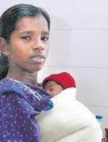
Thank you!

Slide 550
Baada ya dhiki faraja
Baniani mbaya kiatu chake dawa
Hapana marefu yasio na mwisho
Kuagiza kufyekeza
Kujikwa si kuanguka bali ni kwenda mbele
Kula ujana uone tabu kumeza uzee

Slide 551
Thank you

