Slide 1
LABOUR AND PUERPERIUM

Slide 2
Objectives
By the end of this unit you will be able to:
• Describe the process of normal labour
• Describe the management of mother during puerperium
• Describe the management of the newborn during neonatal period
• Apply the knowledge acquired in the management of a woman during labour and puerperium

Slide 3
NORMAL LABOUR

Slide 4
Objectives
By the end of this unit you will be able to:
• Define labour
• Explain the onset of labour
• Identify the three stages of labour
• Describe the physiological changes that occur during labour
• Describe the management of normal labour

Slide 5
Labour
Labour is described as the process whereby the foetus, placenta and membranes are expelled through the birth canal after 28 weeks of gestation.
Labour, can be either normal or abnormal.

Slide 6
Normal labour has several important characteristics, which you should always remember.
These are:
Duration - completed within 18 hours
• Occurs at term between 38 and 40 weeks
• Is spontaneous
• The foetus presents by the vertex
• Has no complications to either mother or baby
• The newborn child requires minimal or no resuscitation

Slide 7
The Onset of Labour
A midwife should ensure women have sufficient information to assist them to recognize the onset of true labour.
A pregnant woman would be best placed to diagnose the onset of labour herself.
Some young women, especially the primigravidae (those pregnant for the first time), may fail to recognize true labour.

Slide 8
It is important that you help them differentiate between false and true labour signs.
The contractions of true labour are regular and intense.
In false labour, the contractions are sporadic (Braxton-Hickscontractions).
False contractions occur during the last weeks of pregnancy

Slide 9
Signs and symptoms will give evidence that the mother is in labour:
Contractions of the uterus, which are increasingly strong, painful and regular
• The cervix is taken up into the lower uterine segment causing dilatation of the cervix
• There is a mucoid blood stained discharge, which is called show
• Sometimes there is rupture of membranes with drainage of liquor amnii (amniotic fluid)

Slide 10
The causes that trigger the onset of labour are not known.
However, many theories have been offered which indicate that both hormonal and mechanical factors play a big part

Slide 11
Hormonal Factors
It is believed that close to term progesterone levels in the body fall, while at the same time levels of oestrogen (which is responsible for sensitizing the uterine muscles) rise.
The fall in progesterone levels is important because it has effect on muscle contractions.
The rise in oestrogen levels meanwhile triggers the release of oxytocin, which causes uterine contractions.

Slide 12
The foetal hypothalamus is believed to produce releasing factors, which stimulate the anterior pituitary gland to produce adrenocorticotrophic hormone (ACTH).
ACTH stimulates the foetal adrenal glands to secrete cortisol, which causes relative levels of placental hormones to rise.
These cause further uterine contractions.

Slide 13
Mechanical Factors
Uterine activity can also result from the mechanical stimulation of the uterus and cervix.
This may be due to over stretching, as in the case of multiple pregnancy and polyhydromnios, or pressure from the presenting part, when it is well applied to the cervix.
It appears that there is a combination of hormonal (from both mother and foetus) and mechanical factors that set labour in motion.

Slide 14
The Contrast Between True Labour and False Labour
REFER NOTES

Slide 15
Pre-Labour or Premonitory Signs of Labour
This is the period two to three weeks prior to the onset of labour when a number of changes take place.

Slide 16
Lightening
Two to three weeks before labour, the lower uterine segment expands allowing the foetal head to sink deep.
The descent of the head and the body of the baby gives space to the lungs, heart and stomach, which enables these organs to function easily.
The symphysis pubis widens and the pelvic floor softens and becomes more relaxed, allowing further descent of the uterus into the pelvis.

Slide 17
Frequency of Micturition
The descent of the foetal head increases pressure within the pelvis.
This limits the capacity of the bladder, which can cause irritation.
The laxity of the pelvic floor muscles gives rise to poor sphincter control causing a degree of stress incontinence.
This pressure results in the congestion of circulation to the lower limbs.
Additionally the relaxation of the pelvic joint may give rise to backache.

Slide 18
Taking up of Cervix
The cervix is taken up gradually and merges into the lower uterine segment.
Shortening of cervix is looked for when labour needs to be induced.

Slide 19
Contractions
The contractions of the uterus are coordinated by two pacemakers in the region of the cornua.
These are located where the fallopian tubes join the uterine body.
The muscle contractions start at the top corner of the uterus, spread to the fundus, and then downward.
During normal pregnancy, the uterus contracts intermittently but the contractions are not strong enough to overcome the resistance of a normal cervix and do not lead to its dilation.

Slide 20
The contractions of pregnancy become more frequent towards full term and get more painful and noticeable.
A multipara may have such 'false pains' for some days before the onset of true labour. They may come to hospital too early thinking they are in established labour.
This is what is referred to as 'false labour'.

Slide 21
Uterine Action
By the end of pregnancy the uterus is divided into two anatomically distinct segments, known as the upper and the lower uterine segments.
The upper uterine segment is a thick muscular, contractile area from where the contractions begin.
The longitudinal fibers retract, pulling on the lower segment and causing it to stretch, pushing the head down.

Slide 22
The lower uterine segment is thinner and develops from the isthmus of the uterus about eight to ten centimeters in length and is prepared for distension and/or dilatation.
The lower segment stretches when being pulled by the longitudinal fibres. The force applied by the descending head or breech also aids the stretching.

Slide 23
The retraction ring which is an imaginary ridge, forms between the upper and the lower uterine segment.
It is present in every labour and is perfectly normal as long as it is not marked enough to be visible above the symphysis pubis

Slide 24
Fundal Dominance
During a contraction the uterus feels hard to touch. At the beginning of the process, contractions are painless and involuntary, and are controlled by the nervous system under the influence of endocrine hormones.
The contraction starts at the upper part of fundus, spreading across, and by the time they reach the lower fundus, they last longer and are very intense.

Slide 25
The peak of the contraction is reached simultaneously over the whole uterus and fades from all parts together. This pattern allows the cervix to dilate and the contracting fundus to expel the foetus.

Slide 26
Polarity
Polarity describes the neuromuscular harmony between the two poles or segments of the uterus throughout labour.
The upper pole contracts strongly and retracts to expel the foetus.
The lower pole contracts slightly and dilates to allow expulsion of the foetus to take place.

Slide 27
Contraction and Retraction
When labour starts, approximately 280 days from the first day of the last menstrual period, the contractions change in character. They become regular and more painful.
Labour contractions differ from those of pregnancy in that they are followed by retraction.
This is characteristic of uterine muscle in labour.
The contracted muscle does not return to its original length when the contraction passes off.

Slide 28
Each succeeding contraction leads to further shortening of the muscle fibres so that the uterine cavity becomes smaller and smaller.

Slide 29
When talking about contractions, you as a midwife are concerned with three factors, namely the strength, the duration and the frequency of the contraction

Slide 30
When you talk of the strength of a contraction, you identify it as one of three categories: weak, fair or fairly strong, and strong.
The strength of a contraction is measured according to the time it has taken.
Thus, a contraction which takes 30 seconds is said to be weak, one that takes 30 to 40 is said to be fair or fairly strong and one that lasts for 40 to 60 seconds is said to be strong.

Slide 31
The duration refers to the time taken by a contraction, for example a weak contraction lasts for 10 to 30 seconds.
Frequency, on the other hand refers to the number of intervals between one contraction and the next.
If a mother has one contraction after every 45 minutes, the frequency is written as 1:45.

Slide 32
The Shortening and Dilation of The Cervix
Before labour begins, the cervix of a primagravida is a thick hard cone which protrudes into the vagina.
The canal is at least one inch long.
When labour begins the strongly contracting upper segment of the uterus starts retracting and getting shorter, while the thinner lower segment of the uterus gets pulled away from the presenting part.
This stretches the lower segment.

Slide 33
The latter, in turn pulls the internal Os. This dragging away of the internal Os from the presenting part starts dilating the upper part of the cervical canal.
This goes on until the canal is shorter and shorter and finally there is no canal at all.

Slide 34
The canal becomes part of the uterine cavity with only the undilated external Os and the thinly stretched cervix separating this cavity from the vagina. When this happens, we say the cervix has been 'effaced' or 'taken up'

Slide 35
In a primigravida the cervix usually becomes almost fully effaced before any dilation takes place, while in multiparous women the two processes take place together.
The cervix of a multipara might be already effaced and be dilated enough to admit a finger internal Os even before labour starts.
These signs of labour are assessed by doing a vaginal examination, though with experience, you can also get a good idea by doing a rectal examination.

Slide 36
The way you guide a mother has a great influence on the progress of her labour

Slide 37
The Show
Throughout pregnancy the cervical canal is sealed by a plug of mucus known as an operculum. Together with the intact membranes this prevents organisms ascending into the uterine cavity.
When labour starts, the internal Os is pulled away from the foetal membranes and the canal is opened up. This releases the mucous plug
which oozes out of the vagina mixed with a little blood. This is called the 'show'.

Slide 38
The Stages of Labour
Labour is divided into four stages, although in real practice, the process is a continuous one and change from one stage to the other may not be clearly obvious. The four stages of labour are
First stage,
Second stage
Third stage
Fourth stage

Slide 39
The First Stage
This is known as the stage of cervical dilatation.
This stage begins when regular, painful uterine contractions start and is detected clinically by the thinning and effacement of the cervix, followed by its dilatation.
The normally thick cervix becomes thinned out and stretched over the presenting part.

Slide 40
The first stage is completed when the cervix is fully dilated and the presenting part starts being expelled
This stage has two phases, known as the latent and the active phase

Slide 41
The contractions of the uterus dilate the cervix.
The dilatation of the internal Os causes the separation of the chorion from the decidua closest to it.
A small bag of membranes is formed and is forced into the internal os by the intrauterine pressure.

Slide 42
At the beginning of each contraction, a little more amniotic fluid is forced into the bag of membranes. The head of the foetus then comes down like a ball valve and separates the amniotic fluid above it from that in the bag.
The bag of membranes may remain intact until nearly the end of the first stage.

Slide 43
However, even if the membranes rupture early the cervix will still become dilated as it is drawn up over the presenting part by the retraction of the upper segment

Slide 44
During the first stage, the foetus does not move downwards to any great degree. When a certain amount of fluid has left the uterus after the membranes have ruptured, a new form of pressure comes into play, namely foetal axis pressure.
The upper pole of the foetus

Slide 45
The upper pole of the foetus, n the breech, is pressed on by the fundus of the uterus, while the lower pole is pressed down onto the lower segment and cervix.
Should the membranes rupture early, foetal axis pressure will operate at an early stage.
In modern practice, the membranes are often deliberately ruptured during labour because this is believed to encourage more efficient uterine action and shorten labour.
You should be cautious carrying out this procedure in this era of HIV.

Slide 46
The duration of the latent phase of labour need not be defined too accurately.
Dilation of the cervix from 0 to 3cm can take six hours, but slower progress may be normal and is perfectly acceptable provided that the woman is comfortable and in no way distressed.

Slide 47
Between 3 and 10cm dilatation (that is in the active phase of labour) the cervix should dilate at a rate of about 1 cm per hour, giving a theoretical duration of seven hours for this phase of labour in both primiparous and multiparous women

Slide 48
During the early part of the latent phase the pains may not be very severe but towards the end of the active phase they are often very distressing, constituting the most painful part of labour.
Vomiting and reflex shivering are common at the end of the active phase of the first stage of labour.

Slide 49
By now the membranes have ruptured. If the membranes remain intact when the cervix is fully dilated, the onset of the expulsive stage may be delayed.
This is because the cervix does not receive the pressure of the head, which helps to stimulate the uterus to increase its activity.
If the membranes remain intact after full dilatation, they should be ruptured with toothed forceps or a sterile plastic amnihook during a contraction

Slide 50
Second Stage
This starts with the full dilatation of the cervix and the expulsion of the presenting part and finishes with the complete delivery of the baby.
As you know, there may be very little descent of the foetus during the first stage. However, in the second stage, the resistance offered by the lower uterine segment and the cervix has been overcome and the presenting part can be pushed down onto the pelvic floor.

Slide 51
The resistance of the pelvic floor then has to be overcome by uterine contractions, aided by the action of the voluntary muscles of the abdominal wall and the diaphragm.
In the absence of an effective epidural block, full dilatation of the cervix is accompanied by a bearing down sensation during contractions and women are usually encouraged to push.
As the contraction comes on, the woman takes a deep breath, then holds it and subsequently bears down with all the force of her abdominal muscles.

Slide 52
These partly voluntary, partly reflex expulsive efforts place the foetus under additional stress and pushing should, therefore, not be allowed to continue for more than one hour.
If delivery is not imminent, assistance in the form of forceps delivery or even a Caesarean section may be necessary.

Slide 53
Third Stage
This stage commences immediately after the birth of the baby. It includes the delivery of the placenta and membranes as well as the control of bleeding.
At this stage the uterus contracts down to follow the body of the foetus as it is being born. As the cavity of the uterus becomes smaller, the area of the placental site is diminished.

Slide 54
The placenta is then cut off from the spongy layer of the decidua basalis.
Further uterine contractions expel the placenta from the upper segment into the lower segment and through the vaginal vault.
This process, whereby the placenta leaves the upper segment to the lower segment and through the vagina, is referred to as separation and descent.

Slide 55
Fourth Stage
This is the period from the delivery of placenta and membranes to the end of the first hour postpartum.
The uterus is firm at level of two fingers breadth above the umbilicus.
Restoration of physiological stability is established.

Slide 56
During this period myometrial contractions and retraction, accompanied by vessel thrombosis, operate effectively to control bleeding from the placenta site.
Failure of this mechanism could result in excessive blood loss (postpartum haemorrhage (PPH)) that could be life threatening.

Slide 57
The mother should be closely observed for haemorrhage, urine retention or hypotension.
The mother and child relationship should be initiated and encouraged, as it has an effect to the subsequent quality of their relationship and bonding.

Slide 58
Physiological Changes in Labour

Slide 59
Physiological Changes in the First Stage of Labour
This is the stage of dilatation of the cervix.
On average, it lasts eight to twelve hours in a primigravida and six to eight hours in a multipara.
It should not go beyond 14 hours in either.
This stage is characterized by the uterus doing an immense amount of muscular work in the form of contracting and relaxing.

Slide 60
Contractions are involuntary in that they do not come on through voluntary effort of the woman nor can they be voluntarily stopped.
They are peristaltic and regular

Slide 61
Contractions at the start of labour come every 10 to 15 minutes and last between 30 to 45 seconds.
They increase in frequency and strength as labour progresses until they are separated by a minute or two.
Towards the end of the first stage they last for one minute. The relaxation phase during which the muscles remain retracted also shortens.

Slide 62
Each contraction begins with a gradual build-up towards a peak of intensity.
This is followed by a relaxation phase.
During the relaxation phase, the muscle recovers and gets ready for the next contraction.
This relaxation phase is important to both the foetus and the mother during the first and second stages of labour.

Slide 63
During a contraction the circulation through the uterine wall is reduced and the foetal heart rate is slowed but regains its normal rate as soon as the contraction has passed.
If there is increasing foetal tachycardia between contractions or if the bradycardia is prolonged after each contraction, then foetal distress sets in. If the uterus contracts continuously the foetus dies from lack of oxygen (anoxia).

Slide 64
The mother is also able to relax during the relaxation phase.
However, if the uterus contracts continuously, the mother also gets very exhausted because the uterus uses up a lot of energy during contractions.
If this goes on for too long, as is the case during prolonged labour, her energy stores become depleted and maternal distress sets in.

Slide 65
As the mother will not be able to eat or absorb much by mouth, she should be given supplementary carbohydrates intravenously.
In a normal first stage, oral fluids to which additional sugar has been added are sufficient.
As the uterus contracts and retracts more and more, the upper muscular part becomes progressively thicker.
The less muscular lower segment is pulled upwards over the presenting part and becomes thinner

Slide 66
The cervix becomes effaced.
The effacement is followed or accompanied by progressive dilation of the cervix until full dilatation when the uterus becomes a continuous cavity with the vagina.
A fully dilated cervix is 10 cm dilated. During the first stage the uterine cavity gets progressively smaller but the foetus moves down very little.
The cervix becomes effaced. The effacement is followed or accompanied by progressive dilation of the cervix until full dilatation when the uterus becomes a continuous cavity with the vagina.

Slide 67
A fully dilated cervix is 10 cm dilated. During the first stage the uterine cavity gets progressively smaller but the foetus moves down very little.
The presenting part helps in dilating the cervix.
During this stage the woman should not use her voluntary efforts to bear down as this will exhaust her unnecessarily and may cause oedema of the cervix and/or foetal distress..

Slide 68
Management of Normal Labour in the
Admission Room
The proper management of labour is essential, if you are to avoid problems or to detect them early when they occur.
The patient will come to you believing she is in labour. You should be able to assess and decide whether she is in labour or not.
The patient may be in early labour, but often she might arrive in the late second or even third stage.

Slide 69
If you are sure she is not in labour send her home to wait. If she is in labour, keep her in the ward and continue monitoring her progress.
Danger, especially to the foetus, can arise suddenly and unexpectedly

Slide 70
No labour should be assumed normal until
the fourth stage has successfully concluded

Slide 71
Admission
You would take the patient's personal history, conduct a physical examination and carry out tests/investigations.
On admission, you should check the woman's antenatal card for any identified risk factors.
It will also help you to see if there were any abnormalities during her pregnancy.
The records will also have information on her medical and obstetric history.
If she has not been attending an antenatal clinic, this is the time to take detailed history

Slide 72
Once this information has been established, find out more about the present labour.
Take her history, do an examination and carry out the necessary investigations to establish the stage of labour and the state of the mother and the foetus.

Slide 73
History Taking
A detailed personal history should have been taken during pre-natal care.
However, if this has not been done, this is a good time to get it recorded.
Make sure the names are correctly spelled because this can eventually result in problems when registering the baby.
Review the last day of menstruation to calculate the expected date of delivery.
Check her age, parity and contraceptive history.

Slide 74
Assuming that a detailed personal history had been taken during pre-natal care, you should now take information about the following:
Any presence of show
Presence or absence of contractions
Onset of contractions and their characteristics
Activity of the foetus
Rupture of the membranes
Any treatment given
Food taken in the last four hours

Slide 75
Head to Toe Physical Examination
Conduct an abdominal examination checking for:
Height of fundus
Over-distension of the abdomen, scars or other abnormality
Over-distension of bladder
Possible presence of twins or multiple pregnancy
Contractions - frequency, length, type and strength
Lie of foetus - this is the relation of the long axis of the foetus to the long axis of the uterus (it can be longitudinal, oblique or transverse)
Rate and rhythm of the foetal heart

Slide 76
You should also check on the presentation.
Which part of the foetus is at the pelvic brim?
Is it a head (cephalic) or the buttocks (breech)? Check the attitude; whether the head is well flexed or extended.
A well-flexed head presents the smallest diameter and delivers easily.

Slide 77
A deflexed head presents a larger diameter and causes delayed or obstructed labour.
Finally check the position of the relation of the foetal parts to the mother.
This is confirmed through a vaginal examination by checking the position of the foetal occiput relative to the mother.
The position of the foetal spine is the same as that of the occiput.

Slide 78
Vaginal Examination in Labour
This is an important examination as it can give you a lot of information, which you might not get from an abdominal examination.
On the other hand, if you do it often it is uncomfortable for the woman and you might introduce an infection into the uterine cavity, especially if the membranes have ruptured.
To avoid infections, you should scrub and put on gloves as you would for any other sterile procedure.

Slide 79
Then thoroughly swab the perineum of the woman with an antiseptic solution such as Savlon or Hibitane, or boiled water if these are not available.

Slide 80
A vaginal examination is necessary to:
Check if the patient is in labour and what stage of labour (this is done on admission of the patient)
• Assess the progress of labour (this is done every four hours during the first stage of labour)
• The degree of effacement and dilatation of the cervix and the station of the head relative to the ischial spines will give you the necessary information
• Check that there is no prolapse of the cord when the membranes rupture

Slide 81
Remember: Do not do a vaginal examination
if the mother has an ante-partum haemorrhage, because if there is placenta praevia, severe haemorrhage will occur.

Slide 82
A vaginal examination is contraindicated if the mother has ante-partum haemorrhage unless it is performed in an operating theatre. In case of pre-eclampsia, the procedure should be performed only after giving a sedative.

Slide 83
Vaginal Examination
Arrange your vaginal examination pack with cheatle forceps and pour solution.
• Scrub your hands for at least five minutes.
• Glove yourself methodically to prevent contamination.
• Explain the semi-lithotomy position that should be maintained during the examination to the mother

Slide 84
Swab the vulva and drop the swab methodically (used swabs should be decontaminated in jik before disposal).
• Ask the mother to breathe in and out while you perform digital examination.
• With the right hand, gently insert the fingers obliquely inside the vagina with the thumb, facing the symphysis pubis. Your left hand should be on the mother’s abdomen.
• The fingers to be introduced are held on a higher level than the vaginal orifice during insertion to avoid contact with the anus. Fingers should not be withdrawn until the required information has been obtained.

Slide 85
The fingers are directed along the anterior wall of the vagina. The wall should feel soft and dilatable while the vagina should be warm and moist.
• The fingers are then directed upwards to the position of the cervical Os.
• At times the Os is not felt readily, the fingers should then be directed backwards and upwards.

Slide 86
While performing a vaginal examination, you should observe the mother’s non-verbal communication

Slide 87
The Vagina
The Cervix
Is it bruised or oedematous?
Is it firm or soft?
Is it taking up, that is effaced?
How much is the Os dilated?

Slide 88
Do not insert more than two fingers in the cervical Os.

Slide 89
The Membranes
After deciding the state of the cervical Os, check for presence of membranes. Note the following:
Are they ruptured or intact?
If intact are they bulging?

Slide 90
The Cord
Is it presenting or prolapsed?
If prolapsed is it pulsating?

Slide 91
The Presenting Part
Next, determine the level of the presenting part. You should ask the following questions:
• Is it fitting the pelvis and cervix well?
• If it is the head, can you feel a suture or fontanel? Which one?
• Is it well flexed?

Slide 92
• If the head is at the brim it, will not be felt vaginally unless you push it down with your left hand which is on the mother's abdomen
• If the head has just engaged, it can be touched or just be tipped
• If the head is deeply engaged, the head is felt at the level of the ischial spines

Slide 93
While performing a vaginal examination, you should observe the mother’s non-verbal communication.

Slide 94
The Presenting Part
The station or level of the presenting part is the level to which the presenting part has descended in the pelvis.
The level of the presenting part is expressed in relation to the easily palpable ischial spines.

Slide 95
You can also state if it is above the brim, at the brim, in the cavity or at the outlet.
Remember that if the presenting part is at the brim then it is at station -5.
As the head descends down in to the cavity of the pelvis it decreases from -5, -4, -3, -2, -1. By the time it is at the ischial spines, it is said to be at 'zero station'. It reappears from the pelvic outlet into the perineum, which is classified as +1, +2, +3, and +4.
By the time it is seen at the perineum it is at station +5.

Slide 96
To get the position right, you have to palpate the sutures and fontanel to determine their position relative to the pelvis.
This can be confirmed by abdominal examination.
In a breech or a face presentation, the reference points on the foetus are the sacrum and the chin or mentum respectively. A soft mass is felt.

Slide 97
Foetal genital parts or the anus may be felt with the examining finger.
The position is determined by the position of the sacrum in relation to the side of the mother's pelvis. The left side is expressed as left sacro-anterior (LSA) or the right side, which is known as right sacro-anterior (RSA).

Slide 98
In a vertex presentation, when the occiput is persistently posterior, this causes prolonged labour.
In a cephalic presentation, you will feel the hard head sutures and fontanel.
Determine whether it is the anterior or posterior fontanel by its shape.
If it is the posterior fontanel, then the position is occipito-anterior.
If it is the anterior fontanel then the position is occipital-posterior.

Slide 99
Face presentation is important as the chin is the facial landmark.
Note how the position of the chin is related to the mother's right thigh (RT) or left thigh (LT), side of the pelvis and the anterior and posterior position expressed as RMP (right mento posterior).
You should also note the brow or sinciput presentation on vaginal examination (VE)

Slide 100
You should be able to feel the brow, frontal sutures and possibly the posterior fontanel.
The extension is usually a temporary presentation, which converts to face or occiput presentation during labour.
However, at times it persists and in such instances, a caesarean section is usually called for.

Slide 101
Note whether the long axis of the body of the foetus is perpendicular to that of the body of the mother.
A left acromiodorso posterior (LADP) indicates that the baby’s lower shoulder is to the mother’s left and its back is towards her back.
A compound presentation is when the hand or occasionally a foot lies alongside the head.

Slide 102
The Pelvis
Next check for moulding or caput succedaneum

Slide 103
What is moulding?
Moulding is when the diameters of the foetal skull are reduced in size.
During labour the bones of the foetal skull tend to overlap at the sutures so that the head can easily pass through the birth canal.

Slide 104
During a vaginal examination this is how you should check for moulding:
In cephalic presentation, run the finger on the head feeling for the sutures
Judge the degree of moulding by feeling the amount of overlapping of skull bones
Check for caput

Slide 105
The pelvis is assessed to check if it is adequate
The following factors should be checked:
• Is it roomy?
• Are the sidewalls well spaced?
• Can you touch the promontory of the sacrum easily?
• Is the pubic arch wide enough?
• After checking for moulding, direct the fingers behind the head and make an effort to reach the sacro-promontory. The palm of the hand should be facing upwards. Promontory of the sacrum should not be reached.

Slide 106
With the palm facing downwards run the two fingers down along the hollow of the sacrum and determine the shape. The hollow of the sacrum should be curved.
• The two fingers are then moved to where the ischial spines are located on either side of the pelvis. Run the finger along this area to determine whether or not the ischial spines are unduly prominent. Or else you can stretch your fingers to see if the spines are prominent. The ischial spines should not be prominent.

Slide 107
As you move the fingers with the palm facing upward, on reaching the pubic arch check if it can accommodate two fingers. The apex usually should accommodate two fingers.
• Make a fist facing downwards then place the fist between the ischial tuberosities.
The Intertuberosity should accommodate four knuckles.

Slide 108
The Discharge
Withdraw the fingers and check if there is:
Any vaginal discharge
Any smell
Any liquor or meconium staining
Any bleeding

Slide 109
The following steps should be taken as part of
your investigation
Take a urine sample for albumin and sugar
• Check for acetone, especially if the patient is in prolonged labour
• Take blood for haemoglobin and cross matching if the patient is anaemic or might need an operation

Slide 110
By this time you will have gathered enough information as to the stage of labour and whether the patient belongs to the ‘at risk’ category and needs referral or not.

Slide 111
Management of First Stage of Labour
When managing the first stage of labour, you should keep to the following procedure, making sure you record your findings in a partogram:
Admit the patient to the waiting room, reassure her and introduce her to other patients
• Reassure her and explain what is being done at every stage
• Give her an enema only if she is in early labour (this will reduce the risk of faecal soiling and infection at delivery)

Slide 112
The patient may have a warm bath and change into a hospital gown
• Encourage her to walk about and empty her bladder frequently
• Give her plenty of fluids with sugar or glucose as she has to work hard and needs the energy
• Do not allow any solid foods as the stomach takes a long time to empty in labour

Slide 113
Should she need an operation and anaesthesia, the emptying of the stomach will be difficult and she might vomit and inhale the vomit

Slide 114
If she is in much pain and the delivery is still far off, give her a sedative

Slide 115
Check the following regularly:
Check the foetal heart rate half hourly or more often if you suspect distress
• Check uterine contractions (strength, type, frequency and duration) as well as maternal pulse, BP and temperature
• Check the urine output and check for albumin and acetone if indicated every two hours
• Every four hours check the level of the presenting part and the degree of dilatation of the cervix

Slide 116
Constantly check the woman's reaction to labour and be aware of her needs, especially for pain relief. You can repeat pethidine 50 mg IM if cervical dilatation is still 5 cm or less. Do not give more pethidine if delivery is imminent as it depresses the baby's respiration
• Towards the end of the first stage, she can rest on her side, or in any position she finds comfortable, for example, squatting

Slide 117
Discourage pushing or bearing down before the cervix is fully dilated
• Early pushing only exhausts the woman and will cause oedema of the cervix and interfere with normal dilatation
• If the bladder is full and she cannot empty it on her own, catheterize her using aseptic technique

Slide 118
When the membranes rupture, usually at the end of the first stage, check the colour of the liquor for meconium staining, the foetal heart rate and do a vaginal examination to exclude prolapse of the cord

Slide 119
Observations to record in the partogram
Vital signs
Blood pressure
Details of vaginal examination
Contraction strength and number of contractions in ten minutes
Fluid balance
Urinalysis
Drugs administered

Slide 120
When observing the contractions, you should note the following
Uterine contraction duration, strength and frequency
• In early labour the contractions are mild, lasting 20 to 30 seconds and are infrequent
• As labour progresses, the contractions become stronger, lasting 40 to 50 seconds and are about three contractions per ten minutes

Slide 121
The uterus should always relax between contractions
• The cervix dilates progressively from 4cm at a rate of approximately 1cm and 1.5cm hourly in primigravida and multigravida respectively
• The descent of the presenting part can be noted by abdominal palpation or vaginal examination.
Avoid unnecessary vaginal examination

Slide 122
Remember to allay the mother's fears and reassure her throughout your examination and indeed throughout labour. A mother in labour needs to feel loved, cared for and to be treated with dignity.

Slide 123
Prevention of Infection
To prepare for clean delivery you should:
• Give an enema or suppositories
• Avoid shaving the pubic hair, given current HIV/AIDS prevalence rates
• Allow the mother to have bath whenever she wishes as it is soothing during labour
• Practice aseptic techniques through labour
• Ensure a clean environment within and around the ward

Slide 124
After conducting a thorough examination of the mother and recording your observations in the partogram, there are a number of things you can do to make her feel comfortable during her labour i.e. allow her to change position and move around, use back massage, have a chosen companion with her during labour, allow her to take fluids as required and return the placenta to parents if so desired and directed by the culture. However do not forget to check on the foetus especially if you suspect foetal distress.

Slide 125
The Second Stage of Labour
As mentioned earlier, the second stage of labour begins with full dilatation of the cervix. It is the stage of descent and expulsion of the baby.
It normally lasts from one to two hours on average in primigravida, and half an hour in multipara.
If this stage goes beyond two hours it is considered abnormal.
The contractions become stronger, lasting 40 to 60 seconds, with a one minute recovery interval.

Slide 126
The retracted and contracting uterus pushes the foetus down into the pelvis.
During the relaxation phase the pelvic floor pushes the presenting part up again but the retracted uterus does not allow all the progress achieved to be lost.
Progressively the presenting part moves down until it reaches the pelvic floor.

Slide 127
The presence of a foreign body in the vagina makes the woman want to bear down even against her will.
The voluntary muscles of her abdomen and diaphragm help the uterus in the pushing.
As a contraction comes the mother should be instructed to take in a deep breath, hold it and then bear down.

Slide 128
These expulsive efforts are partially voluntary.
The vagina widens to accommodate the baby. It is now a continuous cavity with the uterus.
The presenting part may push out faeces from the rectum as it goes through the vagina.
When the presenting part reaches the pelvic floor it starts stretching the vulva, causing much pain, especially in the primigravida.
For some time it keeps popping out during a contraction and receding back during the relaxation phase

Slide 129
After some time it can no longer slip back. This is known as 'crowning'. The head will have passed through the bony outlet of the pelvis.
The perineum becomes stretched and paper-thin and it is at this stage that an episiotomy should be performed if necessary. The next contraction normally expels the presenting part.

Slide 130
Mechanism of the Second Stage of Labour
The mechanism of labour refers to a series of movements the foetus has to make to pass through the birth canal.

Slide 131
Lie
Lie means the relation of the foetus to the long axis of the uterus. It may be longitudinal, oblique or transverse

Slide 132
Presentation
The presenting part of the foetus is that part which is in or over the pelvic brim. Its position is examined in relation to the cervix. It could be vertex, face, or a breech. However, 95% of all presentations are cephalic, and the presenting part is usually the vertex.

Slide 133
Position
The position describes the relationship of a selected part of the foetus to the maternal pelvis.
For example, in a vertex presentation the selected part is the occiput. With face presentation it is the chin, and with a breech presentation, it is the sacrum

Slide 134
Attitude
The pelvis is a curved passage with different diameters at the inlet, mid-cavity and outlet.
The foetus, therefore, has to adapt itself to the shape, size, and curve of the pelvis at different levels as it descends.
To be able to manage labour skilfully, you need to understand the natural movements made by the baby so that, when assisting in delivery, you can follow the movements rather than oppose them.
The factors, which influence the mechanism of labour, are known as the three 'Ps': power, passage, and passenger.

Slide 135
Power
The stronger the contraction in a well prepared mother, the better the outcome of labour.

Slide 136
Passage
The size, shape and resistance of the birth canal including the bony pelvis, cervix, vagina and pelvic floor may speed up or slow down the process of delivery.
A gynaecoid pelvis and a fully dilated cervix speed up the process

Slide 137
Passenger
This refers to the size, lie and presentation of the foetus, as well as the placenta and membranes.
For the foetus, a vertex presentation makes labour shorter as the presenting part fits well on the cervical Os and stimulates the cervix to dilate faster.

Slide 138
It is important to remember that descent occurs throughout and as mentioned earlier, ninety five per cent of all presentations are cephalic, and the presenting part is usually the vertex.
This areas boundaries include the bregma or the anterior fontanel, the perietal eminences and the posterior fontanel.

Slide 139
The presenting diameter is, therefore, the smallest - 9.5cm. In order to present with the smallest diameter, the head must be well flexed on the neck with the chin touching the chest.
As the leading part meets resistance of the pelvic floor it rotates 1/8th forwards until it comes under the symphysispubis.

Slide 140
The mechanism of labour in a cephalic vertex presentation includes the following steps:
Engagement and descent
Internal rotation
Birth by extension of the head
Restitution and external rotation

Slide 141
Engagement and Descent
Engagement is the descent of the presenting diameter through the pelvic brim.
The head usually engages late in pregnancy in the primigravida while in the multipara it does not engage till labour starts.

Slide 142
The head enters the pelvic brim in oblique diameter with sub occipital frontal diameter (10.5cm). With good uterine contraction, there is more flexion of the head.
The head engages with sub occipital bregmatic (9.5 cms) oblique diameter of the pelvis brim.

Slide 143
Internal Rotation
The head rotates 1/8th of a circle. Such a rotation is achieved by the action of the uterine muscle pushing downwards.
The pointed vertex presents on the broad levator ani muscle. When the vertex reaches the perineum, the occiput turns from the posterior to the anterior position.
Anteriorly there is more room for further descent.
When the occiput is below the symphysis pubis, crowning takes place

Slide 144
Birth By Extension of the Head
Once the occiput has escaped from under the symphysis pubis, the head extends forward.
The nape of the neck is pressed firmly against the pubic arch.
This extension of the head causes the anterior part to stretch the perineum gradually.

Slide 145
Further extension allows the sinciput, face and chin to escape the perineum and the head is born by extension. Extension is the result of action from two forces.
The abdominal and thoracic muscles exert downward pressure.
The pelvic floor and perineum resist this pressure and push the head forward and upward through the weak area, which is the vagina

Slide 146
Restitution
The head turns 1/8 of the circle to the left, back to where it was before. This rotation takes place to undo the twist, which occurred during the previous internal rotation.
This 'undoing of the twist' is known as restitution.

Slide 147
Internal Rotation of the shoulder
When the head is passing through the level of the ischial spines and the outlet in anterior posterior position, the shoulders enter in the oblique diameter of the pelvis and rotate forward 1/8 of a circle.
The shoulders are now in the anterior posterior diameter of the outlet. The anterior shoulder escapes the symphysis pubis while the posterior shoulder sweeps the perineum.

Slide 148
External Rotation of the Head
As the internal rotation of the shoulders takes place, the head, which has already been born, rotates 1/8 of a circle as in restitution. The head now lies in the lateral position.

Slide 149
Lateral Flexion
Following these movements the body bends sideways to follow the curve of the birth canal.
The anterior shoulder escapes under the symphysis pubis and the posterior shoulder sweeps the perineum. The body of the baby is born by lateral flexion.

Slide 150
To recap, the cardinal movements of labour in a vertex presentation are:
1. Engagement
2. Descent
3. Flexion
4. Internal rotation
5. Extension
6. External restitution of the head
7. Expulsion
An easy way to remember these movements is by use of the mnemonic device -'Every descent Family In Europe Eats Eggs

Slide 151
Management of the Second Stage of NormalLabour
signs of the second stage of labour
Expulsive uterine contraction. This may happen in occipital posterior or when the head is deeply engaged with fully loaded rectum (in a case where the mother is not in second stage)
• A trickle of blood
• There may be no bleeding while the cervix is fully dilated
• Pouting and gaping of the anus

Slide 152
Gaping of the vulva in primigravida. The vulva of multiparous will gape even in premature pushing
• Tenseness between the anus and coccyx
• Bulging of the perineum usually means delivery is imminent

Slide 153
Equipment required in second stage of labour
You will need a trolley with a top and bottom
shelf.
On the top shelf make sure you have:
• Sterile delivery pack
• Small bucket with 0.5% jik for decontaminating instruments
• Bucket with 0.5% jik for decontaminating linen
• A bucket with plastic bag for used swabs and gloves

Slide 154
On the bottom shelf you should have the following:
• Suturing pack
• Antiseptic solution
• Draw sheet and mackintosh
• Syntocinon drawn, in a receiver
• Lignocaine
• 5% dextrose solution 500mls
• Needles
• Branulars
• Syringes (for emergency)
• Sterile gloves

Slide 155
steps for the management of the second stage of labour:
Explain the procedure to the mother and reassure her
Ask your assistant to open and arrange the delivery pack while you scrub up
• Gown and glove yourself methodically
• Instruct your assistant to put the patient in the dorsal position
• Swab the mother methodically
• Lubricate your two fingers and perform vaginal examination to confirm second stage

Slide 156
You should also instruct your assistant to check the foetal heart beat after every contraction, the mother's pulse after every ten minutes and to administer syntometrin after the delivery of the anterior shoulder

Slide 157
Tell the patient to wait for a contraction. When it comes, she should take in a full breath, close her mouth and bear down as strongly as she can, then quickly take in another breath and bear down again.
• She should be able to make at least two efforts during each contraction and relax between contractions. Encourage her all the time and explain the progress being made towards the birth of her baby.

Slide 158
Place the baby towel on the bed, with the scissors and two forceps for clamping the cord. Prepare two pieces of cotton wool for wiping the newborn’s eyes, some gauze for cleaning the airway and for a covering when cutting the cord.
• At this stage the head might start distending the perineum. The anus starts dilating and the head is seen at the vulva. It keeps receding between contractions

Slide 159
When the head distends the perineum check if the perineum is stretching well.
• Place the left hand on the advancing head with fingers spread equally over the vertex towards the bregma to stop any sudden explosive effort during and after crowning of the head. With the right hand guard the perineum, holding it with the pad.
• Check if the perineum is stretching. If not, give an episiotomy at the height of a contraction if there is any indication that the head is about to crown.

Slide 160
Crowning of the Head
Next is the crowning of the head.
The parietal eminences pass through the bony outlet.
At this stage the head no longer recedes between contractions.
Tell the mother to stop pushing as this might lead to a rapid delivery of the head and consequent brain damage.
Ask her to pant.
Research has shown that a series of short pushes are more effective than a long push.
Encourage her as she pushes.

Slide 161
It is really hard work! So keep encouraging the mother with kind words and warmth

Slide 162
Extension of the head
Assist the extension by grasping the parietal eminences with your left hand. Let the head come out slowly and naturally. Feel for the cord around the baby's neck. If it is there, slip it from the baby's neck over the head. If it is too tight, place two artery forceps on the cord and cut it between them.
When the nose and mouth come out, wipe away the mucus with a sterile swab.

Slide 163
By this point the whole head should be out. The head will have restituted and rotated spontaneously to face the mother’s left or right thigh.
This shows you that the shoulders have descended and rotated to the anterior posterior diameter.

Slide 164
Delivering the Shoulders by Lateral Flexion of the Body
Place one hand above and one below the foetal head
Depress the head gently toward the anus/neck, making sure it is neither twisted nor bent sideways till the anterior shoulder is free

Slide 165
The delivering of anterior shoulder
Remind your assistant to give syntometrine intramuscularly (in a single dose)
Guide the head upwards in the direction of the mother's abdomen

Slide 166
The delivering of posterior shoulder
The posterior shoulder will escape smoothly over the perineum
• The rest of the body will be born by lateral flexion
• Ask your assistant for the time and note the time of birth
• Place the baby at a slight slant to drain the mucous

Slide 167
Put the baby on the baby towel, clamp and cut the cord
• Give the APGAR score to the baby
• Show the baby to the mother to identify the sex of the baby

Slide 168
Ask your assistant to continue with the immediate care of the baby
• Continue with the delivery of the placenta by using control cord traction
• Check the placenta for completeness and/or malformation.
• Measure blood loss

Slide 169
Do the first examination of the baby
• Weigh the baby
• Do a post natal examination and record all the findings
• Give the mother a hot drink and transfer her to the postnatal ward

Slide 170
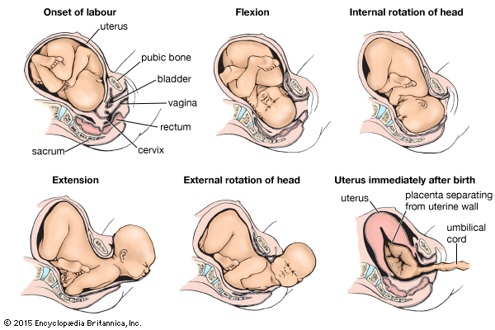

Slide 171
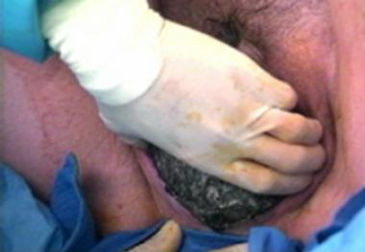

Slide 172
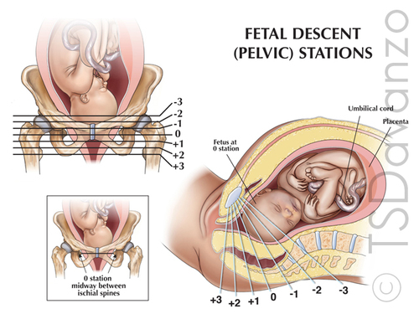

Slide 173
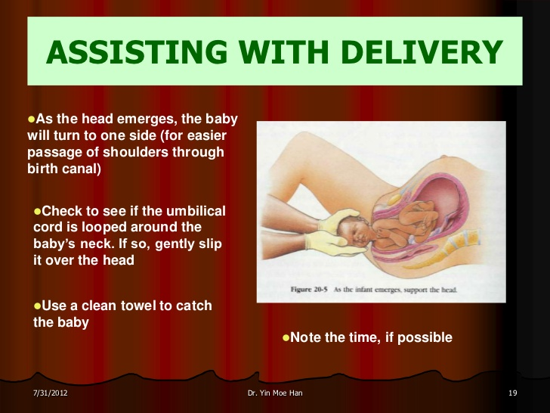

Slide 174
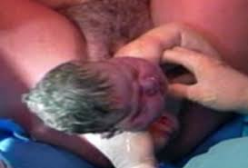

Slide 175
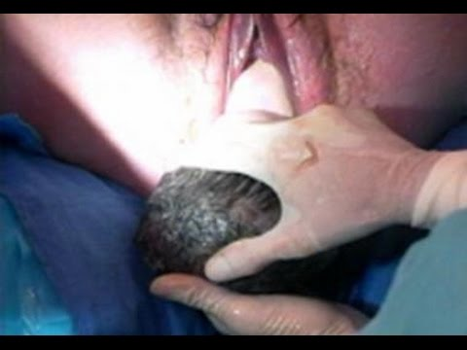

Slide 176


Slide 178
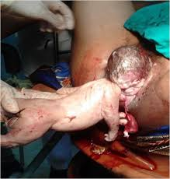

Slide 179
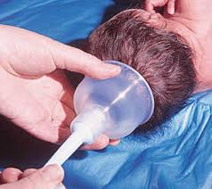

Slide 180
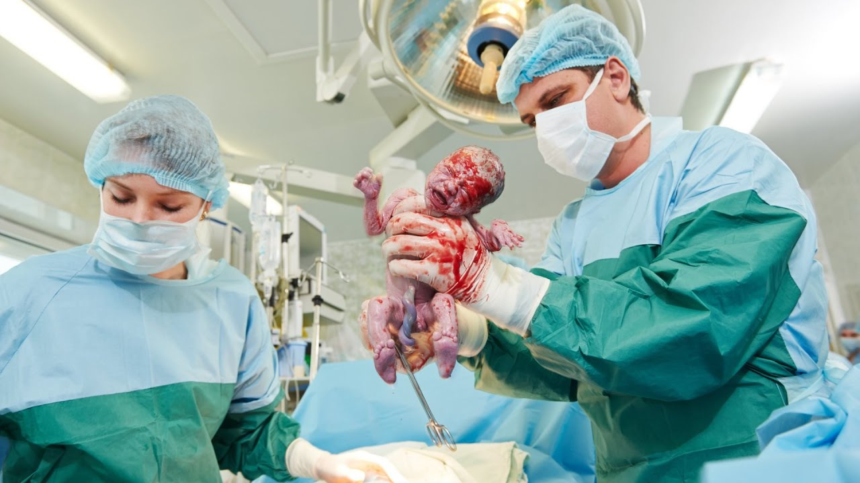

Slide 181
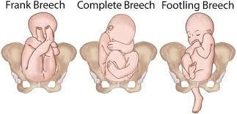

Slide 182
APGAR Score
Once the baby is out into the world, your work has just begun. You will need to assess the baby periodically.
After delivering the baby, an assessment of the general condition is done after one minute and again after five minutes.
This involves the consideration of five specific signs and the degree to which they are present or absent

Slide 183
factors assessed
Appearance - Colour
• Pulse - Heart rate
• Grimace - good grimace
• Activity - Muscle tone
• Respiratory efforts – vigorous crying
A score of 0, 1, 2 is awarded to each of these
signs in accordance with the APGAR Score
Chart.

Slide 184
A normal infant in good condition at birth will achieve an APGAR score of 7 to 10. A score of 0 to 3 is severe birth asphyxia and 4 to 6 is moderate birth asphyxia, both of which require immediate resuscitation of the baby. Immediate Care of the Baby

Slide 185
Clear the airways by sucking mucus from the mouth and nostrils and give oxygen if necessary. Ligate the cord and make sure the ligature is very tight before you cut the cord.
Wipe the baby’s head and the body and wrap to keep warm. You should record the following information about the baby

Slide 186
Label the baby with the mother’s name and I.P. number
• Write the date and time of delivery
• Sex of the baby
• Birth weight

Slide 187
After handing the baby over to your assistant, you will have to continue to deliver the placenta using control cord traction.

Slide 188
Principles of the Third Stage of Labour
Mechanism of the Third Stage of Labour Physiology of Third Stage

Slide 189
The Mechanical Factors
The uterus reduces in size 2.5cm below the umbilicus, or 15cm above the symphysis pubis after the expulsion of the foetus
• The contraction and retraction of the uterine muscles continues
• The placental site is reduced to half
• Since the placenta is inelastic, it does not contract, so it detaches from the shrinking uterine wall
• The placenta is pushed further to the lower uterine segment by the weight of the retro-placental clot

Slide 190
This is accumulated blood from the separated placenta
• With the next contraction the placenta is pushed into the vagina and expelled

Slide 191
You will know that the placenta has separated and has been expelled from the upper uterine segment into the lower segment or into the vagina when you have noted:
• Elongation of the cord which does not recede on pressing at the symphysis pubis
• A gush of blood
• The uterus contracts like a cricket ball

Slide 192
The placenta is expelled either with maternal side exposed, known as the Mathew-Duncan method or the foetal side exposed known as the Shultz Method

Slide 193
Control of Bleeding
steps should be taken to ensure the control of bleeding:
The uterine muscle’s contraction and retraction causes the placental site to reduce into half. Criss-cross fibres control bleeding by compressing the blood vessels. These fibres are also known as ‘living ligatures’
• Clotting of blood takes place in the sinuses sealing the bleeding points a few hours later when uterine contractions are less vigorous.

Slide 194
The time interval between the delivery of the baby and delivery of the placenta is a dangerous period, in which one of the greatest complications of pregnancy and labour can occur.
This complication is excessive bleeding or postpartum haemorrhage (PPH). You should never leave the mother alone even for a short while during this stage.
The third stage of labour can be managed either passively or actively..

Slide 195
The Passive or Natural Method of Managing the Third stage of labour
The passive or natural method occurs naturally, that is without any interference. For example, in a normal delivery, if oxytoxic drugs are not used, the uterus generally remains inactive for a few minutes after the delivery of the baby, after which regular contractions then begin again.
Physiology of the third stage takes place, the placenta is expelled and bleeding is controlled.

Slide 196
Giving Oxytocic Drugs
Oxytocin, ergometrine or syntometrine stimulate uterine contraction.
Ergometrine 0.5mg given IM causes a uterine contraction to occur five to seven minutes after the injection. Given intravenously it acts within 45 seconds.

Slide 197
Syntometrine is a mixture of oxytocin and ergometrine 0.5ml given IM acts within two to three minutes.
Usually sytrometrine is given with the delivery of the anterior shoulder while ergometrine is given at the crowning of the head.

Slide 198
Controlled Cord Traction
The uterus must be firmly contracted before this method can be used. It is not necessary to wait for signs of placenta separation.
Place the left hand above the symphyis pubis, push the uterus upwards and backwards with the right hand and pull the cord downwards and outwards.
Apply traction steadily without jerking When the placenta is visible at the vulva, direct the cord upwards.

Slide 199
The placenta will follow the curve of the birth canal. Receive it with both hands and rotate the placenta. This will twist the membranes. You can then deliver the membranes with up side movements, which enable them to be drawn out without breaking.

Slide 200
Maternal Effort
This method is not commonly used. When the placenta has separated and descended, the palm is placed downwards on the mother’s abdomen to provide a backup that the mother can push against.
During a contraction, the mother should be asked to push down. The placenta will be pushed out of the vagina. This method is useful in the event of a macerated birth

Slide 201
Do not apply downward fundal pressure while doing cord traction as this can lead to inversion of the uterus

Slide 202
The other method that can be used to deliver the placenta is the fundal pressure method.

Slide 203
Fundal Pressure
This method should be used in case of a macerated or pre-term baby as the strength of the cord is reduced. You should wait for the following signs of placental separation:
• The fundus feels hard like a cricket ball
• There is a gush of blood due to placenta separation
• The cord lengthens and doesn't recede with pressure on the symphysis pubis

Slide 204
Procedure
Make sure the bladder is empty.
Instruct the mother to breathe through an open mouth slowly and quietly.
When there is a contraction, grasp the uterus with your left hand fingers behind the uterus.
Thumb in the anterior surface. Apply pressure to the pelvic inlet in downward and backward direction.

Slide 205
Receive the placenta with both hands.
If the membranes do not slip out, turn the placenta around and deliver the membranes slowly with an upward movement.
Rub the uterus and expel the clots. Once the placenta is out, you will need to examine the birth canal

Slide 206
Explain to the mother that you need to check if she has any tears, warn her it will be a bit painful but the worst part has passed, you will be very gentle and quick and that she needs to cooperate
• Change the gloves, roll gauze over pointing and middle fingers of the right hand
• Insert middle fingers of left hand facing upwards pushing the upper vaginal wall
• With the right hand press down the lower vaginal wall exposing the cervix
• Check the cervix for bleeding, oedema or tears

Slide 207
Check for any tears with the two fingers of your right hand, mop both sides of the vaginal wall, finish with the fourchette
• Reassure the mother in case there is any tear for suturing
• Cover the perineum with the folded pad into a half
• Wipe the buttocks from the fourchette towards the rectum cover the perineum completely

Slide 208
Collect any blood loss from the bed
• Change the bed linen with the help of an assistant
• In case of episiotomy or a tear, scrub your hands while your assistant is setting a sterile suturing pack and repair the tear

Slide 209
Ask the mother to lie on her back with her legs crossed on each other
• Ask the assistant to hand over the baby to the mother
• Leave the mother to rest while you go to examine the placenta

Slide 210
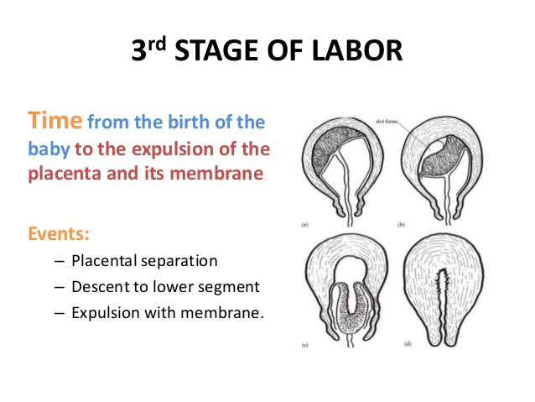

Slide 211
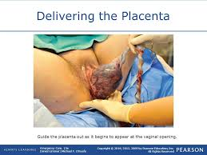

Slide 212
The Fourth Stage of Labour
The fourth stage starts after the delivery of the placenta and lasts for one hour. The nurse or midwife should observe the mother for blood loss, monitor vital signs, reassure her and let the mother hold the baby.
The nurse should also record notes in the patients file, fill in the baby notification form and after the hour is over escort the mother to the maternity unit.

Slide 213
Examination of the Baby
A thorough physical examination is done one hour after birth with the aim of assessing maturity and excluding obvious congenital abnormalities and injuries at birth.
In order to carry out this examination, you need to have with you the following equipment in a tray:

Slide 214
Tape measure
• Second hand watch
• Gloves
• Weighing scale
• Clinical thermometer
• Lubricant
• Swabs
• Stethoscope

Slide 215
Vital signs - heart rate (120-160/min), respiration (20-60 average 44/min), and temperature (36-37 degrees centigrade).
• Head - Check the shape to see if there is excessive moulding, caput succedaneum or depressed fractures to exclude head injury, microcephalus or hydrocephalus. Take head circumference (Approximately 33-37 cm).
• Ears - Check position. If they are low set, this may indicate Down's syndrome or Mongolism. Check for any missing lobes or cartilage

Slide 216
Eyes - Check for presence of eyeball injuries, discharge or jaundice.
• Mouth - Check for harelip, cleft palate, tongue-tie or false teeth, septic spots, thrush, cysts.
• Nostrils - Check for patency with no polyps or flaring.
• Neck - Check for congenital goitre or enlarged glands

Slide 217
Upper limbs - Check for equality, free movement, fractures, webbed fingers, extra digits and any bony tissues. Extra digits can be ligated with silk and will fall off (with the parents permission). Check for Erb's palsy.
• Chest - Check for continuity of sternum and the shape of rib-cage, respiratory rate, enlarged breast or absence of breast tissue

Slide 218
Abdomen - Should be intact and firm, check for umbilical hernia and exomphalus (protrusion of abdominal organs through a defect in the anterior wall). Abdominal distension is present in hydrops foetalis. Check for blood oozing from the cord and clamp again if necessary (cord shrivels within 24 hours, falls off 6-10 days).

Slide 219
External genitalia - Confirm the sex of the baby to rule out pseudohaemophrodism or intersexes. In males check for undescended testes, hypo/hyperspadias and phimosis. In females, check for bleeding from urethral and vaginal orifice. Vaginal bleeding may be due to excessive hormones from the mother

Slide 220
Neurological Assessment
This entails the checking of reflexes, which deal with the function of the baby’s nervous system as well as physical and behavioral assessments. At the beginning of the examination, observe the baby’s movements.
These movements involve all extremities and should be random and symmetrical but never stereotyped. Sometimes jitteriness or tremors will be noted. The first time you notice these movements they may look like fits. To determine the difference between the two, hold the affected limb. If it is the former the tremors should stop.

Slide 221
Moro Reflex
Support the baby’s head and body in supine position about a centimeter from the cot. Allow the head to drop back. Look at the baby’s response. The baby throws out his arms extending the elbows and fingers with embracing movements of the arms. What is the significance of the Moro reflex?

Slide 222
The Moro reflex is symmetrical in a normal baby at birth and disappears after three months.
It is incomplete in the pre-term baby and absent in the baby with inter cranial drainage. If brain damage is not severe it returns after three to four days. If it disappears some hours after birth, you should then suspect increasing cerebral oedema or slow intra cranial haemorrhage.

Slide 223
Tonic Neck Reflex
A fencing position is assumed, that is, the baby lies on the back, head rotated to one side with one arm and leg partially or completely extended. The opposite arm and leg are flexed. This is a manifestation of the immaturity of the newborn’s nervous system.

Slide 224
Rooting Reflex
To test for the rooting reflex, gently touch the corner of the baby’s mouth with clean fingers.
The baby will open his mouth turning towards the stimulus in anticipation of the mother’s nipple. To check for sucking reflex place a clean finger in the baby’s mouth noting the sucking strength. The sucking reflex is poor in pre-term babies

Slide 225
Stepping Reflex
The stepping or dancing reflex is present at birth but disappears soon after. Once this reflex diminishes, the infant does not attempt a stepping motion until he/she starts to walk. Hold the infant up, with the feet touching a surface. The infant will attempt to make some steps or pressing movements.

Slide 226
Grasp Reflex
It is amusing to learn that a newborn baby can grasp. At birth, the grasping reflex of both hands and feet is present. The infant will grasp any object you place in their hand, and then let it go.
They are able to hold on to a finger so securely, that you can lift them to a standing position. Stroking the soles of the feet causes the toes to turn downwards trying to grasp. By applying traction to the baby's wrists raise them to a sitting position. A full term infant will offer a strong resistance while a pre-term does not resist the pull.

Slide 227
Protective Reflex
Other reflexes include protective reflexes such
as:
• The blinking reflex, which protects the eyes from bright light
• Sneezing and coughing reflexes used to infant’s throat
• The yawn reflex, which draws additional oxygen
• Cry reflex, which helps to withdraw from painful stimuli

Slide 228
Once this examination is completed, the baby can be placed on the cot for transfer to the nursery or given to the mother.
After completing the delivery of the baby, you should transfer the mother to the postnatal ward where she will rest.

Slide 229
Changes that take place in a woman who has just delivered during puerperium
The puerperium period covers six to eight weeks
following delivery or abortion and is characterized by:
• General organs return to their pregravida state
• Initiation of lactation
• Recuperation

Slide 230
The Psychology of the Mother During
Puerperium
During the puerperium the mother is subjected to emotional turmoil and you must be supportive and observant.
She should be allowed to cuddle her baby and express her love as she wishes. This maternal instinct is at times delayed.
The midwife should be kind, patient, and compassionate towards the mother and give her the necessary education concerning her and the baby.

Slide 231
Each mother should be taken as an individual based on her maternal experience, educational background, maturity and parity.
Mothers should be given all the information necessary to ensure they know how to care for their babies.

Slide 232
Rooming is the term given when a hospital plans for the mother to stay with the baby for most of the 24 hours in a day.
It is highly recommended because it has been seen to have great psychological advantages for both mother and baby.
Bonding commences immediately and demand breast-feeding can be successfully practiced.
Most baby-friendly hospitals in this country encourage rooming in.

Slide 233
Postpartum Tears or Fourth Day Blues
This condition is characterized by mild depression and mood swings due to a Temporary endocrine hormonal imbalance following childbirth.
It occurs in fifty percent of post-natal mothers on around the fourth day.
A midwife should try to prevent the 'blues' by educating the mother during the pre-natal period on how to take care of herself and the baby to build up her confidence.

Slide 234
Involve the partner in these teachings so that the partner can give moral support.
Teach the mother how to check for minor discomfort and the relevant remedies to reduce the feeling of anxiety that the baby is ill whenever they cry.

Slide 235
It is a time of great physiological change, accompanied by some anatomical and psychological changes as well.
This is a time of change in the body in general with the exception of the breasts.
The breasts continue to develop so as to establish and maintain lactation.

Slide 236
General Involution
Every system in the body is affected during this process, including the heart and circulatory system.
With the cessation of the utero-placental circulation, the work done by the heart decreases.
The quantity of blood required also gradually returns to normal.
The renal and muscular-skeletal systems also return to normal.

Slide 237
Involution of the Uterus
The size of the pregnant uterus is 30 x 22 x 20cm and it weighs 100gms at the end of labour.
It is 15 x 11 x 7.5cm by the end of puerperium.
Involution takes place, by which point it measures 7.5 x 5 x 2.5cm and weighs 60gms.
Involution is the return of the uterus to its normal size, position and tone and is brought about by autolysis and ischaemia

Slide 238
Autolysis is a process by which muscle fibres are digested by the proteolytic hormone.
The muscle fibres have to dissolve a large amount of their protein in order to achieve this reduction in size.
This means that a great deal of nitrogen is excreted by the body in the urine together with the excess fluid retained during pregnancy.
This is why a lot of urine containing large amounts of nitrogen is excreted during the first few days after delivery.

Slide 239
In addition, the epithelial lining of the uterus, other cellular debris, and red blood cells are expelled as lochia from the uterus.
Ischaemia is localized anaemia of the uterus, which occurs when the placenta is expelled.
Blood vessels are constricted, which results in the reduction of the blood supply to the uterus.

Slide 240
The phagocytes dispose of the redundant muscle fibre and elastic tissue.
The vagina, ligaments of the uterus and muscle of the pelvis also return to their pre-gravida state. If not, prolapse of the uterus may occur later

Slide 241
Onset of Lactation
Lowered oestrogen levels trigger the production of prolactin from the anterior pituitary gland, which initiates lactation.
The maintenance of lactation depends on putting the baby on the breast, but secretion of milk commences on the third to fourth day.
The baby should be put on the breast immediately, which leads to oxytocin release and assists in keeping the uterus well contracted.

Slide 242
Management of Normal Puerperium
The aim of managing the puerperium is to:
• Maintain the mother’s good health
• Aid involution of the pelvic area
• Promote breast-feeding
• Prevent infection and other puerperium complications
• Educate the mother on the proper care of her own health and the baby

Slide 243
The mother and the baby should be examined daily and if any abnormality is noted the doctor should be informed.

Slide 244
When noting the mother’s general condition, you should check for the following points:
• Assess happiness, sadness, worries and fears and address them appropriately.
• Ambulation is important to prevent deep venous thrombosis.
• Take her temperature, pulse, respiration and blood pressure twice daily.
• Check the breasts and if she is not lactating, express colostrum.

Slide 245
Increase expressing on the second day and milk should be established on the fourth day.
• Advise the mother on how to feed the infant.
When fixing the baby on the breast she should put the whole areola in the baby’s mouth

Slide 246
She should initially breast feed the baby for three minutes to prevent cracked nipples and empty the breast in cases where the baby does not feed a lot.
This is especially important in the first days to prevent engorgement

Slide 247
Measure the fundal height and record the measurement daily.
Assess whether the involution is taking place satisfactory.
The fundal height should reduce by 0.5 - 1 centimetre daily.

Slide 248
Check on lochia loss, noting the colour.
This should change as per the schedule If there is persistent red lochia, this points to the need for further investigation.
Offensive lochia odour denotes infection

Slide 249
You should also check the perineum to see if there was episiotomy and note its state.
Advise the mother to wash the episiotomy at least four times a day with salt water and change the pad as soon as it is soiled and after she goes to the toilet.

Slide 250
Check on the calf muscles and exclude any pain that may indicate deep venous thrombosis.
You should also exclude oedema and anaemia.
Ensure that the mother gets enough sleep and rest
If she cannot sleep, she should be given a sedative.

Slide 251
Take note of any pain and administer analgesics.
Ask the mother to report if lochia is heavy.
Also encourage her to pass urine when her bladder is full.
Encourage her to continuously check on the baby's cord and to report any bleeding, especially in the first 12 hours.

Slide 252
complications of puerperium?
Major Complications
Venous thrombosis
• Pulmonary embolism
• Retention of urine or retention with overflow
• Urinary tract infection
• Puerperal sepsis and pyrexia
• Engorgement of the breasts
• Cracked nipples or mastitis
• Puerperal psychosis

Slide 253
Post Natal Examination
This is carried out during the sixth post-partum week.
You should inquire about the general health of the mother and baby.
You should also do a haemoglobin estimate and if you find that it is low, embark on treatment.
You should inquire and note any gynaecological symptoms.
Examine the mother’s general condition, with specific emphasis on the breasts.

Slide 254
Find out if the breasts are active
Examine the abdomen for tone of muscle and any masses.
Also examine the vulva and vagina to ascertain the healing of the repaired episiotomy or tear.
Pass a speculum (sims) to see the state of the cervix and if there is any discharge.

Slide 255
Do a Pap smear at this stage. If possible, you should carry out a bimanual examination of the uterus to ascertain that the uterus has involuted to its normal size. Finally, remind the mother of the various family planning methods discussed and re-emphazise the importance of attending maternal and child health clinics.

Slide 256
THANK YOU

