Slide 1
NURSING PROCEDURES
Special procedures

Slide 2
Learning outcomes
By the end of the lesson the learner will be able to:
Define suctioning
Explain various types of suctioning
State the indications of each type of suctioning
Explain the safety measures to consider during suction
Explain the steps of suctioning procedure of each type
Discuss the complications of each type of suctioning

Slide 3
Learning outcomes
By the end of the unit the learners will be able to perform the following nursing procedures;
Insertion and removal of nasogastric tube
Gastric washout
Rectal washout
Colonic washout
Colostomy washout
stoma care

Slide 4
Suctioning
Specialized nursing procedure

Slide 5
Introduction
Under normal circumstances the upper airway warms, cleans and moistens the air one breathes.
When this function is impaired then Suctioning is performed purposely to clear mucus from the tracheostomy tube and facilitate breathing.
Suctioning is a component of bronchial hygiene that involves the mechanical aspiration of secretions from the nasopharynx, oropharynx, and trachea
(Review anatomy and physiology of the respiratory system)

Slide 6
Definition
Suctioning is a technique of aspirating secretions through a catheter connected to a suction machine
Suctioning can also be referred to as “the mechanical aspiration of pulmonary secretions from a patient with or without an artificial airway in place”.
Suctioning of the patient (with or without an artificial airway) is the process of removing (secretions) from the trachea using negative pressure suction.
Suctioning can be done to provide tracheostomy care

Slide 7
Purpose of suctioning
The purpose of suction includes;
To ensure a patent airway.
Airway cleaning: to clear the airway of infections, any secretions left in the tube or trachea could become contaminated and lead chest infection therefore observe strict asepsis and personal hygiene when performing the procedure.
To collect specimen of sputum or secretions for diagnostic examinations

Slide 8
Suctioning
The suctioning process includes nasal, oropharyngeal, and endotracheal secretions removal. Therefore suctioning such areas is termed as;
Nasopharyngeal suctioning,
Oropharyngeal suctioning ,
endotracheal suctioning and
Tracheotomy suctioning

Slide 9
Indications for suction
Clinical indications for suctioning include respiratory distress (diminished breath sounds) in patients who cannot cough well due to loss of adequate cough reflex but have;
increased copious secretions,
retained secretions.
NOTE: Signs of respiratory distress may include; increased respiratory rate, tachycardia, gasping and difficulty talking.

Slide 10
Indications for suctioning include:
Audible or visual signs of secretions in the tube
Suspicion of a blocked or partially blocked tube
Coarse crackles that does not clear
Vomiting
Decreased oxygen saturation on pulse oximetry
Increased respiratory pressure
Request by the patient to be suctioned

Slide 11
Contraindications to suctioning
Epiglottitis or croup are considered absolute contraindications to nasotracheal suctioning.
Other situations, relative (not absolute) need to be taken into consideration and are contraindicated too include;
head or neck injury,
laryngospasm and bronchospasm,
occluded nasal passages, and
bleeding disorders

Slide 12
Types of suctioning
There are two types of suctioning; closed and open for example; endotracheal suctioning (closed) while tracheal tube suctioning is an example of an open type of suctioning.
The most common type of suctioning is the open type such as;
oropharyngeal
nasopharyngeal
nasotracheal, and
However, suctioning through an artificial airway (endotracheal tube) is most often open but can be closed too, especially incases of critically ill patents

Slide 13
Types of suctioning & suction catheters

Slide 14
Types of suctioning
Suction requires application of critical thinking because one’s life depends on how skillfully it is done
Open system suctioning
Is clearing the airway of a mechanically ventilated patient with a suction catheter inserted into the tracheotomy after the patient has been disconnected from the ventilator circuit (often in critical care unit).
Closed system (continuous) suctioning; This is a safe method of removing secretions from tracheo-brochial tree of patients requiring mechanical ventilation without disconnecting ventilator

Slide 15
Methods or techniques of suctioning
The main methods of suctioning are nasal (in the nose), oral (mouth), nasopharyngeal and oropharyngeal (throat),
The amount and texture of secretions often dictate the kind of suction to be performed; either deep or normal /superficial.
Deep suctioning is the continuous insertion of the suction catheter until resistance is met, and the subsequent withdrawal of the catheter by 1 cm before the application of suction pressure
Superficial suctioning is often performed in nasal, oral or oral suctions

Slide 16
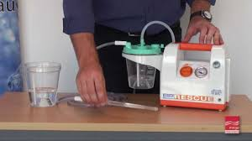
Types of suction machines
Portable suction machines

Slide 17
Nursing procedure
TRACHEOTOMY SUCTIONING & CARE

Slide 18
Tracheostomy/ Tracheotomy
Definition:
A surgical procedure on the neck to open a direct airway via an incision in the trachea
Tracheotomy – derived from Greek; “tom” means “to cut”; therefore this is an emergency procedure in which a trachea is cut to make an opening (between 2nd & 3rd tracheal rings) purposely to facilitate O2 administration
Tracheostomy- when an indwelling tube is inserted into the trachea via the tracheotomy, the term tracheostomy is used

Slide 19
Tracheotomy complications
Complications are Long-term and late complications may occur and these include;
Airway obstruction d/t accumulation of secretions
Infection
Rupture of the innominate artery
Dysphagia
Tracheo-esophagael fistula
Tracheal dilation
Tracheal ischemia & necrosis
After removal of tube: the following may arise;
tracheal stenosis; vocal cord paralysis leading to absence of speech

Slide 20
Care of a patient on tracheotomy
The patient requires continuous monitoring & assessment soon after insertion of tube
Ensure patency of tube- proper sterile suctioning
Position patient in semi-fowler’s position to facilitate ventilation, promote drainage, minimize edema & prevent strain on suture line
Reassure patient to alleviate apprehension; and provide communication gadgets (e.g. pen & paper), sign language may help too.

Slide 21
Tracheostomy tube & skin care
Ensure tracheal dilator & extra T-tube are always at patient’s bedside for use in case of emergency
Suction tracheostomy tube PRN to maintain patency; chest physiotherapy should be performed whenever necessary
Change tracheostomy dressing whenever necessary;
Clean tracheostomy incision site and surrounding area with antiseptic swabs; do NOT allow the solution to enter the tracheostomy opening

Slide 22
Techniques/ Methods of suctioning
Suctioning can be performed using the following methods depending on various factors.
Suction depths can be done deep or shallow
Shallow suctioning: suctioning the secretions coughed up at the opening of the tracheal tube
Deep suctioning: is by inserting the catheter deeper until resistance is felt in order to remove secretions lodged deeper in the trachea

Slide 23
Purposes of tracheotomy suctioning
Tracheotomy suctioning removes thick mucus and secretions from the trachea and lower airway that you are not able to clear by coughing.
Suctioning of the tracheotomy tube is necessary to remove mucus, maintain a patent airway, and avoid tracheotomy tube blockages.
Frequency of suctioning varies and is based on individual patient assessment and needs.
Suctioning is done often when patient wakes up in the morning and right before going to bed in the evening.
Suctioning is also done after any respiratory treatments.

Slide 24
Indications of tracheotomy suctioning
Indications for tracheotomy suctioning includes the indications for suctioning as well as the following;
Presence of a moist cough that does not clear secretions.
Inability to effectively clear secretions from the trachea
Difficulty breathing or one feels lack of adequate lung aeration due to secretions
Copious secretions especially in unconscious patient
Blocked tracheotomy

Slide 25
Safety measures during suction
Use the correct size of suction catheter
It is important to note that tracheal damage may be caused by suctioning. Therefore, this can be minimized by using the appropriate sized suction catheter,
The depth of insertion of the suction catheter needs to be determined prior to suctioning. Use a spare tracheotomy tube of the same type and size and a suction catheter,
Insert the suction catheter to measure the distance from the length of the tracheotomy tube 15mm connector to the end of the tracheotomy tube.

Slide 26
Safety considerations….
Ensure the tip of the suction catheter remains with-in the tracheotomy tube.
Record the required suction depth on the tape measure placed at the bedside and in the patient records. Attach the tape measure to the cot/bedside/suction machine for future use.
Alternatively use pre-measured suction catheters (where available) to ensure accurate suction depth

Slide 27
Safety considerations….
Appropriate suction pressures;
The suction pressure for tracheal suctioning is 80-120mmHg (10-16kpa). To avoid tracheal damage, the suction pressure setting should not exceed 120mmHg or 16kpa. And suction only within the tracheotomy tube.
It is recommended that the episode of suctioning (including passing the catheter and suctioning the tracheotomy tube) is completed within 5-10 seconds.

Slide 28
The Procedure
Refer to NCK procedure manual 4th ed. Pg 196-197
Note that nasotracheal suctioning is similar to nasopharyngeal suctioning with deeper (trachea) suctioning being accomplished.
Before commencing the procedure, explain the procedure to the patient, and obtain an informed consent
Assess the general condition, assess the breathing pattern and breath sounds of the patient
Ensure there is no contra-indication to suctioning
Observe asepsis since this is a sterile procedure

Slide 29
Procedure…..
Prepare the trolley and wheel it to the patient’s bed side
Wash hands, dry them and glove meanwhile the assistant positions the patient with head slightly elevated
Assemble the items on the tray mounted on the top shelf of the trolley.
Ensure the suction machines are in good function
Estimate the distance the catheter is to be inserted. This is achieved by measuring from the patient's nose to the tip of his ear, then to his larynx.
Follow the steps as per the NCK procedure manual

Slide 30
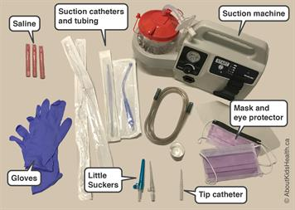
Equipment:
Suction apparatus (wall attachment or portable unit)
Suction canister
Tubing
Suction catheter
Sterile water
Read the procedures on your; Nursing Procedure Manual

Slide 31
Instillation
The instillation of sterile 0.9% saline should not be done on a routine basis but maybe required for tenacious secretions
May promote infection by washing bacteria from artificial airway into lower airway tracts
If required, instil sterile 0.9% saline into the tube, during inspiration:
Neonates 0.3 - 1ml
Infant 0. 5- 1.5ml
Child 1.5 – 2ml
Adult 2 – 3ml

Slide 32
Position for suctioning
Position patient in semi-Fowler's position with head turned to the side.
This facilitates ease of suctioning. In some cases the chest may be slightly elevated if not contra-indicated
Unconscious patients should be in the lateral position.

Slide 33
Procedure…..
Endotracheal suctioning is the removal of secretions from the tracheobronchial tree through an endotracheal tube with the aid of a mechanical suction devise
During the procedure, assess the breathing patterns and sounds, ensure that a lot of excretions are removed as necessary to enhance airway patency and stable respirations

Slide 34
Procedure…
The procedure involves patient preparation, suctioning systems, mostly an intermittent suctioning is performed. Any patient under suction requires vigilant observations in order to ensure the maintenance of patency of the patient’s airway.
The suctioning event(s) require follow-up care to maintain airway patency. Nasotracheal suction may be undertaken directly via the nostril without an airway adjunct
During the procedure, monitor oxygen levels and heart rate to make sure the patient is tolerating the procedure well. Suctioning attempts should be limited to 10 seconds

Slide 35
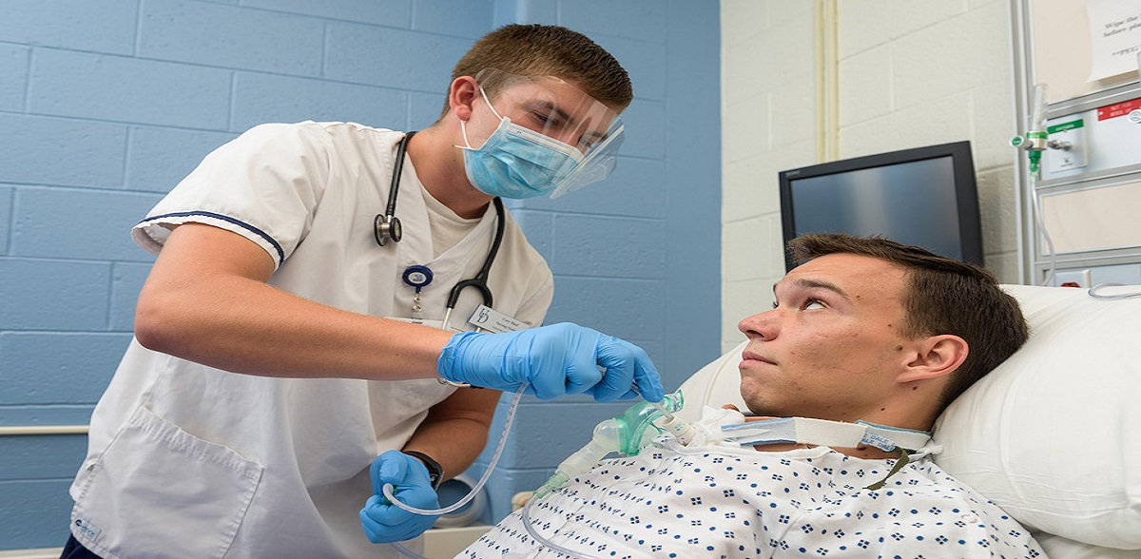
THE END

Slide 36
After the procedure
Thank the patient for co-operation
Leave patient comfortable
Clear the trolley ensure infection prevention and control measures are adhered to
Wash hands and dry them and document the procedure including any abnormality noted and an estimate amount of secretions, texture, colour and odour
Vital signs observations should be taken and recorded

Slide 37
DOCUMENTATION
Type of suctioning- tracheotomy suctioning
Frequency- time
Amount- none, scant, medium, large, copious
Color- clear, white, yellow, green, red streaks
Thickness- thin, thick, frothy
How the patient tolerated the procedure- cooperative, crying, resisting

Slide 38
Complications
The following are the most common Complications of Suctioning;
Hypoxia.
Airway Trauma.
Psychological Trauma.
Pain.
Bradycardia
Infection.
Ineffective Suctioning.

Slide 39
Complications related to suctioning
Hypoxia-Hypoxia during suctioning can happen through at least three routes;
ineffective suctioning, may not disrupt existing hypoxia. There for it is important to ensure use of an effective technique, (most guidelines recommend suction less than 15 seconds) every time the suction tube is pushed down the airway.

Slide 40
Complications related to suctioning…
Airway Trauma-Physical trauma to the airway is a common suctioning injury, especially in patients with difficult or swollen airways. (it can also lead to hypoxia)
Weaker muscles and other physiological changes among geriatric populations make them more vulnerable to airway trauma, therefore it is important to perform suction gently and slowly and ensure you can visualize the airway.

Slide 41
Complications related to suctioning…
Psychological Trauma-Humans naturally resist having anything inserted through their nose or down their throat.
This resistance helps prevent choking and other injuries, but it can also make suctioning more difficult.
Patients may experience fear and frustration before, during, or after suctioning
The worst if the condition will require suction for life, the patient require a lot of psychological support

Slide 42
Complications related to suctioning…
Pain-Suctioning can be painful, especially in a person with a pre-existing airway injury. A careful and diligent technique reduces the risk of pain.
Talk to the patient ahead of time to explain the procedure and let them know that suctioning only takes a few seconds
Ineffective Suctioning-Ineffective suctioning can be stressful and painful for patients, but without any quantifiable benefit.
First responders must ensure that their suctioning technique is sound, and that they use the right equipment

Slide 43
Complications related to suctioning…
Infection-Suctioning can introduce microbes into the airway. This is more likely when first responders reuse equipment, or do not properly sterilize reusable equipment, or do not wear protective gear.
During suctioning, if the airway is injured, the risk of infection increases.
Wounds in the airway open the body to dangerous microbes, especially when a patient already has an infection or has aspirated some stuff.

Slide 44
NASOGASTRIC TUBE INSERTION
A Nursing procedure

Slide 45
Gastrointestinal Intubation
Gastro-intestinal intubation involves inserting a tube into the stomach or past the stomach into the duodenum or jejunum. The insertion point can be the:
Nose – Nasogastric tube (NG tube)
Mouth –orogastric tube (OG tube)
Abdominal wall (gastric tube)
Clinical Indications
To decompress (remove) stomach fluid or air eg in post GIT op
Lavage the stomach and remove toxins
Administer medications and nutrition supplements
Palliative management for partial intestinal obstruction

Slide 46
Nasogastric and orogastric tubes
These type of tubes are often used for decompression of a distended stomach due to air or fluid, administer intermittent medication and administer intermittent or continuous liquid feeds.
They are made of rubber or plastic with multiple distal openings or eyes near its tip. Circular markings at specific points on the tube serve as a guide for insertion.
The tube is connected to low intermittent suction (30-40mmHg) to avoid erosion of the gastric mucosa.

Slide 47
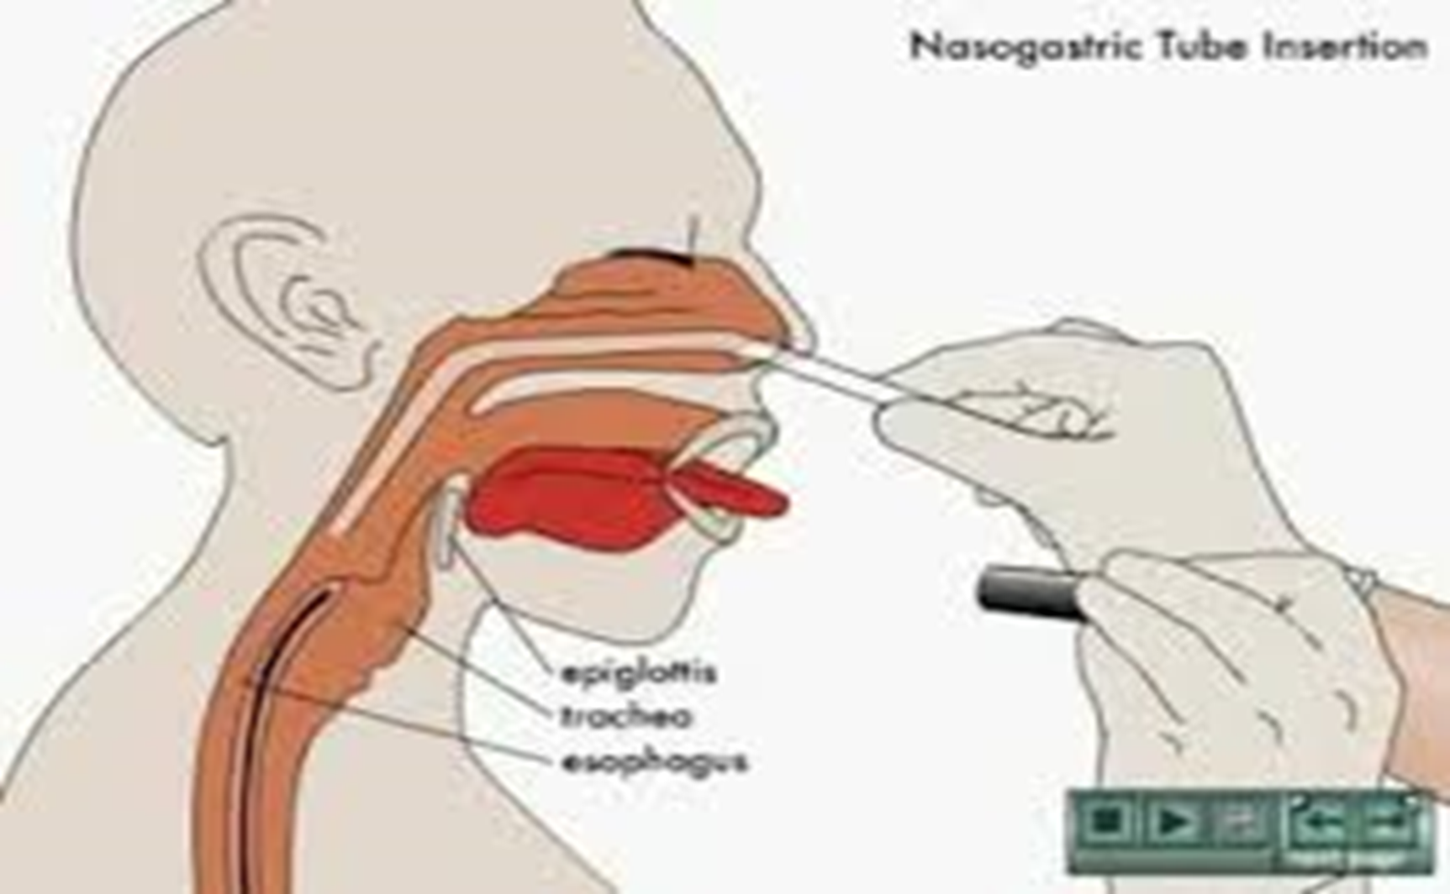

Slide 48
Nasogastric tubes
They come in different sizes depending on the size of the lumen of the tube. Types include:
Levin tube
A gastric or salem sump tube (SST)
Post pyloric tubes – Continue past the stomach and enter the duodenum and jejunum.
They are longer and have a small bore.
They are inserted through the nose and designed for continuous feeding into the small intestines when gastric feeding is not possible e.g post gastric surgery..

Slide 49
Nasogastric tube insertions
post pyloric tubes are inserted before or during surgery assisted by radiologists(fluoroscopy) or at bedside by a trained nurse.
The tube is advanced past the stomach by use of pro-kinetic drugs (metoclopramide 10 min before procedure).
Placing patient on the right enables gravity to aid in pushing the tube through the pyloric sphincter to the small intestine

Slide 50
Contraindication to NGT insertion
Facial and head trauma – May worsen the injuries or may be inserted in the cranial vault
Severe Coagulopathy
Deviated septum
Esophageal strictures or diverticula or varices
Gastric surgery – Risk of perforation, placement difficult due to altered anatomy

Slide 51
NGT INSERTION SKILLs
Assessing and preparing the patient
Inserting the tube
Confirming placement ( use litmus paper or water in gallipot)
Securing the tube
Monitoring the tube and potential complications
Giving feeds through NGT
Gastric lavage
Removing the tube
Refer to NCK procedure manual & read anatomy text book

Slide 52
Gastrostomy
A surgical procedure which an opening is created into the stomach for the purpose of administering foods and fluids via a feeding tube.
Indications
Prolonged enteral nutrition support
Preferred over NGT feeding in a coma patient because Gastroesophageal sphincter is intact therefore less regurgitation and aspiration.

Slide 53
Types of Nutrition & Indications
Enteral – through GIT – oral, NGT, Gastric tube
Parenteral – IV nutrition
Indications for support nutrition
Severe protein calorie malnutrition
Patient’s inability to ingest food orally or by tube
Pre or post operative nutritional needs (extensive bowel surgery)

Slide 54
Parenteral Nutrition
This is a method of providing nutrition to the body through a peripheral or central IV route.
The solution is a mixture of proteins, Carbohydrates, fats and electrolytes, vitamins, minerals and sterile water in a solution.
Purpose
Improve nutritional status, Establish a positive nitrogen balance, maintain muscle mass, weight gain and support healing process

Slide 55
Precautions
Ensure the prescriptions are adhered to
Maintain a balanced fluid chart for whatever the procedure performed
Practice high level of infection prevention standards during the care
Document the procedures performed
Always document and report deviations from normal
Change the NG tubes as appropriate

Slide 56
Gastric lavage
Definition:
Gastric lavage is the aspiration of stomach contents & washing out of the stomach by means of a gastric tube (NGT or OGT)
Also known as “gastric irrigation” or “stomach
emptying”

Slide 57
Indications
Urgent removal of ingested substances so as to decrease systemic absorption (should be done within 1hr of ingestion, as an emergency)
To cleanse the stomach before endoscopic procedures
To diagnose & arrest gastric hemorrhage (Ice cold lavage)

Slide 58
Contraindications
1. Ingestion of;
flammable liquids (e.g. petroleum) or
corrosive liquids (e.g. acids) or
hydrocarbons (e.g. chlorofluorocarbons)- In such cases administer antidote first;
consult physician-since these poisons have effective antidotes
2. During convulsions
3. Compromised unprotected airway
4. Patient at risk of gastrointestinal bleeding or perforation

Slide 59
Procedure
Intubate patient if unconscious or cannot protect airway
Large-bore Oral gastric tube (OGT) or NGT is inserted
Position on left lateral decubitus, with head lowered 15 degrees down, (to allow pooling of gastric contents and decrease passage of fluid into the duodenum during lavage)

Slide 60
Procedure ..…
Irrigation fluid should NOT be forced into the stomach during the lavage- may cause stomach contents to enter the small intestine
Stomach contents are aspirated 1st (specimen sent for analysis) then lavage fluid is instilled; 100-300 mls pure water or Normal saline is use incases of an adult.
Child: 10ml/kg instil Normal saline NOT water, due to risk of hyponatraemia

Slide 61
Procedure ….
Activated charcoal may be administered for poisons ingested
The fluid is then aspirated back gently, samples are taken for toxicology, then it is allowed to flow out by gravity
Lavage is repeated until the returning fluid shows no gastric contents

Slide 62
Complications
Aspiration pneumonia
Laryngospasm
Hypoxia; Bradycardia
Epistaxis
Esophageal perforation/ mechanical injury of stomach
Electrolyte imbalance (hyponatraemia; hypochloraemia)
Hypothermia
Convulsions

Slide 63
Nursing management
Explain procedure to the patient then, insert gastric tube gently and carefully
Position patient appropriately (with aid of an assistant)
Monitor vital signs; TPR, BP and SPO2 closely
Observe general condition and for convulsions (some toxins can cause irritation of CNS or Oxygen deprivation)
Observe for complications, during and after the end of the lavage

Slide 64
Nursing procedure
Rectal washout (enema)

Slide 65
Rectal washout (enema)
Definition
Procedure of introducing liquids into the rectum and colon via the anus for medical reasons
The increasing volume of fluid causes rapid expansion of the lower GI tract resulting in uncomfortable bloating, cramping, powerful peristalsis accompanied with complete evacuation of the lower GIT

Slide 66
Types of enema
There are 2 main types of enema;
Retention enema- small amnt of sol’n (100-300mls) given and retained for 20-30mins then released.
Non-retention enema (cleansing enema)- a greater volume of solution (usually 700- 1000mls) is instilled and patient asked to hold/retain it for about 10mins

Slide 67
Retention enema
Given for the purpose of:
Promoting flatulence
Administering medication
Softening fecal material
Lubricating rectal mucosa
Examples: - Soap & Water enema
- Saline enema (1tbsp salt in 1L water or
Normal saline 1L

Slide 68
Non-retention enema
Given for the purpose of:
Stimulating peristalsis
Evacuating fecal material from the colon; soften feces
Promoting expulsion of flatus
Examples
Phosphate enema (Enemax; already prepared)
Oil (liquid paraffin; glycerin)
Magnesium sulfate + glycerin + H2O ( called one, two, three – in ounces)

Slide 69
Indications of enema
Treatment of severe constipation & fecal impaction
Pre-op preparation for sigmoidoscopy or colonoscopy
Radiologic examination (Barium enema)
Treatment of inflammatory bowel disease
Drug administration (e.g. Amphetamines, opioids, antiemetics, general anaesthetic agents, analgesics)

Slide 70
Contraindications of enema
Bowel, rectal or anal pathologies that contribute to risk of bowel perforation
Diverticulitis ( formation of pouches outside the colon; inflammation/ infection of these pouches)
Ulcerative colitis ( ulcers in colon; autoimmune)
Crohn’s disease ( autoimmune GIT inflammation)
Severe or internal hemorrhoids

Slide 71
Contraindications ..….
Tumors of rectum & colon
Recent GIT surgery
Heart disease (due to vagal nerve stimulation; relative contra-induction,)

Slide 72
Complications of enema
Electrolyte imbalance
Rupture of bowel & rectal tissues (bleeding)
Infection by GIT microbes
Arrhythmia/ Bradycardia- due to irritation of vagus nerve by rectal tube

Slide 73
Procedure of enema administration
Enema administration set composed of container with tubing & clamp; or 50ml syringe barrel with tubing ; a clamp; water soluble lubricant & the prescribed enema solution
The procedure is explained to the patient; assisted to lie on left Sim’s position
The patient is instructed to take a deep breath while the lubricated tube is inserted 3-5 inches beyond the anal sphincter
Warm solution is poured into enema container/ 50mls syringe & raised 16-18 inches above patient’s buttocks
Patient is then instructed to hold the enema for the appropriate period of time; then allowed to release it/ defeacate

Slide 74
Nursing Management
Explain the procedure & its purpose to the patient
Position patient on left Sim’s position
Repeated enema can be very tiring to patient; provide supportive care
If repeated enema are given, observe for signs of electrolyte imbalance; consult doctors if results are not clear after 3rd enema
Observe cardiac patient closely for cardiac arrhythmias during the enema administration (due to vagal stimulation)

Slide 75
Nursing management ….…
Abdominal cramping can occur, encourage patient to take deep breaths; clamp tube to stop flow until cramps stop; then lower enema solution container to decrease pressure or flow of solution
If patient has urge to defecate, reassure and stop flow of solution & hold buttocks together until urge subsides then resume procedure
Report & document the type & amount of solution given, results of the enema and patient’s tolerance of the procedure.

Slide 76
Colonic irrigation
Definition:
Colonic irrigation is the introduction of water via a colostomy or a surgically constructed conduit as a treatment for constipation, using a sterile catheter
It is a clean, non-sterile procedure

Slide 77
Surgically performed
Colostomy

Slide 78
Colostomy
Definition
Colostomy is a surgical procedure whereby a part of the colon is connected onto the anterior abdominal wall leaving an opening (stoma)
The stoma is formed from the end of the large intestine, which is drawn out through the incision & sutured to the skin; stoma allows access of faeces through it.

Slide 79
Types of colostomy
Can be placed on ascending, transverse or descending sections of the colon, or near sigmoid colon
Can be permanent or temporary
3 main types:
Loop colostomy
End colostomy
Double barrel colostomy

Slide 80
Types of colostomy….
Loop colostomy
Temporary; used in emergency
A loop of the bowel is pulled out & sutured onto the abdomen
2 openings are then created on the stoma; one for stool, other for mucus
End colostomy
Stoma is created from one end of the bowel; the other potion is either removed or stitched closed (Hartmann’s pouch)

Slide 81
Types of colostomy….
Double barrel colostomy
The bowel is cut & both ends brought up onto the abdomen; only the proximal stoma is functional
Indications of colostomy
Colon cancer
Diverticulitis
Injury to GI tract
GI colon surgery needing “resting of the gut”
Pelvic tumor (temporary colostomy)

Slide 82
Nursing management
Explain procedure to the patient Encourage patient to report any stoma discomfort
Teach the procedure of colostomy care in a stepwise manner & encourage a return demo. (colostomy equipment; types available & where)
Teach pt how to control odor- can use appliance deodorant & avoid gas-producing foods
Skin care
If colostomy is for irrigation, DO NOT force irrigation tube in- colon has no sensory nerve endings; injury can occur
Encourage patient to participate in his/ her care & to verbalize feelings of body image disturbance

Slide 83
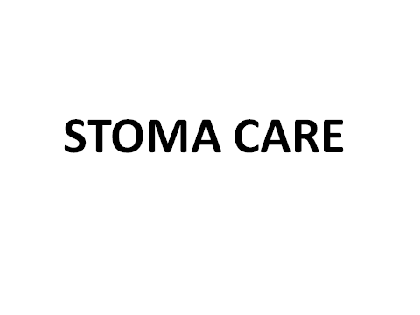
Stoma care

Slide 84
Stoma care
Stoma” is a Greek word for mouth or opening. A stoma is surgically formed to pass feacal matter or urine from the body.
It is made from a segment of bowel so it is pinkish red in colour and wet to touch, similar to the inside of the mouth, soft and moist.
A stoma may sit out above or be slightly below the skin level.
A stomas have no nerve endings that means no nerve supply to it and therefore has no sensations such as pain so it will not hurt when touched.
For this reason a lot of care must be taken with a stoma because an inadvertent damage may occur and fail to be noticed until the next appliance change.

Slide 85
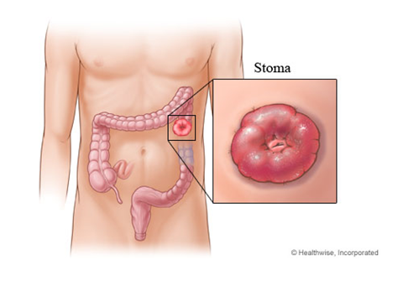

Slide 86
Common types of stoma
Stoma can be temporary and permanent; temporary stomas are often loop stomas and permanent ones are end stoma. It can be any of the following;
Colostomy
Ileostomy
urostomy

Slide 87
The Stomas
Colostomy: a stoma formed from the large bowel or colon
Ileostomy: a stoma formed from the small bowel or ileum
Urostomy: a stoma formed using a segment of bowel to allow the passage of urine
The skin surrounding a stoma is called Peristoma skin

Slide 88
Types of stoma
Colostomy
This is the most common type of stoma.
A colostomy is an opening made into the large intestine or colon.
The stool can then pass from the stoma out of the patient’s body which tends to be solid in consistency but can sometimes be liquid

Slide 89
Indications for Stoma
Considering that a stoma is an opening that is created to allow stool or urine to pass out of the body.
The type of stoma depends on the disease/problem and may be temporary or permanent.
Temporary stomas require further surgery to reverse or close them, so patients can resume passage of flatus and faeces via the anus.
Stomas can be formed for a number of reasons, such as cancer, diverticular disease and inflammatory bowel disease

Slide 90
Indications for Stoma
Common conditions that might necessitate a stoma include;
Imperforate anus: where there is no exit for the bowel or its contents.
Hirschsprungs disease: where nerves called the ganglion nerves are missing and waste matter cannot easily pass.
Inflammatory bowel disease: this includes Crohns Disease and Ulcerative Colitis, both are inflammatory diseases of the intestines.
Neonatal necrotising enterocolitis: this occurs when a portion of the bowel is dead and cannot function
Spina bifida

Slide 91
Appliances and accessories
An appliance is used to contain the stoma output are also called stoma pouches or stoma bags. The appliance is designed to adhere to the abdominal skin around the stoma and collect and contain the stoma effluent.
A stoma appliance has several sections; the adhesive, the bag and the soft cover. The adhesive part of the appliance is called a flange, base plate, face plate or wafer.
Accessories include powders, wipes, sprays

Slide 92
Urostomy
Urostomy is performed for urinary diversion and the reasons for diversion include;
Removal of bladder from cancer
Neurogenic bladder,
congenital anomalies,
strictures,
trauma to the bladder, and
chronic infections with deterioration of renal function

Slide 93
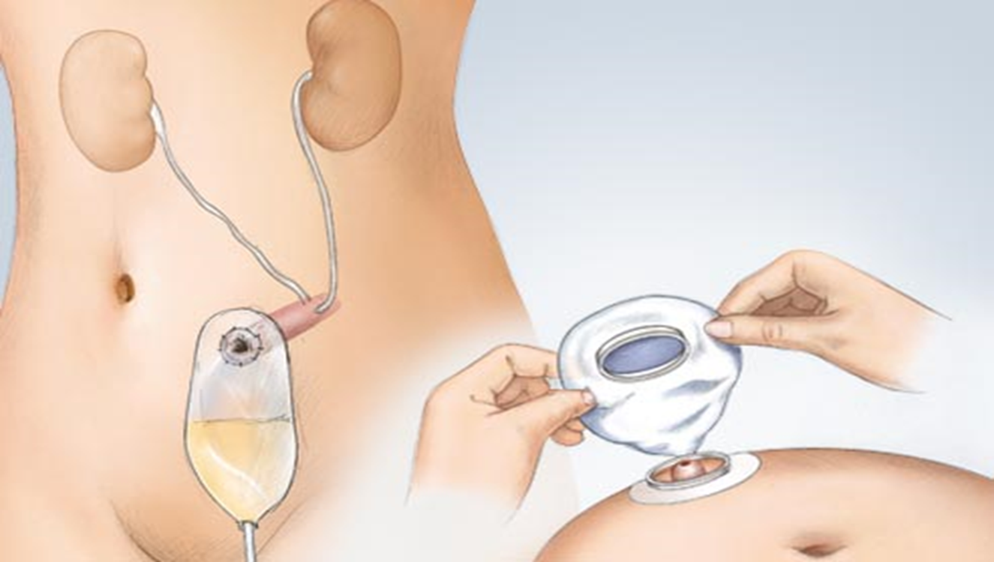
Urostomy
Is an opening made to divert urine from the bladder and also resembles a ‘spout’ as the output is urine.

Slide 94
Nursing Management
Pre-operative care
Assess the patient’s ability and readiness to learn before initiating a teaching program
Involve the patient’s family in the teaching process
Teach the patient who will have a continent diversion how to catheterize, irrigate and adhere to a strict schedule
Patient will require complete bowel clean-out. Assist as needed with bowel preparations as ordered.
Allow patient/family opportunity to explore feelings and begin to cope with changes.

Slide 95
Post operative Care
Stents or catheters are placed in ileal conduit for 7-10 days to promote urinary drainage
Drainage tube is placed in pelvic area for drainage of blood and surgical fluids.
May have NG tube until effective intestinal peristalsis returned. May then start on clear liquids to advance as tolerated.
Monitor urine output carefully.
Blood in urine is expected in immediate post-op period with gradual clearing
Report for prompt intervention in case blood in urine persist for over 72 hours post operation

Slide 96
Post-operative care
High fluid intake is encouraged to flush the ileal conduit or continent diversion.
Be aware that patient is at greater risk for UTI.
Stoma or loop stenosis may result in urine being retained in the conduit with subsequent electrolyte imbalances.
Strive to keep urine acidic because alkaline urine promotes encrustation and stone formation.

Slide 97
Complications
Breakdown of the anastomoses in the gastro-intestinal tract.
Leakage from the ureteroileal or ureterosigmoid anastomosis
Paralytic ileus
Obstruction of ureters
Wound infection
Muco-cutaneous separation
Stoma necrosis
Stoma Prolapse

Slide 98
Ileostomy
In an ileostomy the opening is made in the small intestine – the ileum.
An end or loop of the small intestine is brought through the skin’s surface on the abdomen and the output then passes out through the stoma.
Due to the fact that ileostomy output contains digestive enzymes, this can be harmful to the skin and so requires extra care when pouching.

Slide 99
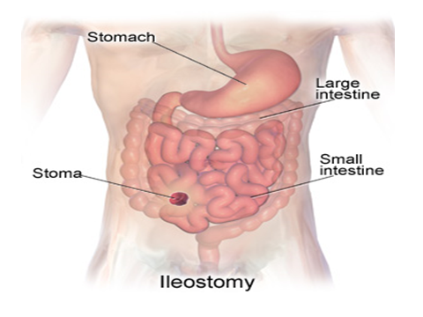

Slide 100
How to change a pouch
For an open-ended pouch, empty the contents from pouch into the toilet.
Gently remove the pouch by pushing the skin down and away from the adhesive skin barrier with one hand.
With the other hand, pull the pouch up and away from the stoma
Clean the skin around the stoma with warm water. You may also use soap but do not use soaps that have oil or perfumes
Use skin protection products if you have irritated skin around the stoma.

Slide 101
How to change a pouch …..
Center the pouch over the stoma and press it firmly into place on clean, dry skin.
It may be helpful to hold your hand over the newly applied pouch for 30 seconds. The warmth of your hand can help to mold the adhesive skin barrier into place.
Place the old pouch in another plastic bag to be thrown away if the pouch is disposable.
If you use a reusable pouch, talk to your caregiver about how to clean the reusable pouch

Slide 102
How to empty a pouch
Empty the pouch when it is one-third to one-half full.
Do not wait until the pouch is completely full because this could put pressure on the seal, causing a leak.
The pouch may also detach, causing all of the pouch contents to spill. If this happens stay calm and clean the spill properly.
Take the end of the pouch and hold it up. Remove the clamp (if the pouch has a clamp system).
You may need to make a cuff at the end of the pouch to keep it from getting soiled
Drain the pouch by gentle squeezing its contents if it is re-usable

Slide 103
How to empty a pouch …..
Clean the cuffed end of the pouch with toilet paper or a moist paper towel
Undo the cuff at the end of the pouch. Replace the clamp or close the end of the pouch

Slide 104
Nursing management
Assessment
Assess the location of the stoma and the type; colostomy or ileostomy that was performed.
Stoma location is an indicator of the section of bowel in which it is located and a predictor of the type of fecal drainage
• Assess stoma appearance and surrounding skin condition frequently

Slide 105
Nurse interventions
Position a collection bag or drainable pouch over the stoma.
Initial drainage may contain more mucus and serosanguineous fluid than fecal material.
Irrigate the colostomy, instilling water into the colon similar to an enema procedure. The water stimulates the colon to empty.
Pay attention to bad smell, skin colour and texture around stoma to rule out infections setting in.

Slide 106
Nursing Interventions ….
When a colostomy irrigation is ordered for a client with a double-barrel or loop colostomy, irrigate the proximal stoma
Empty a drainable pouch or replace the colostomy bag as needed or when it is no more than one-third full
Good skin and stoma care is important to maintain skin integrity and function
For patients with loop colostomy, use stoma adhesive or skin barrier wafer as needed to maintain a secure ostomy pouch

Slide 107
Nursing Interventions ….
A small needle hole high on the colostomy pouch will allow flatus to escape. This hole may be closed with a Band-Aid and opened only while the client is in the bathroom for odor control.
Involve family members on the care of the patient while in the ward for preparation on home care after patient’s discharge from hospital

Slide 108
Client and family care
Prior to discharge, provide written, verbal, and psychomotor instruction on colostomy care, pouch management, skin care, and irrigation for the client
Allow ample time for the client (and family, if necessary) to practice changing the pouch, initially on a model then later
on the client and perform support supervision.
If an abdomino-perineal resection has been performed, emphasize the importance of using no enemas, rectal suppositories nor rectal temperatures,

