Slide 1
NURSING PROCESS

Slide 2
LESSON OBJECTIVES
By the end of the lesson, the student will be able to:-
Define the nursing process
State the importance of the nursing process
Describe the steps of the nursing process
Draw a nursing care plan

Slide 3
Nursing Process
Specific to the nursing profession
A framework for critical thinking
It’s purpose is to:
“Diagnose and treat human responses to actual or potential health problems”

Slide 4
DEFINITION
An evolving procedure consisting of five components by which a person’s health status and needs are identified (assessment and diagnosis), plans are developed (planning), care is delivered (implementation), and outcomes are evaluated (evaluation) as the physical, social, and emotional problems of the person are resolved and/or new problems are identified.

Slide 5
Nursing Process
Organized framework to guide practice
Problem solving method - client focused
Systematic- sequential steps
Goal oriented- outcome criteria
Dynamic-always changing, flexible
Utilizes critical thinking processes

Slide 6
Nursing Process
It can be understood as:-
A form of documentation
As a means of organizing work, that is patient allocation or primary nursing
As an educational tool to help achieve patient centred nursing
As a philosophy to help nursing attain professional status by offering an alternative to the medical model.

Slide 7
Scientific Method of problem solving
Identify the problem
Collect data
Form hypothesis
Plan of action
Hypothesis testing
Interpret results
Evaluate findings

Slide 8
Nursing process is very much like the scientific method of problem solving.
Nursing process is UNIQUE to the nursing profession

Slide 9
Characteristics of the Process
It is a systematic, client – centred method for structuring the delivery of nursing care.
It entails gathering and analyzing data in order to identify client strengths and potential or actual health problems and developing and continually reviewing a plan of nursing interventions to achieve mutually agreed outcomes.
It is cyclical – components follow a logical sequence.

Slide 10
Is interpersonal and collaborative. It requires the nurse to communicate directly and consistently with clients and families to meet their needs.
It is used as a framework for nursing care in all types of health care settings with clients of all age groups.
Nurses must use a variety of critical – thinking skills to carry out the nursing process.

Slide 11
This process is cyclical. While the phases are ongoing, the actual process can end any time if the patient's problems are solved.
The method is designed to be applied to any individual, family, or community need.
The nursing process is used for medical problems and also to help with emotional or social needs of patients as well.
The nursing process is goal-oriented. It is used to make client-centered, measurable, realistic goals for individual or community wellness improvement.

Slide 12
Nursing Process Characteristics
Orderly, step-by-step process
Client is evaluated
Data are collected and analyzed
Plan of care is determined and set into motion
Client is monitored, evaluated
Care plan is revised as needed
Client centered
Assists to plan according to client needs
Client participates
Promotes collaboration

Slide 13
Advantages of Nursing Process
Provides individualized care
Client is an active participant
Promotes continuity of care
Provides more effective communication among nurses and healthcare professionals
Develops a clear and efficient plan of care
Provides personal satisfaction as you see client achieve goals
Professional growth as you evaluate effectiveness of your interventions

Slide 14
Advantages of nursing process
Lets the nurse develop a plan of care for the client and gives the nurse direction
Helps determine the client’s problems and ways to help the client overcome these problems
Based on 5 specific steps which need to be completed in order
Based on goals to determine if client’s needs have been met. Designed on monitoring the outcomes of the process
Continually looked at, reviewed, and changed based on the client’s condition
Guides the nurse to assist the client with reaching their greatest level of health

Slide 15
IMPORTANCE OF THE NURSING PROCESS
The nursing process enables the nurse to organize and deliver nursing care.
The nursing process involves scientific reasoning.
The nursing process is used to identify, diagnose and treat human responses to health and illness

Slide 16
Benefits of the Nursing Process
Improved quality of care
Continuity of care
Promotes client participation in care
Delivery of care is organized, continuous, and systematic
Efficient use of time and resources

Slide 17
PURPOSE OF CARE PLANNING
It is a legal document
Shows accountability “The care plan is a document that identifies the care to be given, and a record that shows who planned and gave that care
It should guide the work of others and be a basis for continuity of care
Should show a logical and systematic flow of ideas through from the initial assessment to the final evaluation

Slide 18
PHASES OF THE NURSING PROCESS
ASSESSING – collect data, organize, validate , document
DIAGNOSING – analyze data, identify problems, risks and strengths,, formulate diagnostic statements.
OUTCOME IDENTIFICATION
PLANNING – prioritize problems/ diagnoses, formulate goals/ desired outcomes, select nursing interventions, write nursing orders.

Slide 19
IMPLEMENTING – reassess the client, determine the nurse’s need for assistance, implement the nursing interventions, supervise delegated care, document nursing activities
EVALUATING – collect data related to outcomes, compare data with outcomes, relate nursing actions to client goals/ outcomes, draw conclusions about problem status, continue, modify or terminate the client’s care plan.

Slide 20
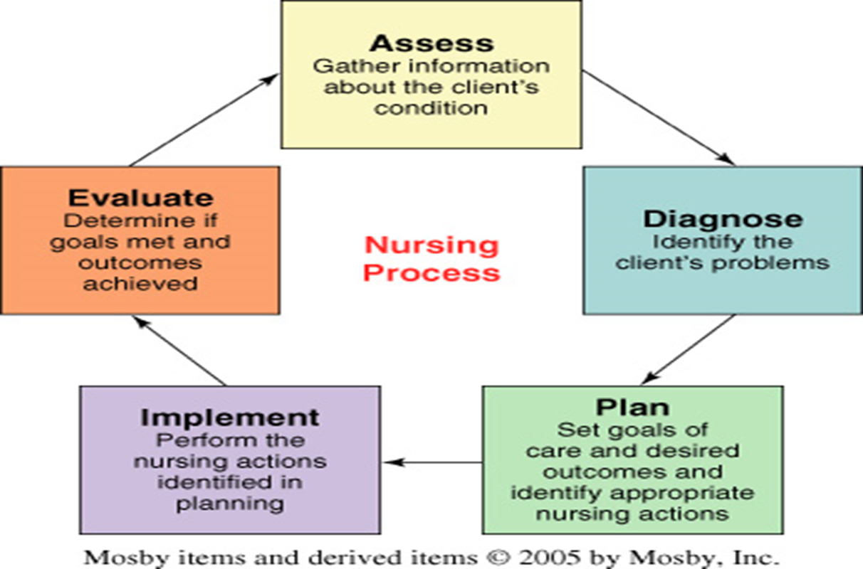

Slide 21
Assessment
First step of the Nursing Process
Gather Information/Collect Data
  Primary Source - Client / Family
  Secondary Source - physical exam, nursing history, team members, lab reports, diagnostic tests…..
  Subjective -from the client (symptom)
    “I have a headache”
  Objective - observable data (sign)
    Blood Pressure 130/80

Slide 22
Sources of Data
1. Non verbal observation
Sight - Physical, psychological (and social)
Touch – Skin, temp, hydration, pulse/BP
Sound - Breath wheeze, stridor
Smell - breath
body fluids infections, gangrene

Slide 23
SOURCES OF DATA
2. Verbal Communication
Patients/ clients
Family and friends (Meaningful others)
Nursing colleagues
Medical colleagues
Other members of multidisciplinary team
3. Written records
G.P Letter
Transfer letter
Old notes

Slide 24
Assessment-collecting data
Nursing Interview (history)
Health Assessment -Review of Systems
Physical Exam
  Inspection
  Palpation
  Percussion
  Auscultation

Slide 25
contd
Make sure information is complete & accurate
Validate prn
Interpret and analyze data
Compare to “standard norms”
Organize and cluster data

Slide 26
Types of Assessments
Initial
  Performed within a specified time period
  Establishes complete database
Problem-Focused
  Ongoing process integrated with care
  Determines status of a specific problem
Emergency
  Performed during physiologic or psychologic crises
  Identifies life-threatening problems
  Identifies new or overlooked problems
Time-lapsed
  Occurs several months after initial
  Compares current status to baseline

Slide 27
What components are needed for a successful assessment
Good communication
A systematic approach to data collection
Interpretation based on nursing knowledge

Slide 28
Nursing Diagnosis
Second step of the Nursing Process
Interpret & analyze clustered data
Identify client’s problems and strengths
Formulate Nursing Diagnosis (NANDA : North American Nursing Diagnosis Association)-Statement of how the client is RESPONDING to an actual or potential problem that requires nursing intervention

Slide 29
A nursing diagnosis is a statement that describes the client’s actual or potential response to health problem is licensed and competent to treat.
Nursing diagnoses provide the basis for selection of nursing interventions to achieve outcome for which the nurse is accountable.

Slide 30
Characteristics of Nursing Diagnoses
Complement physician treatments
Separate and distinct
Structure of Nursing Diagnoses
Nursing Dx is a problem statement of how the client is RESPONDING to a problem…it may be an actual or potential problem
Interpreted data is clustered in according to body systems, risk factors, family factors, emotional factors etc.

Slide 31
Types of Nursing Diagnoses
Actual nursing diagnosis
existing response to condition
problem exists
supporting signs and/or symptoms
Risk Nursing Diagnoses
Possible development of problem
Has not occurred
No signs or symptoms
NANDA describes Risk Diagnosis as:
  “a clinical judgment made when a client is more vulnerable to develop the problem than others in the same or similar situations.”

Slide 32
A wellness diagnosis
Describes human responses to levels of wellness in an individual, family or community that have a readiness for enhancement e.g readiness for enhanced family coping.
A possible nursing diagnosis
Evidence about a health problem is incomplete or unclear e.g possible social isolation related to unknown cause in an elderly lady admitted and has none visiting her.
A syndrome diagnosis
Associated with a cluster of other diagnoses e.g risk for disuse syndrome in bed-ridden patients.

Slide 33
QUALIFIERS FOR DIAGNOSIS
Acute= Severe but short duration
Alter= a change from baseline
Chronic= Lasting along time, recurring, constant
Decrease= lessened
Increase = greater in size
Deficient=inadequate in amount, not sufficient
Depleted= empty, exhausted of..
Disturbed= agitated, interrupted
Dysfunction=abnormal

Slide 34
Excessive= Quantity is greater
Impaired =made worse, damage
Ineffective =Not producing the desired effect
Potential for =powerful
Risk =hazard, chance of loss
Hypothermia= body temperature is reduced below normal
Hyperthermia =body temperature is elevated above normal
Enhanced = made greater, increase quality

Slide 35
DIAGNOSIS
NURSING DIAGNOSIS IS NOT MEDICAL DIAGNOSIS
Nursing Dx
describes the response to health problem
Determined by the nurse
Clinical judgment about the client
Human responses to disease or treatment
Medical Dx - Diagnoses disease
- Determined by physician

Slide 36
Nsg Dx vs MD Dx
Within the scope of nursing practice
Identify responses to health and illness
Can change from day to day
Within the scope of medical practice
Focuses on curing pathology
Stays the same as long as the disease is present

Slide 37
Formulating a Nursing Diagnosis
Composed of 3 parts:
Problem statement- the client’s response to a problem
Etiology- what’s causing/contributing to the client’s problem
Defining Characteristics- what’s the evidence of the problem

Slide 38
Nursing Diagnosis
Problem( Diagnostic Label)-based on your assessment of client…(gathered information), pick a problem from the NANDA list...
Etiology- determine what the problem is caused by or related to.
Defining characteristics- then state as evidenced by (AEB) the specific facts the problem is based on...

Slide 39
NANDA NURSING DIAGNOSES
The purpose of NANDA is to define, refine and promote a taxonomy of nursing diagnostic terminology of general use to professional nurses.
A taxonomy is a classification system or set of categories arranged on the basis of a single principle or set of principles.
Diagnosing refers to the reasoning process.
Diagnosis is a statement or conclusion regarding the nature of a phenomenon.

Slide 40
NANDA NURSING DIAGNOSES
COMPONENTS
Problem (diagnostic label) and its definition.
Etiology
Defining characteristicts.

Slide 41
PROBLEM (DIAGNOSTIC LABEL) AND DEFINITION
Describes the client’s health problem or response for which nursing therapy is given.
Describes the client’s health status clearly and concisely.
Purpose is to direct formation of client goals and desired outcomes.

Slide 42
ETIOLOGY (RELATED FACTORS AND RISK FACTORS)
Identifies one or more probable causes of the health problem, gives direction to the required nursing therapy and enables the nurse to individualize care.
Differentiating among possible causes in the nursing diagnosis is essential because each may require different nursing interventions.

Slide 43
DEFINING CHARACTERISTICS
Are the cluster of signs and symptoms that indicate the presence of a particular diagnostic label.
For actual nursing diagnosis, the defining characteristics are the client’s signs and symptoms.
For risk nursing diagnoses, the factors that cause the client to be more than “normally” vulnerable to the problem form the etiology of a risk nursing diagnosis.

Slide 44
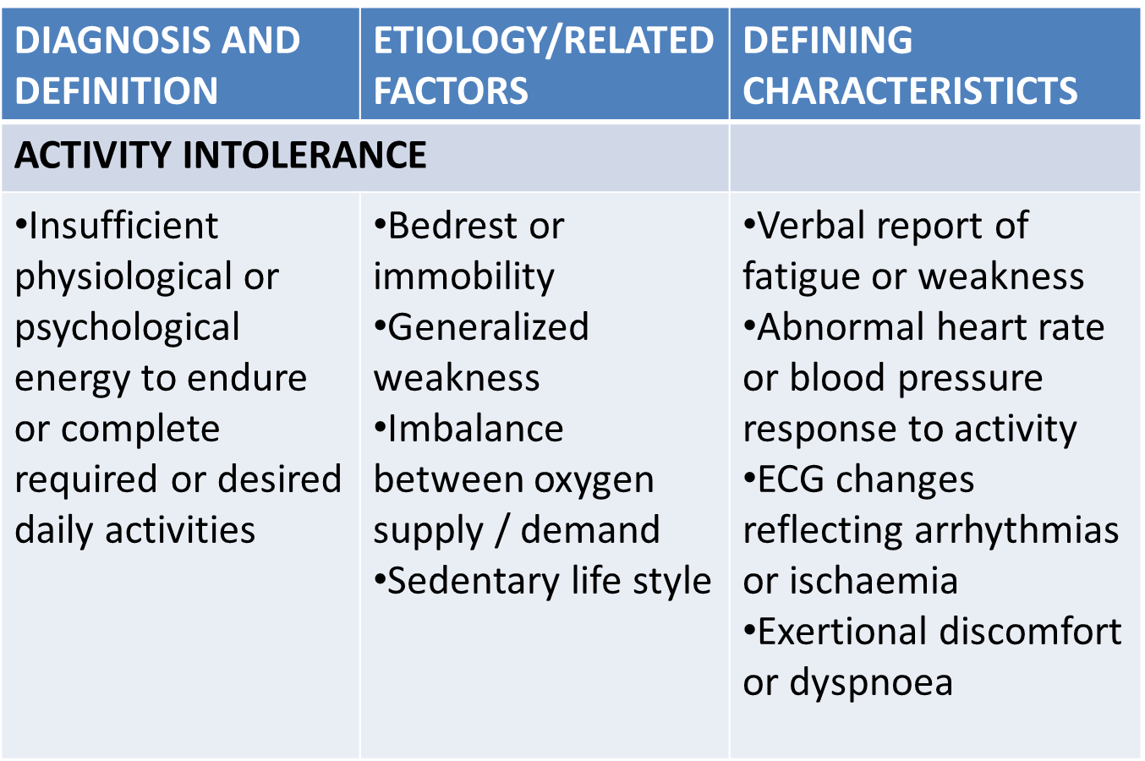
COMPONENTS OF NURSING DIAGNOSIS LABEL

Slide 45
DIAGNOSTIC PROCESS
Uses the critical thinking skills of analysis and synthesis
Used continuously by nurses
Has 3 steps
Analyzing data – compare data against standards; cluster cues; Identify gaps and inconsistencies
Identifying health problems, risks and strengths

Slide 46
Formulating diagnostic statements
– basic two-part statements (problem/etiology), the two parts are joined by the words related to rather than due to. Due to implies that one part causes the other part
Basic three-part statements (problem/etiology/signs and symptoms)- cannot be used for risk diagnosis
One part statements e.g wellness and syndrome nursing diagnosis; consist one label only; more specific e.g rape-trauma syndrome, readiness for enhanced parenting

Slide 47
VARIATIONS OF BASIC FORMATS
Writing unknown etiology when the defining characteristics are present but the nurse does not know the cause or contributing factors
Using the phrase complex factors when there are too many etiologic factors.
Using the word possible to describe either the problem or the etiology
Using secondary to divide the etiology into two parts, thereby making the statements more descriptive and useful
Adding a second part to the general response to make it more specific e.g impaired skin integrity (left lateral ankle)

Slide 48
AVOIDING ERRORS IN DIAGNOSTIC REASONING
Verify
Build a good knowledge base and acquire clinical experience
Have a working knowledge of what is normal – vital signs, lab tests, breath sounds
Consult resources – literature, colleagues
Base diagnoses on patterns – on behaviour over time rather than on an isolated incident
Improve critical thinking skills – help to avoid errors in thinking e.g overgeneralization, stereotyping

Slide 49
Planning
Third step of the Nursing Process
This is when the nurse organizes a nursing care plan based on the nursing diagnoses.
Nurse and client formulate goals to help the client with their problems
Expected outcomes are identified
Interventions (nursing orders) are selected to aid the client reach these goals.

Slide 50
PLANNING
Planning is a deliberative, systematic phase of the nursing process that involves decision making and problem solving.
TYPES OF PLANNING
Initial planning – on admission, the nurse who performs admission assessment develops a comprehensive care plan.
Ongoing planning – done by all nurses who work with the client.
Discharge planning – begins at first client contact and involves comprehensive and ongoing assessment to obtain information about the client’s ongoing needs.

Slide 51
Effective planning depends on the quality and comprehensiveness of the assessment
Determine the problems
Establish the risks and priorities - How ill are they?
Can they breath adequately (safe airway?)
Are they in pain? (physical/ psychological)
Can they maintain a safe environment? If not why not? (Drugs, drink, mental or psychological problem?)
Noncompliance with medical advice

Slide 52
Goals
􀂃 Client centered
􀂃 Focus on the behavior
􀂃 Describe intended or desired change
Expected Outcome
􀂃 Leads to fulfillment of goal
􀂃 Resolution of the problem
􀂃 Nursing Interventions
􀂃 Planned actions
􀂃 Promotes goal attainment

Slide 53
PLANNING PROCESS
Setting priorities
Establishing client goals/ desired outcomes
Selecting nursing interventions
Writing nursing orders

Slide 54
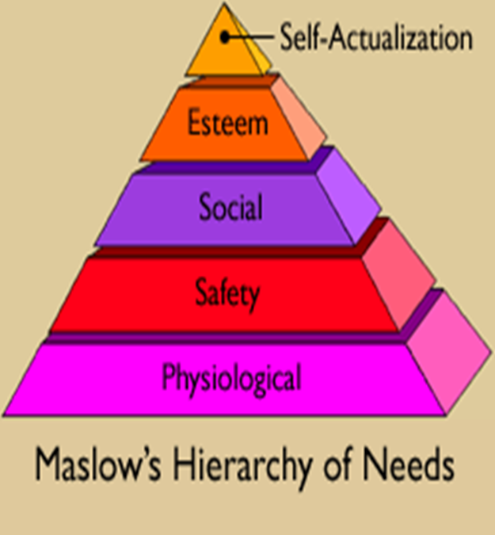
Planning – Begin by prioritizing client problems
Prioritize list of client’s nursing diagnoses using Maslow
Rank as high, intermediate or low
Client specific
Priorities can change

Slide 55
Goals are patient-centered and
SMART
Specific
Measurable
Attainable
Relevant
Time Bound
Pt will walk 50 ft.
Pt will eat 75% of meal
Pt will be OOB 2-4hrs
Pt will maintain HR<100
Pt will state pain level is acceptable 6 (0-10)

Slide 56
Planning
Developing a goal and outcome statement
Goal and outcome statements are client focused.
Worded positively
Measurable, specific observable, time-limited, and realistic
Goal = broad statement
Expected outcome = objective criterion for measurement of goal

Slide 57
EXAMPLE
Goal:
Client will achieve therapeutic management of disease process….
Outcome Statement:
B/P readings of
110-120 / 70-80 and client statement of understanding importance of dietary sodium restrictions by day of discharge.

Slide 58
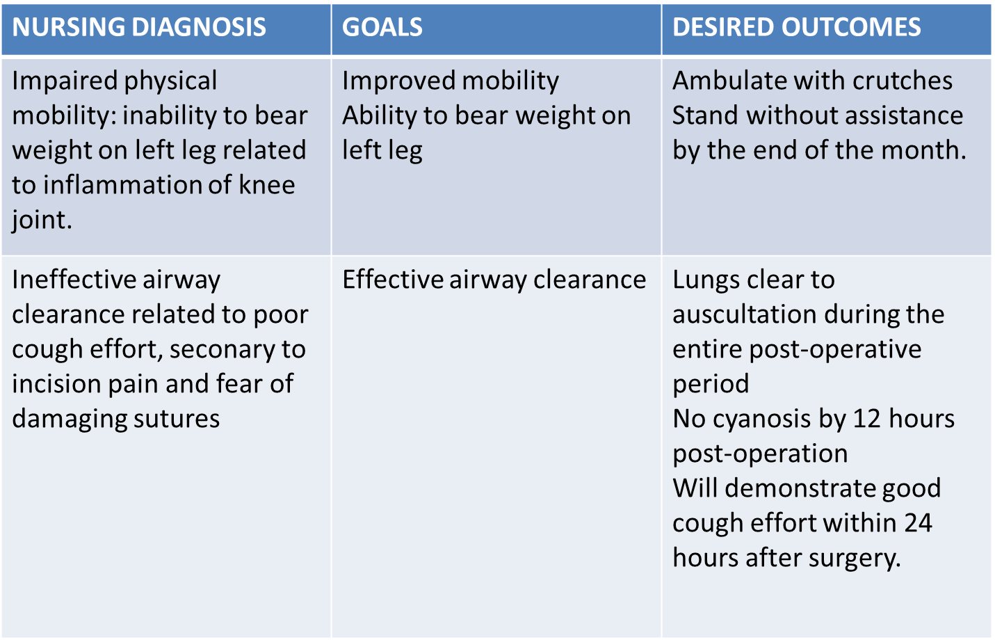
PURPOSE OF DESIRED OUTCOME/ GOAL

Slide 59
Planning-select interventions
Interventions are selected and written.
The nurse uses clinical judgment and professional knowledge to select appropriate interventions that will aid the client in reaching their goal.
Interventions should be examined for feasibility and acceptability to the client
Interventions should be written clearly and specifically.

Slide 60
Interventions – 3 types
Independent ( Nurse initiated )- any action the nurse can initiate without direct supervision
Dependent ( Physician initiated )-nursing actions requiring MD orders
Collaborative- nursing actions performed jointly with other health care team members

Slide 61
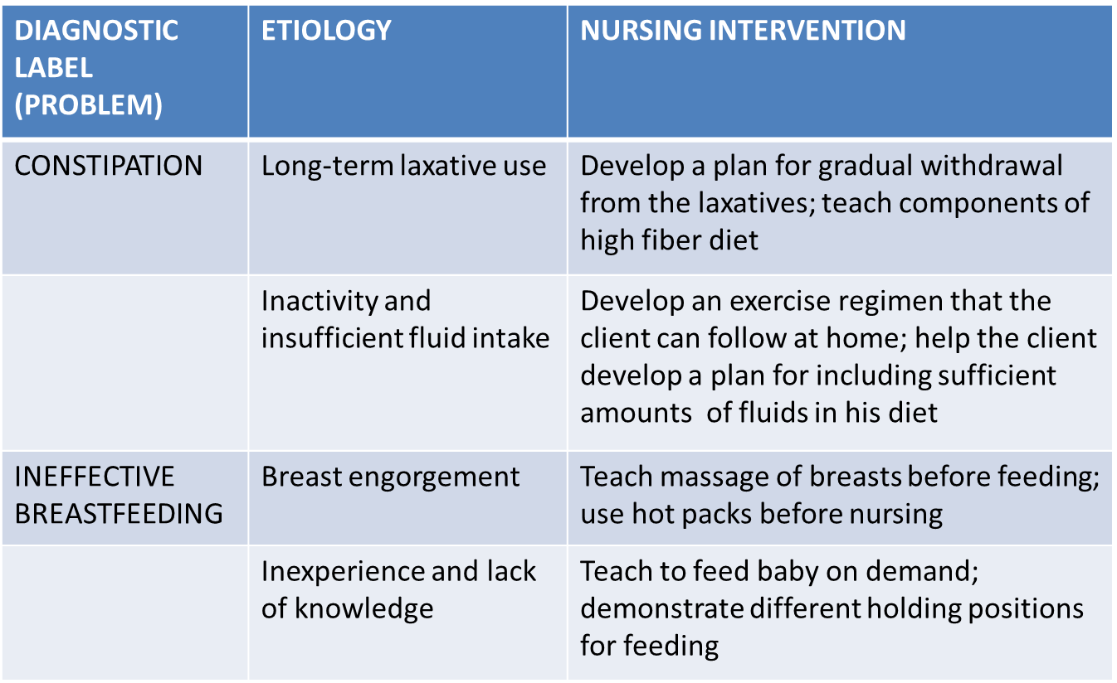
NURSING INTERVENTIONS TO ADDRESS DIFFERENT ETIOLOGIES

Slide 62
Implemention
The fourth step in the Nursing Process
This is the “Doing” step
Carrying out nursing interventions (orders) selected during the planning step
This includes monitoring, teaching, further assessing, reviewing NCP, incorporating physicians orders and monitoring cost effectiveness of interventions
Utilize nursing intervention classification (NIC) as standard

Slide 63
Consists of doing and documenting the activities that are the specific nursing actions needed to carry out the interventions(or nursing orders).
Provides the actual nursing activities and client responses that are examined during the final phase.

Slide 64
Executing the care plan
Interventions are performed
Assessment before, during, and after
Report and document
Includes:
􀂃 Putting the care plan into action
􀂃 Carrying out planned interventions
􀂃 Assessing, reporting, documenting

Slide 65
Five activities of the implementing phase
Five Activities of the Implementing Phase
  Reassessing the client
  Determining the nurse’s need for assistance
  Implementing nursing interventions
  Supervising delegated care
  Documenting nursing activities

Slide 66
IMPLEMENTING SKILLS
Cognitive/ intellectual skills – include problem solving, decision-making, critical thinking and creativity.
Interpersonal skills – are all of the activities, verbal and nonverbal, people use when interacting directly with each other.
Technical skills – are ‘hands-on’ skills/ tasks/procedures/psychomotor skills.

Slide 67
PROCESS OF IMPLEMENTING
INCLUDES:-
Reassessing the client
Determining the nurse’s need for assistance
Implementing the nurse’s interventions
Supervising the delegated care
Documenting the nursing activities

Slide 68
GUIDELINES
Base nursing interventions on scientific knowledge, nursing research and evidence-based practice.
Clearly understand the orders to be implemented and question any that are not understood.
Adapt activities to individual client.

Slide 69
Implement safe care e.g infection prevention
Provide teaching, support and comfort.
Be holistic
Respect the dignity of the client and enhance the client’s self-esteem; encourage clients to make own decisions
Encourage clients to participate actively in implementing the nursing interventions.

Slide 70
RATIONALE
A rationale is the scientific principle given as the reason for selecting a particular nursing intervention.

