Slide 1
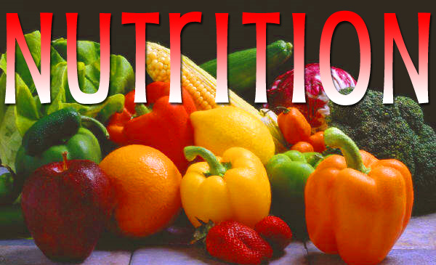

Slide 2
OBJECTIVES
Describe the essential nutrients and their importance in promotion of health
Describe the methods utilized in the assessment of nutritional status of individuals and community
Explain nutrition requirements in the various lifecycle
Discuss the etiology, manifestations, and the management of nutrient deficiency and eating disorders
Describe the principles of dietary management in various disease conditions

Slide 3
NUTRITION:
Sum total of the processes involved in the taking in and the utilization of food substances by which growth, repair and maintenance of the body are accomplished or the process of providing or obtaining the food necessary for health and growth.
Involves ingestion, digestion, absorption and assimilation.
Community Nutrition: The social, economic, cultural and psychological implications of food and eating.

Slide 4
Essential nutrients A nutrient that cannot be synthesized in the body, therefore must be eaten in the diet or are compounds that the body can't make or can't make in sufficient quantity. According to the World Health Organization , these nutrients must come from food, and they're vital for disease prevention, growth, and good health. There are seven major classes of nutrients: carbohydrates, fats, dietary fiber, minerals, proteins, vitamins, and water.
Non essential nutrient – Those nutrients that can be synthesized in the body or an be synthesized by the human body, so they need not be obtained directly from food eg dietary fibre, non essential AA

Slide 5
Food: any nourishing substance that is eaten, drunk, or otherwise taken into the body to sustain life, provide energy, promote growth, etc.
Energy – Measured and expressed in units of work (joules) or units of heat (kilocalories)
Kilocalorie (kcal)- Amount of heat required to raise the temperature of 1 litre of water by 1 degree celcius.
Example
1kcal = 4185 joules (J) = 4.184 kilojoules (kJ)
1 gram of carbohydrate provides 17kilojoules (?kcal)
1 gram of proteins provides 17 kilojoules (?kcal)
1 gram of fat provides 38 kilojoules (? kcal)

Slide 6
Balanced diet- Essential composition that provides the appropriate amount of all nutrients in the correct proportion to meet body requirements or is a diet that contains differing kinds of foods in certain quantities and proportions so that the requirement for calories, proteins, minerals, vitamins and alternative nutrients is adequate and a small provision is reserved for additional nutrients to endure the short length of leanness. It can be assessed by calculating BMI (pg 298)
Diet – is selection of foods eaten by an individual
MALNUTRITION: dictionaryDiseased state caused by over nutrition or under nutrition.
Macronutrient: an essential nutrient required in relatively large amounts, such as carbohydrates, fats, proteins and water;

Slide 7
Micronutrient: A substance essential in minute/small amounts for the proper growth and metabolism of a living organism.
Examples:-
water soluble and fat soluble vitamins (B, C, A, D, E, K)
Minerals (Fe, Ca, P, Na, K)

Slide 8
Importance of good nutrition
Physical and mental dev. of children and adolescents.
Healthy pregnancies and deliveries.
Resistance to infections
To prevent deficiencies i.e. Kwashiorkor & marasmus.
For energy since body needs to function well.
Inadequate nutrition has adverse affects on our sense of wellbeing and can influence our moods, behavior and ability to cope with the stresses and strains of life. Remember a common saying” a hungry man is an angry man!”

Slide 10
Nutrients are classified into six broad groups:-
Carbohydrates
proteins
Fats
Vitamins
Minerals
water.
Water is not technically a nutrient, but it is essential for the utilization of nutrients.
NOTE: The first 2 groups form 2/3 of the diet with the remainder forming 1/3

Slide 11
The five food groups are-
Potatoes, bread, rice, pasta and other carbohydrates
Fruits and vegetables
Dairy and dairy alternatives
Beans, pulses, fish, eggs, meat and other proteins
Oils and spreads

Slide 12
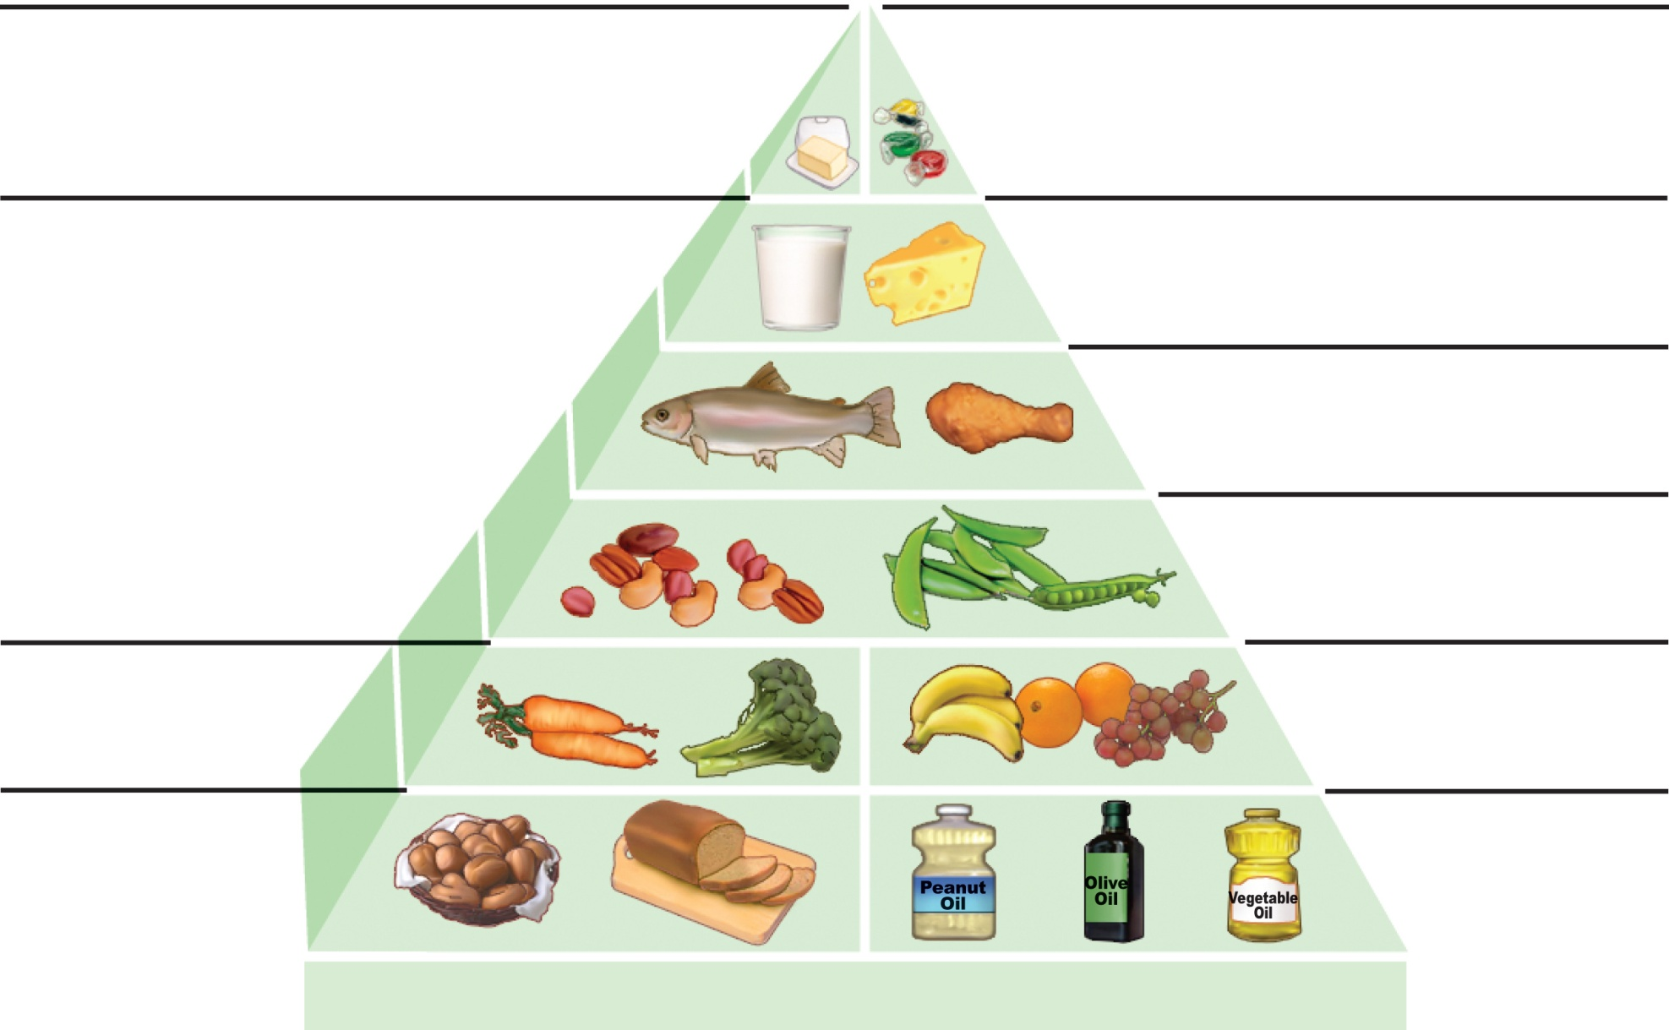
Red meat, butter:
use sparingly
White rice, white bread,
potatoes, pasta, sweets:
use sparingly
Dairy or calcium
supplement: 1–2 servings
Fish, poultry, eggs:
0–2 servings
Nuts, legumes:
1–3 servings
Vegetables in
abundance
Fruits:
2–3 servings
Whole-grain
foods at
most meals
Plant oils
at most
meals
Daily excercise and weight control
(b) Healthy eating pyramid
Figure 24.1b

Slide 13
NUTRIENTS
Nutrient – any chemical compound or substance that is digested, absorbed into blood stream and used to promote body function.

Slide 14
CARBOHYDRATES
Mainly sugars and starches
Most important source of energy.
Contain the elements Carbon, Hydrogen and Oxygen; the H and O are in same proportion as in water.
"carbo-" means they contain Carbon.
"-hydr-" means they contain Hydrogen.
"-ate-" means they contain Oxygen.

Slide 15
Can be classified according to their chemical complexity: i.e. monosaccharide, disaccharides and polysaccharides (build from large number of monosaccharides, some digestible eg glycogen while others are not eg NSP.
Read on glycemic index page 300 and BMI

Slide 16
Calculating BMI
BMI | NUTRITIONAL STATUS
< 18.5 | Underweight
18.5 – 24.9 | Normal weight
 | Overweight
25.0 – 29.9 | Pre obese
 | Obese
30.0 – 34. 9 | Obese class I
35.0 – 39.9 | Obese class II
 | Obese class III

Slide 17
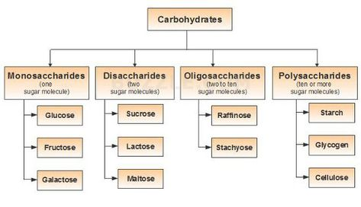

Slide 18
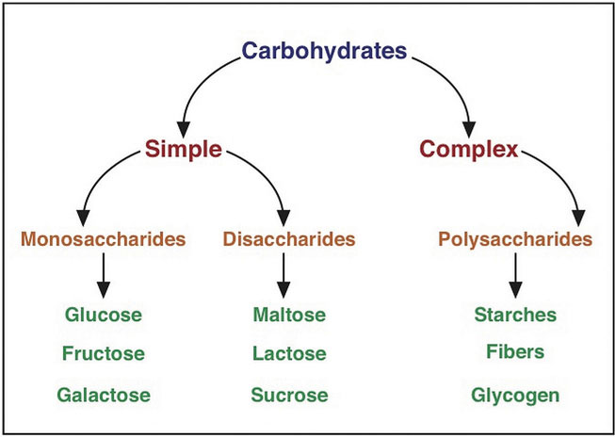

Slide 19
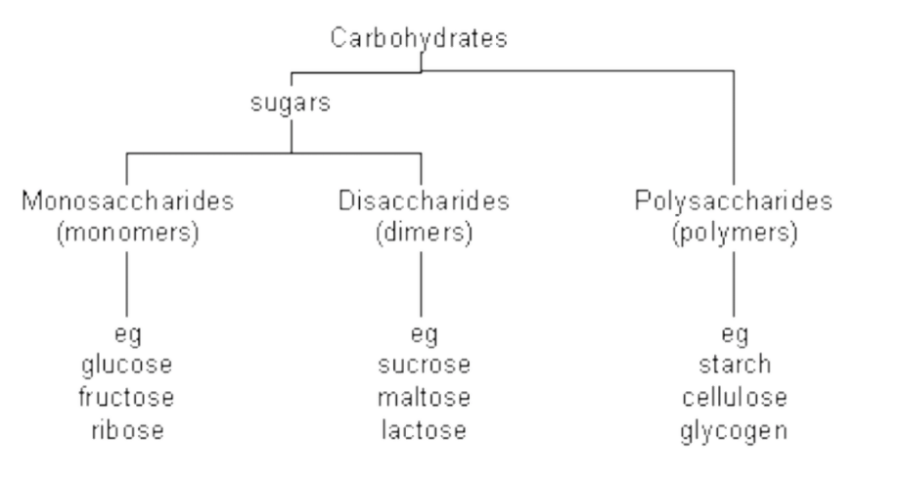

Slide 21
Glucose | From Greek word for sweet wine; grape sugar, blood sugar, dextrose.
Galactose | Greek word for milk--"galact", found as a component of lactose in milk.
Fructose | Latin word for fruit--"fructus", also known as levulose, found in fruits and honey; sweetest sugar.
Ribose | Ribose and Deoxyribose are found in the backbone structure of RNA and DNA, respectively.
Others: Glyceraldehyde

Slide 22
Sucrose | French word for sugar--"sucre", a disaccharide containing glucose and fructose; table sugar, cane sugar, beet sugar.
Lactose | Latin word for milk--"lact"; a disaccharide found in milk containing glucose and galactose.
Maltose | French word for "malt"; a disaccharide containing two units of glucose; found in germinating grains, used to make beer.

Slide 23
Starch | Plants store glucose as the polysaccharide starch. The cereal grains (wheat, rice, corn, oats, barley) as well as tubers such as potatoes are rich in starch.
Cellulose | The major component in the rigid cell walls in plants is cellulose and is a linear polysaccharide polymer with many glucose monosaccharide units.
Glycogen | This is the storage form of glucose in animals and humans which is analogous to the starch in plants. Glycogen is synthesized and stored mainly in the liver and the muscles.
Fibre

Slide 24
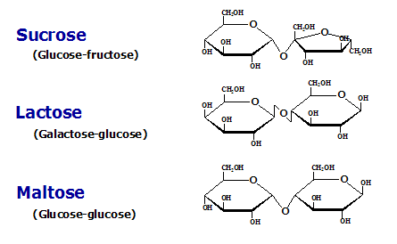

Slide 25
FUNCTIONS (page 276/ 300):
Provide energy and heat. Breakdown of monosaccharides
Sparing use of proteins for energy
Check textbook pg 300

Slide 26
PROTEINS
Essential building blocks of the body broken down into AA.
AA are composed of elements C, H, O, N.
Some contain minerals such as Iron, copper, zinc, iodine, sulphur, phosphate.
AA are divided into the essential and non essential amino acids (page 301)

Slide 27
Biological value is the Nutritional value of a protein measured by how well it meets the nutritional needs of the body.
Proteins of high biological value are of animal origin, easily digested and contain all essential AAs in proportions required by the body (complete proteins).
Proteins of low biological value are of plant origin, digested and contain less essential AAs in proportions required by the body (incomplete proteins).
NOTE: Balance the two

Slide 28
NITROGEN BALANCE (page 301)
State where rate of protein synthesis equals rate of breakdown and loss
Positive nitrogen balance occurs when AA ss meet body needs.(normal in children and tissue repair)
Negative nitrogen balance occurs when AA supply does not meet body needs eg inadequate dietary protein or increased protein requirement (growth or following injury, stress, burns, infection or surgery).

Slide 29
Proteins
Dietary sources
Eggs, milk, fish, and most meats contain complete proteins
Legumes, nuts, and cereals contain incomplete proteins (lack some essential amino acids)
Legumes and cereals together contain all essential amino acids

Slide 30
Proteins functions (check book page 301)
Antibodies – proteins form antibodies that help prevent infection, illness and disease. These proteins identify and assist in destroying antigens such as bacteria, viruses etc
Transport and storage of molecules eg haemoglobin is a protein that transports oxygen throughout the body, ferritin is a protein that combines with iron for storage in the liver.
Energy – protein is a major source of energy if you consume more than the body needs for body tissue maintenance and other necessary functions
Enzymes – Are proteins
Hormones – Proteins is involved in the creation of some hormones eg insulin, secretin.
Repair and maintenance – Protein is vital in maintenance of body tissue including development and repair, hair, skin, eyes, muscles and organs are made of proteins. This is why children need more protein than adults since they are growing and developing new protein tissue.

Slide 31
Proteins
Use of amino acids in the body
All-or-none rule
All amino acids needed must be present for protein synthesis to occur
Adequacy of caloric intake
Protein will be used as fuel if there is insufficient carbohydrate or fat available

Slide 32
Proteins
Hormonal controls
Anabolic hormones (GH, sex hormones) accelerate protein synthesis

Slide 33
Complete Proteins Versus Incomplete Proteins

Slide 34
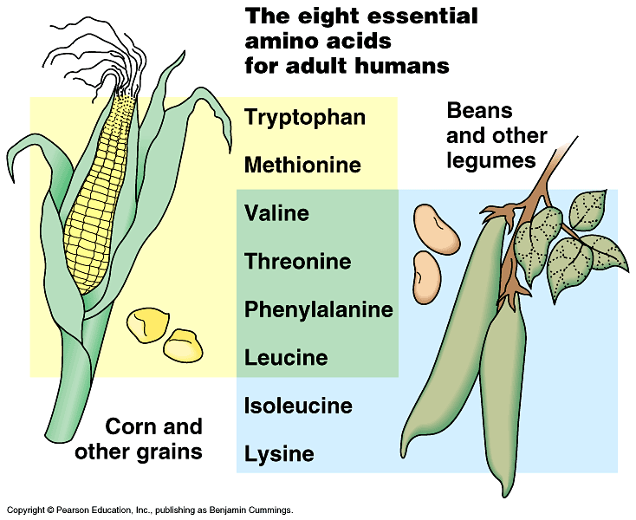

Slide 35
FATS
Made up of C, H, O ; H and O are not in the same proportion as in water.
Some have additional elements N and phosphorus
Consist of a group of compounds that are soluble in organic solvents and insoluble in water.
Fats may be either solid or liquid at room temperature, depending on their structure and composition.
"oils" refer to fats that are liquids at normal room temperature, while "fats" refer to fats that are solids at normal room temperature.

Slide 36
"Lipids" refer to both liquid and solid fats, along with other related substances.
Examples of edible animal fats are lard (Pig fat), fish oil, and butter.
Examples of edible plant fats include peanut, soya bean, sunflower, sesame, coconut, olive, and vegetable oils.

Slide 37
Types of Fat
Saturated Fats: the carbon atoms are saturated with hydrogen; meaning they are bonded to as many hydrogen as possible.
They can freeze easily and are typically solid at room temperature. Mostly from animal sources.
Unsaturated Fats: A carbon atom may instead bond to only one other hydrogen atom, and have a double bond to a neighboring carbon atom.
Mostly liquid, and from plant sources.

Slide 38
Functions of Fats.
Fats maintain healthy skin and hair, insulating body organs against shock, maintaining body temperature, and promoting healthy cell function.
Fat also serves as a useful buffer towards a host of diseases. i.e. toxic substances can be stored in fats so until they are eliminated, this protects harming of vital.
A source of energy – Body system turns to fat as a back up energy source when carbohydrates are not available.
Vitamin absorption – Some types of vitamins rely on fat for absorption and storage; Vitamins ADEK cannot function without adequate daily fat intake.

Slide 39
VITAMINS
Chemicals required in very small amounts for essential metabolic processes.
Most cannot be made by the body (essential).
Divided into:-
Fat soluble vitamins
Water soluble vitamins: B complex and C

Slide 40
FAT SOLUBLE VITAMINS
Vitamin A (Retinol) – Foods include cream, eggyolk, liver, fish oil, milk, cheese, green vegetables, orange coloured fruit, carrots and butter.
Function
Generation of rhodopsin (light sensitive pigment)
Cell growth and differentiation esp epithelial cells covering internal and external organs
Promote immunity and defense against infection
Promote growth esp bones
Deficiency – Night blindness, xerophthalmia

Slide 41
Vitamin D
Found in animal fats (eggs, butter, cheese, fish liver oils).
Function
Increase calcium and phosphate absorption
Calcium and phosphate retention in the kidneys
Promotes calcification of bones and teeth.
Deficiency – rickets in children and osteomalacia in adults
Notes:
Calciferol

Slide 42
Vitamin E (tocophel)
Found in nuts, eggyolk, wheat germ, whole cereal, milk and butter.
Function
Antioxidant
Protect against CAD

Slide 43
Vitamin K
Sources are liver, vegetable oils, green leafy vegetables.
Synthesized by bacteria in the LI.
Liver require Vit K for production of prothrombin and clotting factors (VII, IX, X).
Function- Essential for blood clotting
Deficiency – Prevents normal blood coagulation

Slide 44
THE B-COMPLEX VITAMINS,
The B vitamins are a group of water-soluble vitamins that promote enzyme activities involved in chemical breakdown (catabolism) of nutrients to release energy.
They include the following:
Vitamin B1 (thiamin)
Vitamin B2 (riboflavin)
Vitamin B3 (niacin)
Vitamin B5 (pantothenic acid)
Vitamin B6 (pyridoxine, pyridoxal, or pyridoxamine, or pyridoxine hydrochloride)
Vitamin B7 (biotin)
Vitamin B9 (folic acid)
Vitamin B12 (various cobalamins; commonly cyanocobalamin in vitamin supplements)

Slide 45
General Benefits of Vit. B complex
The B vitamins may be necessary in order to:
Support and increase the rate of metabolism
Maintain healthy skin and muscle tone
Enhance immune and nervous system function
Promote cell growth and division, including that of the red blood cells that help prevent anemia
Reduce the risk of pancreatic cancer - one of the most lethal forms of cancer - when consumed in food, but not when ingested in vitamin tablet form.

Slide 46
Sources of Vit. B
B vitamins are found in whole unprocessed foods.
B vitamins are particularly concentrated in meat such as turkey and tuna, in liver and meat products.
Good sources for B vitamins include: Whole grains, potatoes, bananas, lentils, chili peppers, beans, nutritional yeast, brewer's yeast, and molasses.

Slide 47
Elevated consumption of beer and other ethanol-based drinks results in a net deficit of those B vitamins and the health risks associated with such deficiencies.
The B12 vitamin is not available from plant products, making B12 deficiency a concern for vegetarians (dietary supplements or injections of B12 can be given.)

Slide 48
Vitamin C
Also known as ascorbic acid.
Functions:
Is an antioxidant, since it protects the body against oxidative stress.
It is also a cofactor in at least eight enzymatic reactions.
Important in wound-healing and in preventing bleeding from capillaries, because helps forming collagen.

Slide 49
Sources
Can not be synthesized by the body.
Must be supplied through diet by eating:
Mainly Citrus fruits such as oranges or lemons.
Other sources rich in vitamin C are fruits such as guava, tomatoes, bell peppers, and strawberries.
Vegetables, such as carrots, broccoli, potatoes, cabbage, spinach and paprika.
Some candies and most soft drinks contain vitamin C as a preservative.

Slide 50
Water soluble vitamins
Thiamin B₁
nervous system function, enzymatic energy release of carbohydrates (beef, pork, liver, legumes, breads)
Riboflavin B₂
Participates in enzymatic energy release of carbohydrates, fat & protein (milk, dairy, dark green vegetables, yogurt)
Niacin B₃
Participates in enzymatic energy release of energy nutrients (beef, pork, liver, breads, nuts)
Notes:
Thiamin B1
Type Water Soluble
Forms / Names Vitamin B1
Functions Supports appetite, supports nervous system function, participates in enzymatic energy release of carbohydrates
Deficiencies Beriberi, heart irregularity, edema, mental confusion, central nervous system complications, muscle weakness, impaired growth
Toxicity Rare. Rapid pulse, weakness, headaches, insomnia, irritability
Recommended Intakes RDAs: 0.5 mg / 1000 Kcalories for adults and children 1.0 mg/day minimum Additional 0.4 mg is suggested for pregnant women
Food Sources Beef, pork, liver, legumes, fish, poultry, yeast, whole-grain breads, pasta, nuts
Riboflavin B2
Type Water Soluble
Forms / Names Vitamin B2
Functions Participates in enzymatic energy release of carbohydrate, fat and protein, promotes vision and skin health
Deficiencies Eye problems, weakness, sore throat, skin disorders
Toxicity None known. Possible interference of other B vitamins.
Recommended Intakes RDAs: 1.7 mg/day for adult males 1.3 mg/d for adult females additional 0.3 mg/d during pregnancy additional 0.5 mg/d during lactation 0.4 mg/d for infants
Food Sources Milk / dairy, dark green vegetables, eggs, yogurt, enriched breads/cereals, liver, meat
Niacin Type Water Soluble
Forms / Names Nicotinic acid, Nicotinamide
Functions Participates in enzymatic energy release of energy nutrients; promotes health of nerves, skin and digestive system
Deficiencies Pellagra, dermatitis on body parts exposed to sun, diarrhea, dementia, loss of appetite, weakness, mental confusion, irritability, fatigue
Toxicity Low blood pressure, skin flushing, headaches, ulcer irritation, hepatic/liver abnormalities, nausea
Recommended Intakes RDAs: NE = niacin equivalents 13-19 NE/day for adults additional 2 NE/day during pregnancy additional 5 NE/day during lactation 5-6 NE/day for infants 9-13 NE/day for children, ages 1-10
Food Sources Yeast, meats, eggs, poultry, liver, cereal, legumes, seeds, milk, green leafy vegetables, fish, nuts
FOLATE
Type Water Soluble
Forms / Names Folic acid, folacin
Functions Red blood cell formation, new cell division, protein metabolism
Deficiencies Anemia, diarrhea, smooth tongue, depression, heartburn
Toxicity Insomnia, irritability, diarrhea, may mask B12 deficiency
Recommended Intakes RDA: 400 µg/day for adults 400 µg/d for adult females of childbearing age *see here 600 µg/d during pregnancy 500 µg/d during lactation 150 µg/d for children ages 11-14 years 100 µg/d for children ages 7-10 years 75 µg/d for children 4-6 years 50 µg/d for children 1-3 years 35 µg/d for children six months to 1 year 25 µg/d for infants birth to six months
Food Sources Green leafy vegetables, liver, legumes, seeds, and enriched breads, cereals, rice, and pasta.
Vitamin B12 Type Water Soluble
Forms / Names Vitamin B12, Cobalamin
Functions Red blood cell formation, nervous system maintenance
Deficiencies Anemia, nerve degeneration, paralysis, smooth tongue, fatigue, dementia, depression
Toxicity None known
Recommended Intakes RDAs: (Strict vegetarians should consult a physician or RD for B12 supplements) 2.0 µg/day for adolescents and adults 2.2 µg/d during pregnancy 2.6 µg/d during lactation 1.4 µg/d for children, ages 7-10 1.0 µg/d for children, ages 4-6 1.0 µg/d for children, ages 1-3 0.5 µg/d for infants six months to one year 0.3 µg/d for infants birth to six months
Food Sources Found almost exclusively in animal products. Meats, fish, poultry, milk, eggs, yeast, cheese

Slide 51
Folate (folic acid) B₉
Red blood cell formation, new cell division (vegetables, seeds)
Vitamin B₁₂ (Cobalamin)
Red blood cell formation, nervous system maintainance (animal products)
Pantothenic Acid ()
Biotin (Vitamin H, Coenzyme R)
Vitamin B6 (Pyridoxine)
Vitamin C

Slide 52
FAT SOLUBLE VITAMINS(ADEK)
Small amounts of vitamins A, D, E and K are needed to maintain good health.
Foods that contain these vitamins will not lose them when cooked.
The body does not need these every day and stores them in the liver when not used.
Most people do not need vitamin supplements.
Mega doses of vitamins A, D, E or K can be toxic and lead to health problems.

Slide 53
Unlike water-soluble vitamins that need regular replacement in the body, fat-soluble vitamins are stored in the liver and fatty tissues, and are eliminated much more slowly than water-soluble vitamins.
Because fat-soluble vitamins are stored for long periods, they generally pose a greater risk for toxicity than water-soluble vitamins when consumed in excess.

Slide 54
Fat soluble vitamins
Vitamin A
Essential to vision, fetal development, immune response
Found in dairy products, fish liver oils; as B-carotene found in many plants (e.g. carrots, mango)
Vitamin D
Bone formation, calcium metabolism and absorption
Found in sunlight, egg yolk, dairy products and fish liver oil
Notes:
Vitamin D production by the skin is related to latitude, and the further away from the equator the lower the proportion of the year during which vitamin D can be synthesized. Short UV wavelengths of light are necessary for photoconversion of 7-dehydrocholesterol. Vitamin D is a fat-soluble vitamin that may be absorbed from the intestines or may be produced by the skin when the skin is exposed to ultraviolet light (particularly sunlight). It is converted to its active form by the body in 2 steps, occurring first in the liver and completed in the kidneys. In its active form, vitamin D acts as a hormone to regulate calcium absorption from the intestine and to regulate levels of calcium and phosphate in the bones. Active vitamin D is assisted by the actions of other body hormones.

Slide 55
Vitamin E
Cell membrane construction and maintenance
In fats and oils, green leafy vegetables, poultry, fish
Vitamin K
Blood clotting, protein synthesis
In green leafy vegetables, liver, cabbage

Slide 56
Balanced diet
A balanced diet must contain carbohydrate, protein, fat, vitamins, mineral salts and fibre. It must contain these things in the correct proportions.
Carbohydrates: these provide a source of energy.
Proteins: these provide a source of materials for growth and repair.
Fats: these provide a source of energy and contain fat soluble vitamins.

Slide 57
Vitamins: these are required in very small quantities to keep you healthy.
Mineral Salts: i.e. Iron, Zinc, Calcium etc. are required for healthy teeth, bones, muscles etc..
Fibre: necessary for peristalsis.

Slide 58
Your Cholesterol Level
Cholesterol: <175 mg/dl
Triglycerides: blood fats, 30-175 mg/dl
HDL: Good cholesterol, > 35 mg/dl
LDL: Bad Cholesterol, <130 mg/dl
Chol/HDL ratio: < 4.5 indicates heart disease

Slide 59
Both types of lipoproteins carry fats around in the blood, but to different places and for different purposes.
LDL delivers triglycerides and cholesterol from the liver to tissues, increasing the risk of plaque. In contrast, HDL scavenges excess cholesterol and phospholipids from tissues and returns them to the liver for disposal from the body.
As a result, high levels of LDL-cholesterol in the blood indicate increased risk of heart attack, whereas high levels of HDL-cholesterol are associated with lowered risk.

Slide 60
How much is too much and too little? As a general rule, total cholesterol levels should be less than 200 milligrams per deciliter (mg/dl) of blood, ideally less than 160 mg/dl.
LDL-cholesterol levels should be less than 130 mg/dl, and ideally less than 100 mg/dl.
HDL-cholesterol levels should be at least 35 mg/dl, and ideally 45 mg/dl or higher.
If your cholesterol levels are outside these ranges you should see your doctor for a personalized treatment plan which may include cholesterol-lowering medication.

Slide 61
Even with cholesterol-lowering drugs, it's important to adopt life habits that are healthy for your heart.
These will help bring a larger drop in blood cholesterol levels and reduce risk of heart attack and other chronic diseases.
How does one lower the bad LDL levels without also lowering the good HDL levels? Luckily, the tactics that tend to lower LDL-cholesterol levels usually don't adversely affect HDL-cholesterol. HDL-cholesterol is best raised by increasing activity through exercise, losing weight if you're overweight and quitting smoking if you smoke.

Slide 62
LDL-cholesterol is most affected by diet. The most effective way to lower LDL-cholesterol seems to be to reduce the level of total and saturated fat in the diet.
Lowering total fat is not enough; the focus also needs to be on lowering saturated fat levels and replacing some of the saturated fat you eliminate with monounsaturated fat. In food terms this means trimming meats of visible fat, choosing reduced and non-fat dairy products, reading labels, and eliminating or limiting pastries and high-fat desserts.

Slide 63
In terms of spreads and salad dressings, it means choosing reduced fat products and ones made with canola, olive or peanut oil.
The new margarine products on the market made with sitostanol also can have beneficial cholesterol lowering effects.
And, what about those high-cholesterol foods? They don't simply turn into cholesterol in the blood.
The body primarily uses saturated fat, not dietary cholesterol to make blood cholesterol.

Slide 64
After years of "good egg/bad egg" studies, it appears that people respond in different ways to dietary cholesterol.
About a third of the population responds to a low-cholesterol diet with reduced blood cholesterol levels.
For the rest, the response is minimal. Still, where there's cholesterol, there's usually saturated fat, so prudence is still wise.

Slide 65
Lowering Your Cholesterol Level
Eat healthy
Exercise
Lose wt.
Quit smoking
1 glass of wine or beer
Medications (Lipitor)
Notes:
Cholesterol AHA Scientific Position Cholesterol is a soft, waxy substance found among the lipids (fats) in the bloodstream and in all your body's cells. It's an important part of a healthy body because it's used to form cell membranes, some hormones and is needed for other functions. But a high level of cholesterol in the blood -- hypercholesterolemia -- is a major risk factor for coronary heart disease, which leads to heart attack.
Cholesterol and other fats can't dissolve in the blood. They have to be transported to and from the cells by special carriers called lipoproteins. There are several kinds, but the ones to focus on are low-density lipoprotein (LDL) and high-density lipoprotein (HDL).
What is LDL cholesterol?
Low-density lipoprotein is the major cholesterol carrier in the blood. If too much LDL cholesterol circulates in the blood, it can slowly build up in the walls of the arteries feeding the heart and brain. Together with other substances it can form plaque, a thick, hard deposit that can clog those arteries. This condition is known as atherosclerosis. A clot (thrombus) that forms near this plaque can block the blood flow to part of the heart muscle and cause a heart attack. If a clot blocks the blood flow to part of the brain, a stroke results. A high level of LDL cholesterol (160 mg/dL and above) reflects an increased risk of heart disease. That's why LDL cholesterol is called "bad" cholesterol. Lower levels of LDL cholesterol reflect a lower risk of heart disease.
What is HDL cholesterol?
About one-third to one-fourth of blood cholesterol is carried by HDL. Medical experts think HDL tends to carry cholesterol away from the arteries and back to the liver, where it's passed from the body. Some experts believe HDL removes excess cholesterol from plaques and thus slows their growth. HDL cholesterol is known as "good" cholesterol because a high HDL level seems to protect against heart attack. The opposite is also true: a low HDL level (less than 40 mg/dL) indicates a greater risk. A low HDL cholesterol level also may raise stroke risk.
What is Lp(a) cholesterol?
Lp(a) is a genetic variation of plasma LDL. A high level of Lp(a) is an important risk factor for developing atherosclerosis prematurely. How an increased Lp(a) contributes to heart disease isn't clear. The lesions in artery walls contain substances that may interact with Lp(a), leading to the buildup of fatty deposits.
What about cholesterol and diet?
People get cholesterol in two ways. The body -- mainly the liver -- produces varying amounts, usually about 1,000 milligrams a day. Foods also can contain cholesterol. Foods from animals (especially egg yolks, meat, poultry, fish, seafood and whole-milk dairy products) contain it. Foods from plants (fruits, vegetables, grains, nuts and seeds) don't contain cholesterol.
Typically the body makes all the cholesterol it needs, so people don't need to consume it. Saturated fatty acids are the main culprit in raising blood cholesterol, which increases your risk of heart disease. Trans-fats also raise blood cholesterol. But dietary cholesterol also plays a part. The average American man consumes about 337 milligrams of cholesterol a day; the average woman, 217 milligrams.
Some of the excess dietary cholesterol is removed from the body through the liver. Still, the American Heart Association recommends that you limit your average daily cholesterol intake to less than 300 milligrams. If you have heart disease, limit your daily intake to less than 200 milligrams. Still, everyone should remember that by keeping their dietary intake of saturated fats low, they can significantly lower their dietary cholesterol intake. Foods high in saturated fat generally contain substantial amounts of dietary cholesterol.
People with severe high blood cholesterol levels may need an even greater reduction. Since cholesterol is in all foods from animal sources, care must be taken to eat no more than six ounces of lean meat, fish and poultry per day and to use fat-free and low-fat dairy products. High-quality proteins from vegetable sources such as beans are good substitutes for animal sources of protein.
How does exercise (physical activity) affect cholesterol?
Exercise increases HDL cholesterol in some people. A higher HDL cholesterol is linked with a lower risk of heart disease. Exercise can also help control weight, diabetes and high blood pressure. Exercise that uses oxygen to provide energy to large muscles (aerobic exercise) raises your heart and breathing rates. Regular moderate to intense exercise such as brisk walking, jogging and swimming also condition your heart and lungs.
Physical inactivity is a major risk factor for heart disease. Even moderate-intensity activities, if done daily, help reduce your risk. Examples are walking for pleasure, gardening, yard work, housework, dancing and prescribed home exercise.
How does tobacco smoke affect cholesterol?
Tobacco smoke is one of the six major risk factors of heart disease that you can change or treat. Smoking lowers HDL cholesterol levels.
How does alcohol affect cholesterol?
In some studies, moderate use of alcohol is linked with higher HDL cholesterol levels. However, because of other risks, the benefit isn't great enough to recommend drinking alcohol if you don't do so already.
If you drink, do so in moderation. People who consume moderate amounts of alcohol (an average of one to two drinks per day for men and one drink per day for women) have a lower risk of heart disease than nondrinkers. However, increased consumption of alcohol brings other health dangers, such as alcoholism, high blood pressure, obesity, stroke, cancer, suicide, etc. Given these and other risks, the American Heart Association cautions people against increasing their alcohol intake or starting to drink if they don't already do so. Consult your doctor for advice on consuming alcohol in moderation.

Slide 66
Minerals
Major “Bone” Minerals Trace Minerals
Calcium (bones) Iodine (thyroid function)
Phosphorus (DNA) Iron (hemoglobin)
Magnesium (bones) Zinc (enzyme, hormone)
Sodium (nerve impulse) Copper (abs. of iron)
Chloride (fluid balance) Flouride (bone & teeth)
Notes:
Major minerals: “Bone minerals”
Neural signalling
Calcium – 1kg of calcium in adult skeleton

Slide 67
Water
Solvent in which the chemistry of life occurs
cell chemistry occurs in an aqueous medium
water carries essential nutrients to cells
water carries metabolic wastes away from cells
hydrolysis & dehydration reaction
stabilizes body temp
Notes:
Need 1.5 l/day

Slide 68
For adults, 1–1.5 mls water of energy expenditure is usually sufficient to allow for normal changes in physical activity, sweating, and dietary solute load.
Water losses consist of 50–100 mL/day through faeces, 500–1000 mL/day by evaporation, and approximately 1000 mL/day through urine.

Slide 69
Functions of water
Provide the solvent and medium for the metabolic processes of the body.
Diluting waste products and toxins in the body
Moistening of food for swallowing
Regulate of body temperature- as a constituent of sweat which is secreted onto the skin, it evaporates cooling the body surface.
Being the major constituent of blood and tissue fluid, it transports substances round the body and from body cells
Provide medium for excretion of waste products eg urine and feces

Slide 70
Dilution of waste products and poisonous substances in the body
Providing the medium for the excretion of waste products e.g. urine and faeces
Bread contain – 35%
Cereal - 10%
Oranges/carrots- 85%
Bananas, beef and eggs -75%

Slide 71
Tomatoes - 95%
Milk - 75%
Most of the water we consume is obtained from , soup and vegetables

Slide 72
NON STARCH POLYSACCHARIDE
Indigestible part of the diet
Consist of bran, cellulose and other polysaccharides found in fruits, vegetables and cereals.

Slide 73
Functions
Provide bulk to the diet
Satisfy the appetite – prevent constipation
Stimulates peristalsis – prevent constipation
Attract water increasing fecal bulk
Protect against some GI disorders eg colorectal cancer and diverticular disease

Slide 74
Summary: Nutritional requirements
In order to live and function, humans need macro- and micro- nutrients;
Macro-nutrients are fat, protein and carbohydrates;
Micro-nutrients are water-soluble vitamins, fat-soluble vitamins, and minerals (bone and trace); the most critical micro-nutrients are iron, iodine, zinc, vitamin A and vitamin D.

Slide 75
NUTRITION IN CHILDREN

Slide 76
Terminologies
Hunger – physiological state when food not able to meet energy needs
Malnutrition – impaired development linked to both deficient and excessive nutrient intake
Under nutrition – most common form of malnutrition in developing countries; energy, protein and micronutrients

Slide 77
Nutrition and the Physiology of Malnutrition

Slide 78
Overview of Nutritional Requirements
Definition of Malnutrition
Causes and correlates of Malnutrition
Measurement and Types of Malnutrition
Severe Malnutrition
Mild/Moderate Malnutrition (Underweight and Stunting)
Specific Nutritional Deficiencies (Iodine and Iron)

Slide 79
Dietary Reference Intakes
Macronutrient | F (19-30 y.o.) | M (19-30 y.o.)
Energy (Kcal) Protein (g) | 1940 – 2200 36 – 46 | 2550 – 2900 44 – 60
Fat | 15 – 33% | 15 – 33%

Slide 80
What is malnutrition?
World Health Organization definition:
The term is used to refer to a number of diseases, each with a specific cause related to one or more nutrients (for example, protein, iodine or iron) and each characterized by cellular imbalance between the supply of nutrients and energy on the one hand, and the body's demand for them to ensure growth, maintenance, and specific functions, on the other.

Slide 81
Summary: Definition of malnutrition
Malnutrition is having the inappropriate level of a micro- or macro- nutrient;
In some cases, malnutrition can be associated with being grossly overweight;
In most of the world, malnutrition is defined as a LACK of nutrients;
Malnutrition contributes to over 50% of deaths in children in the world.

Slide 82
Causes of malnutrition
Child malnutrition
death and disability
Inadequate Disease
Diet
Poor water/ sanitation
inadequate health
services
Inadequate
maternal and
child care
Insufficient
access to food

Slide 83
1 Unsafe Water
1% urban and 38% rural households do not have access to safe water
Inadequate Sanitation
21% urban and 75% rural households do not have access to adequate sanitation Poor Education
25% of girls and 19% of boys do not enter primary school;
54% of girls and 45% of boys do not enter secondary school

Slide 84
Poverty
28% of the population lives at below $1 per day
Poor Stimulation
39% of females and 21% of males over the age of 15 cannot read or write
199 radios per 1000 population; 154 TV’s per 1000 population
Poor Public Health
About 30% of 1-year olds are not fully immunized for TB, DPT (Diptheria, Pertussis, and Tetanus), polio and measles

Slide 85
No Breastfeeding
Babies are twins (boy and girl)
Mother was told that she wouldn’t have enough breast milk for both, so should bottle feed girl . . .
girl died the day after this
56% babies in developing countries are not breastfed from 0-3 months

Slide 86
Summary: Causes/correlates
Malnutrition rarely exists in isolation, and many other factors contribute to its detrimental impact;
Poor physical resources, and overcrowded homes
Poor sanitation and water supply
Low income
Parents with little education
Minimal interaction/stimulation in the home
Malnutrition has repercussions throughout the life cycle and is thus multi-generational.

Slide 87
Types of malnutrition
Severe Protein-Energy Malnutrition (>3 S.D.)
Kwashiorkor (low protein)
Marasmus (low calories)
Mild/moderate undernutrition (>2 S.D.)
Stunting
Underweight
Wasting
Micro-nutrient deficiency
Iodine
Iron
Vitamin A
Vitamin D

Slide 88
Measurement of Malnutrition
STUNTING: Height for age – height compared to a reference population of the same age.
= represents long term growth retardation
UNDERWEIGHT: Weight for age – weight compared to age in a reference population
WASTING: Weight for height – weight compared to a reference population of the same height.

Slide 89
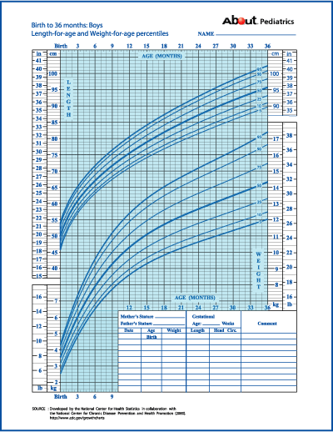
Growth Curves (0-3 years)
Length/
Height
Weight
Age

Slide 90
Summary: Measurement
There are several types of malnutrition, micro- and macro-malnutrition;
Measurement of severe malnutrition (>3 S.D.) and micro-nutrient deficiency usually occurs due to presence of critical signs
Measurement of mild/moderate malnutrition (>2 S.D.) occurs with growth charts.

Slide 91
Kwashiorkor:
Sudden food deprivation due to natural or manmade emergencies produces a condition known as kwashiorkor.
Apathy, swelling (oedema) of the extremities, torso and face, cracked, peeling, infection-prone skin and unnaturally blond, sparse hair are its visible characteristics.

Slide 92
Kwashiorkor (low protein)
Decreased muscle mass (failure to gain weight and of linear growth)
Swollen belly (edema and lipid build-up around the liver)
Changes in skin pigment (pellagra); may lose pigment where the skin has peeled away (desquamated) and the skin may darken where it has been irritated or traumatized
Hair lightens and thins, or becomes reddish and brittle.

Slide 93
Increased infections and increased severity of normally mild infection, diarrhea
Apathy, lethargy, irritability
➔ Death does not occur from actual starvation but from secondary infection

Slide 94
Kwashiorkor – mechanisms
Occurs in reaction to emergency situations (famine)
Kwashiorkor more likely in areas where cassava, yam, plantain, rice and maize are staples, not wheat
Increased carbohydrate intake with decreased protein intake eventually leads to edema (water) and fatty liver

Slide 95
Marasmus
Deficit in calories – “marasmus” comes from Greek origin of word “to waste”
Gross weight loss
Hyper-alert and ravenously hungry
Children have no subcutaneous fat or muscle
eventually starve to death (immediate cause often is pneumonia)
As a result, fat and muscle tissue are depleted, and the skin hangs in loose folds with the bones clearly visible beneath.
Hyper-alert and ravenously hungry, this child's severe wasting
Notes:
As a result, fat and muscle tissue are depleted, and the skin hangs in loose folds with the bones clearly visible beneath. Hyper-alert and ravenously hungry, this child's severe wasting

Slide 96
Marasmus – mechanism
Energy intake is insufficient for body’s requirements – body must draw on own stores
Liver glycogen exhausted in a few hours – skeletal muscle protein used via gluconeogenesis to maintain adequate plasma glucose
When near starvation is prolonged, fatty acids are incompletely oxidized to ketone bodies, which can be used by brain and other organs for energyHigh cortisol and growth hormone levels
➔ Mechanism is same as anorexia

Slide 97
Severe Malnutrition Consequences
Mental development
Lower IQ levels
Poorer school performance
Behaviors of recovered severely malnourished children
shy, isolated, withdrawn
decreased attention span
immature, emotionally unstable
fewer peer relationships/reduced social skills
played less/stayed nearer to mothers

Slide 98
Summary: Severe malnutrition
Severe malnutrition is defined as > 3 s.d. away from median reference standards;
66M children under the age of 5 are severely malnourished (64M of these in developing countries);
Key types of severe malnutrition are kwashiorkor (low protein) and marasmus (low calories);
Severe malnutrition results in severe deficits for children

Slide 99
Stunting – Height for Age
Height for age reflects pre- and post- natal linear growth
“Stunting” refers to shortness that is not genetic, but due to poor health or nutrition
Most standard definition < 2 S.D.
Stunting is good cumulative measure of “well-being” for populations of children (because not affected by weight recovery)

Slide 100
Stunting
These girls are:
From same school and the same
neighborhood
Both have the same birthday

Slide 101
Stunting: Causes
Poor nutrition plays major role
Role of environment: improvements in average height shown by populations over last century (impact of genetic influence subsumed by level of socio-economic development)
In 1833, British children were as tall as children today from India and Guatemala
All immigrant populations have same height after 3 generations in US

Slide 102
Stunting: Timing
Age of onset varies, but usually in first 2-3 years of life
First few months, infants in developing countries grow just as quickly as children in reference populations
Growth retardation starts from 2-6 month of life (often associated with weaning)
Infants at risk during this time because of high nutritional requirements and high rates of infections (breast fed infants often protected)

Slide 103
Stunting: Consequences
Cross-sectional associations – Low height for age associated with:
Reduced cognitive development
Poor motor skills
Poor neuro-sensory integration
Quiet, reserved, withdrawn, timid, passive
Difficulty making decisions
Decreased involvement with environment, toys, tasks
Less able to deal with stressor such as hunger or parasites

Slide 104
Hypothesized Mechanisms
alterations in
development
of CNS
poor mental
development &
behavior
poor
nutrition
emotionalreactivity,
impaired
stress response
“functional
isolation”

Slide 105
Summary: Mild/moderate maln.
Stunting refers to growth retardation (>2 S.D.) secondary to malnutrition;
Almost 40% (223M) of children <5 in the developing world are stunted;
Children are most at risk for stunting in the first 2-3 years of life;
Stunting is associated with poor mental development and altered behavior.

Slide 106
Major Nutritional Problems in the World
Protein-energy malnutrition
Obesity
Micronutrient deficiency problems
Iron deficiency anemia
Vitamin A deficiency
Iodine deficiency disorders
Zinc deficiency
Folate deficiency
Vitamin D
Nutrition-related chronic diseases

Slide 107
“Iodine deficiency - thyroid
Simple goiter is the easiest of all known diseases to prevent . . .
It may be excluded from the list of human diseases as soon as
society determines to make the effort”

Slide 108
Causes of Iodine Deficiency
Mountainous areas at risk (soils leached by high rainfall, melting snow, flooding)
Culturally induced behavioral change
Tasmanian Aboriginals migrated every season until European invasion, became sedentary and had incidence of thyroid problems

Slide 109
Iodine Deficiency Disorders (IDD)
Single most important cause of preventable brain damage and mental retardation
Significantly raises the risk of stillbirth and miscarriage in pregnant women
About 50 million people worldwide suffer from varying degrees of brain damage and physical impairment due to iodine deficiency – Concept of IDD (Spectrum of disability)
The primary intervention for the control of IDD is through salt iodization

Slide 110
Iodine Deficiency: Severe
Goiter: most commonly recognized consequence (enlarged thyroid)
Occurs when thyroid gland is unable to meet the metabolic demands of the body through sufficient hormone production – thyroid compensates by enlarging (works in short term)
Cretenism: proximal pyramidal signs, intellectual impairment, primitive reflexes
Only occurs with severe fetal iodine deficiency

Slide 111
Iodine Deficiency: Moderate
Studies comparing 2 Villages
Consistent results: meta-analysis showed 13.5 IQ point difference between groups
Intervention Studies
Prenatal supplementation (esp. 1st trimester): clear impact – prevents cretenism, and affects mental development in children
Childhood supplementation: many mediocre studies, but positive impact

Slide 112
Iron Deficiency and Anaemia
Most common nutritional disorder in the world
Lowers resistance to disease and weakens a child's learning ability and physical stamina
Significant cause of maternal mortality, increasing the risk of hemorrhage and infection during childbirth.
Nearly 2 billion people estimated to be anemic and millions more are iron deficient, the vast majority are women.
Supplementation and fortification are primary interventions to improve iron intake

Slide 113
Main Factors Contributing to Anaemia
Iron deficiency
Poor bioavailability of consumed iron
Insufficient dietary iron intake
Chronic and recurrent infections that interfere with food intake and absorption/utilization of iron
Helminthes infections, primarily Hookworm
Chronic diarrheal disease
HIV
Malaria

Slide 114
Iron Deficiency
Iron is critical for body:
Carries oxygen to tissues from lungs
Transports electrons within cells
Integral part of important enzyme reactions
Anemia is caused most commonly by iron deficiency (anemia is found in 40-60% of women and children in developing countries)

Slide 115
Iron Deficiency Consequences
Iron deficiency results in:
Decreased work capacity and work productivity
Permanently impaired development
Psychomotor development of anemic children will be reduced by 5-10 IQ points
Increased morbidity and mortality from infections
Decreased growth

Slide 116
Vitamin A Deficiency
Vitamin A is important because it is essential to vision, fetal development, immune response
250 million children of pre-school age lack sufficient Vitamin A in their diet.
350,000 become blind each year, and half of them die within a year of becoming blind….
Notes:
Effect: 250 million children of pre-school age around the world lack sufficient vitamin A in their diet... of these, 2 million die each year and 350,000 become blind.
According to the World Health Organization (WHO), 80% of the blindness today is preventable or treatable. Vitamin A deficiency is the leading cause of blindness in children.
The prevalence of blindness in many parts of the world today is high enough to be classified a public health problem, thus alerting responsive governments of the need to invest in eye health interventions

Slide 117
Vitamin A Deficiency
Contributing factor in 2.2 million deaths each year from diarrhea and 1 million deaths from measles among preschool children under five
Severe deficiency can also cause irreversible corneal damage, leading to partial or total blindness
Results of field trials indicate that VA supplementation of children with can reduce deaths from diarrhea. Four studies showed deaths were reduced by 35-50 per cent.
VA can reduce by half the number of deaths due to measles

Slide 118
Vitamin A Deficiency
Associated with blindness and increased severity of infections such as measles and diarrhoeal disease
WHO estimates that 2.8 million children under 5 years old have signs of clinical xerophthalmia (childhood blindness)
WHO estimates that 14 million pre-school children already have some eye damage from Vitamin A deficiency
Notes:
Vitamin A deficiency is associated with blindness and increased severity of infections such as measles and diarrhoeal disease. The 1995 estimates from the WHO Micronutrient Deficiency Information System database indicate that approximately 2.8 million children under five years old currently exhibit signs of clinical xerophthalmia, and 14 million pre-school children already have some eye damage from vitamin A deficiency. Blindness would almost certainly have a detrimental effect on children’s development and behaviour, especially where facilities for blind children are lacking.

Slide 119
Xerophthalmia
Cause: vitamin A deficiency
Problem: blindness

Slide 120
Interventions to Control VAD
Food Fortification - A number of countries are successfully fortifying staple foods with
vitamin A (e.g. sugar, maize flour, wheat) reaching large populations.
Noma, Cancrum oris
Cause: under/malnutrition
Problem: secondary infection; mucous membranes become inflamed and develop ulcers, often in the mouth

Slide 121
Beriberi
Cause: lack of vitamin B1 (thiamine)
Problem: heart and nervous system damage, muscle wasting, brain damage

Slide 122
Zinc deficiency
Cause: diet deficient in zinc
Problem: poor wound healing, bone deformities, dwarfism, hyperpigmentation, fetal abnormalities, immune system failure

Slide 123
Cretinism & Goiter
Goiter
Causes: lack of iodine
Problem: deafness, fatigue, weight gain, enlarged thyroid
Cretinism
Causes: lack of iodine during pregnancy
Problem: physical & mental retardation, stunted growth

Slide 124
Pellagra
Cause: lack of niacin
Problem: dermatitis, weakness, intestinal distress, neurologic manifestations, organ failure
Osteoporosis
Cause: lack of calcium and/or vitamin D (prevents absorption of calcium)
Problem: weak bones, fractures, decrease bone density

Slide 125
Scurvy
Cause: lack of vitamin C
Problem: irritability, swelling and hemorrhage especially over long bones, death from hemorrhage and cardiac failure Rickets
Cause: lack of vitamin D
Problem: softening and weakening of bones from release of calcium from bones

Slide 126
Summary: Micronutrient deficiency
Iodine is critical for thyroid function – deficiency results in cretinism & goiter
Iron is critical for blood and muscles – deficiency results in anemia
Vitamin A is critical for visual development – deficiency results in blindness
Vitamin D is critical for bone development – deficiency results in rickets

Slide 127
Where do we go from here?
Poverty
reduction
Economic growth
Increased
productivity
Improved child
nutrition
Social sector
investments
Enhanced human
capital

Slide 128
Classification of Malnutrition
WHO recommends three anthropometric indicators for assessment of nutritional status
Wasting (Low weight-for-height)
Stunting (Low height-for-age)
Underweight (Low weight-for-age)
Classification based on International Growth Reference

Slide 129
Causes of Under nutrition
Under nutrition is a complex condition that involves multiple, overlapping deficiencies of protein, energy and micronutrients – rarely do these occur in isolation
The primary cause of under nutrition is an inadequate food intake, but is compounded by illness and malabsorption
Insufficient access to food, poor health services, the lack of safe water and sanitation, inadequate child and maternal care and poverty are underlying causes

Slide 130
Prevention and Management of Under nutrition
Heightened visibility over past 2-3 years due to successful and innovative programs
Gates ….
Public-private partnerships
GAIN: Ten Year Strategy for Micronutrients
World Bank: Repositioning Nutrition
Lancet: Special Series on Undernutrition
Opportunities

Slide 131
Intergenerational Cycle of Undernutrition
The cycle of poor nutrition perpetuates itself across generations - supported by scientific evidence
Childhood: Child growth failure, impaired mental development
Fetal and Infant stages: Low birthweight baby
Pregnancy
Compromised nutritional status
Adolescents: Low weight and height
Adult: Small adult woman, lowered productivity

Slide 132
Consequences of Under nutrition: Economic costs
Under nutrition leads to reduced productivity, hampering economic growth and effectiveness of investments in health and education
Vitamin and mineral deficiencies are estimated to cost some countries the equivalent of more than 5 per cent of their GNP in lost lives, disability and productivity

Slide 133
Infection-Malnutrition Synergism
Weight loss
Growth faltering
Immunity lowered
Inadequate dietary intake
Disease Incidence
Severity
Duration
Appetite loss
Nutrient loss
Malabsorption
Altered Metabolism

Slide 134
Causes of Mortality among Preschool Children, 2005
Other
Perinatal
Deaths associated with undernutrition
55%
HIV/AIDS
Acute Respiratory Infection
Measles
Malaria
Diarrhea

Slide 135
Interventions to improve nutrition and reduce HIV/AIDS progression – from Individual to Community
Therapeutic
Direct food assistance
Food aid provided in conjunction with ARVs
Social protection
Cash transfers
Sustainable Livelihoods
Income generating opportunities
Small-scale fortification
Agriculture, e. small-farmer initiatives

Slide 136
Major “Bone” Minerals Trace Minerals
Potassium(protein. synthesis) Chromium (energy rel.)
Sulfur Molybdenum (enzymes)
Manganese (enzymes)
Selenium (antioxidant)
Cobalt (part of B12)

Slide 137
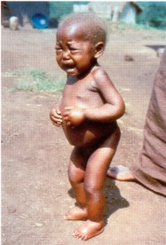
Kwashiorkor
Sparse
hair
Infection
Swollen
belly
Decreased
muscle
mass
Apathy
Pellagra
Notes:
Kwashiorkor: Sudden food deprivation due to natural or manmade emergencies produces a condition known as kwashiorkor. Apathy, swelling (oedema) of the extremities, torso and face, cracked, peeling, infection-prone skin and unnaturally blond, sparse hair are its visible characteristics.

Slide 138
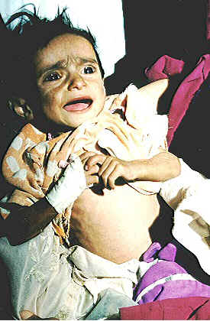
Marasmus (low calories)
Ravenously
hungry
Gross
weight
loss &
no fat

Slide 139
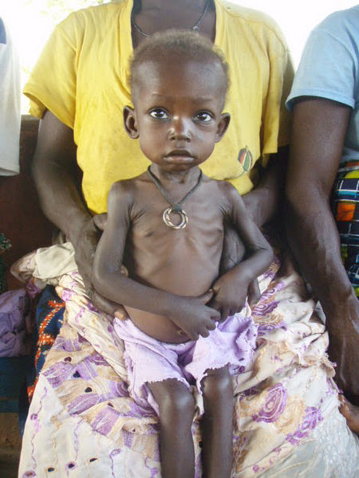
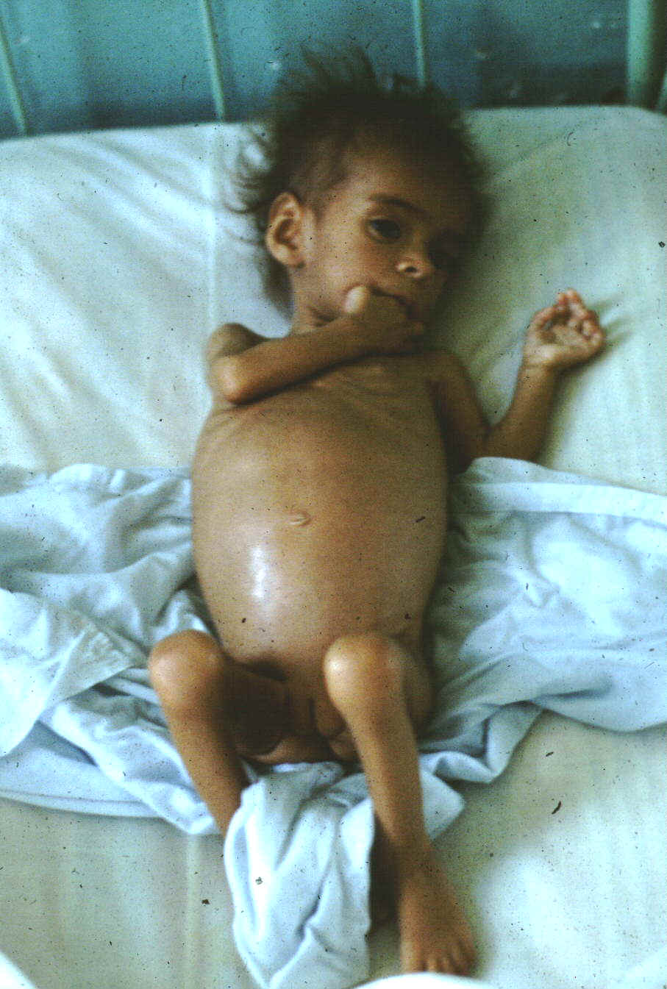
Child
w/Marasmus
Child w/Kwashiorkor

Slide 140
Osteoporosis

Slide 141
Pellagra

Slide 142
Cretinism & Goiter

Slide 143
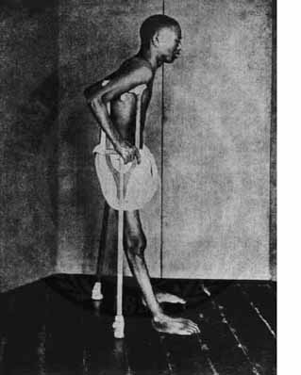
Beriberi

Slide 144
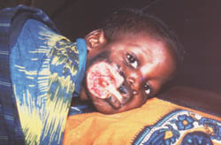
Noma, Cancrum oris

Slide 145
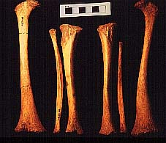
Vitamin D Deficiency: Rickets
Notes:
The left femur has extensive lateral bowing in its distal two-thirds with wide splaying of its distal end. The right femur is deformed in the same way, but less so. The left tibia and fibula are also much deformed, being bowed laterally from just below the head. The right tibia and fibula are somewhat less affected although also deformed. It is likely that this child was an early sufferer of rickets.
Rickets is the result of vitamin D deficiency and is more common in post-medieval and early modern urban industrial populations. The avitaminosis may be attributable to malnutrition, but is also linked with lack of exposure to sunlight. Disease may be a contributory factor, and in this case there were other pathological changes which may indicate an infection or inflammation of the bone.

Slide 146
Scurvy

Slide 147
Xerophthalmia

Slide 148
Zinc deficiency

Slide 149
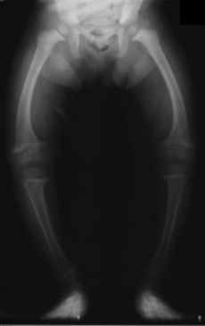
Rickets

