Slide 1
Neonatal Resuscitation
Kiurire S. N.
Master of Clinical Medicine: Accidents and Emergency

Slide 2
Neonatal resuscitation
5-10% of the neonates requires neonatal resuscitation.
The goals of neonatal resuscitation:
to prevent the morbidity and mortality associated with hypoxic–ischemic tissue (brain, heart, kidney) injury;
to reestablish adequate spontaneous respiration and cardiac output.
Resuscitation may be required for some infants:
those born to mothers with chronic illness;

Slide 3
Neonatal resuscitation
to mothers who had a previous fetal or neonatal death;
to mothers with pre-eclampsia;
in multiple pregnancies;
in preterm delivery;
in abnormal presentation of the fetus;
infants with a prolapsed cord, or after prolonged labour;
rupture of membranes or meconium-stained liquor.

Slide 5
Neonatal resuscitation
Rapid and appropriate resuscitative efforts:
improve likelihood of preventing brain damage;
and achieving a successful outcome.
Neonatal resuscitation guidelines propose:
an “integrated” assessment/response approach;
Which consists of simultaneous assessment of :
infant color; general appearance, and risk factors.

Slide 6
Neonatal resuscitation
The fundamental principles include:
Evaluation of the airway;
Establishing effective respiration;
And adequate circulation.
Others highlight in the guidelines are the:
assessment and response to the neonatal heart rate;
and the management of infants with meconiumstained amniotic fluid.

Slide 7
Why do newborns require different approach to resuscitation than adults?
Adult cardiac arrest:
complication of trauma/existing heart disease.
Adult cardiopulmonary resuscitation:
chest compressions used to maintain circulation.
Incontrast, most newborns requiring resuscitation have healthy heart.
Require resuscitation due to a problem with respiration.
Respiratory failure may occur before/after birth.

Slide 8
Why do newborns require different approach to resuscitation than adults?
Before birth, fetal respiratory function performed by placenta.
Oxygen transferred from mother to fetus &CO2 removed.
Placental respiration failure:
fetus receives insufficient oxygen supply for normal cellular functions:
and CO2 cannot be removed.
Fetal monitoring may show:
Decrease inactivity, loss of heart rate variability, and heart rate decelerations.
If placental respiratory failure persists:
fetus will make series of gasps followed by apnea & bradycardia.

Slide 9
Why do newborns require different approach to resuscitation than adults?
Fetus born in early respiratory failure phase:
Tactile stimulation sufficient to initiate spontaneous breathing & recovery.
Fetus born in later respiratory failure phase:
Stimulation not sufficient &newborn requires assisted -ventilation for recovery.
Most severely affected newborns require:
chest compressions & epinephrine to restore circulation;
In the compromised heart muscle.

Slide 10
Why do newborns require different approach to resuscitation than adults?
At birth, can’t tell if the baby is in early or late phase respiratory failure.
After birth, respiratory failure occurs if baby doesn’t initiate or can’t maintain effective breathing effort.
In either situation the primary problem is:
lack of gas exchange &:
the focus of neonatal resuscitation is effective ventilation of the baby’s lungs.

Slide 11
Fetal Circulation Path
Only a small amount of blood travels to the lungs.
There is no gas exchange in the lung.
Blood returning to the right side of the heart from the umbilical vein has the highest oxygen saturation.

Slide 12
Transitional Circulation Path
The baby breathes, pulmonary resistance decreases and blood travels to the lungs.
Gas exchange occurs in the lungs.
Blood returning to the left side of the heart from the lungs has the highest oxygen saturation.

Slide 16
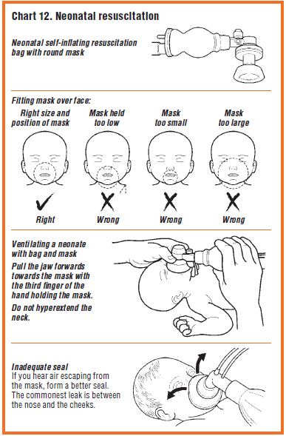

Slide 17
Medication
A very small number of newborns will require emergency medication.
Despite resuscitation, a few newborns will still have HR below 60bpm.
Occurs when blood flow into coronary arteries is severely decreased, resulting in low oxygen delivery.
Epinephrine given to improve coronary artery perfusion &oxygen delivery.
Epinephrine is a cardiac &vascular stimulant.
It causes blood vessels constriction outside the heart which increases blood flow into coronary arteries.
It also increases rate &strength of cardiac contractions.

Slide 18
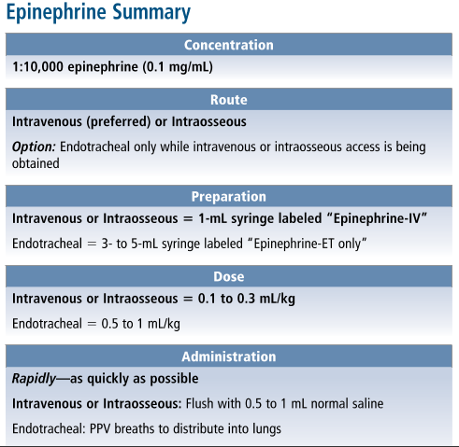

Slide 19
Volume expander
The baby may have a persistently low heart rate that doesn’t respond to ventilation, chest compressions, &epinephrine.
Emergency volume expansion is indicated if the baby is not responding to the steps of resuscitation &has signs of shock or history of acute blood loss.
If there has been:
-an acute fetal-maternal hemorrhage;
-bleeding vasaprevia;
-extensive vaginal bleeding;
-placental laceration;
fetal trauma;
-umbilical cord prolapse;
-tight nuchal cord;
-blood loss from umbilical cord;
the baby may be in hypovolemic shock.

Slide 21
Post resuscitation care
Infants who require resuscitation are at risk for deterioration after their vital signs have returned to normal.
Once adequate ventilation and circulation has
been established: Stop ventilation.
Return to mother for skin-to-skin contact as soon as possible.
Closely monitor breathing difficulties, signs of asphyxia and anticipate need for further care.

Slide 22
Cessation of resuscitation
It’s appropriate to discontinue after effective resuscitation efforts if:
Infant is not breathing and heartbeat is not detectable beyond 10 min, stop resuscitation.
If no spontaneous breathing and heart rate remains below 60/min after 20 min of effective resuscitation, discontinue active resuscitation.
Record the event and explain to the mother or parents that the infant has died.
Give them the infant to hold if they so wish.

Slide 23
References
Pocket book of hospital care for children: Guidelines for the management of common illnesses with limited resources. (2013). World Health Organization.
Basic Paediatric Protocols: for ages upto 5 years. (2016). Republic of Kenya Ministry of Health.
Nelson, ., & In Kliegman, R. M. (2016). Textbook of pediatrics. Philadelphia [etc.: Elsevier Saunders.
Zaichkin, J., Kattwinkel, J., McGowan, J., American Heart Association., & American Academy of Pediatrics. (2011). Textbook of neonatal resuscitation. Elk Grove Village, IL: American Heart Association.

