Slide 1
NERVOUS TISSUE
SAMUEL NGIGI KIURIRE

Slide 2
Objectives
Functions of the nervous system
Organization of the nervous system
Nerve tissue and nerve cell types
Structure of a typical neuron
Structure of a chemical synapse

Slide 3
Histology of Nervous Tissue
Made of two different varieties of cells
1. Neuroglia or supporting cells
-Astrocytes -Schwann cells
-Oligodendrocytes -Satellite cells
-Microglia
-Ependymal
2. Neurons

Slide 4
The Nervous System
Defined: like the CPU of a computer, the nervous system is the master controlling system of the body. It is designed to constantly and rapidly adjust and respond to stimuli the body receives. It includes the brain, cranial nerves, spinal cord, and associated peripheral nerves.
Divisions of the nervous sytem:
CNS = Brain + spinal cord
PNS = Cranial nerves (12) + Spinal nerves (31 pairs)

Slide 5
Supporting Cells CNS
Astrocytes- most abundant and versatile
anchor neurons to nutrient supply lines
deliver glucose to neurons
help with migration of new neurons
control chemical environment of neurons

Slide 6
Supporting Cells CNS
Microglia- act as the macrophage of the CNS
remove dead neurons and microorganisms

Slide 7
Supporting Cells CNS
Ependymal Cells- line the central cavities of the brain and cord to form a permeable barrier between CSF (cerebospinal fluid) and tissue fluid bathing cells of CNS
many are ciliated and help to move CSF

Slide 8
Supporting Cells CNS
Oligodendrocytes- wrap their processes around neurons in CNS producing insulation with myelin sheaths

Slide 9
Supporting Cells PNS
Satellite Cells- surround cell bodies in ganglia; unknown function
Schwann Cells- surround and form myelin sheaths around large nerve fibers
function like oligodendrocytes
wrappings are not continuous; Nodes of Ranvier

Slide 10
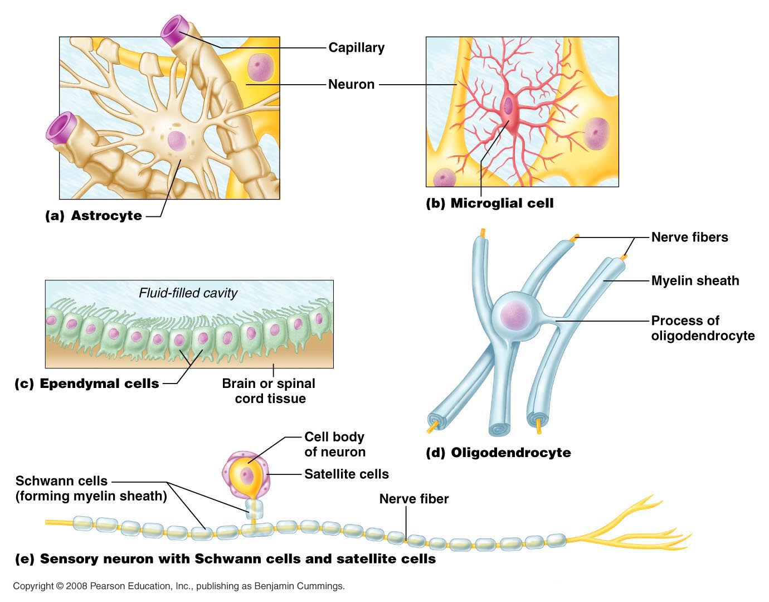
Quiz Pic p.390 11.3a-e

Slide 11
Neuron
Also called nerve cells
The neurons are the basic building blocks of the nervous system, their axons may or may not myelinated.
Structural unit of nervous system
Conduct messages in the form of nerve impulses from one part of the body to another
The myelin sheath is produced by the Schwan cells. It envelops the axon except at the ends & the nodes of Ranvier
The impulse is conducted faster in myelinated than unmyelinated nerves.

Slide 12
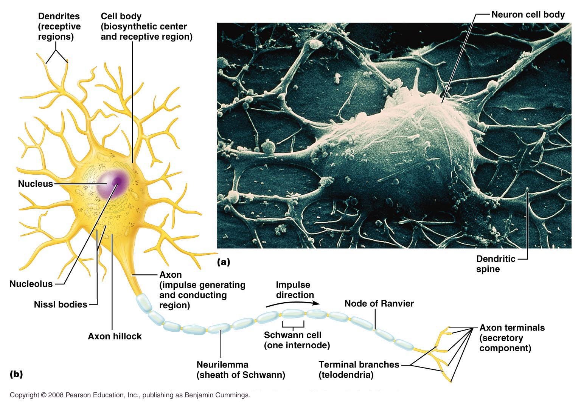
QUIZ PIC p. 392 11.4b

Slide 13
Parts of Neuron
A. Cell body- consists of a nucleus with easily visible nucleolus and some special organelles
1. Nissl bodies (rough ER)
2. neurofibrils which are intermediate filaments to maintain cell structure and integrity
3. Golgi Apparatus – extra important in
neuron

Slide 14
Parts of Neuron
B. Processes
1) Dendrites- receive information for neuron that may or may not become an Action Potential
2) Axons- one per neuron
arises from cell body at the Axon Hillock
sends info away from neuron
transmits action potentials

Slide 15
Axons
Myelinated and unmyelinated
CNS covered by olidodendocytes
PNS Schwann cells

Slide 17
Properties of Neurons
1. Excitability (irritability): ability to respond to environmental changes or stimuli.
Irritable or excitable- with adequate stimulation an electrical impulse can be sent along the entire length of an axon
a) Action Potential- name of nerve impulse use to communicate with other cells(long distance sign)
b) Graded Potential – Shorted lived impulse used to communicate within a cell(signal over short distances)
2. Conductivity: respond to stimuli by initiating electrical signals that travel quickly to other cells at distant locations.
3. Secretion: Upon arrival of the impulse at a distant location the neuron usually secretes a chemical neurotransmitter at a synapse that crosses the synaptic gap and stimulates the next cell.

Slide 19
Functional Classes of Neurons
Sensory (afferent) neurons – afferent neurons are specialized to detect stimuli and transmit the information to CNS. They begin in any organ in the body, but end in the brain or spinal cord.
Interneurons (association neurons): lie entirely in the CNS. They receive signals from many different neurons and perform an integrative function “decision making” to respond to the different stimuli.
Motor (efferent) neurons – efferent neurons transmit the appropriate response from the interneuron to an end organ (muscle and gland cells) to carry out the body’s response to the stimuli.

Slide 20
Functional Classification of Neurons
Based on the direction of conduction
Sensory or afferent conduct toward the CNS ~ 100 million
Motor or efferent conduct away from the CNS ~ 500,000
Interneuron interposed between sensory and motor ~ 500 billion

Slide 21
Organization of the Nervous System
Two main divisions:
The Central Nervous System (CNS)
- Consists of the brain and spinal cord with tracts and nuclei
Nucleus = a collection of nerve cell bodies in the CNS.
Tract = bundle of nerve fibers within the CNS
The Peripheral Nervous System (PNS)
-Consists of ganglia, cranial nerves, spinal nerves and peripheral receptors
Ganglia = a collection of nerve cell bodies in the PNS
Nerve = bundle of nerve fibers in the PNS

Slide 22
Organization of the Nervous System

Slide 23
Functional divisions of nervous system

Slide 24
CNS = brain and spinal cord

Slide 25
Peripheral Nervous System (PNS)
Composed of cranial nerves and spinal nerves and their branches, ganglia and sensory receptors.
PNS is subdivided into sensory and motor divisions:
somatic nervous system (SNS)
autonomic nervous system (ANS) and the
enteric nervous system (ENS)

Slide 26
Sensory or Afferent Division
Somatic sensory = senses touch, pressure, pain, temperature, vibration and proprioception in skin, body wall and limbs.
Visceral sensory = Autonomic sensory division- senses stretch, pain, temperature, chemical changes and irritation in viscera; nausea and hunger.

Slide 27
Motor or Efferent Division
Somatic motor
-motor control to all skeletal muscles except pharyngeal muscles.
Visceral Motor = Autonomic Nervous System
-Sensory receptors convey information from visceral organs (e.g. heart, lungs, intestines, etc.) to the CNS for integration and interpretation.
-A motor response is initiated that conducts impulses from CNS to smooth muscle, cardiac muscle and/or glands for appropriate response

Slide 28
Autonomic Nervous System
Two divisions of ANS
Sympathetic division – Fight or Flight
Parasympathetic division – Food or Sex

Slide 29
CNS & PNS summary

Slide 30
Structural Classification of Neurons
Neurons may be: Multipolar, Bipolar or Unipolar
Determined by the number of processes attached to the cell body

Slide 33
Neurons
Most (99%) neurons in the body are multipolar.
Bipolar neurons are rare and occur in special sense organs of ear, nose and eye.
Unipolar neurons begin as bipolar but processes fuse into one. They are primarily sensory neurons.

Slide 34
Nerve structure
Nerves are only in the periphery
Cable-like organs in PNS = cranial and spinal nerves
Consists of 100’s to 100,000’s of myelinated and unmyelinated axons (nerve fibers).
Endoneurium surrounds each axon (nerve fiber).
Axons are grouped into bundles of fascicles
Perineurium surrounds each fascicle
Epineurium surrounds each nerve bundle
Conduction is saltatory (i.e. jumps node to node) in myelinated nerves and continuous in nonmyelinated.

Slide 35
Nerve anatomy

Slide 37
Synapse
The connection between 2 or more nerves and they are separated by a space or cleft.

Slide 38
Synaptic terminology
Synapse – site where two nerves communicate with each other.
Presynaptic neuron – neuron that is conducting information toward the next neuron
Postsynaptic neuron – transmits information away from synapse
Most synaptic communication is via chemical messengers (e.g. acetylcholine, serotonin, norepinephrine, dopamine, endorphins, GABA, glycine, glutamic acid, etc.)

Slide 39
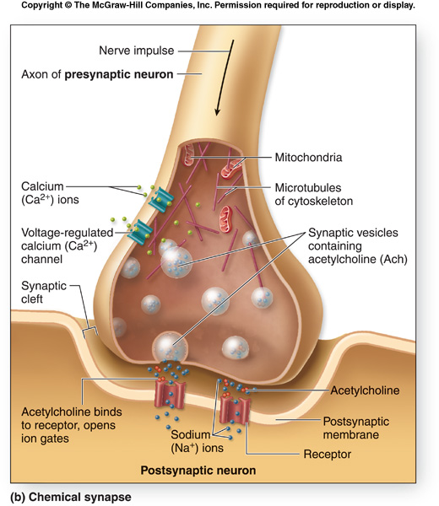
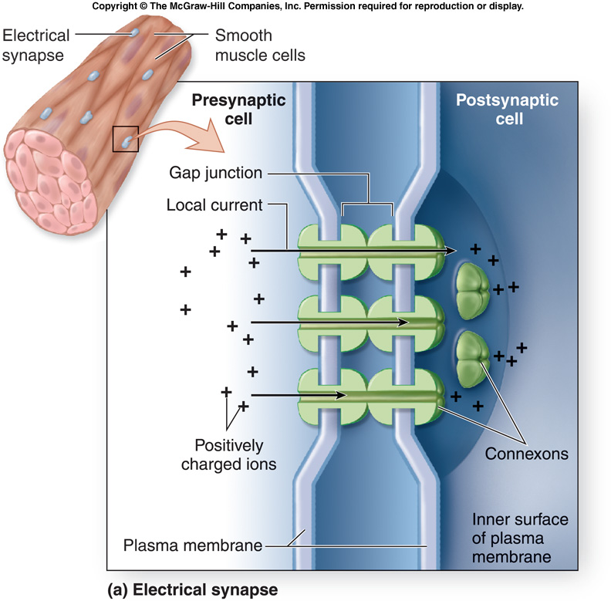
Neurotransmission
Chemical (99%) Electrical (1%)

Slide 40
Types of synapses
Axodendritic = axon to dendrite
Axosomatic = axon to cell body
Axoaxonic = axon to axon

Slide 41
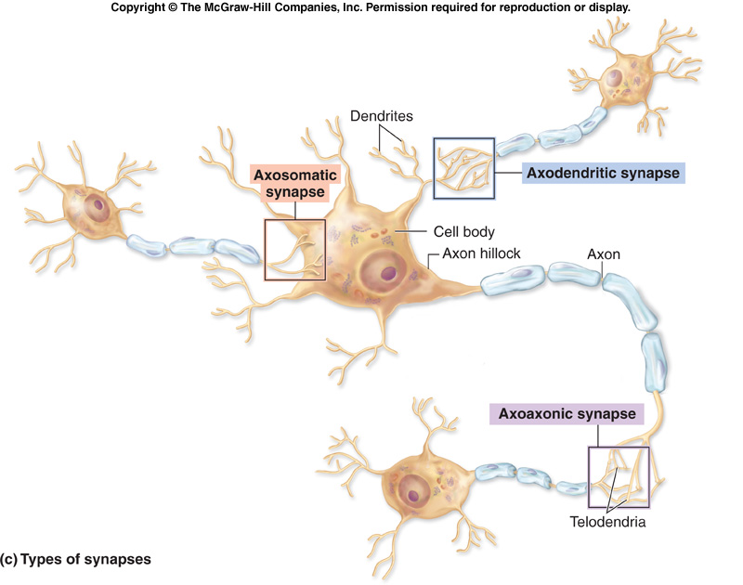
Types of synapses

Slide 42
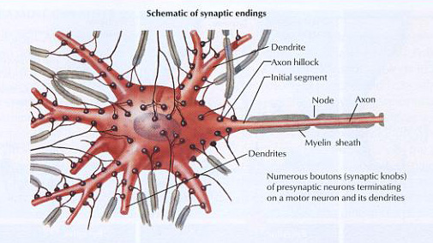
Types of synapses

Slide 43
Types of Neuronal Integration
Neurons form many different types of connections and in so doing can result in finite control over the neuronal circuits.
Such pathways may create converging, diverging or reverberating circuits as is shown in the next slide.

Slide 44
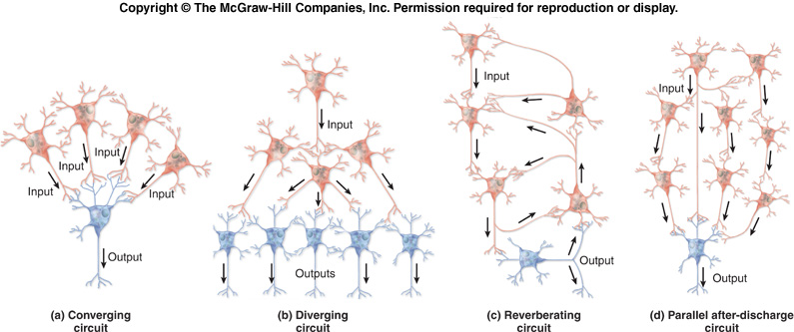
Types of Neuronal Circuits

Slide 45
Axonal regeneration
Nerve tracts in the CNS are incapable of regeneration on their own and there may be hope for stem cells carrying out this process.
In the PNS, nerves can regenerate but vey slowly and under only ideal conditions. Regeneration is dependent on 3 things: (a). Amount of damage, (b). Neurolemocyte secretion of nerve growth factor and (c). The distance from the site of the damage to the end organ being reinnervated.
Regeneration occurs at a rate of ~ 1 to 5 mm/day.

Slide 46
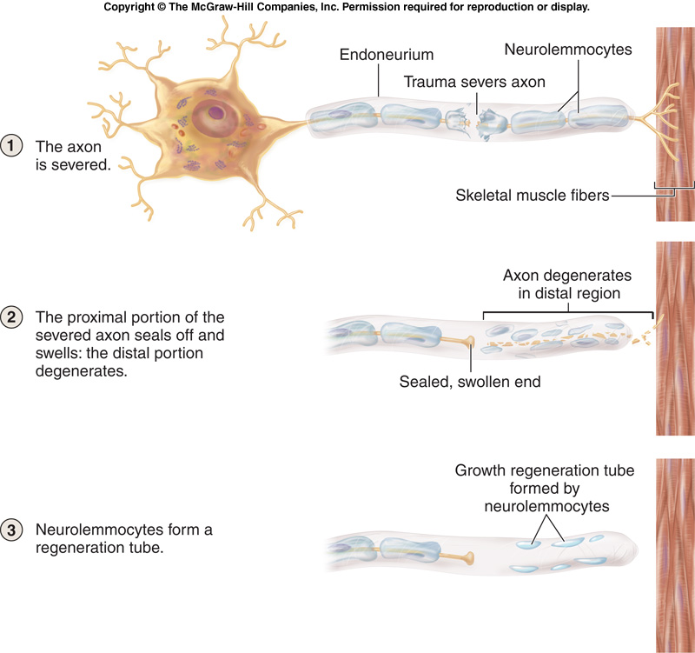
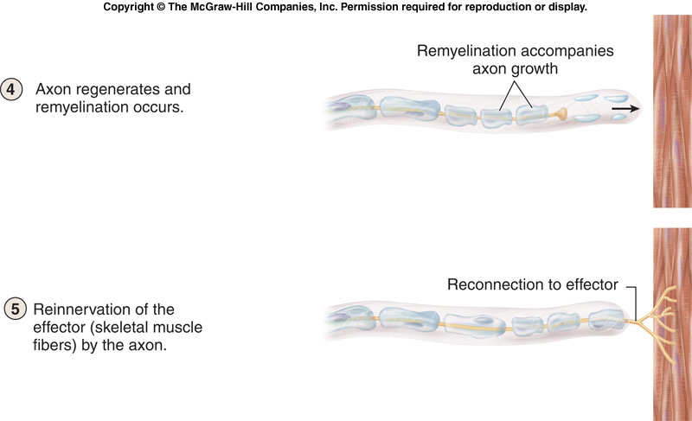
Neuronal regeneration in the PNS

Slide 47
End of Presentation
Thank You

