Slide 1
Nutrition
KECHN
Nutrition 20 Hours
Bernard N. Nderitu

Slide 2
Unit Outcomes
Apply nutrition in the provision of health care
Conceptualize the relationship between anatomy, physiology and nutrition
Plan for meals in health and health

Slide 3
Course outline/Topics
Basic nutrition
Food nutrients
Classification of food
Nutritional measurements (anthropometric)
Meal plans (adults, children, adolescents, elderly, pregnant, sick)
Food taboos and habits
Weaning
Budget
Food security
Clinical nutrition
Common nutritional disorders (causes/predisposing factors, clinical features, management and prevention)
PEM
Marasmus
Iron deficiency
Vitamin deficiencies
Obesity
Levels of malnutrition and its management
Therapeutic diet (food modification according to conditions)

Slide 4
Organization
Principles of nutrition in nursing
Nutrition in health promotion
Nutrition in clinical practice

Slide 5
Introduction
Definition
Nutrition
The process by which organisms utilizes the nutrients in food through digestion, absorption, transportation, storage, metabolism and elimination
Dietetics
Practical application of nutritional sciences to persons and groups of persons in various states of health and disease
Notes:
Nutrition
The process by which organisms utilizes the nutrients in food through digestion, absorption, transportation, storage, metabolism and elimination for the purposes of maintaining life, growth, normal functioning of organs, production of energy.
The science of food, the nutrients and other substances therein, their action, interaction, and the balance in relation to health and disease process by which the organism ingests, digests and absorbs, transports, utilizes and excretes food substances
Dietetics
The science of applying nutritional principles to the planning and preparation and storage and the regulation of the diet in relation to both health and disease

Slide 6
Process
Ingestion
Digestion
Absorption
Transportation
Storage
Metabolism
Elimination

Slide 7
Carbohydrates
Carbohydrates
Monosaccharide
Disaccharide
Complex carbohydrates
Includes starch, glycogen and fiber
Sources
Fruits, vegetables, honey, corn syrup, corn starch
Sugar, milk (glucose and galactose)
Seeds, roots, stems, tubers
Grains, cereals
Functions
Provision of energy to cells
Spare protein and prevent ketosis
Make other compounds e.g. glycogen or converted into fats and stored
Notes:
Fiber
Increases and softening the bulk of the stool, promotes defecation prevents and relieves constipation
Creates bulk preventing diverticuli
Promote fullness thereby reducing overeating and hence obesity
Viscous fiber lower blood cholesterol
Viscous fiber delays gastric emptying rates thereby absorption of glucose (prevents rise of postprandial glucose in diabetes)
Does not supply energy or heat to the body.
Absorbing organic wastes and toxins.
Decreases the rate of carbohydrate breakdown and absorption.

Slide 8
Proteins
Are made up of amino acids
There are 20 common amino acids 9 of which are essential (must be consumed from food and can not be made by the body)
Complete proteins
Animal and soy protein
Incomplete proteins
Plant proteins
Complementary proteins
Outline five functions of proteins in the body
Notes:
Essential amino acids
Histidine, isoleucine, leucine, lysine, methionine, phenylalanine, threonine, trytophan, valine
Non essential
Alanine, arganine, asparagines, aspartic acid, cysteine, lutamic acid, glutamine, glycine, praline, serine and tryosine
Implications of consuming proteins
Protein needs are increased with
increase in body weight
Inadequate calorie intake
Body requires to heal e.g. from surgery, trauma, burns
Normal tissue growth e.g. in pregnancy, lactation, adolescence, infancy
Protein restriction in severe liver disease and renal failure where nitrogenous waste excretion is impaired
Protein deficiency (in developing countries) is common in elderly, fad dieters, hospitalized persons (results in Kwashiorkor)

Slide 9
Lipids/Fats
Fats | Types | Source | Importance
Triglycerides | Unsaturated fats | Seeds, sunflower, corn, soy bean, fish oils | Health skin, inflammation process, lower LDL
 | Saturated fats | Animal products, coconut | Raise LDL cholesterol levels
 | Trans fats | Margarine, hydrogenated vegetable oils
Phospholipids |  |  | Emulsifiers, components of cell membranes
Cholesterol HDL |  | Meats and egg yolk | Cell membranes, hormones, vit D
Notes:
The body can make all the fatty acid it requires except linoleic and alpha linoleic acids. Useful in maintaining normal skin and healthy growth in children.
HDL High density lipoproteins move cholesterol away form the artery walls back to the liver
Functions of fats
Highest source of energy
Cushions against injury
Temperature regulation
Absorption of fat soluble vitamins
Integrity of cell membranes (phospholipids and cholesterol)
Cholesterol is a precursor of vitamin D

Slide 10
Vitamins
Organic compounds necessary for metabolism of energy
Body can not make them except Vitamin A, D and niacin (Vit B3) in the presence of necessary precursors
Microorganisms in the GIT synthesize vitamin K and B₁₂
Some have enzyme like activity others are co-enzymes
Water soluble and fat soluble vitamins
Notes:
Water soluble
Easily absorbed in the small intestines, less stable, minimal storage and are therefore lost in cooking water are destroyed by heat these include Vitamin B (1. thiamine, 2. Riboflavin, 3. Niacin or nicotinic acid, folate or folic acid, 6. pyridoxine, Pantothenic acid, Biotin, 12. cyanocobalamin) and C
Fat soluble vitamins
Are absorbed in the same manner as fats and bile is required for absorption. Are stored for longer, not affected by cooking or storage Vitamins ADEK

Slide 11
Vitamins continued (Fat soluble)
Vitamin | Source | Function
Retinol | Animal food, green and yellow foods (provitamin carotene), fish liver oil, liver, whole milk, egg yolk, margarine, carrots, apricots, pumpkin | Epithelial tissue maintenance Adaptation to changes in light (rhodopsin) Formation of bones and teeth (growth)
D. Calciferol | Exposure to UV light or sunshine, milk, butter, ghee, fatty fish, eggs, cord liver oil | Absorption and use of calcium, hormonal control,
E. Alpha-tocopherol | Vegetable oils, corn, soy, nuts, green leafy vegetables, cereals ans legumes | Antioxidant, antihaemolysis, prevent oxidation of vitamin A
K. | Green leafy veges, dairy products, synthesized by bacteria in the GI tract | Main factor in blood clotting, protein in bones

Slide 12
Vitamins cntd (water soluble)
Vitamin | Source | Function
C. Ascorbic acid | Citrus fruits, juices, guava, tomato juice, greens | Antioxidant, co-enzyme, collagen formation, wound healing, Hb formation, thyroid and adrenal hormone synthesis, fat and protein metabolism
B1 Thiamine | whole grains, yogurt, a variety of protein foods such as lean meats; poultry; eggs; seafood; beans, peas, and lentils; nuts and seeds; and soy products | Aids the body's cells in conversion of carbohydrates into energy

Slide 13
5. Water
Provides shape and structure to cells
Regulates body temperature
Aids in digestion
Transport of nutrients
Solvent

Slide 14
6. Minerals
Inorganic in nature
Calcium
Phosphorus
Iodine
Zinc
Sodium
Magnesium
Flourine

Slide 15
Minerals
Mineral | Function | Sources
Sodium | Needed for proper fluid balance, nerve transmission, and muscle contraction | Table salt, soy sauce; large amounts in processed foods; small amounts in milk, breads, vegetables, and unprocessed meats
Chloride | Needed for proper fluid balance, stomach acid | Table salt, soy sauce; large amounts in processed foods; small amounts in milk, meats, breads, and vegetables
Potassium | Needed for proper fluid balance, nerve transmission, and muscle contraction | Meats, milk, fresh fruits and vegetables, whole grains, legumes

Slide 16
Minerals
Mineral | Function | Sources
Calcium | Important for healthy bones and teeth; helps muscles relax and contract; important in nerve functioning, blood clotting, blood pressure regulation, immune system health | Milk and milk products; canned fish with bones (salmon, sardines); fortified tofu and fortified soy beverage; greens (broccoli, mustard greens); legumes
Phosphorus | Important for healthy bones and teeth; found in every cell; part of the system that maintains acid-base balance | Meat, fish, poultry, eggs, milk, processed foods (including soda pop)

Slide 17
Minerals
Mineral | Function | Sources
Magnesium | Found in bones; needed for making protein, muscle contraction, nerve transmission, immune system health | Nuts and seeds; legumes; leafy, green vegetables; seafood; chocolate; artichokes; "hard" drinking water
Sulfur | Found in protein molecules | Occurs in foods as part of protein: meats, poultry, fish, eggs, milk, legumes, nuts

Slide 18
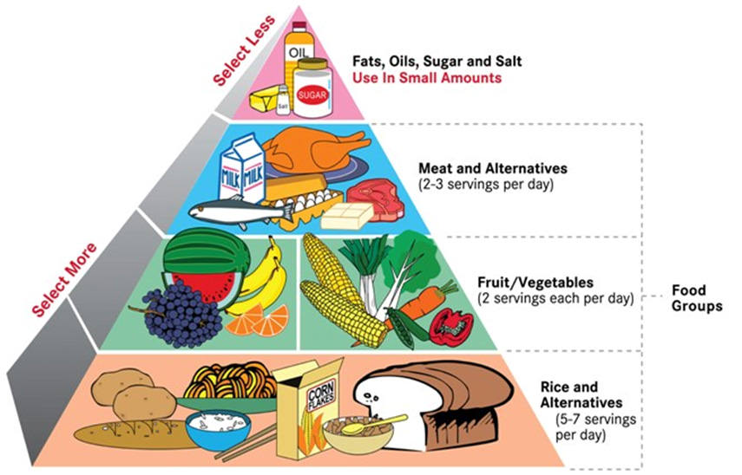
Balanced Diet

Slide 19
Check point
Giving relevant examples of disorders, state the dietary modifications that may be necessary in patient with disorders of
Digestion
Absorption
Transportation
Storage
Metabolism
Elimination

Slide 20
Nutrition and life-cycles
Infants and young children
Breastfeeding: exclusive for 6 months and on demand
Safe and adequate complementary feeds while breastfeeding for up to 2 years or more
Energy and proteins should be higher, expose to sunshine and provide iron in diet from age 6 months
Over 6 months
Pregnancy and lactation
Adolescence
Adults
Geriatrics

Slide 21
Check point
Outline benefits of breastfeeding using the following headings
Benefits to the Infant
Nutritional benefits
Immunological benefits
Benefits to the mother
Benefits to the community
Notes:
Nutritional benefits
Food security
Complete nutritional needs for 6 months
Enough water for infant
Easily digested
Presence of amylase in breast milk aids digestion of fats
Natural and most economical
Immunological benefits
Colostrum contains high levels of immunoglobulins
Provides protection against childhood infections such as RTI and diarrhoea
Protects against allergies
Benefits to the mother
Promotes bonding
Contraceptive benefits (LAM)
Involution of uterus
Reduced risk of breast, ovarian, and other reproductive cancers
Benefits to the community
Cost effective
Reduces infant mortality and morbidity

Slide 22
Assessment (ABCD)
Anthropometric measures
Biochemical
Clinical examination
Dietary evaluation methods
Good nutrition
Borderline
Malnutrition
Notes:
Purpose
Determine the overall nutritional status of a person
Identify persons at risk
Determine current health needs
Assess growth in children
Determine related factors in the person’s current life situation

Slide 23
Assessment : Anthropometric
Weight
Height
Circumferences
MUAC
Head and chest
Waist hip ratio (WHR)
Body mass index (BMI)
Tricep-skin fold thickness

Slide 24
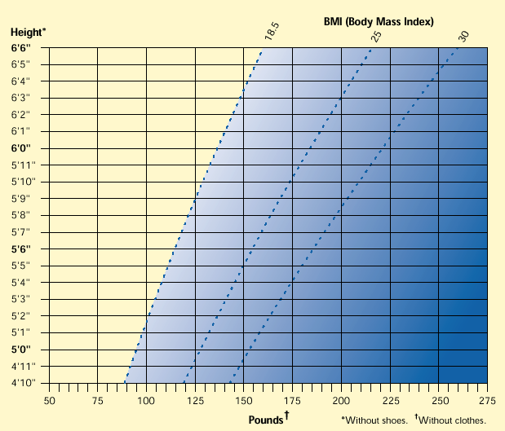

Slide 25
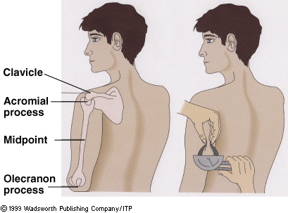

Slide 26
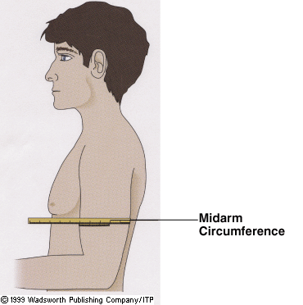

Slide 27
Assessment: Biochemical
Haemoglobin levels
Stool for ova and cyst
Urine for albumin, sugar, blood
Serum iron, retinol etc
Abnormal metabolites e.g. createnine/hydroxyproline ratio
Hair, nails and skin analysis for micronutrients

Slide 28
Assessment: Clinical and dietary
Signs and symptoms
24 hour recall
Weighted intake
Food diary
Dietary history
Interpretation is by qualitative and quantitative

Slide 29
Nutritional disorders
Protein Energy malnutrition
Mineral deficiencies
Vitamins deficiencies
Nutritional anemias e.g. iron deficiency
Obesity/over weight
Eating disorders (e.g. Bulimia, anorexia)

Slide 30
Malnutrition
Malnutrition refers to deficiencies, excesses or imbalances in a person’s intake of energy and/or nutrients.
Refers to 2 broad groups of conditions
‘undernutrition’—which includes stunting (low height for age), wasting (low weight for height), underweight (low weight for age) and micronutrient deficiencies or insufficiencies (a lack of important vitamins and minerals).
overweight, obesity and diet-related non-communicable diseases (such as heart disease, stroke, diabetes and cancer)

Slide 31
Dietary management
The relationship between nutrition and disease
Nutrition and oral health
Drugs and nutrient interactions
Type of diet:- modes of feeding: Parental and enteral
Gastro-intestinal
Respiratory diseases

Slide 32
Dietary management in conditions
Renal disease
Liver disease
Cardiovascular diseases, coronary heart disease/hypertension
Diabetes mellitus
Surgery
Cancer
HIV/AIDS

Slide 33
Dietary adjusted
Low salt
Low fat
Low calorie
High protein
Diabetic

Slide 34
Factors that affect health and nutrition status
Agricultural and food policies
Population policies
Income and employment
Infrastructure development e.g. housing and urbanization
Cultural factors

Slide 35
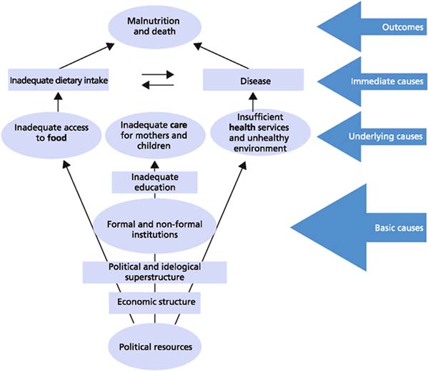

Slide 36
Nutrition in emergencies
Rapid nutrition status assessment in emergencies
Nutrition intervention in emergencies
Feeding programmes

Slide 37
Relationship between illness and malnutrition
Malnutrition
Altered food intake
Altered digestion
Altered metabolism
Nausea
Altered food likes
Nausea/vomiting
Gastritis
Increased energy requirements
Lack

Slide 38
The Nutrition Care Process
Identifying and meeting a person’s nutrient and nutrition education needs. Five steps:
1. Assess Assessment of nutritional status
2. Analyze Analyze assessment data to determine nutrient requirements
3. Develop Develop a nutrition care plan to meet patient’s nutrient and education needs.
4. Implement: Implement care plan
5. Evaluate: Evaluate effectiveness of care plan: ongoing follow-up, reassessment, and modification of care plan.

Slide 39
Issues
Hospital or iatrogenic malnutrition
Hypermetabolism or physiological stress increasing nutritional needs due to particular conditions e.g. thyrotoxicosis, hyperthyroidism, goiter, fever
Lack of proper nutritional screening to identify patients at risk
Prolonged hospital stay
Dietary adjustments in some procedures e.g. nil by mouth, restricted protein etc
Hospital routines e.g. unfamiliar foods, timings, unserved foods due to other procedure
Serious disease can lead to loss of appetite, impair ability to chew, alter absorption, alter metabolism, alter excretion, administration of drugs
Notes:
Alteration of nutritional status

Slide 40
Nursing Dx
Ingestion
Insufficient breast milk
Readiness for enhanced nutrition
Ineffective breastfeeding
Obesity
Interrupted breastfeeding
Overweight
Readiness for enhanced breastfeeding
Risk for overweight
Ineffective infant feeding pattern
Impaired swallowing

Slide 41
Nursing Dx
Metabolism
Risk for unstable blood glucose level
Neonatal jaundice
Risk for neonatal jaundice
Risk for impaired liver function

Slide 42
Nursing Dx
Hydration
Risk for electrolyte imbalance
Risk for deficient fluid volume
Readiness for enhanced fluid balance
Excess fluid volume
Deficient fluid volume
Risk for imbalanced fluid volume

Slide 43
Nursing diagnosis
Elimination (gastro-intestinal)
Constipation
Diarrhea
Risk for constipation
Dysfunctional gastrointestinal motility
Chronic functional constipation
Risk for dysfunctional gastrointestinal motility
Risk for chronic functional constipation
Bowel incontinence
Perceived constipation

Slide 44
Nursing diagnosis
Related
Cardiac: Risk for ineffective gastrointestinal perfusion
Activity: Feeding self-care deficit
Energy balance: Activity intolerance
Energy balance: Risk for activity intolerance
Comfort: Nausea
Growth: Risk for disproportionate growth
Development: Risk for delayed development

Slide 45
DOMAIN 2 NURSING Dx
Ingestion
Digestion (none in Nanda 2015)
Absorption (none in Nanda 2015)
Metabolism
Hydration

Slide 46
DOMAIN 3 NURSING Dx
Class 2 (gastrointestinal functions)
Enumerate nine nursing diagnostic labels as per Nanda 2015

Slide 47
Basic nutrition
Food nutrients
Classification of food
Nutritional measurements (anthropometric)
Meal plans (adults, children, adolescents, elderly, pregnant, sick)
Food taboos and habits
Weaning
Budget
Food security

Slide 48
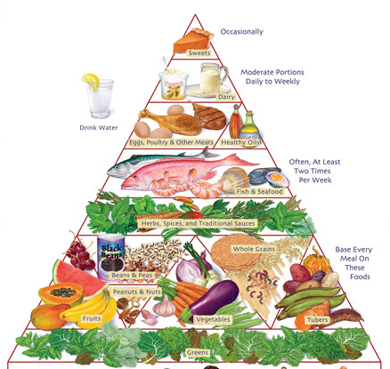
Food nutrients
Macronutrients
Carbohydrates
Proteins
Lipids
Vitamins
Water and minerals

Slide 49
Food nutrients
Discuss the
TOP 10 CAUSES OF DEATH
HIV/AIDS
Lower respiratory infections
Diarrheal diseases
Neonatal disorders
Tuberculosis
lschemic heart disease
Stroke
Cirrhosis
Diabetes
Congenital defects

Slide 50
Clinical nutrition
Common nutritional disorders (causes/predisposing factors, clinical features, management and prevention)
PEM
Marasmus
Iron deficiency
Vitamin deficiencies
Obesity
Levels of malnutrition and its management
Therapeutic diet (food modification according to conditions)

Slide 51
Subjective global assessment
Weight change that is unintentional
Change in dietary intake in type and amount
Gastrointestinal symptoms lasting more than two weeks (nausea, vomiting, anorexia, diarrhea)
Change in functional capacity e.g. bedridden
Disease and its relation to nutritional requirements
Physical signs and severity of findings e.g. edema, muscle wasting

