Slide 1
MIDWIFERY: OBSTETRIC EMERGENCIES

Slide 2
COURSE OUTLINE:
Prolonged pregnancy
Abnormal labour
  Trial of labour
  Obstructed labour
OBSTETRIC EMERGENCIES:
  Ruptured uterus
  Cord presentation
  Cord prolapse
  Vasa praevia
  Shoulder dystocia
  Amniotic fluid embolism
  Acute uterine inversion
  Obstetric shock

Slide 3
OBSTETRIC OPERATIONS:
  Caesarean section
  Vacuum extraction
  Forceps delivery
  Symphysiotomy
MALPOSITIONS AND MALPRESENTATIONS OF THE OCCIPUT;
  Occipito posterior position
  Deep transvese arrest
  Breech presentation
  Face presentation
  Shoulder presentation
  Brow presentation
  Compound lie
  Unstable lie

Slide 4
PROLONGED PREGNANCY
DEFINITION
Pregnancy equal to or more than 42 completed weeks( 294 days from the first day of the last menstrual period, LMP).
The expected date of delivery( EDD) is calculated on the basis of Naegele’s rule, the assumption being that the cycle is 28 days and that ovulation occurs on the 14th day

Slide 5
INCIDENCE
The frequency or incidence of prolonged pregnancy is quoted as anything from 5-10%. Incidence in england is given at 4%
ASSOCIATED RISKS
Viewed from the perspective of the mother, foetus, and neonate with regard to morbidity and mortality
For the mother:
  Large for gestational age
  Macrosomic infant eg shoulder dystocia
  Genital tract trauma
  PPH and operative birth

Slide 6
For the foetus:
  Decrease in liquor volume( oligohydramnios)
  Placental insufficiency( placental dysfuction)
PREDISPOSING FACTORS:
Nulliparity
Previous prolonged pregnancy
Male foetus
Pre-pregnancy BMI>25Kg/M2
anencephaly

Slide 7
SPECIFIC MGT
Purpose: to ensure optimum outcome for the mother and the baby
Increased antenatal surveillance including a non stress test (NST) and ultrasound estimation of amniotic fluid volume(AFV)
A biophysical profile( AFV, Foetal breathing mvts, foetal mvts, foetal tone and NST)
Membrane sweep: to attempt initiate the onset of labour physiologically. Sweeping membranes is designed to separate the membranes from their cervical attachment by introducing the examining fingers into the cervical os and passing them circumferencialy around the cervix
Active mgt: induction of labour at 41 or 42 completed weeks

Slide 8
ABNORMAL LABOUR
DEFINITION:
a pathophysiological process in the conduct of labour
PROLONGED LABOUR
definition
Prolonged labour is active labour with regular uterine contractions and progressive cervical dilatation, which lasts for more than 12 hours in both multiparas and primigravidas.

Slide 9
Labour is prolonged when it exceeds the number of hours considered to be normal for a nulliparous or a multiparous woman. WHO defines prolonged labour as one that exceeds 18hrs in a primiparous woman
Different terms are used for prolonged labour at different times or for different reasons.
CLASSIFICATION PER STAGE
Delay in latent phase of labour
The latent phase lasts from the onset of labour to three centimetre dilatation of the cervical os.

Slide 10
This is the period when structural changes occur in the cervix and it becomes softer and shorter( from 3cm to <0.5cm), its position more central in relation to the presenting part. This takes place in 8-10 hrs
During this time, a woman needs support & encouragement from those caring for her, making sure there is adequate food and fluid intake
Delay in active phase of labour
This is the period of time when the cervix dilates from 3cm-10cm with rotation and descent of the presenting part

Slide 11
This part is most contentious bcoz the expectation is that progress once labour is diagnosed is a cervical dilatation of 1cm/hr
Delay in second stage of labour
The second stage of labour can be divided into passive( pelvic) phase & active(perineal) phase
Delay in this stage may be due to malposition causing failure of the vertex to descend and rotate, ineffective contractions due to prolonged first stage, large foetus & large vertex or absence of desire to push with epidural analgesia
A full bladder or a full rectum can also impede progress

Slide 12
DIAGNOSIS OF PROLONGED LABOUR
Findings from history and physical examination or as interpreted from the partograph that is correctly charted will guide in the diagnosis of prolonged labour.
History
  At what time did the contractions begin?
  How frequent are the contractions?
  When did the membranes (water) break?
Examination
The frequency, duration and intensity of the contractions
Determine the foetal position and identify any evidence of cephalopelvic disproportion and /or foetal malposition

Slide 13
Evaluate foetal heart rate
Determine whether the mother’s bladder is full. Encourage the woman to empty the bladder frequently. If not able to pass urine then catheterize
Inspect the external genitalia to determine the presence of liquid and /or blood
Vaginal exam with sterile gloves every four hours (or at a different frequency when indicated.
Criteria for referral
Refer all patients with prolonged labour to a comprehensive EOC facility if not available in your facility.

Slide 14
Referral process
Explain the dangers of prolonged labour to the family
Write a referral note and refer immediately to the hospital.
A skilled health care provider must escort the woman and continue to monitor her condition.
Monitor maternal vital signs 1/2 hourly
Monitor foetal heart rate 1/2 hourly
Measure the urine volume
Ensure IV fluids (5% dextrose) continue during transfer
Broad-spectrum antibiotics should be started before departure.

Slide 15
LABORATORY INVESTIGATIONS
Blood grouping and cross match two units
Urine for albumin, sugar, acetone

Slide 16
CAUSES
There are 7 cardinal Ps with regard to causes of abnormal labour
1). Patient: certain factors in the patient may contribute to prolonged labour namely, a full bladder, dehydration, keto-acidoses, inadequate pain relief, anxiety and tension.
An exhausted mother may not be prepared well for labour because of the metabolic changes
Psychological causes, for instance;tension and fear of the unknown tend to prolong labour, most commonly in women who are primigravidae

Slide 17
2).Power: the contractions
Uterine powers; although the uterus has prepared itself metabolically for labour, as labour continues, the smooth muscle uses up its metabolic reserves and becomes tired
Excess contraction( hypertonia) makes the uterus too exhausted
Hypotonia( contractions that are too mild)may result from an exausted uterus or because the receptors are not strong enough to signal enough contraction
Atonic uterus: a uterus that is not contracting at all
Incoordinate uterus: uterus that is not contracting uniformly

Slide 18
3). passage
Pelvic abnormalities (passage), where contracted pelvis and tumours of the pelvis cause poor progress in labour
4). Passanger. The passangers are:
The foetus
Placenta
Amniotic fluid
The cord
For the foetus;
Conjoined twins
Premature labour
Postmature labour
Foetal distress
Malpresentation and malposition
Macrosomia and microsomia

Slide 19
For the placenta:
Abruptio placenta
Placenta praevia
Infections eg TB, syphyllis affect the placenta
For the amniotic fluid;
Amniotic fluid embolism. Occurs when the amniotic fluid enters the maternal circulation via the uterus or the placental site leading to maternal collapse
Chorioamnionitis( infection to the amniotic fluid)
Oligohydramnios and polyhydramnios

Slide 20
For the cord:
Cord prolapse: where the cord lies infront of the presenting part and the membranes are ruptured
A short cord causing placental separation
Knotting of the cord
Cord around the neck of the foetus

Slide 21
5). Place of delivery
Delivery units/ hospitals must be easily accessible, affordable & available for the patient to facilitate normal labour and delivery
They must also be equipped with all the necessary apparatus to handle an obstetric emergency including prompt referral systems
6). Person attending
Lack of adequate skills, knowledge and competence can cause labour to be abnormal eg when a caregiver ruptures the membranes prematurely causing card prolapse can change labour from normal to abnormal
Lack of knowledge on to interpret a partograph
7.The partograph
This is a graphical presentation of the progress of labour. Lack of knowledge on how to chart and interprete it may cause delay causing abnormal labour

Slide 22
MGT OF PROLONGED LABOUR
Monitor maternal vital signs: Temperature 2-4 hourly, Pulse ½ hourly, Respirations 4 hourly
Monitor foetal heart rate ½ hourly
Measure the urine volume every 2-4 hours (encourage mother to void regularly)
Start I.V fluid (5% dextrose)
Start broad spectrum antibiotics
Oxygen by mask
First choice antibiotics:
  IV Ampicillin 500mg 6 hourly for 3 days
  IV Gentamicin 80 mg 8 hourly for 7 days
  Followed by Amoxicillin 500mg oral 8 hourly for 7 days

Slide 23
Second choice line antibiotics
IV second generation Cephalosporin
IV amoxicillin/clavulanic acid 1.2g stat dose followed by oral preparation
Second stage
Maternal expulsive efforts increase fetal risk by reducing the delivery of oxygen to the placenta. While spontaneous maternal “pushing” should be allowed, prolonged effort and holding the breath should not be encouraged. If malpresentation and obvious obstruction have been ruled out, labor should be augmented with oxytocin.
If there is no descent after augmentation and:
  If the head is not more than 1/5 above the symphysis pubis or the leading bony edge of the fetal head is at the 0 station, delivery should be by vacuum extraction or forceps

Slide 24
  If the head is between 1/5 and 3/5 above the symphysis pubis or the leading bony edge of the fetal head is between 0 station and -2 station, and birth is taking place in a facility where safe caesarean section is not possible, delivery should be by vacuum extraction and symphysiotomy
  If the service provider is not proficient in symphysiotomy, immediate referral is required for delivery by caesarean section
  If the head is more than 3/5 above the symphysis pubis or the leading bony edge of the fetal head is above -2 station, delivery must be by caesarean section.
  If the woman arrived very late and the foetus is dead, do destructive obstetric procedure

Slide 25
Third Stage
Perform active management of third stage of labour:
  Cutting and clampng of the cord
  CCT
  Administration of an oxytocic agent
Management of prolonged labour when there is uterine dysfunction
Hypotonic dysfunction
  If the foetal heart rate is normal, the cervical Os is ≥4cm and there is no evidence of foetal malpresentation or CPD, perform ARM then wait for 1-2 hours for improvement of contractions. If contractions do not pick up, start on 5IU oxytocin in 500ml of physiologic solution such as Normal Saline, Ringer’s lactate or 5% dextrose at a rate of 10 drops per minute.

Slide 26
Increase the rate of oxytocin administration at 10 drops per minute every 30 minutes to maximum 60 drops per minute or until 3 contractions every 10 minutes each lasting 20-40 minutes are achieved.
If the liquor is meconium stained, deliver by caesarean section if she is not fully dilated or there is evidence of Cephalo -Pelvic Disproportion (CPD).

Slide 27
TRIAL OF LABOUR
DEFINITION;
Trial of labour is a test of labour conducted where there is a minor or moderate degree of Cephalopelvic Disproportion (CPD) in which it is difficult to decide whether delivery per vagina is possible because of a previous caesarean section
VAGINAL BIRTH AFTER CAESAREAN SECTION (VBAC) - Also commonly referred to as Trial of scar

Slide 28
Conditions for trial of scar
Only one previous C/S which must be LUSCS
Non-recurring indication for previous C/S; foetal distress, cord prolapse, malpresentation, placenta praevia etc.
No post-operative sepsis after previous C/S
Parity <5, where previous delivery was via SVD
Cephalic presentation
Estimated foetal weight ≤3500g
Adequate pelvis with true conjugate 10.5cm
No other indication for C/S
Facilities for blood transfusion available
Ready theatre, available immediately

Slide 29
CRITERIA
After adequate supervision, it is established that the presenting part is capable of flexing adequately to pass thru the pelvic brim
All the facilities for assisted birth are readily available
Progress of labour is sufficient, both in descent of the presenting part and the dilatation of the cervix
Time limits as to the duration of the trial are set

Slide 30
Predictors of decreased chances of success
Maternal obesity
Short maternal stature
Macrosomia
Increase maternal age>40yrs
Recurring indications e.g. CPD, failed second stage
Gestational age >41wks
Pre-conceptional or gestational diabetes mellitus
Increased inter-pregnancy weight gain

Slide 31
Increased rate of uterine rupture
Classical hysterotomy
Single layer closure
Induction of labour
Use of prostaglandins
Short inter-pregnancy interval
Infection at prior C/S

Slide 32
INDICATIONS FOR TRIAL OF LABOUR
Borderline obstruction with a favourable outcome. After adequate supervision,it is established that the presenting part is capable of flexing adequately to pass through the pelvic brim
When the progress of labour is sufficient, as observed both in the descent of the presenting part and by dilatation of the cervix

Slide 33
CONTRAINDICATING FACTORS TO TRIAL OF LABOUR
Grossly contracted pelvis
Medical or obstetrical complications
Malpresentations, for example, breech
Elderly primigravida
Cases where trial of labour failed before
Cases of two previous caesarean Sections
Where the reason for the first scar is likely to be repeated, for example, in cephalopelvic disproportion
Two previous caesarean section scars,regardless of the causes

Slide 34
Where the previous scar wound did not heal with the first intension
Where pregnancy occurs within six months of a caesarean section
Where there is over-distension due to multiple pregnancy or polyhydramnios
Multiparty

Slide 35
Mgt of trial of labour
Explain the situation to the mother and prepare her for possible operative intervention.
Assess patient carefully on admission to ascertain the following:
Whether the mother is in established labour
Presentation of foetus
Check for flexion of the head
State of foetal heart; that is, rate, rhythm and volume
General condition of mother physically and emotionally
Confine the mother to bed to prevent early rupture of membranes
Close observations of temperature and blood pressure every four hours

Slide 36
Observe foetal heart rate and maternal pulse quarterly to half hourly
You should always observe for signs of foetal and maternal distress.
Accurately observe and record for onset,strength, frequency and duration of the contractions.
Closely observe the descent of the head every one to two hours per abdominal palpation by the same midwife if possible.
Encourage the mother to pass urine every two hours and test for acetone to exclude acidosis

Slide 37
A vaginal examination should be done every four hours to assess the level of the presenting part, the degree moulding and flexion, the dilation of the cervix (whether progressive or not), the consistency of the cervix and the presence or absence of caput.
You should also check whether the membranes are intact or ruptured.
Encourage adequate hydration by giving intravenous 5% dextrose
early labour to promote rest, and reduce anxiety

Slide 38
Early ANC (first half of pregnancy)
Review history
Obstetric U/S scan in first half of pregnancy
ANP
Counsel patient on the risks and benefits of undergoing trial of scar
Pelvic assessment at 36 weeks; clinical/radiological
Estimate weight of baby
Admit in early labour
IV line and GXM
Consent for C/S
Partograph (pulse, BP, FHR, contractions, descent, cervical dilatation, colour of liquor, PV bleed)

Slide 39
OBSTRUCTED LABOUR
DEFINITION:
Obstructed labour means that, in spite of strong uterine contraction, the foetus cannot descend because of mechanical factors. Obstruction usually occurs at the brim, but it may occur in the mid cavity or pelvic outlet.
DEFINITION OF CEPHALOPELVIC DISPROPORTION (CPD):
This occurs when foetal head is large in comparison with the pelvis. Cephalopelvic disproportion may be due to a small pelvis with a normal sized head, or a normal pelvis with a large foetus or a combination of a large baby and small pelvis. This means it is difficult or impossible for the foetus to pass safely through the pelvis.

Slide 40
Cephalopelvic disproportion may be:
Marginal CPD, which means that the problem may be overcome during labour. The relaxation of the pelvic joints and moulding of the foetal skull may enable vaginal delivery. Half of these patients will need an operative delivery.
True CPD: This means the pelvis is small or abnormally shaped and/or foetus is unusually large or abnormal e.g. hydrocephalus. Operative delivery will be needed.

Slide 41
Factors associated with obstructed labour
Childhood malnutrition leading to contracted pelvis
History of previous still birth, or previous prolonged labour
Young age of mother (under 17 years)
Female genital mutilation/cutting
Some medical illnesses like diabetes mellitus
Pelvic abnormalities following childhood illnesses like polio or pelvic injuries

Slide 42
Causes of obstructed labour
Common factors predisposing to obstructed labour include:
Cephalopelvic disproportion
Foetal macrosomia e.g. in poorly controlled diabetes mellitus in pregnancy
Malpresentation e.g. brow, shoulder, face with mentoposterior, breech
Foetal abnormalities e.g. hydrocephalus
Multiple gestation with locked twins
Abnormalities of the reproductive tract e.g. pelvic tumour, cervical or vaginal stenosis, tight perineum and FGM/FGC scar.
Underdeveloped pelvis e.g. adolescent pregnancy
Childhood malnutrition leading to contracted pelvis

Slide 43
Diagnosis of obstructed labour
History
Relevant points to find out from the woman or her family are:
Her age, parity, gravidity
History of previous operative delivery
History of previous stillbirth
Duration of previous labour and outcome
Duration of current labour
Duration of ruptured membranes

Slide 44
Physical Examination
General examination
The following may be observed:
Signs of physical and mental exhaustion
Dehydration- dry mouth,
Acetone breath due to ketoacidosis.
Fever
Shock - rapid pulse, anuria or oliguria, cold extremities, pale complexion, low blood pressure.
NB: Shock may be due to a ruptured uterus or sepsis

Slide 45
Abdominal examination
The foetal head may be palpable above the pelvic brim
There may be frequent and strong uterine contractions
The uterus may have gone into tetanic contractions and sits tightly moulded around the foetus
Bandl’s ring may be evident. This is when the border of upper and lower uterine segments becomes visible and/or palpable during labour. It is usually seen as a depression across the abdomen at about the level of the umbilicus. This is a late sign of obstructed labour occurring mostly in primigravida.
The uterus may stop contracting especially in primigravidas

Slide 46
Vaginal examination
Signs of obstruction include:
Oedema of the vulva present, especially if the woman has been pushing for a long time
Foul smelling - meconium stained liquor
Absence of amniotic fluid (fluid has already drained away)
Catheterization will produce concentrated urine which may contain blood
Hot and dry vagina
Oedema of the cervix.
Incomplete dilatation of the cervix
Large caput succedaneum can be felt
May palpate a severely moulded head, or a shoulder presentation or prolapsed arm

Slide 47
Partograph reading
Examination of the partograph may reveal:
Foetal heart rate of more than 160/minute or less than 120/minute indicating foetal distress
Foul smelling meconium-stained liquor
Severe moulding
Severe caput formation
The rate of cervical dilatation slow or remains static in spite of strong contraction
Maternal tachycardia and pyrexia
Scanty urine with ketonuria.

Slide 48
MANAGEMENT OF OBSTRUCTED LABOUR
a) Resuscitation of the Mother
Perform a rapid assessment of the airway, breathing and circulation and manage as appropriate.
b) Rehydrate the patient
Aim to maintain normal plasma volume and to prevent or treat dehydration and ketosis. Put up an intravenous infusion; use a large bore needle or cannula.
If the woman is in shock give IV fluids e.g. normal saline. Run 1 litre in the first 15 minutes or as quickly as possible. If the woman is mainly starved and exhausted, give 1-2 litres 5 or 10% dextrose in 6 hours.

Slide 49
c) Catheterize
Insert an indwelling urinary catheter using aseptic technique and monitor urine output.
d) Give antibiotics
If there are signs of infection, or the membranes have been ruptured for 18 hours or more, or the period of gestation is 37 weeks or less, give antibiotics as follows:
Ampicillin 2 g every 6 hours, and
Gentamicin 5 mg/body weight IV every 24 hours.
If the woman is delivered by caesarean section, continue antibiotics and give Metronidazole 500 mg IV every 8 hours until the woman is fever-free for 48 hours.

Slide 50
(e.) Deliver the baby
Cephalo -pelvic disproportion:
If cephalo -pelvic disproportion is confirmed, delivery should be by caesarean section
If the fetus is dead: - delivery should be by craniotomy - if this is not possible, delivery should be by caesarean section.
Obstruction:
If the fetus is alive, the cervix is fully dilated and the head is at 0 station or below, deliver by vacuum extraction
If the fetus is alive and the cervix is fully dilated and there is evidence of or indication for symphysiotomy for relatively minor obstruction (if safe caesarean section is not possible) and the fetal head is at -2 station, then delivery should be by symphysiotomy and vacuum extraction.

Slide 51
If the fetus is alive but the cervix is not fully dilated or if the fetal head is too high for vacuum extraction, referral should be made immediately for delivery by caesarean section
If the fetus is dead: - delivery should be by craniotomy - if this is not possible, delivery should be by caesarean section. Destructive obstetric procedures such as craniotomy should be performed by a competent health provider using the appropriate equipment.

Slide 52
Complications of obstructed labour
Maternal complications
Maternal death
Chorioamnionitis
Uterine rupture
Obstetric fistula
Puerperal sepsis
Neurological injury e.g. foot drop
Spontaneous symphysiotomy and/or osteitis pubis

Slide 53
Foetal complications
Intrauterine foetal death
Foetal distress
Foetal injury
Birth asphyxia
Neonatal sepsis

Slide 54
REFERRAL PROCESS
Explain the dangers of obstructed labour to the family members.
Write a referral note and refer immediately to a hospital with comprehensive obstetric care.
A skilled health care provider must escort the woman and continue to monitor her condition.
Monitor maternal vital signs 1/2 hourly
Monitor foetal heart rate 1/2 hourly
Ensure IV fluids (5% dextrose) continue during transfer
Start on intravenous antibiotics (Ampicillin 500mg and Gentamicin 80mg)
END

Slide 55
OBSTETRIC EMERGENCIES

Slide 56
Broad objective:
By the end of this session, the KRCHN student will be able to describe and manage various obstetric emergencies to include;
Specific objectives; the student should be able to describe and manage the following:
  Ruptured uterus
  Cord presentation
  Cord prolapse
  Vasa praevia
  Shoulder dystocia
  Postpartum hemmorrhage
  Disseminated intravascular coagulation DIC
  Amniotic fluid embolism
  Acute uterine inversion
  Obstetric shock

Slide 57
INTRODUCTION TO OBSTETRICAL EMERGENCIES
DEF: OBSTETRICAL EMERGENCIES:
  Obstetrical emergencies are life-threatening medical conditions that occur in pregnancy or during or after labor and delivery
  As a midewife you must always take of the pregnant woman and give attention it deserves to ensure that no mother develop an obstetric emergency.
  In an obstetric emergency,you can easily loose the baby,the mother both.You must always be vigilant

Slide 58
RUPTURE OF THE UTERUS
DEFINITION:
Rupture of the uterus is defined as a complete separation or tear in the wall of the uterus with or without expulsion of the foetus.
It may be complete when the visceral peritoneum is involved or incomplete when the visceral peritoneum is intact.
In complete uterine rupture, the uterus communicates directly with the peritoneal cavity and bleeding occurs into the peritoneal cavity.
In incomplete rupture, bleeding occurs behind the visceral peritoneum.

Slide 59
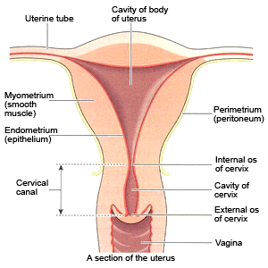

Slide 60
Classification of uterine rapture
Rupture of the uterus can be classified as being complete or incomplete uterine rapture

Slide 61
Complete rupture
Also known as intraperitoneal
This is a tear in the wall of the uterus, which involves the endometrium,myometrium and perimetrium/peritoneum
This involves a tear in the wall of the uterus, with or without expulsion of the foetus

Slide 62
Incomplete or Extra Peritoneal
This is the tearing of the uterus, which involves the endometrium and myometrium.
Tears can occur during prenatal, labour or delivery and may endanger the lives of both mother and foetus

Slide 63
PREDISPOSING FACTORS
Predisposing factors include those that contribute to over distension of the uterus such as:
Neglected obstructed labour
Previous operations on the uterus ( e.g. caesarean section, myomectomy, previous uterine rupture)
Obstetric manoeuvres on the uterus (e.g. external cephalic version, breech extraction
Harmful obstetric practice e.g. Application of fundal pressure
High parity
Multiple pregnancies
Large foetus

Slide 64
Diagnosis of ruptured uterus
A patient with ruptured uterus may present with hemorrhagic or neurogenic shock from bleeding or vasovagal stimulation, respectively.
Resuscitate and manage maternal shock expeditiously as per guidelines. It is important to note that even though rupture of the uterus is more commonly associated with labour, it can occur before onset labour or even long before term pregnancy especially when the uterus has been scarred.

Slide 65
History
During history taking, explore the presence of risk factors
Suspect rupture of the uterus if the following signs and symptoms are present:
  Shock (Signs of hypovolemia and shock include: tachycardia, hypotension, cold clammy extremities, sweating, restlessness and confusion).
  Abdominal distension/free fluid (Paracentesis may be positive in the presence of haemoperitoneum but its absence does rule out ruptured uterus.
  Abnormal uterine contour (Bandl’s ring)
  Tender abdomen and especially tenderness over the lower segment of the uterus and abdominal distension.
  Easily palpable fetal parts or dislodged presenting part

Slide 66
Absent fetal movements and fetal heart sounds
Rapid maternal pulse (Suspect rupture if the fetus suddenly becomes distressed and the mother’s pulse starts rising).
Speculum vaginal examination may reveal vaginal bleeding. (Digital vaginal examination must be avoided unless placenta previa has been ruled out).
Investigations
Blood for grouping and cross matching
Urinalysis for Haematuria, protein, sugar and acetone.

Slide 67
Signs of ruptured uterus
Signs of ruptured uterus include:
Rupture may be gradual with vaginal bleeding
Pain and tenderness at the central region/abdomen are present or pain over previous c/s scar
Abnormalities of the foetal heart rate & pattern
Maternal tachycardia & Poor progress in labour
Diagnosis is difficult; therefore close monitoring is very important

Slide 68
The Causes of Ruptured Uterus
Prenatally, a ruptured uterus may occur due to a weak scar. During labour and delivery or when not in labour a ruptured uterus may occur as a result of:
Obstructed labour, for example in malpresentation, cephalopelvic disproportion, contracted pelvis
Excessive or injudicious use of oxytocin
Intrauterine manipulation, for example, internal cephalic version of second twin
Forceps delivery and vacuum extraction

Slide 69
The Causes of Ruptured Uterus ctd
Rigid cervix
Breech delivery
Multiparity, due to the degeneration of the uterine muscle
Previous scar: the most common cause of uterine rapture is separation of previous scar
Manual removal of placenta
Perforation of uterus

Slide 70
Early Signs of Scar Rupture
Early signs of scar rupture include a constant lower abnormal pain. This pain worsens during a contraction. There is fresh vaginal bleeding, which may be mistaken for show.
Contractions may continue but the cervical os fails to dilate. Pulse rate is raised due to shock and tends to increase slowly.
Vigilant observation is required for a mother with a uterine scar showing the above signs so that she can be sectioned before rupture occurs.
Epidural analgesia masks the early signs, and is therefore contraindicated in the mother with a caesarean scar.

Slide 71
Early Signs of Scar Rupture ctd
In the advanced stage, the mother complains of severe and drastic pain, which is continuous and does not correspond to the uterine action. When the scar rupture contraction ceases, the mother rapidly becomes shocked. Rupture through a scar has less chance of infection than a rupture due to obstructed labour.
The presenting part does not descend to the pelvic brim in spite of strong contraction.
The cervical os dilates slowly and hangs loosely like an empty sleeve and the membranes rupture early or the bag of water is elongated like a sausage

Slide 72
The Late Signs of Scar Rupture
Mother is dehydrated, shows ketosis and is in severe pain
Rapid pulse and pyrexia of over 38°C
Poor urinary output, concentrated with ketosis and often blood stained
Uterus gets moulded round the foetus
Strong uterine contraction, which does not relax between contractions

Slide 73
The Late Signs of Scar Rupture ctd
A Bandl's ring (also known as pathological retraction ring) is the abnormal junction between the two segments of the uterus, which is a late sign associated with obstructed labor
On vaginal examination, the vagina is hot and dry
Presenting part is high, wedged and immovable
There is over lapping of foetal bones and big caput succedaneum:

Slide 74
Rupture Secondary to Manipulation
There is a sudden change in the general condition of the mother with severe pain . After any difficult manipulation, the uterus must be explored to rule out injury or rupture. Caesarean section is preferred to difficult manipulation

Slide 75
Rupture Secondary to Oxytocic Drugs
This is common when close monitoring is not done.
There is less danger when these drugs are used as a dilute in an intravenous drip.
The risk is much greater in multipara where many cases of rupture have followed unmonitored use of oxytocic drugs

Slide 76
The management of a ruptured uterus
a) Emergency Treatment
Set up IV line with a wide bore branula and start Ringer’s lactate solution or normal saline
Give oxygen by face mask
Transfuse blood
Catheterise for continuous bladder drainage
Provide loading dose of parenteral antibiotics
Monitor vital signs quarter hourly.
Prepare the patient for theatre

Slide 77
ctd
b) Definitive management
Surgery-laparotomy
Perform the quickest and safest operative procedure (e.g. repair with or without tubal ligation, or subtotal hysterectomy)
Continue with IV fluids
Broad-spectrum parenteral antibiotics
Continuous bladder drainage (keep bladder catheter for 10-14 days)

Slide 78
c) Precautions to take in order to avoid complications
Resuscitate patient adequately before surgery
Cross match enough blood
Administer parenteral broad spectrum antibiotics
If the uterus was repaired and tubal ligation was not performed for desired for future fertility, counsel the patient on need for both future antenatal care and delivery by elective caesarean section in a level 4 or above health care facility. If hysterectomy was done, counsel woman on consequences (amenorrhea, infertility).
d) Follow up
  Postpartum care: Review within one week, and as may be appropriate.

Slide 79
Complications of ruptured uterus
Paralytic ileus:obstruction of intestine due to paralysis of the intestine
Peritonitis : inflammation of peritoneum
Septicaemia:presence of bacterial toxins in blood.
Urinary tract infection
Renal failure
The foetus may experience complications such as birth asphyxia, stillbirths in complete rupture and neonatal death.

Slide 80
Prevention of Uterus Rupture
Prevention is possible through good antenatal care after a thorough history taking.
Refer high risk patients with previous scars and contracted pelvis for assessment.
Vigilant observations in labour, especially in trial and induction of labour are necessary. You should be able to recognise,at an early stage, signs of obstructed labour and ruptured uterus.
Maternal education is important in case of risk factors such as a previous scar.
The community should be educated on pregnancy and childbirth complications. They should be advised on the need to deliver in a hospital rather than at home.

Slide 81
CORD PRESENTATION
This is a condition where the cord lies in front of the presenting part BEFORE the membranes have ruptured
This is diagnosed on vaginal examination when the cord is felt behind intact membranes

Slide 82
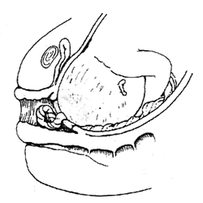

Slide 83
Mgt of cord presentation
Never rapture the membranes
Discontinue the vaginal examination in order to reduce the risk of rupturing the membranes
Continuous foetal heart monitoring
Help the mother adopt a position that will reduce the likelihood of cord compression

Slide 84
CORD PROLAPSE
Cord prolapse is a term used when the umbilical cord lies in front of the presenting part AFTER the membranes have ruptured.

Slide 86
Diagnosis of cord presentation and cord prolapse is made on:
Vaginal examination by palpating cord under the intact membranes (cord presentation)
Vaginal examination after rupture of the membranes reveals loops of the cord in the birth canal (cord prolapse).

Slide 87
Potential predisposing risk factors
Premature rupture of the amniotic sac
Polyhydramnios (having a large volume of amniotic fluid. The cord may be forced out with the more forceful gush of waters.
Long umbilical cord
Foetal malpresentation
Multiparity
Multiple gestation

Slide 88
Causes of Cord Prolapse
malpresentation and malposition e.g breech presentation, face and brow presentation, shoulder presentation resulting from transverse lie and occipito posterior position.In these conditions,the presenting part is not well applied to the cervix.
Contracted pelvis: the presenting part may not engage thus cord prolapses through the space left,
Unusually long cord above 60 cm and when membranes rapture it prolapses

Slide 89
ct…
Multiple pregnancy as a result of malpresentation of 2nd twin
High head: the membranes rupture spontaneously when the foetal still high
Prematurity: there is more room between the small foetal head and the maternal pelvis.
Low implantation of placenta
Polyhydramnios : excess amniotic fluid sweep the cord when the membranes raptures

Slide 90
Management of Cord Prolapse
The aim of management is to deliver the foetus as quickly as possible before hypoxia and death occurs due to cord compression.
Assess dilation of the cervix, presenting part and check if the cord is pulsating and fetal heart rate
Remove pressure by putting patient in knee chest position
Monitor the foetal heart appropriately, every 5 minutes
Put on oxygen by mask to prevent or reduce hypoxia
Counsel mother on the condition of the foetus.

Slide 91
Knee chest position

Slide 92
If the cord is pulsating and patient is in first stage of labour:
Replace the cord into the vagina.
Set up an infusion to rehydrate.
If cord is outside,clean with warm antiseptic and return it to vagina
Obtain consent to take the mother to emergency c/s.

Slide 93
If the cord is pulsating and patient is in second stage of labour:
Rule out cephalopelvic disproportion and other malpresentations
If pelvis and presentation are normal, and lie is longitudinal,encourage her to push,give episiotomy and deliver immediately
If in doubt about pelvic capacity, perform emergency caesarean section
If the cord is not pulsating and patient is in first or second stage of labour:
Rule out any contraindication to vaginal delivery (e.g. CPD, mal-presentation)
Allow normal labour to progress & she delivers a fresh still birth.

Slide 94
Subsequent Management
Postpartum and neonatal care as appropriate
Counsel mother on infant feeding and care, diet, family planning and sexual relationships
Provide supportive counselling if baby is dead.

Slide 95
Complications of cord prolapse and presentation
Asphyxia neonatorum
Respiratory distress
Pueperal sepsis
Psychological trauma to mother

Slide 96
Precautions to take in order to avoid complications
Apply any of the following principles prior to definitive management:
Avoid iatrogenic cord prolapse (correct skill for artificial rupture of membranes –ARM )
Remove pressure from the cord
Keep the cord warm
Refer promptly if you are not in level four hospital or facility that can do a Cs.
Deliver quickly
Be prepared for neonatal resuscitation.

Slide 97
Preventive measures
ANC screening for the risk f malpresentation
Avoid rapture of membranes
Proper pelvic examination for cpd
Proper management of the risk discovered early

Slide 98
VASA PRAEVIA
This condition occurs when there is a velamentous insertion and the blood vessel from the cord lies over the os, in front of the presenting part. This endangers the life of the foetus.
Velamentous cord insertion refers to the insertion of umblical cord on chorioamiotic membranes or placental membranes rather than palcental mass
Vasa praevia may be diagnosed antenatally using ultrasound
Vasa praevia can be felt on vaginal examination when the membranes are still intact. A speculum examination should be undertaken if this is suspected

Slide 99
Ruptured vasa praevia
When the membranes rupture in a case of vasa praevia, a foetal vessel may also rupture. This leads to exsanguination ( bloodloss to a degree sufficient to cause death) of the foetus unless birth occurs within minutes

Slide 100
DIAGNOSIS
Fresh vaginal bleeding, especially if it commences at the same time as rupture of the membranes
Fetal compromise dispropotionate to blood loss may be suggestive of vasa praevia

Slide 101
Management of Vasa Praevia
inform the doctor immediately.
Take the foetal heartbeat and, if the foetus is alive, administer oxygen and prepare the mother for an emergency caesarean section.
A paediatrician should be present at the time of delivery of the baby.
The baby's haemoglobin level should be estimated and transfused as necessary.
There is high mortality associated with this condition

Slide 102
ANTEPARTUM HAEMORRHAGE (APH)
APH is vaginal bleeding during pregnancy usually presenting in the last trimester of pregnancy.
Any vaginal bleeding after 28 weeks should be assumed to be due to either placenta praevia or abruptio placentae, unless proven otherwise

Slide 103
Causes of APH
Bleeding in late pregnancy and in labour is usually due to
placenta abruption or
placenta praevia

Slide 104
PLACENTA PRAEVIA
This is when implantation of the placenta occurs at or near the cervix
the placenta is implanted in the lower uterine segment and located over the internal os.
It constitutes an obstruction of descent of the presenting part.
Main cause of obstetrical hemorrhage

Slide 105
causes
Endometrial abnormality
Scared or poorly vascularized endometrium in the corpus.
Curettage, Delivery, CS and infection of endometrium
Placental abnormality
Large placenta (multiple pregnancy), succenturiate lobe
Delayed development of trophoblast

Slide 106
High risk factors include:
    maternal age: >35 years
    multiparity: 85% - 90%
    prior cesarean delivery: 5 times

Slide 107
Classification
Total placenta previa {type iii placenta praevia}
  The internal cervical os is covered completely by placenta
  Severe bleeding
  -C.S delivery better
Marginal placenta previa{type ii}
The edge of the placenta is at the margin of the intenal os
Vaginal birth is possible particularly if the implantation is in the anterior. Blood loss is minimal and the condition of the mother and the fetus varies.
Partial placenta previa {type i}
The internal os is partially covered by placenta
Bleeding is minimal, vaginal birth is possible and both mother and the fetus remain in good condition

Slide 108
Type 4 placenta praevia ( 4th degree placenta praevia)
The placenta is located entrally over the internal cervical os. Severe haemorrage is likely to occur

Slide 109
Clinical manifestations
painless bleeding :The most characteristic symptom. Occurs in late pregnancy (after the 28th week) and delivery.Blood is bright red and may be Scanty or heavy
Pale looking patient, the degree of which corresponds to the amount of blood loss.
No tenderness in the abdomen
Soft and relaxed uterus
The presenting part may be high or there may be abnormal presentation
The foetal parts are easily palpable
Foetal heart sounds are usually present

Slide 110
Diagnosis
Based on signs and symptoms through history
Ultrasonography:The most useful diagnostic method: 95%

Slide 111
Management of placenta praeva
Depends on the:
  Amount of bleeding
  Condition of the mother and fetus
  Location of the placenta
  Stage of pregnancy
CONSERVATIVE MANAGEMENT
Is carried out if bleeding is minical and the condition of the mother and baby is stable
Mother is admitted in hospital for complete bedrest until bleeding stops
Speculum examination is done to rule out cause of bleeding

Slide 112
cont
Placental function is monitored through fetal kick chart
Ultrasound scans are repeated to monitor the position of the placenta in relation to the to the cervical os
Monitor the condition of the monitor including vs,fhrand general condition of the mother
Psychotherapy to allay anxiety and stress
Assessment of progress is done and if no placenta is felt in the lower segment,the membranes are raptured and labour induced by oxytocin.
Vaginal delivery is possible with type I and ii
If it is type iii and iv ,then c/s is done.

Slide 113
SHOULDER DYSTOCIA
DEFINITION: This describes the Impaction of the anterior shoulder against the symphysis pubis after delivery of the fetal head.
Shoulder dystocia is said to have occurred when there is:
Failure of the shoulder to rotate spontaneously into anterior, posterior diameter of the pelvis outlet after delivery of the head
The anterior shoulder becomes trapped behind or on the symphysis pubis while the posterior shoulder may be in the hollow of the sacrum or high above the sacral promontory

Slide 115
INCIDENCE
Shoulder dystocia is not a common emergency. The incidence is reported as varying between 0.37% and 1.1%

Slide 116
PREDISPOSING FACTORS
Maternal:
Abnormal pelvic anatomy
Gestational diabetes
Post-dates pregnancy
Previous shoulder dystocia
Short stature
High pre pregnancy weight and increased weight gain.

Slide 117
Fetal;
Suspected macrosomia
Labor related ;
  Assisted vaginal delivery (forceps or vacuum)
  Protracted active phase of first-stage labor
  Protracted second-stage labour
  Prior shoulder dystocia
DIAGNOSIS
The following signs are indicative of possible shoulder dystocia:
  The shoulders fail to deliver shortly after the foetal head.
  The fetal head retracts against perineum (“turtle sign”)
  The face of the baby becomes erythematous, red and puffy - indicative of facial flushing.
  Gentle traction does not effect delivery

Slide 118
Warning signs
There is slow advance of the head and failure of the head to rotate externally following restitution
Slow crowning of the head
There are difficulties in extension of the face during delivery of the head
There is slow restitution of the occiput to the lateral position

Slide 119
MANAGEMENT OF SHOULDER DYSTOCIA
Shoulder dystocia is an obstetrical emergency, with foetal demise occurring within about 5 minutes if the infant is not delivered, due to compression of the umbilical cord within the birth canal. Several algorithms have been proffered to facilitate rapid delivery in case of shoulder dystocia. The basic principles are similar.
A common treatment algorithm is ALARMER; which stands for:
Ask for help. This involves requesting the help of an obstetrician, a paediatrician for subsequent resuscitation of the infant and anaesthesia in case if surgical intervention.

Slide 120
Leg hyper flexion (McRobert’s manoeuvre)
Anterior shoulder disimpaction (apply suprapubic pressure)
Rubin manoeuvre
Manual delivery of posterior arm
Episiotomy
Roll over on all fours (Gaskin Manoeuvre)

Slide 121
Also commonly used is the HELPERR Mnemonic. This is a clinical tool that offers a structured framework for coping with shoulder dystocia. These manoeuvres are designed to do one of three things:
  Increase the functional size of the bony pelvis through flattening of the lumbar lordosis and cephalad rotation of the symphysis (i.e., the McRobert's manoeuvre);
  Decrease the bisacromial diameter (i.e., the breadth of the shoulders) of the foetus through application of suprapubic pressure (i.e., internal pressure on the posterior aspect of the impacted shoulder);
  Change the relationship of the bisacromial diameter within the bony pelvis through internal rotation manoeuvres.

Slide 122
THE HELPERR MNEMONIC
H Call for help.
This refers to activating the pre-arranged protocol or requesting the appropriate personnel to respond with necessary equipment to the labor and delivery unit.
E Evaluate for episiotomy.
Episiotomy should be considered throughout the management of shoulder dystocia but is necessary only to make more room if rotation maneuvers are required. Shoulder dystocia is a bony impaction, so episiotomy alone will not release the shoulder. Because most cases of shoulder dystocia can be relieved with the McRobert's maneuver and suprapubic pressure, many women can be spared a surgical incision.

Slide 123
L Legs (the McRobert's maneuver)
This procedure involves flexing and abducting the maternal hips, positioning the maternal thighs up onto the maternal abdomen. This in effect straightens the lumbosacral lordosis, Increases AP diameter of pelvis, Flexes the fetal spine and as a result Reduces >40% of shoulder dystocia.
Nurses and family members present at the delivery can provide assistance for this maneuver

Slide 124
P Suprapubic pressure
The hand of an assistant should be placed suprapubically over the fetal anterior shoulder, applying pressure in a cardiopulmonary resuscitation style with a downward and lateral motion on the posterior aspect of the fetal shoulder. The aim is to adduct the anterior shoulder. This maneuver should be attempted while continuing downward traction. Initially this is continuous, but may involve a rocking motion

Slide 125
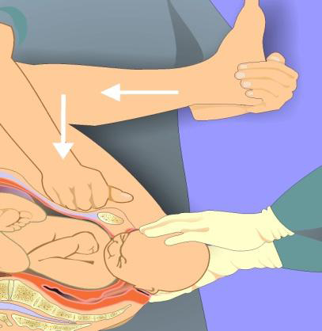

Slide 126
E Enter maneuvers (internal rotation)
These maneuvers attempt to manipulate the fetus to rotate the anterior shoulder into an oblique plane and under the maternal symphysis.
In the Rubin maneuver, the anterior shoulder should be approached from behind and the scapula adducted and rotated to oblique position.
If the above fails, the Woodscrew maneuver may be applied. In this case the posterior shoulder is approached from the front and gently rotated towards the symphysis pubis.
When this fails, the Reverse woodscrew maneuver may be applied; In this instance the posterior shoulder is approached from behind and rotated In the opposite direction from Rubin or woodscrew maneuver

Slide 127
These maneuvers can be difficult to perform when the anterior shoulder is wedged beneath the symphysis. At times, it is necessary to push the fetus up into the pelvis slightly to accomplish the maneuvers. McRobert's maneuver should continue throughout this process.
R Remove the posterior arm.
Removing the posterior arm from the birth canal also shortens the bisacromial diameter, allowing the fetus to drop into the sacral hollow, freeing the impaction. The elbow then should be flexed and the forearm delivered in a sweeping motion over the fetal anterior chest wall. Grasping and pulling directly on the fetal arm may fracture the humerus.

Slide 128
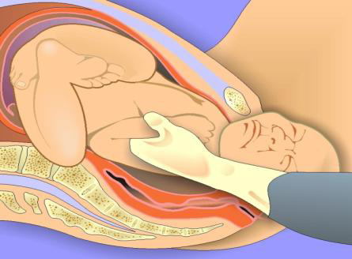
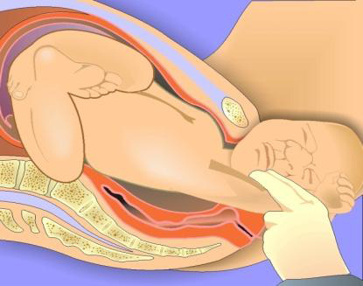

Slide 129
R Roll the patient.
The patient rolls from her existing position to the all-fours position. This usually increases the pelvic diameters. Often, the shoulder will dislodge during the act of turning, so that this movement alone may be sufficient to dislodge the impaction. In addition, once the position change is completed, gravitational forces may aid in the disimpaction of the fetal shoulders.

Slide 130
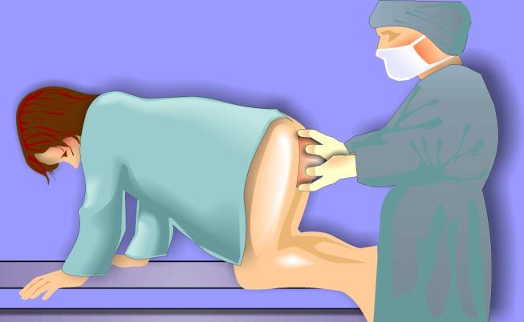

Slide 131
MANOEUVRES OF LAST RESORT FOR SHOULDER DYSTOCIA
Deliberate clavicle fracture
Direct upward pressure on the mid-portion of the fetal clavicle; reduces the shoulder-to-shoulder distance.
Zavanelli maneuver
Cephalic replacement followed by cesarean delivery; involves rotating the fetal head into a direct occiput anterior position, then flexing and pushing the vertex back into the birth canal, while holding continuous upward pressure until cesarean delivery is accomplished.

Slide 132
Tocolysis(inhibition of uterine contraction by ritodrine or tarbutaline) may be a helpful adjunct to this procedure, although it has not been proved to enhance success over cases in which it was not used. An operating team, anesthesiologist, and physicians capable of performing a cesarean delivery must be present, and this maneuver should never be attempted if a nuchal cord previously has been clamped and cut.
Use of General anesthesia
Musculoskeletal or uterine relaxation with halothane (Fluothane) or another general anesthetic may bring about enough uterine relaxation to affect delivery. Oral or intravenous nitroglycerin may be used as an alternative to general anesthesia.

Slide 133
ABDOMINAL SURGERY WITH HYSTERECTOMY
General anesthesia is induced and cesarean incision performed, after which the surgeon rotates the infant transabdominally through the hysterotomy incision, allowing the shoulders to rotate, much like a woods corkscrew maneuver. Vaginal extraction is then accomplished by another physician.
SYMPHYSIOTOMY
Intentional division of the fibrous cartilage of the symphysis pubis under local anesthesia has been used more widely in developing countries. It should be used only when all other maneuvers have failed and capability of cesarean delivery is unavailable

Slide 134
COMPLICATIONS OF SHOULDER DYSTOCIA:
Maternal
Postpartum hemorrhage –commonest (11%)
Rectovaginal fistula
Symphyseal separation or diathesis, with or without transient femoral neuropathy
Third- or fourth-degree episiotomy or tear with anal sphincter damage
Uterine rupture
Soft tissue injuries

Slide 135
Fetal
Brachial plexus palsy- commonest 3-15%
Clavicle fracture
Fetal death
Fetal hypoxia, with or without permanent neurologic damage
Fracture of the humerus

Slide 136
Prevention
If shoulder dystocia is anticipated on the basis of risk factors, preparatory tasks can be accomplished before delivery. Key personnel can be alerted, and the patient and her family can be educated about the steps that will be taken in the event of a difficult delivery.
The patient's bladder should be emptied, and the delivery room cleared of unnecessary clutter to make room for additional personnel and equipment.
Glycaemia control and weight control for at risk patients is also helpful in preventing foetal macrosomia. Patients may also be encouraged to deliver in alternative positions that favour increased pelvic diameters.

Slide 137
AMNIOTIC FLUID EMBOLISM
This is a very rare catastrophic condition.
Amniotic fluid embolism occurs when amniotic fluid enters the maternal circulation via the uterus or placental site
An emboli is formed which obstructs one of the pulmonary arteries or alveolar capillaries.
It is associated with strong contractions, the membranes having ruptured.

Slide 138
The body responds into two phases;
In the initial phase, the pulmonary artery goes into vaso spasm causing hypoxia, hypotension, pulmonary oedema & cardiovascular collapse
In the second phase, there is left ventricular failure, haemorrhage, and blood coagulation disorders followed by pulmonary oedema
Mortality & morbidity rates are high though early diagnosis may lead to better outcome

Slide 139
Predisposing factors to amniotic fluid embolism
Hypertonic uterine action
Placenta abruptio, where the barrier between maternal circulation and amniotic sack is breached and the placenta bed is disrupted
Procedures like insertion of intrauterine catheter
Rupture of membranes i.e artificial rupture of membranes( ARM)
Caesarean section

Slide 140
Signs & symptoms of amniotic fluid embolism
Foetal compromise
Respiratory;
  Cyanosis
  Dyspnoea
  Respiratory arrest
Cardiovascular
  Tachycardia
  Hypotension
  Pale clammy skin/ shivering
  Cardiac arrest

Slide 141
Ct…
Haematological
  Haemorrhage from placental site
  Coagulation disorders, DIC(disseminated intravascular coagulopathy)
Neurological
  Restlessness, panic
  Convulsions
  Pain less likely

Slide 142
Clinical signs & symptoms
Premonitory signs & symptoms( restlessness, abnormal behaviour, respiratory distress & cyanosis) may occur before collapse
Maternal hypotension
Hypertonic uterus
Uterine hypoxia
Cardiopulmonary arrest
Blood coagulopathy

Slide 143
Management of Amniotic Fluid Embolism
Emergency action:
The following procedures should be followed when trying to manage the condition:
Call the Dr. and the resuscitation team
Administer oxygen
Give aminophylline slowly to reduce bronchial spasm
Give fresh blood or fibrinogen to combat hypofibrinogen anaemia
Maintain an intake and output chart, checking on urinary output
Assisted delivery

Slide 144
Complications of amniotic fluid embolism
DIC( disseminated intravascular coagulopathy)
Severe haemorrhage
Uterine atony
Acute renal failure
Hypovolaemic hypotension
Perinatal morbidity & mortality

Slide 145
Effect of amniotic fluid embolism on the foetus
Perinatal morbidity & mortality are high where amniotic fluid embolism occurs before birth of the baby

Slide 146
ACUTE INVERSION OF THE UTERUS
This is rare but potentially life threatening complication of the 3rd stage of labour. Occurs in approximately 1:20,000 births
Inversion of the uterus refers to when the uterus has turned inside out. It occurs when the placenta fails to detach from the uterus as it exits, pulls on the inside surface, and turns the organ inside out
A midwife’s awareness of the precipitating factors enables her to take preventive measures to avoid this emergency

Slide 147
Inversion can be classified as follows:
First degree; where the fundus reaches the internal os.
Second degree; where the corpus of the uterus is inverted to internal os.
Third degree; where both the uterus, cervix and vagina are inverted and rare visible at the vagina.

Slide 148
Classification of inversions is also based on the time they occur;
Acute inversion; refers to immediate prolapsed after delivery while the placenta is still attached. Occurs within the first 24hrs
Sub acute inversion; occurs after the first 24hrs & within 4 weeks
Chronic inversion; occurs after 4 weeks & is rare

Slide 149
Causes of acute uterine inversion
Mismanagement in the 3rd stage of labour involving excessive cord traction to manage the delivery of the placenta actively
Combining fundal pressure & cord traction to deliver the placenta
Use of fundal pressure while the uterus is atonic to deliver the placenta
Pathologically adherent placenta

Slide 150
Causes of acute uterine inversion ctd…
Spontaneous occurrence of unknown cause
Primiparity
Foetal macrosomia
Short umbilical coRD

Slide 151
Warning signs & diagnosis
How to diagnose acute inversion of the uterus;
Haemorrhage between 800ml –1,880ml, which depends on the degree of placenta adherent on the uterine wall
pain, which is caused by the stretching of peritoneal nerves and the ovaries being pulled
No fundus is palpable abdominally
If inversion is partial, the fundus will not be visible per vagina
On vaginal examination a mass may be felt

Slide 152
Management of acute uterine inversion
The hydrostatic method of replacement involves the instillation of several litres of warm saline infused though a giving set into the vagina. The pressure of the fluid builds up in the vagina & restores the uterus to the normal position
If the inversion not replaceable manually, a cervical constriction ring may be developed. Drugs can be given to relax the constriction & facilitate the return of the uterus to its normal position

Slide 153
BASIC LIFE SUPPORT MEASURES
BLS refers to the maintenance of an airway & support for breathing

Slide 154
The basic principles are
  AIRWAY
  BREATHING
  CIRCULATION

Slide 155
OBSTETRIC SHOCK
Shock refers to the collapse of the circulation system, which results in the reduction of blood flow to the tissue. This causes dysfunction of organs and cells. In obstetric shock, the condition may be due to complications of pregnancy and labor

Slide 156
Classification/types of shock
Hypovolaemic, which is as a result of reduction in intravascular volume.
Cardiogenic, which is due to the inability of the heart to pump blood.
Neurogenic; results from an insult to the nervous system as in uterine inversion
Septic/toxic; occurs with a severe generalized infection
Anaphylactic; may occur as a result of severe allergy or drug reaction

Slide 157
The causes of obstetric shock
Haemorrhage during pregnancy, labor and puerperium
Obstetric trauma such as difficult instrumental delivery, forcible breech extraction, manual removal of placenta or caesarean section
Prolonged labour
Fluid loss, for instance, excessive diuresis or hyperemesis gravidarum
Supine hypotensive syndrome
Pulmonary embolism, which may dislodge and cause oxygen deprivation
Reaction due to blood transfusion or drugs

Slide 158
Management of Hypovolaemic Shock
Urgent resuscitation measures should be applied to prevent irreversible damage to the patient.
The first thing you should do is to maintain a clear airway by turning her on one side. If she is unconscious, insert an airway by turning her on one side and administer oxygen

Slide 159
ctd…
Find the source of bleeding, whenever possible and try to stop the bleeding. Replace fluid immediately.
Take blood for a cross match and give blood transfusion as and when ready.
Meanwhile a plasma expander such as dextran, haemocel or glucose saline (1 litre) should be administered as soon as possible

Slide 160
When the blood is ready, the first 1,200mls should be given rapidly (within 30 minutes). The doctor should remain with the patient during this exercise. Avoid excessive warmth as it will interfere with the constriction of the peripheral blood vessels, which usually occurs in response to shock.

Slide 161
Elevate the foot of the bed by 30cm. This will raise blood pressure 10mm Hg by gravity. This allows the blood to flow to vital centres in the brain.
Hydrocortisone 100-500mg is given slowly in cases of suparenal failure. A sedative may be necessary in the case of restlessness to calm an apprehensive patient.

Slide 162
Septic Shock
This is also known as endotoxic or bactereamic shock. The main cause of septic shock is gram negative organism such as Escherichia coli & Bacillus Proteus

Slide 163
Drug therapy for septic shock
Use quick fluid therapy including glucose, saline, Ringers lactate or whole.
An injection of dopamine 20mg per kilogram, is infused in the vasodilation stage. Hydrocortisone is given, 100mgs IV stat, followed by 100mg six hourly until the pulse and blood pressure are stabilised

Slide 164
Antibiotics are commenced immediately after the specimens for culture and other investigations are completed. These include:
  Gentamycin 80mg IV eight hourly
  Metronidazole 500mg IV eight hourly
  Ampicillin 500mg IV six hourly
These should be administered until the bowel sound returns. You should then continue with 400mg metronidazole orally eight hourly for 10 days
END

Slide 165
OBSTETRIC OPERATIONS

Slide 166
GENERAL OBJECTIVE:
By the end of this session, the student nurse should be able to describe and manage the various obstetric operations
SPECIFIC OBJECTIVES:
To describe and manage clients undergoing the following procedures/operations:
  Caesarean section
  Vacuum extraction
  Forceps delivery
  symphysiotomy

Slide 167
CAESAREAN SECTION
DEFINITION:
A Caesarean section also C-section, etc., is a surgical procedure in which one or more incisions are made through a mother's abdomen (laparotomy) and uterus (hysterotomy-incising to wall of uterus) to deliver one or more babies, or, rarely, to remove a dead foetus.
Surgical delivery of a previable foetus using Caesarean section procedures is termed hysterotomy.

Slide 168
INDICATIONS OF A C/S
These may be divided into maternal, foetal or combined.
A) Maternal Indications
Previous uterine scar
Previous Lower Uterine Segment C/S due to a recurring reason e.g. contracted pelvis or a previous scar with a concomitant obstetric complication
History of two (2) or more previous C/S
After High vertical /classical C/S
Previous ruptured uterus
Previous myomectomy
Severe Pre ecclampsia (PET) or eclampsia with unfavourable cervix

Slide 169
Life-threatening antepartum haemorrhage (APH) or Placenta praevia type IIb-IV
Contracted pelvis (congenital, fracture)
Following repair of obstetric fistula (VVF, RVF)
Medical illness; severe heart or respiratory disease, severe hypertension, cerebral aneurysm, musculoskeletal disorders, severe neurological disorders (C/S is then safer than vaginal delivery).
Prolonged labour, uterine inertia, cervical dystocia and failed induction
Pelvic tumours obstructing labour (fibroids, entrapped ovarian tumour, genital warts)
Invasive carcinoma of the cervix
Infections: (HIV, active Herpes Simplex Virus II, Human Papilloma Virus, Hepatitis B Virus)

Slide 170
Relative indications
C/ Section may also be considered in the following conditions
Postdatism
Elderly primigravida
Prior infertility
Bad obstetric history
B) Foetal
Foetal distress /Poor biophysical profile score (Myles pg276 and 553)
Malpresentation and malposition;
Cord presentation and/or cord prolapse
Multiple pregnancy: (1st non-cephalic, retained 2nd twin, extreme prematurity, discordant foetal growth, single amniotic sac, conjoined twins, >2 foetuses)
Foetal Macrosomia: estimated weight > 4000g
Foetal anomalies: (e.g. hydrocephalus, sacral tumour, Conjoined twins)
Others: (e.g. Intrauterine Growth Retardation, oligohydramnios)

Slide 171
C) Feto-maternal
Failure to progress in labour
Peri mortem C/ Section
Lack of competency by service provider in assisted delivery techniques

Slide 172
Types of Caesarean Section
Based on uterine incision ;
Lower segment section, which is the operation of choice. The lower segment of the uterus forms after 32 weeks gestation & is less muscular than the upper segment of the uterus
Classical section
Extraperitonial caesarean section
Caesarean hysterectomy

Slide 173
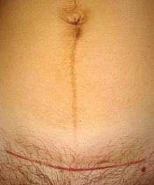

Slide 174
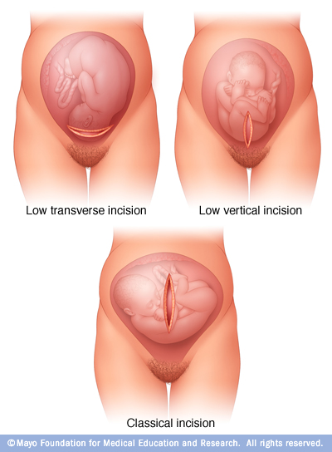

Slide 175
Advantages of lower segment section are;
Blood loss is minimal
Incision is easy to repair
The risk of rupture during labour is lessened as the lower uterine segment has less uterine activity
The operation is associated with lower incidence of postoperative infection

Slide 176
Classical Caesarean Section
The incision is made directly into the wall of the body of the uterus. The procedure is rarely performed
its indications are:
  Gestation of less than 32 weeks (i.e before the lower segment has formed)
  Placenta previa which is Anteriorly situated
  An hour glass contraction (constriction ring)
It is always performed through a midline incision

Slide 177
Extra Peritoneal Caesarean Section Procedure
Access to the lower uterine segment is secured by appropriate dissection of tissues around the bladder to by pass the peritoneal cavity and the baby is extracted.
As the peritoneal cavity is not disturbed there is no risk of introducing infection from infected liquor or infection from the uterus

Slide 178
Caesarean Section Hysterectomy
This is also known as Porro’s Operation.
The removal of the uterus follows after caesarean section, due to other conditions of the uterus; such as placenta accreta, multiple fibroids, tumours of the uterus and so on.
On rare occasions and in conjuction with other gynaecological disorders this operation may be used for sterilisation purposes

Slide 179
Elective Caesarean Section
Based on timing of the operation, C Section maybe:
  Elective C/S (planned procedure) or
  Emergency C/S
The decision to deliver by caesarean section is made during pregnancy before the onset of labour (Elective c/s)
Some reasons for this decision are absolute while others depend on combination of factors and the opinion of the obstetrician
Definite indications of an elective c/section are;
  CPD
  Major degree of placenta praevia
  High order multiple pregnancy with three or more foetuses

Slide 180
Other possible indications of an elective c/s are;
Breech presentation
Moderate to severe pre-eclampsia
A medical condition that warrants the exclusion of maternal effort
DM
Intrauterine growth restriction
APH
Certain foetal abnormalities e.g. hydrocephalus

Slide 181
If the indication for c/s pertains specifically to one pregnancy, such as placenta praevia, vaginal delivery may be expected on subsequent occasions
Certain conditions warrant repeated c/s. CPD due to contracted pelvis will recur & a uterus which has been scared twice or more carries a greater risk of uterine rupture

Slide 182
Emergency caesarean section
This is carried out when adverse conditions develop during pregnancy or labour
The psychological preparation of the mother for the operation is of paramount importance. You should be prepared to deal with the different feelings of different mothers.

Slide 183
Definite Indications of an emergency caesarean section
APH
Cord prolapse
Uterine rupture
CPD diagnosed in labour
Fulminating PET
Eclampsia
Failure to progress in the first or second stage of labour
Foetal compromise/distress if delivery is not imminent

Slide 184
Pre-Operative Care For Elective Caesarean Section
The following are characteristic of pre-operative care during an elective caesarean section:
The doctor explains the procedure to the mother and her partner and consent is obtained.
Physical examination is carried out to make sure the mother is fit for general anaesthesia
Blood for haemoglobin, cross match and two pints of blood are kept ready.
Antacid therapy. It is a common practice for women with any risk factors to receive antacid therapy throughout labour & if not given, it should be administered immediately a decision for c/s is made. In order to minimize the secretion of gastric acid the anaesthetist may also prescribe preparations such as ranitidine

Slide 185
Mother is admitted and not fed overnight
A bath is taken in the morning.
Pubic shave is also done
Bowel care. If c/s is elective, two glycerine suppositories are administered on the evening b4 operation in order to empty the rectum
A retention catheter is inserted to ensure an empty bladder throughout the operation.
An intravenous infusion is started as per prescription.
Valuables are kept safely.
Nail polish, dentures, glasses or contact lenses are removed.

Slide 186
Theatre gown, leggings and scarf are put on the mother.
Pre-operative medication is usually administered half an hour before the operation (1m atropine and analgesic).
Foetal heart, foetal position, and presentation are determined.
Maternal observations are recorded: pulse, respiration, blood pressure and temperature.
A urinalysis is carried out for albumin

Slide 187
Post Operative Care
This is the same care given to any woman who has undergone a major abdominal operation.
Observations. Bp & pulse are recorded every ¼ hour in the immediate recovery period
Temperature is recorded every 2 hrs
Inspect the wound every ½ hour to detect any bloodloss
Inspect the lochia. Drainage should be small initially
Nurse the pt in the left lateral/recovery position until she is fully conscious since the risk of airway obstruction or regurgitation & silent aspiration of the stomach contents are still present

Slide 188
Analgesia is prescribed & is given as required
Fluids are introduced gradually followed by a light diet
The mother should breast feed as soon as her condition permits. If for any reason she cannot breast feed, the breast should manually be expressed from the third day to prevent engorgement of the breasts.
Four hourly vulva swabbing should be taken if the patient is confined to bed
Prophylactic antibiotics should be administered to prevent infections

Slide 189
Care in the postnatal ward
When mother & baby are transferred to the postnatal ward, check BP, pulse & temp every 4hrs
Ct intravenous infusion
The urinary catheter remains in situ until the woman is ambulant
Observe the lochia & the wound every 4 hrs initially

Slide 190
Ensure that the mother has adequate rest
Encourage the woman to move her legs & perform legs & breathing exercises
The physiotherapist should teach chest physiotherapy
Prophylactic low dose heparin is often prescribed

Slide 191
Monitor urinary output carefully both b4 & after removal of catheter. Women may have difficulty in micturition initially & the bladder may be incompletely emptied. Any haematuria must be reported to the doctor
Give appropriate analgesia as frequently as possible. Intramuscular opiates are given within the 1st 48hrs & thereafter oral analgesics
Observe the mother when breastfeeding & assist where necessary

Slide 192
Complications
Maternal Complications
Immediate:
  Anaesthetic - difficult intubation, Mendelson’s syndrome, hypotension, spinal headache
  Haemorrhage – lacerations, uterine atony, placenta praevia or accreta
  Complications of blood transfusion
  GI and urinary tract injuries
  Death (risk of death is 7x that of vaginal delivery)
Late
  General post-op. complications; atelectasis, pneumonia, paralytic ileus, UTI, thromboembolism
  Infection (endometritis, wound infection)
  Intestinal obstruction (adhesions especially after classical)

Slide 193
  Uterine scar dehiscence /rupture in subsequent pregnancy (10x more likely in classical than LUSCS)
  Chronic abdominal pain
Fetal Complications
  Prematurity
  Respiratory depression
  Intracranial haemorrhage (due to small incision)

Slide 194
INTRODUCTION TO VACUUM EXTRACTION( VENTOUSE DELIVERY)
Younge invented the basic idea for the vacuum extractor in 1706 when he used a glass suction cup. In 1849, Simpson designed the instrument, but at the time it was hardly used.
In 1874, Mostron introduced the modern vacuum extractor.
There are opinions about the value in assisting delivery by this method and it is rarely used these days. However, it is still useful in remote areas

Slide 195
DEFINITION:
Ventouse is a vacuum device used to assist the delivery of a baby when the second stage of labour has not progressed adequately. It is an alternative to a forceps delivery and caesarean section. It cannot be used when the baby is in the breech position or for premature births.
This technique is also called vacuum-assisted vaginal delivery or vacuum extraction (VE). The use of VE is generally safe, but it can occasionally have negative effects on either the mother and the child
The ventouse or vacuum extractor consists of a cup which is attached to the foetal scalp by suction, & the means of providing the vacuum

Slide 196
advantages
It does not add to the presenting diameters
If correctly positioned brings about flexion of the head & natural rotation
An episiotomy may not be required.
The mother still takes an active role in the birth.
No special anesthesia is required.
The force applied to the baby can be less than that of a forceps delivery, and leaves no marks on the face.
There is less potential for maternal trauma compared to forceps and caesarean section.

Slide 197
disadvantages
The operator may be too hasty in applying traction b4 the suction has been built up, so that the cup comes off
The baby will be left with a temporary lump on its head, known as a chignon.
There is a possibility of cephalohematoma formation

Slide 198
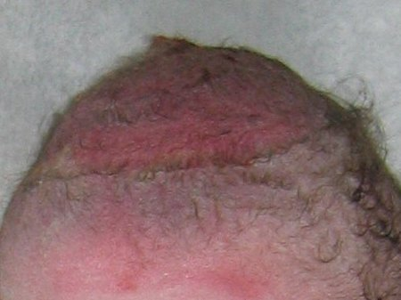
chignon

Slide 199
The vacuum Extractor
Modern extractors are constructed of varied materials including polyethylene or silastic and stainless steel. Several features are found in all VE designs. These include:
  A mushroom shaped vacuum cup of varied composition and depth
  A cup including a fixed internal vacuum grid or guard
  A combined vacuum pump / handle or a vacuum port to permit a vacuum hose attachment
  A handle, wire or chain for traction

Slide 200
Prerequisites for vacuum
Informed consent is required for any surgical procedure, including an instrumental delivery
The clinician must be competent in the use of the vacuum extractor and knowledgeable of the VE indications. Most importantly, they must be prepared to reconsider or abandon any operation that proves difficult
The pregnancy should be term, the foetus alive or FSB (foetal heart stopped during labour) and in vertex presentation
The patient should have an empty bladder either by catheterization or spontaneous voiding, full cervical dilation, ruptured membranes, an engaged foetal head, and no suspicion of cephalopelvic disproportion.

Slide 201
Indications for vacuum delivery:
Maternal indications
Prolonged second stage of labour (In general, second stages of more than 2 hours without epidural anaesthesia and 3 hours which are the acceptable measures for nulliparas
Shortening of the second stage of labour: This may be necessary in case of Maternal illness (e.g. cardio-respiratory, neuromuscular, cerebrovascular when voluntary expulsive efforts are contraindicated); Haemorrhage; Severe Pre eclampsia.
Presumed foetal jeopardy/foetal distress: That is in case of Foetal compromise necessitating immediate delivery in 2nd stage or Non-reassuring FHR tracing.

Slide 202
Contraindications to Vacuum Extraction
Vacuum operation is contraindicated in the following instances:
  Operator inexperience
  Inability to achieve a correct application
  An inadequate trial of labour
  Lack of a standard indication
  Gestational age less than 37 weeks
  Uncertainty concerning foetal position and station
  Known or suspected foetal coagulation defects
  Suspicion of cephalopelvic disproportion
  Non-vertex presentation(e.g. breech, face, brow)
  Absence of contractions
  Incomplete cervical dilation & Unengaged head

Slide 203
THE PROCEDURE
The ABCEFGHIJ Mnemonic has been used to facilitate the remembering of the steps in VE
A: Ask for help; Address the patient (counsel on procedure and obtain informed consent); ensure adequate Anaesthesia as necessary
B: Empty the Bladder
C: Confirm that the Cervix is fully dilated
E: Prepare the Equipment and Extractor ensuring that they are ready to use
F: Apply the vacuum cup over sagittal suture 3cm in front of posterior Fontanel. This is known as the “Flexion point” – (proper application results in flexion of foetal head when traction applied)

Slide 204
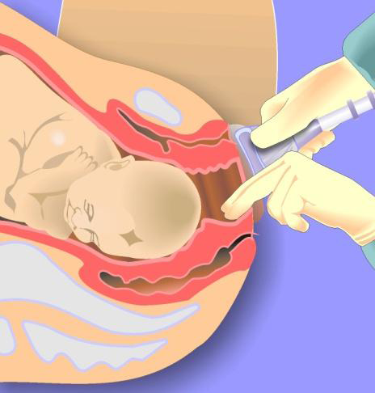

Slide 205
G: Apply Gentle traction at right angles to plane of cup only during contractions. Note that Bending, rotary force, or paramedian application will cause detachment!

Slide 206
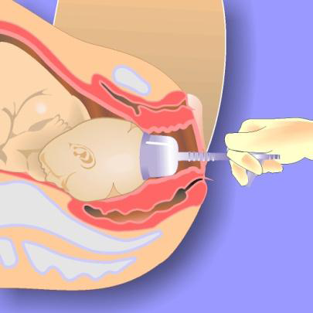
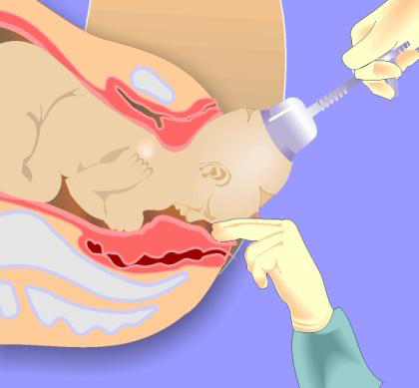

Slide 207
H= Halt
Further attempts at vacuum extraction should be stopped in the following circumstances: Halt traction after a contraction and Reduce pressure between contractions
  Halt procedure if there is:
  Disengagement of cup 3 times
  No progress in 3 consecutive pulls
  Total time that has elapsed after application is more than 20 minutes– foetal injuries increase after 10 minutes of application time
I= Incision
Evaluate for Incision (episiotomy) when the head is being delivered. An episiotomy may not be necessary for vacuum per se, but in case of subsequent shoulder dystocia or difficult delivery

Slide 208
J= Jaw
It is recommended that the vacuum cup is removed when the Jaw is reachable

Slide 209
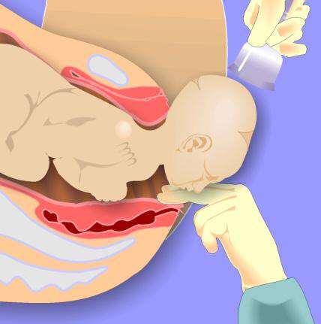

Slide 210
Complications of vacuum extraction
These complications occur mainly due to some degree of disproportion where the cup has been applied for long period and forceful traction used
Failure of the procedure
Trauma to the foetal scalp
Chignon, that is, oedema and bruising where the cup had been applied, which can occasionally get infected
Some babies develop cephallohaematoma
Intracranial haemorrhage
Necrosis of the scalp
Aponeurotic haematoma

Slide 211
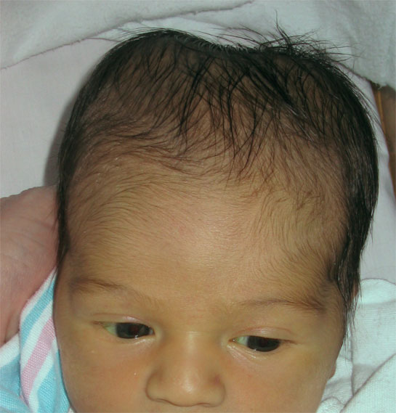
cephallhaematoma

Slide 212
INTRODUCTION TO FORCEPS DELIVERY
Forceps delivery is a means of extracting the foetus with the aid of obstetric forceps when it is inadvisable or impossible for the mother to complete the delivery by her own effort
This procedure is performed by a forceps which is an instrument that has two parts that cross each other like scissors and lock at the intersection. The lock may be of sliding type that of screw type.
Each part consists of a handle, a lock, a shank and a blade.
The blade is joined to the handle by a shank.
The blade has two curves, cephalic curve to fit the head, and pelvic curve that correspond with the curved axis of the pelvis.

Slide 213
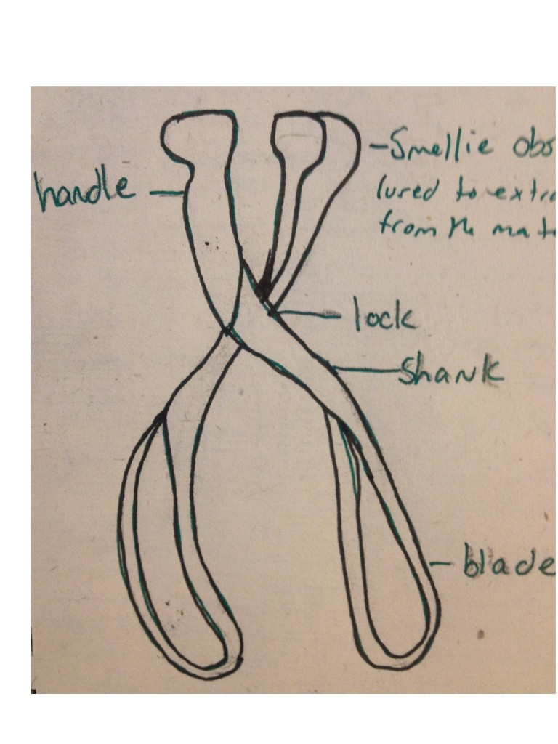

Slide 214
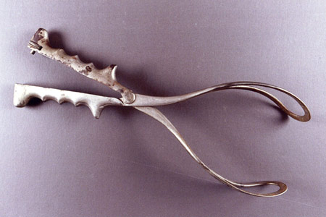
forceps

Slide 215
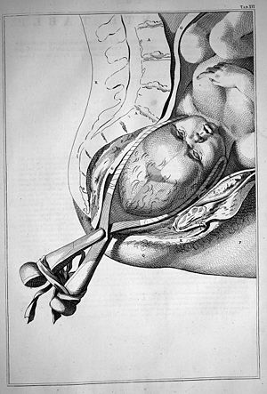

Slide 216
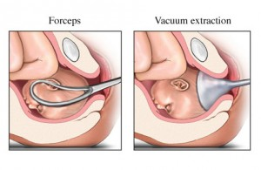

Slide 217
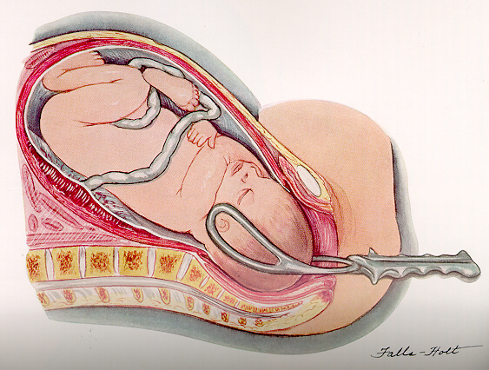
.

Slide 218
types of forceps
There are several types of forceps including;
Kielland’s, Simpson’s, Wrigley’s, Neville- Barne’s, Haig-Fwerguson’s, Milne-Murray and Diper forceps among others.

Slide 219
Simpson forceps are the most commonly used among the types of forceps and has an elongated cephalic curve. These are used when there is substantial molding, that is, temporary elongation of the fetal head as it moves through the birth canal
Elliot forceps are similar to Simpson forceps but with an adjustable pin in the end of the handles which can be drawn out as a means of regulating the lateral pressure on the handles when the instrument is positioned for use. They are used most often with women who have had at least one previous vaginal delivery because the muscles and ligaments of the birth canal provide less resistance during second and subsequent deliveries. In these cases the fetal head may thus remain rounder.

Slide 220
Kielland forceps are distinguished by an extremely small pelvic curve and a sliding lock. They are the most common forceps used for rotation. The sliding mechanism at the articulation can be helpful in asynclitic births (when the fetal head is tilted to the side), since the fetal head is no longer in line with the birth canal
Wrigley's forceps are used in low or outlet delivery, when the maximum diameter is about 2.5 cm above the vulva
Piper's forceps have a perineal curve to allow application to the after-coming head in breech delivery.

Slide 221
Types of Forceps Delivery
Low Forceps
Today the majority of forceps delivery is carried out when the foetal head is on the perineal floor whereby the internal rotation may have already occurred. This is called outlet forceps or low forceps delivery

Slide 222
Ct…
Mid Forceps
This is when the head is higher in the pelvis but engaged and the greater diameter has passed the inlet. This is known as mid forceps.

Slide 223
High Forceps
If the head is not engaged, the procedure is termed high forceps. This is an extremely difficult and dangerous operation. A caesarean section is usually preferred to mid/high forceps.

Slide 224
Pre-requisites for forceps delivery
Prerequisites for forceps delivery include:
Presentation must be suitable
Head has to be engaged
The pelvic outlet needs to be adequate
Good uterine contraction
Membranes should be ruptured
Bladder must be empty
Cervix must be fully dilated

Slide 225
procedure
The mother is given analgesia and placed in the lithotomy position.
The vulva is swabbed and draped.
Catheterisation is done.
The physician checks the exact position of the foetal head by vaginal examination.
The fingers of the right hand are passed in the vagina.

Slide 226
The left blade is applied first and held by the left hand between the fingers and thumbs of the left hand.
The blade is then passed between the head and the palm or surface of the right fingers. The handle is carried backwards towards the middle well over the mother’s abdomen to the right side almost parallel with her right inguinal ligament.
The above position of the blade will ensure the instrument follows the directions of both the pelvic and cephalic curve.
After ascertaining it lies in the correct position next to the head, the fingers of the right hand are withdrawn.

Slide 227
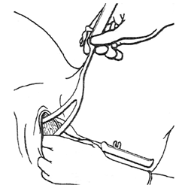

Slide 228
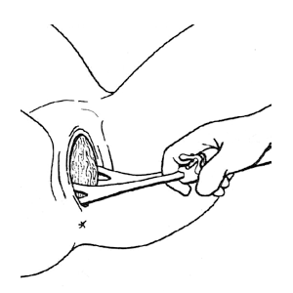

Slide 229
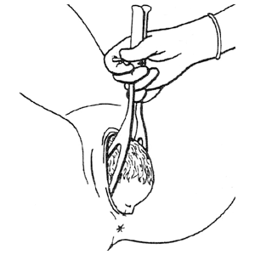

Slide 230
Indications for use of forceps delivery
Delay in second stage of labour
Foetal compromise/distress in 2nd stage of labour
Maternal distress/exhaustion
Malposition e.g. OPP
Breech presentation: forceps are usually used to deliver the after-coming head in a controlled fashion

Slide 231
contraindications
The following are contraindications to forceps-assisted vaginal deliveries:
Any contraindication to vaginal delivery
Inability to obtain adequate informed consent
A cervix that is not fully dilated or retracted
Inability to determine the presentation and fetal head position
Inadequate pelvic size
Confirmed cephalopelvic disproportion
Unsuccessful trial of vacuum extraction (relative contraindication)
Inadequate facilities and support staff
An insufficiently experienced operator

Slide 232
Complications of forceps delivery
Maternal complications;
Trauma or soft tissue damage
Haemorrhage from the above
Dysuria or urinary retension which may result from bruising or oedema to the urethra
Painful perineum
Postnatal morbidity

Slide 233
neonatal complications
Marks on the baby’s face caused by the pressure of the forceps
Excessive bruising from the forceps
Facial palsy, resulting from pressure from a blade compressing a facial nerve
Cephalhaematoma: an effusion of blood under the periosteum which covers the skull bones secondary to rupture of blood vessels crossing the periosteum
Cerebral irritability-causing cerebral oedema or haemorrhage

Slide 234
SYMPHYSIOTOMY
DEFINITION
Symphysiotomy is a surgical procedure in which the cartilage of the pubic symphysis is divided to widen the pelvis allowing childbirth when there is a mechanical problem. It is also known as pelviotomy, synchondrotomy, pubiotomy, and Gigli's operation after Leonardo Gigli, who invented a saw commonly used in Europe to accomplish the operation

Slide 235
Indications for symphysiotomy
The most common indications are;
a trapped head of a breech baby
shoulder dystocia which does not resolve with routine manoeuvres
obstructed labour at full cervical dilation when there is no option of a caesarean section.
Currently the procedure is rarely performed in developed countries, but is still routine in developing countries where caesarean section is not always an option

Slide 236
Symphysiotomy results in a temporary increase in pelvic diameter (up to 2 cm) by surgically dividing the ligaments of the symphysis under local anaesthesia. This procedure should be carried out only in combination with vacuum extraction.
Symphysiotomy in combination with vacuum extraction can be a life-saving procedure in areas of the world where caesarean section is not feasible or immediately available.

Slide 237
Complications of symphysiotomy
urethral and bladder injury
Infection
pain and
long-term walking difficulty.
Symphysiotomy should, therefore, be carried out only when there is no safe alternative. It is advised that this procedure should not be repeated due to the risk of gait problems and continual pain
END

Slide 238
MALPOSITIONS OF THE OCCIPUT & MALPRESENTATIONS

Slide 239
GENERAL OBJECTIVE:
By the end of this session, the student nurse should be able to describe and manage the major malpresentations of the occiput and occipitoposterior position
SPECIFIC OBJECTIVES:
Describe and manage the following;
  Occipito posterior position
  Deep transvese arrest
  Breech presentation
  Face presentation
  Shoulder presentation
  Brow presentation
  Compound lie
  Unstable lie

Slide 240
OCCIPITO POSTERIOR POSITION(OPP)
OPPs are the most common type of malposition of the occiput & occur in approximately 10% of labours.
Occipito posterior position is a malposition of the occiput. In this position, the vertex is present but it occupies the posterior position instead of the anterior part of the pelvis. As a consequence, the foetal head is deflexed & larger diameters of the foetal skull present
The occipito posterior position can be either left or right. The cause is not clear but it is associated with abnormalities of the pelvis.

Slide 241
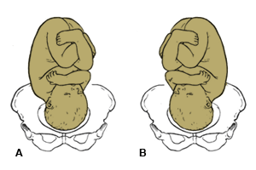
Right (A) and left (B) occipito posterior position

Slide 242
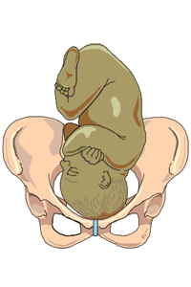
Illustration of baby in mothers womb
Showing normal presentation

Slide 243
Causes
Direct cause unknown but may be associated with an abnormally shaped pelvis
In an android pelvis, the forepelvis is narrow & the occiput tends to occupy the roomier hindpelvis. The oval shape of the anthropoid pelvis, with its narrow transverse diameter, favours a direct opp

Slide 244
Antenatal diagnosis
Abdominal examination
Listen to the mother. The mother may complain of backache and she may feel that her baby’s bottom is very high up against her ribs. She may report feeling movements across both sides of her abdomen
On inspection, there is a sauser-shaped depression at or just below the umbilicus. The depression is created by the ‘dip’ between the head & the lower limbs of the foetus
On palpation, the head is high, as the engaged diameter of 11.5cm cannot enter the brim until flexion takes place. The head feels large and the occiput and sinciput are on the same level. The back is difficult to palpate. Limbs are felt on both sides of the abdomen

Slide 245
On auscultation, the foetal heart is heard on the right flank. It could also be heard at the umbilicus, either at the middle line or slightly to the left.

Slide 246
Diagnosis during labour
The woman may complain of continous & severe backache worsening with contractions. The absence of backache does not necessarily indicate an anteriorly positioned foetus
There is slow descent of the presenting part in spite of good contractions becoz the large & irregularly shaped presenting circumference does not fit well onto the cervix. Early rupture of membranes also occurs & the contractions may be incoordinate

Slide 247
On vaginal examination, findings depend upon the degree of flexion of the head. Locating the anterior fontanelle in the anterior part of the pelvis is diagnostic but this may be difficult if caput succedaneum is present. The Sagittal sutures will be in the right oblique of the pelvis

Slide 248
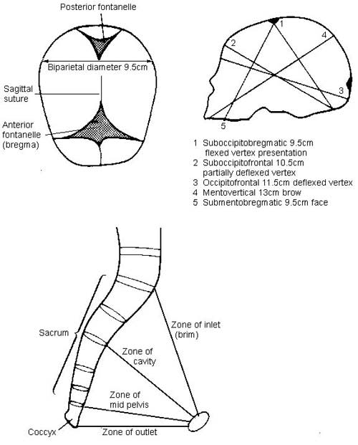

Slide 249
Care in labour
In the occipito posterior position you should expect prolonged, painful labour due to poor fitting of the presenting part, the deflexed head does not fit well onto the cervix therefore does not produce optimum stimulation for uterine contractions
The midwife can help to provide physical support such as massage and other comfort measures and suggest changes of posture and position. The all-fours position may relieve some discomfort

Slide 250
Care during first stage of labour
Pain relieving and is also believed to aid in the rotation of the foetal head. Labour is prolonged with incoordinate uterine action.
Give intravenous fluid to ensure that the mother is not dehydrated

Slide 251
ctd…
Uterine action should be regulated by the use of syntocinon infusion
Keep accurate records by plotting half-hourly observations of the foetal heart, contractions every four hours, and blood pressure in the partograph.
Maintain a strict intake and output chart.
The mother may have the urge of early pushing due to the occiput pressing on the rectum. You should discourage her from pushing at this stage as this will cause the cervix to be oedematous and delay the onset of the second stage. Encourage her to change her position and use breathing techniques, as these will control the urge of early pushing

Slide 252
Care during second stage of labour
The second stage/ full dilatation of the cervix should be confirmed by vaginal examination as the caput may be seen at the vulva with the anterior lip of the cervix.
If head is not visible at the onset of second stage, then the midwife could encourage the woman to remain upright. This position may shorten the length of 2nd stage & may reduce the need for operative delivery
Where contractions are weak & ineffective, syntocinon infusions may be commenced to stimulate adequate contractions & achieve advance
Maternal & foetal conditions are closely observed throughout 2nd stage. Length of 2nd stage is increased in opp & chances of c/section are high
During labour, one of the following may occur:
  Long internal rotation
  Short internal rotation
  Deep transverse arrest

Slide 253
Characteristics of Long Internal Rotation( mechanism of right opp)
The lie is longitudinal
The attitude is one of deflexion
The presentation is vertex
The presenting part is the middle or anterior area of the left pariental bone
The position is right occipito posterior
The denominator is the occiput
The occipito frontal diameter 11.5cm lies in the right oblique diameter of the pelvic brim. The occiput points to the right sacroiliac joint & the sinciput to the left iliopectineal eminence

Slide 254
flexion
There is increased flexion and descent takes place with increasing flexion. The occiput becomes the leading part
Internal rotation of the head
The occiput reaches the pelvic floor first & rotates forwards 3/8 of a circle along the right side of the pelvis to lie under the symphysis pubis. The shoulders follow, turning 2/8 of a circle from the left to the right oblique diameter

Slide 255
Crowning
The occiput escapes under the symphysis pubis & the head is crowned
Extension
The sinciput, face and chin sweep the perineum, the head is born by extension

Slide 256
restitution
the occiput turns 1/8 of a circle to the right, undoes the twist at the neck and the head rights itself with the shoulders
Internal rotation of the shoulders
The shoulder enters in the same oblique diameter of the pelvis. Anterior shoulder reaches the pelvic floor first and rotates 1/8 of a circle forward and lies under the symphysis pubis
External rotation of the head
accompanies the internal rotation of the shoulders. The occiput turns a further 1/8 of a circle to the right
Lateral flexion
Anterior shoulder escapes under the symphysis pubis, while the posterior shoulder sweeps the perineum & The body is born by movement of lateral flexion

Slide 257
Possible course and outcomes of labour
As with all labours, complicated or otherwise, the mother should be kept informed of her progress and proposed interventions so that she can make informed choices and give informed consent, ensuring the optimum outcome for herself and her baby.
Long internal rotation
This is the commonest outcome, with good uterine contractions producing flexion and descent of the head so that the occiput rotates forward 3/8 of a circle as described above

Slide 258
Short internal Rotation-persistent opp
In cases of short internal rotation or persistent occipito posterior position, the occiput fails to rotate forward. It persists with the same position. The sinciput reaches the pelvic floor first and rotates forwards, while the occiput sinks in the hollow of the sacrum.
The baby is born face to pubis
Cause
Failure of flexion. The head descends without increased flexion and the sinciput becomes the leading part. It reaches the pelvic floor first and rotates forwards to lie under the symphysis pubis

Slide 259
diagnosis
In first stage of labour,Signs are mainly a deflexed head & foetal heart heard in the flank or in the midline. Descent is slow
In 2nd stage of labour, there is delayed 2nd stage. On VE, the anterior fontanelle is felt behind the symphysis pubis but a large caput succedaneum may mask this. If the pinna of the ear is felt pointing towards the mother’s sacrum, this indicates a posterior position

Slide 260
Ct…
The long occipitalfrontal diameter,11.5cm, causes considerable dilatation of the anus & gaping of the vagina while the foetal head is barely visible & the broad biparietal diameter distends the perineum & may cause excessive bulging

Slide 261
Management of Face to Pubis Delivery
The sinciput emerges first from under the symphysis pubis & the midwife should maintain flexion by restraining it from escaping further, allowing the occiput to sweep the perineum & be born first
Give an episiotomy when necessary: You should watch for signs of buttonhole tear due to the large presenting diameter. A buttonhole tear is a rupture at the centre of the perineum.
If you failed to diagnose this earlier you may be extending the head thinking it is a vertex delivery, until you see the hairless forehead escaping under the pubis arch. You should then flex the head towards the symphysis pubis

Slide 262
The mother must be kept informed of progress and participate in decisions. Pushing at this time may not resolve the problem; the midwife and the woman’s partner can help by encouraging SOS breathing . A change of position may help to overcome the urge to bear down.
If an operative delivery is required for the safe delivery of a healthy baby then the mother’s informed consent is required/obtained
Assisted delivery via vacuum extraction is necessary & is associated with lower incidence of trauma to both the mother and the infant

Slide 263
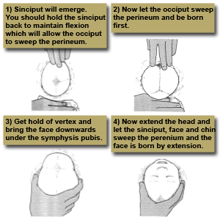

Slide 264
Deep transverse arrest
This is where the occiput fails to rotate forward. This forces the sinciput to reach the pelvic floor first and rotate forwards. The occiput then goes into the hollow of the sacrum, which results in the face to pubis delivery. At first there is good flexion. The occipit reaches the pelvic floor and begins to rotate but flexion is not maintained & the OF diameter becomes caught at the narrow bispinous diameter of the outlet. This arrest may be due to poor contractions, a straight sacrum or prominent ischial spines.

Slide 265
diagnosis
On vaginal examination the sagittal suture is on the transverse diameter of the pelvis and both anterior and posterior fontanels are palpable.
The head is caught at the ischial spines.

Slide 266
Management of Deep Transverse Arrest
Reassure the mother while explaining the position of her labour. Take her consent for the operative procedures which will be necessary.
Pushing at this time may not resolve the problem & the MW should encourage on breathing exercises. A change in position may help overcome the urge to bear down
Inform the doctor of her situation. Encourage her to breathe slowly and change her position to discourage pushing.
A vacuum extraction may be performed or the head may be rotated with forceps and the baby delivered. Vacuum extraction is associated with a lower incidence of trauma to both the mother & the infant

Slide 267
Conversion to Face or Brow presentation
At the onset of labour with a deflexed head, an extension ocassionally occurs instead of flexion. When there is complete extension, the baby will be born as face presentation but when there is incomplete extension (this is refered to as ’military attitude‘), the presenting part turns to brow. A delivery by caesarean section is recommended.
This is a rare complication of posterior positions & is more commonly found in multiparous women

Slide 268
Complications associated with OPP
Obstructed labour, as a result of deflexed or partially extended head that is impacted in the pelvis
Maternal trauma, as a result of prolonged labour, or instrumental delivery causing perineum tears. In undiagnosed OPP, instrumental delivery may cause third degree tears
Neonatal trauma to the baby, if forceps or vacuum extraction are used
Cord prolapse which may cause hypoxia, that may result in stillbirth
Cerebral haemorrhage, due to the compression of a large presenting part
Asphyxia, leading to brain damage

Slide 269
FACE PRESENTATION
Face presentation occurs when the head is one of complete extension, the occiput of the foetus being in contact with the spine
Incidence about <1:500 & the majority develop during labour from vertex presentations with the occiput posterior( secondary face presentation). Less commonly, the face presents before labour( primary face presentation)

Slide 270
In face presentation, the denominator is the mentum & the presenting diameters are submentobregmatic(9.5cm) & bitemporal(8.2cm)

Slide 271
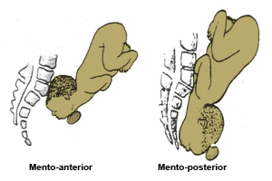

Slide 272
causes
Anterior obliquity of the uterus
The pendulous abdomen of a multiparous woman leans forward resulting in the alteration of the direction of the uterine axis. This causes the foetal buttocks to also lean forward and the force of the contractions to be directed in a line towards the chin, rather than occiput, which usually results in extension of the head.

Slide 273
Causes ctd…
Contracted Pelvis
In the flat pelvis, the head enters in the transverse diameter of the brim & the parietal eminences may be held up in the obstetrical conjugate, the head becomes extended & face presentation develops
Polyhydramnios
If the vertex is presenting & the membranes rupture spontaneously, the resulting rush of fluid may cause the head to extend as it sinks into the lower uterine segment

Slide 274
Causes ctd…
Congenital Abnormality
Anencephaly can be a foetal cause of face presentation. In a cephalic presentation, becoz the vertex is absent, the face is thrust forward & presents. A tumour of the foetal neck may cause extension of the head

Slide 275
Abdominal and Per Vaginal Diagnosis of a Face Presentation
Antenatal dx
Antenatal diagnosis is rare since face presentation develops during labour in the majority of cases.
A cephalic presentation in a known anencephalic fetus may be presumed to be a face presentation.
Intrapartum dx
On abdominal palpation, Face presentation may not be detected, especially if the mentum is anterior. The occiput feels prominent, with a groove between head and back, but it may be mistaken for the sinciput.

Slide 276
The limbs may be palpated on the side opposite to the occiput and the fetal heart is best heard through the fetal chest on the same side as the limbs. In a mentoposterior position the fetal heart is difficult to hear because the fetal chest is in contact with the maternal spine
On vaginal examination; The presenting part is high, soft and irregular. When the cervix is sufficiently dilated, the orbital ridges, eyes, nose and mouth may be felt. Confusion between the mouth and anus could arise, however. The mouth may be open, and the hard gums are diagnostic. The fetus may suck the examining finger.

Slide 277
As labour progresses the face becomes oedematous, making it more difficult to distinguish from a breech presentation. To determine position the mentum must be located; if it is posterior, the midwife should decide whether it is lower than the sinciput; if so, it will rotate forwards if it can advance.
In a left mentoanterior position, the orbital ridges will be in the left oblique diameter of the pelvis. Care must be taken not to injure or infect the eyes with the examining finger.

Slide 278
There are six positions in a face presentation, namely:
Right mento-posterior
Left mento-posterior
Right mento-lateral
Left mento-lateral
Right mento-anterior
Left mento-anterior

Slide 279
The denominator is the mentum, the presenting diameters are the submento bregmatic (9.5cm) and the bi-temporal (8.2cm).

Slide 280
Mechanism of a left mentoanterior position
Lie is longitudinal
Attitude is one of extension of the head and the back
The presentation is face
The position is left mento anterior. In a left mento anterior position the orbital ridges will be in the left oblique diameter of the pelvis
The denominator is the mentum
The presenting part is the left molar bone

Slide 281
Extension
Descent takes place throughout and with increasing extension and thus the mentum becomes the leading part
Internal Rotation of the Head
This occurs when the chin reaches the pelvic floor and rotates forwards 1/8 of a circle. The chin escapes under the symphysis pubis.
Flexion takes place and the sinciput, vertex and occiput sweep the perineum, the head is born

Slide 282
Restitution
This occurs when the chin turns 1/8 of a circle to the mother’s left.
Internal Rotation of Shoulders
The shoulders enter the pelvis in the left oblique diameter and the anterior shoulder reaches the pelvis floor first and rotates forward 1/8 of a circle along the right side of the pelvis.

Slide 283
External Rotation of the Head
This occurs simultaneously and the chin moves a further 1/8 of a circle to the left
Lateral Flexion
The anterior shoulder escapes under the symphysis pubis, the posterior shoulder sweeps the perineum and the body is born by a movement of lateral flexion

Slide 284
Possible course & outcome of labour
Prolonged labour- labour is usually prolonged because the face is an illfitting presenting part & does not usually stimulate effective uterine contractions
Mentoanterior positions- with good uterine contractions, descent & rotation of the head occurs & labour progresses to a spontaneous delivery
Mentoposterior positions- if head is completely extended, so that the mentum reaches the pelvic floor first, & the contractions are effective, the mentum will rotate forwards & the position becomes anterior

Slide 285
Management of Labour in Face Presentation
First stage
Upon diagnosing the condition the first action you must take is to inform the doctor about the face presentation.
Routine maternal and foetal condition observations are done as in normal labour (maternal pulse, foetal heart rate and contraction) half hourly. Blood pressure and temperature is done two hourly.
Care should be taken not to infect or injure the foetal eyes during VEs

Slide 286
Empty the urinary bladder every two hours.
Vaginal examination to determine cervical dilation and descent of the head, is done every four hours to monitor progress of labour.
Immediately following rupture of the membranes, a VE should be performed to exclude cord prolapse as such an occurrence is more likely becoz the face is an illfitting presenting part
In mentoposterior positions, the midwife should note whether the mentum is lower than the sinciput since rotation and descent depends on this. If the head remains high despite good uterine contractions, the mother is prepared for caesarean section

Slide 287
ctd…
Delivery
When the face appears at the vulva, extension must be maintained by holding back the sinciput & permitting the mentum to escape under the symphysis pubis before the occiput is allowed to sweep the perineum. This way, the submentovertical diameter(11.5cm) distends the vaginal orifice instead of the mentovertical diameter(13.5cm)
Episiotomy is performed to avoid extensive perineal lacerations

Slide 288
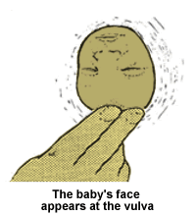

Slide 289
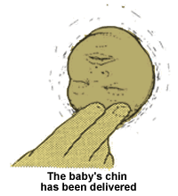
Ct…

Slide 290
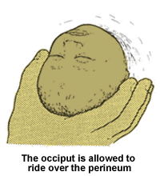
Ct…

Slide 291
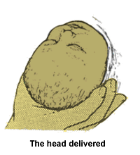
Ct…

Slide 292
Complications of face presentation
Obstructed labour; Because the face, unlike the vertex, does not mould, a minor degree of pelvic contraction may result in obstructed labour
Cord prolapse; A prolapsed cord is more common when the membranes rupture because the face is an ill-fitting presenting part.
Facial bruising;The baby’s face is always bruised and swollen at birth with oedematous eyelids and lips;
Cerebral haemorrhage;The lack of moulding of the facial bones can lead to intracranial haemorrhage caused by excessive compression of the fetal skull or by rearward compression, in the typical moulding of the fetal skull found in this presentation;

Slide 293
Maternal trauma; Extensive perineal lacerations may occur at birth owing to the large submentovertical and biparietal diameters distending the vagina and perineum.There is an increased incidence of operative delivery, either forceps delivery or caesarean section, both of which increase maternal morbidity.

Slide 294
BREECH PRESENTATION
Breech presentation occurs in about three percent of labour . Due to the high risks to both the mother and the baby, the present practice is to book all mothers with breech presentation for caesarean section.
In breech presentation, the foetus lies with the buttocks in the lower pole of the uterus, after 34 weeks of pregnancy

Slide 295
Factors contributing to breech presentation are
Maternal causes include contracted pelvis, polyhydramnios and multiple pregnancy
Foetal causes include pre-term labour, hydrocephalus, extended legs

Slide 296
Types of breech presentation & position
Complete breech
Foetal attitude is one of complete flexion, with hips & knees both flexed & feet tucked in beside the buttocks
Breech with extended legs( frank breech)
the buttocks present with the hips flexed and the legs extended against the abdomen and chest; this is the most common type of breech presentation
Footling breech
Rare. One or both feet present because neither hips nor knees are fully flexed. The feet are lower than the buttocks
Knee presentation
Very rare. One or both hips are extended with the knees flexed

Slide 297
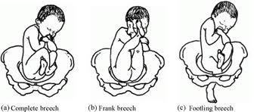

Slide 298
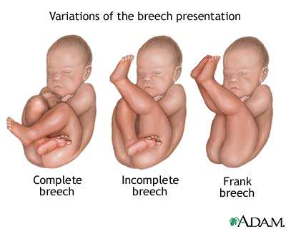
`

Slide 299
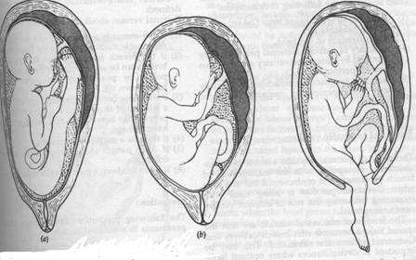
.

Slide 300
Causes of breech presentation
Extended legs
Preterm labour
Multiple pregnancy
Polyhydramnios
Hydrocephaly
Uterine abnormalities
Placenta praevia

Slide 301
Diagnosis of breech presentation
Antenatal dx:
Abdominal examination;
Listen to the mother: She may tell you that she can feel that there is something very hard and uncomfortable under her ribs that makes breathing uncomfortable at times. If her baby’s feet are in the lower pole of the uterus she may feel some very hard kicks on her bladder
Palpation: In primigravidae, diagnosis is more difficult because of their firm abdominal muscles. On palpation the lie is longitudinal with a soft presentation

Slide 302
The head can usually be felt in the fundus as a round hard mass, which may be made to move independently of the back by balloting it with one or both hands
Auscultation
When the breech has not passed through the pelvic brim the fetal heart is heard most clearly above the umbilicus. When the legs are extended the breech descends into the pelvis easily. The fetal heart is then heard at a lower level
Ultrasound examination
This may be used to demonstrate a breech presentation.
X-ray examination
Although largely superseded by ultrasound, X-ray has the added advantage of allowing pelvimetry to be performed at the same time.

Slide 303
DX during labour:
Abdominal examination;
  Breech presentation may be diagnosed on admission in labour.
Vaginal examination
  The breech feels soft and irregular with no sutures palpable, although occasionally the sacrum may be mistaken for a hard head and the buttocks mistaken for caput succedaneum. The anus may be felt and fresh meconium on the examining finger is usually diagnostic. If the legs are extended the external genitalia are very evident

Slide 304
Pre-Natal Management of Breech
Presentation
The midwife refers the mother to a doctor at thirty two weeks if the breech presentation persists.
An x-ray may be done should there be any doubts in diagnosis. It may reveal the following:
  Shape and size of the pelvis
  Size of foetus
  Foetal abnormalities, for example; hydrocephally
  Whether the legs are extended or flexed

Slide 305
ANTENATAL MANAGEMENT
If the MW suspects or detects breech presentation at 36weeks’ gestation or later, she should refer the woman to a doctor
The presentation may be confirmed by ultrasound scan or occasionally by abdominal xray

Slide 306
External cephalic version(ECV)
ECV is the use of external manipulation on the mother’s abdomen to convert a breech to a cephalic presentation. ECV is offered at term by an experienced & skilled practitioner
The success of the procedure not only depends on the skills & experience of the practitioner, but also the position & engagement of the foetus, liquor volume & maternal parity
Ecv can reduce the number of babies presenting by breech at term by 2/3 thus reducing the c/section rates

Slide 307
Procedure of performing ECV
Ultrasound scan is performed to localise the placenta & confirm the position & presentation of the foetus
A 3o minute CTG is performed to establish that the foetus is not distressed at the start of the procedure & maternal bp & pulse are recorded
Patient is asked to empty the bladder. The MW assists the patient into a comfortable supine position
Elevate the foot of the bed to help free the breech from the pelvic brim
The breech is displaced from the pelvic brim towards the iliac fossa. simultaneous force is then used as with one hand on each pole the operator makes the foetus perform a forward somersault

Slide 308
.
If the woman is rhesus negative, an injection of anti-D immunoglobulin is given as prophylaxis against iso-immunisation caused by any placental separation. If the version is performed immediately prior to the onset of labour, this should be delayed until after delivery when the blood grp of the baby is known

Slide 309
Complications of ECV
Knotting of the umbilical cord-this should be suspected if bradycardia occurs & persists. The foetus is immediately turned back to a breech presentation
Separation of the placenta-the MW should ask the woman to report pain or vaginal bleeding during and after the procedure
Rupture of the membranes-if this occurs the cord may prolapse becoz neither the head nor breech is engaged

Slide 310
Contraindications of ECV
Presence of a previous uterine scar
P.E.T or hypertension- becoz of the increased risk of placenta abruption
Multiple pregnancy
Oligohydramnios- becoz too much force has to be applied directly to the foetus & the version is likely to be unsuccessful
Ruptured membranes
A hydrocephalic foetus
Any condition which would require delivery by cs

Slide 311
Mechanism of Labour in a Left Sacro Anterior (LSA) Position
The bitrochanteric diameter (10cm) enters in the left oblique diameter of the pelvic brim. The sacrum points to the left ilio-pectineal eminence

Slide 312
Summary of LSA Position
Position :Left Sacro-Anterior, LSA
Lie :Longitudinal
Attitude :Complete flexion
Presentation :Breech
Denominator :Sacrum
Presenting part :Anterior left buttock

Slide 313
Descent
This takes place with increasing compaction due to increased flexion of limbs

Slide 314
Internal Rotation of the Buttocks
The anterior buttock reaches the pelvic floor first and rotates one eighth of a circle (1/8) forwards along the right side of pelvis to lie
underneath the symphysis pubis. The bitrochanteric diameter is now in the antero-posterior diameter of the outlet

Slide 315
Lateral Flexion of the Body
The anterior buttock escapes under the symphysis pubis. The posterior buttock sweeps the perineum and the buttocks are born by a movement of lateral flexion

Slide 316
Restitution of the Buttock
The anterior buttock turns slightly to the patient’s right side

Slide 317
Internal Rotation of the Shoulders
The shoulders enter in the same oblique diameter of the brim as the buttocks. The anterior shoulder rotates forwards one eighth of a circle along the right side of the pelvis and escapes under the symphysis pubis. The posterior shoulder sweeps the perineum and the shoulders are born.

Slide 318
Internal Rotation of the Head
The head enters in the transverse diameter of the pelvic brim. The occiput rotates along the left or right side of the pelvis. The sub-occipital region (nape of the neck) impinges under surface of the symphysis pubis

Slide 319
External Rotation of the Body
The body turns so that the back is uppermost, a movement which accompanies internal rotation of the head.

Slide 320
Birth of the Head
The chin, face and sinciput sweep the perineum and the head is born in flexed attitude

Slide 321
Management of labour
1st stage of labour
Basic care at this stage is same as in normal labour. In complete breech, there is a less well-fitting presenting part & the membranes tend to rupture early. A VE should be performed to exclude cord prolapse
An epidural block(analgesia) is offered to a woman with breech presentation as it inhibits the urge to push prematurely

Slide 322
2nd stage
Confirm full dilatation of the cervix thru a VE b4 the woman commences active pushing& reassure the mother
Inform the obstetrician of the onset of 2nd stage & a paediatrician should be present at the time of delivery

Slide 323
The following procedure should be followed when delivering the complete breech:
Mother’s buttocks are positioned at the edge of the bed to allow the baby to hang and apply supra-pubic pressure to the head if required
Give episiotomy when the buttocks extend the perineum, to avoid compression of a moulded head
The buttocks should be expelled by an aided bearing down effort of the mother

Slide 324
With the same contraction the baby is born up to the umbilicus
Pull a loop of cord to prevent traction of the cord. The cord should be handled gently to avoid inducing spasm and should be nipped under the pubic arch to avoid anoxia(hypoxia).
Check if elbows are on the chest as is the case with complete breech
The midwife can assist the expulsion of the shoulder by wrapping a small towel around the baby's hips as it is slippery and loses heat
Hold the baby by the iliac crest to avoid crushing of liver and spleen

Slide 325
While the uterus is contracting and the woman pushing, the anterior shoulder escapes under the symphysis pubis
Elevate the buttocks to allow the posterior shoulder to sweep the perineum
The back should be in the uppermost position until the shoulders are born
As soon as the shoulders are born, let the baby hang by its weight for one or two minutes

Slide 326
Types of delivery
Spontaneous breech delivery(SBD)- occurs with little assistance from the attendant
Assisted breech delivery-the buttocks are born spontaneously, but some assistance is required for delivery of extended legs or arms & the head
Breech extraction-this is a manipulative delivery carried out usually by an obstetrician & is performed to hasten delivery in an emergency situation such as foetal distress

Slide 327
Delivery of the head
Burns marshall method
The mw or the doctor stands facing away from the mother, and with the left hand, grasps the baby’s ankles from behind with forefingers between the two ankles and hold the stretch, applying sufficient traction to prevent fracture of the neck
Move the feet through an arch of 180° until the mouth and nose are free at the vulva
You are now holding the baby upside down and mechanical suction can be used to clear the airway to avoid asphyxia
At this stage, ask the mother to pant through an open mouth, 'breathing out the head'. One or two minutes should elapse to allow slow delivery of the vault
of the head to prevent a tentorial tear

Slide 328
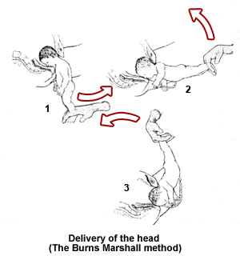
.

Slide 329
2nd stage breech with extended legs
Apply downward traction until popliteal fossae appear at the vulva
An episiotomy is made when the buttocks extend the perineum
Pressure is applied at the popliteal fossae with abduction of the thigh
The knee will flex and this will aid extraction of the feet and avoid fractures of lower limbs

Slide 330
The foot will be swept over the baby’s abdomen and the feet are born
You should now wait until the baby is delivered up to the umbilicus, pull a loop of cord
Feel for the elbow at the chest, which should not be felt with extended hands

Slide 331
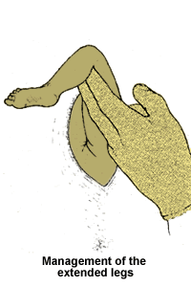
.

Slide 332
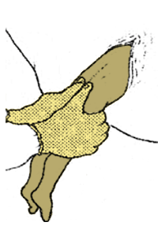
.

Slide 333
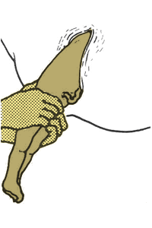
.

Slide 334
Mauriceau-smellie-veit manoeuvre
( jaw flexion & shoulder traction)
Mainly used where there is delay in descent of the head because of extension
The baby is laid astride the right arm with the palm supporting the chest. Two fingers are inserted well back into the mouth to pull the jaw downwards & flex the head
2 fingers of the left hand are hooked over the shoulders with the middle finger pushing up the occiput to aid flexion. Traction is applied to draw the head out of the vagina

Slide 335
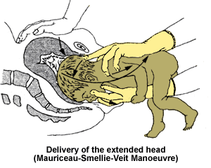
.

Slide 336
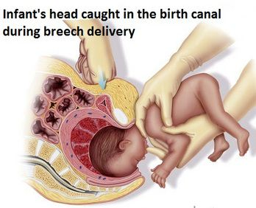

Slide 337
Delivery of extended arms (lovset manoeuvre)
Extended arms are diagnosed when the elbows are not felt on the chest after the umbilicus is born
Prompt action should be taken to prevent hypoxia. This can be dealt with using lovset manoeuvre( a combination of rotation& downward traction) employed to deliver the arms whatever position they are in
When the umbilicus is born & the shoulders are in AP diameter, the baby is grasped by the iliac crests with the thumbs over the sacrum. Downward traction is applied until the axilla is visible

Slide 338
Maintain a downward traction throughout. Body is rotated through half a circle, 180 degrees, start by turning the back uppermost
Friction of the posterior arm against the pubic bone as the shoulder becomes anterior sweeps the arm infront of the face. This movement allows the shoulders to enter the pelvis in the transverse diameter
The arm which is now anterior is delivered
Body is rotated back in the opposite direction & the 2nd arm is delivered in a similar fashion

Slide 339
Causes of Delayed Breech
Delay in the first stage is rare, though it may be caused by impaction due to a large baby, a small pelvis or weak contractions in which case a caesarean section is done
Delay during the second stage is usually caused by extended legs

Slide 340
Delay in the Birth of the Head
If an insufficiently dilated cervix holds up the head, the baby will make gasping movements.
You should mop the vaginal wall in contact with the baby’s face and inserting two fingers make a channel through which you can meet the baby.
If the head is arrested high in the cavity, disproportion may exist. Suprapubic pressure may help, but application of forceps is necessary. The doctor will use piper’s forceps for the delivery of the coming head.

Slide 341
Complications of breech presentation
Impacted breech- labour becomes obstructed when the foetus is disproportionately large for the size of the maternal pelvis
Cord prolapse-more common in a flexed or footling breech
Birth injury
  Superficial tissue damage
  Fractures of the humerus, clavicle or femur or dilocation of the shoulder or hip caused during delivery of extended arms or legs
  Erb’s palsy-caused by brachial plexus being damaged by twisting the neck

Slide 342
  Trauma to internal organs- especially a ruptured liver or spleen produced by grasping the abdomen
  Damage to the adrenals- by grasping the baby’s abdomen, leading to shock caused by adrenaline release
  Spinal cord damage or fracture of the spine
  Intracranial haemorrhage- caused by rapid delivery of the head which has had no opportunity to mould. Hypoxia may also cause intracranial haemorrhage

Slide 343
Complications ctd…
Foetal hypoxia- due to cord prolapse or cord compression or due to premature separation of the placenta
Premature separation of the placenta
Maternal trauma

Slide 344
SHOULDER PRESENTATION
Occurs when the foetus lies with its long axis across the long axis of the uterus( transverse lie)
Occurs in approximately 1:300 pregnancies near term. Only 17% of these cases remain as a transverse lie at the onset of labour, the majority are multigravidae
The head lies on one side of the abdomen, with the breech at a slightly higher level on the other. The foetal back may be anterior or posterior & the leading part is the arm, shoulder or the trunk

Slide 345
Causes of shoulder presentation
Maternal causes
  Lax abdominal & uterine muscles especially in multiparity. This is the most common cause & is found in the multigravidae
  Uterine abnormality eg bicornuate or subseptate uterus as well as uterine fibroids
  Contracted pelvis. This may prevent the head from entering the pelvic brim

Slide 346
Causes of shoulder presentation cntd…
Foetal causes
  Preterm pregnancy: the amount of more amniotic fluid in relation to the foetus is greater, allowing the foetus more mobility than at term
  Multiple pregnancy: this is a possibility of polyhydramnios but the presence of more than one foetus reduces the room for manoeuvre when amounts of liquor are normal
  Polyhydramnios: the distended uterus is globular & the foetus can move freely in the excessive liquor
  Macerated foetus: lack of muscle tone causes the foetus to slump down into the lower pole of the uterus
  Placenta praevia: may prevent the head from entering the pelvic brim

Slide 347
Diagnosis of shoulder presentation
Antenatal
On abdominal palpation , the uterus appears broad & the fundal height is less than expected for the period of gestation
On pelvic & fundal palpation, neither head nor breech is felt. The mobile head is found on one side of the abdomen & the breech at a slightly higher level on the other
Auscultation: FHS are best heard on one side of the umbilicus towards the foetal head
An ultrasound scan may be used to confirm the lie & presentation

Slide 348
Intrapartum diagnosis
On abdominal palpation, findings are as above but with membranes ruptured, the irregular outline of the uterus is more marked. If the uterus is contracting strongly & becomes moulded around the foetus, palpation is very difficult
On VE, the shoulder is felt as a soft irregular mass
Note; vaginal examination should not be performed without first excluding placenta praevia

Slide 349
In early labour, the presenting part may not be felt. The membranes usually rupture early becoz of the ill-fitting presenting part with a high risk of cord prolapse
When the cervix is sufficiently dilated particularly after rupture of the membranes, the scapula, acromion, clavicle, ribs and axilla can be felt.

Slide 350
Possible outcome
There is no mechanism for delivery of shoulder presentation. If this persists in labour, delivery should be via c/section to avoid obstructed labour & subsequent uterine rupture

Slide 351
management
Antenatal;
Ultrasound examination to detect& rule out placenta praevia & uterine abnormalities
Pelvic x-ray to detect a contracted pelvis
Plan for Elective c/section
Admit the patient for further investigations

Slide 352
Intrapartum management;
If membranes still intact, external cephalic version may be performed. Can be done in late pregnancy or even early in labour if the membranes are intact and vaginal delivery is feasible. In early labour, if version succeeded apply abdominal binder and rupture the membranes as if there are uterine contractions
If membranes already ruptured spontaneously, a VE should be done to detect possible cord prolapse
Emergency c/section should be performed if;
  The cord prolapses
  When membranes already ruptured
  When external version is unsuccessful
  When labour has been in progress for some hours

Slide 353
Mgt cntd…
Internal podalic version
It is mainly indicated in 2nd twin of transverse lie and followed by breech extraction.
Prerequisites:
General or epidural anaesthesia.
Fully dilated cervix.
Intact membranes or just ruptured.

Slide 354
complications
Cord prolapse
Prolapsed arm
Neglected shoulder presentation- the shoulder becomes impacted, having been forced down & wedged into the pelvic brim. The membranes have ruptured spontaneously & if the arm has prolapsed, it becomes blue & oedematous. The uterus goes into a state of tonic contraction, the overstreched lower segment is tender to touch & the foetal heart may be absent. All the maternal signs of obstructed labour are present & the outcome if not treated in time is a ruptured uterus & a still birth
With adequate supervision both antenatally & during labour, this should never occur

Slide 355
BROW PRESENTATION
In brow presentation, the foetal head is partially extended with the frontal bone, which is bounded by the anterior fontanelle & the orbital ridges, lying at the pelvic brim
The presenting diameter is mentovertical (13.5cm), which exceeds all diameters in an average pelvis
Occurs in 1:1000 deliveries

Slide 356
Causes of brow presentation
Maternal.These include:
  lax uterine muscles in multigravidae
  contracted pelvis.
Fetal. These include:
  polyhydramnios
  placenta praevia.

Slide 357
Diagnosis of brow presentation
On abdominal palpation, the head is high, appers undully large & does not descend into the pelvis despite good contractions
On vaginal examination, the presenting part is high & may be diffucult to reach. The anterior fontanelle may be found on the side of the pelvis & on the orbital ridges

Slide 358
Management
Inform the doctor immediately this presentation is suspected
Inform the mother about the possible outcome of labour
Vaginal delivery is extremely rare & obstructed labour usually results
c/section

Slide 359
complications
Same as in face presentation with marked obstructed labour

Slide 360
UNSTABLE LIE
The lie is defined as unstable when after 36 weeks’ gestation, instead of remaining longitudinal, it varies from one examination to another between longitudinal & oblique or transverse

Slide 361
Causes of unstable lie
Any condition in late pregnancy that increases the mobility of the foetus or prevents the head from entering the pelvic brim may cause this
Maternal causes;
  Lax uterine muscles in multigravudae
  Contracted pelvis
Foetal causes;
  Polyhydramnios
  Placenta praevia

Slide 362
Management of unstable lie
Antenatal mgt;
Admit the patient to hospital to avoid unsupervised onset of labour. Alternatively, advice the woman to come to hopspital as soon as labour commences
Ultrasonography to rule out placenta praevia
Intrapartum mgt;
Induction of labour after 36 weeks’ gestation when lie is longitudinal. The induction is performed by commencing an intravenous infusion of oxytocin to stimulate contractions. A controlled rupture of the membranes is performed so that the head enters the pelvis

Slide 363
Ensure that the woman has an empty rectum & bladder before the procedure, as a loaded rectum or a full bladder can prevent the presenting part from entering the pelvis

Slide 364
complications
If labour commences with a lie other than longitudinal, the complications are the same as for a transverse lie

Slide 365
COMPOUND PRESENTATION
When a hand, or occasionally a foot, lies alongside the head, the presentation is said to be compound
Occurs with a small foetus or a roomy pelvis & seldom is difficulty encountered except in cases where it is associated with a flat pelvis
On rare occasions, the head, hand & foot are felt in the vagina, a serious situation which may occur with a dead foetus
If diagnosed during first stage, medical aid must be sought. If during 2nd stage the midwife sees a hand presenting alongside the vertex, she should try to hold the hand back

Slide 366

THANKYOU

