Slide 1
ONCOLOGY NURSING

Slide 2
INTRODUCTION
cancer is a collection of related diseases in which some of the body’s cells begin to divide without stopping and spread into surrounding tissues.
Cancer has different causes, manifestations, treatment and prognosis
Oncology nursing refers to the scope and responsibilities of providing nursing care related to cancer
Lung, prostate, colorectal and breast cancer are a few of the most common cancers in the United States.
In Kenya – Breast, cervical and prostrate cancer are leading

Slide 3
Cancer
Cancer is a malignant neoplastic (abnormal cell growth) disorder that can involve all body organs with manifestations that vary according to the body system affected and type of tumor cells.
Cancer is characterized by Changes in the cell and genetic changes that cause loss of normal cell regulation leading to Abnormal and uncontrolled cell growth
Cancer produces serious health problems such as impaired immune and hematopoietic (blood producing) function, altered gastrointestinal tract structure and function, motor and sensory deficits, and decreased respiratory function.

Slide 4
Classification of cell growths (Tumors)
Tumors can be classified as:
Benign (non cancerous)
Malignant (cancerous)
NB: Not all abnormal cell growths are cancerous

Slide 5
Benign versus Malignant Tumors
Characteristic | Benign | Malignant
Differentiation | Well differentiated cells that resemble tissue of origin | Cells undifferentiated with little resemblance to tissue of origin(Anaplasia)
Growth Rate | Slow | Rapid
Mode of growth | Expands without invading surrounding tissues | Grows by invading and infiltrating surrounding tissues
Metastases (spread) | None | Can spread to distant sites
Prognosis | Usually harmless | Can be fatal if not treated

Slide 6
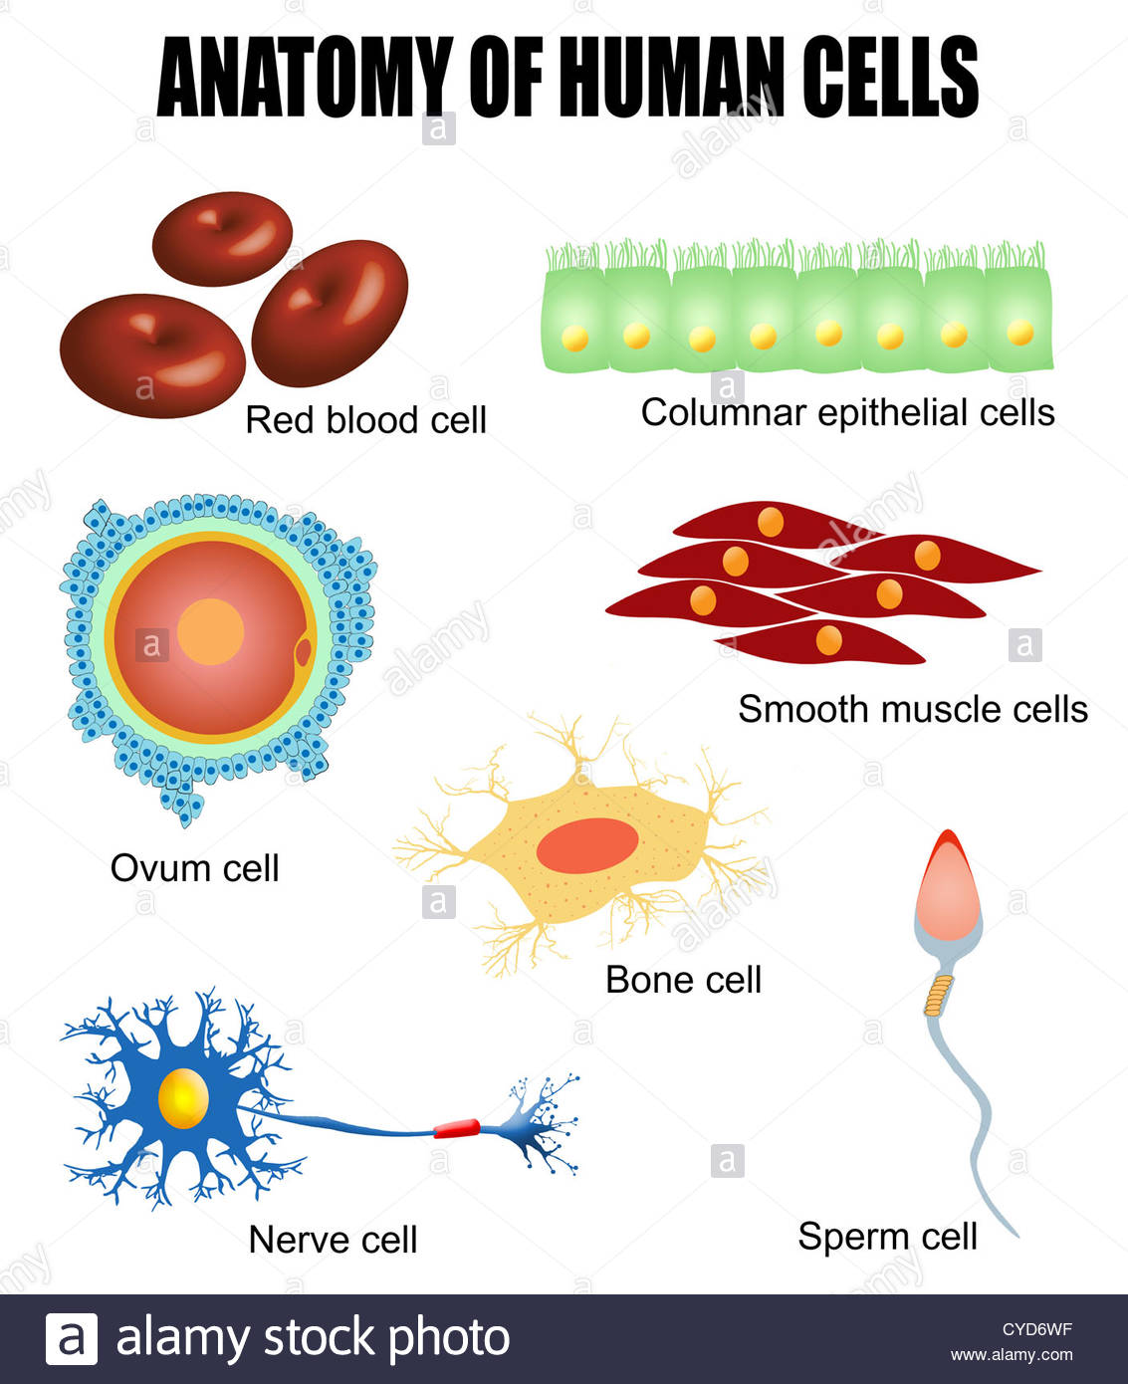
Differentiated cells

Slide 7
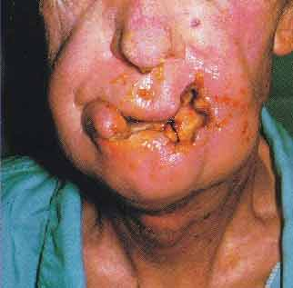
Characteristics of Cancer
Malignant growth (Cells that are Undifferentiated from tissue of origin)
Erratic and Uncontrolled Growth
Expansive and Invasive
Metastasis (spread to distant organs)
They secrete abnormal proteins as they grow
NB: Cancer cells continue to grow at the expense of the host
Notes:
Cells lose their normal growth-controlling mechanism, and the growth of the cells is now uncontrolled

Slide 8
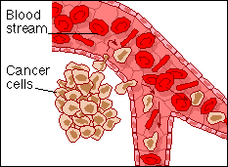
Metastasis
Cancer cells move/spread from their original location to other sites. Routes of metastasis include:
Local seeding: Distribution of shed cancer cells occurs in the local area of the primary tumor.
Blood borne metastasis: Tumor cells enter the blood, which is the most common cause of cancer spread.
Lymphatic spread: Primary sites rich in lymphatics are more susceptible to early metastatic spread e.g. breast
Common sites of metastasis are bone, lung, brain, liver, spine

Slide 9
Cancer classification
1. Solid tumors: Associated with the organs from which they develop, such as breast cancer or lung cancer
2. Hematological cancers: Originate from blood cell–forming tissues, such as leukemias, lymphomas, and multiple myeloma

Slide 10
Grading and staging of cancer
Grading and staging are methods used to describe the tumor. These methods describe the extent of the tumor, the extent to which malignancy has increased in size, the involvement of regional nodes and metastasis.
Grading a tumor classifies the changes taking place in the cancer cells and is an indicator of tumor growth rate and spread.
Staging classifies the severity and clinical features of the cancer and degree of metastasis.

Slide 11
Cancer Grading
Grade I: Cells differ slightly from normal cells and are well differentiated (mild dysplasia (gradual loss of differentiation)).
Grade II: Cells are more abnormal and are moderately differentiated (moderate dysplasia).
Grade III: Cells are very abnormal and are poorly differentiated (severe dysplasia).
Grade IV: Cells are immature and undifferentiated (anaplasia) ; cell of origin is difficult to determine (Irreversible)

Slide 12
Differentiated cells

Slide 13
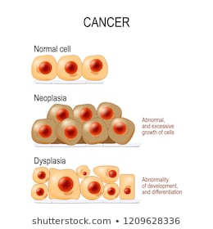
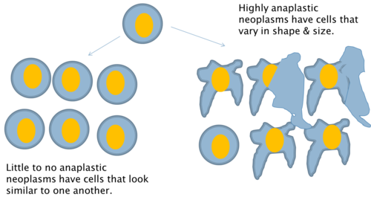

Slide 14
Cancer Staging
Stage 0: Abnormal cells are present but have not spread to nearby tissue. Also called carcinoma in situ (CIS). CIS is not cancer, but it may become cancer.
Stage I: Tumor limited to the tissue of origin; localized tumor growth
Stage II: Limited local spread. regional- extends beyond organ of origin but remains nearby
Stage III: Extensive local and regional spread – extended via lymphatics and blood
Stage IV: Distant metastasis – spread to multiple distant organs

Slide 15
The TNM Staging System
The TNM system is the most widely used cancer staging system. Most hospitals and medical centers use the TNM system as their main method for cancer reporting. In the TNM system:
The T refers to the size and extent of the main tumor. The main tumor is usually called the primary tumor.
The N refers to the the number of nearby lymph nodes that have cancer.
The M refers to whether the cancer has metastasized.

Slide 16
When cancer is described by the TNM system, there will be numbers after each letter that give more details about the cancer—for example, T1N0MX or T3N1M0. The following explains what the letters and numbers mean:
Primary tumor (T) - TX: Main tumor cannot be measured. T0: Main tumor cannot be found. T1, T2, T3, T4: Refers to the size and/or extent of the main tumor.
Regional lymph nodes (N) - NX: Cancer in nearby lymph nodes cannot be measured. N0: There is no cancer in nearby lymph nodes. N1, N2, N3: Refers to the number and location of lymph nodes that contain cancer.
Distant metastasis (M) - MX: Metastasis cannot be measured. M0: Cancer has not spread to other parts of the body. M1: Cancer has spread to other parts of the body.

Slide 17
Naming of cancers
Cancers are classified by the type of cell that the tumor cells resemble and is therefore presumed to be the origin of the tumor. These types include:
Carcinoma: Cancers derived from epithelial cells. This group includes many of the most common cancers and include: breast, prostate, lung, pancreas and colon.
Sarcoma: Cancers arising from connective tissue (i.e. bone, cartilage, fat, nerve),
Lymphoma and leukemia: These two classes arise from hematopoietic (blood-forming) cells that leave the marrow
Germ cell tumor: Cancers derived from pluripotent cells, most often presenting in the testicle or the ovary .
Blastoma: Cancers derived from immature embryonic tissue

Slide 18
Body Defenses Against Cancer Cells
The immune system is capable of recognizing and destroying cancer cells
1. T lymphocytes / Cellular Immunity
  Cytotoxic T cells kill tumor cells
2. B lymphocytes / Humoral immunity
  B cells can produce antibodies against cancer cells
3. Phagocytic cells
  Macrophages can engulf cancer cell debris
4. Natural Killer cells
  Kill cancerous cells
  NB: current research in cancer treatment is focusing on drugs that can activate the immune system to destroy cancer cells and prevent their growth

Slide 19
Etiological/Risk Factors For cancer
Chemical carcinogen: Factors include industrial chemicals, medications, and tobacco.
Physical carcinogen: Factors include radiation (diagnostic and therapeutic x-rays) and ultraviolet radiation (sun, tanning beds, and germicidal lights), chronic irritation, and tissue trauma.
Viral carcinogen : Viruses capable of causing cancer are known as oncoviruses, such as Epstein-Barr virus, hepatitis B virus, and human papillomavirus (HPV).

Slide 20
Obesity and dietary factors, including preservatives, contaminants, additives, alcohol, and nitrates
Genetic predisposition: Factors include an inherited predisposition to specific cancers, inherited conditions associated with cancer, familial clustering, and chromosomal aberrations.
Age: Advancing age is a significant risk factor for the development of cancer.
Immune function: The incidence of cancer is higher in immunosuppressed individuals, such as those with acquired immunodeficiency syndrome and organ transplant recipients who are taking immunosuppressive medication

Slide 21
Diagnostic Tests
▪ Biopsy
▪ Bone marrow examination (particularly if a hematolymphoid malignancy is suspected)
▪ Chest radiograph
▪ Complete blood count (CBC)
▪ Computed tomography (CT)
▪ Cytological studies (Papanicolaou test)
▪ Evaluation of serum tumor markers (e.g., carcinoembryonic antigen and alpha-fetoprotein)
▪ Liver function studies

Slide 22
Magnetic resonance imaging (MRI)
▪ Proctoscopic examination (including guaiac test for occult blood)
▪ Radiographic studies (mammography)
▪ Radioisotope scanning (liver, brain, bone, lung)
Tumor markers

Slide 23
Biopsy
Biopsy is the definitive means of diagnosing cancer and provides proof of malignancy. Biopsy involves the surgical incision to obtain a small piece of tissue for microscopic examination.
Types
a. Needle biopsy: Aspiration of cells
b. Incisional biopsy : Removal of a wedge of suspected tissue from a larger mass
c. Excisional biopsy : Complete removal of the entire lesion

Slide 24
Warning Signs of Cancer—CAUTION
▪ Change in bowel or bladder habits
▪ Any sore that does not heal
▪ Unusual bleeding or discharge
▪ Thickening or lump in breast or elsewhere
▪ Indigestion
▪ Obvious change in wart or mole
▪ Nagging cough or hoarseness

Slide 25
Cancer Prevention
Prevention: Avoidance of known or potential carcinogens and avoidance or modification of the factors associated with the development of cancer cells.
Early detection
    Mammography
    Papanicolaou (Pap) test
    Rectal exams and stools for occult blood
    Sigmoidoscopy, colonoscopy
    Breast self-examination (BSE) and clinical breast examination
    Testicular self-examination
    Skin inspection

Slide 26
Cancer Prevention and Detection
Eat balanced diet
Exercise regularly
Adequate rest
Health examination on a regular basis
Enjoy consistent periods of relaxation and leisure
Know 7 warning signs of cancer
Self-examination

Slide 27
Cancer management

Slide 28
Cancer management involves:
Pain control
Surgery
Radiotherapy
Chemotherapy
Bone marrow and stem cell transplant
Psychological support

Slide 29
Cancer Pain Control
Causes of pain
1. Bone destruction
2. Obstruction of an organ
3. Compression of peripheral nerves
4. Infiltration, distention of tissue
5. Inflammation, necrosis
6. Psychological factors, such as fear or anxiety
NB: Pain management involves pharmacologic and non pharmacologic interventions. Patient report should always be accepted as primary pain assessment data. Drug therapy should be used following WHO analgesic ladder

Slide 30
Surgery
Surgery is indicated to diagnose, stage, and treat certain types of cancer. It can be:
1. Prophylactic surgery -is performed in clients with an existing premalignant condition or a known family history or genetic mutation that strongly predisposes the person to the development of cancer. An attempt is made to remove the tissue or organ at risk and thus prevent the development of cancer.
2. Curative surgery: The entire tumor is removed or destroyed.
3. Control (cytoreductive or “debulking”) surgery - Control surgery is a debulking procedure that consists of removing a large portion of a locally invasive tumor, such as advanced ovarian cancer.
NB: Surgery decreases the number of cancer cells; therefore, it may increase the chance that other therapies will be successful

Slide 31
4. Palliative surgery - Palliative surgery is performed to improve quality of life during the survival time. Palliative surgery is performed to reduce pain, relieve airway obstruction, relieve obstructions in the gastrointestinal or urinary tract, relieve pressure on the brain or spinal cord, prevent hemorrhage, remove infected or ulcerated tumors, or drain abscesses.
5. Reconstructive or rehabilitative surgery is performed to improve quality of life by restoring maximal function and appearance, such as breast reconstruction after mastectomy.

Slide 32
Adverse effects of surgery
1. Loss or loss of function of a specific body part
2. Reduced function as a result of organ loss
3. Scarring or disfigurement
4. Grieving about altered body image or imposed change in lifestyle
5. Pain, infection, bleeding, thromboembolism

Slide 33
Radiation Therapy
Radiation therapy destroys cancer cells, with minimal exposure of normal cells to the damaging effects of radiation; the damaged cells die or become unable to divide.
Radiation therapy is effective on tissues directly within the path of the radiation beam.
Side effects include local skin changes and irritation, alopecia (hair loss), fatigue (most common side effect of radiation), and altered taste sensation; the effects vary according to the site of treatment

Slide 34
TYPES OF RADIATION
External beam radiation (teletherapy): The actual radiation source is external to the client. Instruct the client regarding self-care of the skin . The client does not emit radiation and does not pose a hazard to anyone else.
Brachytherapy - The radiation source comes into direct, continuous contact with tumor tissues for a specific time. The radiation source is implanted within the client; for a period of time, the client emits radiation and can pose a hazard to others. Brachytherapy includes an unsealed source or a sealed source of radiation.

Slide 35
Nursing Intervention for teletherapy
MANAGEMENT OF STOMATITIS - Use soft-bristled toothbrush , Oral rinses with saline gargles/ tap water, Avoid ALCOHOL-based rinses
MAINTAIN TISSUE INTEGRITY - Handle skin gently, Do NOT rub affected area, Lotion may be applied, Wash skin only with SOAP and Water

Slide 36
BRACHYTHERAPY
Unsealed radiation source - Administration is via the oral or IV route or by instillation into body cavities. The source is not confined completely to one body area, and it enters body fluids and eventually is eliminated via various excreta, which are radioactive and harmful to others. Most of the source is eliminated from the body within 48 hours; then neither the client nor the excreta is radioactive or harmful.
Sealed radiation source - sealed, temporary or permanent radiation source (solid implant) is implanted within the tumor target tissues. The client emits radiation while the implant is in place, but the excreta are not radioactive.

Slide 37
Care of the Client with a Sealed Radiation Implant
Place the client in a private room with a private bath.
Place a radiation precaution sign on the client’s door.
Organize nursing tasks to minimize exposure to the radiation source.
Nursing assignments to a client with a radiation implant should be rotated.
Limit time to 30 minutes per care provider per shift.
Wear a dosimeter film badge to measure radiation exposure.
Lead shielding may be used to reduce exposure to radiation.
The nurse should never care for more than 1 client with a radiation implant at 1 time.
Do not allow a pregnant nurse to care for the client.

Slide 38
Do not allow children younger than 16 years or a pregnant woman to visit the client.
Limit visitors to 30 minutes per day; visitors should be at least 6 feet from the source.
Save bed linens and dressings until the source is removed; then dispose of the linens and dressings in the usual manner.
Other equipment can be removed from the room at any time.
If dislodged - Encourage the client to lie still. Use a long-handled forceps to retrieve the radioactive source. Deposit the radioactive source in a lead container. Contact the radiation oncologist.
The client is not radioactive after removal.

Slide 39
Chemotherapy
Chemotherapy kills or inhibits the reproduction of neoplastic cells but also kills normal cells.
The effects are systemic because chemotherapy is usually administered systemically.
Normal cells that are most affected by chemotherapy include those of the skin, hair, and lining of the gastrointestinal tract; spermatocytes; and hematopoietic cells.

Slide 40
Usually, several chemotherapy agents are used in combination to increase the therapeutic response.
Combination chemotherapy is planned to minimize toxicities and nadir (the time during which bone marrow activity and white blood cell counts are at their lowest (immunosuppression).
Chemotherapy may be combined with other treatments, such as surgery and radiation.

Slide 41
Chemotherapy
Chemotherapy refers to use of specific drugs for management of cancer
Goal is to reduce number of cancer cells in the tumor site(s)
Chemotherapy drugs effects are: Cell cycle non-specific or Cell cycle phase-specific
Cancer cells can escape death by staying in an inactive phase. This causes a problem of drug- resistant cancer cells which are in the resting phase

Slide 42
Chemotherapy
Methods of Administration
Oral, Intramuscular
IV - Many agents are vesicants, causing severe tissue breakdown and necrosis if infiltration occurs - S/S infiltration: pain, redness, swelling, vesicles
Central line IV devices permit frequent, continuous, or intermittent administration. Including administration of fluids and transfusion if required.
Regional administration - Delivery of drug directly into the tumor site. Higher concentrations can be delivered with reduced systemic toxicity. Can be:
  Intrathecal – into subarachnoid space via lumbar puncture
  Intraarterial – into artery the supplies tumor
  Intravesical (bladder)
  Intraperitoneal

Slide 43
Chemotherapy:
Classification of Drugs
Alkylating Agents
Antimetabolites
Anti-tumor antibiotics
Plant Alkaloids
Nitrosoureas
Corticosteroids
Hormone Therapy

Slide 44
Chemotherapy
Chemotherapeutic agents cannot distinguish between normal and cancer cells, they destroy both.
Rapidly dividing cells are most affected (tumor cells, hair, GIT, reproductive, & blood cells)
Doses are Carefully calculated according to body weight or body surface area
Drugs usually given in combination of drugs with different toxic side effects
Combinations Include drugs that cause nadir (lowest level of blood cell counts secondary to bone marrow depression) at different time intervals
Combinations Includes cell cycle phase-specific and cell cycle nonspecific drugs with different mechanisms of action- Synergy
Timed to maximize cancer cell kill and minimize damage to normal cells eg. every 3-4 weeks for 6 – 10 treatments

Slide 45
Chemotherapy - Effects on Normal Tissues
Acute toxicity
  Vomiting
  Allergic reactions
  Arrhythmias
Delayed effects
  Mucositis (Mouth sores)
  Alopecia
  Bone marrow suppression
Chronic toxicities - Damage to
    Heart
    Kidney
    Liver
    Lungs
Cancer survivors are at risk for other secondary malignancies resulting from therapy - Includes breast, ovarian, uterine, thyroid, and lung cancers, leukemia (late effects)

Slide 46
Chemotherapy - Side Effects
Alopecia (hair loss)
  Generally reversible
  New hair grows often of different color and texture
Anorexia and weight loss
Fatigue
Nausea & vomiting
Mucositis
Skin changes
Bone marrow suppression (Myelosuppression)
    Leukopenia, neutropenia - Risk for infection
    Anemia - Activity intolerance, Hypoxemia
    Thrombocytopenia - Risk for bleeding

Slide 47
Nursing Interventions for patient on chemotherapy
MANAGEMENT OF ALOPECIA - Alopecia begins within 2 weeks of therapy, Regrowth within 8 weeks of termination. Encourage to acquire wig before hair loss occurs, Encourage use of attractive scarves and hats. Provide information that hair loss is temporary BUT anticipate change in texture and color
PROMOTE NUTRITION - Serve food in ways to make it appealing, Consider patient’s preferences, Provide small frequent meals. Avoids giving fluids while eating. Oral hygiene PRIOR to mealtime. Vitamin supplements

Slide 48
Nursing Intervention
RELIEVE PAIN-N Mild pain- NSAIDS, Moderate pain- Weak opiods, Severe pain- Morphine. Administer analgesics round the clock with additional dose for breakthrough pain
DECREASE FATIGUE - Plan daily activities to allow alternating rest periods. Light exercise is encouraged. Small frequent meals
IMPROVE BODY IMAGE - Therapeutic communication is essential. Encourage independence in self-care and decision making. Offer cosmetic material like make-up and wigs

Slide 49
Nursing Intervention
ASSIST IN THE GRIEVING PROCESS - Grieving can be due to loss of health, income, sexuality, and body image. Answer and clarify information about cancer and treatment options. Identify resource people. Refer to support groups

Slide 50
Nursing Intervention
MANAGE COMPLICATION: INFECTION
  Fever is the most important sign
  Administer prescribed antibiotics
  Maintain aseptic technique
  Avoid exposure to crowds
  Avoid giving fresh fruits and vegetables
  Handwashing
  Avoid frequent invasive procedures
  Assess for Septic shock - Monitor P, BP, temp, Administer IV antibiotics

Slide 51
Nursing Intervention
MANAGE COMPLICATION: Bleeding
  Thrombocytopenia (<100,000) is the most common cause
  <20, 000→ spontaneous bleeding
  Use soft toothbrush
  Use electric razor
  Avoid frequent IM, IV, rectal and catheterization
  Soft foods and stool softeners

Slide 52
Bone Marrow and Stem Cell Transplantation
Involves use of very high doses of chemotherapy or radiation therapy to kill all cells of bone marrow(Highly toxic)
Harvested bone marrow stem cells from the patient or donor are thereafter engrafted so as to begin producing healthy cells
Procedure with many risks, including life threatening bone marrow suppression and death
Complications
  Bacterial, viral and fungal infections are common
    Prophylactic antibiotic therapy
  Graft-versus-host disease
    Lymphocytes from donated marrow recognize recipient as foreign
    Attack organs such as skin, liver, and intestines

Slide 53
Cancer - Psychologic Support
Emphasis placed on maintaining optimal quality of life
Positive attitude of patient, family, and health care providers has significant positive impact on quality of life for patient
  May also influence prognosis
Continue to be available
Exhibit caring attitude
Listen actively to fears and concerns
Provide relief from distressing symptoms
Maintain relationship based on trust and confidence

Slide 54
Cancer
Psychologic Support
Use touch to exhibit caring
Assist patient in setting realistic short- term goals
Assist in maintaining usual lifestyle patterns
Maintain hope, which can vary
  Provides control over what is occurring
  Basis of positive attitude

